Slide 1
Pumpdown strategy and bakeout of the 10km beam pipe
Carlo Scarcia
20.11.2024

Slide 2
Glossary
ROUGH VACUUM
Volume evacuation from the air contained in a vacuum vessel.
INTERMEDIATE VACUUM
Pumpdown at room temperature of a vacuum vessel. The process is dominated by water adsorbed to the vessel’s internal surface. For a metal surface P ∝ t⁻¹.
BAKEOUT
Heat treatment of a vacuum system/component to accelerate the desorption of water from the metal surface. Bakeout temperatures are typically ≤ 350°C.

Slide 3
Requirements and technical consequences
Requirements^{[1]}
Residual gas noise: < 10⁻²⁵ Hz-^{1/2}
Technical consequences
Low contamination levels
Only dry fore pumps and Maglev turbomolecular pumps
No/low vibration from pumps during operation
UHV with chemical pumps only (Ion pumps, NEGs, etc.)
Vacuum system lifetime must > 50 years
Interlocks, gate valves on pumping ports, venting system
Additional constraints
Rough pumping always in laminar conditions
Compact UHV pumping groups
Tunnel temperature during bakeout ≤ 29 °C

Slide 4
Assumptions
For the vacuum system design, AISI 441 is assumed to be used as the structural material for beam pipes.
Gas | Specific outgassing rate [mbar l s⁻¹ cm⁻²]
H₂ | < 1.0 × 10⁻¹⁵
CH₄ | < 1.0 × 10⁻¹⁷
CO | < 3.7 × 10⁻¹⁷
CO₂ | < 1.4 × 10⁻¹⁷
Water outgassing rate simulated using Temkin isotherm
Parameter | Value
n_{m} [molecules cm⁻²] | 4.5 × 10¹⁵
E₀ [eV] | 0.2
E₁ [eV] | 1.5
AISI 441 outgassing rates measured at 21±2°C after a 150 °C, 48 h bakeout.
[Data to be published soon]
AISI 441 water binding energies and surface coverage extracted experimentally
[Data to be published soon]

Slide 5
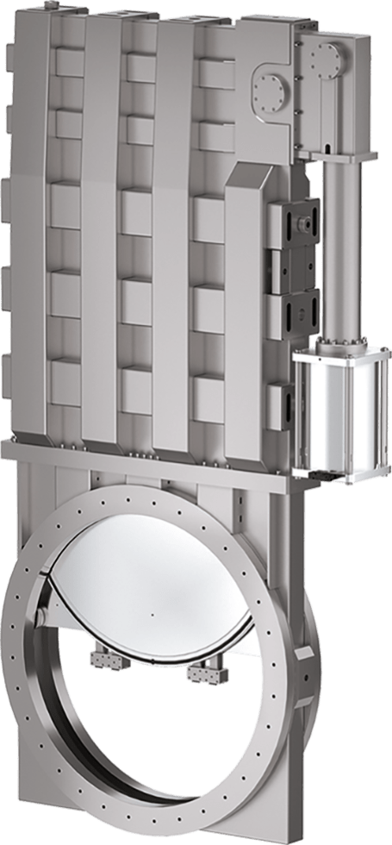
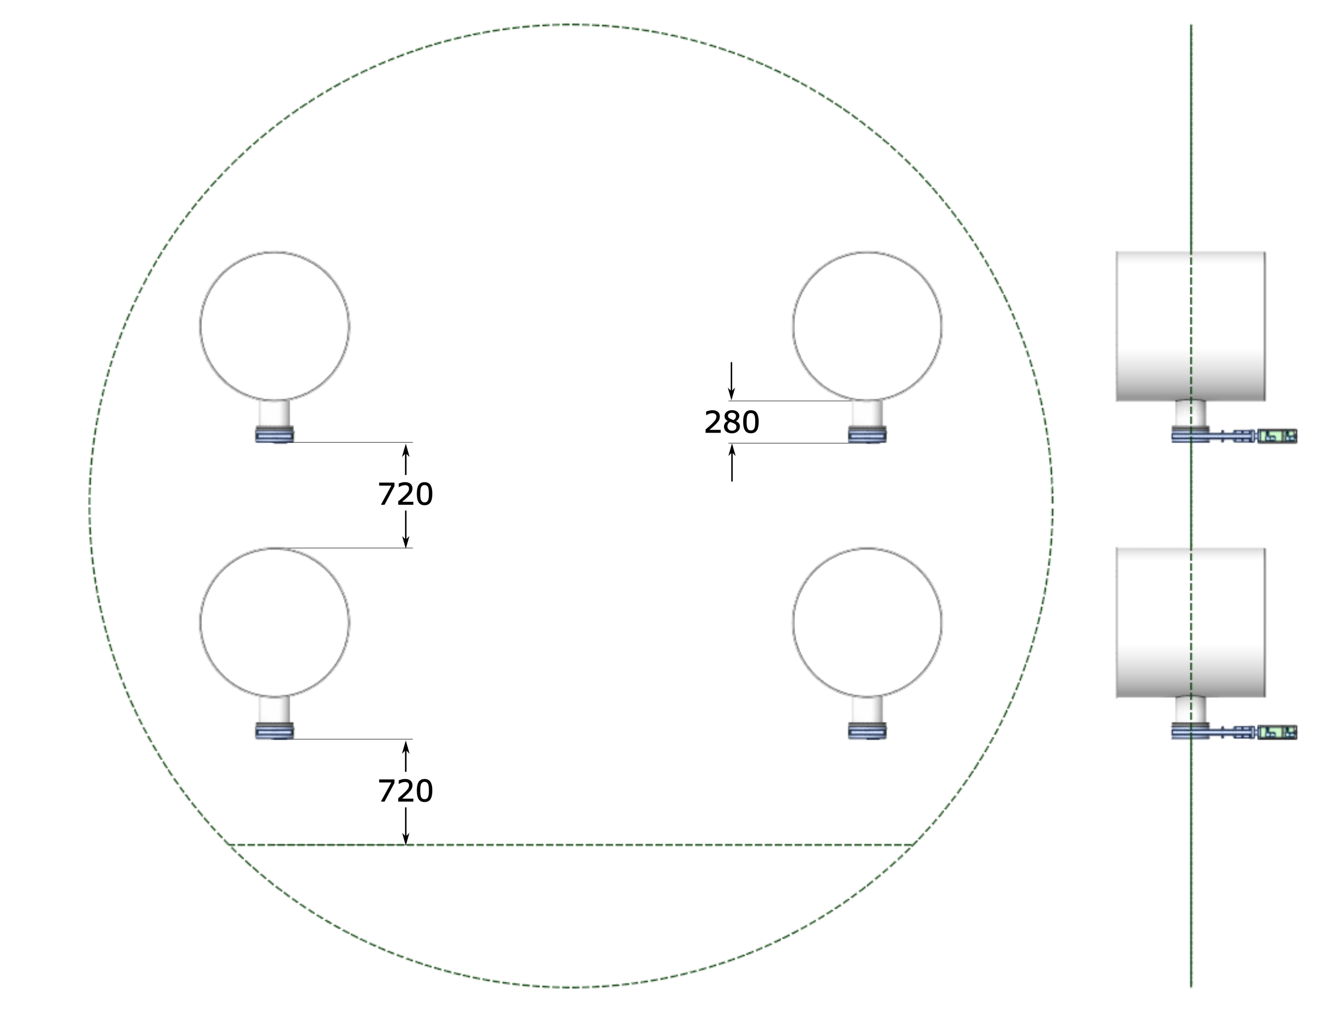
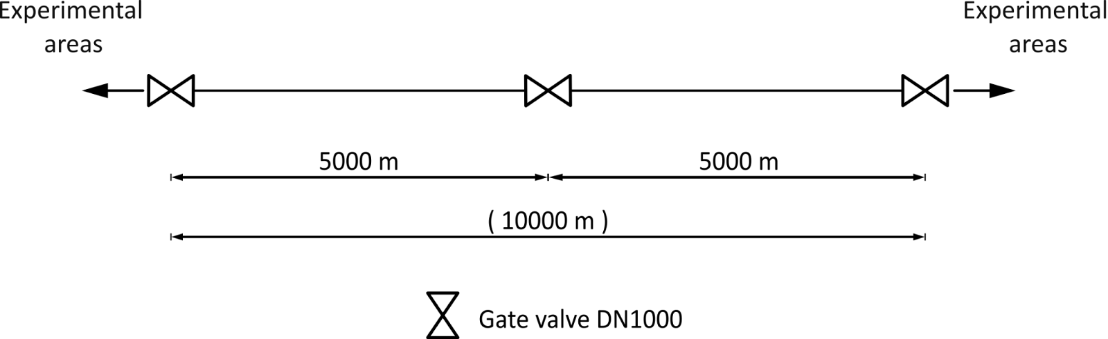
Sectorisation and ports distribution
One pumping port DN200 CF every 500 m.
Each pumping port is equipped with a gate valve FKM sealed.
~1600 x 2800 x 400 mm – 1700 kg
Source: VAT
Sector and pumping port gate valves must be heat treated to reduce their impact on the outgassing rate budget (mainly hydrogen).

Slide 6
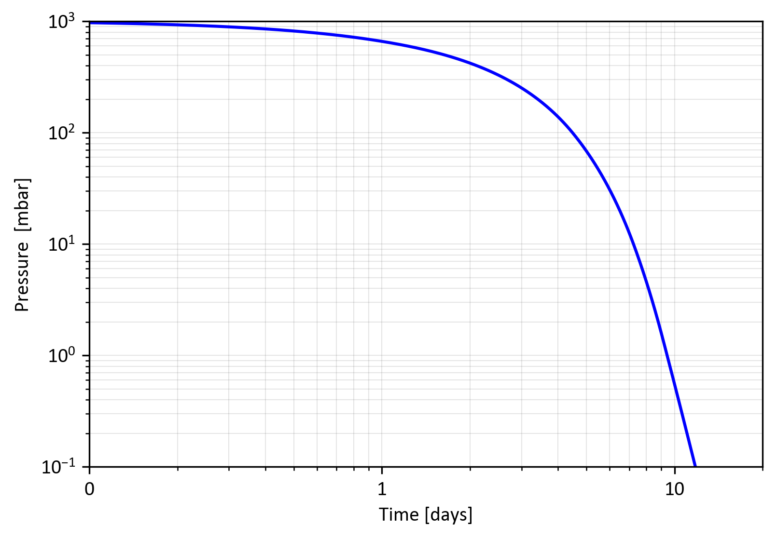
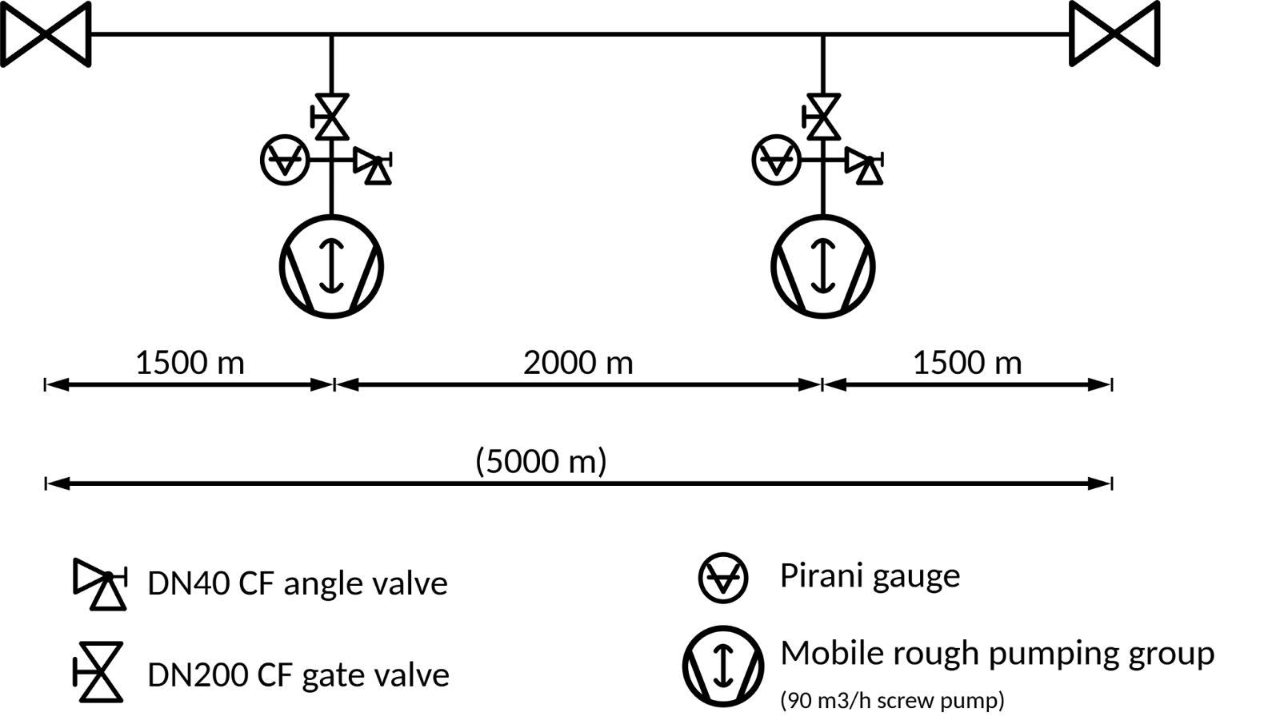
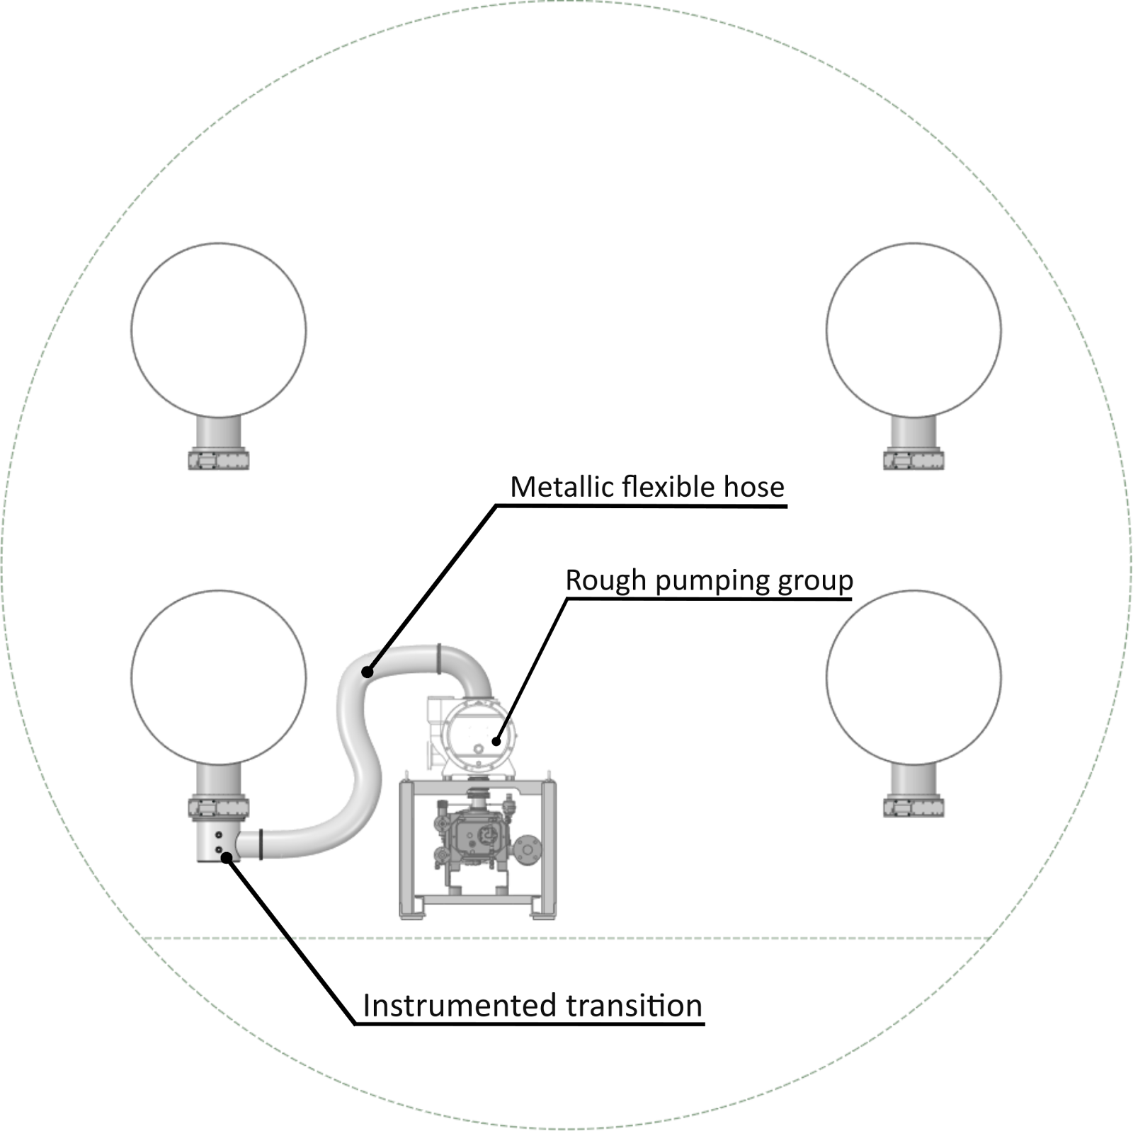
Rough vacuum
From atmospheric pressure to 10⁻¹ mbar in ~ 12 days.
The selected pumping scheme should guarantee not transport of residual dust in the beampipe.
Example of the rough pumping group assembly
(not in scale)

Slide 7
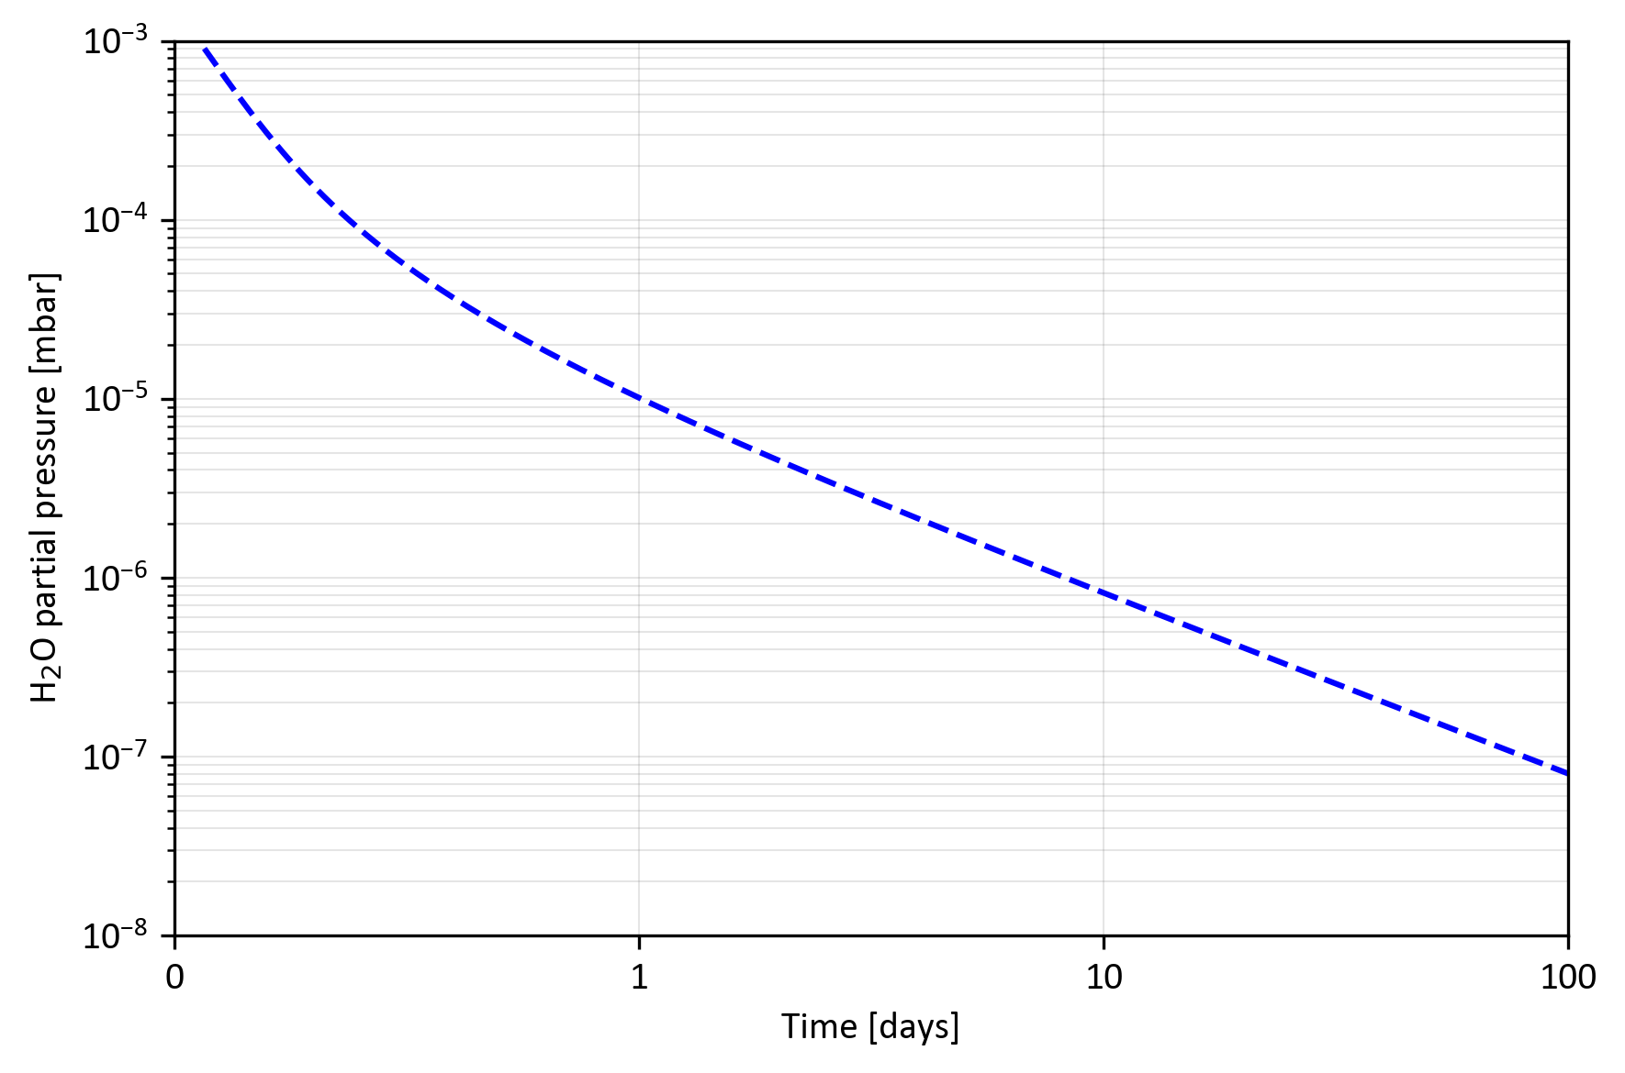
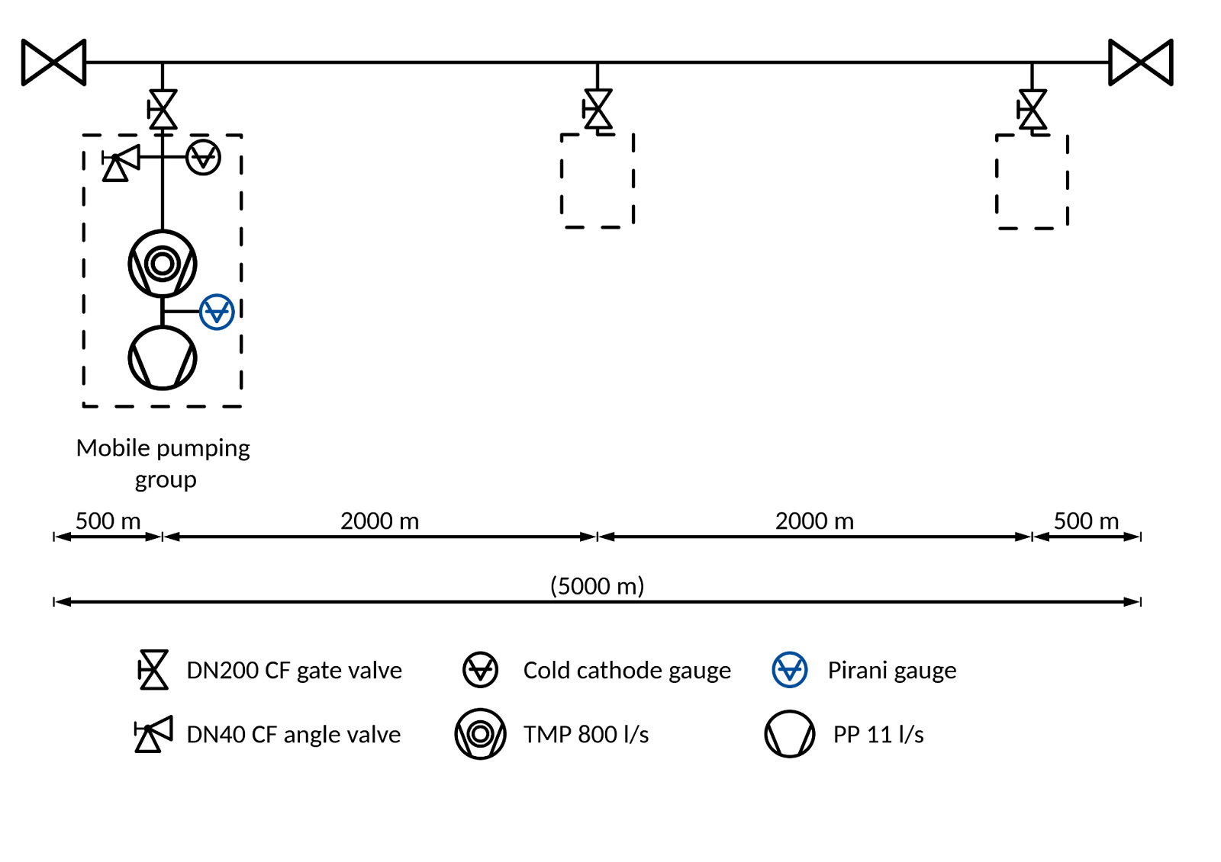
Intermediate vacuum: room temperature pumpdown
in-situ leak detections
insulation installation
At 10⁻¹ mbar, the mobile pumping groups can be activated.
The pumpdown at room temperature is foreseen to last 7 days (to allow in-situ leak detections and insulation installation).

Slide 8
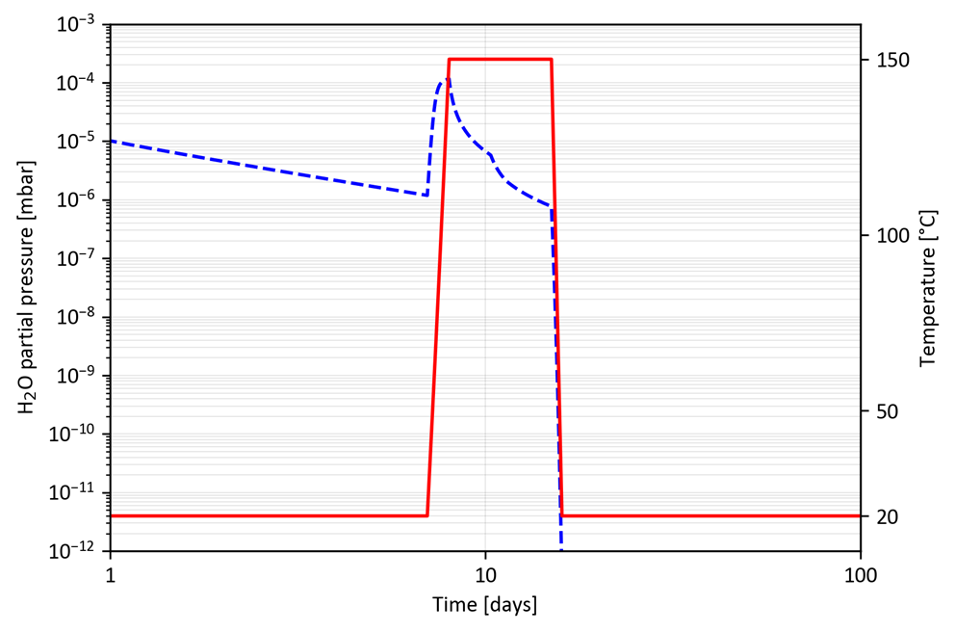
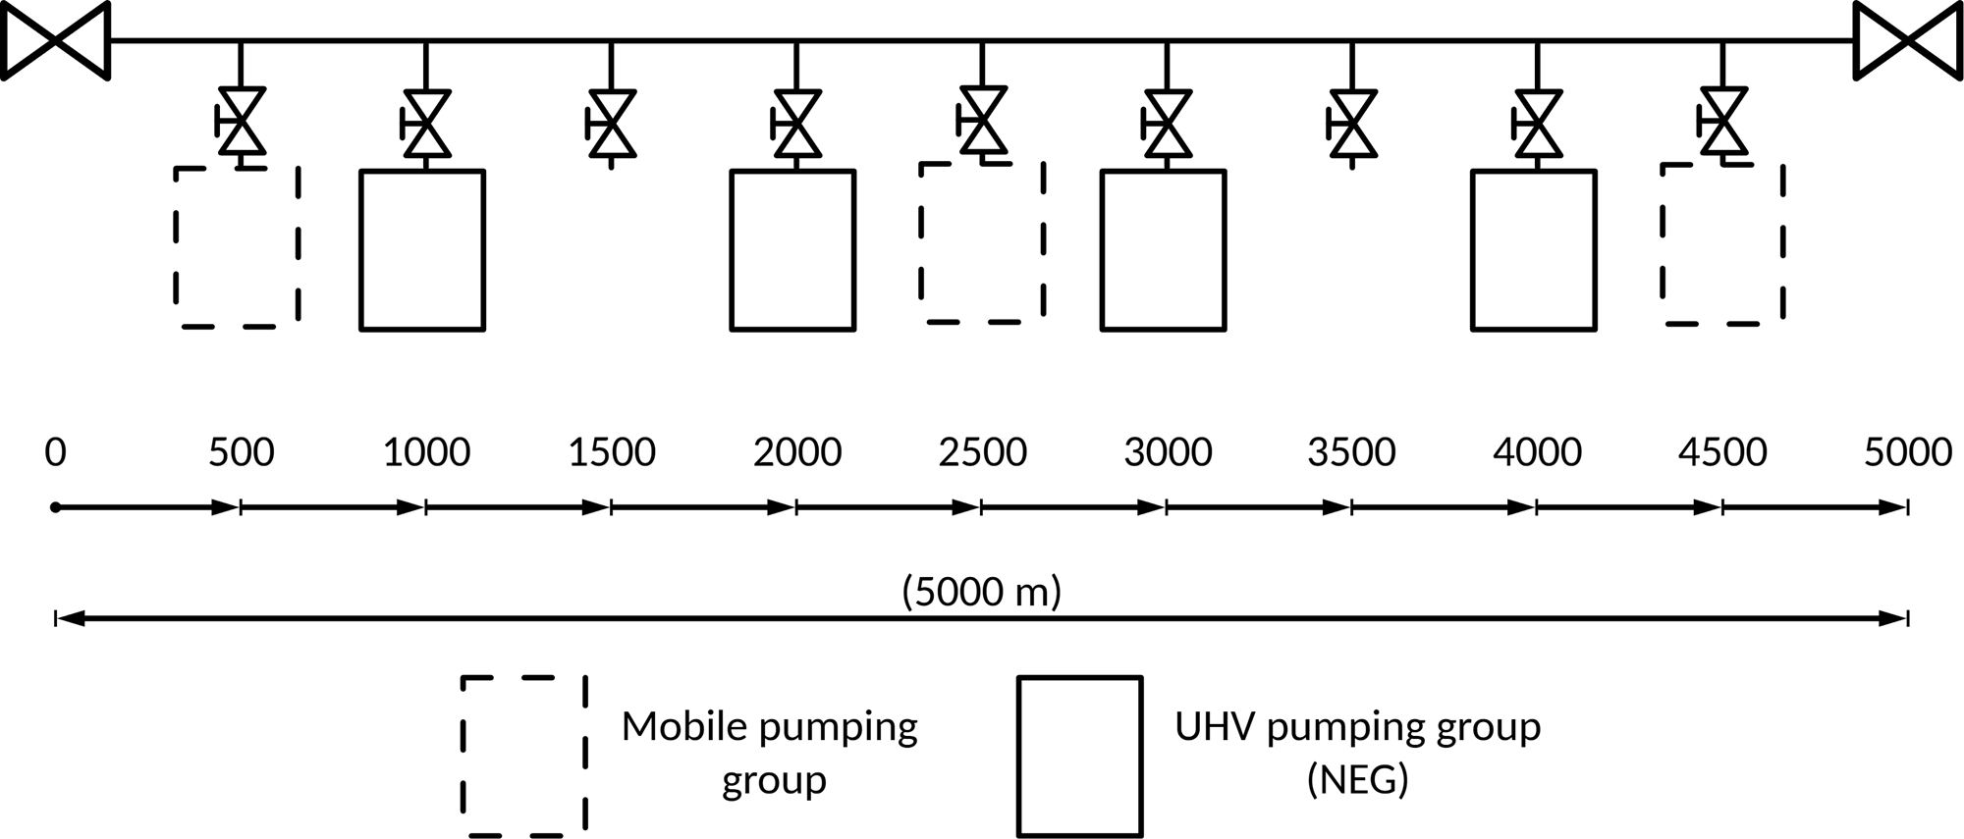
Intermediate vacuum: bakeout
NEG activation
After 7 days, the sector is baked out at 150°C for 7 days.
Two days after the bakeout start, NEG pumps
(from the UHV pumping groups, spaced 1000 m) will be activated until the end of the bakeout.

Slide 9
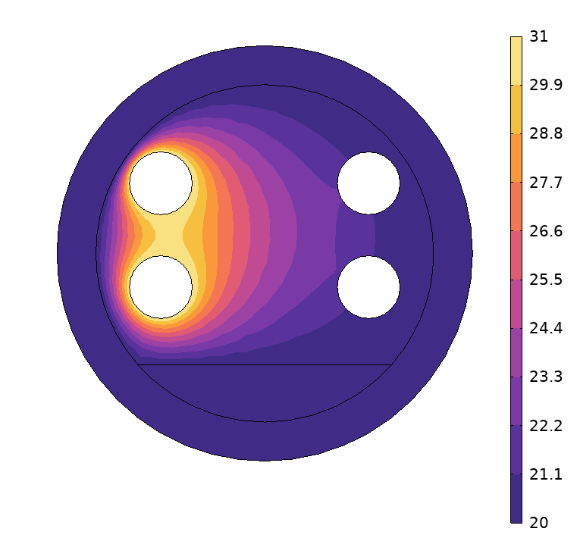
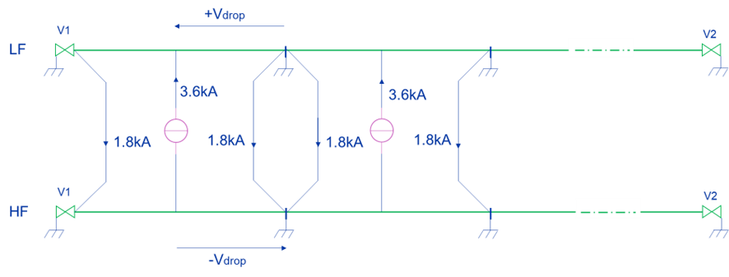
Intermediate vacuum: bakeout
The bakeout will be done using direct joule effect (high current flowing through the beampipe).
Thermal insulation is, for the moment, considered to be made of 10 cm thick mineral wool shells.
Two neighbouring sectors baked out simultaneously, using one as a returning cable for the other.
Vacuum pumps and ancillary components baked out at 140 °C < T < 350°C.
 | Straight pipe (4 mm) | Corrugated pipe (1.5 mm)
Insulation thickness [cm] | 10
Thermal power [W/m] | 208 | 207
Ramp up duration [days] | 1
Bakeout duration [days] | 7
Cooldown duration [days] | 1
Current [A] | 1800 | 1097
Insulation surface temperature [°C] | 31
Temperature and current distribution for two parallel sectors (straight pipes, 4 mm thick) baked-out at 150°C for 7 days

Slide 10
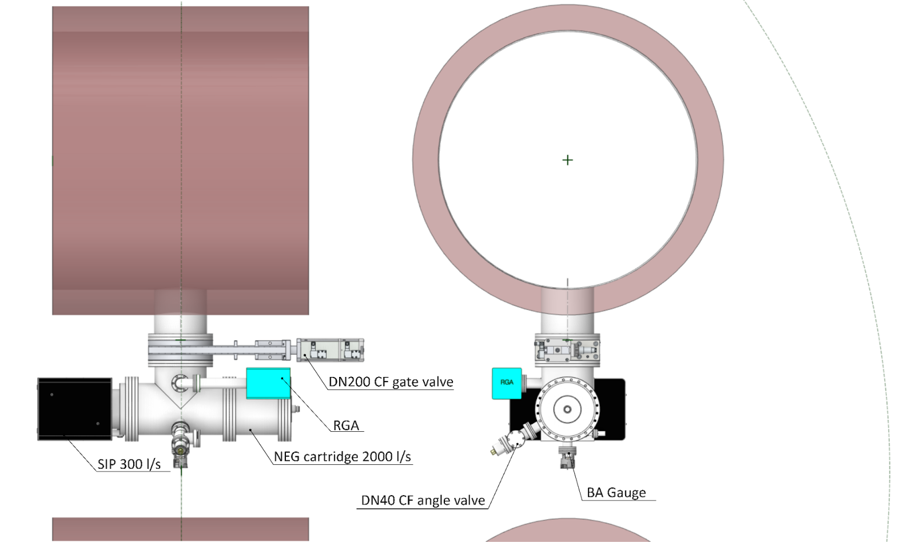
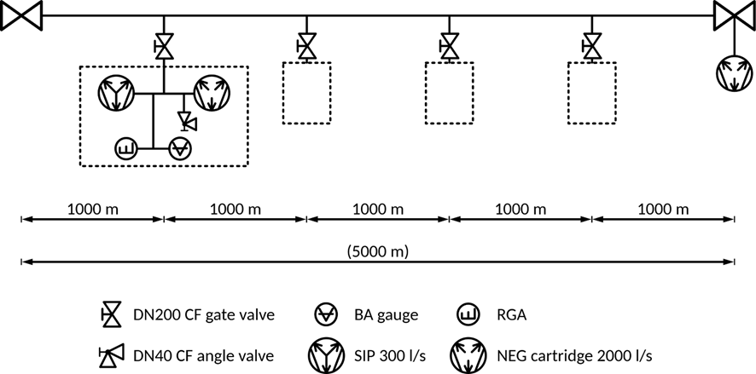
Ultra High Vacuum: layout
The UHV pumping group is equipped with a Sputter Ion Pump (SIP) and a NEG (Non-Evaporable Getter) pump.
The group is instrumented with a Bayard-Alpert gauge (BA) and a Residual Gas Analyser (RGA) to measure the total pressure and the gas composition, respectively.

Slide 11
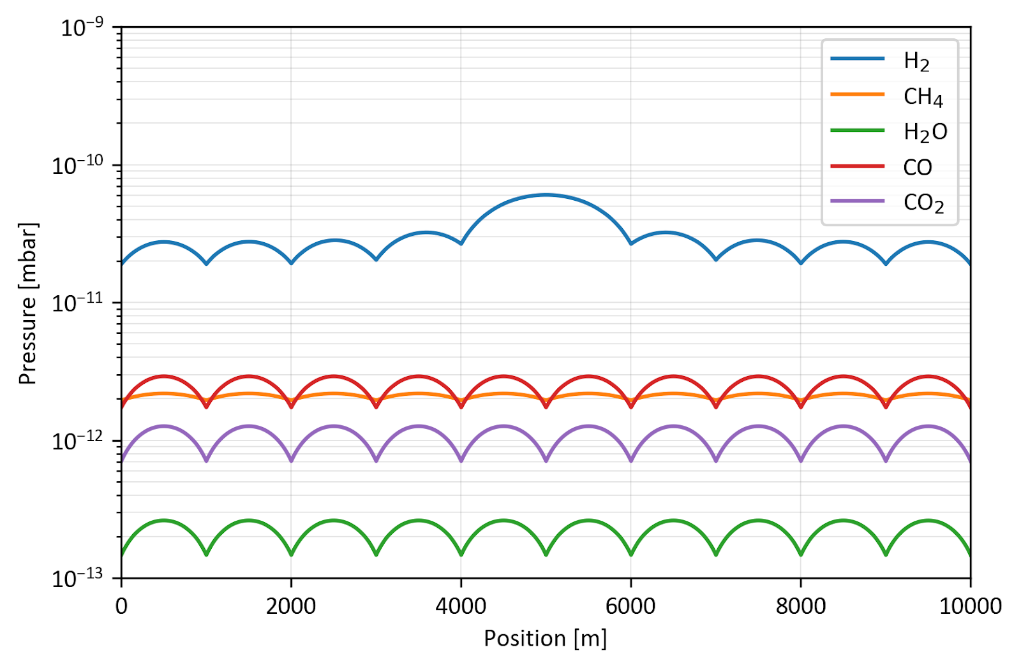
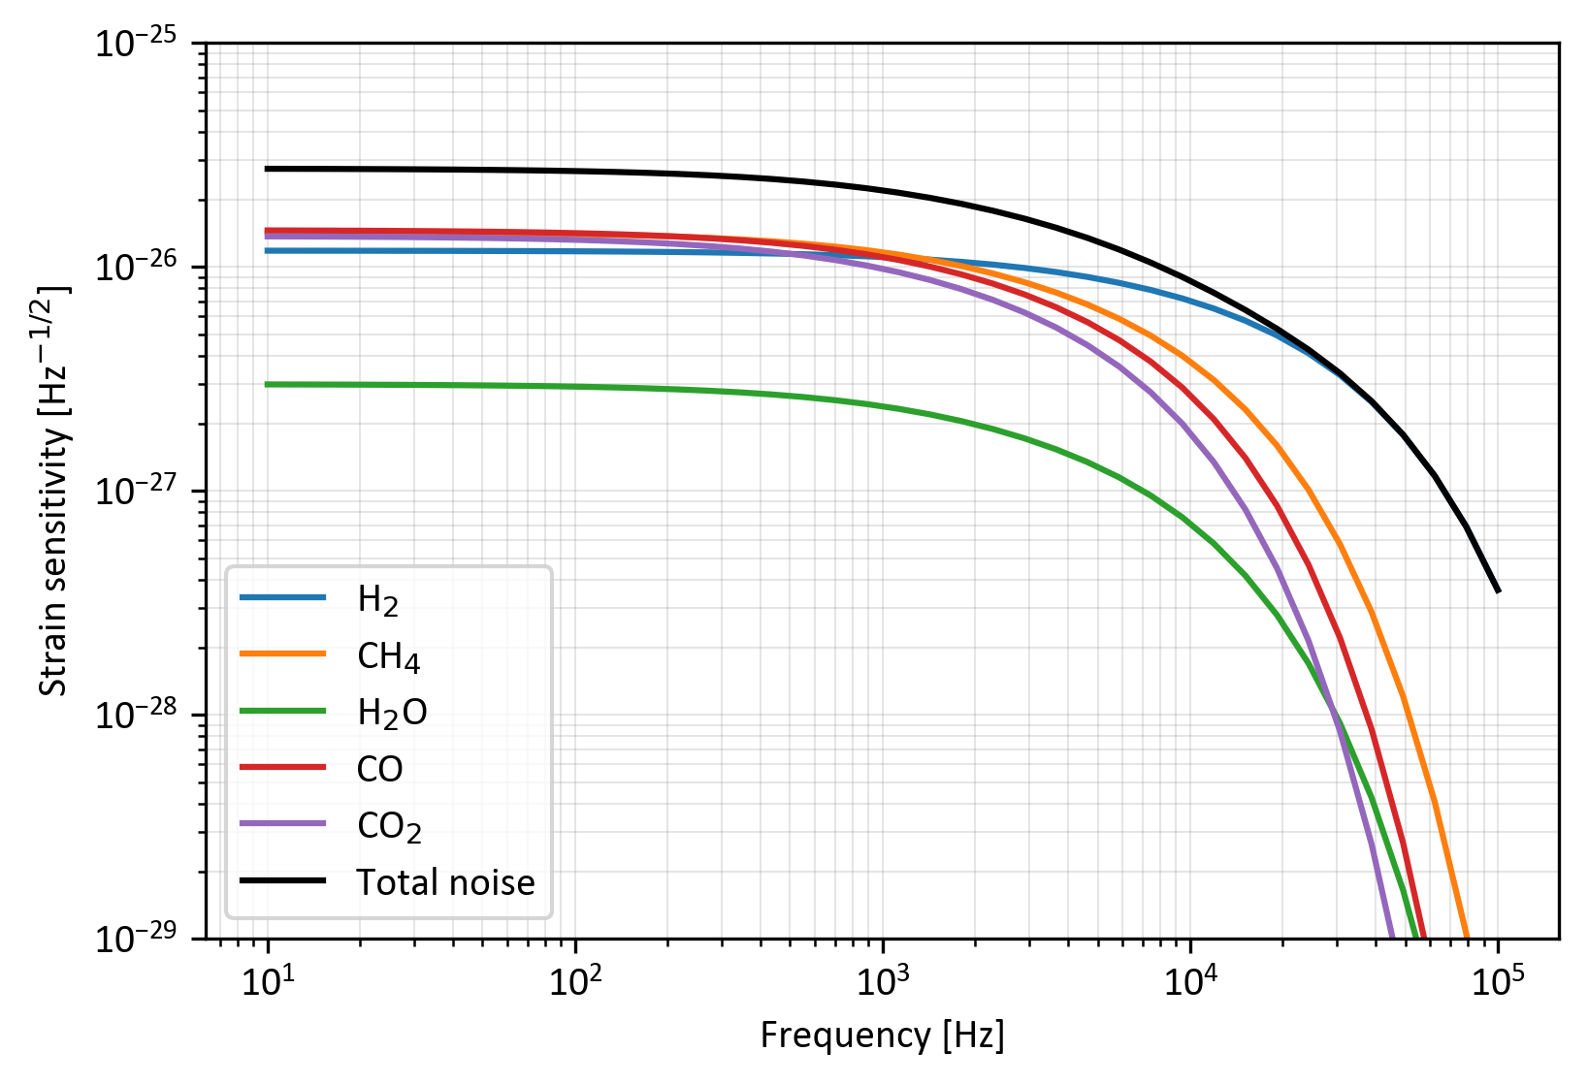
Ultra High Vacuum: ultimate partial pressures
Due to sector valve outgassing^{[2]}
Project upper limit
Strain noise as a function of the frequency for ET-LF.
Similar results apply to ET-HF.

Slide 12
Conclusions
Commissioning of two sectors from atmospheric pressure to UHV in about one month.
SECTORISATION
  Minimum sectorisation for sufficient flexibility in commissioning and preserving vacuum quality during maintenance/reparation.
ROUGH VACUUM
  The small size of the chosen pumping groups allows for the control of dust movement, ensuring non-turbulent conditions during the volume evacuation.
INTERMEDIATE VACUUM
  The use of mobile pumping groups and reusable bakeout insulation permits flexibility during commissioning and reduces its cost.
  After 7 days of bakeout of two sectors at 150°C, the temperature in the tunnel is < 29°C.
  The current needed for the corrugated solution (1.5 mm) is 40% less than the straight pipe (4 mm).
ULTRA HIGH VACUUM
  The low outgassing rates of AISI 441 enable the use of compact pumping groups and are integrated within the beamlines volume occupancy.

Slide 13
References
[1] A. Grado et al. Einstein Telescope beampipe requirements, ET-0385A-24, version June 10, 2024
[2] V. Brisson, C. Garnier, P. Marin, A. Reboux, Large ultra-high-vacuum VAT gate valve with Viton gasket for the VIRGO interferometer, Vacuum, Volume 60, Issues 1–2, 2001, Pages 221-227, https://doi.org/10.1016/S0042-207X(00)00375-4.

