Slide 1

FCC-ee Arc Half-Cell 1:1 Mock-up status
FCC-ee Arc Half Cell 1:1 Mock-up team
A. Piccini, F. Carra, M. Timmins, M. Rouchouse, P. Catherine, J. Coupard, J. Bossy, E. Bernard, Y. Grislain, A. Manios with many contributions from Equipment Groups, HSE, SCE, Senior Advisors
Tuesday 19th November 2024

Slide 2
Points presented during the ADTC meeting 10/1024
The aim was to validate and agree with FCC management on the following decisions:
  Dimensions of the mock-up
  Envelope dimensions and detailed dimensions: cross-section and longitudinal drawings
  Installation site
  Analysis of building 355-358, integration into this building, IRP due diligence
  Type of envelope for the mock-up
  Steel vs concrete structure
  What will be installed inside the mock-up
  Mixed of dummy and real elements: decisions with equipment groups also discussed at an internal review

Slide 3
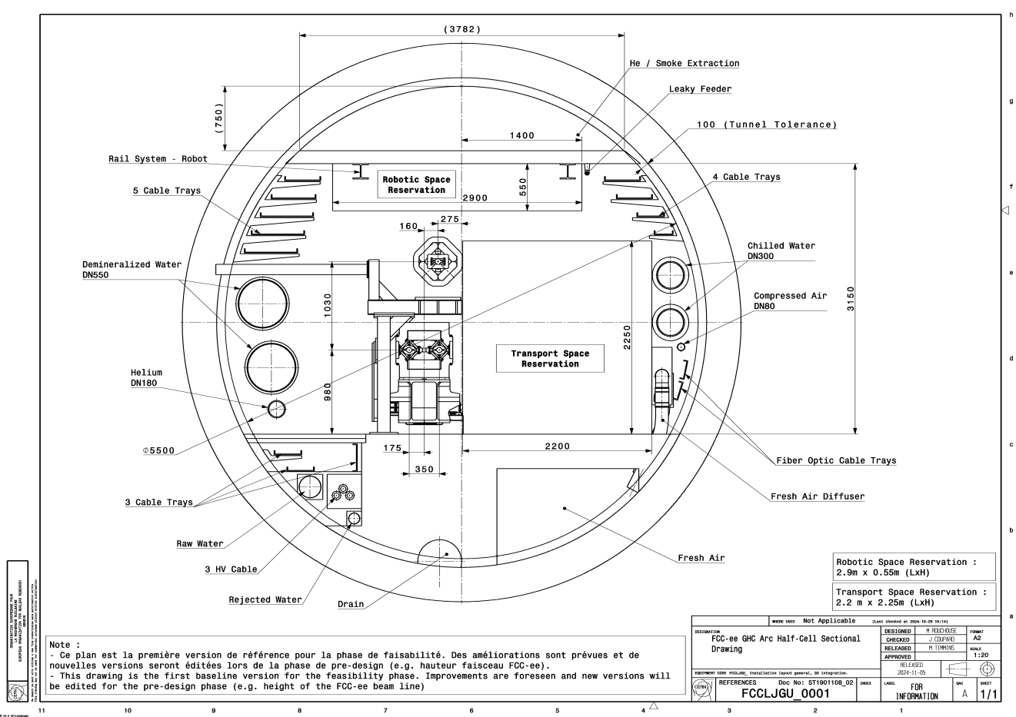
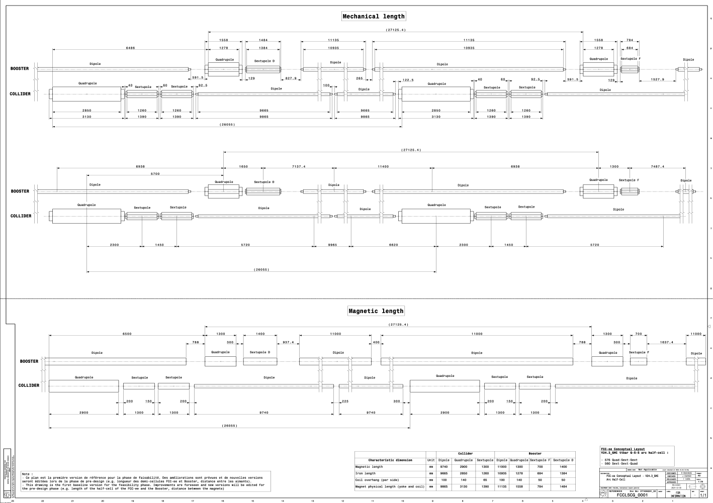
1. Dimensions of the mock-up
Release of the two drawings: baseline definition for the arc, approved by ATDC management
Iterations will be carried out during the Pre-TDR phase
FCC-ee GHC Arc Half-Cell Sectional Drawing | Document FCCLJGU_0001 (v.0) (cern.ch)
FCC-ee Conceptual Layout - V24.3_GHC Arc Half-Cell | Document FCCLSCG_0001 (v.0) (cern.ch)

Slide 4
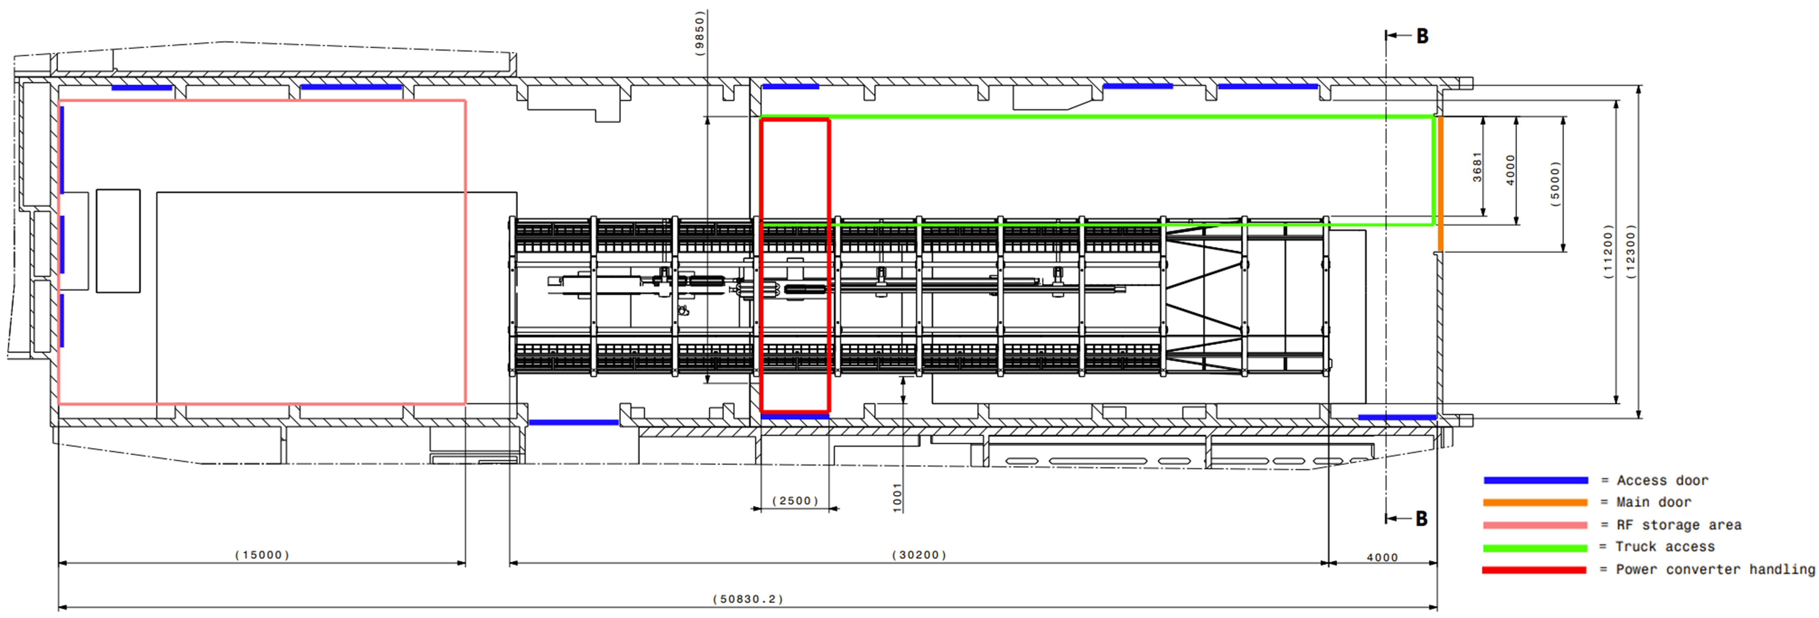
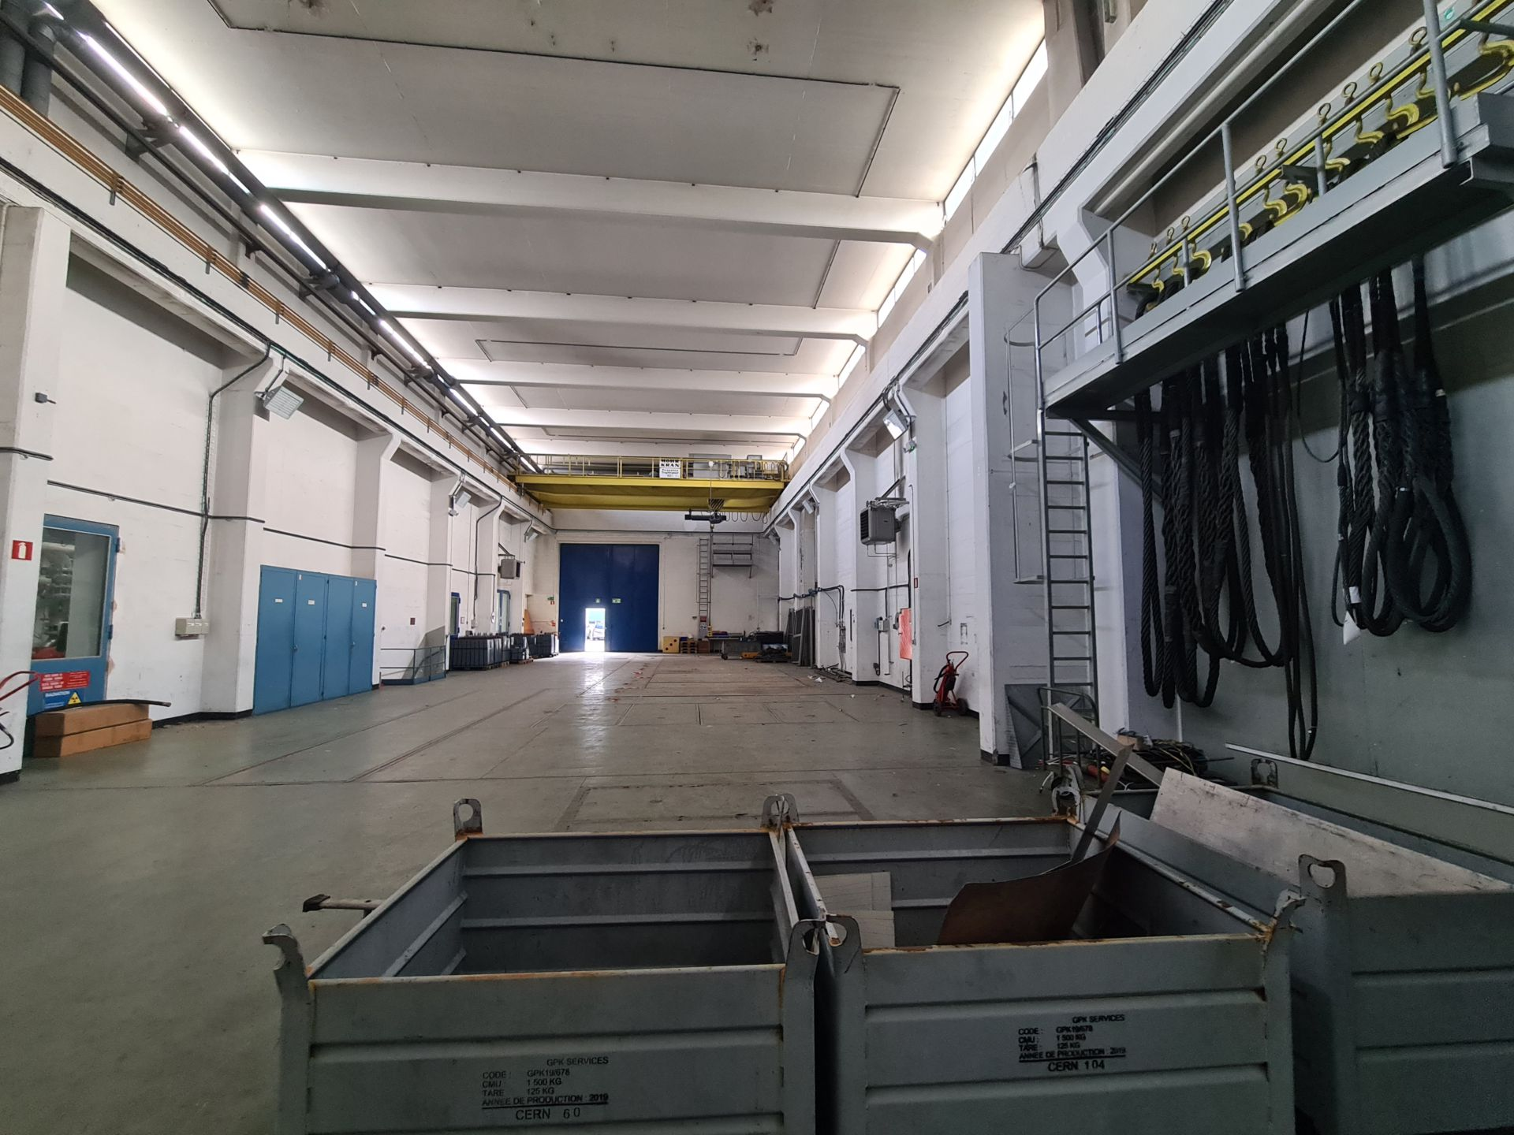
2. Installation site
Integration work in building 355-358 is still ongoing. Discussion with the EN-HE team.
The IRP due diligence has been submitted and will be reviewed during the next SCE internal regular IRP follow-up meeting.
Once it is done, the preparation work on building may be launched.
A memo about the transfer of part of building 355/358 from SY to FCC management has been prepared and is circulating on EDMS

Slide 5
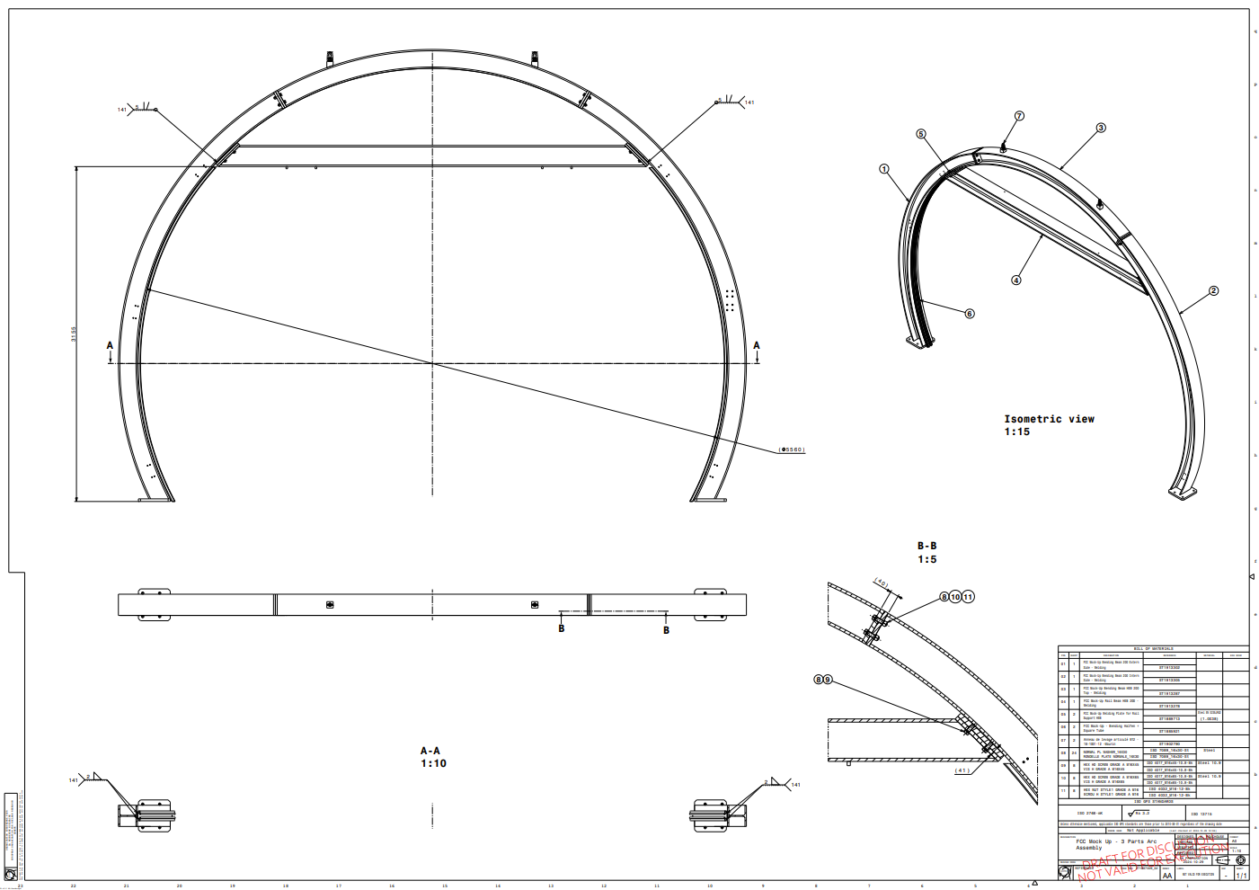
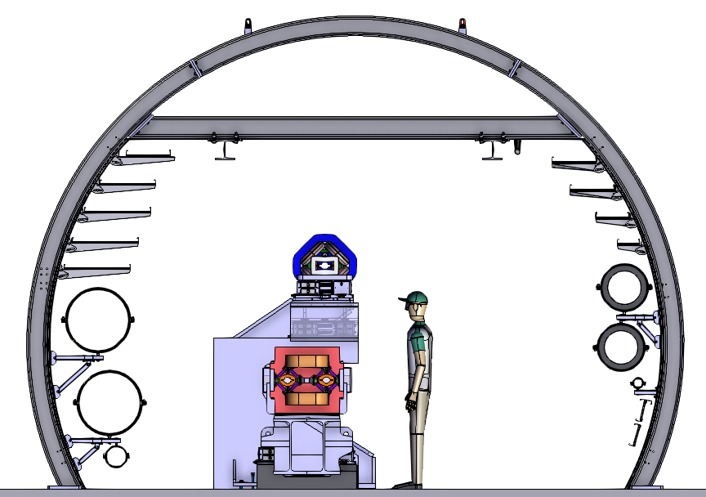
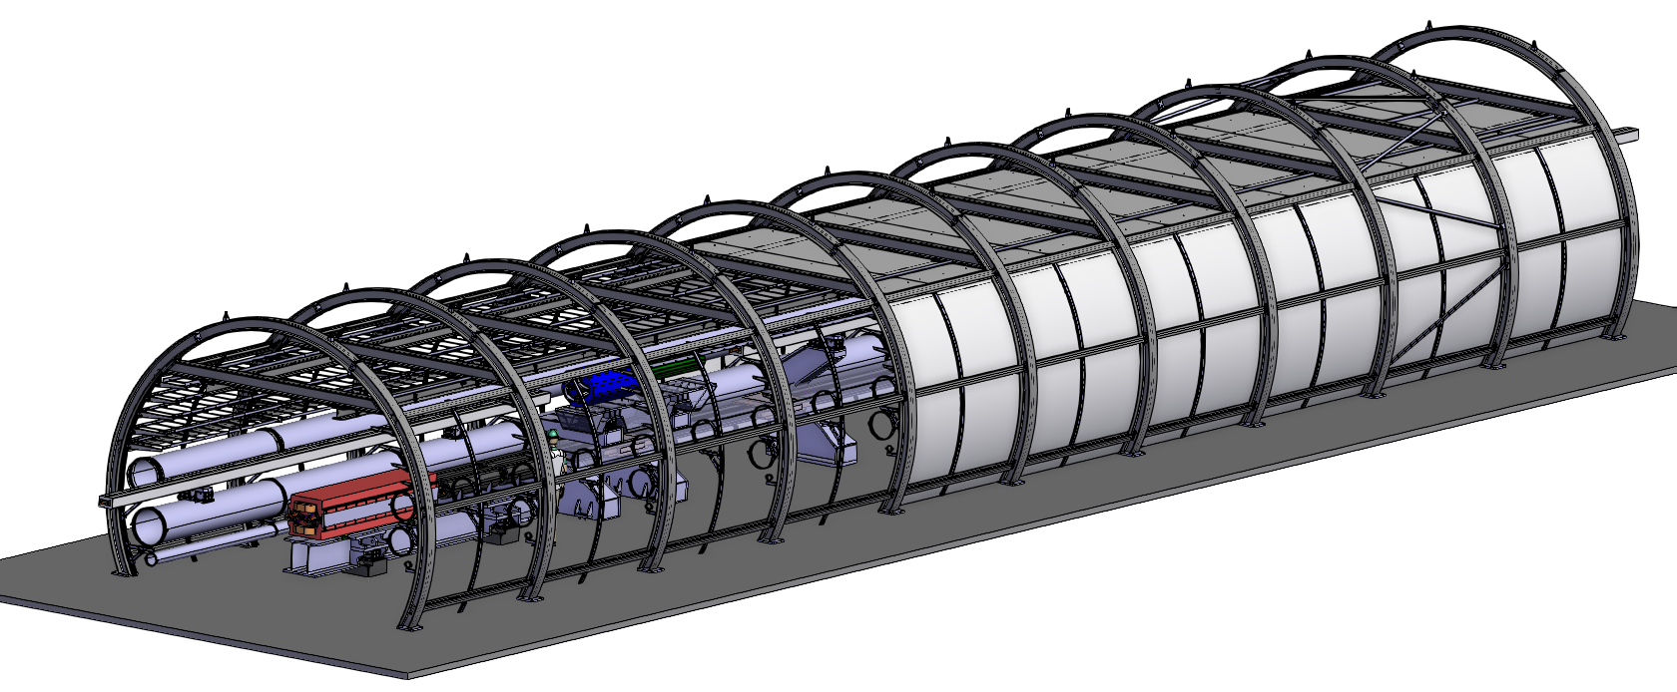
3. Type of envelope
The steel structure has been validated
Completion of calculations and preparation of a calculation file to be reviewed by HSE.
Ground anchoring assessment with the help of the SCE team.
Finalise and refine drawings in preparation for manufacturing launch.

Slide 6
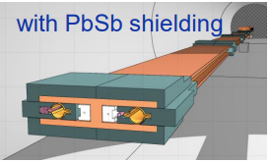
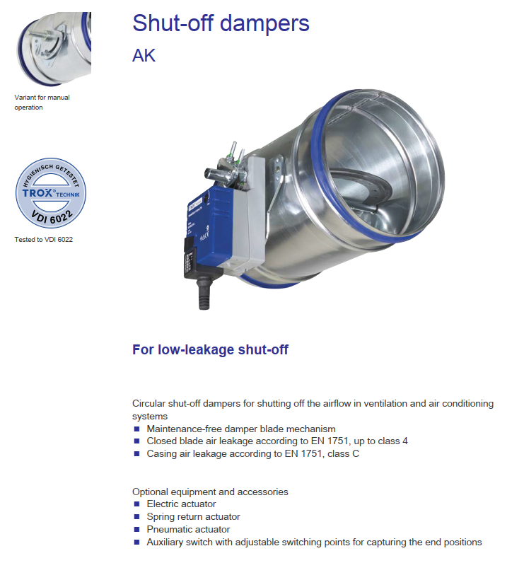
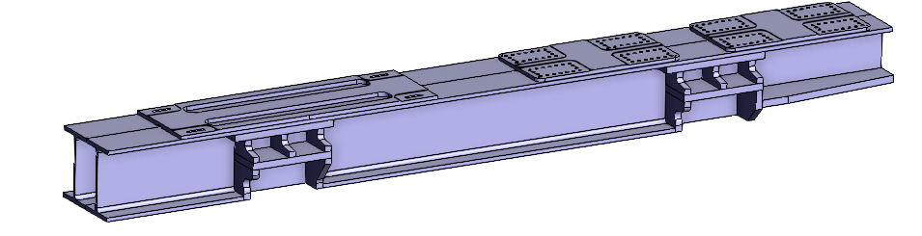
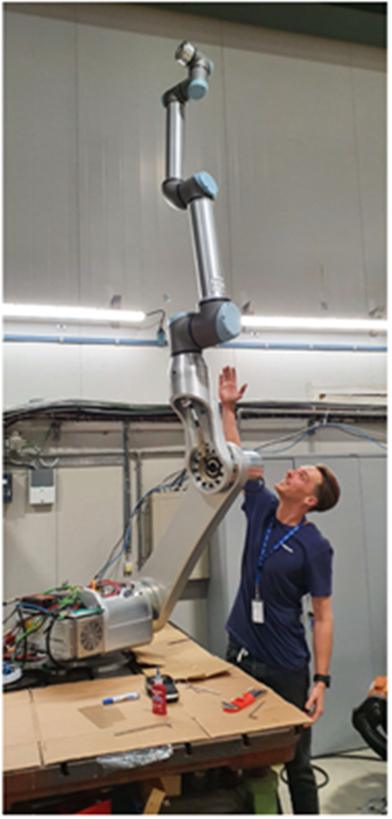
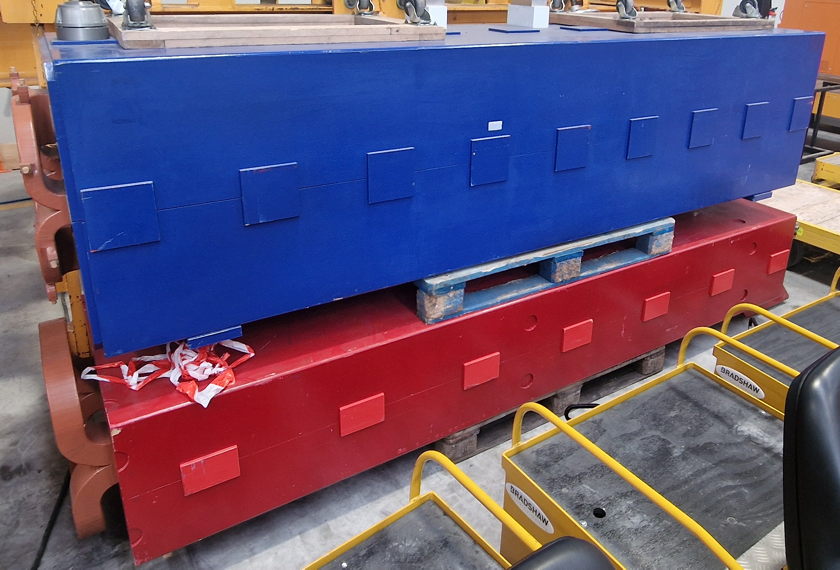
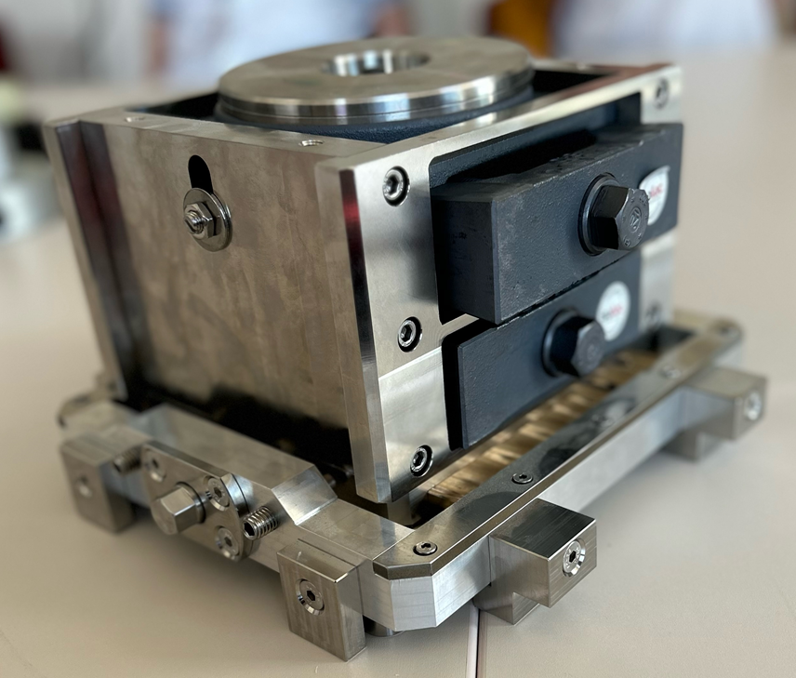
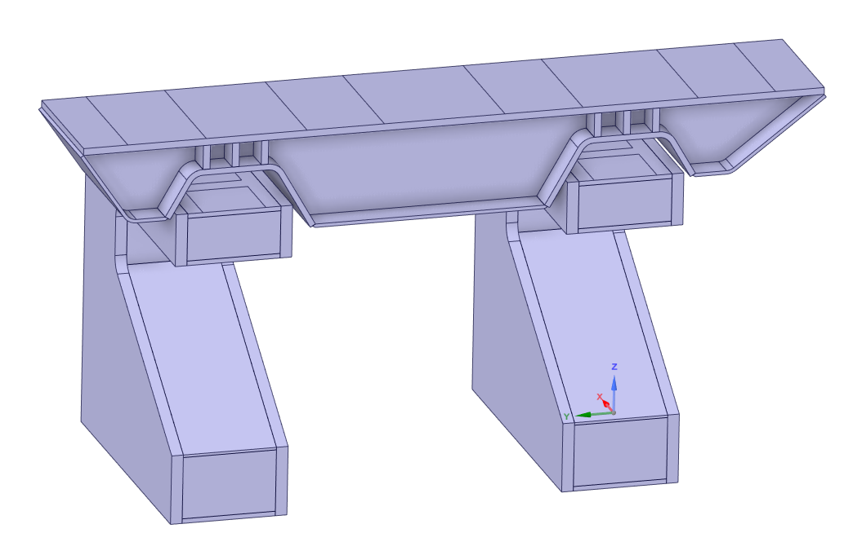
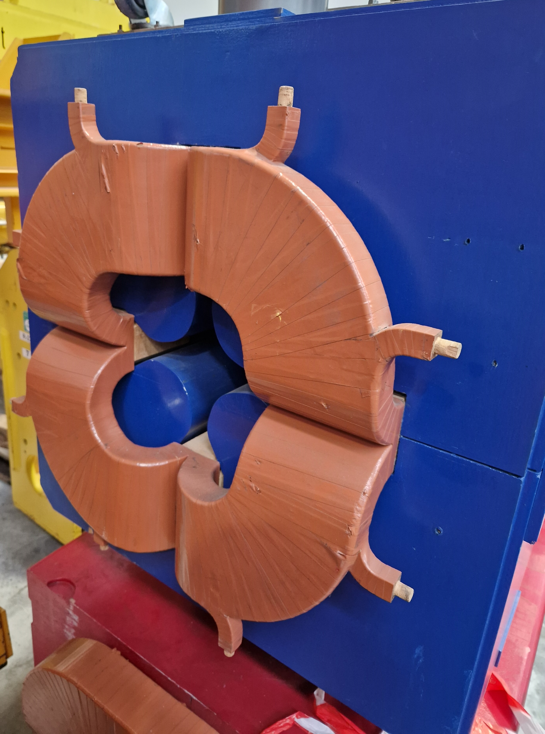
4. What will be installed?
Procurement process launched (DAIs, tenders, etc.)
Discussion with groups ongoing to define orders to be placed
5. Collaborations
Digitalization of agreements with PSI and PAEC ongoing – last step!

