Slide 1

Higgs searches at the
Large Hadron Collider
Aleandro Nisati (INFN-Roma)
CHIPP
Engelberg, 22-27 January 2012

Slide 2
index
Standard Model Higgs phenomenology: see lectures by Giulia Zanderighi
SM Higgs searches at LHC:
  H→γγ
  H→ ττ, bb
  H→WW^{(*)}
  H→ZZ^{(*)}
Perspectives

Slide 3
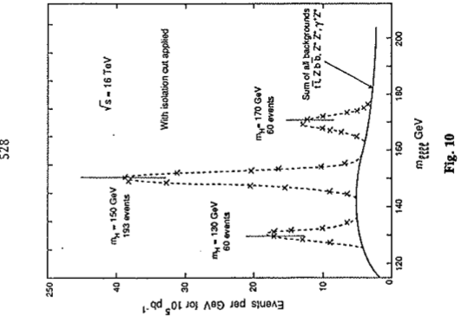
Introduction
Proceedings of LHC Workshop
(Aachen, 1990): H→ 4l signals
m_{H}=130, 150, 170 GeV
√s = 16 TeV, 100 fb⁻¹
Higgs searches represent on of the most important themes of the LHC scientific programme
➔ Higgs searches guided the conception design and technological choices of ATLAS and CMS
Among the most challenging physics processes, in particular in the mass region below m_{H} = 2m_{Z}
→ high energy resolution and reconstruction+identification efficiency of leptons, jets, b-jets tagging, missing transverse energy, etc
After two years of operations, the situation is very exciting:
  The LHC is working very well: more than 5 fb-1 of data/experiment delivered
  The understanding of the detectors ATLAS and CMS is quite advanced

Slide 4
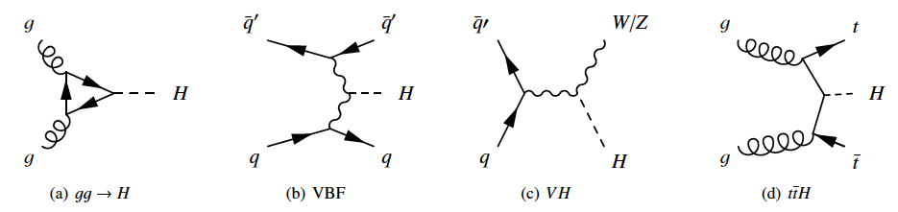
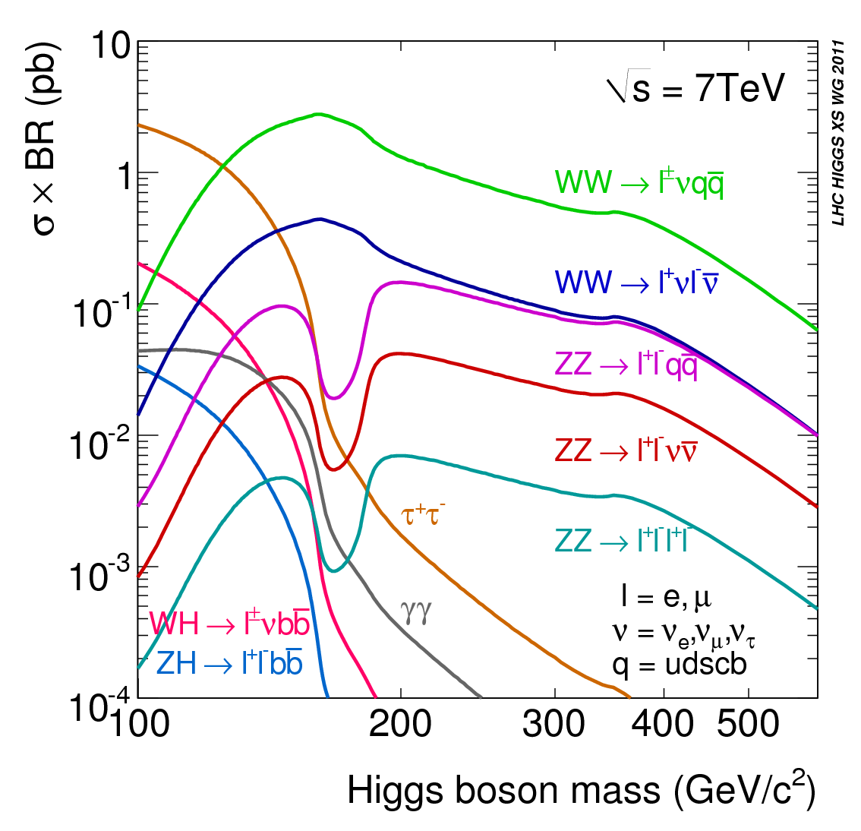
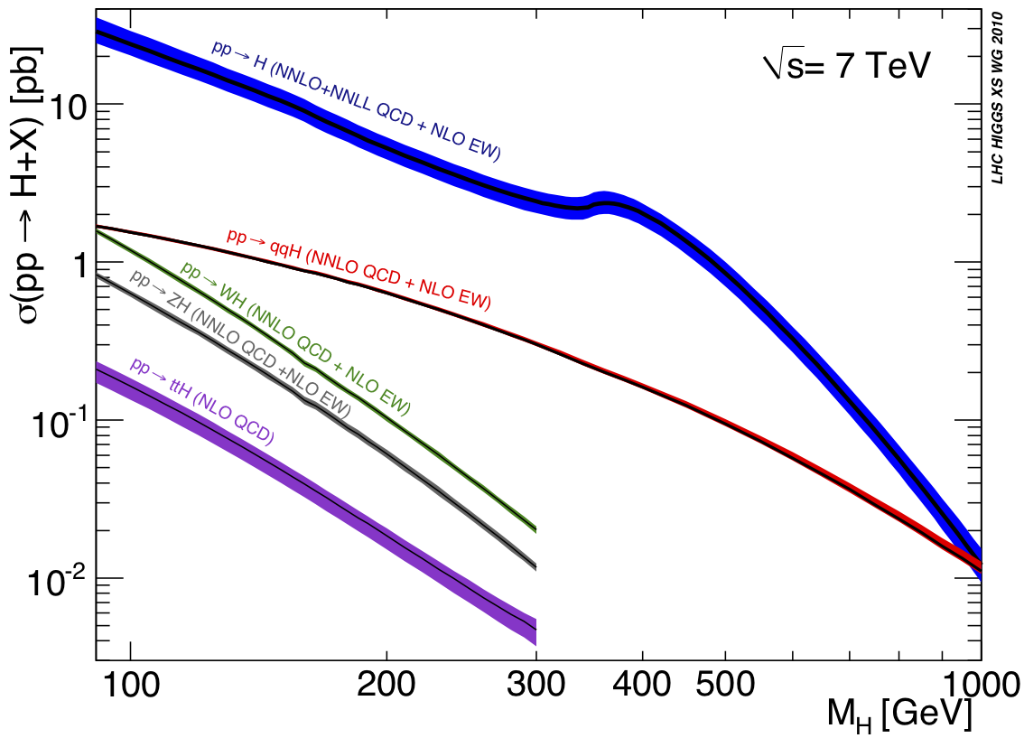
Higgs phenomenology
Experimentally most sensitive channels vs m_{H}
125-180
WW^{(*)}→ lνlν
<130
γγ
300-600
ZZ→ llνν
125-300
ZZ^{(*)}→ llll
Cross-sections computed to NNLO in most cases → theory uncertainties reduced to < 20%
Huge progress also in the theoretical predictions of numerous and complex backgrounds
Excellent achievements of the theory community; very fruitful discussions with the experiments (e.g. through LHC Higgs Cross Section WG, LPCC, etc.)

Slide 5
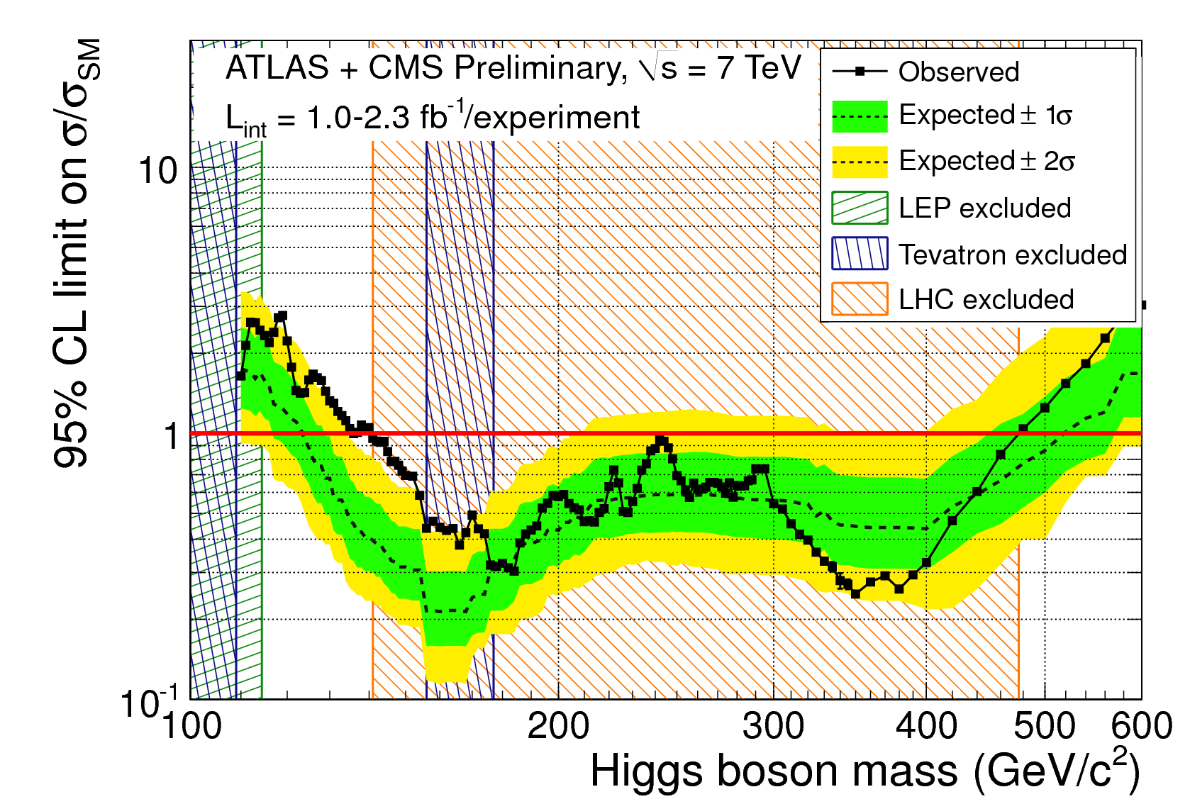
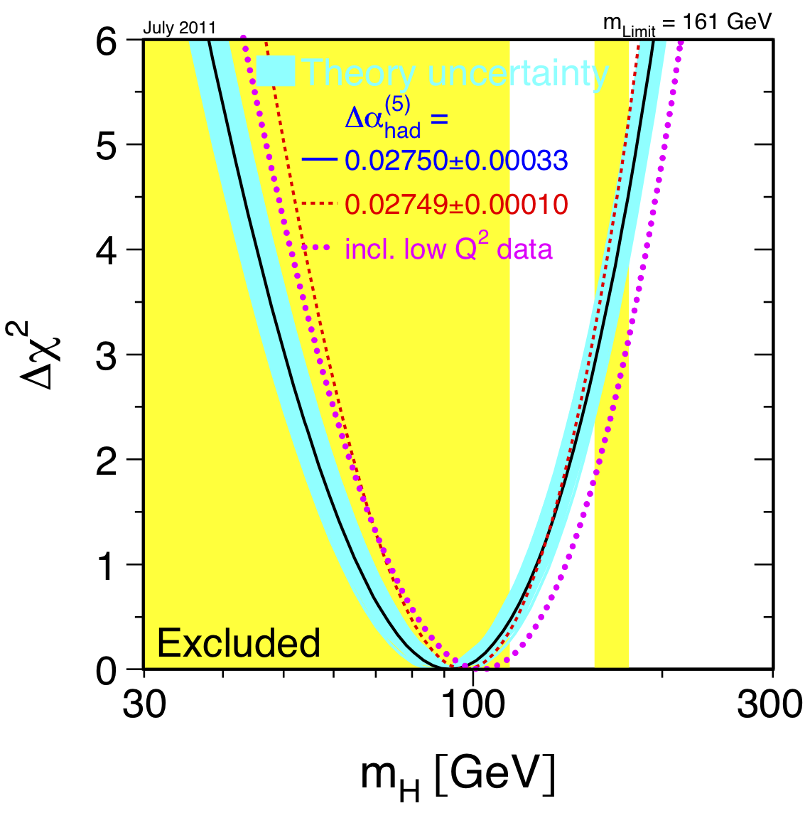
The Higgs searches status at HCP 2011
November 2011
CMS PAS HIG-11-023,
ATLAS-CONF-201-157
LEP (95%CL)
m_{H} > 114.4 GeV
Tevatron exclusion (95%CL):
100 < m_{H} < 109 GeV
156 < m_{H} < 177 GeV
First ATLAS+CMS combination: based on data recorded until end August 2011:
up to ~2.3 fb⁻¹ per experiment
Excluded 95% CL : 141-476 GeV
Excluded 99% CL : 146-443 GeV (except ~222, 238-248, ~295 GeV)
Expected 95% CL : 124-520 GeV → max deviation from background-only: ~ 3σ (m_{H}~144 GeV)

Slide 6
During the last few months of 2011…
ATLAS and CMS collaborations worked very hard to analyse the full 2011 datasets:
  ATLAS: updated the most sensitive channels in the best motivated and not-yet excluded low mass region: H→γγ (4.9 fb⁻¹); H→ZZ^{(*)}→4l (4.8 fb⁻¹); H→WW^{(*)}→lνlν (2.1 fb⁻¹);
  CMS: updated all channels considered for physics analysis during last summer

Slide 7
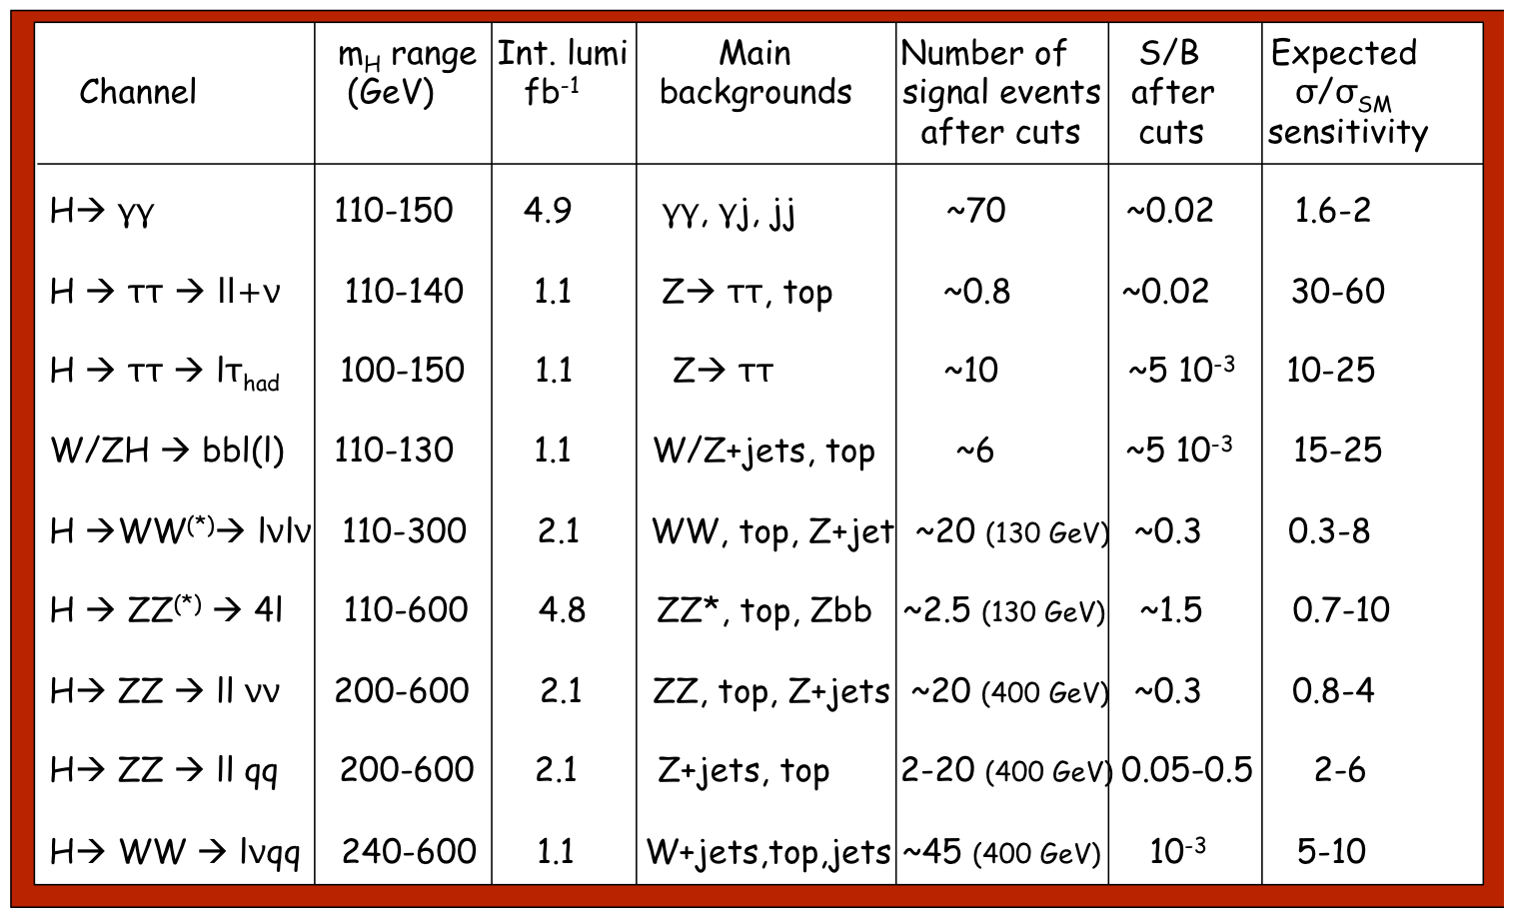
Micro-summary of present Higgs searches in ATLAS
Based on (conservative) cut-based selections
Large and sometimes not well-known backgrounds estimated mostly with data-driven
techniques using signal-free control regions

Slide 8
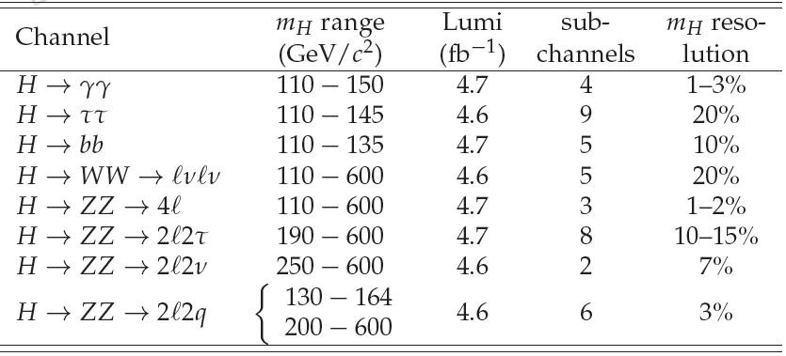
CMS Analyses
All 8 analyses yielded a preliminary result to be shown today,
and contributed to the CMS combination documented in HIG-011-32.

Slide 9

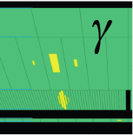
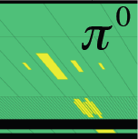
H→γγ – event selection
Very simple signature (and analysis)
Photon identification based both on lateral and longitudinal segmentation of the Electromagnetic calorimeter
Two high-quality isolated high-p_{T} photons
  p_{T1} > 40 GeV; p_{T2} > 25 GeV
  |η₁₂| < 1.37 and 1.52 < |η₁₂| <2.37
ATLAS
Sampling 3
Sampling 2
Sampling 1
preshower
Spring 2011 data

Slide 10

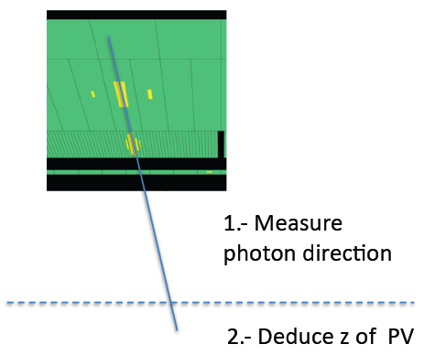
H→γγ – mass reconstruction
ATLAS
Mass reconstruction
m² = 2P₁P₂(1-cosϑ) ≅ P₁P₂ϑ²
δm/m = (1/√2)(δP/P) ⊕ δϑ/ϑ
p₁
It is important to measure the photon momentum in space with high resolution:
➔ accurate measurement of the photon energy
➔ accurate measurement of the photon direction of flight
p₂
θ
CMS:
  very high energy resolution
  Measure the photon direction using the impact point measured by the crystal calorimeter, and the hard-scattering proton-proton vertex ➔ requires correct vertex identification in presence of large pile-up
ATLAS:
  high energy resolution
  Measure the photon direction using the longitudinal segmentation of the LAr calorimeter, and fit the γγ production vertex using the pp beam line

Slide 11
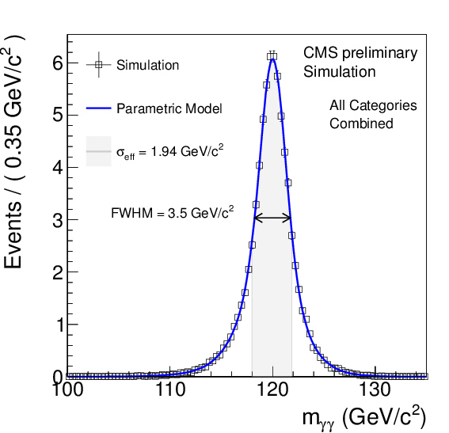
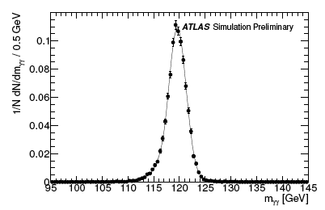
H→γγ – mass reconstruction
ATLAS
Energy resolution contribution δp ≈ 1.3 GeV
  Energy scale calibration from Z→e⁺e⁻
Interaction point spread: σ(z) ≈ 5.6 cm → δm (θ) ≈ 1.4 GeV
Resolution with pointing: σ(z) ≈ 1.5 cm;
  Use of recoil tracks less effective with large number of pile-up collisions
Use conversion tracks as well
CMS: correct primary vertex reconstruction efficiency as a function of run (top table), and of the Higgs transverse momentum. Distribution of the simulated m_{H} = 120 GeV Higgs events
ATLAS: Distribution of simulated m_{H} = 120 GeV Higgs events; σ(m) ~ 1.7 GeV (using 2010 calibration)

Slide 12
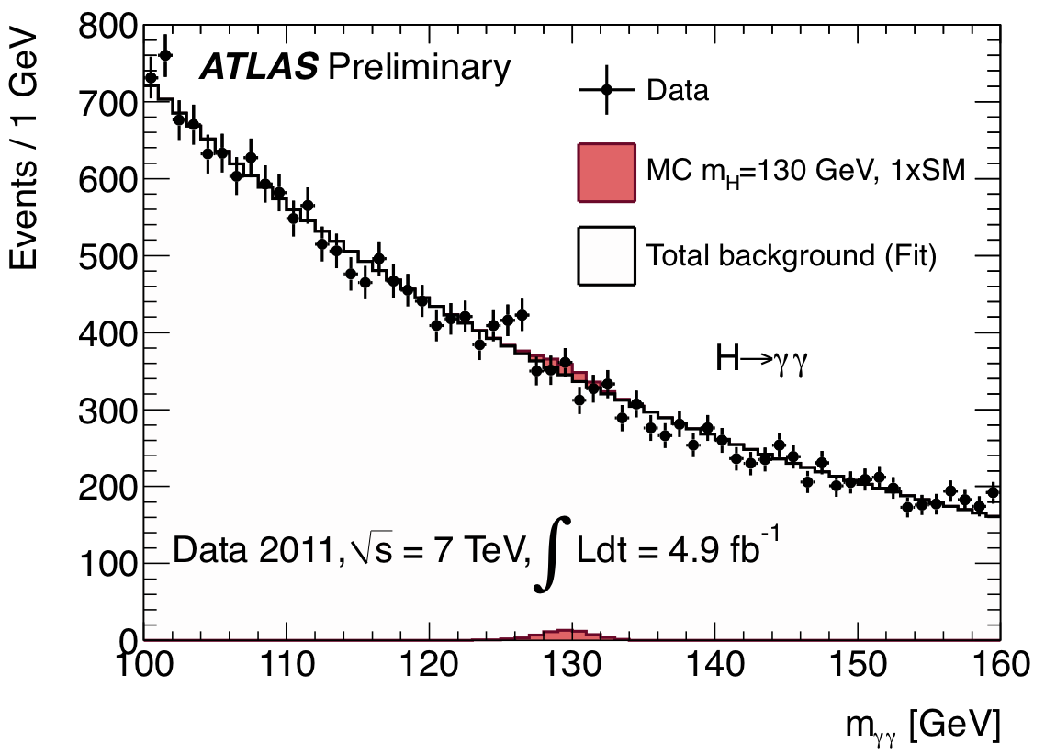
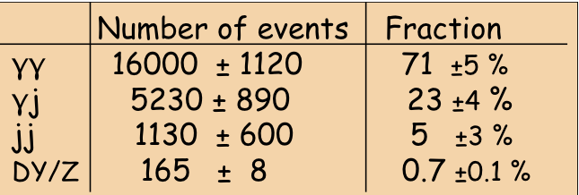
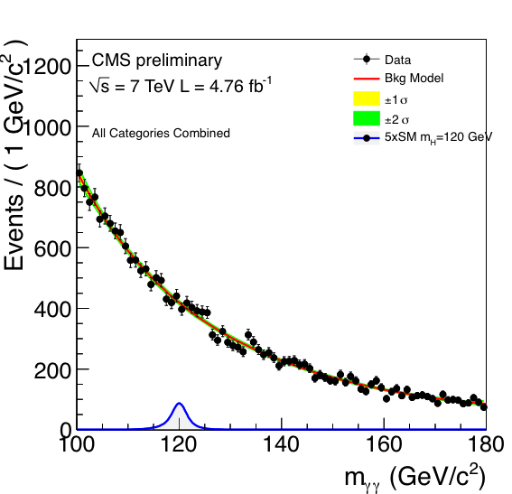
H→γγ – results
ATLAS
After all cuts: 22489 events with 100 < m_{γγ} < 160 GeV observed in the data
Background estimated with data control samples
γj + jj << γγ irreducible (purity ~ 70%)

Slide 13
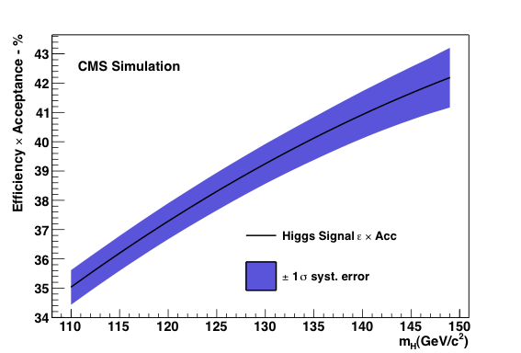
H→γγ – results
Photon reconstruction efficiency: ~98%
Photon identification efficiency: ~ 85±5% from MC, cross-checked with data
(Z→ ee, Z→ eeγ, μμγ)
Signal efficiency: ~ 35% for m_{H} = 125 GeV
ATLAS
Divide the data in different categories, based on photon pseudorapidity, whether it is unconverted-converted, and (ATLAS) the the γγ transverse momentum with respect to the γγ thrust axis
  Four categories for CMS
  Nine categories for ATLAS

Slide 14
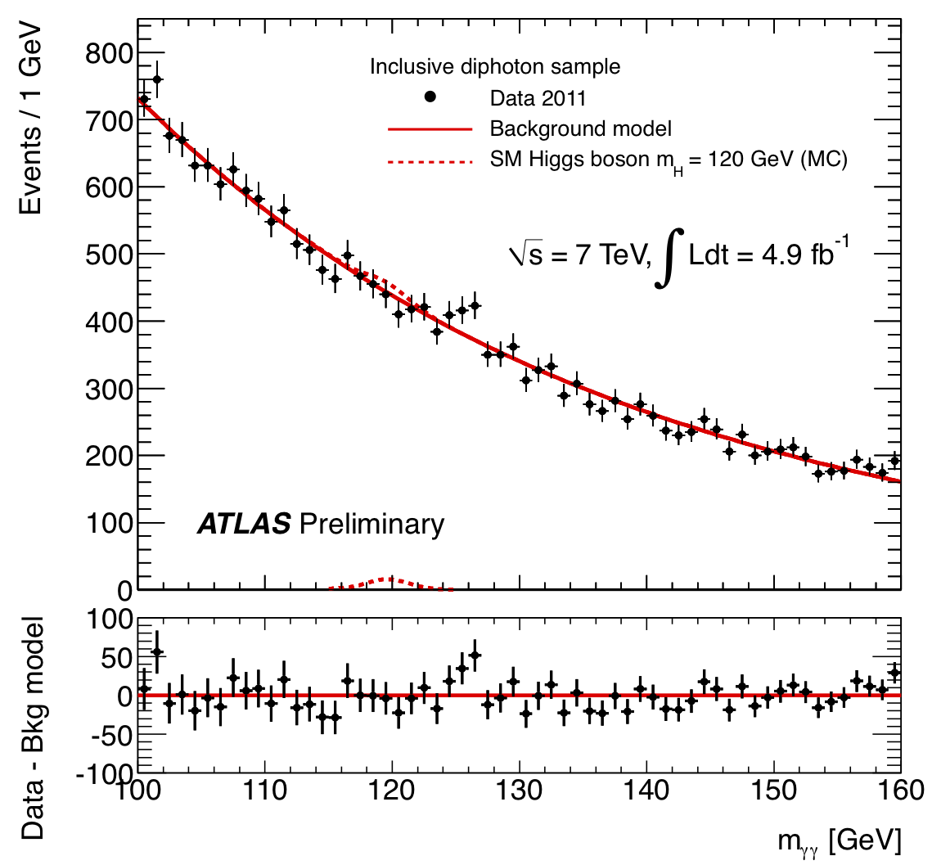
H→γγ – results
ATLAS
The background is measured both in ATLAS and CMS
  ATLAS fits the full spectrum with a single exponential curve (evaluate systematics using a double exponential curve, or a Bernstein polynomial of 2nd order)
  CMS fits the full spectrum using a Bernstein polynomial of 5th order (systematics evaluated using four different analytical functions)
ATLAS: Main systematic uncertainties
Expected signal yield : ~ 20%
H→ γγ mass resolution : ~ 14%
H→ γγ p_{T} modeling : ~ 8%
Background modeling : ±0.1-5.6 events

Slide 15
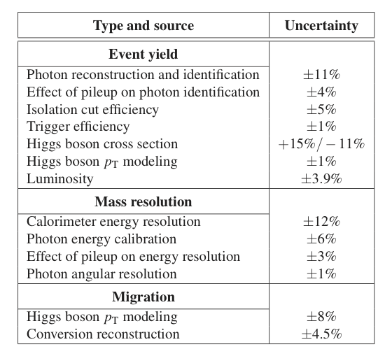
H→γγ – results
ATLAS
ATLAS: Systematic uncertainties on
signal expectation
Signal modelling:
  ATLAS describes the Higgs boson signal with the combination of a Crystal Ball function and a Gaussian function;
  CMS describes the Higgs boson signal with similar analytical fit to MC events (unbinned analysis), or with MC templates (binned analysis)

Slide 16
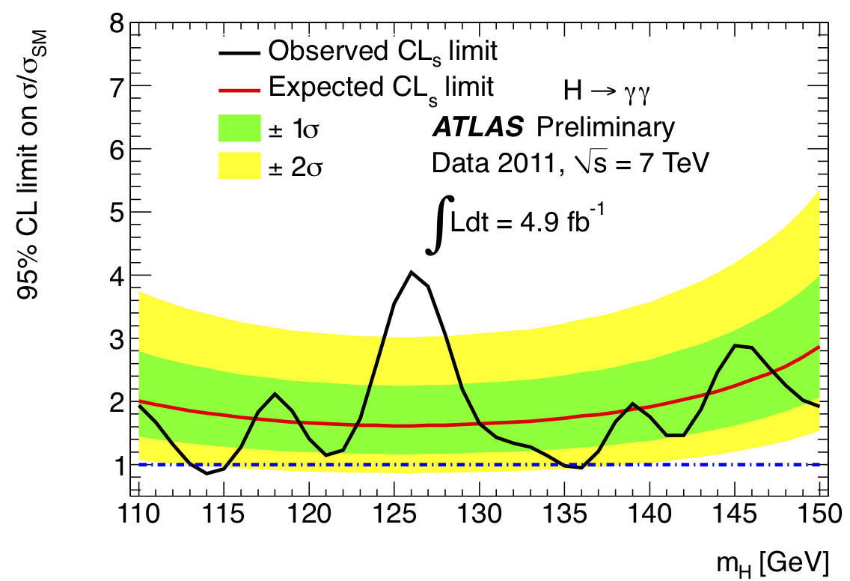
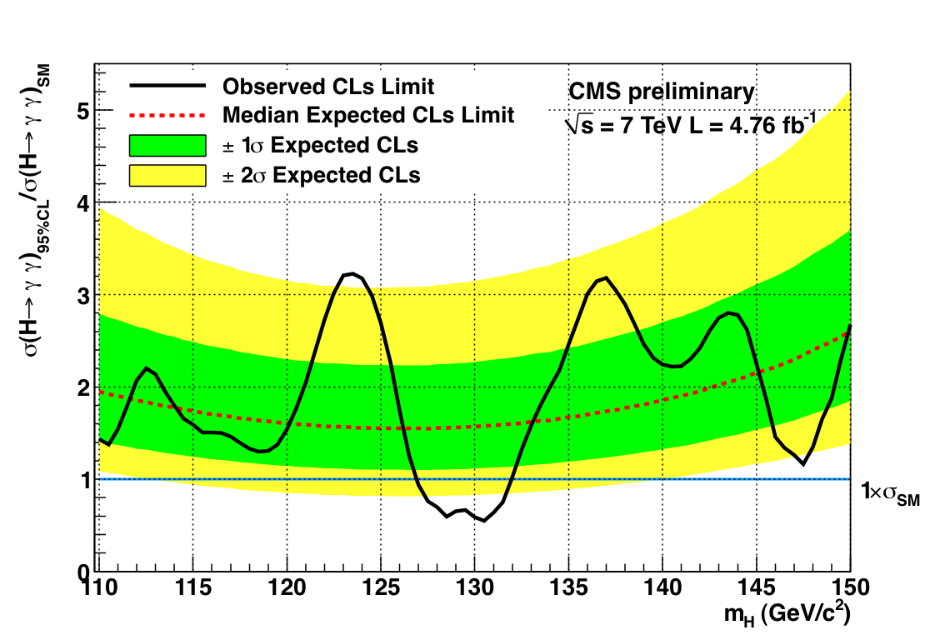
H→γγ - exclusion limits
ATLAS
ATLAS: Excluded (95% CL):
114 ≤ m_{H} ≤ 115 GeV, 135 ≤ m_{H}≤ 136 GeV
CMS: Excluded (95% CL):
127 ≤ m_{H} ≤ 131 GeV

Slide 17
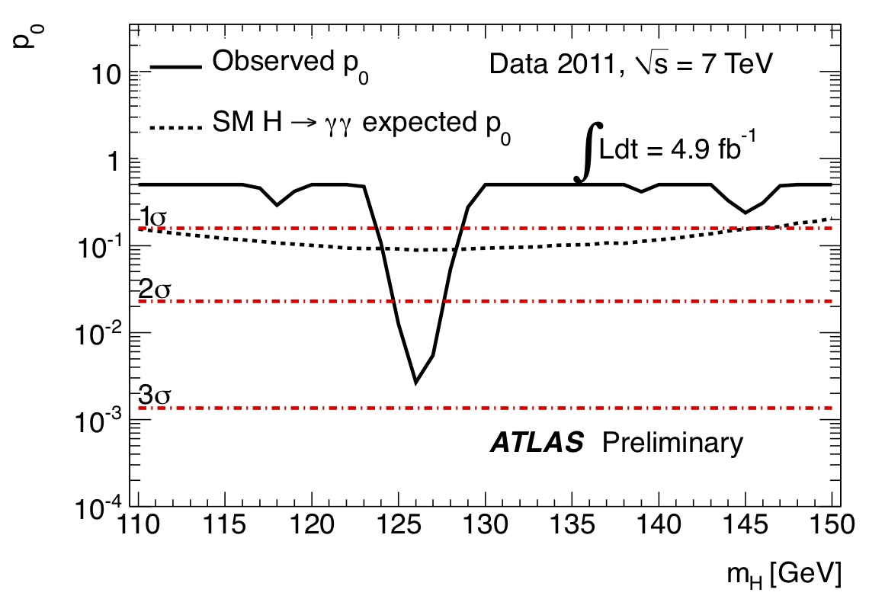
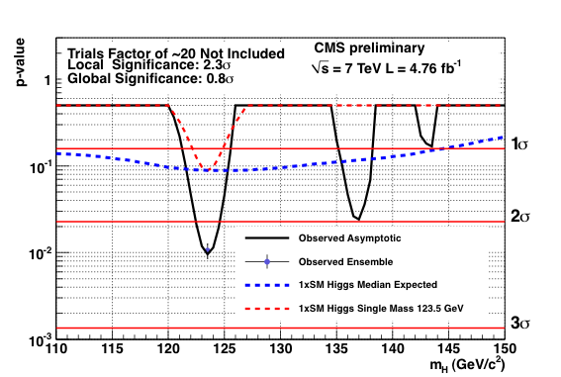
H→γγ – excess study
ATLAS
Maximum deviation from background-only
expectation observed for m_{H}~126 GeV:
local p₀-value: 0.27% (or 2.8σ)
expected from SM Higgs: ~ 1.4σ local
global p₀-value: includes probability for
such an excess to appear anywhere in
the investigated mass range (110-150 GeV)
(“Look-Elsewhere-Effect”): ~7% (1.5σ)
Maximum deviation from background-only
expectation observed for m_{H}123.5 GeV:
local p₀-value: ~1% (or 2.3σ)
expected from SM Higgs: ~ 1.4σ local
global p₀-value: includes probability for
such an excess to appear anywhere in
the investigated mass range (110-150 GeV)
(“Look-Elsewhere-Effect”): ~21% (0.8σ)

Slide 18
H→ZZ^{(*)}→4l
Small cross section × BR: σ×BR ~ 2-5 fb
However:
  mass can be fully reconstructed → events would cluster in a (narrow) peak
  large signal-to-background ratio: S/B ~ 1
4 leptons: p_{T}^{1,2,3,4} > 20,20,7,7 GeV; m₁₂ = m_{Z} ± 15 GeV; m₃₄ > 15-60 GeV (depending on m_{H}) [ATLAS]
Main backgrounds:
  ZZ^{(*)} (irreducible)
  m_{H} < 2m_{Z} : Zbb, Z+jets, tt with two leptons from b/q-jets → lepton
Suppressed with isolation and impact parameter cuts on two softest leptons
Signal acceptance x efficiency: ~ 15 % for m_{H}~ 125 GeV
Crucial experimental aspects:
High lepton reconstruction and identification efficiency down to lowest p_{T}
Good lepton energy/momentum resolution
Good control of reducible backgrounds (Zbb, Z+jets, tt) in low-mass region:
→ cannot rely on MC alone (theoretical uncertainties, b/q-jet → l modeling, ..)
→ need to compare MC to data in background-enriched control regions (but: low statistics ..)
→ Conservative/stringent p_{T} and m(ll) cuts used at this stage

Slide 19
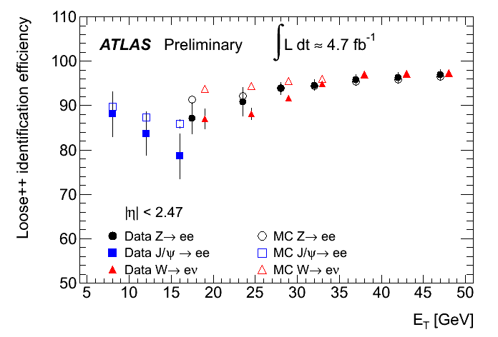
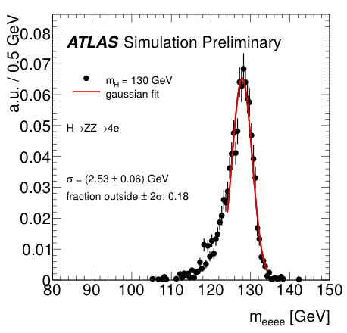
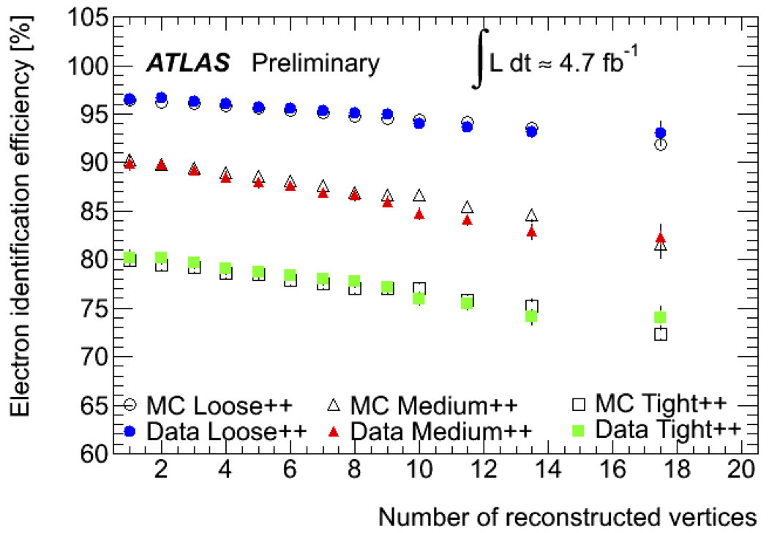
ATLAS: Electron performance
Identification efficiency from
J/ψ → ee, W → eν, Z→ ee data samples
Systematic uncertainty:
6% (p_{T}~7 GeV)
< 2 % (p_{T}~50 GeV)
Crucial to understand low-p_{T} electrons
(affected by material) with data
Variation of electron efficiency with
pile-up (cuts not re-tuned yet) well modeled by
simulation: from Z→ ee data and MC samples
H→ 4e mass resolution: 2.5 GeV
Event fraction in ±2σ: ~ 82%
No Z-mass fit constraint

Slide 20
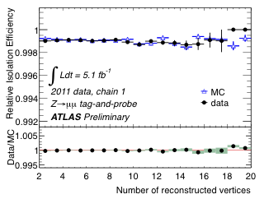
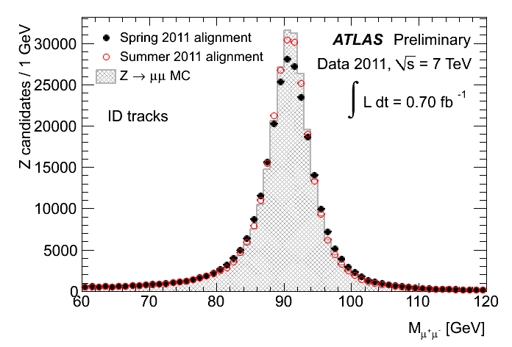
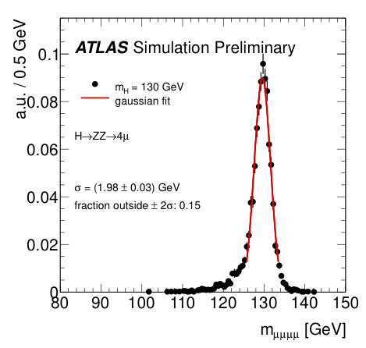
Muon (calorimetric) isolation efficiency
from Z→μμ events in data and MC
ATLAS Muon performance
Muon reconstruction efficiency > 95%
over 4 < p < 100 GeV
Improving Z→μμ mass resolution
MC (perfect): 2.31±.01 GeV
Data Spring 2011 : 2.89±.01 GeV
Data Summer 2011: 2.45±.01 GeV
No Z-mass fit constraint
H→ 4μ mass
resolution: ~2 GeV
Event fraction
in ±2σ: ~ 85%

Slide 21
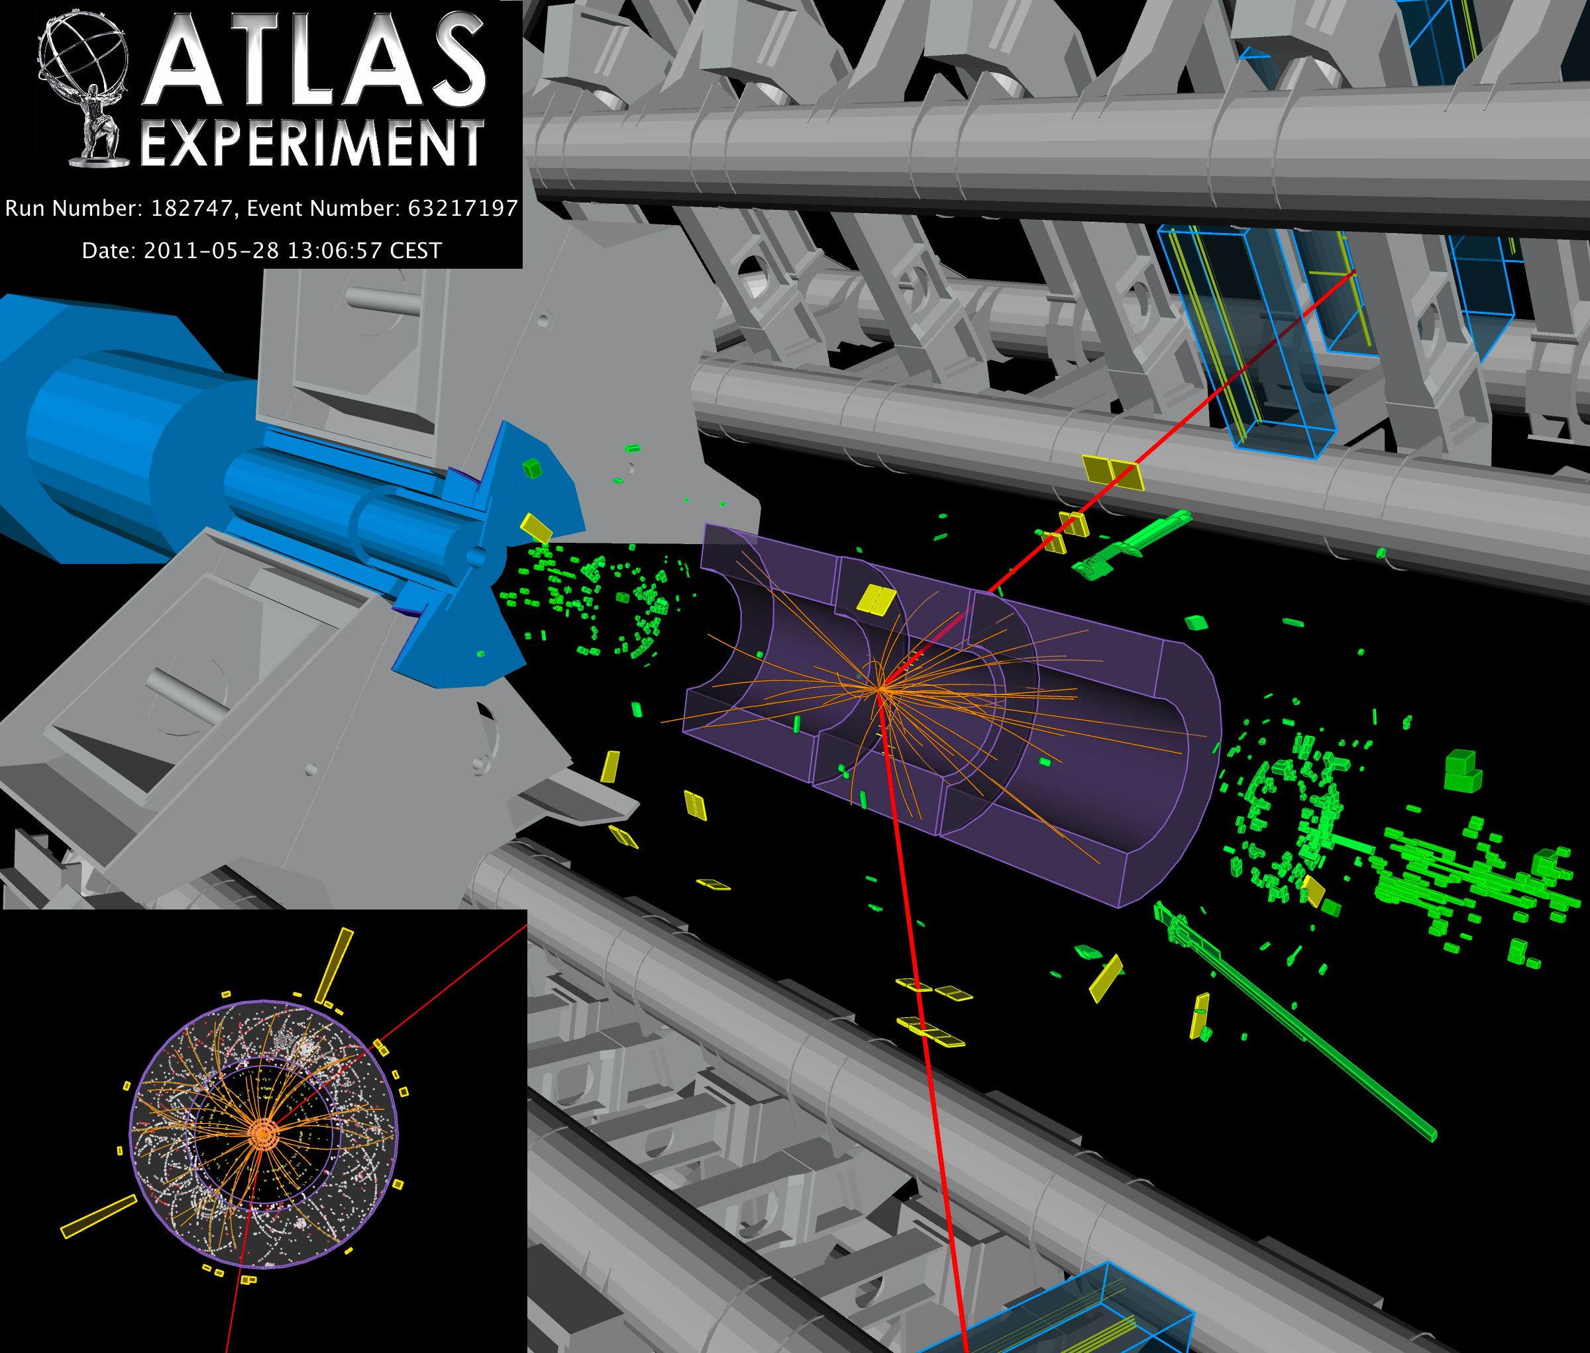
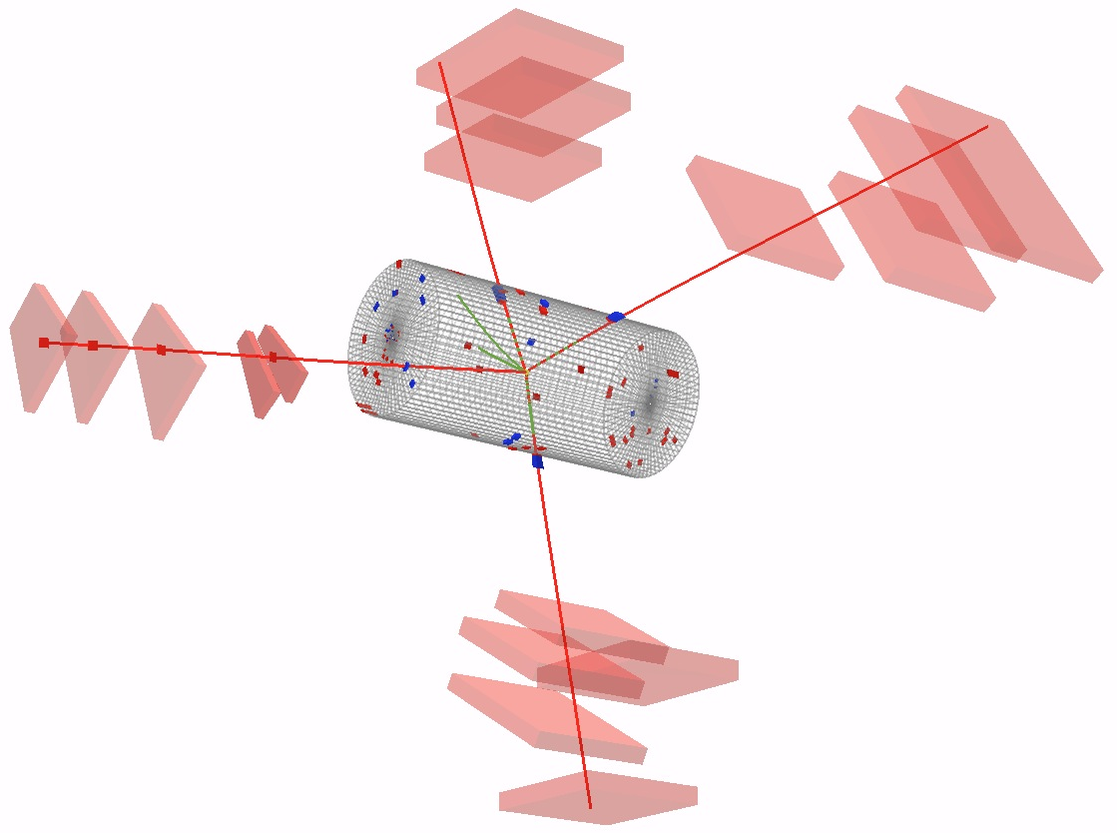
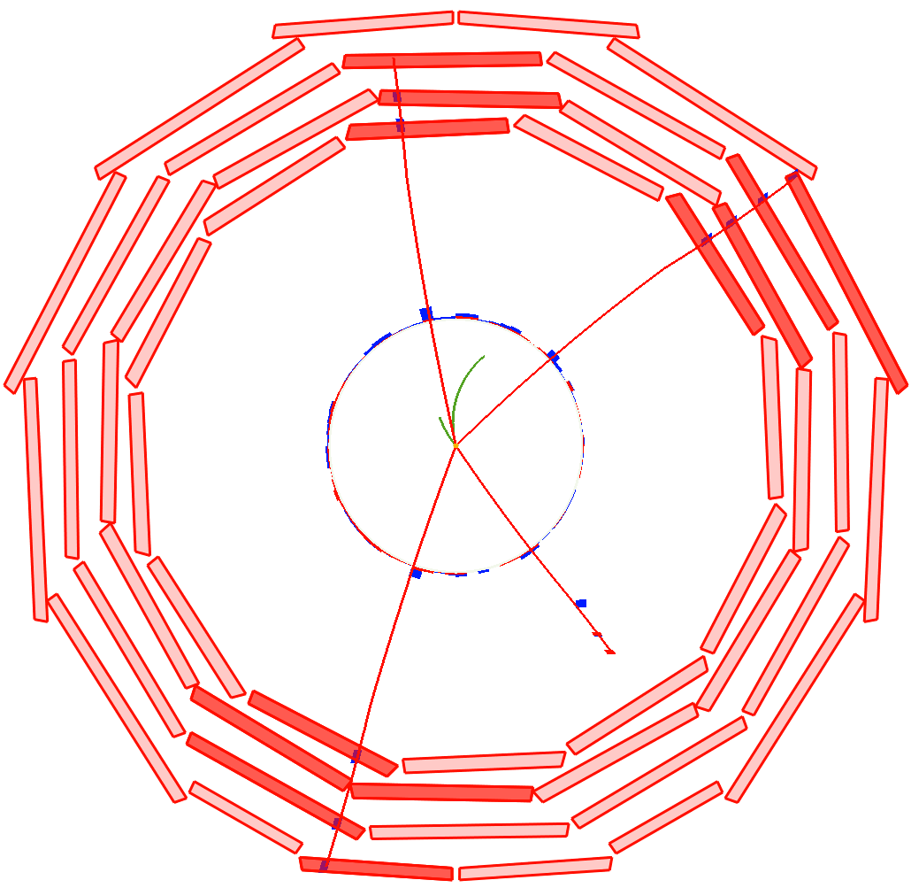
H → ZZ →4e, 4μ, 2e2μ: The Golden Channel
4μ candidate
P_{T} 43 GeV
P_{T} 26 GeV
P_{T} 48 GeV
P_{T} 20 GeV
2μ2e candidate:
m_{lead}: 85.9 GeV
m_{subl}: 85.5 GeV
m_{4l}: 210 GeV

Slide 22
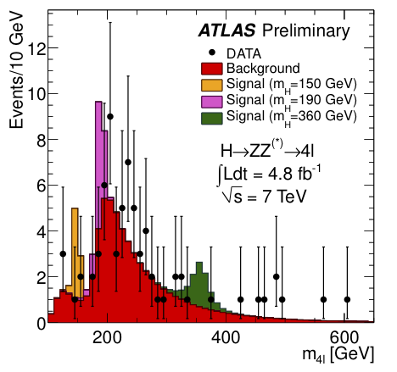
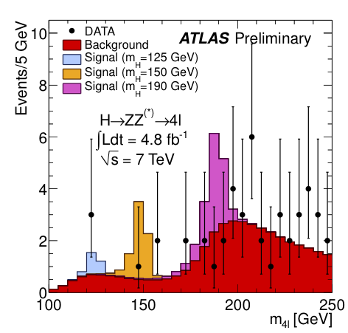
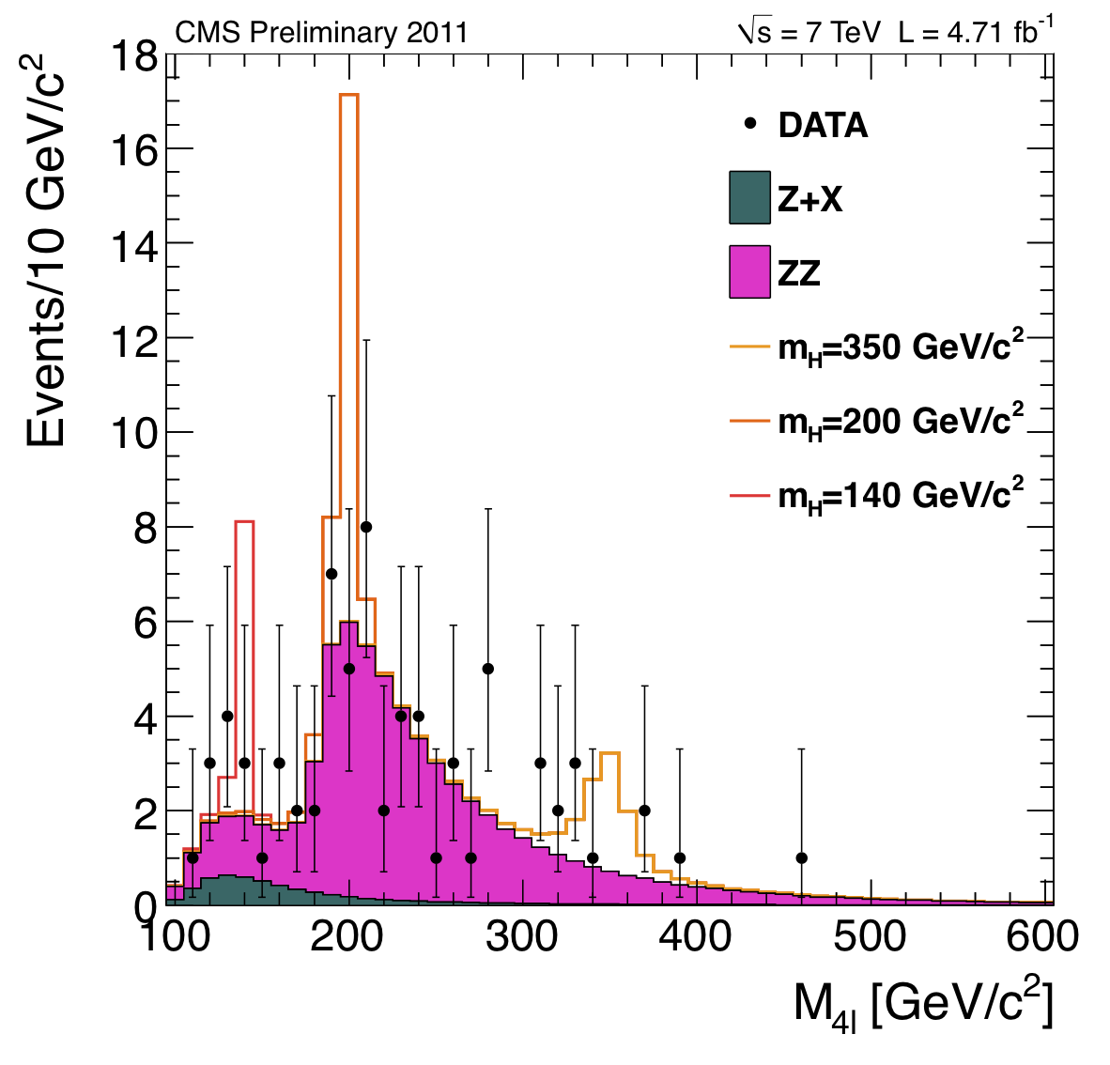
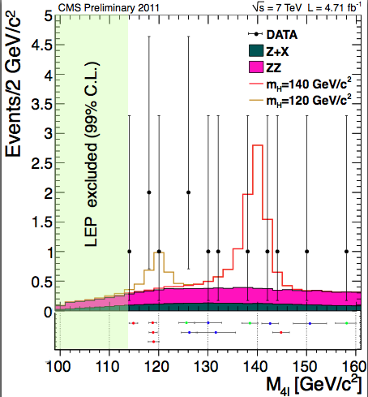
H→ZZ^{(*)}→4l
After all selections: kinematic cuts, isolation, impact parameter
ATLAS: Full mass range
Observed: 71 events: 24 4μ + 30 2e2μ + 17 4e
Expected from background: 62±9
ATLAS: m(4l) < 180 GeV
Observed: 8 events: 3 4μ + 3 2e2μ + 2 4e
Expected from background: 9.3±1.5
CMS: Full mass range
Observed: 72 events: 23 4μ + 37 2e2μ + 12 4e
Expected from background: 67.1±6.0
CMS: m(4l) < 160 GeV
Observed: 13 events: 5 4μ + 5 2e2μ + 3 4e
Expected from background: 9.5±1.3

Slide 23
H→ZZ^{(*)}→4l
After all selections: kinematic cuts, isolation, impact parameter
ATLAS: In the region m_{H} < 141 GeV (not already excluded at 95% C.L.) 3 events are observed: two 2e2μ events (m=123.6 GeV, m=124.3 GeV) and one 4μ event (m=124.6 GeV)
In the region 117< m_{4l} <128 GeV
(containing ~90% of a m_{H}=125 GeV signal):
similar contributions expected from signal and background: ~ 1.5 events each
Background dominated by ZZ* (4μ and 2e2μ), ZZ* and Z+jets (4e)
Background dominated by ZZ* (4μ and 2e2μ), ZZ* and Z=jets (4e)
CMS: In the region m_{H} < 141 GeV (not already excluded at 95% C.L.) 9 events are observed.

Slide 24
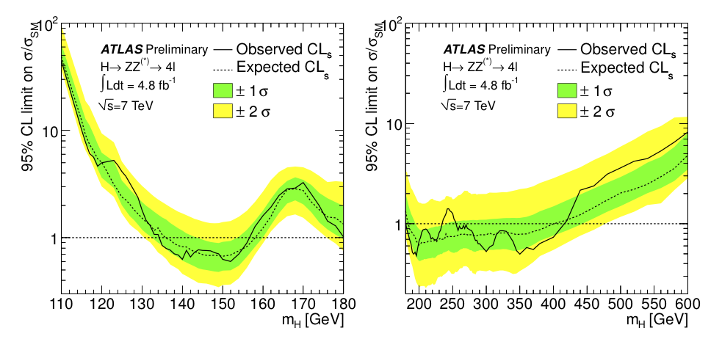
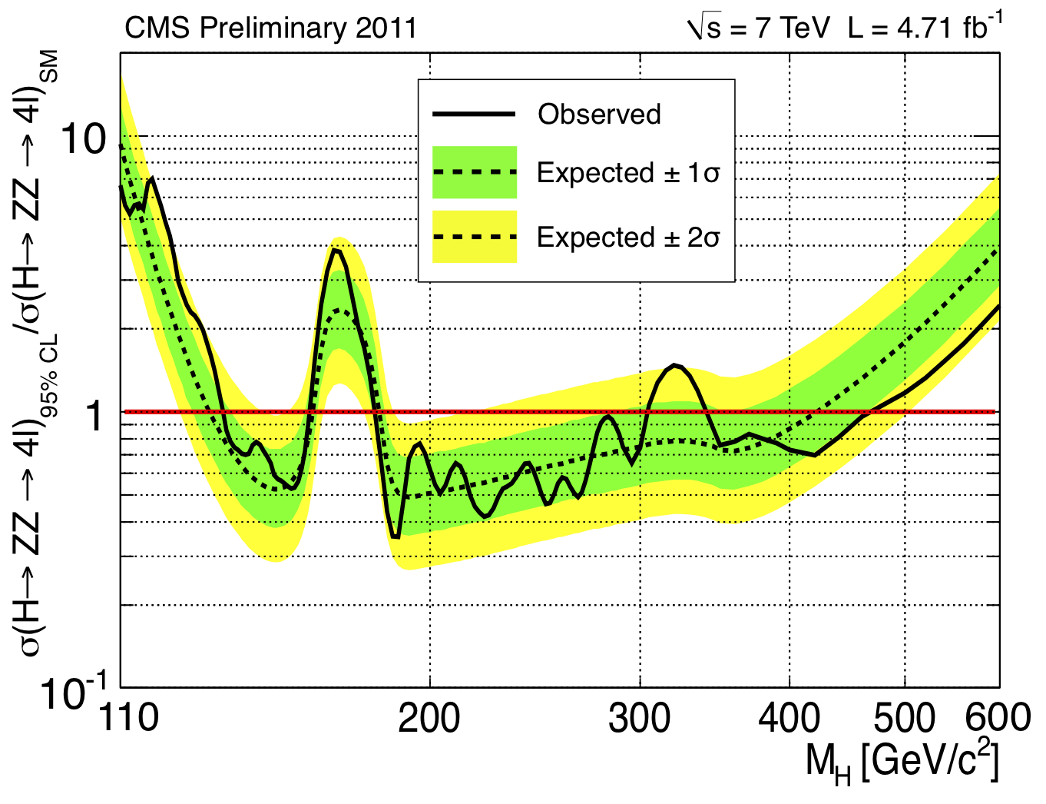
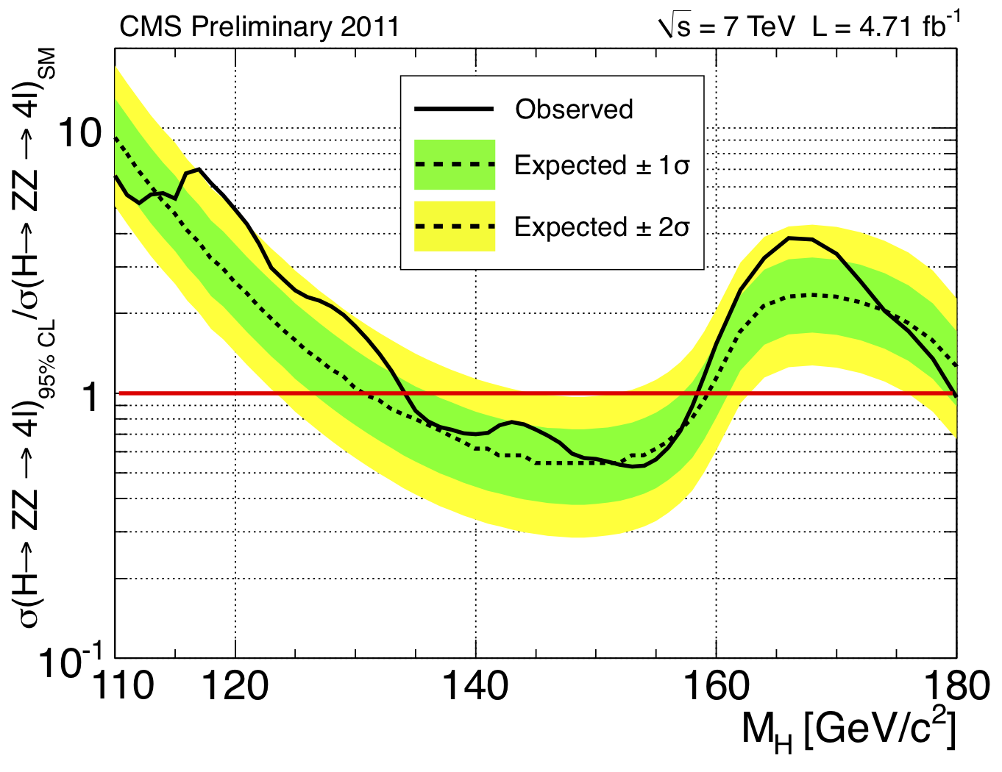
95% C.L Exclusion Limits
ATLAS
Observed Excluded range
135 < m_{H} < 156 GeV,
181 < m_{H} < 415 GeV
(except 234-255 GeV)
Expected excluded range: 137 < m_{H} < 158 GeV
185 < m_{H} < 400 GeV
CMS
Expected excluded range:
130 < M_{H} < 160 GeV;
182 < M_{H} < 420 GeV
Observed excluded range:
134 < M_{H} < 158 GeV;
180 < M_{H} < 305 GeV;
340 < M_{H} < 460 GeV

Slide 25

H→WW^{(*)}→lνlν
The most sensitive process for 130 < m_{H} < 200 GeV
But also one of the most challenging channels: complete reconstruction of the invariant mass of this final system is not possible
Largest background is the irreducible WW SM production
  But also Drell-Yan and top process when looking to final states associated to one jet
Select events with two high-p_{T} opposite sign leptons and large transverse missing energy (E_{T}^{miss})
ATLAS analysis cuts | e-e | μ-μ | e-μ
p_{T} leading, GeV | 25 | 25 | 25
p_{T} subleading, GeV | 20 | 15 | e:15, μ:20
E_{T}^{miss}rel | 40 | 40 | 25
ATLAS

Slide 26
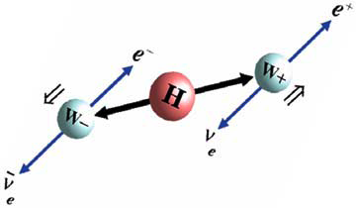

H→WW^{(*)}→lνlν
After E_{T}^{miss}rel cut, divide the events in two categories:
  Events with 1 jet with p_{T}>25 GeV and |η|<4.5;
  Events with no jets
Apply topological cuts (m^{ll}, p_{T}^{ll}, Δφ^{ll})
Reconstruct the transverse mass m_{T} and apply the cut 0.75×m_{H}<m_{T}<m_{H}
ATLAS

Slide 27
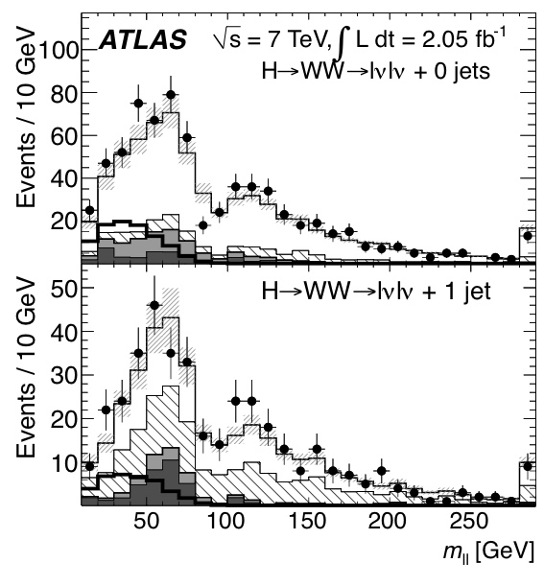
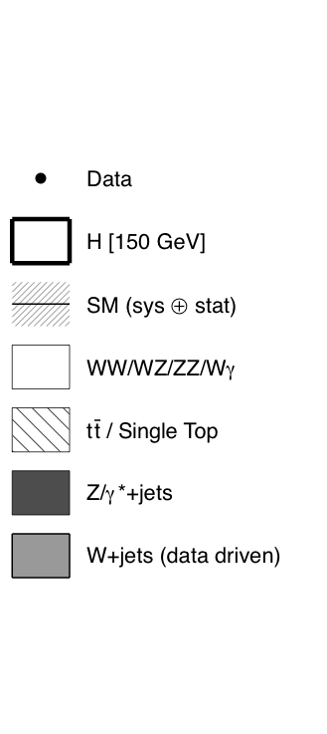
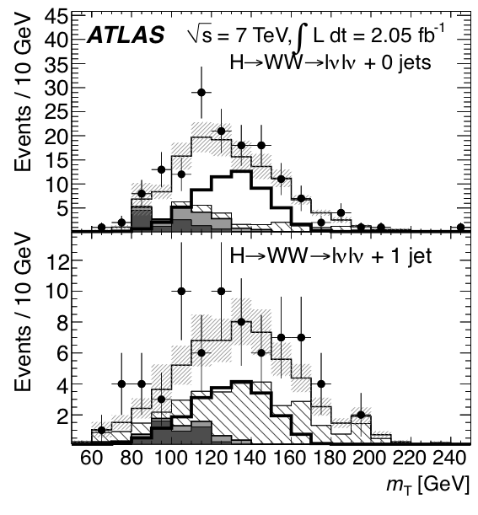
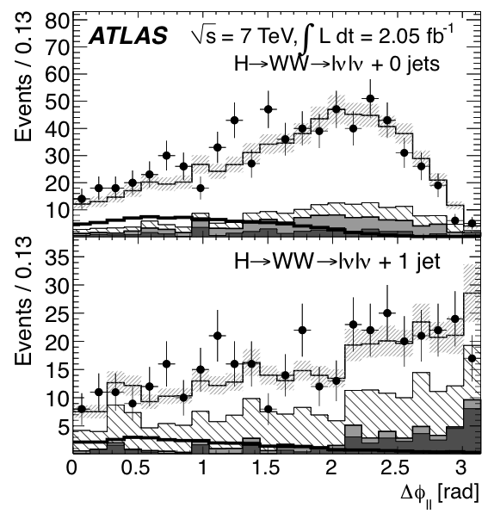
H→WW^{(*)}→lνlν
ATLAS
Distributions of m_{ll} (left), Δϕ_{ll} (center), and m_{T} (right). The top row shows the selection for the H+0-jet channel and the bottom row for the H+1-jet channel. The left and central plots are shown after the p_{Tll} selection for the H+0-jet channel and after the p_{T}^{tot} cut for the $H+1-jet channel. For the rightmost plots, the distributions are shown after all the cuts for m_{H}=150 GeV (except the cut on m_{T} itself). The background distributions are stacked, so that the top of the diboson background coincides with the Standard Model (SM) line which includes the statistical and systematic uncertainties on the expectation in the absence of a signal. The expected signal for m_{H}=150 GeV is shown as a separate thicker line, and the final bin includes the overflow.

Slide 28
H→WW^{(*)}→lνlν
ATLAS
Background estimate from data in counting experiment is essential
In the current version of this analysis we estimate from data the two largest backgrounds, namely those from WW and top
  Approach:
    Define control regions rich in WW or top backgrounds and measure this backgrounds in data
    Extrapolate this measurement to the signal region(s) using MC shapes
W+ jets entirely determined from data
Remaining backgrounds (smaller) are taken from MC
  Apply scale factor to Drell-Yan for potential E_{T}^{miss} mis-modelling
Final selection, optimized for m_{H}=150 GeV
 | WW | ttbar | Total SM back. | Data | Higgs m_{H}=150
0-jet | 52±7 | 2.4±1.6 | 63±9 | 81 | 40±9
1-jet | 12±3 | 8±2 | 28±4 | 29 | 14±3
Event yield after full selection, in data and MC (W+jets estimated with data driven methods). The cuts are here optimized to select m_{H}=150 GeV Higgs decays.

Slide 29
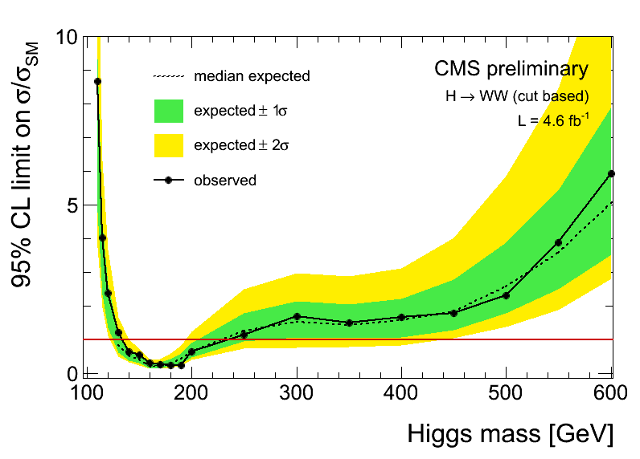
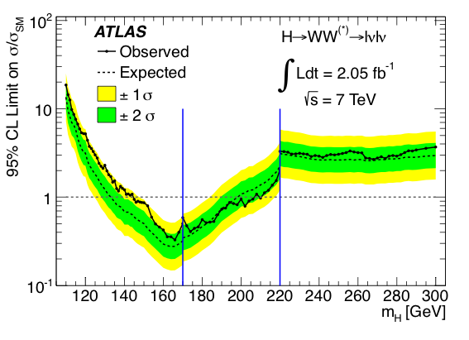
H→WW^{(*)}→lνlν
ATLAS
ATLAS exclusion limits
CMS exclusion limits – CMS results are based on a multivariate analysis (Boosted Decision Tree)
Expected range: 134 < M_{H} < 200 GeV
Observed range: 145 < M_{H} < 206 GeV
Expected range: 129 < M_{H} < 236 GeV
Observed range: 132< M_{H} < 238 GeV

Slide 30
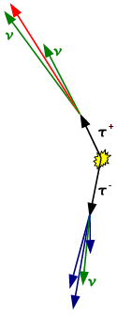


H→ττ
Promising channel for SM Higgs searches in the mass range m_{H}=110-140 GeV
  The VBF production offer the advantage of a small background, at the price of a low signal production rate
Three classes of final states, depending on the τ-decay:
  lepton-lepton, ll
  lepton-hadron, lh
  hadron-hadron, hh
  ATLAS studied the ll and lh final states
  CMS studied the lh and the e-μ final states
Most important backgrounds:
  Z/γ* → ll + jets (→ττ is largely irreducible); W→lυ + jets; dibosons, ttbar and single top, QCD jets
ll finale state: reconstruct the tau momentum in the collinear approximation
Apply dilepton invariant mass and topological cuts
➔ Study the tau-tau invariant mass
Collinear approximation

Slide 31
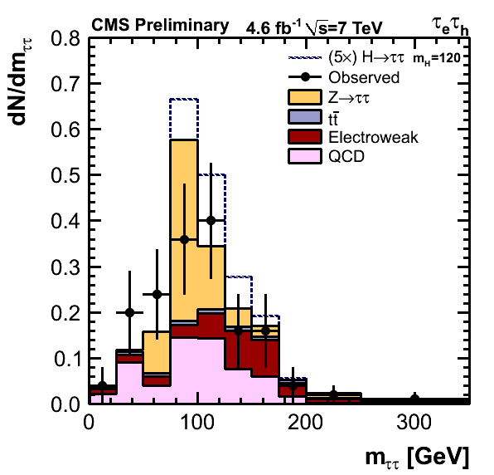
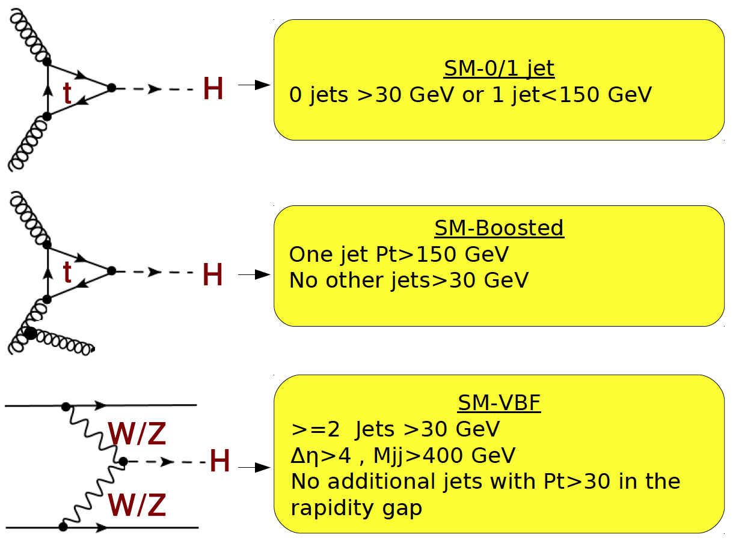
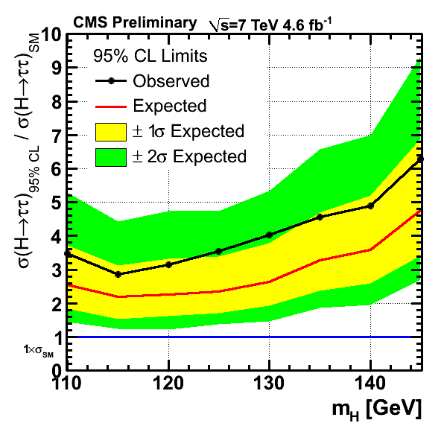
0 or 1 JET
0 jets>30GeV or 1jet<150GeV
BOOSTED
One jet P_{T}>150GeV
VBF
>= 2jets >30GeV
Δη>4, M_{jj}>400GeV
No additional jets with P_{T}>30GeV
In the rapidity gap
Example of data in VBF Channels: : presence of tagging jets suppresses backgrounds.
ATLAS has analyzed till 1.04 fb-1 of data, with results consistent with those from CMS (taking into account the integrated luminosity).
This channel is approaching the sensitivity to the SM Higgs production

Slide 32


H→bb
5 sub channels
  Z(→ll); H→bb, l = μ, e
  W(→lν) ; H→bb, l = μ, e
  Z(→νν); H→bb
Analysis method largely unchanged w.r.t LP’11
Extensive use of data driven methods to control the backgrounds.
gg→ H→ bb and VBF are dominant production modes but overwhelmed
by enormous QCD di-jet background
Best option: qq→ VH; H → bb
  Major backgrounds are V+jets, VV, ttbar
Use
  VH topology : ΔΦ(V,H) > 3
  P_{T}(V)> 100-160 GeV (boosted W/Z)
  Tight b-tagging & MET quality
  Backgrounds estimated from control data

Slide 33

H→ZZ→llνν
Final state characterized by the production of a Z in leptons accompained by large transverse missing energy, it offers a significant branching fraction in combination with a good separation from background processes
Main background: reducible QCD W/Z+jets, top; irreducible WW,WZ,ZZ
Select events with two same-flavour opposite charge leptons whose invariant mass is consistent with the Z-mass, and E_{T}^{miss} > 66(82) GeV (ATLAS) depending on the “low’(“high”) mass analysis
  Apply also topological cuts to suppress W/Z+jet QCD background
Finally, study the transverse mass distribution, m_{T}:

Slide 34




H→ZZ→llνν
Left: E_{t}^{miss} distribution after the m_{ll} window cut.
Right: the dilepton transverse mass distribution of selected candidate events;
M_{T} shape
ATLAS
ATLAS: The observed limit is slightly lower and a Standard Model Higgs boson in the range 350 GeV < m_{H} < 450 GeV, can be excluded at the 95% confidence level.
CMS: 95%CL exclusion limits for a SM Higgs boson in the range 270-440 GeV (M_{T} shape based analysis)

Slide 35

H→ZZ→llqq
Very helpful channel in the Higgs mass range m_{H} > 2m_{Z}, with acceptable signal-to-background ratio
Signature: Z→ll+2 jets final states
Main backgrounds: QCD Z+jets
Event selection (ATLAS):
  Same flavour pair of isolated leptons with p_{T}>20 GeV, with 76 <m_{ll}<106 GeV
    Third lepton veto, E_{T}^{miss}<50 GeV
  ≥2 jets p_{T}>25 GeV |η|<2.5, with 70 <m_{ll}<105 GeV
  Reconstruct the final state invariant mass m_{lljj} (with m_{jj} scaled to m_{Z})
Jet: 207 GeV
Jet: 114 GeV
e: 177 GeV
e: 114 GeV
M_{2l2j} = 580 GeV

Slide 36



H→ZZ→llqq
The invariant mass of the lljj system for the b-untagged (left) and b-tagged (right) selections, for m_{H} = 200 and 400 GeV. The Higgs boson signal in the untagged plots has been scaled up by a factor of 10.
Very helpful channel in the Higgs mass range m_{H} > 2m_{Z}, with acceptable signal-to-background ratio
Signature: Z→ll+2 jets final states:
Reconstruct a Z→ll, a second Z→jj;
Reconstruct then the final state invariant
mass m_{lljj} (with m_{jj} scaled to m_{Z})
ATLAS

Slide 37


Overall ATLAS Higgs Combination
H→γγ, H→ ττ
H→ WW^{(*)}→ lνlν
H→ ZZ^{(*)} → 4l, H→ ZZ → llνν
H→ ZZ → llqq, H→ WW→lνqq
W/ZH→ lbb+X not included
LEP
ATLAS+CMS
Combination
ATLAS
today
95% C.L. exclusion limits:
Obs: 112.7-115.5 GeV and 131-453 GeV except 237-251 GeV
exp: 124.6-520 GeV
Excluded at 99% CL : 133 <m_{H} < 230 GeV, 260 < m_{H} < 437 GeV

Slide 38


Overall ATLAS Higgs Combination
Maximum deviation from background-only
expectation observed for m_{H}~126 GeV
Local p₀-value: 1.9 10⁻⁴
local significance of the excess: 3.6σ
~ 2.8σ H→ γγ, 2.1σ H→ 4l, 1.4σ H→ lνlν
Expected from SM Higgs: ~2.4σ local (~1.4σ per channel)
Global p₀-value : 0.6% →2.5σ LEE over 110-146 GeV
Global p₀-value : 1.4% →2.2σ LEE over 110-600 GeV

Slide 39




Compatibility of the observation with the
expected strength of a SM Higgs signal
Total
H → γγ
H → lνlν
H → 4l
The observed excess is slightly larger (2±0.8) than expected in the H→γγ channel
and compatible within 1σ for the other channels and the combined result

Slide 40


Overall CMS Higgs Combination
CMS Expected limit in case of no SM Higgs boson, with L~4.7 fb⁻¹ of data
Very close or better than 1xSM in the full mass range.
Optimization of some analyses still ongoing.
Additional sub-channels under study.

Slide 41

Overall CMS Higgs Combination
95%CL: obs 127-600, exp:117-543 GeV

Slide 42

Overall CMS Higgs Combination
The excess at low mass is produced by a broad excess driven by the low resolution channels (H2TT, H2WW, H2BB, center), modulated by the localized excesses seen by the high resolution channels (H2GG and H2ZZ, right).

Slide 43

Overall CMS Higgs Combination
The excess at low mass is produced by a broad excess driven by the low resolution channels (H2TT, H2WW, H2BB, center), modulated by the localized excesses seen by the high resolution channels (H2GG and H2ZZ, right).

Slide 44

Overall CMS Higgs Combination
The excess at low mass is produced by a broad excess driven by the low resolution channels (H2TT, H2WW, H2BB, center), modulated by the localized excesses seen by the high resolution channels (H2GG and H2ZZ, right).

Slide 45
Overall CMS Higgs Combination
The excess at low mass is produced by a broad excess driven by the low resolution channels (H2TT, H2WW, H2BB, center), modulated by the localized excesses seen by the high resolution channels (H2GG and H2ZZ, right).
We cannot exclude the presence of the SM Higgs boson below 127GeV because of a modest excess of events in the region between 115 and 127GeV.

Slide 46


Overall CMS Higgs Combination
Maximum local significance 2.6σ.
LEE-corrected significance (full mass range: 110-600GeV)= 0.6σ
LEE-corrected significance (low mass range: 110-145GeV)= 1.9σ
The excess we see in the low mass region has a modest statistical significance and could be reasonably a fluctuation of the background.

Slide 47

perspectives
Lepton-Photon 2011
Take and analyze more data
  Further improve/optimize the analysis, where still possible
Scrutinize the mass intervals that will be further excluded by data under the assumption of the existence of a SM Higgs boson
Scrutinize the mass intervals that will (still) show event excess(es), and the associated significance for the individual channels, and for the overall combination
Further produce lots of tests and cross-checks to ensure this excess is physics (as opposed to systematics effects detector-related)
If a genuine physics excess will be observed with high significance then a new phase of our research at the LHC opens up: understand what it is, i.e. measure the physics properties associated to the resonance

Slide 48
Short summary of MSSM Higgs results

Slide 49



Search for A/H→ττ
The production of neutral Higgs bosons A/H is enhanced at large tanβ in the MSSM
Three classes of final states, depending on the τ-decay:
  (lepton-lepton) eνν μνν
  lepton-hadron, eνντ_{had} μνντ_{had}
  hadron-hadron, ντ_{had} ντ_{had}
Good τ identification required, m_{ττ} reconstructed via visible mass or using the missing mass calculation technique

Slide 50


Search for A/H→ττ
Expected and observed exclusion limits in the MSSM (m_{A} – tanβ) plane
mh max scenario

Slide 51

Search for a fermiophobic Higgs
Consider the following benchmark scenario:
  all fermion couplings set to 0
  bosonic couplings kept at the SM values
modified Higgs production and decay branching ratios, e.g. no contributions from the gluon-fusion and ttH associated production modes
→ VBF production mechanism becomes important → higher transverse momentum due to recoiling jets or vector bosons

Slide 52


Search for a fermiophobic Higgs
Background fits to the diphoton invariant mass spectra for the three pT categories. The signal expectation for a Higgs boson with a mass of 115 GeV on top of the background fit is also shown.
Excluded mass regions:
  110 – 111 GeV and
  113.5 – 117.5 GeV
Expected exclusion: 110 – 116 GeV

Slide 53


MSSM H⁺→τν
MSSM has 5 Higgs bosons (CP even h and H; CP odd A; H⁺; H⁻)
If lighter than top quark, the charged Higgs is produced dominantly through top decays
With tanβ > 3, prefer to decay to τν final states
τ + jets
μ + τ
e + μ
Three channels analysed by CMS

Slide 54




MSSM H⁺→τν
Select events with electrons, muons, hadronic taus and missing transverse energy, as well as jets b-tagged
Excluding BR(t → bH) ~5% 80 < m_{H+} < 160 GeV,a ssuming Br(H+ → τν)=1
Similar results from ATLAS

Slide 55
Backup

Slide 56
Improvements in the H→ γγ analysis
  Vertex ID uses BDT
    Improved vertex identification (gain → 3%)
  Progressive (“sliding”) cuts on photon p_{T}
    p_{T}¹ > m_{γγ}/3, p_{T}² > m_{γγ}/4
  Cluster energy corrections + new intercalibrations+new transparency corrections
  using the lasers.
    Improved energy resolution
  p_{T}^{γγ} event classification dropped for SM analysis
    Remove threshold shaping of mass spectrum
In order to take advantage of
  The better signal over background ratio in the central part of the detector
  The better resolution for central/unconverted photons
The analysis is performed simultaneously in 4 categories (R9 is a metric of the shower transverse
size: R9 = E_{3x3 array} / E_{super-cluster} . It discriminates unconverted from converted photons)
  Both photons in the Barrel, min(R9) > 0.94
  Both photons in the Barrel, min(R9) < 0.94
  At least one photon in Endcap, min(R9) > 0.94
  At least one photon in Endcap, min(R9) < 0.94
  Better parameterization of background shape.

Slide 57
Improvements in Vertex Finding efficiency
Training BDT using input variables computed from
  Track momenta
  Photon kinematics
BDT improves correct vertex selection efficiency
by 3% with respect to ranking algorithm used in
EPS/LP analyses.
‘Correct vertex’ is defined as being within
10mm of true vertex z position
Vertex finding efficiency
  From Z →μm and g+ jets
  Photon Selection efficiency
  From Z → ee

Slide 58


Photon identification efficiency: ~ 85±5% from MC, cross-checked with data
(Z→ ee, Z→ eeγ, μμγ)
Photon isolation requirement: E_{T} < 5 GeV inside a cone ΔR < 0.4 around γ direction.
Underlying event and pile-up contribution subtracted using an “ambient energy density”
determined event-by-event.
If the subtraction is not perfect, a residual dependence of the corrected isolation
energy on the bunch position in the train is observed, due to the impact of pile-up from
neighbouring bunches convolved with the LAr calorimeter pulse shape.
Beginning of the train: no cancellation
from previous bunches
Calorimeter bipolar pulse shape:
average pile-up is zero over
~ 600 ns (~12 bunches)
Effect well described by the
(detailed !) ATLAS simulation
From 12 bunches inside the
train: full cancellation

Slide 59
After all selections: kinematic cuts, γ identification and isolation
22489 events with 100 < m_{γγ} < 160 GeV observed in the data
expected signal efficiency: ~ 35% for m_{H}=125 GeV
m_{γγ} spectrum fit with exponential function for
background plus Crystal Ball + Gaussian for signal
background determined directly from data
Systematic uncertainties on
signal expectation
Main systematic uncertainties
Expected signal yield : ~ 20%
H→ γγ mass resolution : ~ 14%
H→ γγ p_{T} modeling : ~ 8%
Background modeling : ±0.1-5.6 events

Slide 60

Consistency of the data with the background-only expectation
Maximum deviations from background-only expectations
m_{H} (GeV) Local (global) p₀ Local significance Expected from SM Higgs
125 1.8% (~50%) 2.1 σ 1.4σ
244 1.1% (~50%) 2.3 σ 3.2σ
500 1.4% (~50%) 2.2 σ 1.5σ
Excluded at
95% C.L. by
ATLAS+CMS
combination
LEE estimated over
mass range: 110-600 GeV

