Slide 1
BI CONS Day:
Consolidation of Standard LHC BLM Tunnel front-end Electronics
Christos Zamantzas, SY-BI-BL
23/01/2025

Slide 2
Overview
Consolidation scope
System architecture
Status and current spending profile extracted from CET/EVM
Proposal for Work units, Deliverables and Milestones
Risk and mitigation

Slide 3
Consolidation scope
Link to the EDMS document
  No document – original plan to fund the front-end cards only (3 kCHF x 1000 units)
  With the cost reduction of BLEIC, we can fund all parts (i.e. complete crate)
Short summary of the proposed consolidation activity (Why, what and when)
  Aging electronics reaching EoL, spares will diminish before 2042
  Replace the complete acquisition crate and its electronics
  Deployment in LS4 (prototype in LS3)
Specification – EDMS link (if no spec, to be mentioned what we want to achieve)
  Both old & new acquisition electronics have similar performance (new are faster & higher rad-tolerance)
  Replacement and harmonization with SPS Ring.

Slide 4
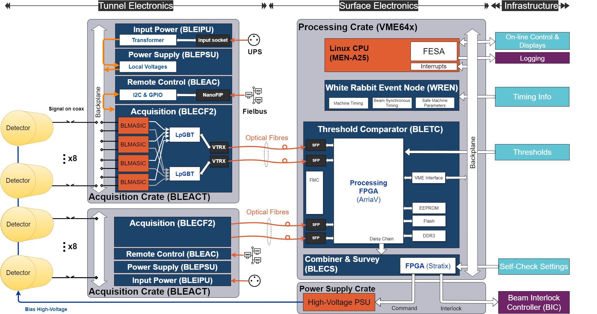
Proposed system architecture - Overview

Slide 5
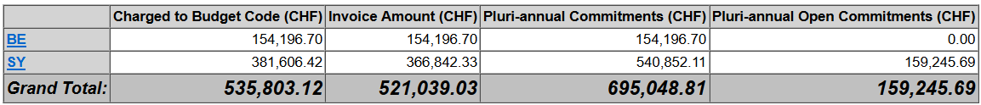
Current status and spending profiles
Budget already spent from CET/EVM
Budget profile till completion
  To reprofile the period from 2027 and beyond (see next slides)
Main achievements and deliverables
  Despite the failed MS for VTRx, now back on track
  Large number of material already procured, assembled and verified
  Majority of designs completed

Slide 6
Current status and spending profiles 1/2
Budget estimates for EP-ESE costs
Investigating with EN-EL if we can replace mux with additional fibres in the LSS

Slide 7
Current status and spending profiles 2/2
Budget estimates for Tunnel crate electronics
Totals (VTRx & Electronics)
Large production; can be shifted

Slide 8
Proposed project structure
Definition of Work-units
  Create detailed WUs for EP-ESE costs and
  Simple (for now) WU for production >2030
 |  | 2025 | 2026 | 2027 | 2028 | 2029 | 2030 | 2031 | 2032 | 2033 | Total
WU 1 | ROSA Procurement | 180 |  |  |  |  |  |  |  |  | 180
WU 2 | VTRx SFP package |  | 70 |  |  |  |  |  |  |  | 70
WU 3 | MUX procurement |  |  | 230 |  |  |  |  |  |  | 230
WU 4 | SFP (surface) procurement |  |  | 120 |  |  |  |  |  |  | 120
WU 5 | Electronics production |  |  |  |  |  | 1000 | 1400 | 600 |  | 3000
 |  |  |  |  |  |  |  |  |  |  | 3600

Slide 9
Proposed project structure
Milestones and Deliverables
  Linked to each WUs e.g. design, test, production/procurement, installation, ..
WU | Next activities/ milestones/deliverables | Date Expected

Slide 10
Risk and Mitigation
Maturity of the technology proposed ?
  Novel design with custom ICs (rad-hard ASICs)
Performance risk ? Linked to challenging specifications
  Both old & new acquisition electronics have similar performance (new are faster & higher rad-tolerance)
Procurement risk ? Cost overrun and delay
  Cost under control, budget is healthy
Installation risk ?
  LS4 – too far to speculate

