Slide 1

Run 2c BPM Development Update
L. Stant
AWAKE BI meeting, 26 November 2024

Slide 2
Recap of Requirements
Protons:
Improve resolution from 70 μm to 20 μm.
Electrons:
Additional 9+3 BPMs (7+2 of 40mm pickup, 2+1 of 60mm pickup).
Replace existing TRIUMF electronics so CERN can maintain.
Preserve existing resolution of 10 μm (15 μm for 60mm pickup).
Both:
Share all software and as much hardware as possible with HL-LHC.

Slide 3
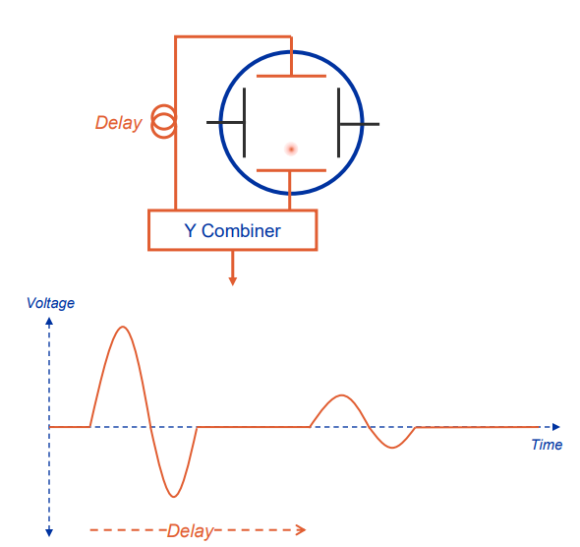
Desired Architecture - Multiplexing
Time multiplexing our pulsed signals is beneficial:
  Reduced channel count – less electronics to procure and maintain.
  Systematic error in cabling, front-end electronics and digitizer largely eliminated as both signals normalised to their sum.

Slide 4
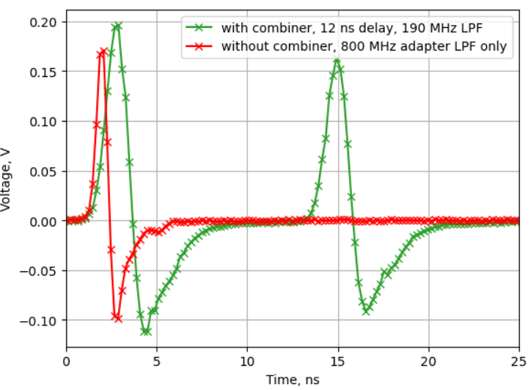
Proton BPM Status
Measurements using prototype lowpass filtering front-end show that the 15 μm required resolution will be achievable using unmodified HL-LHC electronics.
These agreed well with simulations and lab tests of the front-end.
Next steps involve designing local multiplex cabling (delay and combiner) with mounting.

Slide 5
Electron BPM Status – Beam Specification
To confirm the beam specification:
  18 MeV
    Unchanged from Run 2b.
    100 pC to 600 pC charge.
    4 ps bunch length (RMS?).
    Repetition rate of 10 Hz.
  150 MeV
    100 pC to 200 pC.
    0.2 ps to 0.4 ps bunch length (RMS?).
    Repetition rate of 10 Hz.

Slide 6
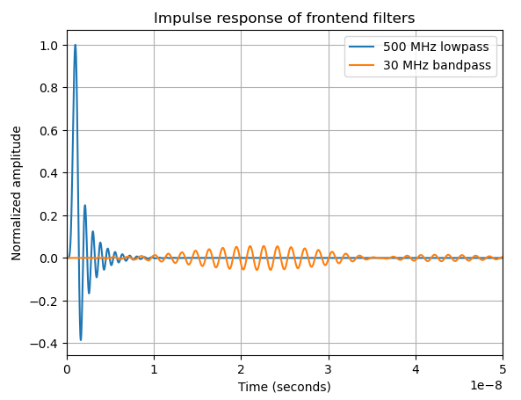
Electron BPM Status – Challenges
Considering the same HL-LHC frontend, electron bunches are very short and give a much weaker signal than the protons.
Existing TRIUMF system uses a bandpass “ringing” filter to provide more samples to the 100 Msps digitizer.
HL-LHC frontend uses lowpass filtering, but we have much faster sampling (5 Gsps).
If lowpass works, the pulses are short enough to time multiplex pickups. This provides systematic error and cable drift correction per plane.

Slide 7
Electron BPM Status – Challenges
But <100 ms after our last electron bunch, with a high gain frontend configuration, a proton will arrive and provide 500 times the amplitude.
The existing system uses heavy attenuation to reduce the proton signal below damage threshold for the electronics.
We will need to either do the same (degrading performance) or implement a method to bypass the receiver when the proton bunch arrives.
TRIG
-xx dB
Attenuation
Diode Limiter
Fast Switch

Slide 8
Electron BPM Status – Measurements
Tested filter options with fast scope in AWAKE during October.
Lowpass included a multiplex setup to demonstrate feasibility with real signal levels.
SCOPE
12 ns (~2m)
500 MHz
-10 dB
ch1
30 MHz BW
@ 400 MHz
500 MHz
ch2

Slide 9
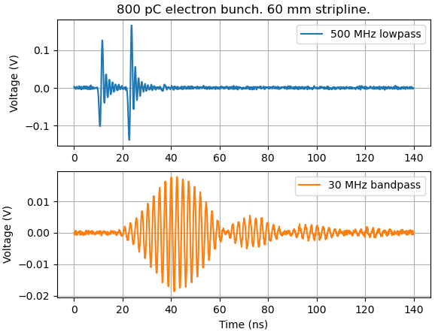
Electron BPM Status – Measurements
Tested filter options with fast scope in AWAKE during October.
Lowpass included a multiplex setup to demonstrate feasibility with real signal levels.
Bandpass cannot work with combiner. Ringing would require around a hundred metres of delay cable, degrading the signal.
These measurements suggest that using planned HL LHC electronics, we can meet the spec using lowpass and multiplexing.
Further analysis required; more measurements next year would be useful to check against thermal noise predictions.

Slide 10
Electron BPM Status – Next Steps
Finish design report with all information and results to date.
Complete analysis of electron bunch measurements.
Decide on filtering method, or more measurements if required.
Test technique for limiting proton signals during run next year.
Design cable and combiner mount for proton BPM multiplexing.

