Slide 1


LHCONE L3VPN Updates
Enzo Capone
Head of Research Engagement and Support
18 March 2025
LHCOPN-LHCONE meeting – University of Manchester (UK)

Slide 2









































LHCONE around the world

Slide 5
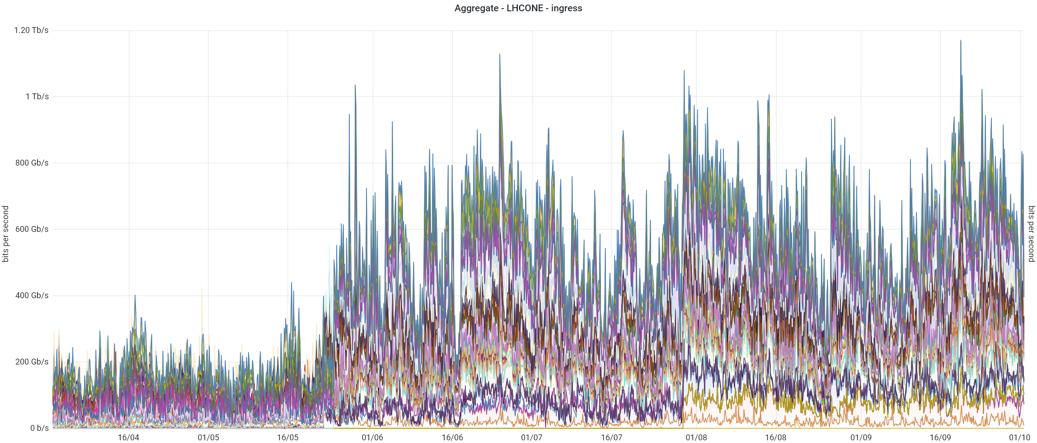
GÉANT aggregate

Slide 6
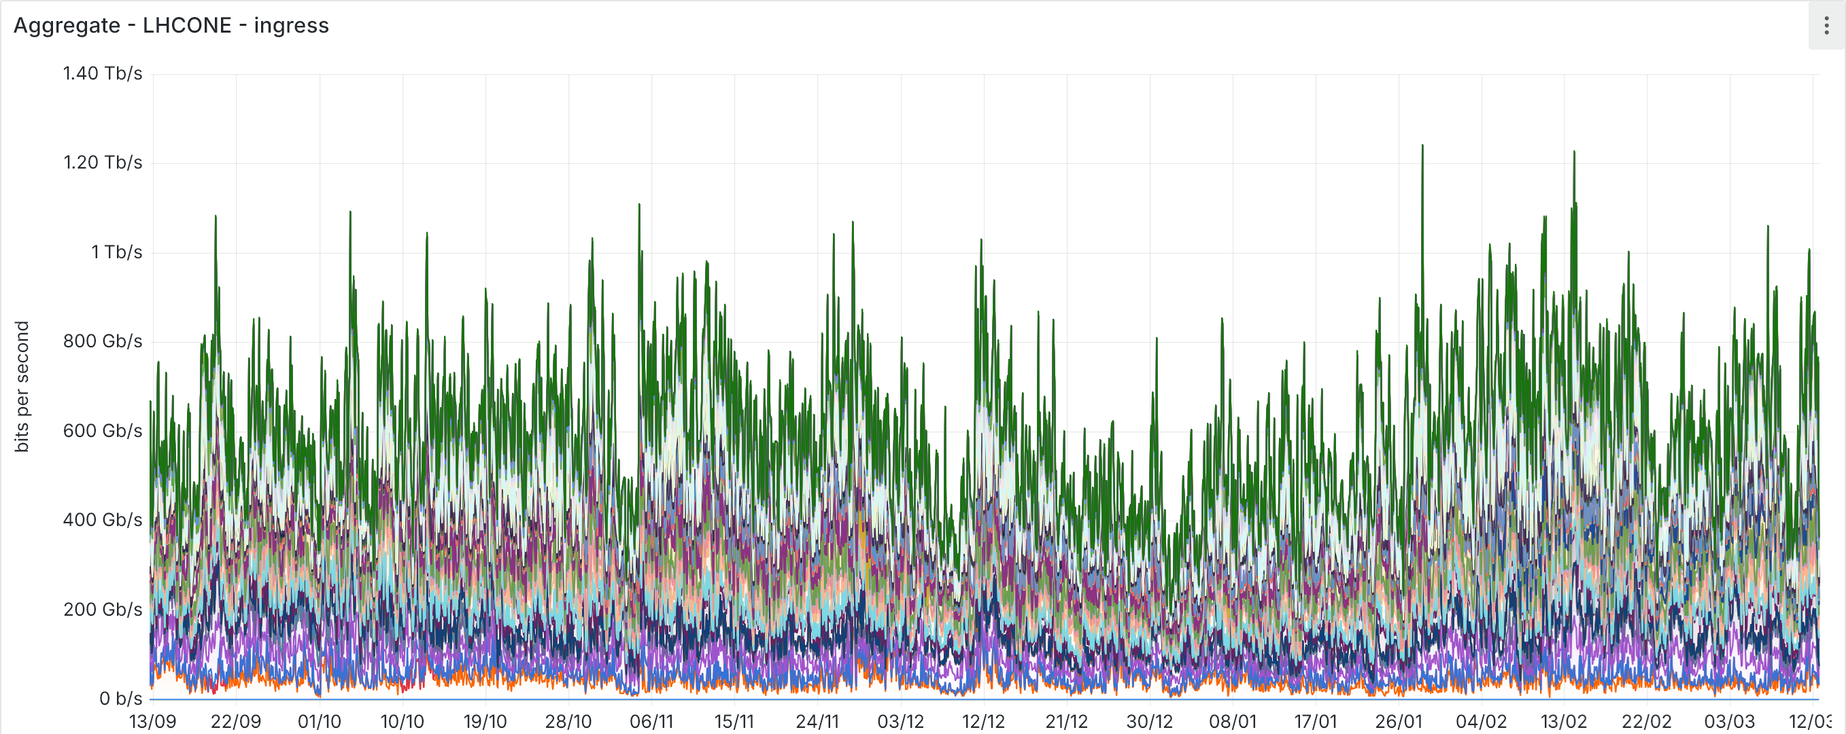
GÉANT aggregate
Notes:
A massive increase in traffic from June, very frequent peaks over 800Gbps, with some beyond 1Tbps

Slide 7
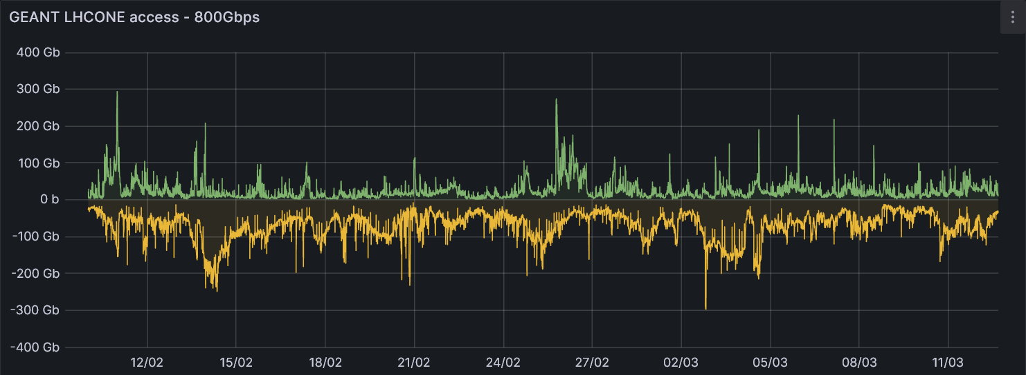
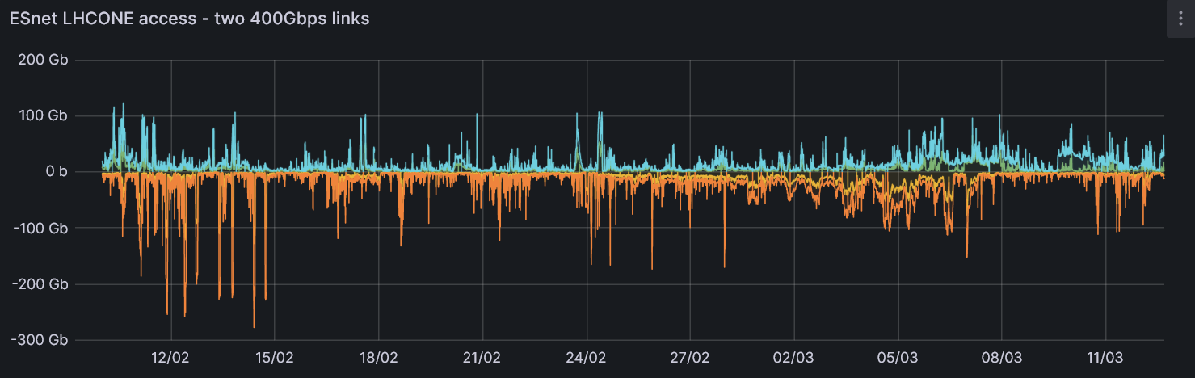

CERN
Notes:
https://monit-grafana-open.cern.ch
Consistent rise of traffic starting may/june

Slide 8

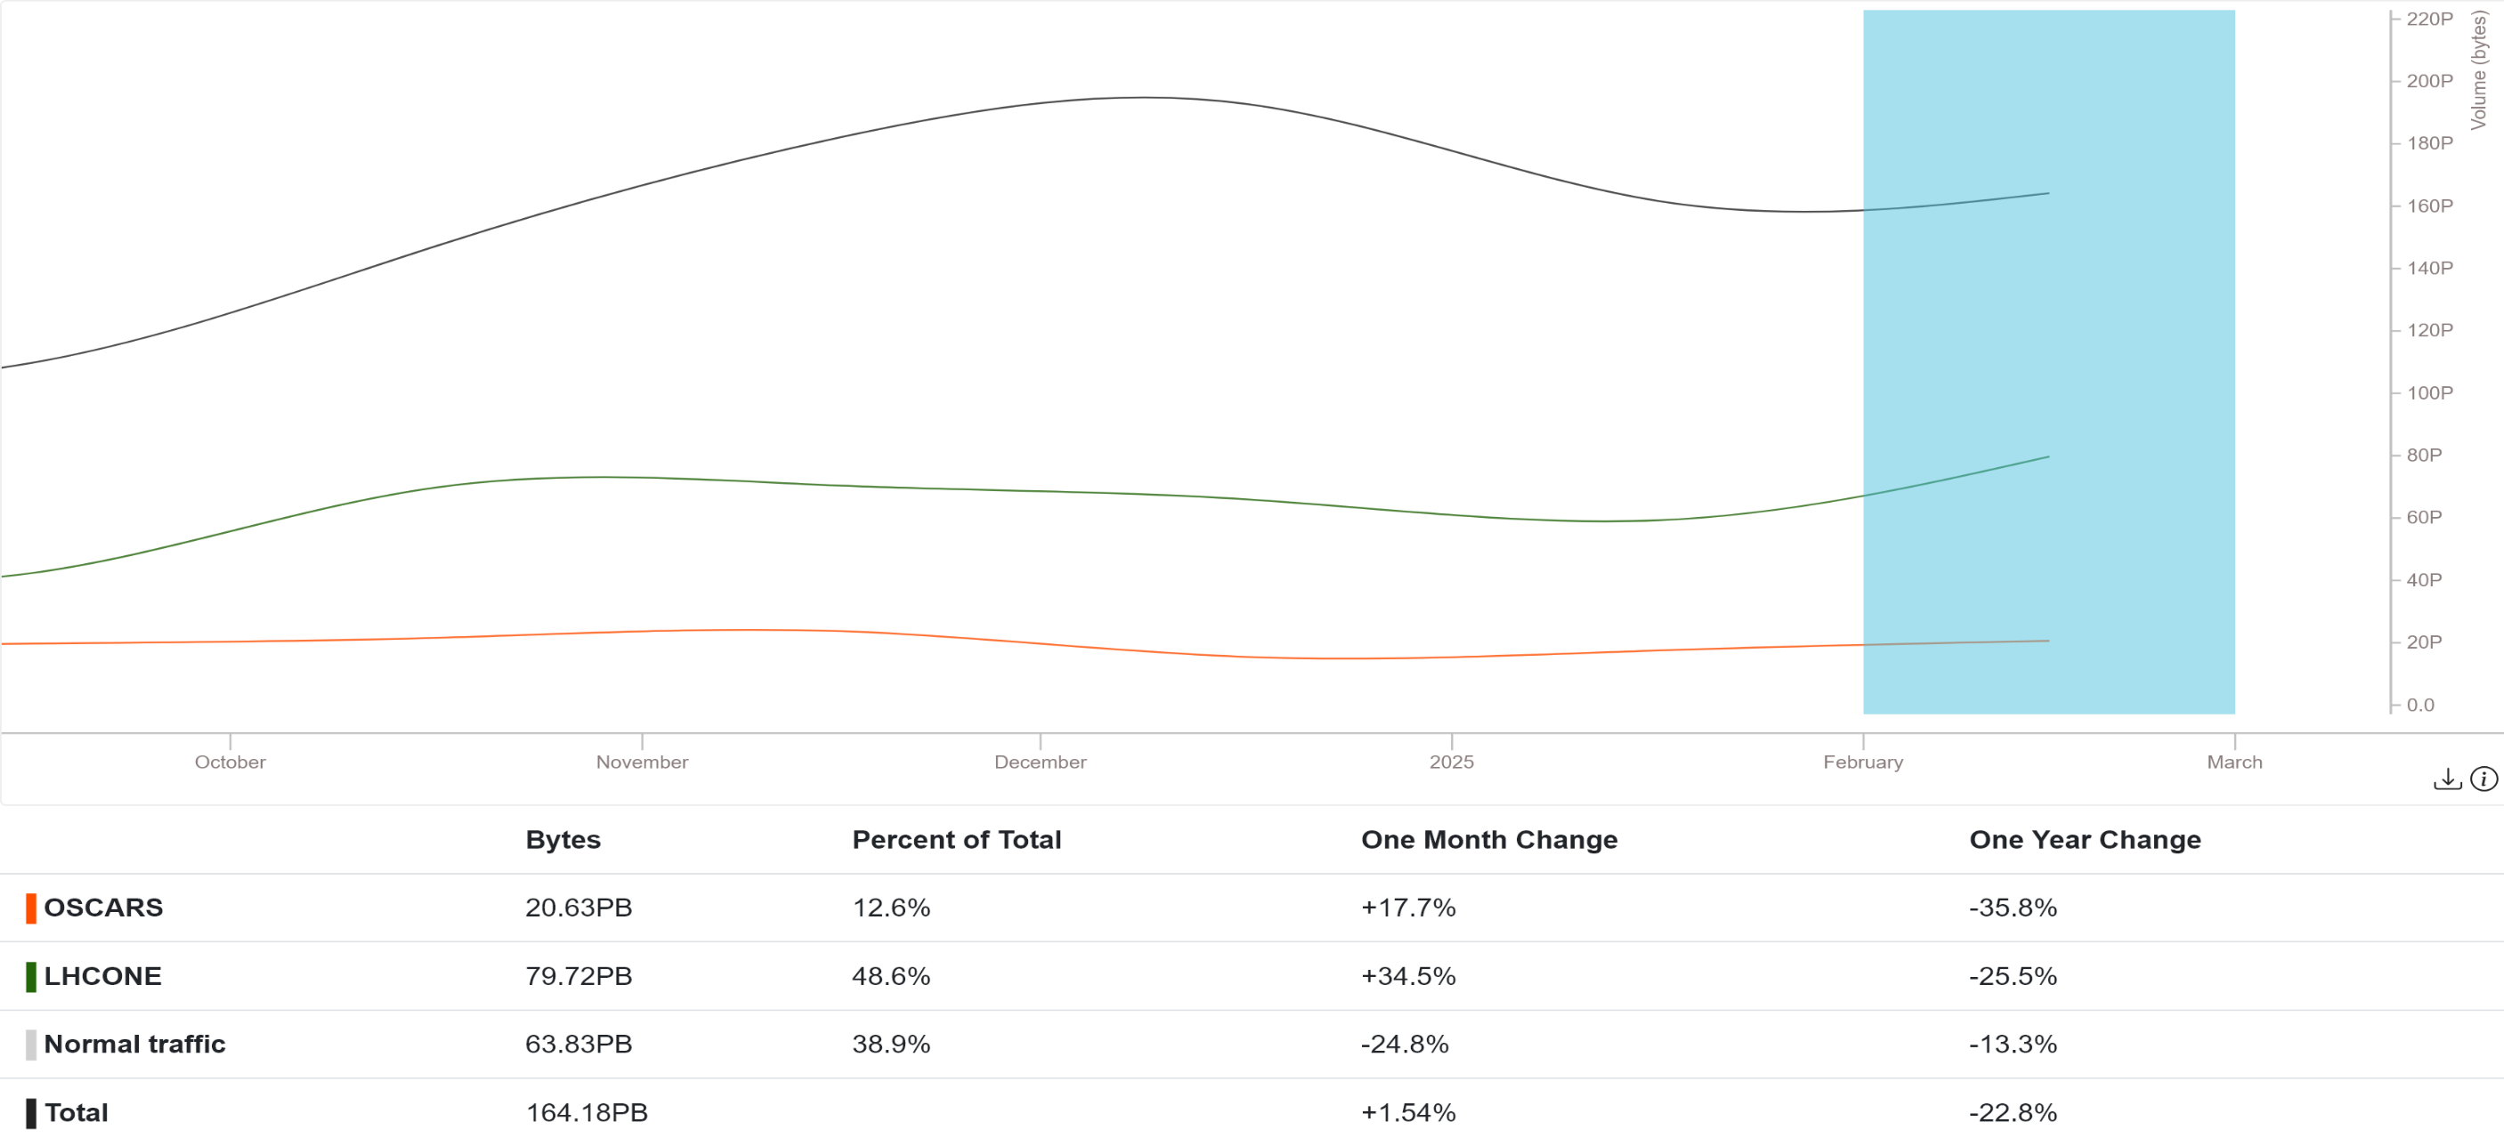
ESnet
Notes:
https://my.es.net/traffic-volume?t=6M&scale=linear

Slide 9
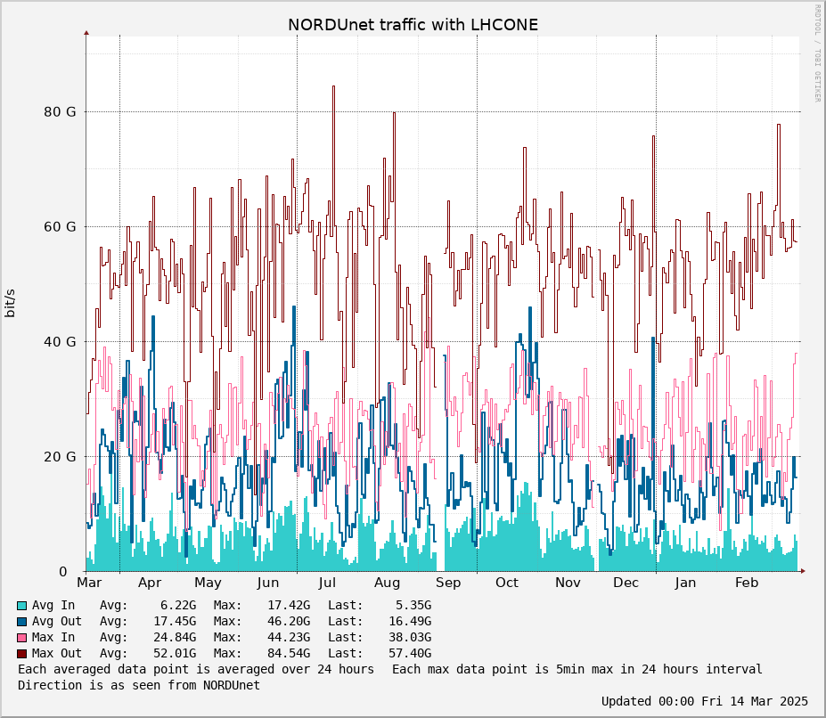
NORDUnet
Notes:
http://stats.nordu.net/connections.html
Also for NORDUnet it’s visible a slight increase in the last 4-5 months.

Slide 10

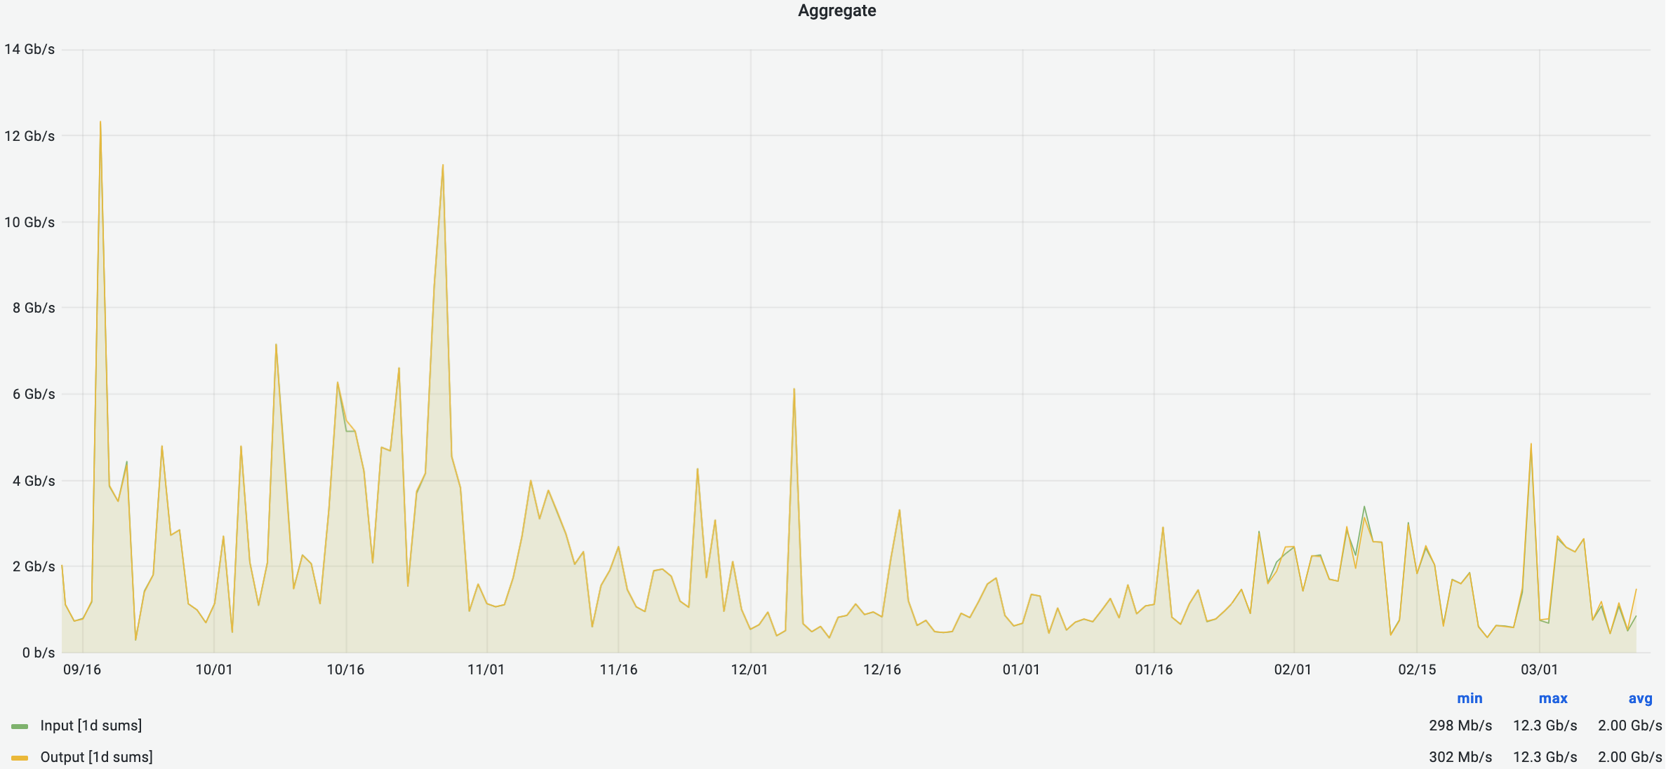
Internet2

Slide 11
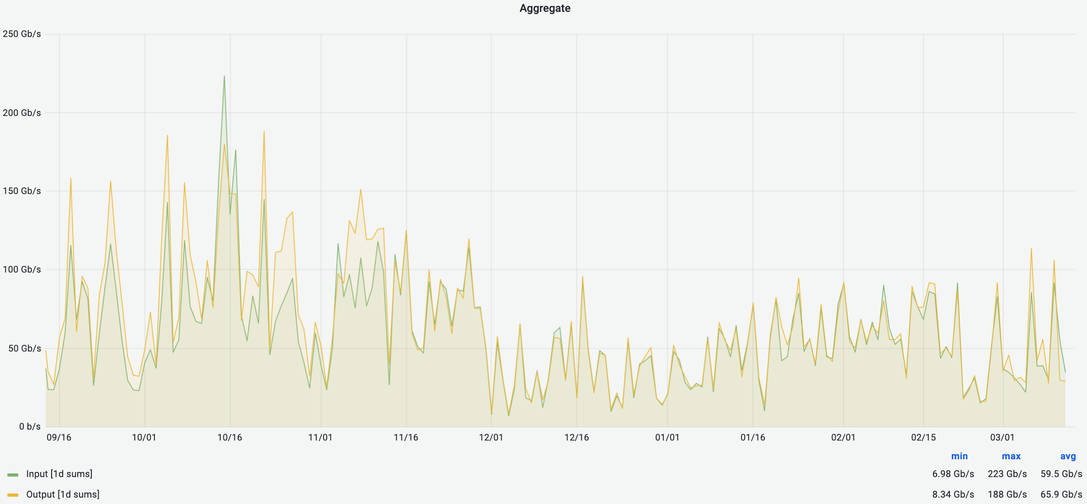
Internet2

Slide 12
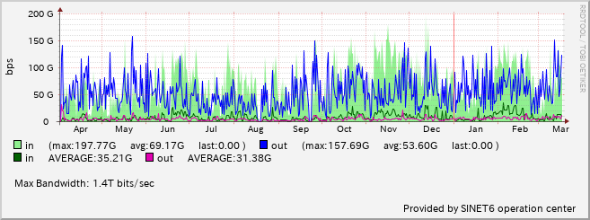
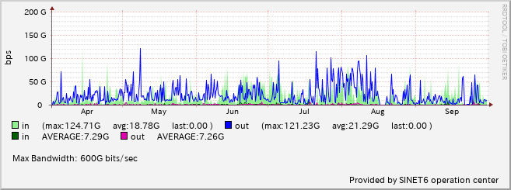
SINET
Europe
North America
Notes:
A massive increase in the traffic to Europe starting from April, with peaks beyond 150Gbps. Also very high traffic from Europe, consistent peaks >100G.
Also traffic to North America has seen a definite increase, although less remarkable.
Traffic to Asia is being rerouted via these other 2 routes because of a cable cut of the JP-HK route in March that hasn’t yet been fixed

Slide 13
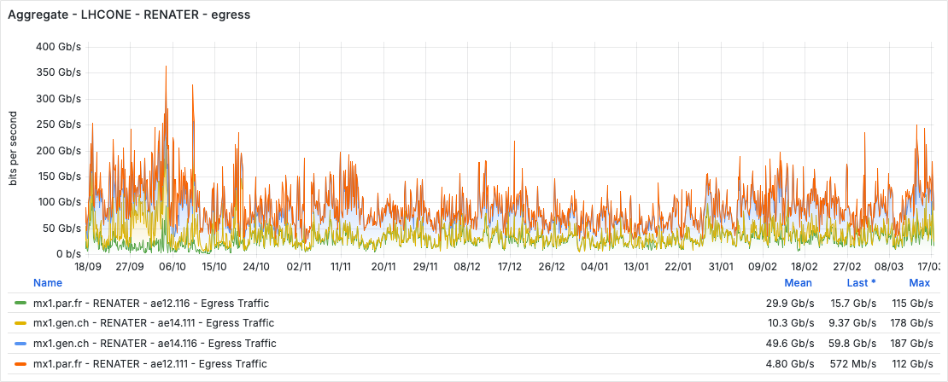
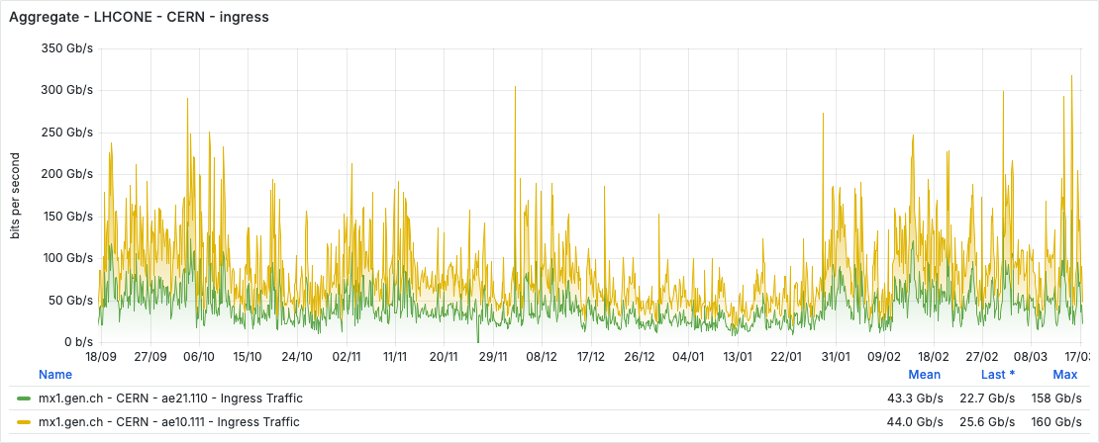
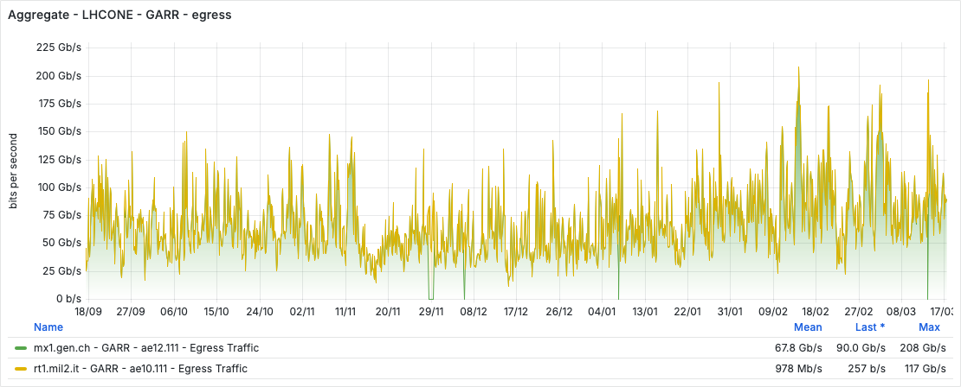
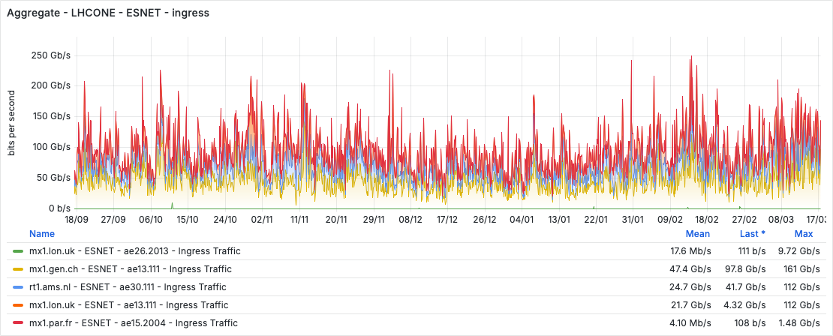
Highlights: the 400G club

Slide 14
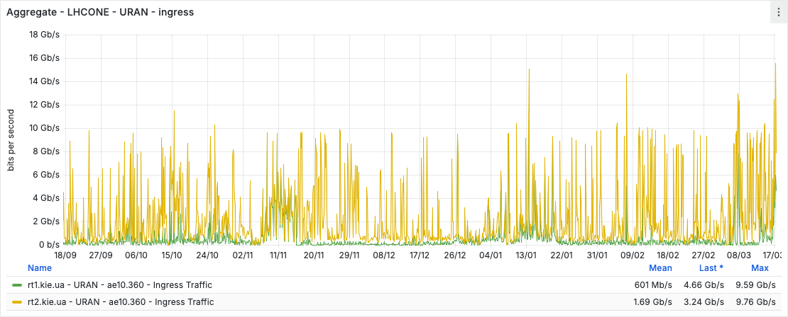
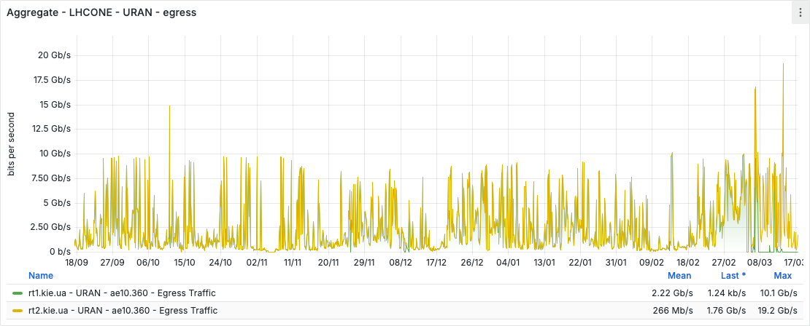
Highlights: Ukranian resiliency

Slide 15
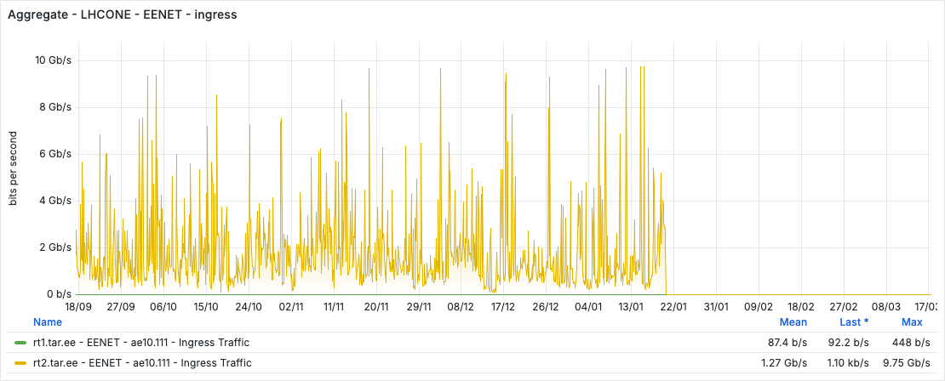
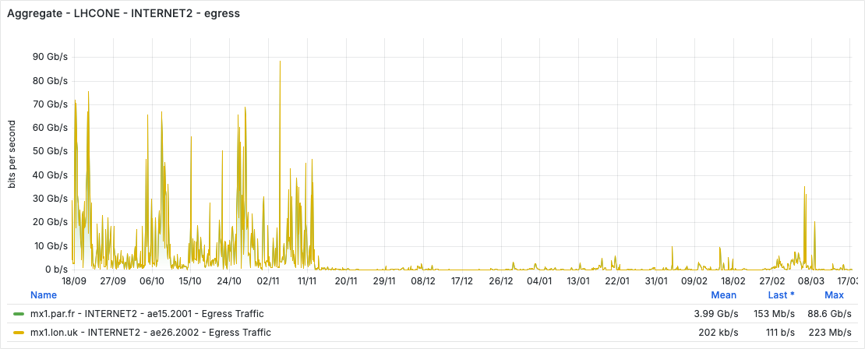
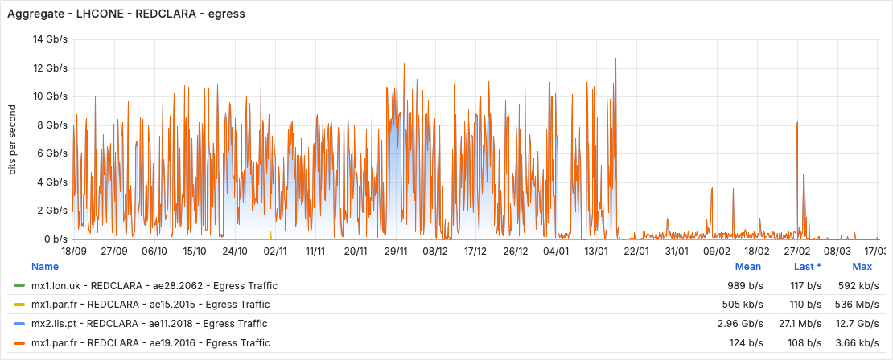
Highlights: strange traffic drops

Slide 16
Top-talkers (GÉANT only)

Slide 17
EuroHPC flows (last month)

Slide 18
Site news (upgrades)
GARR
INFN-CNAF T1: 4x100G (and currently moving to a different location)
INFN-Catania T2: 100G
INFN-Frascati T2: 100G

Slide 19
Summary
No major changes to the topology
A general increase in the overall global traffic
Mutual backup arrangement have proved to be very effective in keeping LHCONE up-and-running despite fibres cuts

Slide 20

Thank You
Any questions?
www.geant.org

