Slide 1

LHCOPN
History of LHCOPN
Bruno Hoeft
Karlsruhe Institute of Technology

Slide 2
Agenda
First initial steps
Evaluate different topology
IP-Design WG
Mission Statement
Operation WG
Evolvement – bandwidth + additional sites
Service challenges
IPv6
Responses of former colleagues

Slide 3

Disclaimer
It is not possible to cover all LHCOPN history in these slides
Slides are mainly about LHCOPN history
  Tier-2/3… are part of the early discussions/efforts
  history and evolvement of LHCONE, they have no part in these slides
LHC accelerator should start in 2007/8
  This explains the pressure in planning how to achieve the required load

Slide 4
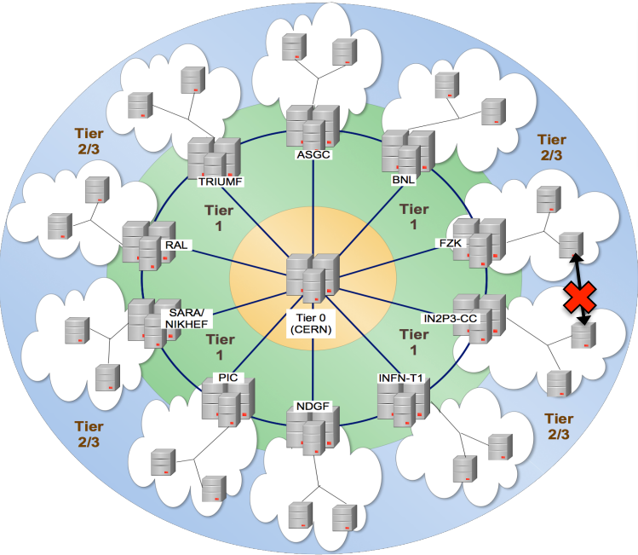
LHC Challenge
MONARC
Models Of Networked Analysis at Regional Centers
Towards the millennium a decision was made to a distributed computing engine for LHC (WLCG).
Beginning of 2000 –
the biggest challenge were the expected high data rates
  detector data ⬄sent straight to the Tier-1s
    for storing and first compute run (at CERN was no capacity)
  extremely stable and “unbreakable” network between Tier-0 and Tier-1
  In 2004 the connection to CERN was only 1 Gbps (most STM-4 and less)
  not sufficient ⬄ expected high data load of LHC
followed strict the model
Political navigation
  Dante (/Géant) as the aggregator and interconnect of the European NRENs
  Besides that LHCOPN required “cross-border-fiber” between NRENs
  Investments in transatlantic links were necessary (ESnet/USLHCnet)

Slide 5
First initial steps

Slide 6
First Meeting
Davis Foster steering
Kors Bos (chair of GDB) invited to
„Data Challenge Meeting LHC“ at 12.-13.10.2004 in Amsterdam (SARA)
  Small group of people (6 or 7) (CERN/NRENs/Tier-1s)
  Only topic : how to build a network reaching the expected data rate
    100PetaByte/Year Detector Data
Envisioned start of LHC : 2007 running up / 2008 first collision
Optical Lightpath Network was just developed
    NRENs establishing their first backbone with this technique

Slide 7
Next meeting (Jan. 20/21 2005)
„T0/T1 Network Meeting“ – CERN much bigger (39 people):
    of three Continents, nine Tier-1s and two Tier-2s, three experiment representatives, six NRENs
Topics:
  Who pays for what ?
  Who ensures the service – operations – evolution ?
  Who ensures the funding – longevity ?
  How to manage security, firewalling, especially at high speed (10Gb/sec)?
  Different working groups were built:
    Architecture (Erik-Jan Bos)
    Security (Robin Tasker)
    IP Design (Edoardo Martelli)
    Monitoring (Shawn McKee)
    Operation (Roberto Sabatino, Mathieu Goutelle)
The Group effort started
⬄ essential to keep all stake holder together
  The Tier-1 Manager and Network Administrator
  Géant/ESnet and all other NRENs
During 2005 the abbreviation LHCOpticalPrivateNetwork was chosen

Slide 8
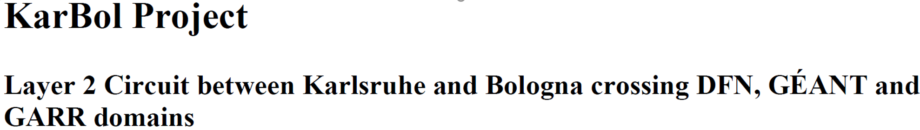
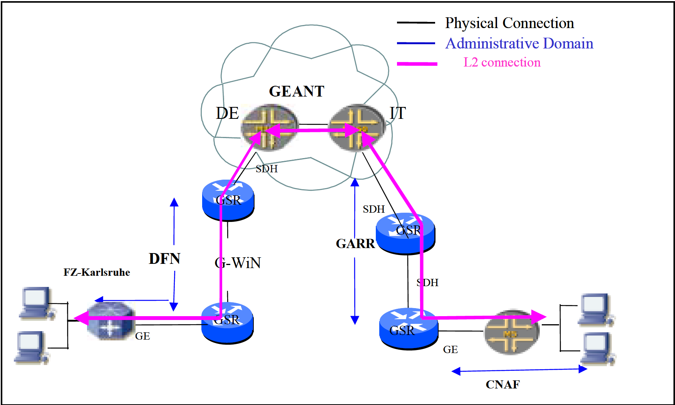

layer-2 approach
CERN
← dataTAG →
KIT
← Karbol →
CNAF
Next step of a triangle between CNAF (Bologna) KIT (Karlsruhe) and CERN
Tiziana Ferrari, CNAF (Tiziana.Ferrari@cnaf.infn.it)
The MPLS-Layer-2-VPN approach was successfully deployed but dropped
scalability issues
the difficulty to deploy cross multidomain layer-2 circuits at that time
KarBol
dataTag
GARR
CERN
LSP5
LSP3
LSP6
LSP1
LSP4
CCC2
LSP2
CCC1
Géant

Slide 9
Evaluate different topology

Slide 10

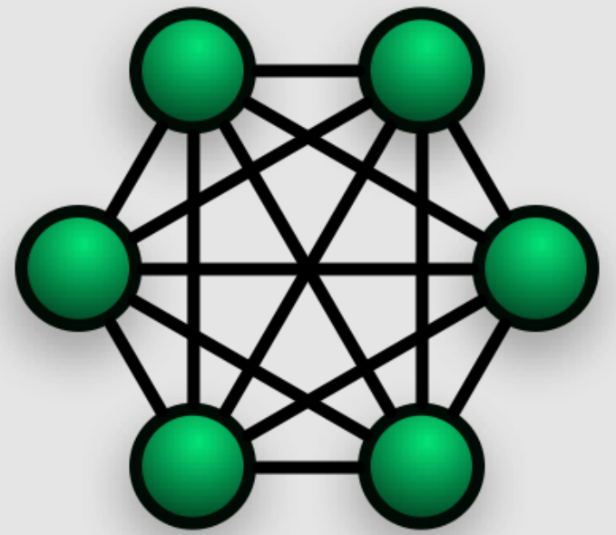

different topologies
ring topology did not support the required structure
full mesh topology – suited best, but was too complex to deploy
CERN centric Star topology was chosen
ring
full mesh
star
Tier-1
Tier-1
Tier-1
CERN
Tier-1
Tier-1

Slide 11
IP-Design WG

Slide 12

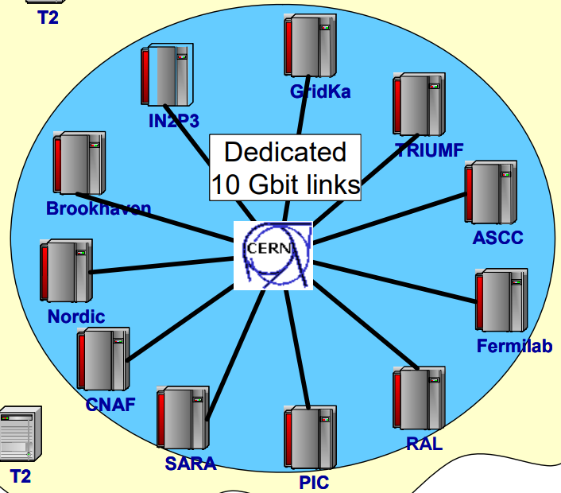
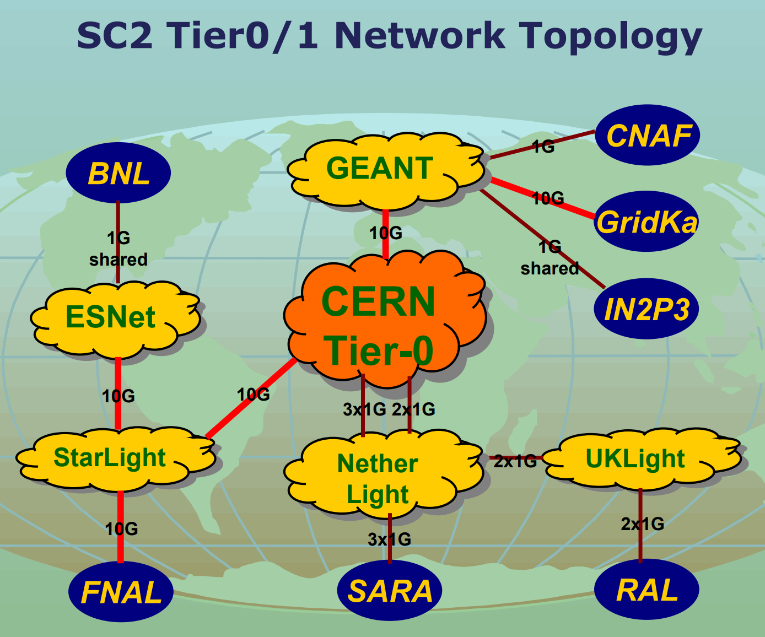
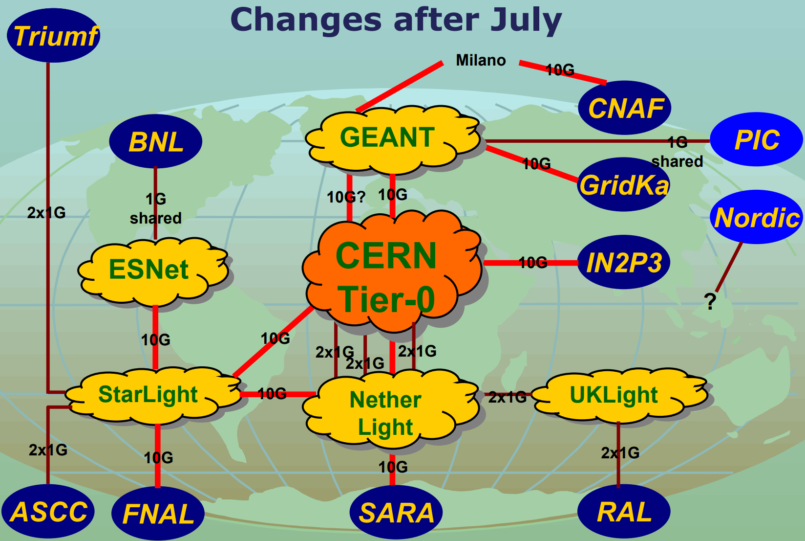
IP-Design
star
Tier-1
IP-Network Group https://twiki.cern.ch/twiki/bin/view/LHCOPN/LHCopnRoutingDoc
Layer-3 BGP deployed between CERN and Tier-1s
  LHCOPN transitnet 192.16.166.0/24
      CIDR /30 between Tier-0 and Tier-1
      with BGP advertisement of the reachability
      each Tier-0/1 needs its own AS-#
BGP
Tier-1
BGP
Tier-1
CERN
BGP
BGP
BGP
meeting Amsterdam, April 2005
Tier-1
Tier-1
define LHCOPN model
T1s to be connected
  all 10 Tier-1s
  Stated in the MOU
2005
already two examples of 2005

Slide 13
Mission Statement

Slide 14
LHC Mission statement
In the early state of building LHCOPN and after long and intensive discussions it was decided that LHCOPN shall be limited:
Mission:
  Tier-0 –Tier-1 transfers
    transfer detector raw data from CERN to Tier-1s
  Tier 1 – Tier 1
    data exchange transit through CERN
    a “best effort” base was agreed upon
  Mission won’t be extended (no Tier-2/3 traffic through LHCOPN)

Slide 15
Operation WG

Slide 16
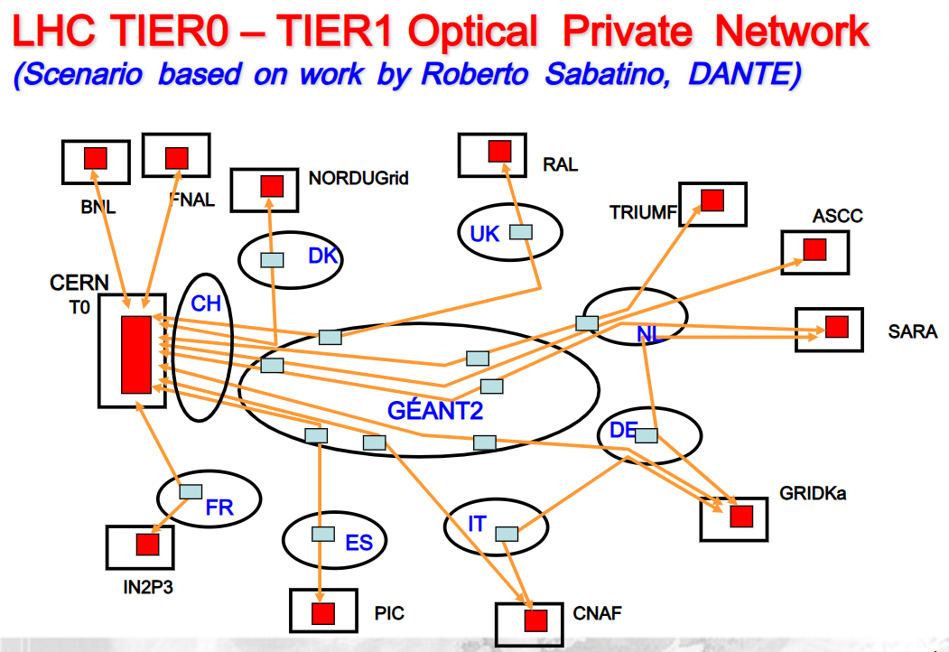
ENOC → EGEE NOC (Roberto Sabatino)
Red Boxes (proposal by Géant → Géant administrated routing gear)
Routing gear bought by Tier-1 sites
managed by the ENOC
→ Tier-1s decided on a federated / collaborative management approach by Tier-0/1s sites

Slide 17
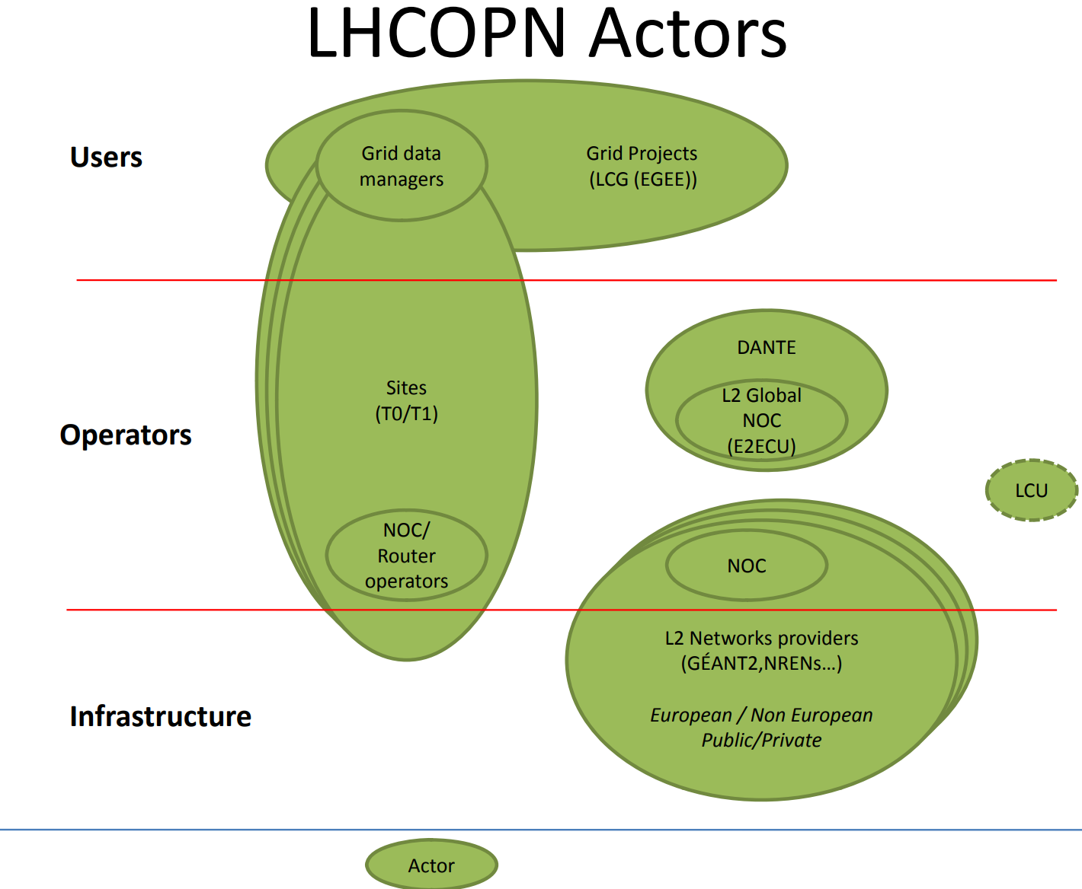
LHCOPN Operation
Mathieu Goutelle
Bruno Hoeft
Manager:
2006 - 2008 - 2012 - 2015
Guillaume Cessieux
2005 Roberto Sabatino first sketch
    Centralised model
    LHC NOC resides in Géant → solves ASN and routing issues
2006 Mathieu Goutelle
    LHC OPTICAL PRIVATE NETWORK Operational Handbook is written (part of EU funded EGEE-II-SA2 task)
2008 Guillaume Cessieux (EGEE-II,SA2)
    Operational procedures of each site
    identifying weak spots (unsupported time slots)
    Include backup links, incl. site connection between backup links
    Operation of both layer-2 and layer-3 part of LHCOPN
2012 Bruno Hoeft
    Tests of backup links
    Mature ticketing system → GGUS

Slide 18
Evolvement – bandwidth + additional sites

Slide 19
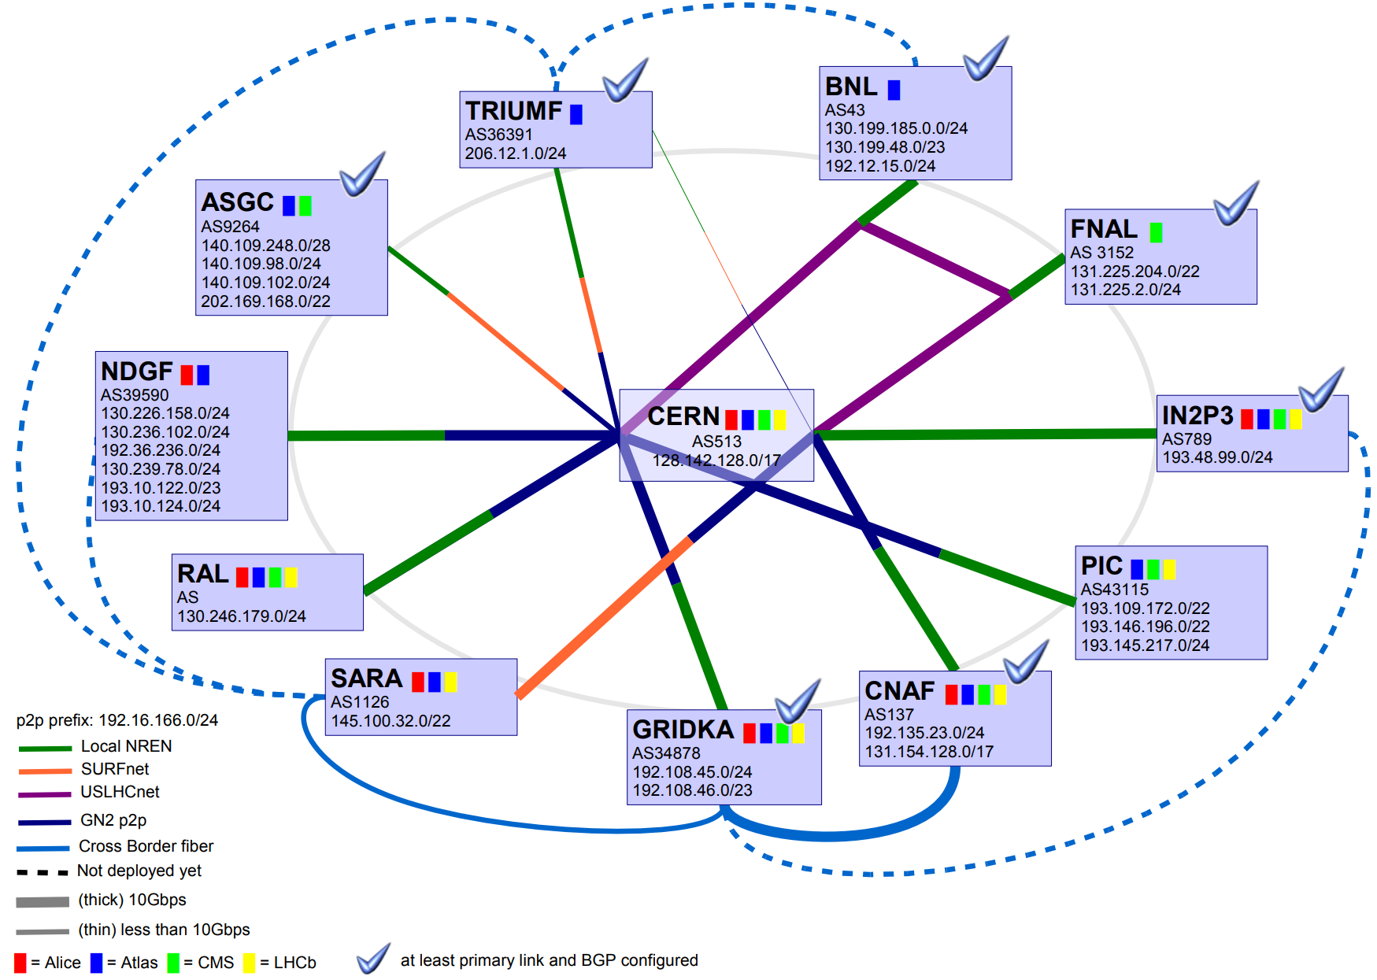
T1 1Gb Uplink to CERN
10Gbps Uplinks ⬄ for the expected raw data traffic load from Tier-0 to Tier-1
Upgrade process of Tier-1s to Tier-0 to 10Gbps LHCOPN took till 2008
Crossborder connections accross different European NRENs between Tier-1s were deployed and considered as part of LHCOPN
  CNAF Bologna ⬄ DE-KIT GARR/Switch/DFN (2005)
  NLT1/Sara ⬄ DE-KIT Surf(Netherlight)/DFN (2007)
  IN2P3 ⬄ DE-KIT Renater/DFN (10Gbps)(2006)
  NLT1/Sara ⬄ NGDF (2008)
  NLT1/Sara ⬄ TRIUMF (2008)
  TRIUMF ⬄ BNL (2008)
  transit of Tier-1s through direct Tier-1 links:
    e.g. SARA, CNAF, IN2P3 through DE-KIT
DE-KIT
2005/6/7

Slide 20
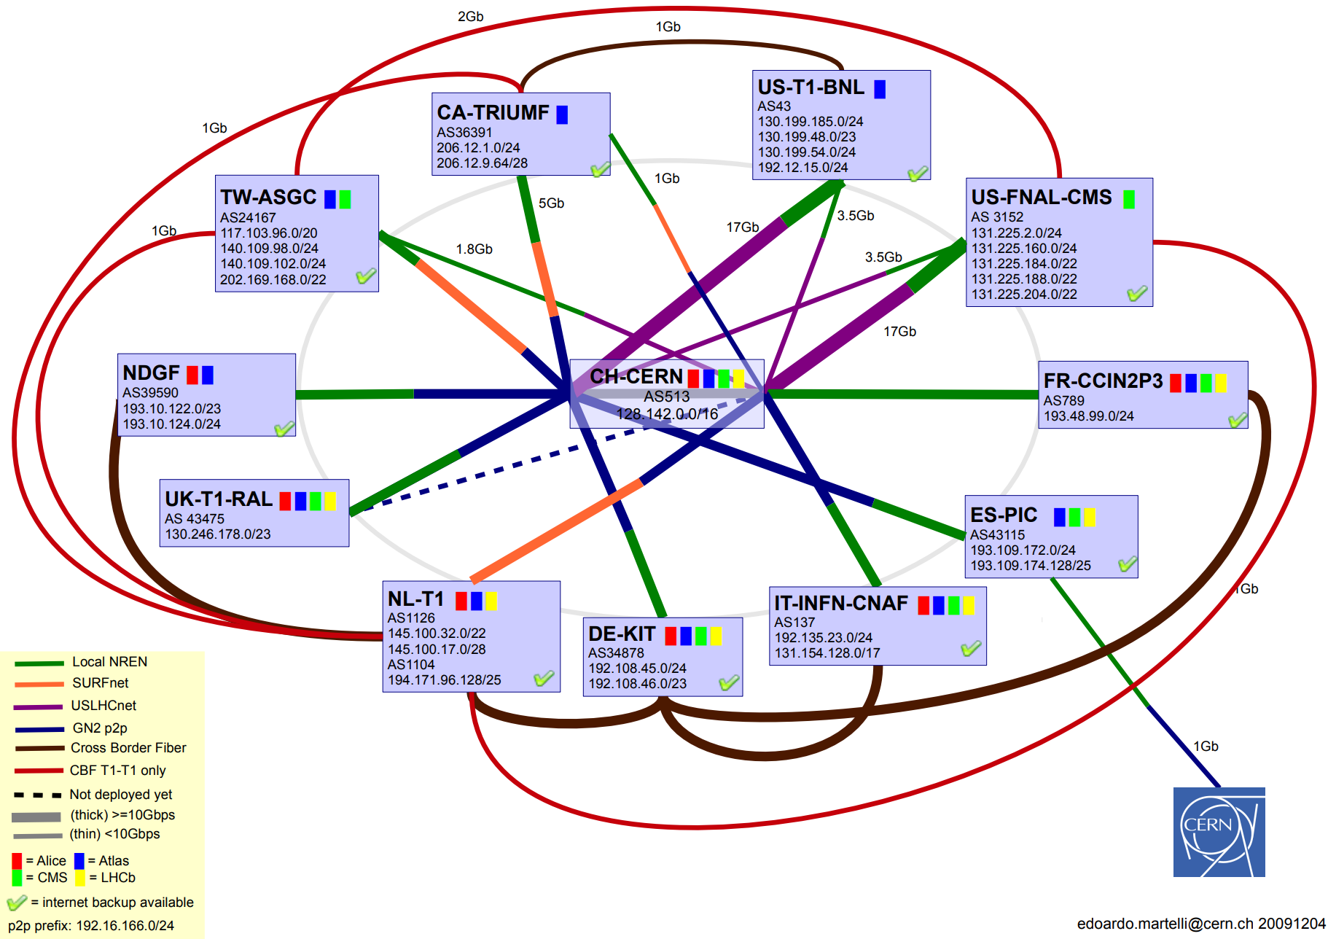
LHCOPN status 2008/9/10/11/12
Additional Tier-1 to Tier-1 links in production:
    NL-T1 ⬄ TW-ASGC (1Gbps)
    NL-T1 ⬄ CA-Triumf (1Gbps)
    NL-T1 ⬄ US-FNAL-CMS (1Gbps)
    TW-Triumf ⬄ US-FNAL-CMS (1Gbps)
    DE-KIT to FR-CCIN2P3 (10Gbps)
Upgrade 2012
Tier-1 to Tier-1 link to 2Gpbs
    NL-T1 ⬄ TW-ASGC (2Gbps)
    NL-T1 ⬄ US-FNAL-CMS (2Gbps)
    TW-Triumf ⬄ US-FNAL-CMS (2Gbps)
2009

Slide 21
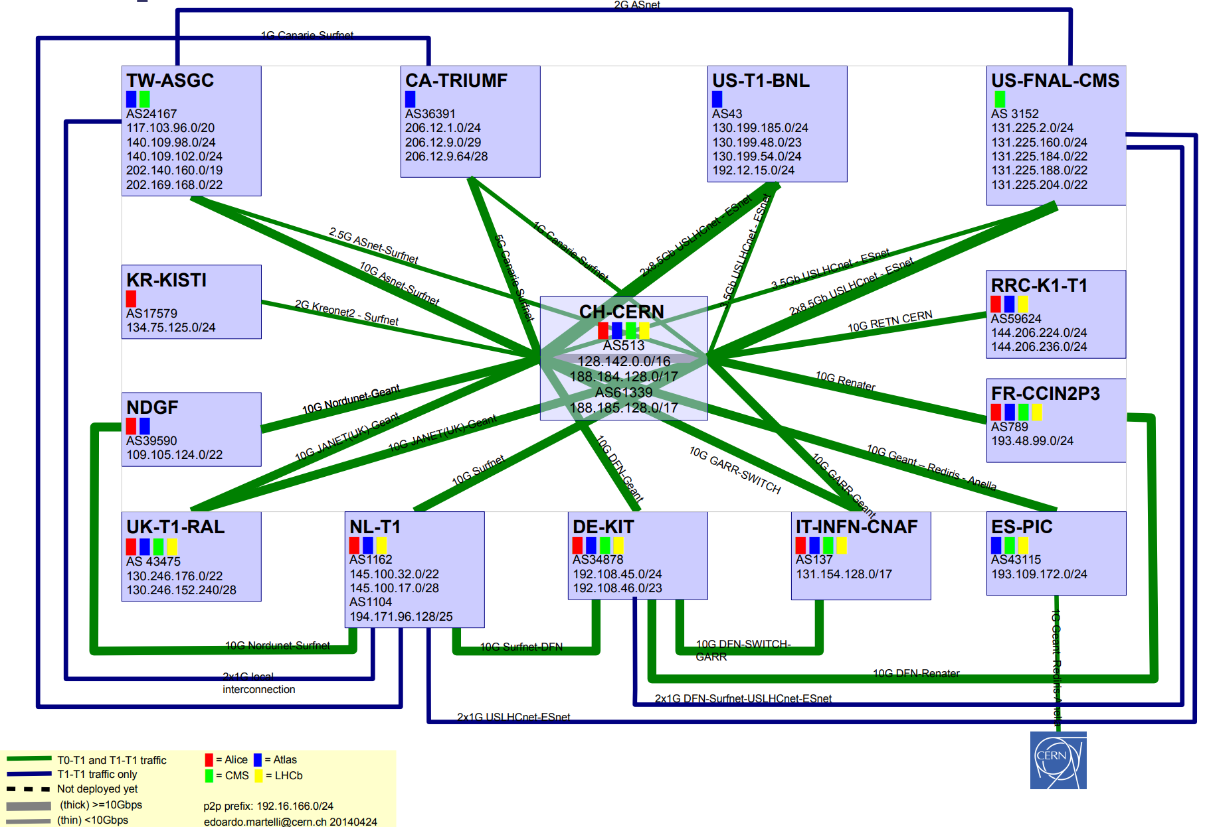
LHCOPN status 2013/4
2013/4
Tier-1 joined:
  KR-KISTI
  RRC-K1-T1
  +
  RRC-JINR-T1

Slide 22
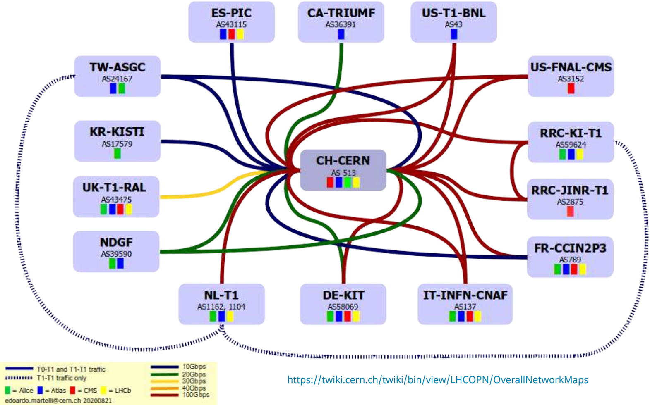
LHCOPN bandwidth upgrades
ESnet connected with 100 Gbps (transatlantic) (2015)
    FNAL and BNL connected each with 100 Gbps (plus 40Gbps backup) (Sept. 2016)
FNAL and BNL connected each with 40 Gbps (plus 20Gbps backup) (Feb. 2015)
    FNAL and BNL connected each with 2* 100 Gbps (June 2019)
NDGF
    2* 20 Gbps (March 2018)
UK-T1-RAL
    30 Gbps (Oct. 2017)
DE-KIT
    100 Gbps (20 Gpbs backup) (Oct. 2018)
2020
IT-INFN-CNAF
    2* 100 from (June 2019)
FR-CCIN2P3
    1*100 Gbps and 10 Gbps backup (Oct. 2018)
NL-T1
    100 Gbps (Oct. 2019)
RRC-KI-T1 and RRC-JINR-T1
100 Gbps (June 2019)
Triumf
20 Gbps (Sept. 2020)

Slide 23
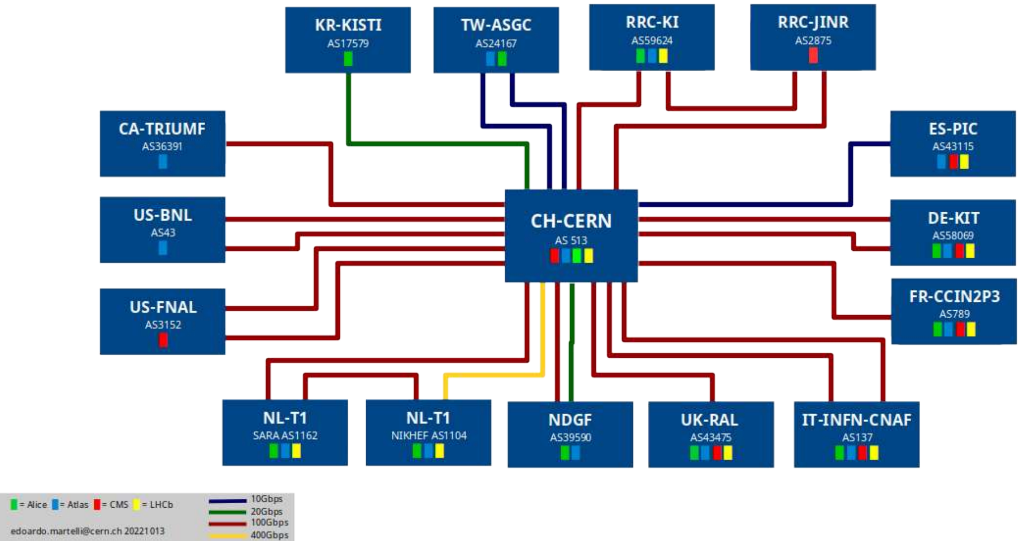
LHCOPN bandwidth upgrades
ESnet connected with 100 Gbps (transatlantic) (2015)
    FNAL and BNL connected each with 2* 100 Gbps (June 2019)
NDGF
    1* 100 Gbps and 20 Gbps backup Oct. 2022)
UK-T1-RAL
    100 Gbps (March 2021)
DE-KIT
    2* 100 Gbps (March 2021)
2022
IT-INFN-CNAF
    2* 100 from (June 2019)
FR-CCIN2P3
    1*100 Gbps and 10 Gbps backup (Oct. 2018)
NL-T1
    400 Gbps (Oct. 2022)
RRC-KI-T1 and RRC-JINR-T1
After 2022 Russian Ukraine invasion decomissioned
Triumf
100 Gbps (Oct. 2022)

Slide 24
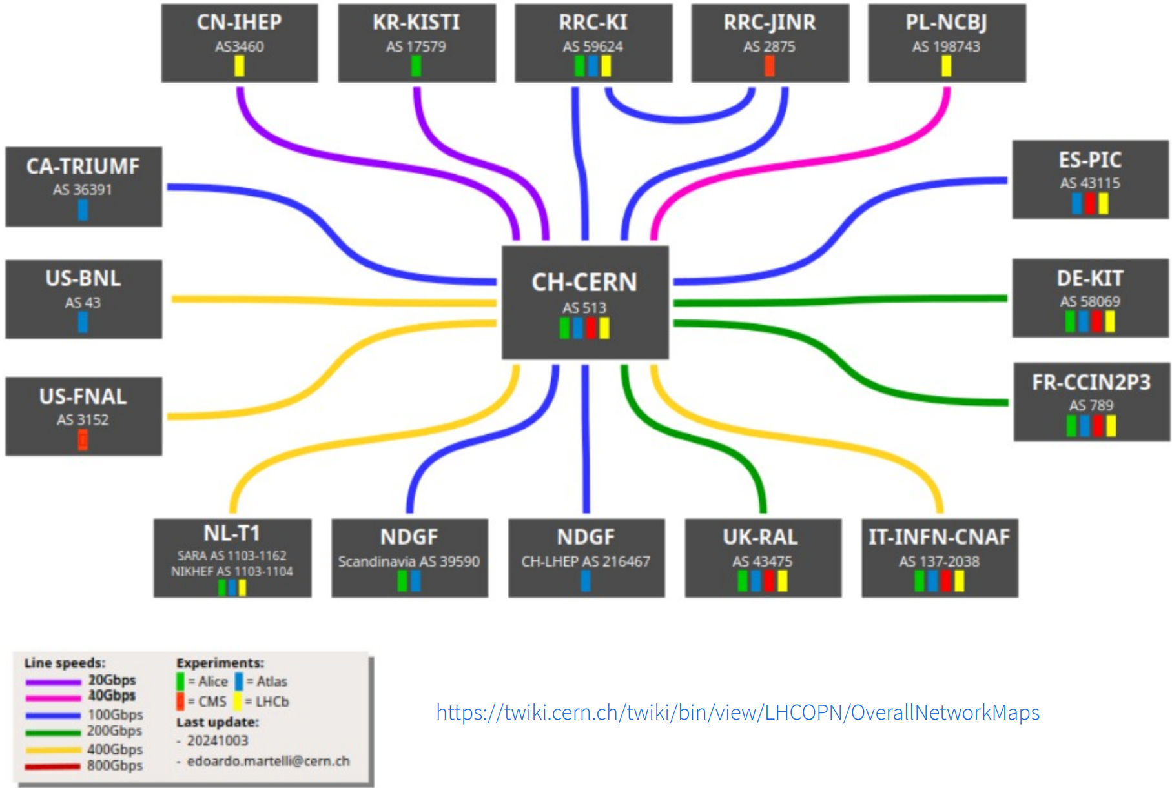
LHCOPN bandwidth upgrades
ESnet connected with 100 Gbps (transatlantic) (2015)
PL-NCBJ
    FNAL 400 Gbps (April 2024) + BNL 400 Gbps (Oct. 2024)
20 Gbps (April 2023)
40 Gbps (Oct. 2024)
NDGF
    1* 100 Gbps and 20 Gbps backup Oct. 2022)
UK-T1-RAL
2024
    200 Gbps (Oct. 2023)
DE-KIT connected with
    2* 100 Gbps (March 2021)
IT-INFN-CNAF
    4x100 Gbps (April 2024) ⬄ DCI upgradable to 1.6Tb/s
FR-CCIN2P3
    1*100 Gbps and 10 Gbps backup (Oct. 2018)
NL-T1
    400 Gbps (Oct. 2022)
    800 Gbps test (Oct. 2023/4)
Triumf
100 Gbps (Oct. 2022)
PIC → 100 Gbps
100 Gbps (April 2023)
CN-IHEP 20 Gbps
20 Gbps (April 2023)

Slide 25
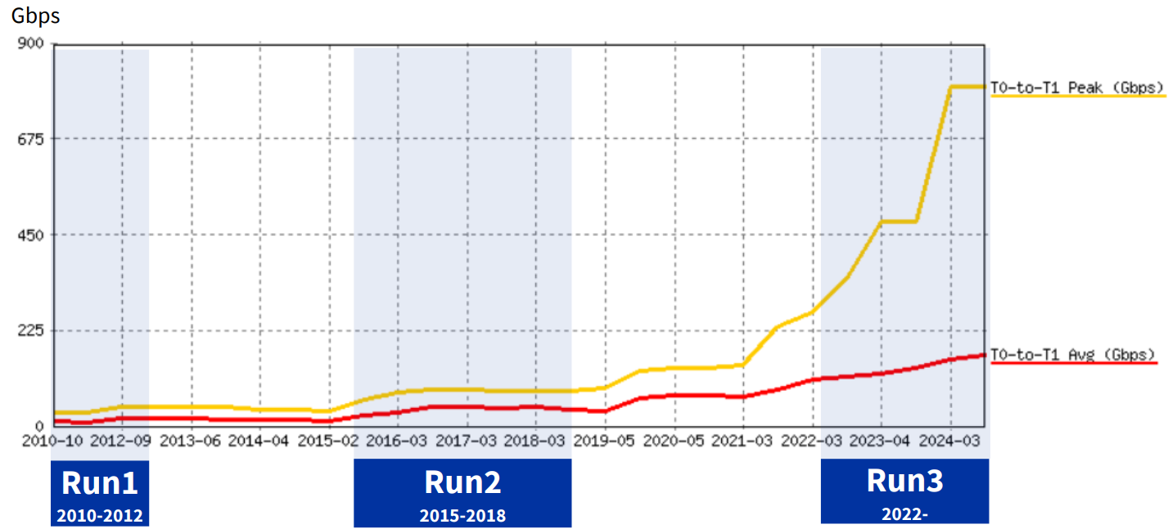
LHCOPN traffic growth

Slide 26
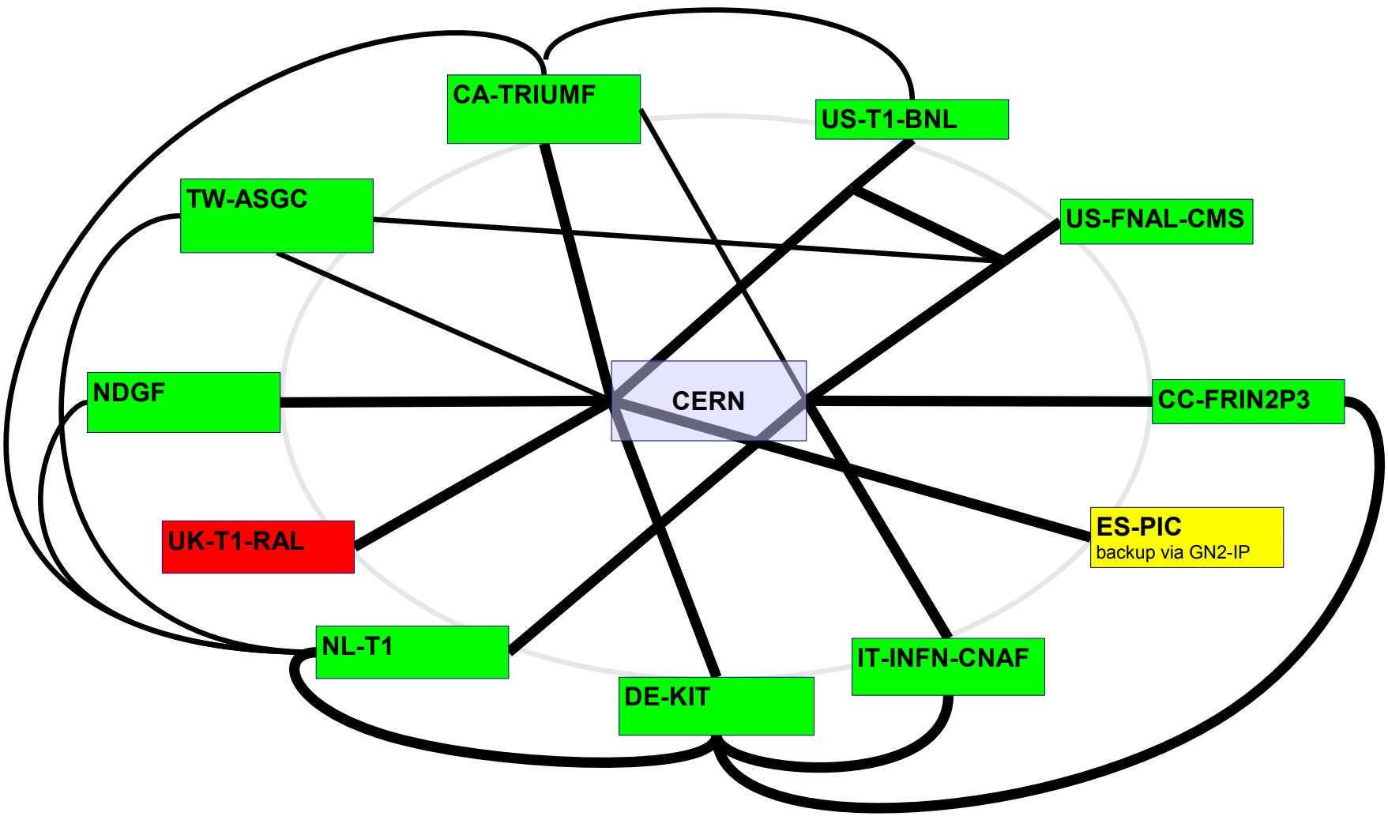
Backup status
Because of limited resources at CERN detector data of the four LHC experiments should straight be transfered to the Tier-1 sites for the first computing run (reducing data and producing the so called DSTs)
  For not loosing any data a detailed backup strategy was implemented
    „normal operation“ LHCOPN
    most of the Tier-1s were equipped with a second uplink which kept the connection to CERN
    the third backup: Raw data transfered via general purpose internet (last resort)
2008/9
When LHC started in 2010 situation was quite different
  The resources allowed that
    all detector raw data were stored at CERN before sending to the Tier-1s
    keeping pressure off the network

Slide 27
Service challenges

Slide 28
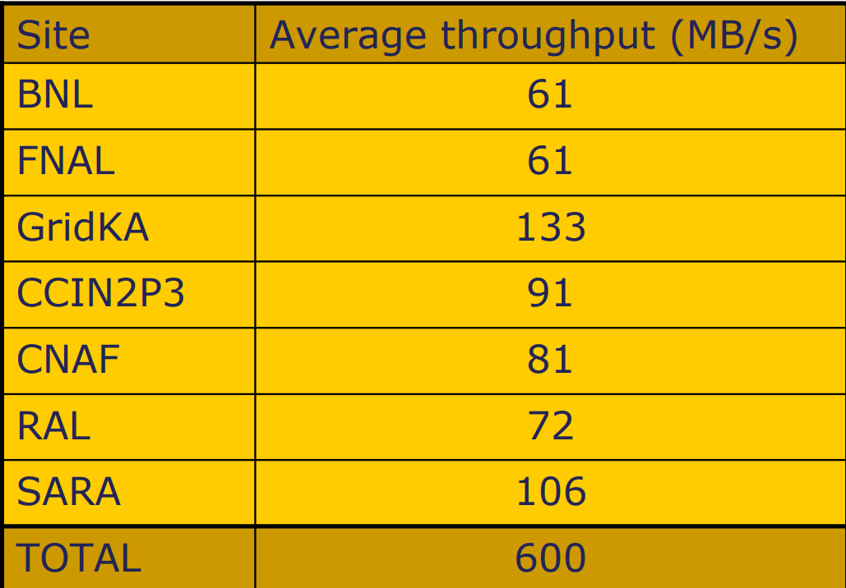
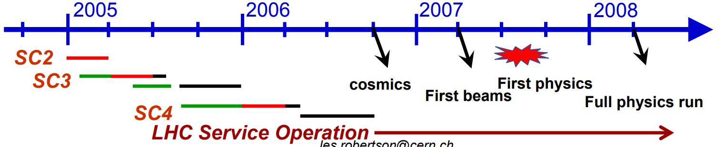
Service Challenge (SC) 1/2/3/4
To build up required disk/storage + tape, network and compute capacity
SC1 ?
SC2 March 23 – April 2 2005 → up to 600MB/s at CERN
    Up to this point → for SC were special upgrades/deployments necessary for achieving the required load
    From here SC shall be covered in “normal” Tier-1 operation
    From SC2 onwards SC has three phases preparation/execute/validate
SC3 Q2 2005 → target data rate ~1 GB/sec at Tier-0
SC4 Q1 2006 → target full data rate ~2 GB/sec at Tier-0
SCs shall lead to required LHC (wlcg) performance and lead smoothly into standard service (Cosmics at Q4 2006)
Statement at every service/data challenge was:
    the network is not a problem
Common Computing Readiness Challenge (CCRC’08)
STEP09

Slide 29
IPv6

Slide 30
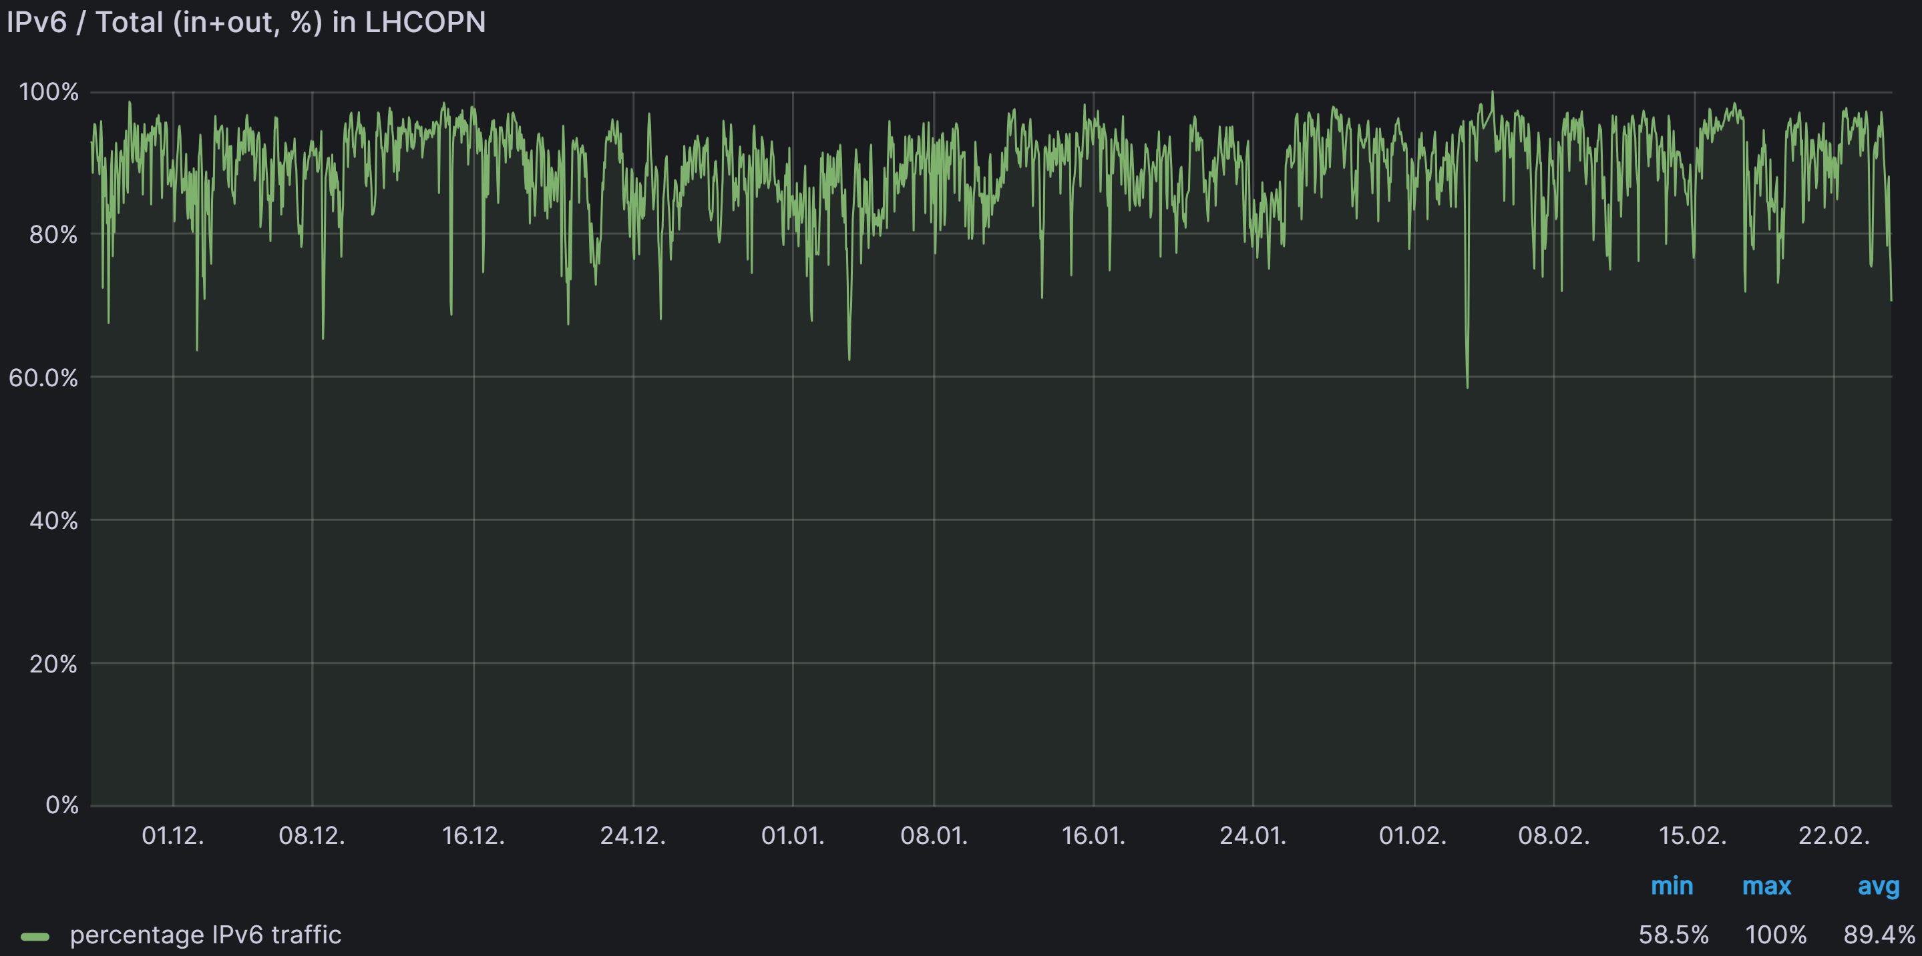
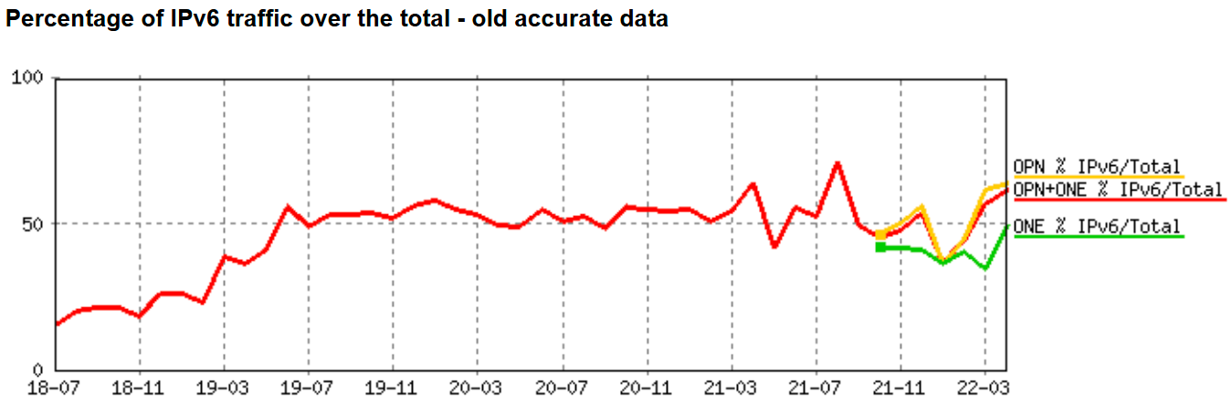
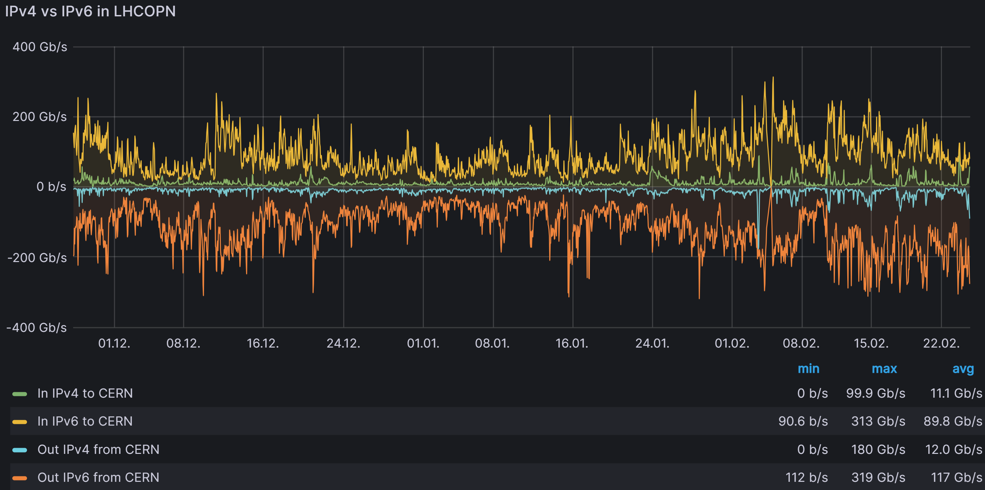
IPv6
HEPiX-IPv6 Working Group started in 2011
  First LHCOPN BGP peering between CERN and DE-KIT deployed
LHCOPN IPv6 deployment T0/T1 started 2012/3
IPv6 peering CERN and NDGF (Feb. 2013), PIC (June 2013)
IPv6 peering FR-CCIN2P3 (Sept. 2014)
IPv6 peering IT-INFN-CNAF and US-FNAL-CMS (Oct. 2015)
IPv6 peering US-T1-BNL and CA-Triumf (Sept. 2016)
IPv6 peering RAL (April 2017)
Since 2018 - all Tier-1s peer with IPv6 prefixes
Today -Average: ~90% IPv6

Slide 31
LHCOPN meetings during 20 years
2005 - 2006 - 2007 - 2008 - 2009 - 2010 - 2011 - 2012 - 2013 - 2014 - 2015 - 2016 - 2017 - 2018 - 2019 - 2020 - 2021 - 2022 - 2023 - 2024 - 2025
29.-30. Mar. LHCOPN Meeting – VC
23.-24. Mar. LHCOPN Meeting – VC
04.-05. Apr. LHCOPN Meeting – BNL
11.-12. Oct. LHCOPN Meeting – VC
06.-07. Mar. LHCOPN Meeting – RAL
20.-21. Jan. T0/1 Network Meeting – CERN
20.-21. Sept. LHCOPN Meeting – Oslo
13. May LHCOPN Meeting – VC
07. Juli ESnet Network Meeting – CERN
10.-11. Feb. LHCOPN Meeting – Lyon
16.-17. Oct. LHCOPN Meeting – KEK
16.-17. Sept. LHCOPN Meeting – VC
19. Juli T0/1 Network Meeting – CERN
17.-18. Jun. LHCOPN Meeting – Paris
13.-14. Jan. LHCOPN Meeting – CERN
04. Apr. LHCOPN Meeting – Rome
07.-08. Oct. LHCOPN Meeting – CERN
24.-25. Oct. LHCOPN Meeting – CERN
15.-16. Jan. LHCOPN Meeting – Berlin
28.-29. Apr. LHCOPN Meeting – Rome
04.-05. Mar. LHCOPN Meeting – Umeå
18.-19. Apr. LHCOPN Meeting – Prag
13.-14. Mar. LHCOPN Meeting – Taipei
16.-17. Jun. LHCOPN Meeting – CERN
16.-17. Oct. LHCOPN Meeting – FNAL
09.-10. Apr. LHCOPN Meeting – Catania
04. Apr. LHCOPN Meeting – Munich
08.-09. Mar. LHCOPN Meeting – London
19.-20. Sept. LHCOPN Meeting – Helsinki
09.-12. Oct. LHCOPN Meeting – Beijing
21. Sept. T0/1 Network Meeting – Utrecht
21.-22. Apr. LHCOPN Meeting – Utrecht
10.-11. Mar. LHCOPN Meeting – Madrid
10.-11. Dec. LHCOPN Meeting – Bologna
03.-04. Dec. LHCOPN Meeting – Pasadena
18.-19. Oct. LHCOPN Meeting – Victoria
15.-16. Sept. LHCOPN Meeting – Michigan
03.-04. May LHCOPN Meeting – Stockholm
08. Apr. T0/1 Network Meeting – Amsterdam
21.-22. Apr. LHCOPN Meeting – Barcelona
09.-10. Feb. LHCOPN Meeting – Cambridge
16. Juni LHCOPN Meeting – Cambridge
31. Aug.-01. Sept. LHCOPN Meeting – Vancouver
12. Jan. LHCOPN Meeting – Cambridge
28.-29. Oct. LHCOPN Meeting – Amsterdam
31. Jan. LHCOPN Meeting – Amsterdam
26.-27. Sept. LHCOPN Meeting – Amsterdam
05.-06. Nov. LHCOPN Operation Workshop – CERN
07. Dec. LHCOPN Operation Workshop – CERN
16. Juni LHCOPN Meeting – Amsterdam
13.-14. Jun. LHCOPN Meeting – Washington
14. Nov. T0/1 Network Meeting – Seatle (SC05)
16.-17. Oct. LHCOPN Meeting – Copenhagen
30.-31. Jan. LHCOPN Meeting – LBL Berkeley
01.-02. Jun. LHCOPN Meeting – LBL Berkeley
18.-20. Mar. LHCOPN Meeting – Manchester
31.Jan.-01.Feb. LHCOPN Meeting – Washington (DC)
2005 to 2011
2011 to 2025
24 LHCOPN Meetings
32 combined LHCOPN and LHCONE Meetings

Slide 32
Responses of former colleagues

Slide 33
Responses by some early contributor
Roberto Sabatino (Géant/HEAnet)
  2004 was a very interesting time, with fibre optic networks being deployed in many cases by NRENs and GEANT for the first time, and the LHCOPN being the first large scale use case for services delivered over fibre networks. It posed many challenges, from having to work with new technology to delivering end to end services in a global, multidomain environment. It wasn’t easy, but it was certainly exciting and through the collective persistence and dedication of all the stakeholders we got there. On time. To spec. We also worked together to deliver a novel concept: cross border fibre connections, where neighbouring NRENs (GARR, SWITH, DFN, RENATER) partnered in delivering connectivity to the LHCOPN over their own fibre networks, thus providing additional resilience and diversity from the pan-European network, GEANT.
  LHCOPN has been, and still is, instrumental in pushing the boundaries of what can be done with new technology , novel approaches and remains a perfect example of global collaboration in support of science.
Enzo Valente
  Chep 2000 in Padua → agreed with Les Robertson on distributed WLCG
  LHCOPN did a greate Job

Slide 34
Responses by some early contributor - 2
Kors Bos
  I got to see the LHCOPN doing its good work
  saw the Higgs in my last weeks at CERN → a good time to retire
Guillaume Cessieux
  Sends his greetings
David Foster
  “father” of LHCOPN
  the lhcopn was very political as it involved Géant and the NRENs directly, but it gave a groundbreaking goal to bring the community together in a common objective.
  It was not an easy task to navigate the technical and political issues, of which there were many. But I think that 20 years later we can declare it a major success. It is one of the things I am most proud of doing in my time at CERN. I created something that was fundamental to the success of the LHC.
  Setting the ambitious goal of a 10 Gb/s CERN centric star network

Slide 35
Success story of LHCOPN
Operation still stable
  Thanks to all collaborators
    NRENs
    Sites
    Different working groups (operation/monitoring/…)
    …
  LHCOPN is still dedicated light path (or assured dedicated bandwidth)
    approaches to run LHCOPN as overlay did not succeed
  Bandwidth upgrade from 1 Gb/s (2004/5) to 400 Gb/s today
  Extreme stable LHC production support
  Aggregated LHCOPN throughput:
2005 – SC2 | 3.2 Gb/s
2024 – DC24 | in: 656 Gb/s out: 945 Gb/s
  All Service and Data challenges stated that:
  problems where never network caused

Slide 36
Thank you for your attantion

