Slide 1

SKA Regional Centre Global and Local Network Provisioning
Ian Collier
ian.collier@stfc.ac.uk
54th LHCOPN LHCONE Meeting
Manchester
19th March 2025

Slide 2
SRCNet Global and Local Network Provisioning
Background
SRC Distribution & GREN
Estimating data volumes and bandwidths
Strategic Coordination
Summary

Slide 3
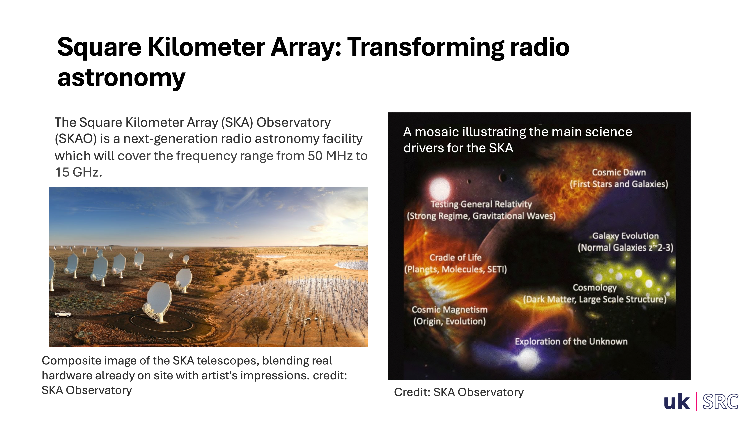

Slide 4
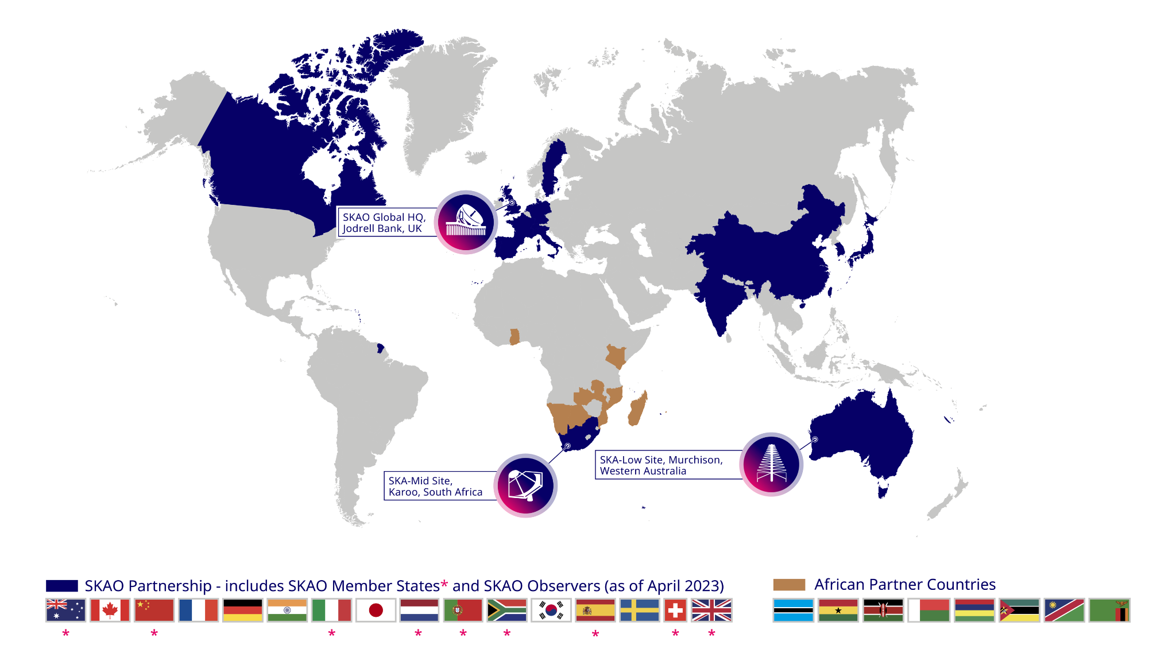

Slide 5
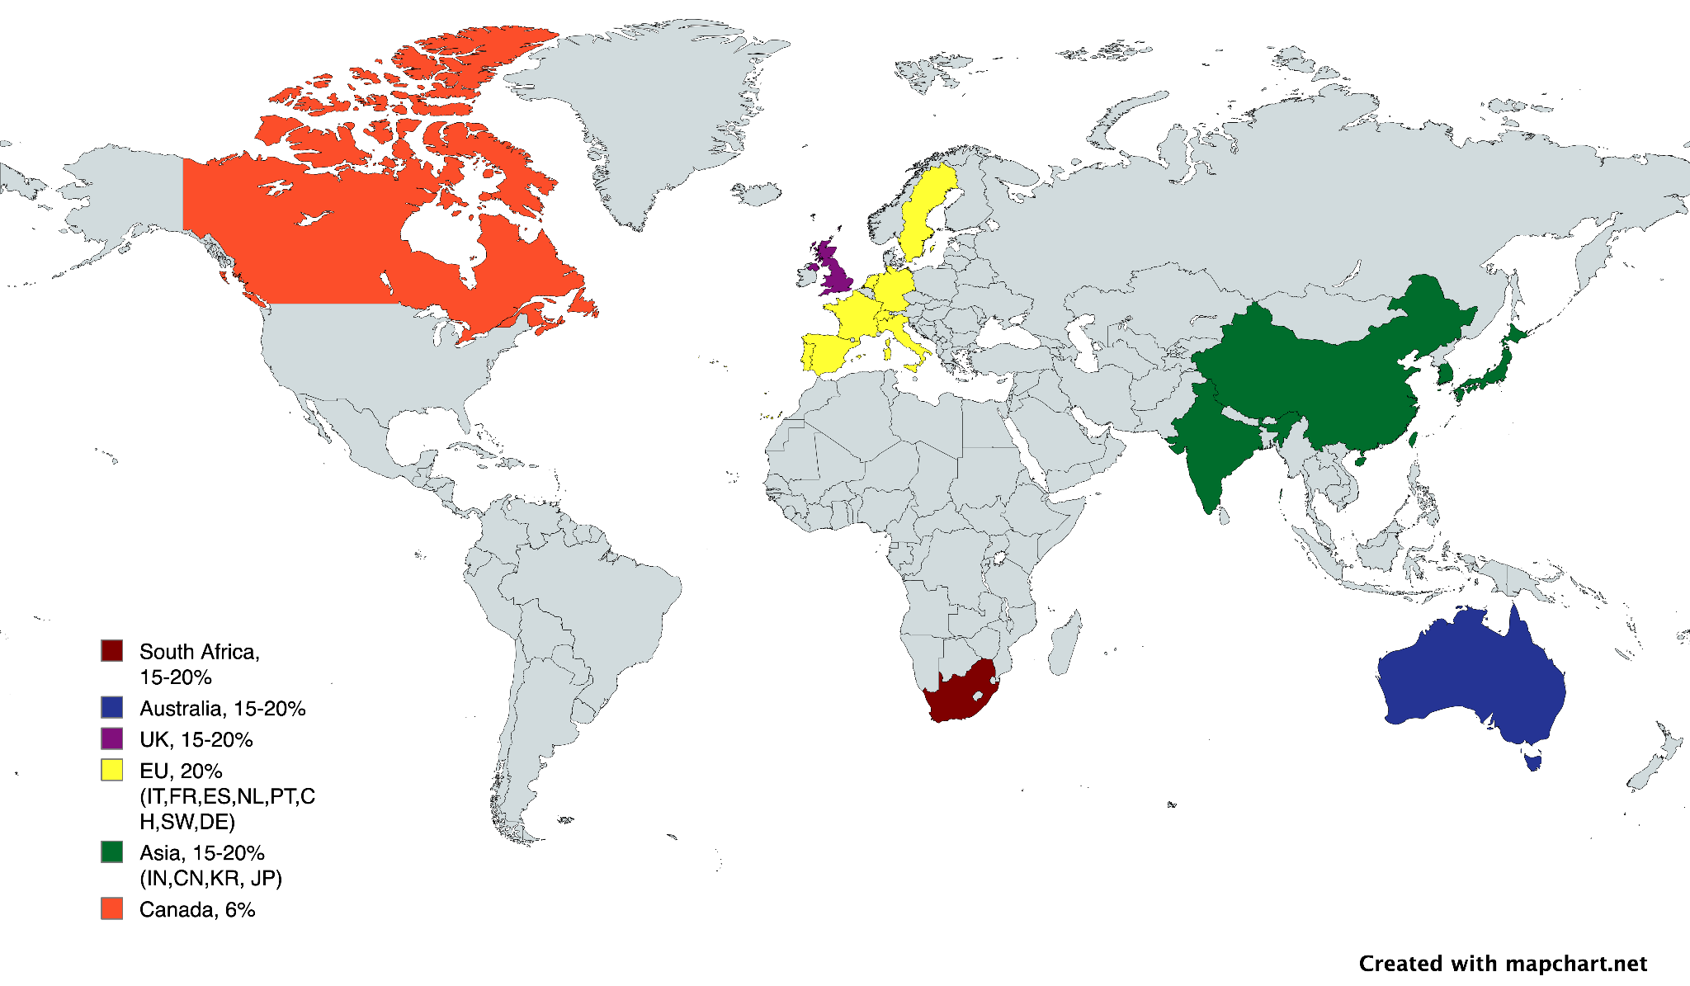
SKA Regional Centre Broad Distribution
Roughly, 6 global zones of equivalent size (Canada smaller)
Distribute two base copies of each data product to different countries, and perhaps insist to different regions
Average incoming rate per (20%) region not more than 2x40 Gbit/s = 80Gbit/s (~2x12 Gbit/s for Canada)
Modelling assumes average 100 Gbit/s out of SA and AUS
CAN
UK
EUROPE
ASIA
AUS
SA
e.g. if 100+100 gbps from instruments, a 10% partner receives 40gbps data (400 TBytes per day, 140 PBytes per year)

Slide 6
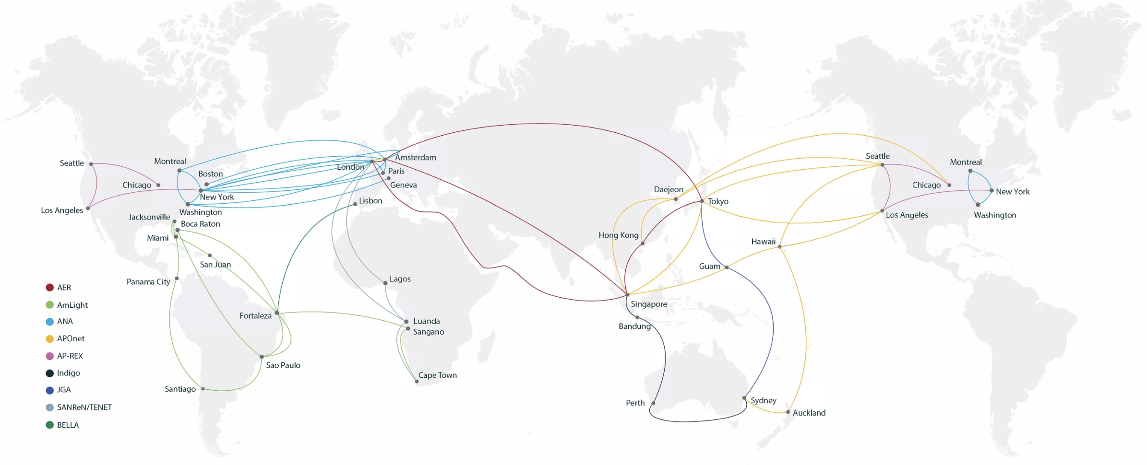
The Global Research & Education Network

Slide 7
The Global Research & Education Network
From Shari’s talk we’re heading towards ~150PB/year from each of WA & SA to Singapore and London respectively. Average of ~50Gbit/s.

Slide 8

Estimating SRC data volumes and bandwidths
Developing a modeling tool that takes
  Total data volume being sent to the SRC network
  Assumptions about retries, ratio of analysis products to data from instruments, etc
For a given percentage size SRC gives
  Total disk storage
  Tape growth per year
  Ingress and egress average bandwiths
  Ingress and egress peak bandwidths
This is enough for SRCs to know where they should be aiming in discussions with their NRENs

Slide 9

Estimating SRC data volumes and bandwidths
Tool that takes
  Total data volume being sent to the SRC network
  Assumptions about retries, ratio of analysis products to data from instruments, etc
For a given percentage size SRC gives
  Total disk storage
  Tape growth per year
  Ingress and egress average bandwiths
  Ingress and egress peak bandwidths
This is enough for SRCs to know where they should be aiming in discussions with their NRENs

Slide 10
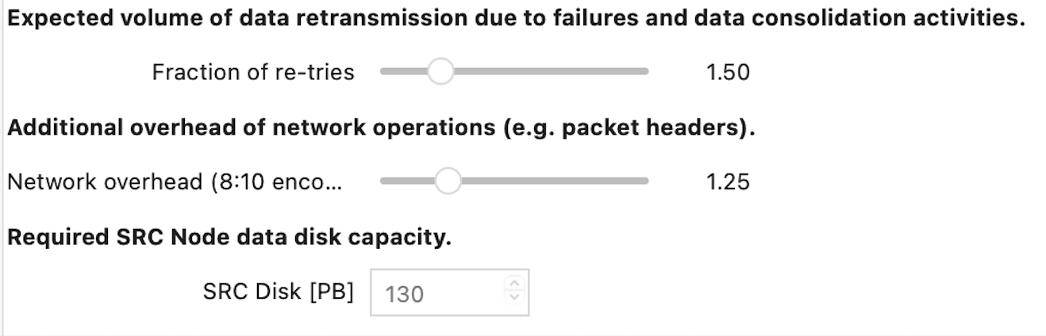
Estimating SRC data volumes and bandwidths
Tool that takes
  Total data volume being sent to the SRC network
  Assumptions about retries, ratio of analysis products to data from instruments, etc
For a given percentage size SRC gives
  Total disk storage
  Tape growth per year
  Ingress and egress average bandwiths
  Ingress and egress peak bandwidths
This is enough for SRCs to know where they should be aiming in discussions with their NRENs

Slide 11
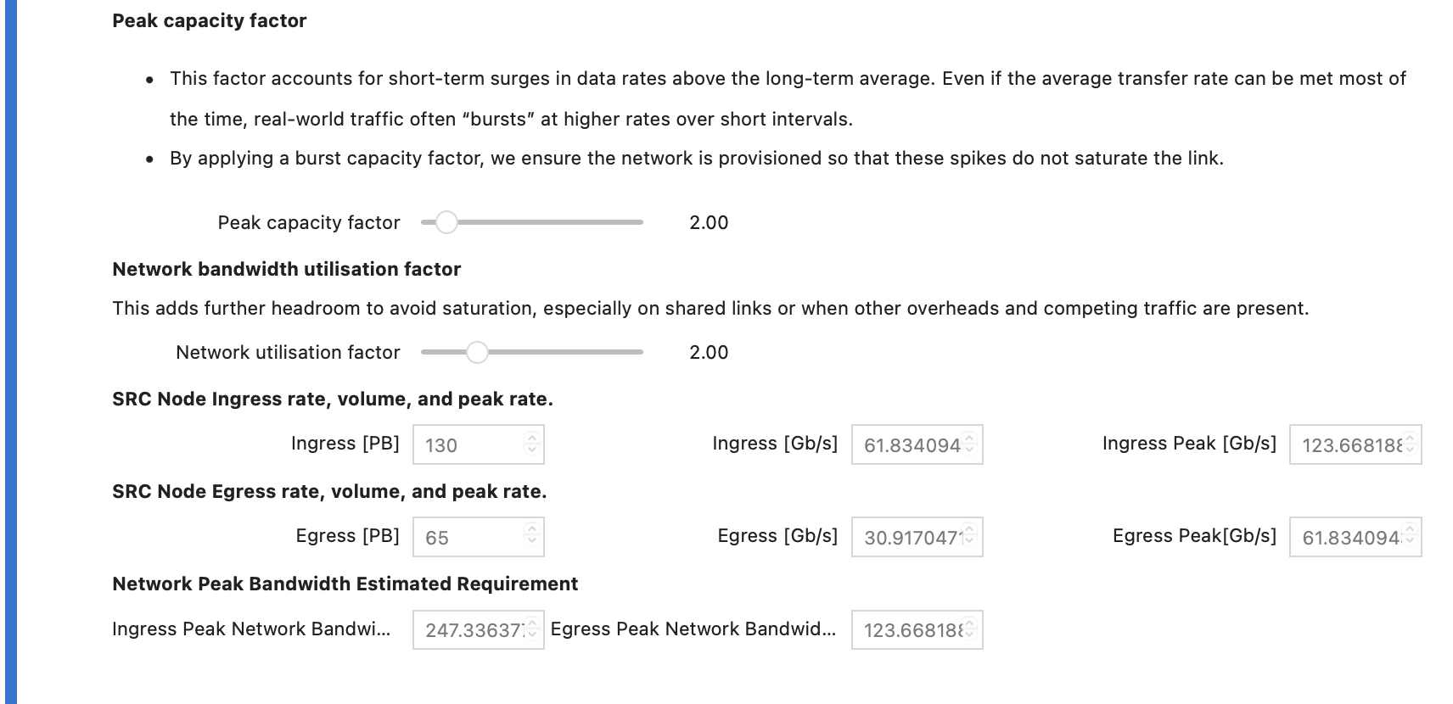
Estimating SRC data volumes and bandwidths

Slide 12
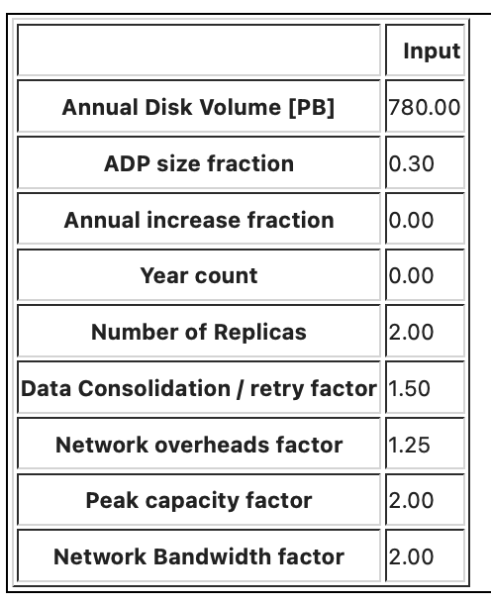
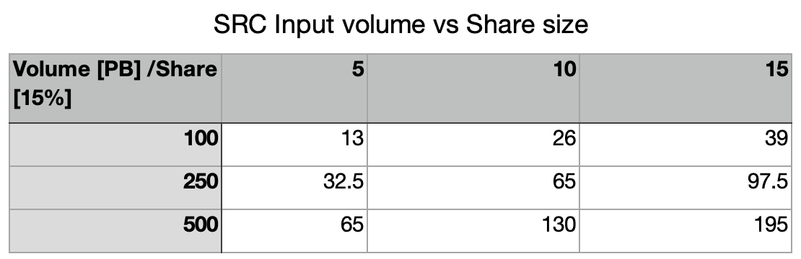
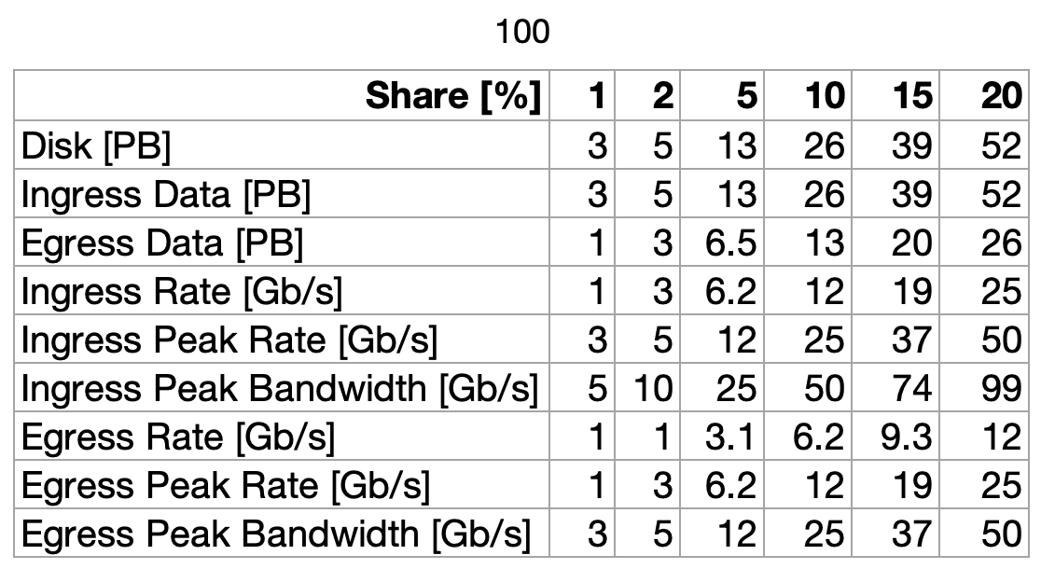
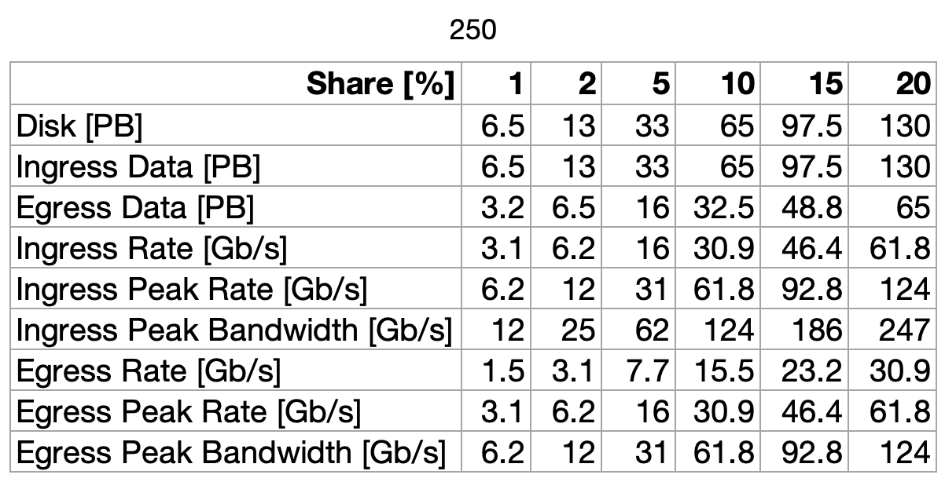
Estimating SRC data volumes and bandwidths

Slide 13
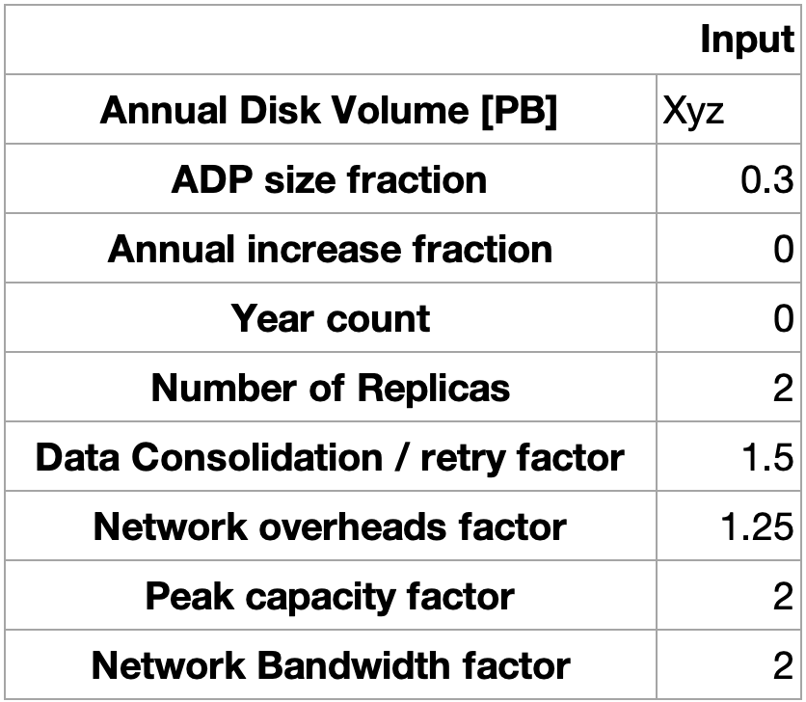
Estimating SRC data volumes and bandwidths
  For one of the (ultimately) largest SRCs such as the UK these bandwidths could already be accommodated by the existing links provided by JISC both to the labs involved and to GÉANT.
  By 2029 those campus connections and the connections to GÉANT should accommodate the requirement comfortably.
  The model provides a justified starting point and allows us to tune assumptions and can be adapted as our experience grows as the SRCNet capabilities and requirements develop.

Slide 14
Whose responsibility?
Analogy with WLCG holds.
The T1s are responsible for assuring agreed bandwith to CERN – which they do by procuring OPN links
CERN in turn has to provide its own endpoints
This is all done by negotiation with (and payments to) network providers
In SRCNet (and the SKAO SDPs)
The sites are responsible for negotiating sufficient bandwith – effectively connecting them to one part or another of the GREN
In almost all cases – both in terms of countries and specific campuses the bandwidth itself is there
  Mostly, comfortably more than necessary
The only question is agreeing with the NREN in question about paying for utilization
There are some ongoing discussions WRT to
China (100GB may not be enough for both WLCG & SRCNet)
India
Some specific sites

Slide 15
New SRCNET Network Strategy group
Convening SRCNET Network Strategy Group
Rosie’s request last year
Aim
  Provide assurance that global network provision is in place
  Provide forum to coordinate any action required
  Provide forum for more strategic technical discussions
    Eg use of VRFs
Email list set up (took longer than you’d think)
There is still the more technically oriented NREN forum
Scheduling meetings
Looking for F2F meetings with critical mass of members present
  TNC?
  TechEx?
  APAN?
  We’re unlikely to find one that everyone attends
But also important to strengthen the technical collaboration we see at meetings like this.
We can expect the data movement model to “loosen”
  Network likely to be less of a limitation than storage availibilty – as has happened in WLCG

Slide 16
Summary
Data Volumes and Bandwidth estimation
SKAO is refining its roadmap for how much data will be produced and when
In SRCNet we can translate that to local bandwidth requirements at SRCNet sites
  Can map that to the developing requirement
It is the responsibility of sites to ensure the have the network provision required locally
NRENs and SRCNet sites can negotiate if investment/development is required
SRCNet Networking coordination
SRCNet Network Strategy Group
  Able to confirm global requirements fit in existing or planned capacity
  Able to ensure any global or local issues are addressed
  Meeting at existing international for a around the world
NREN Forum
  Continue to work on more technical coordination – eg monitoring
These sessions in the LHCOPN-LHCONE context are invaluable
  It is vital that we are able to collaborate

Slide 17
Summary
Data Volumes and Bandwidth estimation
SKAO is refining its roadmap for how much data will be produced and when
In SRCNet we can translate that to local bandwidth requirements at SRCNet sites
  Can map that to the developing requirement
It is the responsibility of sites to ensure the have the network provision required locally
NRENs and SRCNet sites can negotiate if investment/development is required
SRCNet Networking coordination
SRCNet Network Strategy Group
  Able to confirm global requirements fit in existing or planned capacity
  Able to ensure any global or local issues are addressed
  Meeting at existing international for a around the world
NREN Forum
  Continue to work on more technical coordination – eg monitoring
These sessions in the LHCOPN-LHCONE context are invaluable
  It is vital that we are able to collaborate
Also, SKA/SRCNet will not need anything like the OPN – the GREN has (or will have) ample capacity
See next discussion for VRFs

Slide 18
Questions / discussion

