Slide 1

SKA perfSONAR mesh
LHCONE meeting 18/03/2025
Notes:
The abstract pattern can be removed or repositioned if required. Be careful to ‘Send to Back’ so that it does not obscure any important information.

Slide 2
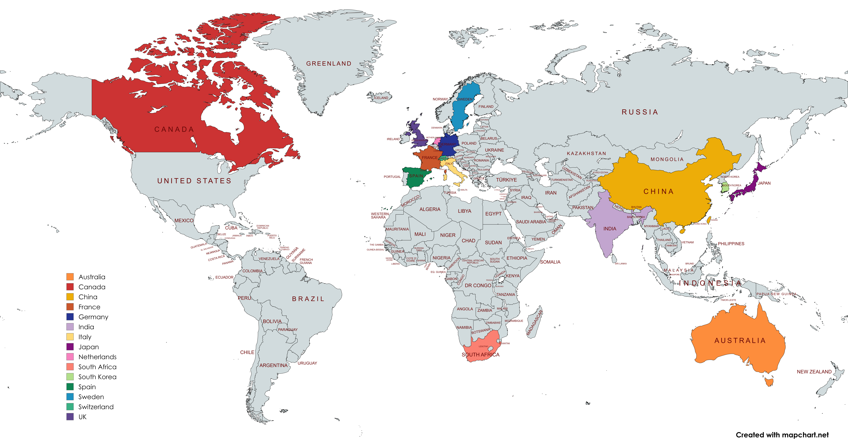
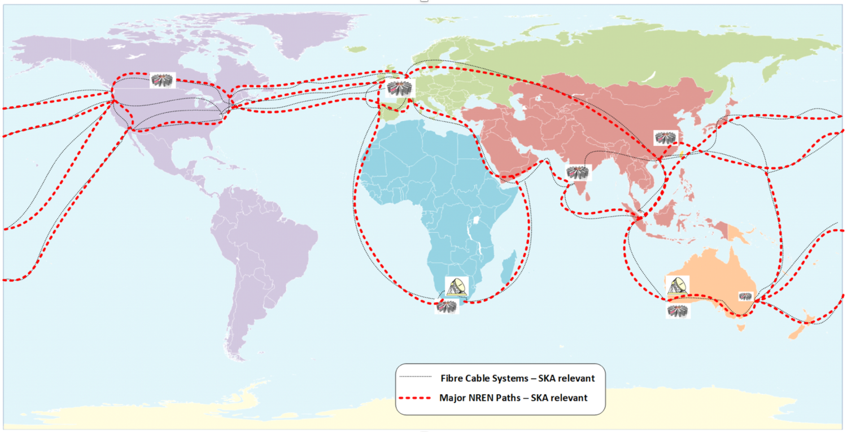
SKA Regional Centres
Square Kilometre Array project split into regional centres:

Slide 3
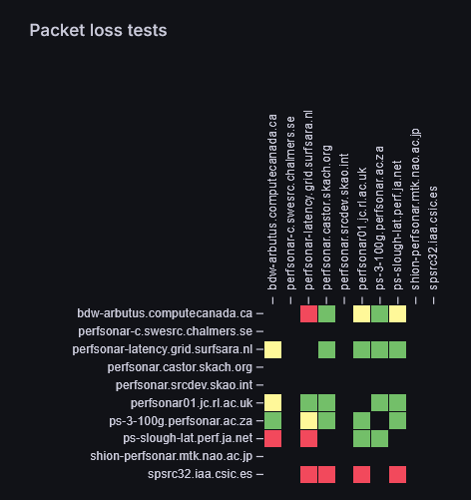
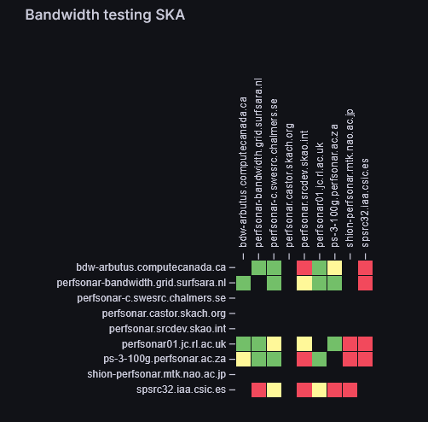
Current Mesh

Slide 4
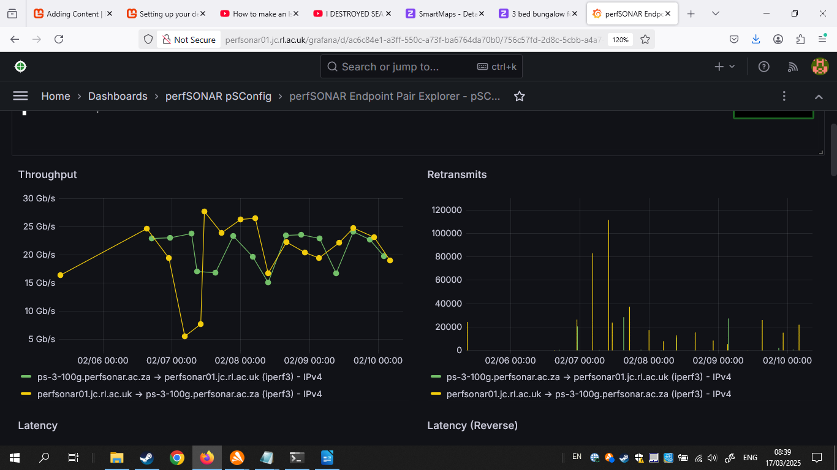
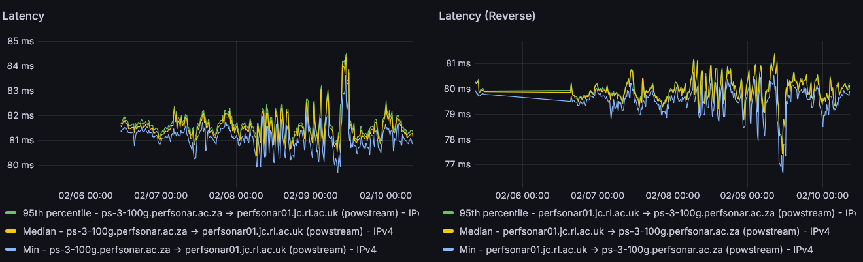
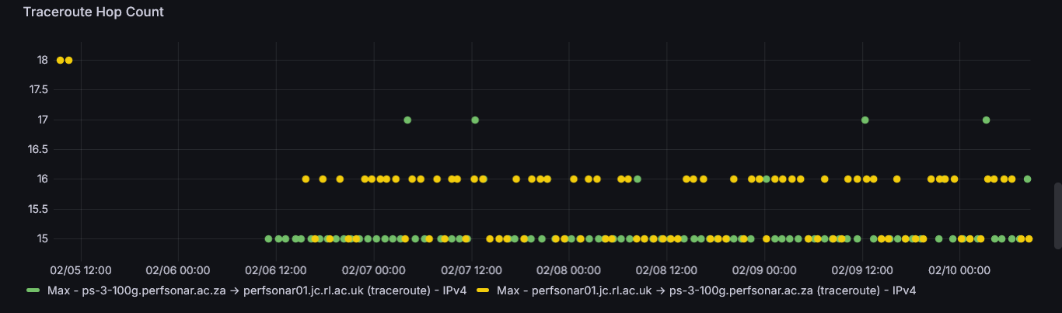
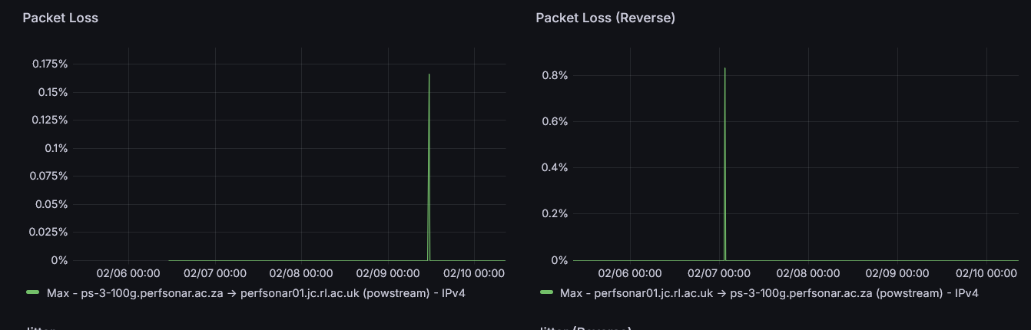
Current Mesh

Slide 5
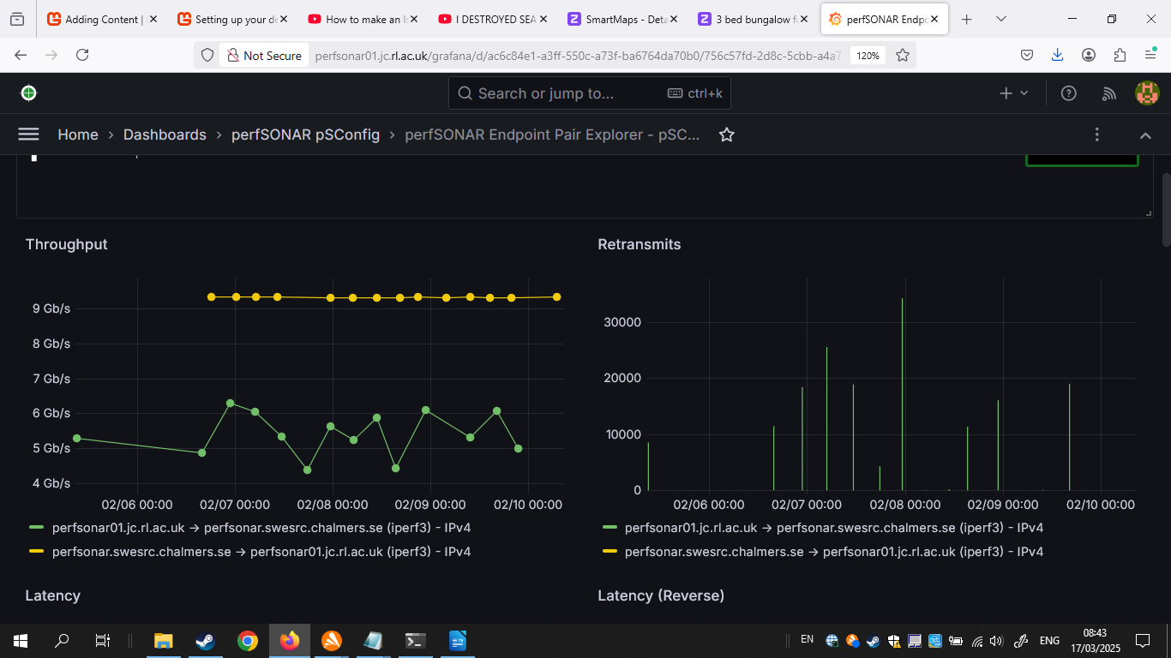
Different Capacities
Different nodes have different capacities
Some 100Gb, others 10Gb etc

Slide 6
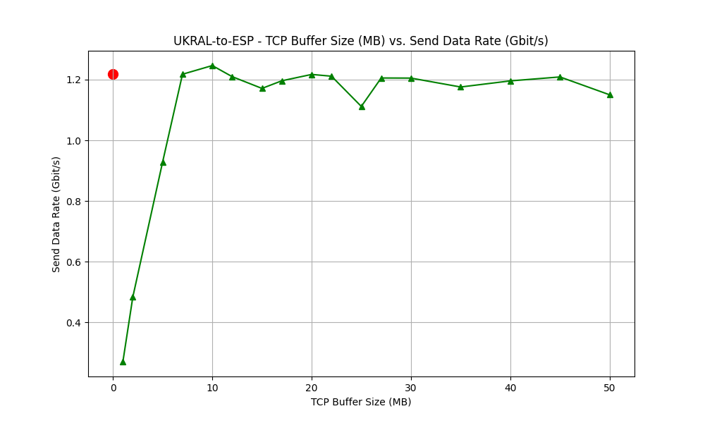
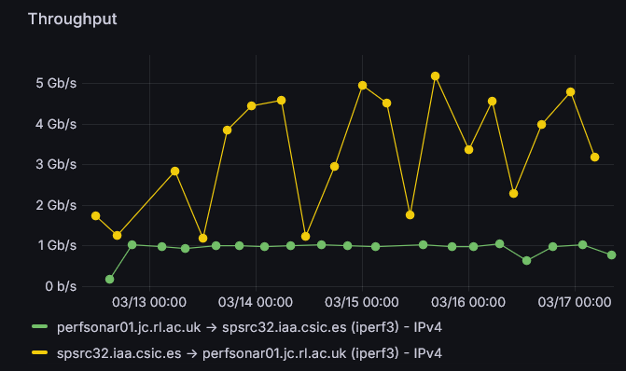
Comparing tests
Tests using TCPmon compared to single stream iperf3 for some lower capacity nodes.
Some nodes have not enough hardware currently for deployment, using cloud architecture temporarily.
Sanity checking perfSONAR iperf results with different methods:

Slide 7
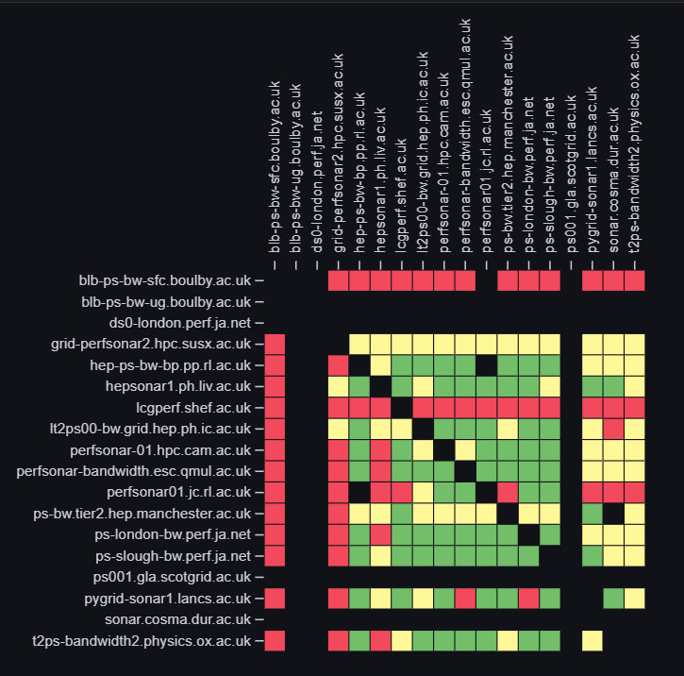
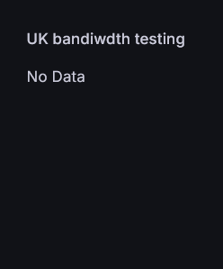
SKA regional centres (SRC) nodes =/= sites
SRC nodes are country members of the SRCnetwork
Each of these can have different sites, such as the UK node having >3 sites.
Sites will be setup with a separate mini mesh currently…
(I broke the dashboard prior to this, currently 3 nodes, RAL, Cambridge, Manchester)
Extraordinarily huge help from JISC in general

Slide 8
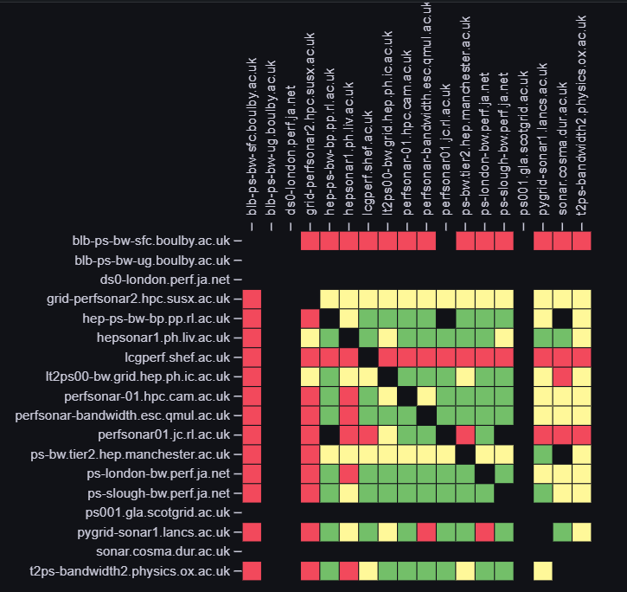
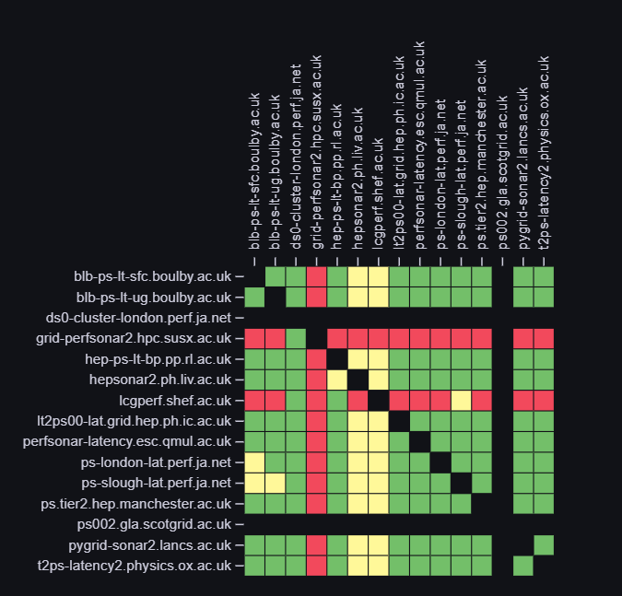
JISC – UK tests
Jisc perfsonar mesh has large number of sites
Some overlap between UKSRC sites
This allows measurements despite changes to SRCnet mesh

Slide 9
Changes to the SRCnet mesh
Current setup used Esnet recommendations for host tuning ~ 100Gb/s: https://fasterdata.es.net/host-tuning/linux/100g-tuning/
E.g. TCP buffer size 2GB
NIC buffer size max
Disabled SMT
Fair Queing
Additionally bonded dual 100Gb interface
With 9000 MTU

Slide 10
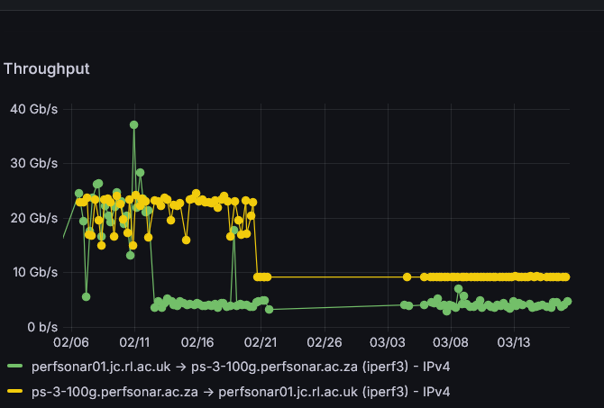
Changes to the SRCnet mesh
To do list:
Split interfaces
IPv6
Ongoing improvement from nodes (as more hardware gets installed)
Full representation from SRCs
… Needs more looking into so I can *not* break the networking… Apologies to networking teams at RAL

Slide 11
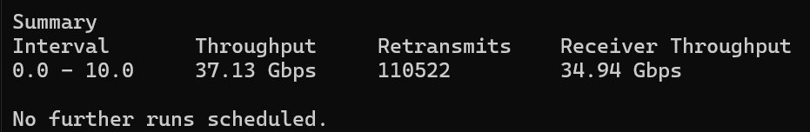
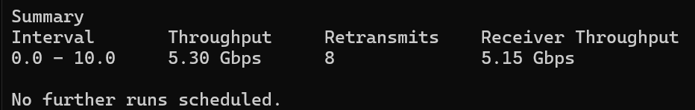
Changes to the SRCnet mesh
Other sites increasing hardware for deployments:
Changing from 10Gb interfaces to 100Gb interfaces: Old Node:
New Node:

Slide 12
Summary
Work in progress…
Nodes updating and upgrading hardware
Configuration changes being made to existing nodes
Sites coming online and adding to mesh
Different deployment methods (currently)
Mesh config still to be determined
Needing IPv6 / split interface setup for RAL
SRCnet still developing

Slide 13




Acknowledgements/thanks
Images from SKA website (and SKA confluence… )
SRCnet program team,
SRC teams (especially Spain, Sweden, Manchester/HQ, Switzerland)
UK RAL SKA team
JISC
RAL Networking team
perfSONAR developers
Richard Hughes Jones for TCPmon script

Slide 14
Questions?

