Slide 1


Happy Birthday LHCOPN!
Enzo Capone
Head of Research Engagement and Support
18 March 2025
LHCOPN-LHCONE meeting – University of Manchester (UK)

Slide 2
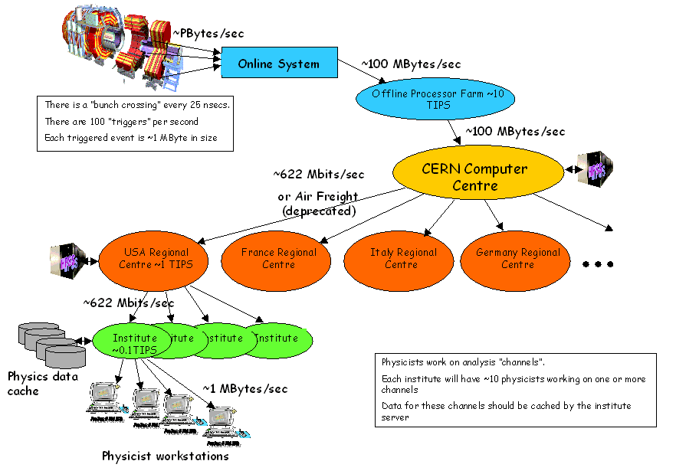
In the beginning, there was MONARC…
T0
T1
T1
T2
T2
T2
T2
T2
T2

Slide 3
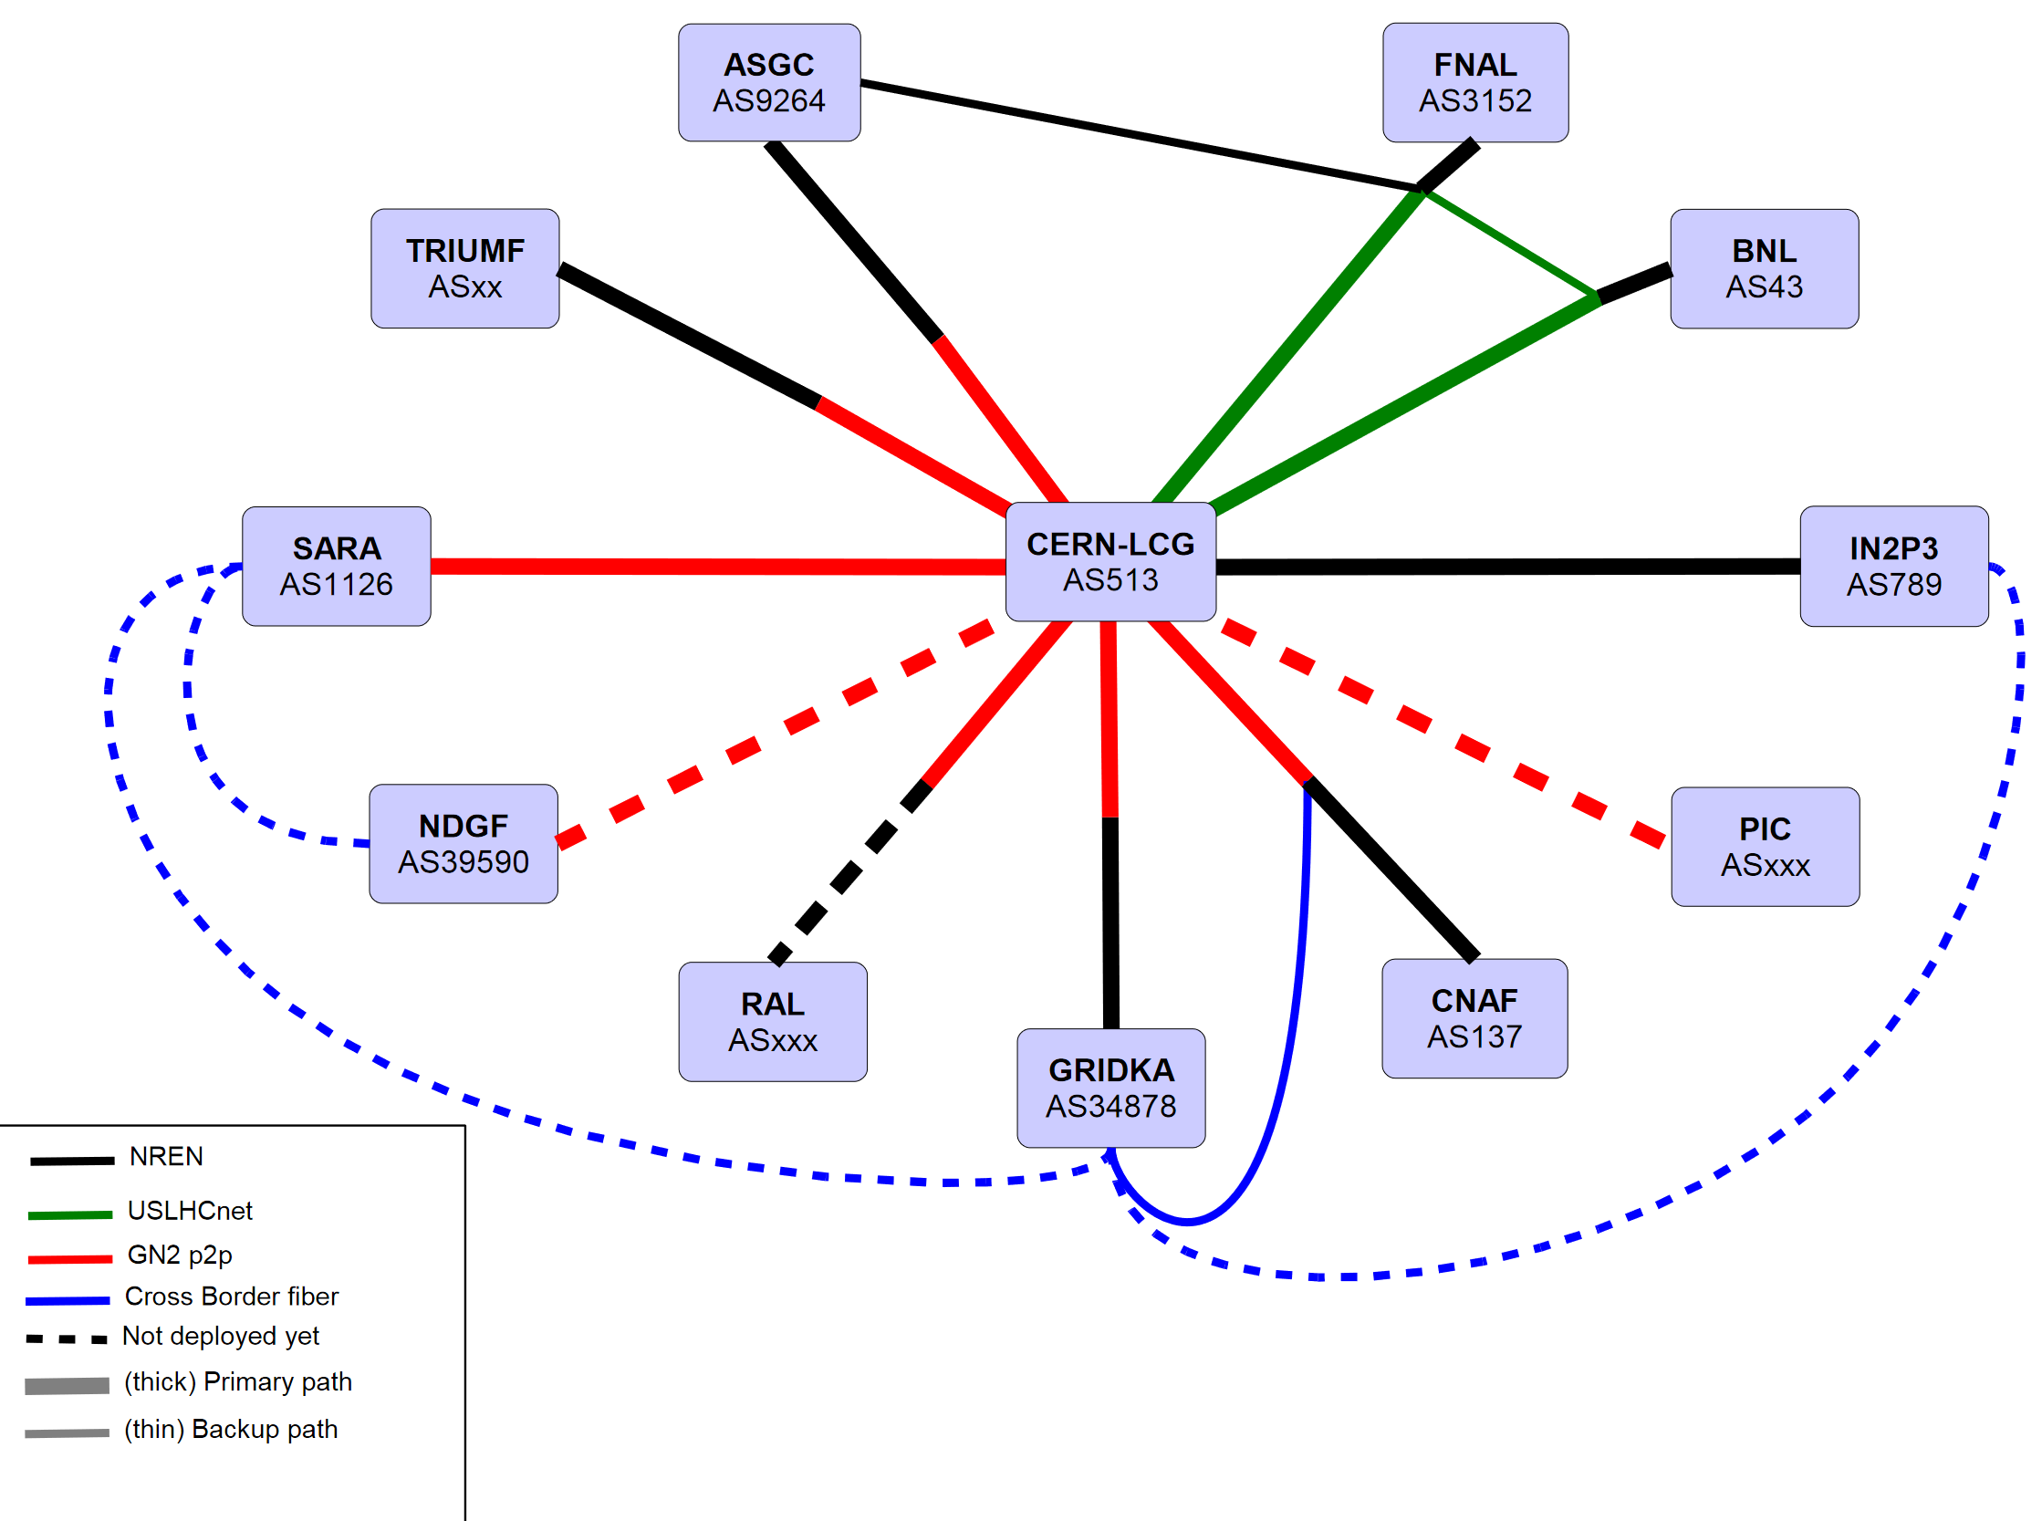
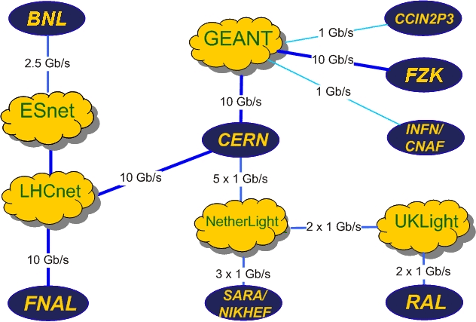
…and LHCOPN was the solution.

Slide 4
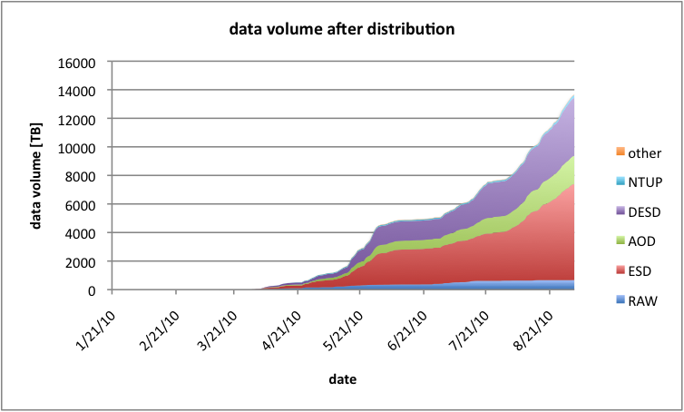
From MONARC to Anarch(y)
Tier-0
User-generated
Tier-1
Tier-1
Tier-1
DAQ-generated
Tier-2
Tier-2
Tier-2
Tier-2
Tier-2
Tier-2
Tier-2
4

Slide 5
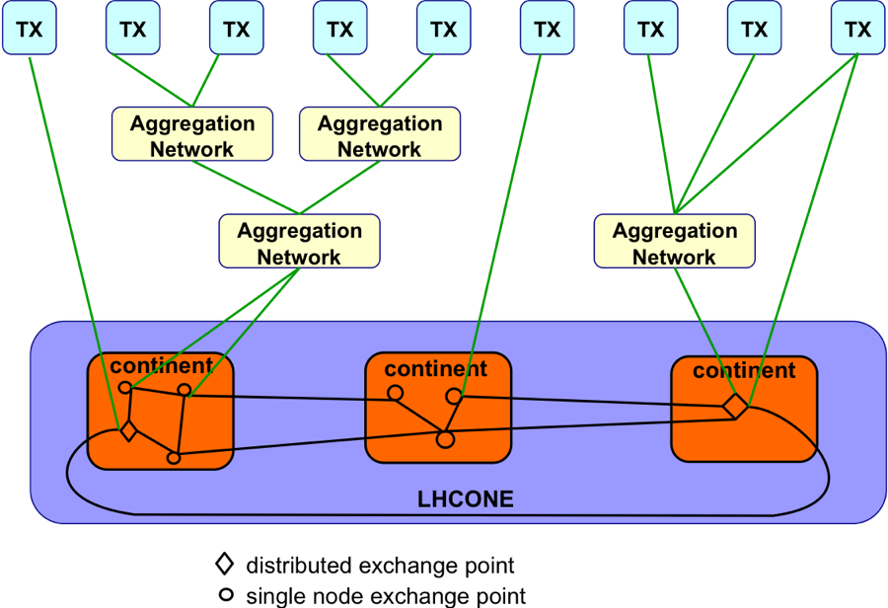
The birth of a new idea
Notes:
September 2010: Bos-Fisk report on changes in LHC computing model
January 2011: enter the “LHC Open Network Environment”

Slide 6
LHCONE in 2014

Slide 7
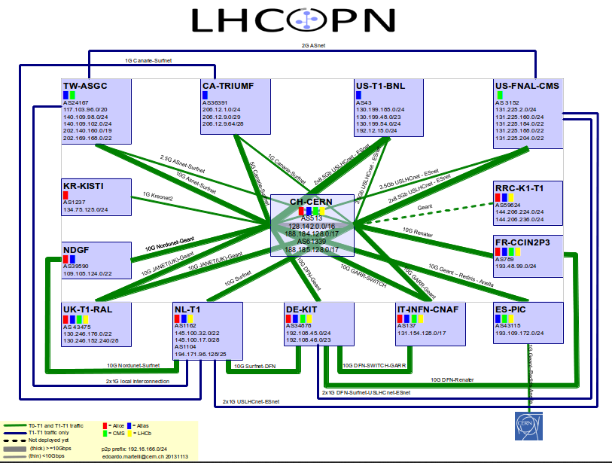
The age of convergence (2014)
Complete block
Prefix filtering

Slide 8
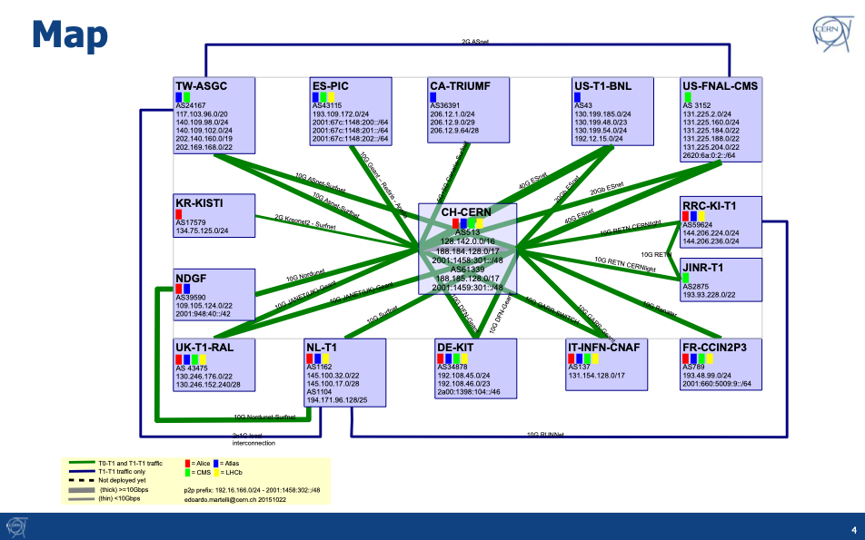
A new LHCOPN

Slide 9

Thank You
Any questions?
www.geant.org

