Slide 1

Preliminary evaluation of GVOS model parameters on the asymptotic solutions for current carrying cosmic strings networks evolution
Francisco Pimenta
Carlos Martins
IberiCOS 2025
Coimbra, Portugal

Slide 2


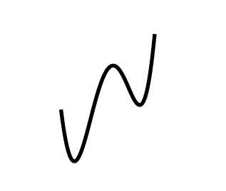
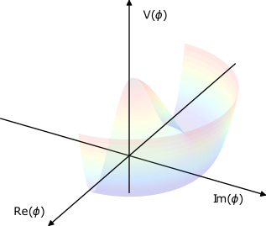


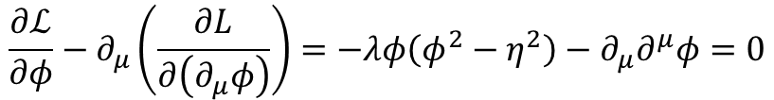

Topological defects
Goldstone model Lagrangian:
$ℒ=\frac{1}{2}\left(∂_{μ}\overline{φ}\right)\left(∂^{μ}φ\right)−V(φ)$ ,
$$V\left(φ\right)=\frac{λ}{4}{\left(\overline{φ}φ−η^{2}\right)}^{2}$$
Real field:
$$ℒ=\frac{1}{2}\left(∂_{μ}φ\right)(∂^{μ}φ)−\frac{λ}{4}{\left(φ^{2}−η^{2}\right)}^{2}$$
Field equation:
$$\frac{∂ℒ}{∂φ}−∂_{μ}\left(\frac{∂L}{∂\left(∂_{μ}φ\right)}\right)=−λφ\left(φ^{2}−η^{2}\right)−∂_{μ}∂^{μ}φ=0$$
Notes:
From simple variational principle, we can derive the equations of motion for this field and simulate the response for two different situations.
In both, we will assume as initial the conditions the symmetric and unstable state.

Slide 3
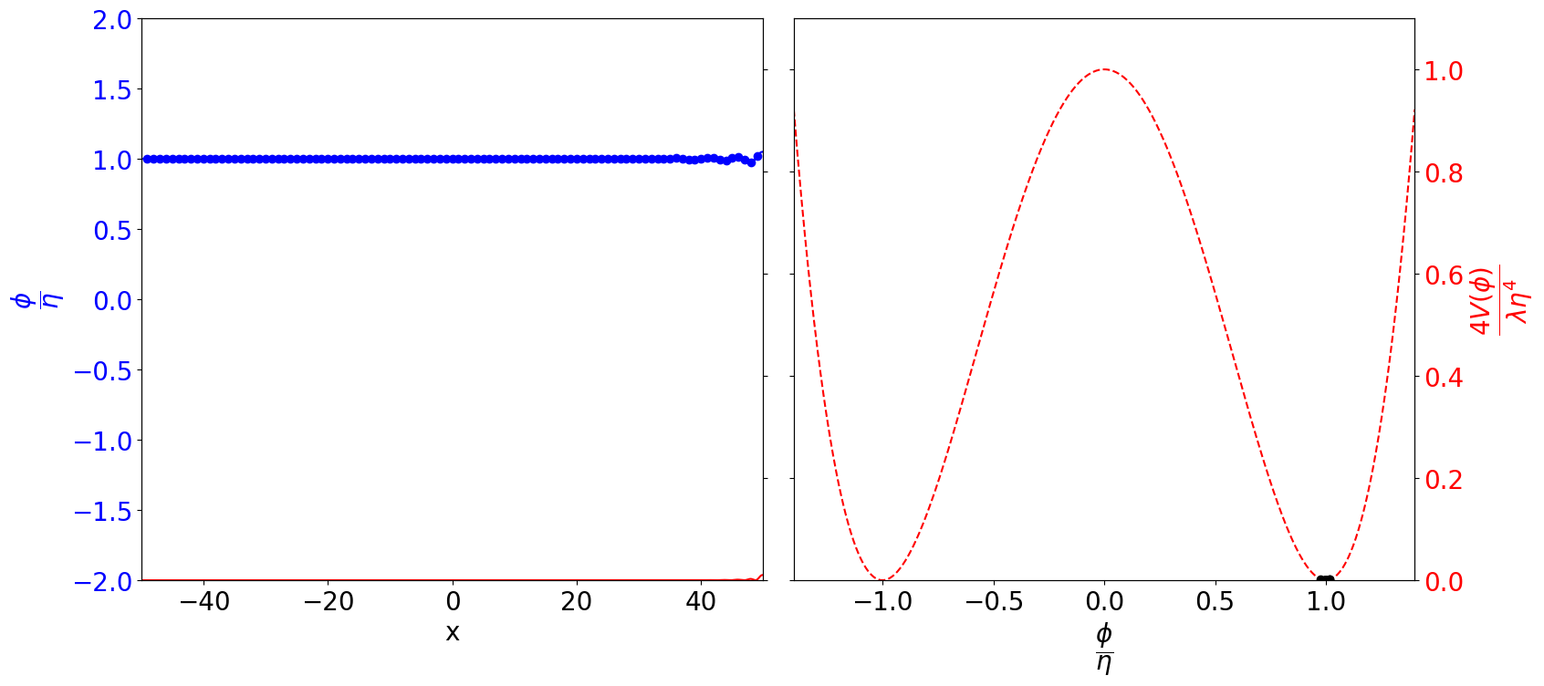
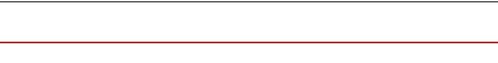
Topological defects
Goldstone model Lagrangian:
$ℒ=\frac{1}{2}\left(∂_{μ}\overline{φ}\right)\left(∂^{μ}φ\right)−V(φ)$ ,
$$V\left(φ\right)=\frac{λ}{4}{\left(\overline{φ}φ−η^{2}\right)}^{2}$$
Real field:
$$ℒ=\frac{1}{2}\left(∂_{μ}φ\right)(∂^{μ}φ)−\frac{λ}{4}{\left(φ^{2}−η^{2}\right)}^{2}$$
Field equation:
$$\frac{∂ℒ}{∂φ}−∂_{μ}\left(\frac{∂L}{∂\left(∂_{μ}φ\right)}\right)=−λφ\left(φ^{2}−η^{2}\right)−∂_{μ}∂^{μ}φ=0$$
Notes:
So let’s go back to our initial state and now perturb the field in two different directions

Slide 4

Topological defects
Goldstone model Lagrangian:
$ℒ=\frac{1}{2}\left(∂_{μ}\overline{φ}\right)\left(∂^{μ}φ\right)−V(φ)$ ,
$$V\left(φ\right)=\frac{λ}{4}{\left(\overline{φ}φ−η^{2}\right)}^{2}$$
Real field:
$$ℒ=\frac{1}{2}\left(∂_{μ}φ\right)(∂^{μ}φ)−\frac{λ}{4}{\left(φ^{2}−η^{2}\right)}^{2}$$
Field equation:
$$\frac{∂ℒ}{∂φ}−∂_{μ}\left(\frac{∂L}{∂\left(∂_{μ}φ\right)}\right)=−λφ\left(φ^{2}−η^{2}\right)−∂_{μ}∂^{μ}φ=0$$
Notes:
Now things are drastically different. In fact, each perturbation perturbs itself with a given maximum velocity, as imposed by causality.
Everything goes smoothly, but now the field rests at one minimum of the theory on the left side and on a different minimum of the right side. Energy is trapped in this configuration due to the departure of the field from its true vacuum value and rising over the potential hill of the double-well potential and a defects is formed.

Slide 5



Topological defects
Topological defect formation
Non trivial degenerate vaccuum
System at unstable equilibrium state
Effective potential with temperature dependence:
$$V_{eff}\left(φ,T\right)=\frac{λ}{12}\left(T^{2}−6η^{2}\right){\left|φ\right|}^{2}+\frac{λ}{4}{\left|φ\right|}^{4}+C(T;λ,η)$$
$$T>T_{C}=\sqrt{6η}$$
Stable symmetric state
$$T<T_{C}$$
Unstable symmetric state
Notes:
For temperatures higher than this critical value, the symmetric state is stable, and the field has 0 expected value.
But for temperature lower than this, the symmetric state is now unstable and the potential resembles the one we have studied in the Goldstone model.
This means that through cosmic evolution as the temperature drops an initial symmetric and stable state is smoothly mapped into an unstable configuration, and hence cosmic strings may be formed.

Slide 6
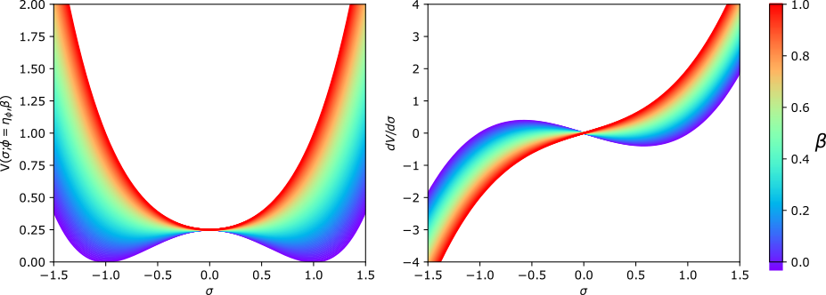

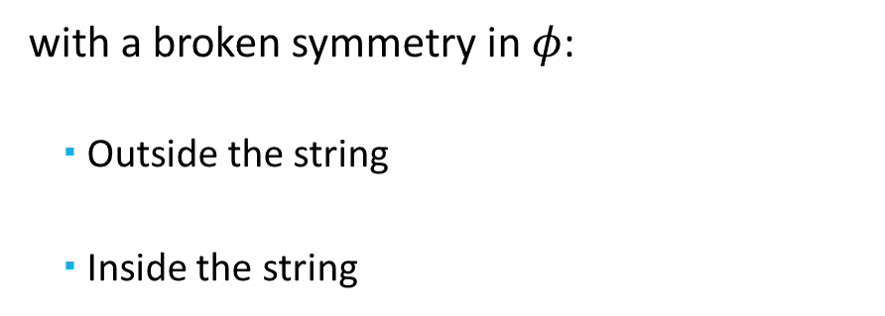


Topological defects
2-fields Abelian-Higgs Lagrangian:
$$ℒ={\left|{\tilde{D}}_{μ}φ\right|}^{2}+{\left|{\tilde{D}}_{μ}σ\right|}^{2}−\frac{1}{4}F_{μν}F^{μν}−\frac{1}{4}{\tilde{F}}_{μν}{\tilde{F}}^{μν}−V(φ,σ)$$
where:
$$V\left(φ,σ\right)=\frac{λ_{φ}}{4}{\left({\left|φ\right|}^{2}−η_{φ}^{2}\right)}^{2}+\frac{λ_{σ}}{4}{\left({\left|σ\right|}^{2}−η_{σ}^{2}\right)}^{2}+β{\left|φ\right|}^{2}{\left|σ\right|}^{2}$$
with a broken symmetry in $φ$:
    Outside the string
    Inside the string
$$|φ|=η_{φ}$$
$σ$ can condensate on the string
$$|φ|=0$$
$$ℐ_{μ}=ie\left(σ^{∗}D_{μ}σ−σD_{μ}^{∗}σ^{∗}\right)=2e{ℑ(σ}^{∗}D_{μ}σ)$$
Notes:
Having studied how strings may be born in a cosmological context, the next question is, can they have charge and carry currents?
To answer this question we need a slightly more complex, 2-fields toy model, with a potential similar to the one we have studied, but with a coupling term.
Additionally, we will assume the symmetry in phi to be broken as discussed, leading to strings formation.
On the right, you may the potential evaluated as a function sigma, assuming phi symmetry to be broken, where it can be seen that for sufficiently high beta both symmetries cannot be broken simultaneously.
We will conside this is the case

Slide 7




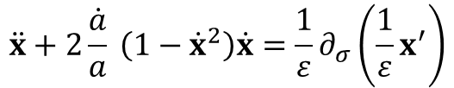

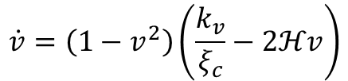
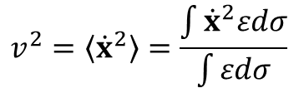
Strings evolution
Nambu-Goto action:
$$S=\int{ℒ\sqrt{−γ}dσ^{2}}≈−μ\int{\sqrt{−γ}dσ_{0}}dσ_{1}$$
Equations of motion:
$$\ddot{x}+2\frac{\dot{a}}{a} \left(1−{\dot{x}}^{2}\right)\dot{x}=\frac{1}{ε}∂_{σ}\left(\frac{1}{ε}x^{′}\right)$$
$$τ$$
Macroscopic quantities
$$E=μa\left(τ\right)\int{εdσ}$$
$$ρ=\frac{E}{a^{3}}=\frac{μ}{ξ^{2}}=\frac{μ}{{\left(ξ_{c}a\right)}^{2}}$$
$$\frac{\dot{ξ_{c}}}{ξ_{c}}=ℋv^{2}$$
$$v^{2}=\left\langle {\dot{x}}^{2}\right\rangle =\frac{\int{{\dot{x}}^{2}εdσ}}{\int{εdσ}}$$
$$\dot{v}=\left(1−v^{2}\right)\left(\frac{k_{v}}{ξ_{c}}−2ℋv\right)$$
Notes:
Making use of the equations of motion,, the problem can be stated as a function of the correlation length evolution, and not the individual strings.
Here, v^2 is the average velocity of the strings in the box, and hence also a macroscopical parameter with its own evolution equation.
Together, these 2 equations are the basis of the velocity one-scale model, where additional degrees of freedom like charges or small scale structure are not considered.

Slide 8
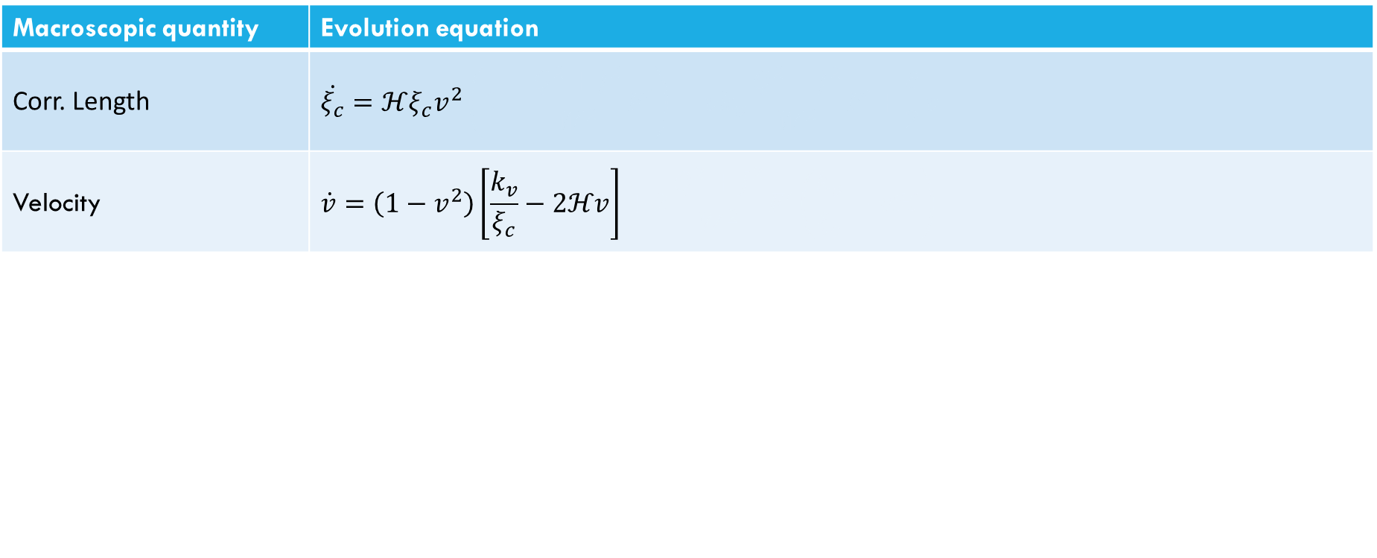

VOS model
$$S≈−μ\int{\sqrt{−γ}dσ_{0}}dσ_{1}$$
Macroscopic quantity | Evolution equation
Corr. Length | $$\dot{ξ_{c}}=ℋξ_{c}v^{2}\left(1+\frac{{Q^{2}+J}^{2}}{W^{2}}F^{′}\right)−vk_{v}\frac{Q^{2}+J^{2}}{W^{2}}F′+\frac{\tilde{c}}{2}v$$
Velocity | $$\dot{v}=\left(1−v^{2}\right)\left[\frac{k_{v}}{ξ_{c}}−2ℋv\right]+2\frac{Q^{2}+J^{2}}{W^{2}}F^{′}\left(\frac{k_{v}}{ξ_{c}}−vℋ\right)$$
Current | $$\left(J^{2}\right)=2J^{2}\left(\frac{vk_{v}}{ξ_{c}}−ℋ\right)+(g−1)ρ\tilde{c}\frac{v}{L_{c}}\frac{W}{F^{′}−2Q^{2}F′′}$$
Charge | $$\left(Q^{2}\right)=2Q^{2}\frac{F^{′}+2J^{2}F′′}{F^{′}+2Q^{2}F′′}\left(\frac{vk_{v}}{ξ_{c}}−ℋ\right)+(g−1)(1−ρ)\tilde{c}\frac{v}{L_{c}}\frac{W}{F^{′}+2Q^{2}F′′}$$
Energy length | $${\dot{L}}_{c}=ℋL_{c}\left[v^{2}−\left(1−v^{2}\right)\frac{Q^{2}+J^{2}}{W^{2}}F^{′}\right]+g\frac{\tilde{c}}{2W}v$$
Notes:
Together, these 2 equations are the basis of the velocity one-scale model, where additional degrees of freedom like charges or small scale structure are not considered.

Slide 9
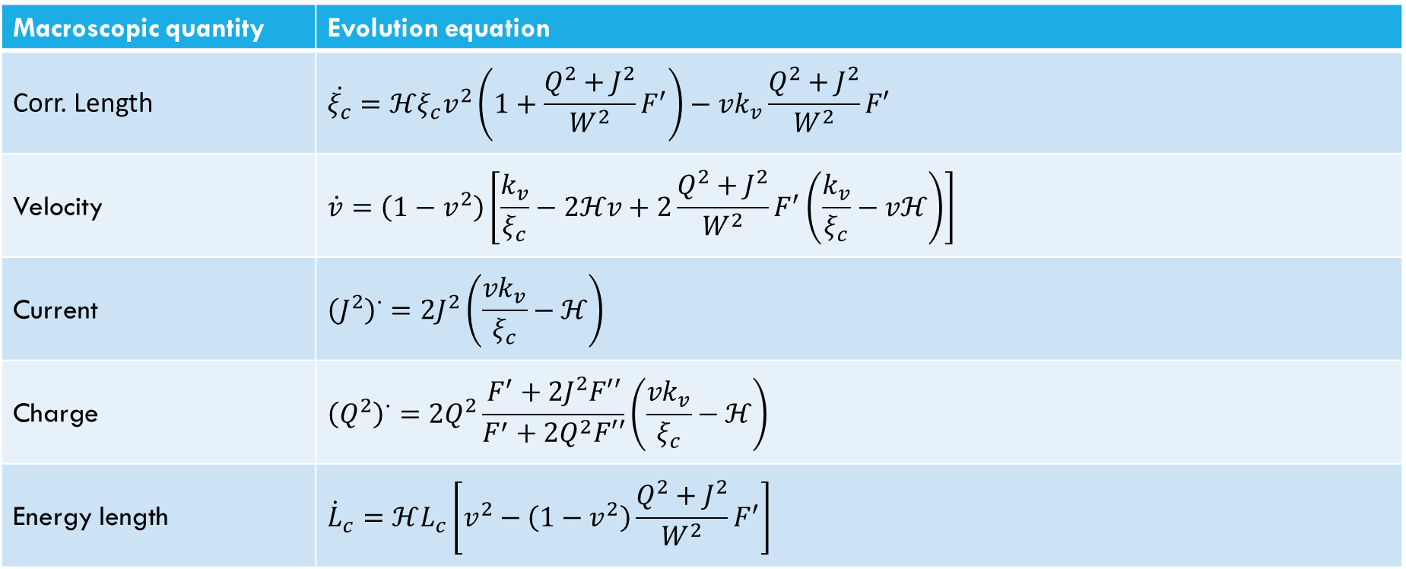

Generalised VOS model
$$S≈−μ\int{f(κ)\sqrt{−γ}dσ_{0}}dσ_{1}$$
Macroscopic quantity | Evolution equation
Corr. Length | $$\dot{ξ_{c}}=ℋξ_{c}v^{2}\left(1+\frac{{Q^{2}+J}^{2}}{W^{2}}F^{′}\right)−vk_{v}\frac{Q^{2}+J^{2}}{W^{2}}F′$$
Velocity | $$\dot{v}=\left(1−v^{2}\right)\left[\frac{k_{v}}{ξ_{c}}−2ℋv+2\frac{Q^{2}+J^{2}}{W^{2}}F^{′}\left(\frac{k_{v}}{ξ_{c}}−vℋ\right)\right]$$
Current | $${\left(J^{2}\right)}^{∙}=2J^{2}\left(\frac{vk_{v}}{ξ_{c}}−ℋ\right)+(g−1)ρ\tilde{c}\frac{v}{L_{c}}\frac{W}{F^{′}−2Q^{2}F′′}$$
Charge | $${\left(Q^{2}\right)}^{∙}=2Q^{2}\frac{F^{′}+2J^{2}F′′}{F^{′}+2Q^{2}F′′}\left(\frac{vk_{v}}{ξ_{c}}−ℋ\right)+(g−1)(1−ρ)\tilde{c}\frac{v}{L_{c}}\frac{W}{F^{′}+2Q^{2}F′′}$$
Energy length | $${\dot{L}}_{c}=ℋL_{c}\left[v^{2}−\left(1−v^{2}\right)\frac{Q^{2}+J^{2}}{W^{2}}F^{′}\right]$$
Notes:
Finally, we have been hiding an important limitation of these approaches, that inherently must loose some information on the average procedure. To bypass this limitation, it is convenient to introduce some phenomenological parameters that try to capture the erased effects.
Here, we will consider a parameter that is related with energy loss

Slide 10
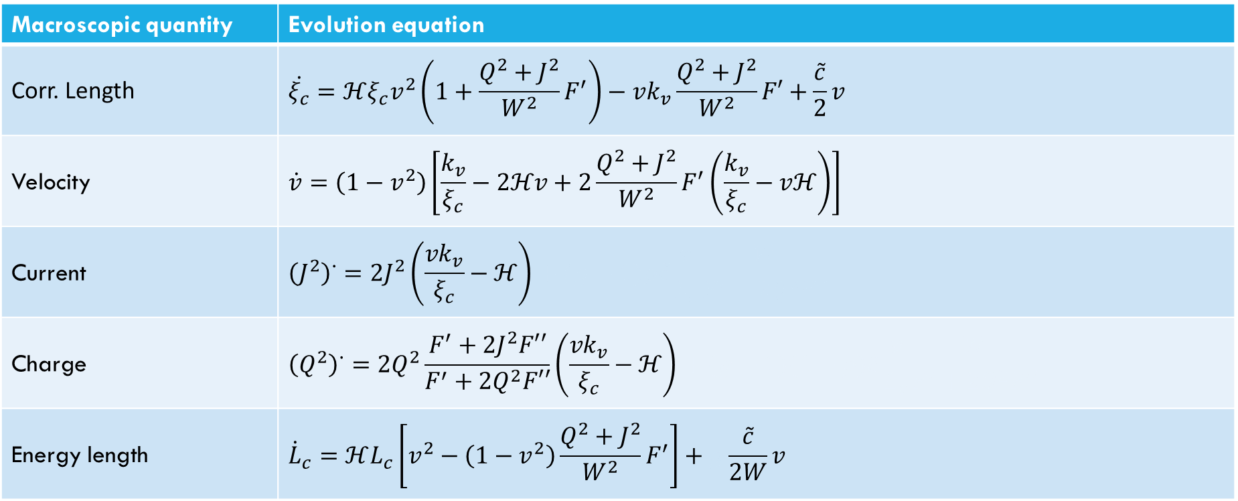
Generalised VOS model
$$S≈−μ\int{f(κ)\sqrt{−γ}dσ_{0}}dσ_{1}$$
Macroscopic quantity | Evolution equation
Corr. Length | $$\dot{ξ_{c}}=ℋξ_{c}v^{2}\left(1+\frac{{Q^{2}+J}^{2}}{W^{2}}F^{′}\right)−vk_{v}\frac{Q^{2}+J^{2}}{W^{2}}F′+\frac{\tilde{c}}{2}v$$
Velocity | $$\dot{v}=\left(1−v^{2}\right)\left[\frac{k_{v}}{ξ_{c}}−2ℋv+2\frac{Q^{2}+J^{2}}{W^{2}}F^{′}\left(\frac{k_{v}}{ξ_{c}}−vℋ\right)\right]$$
Current | $${\left(J^{2}\right)}^{∙}=2J^{2}\left(\frac{vk_{v}}{ξ_{c}}−ℋ\right)+(g−1)ρ\tilde{c}\frac{v}{L_{c}}\frac{W}{F^{′}−2Q^{2}F′′}$$
Charge | $${\left(Q^{2}\right)}^{∙}=2Q^{2}\frac{F^{′}+2J^{2}F′′}{F^{′}+2Q^{2}F′′}\left(\frac{vk_{v}}{ξ_{c}}−ℋ\right)+(g−1)(1−ρ)\tilde{c}\frac{v}{L_{c}}\frac{W}{F^{′}+2Q^{2}F′′}$$
Energy length | $${\dot{L}}_{c}=ℋL_{c}\left[v^{2}−\left(1−v^{2}\right)\frac{Q^{2}+J^{2}}{W^{2}}F^{′}\right]+g\frac{\tilde{c}}{2W}v$$
Notes:
Finally, we have been hiding an important limitation of these approaches, that inherently must loose some information on the average procedure. To bypass this limitation, it is convenient to introduce some phenomenological parameters that try to capture the erased effects.
Here, we will consider a parameter that is related with energy loss

Slide 11
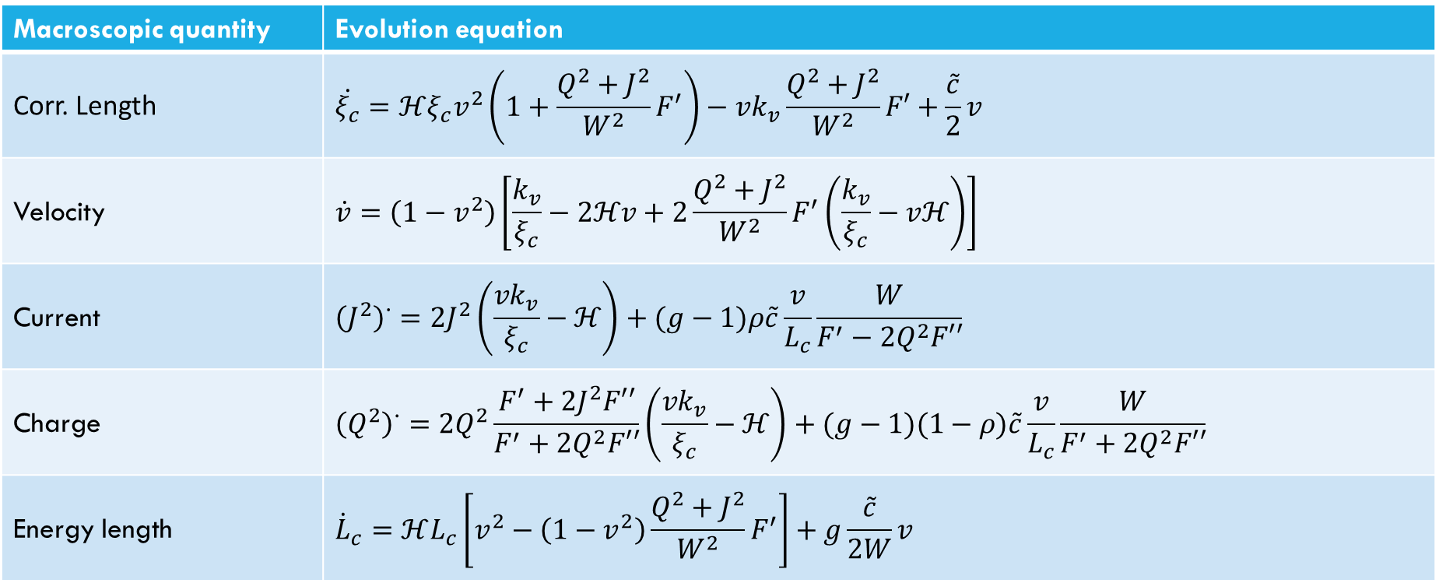
Generalised VOS model
$$S≈−μ\int{f(κ)\sqrt{−γ}dσ_{0}}dσ_{1}$$
Macroscopic quantity | Evolution equation
Corr. Length | $$\dot{ξ_{c}}=ℋξ_{c}v^{2}\left(1+\frac{{Q^{2}+J}^{2}}{W^{2}}F^{′}\right)−vk_{v}\frac{Q^{2}+J^{2}}{W^{2}}F′+\frac{\tilde{c}}{2}v$$
Velocity | $$\dot{v}=\left(1−v^{2}\right)\left[\frac{k_{v}}{ξ_{c}}−2ℋv+2\frac{Q^{2}+J^{2}}{W^{2}}F^{′}\left(\frac{k_{v}}{ξ_{c}}−vℋ\right)\right]$$
Current | $${\left(J^{2}\right)}^{∙}=2J^{2}\left(\frac{vk_{v}}{ξ_{c}}−ℋ\right)+(g−1)ρ\tilde{c}\frac{v}{L_{c}}\frac{W}{F^{′}−2Q^{2}F′′}$$
Charge | $${\left(Q^{2}\right)}^{∙}=2Q^{2}\frac{F^{′}+2J^{2}F′′}{F^{′}+2Q^{2}F′′}\left(\frac{vk_{v}}{ξ_{c}}−ℋ\right)+(g−1)(1−ρ)\tilde{c}\frac{v}{L_{c}}\frac{W}{F^{′}+2Q^{2}F′′}$$
Energy length | $${\dot{L}}_{c}=ℋL_{c}\left[v^{2}−\left(1−v^{2}\right)\frac{Q^{2}+J^{2}}{W^{2}}F^{′}\right]+g\frac{\tilde{c}}{2W}v$$
Notes:
But also two bias parameters that are related to charge loss, rho and g. Here, it should be that g has been shown by Rybak to carry an explicit dependency on the charge and current, but that is assymptocail equivalent to setting g=1 for decaying charge and currents. In this sense, networks with g=1 should be read as networks wihtout charge loss mechanism, but also as networks with arbitrary charge loss, but with decaying charges and currents.
Although simplified, these macroscopical equations are still mostly untractable for arbitrary conditions and hence we will take another simplification by studying the so-called scaling solutions.

Slide 12
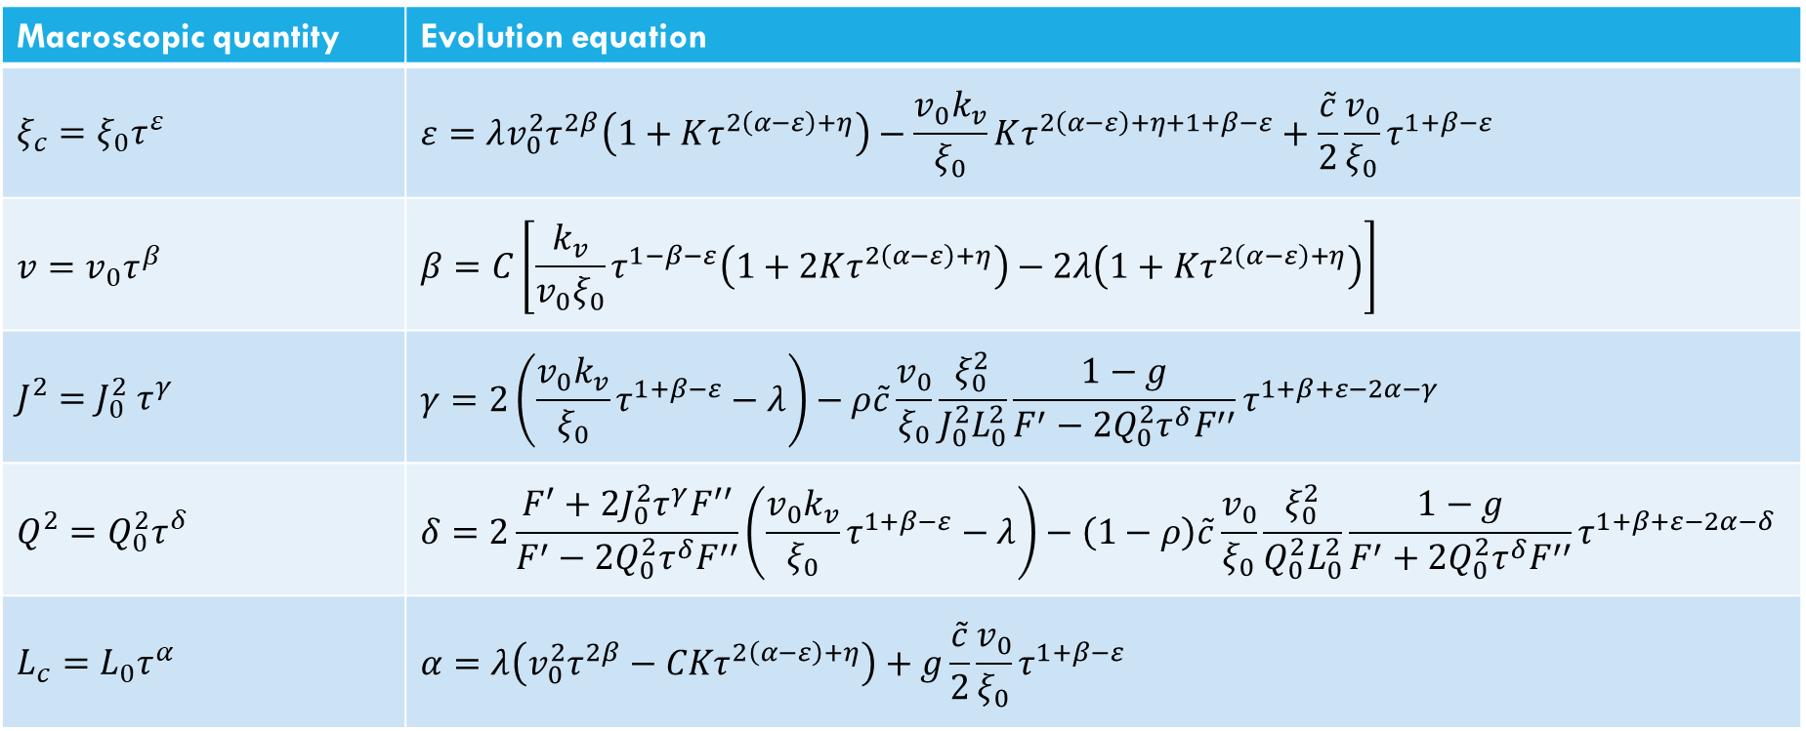
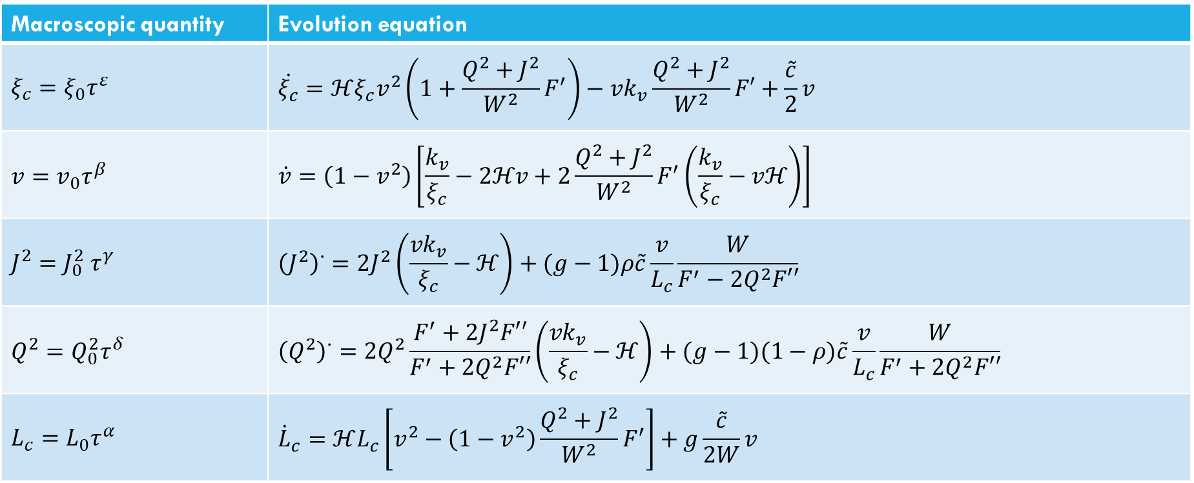
Generalised VOS model
$$S≈−μ\int{f(κ)\sqrt{−γ}dσ_{0}}dσ_{1}$$
Macroscopic quantity | Evolution equation
$$ξ_{c}=ξ_{0}τ^{ε}$$ | $$\dot{ξ_{c}}=ℋξ_{c}v^{2}\left(1+\frac{{Q^{2}+J}^{2}}{W^{2}}F^{′}\right)−vk_{v}\frac{Q^{2}+J^{2}}{W^{2}}F′+\frac{\tilde{c}}{2}v$$
$$v=v_{0}τ^{β}$$ | $$\dot{v}=\left(1−v^{2}\right)\left[\frac{k_{v}}{ξ_{c}}−2ℋv+2\frac{Q^{2}+J^{2}}{W^{2}}F^{′}\left(\frac{k_{v}}{ξ_{c}}−vℋ\right)\right]$$
$$J^{2}=J_{0}^{2} τ^{γ}$$ | $${\left(J^{2}\right)}^{∙}=2J^{2}\left(\frac{vk_{v}}{ξ_{c}}−ℋ\right)+(g−1)ρ\tilde{c}\frac{v}{L_{c}}\frac{W}{F^{′}−2Q^{2}F′′}$$
$$Q^{2}=Q_{0}^{2}τ^{δ}$$ | $${\left(Q^{2}\right)}^{∙}=2Q^{2}\frac{F^{′}+2J^{2}F′′}{F^{′}+2Q^{2}F′′}\left(\frac{vk_{v}}{ξ_{c}}−ℋ\right)+(g−1)(1−ρ)\tilde{c}\frac{v}{L_{c}}\frac{W}{F^{′}+2Q^{2}F′′}$$
$$L_{c}=L_{0}τ^{α}$$ | $${\dot{L}}_{c}=ℋL_{c}\left[v^{2}−\left(1−v^{2}\right)\frac{Q^{2}+J^{2}}{W^{2}}F^{′}\right]+g\frac{\tilde{c}}{2W}v$$
Macroscopic quantity | Evolution equation
$$ξ_{c}=ξ_{0}τ^{ε}$$ | $$ε=λv_{0}^{2}τ^{2β}\left(1+Kτ^{2\left(α−ε\right)+η}\right)−\frac{v_{0}k_{v}}{ξ_{0}}Kτ^{2\left(α−ε\right)+η+1+β−ε}+\frac{\tilde{c}}{2}\frac{v_{0}}{ξ_{0}}τ^{1+β−ε}$$
$$v=v_{0}τ^{β}$$ | $$β=C\left[\frac{k_{v}}{v_{0}ξ_{0}}τ^{1−β−ε}\left(1+2Kτ^{2\left(α−ε\right)+η}\right)−2λ\left(1+Kτ^{2\left(α−ε\right)+η}\right)\right]$$
$$J^{2}=J_{0}^{2} τ^{γ}$$ | $$γ=2\left(\frac{v_{0}k_{v}}{ξ_{0}}τ^{1+β−ε}−λ\right)−ρ\tilde{c}\frac{v_{0}}{ξ_{0}}\frac{ξ_{0}^{2}}{J_{0}^{2}L_{0}^{2}}\frac{1−g}{F^{′}−2Q_{0}^{2}τ^{δ}F^{′′}}τ^{1+β+ε−2α−γ}$$
$$Q^{2}=Q_{0}^{2}τ^{δ}$$ | $$δ=2\frac{F^{′}+2J_{0}^{2}τ^{γ}F^{′′}}{F^{′}−2Q_{0}^{2}τ^{δ}F^{′′}}\left(\frac{v_{0}k_{v}}{ξ_{0}}τ^{1+β−ε}−λ\right)−\left(1−ρ\right)\tilde{c}\frac{v_{0}}{ξ_{0}}\frac{ξ_{0}^{2}}{Q_{0}^{2}L_{0}^{2}}\frac{1−g}{F^{′}+2Q_{0}^{2}τ^{δ}F^{′′}}τ^{1+β+ε−2α−δ}$$
$$L_{c}=L_{0}τ^{α}$$ | $$α=λ\left(v_{0}^{2}τ^{2β}−CKτ^{2\left(α−ε\right)+η}\right)+g\frac{\tilde{c}}{2}\frac{v_{0}}{ξ_{0}}τ^{1+β−ε}$$
Notes:
Naturally, the physical solutions must respect some additional constraints, like beta<=0, in order for velocitites to be lower than the speed of light, while the correlation length cannot scale faster than linearly, as imposed by causality.
Here, eta and K are the charge and/or current decay rates and proportionality constant, depending on which dominates the network evolution.
Finally, it should be said that due to the charge dependent relation between the two characteristic lengths, networks where charged decays should exhibit the same behavior for the evolution of the characteristic lengthscales.

Slide 13
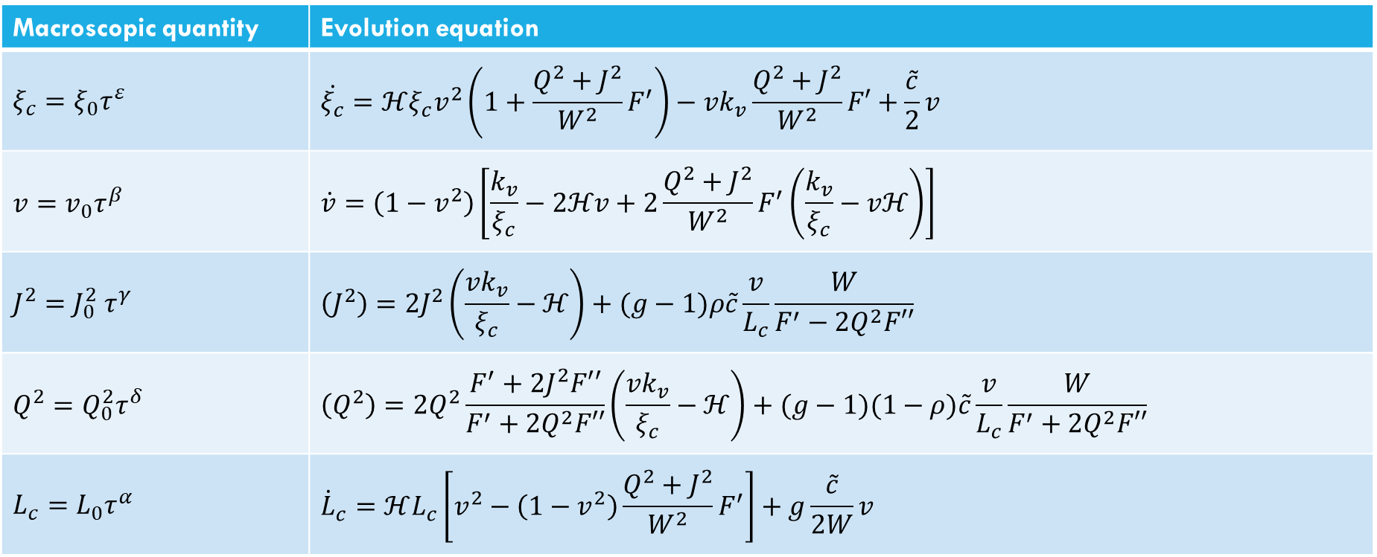
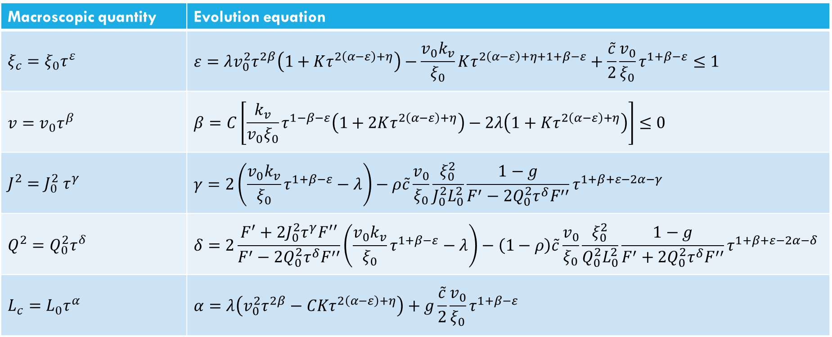
Generalised VOS model
$$S≈−μ\int{f(κ)\sqrt{−γ}dσ_{0}}dσ_{1}$$
Macroscopic quantity | Evolution equation
$$ξ_{c}=ξ_{0}τ^{ε}$$ | $$\dot{ξ_{c}}=ℋξ_{c}v^{2}\left(1+\frac{{Q^{2}+J}^{2}}{W^{2}}F^{′}\right)−vk_{v}\frac{Q^{2}+J^{2}}{W^{2}}F′+\frac{\tilde{c}}{2}v$$
$$v=v_{0}τ^{β}$$ | $$\dot{v}=\left(1−v^{2}\right)\left[\frac{k_{v}}{ξ_{c}}−2ℋv+2\frac{Q^{2}+J^{2}}{W^{2}}F^{′}\left(\frac{k_{v}}{ξ_{c}}−vℋ\right)\right]$$
$$J^{2}=J_{0}^{2} τ^{γ}$$ | $$\left(J^{2}\right)=2J^{2}\left(\frac{vk_{v}}{ξ_{c}}−ℋ\right)+(g−1)ρ\tilde{c}\frac{v}{L_{c}}\frac{W}{F^{′}−2Q^{2}F′′}$$
$$Q^{2}=Q_{0}^{2}τ^{δ}$$ | $$\left(Q^{2}\right)=2Q^{2}\frac{F^{′}+2J^{2}F′′}{F^{′}+2Q^{2}F′′}\left(\frac{vk_{v}}{ξ_{c}}−ℋ\right)+(g−1)(1−ρ)\tilde{c}\frac{v}{L_{c}}\frac{W}{F^{′}+2Q^{2}F′′}$$
$$L_{c}=L_{0}τ^{α}$$ | $${\dot{L}}_{c}=ℋL_{c}\left[v^{2}−\left(1−v^{2}\right)\frac{Q^{2}+J^{2}}{W^{2}}F^{′}\right]+g\frac{\tilde{c}}{2W}v$$
Macroscopic quantity | Evolution equation
$$ξ_{c}=ξ_{0}τ^{ε}$$ | $$ε=λv_{0}^{2}τ^{2β}\left(1+Kτ^{2\left(α−ε\right)+η}\right)−\frac{v_{0}k_{v}}{ξ_{0}}Kτ^{2\left(α−ε\right)+η+1+β−ε}+\frac{\tilde{c}}{2}\frac{v_{0}}{ξ_{0}}τ^{1+β−ε}≤1$$
$$v=v_{0}τ^{β}$$ | $$β=C\left[\frac{k_{v}}{v_{0}ξ_{0}}τ^{1−β−ε}\left(1+2Kτ^{2\left(α−ε\right)+η}\right)−2λ\left(1+Kτ^{2\left(α−ε\right)+η}\right)\right]≤0$$
$$J^{2}=J_{0}^{2} τ^{γ}$$ | $$γ=2\left(\frac{v_{0}k_{v}}{ξ_{0}}τ^{1+β−ε}−λ\right)−ρ\tilde{c}\frac{v_{0}}{ξ_{0}}\frac{ξ_{0}^{2}}{J_{0}^{2}L_{0}^{2}}\frac{1−g}{F^{′}−2Q_{0}^{2}τ^{δ}F^{′′}}τ^{1+β+ε−2α−γ}$$
$$Q^{2}=Q_{0}^{2}τ^{δ}$$ | $$δ=2\frac{F^{′}+2J_{0}^{2}τ^{γ}F^{′′}}{F^{′}−2Q_{0}^{2}τ^{δ}F^{′′}}\left(\frac{v_{0}k_{v}}{ξ_{0}}τ^{1+β−ε}−λ\right)−\left(1−ρ\right)\tilde{c}\frac{v_{0}}{ξ_{0}}\frac{ξ_{0}^{2}}{Q_{0}^{2}L_{0}^{2}}\frac{1−g}{F^{′}+2Q_{0}^{2}τ^{δ}F^{′′}}τ^{1+β+ε−2α−δ}$$
$$L_{c}=L_{0}τ^{α}$$ | $$α=λ\left(v_{0}^{2}τ^{2β}−CKτ^{2\left(α−ε\right)+η}\right)+g\frac{\tilde{c}}{2}\frac{v_{0}}{ξ_{0}}τ^{1+β−ε}$$
Notes:
Naturally, the physical solutions must respect some additional constraints, like beta<=0, in order for velocitites to be lower than the speed of light, while the correlation length cannot scale faster than linearly, as imposed by causality.
Finally, it should be said that due to the charge dependent relation between the two characteristic lengths, networks where charged decays should exhibit the same behavior for the evolution of the characteristic lengthscales.

Slide 14
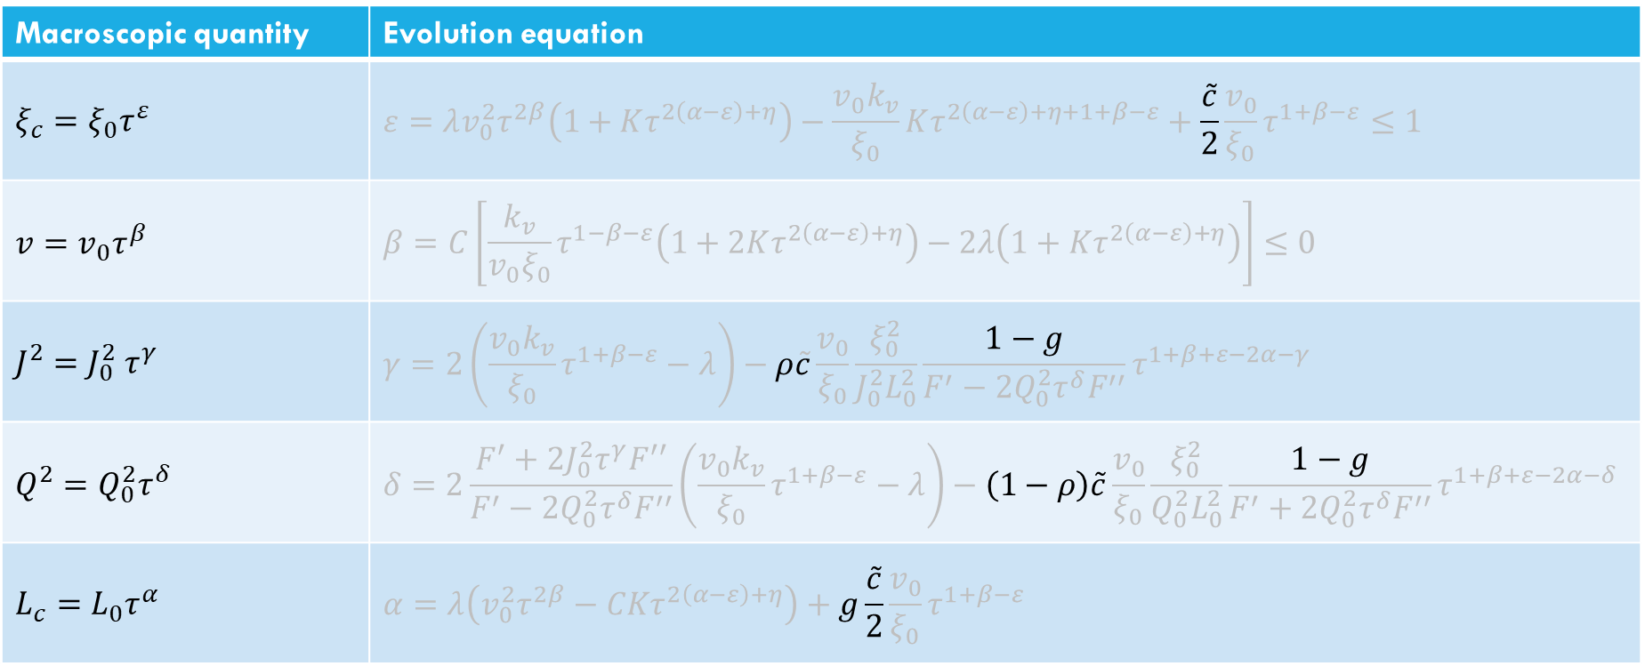
Generalised VOS model
$$S≈−μ\int{f(κ)\sqrt{−γ}dσ_{0}}dσ_{1}$$
Macroscopic quantity | Evolution equation
$$ξ_{c}=ξ_{0}τ^{ε}$$ | $$\dot{ξ_{c}}=ℋξ_{c}v^{2}\left(1+\frac{{Q^{2}+J}^{2}}{W^{2}}F^{′}\right)−vk_{v}\frac{Q^{2}+J^{2}}{W^{2}}F′+\frac{\tilde{c}}{2}v$$
$$v=v_{0}τ^{β}$$ | $$\dot{v}=\left(1−v^{2}\right)\left[\frac{k_{v}}{ξ_{c}}−2ℋv+2\frac{Q^{2}+J^{2}}{W^{2}}F^{′}\left(\frac{k_{v}}{ξ_{c}}−vℋ\right)\right]$$
$$J^{2}=J_{0}^{2} τ^{γ}$$ | $$\left(J^{2}\right)=2J^{2}\left(\frac{vk_{v}}{ξ_{c}}−ℋ\right)+(g−1)ρ\tilde{c}\frac{v}{L_{c}}\frac{W}{F^{′}−2Q^{2}F′′}$$
$$Q^{2}=Q_{0}^{2}τ^{δ}$$ | $$\left(Q^{2}\right)=2Q^{2}\frac{F^{′}+2J^{2}F′′}{F^{′}+2Q^{2}F′′}\left(\frac{vk_{v}}{ξ_{c}}−ℋ\right)+(g−1)(1−ρ)\tilde{c}\frac{v}{L_{c}}\frac{W}{F^{′}+2Q^{2}F′′}$$
$$L_{c}=L_{0}τ^{α}$$ | $${\dot{L}}_{c}=ℋL_{c}\left[v^{2}−\left(1−v^{2}\right)\frac{Q^{2}+J^{2}}{W^{2}}F^{′}\right]+g\frac{\tilde{c}}{2W}v$$
Macroscopic quantity | Evolution equation
$$ξ_{c}=ξ_{0}τ^{ε}$$ | $$ε=λv_{0}^{2}τ^{2β}\left(1+Kτ^{2\left(α−ε\right)+η}\right)−\frac{v_{0}k_{v}}{ξ_{0}}Kτ^{2\left(α−ε\right)+η+1+β−ε}+\frac{\tilde{c}}{2}\frac{v_{0}}{ξ_{0}}τ^{1+β−ε}≤1$$
$$v=v_{0}τ^{β}$$ | $$β=C\left[\frac{k_{v}}{v_{0}ξ_{0}}τ^{1−β−ε}\left(1+2Kτ^{2\left(α−ε\right)+η}\right)−2λ\left(1+Kτ^{2\left(α−ε\right)+η}\right)\right]≤0$$
$$J^{2}=J_{0}^{2} τ^{γ}$$ | $$γ=2\left(\frac{v_{0}k_{v}}{ξ_{0}}τ^{1+β−ε}−λ\right)−ρ\tilde{c}\frac{v_{0}}{ξ_{0}}\frac{ξ_{0}^{2}}{J_{0}^{2}L_{0}^{2}}\frac{1−g}{F^{′}−2Q_{0}^{2}τ^{δ}F^{′′}}τ^{1+β+ε−2α−γ}$$
$$Q^{2}=Q_{0}^{2}τ^{δ}$$ | $$δ=2\frac{F^{′}+2J_{0}^{2}τ^{γ}F^{′′}}{F^{′}−2Q_{0}^{2}τ^{δ}F^{′′}}\left(\frac{v_{0}k_{v}}{ξ_{0}}τ^{1+β−ε}−λ\right)−\left(1−ρ\right)\tilde{c}\frac{v_{0}}{ξ_{0}}\frac{ξ_{0}^{2}}{Q_{0}^{2}L_{0}^{2}}\frac{1−g}{F^{′}+2Q_{0}^{2}τ^{δ}F^{′′}}τ^{1+β+ε−2α−δ}$$
$$L_{c}=L_{0}τ^{α}$$ | $$α=λ\left(v_{0}^{2}τ^{2β}−CKτ^{2\left(α−ε\right)+η}\right)+g\frac{\tilde{c}}{2}\frac{v_{0}}{ξ_{0}}τ^{1+β−ε}$$
Notes:
Naturally, the physical solutions must respect some additional constraints, like beta<=0, in order for velocitites to be lower than the speed of light, while the correlation length cannot scale faster than linearly, as imposed by causality.
Finally, it should be said that due to the charge dependent relation between the two characteristic lengths, networks where charged decays should exhibit the same behavior for the evolution of the characteristic lengthscales.

Slide 15
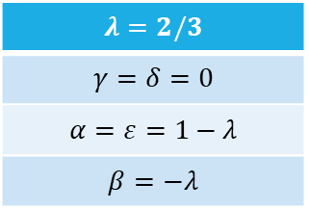
Solutions without loss mechanisms $(\tilde{c}=0)$
$$λ=2/3$$
$$γ=δ=0$$
$$α=ε=1−λ$$
$$β=−λ$$
Notes:
To ensure that this was indeed a solutions, we have solved numerically the system of different equations (the VOS mode, not the full network evolution) and found good agreement between predicted and obtained responses.
It can also be shown that for expansion rate higher than 2, charge and current decay and velocity reaches a constant value.
This solutions is associated with higher velocities for lower expansion rates and is valid until lambda=2, where charge and current are preserved. I recall that these expansion rates are expressed with respect to conformal tme, meaning that this critical expansion rate is compatible with matter epoch expansion.

Slide 16
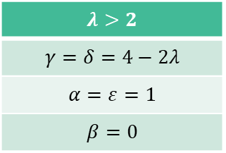
Solutions without loss mechanisms $(\tilde{c}=0)$
$$λ=2/3$$
$$γ=δ=0$$
$$α=ε=1−λ$$
$$β=−λ$$
$$λ>2$$
$$γ=δ=4−2λ$$
$$α=ε=1$$
$$β=0$$
Notes:
To ensure that this was indeed a solutions, we have solved numerically the system of different equations (the VOS mode, not the full network evolution) and found good agreement between predicted and obtained responses.
It can also be shown that for expansion rate higher than 2, charge and current decay and velocity reaches a constant value.
This solutions is associated with higher velocities for lower expansion rates and is valid until lambda=2, where charge and current are preserved. I recall that these expansion rates are expressed with respect to conformal tme, meaning that this critical expansion rate is compatible with matter epoch expansion.

Slide 17
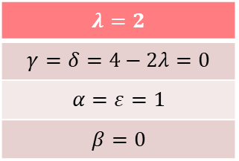
Solutions without loss mechanisms $(\tilde{c}=0)$
$$λ=2/3$$
$$γ=δ=0$$
$$α=ε=1−λ$$
$$β=−λ$$
$$λ=2$$
$$γ=δ=4−2λ=0$$
$$α=ε=1$$
$$β=0$$
$$λ>2$$
$$γ=δ=4−2λ$$
$$α=ε=1$$
$$β=0$$
Notes:
To ensure that this was indeed a solutions, we have solved numerically the system of different equations (the VOS mode, not the full network evolution) and found good agreement between predicted and obtained responses.
It can also be shown that for expansion rate higher than 2, charge and current decay and velocity reaches a constant value.
This solutions is associated with higher velocities for lower expansion rates and is valid until lambda=2, where charge and current are preserved. I recall that these expansion rates are expressed with respect to conformal tme, meaning that this critical expansion rate is compatible with matter epoch expansion.

Slide 18
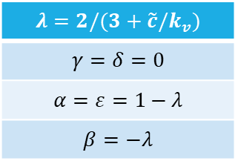
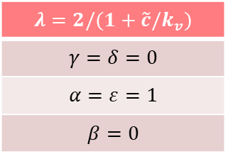
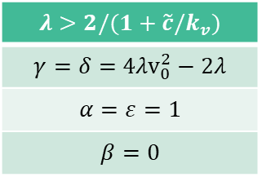
Solutions for unbiased networks $(\tilde{c}≠0;g=1)$
$$λ=2/(3+\tilde{c}/k_{v})$$
$$γ=δ=0$$
$$α=ε=1−λ$$
$$β=−λ$$
$$λ=2/(1+\tilde{c}/k_{v})$$
$$γ=δ=0$$
$$α=ε=1$$
$$β=0$$
$$λ>2/(1+\tilde{c}/k_{v})$$
$$γ=δ={4λv}_{0}^{2}−2λ$$
$$α=ε=1$$
$$β=0$$
Notes:
If we do the same analysis, but now allowing for energy loss in the network, as parameterized by c, the same solutions are found, but associated with different, lower assymptoitc velocities, and a lower value for the critical expansion rate. Here, you see that the simulation for the matter epoch expansion rate is still associated with decaying charge and currents.
This implies that preserving charge and currents is more easily achieved in radiation epoch, but not in the matter one.

Slide 19
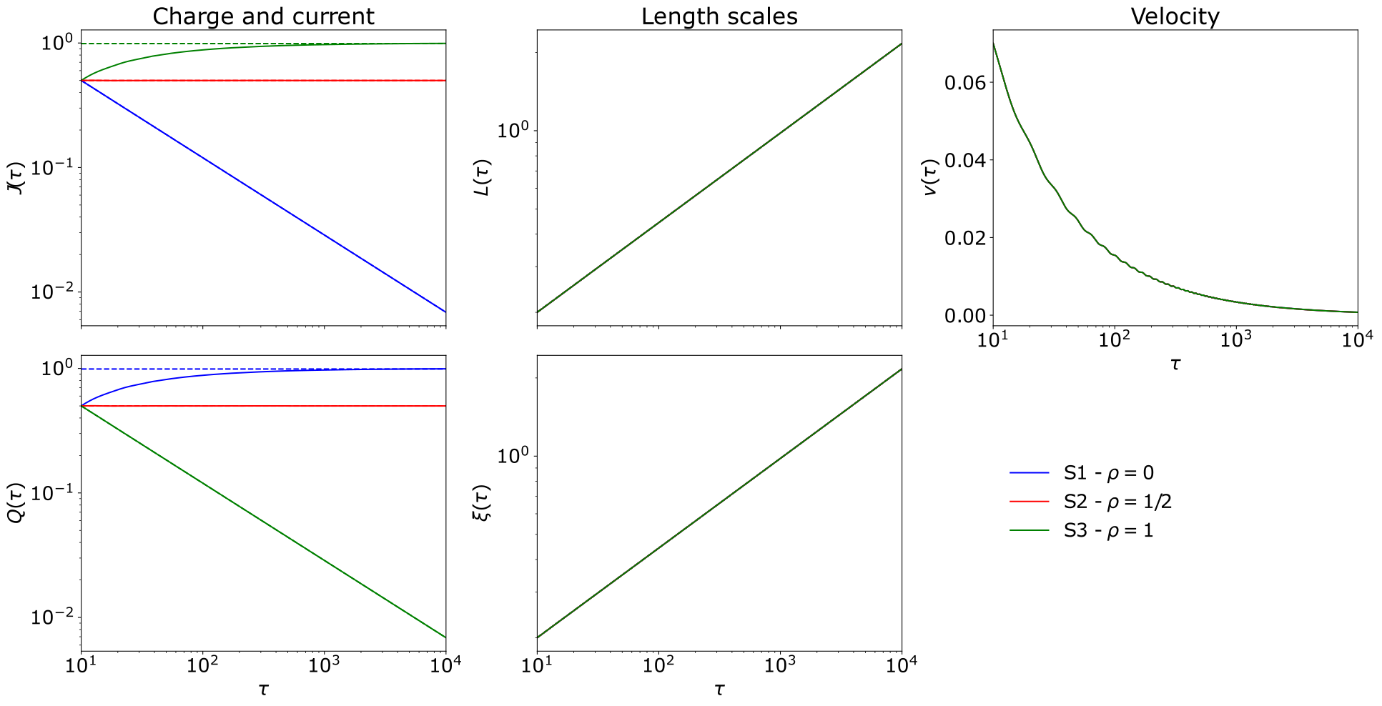
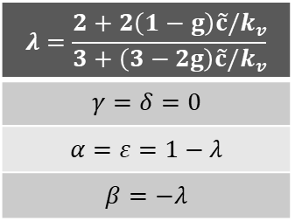
Solutions for biased networks $(\tilde{c}≠0;g≠1)$
$$λ=\frac{2+2\left(1−g\right)\tilde{c}{/k}_{v}}{3+\left(3−2g\right)\tilde{c}{/k}_{v}}$$
$$γ=δ=0$$
$$α=ε=1−λ$$
$$β=−λ$$
Notes:
If we do the same analysis, but now allowing for energy loss in the network, as parameterized by c, the same solutions are found, but associated with different, lower assymptoitc velocities, and a lower value for the critical expansion rate. Here, you see that the simulation for the matter epoch expansion rate is still associated with decaying charge and currents.
This implies that preserving charge and currents is more easily achieved in radiation epoch, but not in the matter one.

Slide 20
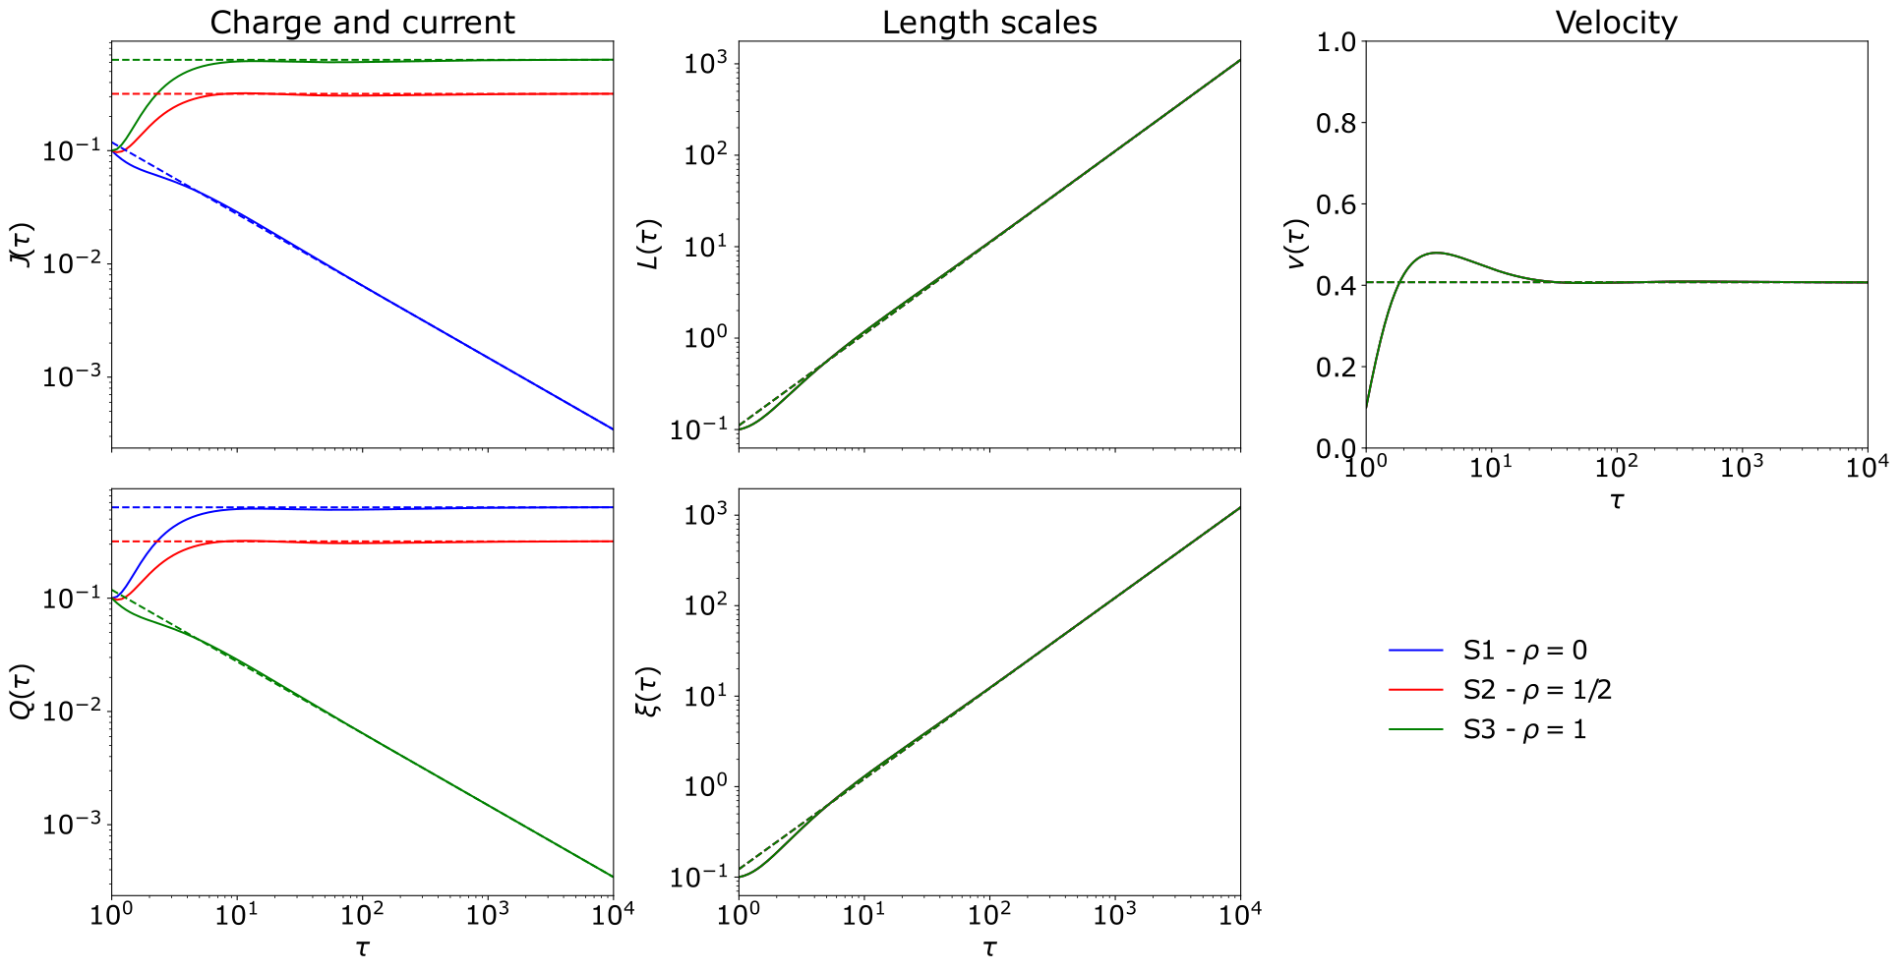
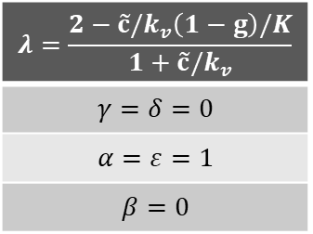
Solutions for biased networks
$$λ=\frac{2−\tilde{c}/k_{v}\left(1−g\right)/K}{1+\tilde{c}/k_{v}}$$
$$γ=δ=0$$
$$α=ε=1$$
$$β=0$$
Notes:
If we do the same analysis, but now allowing for energy loss in the network, as parameterized by c, the same solutions are found, but associated with different, lower assymptoitc velocities, and a lower value for the critical expansion rate. Here, you see that the simulation for the matter epoch expansion rate is still associated with decaying charge and currents.
This implies that preserving charge and currents is more easily achieved in radiation epoch, but not in the matter one.

Slide 21
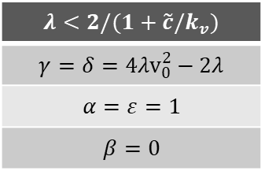
Solutions for biased networks
$$λ=\frac{2−\tilde{c}/k_{v}\left(1−g\right)/K}{1+\tilde{c}/k_{v}}$$
$$γ=δ=0$$
$$α=ε=1$$
$$β=0$$
$$λ<2/(1+\tilde{c}/k_{v})$$
$$γ=δ={4λv}_{0}^{2}−2λ$$
$$α=ε=1$$
$$β=0$$
Notes:
If we do the same analysis, but now allowing for energy loss in the network, as parameterized by c, the same solutions are found, but associated with different, lower assymptoitc velocities, and a lower value for the critical expansion rate. Here, you see that the simulation for the matter epoch expansion rate is still associated with decaying charge and currents.
This implies that preserving charge and currents is more easily achieved in radiation epoch, but not in the matter one.

Slide 22
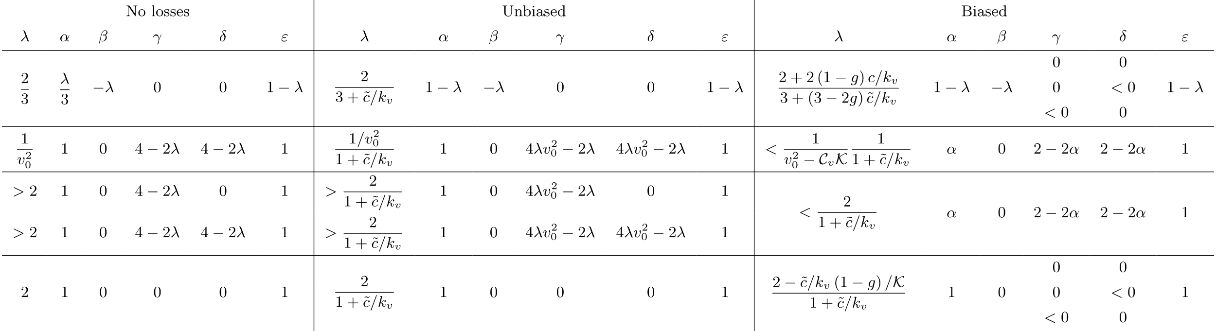
Results summary

Slide 23
Conclusions
Main findings
Future works
Analytical solutions for general current carrying cosmic strings derived
Scaling solutions were identified that are similar to the ones obtained for chiral strings and/or strings with small scale structure
Charge and current are more easily preserved for slow expansion rates
Model parameters impact the possible solutions
Compare the analytical solutions with numerical simulations results
Evaluate the validity of the assumptions of the CVOS model

