Slide 1



Analytical Methods for Realistic Cosmic Strings and Superstrings
Done by:
Pedro Barbosa
Supervised by:
Prof. Carlos Martins

Slide 2
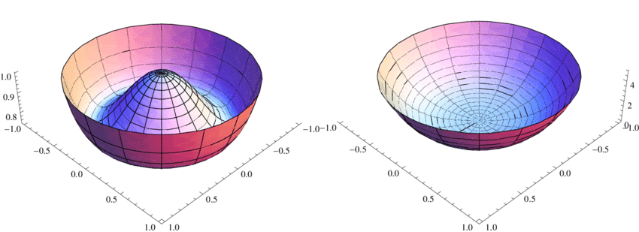
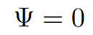
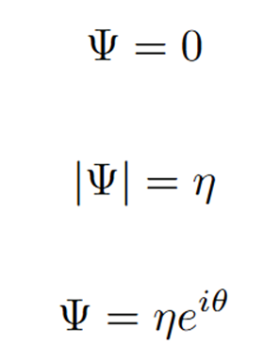
Cosmic Strings - Introduction
Cosmic strings are topological defects originated in symmetry-breaking phase transitions;
Initially, we have a complex scalar field whose vacuum expectation value is 0;
As temperature drops, the potential well changes, leading to a new vacuum state, which does not hold the symmetry.
Cosmic strings are formed if the new vacuum manifold has a non trivial first homotopy group.
Old vacum state
Temperature decreases
New degenerate vacum state
Ednilson, Francisco & Dos Santos, F E A. Ginzburg-Landau Theory for Bosonic Gases in Optical Lattices.

Slide 3
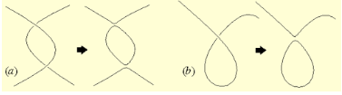
Loop production and Superconducting Strings
The intersection of strings segments leads to the formation of loops, which decay through gravitational radiation;
It is an energy loss mechanism;
However, if we consider current-carrying strings, the evolution of the loops is not that straightforward.
https://www.ctc.cam.ac.uk/outreach/origins/cosmic_structures_three.php

Slide 4
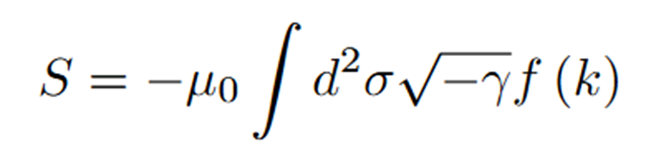

CVOS
CVOS considers an invariant action which depends only on the chirality, k:
Chirality measures whether the current is:
  space-like (k<0), which corresponds to the magnetic regime;
  time-like (k>0), electric regime;
  light-like (k=0), chiral regime.

Slide 5
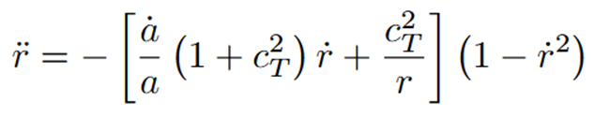
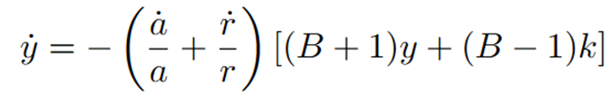
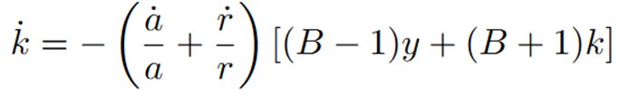

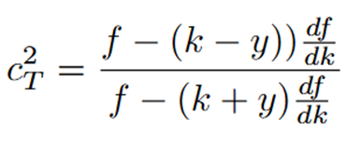
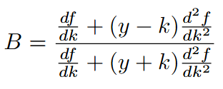
CVOS
The equations of motion are obtained by varying the previous action in relation to the position and the scalar field;
They describe the evolution of the radius of the loop, r, the chirality, k, and what we shall call the total charge, y.

Slide 6
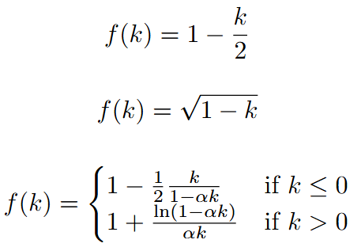
Models to analyze
The Witten model introduces a dimensionless parameter that must be less than unity;
All models coincide in the chiral case and up to first order.
Linear Case:
Kaluza-Klein Model:
Witten Model:

Slide 7
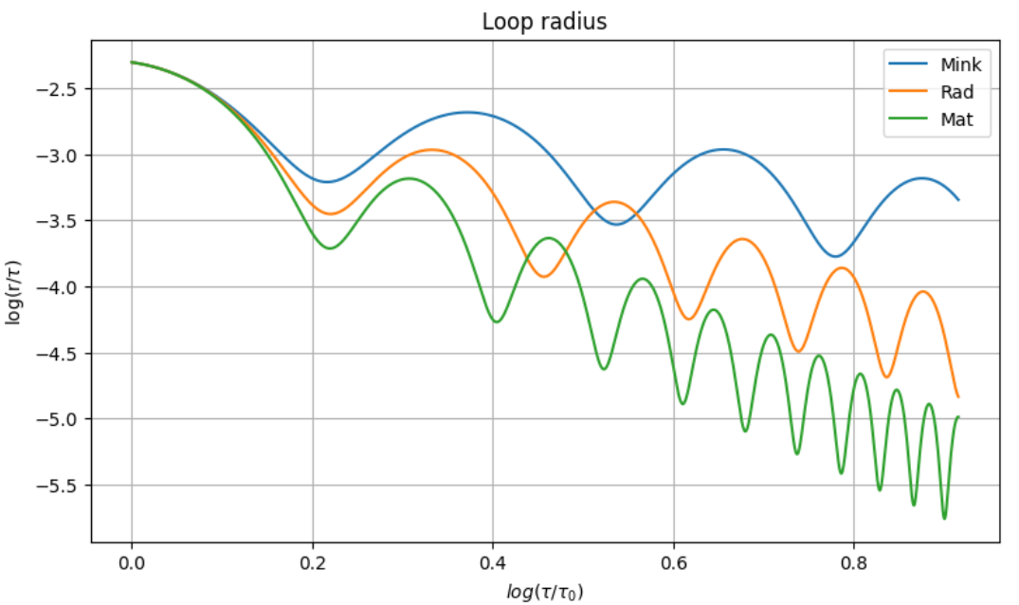
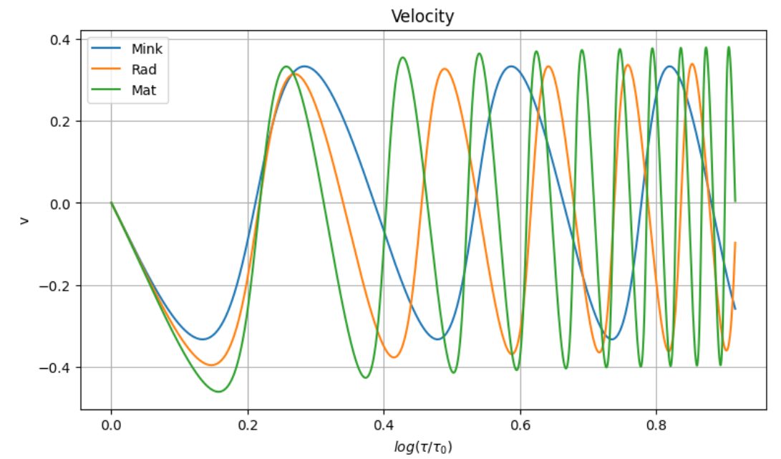
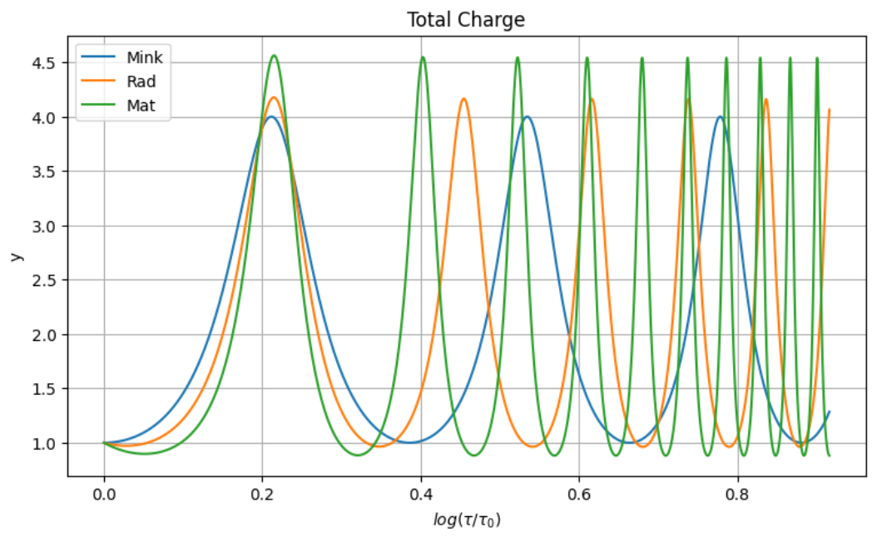
Linear Case
In this case, the system is fully described by the total charge;
The peaks in the total charge happen when the radius reachs its minimum;
There is a clear, expected distinction between the different eras;

Slide 8
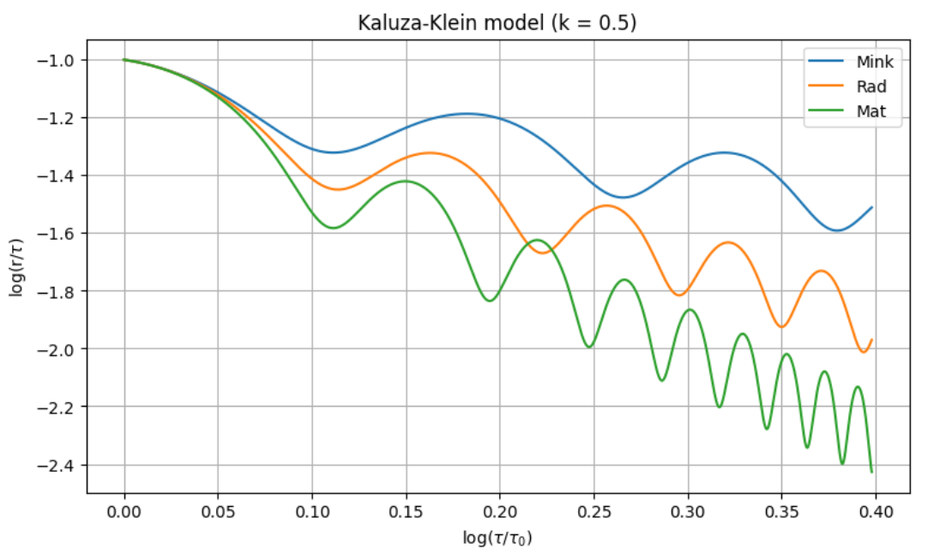
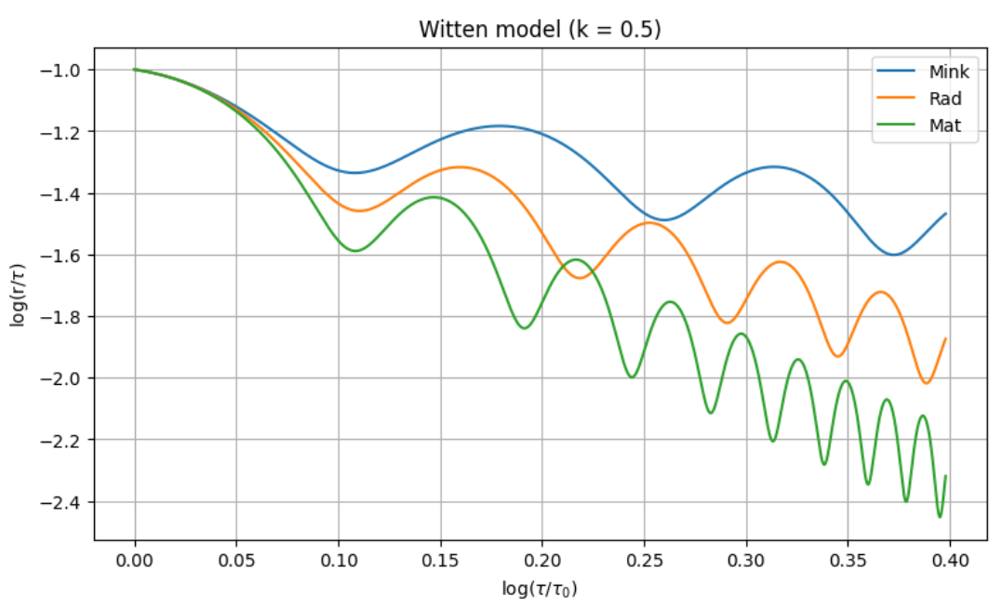
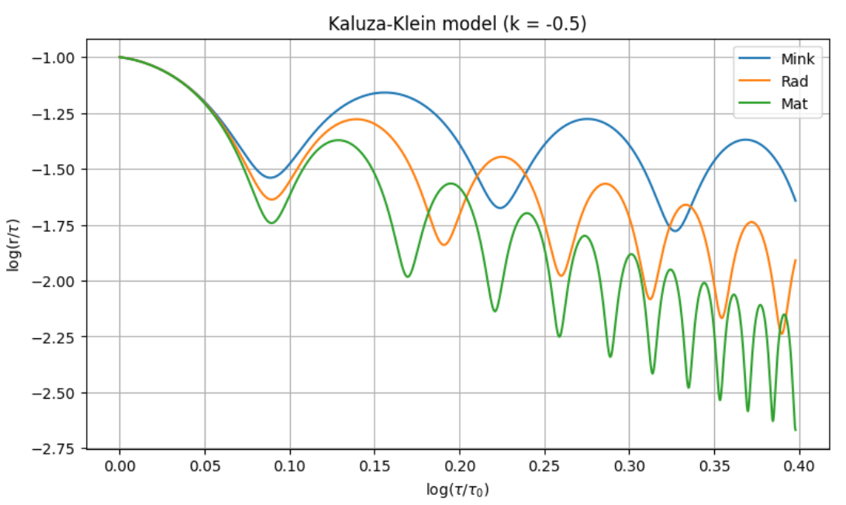
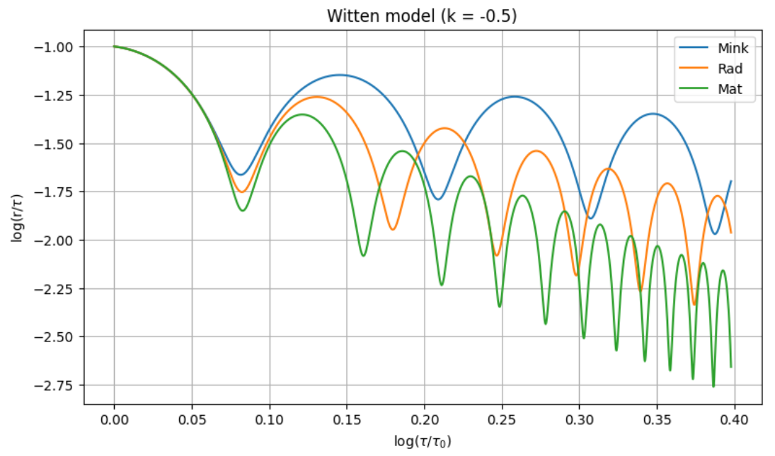
Kaluza-Klein and Witten models
The two models give similar results;
There is a noticeable difference between both regimes;
The magnetic regime seems a more hostile environment.

Slide 9
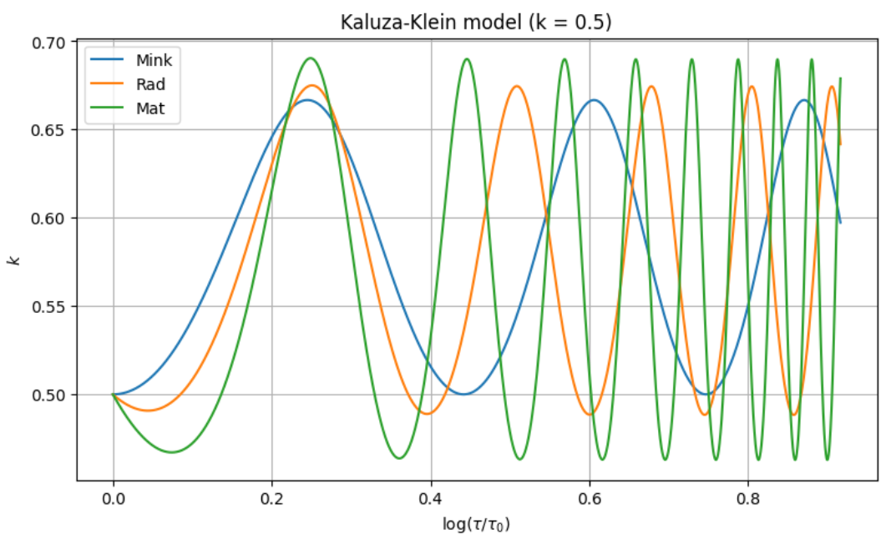
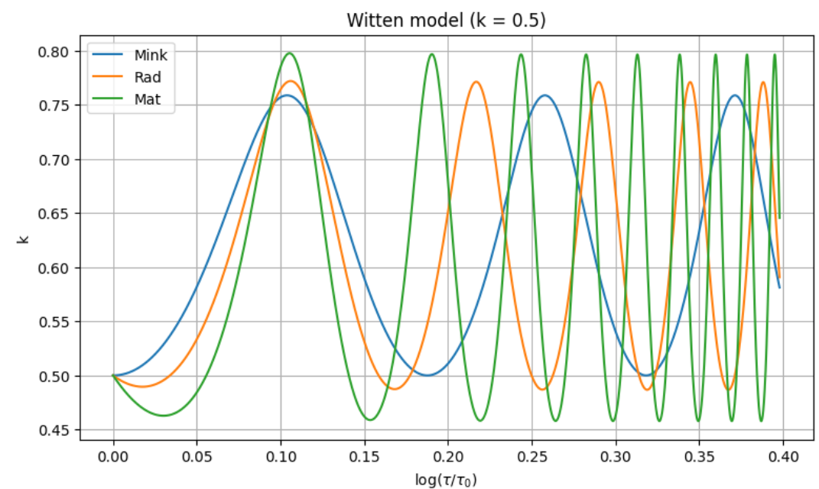
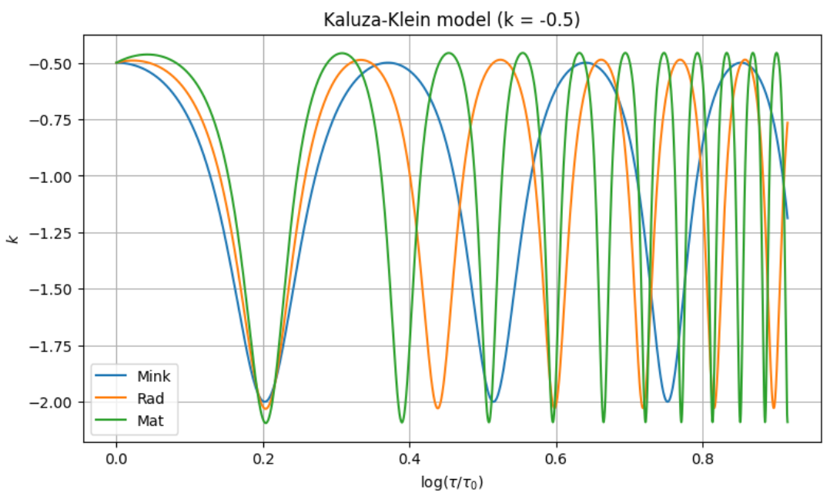
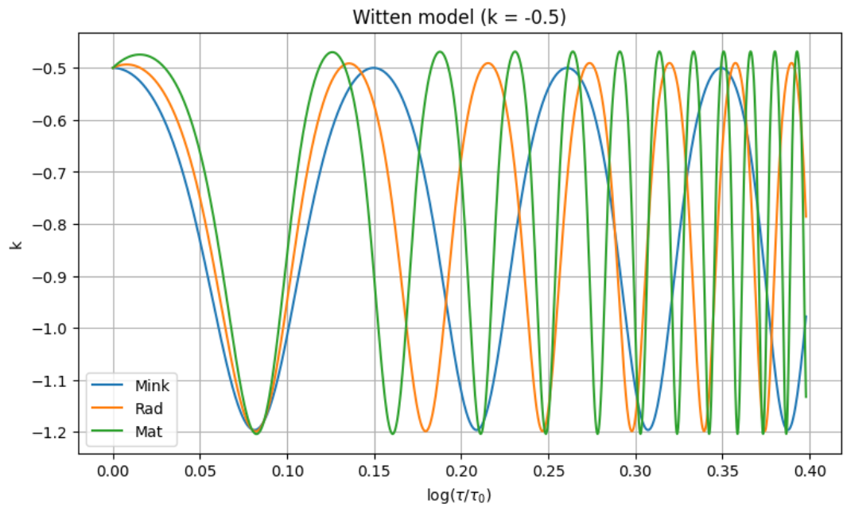
Kaluza-Klein and Witten models
The chirality is preserved in all cases;
The difference in the maximum of the absolute values of chirality varies in the two models;
The minimum total charge is greater in the magnetic regime.

Slide 10
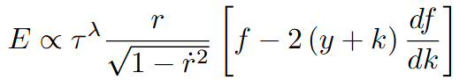
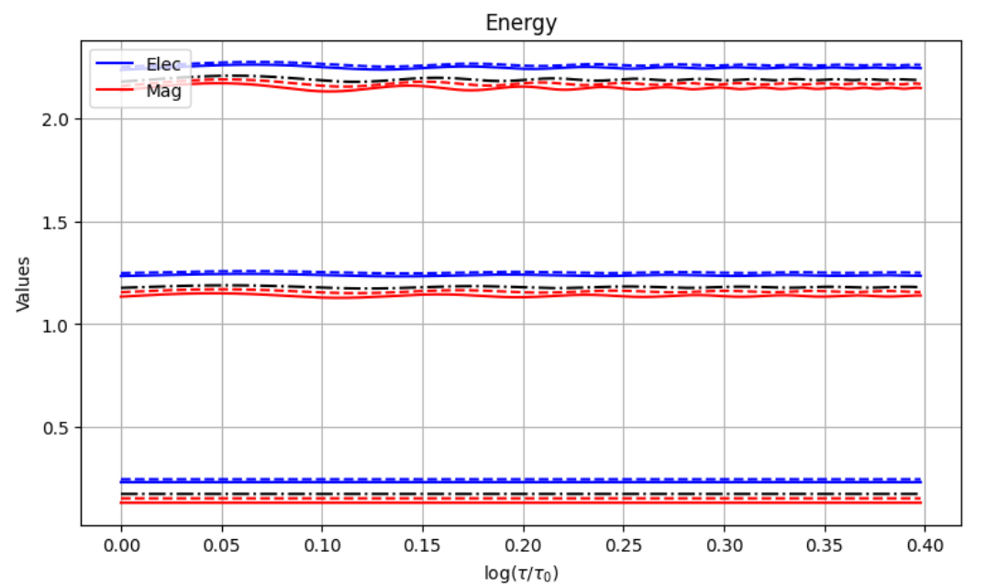
Energy Conservation
The energy is proportional to:
There is some initial wiggliness for the radiation and matter eras;
The energy is greater in the electric regime, for both the models and for all expansion rates.

Slide 11
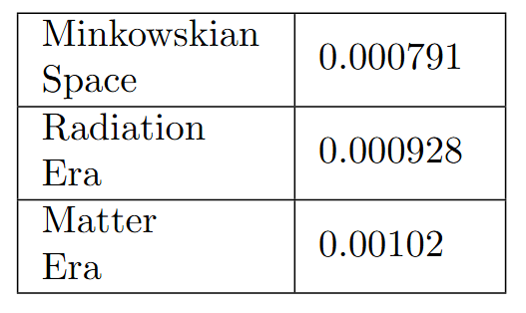
Initial Total Charge in the Linear Case
In the linear case, the total charge needed for the loop to survive does not depend on the chirality;
Therefore, for absolute values of k greater than those on the table, the loop does not decay;
As expected, the initial total charge needed for higher expansion rates is bigger.

Slide 12
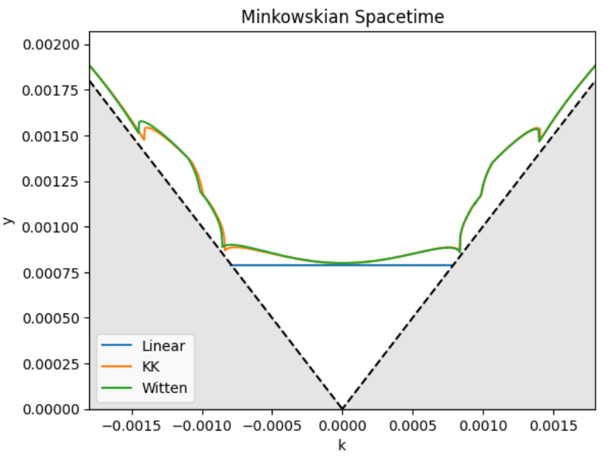
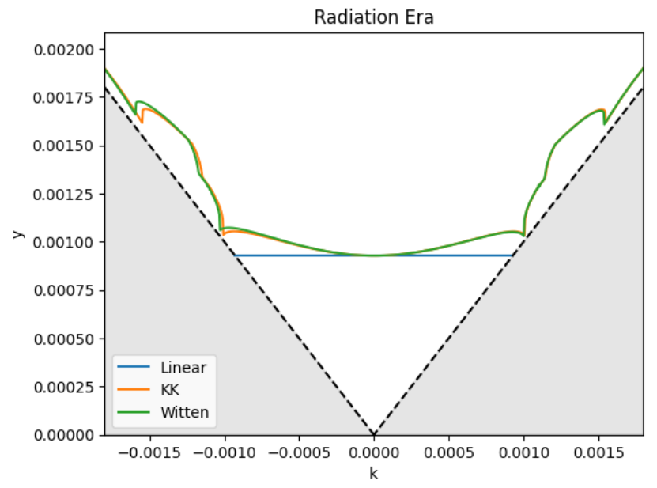
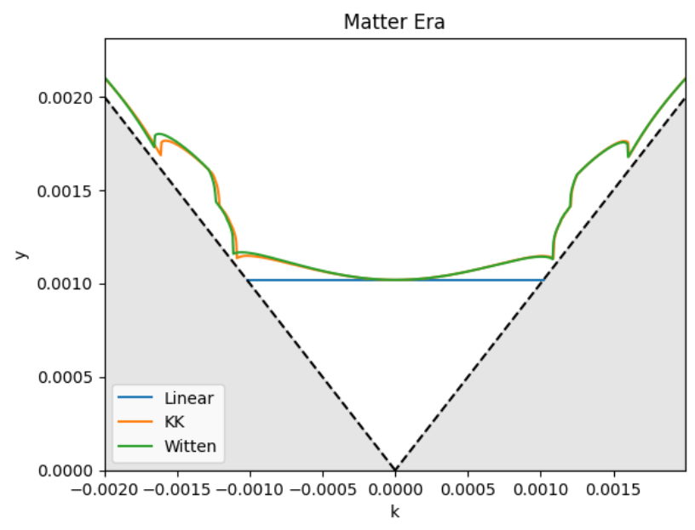
Initial Conditions for the Loop to Survive
The total charge has to be greater or equal to the absolute value of the chirality. So the regions in grey do not belong to the parameter space;
The two models seem to coincide in the electric regime, while there is a clear difference in the magnetic one;
It is easier for the loop to oscillate in the linear model compared to the other two.

Slide 13
Conclusion
The new degree of freedom, in a current-carrying string, can prevent the loop from decaying;
The higher the expansion rate, the easier for the loop to disappear;
It seems that the magnetic regime is more hostile, in comparison with the electric regime.
According to the regions in the parameter space where the loop survives, it seems more probable to have loops oscillating than decaying.

