Slide 1
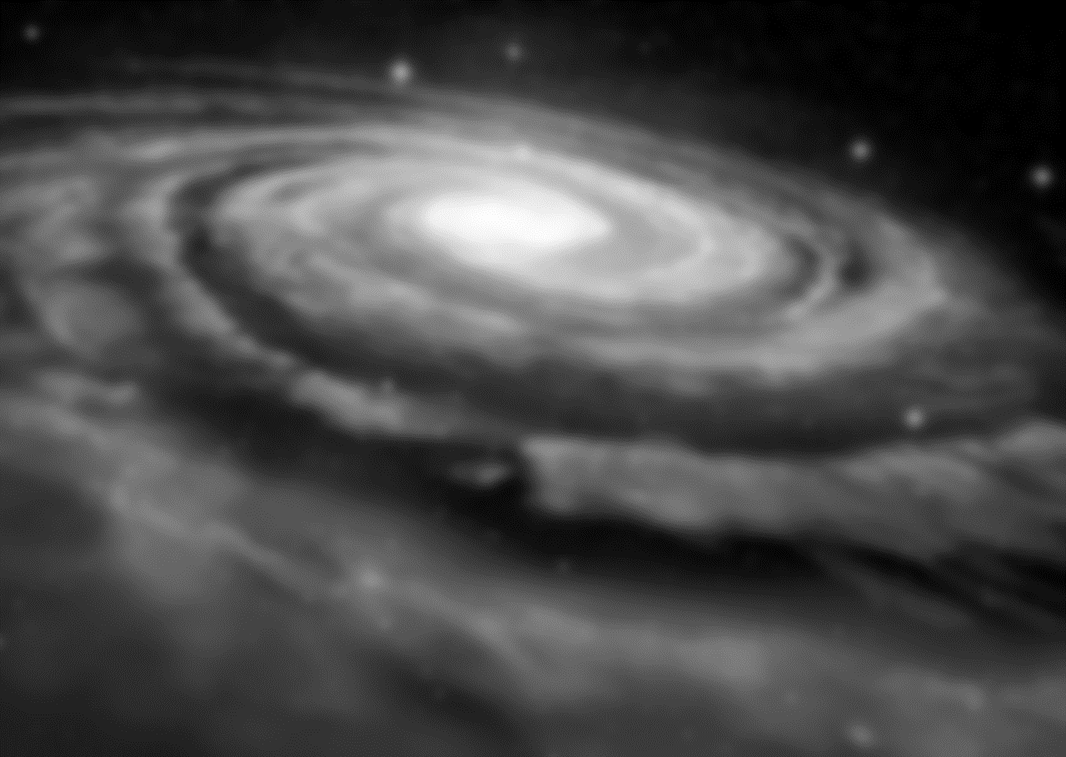
Monday, April 14, 2025
Testing hyperconical modified gravity in galaxies and clusters with distinct datasets
Dr. Robert Monjo i Agut
Department of Physics and Mathematics
University of Alcalá
Notes:
Hello good afternoon. In this talk, we will talk on the main aspects of the hyperconical modified gravity and its observational constraint with galaxy rotation curves and galaxy cluster radial acceleration.
1

Slide 2
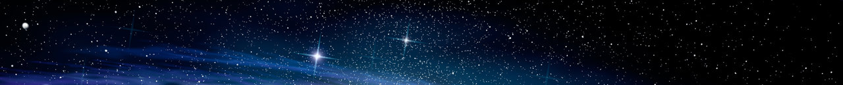
Robert Monjo: Testing hyperconical modified gravity in galaxies and clusters
Contents
15.
Motivation
  Dynamical embedding
Approach:
  Hyperconical modified gravity
  Observations
Results: Fictitious acceleration of...
  Cosmos
  Clusters
  Galaxies
Final remarks
Notes:
The talk is structured with a brief reminder of key background points, a description of the approach considered and the observed data used, to finally introduce the results on spacetime, galaxies and clusters, ending with final remarks.
As you know…
2

Slide 3
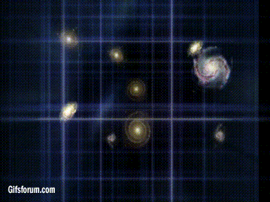
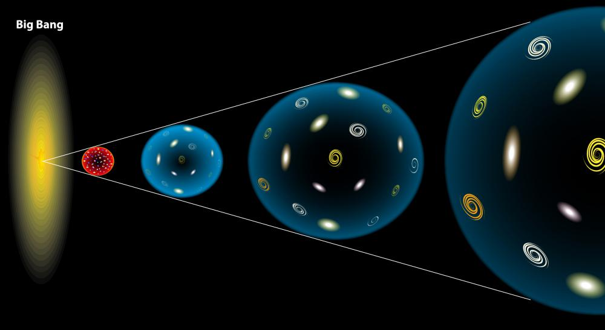
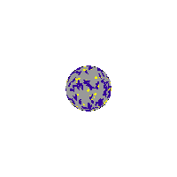
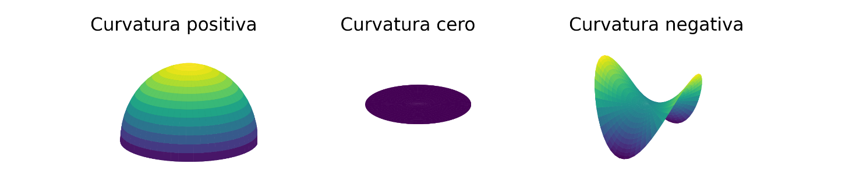

Robert Monjo: Testing hyperconical modified gravity in galaxies and clusters
Motivation: Embedding and projection
3
of Lorentzian manifolds
15.
Intrinsic perspective
Extrinsic perspective
u
z
xy
(Pseudo-) Riemannian manifolds
Embedding in flat spacetimes
Friedman-Lemaitre-Robertson-Walker metric
GR
a(t)
K > 0
K = 0
K < 0
Local GR
Notes:
As you know, there are two geometrical perspectives: the intrinsic (typically studied in Riemannian and pseudo-Riemannian geometry) and the extrinsic of classical geometry. Both perspectives describe the same geomertrical objects: the manifols.
We analyse the dynamical embedding of the Lorentizan manifolds, that is taking into account the spacetime as a dynamical system

Slide 4
Robert Monjo: Testing hyperconical modified gravity in galaxies and clusters
Contents
15.
Motivation
  Dynamical embedding
Approach:
  Hyperconical modified gravity
  Observations
Results: Fictitious acceleration of...
  Cosmos
  Clusters
  Galaxies
Final remarks
Notes:
4

Slide 5
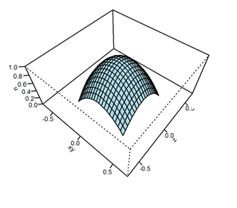
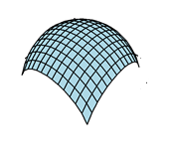
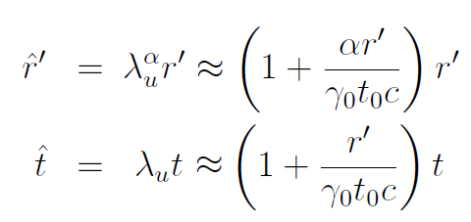

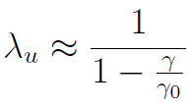
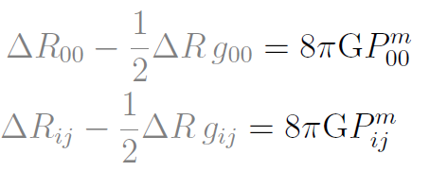
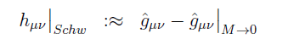
Robert Monjo: Testing hyperconical modified gravity in galaxies and clusters
HMG model
Monjo, R & C-S, R. (2023) CQG 40, 195006. 10.1088/1361-6382/aceacc ​
Monjo, R (2023) CQG 40, 235002. 10.1088/1361-6382/aceacc ​ ​
Monjo, R. (2024): ApJ 967, 66, 10.3847/1538-4357/ad3df7
15.
Spatial curvature and temporal acceleration are not geometric invariants! Ricci scalar is!
Cosmic projection ...
Hyperconical metric
General relativity over the manifold
… to assimilate apparent radial inhomogeneity (space) in a fictitious acceleration (time)
Step 1. Solve Einstein Equations as usual by assuming that the backgrround metric is irrelevant
Step 2: Change the coordinates to incorporate the effect of the fictitious acceleration
Notes:
5

Slide 6
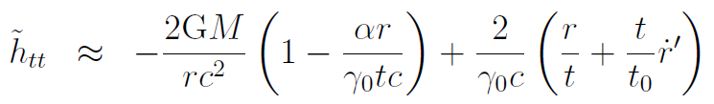
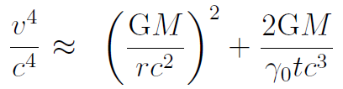

Robert Monjo: Testing hyperconical modified gravity in galaxies and clusters
HMG model
Monjo, R & C-S, R. (2023) CQG 40, 195006. 10.1088/1361-6382/aceacc ​
Monjo, R (2023) CQG 40, 235002. 10.1088/1361-6382/aceacc ​ ​
Monjo, R. (2024): ApJ 967, 66, 10.3847/1538-4357/ad3df7
15.
Cosmic projection
Hyperconical modified gravity (HMG)
Local GR + cosmic projection
but now with:
Milgromian acceleration
Baryonic Tully-Fisher relation (BTFR) and the mass-discrepancy acceleration relation (MDAR)
Step 3: The fictitious acceleration depends on the perturbing system M
Notes:
γ_{U} ≈ $π$/3 ↦ γ₀ ≈ 2$π$/3 ≈ 2
1-parameter (γ₀)
2-parameter (γ_{max}, ε_{Η})
6

Slide 7






Robert Monjo: Testing hyperconical modified gravity in galaxies and clusters
HMG model
Monjo, R & C-S, R. (2023) CQG 40, 195006. 10.1088/1361-6382/aceacc ​
Monjo, R (2023) CQG 40, 235002. 10.1088/1361-6382/aceacc ​ ​
Monjo, R. (2024): ApJ 967, 66, 10.3847/1538-4357/ad3df7
15.
Cosmic projection as a function of the system geometry (velocity and density)
0-parameter HMG model: γ₀ = global constant ≈ 9 ± 1 (reproduces MOND)
1-parameter HMG model: γ₀ = constant for each system
2-parameter HMG model: γ₀ = f(geometry of the system, that is: γ_{center} and ε_{Η})
1-parameter HMG model: ε_{Η} = fitted value for each system
1-parameter HMG model: ε_{Η} = f(relative density of the system, that is: (r_{sys}/r _{nei})³)
Notes:
γ_{U} ≈ $π$/3 ↦ γ₀ ≈ 2$π$/3 ≈ 2
1-parameter (γ₀)
2-parameter (γ_{max}, ε_{Η})
7

Slide 8
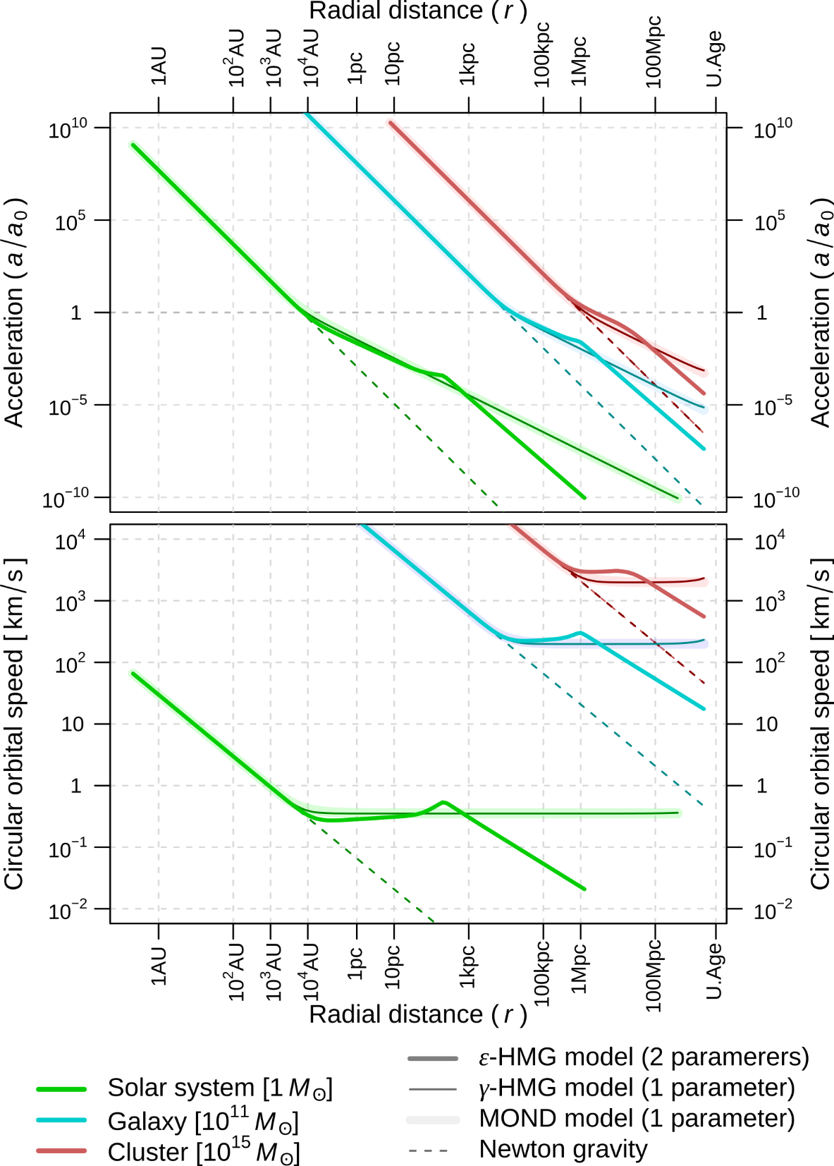
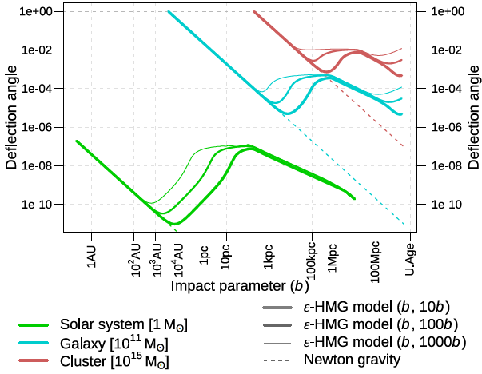
Robert Monjo: Testing hyperconical modified gravity in galaxies and clusters
HMG model
Monjo, R & C-S, R. (2023) CQG 40, 195006. 10.1088/1361-6382/aceacc ​
Monjo, R (2023) CQG 40, 235002. 10.1088/1361-6382/aceacc ​ ​
Monjo, R. (2024): ApJ 967, 66, 10.3847/1538-4357/ad3df7
28.
Flat orbital curves
Fictitious acceleration
anomaly
Gravitational lensing
Notes:
8

Slide 9
Robert Monjo: Testing hyperconical modified gravity in galaxies and clusters
Observations: five datasets
15.
(1)
60 high-quality rotation curves
Range: 0.00022 < z < 0.028; Radial acceleration relationship (RAR)
Source: Spitzer Photometry and Accurate Rotation Curves (SPARC; McGaugh et al. 2007, 2016)
Features: Galaxies filtered to well-measured intermediate radii (Lelli et al. 2019).
(2)
20 accurate estimates of flat speed inferred from weak lensing
Range: 0.24 < z < 0.42
Source: Mistele et al. (2024), four bins: 1.29, 4.57, 9.13, and 19.5 in units of 10¹⁰M⊙.
(3)
10 galaxy clústers for radial acceleration and
Range: 0.033 < z < 0.090; Rotation curves (distances; observed and Keplerian speeds)
Source: HIghest X-ray FLUx Galaxy Cluster Sample (HIFLUGCS; Ghirardini et al. 2019; Li et al. 2023)
(4)
12 X-COP galaxy clusters for hydrostatic equilibrium (Ghirardini et al. 2019)
Range: 0.055 < z < 0.090;
(5)
5 complete stellar mass info: A1795, A2029, A2142, A2319, A644 (Eckert et al. 2022; Kelleher & Lelli 2024).
Range: 0.055 < z < 0.090;
Notes:
9

Slide 10
Robert Monjo: Testing hyperconical modified gravity in galaxies and clusters
Contents
15.
Motivation
  Dynamical embedding
Approach:
  Hyperconical modified gravity
  Observations
Results: Fictitious acceleration of...
  Cosmos
  Clusters
  Galaxies
Final remarks
Notes:
10

Slide 11
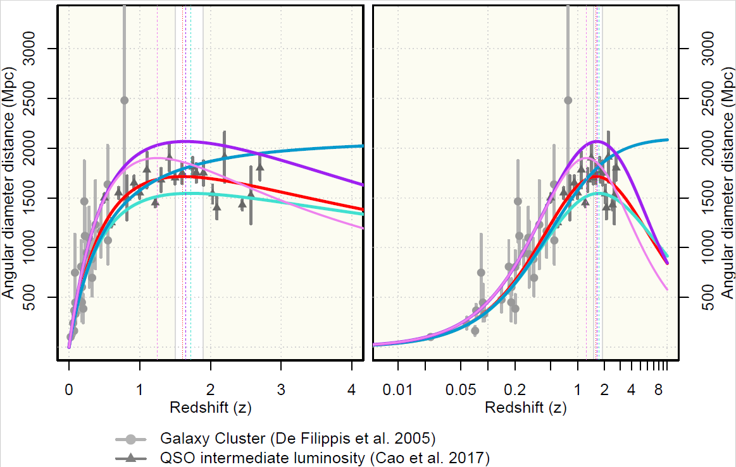
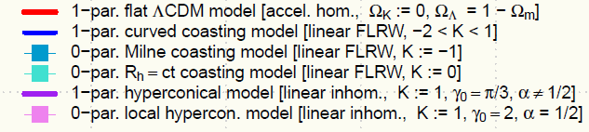




Robert Monjo: Testing hyperconical modified gravity in galaxies and clusters
Cosmos
11
Monjo, R. (2024): ApJ 967, 66, 10.3847/1538-4357/ad3df7
15.
Performance of the cosmic projection (γ₀)
Angular diameter distance
Luminosty distance
Notes:
1,550 distinct Type Ia supernovae (SNe Ia) pairs of redshift and luminosity distance (modulus)
Source: Pantheon+ data of 1,701 light curves corresponding to 1,550 distinct SNe Ia (Scolnic et al.2022; Brout et al. 2022).
51 measurements of expansion rate
Cosmic chronometers (CC: 34)
Type-Ia SNe distance ladder (Ladder: 3)
Radial BAO size from several approaches:
Galaxy distribution (BAO-Gal:7),
redshift space distortions from eBOSS quasars (BAO-QSO: 4)
Lymann-α forest (BAO-Lya: 3).
11

Slide 12
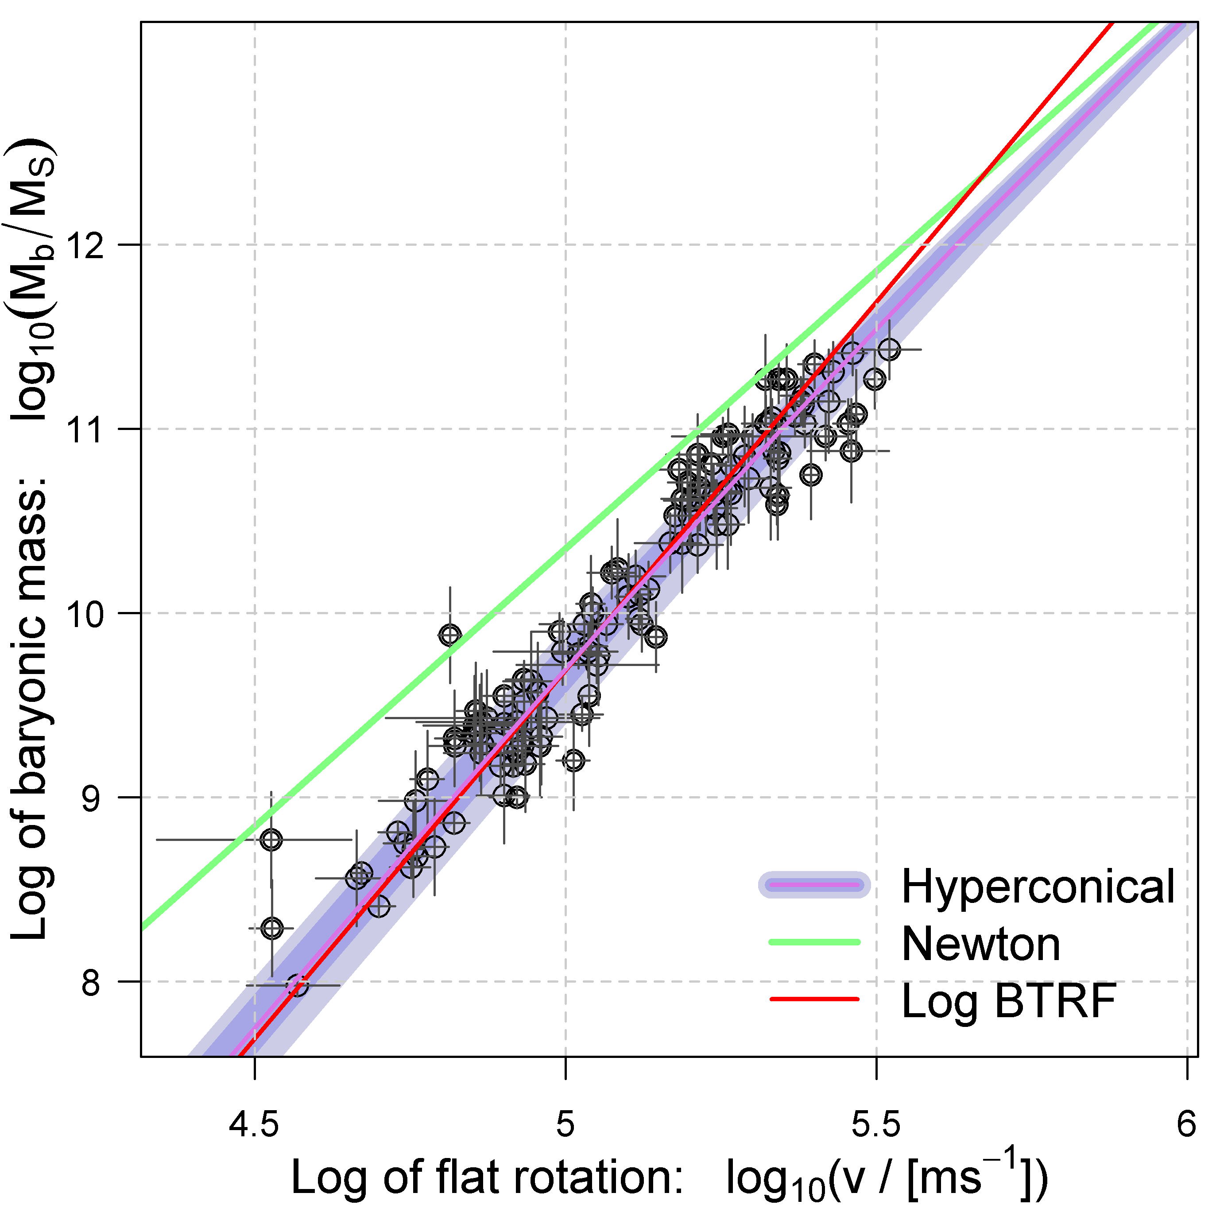
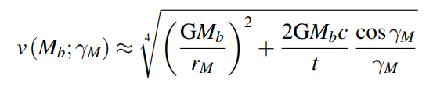
Robert Monjo: Testing hyperconical modified gravity in galaxies and clusters
Galaxies
12
Monjo, R. (2023): CQG 40, 235002, 10.1088/1361-6382/ad0422 ​
15.
Fictitious cosmic acceleration for maximum galaxy rotation velocity
MDAR modeling. Fitting of the hyperconical model to the baryonic Tully–Fisher (BTRF) relation with v(M_{b}) for 123 galaxies
DOI:10.1088/1361-6382/ad0422
Mass-discrepancy acceleration relation (MDAR)
GM_{b}a₀
Milgromian acceleration
a₀ = (2c/t)·cosɣ_{M} /ɣ_{M}
Notes:
Kinetic Sunyaev-Zel'dovich effect : distortion of the microwave background radiation (CMB) due to the inverse Compton effect (interaction between photons and electrons). It is used to analyze perturbations in the density of the universe
LTB : Lema^tre-Tolman-Bondi
10 Killing vectors: 3 angular rotations (global symmetries) + 1 temporal translation (global conformal static) + 3 spatial translations (local comoving ) + 3 three Lorentz boosts (local ordinary).
12

Slide 13
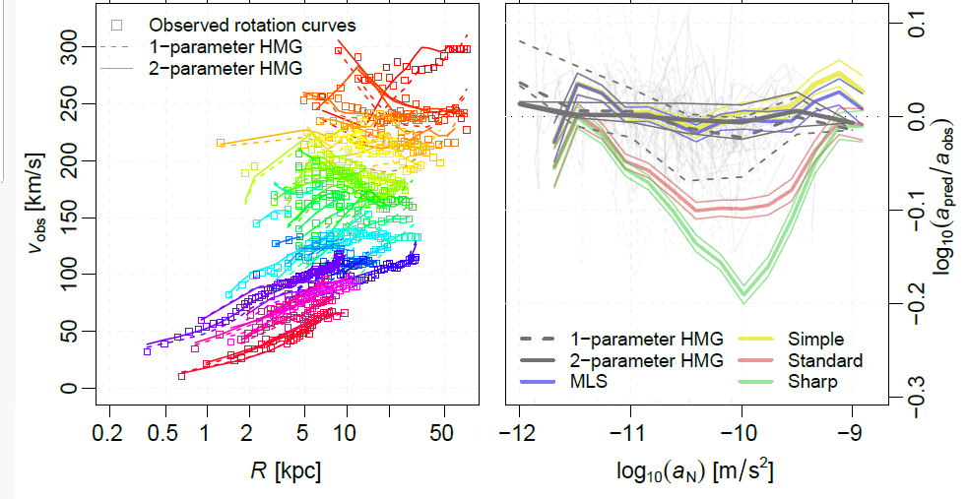
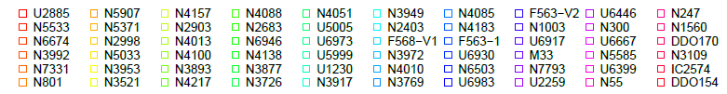
Robert Monjo: Testing hyperconical modified gravity in galaxies and clusters
Galaxies
Monjo, R. (2023): CQG 40, 235002, 10.1088/1361-6382/ad0422 ​
Monjo, R. & Banik, I. (2024): https://arxiv.org/abs/2405.10019
15.
Fictitious cosmic acceleration for galaxy rotation curves
Left: Fitting of 60 galaxy rotation curves according to the HMG model with 1 parameter (dashed lines) or 2 parameters (continuous lines).
Right: Performance of the 1- and 2-parameter HMG model for the ratio of
predicted (apred) and observed (aobs) centripetal acceleration for the 60 galaxies (light gray lines) and comparison with MOND interpolation functions (MLS, simple, standard, and sharp functions, fitted to 153 suitable galaxies): as in Fig.23 of Banik et al. (2023)
Banik et al. 2023. MNRAS, 527, 4573 10.1093/mnras/stad3393
Notes:
13

Slide 14
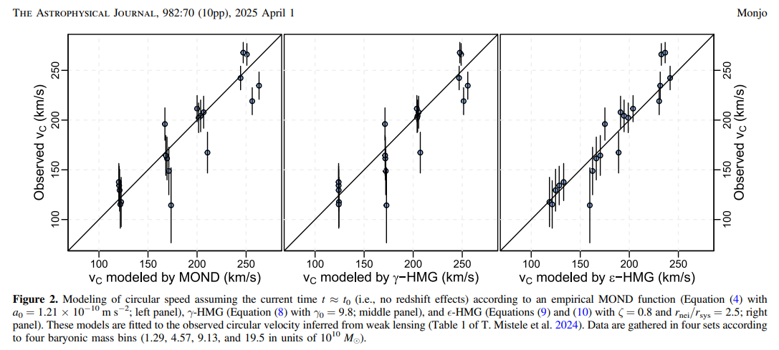
Robert Monjo: Testing hyperconical modified gravity in galaxies and clusters
Galaxies
Monjo, R. (2023): CQG 40, 235002, 10.1088/1361-6382/ad0422 ​
Monjo, R. (2025): ApJ 982, 7010.3847/1538-4357/adb723
15.
Fictitious cosmic acceleration for galaxy rotation curves
Notes:
14

Slide 15
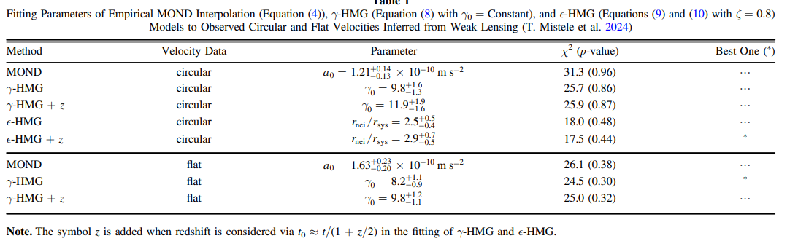
Robert Monjo: Testing hyperconical modified gravity in galaxies and clusters
Galaxies
Monjo, R. (2023): CQG 40, 235002, 10.1088/1361-6382/ad0422 ​
Monjo, R. (2025): ApJ 982, 7010.3847/1538-4357/adb723
15.
Fictitious cosmic acceleration for galaxy rotation curves
Notes:
15

Slide 16
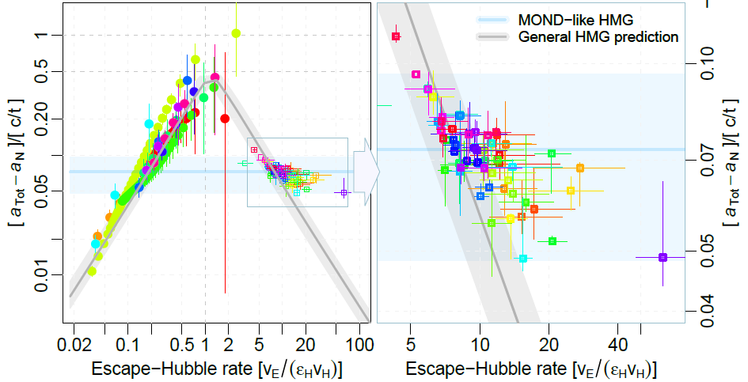
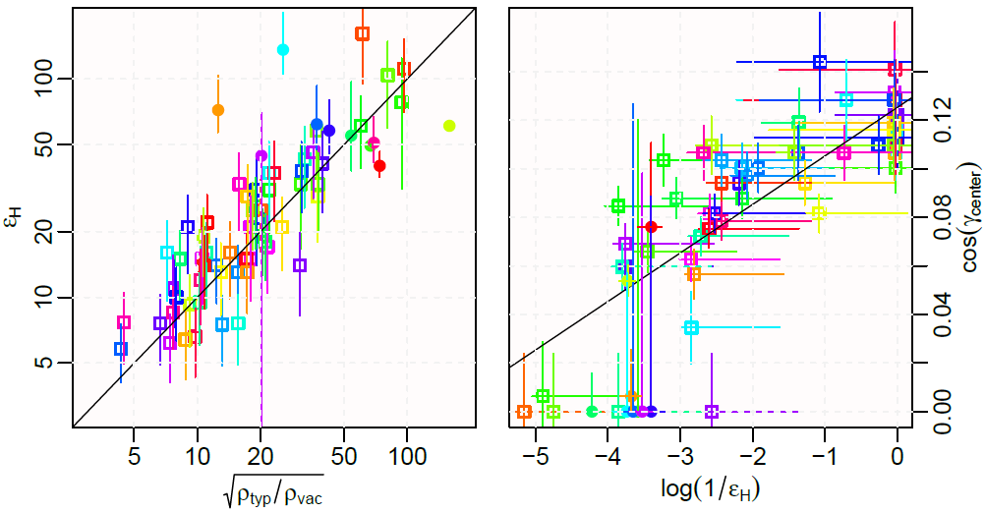
Robert Monjo: Testing hyperconical modified gravity in galaxies and clusters
Clusters vs galaxies
Monjo, R. & Banik, I. (2024): https://arxiv.org/abs/2405.10019
15.
Fictitious cosmic acceleration for galaxy dynamics
Equilibrium
(γ₀ = 2)
Left: Global fitting of the 10 galaxy clusters.
Right: Zoom in on the theoretical prediction made for galaxies.
Bottom: Model parameters for 60 galaxies
ε_{H} = 56
Notes:
Equilibrium (γ₀ = 2)
16

Slide 17
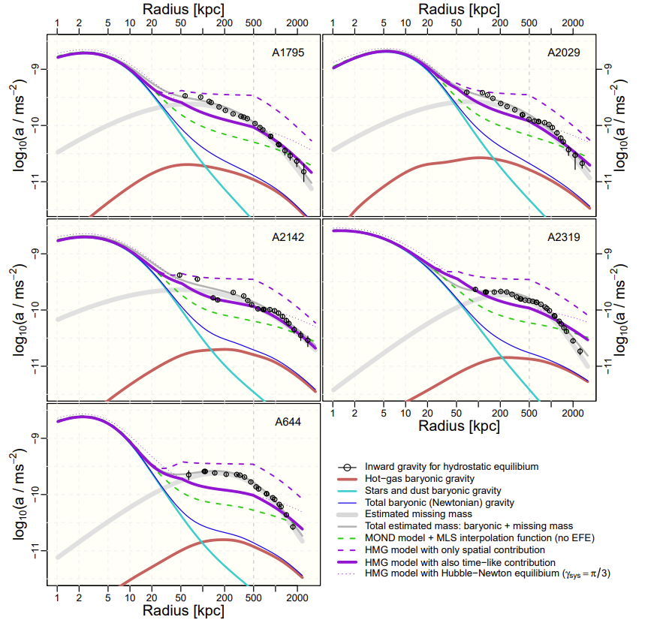
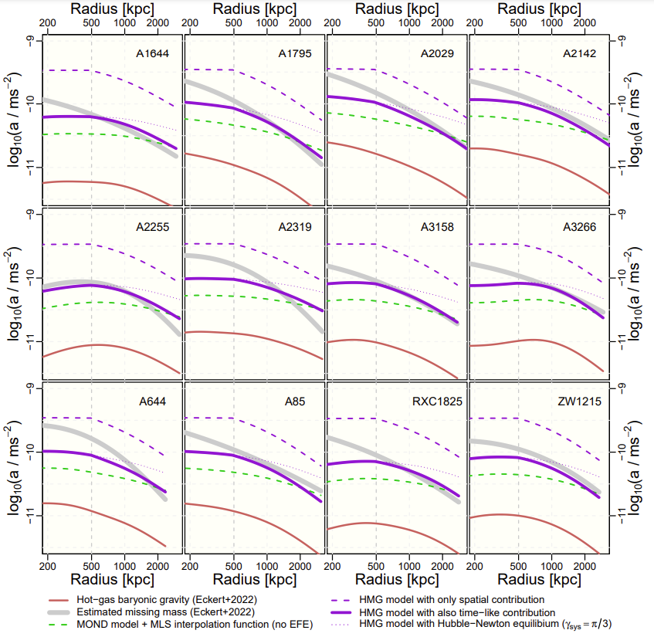
Robert Monjo: Testing hyperconical modified gravity in galaxies and clusters
Clusters
Monjo, R. (2025): ApJ 981, 195, 10.3847/1538-4357/adb8d7
15.
Hydrostatic equilibrium for galaxy clusters (X-ray gas)
Acceleration profiles for the five X-COP galaxy clusters that have complete information on mass profiles:
Notes:
xx
17

Slide 18
Robert Monjo: Testing hyperconical modified gravity in galaxies and clusters
Contents
15.
Motivation
  Dynamical embedding
Approach:
  Hyperconical modified gravity
  Observations
Results: Fictitious acceleration of...
  Cosmos
  Clusters
  Galaxies
Final remarks
Notes:
18

Slide 19
Robert Monjo: Testing hyperconical modified gravity in galaxies and clusters
Final remarks
15.
(1)
Projected radially-inhomogeneous metric is consistent with a “local general relativity”.
(2)
Prediction of specific values of fictitious acceleration assimilable to cosmic dark matter-energy.
(3)
Fictitious acceleration in galaxies and galaxy clusters: Hyperconical modified gravity (HMG)
(4)
Better performance than MOND even for weak-lensing and hidrostatic-equilibrium inferred data
(5)
Success in flat speed and hot-gas regions beyond 500–1000 kpc without dark matter
(6)
Discrepancies for some galaxy clusters beyond 2Mpc (especially for A644, A2255, and A2319 )
(7)
Future works:
Modeling CMB and BBN
Growth and dynamics of larger cosmic structures
Notes:
Success in flat speed and hot-gas regions beyond 500–1000 kpc without dark matter
19

Slide 20
Thanks to Prof. Stacy McGaugh, Prof. Pengfei Li, Dr. Tobias Mistele and Prof. Dominique Eckert
for the data
and
Thank you very much for your attention
References:​
Monjo, R. (2025): ApJ 982, 7010.3847/1538-4357/adb723
Monjo, R. (2025): ApJ 981, 195,, 10.3847/1538-4357/adb8d7
Monjo, R. & Banik, I. (2024): https://arxiv.org/abs/2405.10019
Monjo, R. (2024): ApJ 967, 66, 10.3847/1538-4357/ad3df7
Monjo, R. (2023): CQG 40, 235002, 10.1088/1361-6382/ad0422 ​
Monjo, R. & Campoamor-Stursberg R. (2023) CQG 40, 195006. 10.1088/1361-6382/aceacc ​
Monjo, R. & Campoamor-Stursberg R. (2020). CQG 37, 205015. 10.1088/1361-6382/abadaf ​
Monjo, R. (2018). PRD 98, 043508 10.1103/PhysRevD.98.043508 ​
Monjo, R. (2017). PRD 96, 103505. 10.1103/PhysRevD.96.103505
Notes:
20

Slide 21
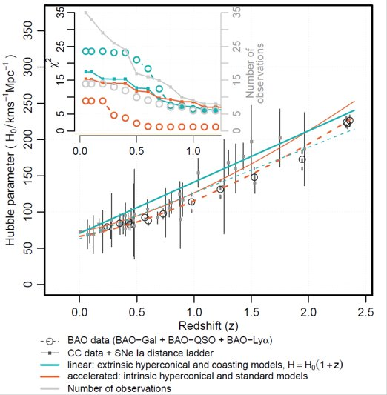
Robert Monjo: Testing hyperconical modified gravity in galaxies and clusters
Cosmos
21
Monjo, R. (2024): ApJ 967, 66, 10.3847/1538-4357/ad3df7
15.
Expansion rate (H)
Hubble parameter (H) and statistical error (σ) as a function of redshift (z), estimated by using cosmic chronometers (CC: 34), type-Ia SNe distance ladder (Ladder: 3) and radial BAO size from several approaches: Galaxy distribution (BAO-Gal: 7), redshift space distortions from eBOSS quasars (BAO-QSO: 4) and Lymann-α forest (BAO-Lya: 3).
Notes:
1,550 distinct Type Ia supernovae (SNe Ia) pairs of redshift and luminosity distance (modulus)
Source: Pantheon+ data of 1,701 light curves corresponding to 1,550 distinct SNe Ia (Scolnic et al.2022; Brout et al. 2022).
51 measurements of expansion rate
Cosmic chronometers (CC: 34)
Type-Ia SNe distance ladder (Ladder: 3)
Radial BAO size from several approaches:
Galaxy distribution (BAO-Gal:7),
redshift space distortions from eBOSS quasars (BAO-QSO: 4)
Lymann-α forest (BAO-Lya: 3).
21

