Slide 1
Talk-for-Guides: Lifecycle of the LHC
The CERN Accelerator complex and its running
Rende Steerenberg – BE/OP
6 December 2024

Slide 2
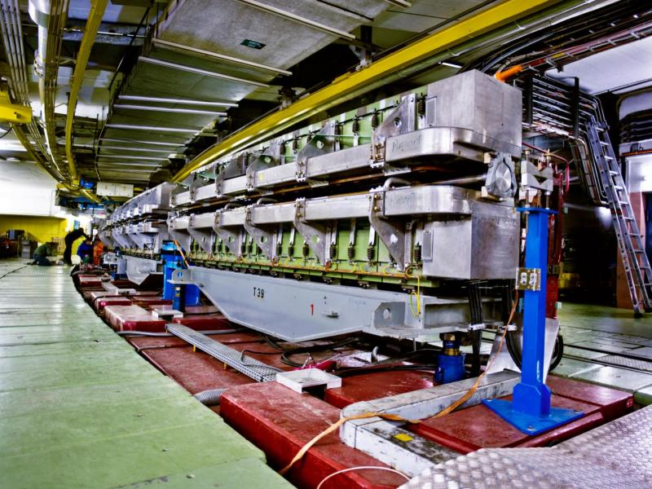

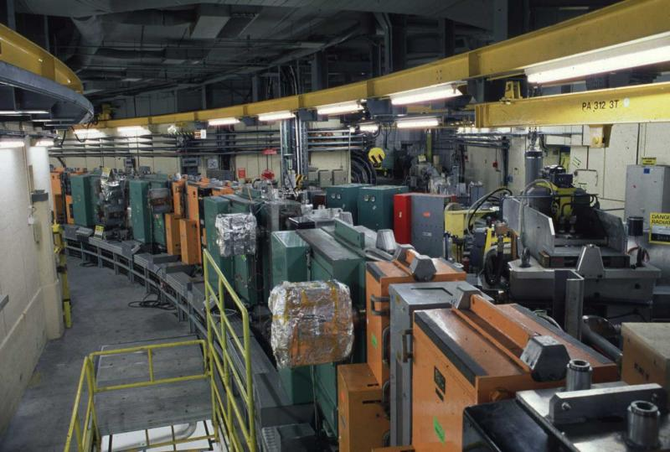
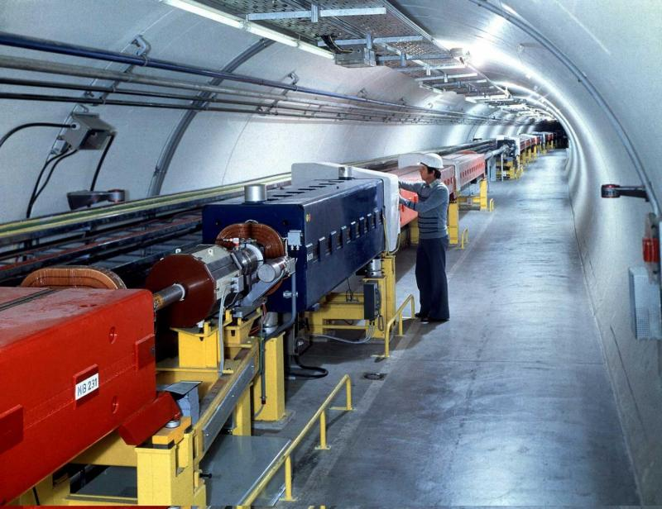
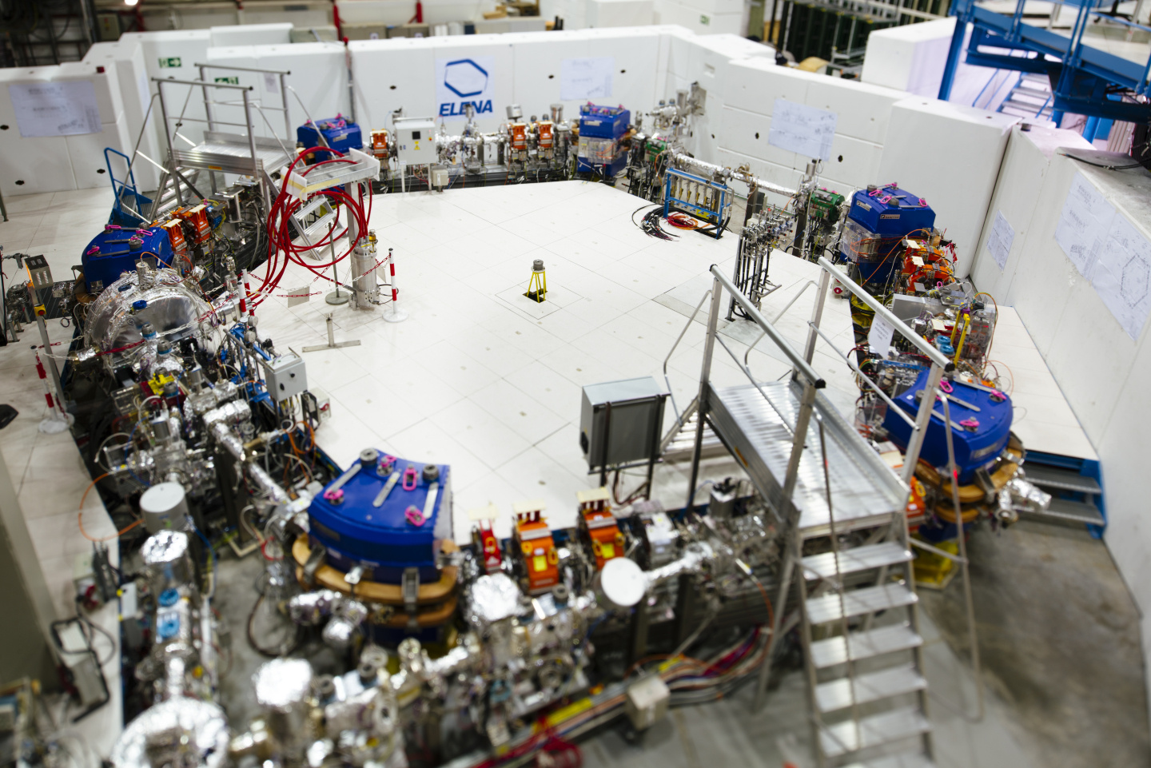
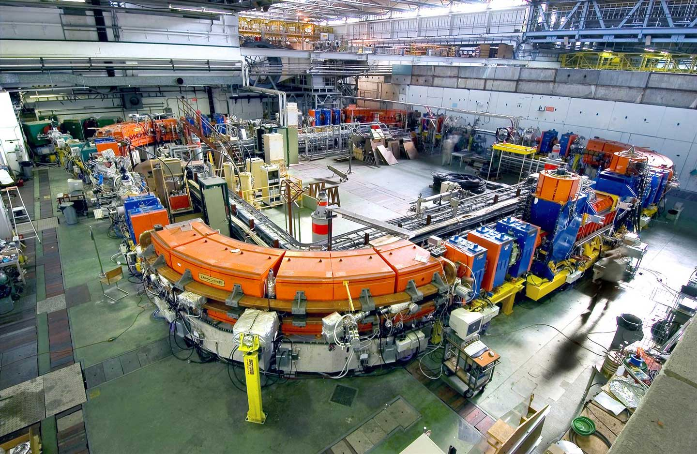
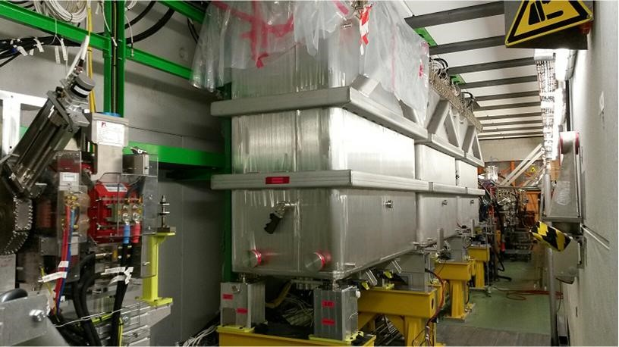
The CERN Accelerator Complex

Slide 3
Topics
Scheduling
Satisfying our Users
Controlling the Accelerator Complex
Some things that will happen during LS3

Slide 4
Scheduling
Satisfying our Users
Controlling the Accelerator Complex
Some things that will happen during LS3

Slide 5
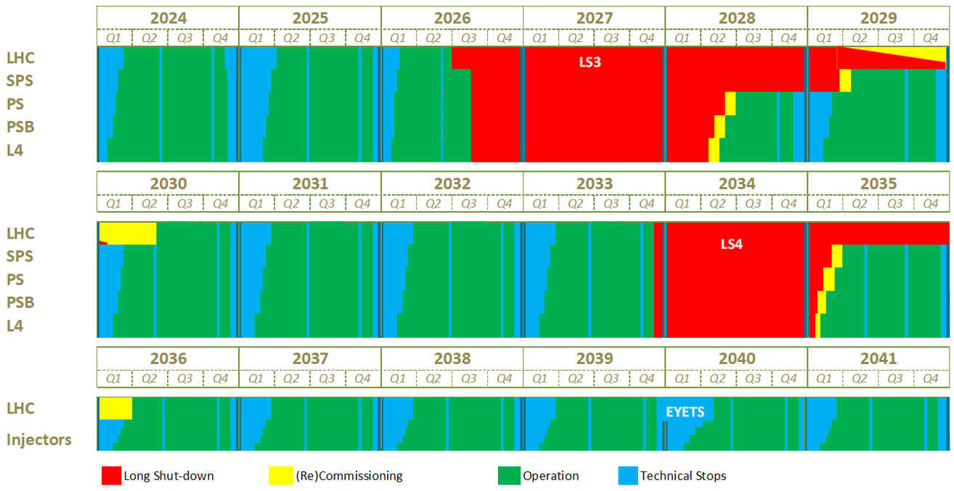
The long-term accelerator schedule
NA Consolidation Phase 1

Slide 6
The long-term accelerator schedule
The running of the accelerator complex is interleaved with:
  Technical stops – TS
  Year End Technical Stops - YETS
  Long shutdowns – LS
The periods between the LS’s are typically 4 to 5 years
Yearly schedules are made and approved by the Research Board based on this long-term schedule
The present Long-term schedule runs until 2041 incl.
  This is at present the foreseen date to complete the (HL-)LHC programme
Run 3
NA Consolidation Phase 1
Run 4
Run 5

Slide 7
The long-term accelerator schedule
End of the Run 3:
  LHC – last beams scheduled to be dumped on 29 June 2026
  Injectors – End of beam production and physics scheduled for 31 August
Tentative dates to resume beam operation post-LS3 (still under discussion)
  (HL-)LHC
    Hardware re-commissioning January 2029
    Beam re-commissioning May 2030
  SPS: May 2029
  PS Complex: May/June 2028
Run 3
NA Consolidation Phase 1
Run 4
Run 5

Slide 8
Global overview of the LHC running until LS3
25.11.2024
05.04.2025
08.12.2025
23.02.2026
29.06.2026
2025
2026
YETS 24-25
19 weeks
YETS 25-26
11 weeks
LS3
35 weeks
18 weeks
2025: 35 weeks YETS to YETS → 165 physics days (protons, oxygen ions and lead ions)
2026: 18 weeks YETS to YETS → 88 physics days (protons and lead ions)

Slide 9

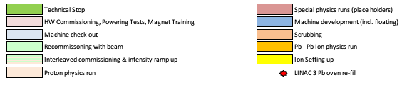
The Yearly Schedule: 2025
Yearly Schedules are based on:
  The long-term schedule
  Physics needs as defined by the experimental committees and the Research board
  The period necessary to restart the complex and to prepare the different beam types required
There are two yearly schedules:
  The LHC schedule
  The Injectors schedule
Commissioning
Commissioning
25 ns p+ physics
O ions
25 ns p+ physics
25 ns p+ physics
Pb ions

Slide 10
Scheduling
Satisfying our Users
Controlling the Accelerator Complex
Some things that will happen during LS3

Slide 11
Filling the LHC

Slide 12
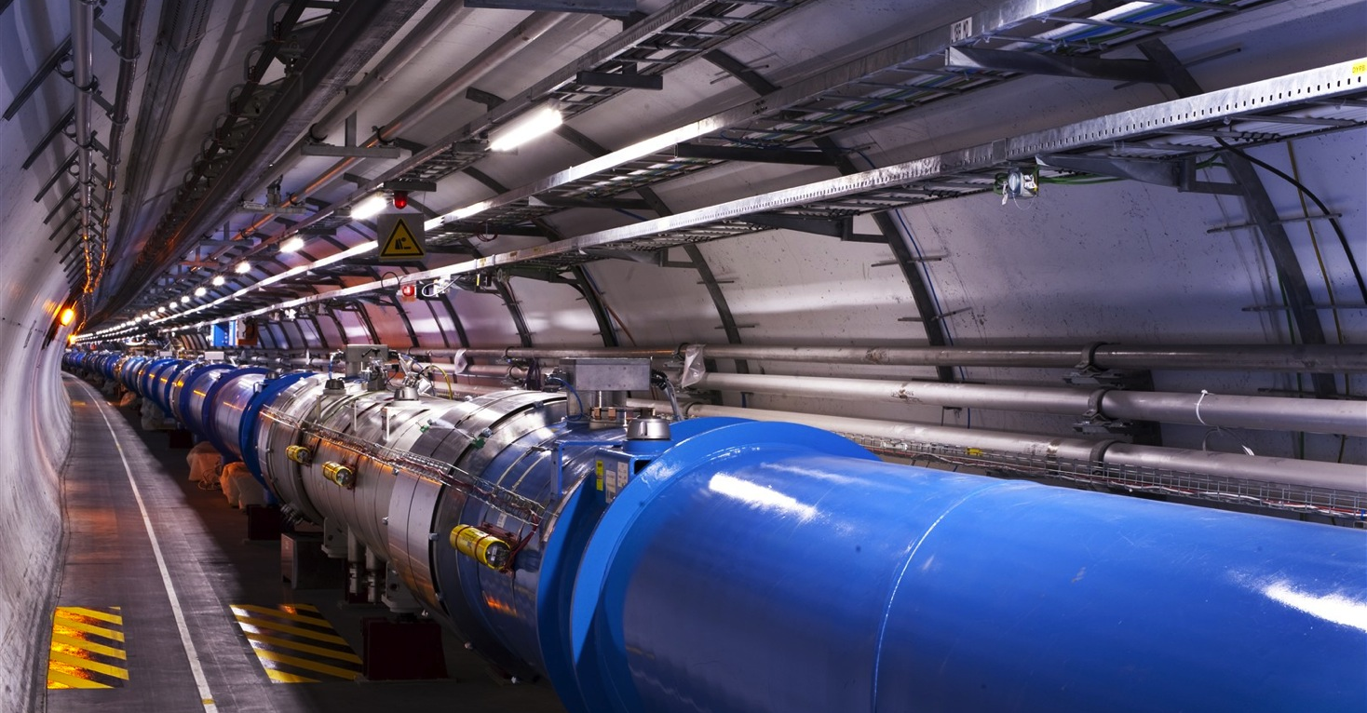
LHC
1232 main dipoles of 15 m each that deviate the beams around the 27 km circumference
858 main quadrupoles that keep the beam focused
6000 corrector magnets to preserve the beam quality
Main magnets use superconducting cables (Cu-clad Nb-Ti)
12’000 A provides a nominal field of 8.33 Tesla
Operating in superfluid helium at 1.9K

Slide 13
The LHC Cycle
= Field in main magnets
= Beam 1 intensity (current)
= Beam 2 intensity (current)
Time
6.8 TeV
450 GeV
Injection
Ramp
Squeeze
&
Adjust
Stable beams for physics
Dump
&
Ramp down

Slide 14
Stored Beam Energy in the LHC
The stored energy in one LHC beam at 6.8 TeV nowadays is about 400 Million Joules
This corresponds to the energy of a TGV train going at ~160 km/h
...... but then concentrated in the size of a hair

Slide 15
Filling the LHC & Satisfying Fixed Target users
To LHC clock-wise or counter clock-wise
= Field in main magnets
= Proton beam intensity (current)
450 GeV
= Beam transfer
SPS
26 GeV
PS
1.4 GeV
PSB
1.2 seconds
Time

Slide 16
Satisfying the Fixed Target Users

Slide 17
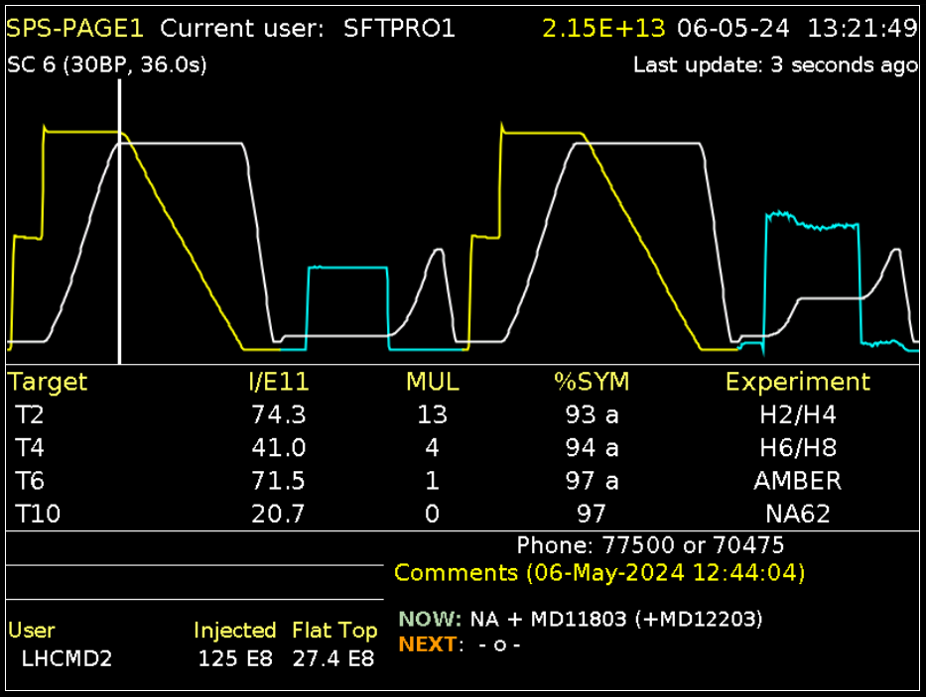
Satisfying Fixed Target users, when LHC is not filling
Example SPS:
https://op-webtools.web.cern.ch/vistar/?usr=SPS1
Cycle (e.g. SFTPRO1):
  Flat bottom – injection
  Ramp – acceleration
  Flattop – extraction
  Ramp down – no beam
Super Cycle & Basic Periods:
  Sequence of multiple cycles of the same or different type that repeats itself
  Length 30BP, 36.0s

Slide 18
Satisfying Fixed Target users, when LHC is not filling
Cycle SFTPRO1:
  Two injections from the PS
    Each PS cycle injecting takes 1.2S
  Final destination North Area
  Slow extraction over ~ 4.5 sec.
  Total cycle duration 9BP, 10.8s
  Used for physics
1st Short parallel MD
2nd Short parallel MD
North Area
Cycle MD1:
  One injections from the PS
  Destination internal beam dump
  Total cycle duration 6BP, 7.2s
  Used for Machine development studies (MD)
North Area

Slide 19
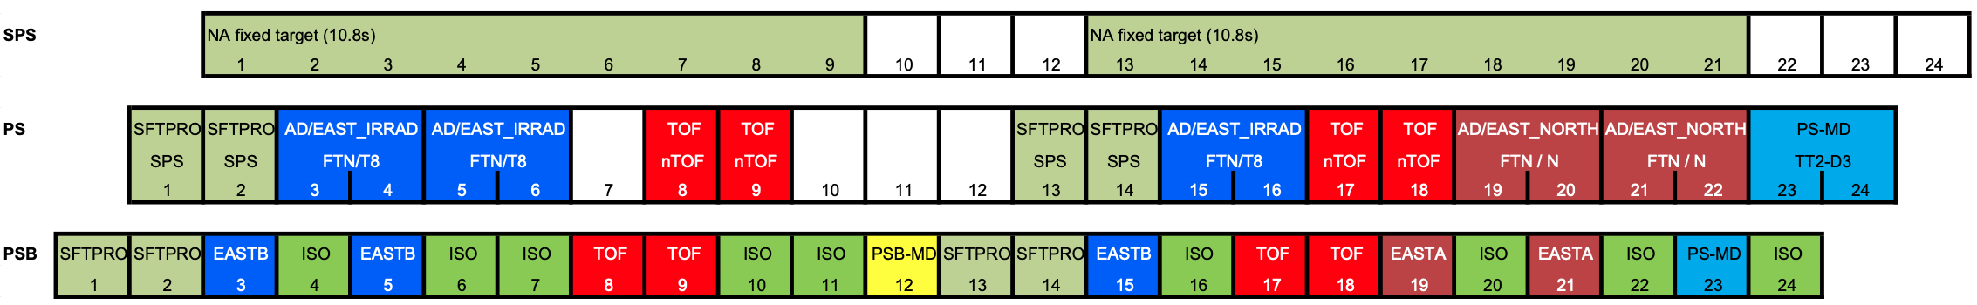
PSB, PS and SPS super cycle composition example
SPS Fixed target (=SFTPRO1):
  Requires 2 cycles in the PSB injecting into the PS injecting into the SPS
  While SPS is accelerating and extracting PS can PSB can serve ‘their’ users
    PS: 2 x East Area requiring each 1 cycle in the PSB + 2 x nTOF requiring each 1 cycles in the PSB
    PSB: in the shadow of the PS accelerating and extracting for East Area, PSB can produce ISOLDE
    PSB can also use the cycles for ISOLDE that are not required by PS or PS and SPS

Slide 20
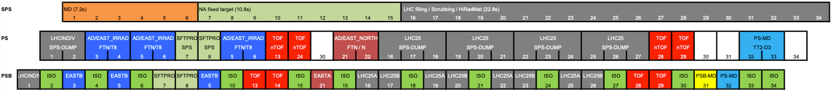
Other examples
Infinitely other combinations possible….

Slide 21
Scheduling
Satisfying our Users
Controlling the Accelerator Complex
Some things that will happen during LS3

Slide 22
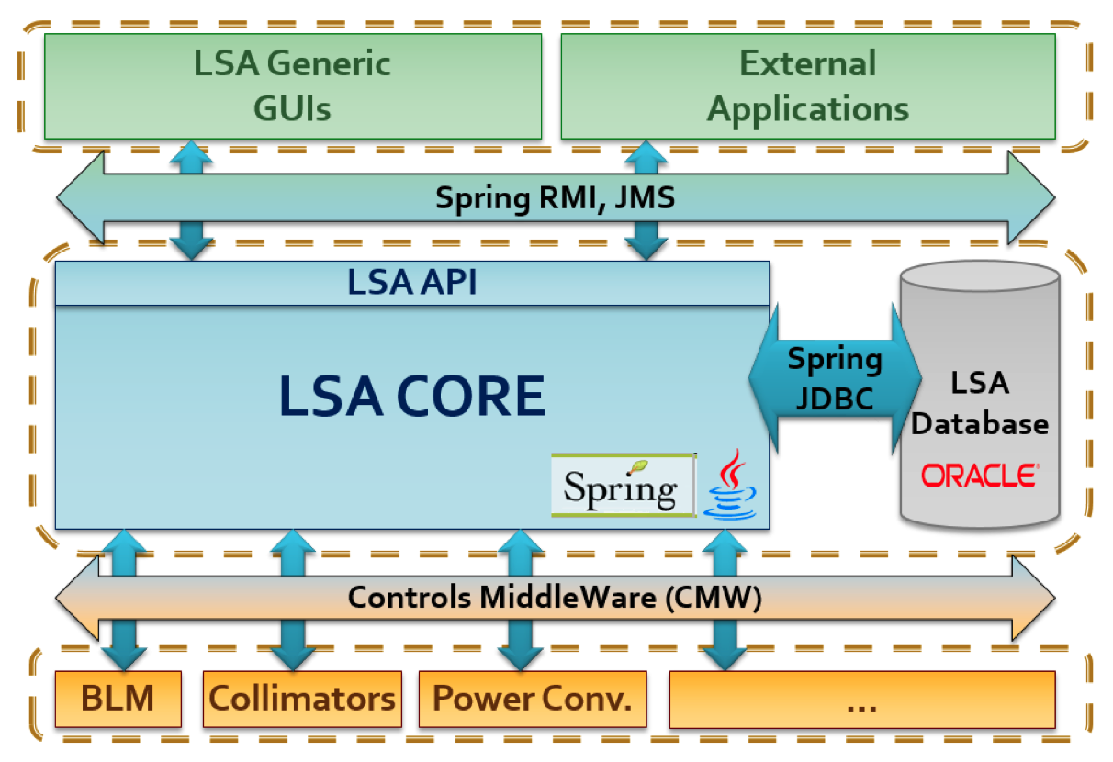
Settings Management
All machine equipment (e.g. power converters, RF cavities, beam instrumentation, …) are items in a database with various properties
Each cycle has a label (e.g. SFTPRO1, MD1, LHCINDIV, ISO,….) which are stored in a database
The database contains settings (values, functions) for each cycles in each machine
Every time a cycle is executed:
  These values are sent to the equipment
  The values and functions are activated by timing events that are also programmed in a database
This allows to program each cycle differently enabling the production of very different types of beams

Slide 23
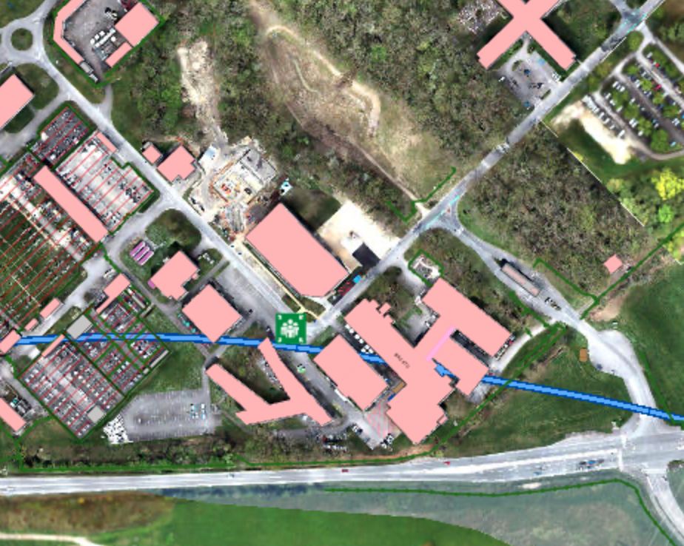
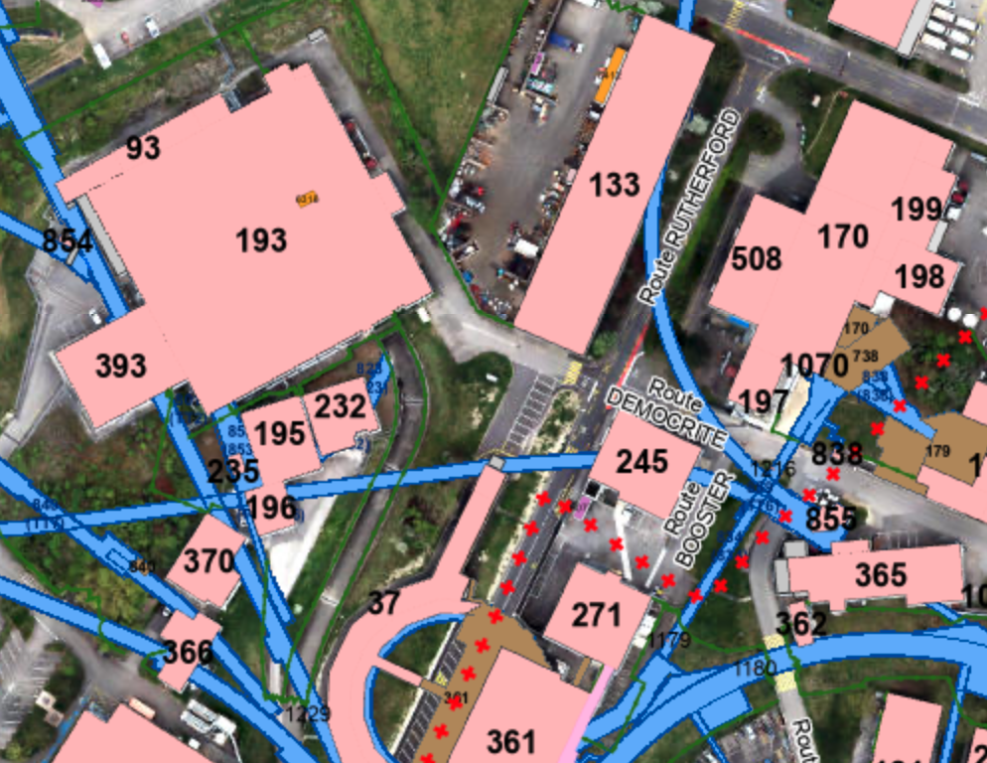
Control Rooms
CERN Control Centre (CCC) – Prevessin
  24/7 shifts
  Linac4, PSB, PS, SPS, LHC
  LINAC3, LEIR
  Technical Infrastructure, Cryogenics
AD Control Room (ACR) - Meyrin
  Day time operation
  Back-up operation from CCC during nights & weekends
  Standby service by AD/ELENA operator
ISOLDE Control Room (ICR) - Meyrin
  Day time operation
  Limited back-up operation by experimentalists during nights & weekends
  Standby service by ISOLDE operator

Slide 24
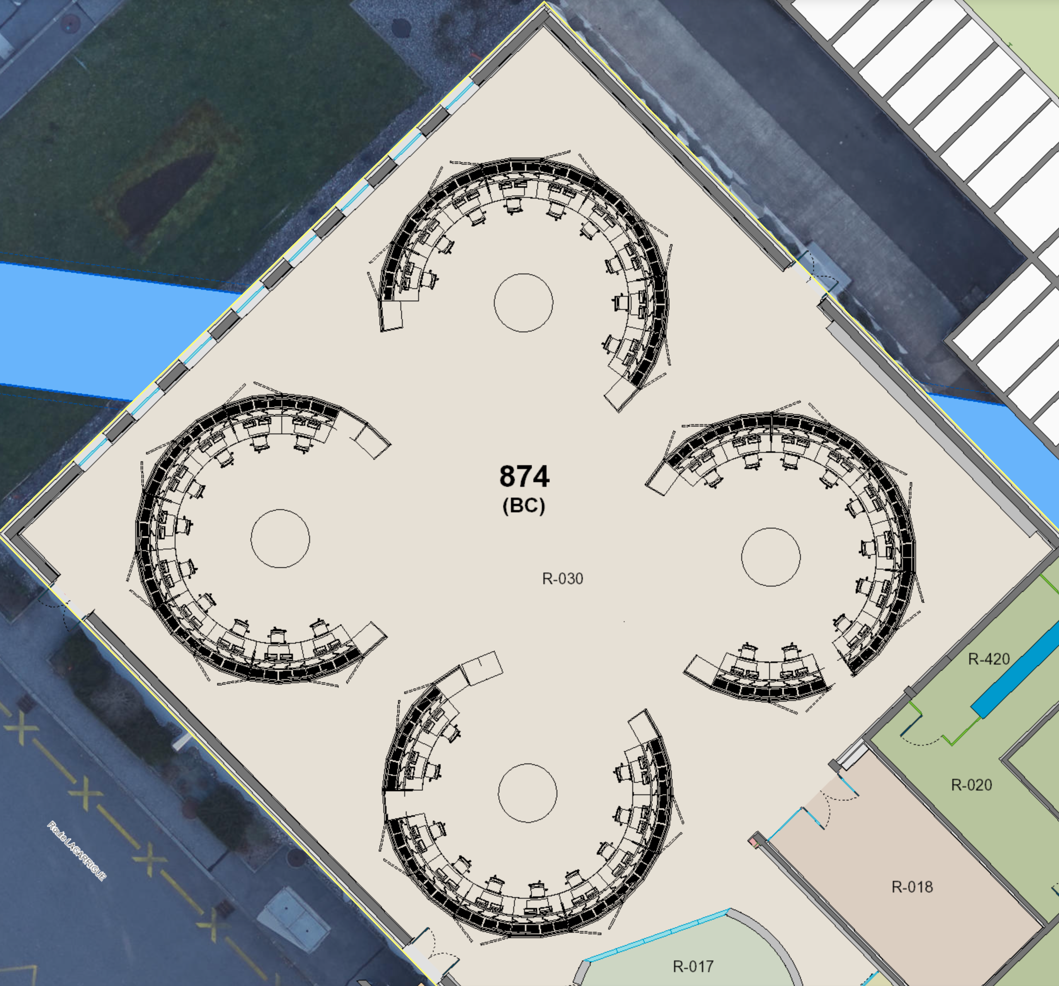
CERN Control Centre (CCC) lay-out
PS island
  1 Shift leader + 1 or 2 Operators
SPS island
  1 Shift leader + 1 Operator
LHC island
  1 Engineer in charge (LHC-EiC)
TI/Cryo island
  1 Technical infrastructure operator
  1 (or 2) Cryo operator(s)
During daytime 20 to 30 people extra for studies, setting-up new beams, issues, etc.
TI
Cryo
Linac 4, PSB, PS
Back-up operation for AD/ELENA
LHC
SPS/LEIR

Slide 25
Scheduling
Satisfying our Users
Controlling the Accelerator Complex
Some things that will happen during LS3

Slide 26
What will happen during LS3?
HL-LHC project will be deployed
  The LHC Injector Upgrade (LIU) project was completed during LS2
  During run the performance potential given to the injectors has been exploited and HL-LHC beam parameters have been achieved in the injectors.
  Now LHC will be prepared to be able to cope with the high intensity and high brightness beams

Slide 27
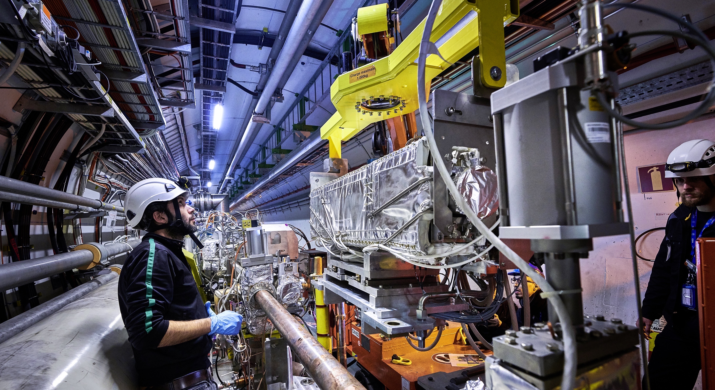
Upgrade to the
High-Luminosity LHC is under way
The HL-LHC will use new technologies to provide
10 times more collisions
than the LHC.
The stored beam energy will increase from ~300 MJ to ~600 MJ.
It will give access to rare phenomena, greater precision and larger discovery potential.
It will start operating in 2030, and run until 2041.
Notes:
Additional information (OPTIONAL, TIME PERMITTING)
Key innovations in HL-LHC:
1) Powerful superconducting quadrupole magnets (12 Tesla) will be installed on either side of the ATLAS and CMS experiments to focus the particle bunches. These magnets will be made using niobium-tin (Nb₃Sn), used for the first time in an accelerator (instead of niobium-titanium)
2) Crab cavities for tilting the beams (16 in total) - give the head and tail of the particle bunches opposite-sign transverse momentum before they meet, enlarging the overlap area of the two bunches and thus increasing the probability of collisions.
3) One hundred new, more effective collimators will be installed: these devices absorb particles that stray from the beam trajectory and might otherwise damage the machine.
5) Innovative superconducting power lines will connect the power converters to the accelerator; will be able to carry currents of record intensities, up to 100 000 amps!

Slide 28
Luminosity, the Figure of Merit
Revolution
frequency
Intensity per bunch
Number of bunches
Geometrical
Correction
factors
Beam dimensions
What to do to maximise luminosity?
Increase the number of bunches and revolution frequency → constraint
Increase the bunch intensity
Reduce the transverse beam size (emittance)
Reduce the beam size at the collision point
Minimise the crossing angle
Ensure good machine availability to increase integrated luminosity
LHC Injectors Upgrade
HL-LHC Upgrade

Slide 29
Key Ingredient Injector Upgrade
Before stripping foil
Charge exchange injection with H⁻
x’
+
-
+
+
-
-
-
+
-
+
+
-
+
-
+
-
+
x
+
-
+
-
+
+
-
+
Behind stripping foil
x’
+
+
+
+
+
+
+
+
+
+
+
+
+
+
+
+
+
x
+
+
+
+
+
+
+
+
Phase Space Painting is possible (various particle distributions)

Slide 30
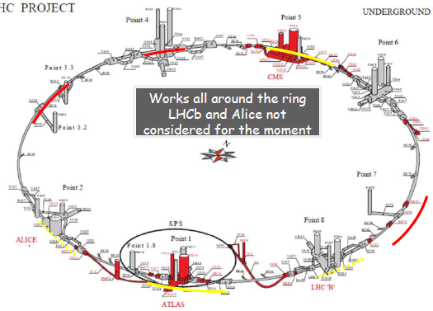
The High Luminosity LHC Project
Major civil engineering
New interaction region magnets
Collimation upgrade
  Cryogenics upgrade
  Crab Cavities to reduce crossing angle
  Cold powering
  Machine protection
  …and much more…

Slide 31
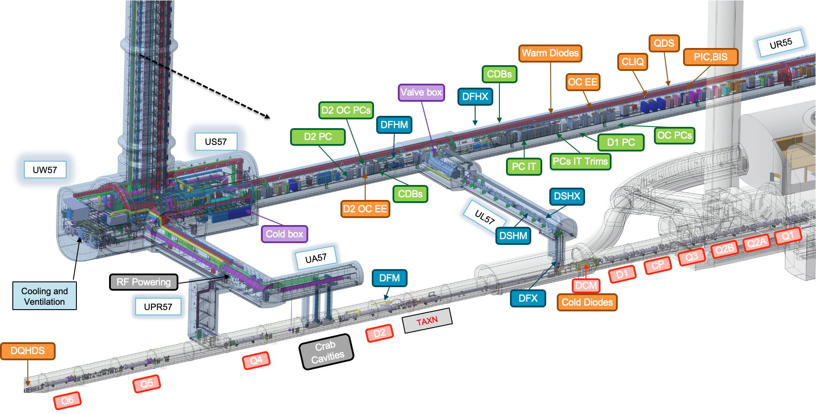
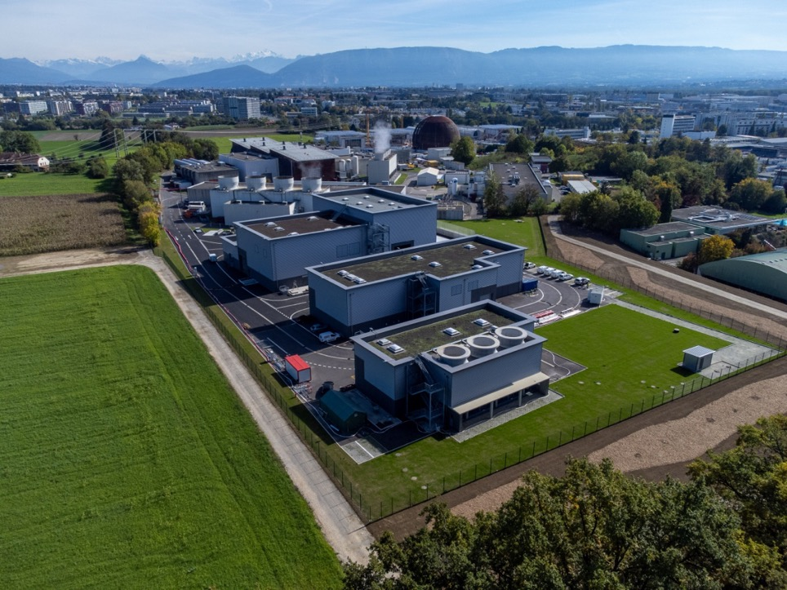
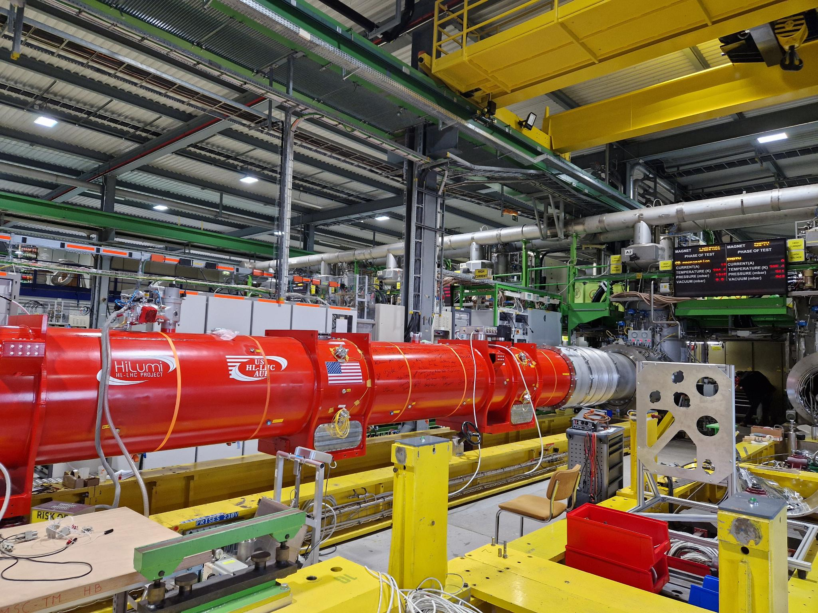
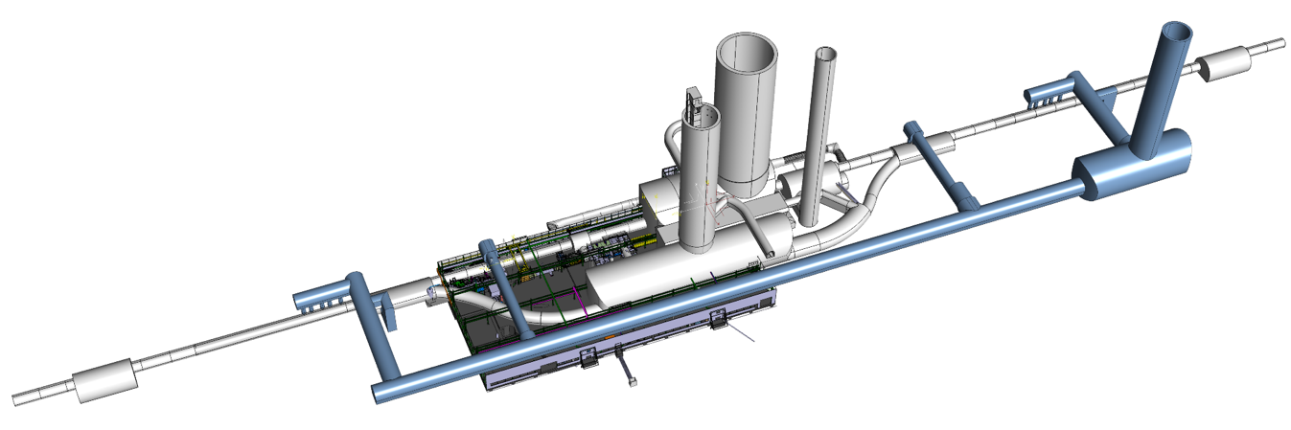
New Facilities and Equipement Being Added
The HL-LHC is to be commissioned in 2030
….stay tuned….

Slide 32
What will happen during LS3?
HL-LHC project will be deployed
  The LHC Injector Upgrade (LIU) project was completed during LS2
  During run the performance potential given to the injectors has been exploited and HL-LHC beam parameters have been achieved in the injectors.
  Now LHC will be prepared to be able to cope with the high intensity and high brightness beams
SPS North Area consolidation phase 1 & HI-ECN3 in view of the SHiP experiment

Slide 33
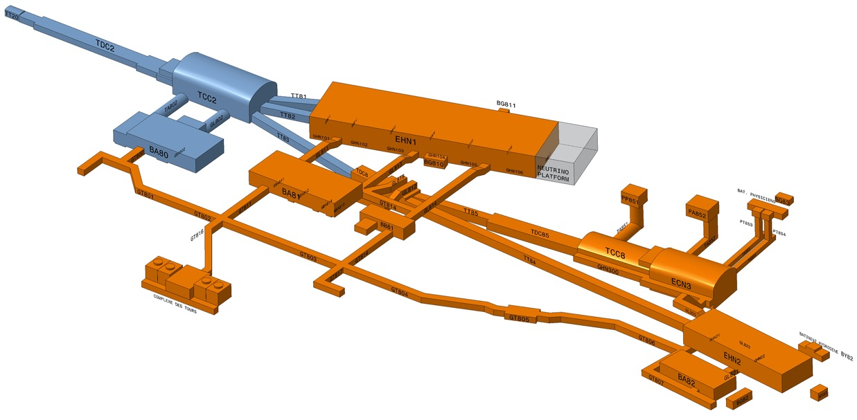
Scope of SPS North Area Consolidation
Consolidation Phase 1 (2019 – 2028)
Primary areas incl. TDC2, TCC2, BA2, BA80 & beam lines towards EHN1 & TDC8
Consolidation Phase 2 (2029 – 2034): BA81, BA82, EHN1, EHN2 & associated beamlines

Slide 34
High Intensity ECN3 for the SHiP experiment
  TCC8/ECN3:
  Beam Dump Facility
  HI Target Complex
  Related Infrastructure &
  Services
q

Slide 35
What will happen during LS3?
HL-LHC project will be deployed
  The LHC Injector Upgrade (LIU) project was completed during LS2
  During run the performance potential given to the injectors has been exploited and HL-LHC beam parameters have been achieved in the injectors.
  Now LHC will be prepared to be able to cope with the high intensity and high brightness beams
SPS North Area consolidation phase 1 & HI-ECN3
ISOLDE beam dumps replacement in view of possible energy and intensity upgrade

Slide 36
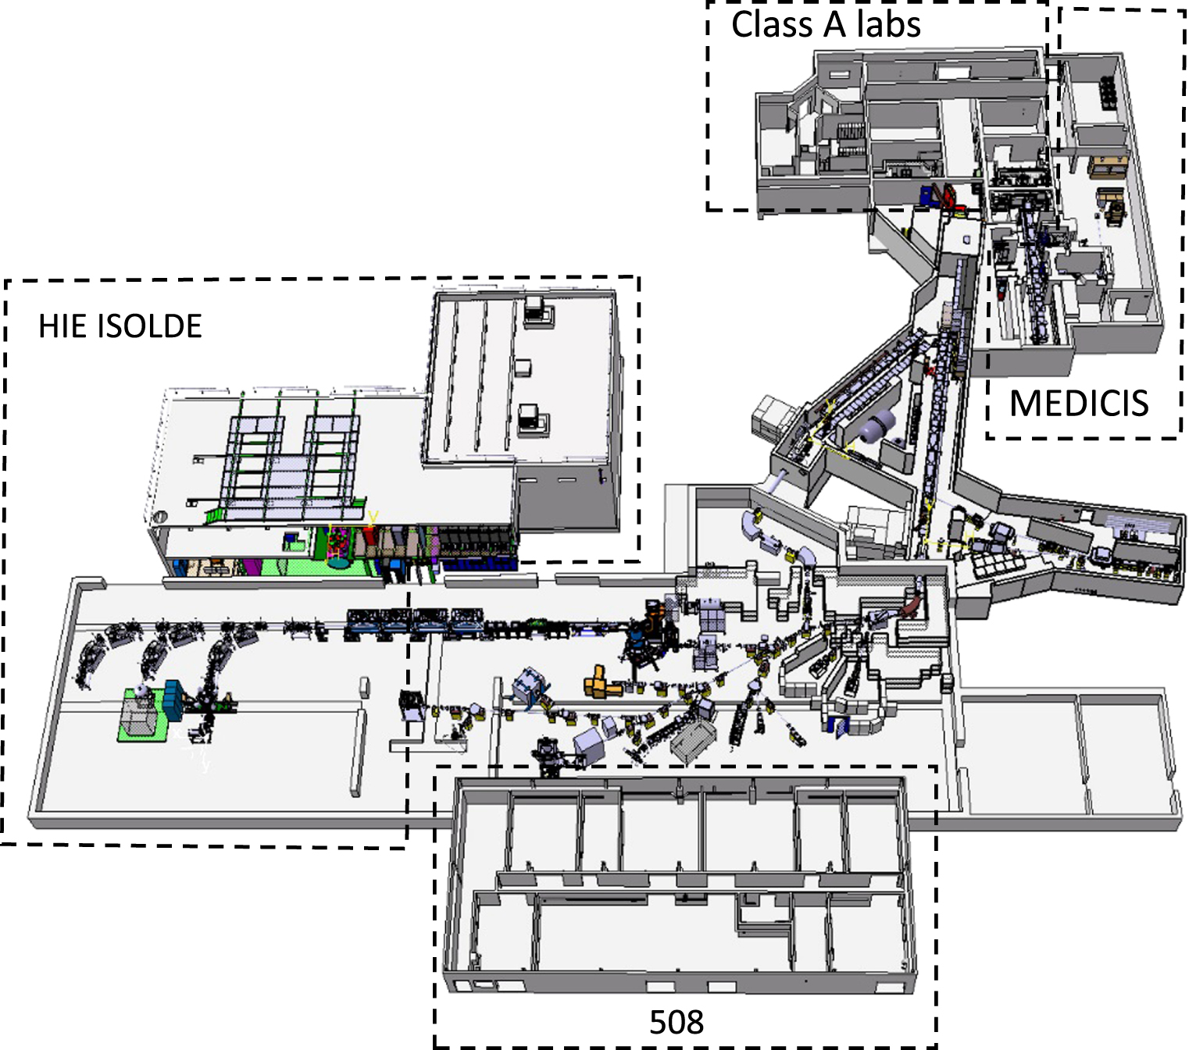
The ISOLDE layout
With the LIU upgrade the PSB:
Can provide higher energy beam at 2 GeV instead of 1.4 GeV
Has the potential to provide higher intensity beam to ISOLDE
To allow for this ISOLDE will need to be consolidated and possibly upgraded
One major ingredient for this is the replacement of the beam dumps
PSB Protons

Slide 37
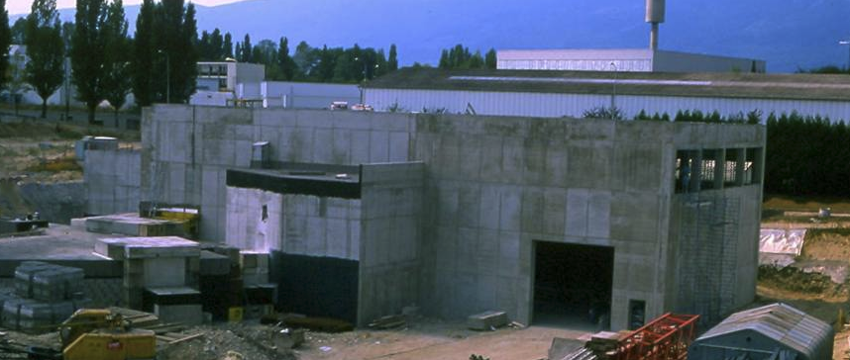
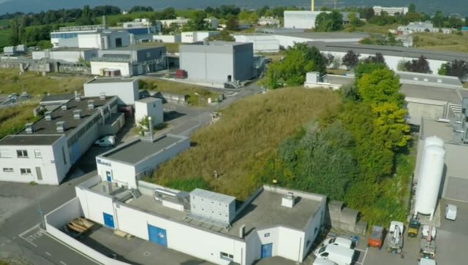
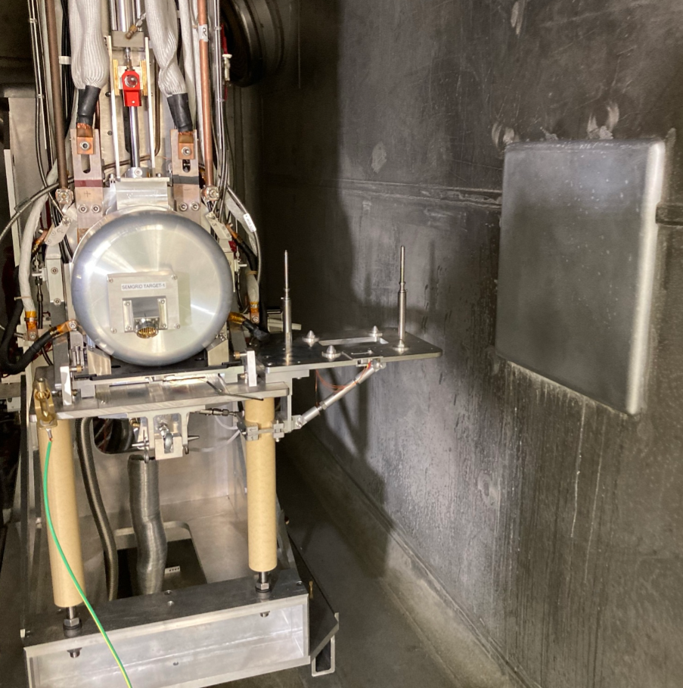
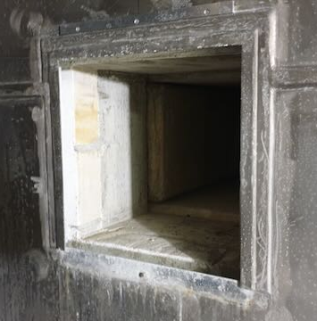
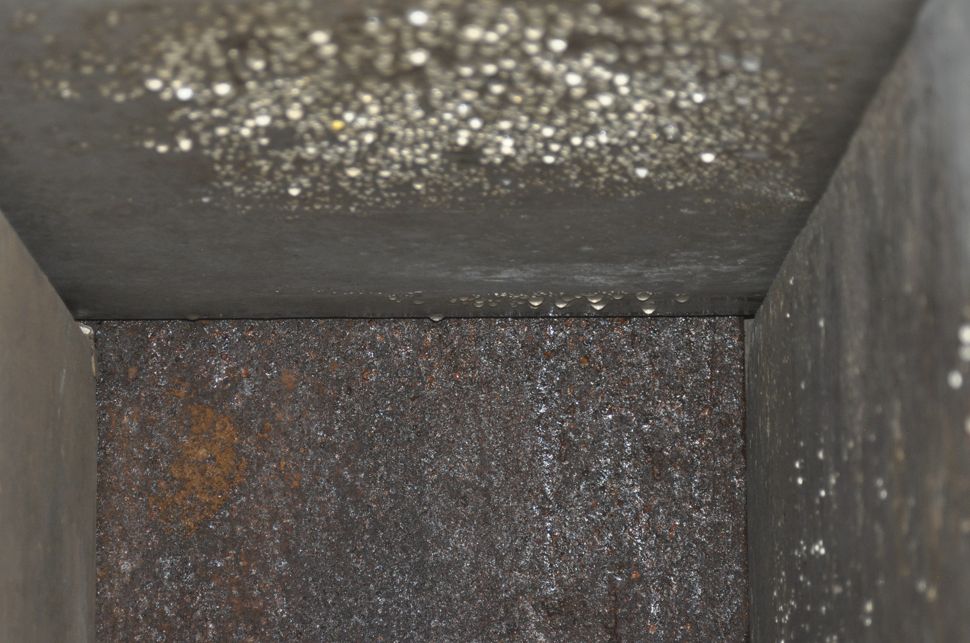
ISOLDE Beam Dump Replacement
ISOLDE construction1991-1992
ISOLDE 2023
GPS dump
HRS dump
GPS dump and shielding
HRS dump and shielding
Dumps already operate at their limit in terms of temperature and mechanical stresses
Suffering from:
Corrosion
PSB Protons

Slide 38
What will happen during LS3?
HL-LHC project will be deployed
  The LHC Injector Upgrade (LIU) project was completed during LS2
  During run the performance potential given to the injectors has been exploited and HL-LHC beam parameters have been achieved in the injectors.
  Now LHC will be prepared to be able to cope with the high intensity and high brightness beams
SPS North Area consolidation phase 1 & HI-ECN3
ISOLDE beam dumps replacement in view of possible energy and intensity upgrade
Massive consolidation work (e.g. electrical infrastructure, …)
…. Many more… plus… the usual preventive and corrective maintenance

Slide 39
But until then the focus will be on beam production for physics Stay tuned…!

Slide 41
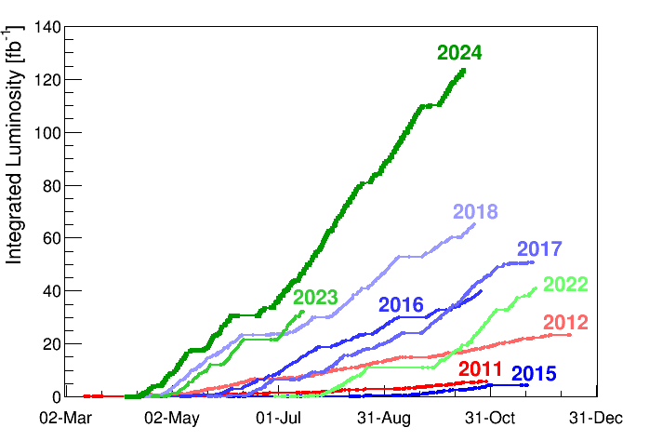
Breaking Performance Records
Peak Luminosity | 2.33x10³⁴ cm⁻²s⁻¹
Max. Luminosity in one day | 1.525 fb⁻¹
Max. Luminosity in 7 days | 8.342 fb⁻¹
Longest time in Stable Beams | 5 days 3 hr 35 min
Max. Charge per bunch | 1.64x10¹¹
The integrated luminosity for proton physics during Run 3 so far stands at an impressive 196 fb⁻¹, surpassing the combined total of Runs 1 and 2 - and Run 3 is far from over, with 2025 and 2026 still ahead of us.

Slide 42
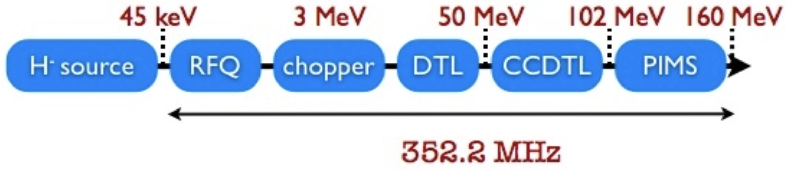
Linac 4
H⁻ ion source at 45 keV
Accelerates beam up to 160 MeV
The chopping scheme allows removing some of the Linac bunches to make the beam fit into the PS Booster RF buckets
Pulse rate 1.2 s

Slide 43
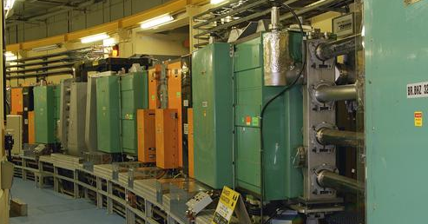
PS Booster
1st Synchrotron with 4 superposed rings
Circumference of 157 m
Proton energy from 160 MeV to 2 GeV
Can cycle every 1.2 s
Each ring will inject over multi-turns, using charge exchange injection
Before stripping foil
Behind stripping foil
x’
x’
+
+
-
+
+
+
+
+
-
-
-
+
+
+
+
-
+
+
-
+
+
+
+
+
+
-
+
-
+
x
+
+
+
+
+
x
+
-
+
+
+
+
-
+
+
+
+
+
-
+
+
+

Slide 44
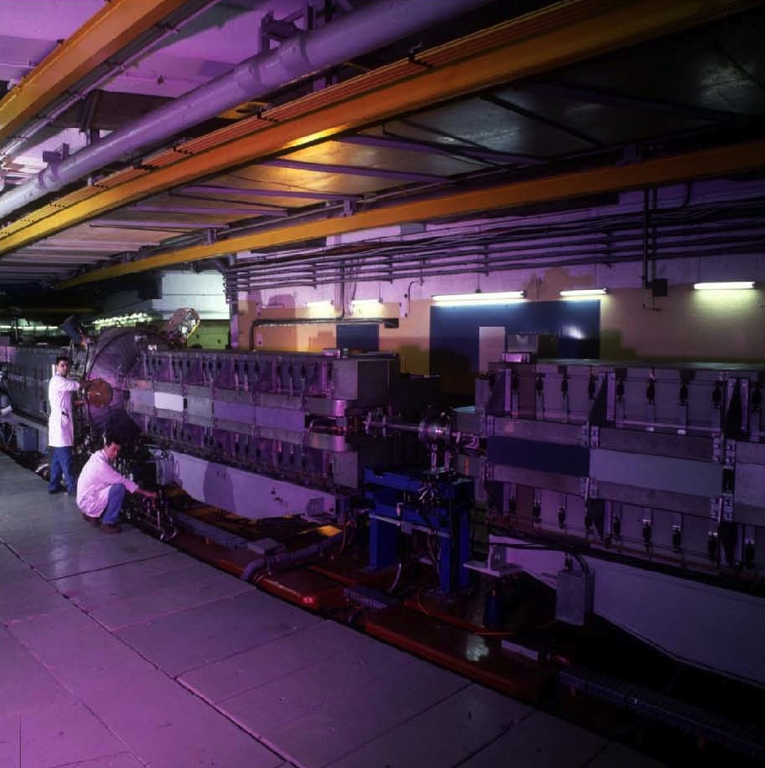
PS
The oldest operating synchrotron at CERN
Circumference of 628m
  4 x PSB circumference
Increases proton energy from 2 GeV to max. 26 GeV
Cycle length ranges from 1.2s to 3.6s
Many RF systems allow for complex RF gymnastics
Various types of extractions:
  Fast extraction
  Multi-turn extraction (MTE)
  Slow extraction

Slide 45
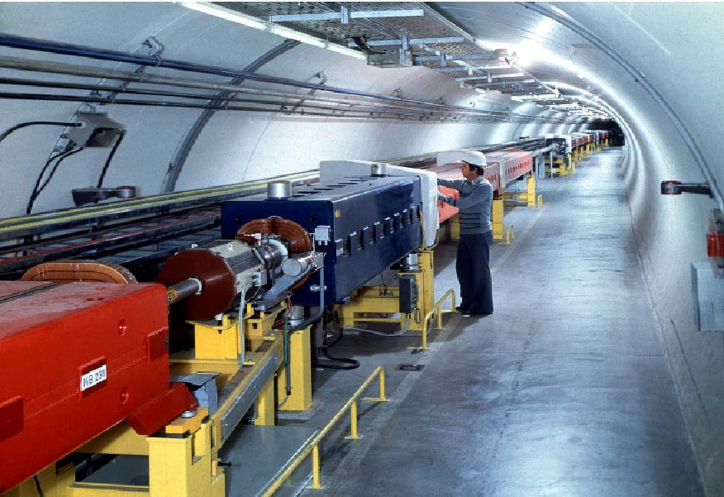
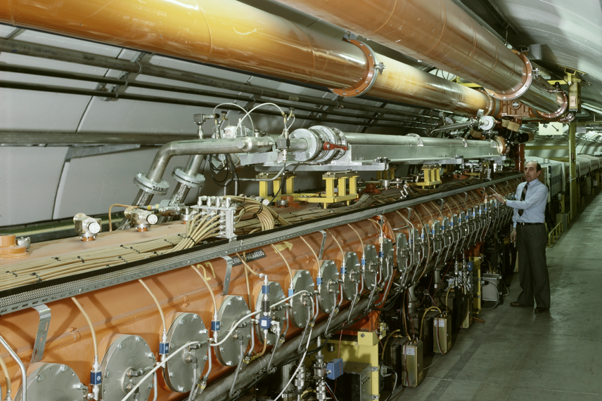
SPS
The first synchrotron in the chain at ~30m under ground
Circumference of 6.9 km
  11 x PS circumference
Increases proton beam energy up to 450 GeV with up to ~5x10¹³ protons per cycle
Provides slow extracted beam to the North Area
Provides fast extracted beam to LHC, AWAKE and HiRadMat

Slide 46
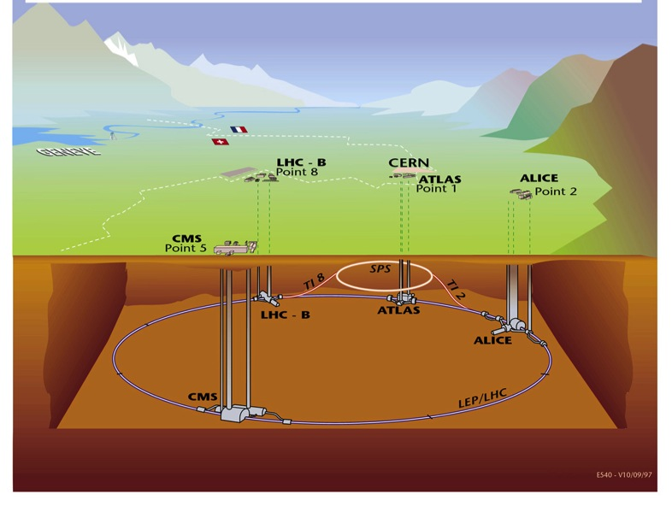
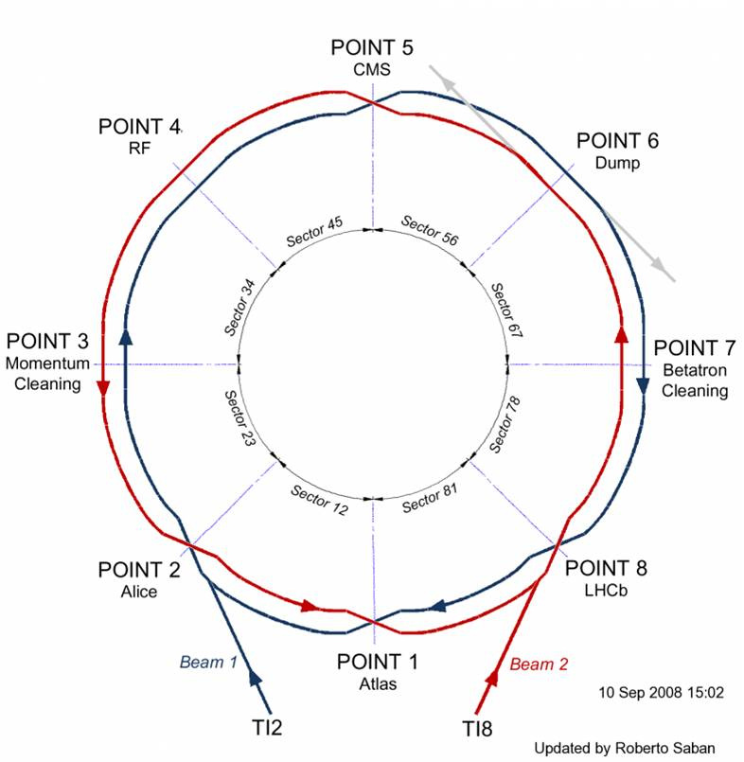
LHC
Situated on average ~100 m under ground
Four major experiments
Circumference 26.7 km
Two separate beam pipes going through the same cold mass 19.4 cm apart
150 tons of liquid helium to keep the magnets cold and superconducting

Slide 47
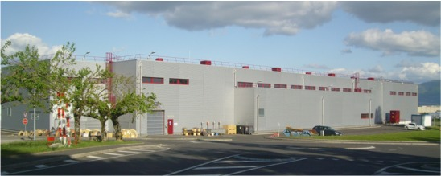
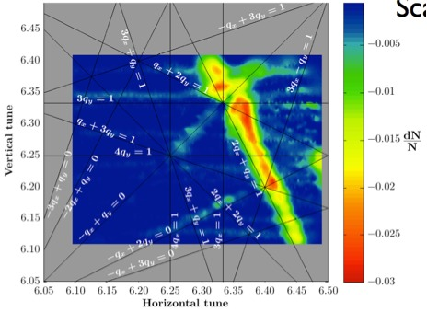
The LIU Project was completed in LS2
LINAC4 – PS Booster:
  New LINAC 4 with H⁻ injection
  Higher injection energy
  New Finemet® RF cavity system
  Increase of extraction energy
PS:
  Injection energy increase from 1.4 GeV to 2 GeV
  New Finemet® RF Longitudinal feedback system
  New RF beam manipulation scheme to increase beam brightness
SPS
  Machine Impedance reduction (instabilities)
  New 200 MHz RF system
  Vacuum chamber coating against e-cloud
These are only the main modifications and this list is not exhaustive

