Slide 1
Data Streams feature in OpenSearch
Emil Kleszcz
it-opensearch-experts@cern.ch

Slide 2

Agenda
Background
What are Data Streams?
When to use them?
Why to use them?
How can I use them?
Demo
Migrate your current data
Summary

Slide 3

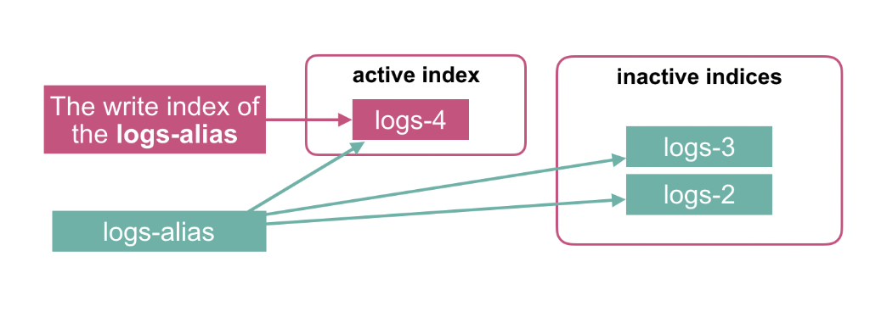
Background
Time series data refer to data points recorded and
organized in chronological order
Classic way of ingesting time-series data with indices:
  Create an index template (like a scheme in SQL)
  Set up an ISM policy (e.g. retention)
  Define a write alias and handle manually rollovers
  Ingest data, splitting it across multiple indices over time
Challenges:
  Complex setup: requires configuring ISM, aliases, and templates
  Manual oversight: error-prone rollover and lifecycle management
  Scalability: high-throughput data ingestion needs extensive tuning
Notes:
ISM Index State Management

Slide 4

Background
Time-series data is voluminous and snowballs quickly
For example: For an average user, syslogs from MacBook might be anything from the range of 300MB-1GB per day.
  Now multiply it with the number of days, it starts to look prominent…
There are two ways of storing and managing time-series data in OS:
  Indexes
    Independent units requiring manual setup and management
  Data streams
    Automated abstraction managing time-based indices seamlessly
Notes:
ISM Index State Management
DS decides by default automatically when to rollover this can be further tuned with an ISM if needed

Slide 5
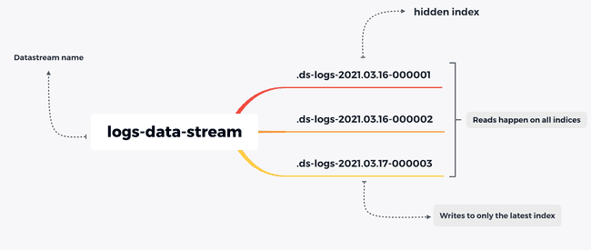
What are OpenSearch Data Streams?
Designed for indexing and querying time-series append-only data
  typically logs, metrics, or observability data
Collection of hidden automatically generated indices
Rolls over the index automatically based on the ISM policy

Slide 6
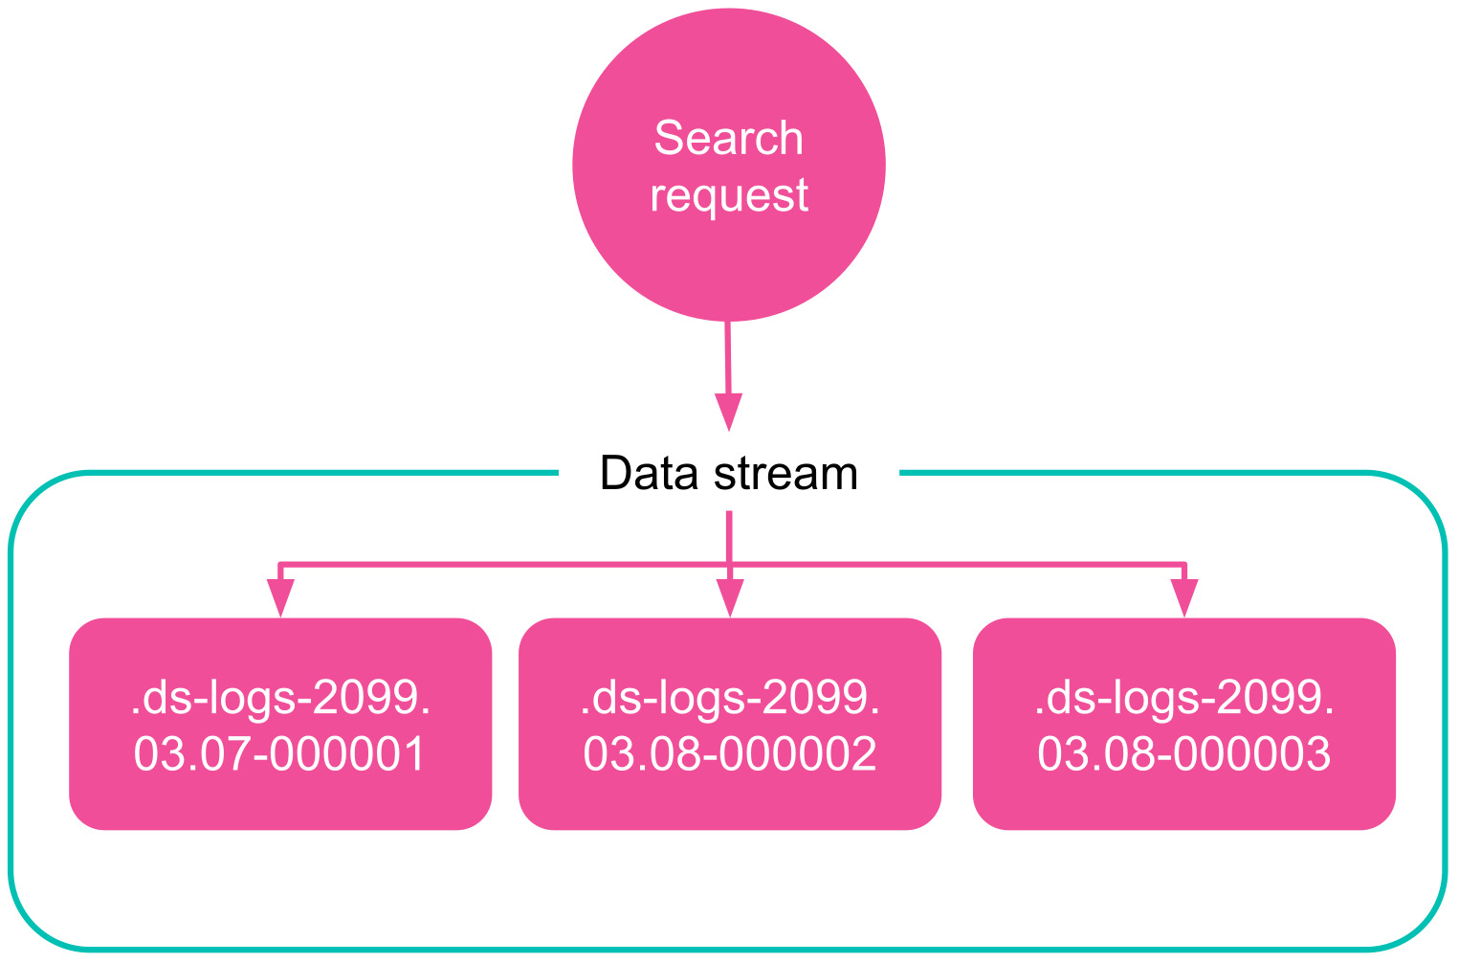
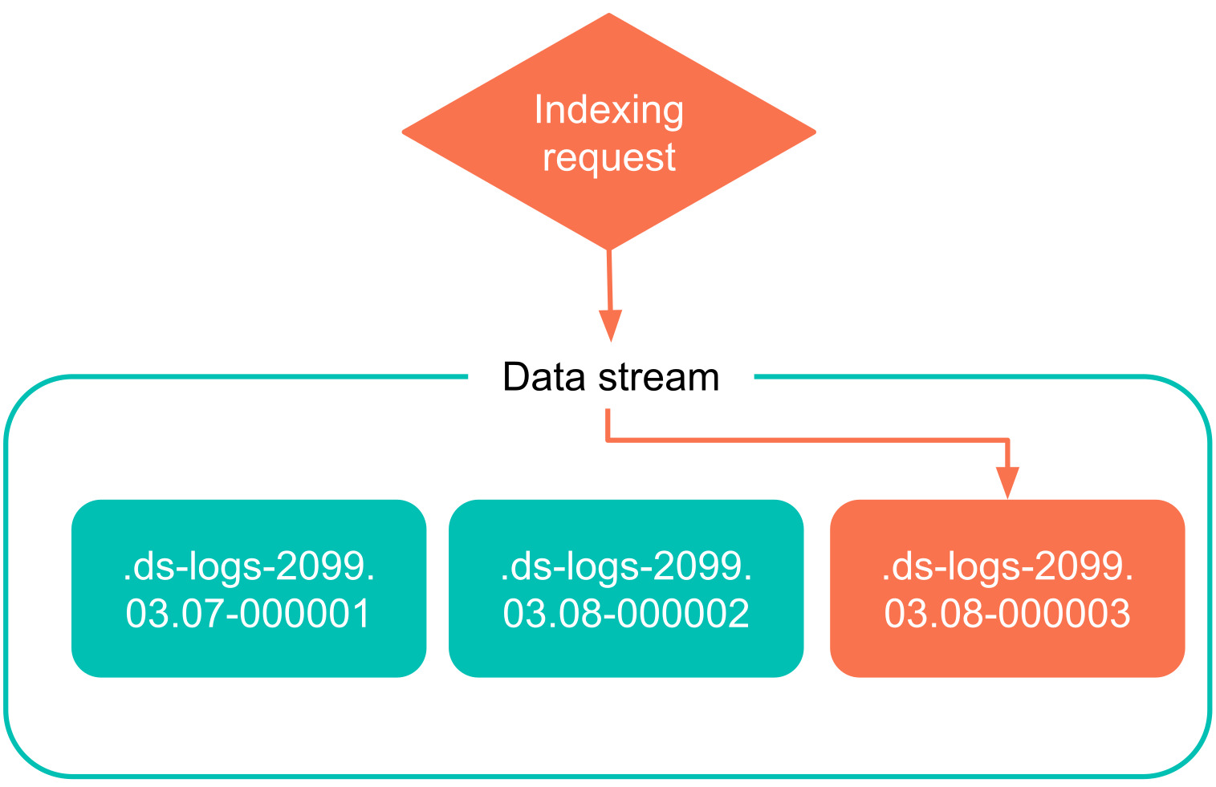
What are Data Streams?
Made of a list of hidden indices (backing indices)
Read requests are automatically routed to the proper backing indices
Write requests are routed to the write index (most recent backing index) only

Slide 7

When to use Data Streams?
Time-series data: logs, metrics, and traces
For append-only logs with timestamp!
Examples of logs:
  Application (e.g. Nginx, Apache, logstash, systemd…)
  Audit
  Metrics (Prometheus sending to OpenSearch, etc.)
  Stream of events (IoT, app telemetry, etc.)
  System logs
When not to use?
  Mutable data
  Non-time-series (no timestamp)
  Very small static data volumes
  Highly customised index management

Slide 8
Why use Data Streams?
Previously: creating a rollover index alias, defining a write index, and defining common mappings and settings for the backing indices
Feature | Classic Indices | Data Streams
Management complexity | Requires manual ISM, aliases, templates | Simplified with automatic rollover & retention
Time-based queries | Requires complex queries across indices | Optimized for time-based queries
Write alias management | Manual alias updates needed | Managed automatically as part of the stream
Scalability | Manual tuning for large data volumes | Seamless scaling with automatic index creation
Data retention | Manual lifecycle management by default | Automatic data retention and deletion

Slide 9
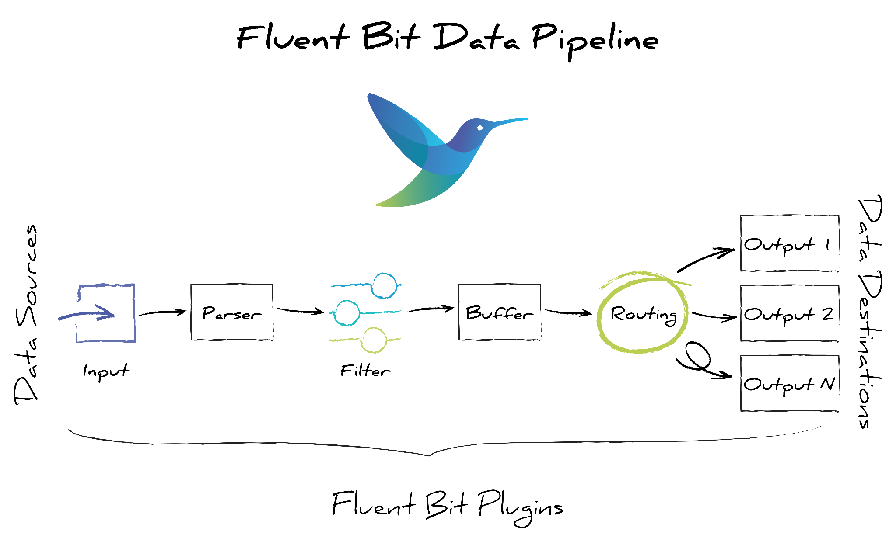
How to use Data Streams?
# Fluent bit output plugin example
[OUTPUT]
Name opensearch
Match some_logs*
Host os-playground.cern.ch
Port 443
Path /os
Buffer_Size 128KB
Logstash_Format Off
Index fluentbit-logs
Type _doc
Time_Key @timestamp
Time_Key_Format %Y-%m-%dT%H:%M:%S
Time_Key_Nanos Off
Tls On
HTTP_User XXX
HTTP_Passwd YYY
Suppress_Type_Name On
Workers 0
Compress ""
Write_Operation create
Generate_ID Off
OpenSearch treats indexed documents as immutable
  Aligning well with append-only log use-cases
Write once - read many
Recommended to define a ISM retention policy
  to manage lifecycle of the data hot->cold->delete
Works with the popular ingestion tools such as:
  Logstash, Fluent bit, vector.dev, Fluentd

Slide 10
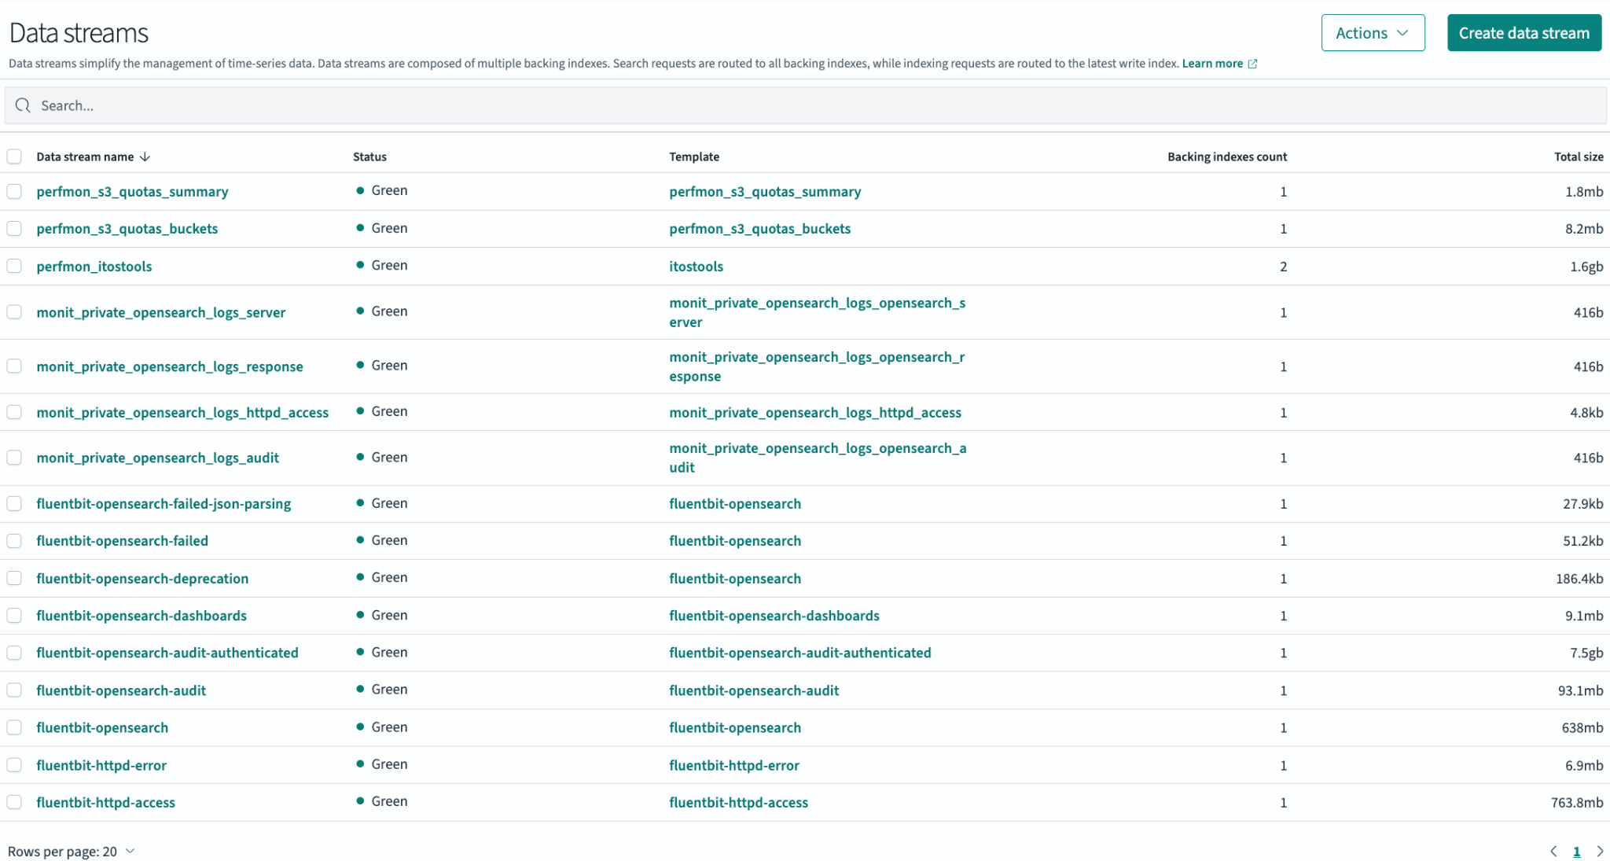
Demo
Demo

Slide 11

Migrate your current data from indexes to Data Streams
Create an index template of type Data Stream
Create a Data Stream:
  PUT _data_stream/logs-app
Check if source index has field @timestamp and add it
Reindex data
Recommended: define ISM policy for data retention
POST _reindex
{
"source": {
"index": "old-logs-index"
},
"dest": {
"index": "logs-data-stream"
}
}
Example of LanDB migration (TBs)
Notes:
Like a flock migrating, your data can seamlessly transition to data streams.

Slide 12

Summary
Time-series data can be simplified with Data Streams
Migration to Data Streams is easy
Provides considerable improvement of operations
Reach out to OpenSearch team for help
Happy streaming! :-)
Reach for more details:
  https://opensearch.org/docs/latest/im-plugin/data-streams
  https://opensearch.docs.cern.ch/data_ingestion/#data-streams

