Slide 1


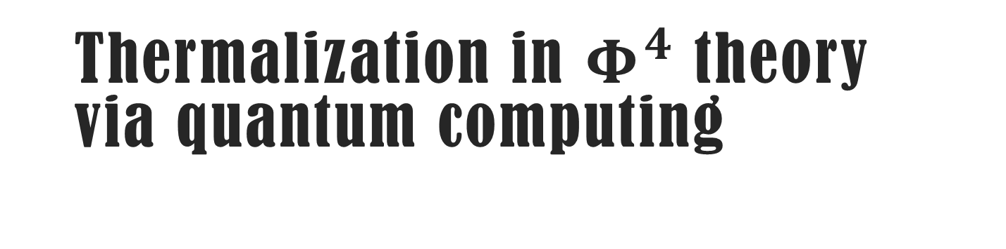
Thermalization in $Φ^{4}$theory via quantum computing
Iván Cuntín
In collaboration with Wenyang Qian, Bin Wu
Initial Stages 2025, 7-12 September 2025, Taipei
Instituto Galego de Física de Altas Enerxías – Universidade de Santiago de Compostela

Slide 2
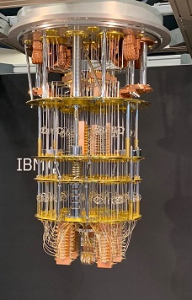
State of the art in quantum computer technology
Quantum computing (QC) is a rapidly-emerging technology that harnesses the laws of quantum mechanics to solve problems too complex for classical computers.
Currently, we are in the Noisy Intermediate-Scale quantum (NISQ) era:
Quantum processors containing up to ~1000 qubits
Sensitive to their environment
Prone to quantum decoherence
Quantum information science has proved useful in a broad range of physics applications
Quantum simulation is potentially more advantageous in reducing the problem complexity from exponential to polynomial
IBM Condor employs over 1000 qubits ⇨

Slide 3
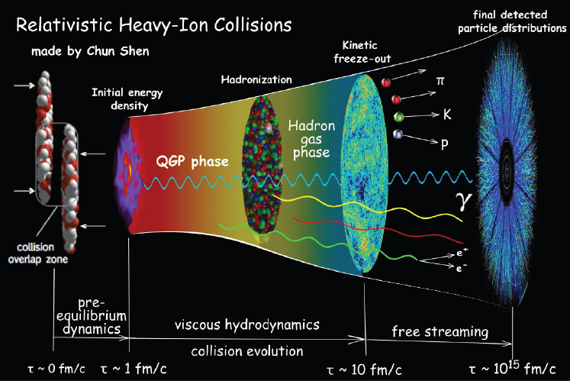
Thermalisation in heavy-ion collisions
QGP constitutes one of the main research areas in QCD physics.
Time evolution of QCD matter before thermalisation has been studied using classical approaches such as classical field simulations or kinetic theory
It has not yet been resolved from first principles of QCD
Lattice QCD is only applicable at low baryon densities in imaginary time where the numerical sign problem does not interfere with calculations

Slide 4

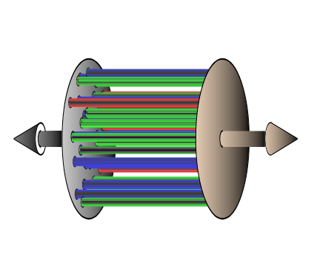
Motivation
Gelis, 2012 [arXiv:1211.3327v2]
Color Glass Condensate (CGC) ​can be described as a classical field at leading order with
Glasma: state during which the classical field stays coherent
It remains an open question how these classical fields lose their coherence and form a plasma of quarks and gluons in local thermal equilibrium.
Quantum computing is a potential tool for solving this issue from QCD first principles ​
Glasma flux tubes, along which glasma fields are coherent

Slide 5

Warm up: Φ⁴ theory
Before solving this issue in QCD, we start with Φ⁴ theory
Jordan, Lee & Preskill, 2011 [arXiv:1112.4833]
Klco & Savage, 2018 [arXiv:1808.10378]
In order to mimic classical field (CGC) background, we use coherent states and study the real-time evolution and thermalisation from them.
Coherent states: states that have the minimal extent in phase-space allowed by the uncertainty principle.

Slide 6



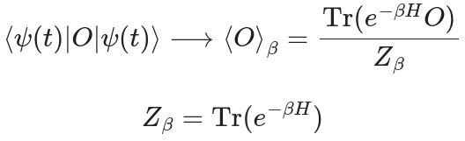
Thermalisation process
Real-time evolution:
Initial state
Trotterisation:
Fixed-point thermal property after thermalisation is established:
Partition function
The trace can be calculated by summing the expectation values over the complete set of states

Slide 7

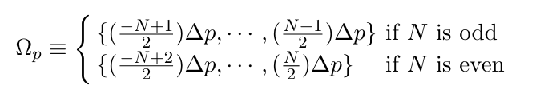


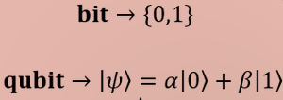
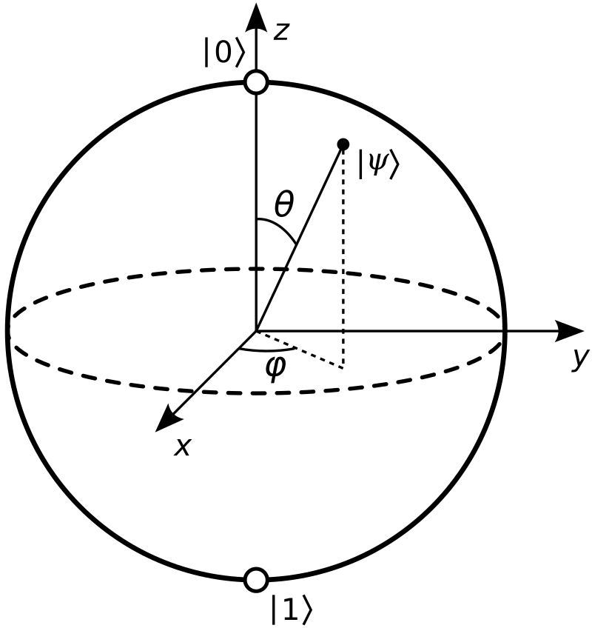
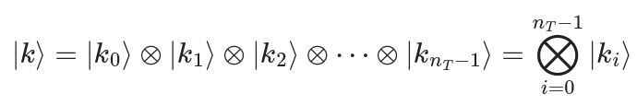
Representing fields with qubits
We approximate the continuum theory with a discrete theory that’s similar to lattice QCD but with continuous time.
1
2
We map the fields into qubits

Slide 8






SCALAR FIELD THEORY
IC, Qian & Wu, 2024 [arXiv:2411.19601]
Lagrangian density for the $φ^{4}$ theory in d + 1
Field and conjugate-field operators
Step 1: Discretised hamiltonian
FIELD OPERATOR (FO) BASIS: Spatial Lattice Sites Eigenstates of Φ fields
Step 2: Map it onto qubits​
HARMONIC OSCILLATOR (HO) BASIS: Particle quanta Eigenstates of occupancy
8

Slide 9

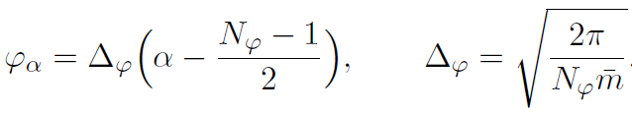



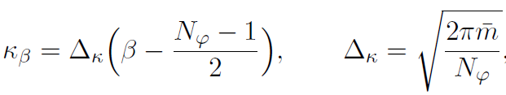


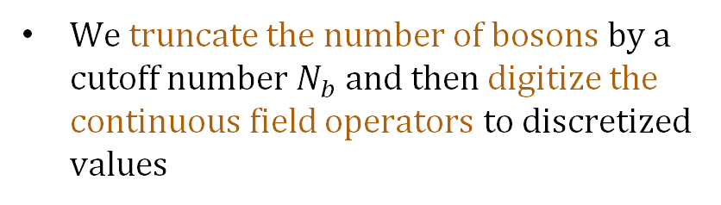

FO Basis: Field operator digitisation
Macridin et al., 2021 [arXiv:2108.10793]
The lattice Hilbert space is a tensor product of local Hilbert space at each lattice site
Digitised field operators
The local Hilbert space at a single lattice site is infinite dimensional because there are infinitely many bosons contributing to the local wave function
$φ_{α}=\left(−∞,∞\right)$
Digitised conjugate-field operators
We truncate the number of bosons by a cutoff number $N_{b}$ and then digitize the continuous field operators to discretized values
$$φ_{α}=\left[−φ_{max},φ_{max}\right]$$

Slide 10
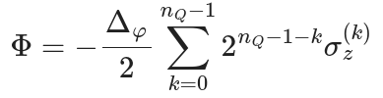
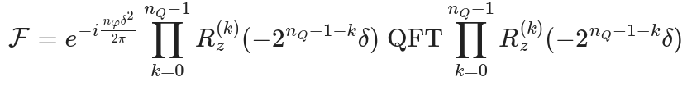
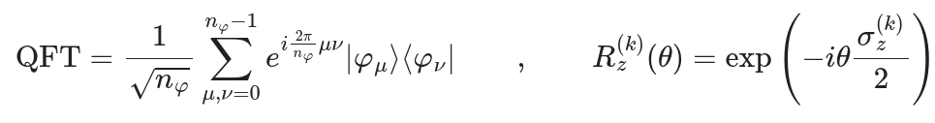
Field operator representation
To obtain the correct eigenvalues, we represent the field operator in this way
The symmetric Quantum Fourier Transform (sQFT) can be obtained from the regular QFT

Slide 11

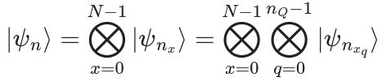
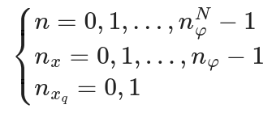
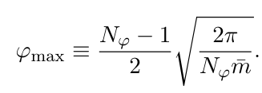


FO Basis: Scalar field theory on the qubit
We map bosons onto qubits using eigenstates of the field operator as the computational basis
We use a 1D lattice of N quantum registers to represent N lattice points. In each register, we use n_{Q} qubits to digitise the fields
$$N_{φ}=2^{n_{Q}}$$
$$n_{T}=Nn_{Q}$$

Slide 12
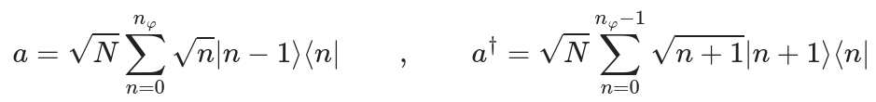





HO Basis
Klco & Savage, 2019 [arXiv:1808.10378]
Step 1: Hamiltonian in terms of creation and annihilation operators in momentum space
1
2
3
Step 2: Map it onto qubits using eigenstates of $a_{p}^{†}a_{p}$ as the computation basis
Max number of bosons

Slide 13

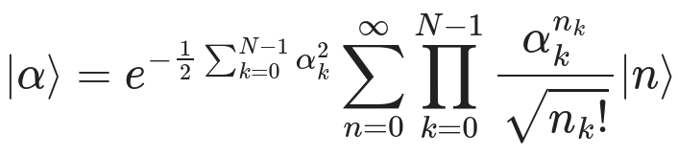
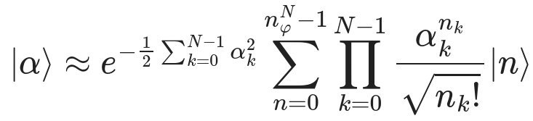
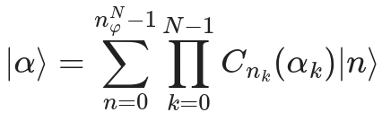
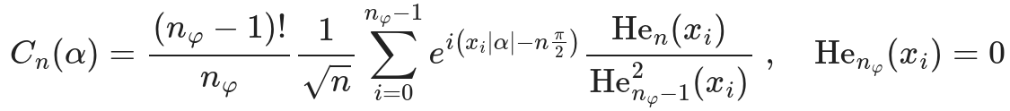

Coherent states
The coherent state |α⟩ of a HO is defined as the eigenstate of the annihilation operator
$$a\left.|α\right\rangle =α\left.|α\right\rangle$$
Infinite-dimensional Hilbert space:
Glauber, 1963 [DOI:10.1103/PhysRev.131.2766]
small α
Finite-dimensional Hilbert space:
Miranowicz, Pia̧tek and Tanaś, 1994 [DOI:10.1103/PhysRevA.50.3423]

Slide 14
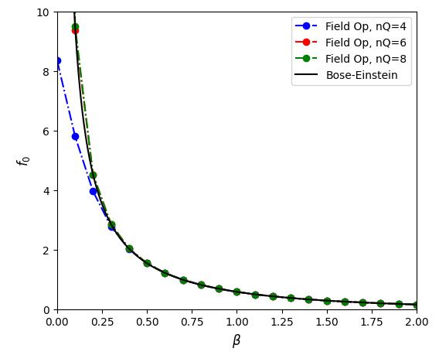
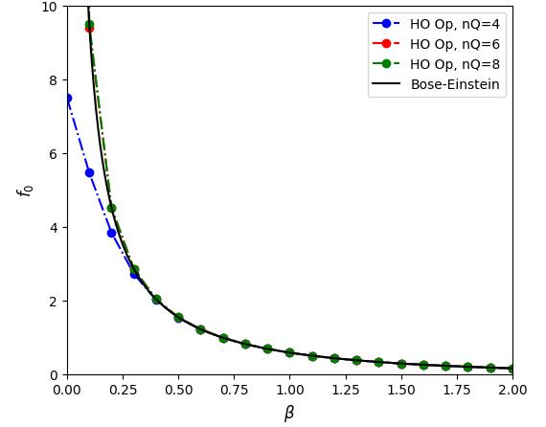
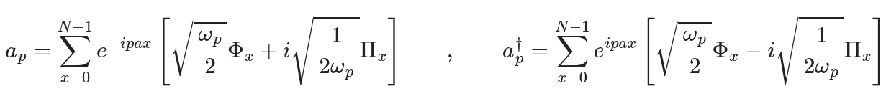
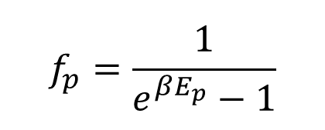
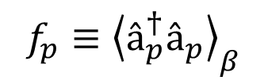
Results for Scalar Fields in Thermal Equilibrium (N = 1)
$$f_{p}=\frac{1}{e^{βE_{p}}−1}$$
IC, Qian & Wu, 2024 [arXiv:2411.19601]
Analytical results:
Bose-Einstein distribution
$$f_{p}≡{\left\langle â_{p}^{†}â_{p}\right\rangle }_{β}$$

Slide 15
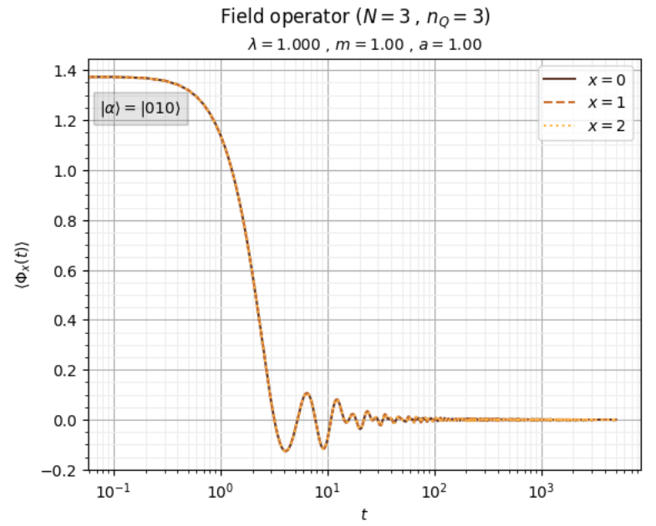
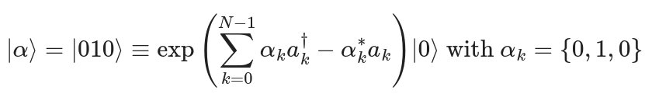
HO Results: Real-time evolution
Preliminary results
(9 qubits)
Initial state for homogeneous field:

Slide 16
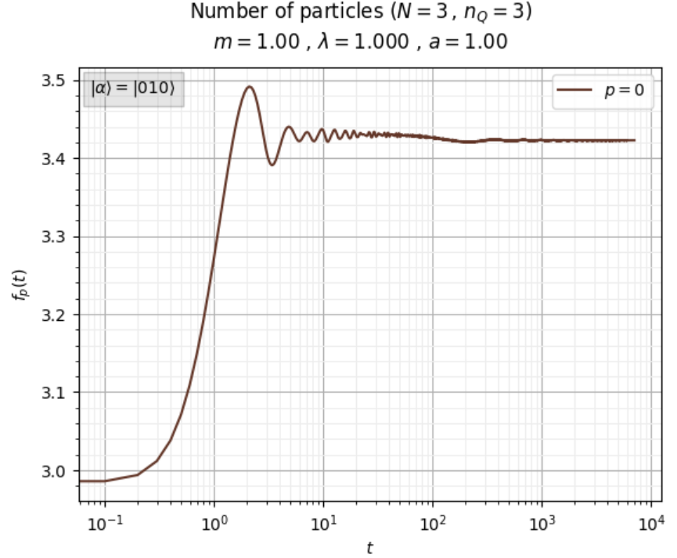
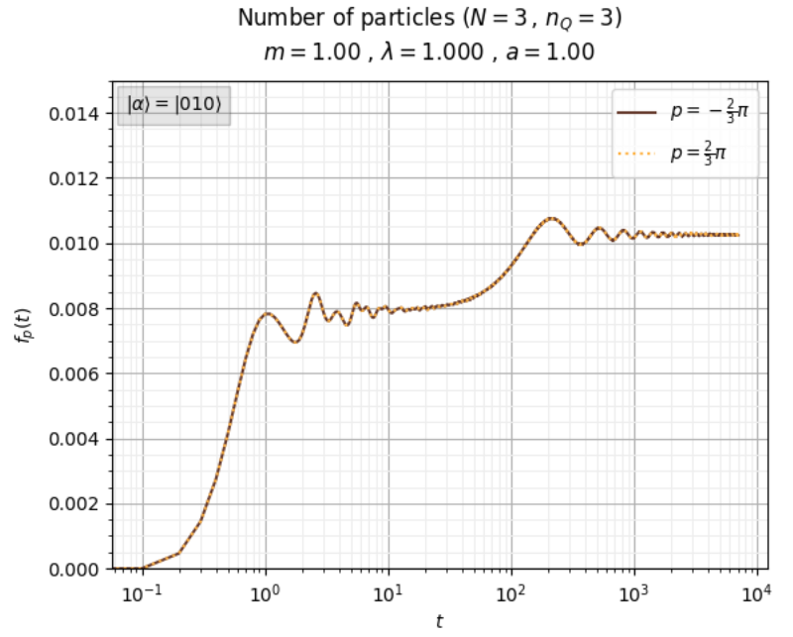
HO Results: Real-time evolution
IC, Qian & Wu [work in progress]
Preliminary results
(9 qubits)

Slide 17
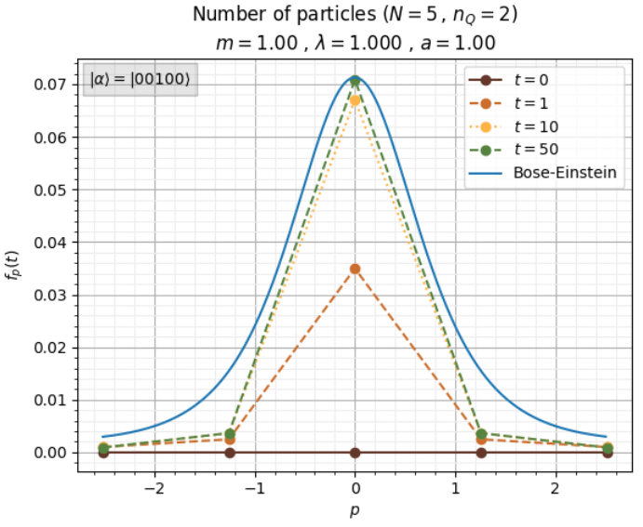
HO Results: Thermalisation
IC, Qian & Wu [work in progress]
Preliminary results
(10 qubits)

Slide 18
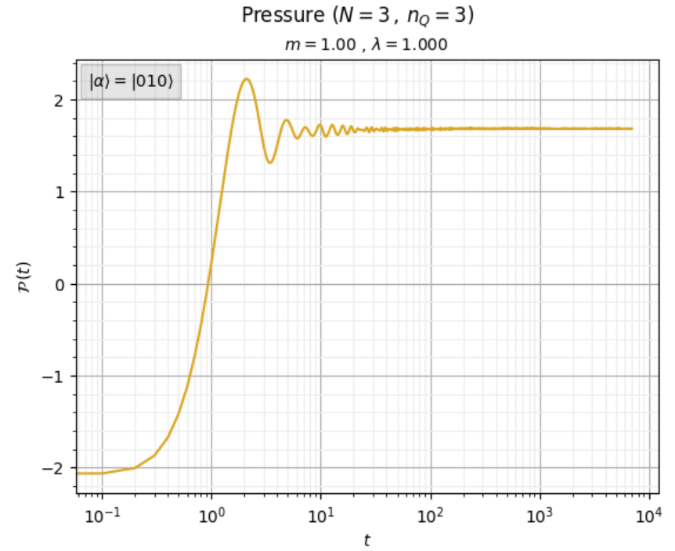
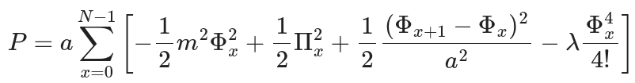
HO Results: Real-time evolution
IC, Qian & Wu [work in progress]
Preliminary results
(9 qubits)

Slide 19



Summary and outlook
Quantum computing technology is available today and developing fast for HEP
We formulated the quantum field theory for scalar fields in 1+1 dimensions on the qubits and studied its various thermal properties at finite temperature as well as thermalisation using quantum simulation algorithms
Quantum simulation helps to understand real-time evolution of non-equilibrium dynamics relevant to heavy-ion collisions.
Larger scale simulation under development. It remains interesting to explore other options such as tensor networks
THANK YOU FOR YOUR ATTENTION!

Slide 20
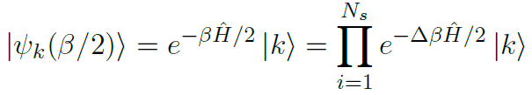

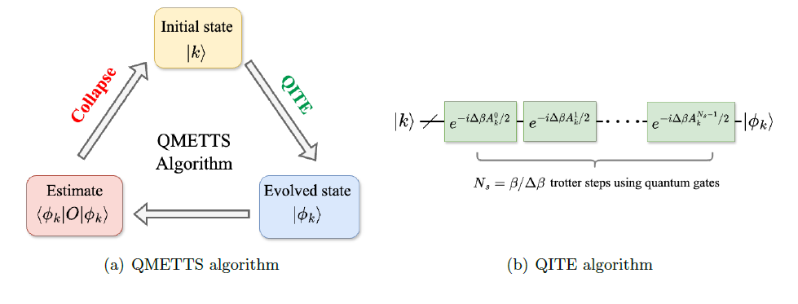




Quantum imaginary time evolution
Motta, 2019 [arXiv:1901.07653]
Trotter formula:
Real-time Hamiltonian operator
determined by solving the linear matrix equation
whose matrix elements are evaluated as expectation values on the quantum circuit

Slide 21



Thermal expectation on the circuit
White, 2009 [arXiv:0902.4475]
Minimally entangled typical thermal state method (METTS)
Redefined quantum state
in QITE:
Thermal observables
Equivalent to sampling $\left|φ_{k}\right\rangle$ with probability $P_{k}/Z$ and summing its expectations ${\left\langle O_{k}\right\rangle }_{β}$

