Slide 1




FoCal Forward Calorimeter Upgrade for ALICE
Takashi Hachiya
Nara Women’s University
for the ALICE collaboration

Slide 2
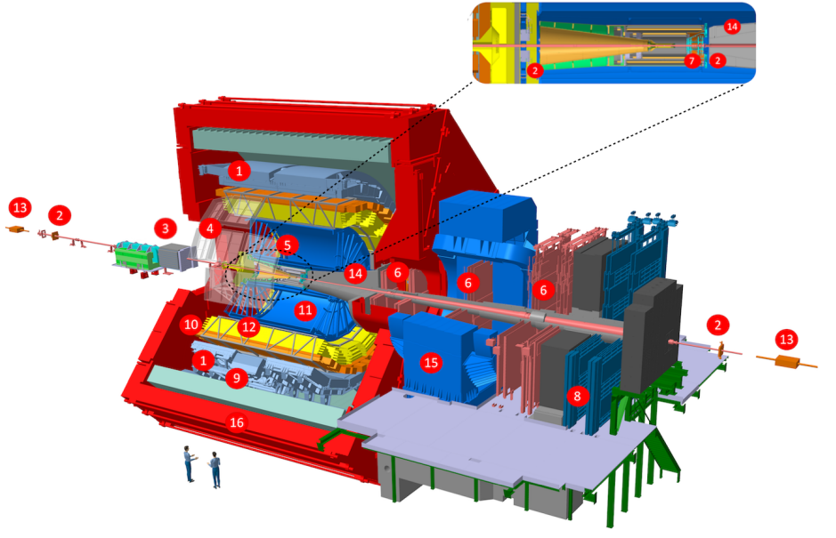
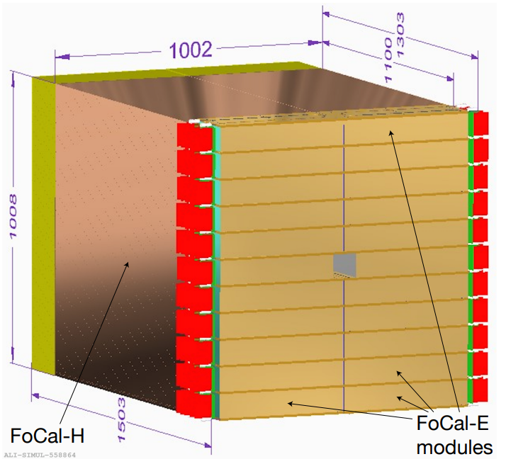
FoCal - Forward Calorimeter
FoCal is new Forward Calorimeter as an upgrade of ALICE for Run 4 (2030-2034)
Approved by the LHCC in 2024
Installation during LS3 (2026-2030)
FoCal consists of EM and Hadronic calorimeter
7m from IP
Full azimuth coverage for 3.4<η<5.5
η : 3.2-3.4 & 5.5-5.8 with partial azimuth
LOI CERN-LHCC-2020-009
TDR CERN-LHCC-2024-004

Slide 3
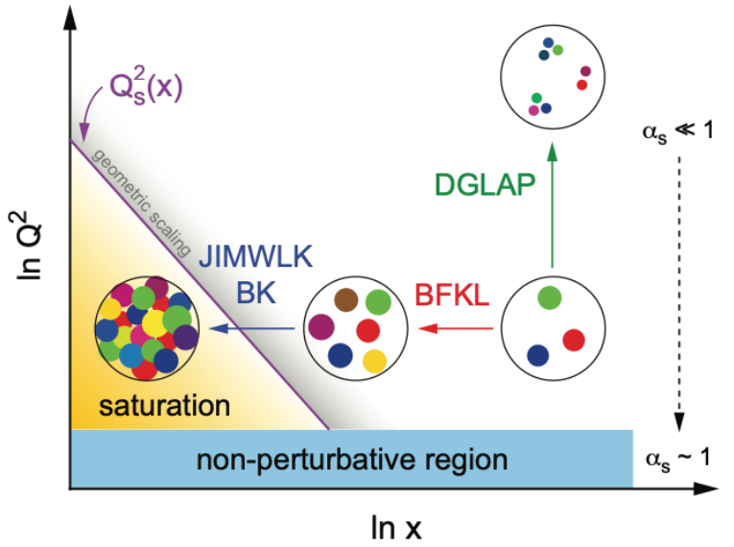
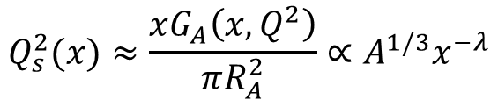
FoCal Physics
Explore non-linear QCD evolution at extremely small-x region
Gluon saturation expected due to balance between split and recombination of gluons
Saturation Scale; Q_{s}² ∝ A^{1/3}
p+A is preferable for saturation study
Both p+p and p+A are necessary
Understanding the initial conditions of QGP physics
Origin of long-range correlations in small system
Early thermalization puzzle
$$Q_{s}^{2}(x)≈\frac{xG_{A}\left(x, Q^{2}\right)}{πR_{A}^{2}}∝A^{1/3}x^{−λ}$$

Slide 4
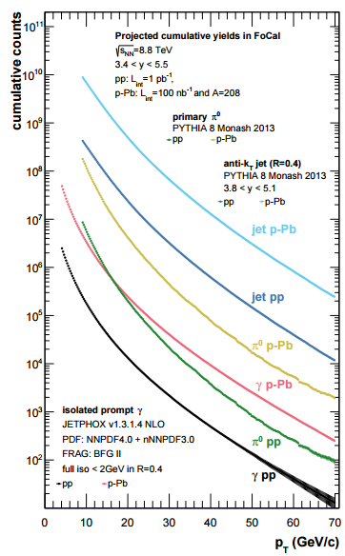
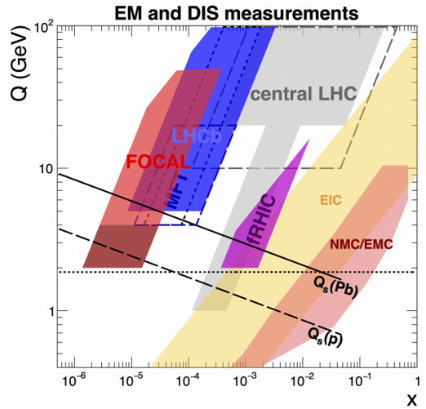
FoCal Capabilities
Physics of FoCal, ALICE-PUBLIC-2023-001
Expected statistics
FoCal covers small-x region (∼10⁻⁶)
Complementary to LHCb and EIC
Observables
Prompt photons
π⁰, η,
Jet, γ +jet,
J/ψ, ψ(2s) in UPC
and more …
Multi-messenger approach

Slide 5




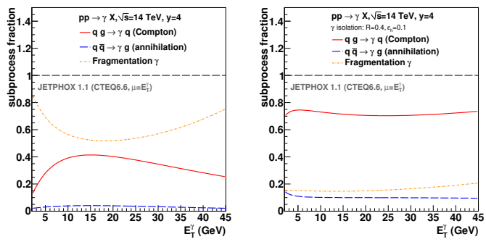
Prompt photons with isolation
Theoretically clean probe of the gluon PDF in p & A
Isolation significantly improve S/N
Compton
Fragment BG
q
γ
R
q
γ
R
g
g
Phys.Rev.D82:014015,2010
R < 0.4

Slide 6
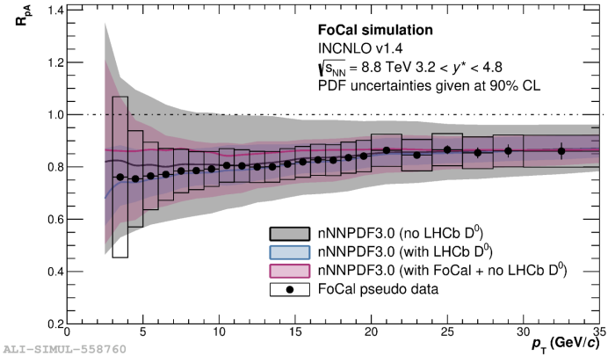
Prompt photons with isolation
Theoretically clean probe of the gluon PDF in p & A
Isolation significantly improve S/N
FoCal can constrain (n)PDF
No strong interaction at final state
Comparable with LHCb D⁰
Compton
Fragment BG
γ
R
Physics performance of FoCal, ALICE-PUBLIC-2023-004
q
γ
R
q
g
g
Phys.Rev.D82:014015,2010
R < 0.4
Key observable to explore gluons at the small-x

Slide 7
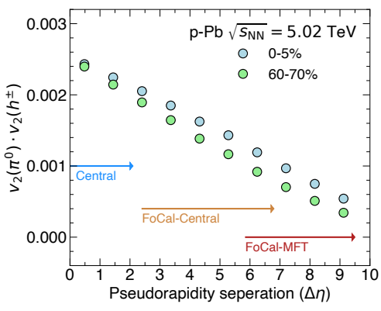
Long range correlations
Initial state vs final state anisotropy in small systems
FoCal extend the rapidity gap up to 9 with the ALICE Central and Backward(MFT)
Large rapidity gap gives early-stage correlation
3.4<η<5.5
|η|<0.9
-3.6<η<-2.5
FoCal
Central
Backward
MFT
π⁰, η
π⁰, h, e⁻
h, μ

Slide 8
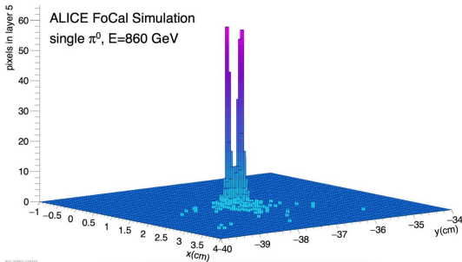
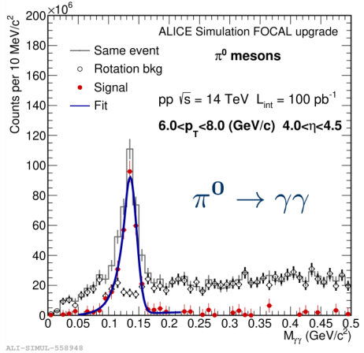
Long range correlations
Initial state vs final state anisotropy in small systems
FoCal extend the rapidity gap up to 9 with the ALICE Central and Backward(MFT)
Large rapidity gap gives early-stage correlation
3.4<η<5.5
|η|<0.9
-3.6<η<-2.5
FoCal
Central
Backward
MFT
π⁰, η
π⁰, h, e⁻
h, μ
Physics of FoCal, ALICE-PUBLIC-2023-001
Physics Performance, ALICE-PUBLIC-2023-004

Slide 9
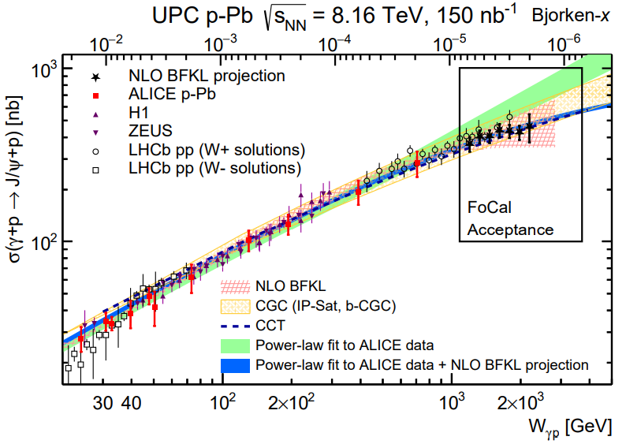
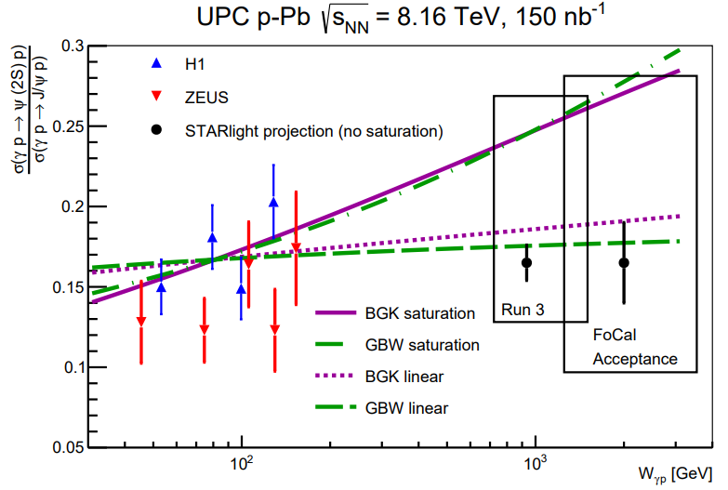
J/ψ photo-production in UPC
Sensitive to the non-linear behavior in small-x in p and A
Photo-production is proportional to the gluon density at LO-pQCD calculation
Accessible to small-x with W_{γp} ∼ 2 TeV
ψ(2s)/J/ψ ratio can provide a clearer signal
Physics of FoCal,
ALICE-PUBLIC-2023-001
Physics performance of FoCal,
ALICE-PUBLIC-2023-004

Slide 10
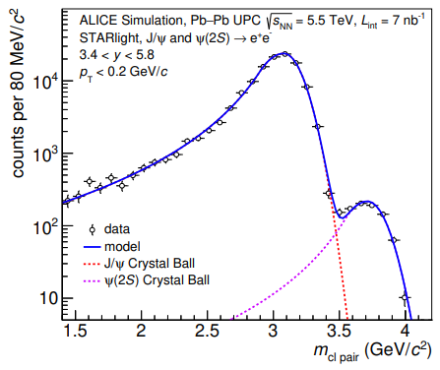
J/ψ photo-production in UPC
Sensitive to the non-linear behavior in small-x in p and A
Photo-production is proportional to the gluon density at LO-pQCD calculation
Accessible to small-x with W_{γp} ∼ 2 TeV
ψ(2s)/J/ψ ratio can provide a clearer signal
Mass from simulated FoCal cluster-pairs
Physics of FoCal,
ALICE-PUBLIC-2023-001
Physics performance of FoCal,
ALICE-PUBLIC-2023-004

Slide 11
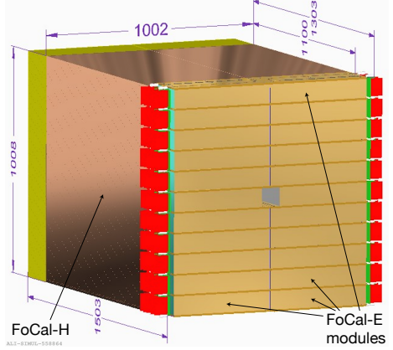
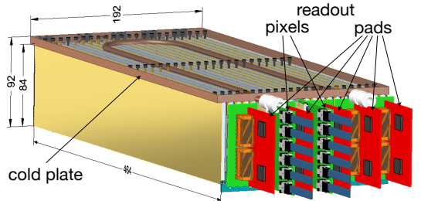

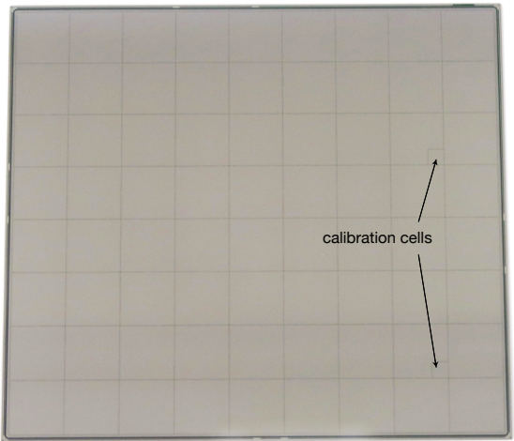
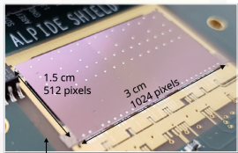
FoCal－E : EM Calorimeter
High-granularity EM Calorimeter w/ Pixel & Pad Si sensors
22 modules (93 x 101 cm²)
Photon Energy up to ∼2 TeV
20 X₀ : 20 W absorber
W : X₀ ∼ 3.5mm, R_{m} ∼ 9mm
18 Pad layers (1 x 1 cm²)
Energy measurements by ADC & TOT
Timing (HGCROC)
P-type Si sensor (radiation hardness)
2 Pixel layers (27 x 29 μm²)
Shower position for two photon separation
ALPIDE MAPS chips (from ITS2 and MFT)
3D imaging of EM-shower by reading individual layer and channels
Pad Sensor
Pixel Sensor
1x1cm²
TDR CERN-LHCC-2024-004

Slide 12
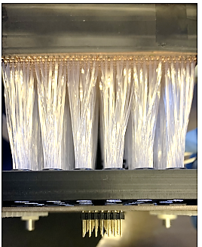
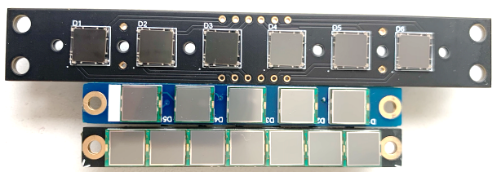
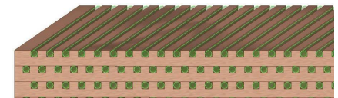
FoCal-H : Hadron Calorimeter
Cu + SciFi hadronic calorimeter
90 x 90 x 110 cm³ depth ∼ 6 λ_{had}
SiPM readout + H2GCROC (HGCROC for SiPM)
Final design in progress
Cu sheet w/ grooves for SciFi
5 x 50 x 110 cm³
New design to be tested in 2025
SiPM
SciFi connected to SiPM
Cu sheet w/ grooves
TDR CERN-LHCC-2024-004

Slide 13
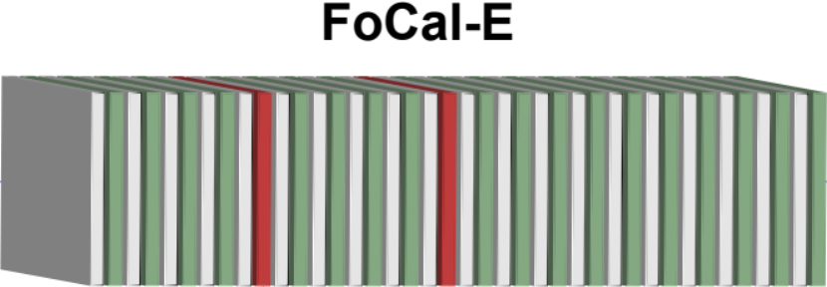
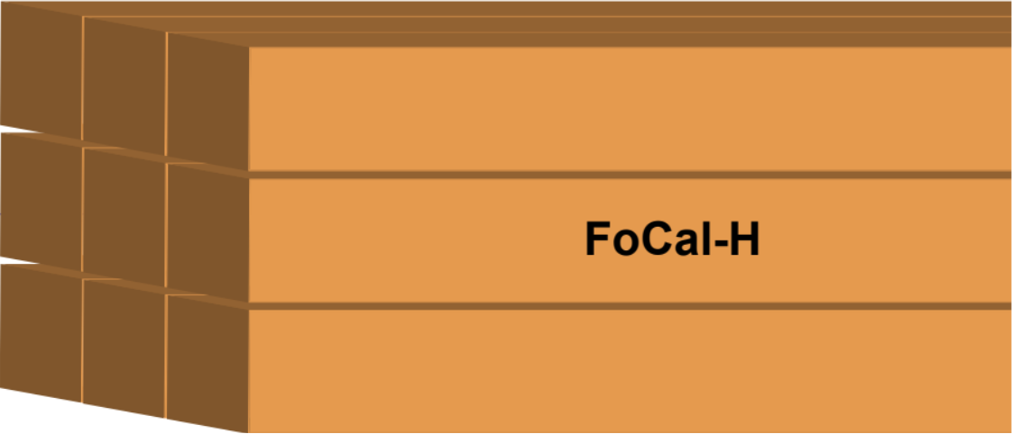
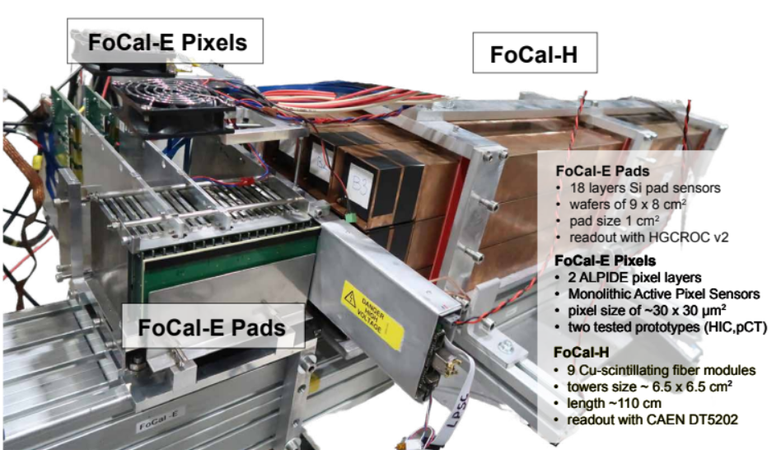
Performance at Beam Test
Test beam paper JINST 19 P07006
Test Beam at CERN PS & SPS (2022 & 2023)
Electron beam < 300 GeV
Hadron beam < 350 GeV
FoCal E & H Prototype
Full stack of modules in longitudinal configuration
EM calorimeter
18 Si Pad layers
2 Si Pixel layers
Hadronic calorimeter
110cm Cu capillary tube
e⁻, h⁺

Slide 14

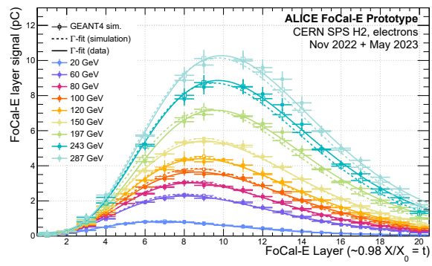
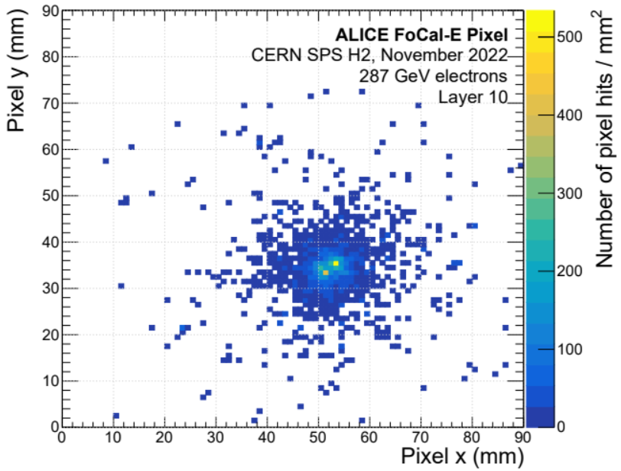
FoCal-E EM-shower
Longitudinal shower profile in FoCal-E
Two electron separation in pixel
Shower profile is good agreement w/ simulations : 20 – 287 GeV
A clear two electron separation
Good for isolated photon
Test beam paper JINST 19 P07006

Slide 15
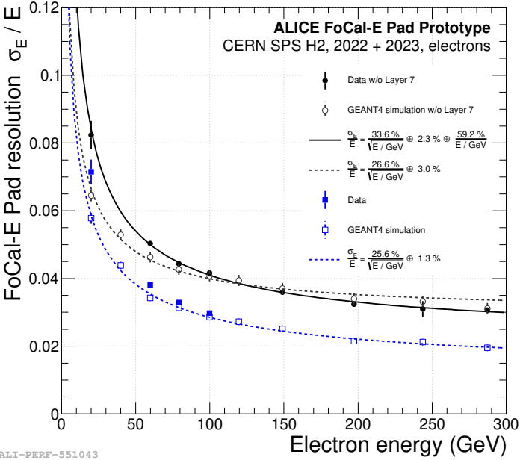

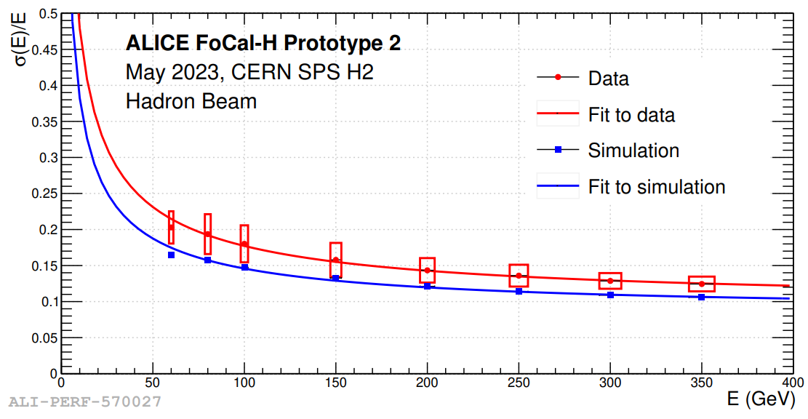

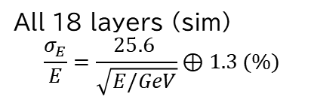
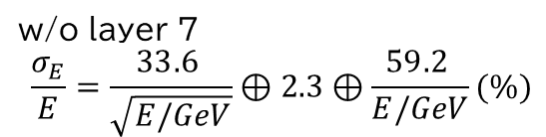

FoCal Energy resolution
FoCal-E resolution w/ electron beam
Test beam paper JINST 19 P07006
FoCal-H resolution w/ hadron beam
Data w/o L7
GEANT4 w/o L7
Data (all layer)
GEANT4 (all layer)
w/o layer 7
$$\frac{σ_{E}}{E}=\frac{33.6 }{\sqrt{E/GeV}}⊕2.3⊕\frac{59.2 }{E/GeV}(\%)$$
$$\frac{σ_{E}}{E}=\frac{148 }{\sqrt{E/GeV}}⊕10⊕\frac{0 }{E/GeV}\%$$
All 18 layers (sim)
$$\frac{σ_{E}}{E}=\frac{25.6 }{\sqrt{E/GeV}}⊕1.3 (\%)$$
FoCal-E Energy resolution 3% > 200 GeV
Simulation describes data well, but resolution degrades due to ADC/TOT noise at low energy
Performance can be further improved with 18-layer configuration
FoCal-H Energy resolution 15% (>60 GeV)
Simulation doesn’t reproduce data, light collection in data and/or need the simulation-tuning

Slide 16
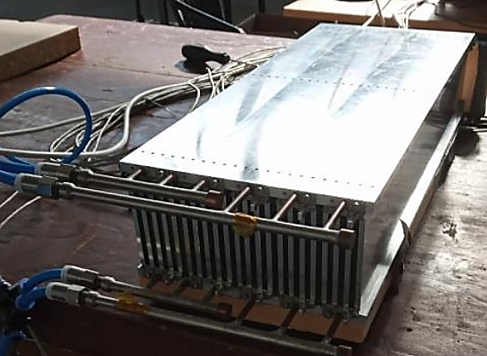
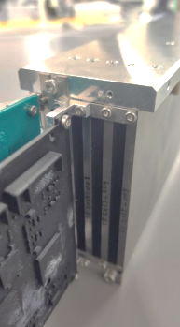
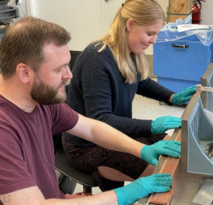
Schedule and Mass-production
2020 | 2021 | 2022 | 2023 | 2024 | 2025 | 2026 | 2027 | 2028 | 2029 | 2030 | 2031
LOI |  |  |  | TDR
 |  | Beam Test@ PS, SPS | Beam Best@ PS, SPS
Run3
LS3
Run4
Final Design
Preproduction + Production
Installation commissioning
Final design & Mass production
Prototype shows good performance
Procedure
Mechanical structure + Cooling test
Production
Pre-production + Beam Test
Installation & Commissioning
FoCal-E mockup for cooling test
FoCal-E segment
mockup w/ Tungsten
FoCal-H prototype

Slide 17
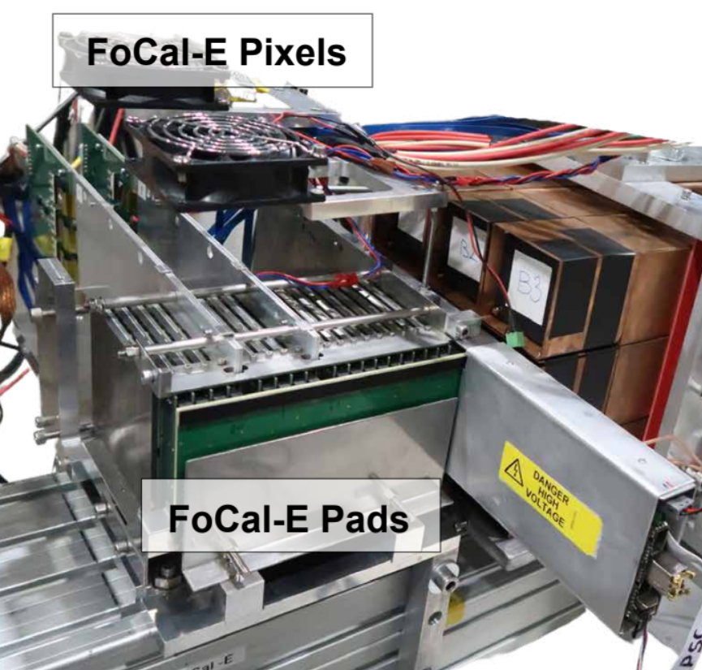
Summary
FoCal is a new forward calorimeter for ALICE Run4
High granularity EM + Hadronic calorimeters
Broad phase space coverage (3.4 < η < 5.5)
Complimentary with EIC and LHCb
Goal is gluon saturation at small-x region (∼ 10⁻⁶) with multi-messenger approach
Prompt photons, π⁰, Jet, J/ψ in UPC
Simulation study demonstrates FoCal capabilities
FoCal prototype shows good energy resolutions and two cluster separation
Mass production is about to start !
FoCal-H

Slide 18
Paper list
FOCAL Letter of Intent CERN-LHCC-2020-009
Physics of the ALICE Forward calorimeter upgrade, ALICE-PUBLIC-2023-001
Physics performance of the ALICE FoCal upgrade, ALICE-PUBLIC-2023-004
Test beam paper: Performance of the electromagnetic and hadronic prototype segments of the ALICE Forward Calorimeter, JINST 19 P07006
Technical Design Report, CERN-LHCC-2024-004

