Slide 1
2024-25 EYETS planning meeting
13.12.2024
A.Tauro

Slide 2
EYETS 2024-25
EYETS from Mon, November 25th, 2024 to Fri, April 4th, 2025 – 19 weeks beam to beam
  Access in General mode
  Cavern access stops on Tue, April 1st
  Start beam commissioning on Sat, April 5th
Standard maintenance of P2 services and infrastructure:
  Cooling & ventilation maintenance from 3 to 21 February → cooling perturbations, one-day complete cooling stop
  Electricity: test arrets-d’urgence (AUG) on February 4th → power cut of nearly every systems at P2, no access onsite
  Test of safety, gas & fire detection systems → alarms will be triggered, access perturbations
We do not plan to open the L3 doors.
Magnets turned off and locked-out
Private visits possible until 27 March 2025 (12:00)
  Visitor’s path will be declassified from January

Slide 3
Summary of access interruptions
Opening PX24 shaft: 2 December → no access UX25 and CRs from 8:00 AM to 16:00 PM
Safety tests (sirens and flashing light): 24 December (during EOY closure) → no access UX25
CSAM test: 3 January (during EOY closure) from 8:00 to 13:00 → no access UX25
Test N/S (CERN wide): 8 January 6:00 – 6:10 AM → no access UX25 5:00 AM - 9:00 AM
Transformer maintenance: 3 February → no access UX25 cavern
AUG LHC2 + ALICE: 4 February → no access P2 site
Individual System Test (IST): 28 February from 13:00 to 19:30 and 3 March from 17:00 to 19:30 → no access UX25 from ~1h before the tests
Department Safety Office (DSO) test: 13-14 March → no access UX25 from March 13 at 15:00 to March 14 at 18:00
Closing PX24 shaft: 14 March → no access UX25 and CRs

Slide 4
DCS
Stop of DCS for backup of WinCC projects on Monday 25.11 from 09h till ~12h (pending final approval by Run Coordination).
1-2 day stop of full DCS for maintenance and upgrades. Most likely around the AUG test (04.02.2025), to be confirmed.
Otherwise DCS will remain operational throughout EYETS (including EoY closure). Upgrades of Framework and patching of WinCC will be coordinated with individual detectors.
Andrè

Slide 5
EPN
2024:
Test shock treatment on 1 AHU to validate procedure: DONE
External/internal and fresh air filters: DONE
Cleaning of water tanks: DONE
Replacing raw water inlet fluxmeter: ONGOING
2025:
Full shock treatment (spring, EN-CV)
Relocation of temperature probes (EN-CV)
Purchase and install power monitoring (DCS, EPN)
Implement AHU RS232 access via TCP/IP (DCS, EPN)
Implement DCS modbus readout of new fluxmeter (DCS, EPN)
Routine external air filter changeover (June, Dec - Philippe/Julien)
Routine bi-weekly water filter changer over during summer (EN-CV)
AHU Water tanks cleaning (Dec, EN-CV)
Install PLCs for smoke and humidity detection (DCS)
Federico

Slide 6
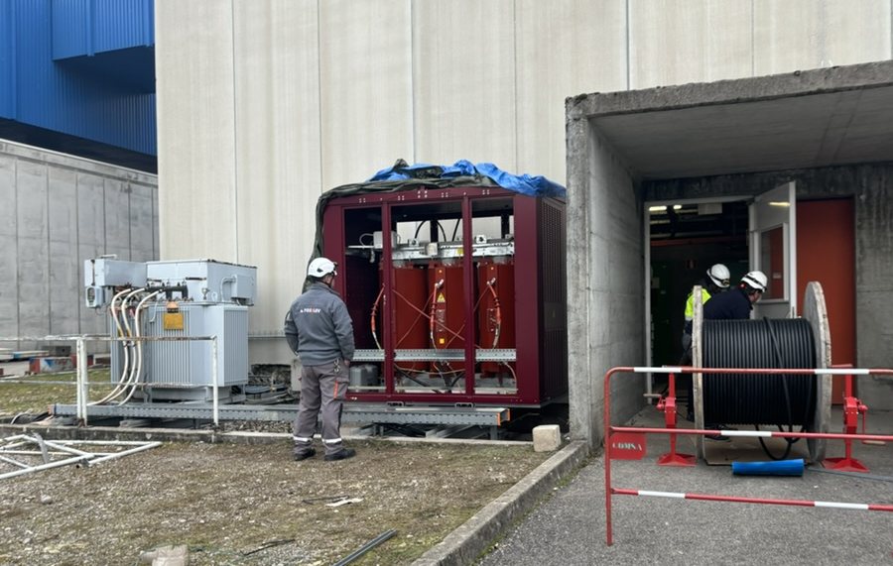
Electrical interventions (EN-EL)
Transformer maintenance: Mon 3rd February
  EBD3/25 will be cut (powered from EMT304/25 via EBD1/25) → various power cuts on UX25 cavern: lights, cooling plants, ventilation
  No access to UX25 cavern
AUG test LHC2 + ALICE: Tue 4th February
  Various power cuts on whole site
  No access to P2 site
Replacement of SX2 transformers:
  EMT406/2X: 25.11.2024 to 13.12.2024 → done. Power rating reduced from 2MVA (2880A) to 1.25MVA (1800A)
  EMT302/2X: 27.1.2025 to 14.2.2025
  Transparent as it is possible to re-power the switchboards that will be replaced
UPS maintenance:
  9 Dec for the 200KVA (CR3/CR4) and Diesel UPS, 11 Dec for the 500KVA (CR1/ARC/CR0) UPS
  During the maintenance we will run on bypass (no battery backup in case of power cut); in the past this never caused an issue, so no need to switch things off
Install cable RAMSES to CROME HSE-RP in PX24
  Planned in week 11
CERN-wide tests:
  Auto-transfert test: 20-22 January (week 4) → transparent
  Test N/S: 8 January 6:00 – 6:10 AM (week 2) → will cut general services and gas systems for few minutes, no access UX25 from 5:00 AM to 9:00 AM
  AUG Adm. Zone Meyrin: 4 January (week 1)
EN-EL overall planning
EMT406/2X will be put in service today or next Monday
Yann Maurer/Juliano Perret

Slide 7
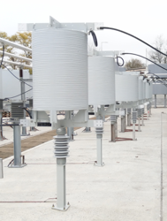
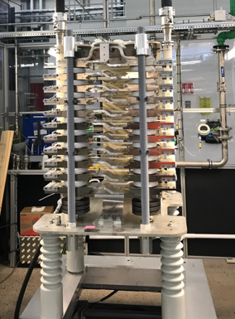
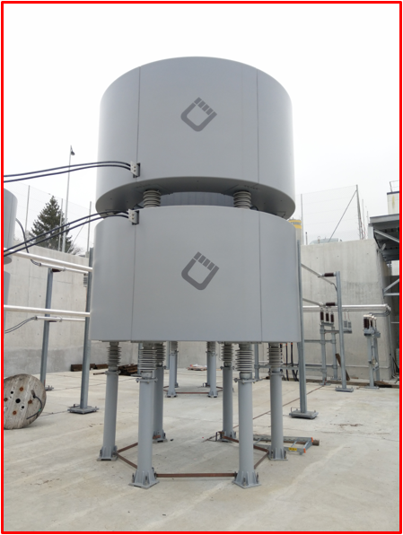
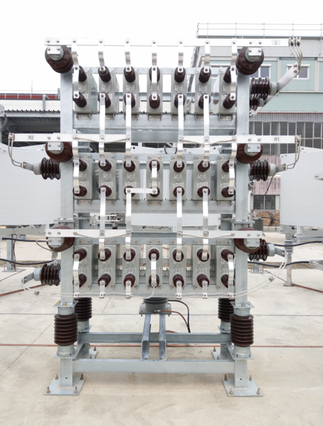
SVC maintenance (SY-EPC)
In view of the usual maintenance of the filters by SY-EPC, the P2 SVC was switched off this Monday, December 9th.
The filter will be re-energized on 24 February.
It is agreed with the machine that they won’t switch on/off the transfer line magnets until the SVC is back on, to avoid glitches on the ALICE electrical network.

Slide 8
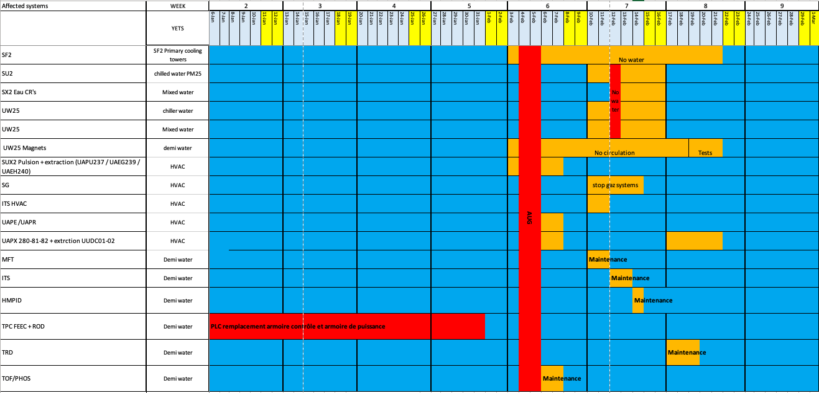
Cooling interventions (EN-CV)
Maintenance water cooling systems: 3 to 21 February 2025 (week 6-7-8)
  Week 6: SF maintenance (cooling towers) → switchover to external chillers
  Week 7: SU2, SX2, UW25 maintenance → various perturbations on iced water & mixed water
    Complete stop of iced & mixed water on Wed 12 February → stop racks cooling + detector cooling (ok if reduced power on detectors)
  Week 8: UW + tunnel ventilation units
Maintenance ventilation units:
  Week 6: UX25, L3. Small cuts (30’) → no impact on access
  Week 7: SG2 → stop flammable gases; ITS → 3 days without air cooling
  Week 8: MCH, MID
Maintenance cooling plants:
  Week 6: TOF/PHOS
  Week 7: MFT, ITS, HMPID
  Week 8: TRD
Replacement of TPC cooling plant electrical cupboard (switch to UNICOS) → postponed to LS3
  2 weeks wo cooling + 1 week commissioning
  TPC should redo the DCS part (DIP)
UX25 sump systems control replacement
EN-CV overall planning
Dominique/Olivier

Slide 9
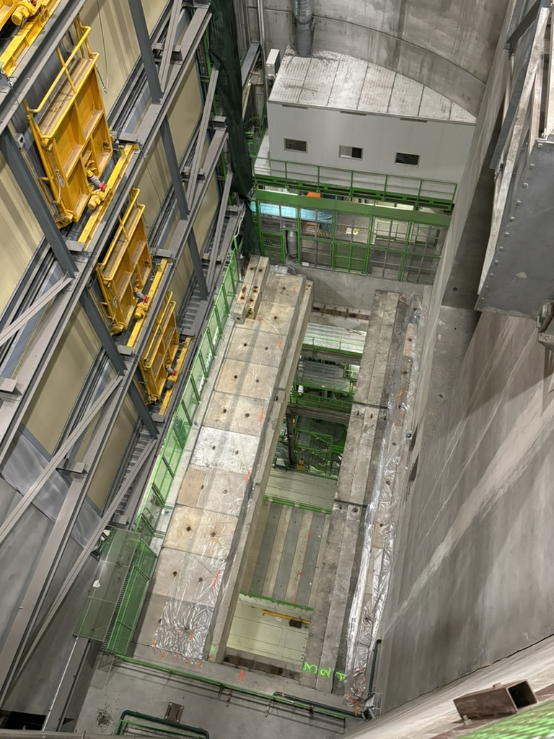
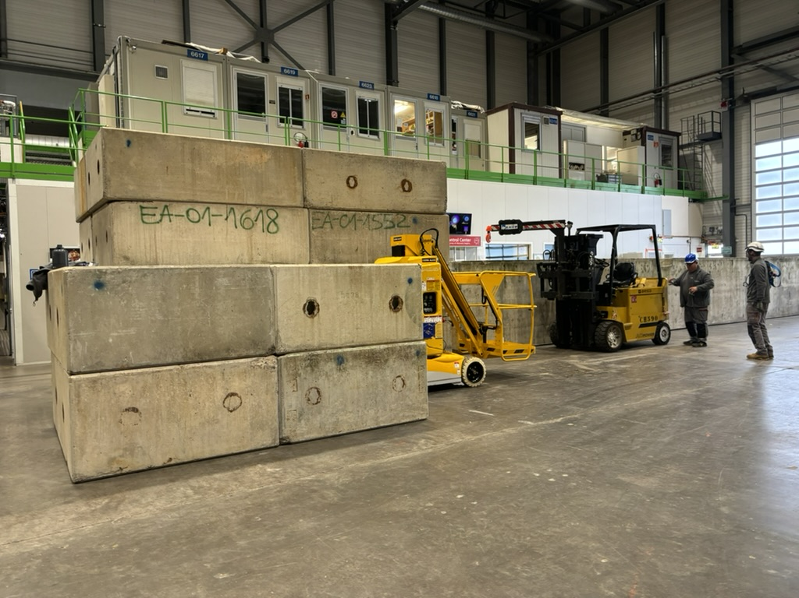
PX24 shaft
The PX24 shaft was opened last week to allow bringing to surface the two trolleys of the UX25 crane
MCH and MID ‘nacelles’ in place – batteries re-installed
2 crane drivers onsite from 25 November to 31 March

Slide 10
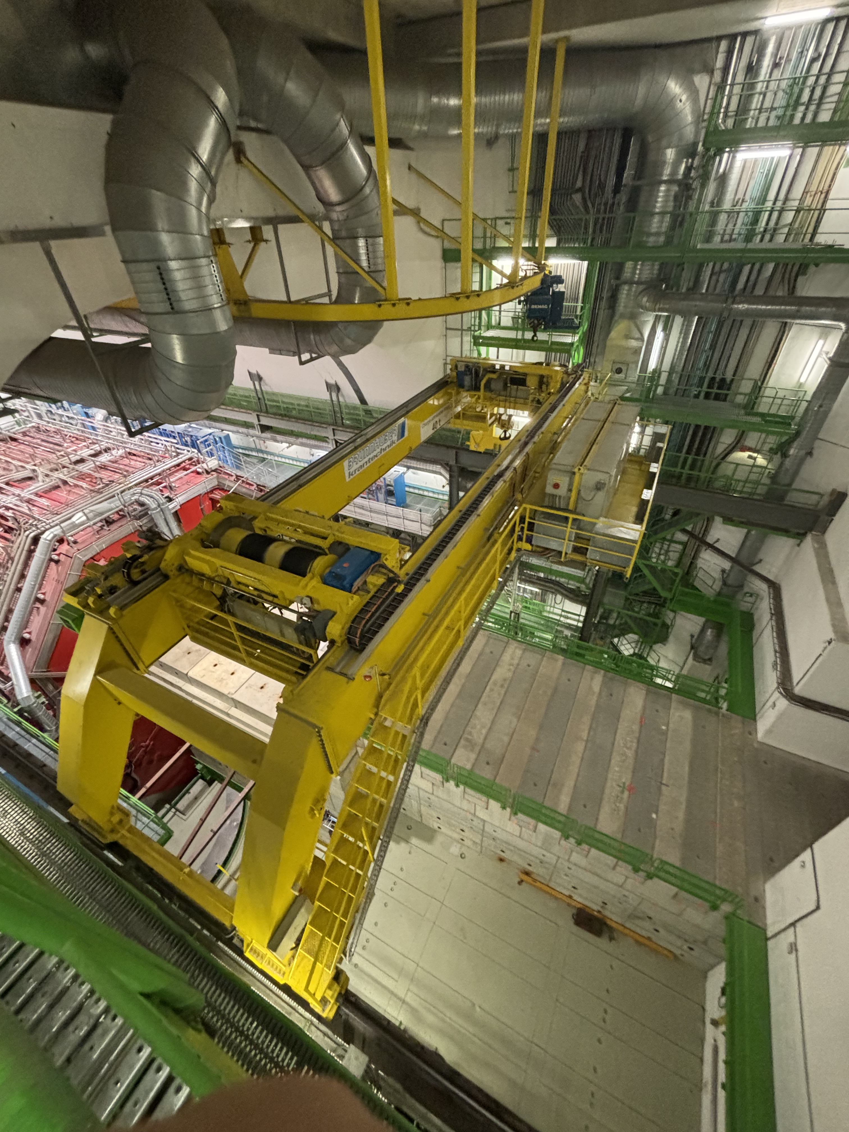
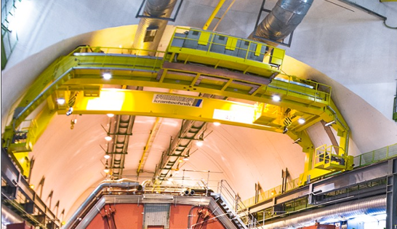
UX25 crane refurbishment (EN-HE)
Refurbishment of cavern crane
  Install new cupboards, cables, sensors and motors
  Check weldings
  Cables and mechanical structure won’t be replaced
  Both crane trolleys will be brought in SX2 for rework
Work executed by Visan, Turkish company
Crane will be unavailable between 12 January and 15 February
Detailed planning:
  VIC: 25-29 November
  Load test (check brakes): 5-6 December
  Visan onsite rework: 12 January to 15 february
  Check crane weldings: in January (need nacelle)
  Closing PX24 shaft: 12-14 March → no access UX25 and CRs 14 March
Total cost: 600 kCHF (Hostlab)
UX25 cavern crane
Roberto/Filippo

Slide 11
ITS activities
Exchange of power unit patch cords at PP1 (Mini-frame)
Investigation and possibly implementation of an improved power unit connection scheme at PP1 to reduce the number of patch cord changes in the future (Mini-frame)
Investigation of problems with CAEN bulk power supplies (Rack area A)
Exclusion of L5_19 from cooling to assess leak rate of the rest of the system
Installation of hot-plugging capable back planes in the safety system ITS2S (Rack area A)
No PP1 filter exchange
All extensive activities in the mini-frame will be announced in advance.
The ITS cooling plant will likely be kept running to prevent air infiltration
ITS2 reference setup and servers in Meyrin need to be shut down before the Meyrin AUG planned for January 4th
Markus/Felix

Slide 12
TPC activities
Check and maybe replace some Wiener PS
Install current measurement devices on Field Cage
Other work

Slide 13
TRD activities
Check Wiener PS with thermal camera

Slide 14
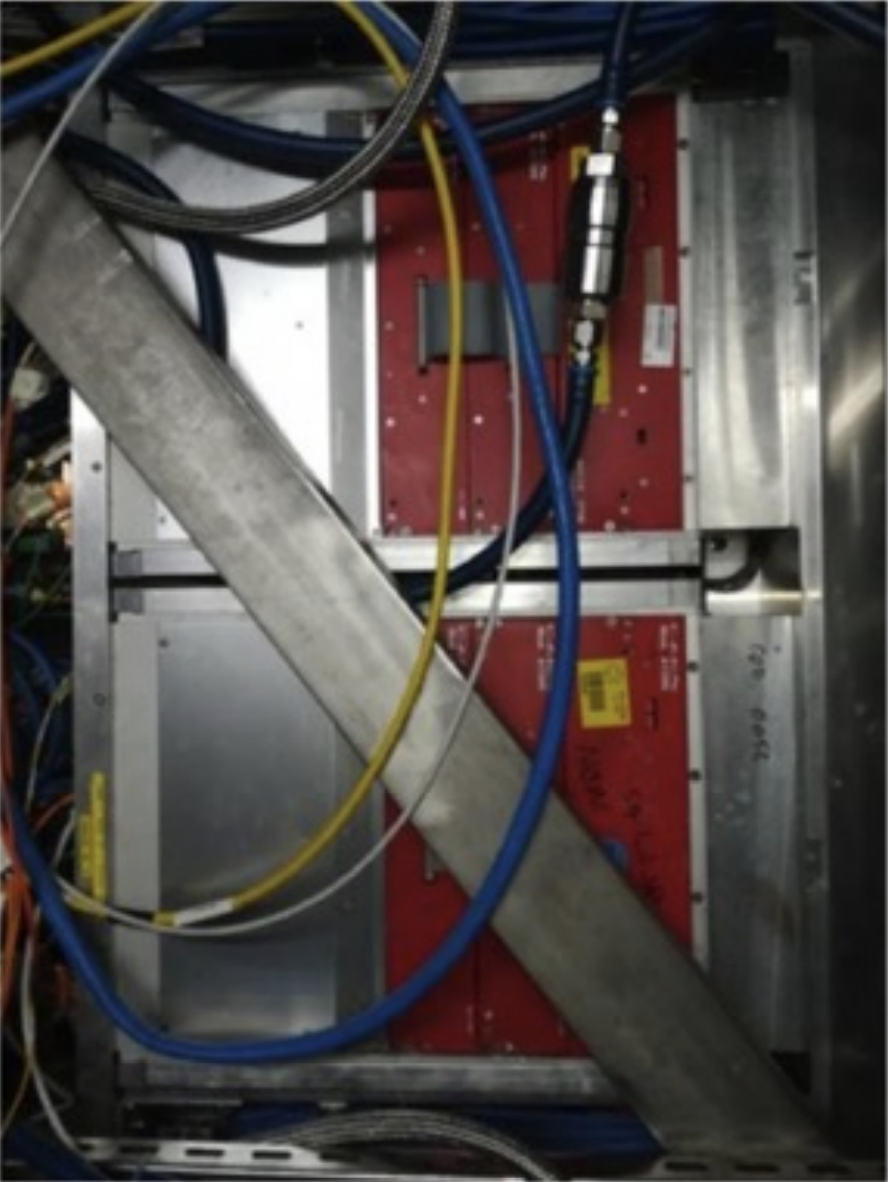
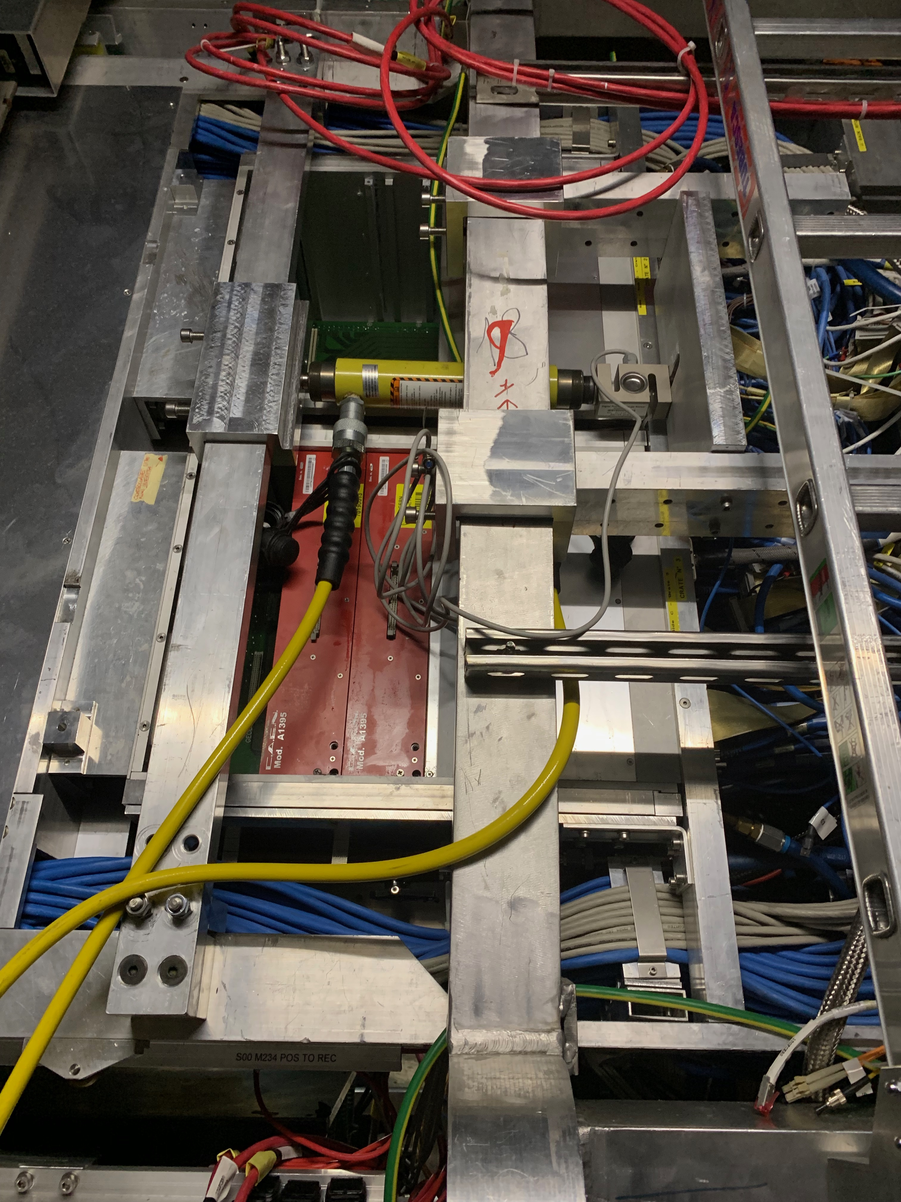
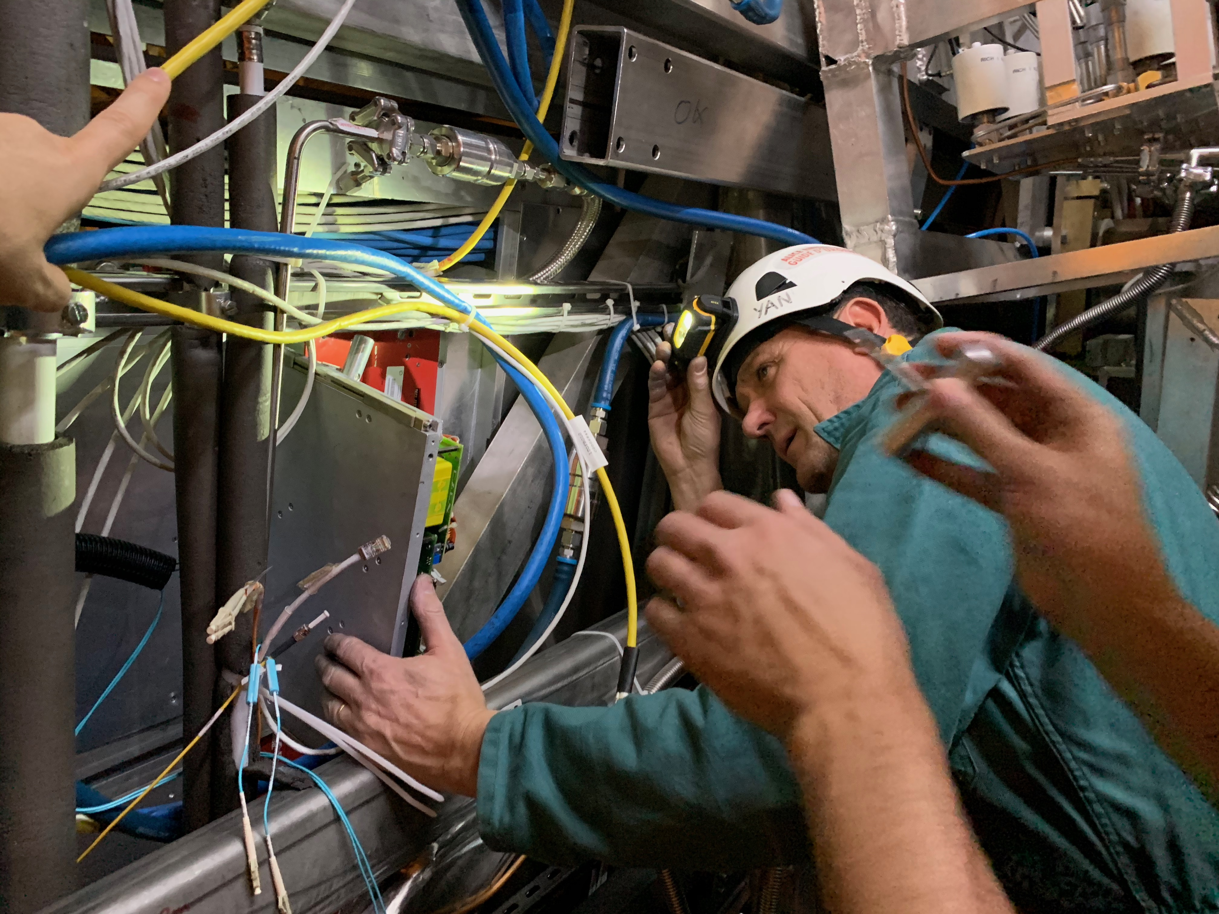
TOF activities
TOF: displace SM1 to replace one DC-DC converter (A-side) → to be confirmed when TOF is restarted in mid-January
  Mon 27/1: disconnect services TOF SM1 (TOF team)
  Tue 28/1: install hydraulics and prepare for TOF SM1 displacement (Philippe/Julien)
  Wed 29/1: displace TOF SM1, replace DC-DC and put back TOF SM1
DC-DC replaced in crates 21 and 62
Unclogging crates
Fix crates 39 and 57 (debug in situ needed)
Fix HV for SM14Mod4Pos
Installation of two new CAEN mainframes (A4527) in CR4
Space-frame beam blocking DC-DC access
Hydraulic jacks used to move TOF SM
Yannick replacing one TOF DRM (LS2)
Sofia/Manuel

Slide 15
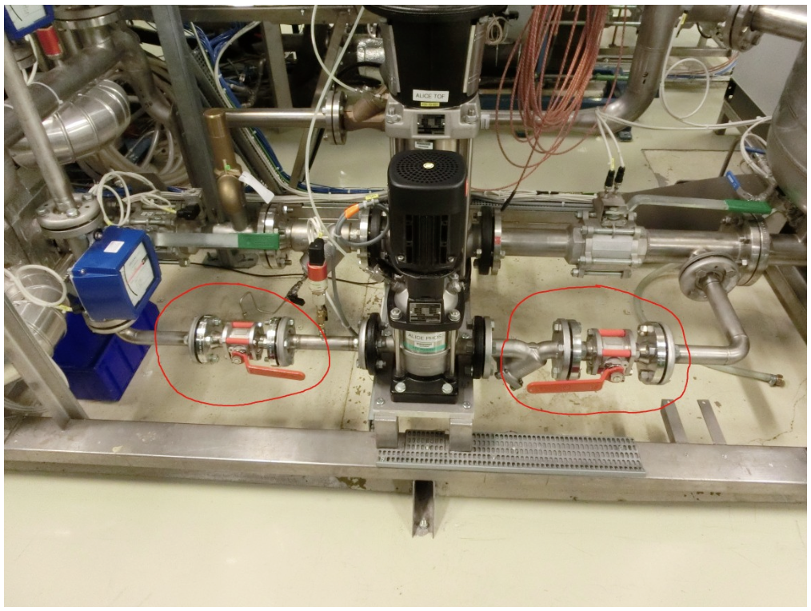
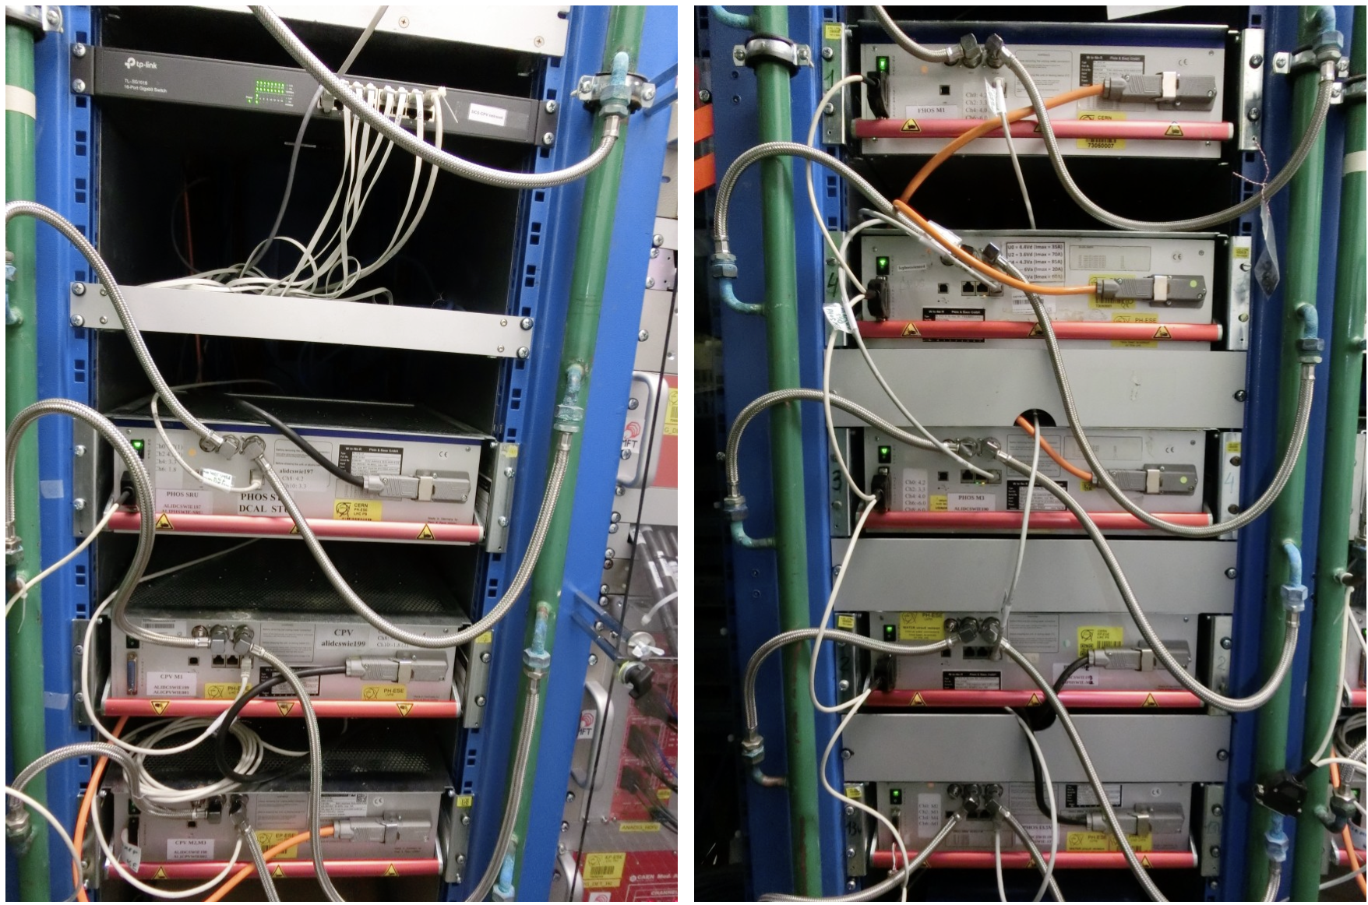
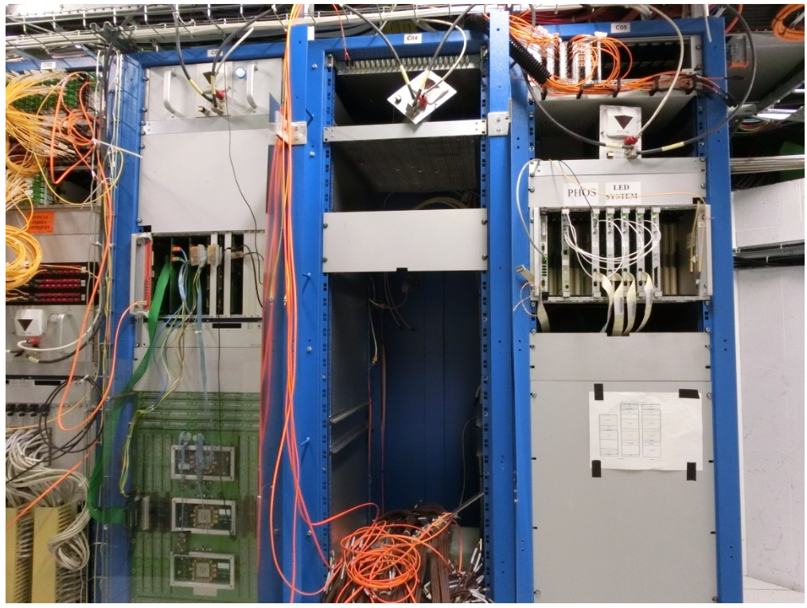
PHOS activities
Switching PHOS & CPV to ‘safe mode’ started on 25 November:
  Crystals warmed to +18℃ since 2 December
  Switch-off modules and readout units inside L3 magnet. Done on 2 December
  Drain C6F14 fluid (about 50 litres) from the crystal cooling plant and modules, then stop water cooling of PHOS/CPV electronics
  Power off racks A16, A17, C05
  Power off crystal cooling plant, exhaust residual water from PHOS/CPV FEE
  Put PHOS/CPV to the safe state
PHOS workshop in b.167 can now be handed over to FoCal
PHOS experts left CERN on 28 November (DCS access maintained until the end of the year)
PHOS/CPV main water pump
PHOS Wiener LVPS in A16-17
PHOS VME crates in C05
Yuri

Slide 16
MFT activities
Cooling:
  Cooling plant maintenance (10-11/02) – EN-CV
  Buffer tank check (loss of water?) – EN-CV - (date tbc)
  No PP1 filter exchange
Electronics:
  Reinforcement of connectors on 8 dispatching boards (glue point + additional 3D printed connector supports) - L3 C-side - 2 days (not necessarily contiguous, date tbc in Dec/Jan)
  Replacement of the 3 VTRx affected by sticky fluid on 23 readout units - L3 C-I-side - 6 days (not necessarily contiguous, dates tbc in Jan/Feb)
Access to power off/on everything (including racks) for Christmas closure and AUG tests (CR4 + cavern)
Charlotte/Sarah

Slide 17
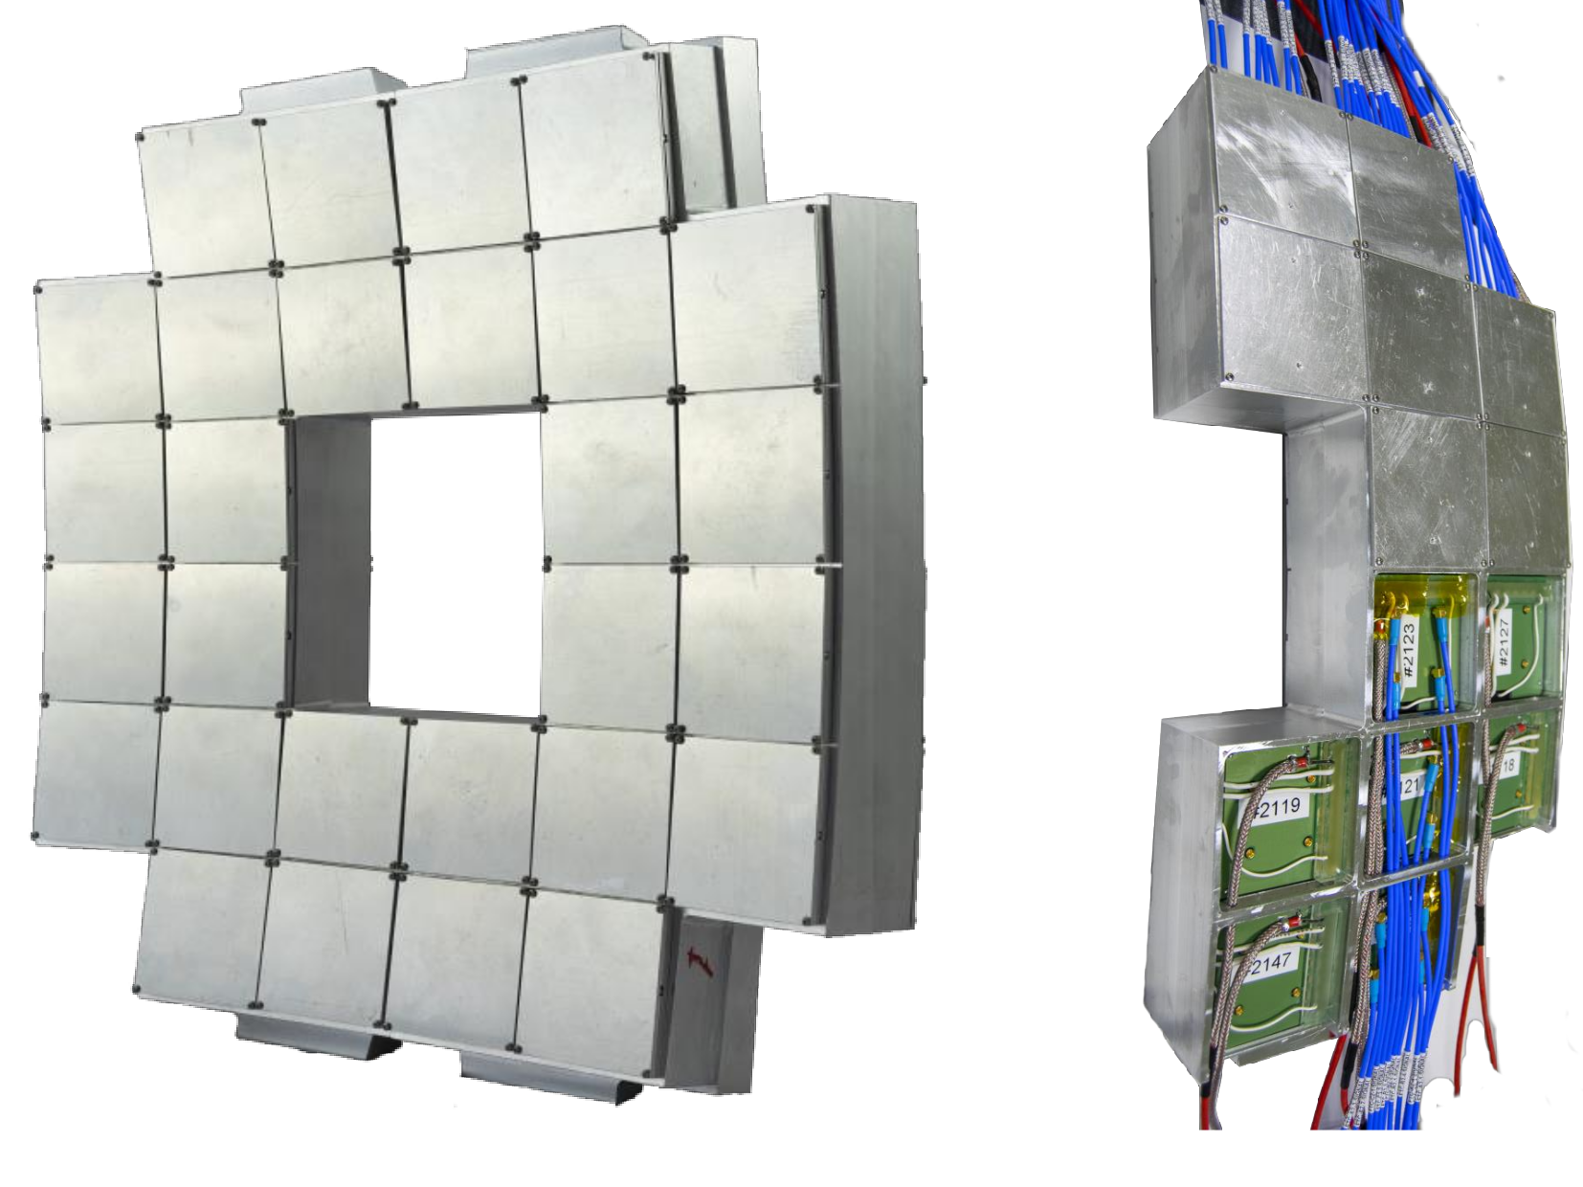
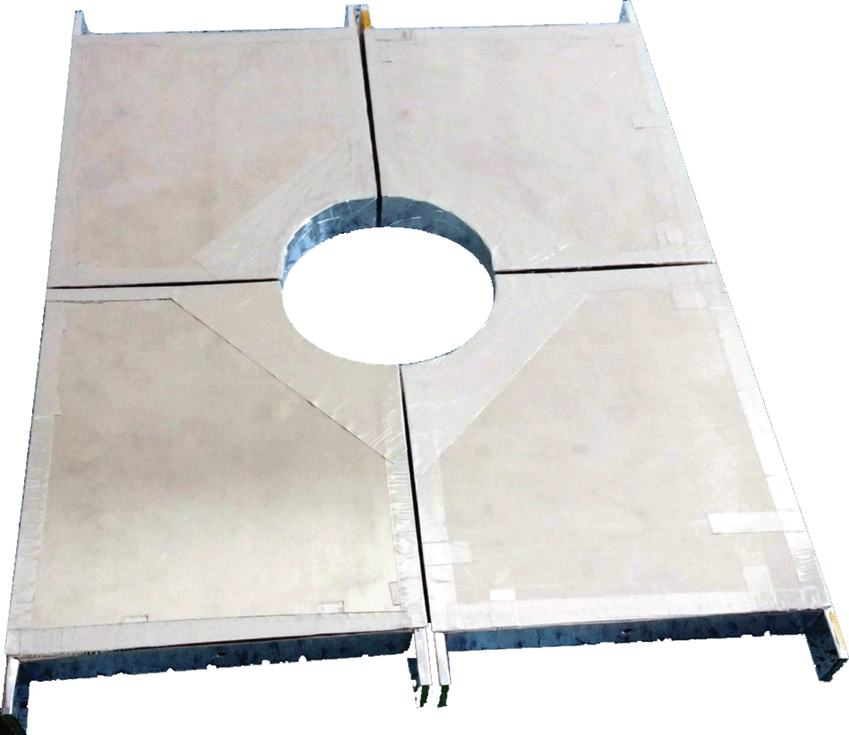
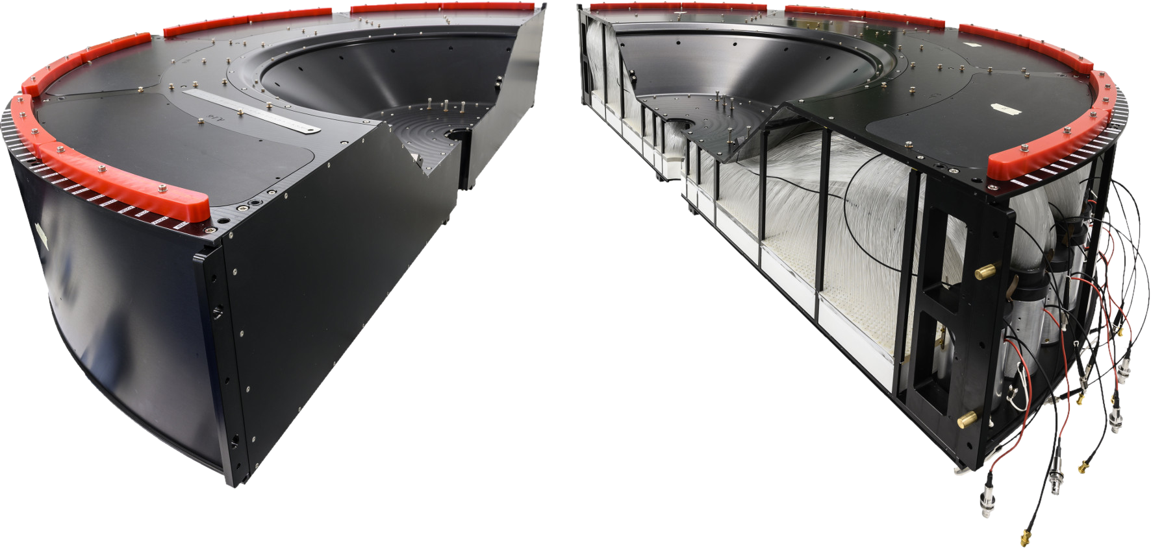
FV0 ALFRED implementation plans
Preliminary timeline:
  25–26 November 2024: Central DCS provides the required nodes. - DONE
  27 November–19 December 2024: ALFRED framework implementation. - DONE
  2 December–2 March 2025: Testing phase. – ONGOING
    20 December – 22 December 2025 – Testing with FT0 Detector: HV OFF, Wiener Crate ON, access to DCS;
    20 December – 06 January (EoY closure) - WIENER Crate turned on and use the DCS
  3 March: The detector will be handed back to RC.
FT0
FV0
FDD
Krystian Roslon

Slide 18
MCH
NO intervention before beginning of January
Gas system stopped at the beginning of December
For stations 3, 4 and 5 we will start on Week 3 in January:
  first test one spare slat in X-Ray to change DE900
  try to improve readout and some HV problems on some slats, mainly on station 3
For station 2, our Indian colleagues should come in February for 3 weeks (19/02 - 11/03/2025 tbc) :
  exchange quadrants DE300 (on CH3) and DE403 (on CH4)
  more measurement on the PCB to investigate the configuration failure
  mainly work on readout improvements
For station 1: continue with consolidation (probably some recabling and fixe a faulty cable in DE100)
  dates not fixed yet
Hervé/Christphe/Livia

Slide 19
Other activities
EN-HE: reinstall batteries on both nacelles (Mon 25 November)
HSE-RP: RP sampling on 25.11 (TOF, ITS, MFT, TPC, TRD, HMPID)
TE-VSC:
  Close manual beampipe valve on Monday, November 25 after 10:00
  Re-open it on Thursday, March 27 AM
HSE-FRS: on February 16th & March 9th & March 23rd, the firefighters will simulate the evacuation of a person injured by electric shock and the spread of a fire in the electrical rack. This exercise will be carried out in collaboration with firefighters from SDIS 01. Red Key required
EN-AA: maintenance cavern lift (AS-724):
  Thursday, December 5th, between 6:00 AM and 8:00 AM → no access to UX25 cavern
  Monday, January 13th, between 6:00 AM and 8:00 AM → no access to UX25 cavern

Slide 20
Access, fire, gas and SNIFFER detection systems (EN-AA)
Access system preventive maintenance: 3-4 December
Yearly maintenance red phones: 9 December
Safety test (sirens and flashing light): 24 December → no access underground whole day
CSAM test: 3 January from 8:00 to 13:00 → no access underground
Individual System Test (IST): 28th February from 13h to 19h30 and 3rd March from 17h to 19h30 → ALL DOORS must be closed and no emergency green handle pulled (no patrol needed). Underground access will be stopped ~1h before the tests.
Beam Imminent Warning (BIW) test: 28th February, in the shadow of IST test
Department Safety Office (DSO) test: 13-14 March → patrol and close ALICE on March 13th at 15:00 (test starts at 16:00). No underground access from March 13th at 15:00 to March 14th at 18:00
Tests on Fire, Gas and SNIFFER Detection Systems
System | Buildings | Dates | Comments
Gas Detection Activity #1 | SG2, CR5 and UX25 | 25/11/2024 to 27/11/2024
Gas Detection Activity #2 | SG2, CR5 | 04/02/2025 | Electrical Interlocks test of gas system in the shadow AUG test in collaboration with EN/EL and EP/DT
Fire Detection Activity #1 | UX25 and Counting Rooms | 25/11/2024 to 29/11/2024
Fire Detection Activity #2 | UX25 Racks | 21/02/2025 to 27/02/2025
SNIFFER Activity #1 | CR5 and UX25 | 26/02/2025 | Test of level 3 alarms and DSS after all rotations are done
SNIFFER Activity #2 | CR5 and UX25 | 27/02/2025 or 03/03/2025 | Assistance to ALICE for air sampling network cleaning
Nicolas Broca/Vitor Rios

Slide 21
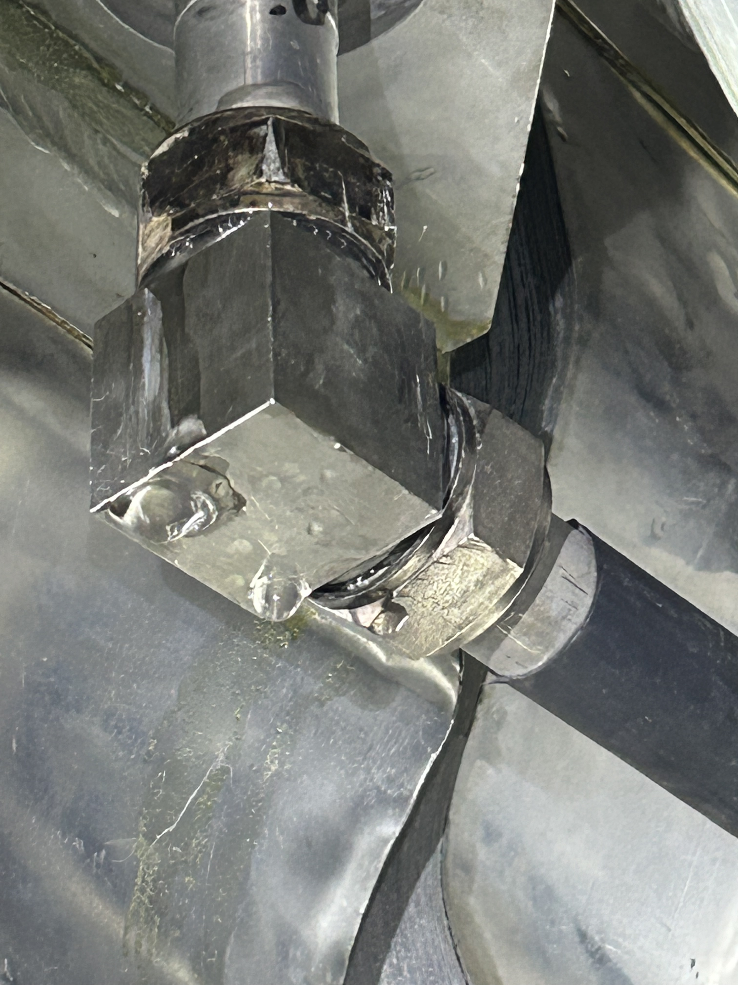
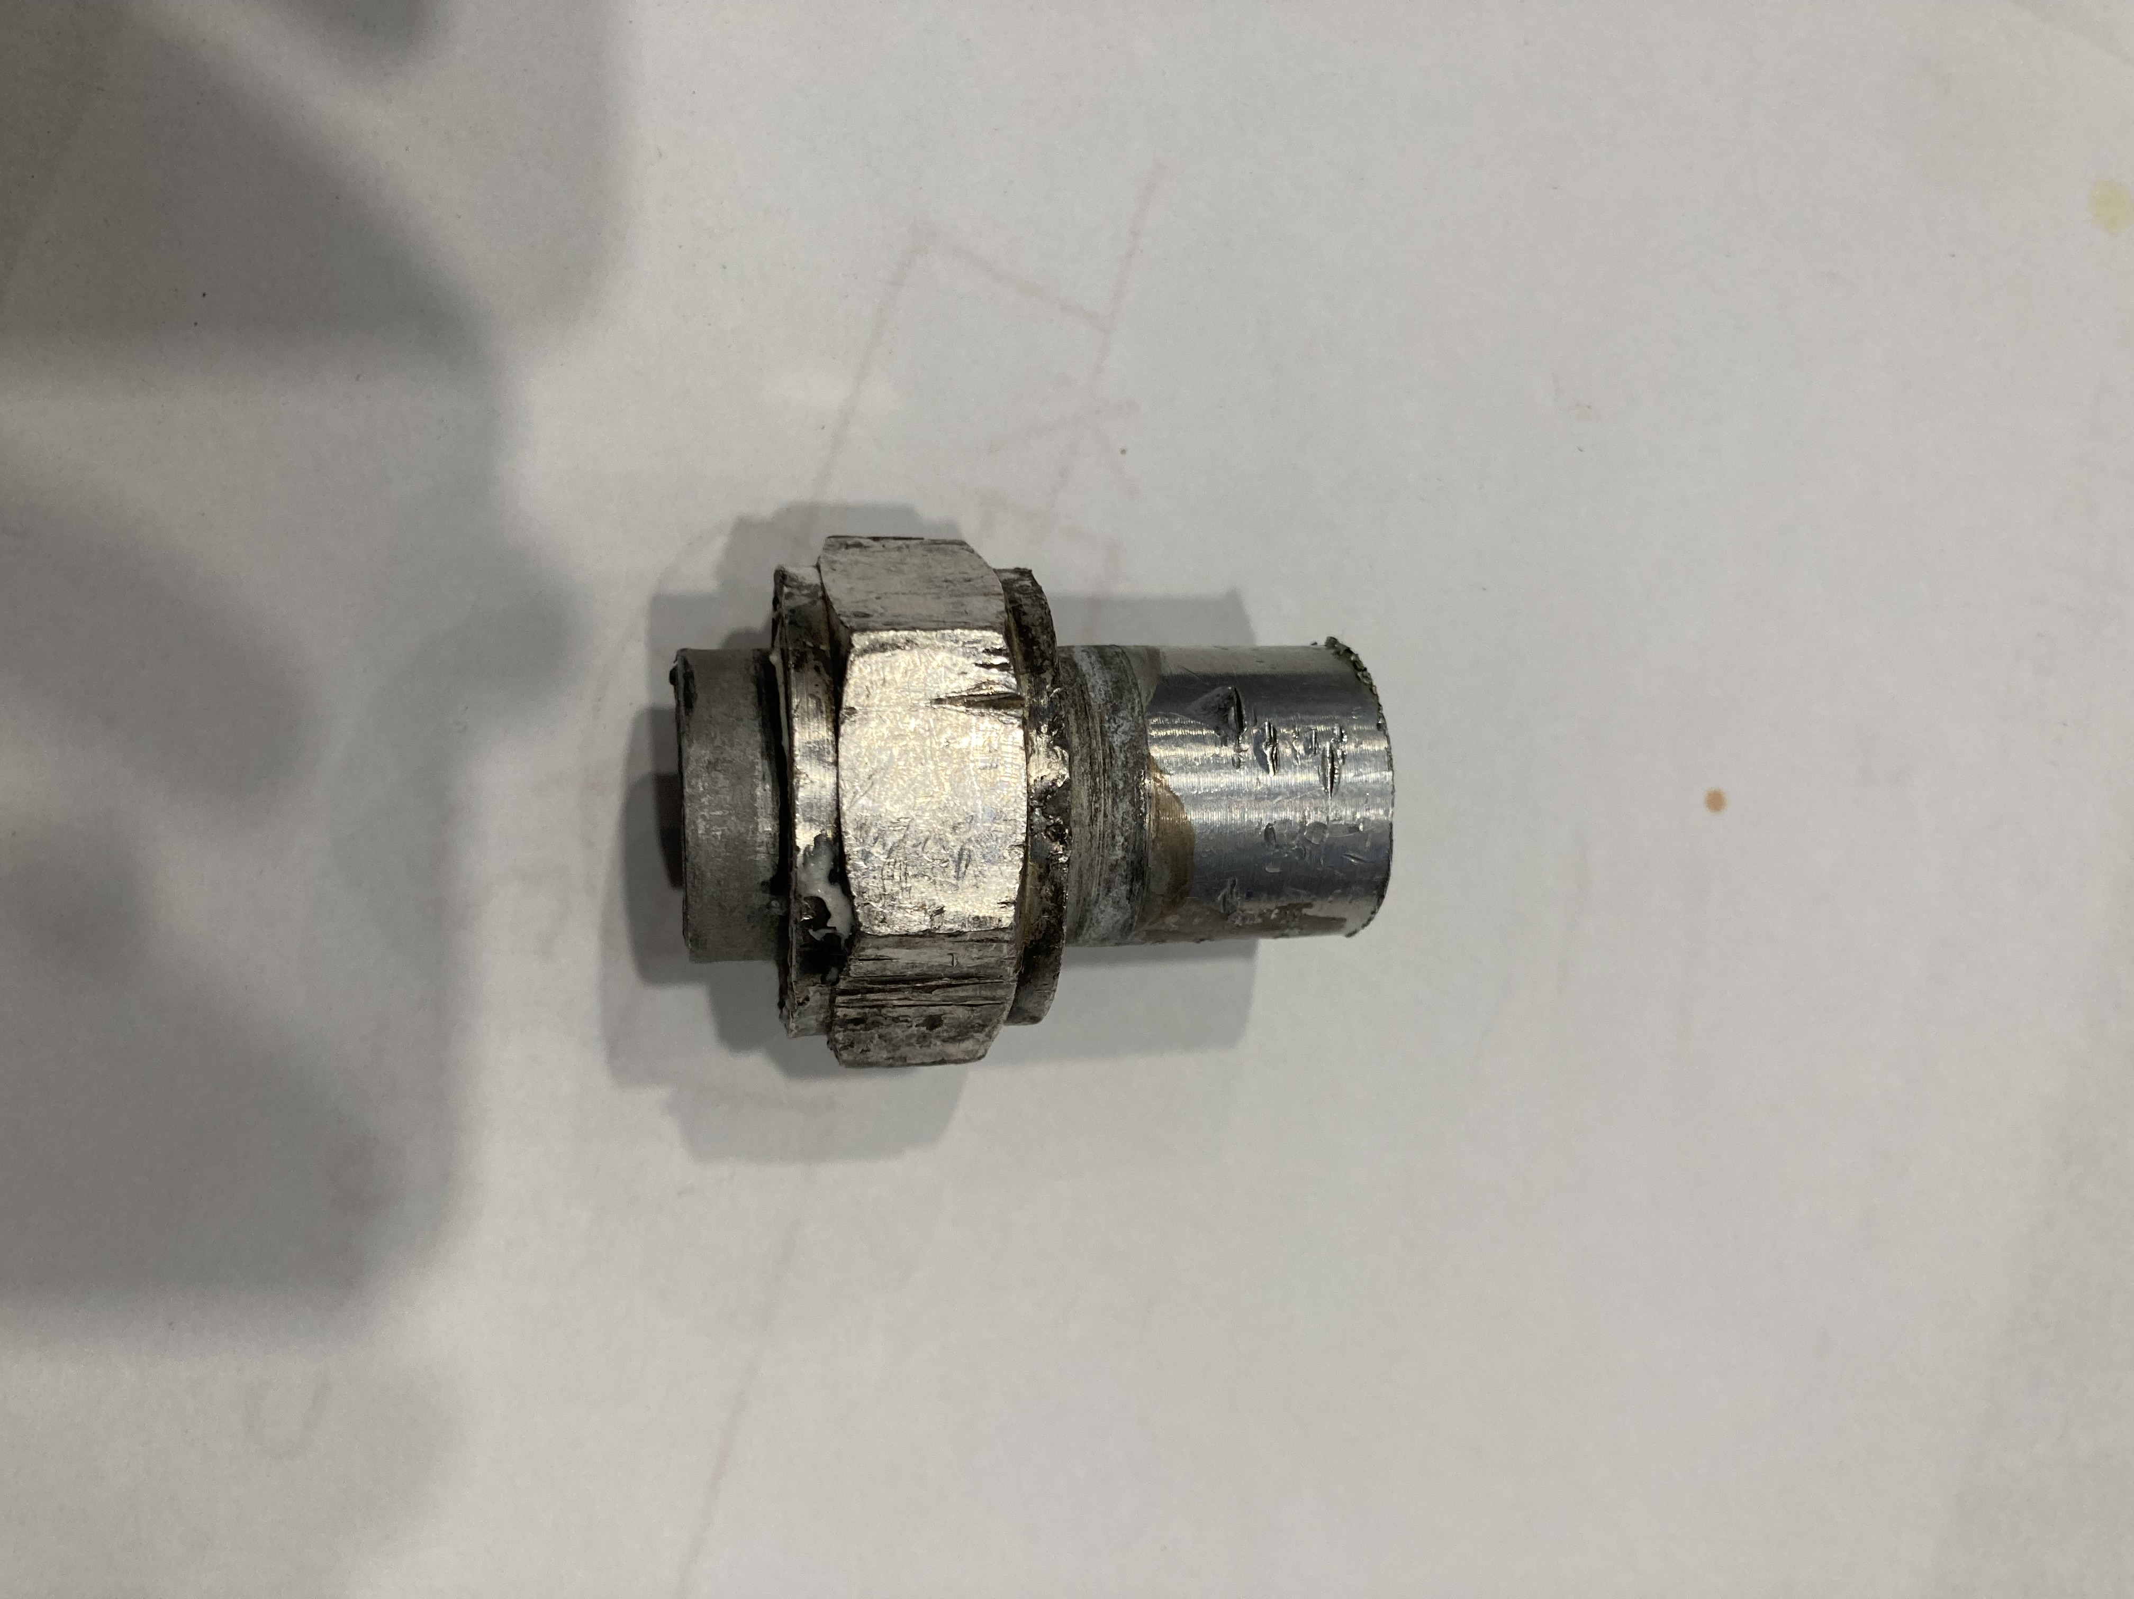
L3 leak update
A quite big leak in the L3 busbar cooling system detected in July
The leak was repaired last week, requiring welding a new pipe and replacing the fitting
The magnet was powered on on Friday, to verify the tightness of the new fitting at 50℃. A second powering test foreseen before the end of the EYETS
Thanks to Philippe and Julien who have organised this repair with the help of a welder from EN-MME!
Old fitting
Philippe/Julien

Slide 22
Gas activities (EP-DT)
TPC:
  Installation of a pressure dumper on the input of the pumps to reduce the gas vibration impacts on the chamber and test (before Christmas)
  Filling of the Envelop humidifier (Jan-Feb/2025)
  Replace filters, pump, purifier, distribution (Dec/2024)
  Dismount and check safety valves (Dec/2024 and Jan/2025)
  Maybe dismantling of the pump 2 and send it to manufacturer for maintenance and cleaning (Jan-Feb/2025)
TRD:
  Replace the Festo module (Dec/2024)
  Check safety valves (Dec/2024 and Jan/2025)
  Replace 1 pump by the spare and send it to maintenance (Dec/2024)
HMPID:
  Regeneration of the manual purifier (Jan/2025)
  Check the analysis devices in CR5 (Jan/2025)
TOF:
  Replacement of one pump by the spare and send it to the manufacturer (Dec/2024)
  Replace the Festo Module (pilote of the pneumatic valves) (Dec/2024)
  Filter to be change in purifier, pump, exhaust (Dec/2024 or Jan/2025)
  Installation of flow meters in the backup lines in the cavern (Jan-Feb/2025)
MCH:
  Test of the mixture to check the ratio (if not good, then calibration of the mass flow controllers) (Dec/2024)
  Filling humidifier (Jan-Feb/2025)
  Reading of the distribution rack 61, one channel totally wrong to be fixed (ongoing)
MID:
  Purge the system and then open it (ongoing)
  Remove the Zimmerli in the mixer to test it (Dec/2024)
  Test the functioning in “dummy chamber mode” (ongoing)
  Change the pressure sensor on the distribution (second half of January) → implies openng the detector
  Pump membrane to be changed (Jan/2025)
  Filling of the humidifier (Feb/2025)
Louis-Philippe

Slide 23
EOY gas consumption
 |  |  |  | In service during the closure (Y/N) | If in service, expected consumption (m3/d) | If not in service during the closure, proposed date for the switch off (Before the 21st of December) | If restarted in January, proposed date for the switch on in 2025
ALICE | CRFDG-PGS_ALICE-N2 | CRFDGRF001-00001800 | 2270/R-011 | Y | 90-100
ALICE | CRFDG-PGS_ALICE-AR | CRFDGRF001-00001700 | 2270/R-011 | Y | 6
ALICE | CRFDG-PGS_ALICE-CO2 | CRFDGRF001-00011200 | 2270/R-011 | Y | 3
ALICE | CRFDG-PGS_ALICE-HE | CRFDGRF001-00001900 | 2270/R-011 | Y | Nominal
ALICE | CRFDG-PGS_ALICE-NE | CRFDGRF001-00002000 | 2270/R-011 | Y | 0.3
ALICE | CRFDG-PGS_ALICE-AR_H2 | CRFDGRF001-00002100 | 2270/R-009 | Y | x2 wrt nominal (switch to non flammable mixture) | 18 Dec | From 7th to 10th Jan
ALICE | CRFDG-PGS_ALICE-C2H2F4 | CRFDGRF001-00002200 | 2270/R-009 | Y | 0.7
ALICE | CRFDG-PGS_ALICE-NE_CO2_N2 | CRFDGRF001-00002500 | 2270/R-009 | N |  | As soon as possible | No need
ALICE | CRFDG-PGS_ALICE-SF6 | CRFDGRF001-00002600 | 2270/R-009 | Y | 0.07
ALICE | CRFDG-PGS_ALICE-ISOBUTANE | CRFDGRF001-00002300 | 2270/R-009 | N |  | As soon as possible | End Jan
ALICE | CRFDG-PGS_ALICE-CH4 | CRFDGRF001-00002400 | 2270/R-009 | N |  | As soon as possible | End March (exact date t.b.c.)
Louis-Philippe

Slide 24
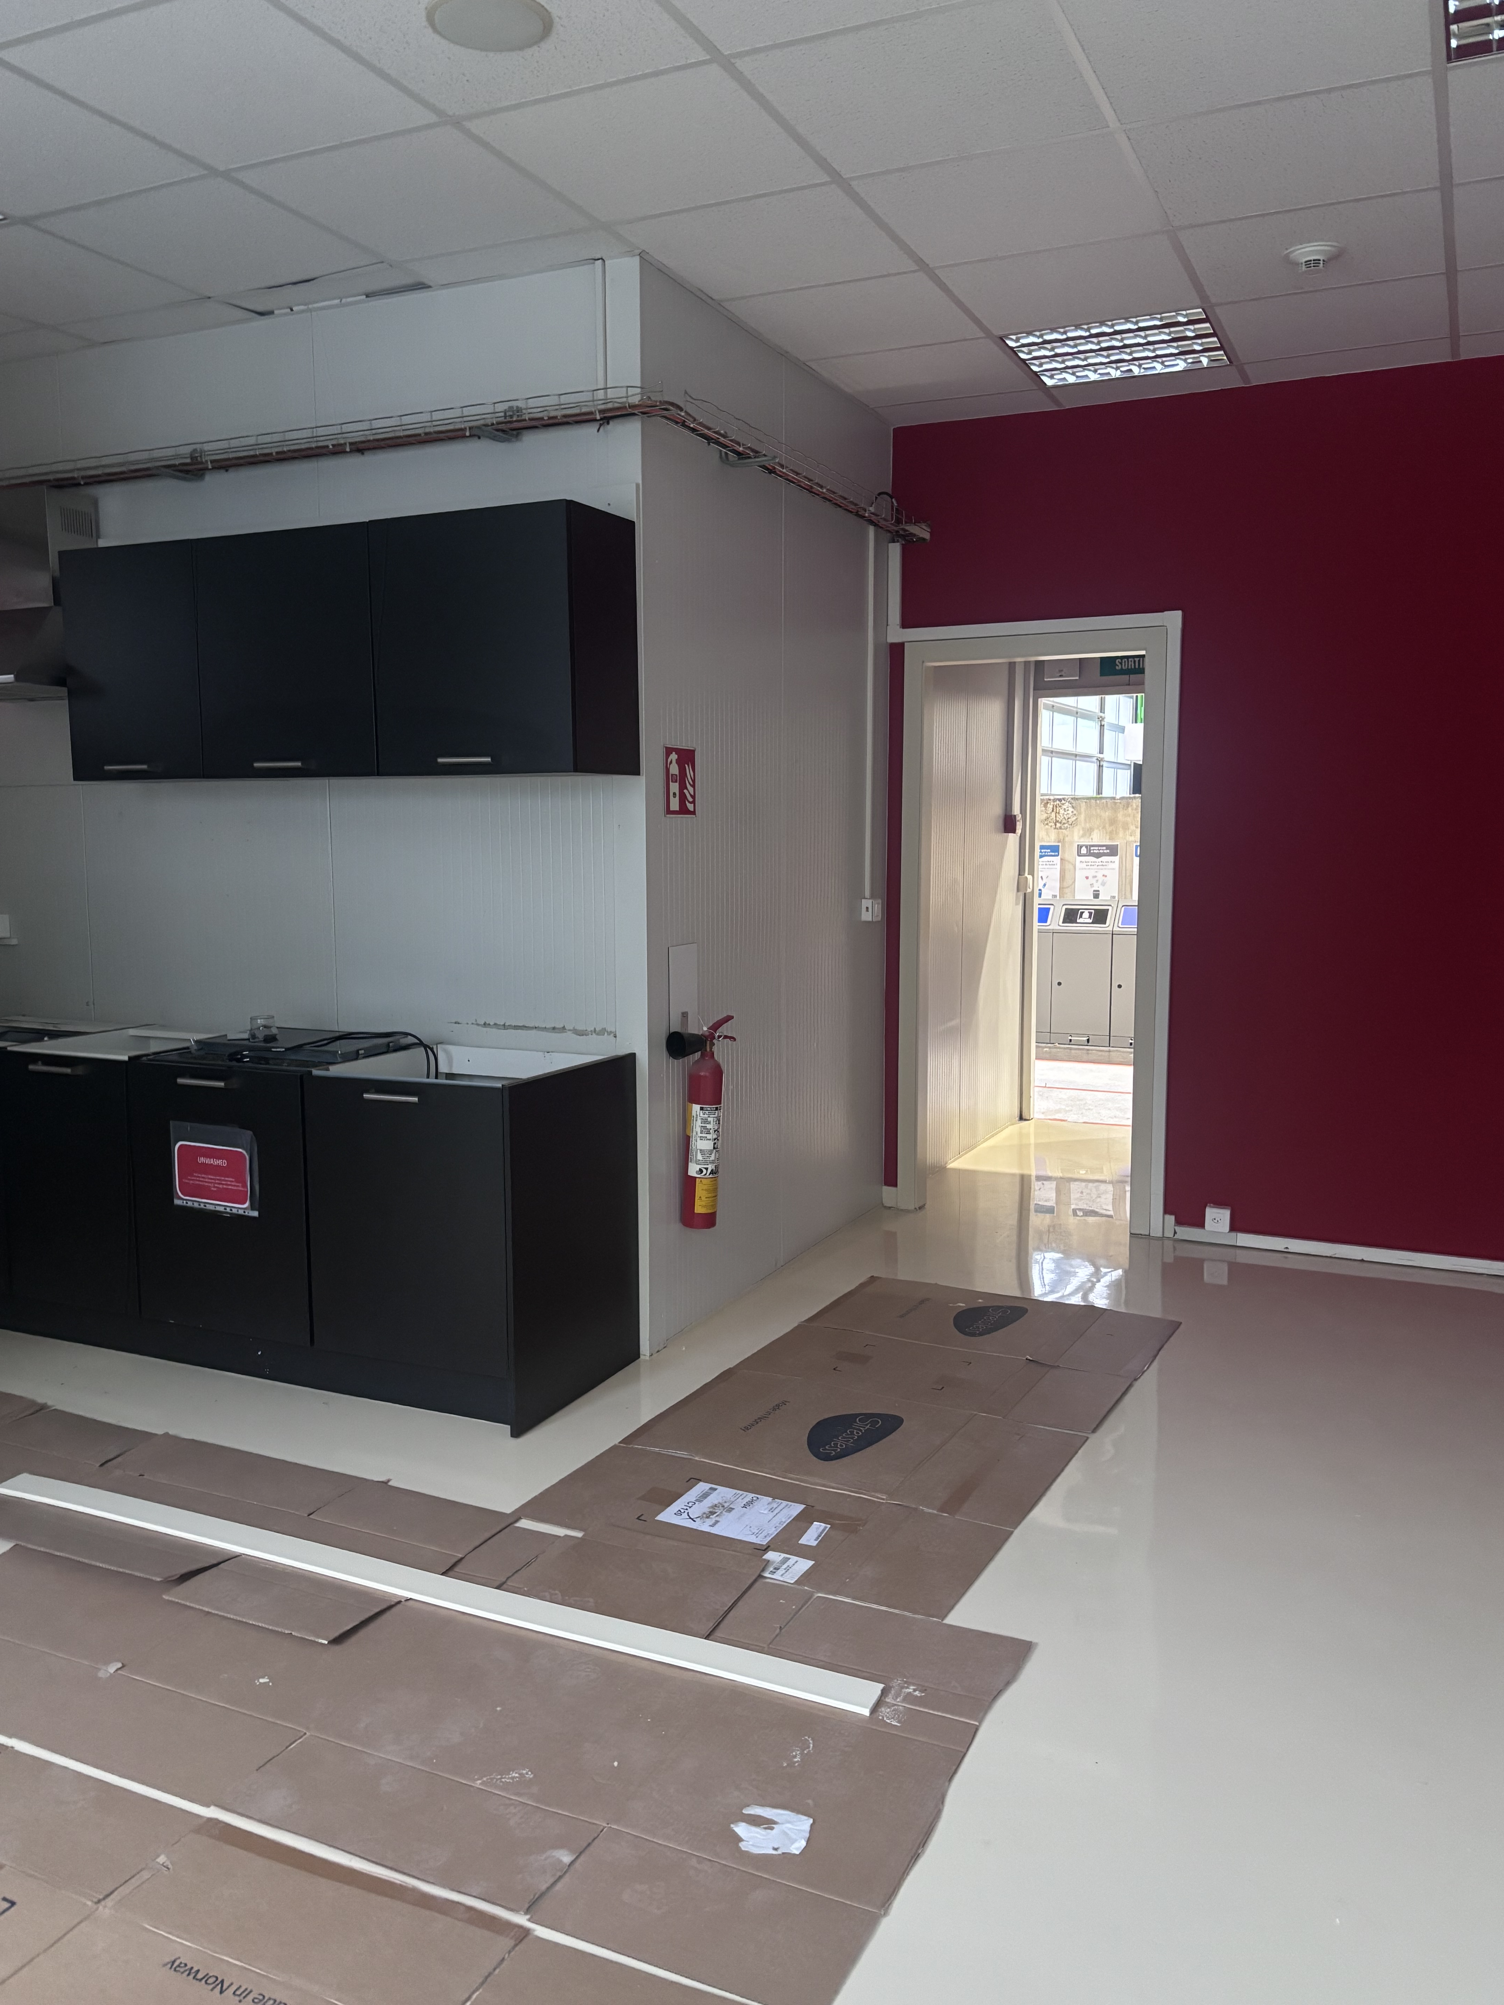
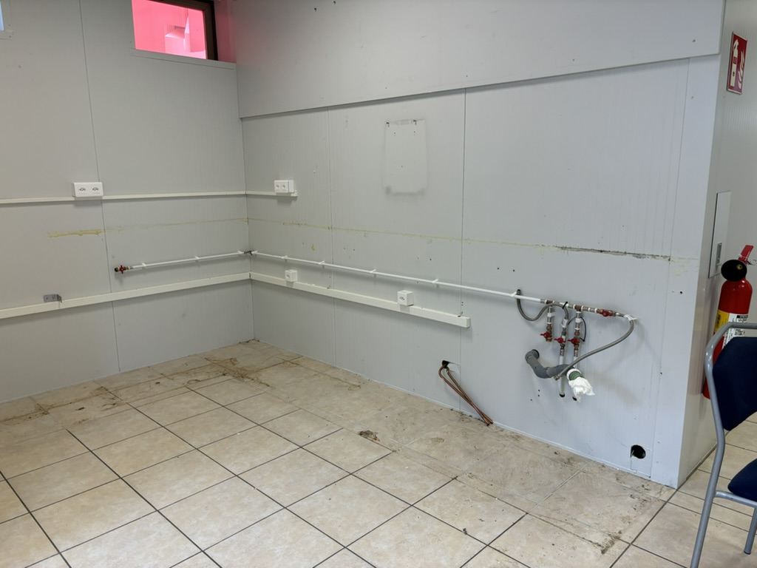
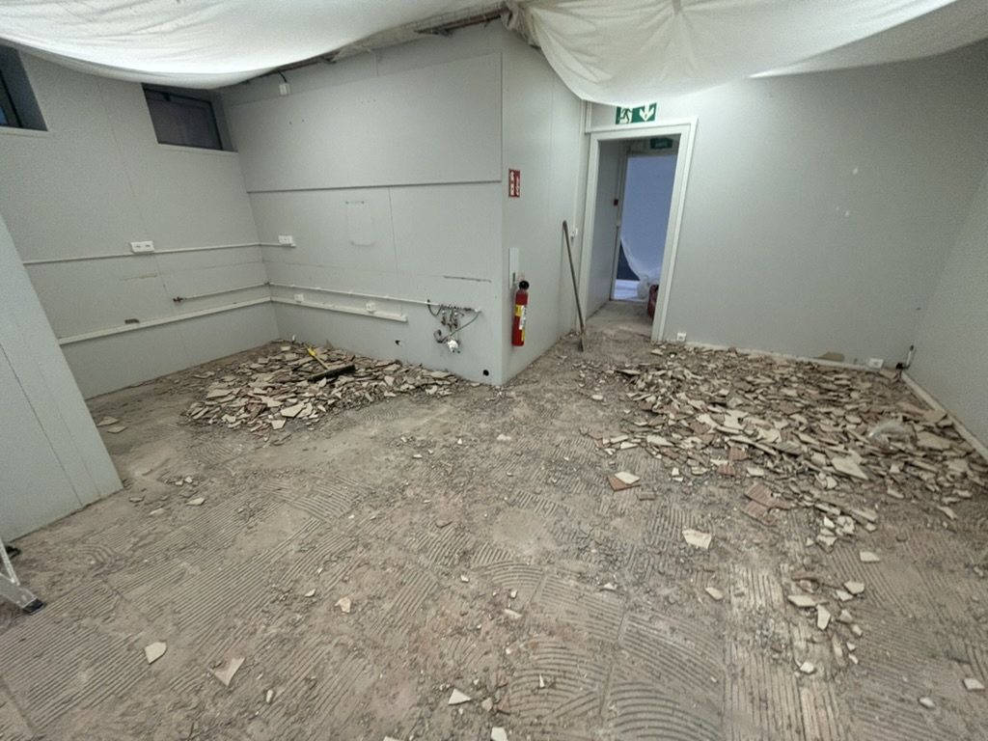
Renovation SX2 kitchen
Renovation SX2 kitchen, starting on Monday, November 25th→ Kitchen unavailable until January
  Disassemble kitchen: 25.11
  Remove floor tiles, floor resin & paint wall: 26.11 to 6.12
  Reassemble kitchen + new hard top: 9-13.12
  New furniture (tables, chairs)
  Install new TV screens outside ARC and inside kitchen
Philippe/Julien

Slide 25
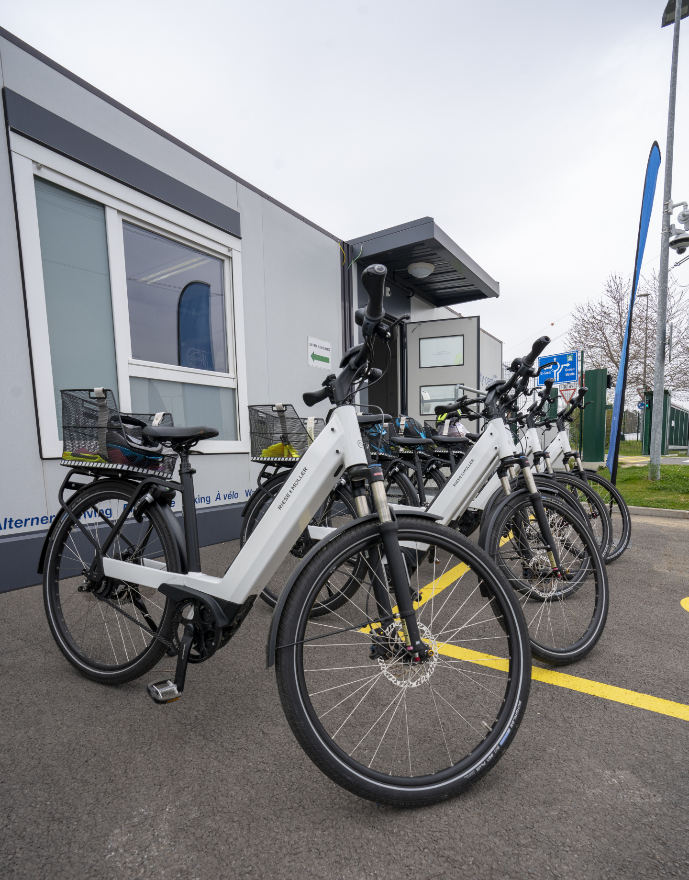
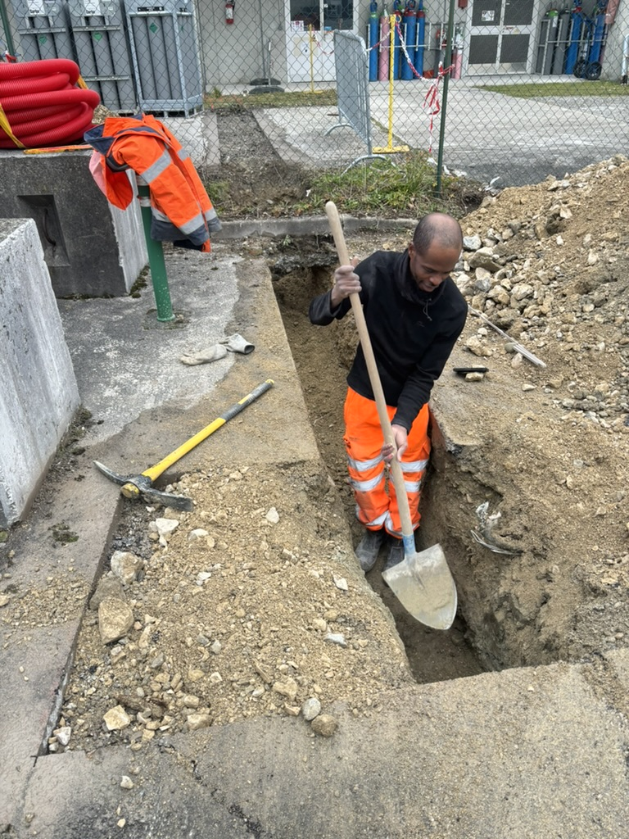
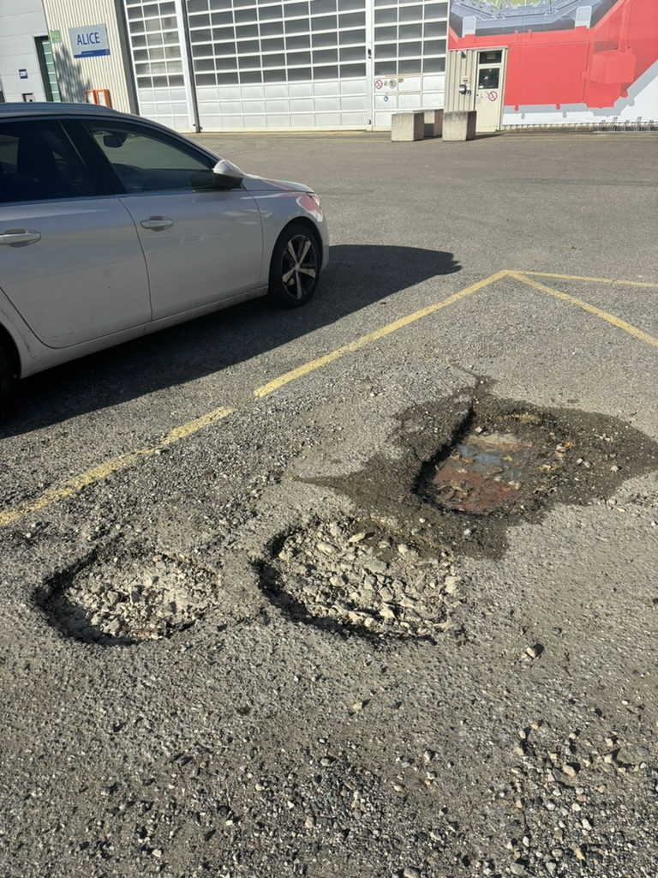
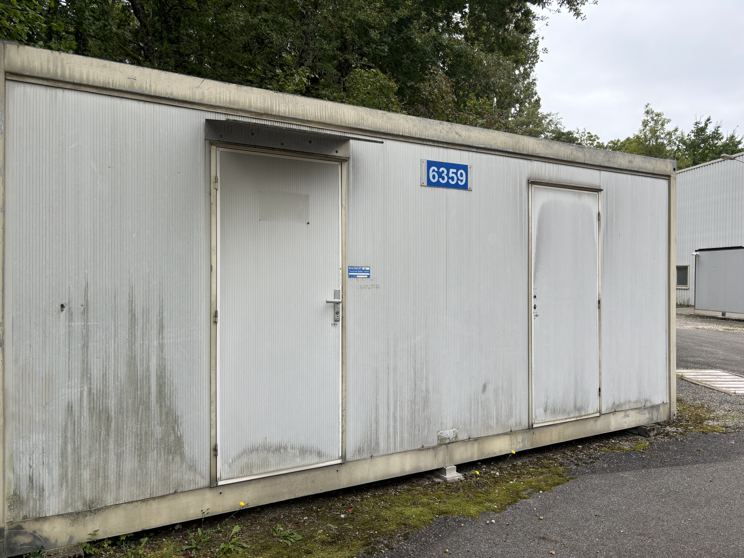
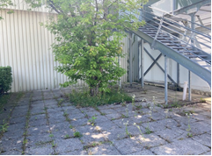
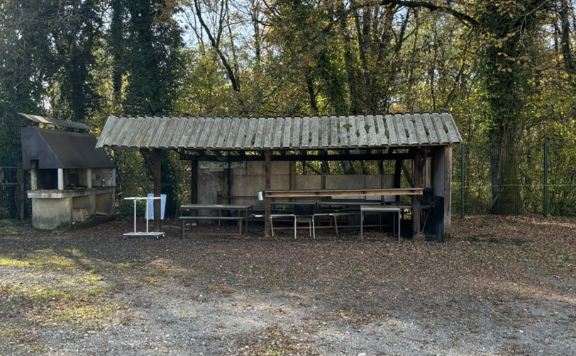
Site activities (SCE)
New charging station for cars
(3-5 Dec)
Parking lot markings
Electric bikes
Repair potholes parking
MCH barrack removal
New rest area outside b.3294
Redo P2 BBQ area

Slide 26
EOY closure – 23 Dec 2024 to 6 Jan 2025
As always, we ask detectors to switch off all equipment that is not strictly needed
  In the past mainly for safety reasons, as there is only limited monitoring; and to protect the equipment itself (e.g. in case of power cuts)
  But also to save power (so this recommendation goes for the whole EYETS)
Gas & cooling systems will go to pre-defined status and no flammable gases will be circulated
  Flammable gases: stop CH4 Dec 2 (restart end March); stop i-butane Dec 2 (restart end Jan); stop Ar-H2 Dec 18 (restart 7 Jan)
There will be the usual inspection tours in ALICE, every second day (schedule tbc)
  Let us know if there is something specific to be checked.
  Let us know if you plan to remain in the local area to help with the tours
Shuttle service to P2 will be stopped between 21st December and end-February
Access to CERN premises during the EOY closure:
  Only for authorized persons for strictly professional reasons such as stand-by service and indispensable maintenance work
  No private visits (even on surface)
  Please send an email to me (with justification) if you need access to CERN during the EOY closure

Slide 27
YETS planning meetings
Friday, January 17th at 10:00
Friday, February 7th at 10:00
Friday, February 21st at 10:00
Friday, March 14th at 10:00
Friday, March 28^{h} at 10:00

