Slide 1
HVAC Safety Coordination Meeting HI-ECN3/SHiP
F. Dragoni, N.Zaric/ EN-CV ,
29.11.2024.

Slide 2
Questions
What is the boundary between the HI-ECN3 and SHiP projects wrt CV ?
E.g. who is in charge of the ventilation of the control room , meeting rooms, etc in B918?
Is the values for the underpressure correlated to the class C1, C2, etc? Was there a radiological risk assessment performed to which you based your design?
Does the WP include the ventilation of ECN3?
Is there dynamic confinement requirements between TCC8 and ECN3?
What type of filtration is foreseen?
From the FIRIA studies to we have an idea if smoke extraction is required underground?
How many exhaust stacks will there be?
29/11/2024
F. Dragoni, N.Zaric | HVAC Safety Coordination Meeting HI-ECN3/SHiP| Indico 1479436

Slide 3
Who is in charge of the ventilation of the control room , meeting rooms, etc in B918?
EN-CV with the Operation team
29/11/2024
F. Dragoni, N.Zaric | HVAC Safety Coordination Meeting HI-ECN3/SHiP| Indico 1479436

Slide 4
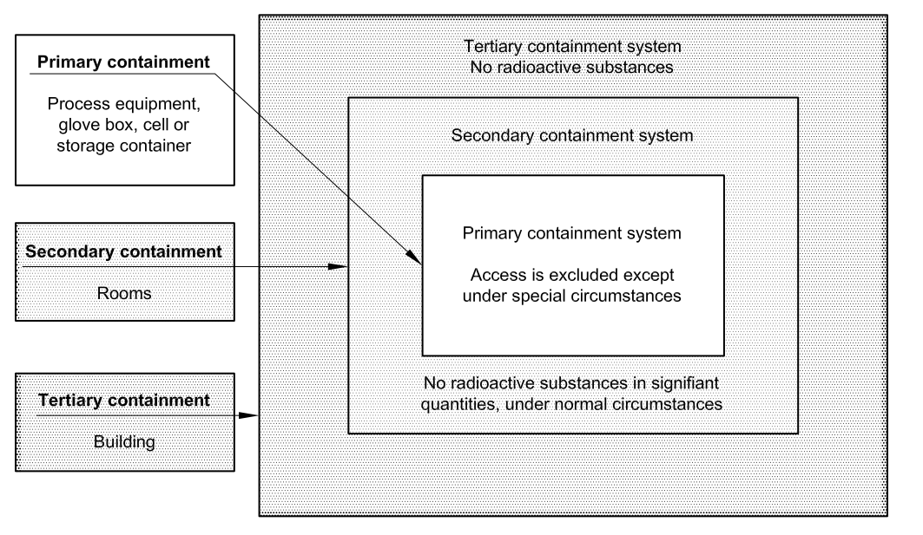
Is the values for the underpressure correlated to the class C1, C2, etc? Was there a radiological risk assessment performed to which you based your design?
ISO 17873:2004(E) standard
Guidelines: Attention must be paid to designing protection for personnel in charge of operations that may lead to the spread of radioactive contamination, as well as additional protection for personnel in adjacent areas
29/11/2024
F. Dragoni, N.Zaric | HVAC Safety Coordination Meeting HI-ECN3/SHiP| Indico 1479436

Slide 5
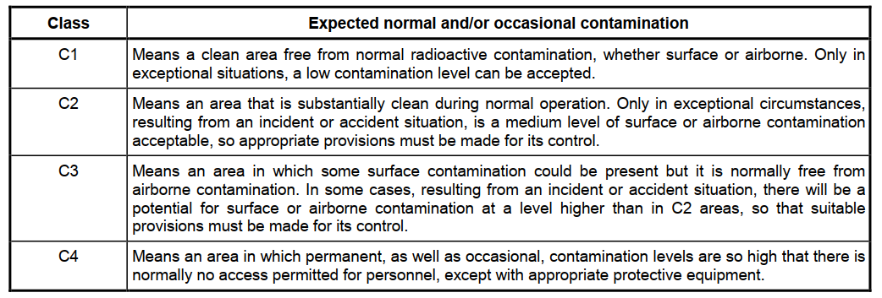
Is the values for the underpressure correlated to the class C1, C2, etc? Was there a radiological risk assessment performed to which you based your design?
Methodology for dimensioning ventilation systems:
  The areas in which work on radioactive materials takes place shall be classified according to the degree of radioactive hazard they contain. The classification is usually set according to the direct radiation (external exposure), and the potential level of surface contamination and/or airborne contamination (internal exposure).
  In order to optimize the ventilation system, the installation shall be divided into separate areas with regard to the risk of spread of radioactive contamination.
29/11/2024
F. Dragoni, N.Zaric | HVAC Safety Coordination Meeting HI-ECN3/SHiP| Indico 1479436

Slide 6
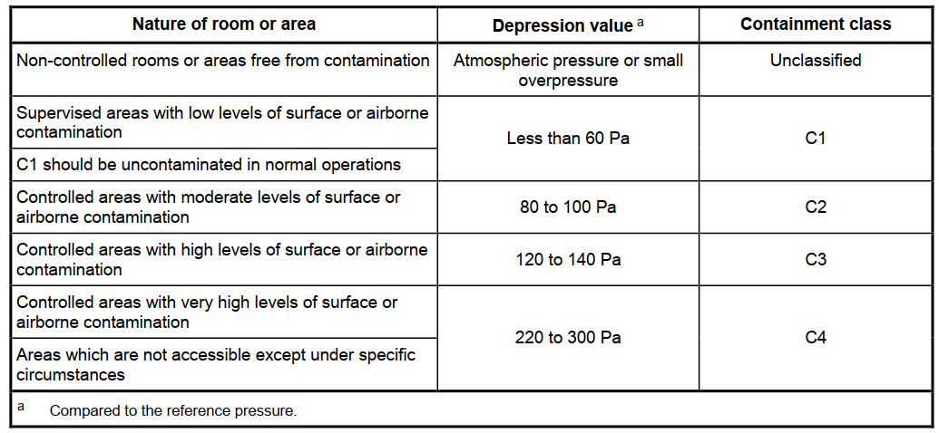
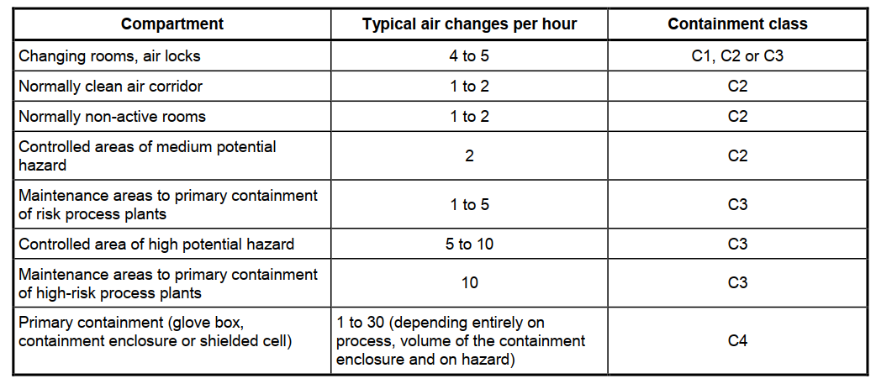
Is the values for the underpressure correlated to the class C1, C2, etc? Was there a radiological risk assessment performed to which you based your design?
  Some examples of classifications are given as follows:
    Non-contaminated change rooms are classified C1;
    Mechanical process cells presenting a high level of permanent radioactive contamination are generally
    classified as C3 or C4;
    Mechanical process cells presenting a low level of accidental radioactive contamination are generally
    classified as C2 or C3;
    Chemical process cells, according to their level of toxicity and whether or not permanent contamination is expected to be present, are generally classified as C2 to C4
29/11/2024
F. Dragoni, N.Zaric | HVAC Safety Coordination Meeting HI-ECN3/SHiP| Indico 1479436

Slide 7
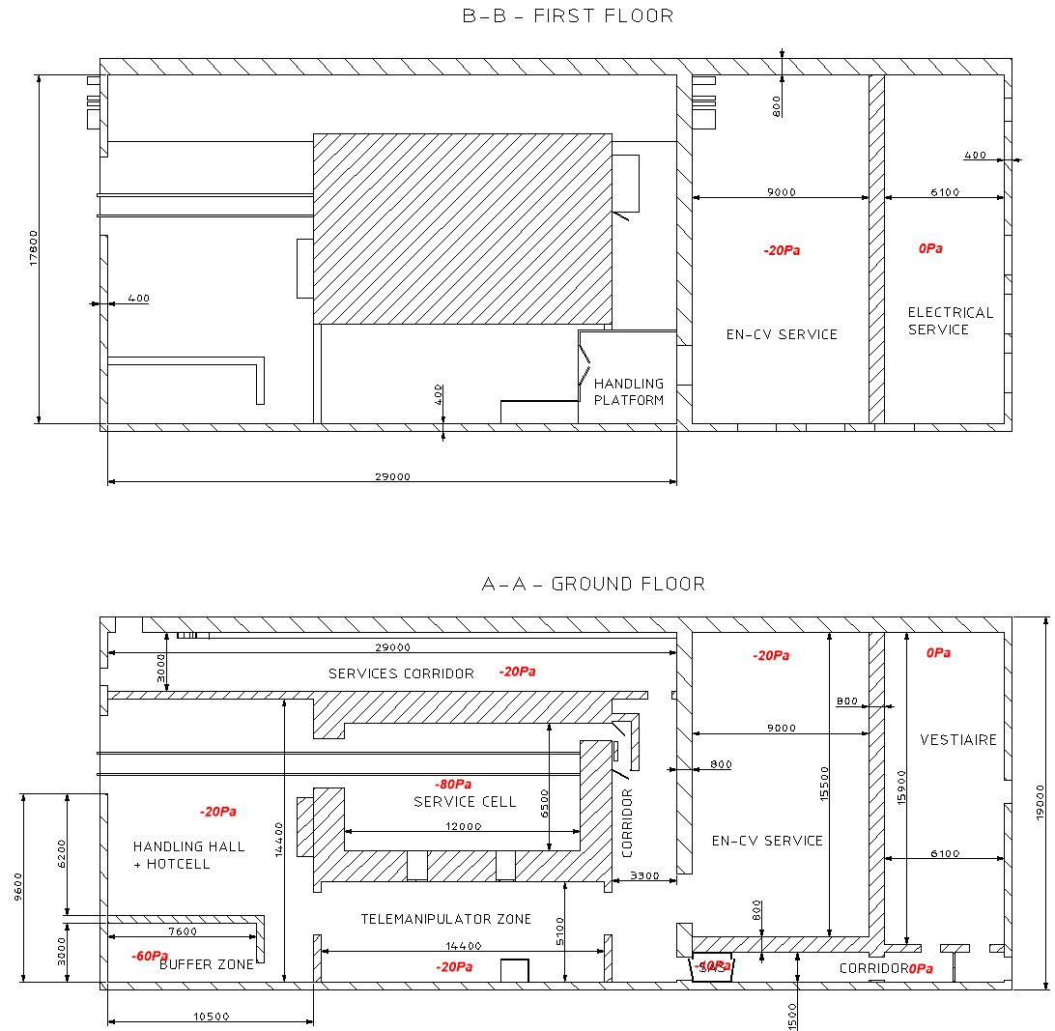
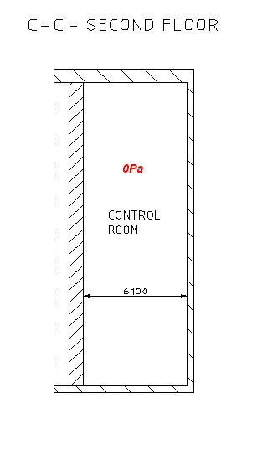
Is the values for the underpressure correlated to the class C1, C2, etc? Was there a radiological risk assessment performed to which you based your design?
New service building – pressure cascade system
29/11/2024
F. Dragoni, N.Zaric | HVAC Safety Coordination Meeting HI-ECN3/SHiP| Indico 1479436

Slide 8
Is the values for the underpressure correlated to the class C1, C2, etc? Was there a radiological risk assessment performed to which you based your design?
Based on our knowledge, there was no radiological risk assessment
29/11/2024
F. Dragoni, N.Zaric | HVAC Safety Coordination Meeting HI-ECN3/SHiP| Indico 1479436

Slide 9
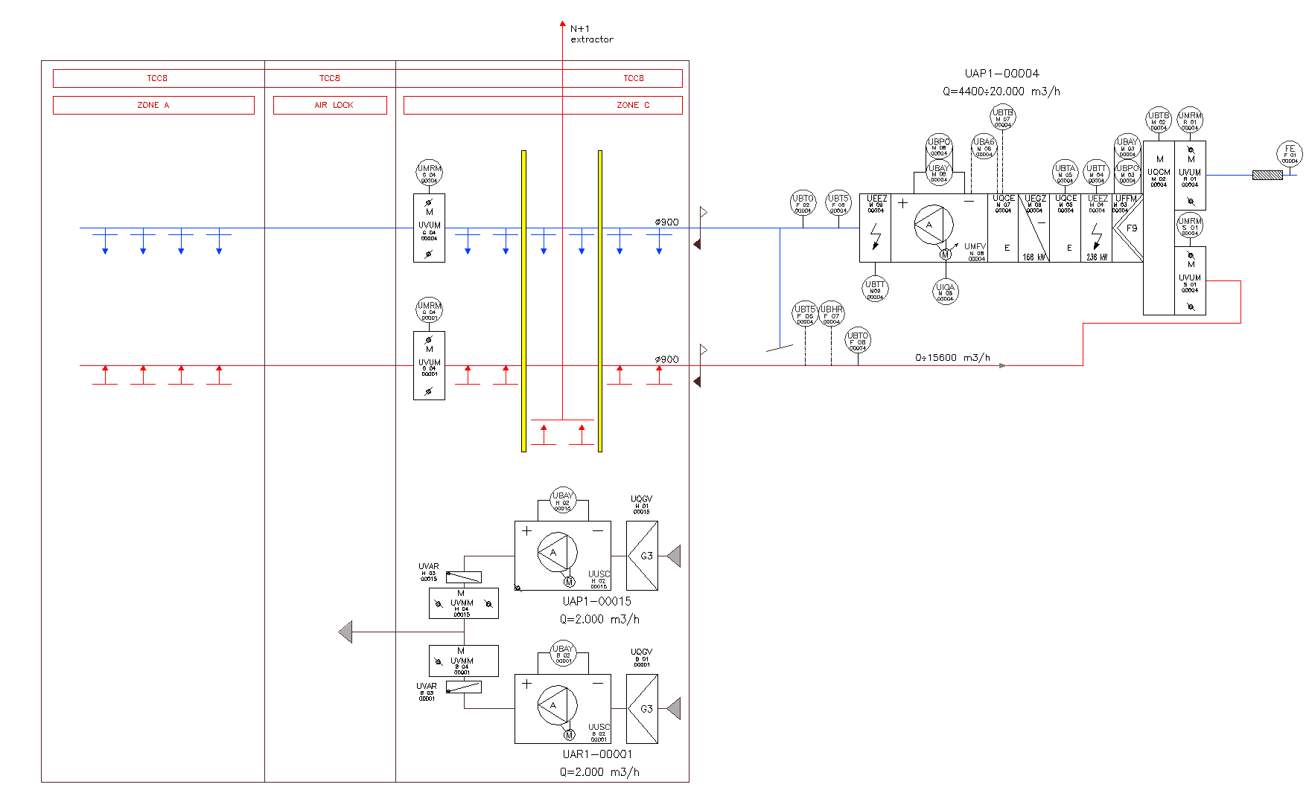
Does the WP include the ventilation of ECN3?
Is there dynamic confinement requirements between TCC8 and ECN3?
At the moment, we are not planning to do any modification to ECN3, apart from the extraction where will be Target
Not question for CV, we can modify if necessary, but at this moment, we don’t plane to have any modifications
29/11/2024
F. Dragoni, N.Zaric | HVAC Safety Coordination Meeting HI-ECN3/SHiP| Indico 1479436

Slide 10
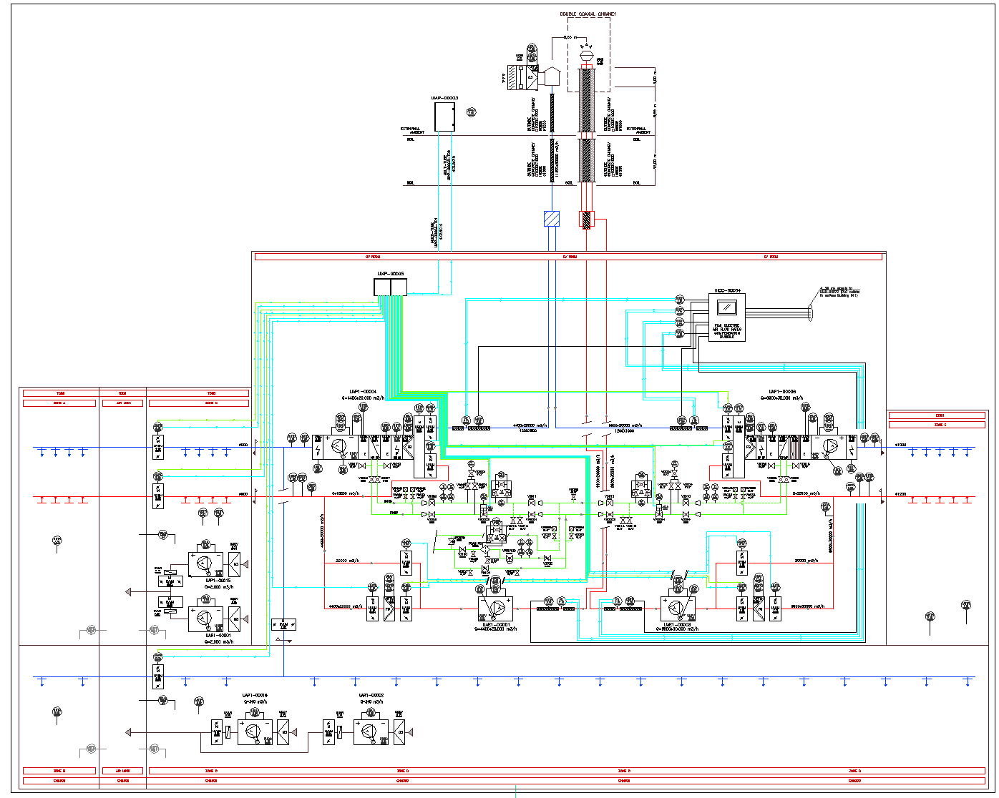
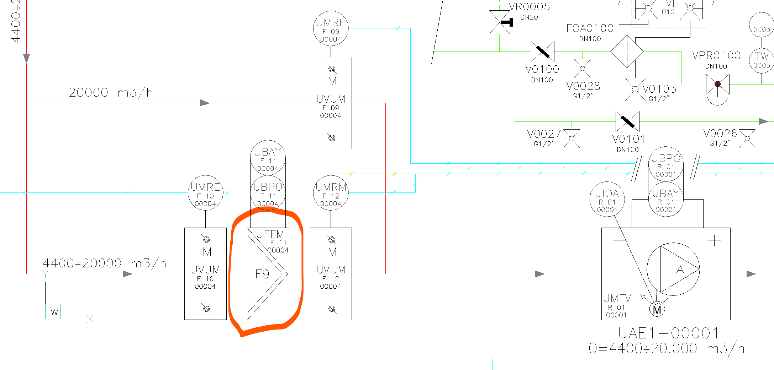
What type of filtration is foreseen?
TCC8 & ECN3: current filtration F9
29/11/2024
F. Dragoni, N.Zaric | HVAC Safety Coordination Meeting HI-ECN3/SHiP| Indico 1479436

Slide 11
What type of filtration is foreseen?
TCC8 new zone: filter type to be seen, could be F9 or any other level
29/11/2024
F. Dragoni, N.Zaric | HVAC Safety Coordination Meeting HI-ECN3/SHiP| Indico 1479436

Slide 12
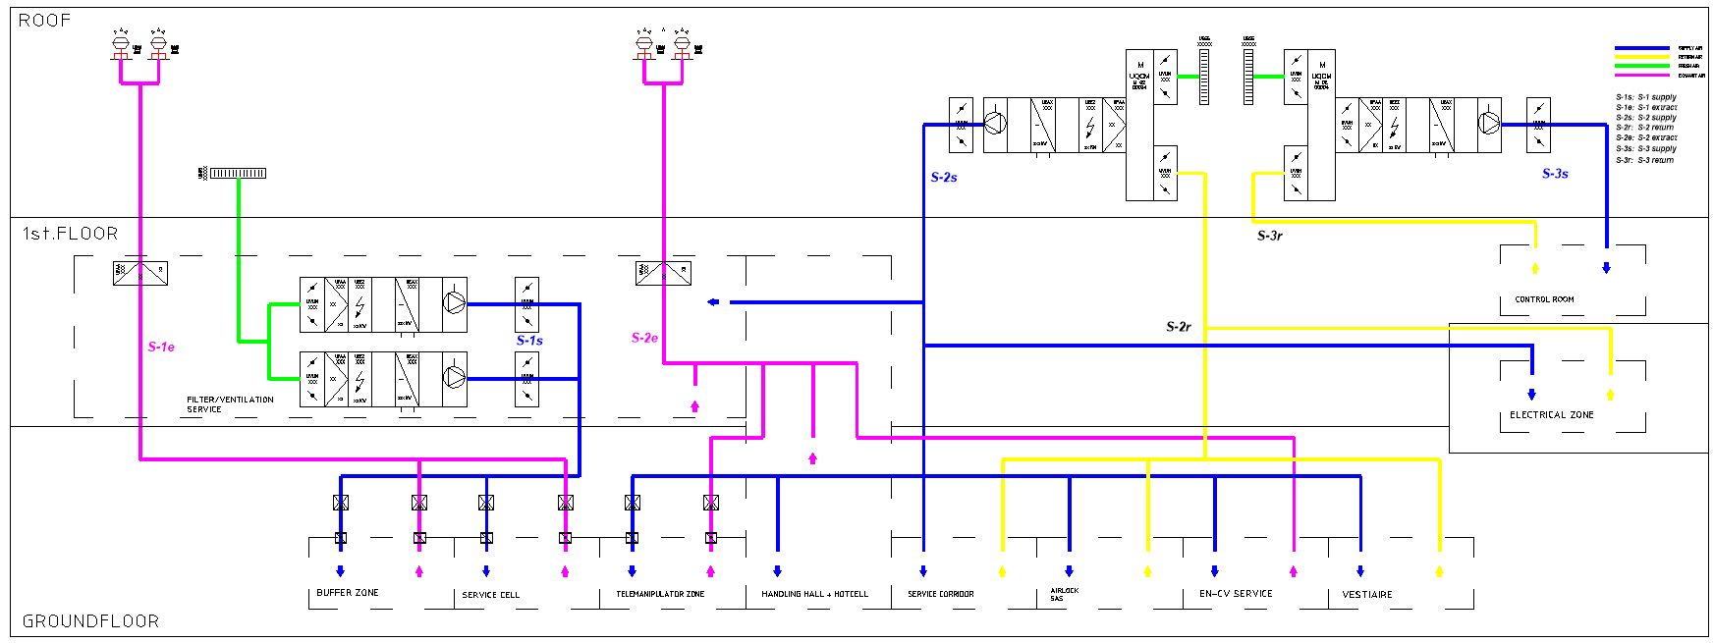
What type of filtration is foreseen?
New service building: filtration level not decided yet
29/11/2024
F. Dragoni, N.Zaric | HVAC Safety Coordination Meeting HI-ECN3/SHiP| Indico 1479436

Slide 13
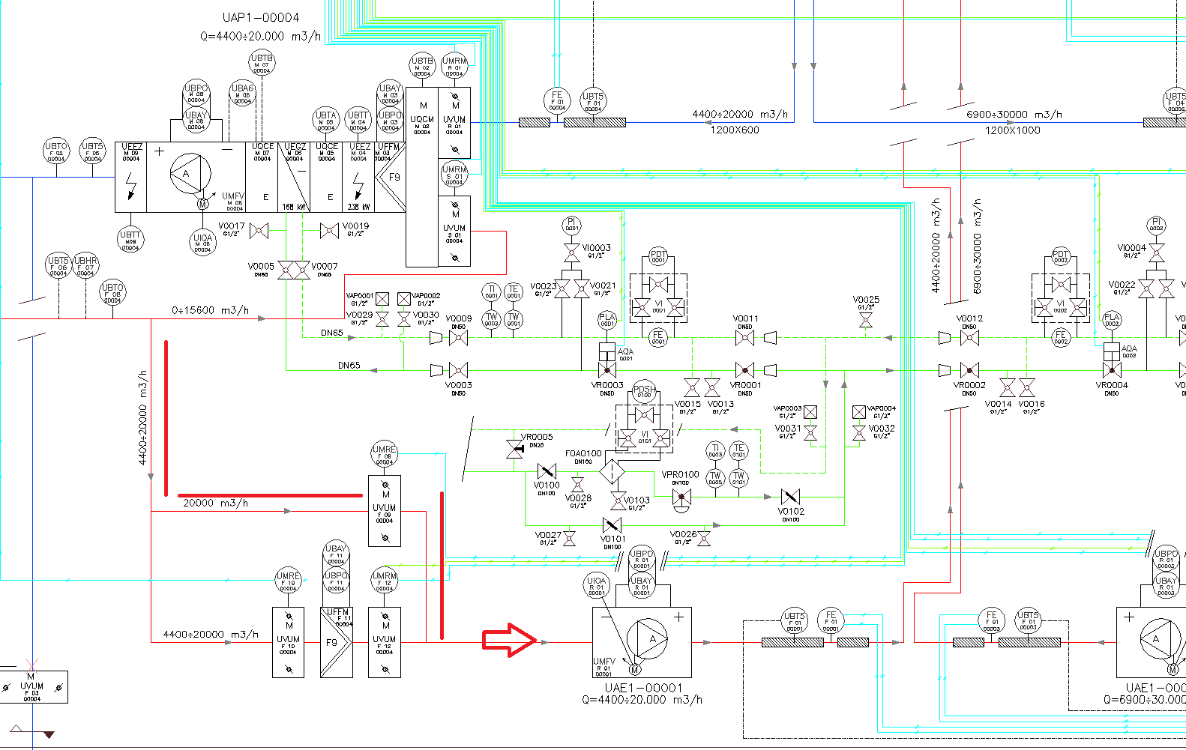
From the FIRIA studies to we have an idea if smoke extraction is required underground?
Bypass for the smoke extraction is present in the underground, maximum temperature of air up to 400̊ C, for 120 min
29/11/2024
F. Dragoni, N.Zaric | HVAC Safety Coordination Meeting HI-ECN3/SHiP| Indico 1479436

Slide 14
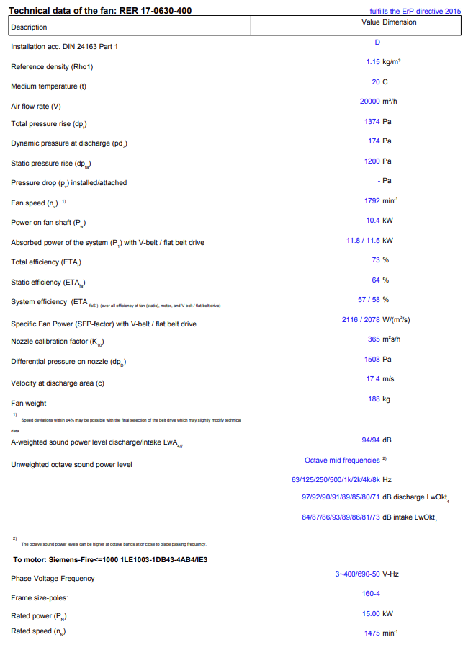
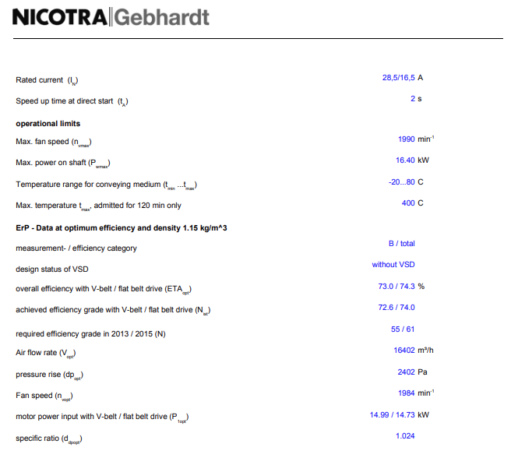
From the FIRIA studies to we have an idea if smoke extraction is required underground?
29/11/2024
F. Dragoni, N.Zaric | HVAC Safety Coordination Meeting HI-ECN3/SHiP| Indico 1479436

Slide 15
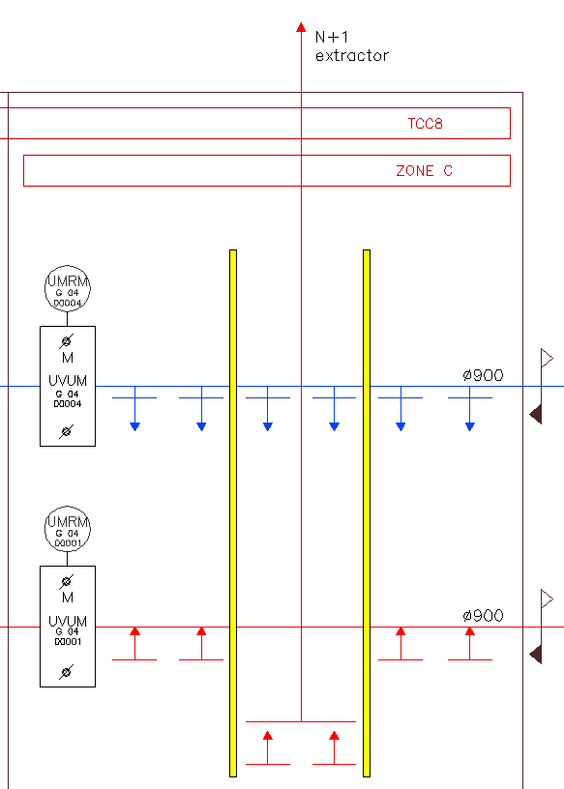
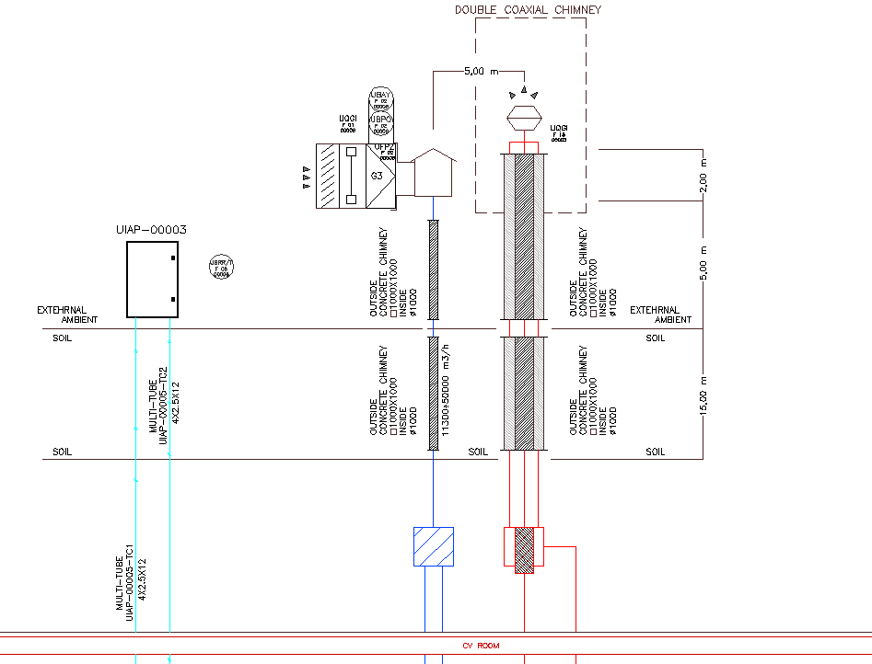
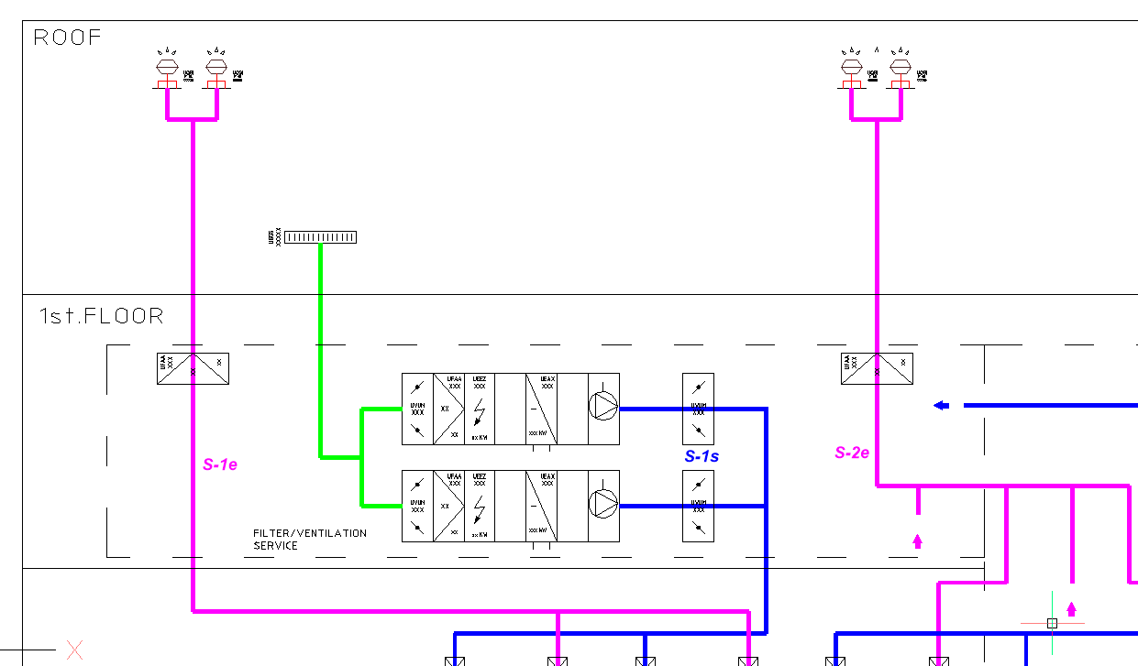
How many exhaust stacks will there be?
  TCC8 & ECN3: 1 existing common exhaust stack
  TCC8 new zone: +1 new exhaust stack (to be discussed)
  New service building: +2 new exhaust stacks
29/11/2024
F. Dragoni, N.Zaric | HVAC Safety Coordination Meeting HI-ECN3/SHiP| Indico 1479436

