Slide 1
2024-25 EYETS planning meeting
7.2.2025
A.Tauro

Slide 2
EYETS 2024-25
EYETS from Mon, November 25th, 2024 to Fri, April 4th, 2025 – 19 weeks beam to beam
  Access in General mode
  Cavern access stops on Tue, April 1st → restricted access during machine checkout
  Start beam commissioning on Sat, April 5th
Standard maintenance of P2 services and infrastructure:
  Cooling & ventilation maintenance from 3 to 21 February → cooling perturbations, one-day complete cooling stop
  Electricity: test arrets-d’urgence (AUG) on February 4th → power cut of nearly every systems at P2, no access onsite
  Test of safety, gas & fire detection systems → alarms will be triggered, access perturbations
Magnets turned off and locked-out, L3 doors will not be opened
Private visits until 27 March 2025 (12:00)
  Visitor’s path will be declassified from last week

Slide 3
Summary of access interruptions
Opening PX24 shaft: 2 December → no access UX25 and CRs from 8:00 AM to 16:00 PM
Safety tests (sirens and flashing light): 24 December (during EOY closure) → no access UX25
CSAM test: 3 January (during EOY closure) from 8:00 to 13:00 → no access UX25
Test N/S (CERN wide): 8 January 6:00 – 6:10 AM → no access UX25 5:00 AM - 9:00 AM
Transformer maintenance: 3 February → no access UX25 cavern 8:00 AM – 12:00 PM
AUG LHC2 + ALICE: 4 February → no access P2 site
Tests on the fire detection (EN-AA) on Saturday, February 22 → no access UX25 cavern from 17:00 to 18:00
Individual System Test (IST): 28 February from 13:00 to 19:30 and 3 March from 17:00 to 19:30 → no access UX25 from ~1h before the tests
Department Safety Office (DSO) test: 13-14 March → no access UX25 from March 13 at 15:00 to March 14 at 18:00
Closing PX24 shaft: 14 March → no access UX25 and CRs

Slide 4
EPN
AHU water tanks cleaning (Dec, EN-CV)
Full shock treatment (spring, EN-CV)
Relocation of temperature probes (EN-CV)
Purchase and install power monitoring (DCS, EPN)
Implement AHU RS232 access via TCP/IP (DCS, EPN)
Implement DCS modbus readout of new fluxmeter (DCS, EPN)
Routine external air filter changeover (June, Dec - Philippe/Julien)
Routine bi-weekly water filter changer over during summer (EN-CV)
Install PLCs for smoke and humidity detection (DCS)
Federico

Slide 5
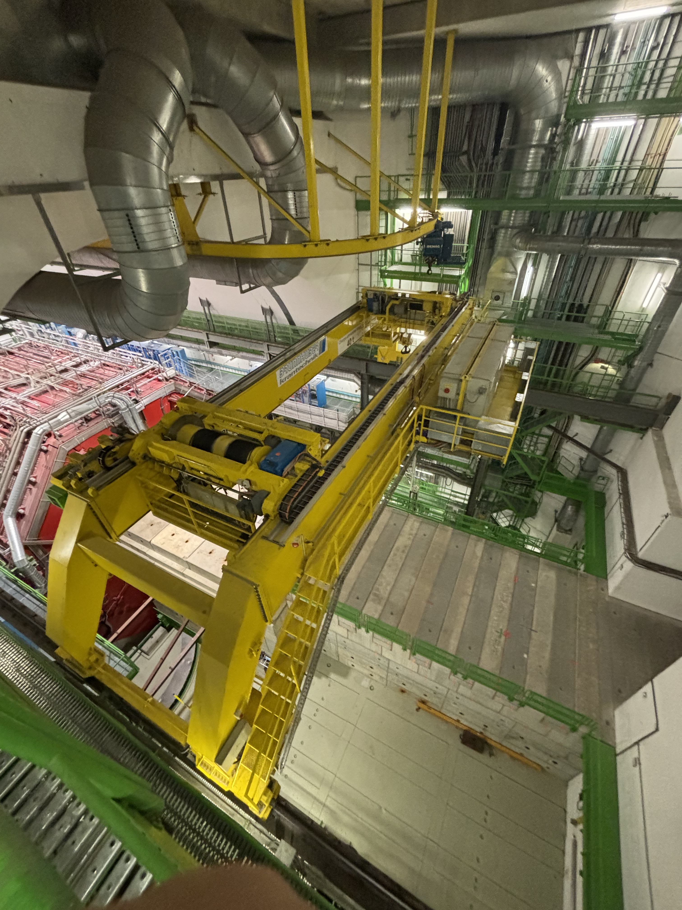
UX25 crane refurbishment (EN-HE)
Refurbishment of cavern crane (PR-774 - 2002)
  Install new cupboards, cables, sensors and motors
  Steel cables and mechanical structure won’t be replaced
  Check weldings (this week)
Work executed by Visan, Turkish company
Total cost: 600 kCHF (Hostlab)
The renovation work is progressing well; the two trolley were lowered down in UX25 on 24/01 after a complete refurbishment in the surface.
The contractor team has completed the cabling and he has now started the crane commissioning.
Site Acceptance Tests with HSE inspector are scheduled for February 18th at 2pm.
Crane will be unavailable until February 18
PX24 shaft will be closed on March 12-14
UX25 cavern crane
Roberto/Filippo

Slide 6
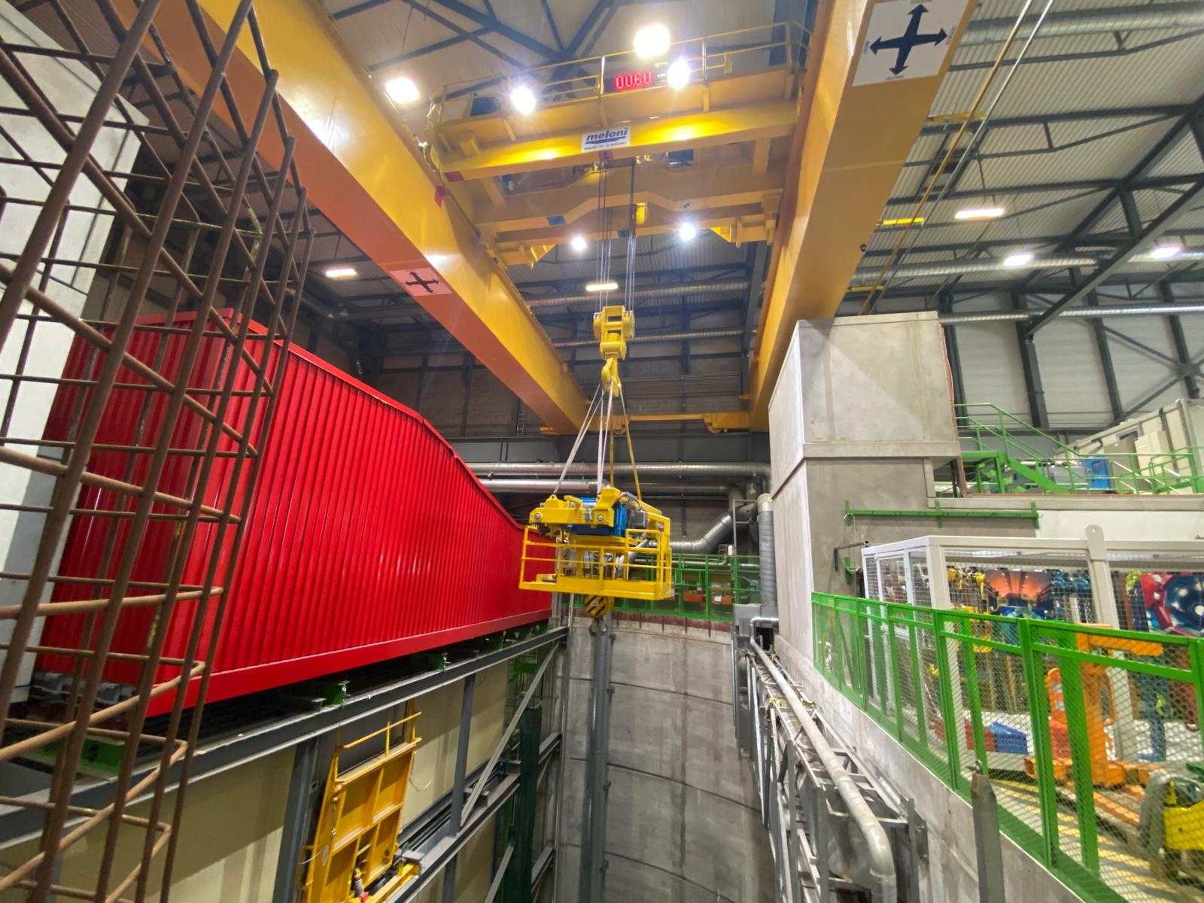
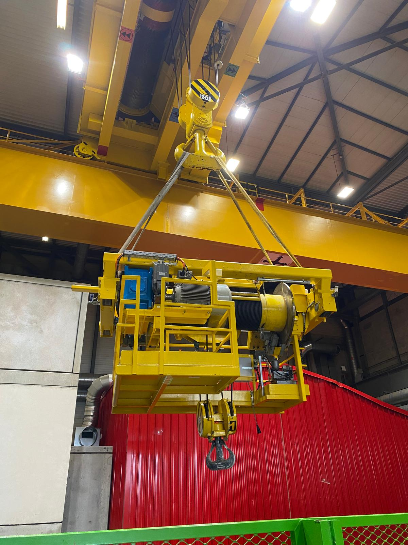
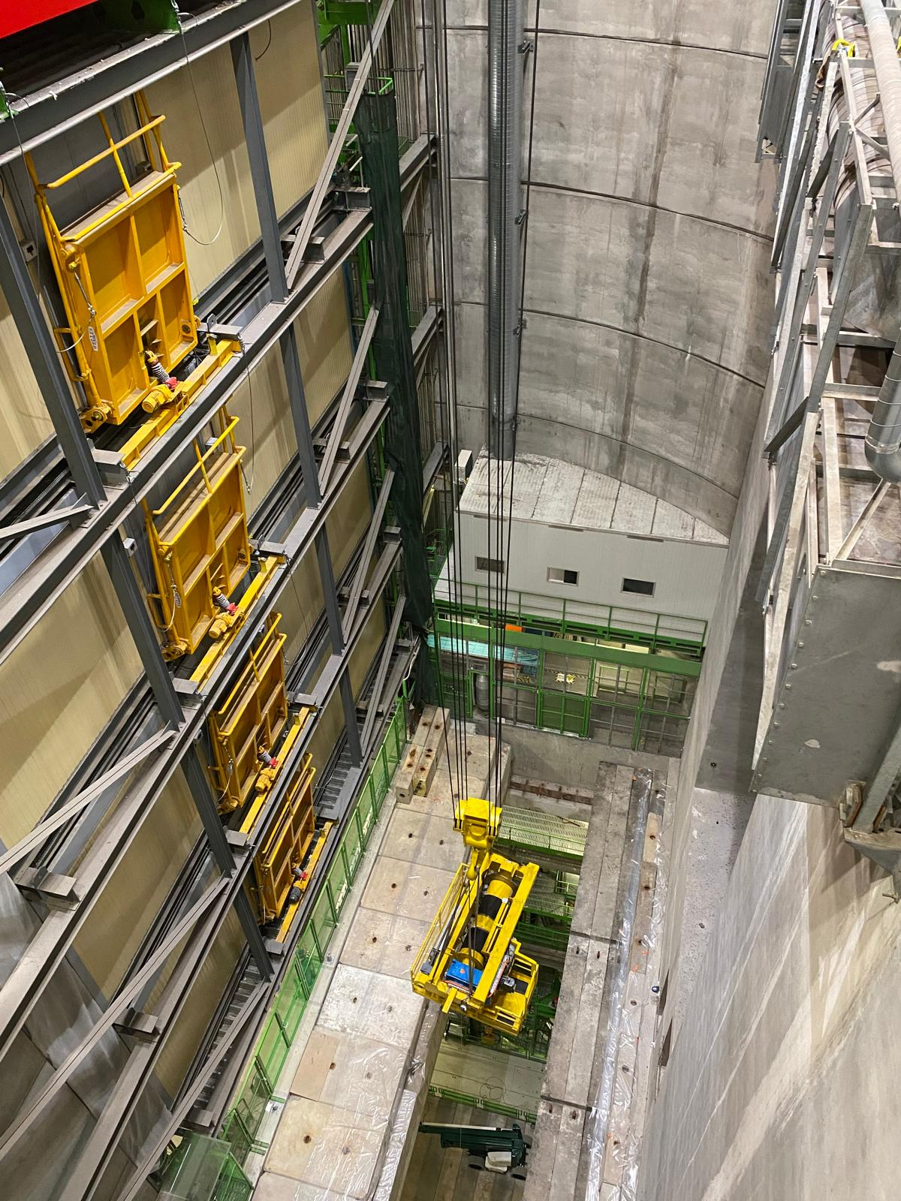
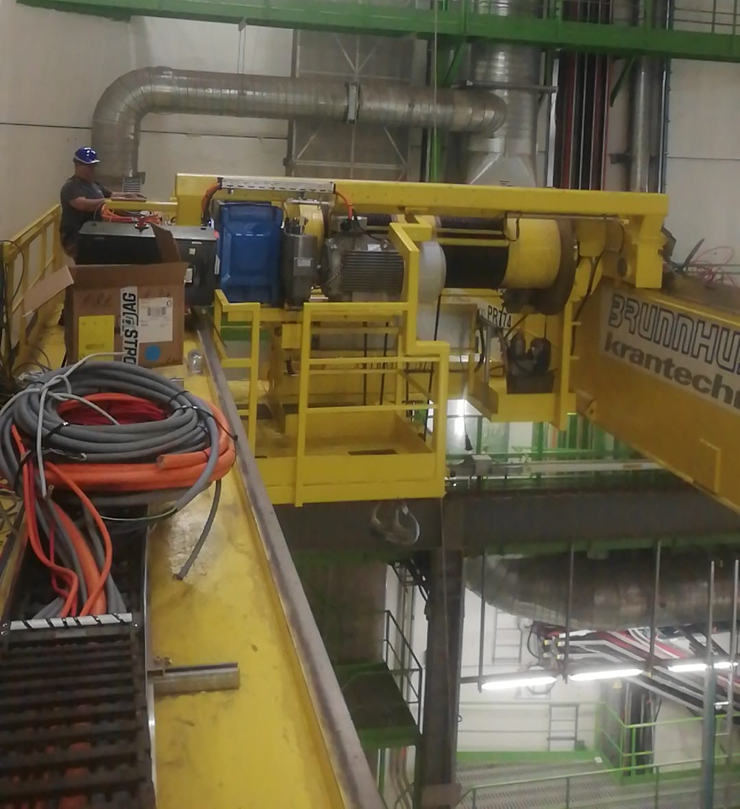
UX25 crane refurbishment (EN-HE)
Roberto/Filippo

Slide 7
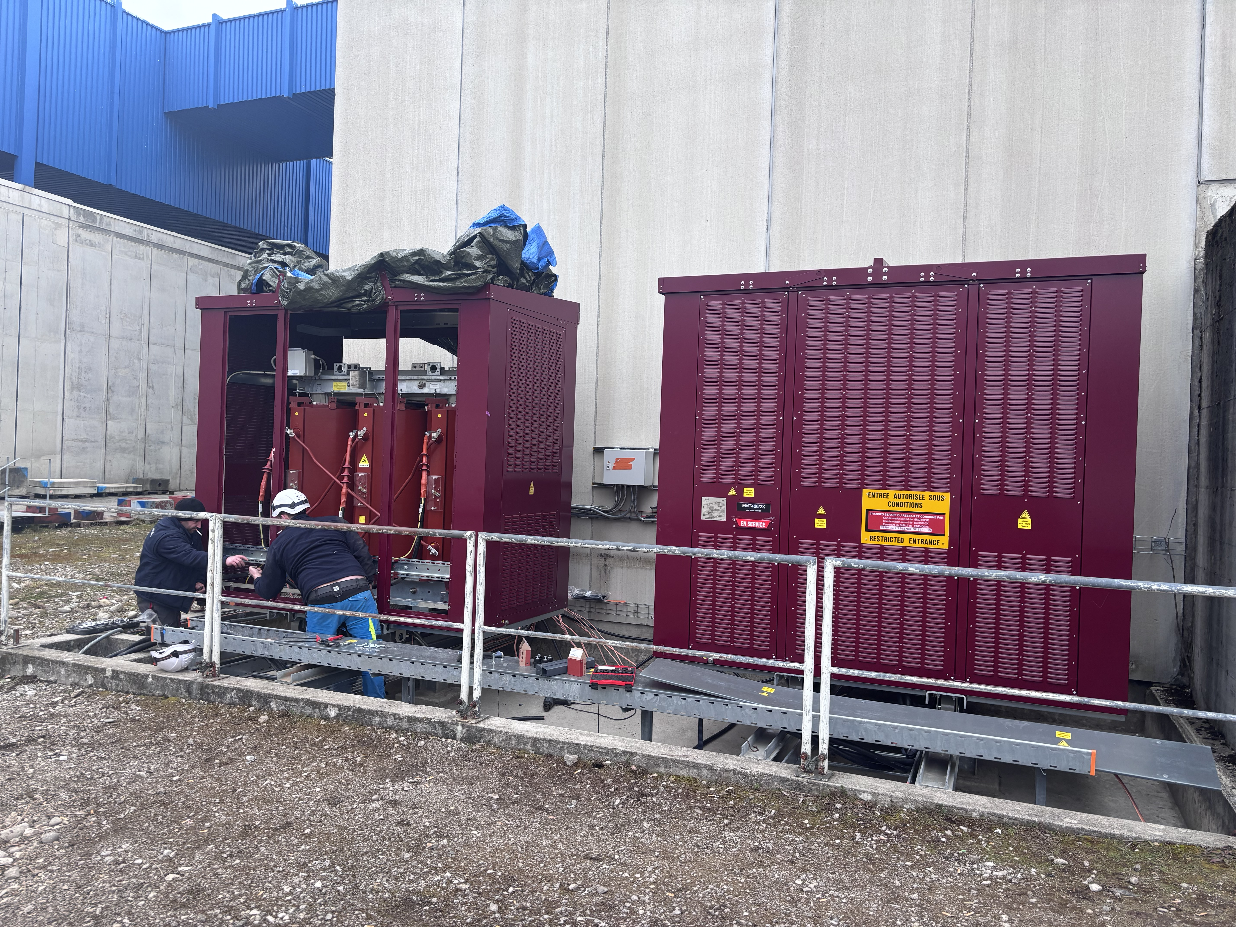
Electrical interventions (EN-EL)
Transformer maintenance: Mon 3rd February AM
  EMT103/22 – EMT103/28 and EMT304/25 → various power cuts on UX25 cavern: lights, cooling plants, ventilation
  No access to UX25 cavern
AUG test LHC2 + ALICE: Tue 4th February
  Maintenance transformers EMT408/25 – EMT411/25 and EMT306/2X
  Various power cuts on whole site
  No access to P2 site
Replacement of SX2 transformers:
  EMT406/2X: 25.11.2024 to 13.12.2024 → done. Power rating reduced from 2MVA (2880A) to 1.25MVA (1800A)
  EMT302/2X: 27.1.2025 to 13 or 14.2.2025
  Transparent as it is possible to re-power the switchboards that will be replaced
UPS maintenance:
  9 Dec for the 200KVA (CR3/CR4) and Diesel UPS, 11 Dec for the 500KVA (CR1/ARC/CR0) UPS
  During the maintenance we will run on bypass (no battery backup in case of power cut); in the past this never caused an issue, so no need to switch things off
CERN-wide tests:
  Auto-transfert test: 20-22 January (week 4) → transparent
  Test N/S: 8 January 6:00 – 6:10 AM (week 2) → will cut general services and gas systems for few minutes, no access UX25 from 5:00 AM to 9:00 AM
  AUG Adm. Zone Meyrin: 4 January (week 1)
EMT302/2X will be energised next week
Juliano/Yann

Slide 8
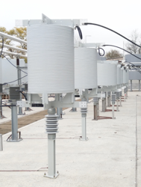
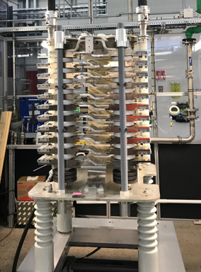
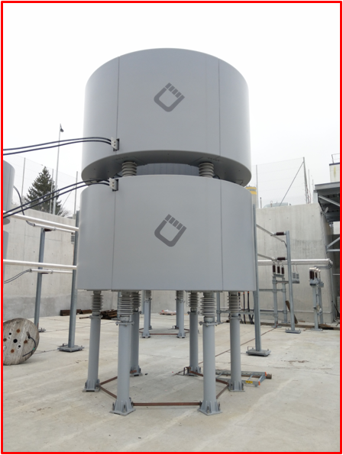
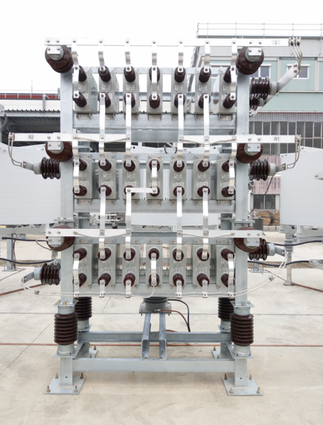
SVC maintenance (SY-EPC)
In view of the usual maintenance of the filters by SY-EPC, the P2 SVC was switched off this Monday, December 9th.
The filter will be re-energized on 24 February.
It is agreed with the machine that they won’t switch on/off the transfer line magnets until the SVC is back on, to avoid glitches on the ALICE electrical network.

Slide 9
Cooling interventions (EN-CV)
Maintenance water cooling systems: 3 to 21 February (week 6-7-8)
  Week 6: SF maintenance (cooling towers) → switchover to external chillers
  Week 7: SU2, SX2, UW25 maintenance → various perturbations on iced water & mixed water
    Complete stop of iced & mixed water on Wed 12 February → stop racks cooling + detector cooling (ok if reduced power on detectors)
  Week 8: UW + tunnel ventilation units
Maintenance ventilation units (HVAC):
  Week 6: UX25, L3. Small cuts (30’) → no impact on access
  Week 7: SG2 → stop flammable gases; ITS → 3 days without air cooling
  Week 8: MCH, MID
Maintenance cooling plants:
  Week 6: TOF/PHOS
  Week 7: MFT, ITS, HMPID
  Week 8: TRD
EN-CV overall planning
Dominique/Olivier

Slide 10
ITS activities
Improvement of power unit connection scheme at PP1:
  Custom back plane and PCB for PB modification designed; moves sensing point on power unit, i.e. after patch cord connections
  All components ordered / being produced; waiting for delivery dates for the custom back planes
  Plan to install in two sub-racks during YETS (requires all components arriving in time)
CAEN system:
  Replaced Easy crate (Hypothesis after visit with CAEN experts: defective opto couplers in crate responsible for communication problems)
Cooling plant
  Unexpected full stop on Monday (pump stopped during power cut)
  L5_19 leak rate stable for the moment (despite the full stop on Monday)
  Planned EN-CV maintenance next week (cooling plant and ventilation plant)
Installation of hot-plugging capable back planes in the safety system ITS2S (Rack area A): Done (reported orally last meeting)
Markus/Felix

Slide 11
TPC activities
The TPC laser maintenance could not be finished. The experts will have to return in March.
One power supply broke and is being sent to the manufacturer.
The work on the HV resistor boxes continues and might be finished this week or next week.
Christian/Chilo

Slide 12
TRD activities
Clean Wiener LVPS (Philippe/Julien) – done
Check Wiener PS with thermal camera – nothing abnormal spotted
Hunting a leak on the Xe (Chilo/Louis-Philippe) → leak found
5m³ of Xe delivered, waiting to fix the leak before start injection
Anastasia/Chilo

Slide 13
TOF activities
DC-DC replaced in crates 21 and 62 → Done
Unclogging of crate 35 → Done
Installation of two new CAEN mainframes (A4527) in CR4 → Done (two boards to be changed when back from repair)
Fix HV for SM14Mod4Pos (not showing problem at the moment)
Fix crates 39 and 57 → Test and debug from next week
Unclogging of crate 19 → Next week
Sofia/Manuel

Slide 14
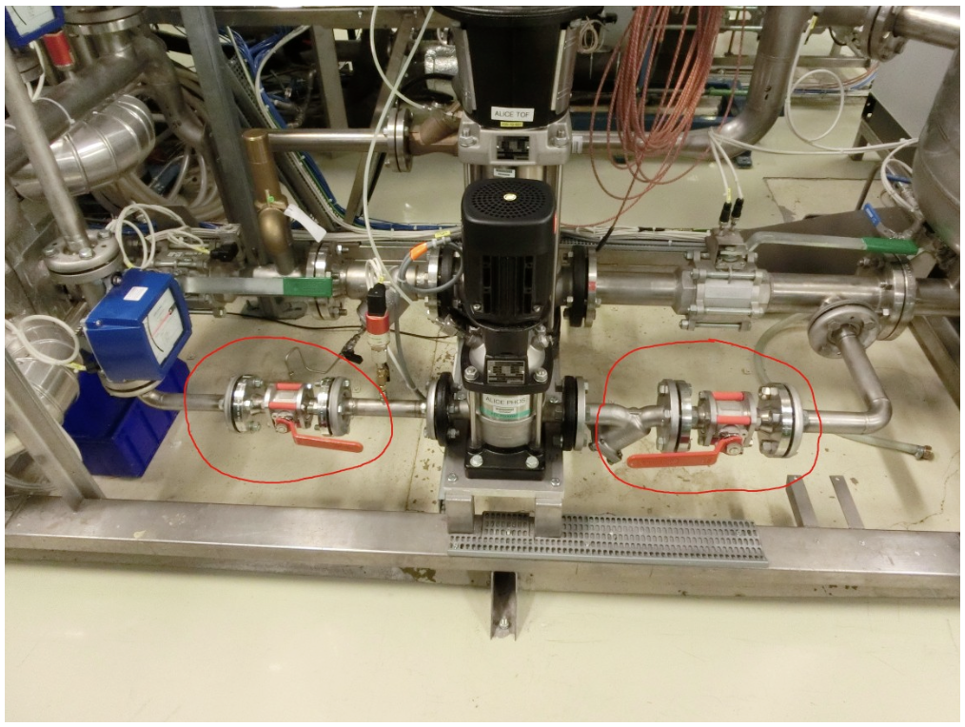
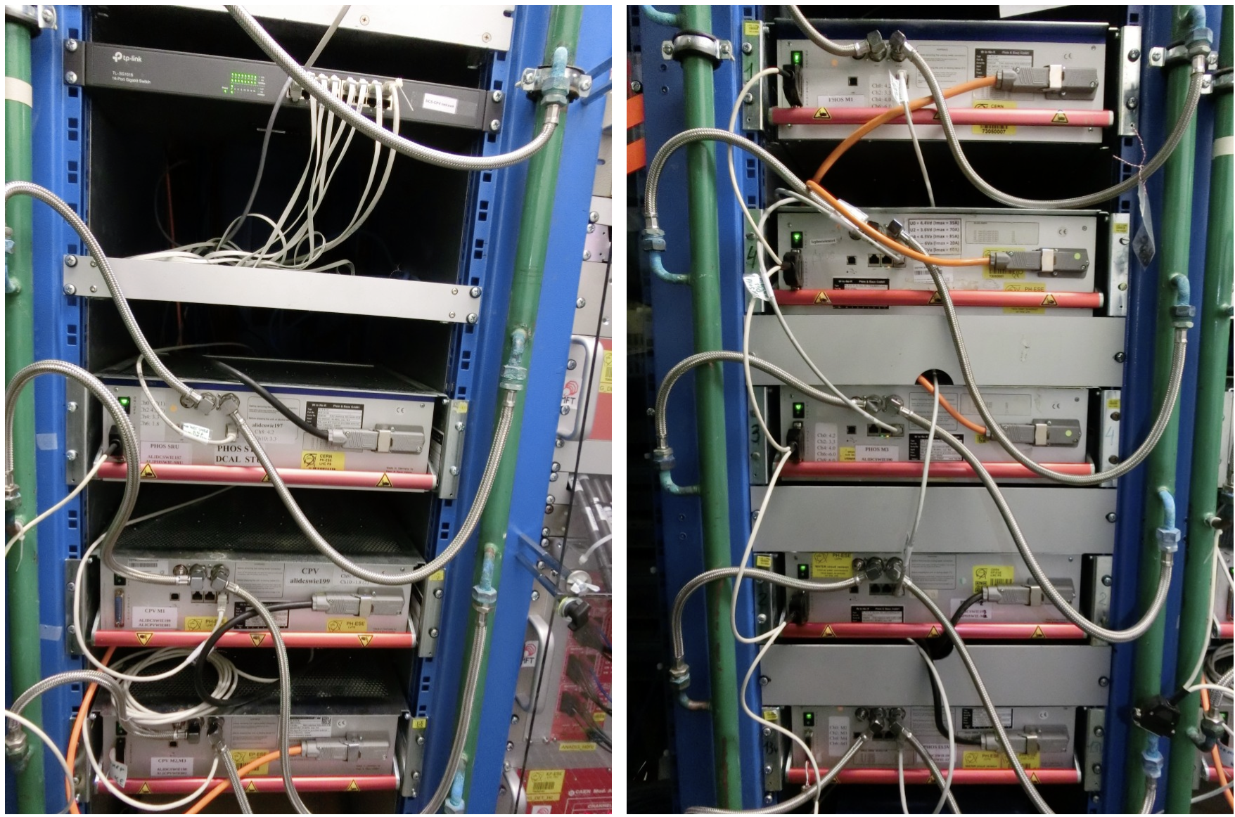
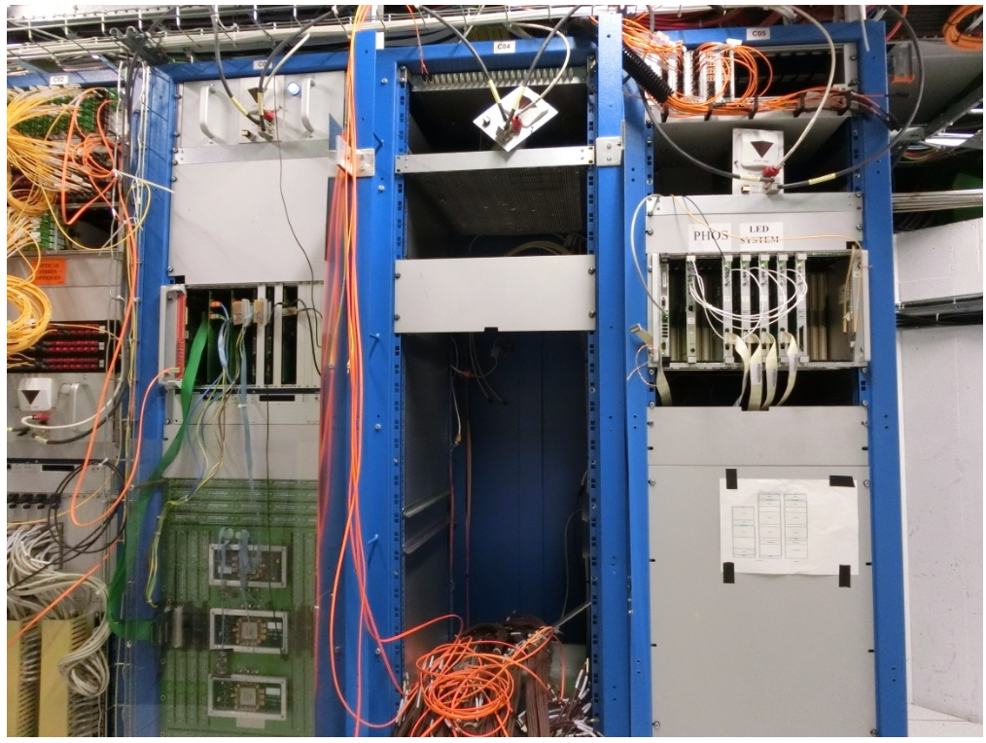
PHOS activities
Switching PHOS & CPV to ‘safe mode’ started on 25 November:
  Crystals warmed to +18℃ since 2 December
  Switch-off modules and readout units inside L3 magnet → done on 2 December
  Drain C6F14 fluid (10 canisters, 100 litres) from the crystal cooling plant and modules, then stop water cooling of PHOS/CPV electronics
  Flush dry Ar inside water pipes (Philippe/Julien) --> requires crane to bring down the gas bottle
  Power off racks A16, A17, C05
  Power off crystal cooling plant, exhaust residual water from PHOS/CPV FEE
  Put PHOS/CPV to the safe state
PHOS workshop in b.167 handed over to FoCal → emptying between February and April. Works in May-June
PHOS experts left CERN on 28 November (DCS access maintained until the end of the year)
PHOS/CPV main water pump
PHOS Wiener LVPS in A16-17
PHOS VME crates in C05
Yuri

Slide 15
MFT activities
Work inside L3: dispatching boards connectors reinforcement done
Still some short accesses in L3 needed for some VTRx replacement (I will profit of an access of another detector)
Charlotte/Sarah

Slide 16
MCH
Gas system stopped at the beginning of December
Station 1:
  No interventions planned before the work in Station 2 starts
Station 2: Indian colleagues will come in February for 3 weeks (25/2 - 17/3):
  exchange quadrants DE300 (on CH3) and DE403 (on CH4)
  work on the readout stability
For stations 3, 4 and 5: no activity this week in cavern:
  Work on readout improvements will resume next week
X-ray test of quadrants in the P2 Buffer zone (2285 SX2) after working hours (>18:00) → will be done by Indians. Test of the spare slats to be arranged (date not fixed yet)
Hervé/Christphe/Livia

Slide 17
Other activities
EN-HE: reinstall batteries on both nacelles (Mon 25 November)
HSE-RP: RP sampling on 25.11 (TOF, ITS, MFT, TPC, TRD, HMPID)
TE-VSC:
  Close manual beampipe valve on Monday, November 25 after 10:00
  Re-open it on Thursday, March 27 AM
HSE-FRS: on February 16th & March 9th & March 23rd, the firefighters will simulate the evacuation of a person injured by electric shock and the spread of a fire in the electrical rack. This exercise will be carried out in collaboration with firefighters from SDIS 01. Red Key required
EN-AA: maintenance cavern lift (AS-724):
  Thursday, December 5th, between 6:00 AM and 8:00 AM → no access to UX25 cavern
  Monday, January 13th, between 6:00 AM and 8:00 AM → no access to UX25 cavern
  Friday, February 14th, between 6:00 AM and 8:00 AM → no access to UX25 cavern

Slide 18
Access, fire, gas and SNIFFER detection systems (EN-AA)
Access system preventive maintenance: 3-4 December
Yearly maintenance red phones: 9 December
Safety test (sirens and flashing light): 24 December → no access underground whole day
CSAM test: 3 January from 8:00 to 13:00 → no access underground
Tests on the fire detection on Saturday, February 22 → no access UX25 cavern from 17:00 to 18:00
Individual System Test (IST): 28th February from 13h to 19h30 and 3rd March from 17h to 19h30 → ALL DOORS must be closed and no emergency green handle pulled (no patrol needed). Underground access will be stopped ~1h before the tests.
Beam Imminent Warning (BIW) test: 28th February, in the shadow of IST test
Department Safety Office (DSO) test: 13-14 March → patrol and close ALICE on March 13th at 15:00 (test starts at 16:00). No underground access from March 13th at 15:00 to March 14th at 18:00
Tests on Fire, Gas and SNIFFER Detection Systems
System | Buildings | Dates | Comments
Gas Detection Activity #1 | SG2, CR5 and UX25 | 25/11/2024 to 27/11/2024
Gas Detection Activity #2 | SG2, CR5 | 04/02/2025 | Electrical Interlocks test of gas system in the shadow AUG test in collaboration with EN/EL and EP/DT
Fire Detection Activity #1 | UX25 and Counting Rooms | 25/11/2024 to 29/11/2024
Fire Detection Activity #2 | UX25 Racks | 21/02/2025 to 27/02/2025
SNIFFER Activity #1 | CR5 and UX25 | 26/02/2025 | Test of level 3 alarms and DSS after all rotations are done
SNIFFER Activity #2 | CR5 and UX25 | 27/02/2025 or 03/03/2025 | Assistance to ALICE for air sampling network cleaning
Nicolas Broca/Vitor Rios

Slide 19
Gas activities (EP-DT)
TPC:
  Filling of the Envelope humidifier (Jan-Feb/2025)
  Installation of a pressure dumper on the input of the pumps to reduce the gas vibration impacts on the chamber and test (built, tests second part of January) → ongoing
  Replace filters, pump, purifier, distribution
  Dismount and check safety valves
  Maybe dismantling of the pump 2 and send it to manufacturer for maintenance and cleaning (Jan-Feb/2025)
  Leak search
TRD:
  Replace 1 pump by the spare and send it to maintenance (Dec/2024)
  Replace the Festo module
  Replace Festo in distribution module (Leak N2)
  Leak search (leak found by Chilo) → ongoing
  Check safety valves
HMPID:
  Regeneration of the manual purifier → ongoing
  Check the analysis devices in CR5 → ongoing
TOF:
  Replacement of one pump by the spare and send it to the manufacturer (Dec/2024)
  Replace the Festo Module (pilote of the pneumatic valves) (Dec/2024)
  Filter to be changes in purifier, pump, exhaust (Dec/2024 or Jan/2025)
  Installation of flow meters in the backup lines in the cavern (Jan-Feb/2025)
MCH:
  Test of the mixture to check the ratio (if not good, then calibration of the mass flow controllers) (Dec/2024)
  Filling humidifier (Jan-Feb/2025)
  Leak search Mixer and Humidifier
  Reading of the distribution rack 61, one channel totally wrong to be fixed → ongoing
MID:
  Purge the system and then open it
  Remove the Zimmerli in the mixer to test it (Dec/2024)
  Test the functioning in “dummy chamber mode”
  Change the pressure sensor on the distribution (second half of January) → implies openng the detector
  Pump membrane to be changed (Jan/2025)
  Filling of the humidifier (Feb/2025)
  Leak search on mixer and exhaust modules
Louis-Philippe

Slide 20
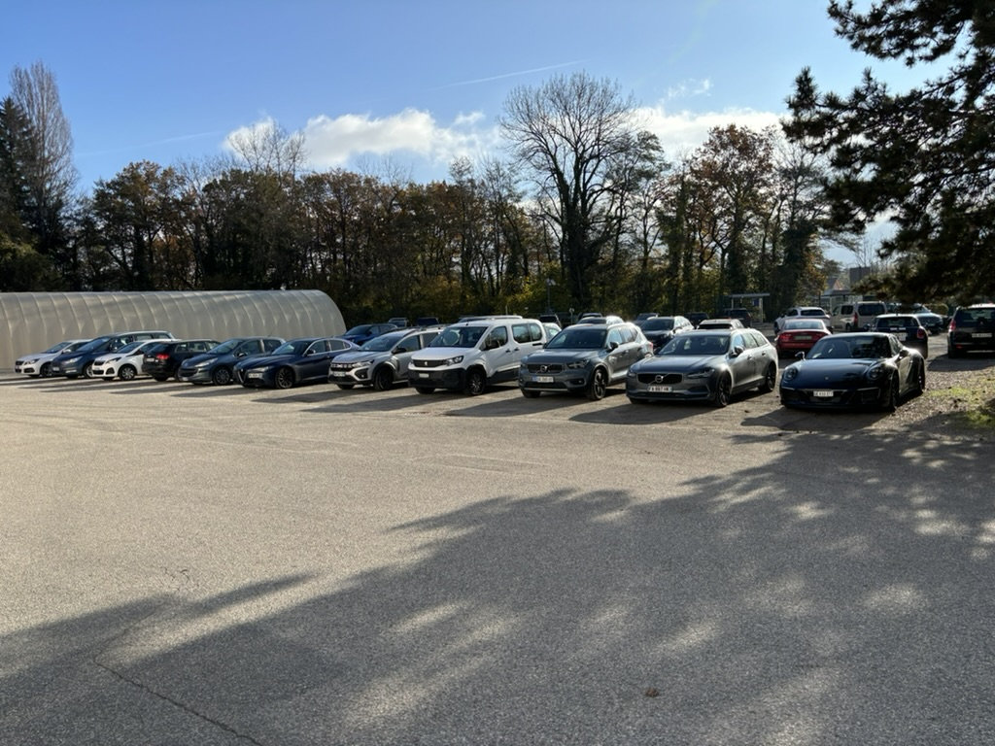
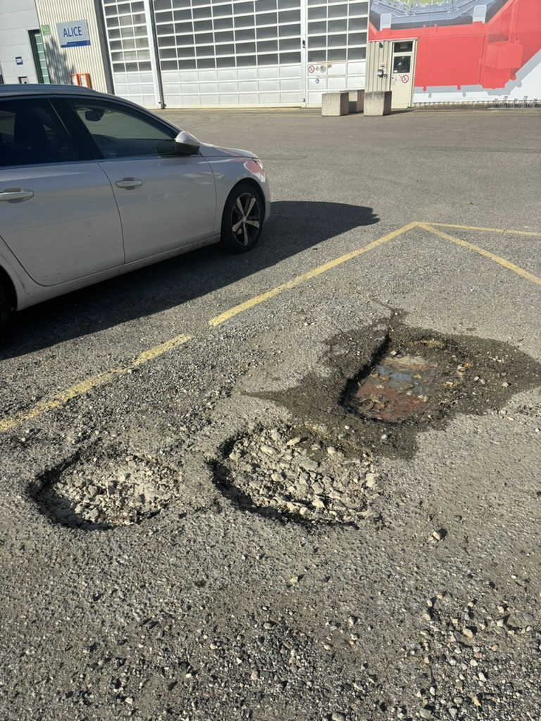
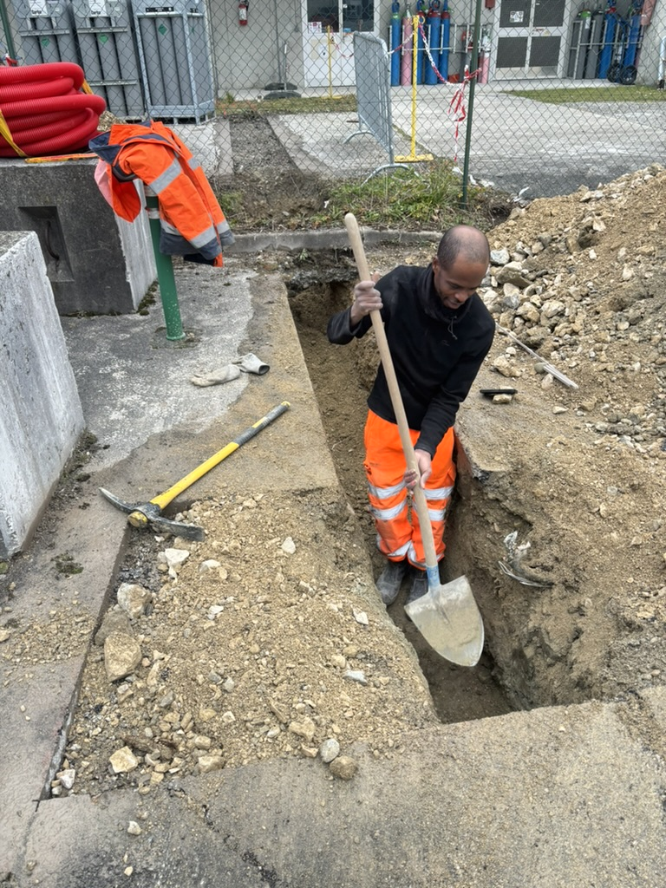
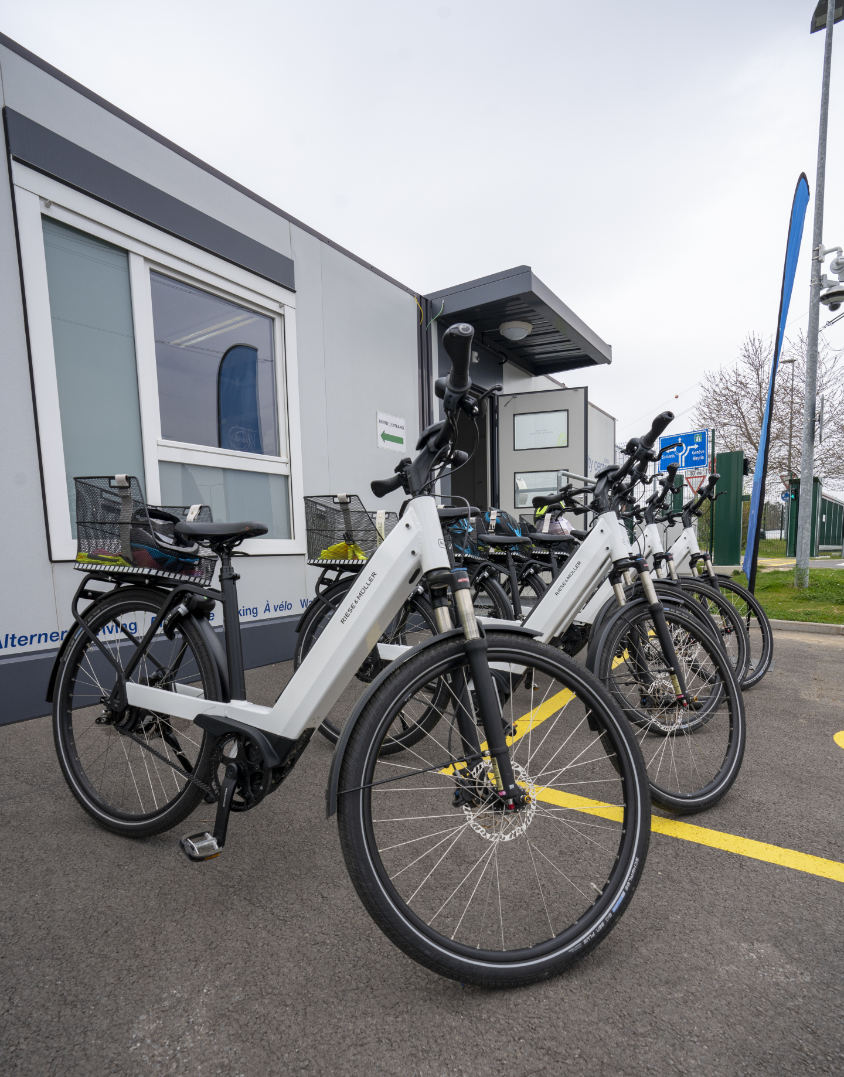
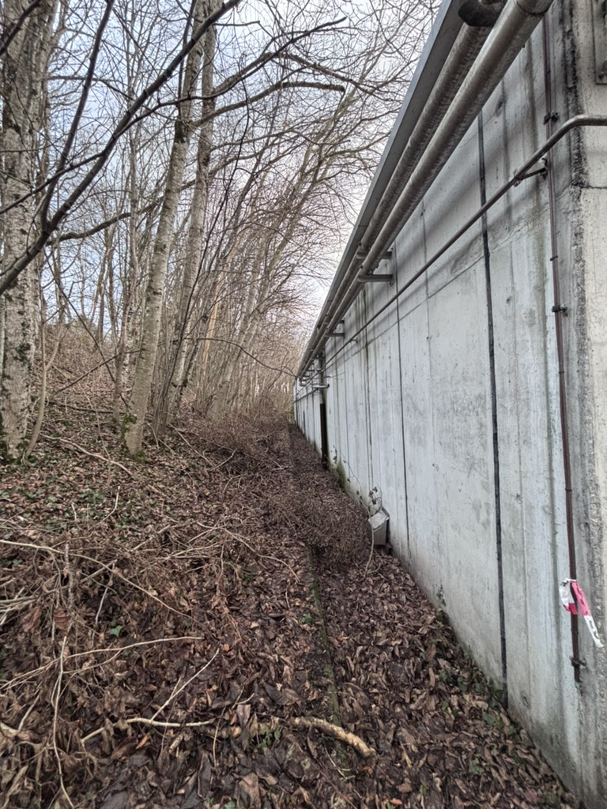
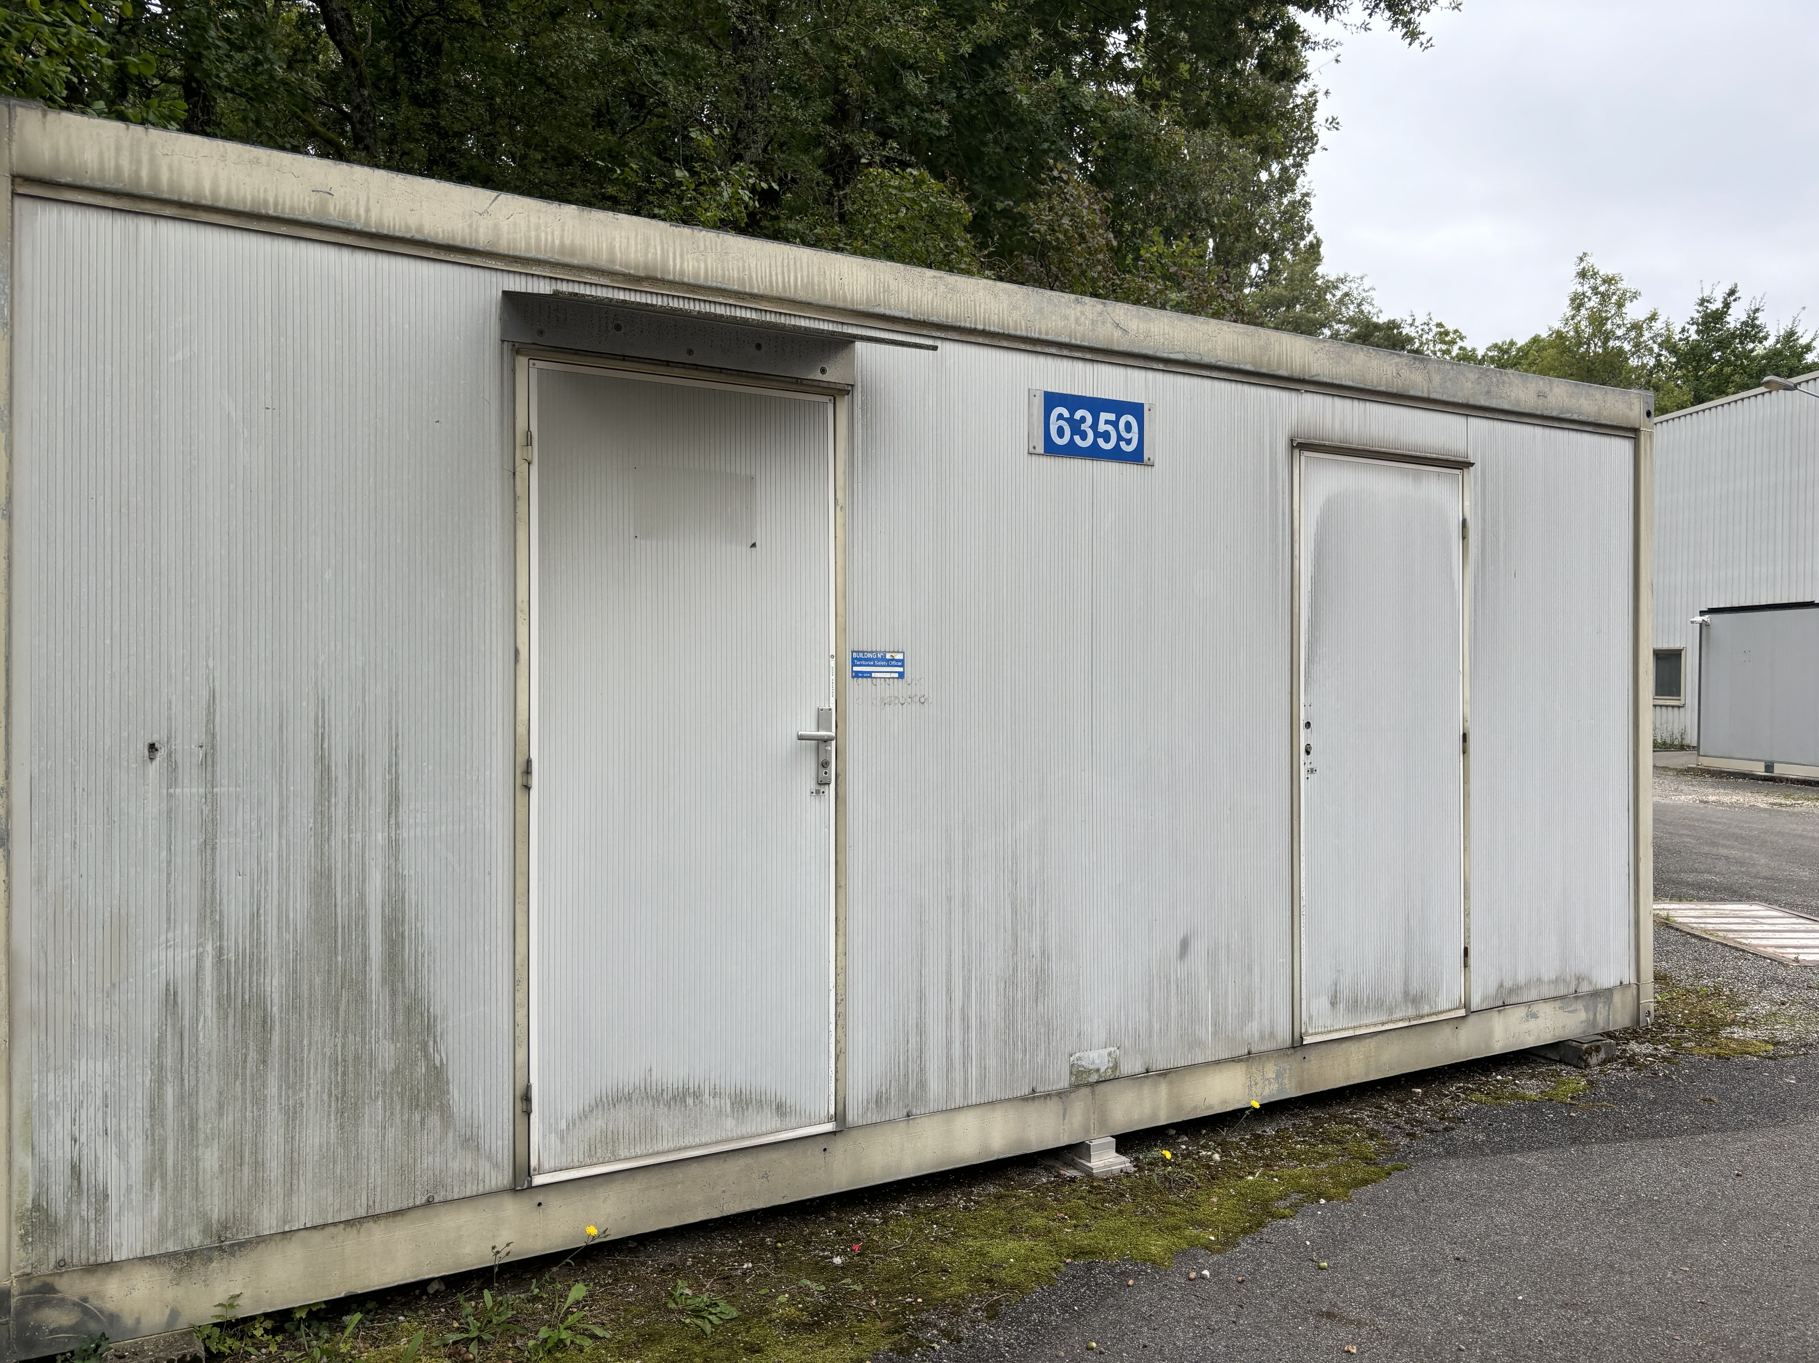
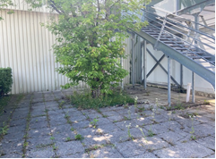
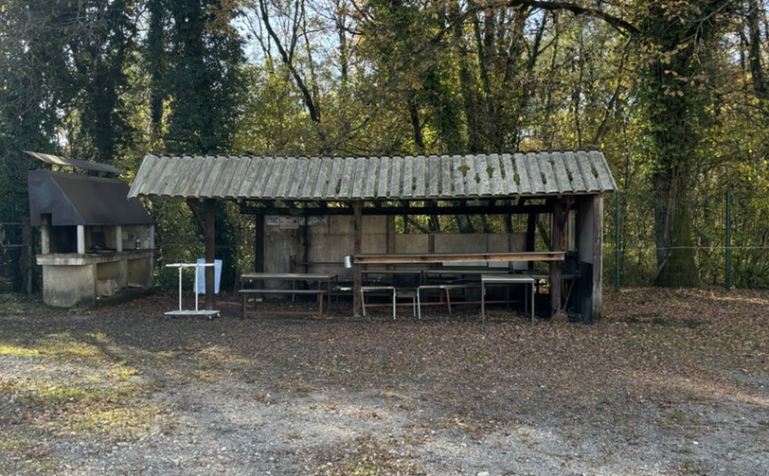
Site activities (SCE)
Redo parking asphalt
(Hostlab, SCE budget)
Temporary repair potholes parking
New car charging station
Electric bikes
New rest area outside b.3294 (spring)
MCH barrack removal
Redo P2 BBQ area (summer)
SG2: clean green areas

Slide 21
YETS planning meetings
Friday, February 21st at 10:00
Friday, March 14th at 10:00
Friday, March 28^{h} at 10:00

