Slide 1
2024-25 EYETS planning meeting
21.2.2025
A.Tauro

Slide 2
EYETS 2024-25
EYETS from Mon, November 25th, 2024 to Fri, April 4th, 2025 – 19 weeks beam to beam
  Access in General mode
  Cavern access stops on Tue, April 1st → restricted access during machine checkout
  Start beam commissioning on Sat, April 5th
Standard maintenance of P2 services and infrastructure:
  Cooling & ventilation maintenance from 3 to 21 February → cooling perturbations, one-day complete cooling stop
  Electricity: test arrets-d’urgence (AUG) on February 4th → power cut of nearly every systems at P2, no access onsite
  Test of safety, gas & fire detection systems → alarms will be triggered, access perturbations
Magnets turned off and locked-out, L3 doors will not be opened
Private visits until 27 March 2025 (12:00)
  Visitor’s path declassified since last week

Slide 3
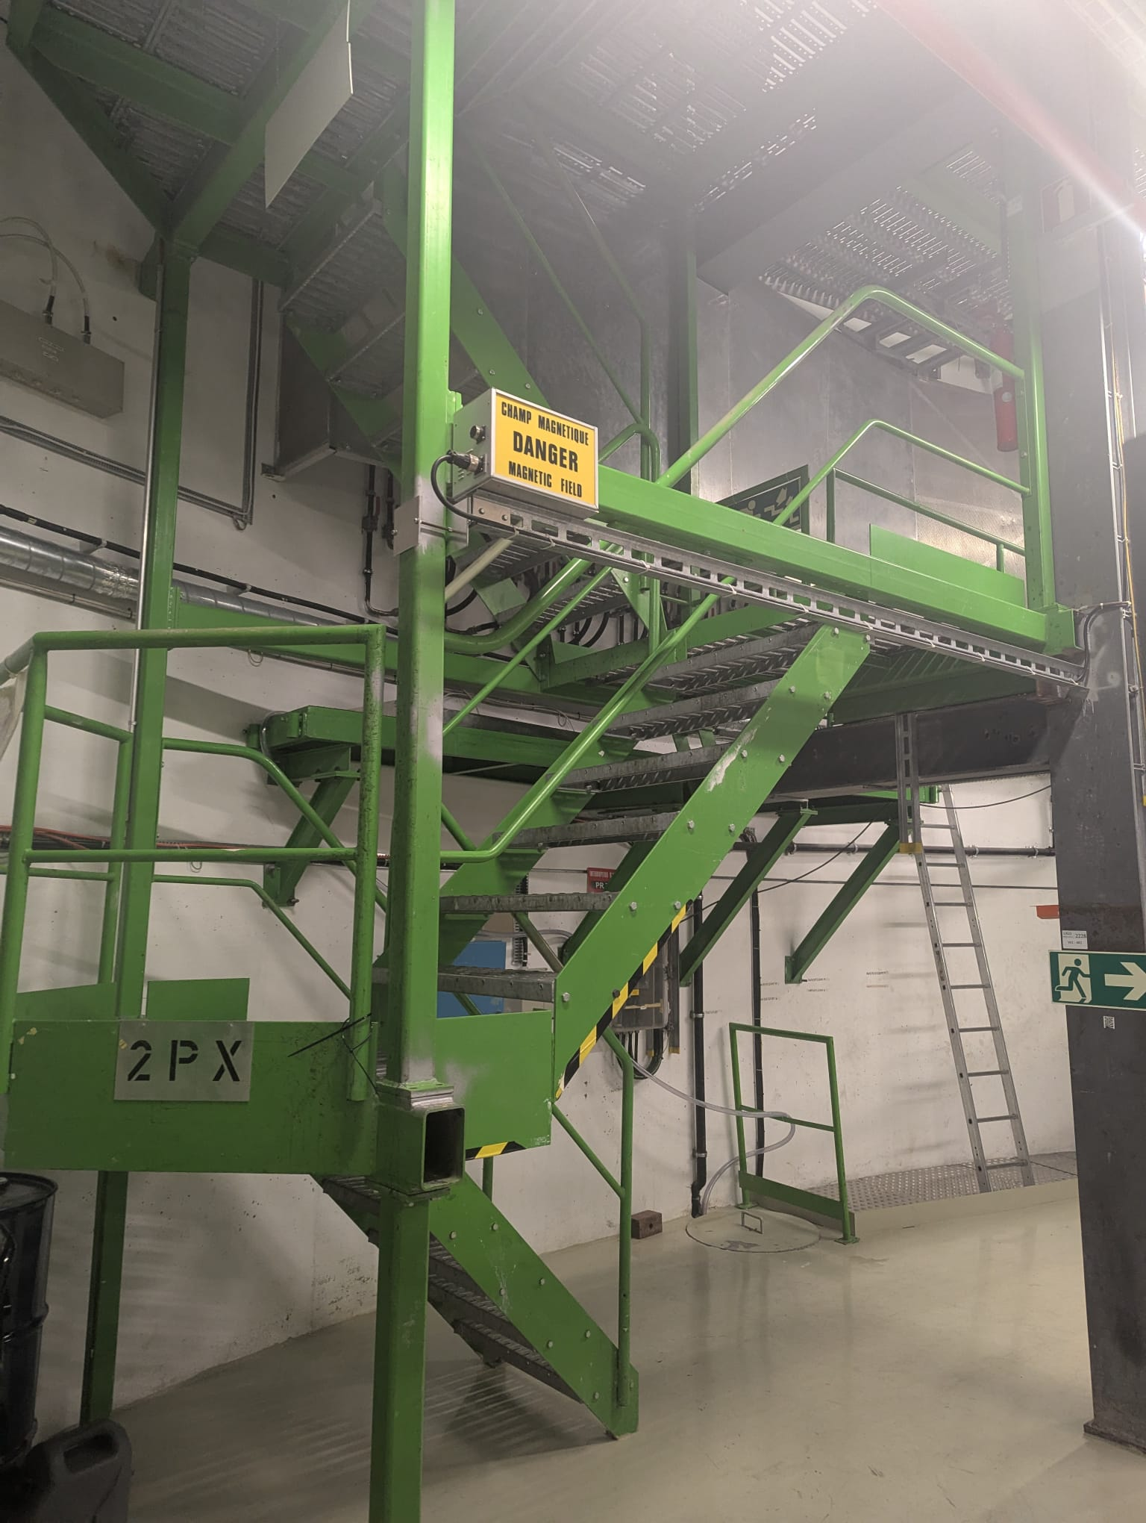
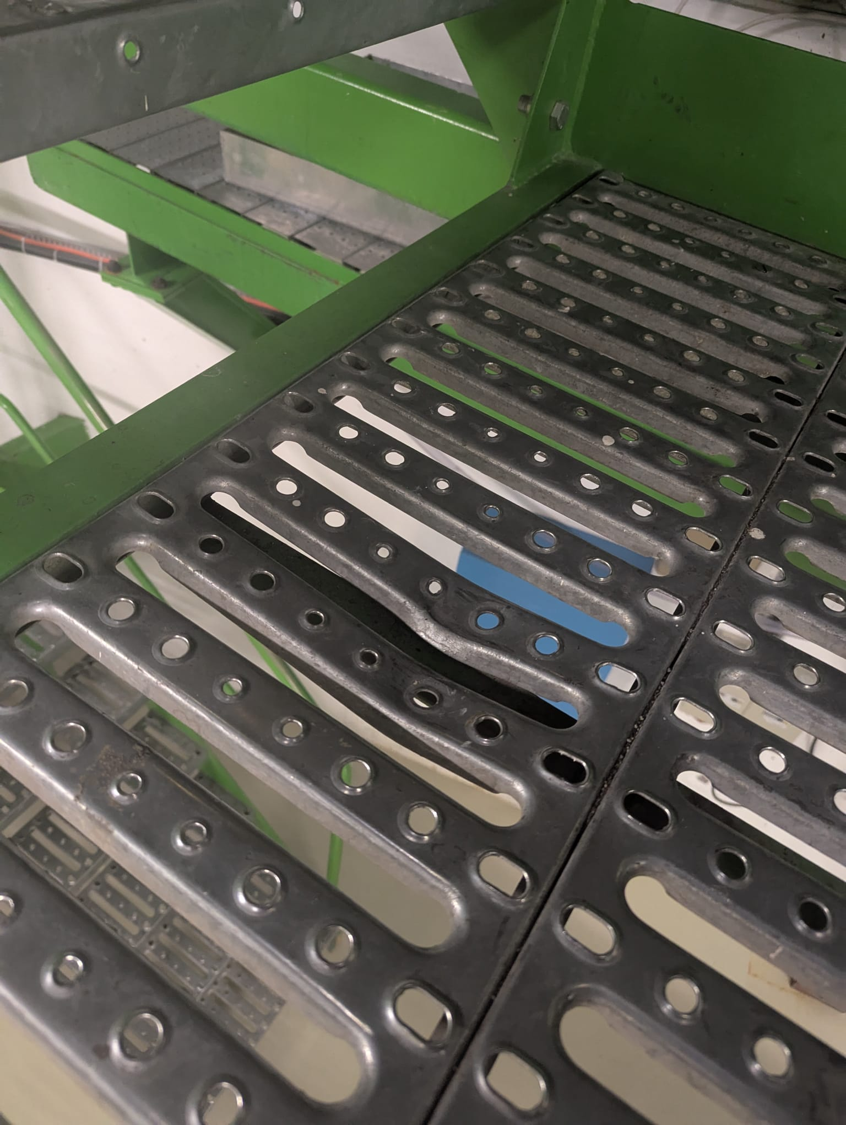
Safety first
Positive points :
Positive feedback about VISAN & FOSELEV activities
  Marking, wearing harness, etc...
Order and cleanliness
  Most of the material and waste have been evacuated. Continue keep a clean site after the end of the works.
Points of improvement :
Lone workers
  Lone workers in the ALICE cavern sometimes
3 illnesses during the YETS in the cavern, fortunately, each time the victims were accompanied
Chemical products storage
  Storage without tank
Damaged gangway → seen with Klaus
Alexandre

Slide 4
Summary of access interruptions
Opening PX24 shaft: 2 December → no access UX25 and CRs from 8:00 AM to 16:00 PM
Safety tests (sirens and flashing light): 24 December (during EOY closure) → no access UX25
CSAM test: 3 January (during EOY closure) from 8:00 to 13:00 → no access UX25
Test N/S (CERN wide): 8 January 6:00 – 6:10 AM → no access UX25 5:00 AM - 9:00 AM
Transformer maintenance: 3 February → no access UX25 cavern 8:00 AM – 12:00 PM
AUG LHC2 + ALICE: 4 February → no access P2 site
Individual System Test (IST): 28 February from 13:00 to 19:30 and 3 March from 17:00 to 19:30 → no access UX25 from ~1h before the tests
Department Safety Office (DSO) test: 13-14 March → no access UX25 from March 13 at 15:00 to March 14 at 18:00
Closing PX24 shaft: 14 March → no access UX25 and CRs
L3 + Dipole magnet test: 21 March from 8:30 to 14:30 → no access to L3, Miniframe and Dipole

Slide 5
L3 & Dipole magnets test
Powering test Friday March 21st from 8:30 to 14:30
  No access to L3, Miniframe and Dipole
Restart L3 cooling → next week
Interlock tests with EP-DT → next week

Slide 6
EPN
Install PLCs for smoke and humidity detection (DCS) → done for 2024, to be repeated in Dec 2025
Full shock treatment (spring, EN-CV) → to be scheduled: need to restart the RO water: proposed dates weeks 1-2 of April if temperatures are ok
Relocation of temperature probes (EN-CV) → pending, not urgent but should be done before the fall/winter
Purchase and install power monitoring (DCS, EPN) → urgent, either proceed with the shelly units or purchase industrial components with LHCb: under discussion with DCS. Needed to have reliable PUE values to be calculated and published in Grafana
Implement AHU RS232 access via TCP/IP (DCS, EPN) → urgent, not yet working. AHU RS232 can be correctly readout with a pc and a USB serial cable, however the DIGI unit for serial access over TCP/IP cannot be successfully used. All debugging failed up to now. Problem with DIGI needs to be addressed (if possible) or we have to purchase an alternative system (à la LHCb)
Implement DCS modbus readout of new fluxmeter (DCS, EPN) → still pending should be installed and configured in DCS before we start the water so we can have the values of the WUE (Water Usage Effectiveness) for 2025
Routine external air filter changeover (June, Dec - Philippe/Julien)
Routine bi-weekly water filter changer over during summer (EN-CV) → being followed by DCS with the help of FIT team (Krystian)
Federico

Slide 7
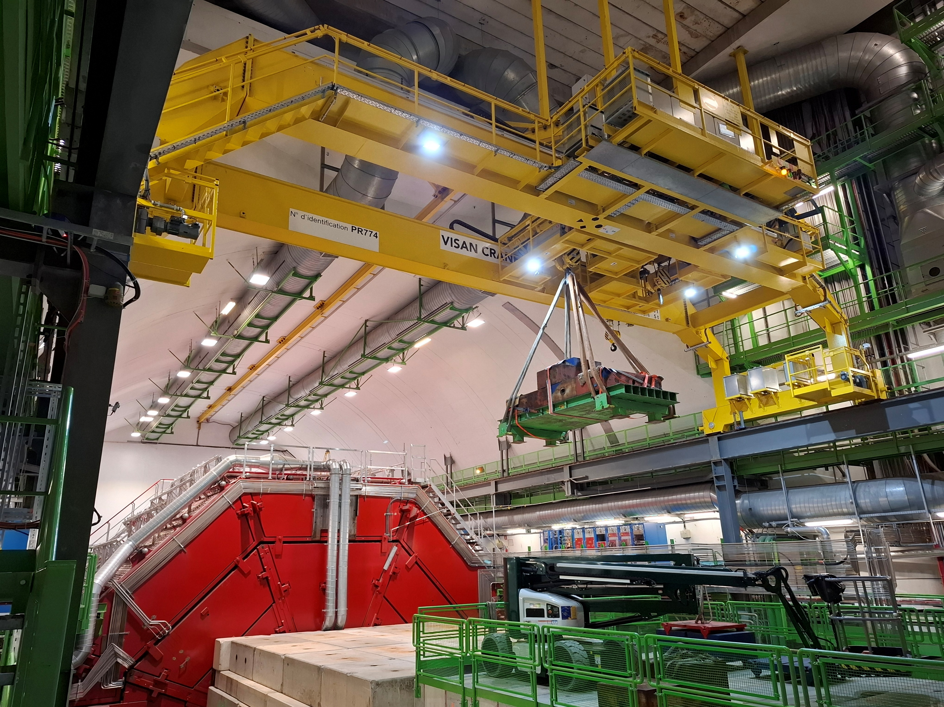
UX25 crane refurbishment (EN-HE)
Refurbishment of cavern crane (PR-774 - 2002)
  Install new cupboards, cables, sensors and motors
  Steel cables and mechanical structure won’t be replaced
  Check weldings (this week)
Work executed by Visan, Turkish company
Total cost: 600 kCHF (Hostlab)
Site Acceptance Tests with dynamic load test held on 18th Feb
Crane is now operational
Crane operators informed about the use of the crane
There are some remarks that don’t prevent the use of the crane. Contractor is waiting support from suppliers for some of them; if it takes too long, they can be done during a TS or the next YETS:
  Tidy up the cabling on board of the crane
  Fix the bug on the display of the hook coordinates
  Update the PLC firmware
Waste stored outside SX2 will be evacuated in the coming days
PX24 shaft will be closed on March 12-14
Roberto/Filippo

Slide 8
Electrical interventions (EN-EL)
Transformer maintenance: Mon 3rd February AM
  EMT103/22 – EMT103/28 and EMT304/25 → various power cuts on UX25 cavern: lights, cooling plants, ventilation
  No access to UX25 cavern
AUG test LHC2 + ALICE: Tue 4th February
  Maintenance transformers EMT408/25 – EMT411/25 and EMT306/2X
  Various power cuts on whole site
  No access to P2 site
Replacement of SX2 transformers:
  EMT406/2X: 25.11.2024 to 13.12.2024 → done. Power rating reduced from 2MVA (2880A) to 1.25MVA (1800A)
  EMT302/2X: 27.1.2025 to 13 or 14.2.2025
  Transparent as it is possible to re-power the switchboards that will be replaced
UPS maintenance:
  9 Dec for the 200KVA (CR3/CR4) and Diesel UPS, 11 Dec for the 500KVA (CR1/ARC/CR0) UPS
  During the maintenance we will run on bypass (no battery backup in case of power cut); in the past this never caused an issue, so no need to switch things off
CERN-wide tests:
  Auto-transfert test: 20-22 January (week 4) → transparent
  Test N/S: 8 January 6:00 – 6:10 AM (week 2) → will cut general services and gas systems for few minutes, no access UX25 from 5:00 AM to 9:00 AM
  AUG Adm. Zone Meyrin: 4 January (week 1)
Juliano/Yann

Slide 9
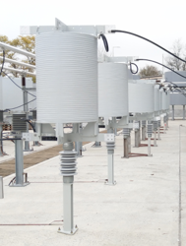
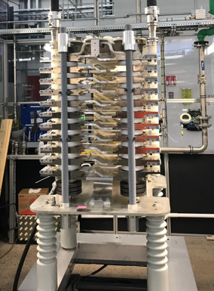
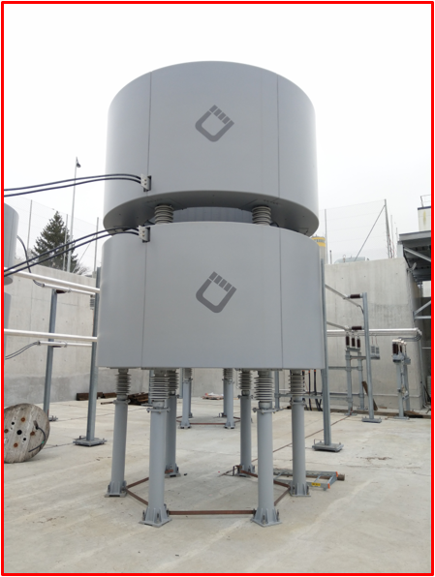
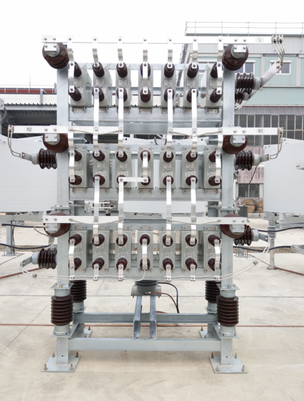
SVC maintenance (SY-EPC)
In view of the usual maintenance of the filters by SY-EPC, the P2 SVC was switched off this Monday, December 9th.
The filter will be re-energized on 24 February.
It is agreed with the machine that they won’t switch on/off the transfer line magnets until the SVC is back on, to avoid glitches on the ALICE electrical network.

Slide 10
Cooling interventions (EN-CV)
Maintenance water cooling systems: 3 to 21 February (week 6-7-8)
  Week 6: SF maintenance (cooling towers) → switchover to external chillers
  Week 7: SU2, SX2, UW25 maintenance → various perturbations on iced water & mixed water
    Complete stop of iced & mixed water on Wed 12 February → stop racks cooling + detector cooling (ok if reduced power on detectors)
  Week 8: UW + tunnel ventilation units
Maintenance ventilation units (HVAC):
  Week 6: UX25, L3. Small cuts (30’) → no impact on access
  Week 7: SG2 → stop flammable gases; ITS → 3 days without air cooling
  Week 8: MCH, MID
Maintenance cooling plants:
  Week 6: TOF/PHOS
  Week 7: MFT, ITS, HMPID
  Week 8: TRD
EN-CV overall planning
Dominique/Olivier/Florent

Slide 11
ITS activities
Improvement of power unit connection scheme at PP1 → week of March 17
  Custom back plane and PCB for PB modification designed; moves sensing point on power unit, i.e. after patch cord connections
  All components ordered / being produced; waiting for delivery dates for the custom back planes
  Plan to install in two sub-racks during YETS (requires all components arriving in time)
Markus/Felix

Slide 12
TPC activities
All work in the cavern is done, with the exception of the laser maintenance. Borge and Dariusz will have to return.
One power supply needs to be fixed and was sent to the company.
Christian/Chilo

Slide 13
TRD activities
Clean Wiener LVPS (Philippe/Julien) – done
Check Wiener PS with thermal camera – nothing abnormal spotted
Hunting a leak on the Xe (Chilo/Louis-Philippe) → leak found
5m³ of Xe delivered, waiting to fix the leak before start injection
Anastasia/Chilo

Slide 14
TOF activities
SM1 DC-DC fine, no need to move SM1!
DC-DC replaced in crates 21 and 62 → done
Unclogging of crates 19 and 35 → done
Installation of two new CAEN mainframes (A4527) in CR4 → done (two boards to be changed when back from repair)
Fix HV for SM14Mod4Pos (not showing problem at the moment)
Fix crates 39 and 57 → test and debug ongoing
Sofia/Manuel

Slide 15
PHOS activities
PHOS & CPV in ‘safe mode’ from November 25
  Crystals warmed to +18℃ since 2 December
  Switch-off modules and readout units inside L3 magnet → done on 2 December
  Power off racks A16, A17, C05
  Power off crystal cooling plant, exhaust residual water from PHOS/CPV FEE
PHOS & CPV cooling water drained and loops flushed with Ar
PHOS workshop in b.167 handed over to FoCal
C6F14 cooling liquid collected
  100 litres collected (10 tanks) → will be evacuated next week
Yuri/Philippe/Julien

Slide 16
MFT activities
The cooling plant maintenance was successful. The replacement of some VTRx was done last week and we are still assessing if it improves the stability of the communication with the chips.
Nothing scheduled for next week except a short access inside L3 to recover communication with one ladder.
Charlotte/Sarah/Guillaume

Slide 17
MCH
Station 1:
  No interventions planned before the work in Station 2 starts
Station 2: Indian colleagues will come in February for 3 weeks (25/2 - 17/3):
  exchange quadrants DE300 (on CH3) and DE403 (on CH4)
  work on the readout stability
For stations 3, 4 and 5: no activity this week in cavern:
  Work on readout improvements will resume next week
X-ray test of quadrants in the P2 Buffer zone (2285 SX2) after working hours (>18:00) → will be done by Indians. Test of the spare slats to be arranged (date not fixed yet)
Hervé/Christphe/Livia

Slide 18
EMC
January 24th, 29th and February 7th - replaced Front End Cards masked last year:
  SMC1: FEC 27; SMC3: FEC 8; SMC5: FEC 31; SMA3: FEC 19, 21; SMA4: FEC 21,22; SMA5: FEC 11 and SMC10: FEC 15
January 30th - change TRU power connectors to understand the hotspots observed at the end of 2024:
  TRU8; TRU25; TRU39; TRU41
Access today, to verify the connections of the TRUs of SMC4, SMC5 (not responding), and measure the power provided to SMA4, where a block of 6 FECs is currently not working.
Tommaso

Slide 19
FDD
Check the laser system, requiring removal of the shielding in the Miniframe (next week)
Solangel

Slide 20
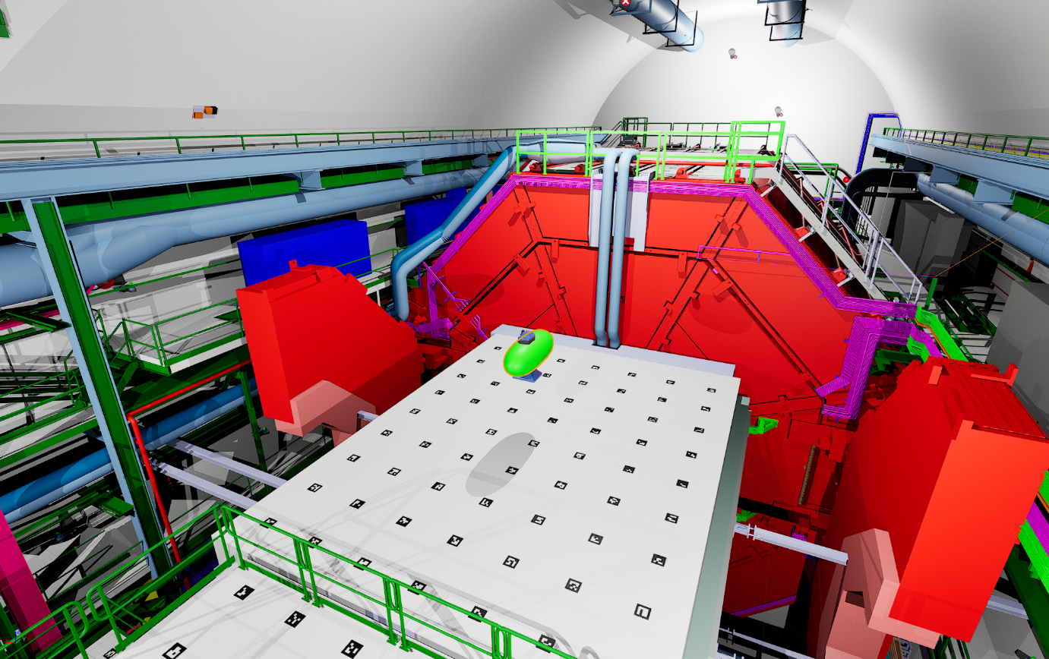
Blimp flight test
Planned on 6 and 7 March (backup 21 March, when magnets are on)
Elisa

Slide 21
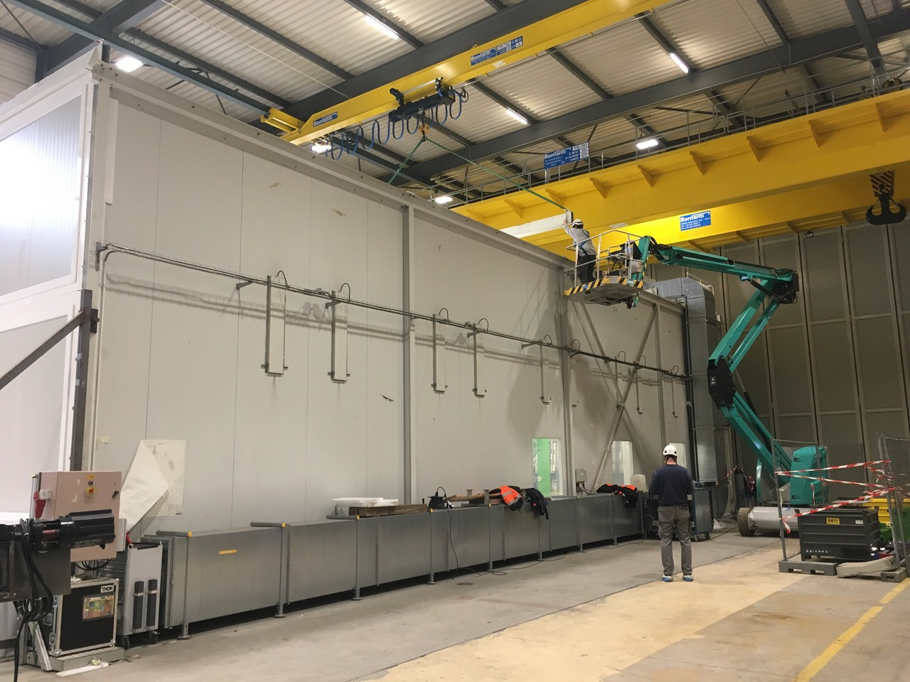
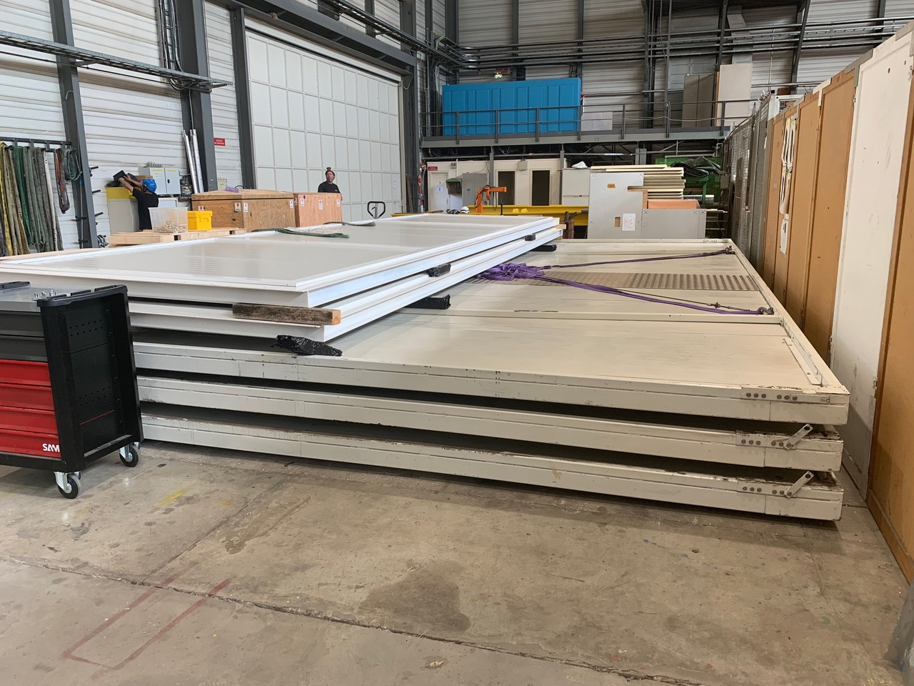
SXL2 cleanroom roof
Roof panel in bad conditions, consolidation required
Inspection next Wednesday AM → open one panel
Work will be organised afterwards

Slide 22
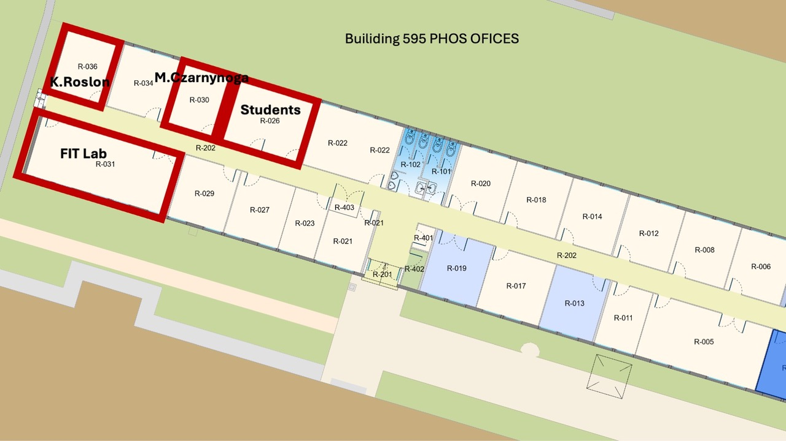
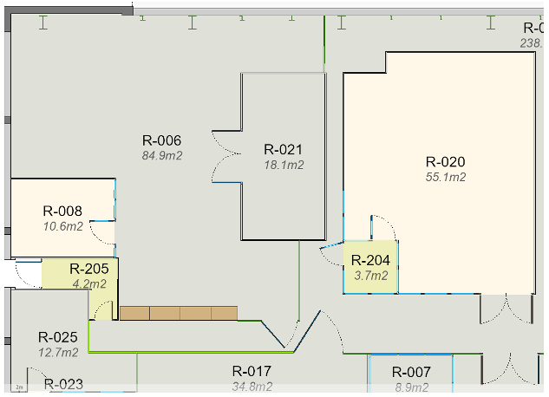
FIT & FoCal space
FIT & FoCal offices in b.595:
2 offices (R-030 and R-036) vacated last week → renovation (EP-AGS) from March 3rd
Laboratory (R-031) will be done later
FoCal workshop in b.167:
Empty workshop, transport all items to P2 → next week (Foslev, Philippe/Julien)
Renovation (EP-AGS): May-June: floor, electricity and ethernet, remove room R-021
Maciej/Krystian

Slide 23
Other activities
EN-HE: reinstall batteries on both nacelles (Mon 25 November)
HSE-RP: RP sampling on 25.11 (TOF, ITS, MFT, TPC, TRD, HMPID)
TRAKA in ARC: remove part 31 March – 1 April (Klaus will take out all the keys beforehand)
TE-VSC:
  Close manual beampipe valve on Monday, November 25 after 10:00
  Re-open it on Thursday, March 27 AM
HSE-FRS: on February 16th & March 9th & March 23rd, the firefighters will simulate the evacuation of a person injured by electric shock and the spread of a fire in the electrical rack. This exercise will be carried out in collaboration with firefighters from SDIS 01. Red Key required
EN-AA: maintenance cavern lift (AS-724):
  Thursday, December 5th, between 6:00 AM and 8:00 AM → no access to UX25 cavern
  Monday, January 13th, between 6:00 AM and 8:00 AM → no access to UX25 cavern
  Friday, February 14th, between 6:00 AM and 8:00 AM → no access to UX25 cavern

Slide 24
Access, fire, gas and SNIFFER detection systems (EN-AA)
Access system preventive maintenance: 3-4 December
Yearly maintenance red phones: 9 December
Safety test (sirens and flashing light): 24 December → no access underground whole day
CSAM test: 3 January from 8:00 to 13:00 → no access underground
Individual System Test (IST): 28th February from 13h to 19h30 and 3rd March from 17h to 19h30 → ALL DOORS must be closed and no emergency green handle pulled (no patrol needed). Underground access will be stopped ~1h before the tests.
Beam Imminent Warning (BIW) test: 28th February, in the shadow of IST test
Department Safety Office (DSO) test: 13-14 March → patrol and close ALICE on March 13th at 15:00 (test starts at 16:00). No underground access from March 13th at 15:00 to March 14th at 18:00
Tests on Fire, Gas and SNIFFER Detection Systems
System | Buildings | Dates | Comments
Gas Detection Activity #1 | SG2, CR5 and UX25 | 25/11/2024 to 27/11/2024
Gas Detection Activity #2 | SG2, CR5 | 04/02/2025 | Electrical Interlocks test of gas system in the shadow AUG test in collaboration with EN/EL and EP/DT
Fire Detection Activity #1 | UX25 and Counting Rooms | 25/11/2024 to 29/11/2024
Fire Detection Activity #2 | UX25 Racks | 21/02/2025 to 27/02/2025
SNIFFER Activity #1 | CR5 and UX25 | 26/02/2025 | Test of level 3 alarms and DSS after all rotations are done
SNIFFER Activity #2 | CR5 and UX25 | 27/02/2025 or 03/03/2025 | Assistance to ALICE for air sampling network cleaning
Nicolas Broca/Vitor Rios

Slide 25
Gas activities (EP-DT)
TPC:
  Filling of the Envelope humidifier → done
  Leak search → done
  Installation of a pressure dumper on the input of the pumps to reduce the gas vibration impacts on the chamber and test (built, tests second part of February) → ongoing
  Dismount and check safety valves (Dec-Jan) → ongoing
  Replace filters, pump, purifier, distribution → Feb
  Maybe dismantling of the pump 2 and send it to manufacturer for maintenance and cleaning → Jan-Feb
TRD:
  Replace 1 pump by the spare and send it to maintenance → done
  Replace the Festo module purifier → done
  Replace Festo in distribution module (leak N2)
  Leak search → ongoing
  Check safety valves → ongoing
HMPID:
  Regeneration of the manual purifier → done
  Check the analysis devices in CR5 → ongoing
TOF:
  Replace one pump with spare and send it to the manufacturer → done
  Replace the Festo Module → done
  Change filter in purifier, pump, exhaust → done
  Installation of flow meters in the backup lines in the cavern → Jan-Feb
  Leak in the purifier, pollution on the flammable gas detection sensor → ongoing
  Change second pump in pump module and send to manufacturer
MCH:
  Test of the mixture to check the ratio (if not good, then calibration of the mass flow controllers) → done
  Filling humidifier → done
  Leak search Mixer and Humidifier → done
  Reading of the distribution rack 61, one channel totally wrong to be fixed → ongoing
MID:
  Distribution bubbler reconnected, system restarted, purged with Ar and then restarted
  Remove the Zimmerli in the mixer to test it → done
  Test the functioning in “dummy chamber mode” → done
  Change the pressure sensor on the distribution → done
  Leak search on mixer and exhaust modules → done
  Pump membrane to be changed → March
  Filling of the humidifier → Feb
Louis-Philippe

Slide 26
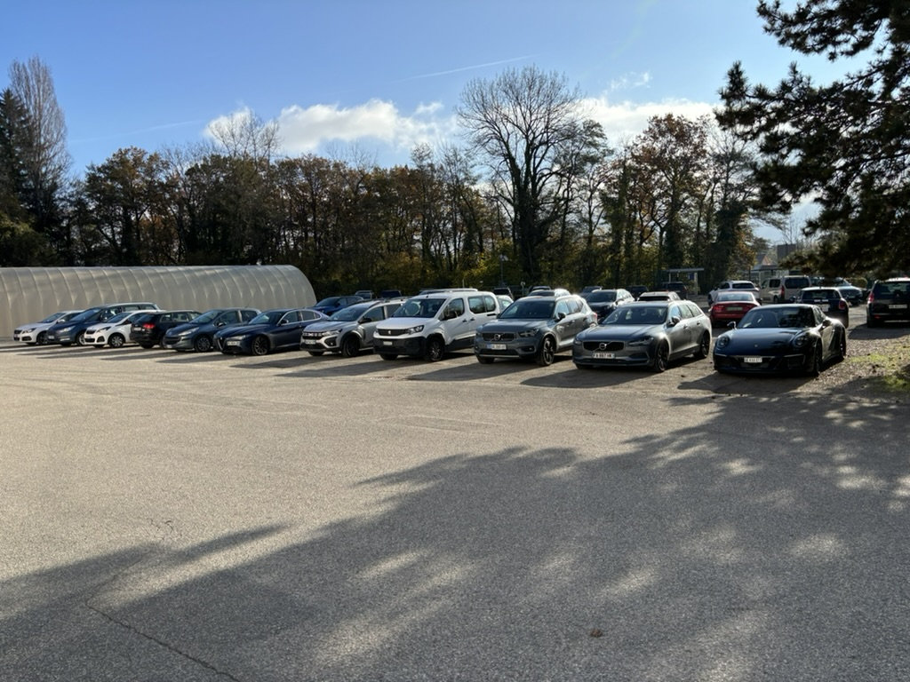
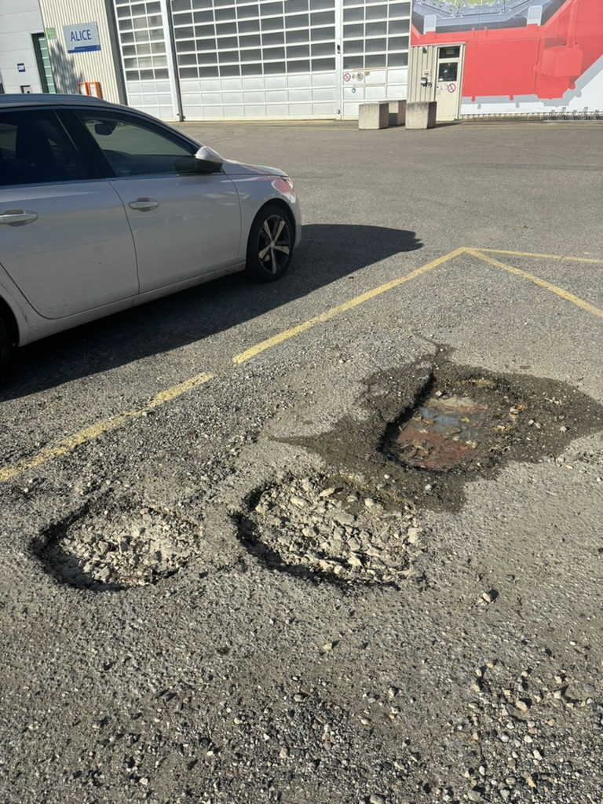
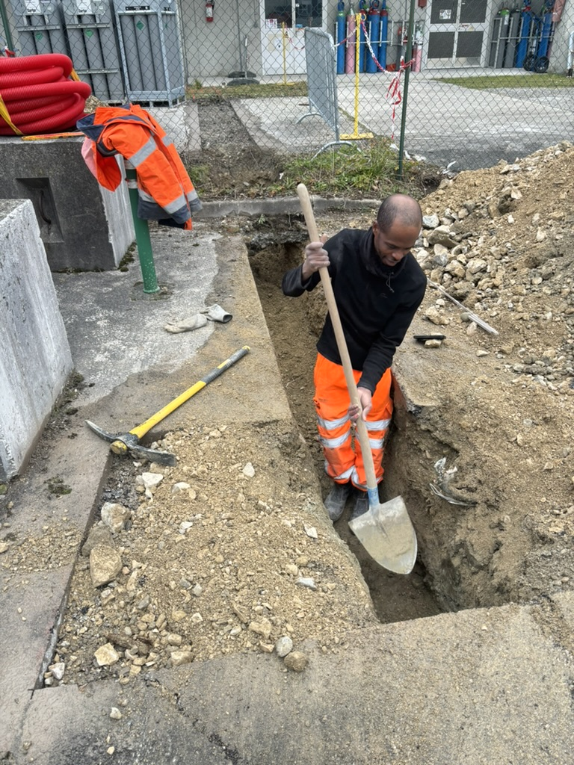
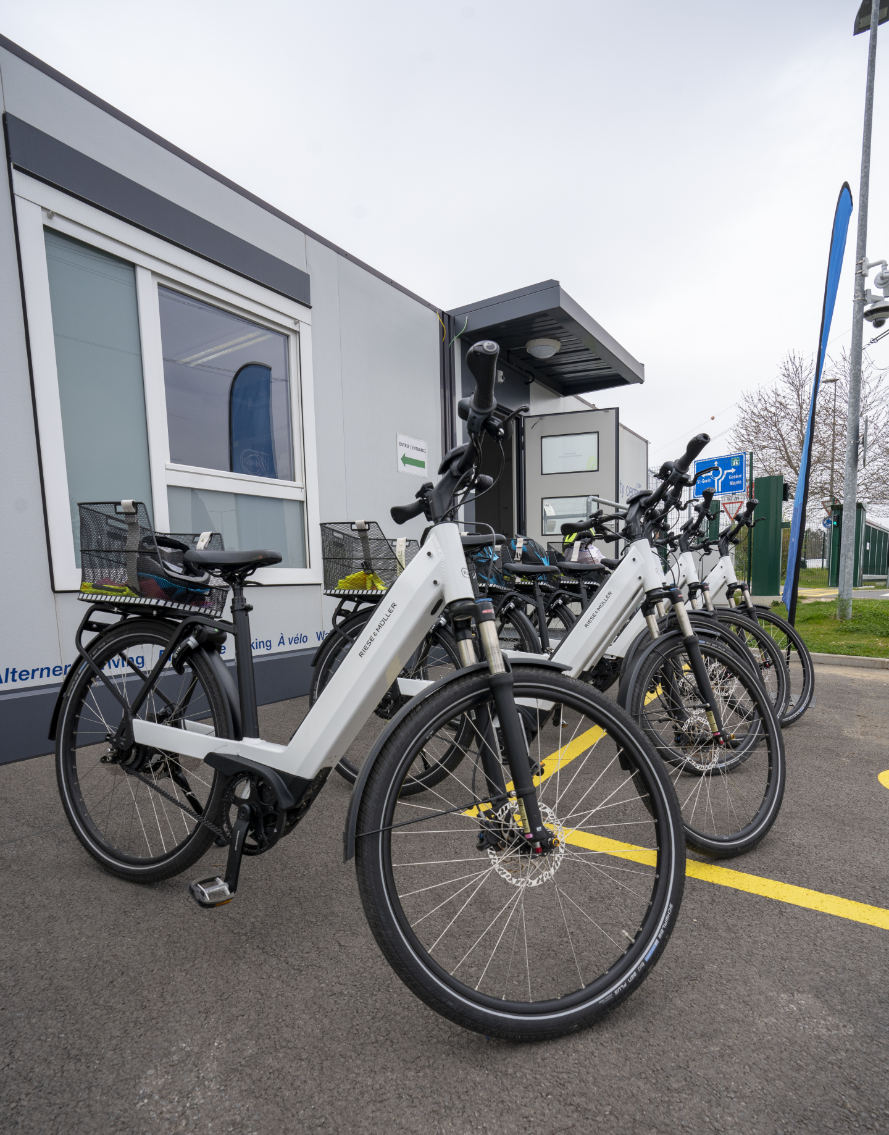
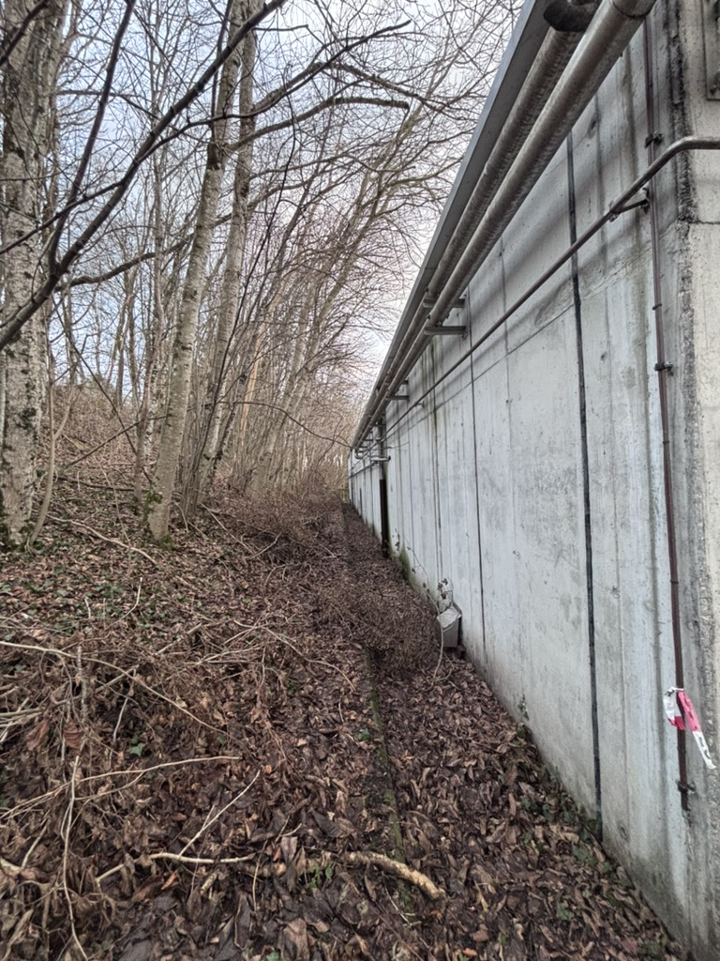
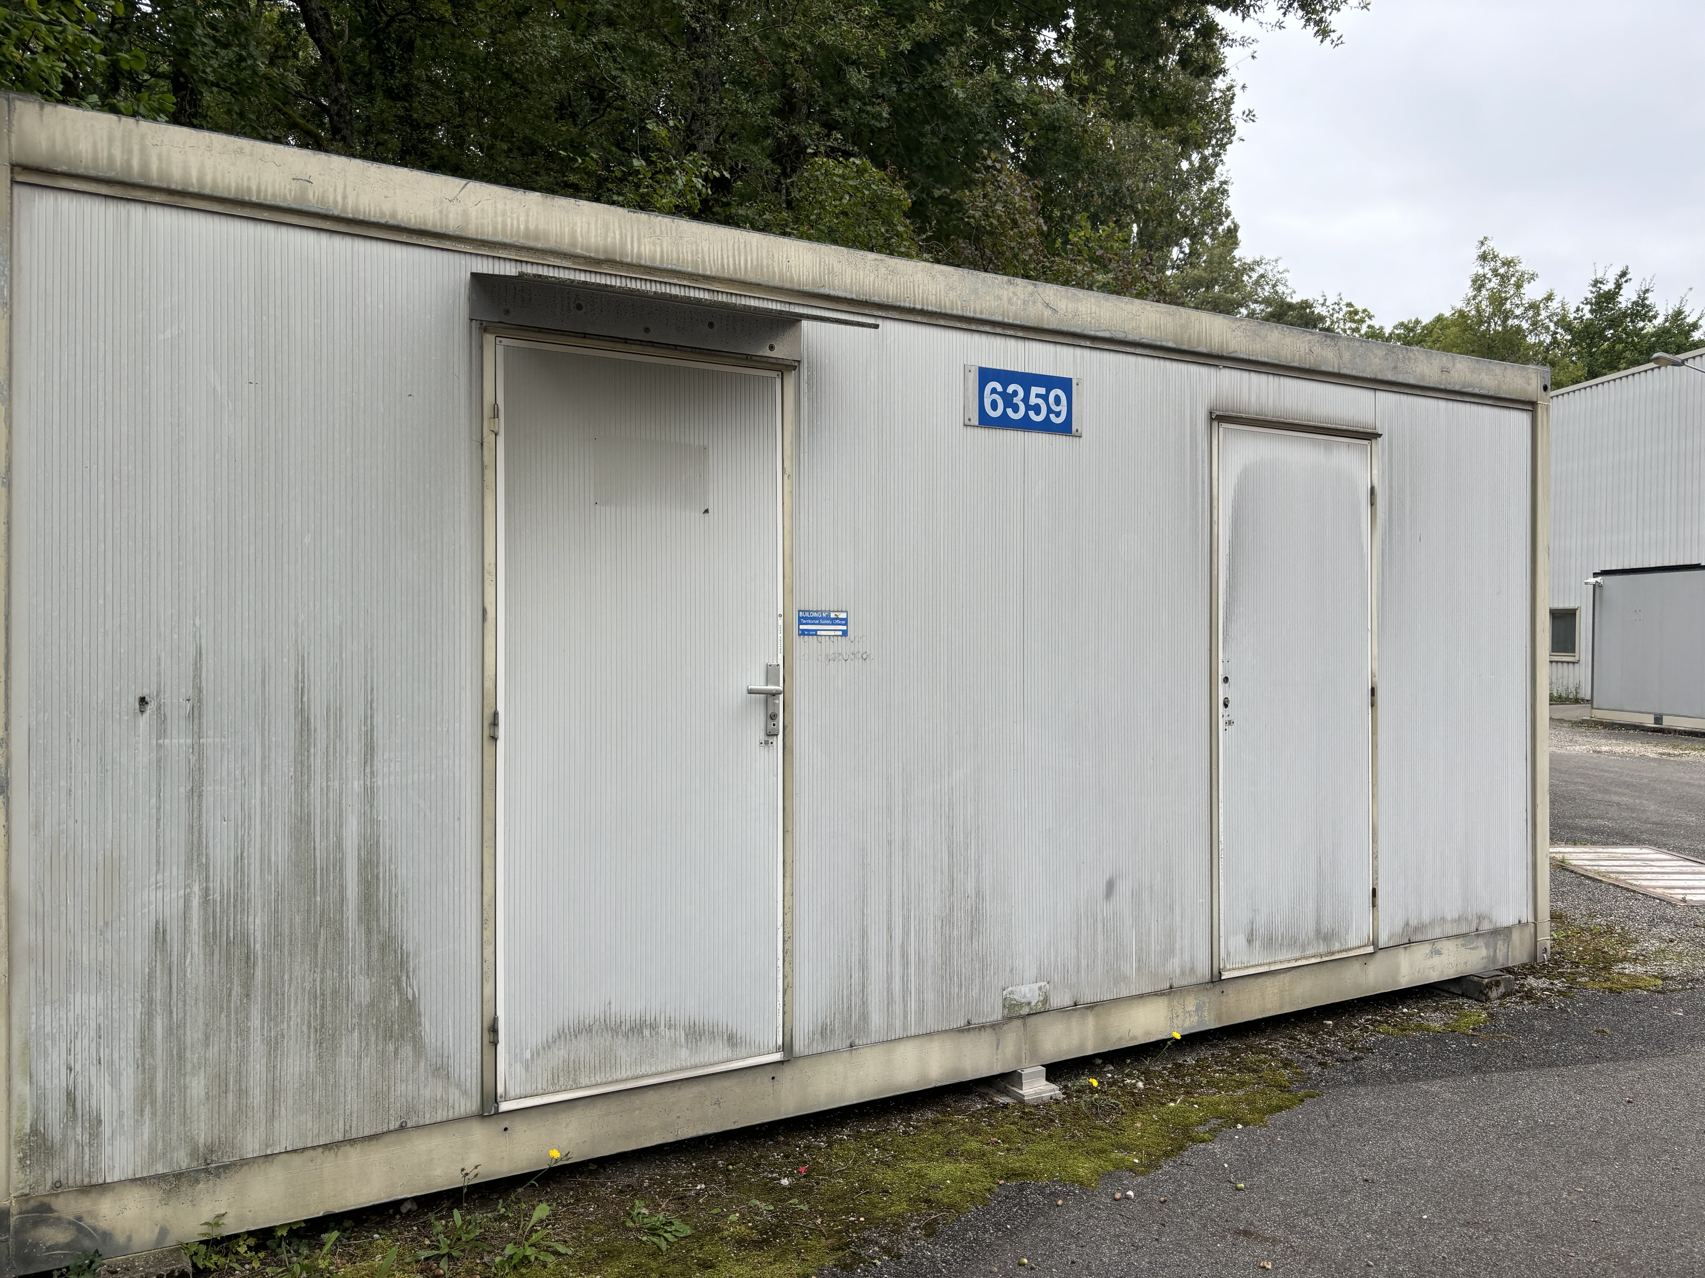
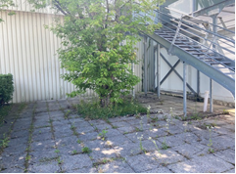
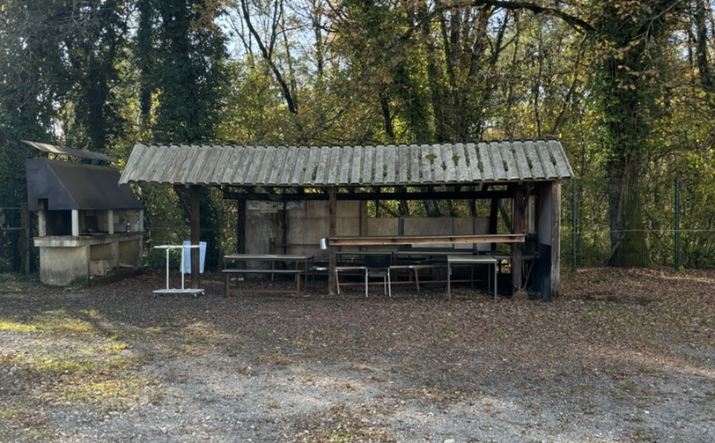
Site activities (SCE)
Redo parking asphalt
(Hostlab, SCE budget)
Temporary repair potholes parking
New car charging station
Electric bikes
New rest area outside b.3294 (spring)
MCH barrack removal
Redo P2 BBQ area (summer)
SG2: clean green areas

Slide 27
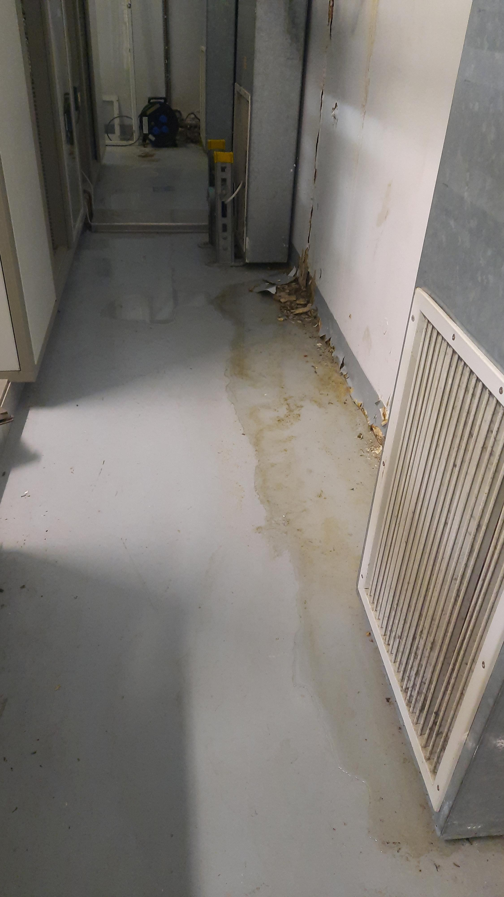
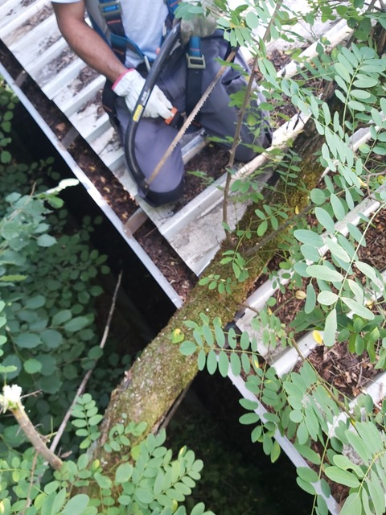
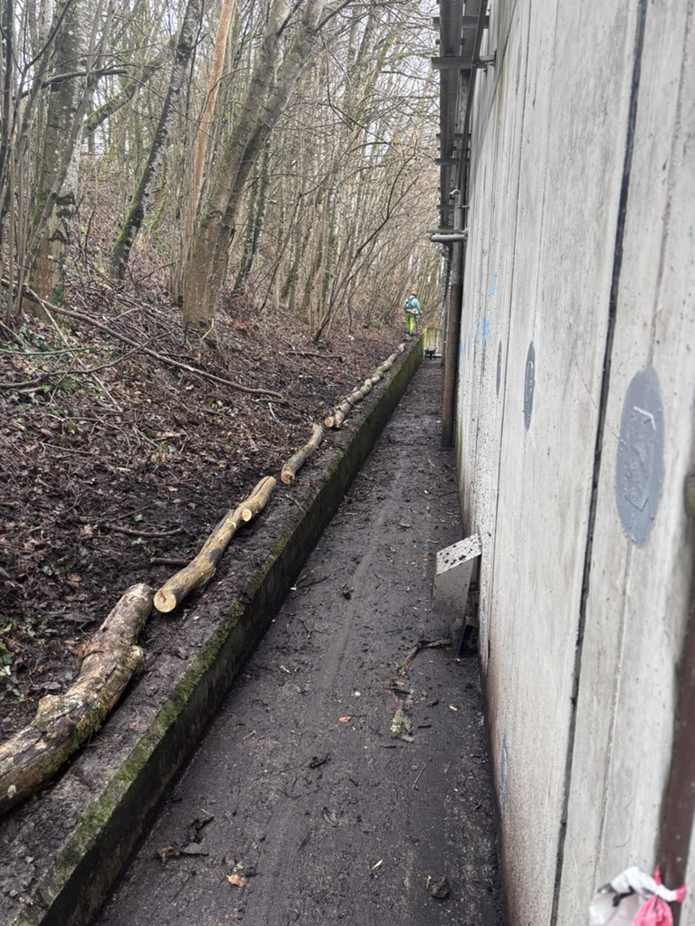
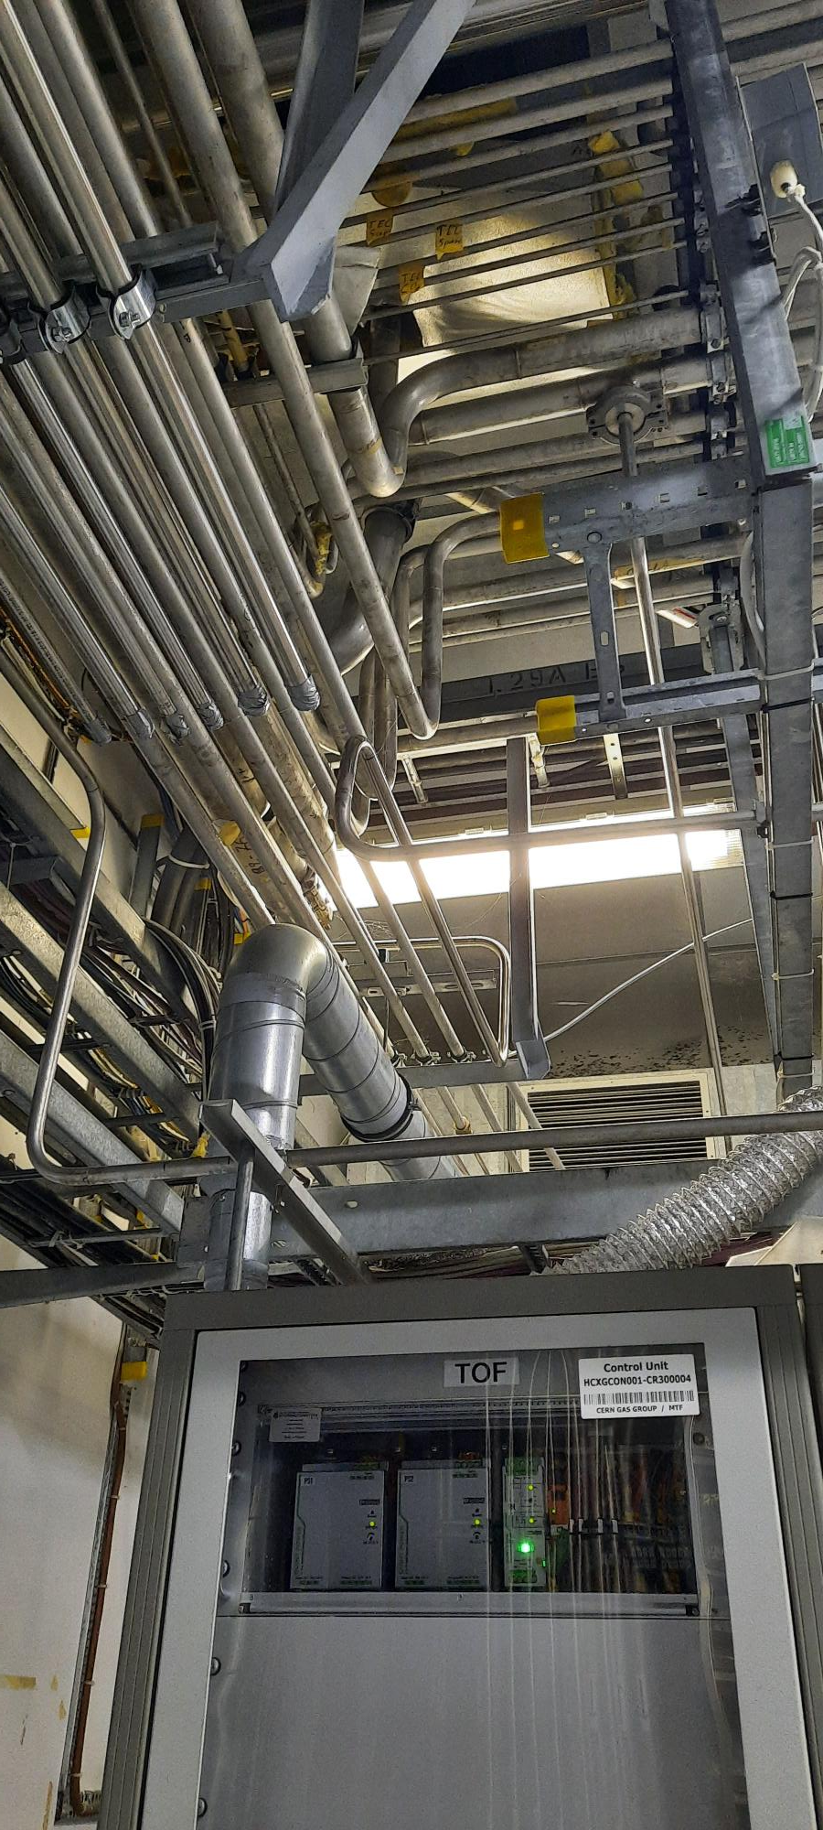
Update on SG2 water infiltrations
Water infiltration in the coming months (from roof & from floor)
After various discussions and tickets → SCE inspections / cleaning of the green areas / sealing of the roof
Still to do: install drainage to evacuate water on the outside trench. It will be done within a couple of months

Slide 28
YETS planning meetings
Friday, March 7th at 10:00
Friday, March 28^{h} at 10:00

