Slide 1
2024-25 EYETS planning meeting
21.2.2025
A.Tauro

Slide 2
Cavern closure, end of EYETS
Thursday, March 27th at 12:00 PM: stop underground visits
Monday, March 31st at 16:00: stop cavern access, all IMPACTs closed
  Patrol 16:00 - 17:00: Klaus/André/Arturo then go to restricted access with delegation
Urgent access beyond this date still possible (access with key)
Wednesday, April 2nd: start machine check-out
Thursday, April 3rd PM: TL test (beam to TED)
Afterwards, beam through ALICE

Slide 3
L3 and Dipole magnets test
L3 and Dipole cooling restarted last week
Interlock tests with EP-DT done last week
Power supplies unlocked-out yesterday
Magnet search done yesterday (Klaus)
Today, Friday March 21st:
  Start at 8:30 with positive polarity for ~4h until FIT is done with the calibration and then revert polarity. Run until ~16:30 or later.
Friday March 28th:
  Repeat test with reduced solenoid field and similar schedule.
No access to L3, Miniframe, Dipole and FASS during magnet operation.
In the shadow of the magnet test:
  FoCal: B field measurement
  Blimp flight test

Slide 4
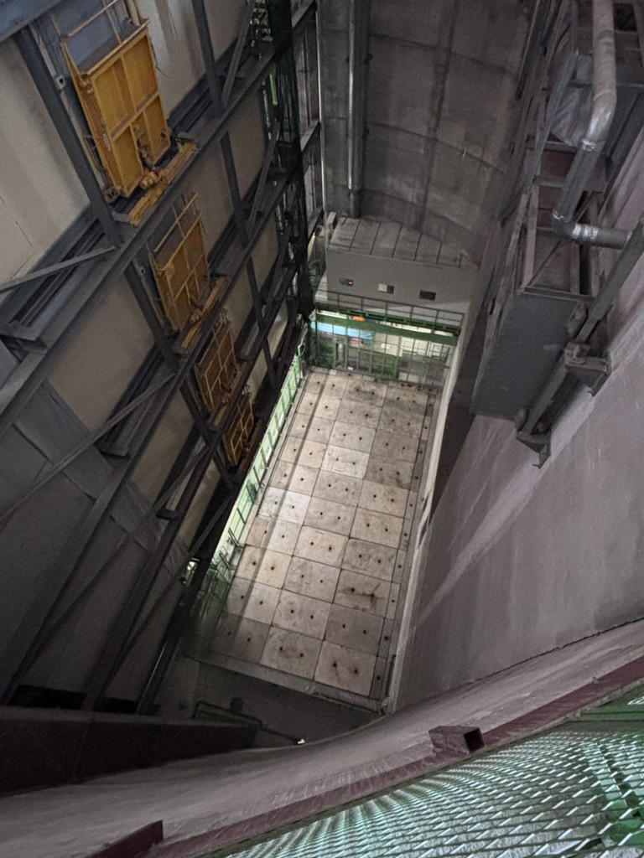
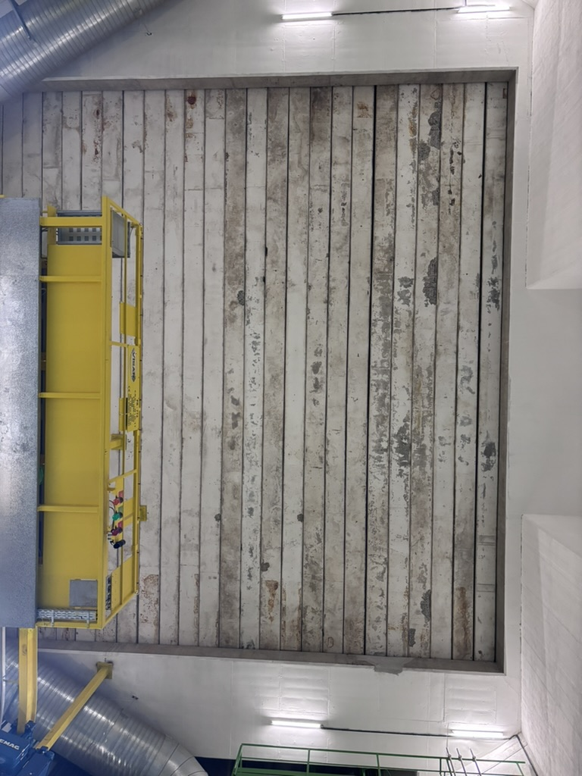
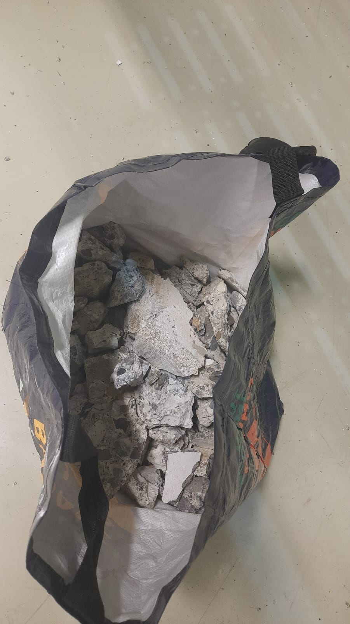
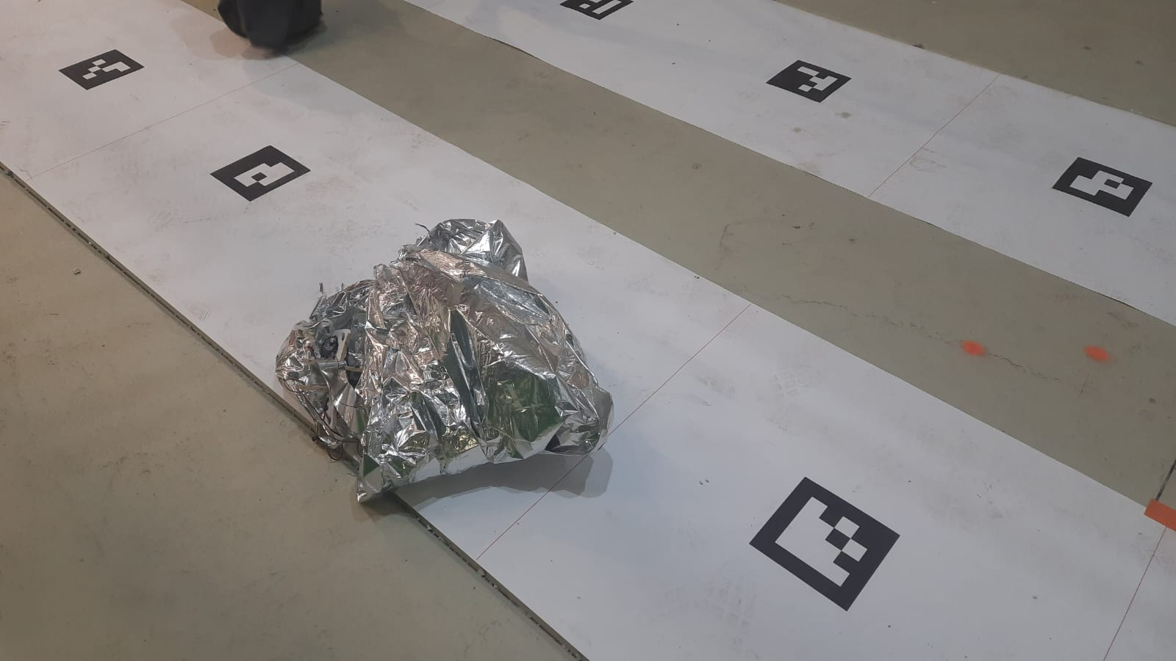
PX24 shaft closing
32 tons beams installed on Friday (no access to cavern). The last beam got stuck when it was almost in place, then dropped for ~10cm producing debris inside the cavern.
Small 7.5 tons blocks installed on Monday. We did not block cavern access, however we should change this rule and block access also during this phase, epecially because 2x blocks were installed at once.

Slide 5
Detector activities
ITS: power unit connection scheme improvement at PP1 completed yesterday (2 crates)
TPC: laser maintenance completed yesterday
MCH: see next slide

Slide 6
MCH
Station 1:
  Fix minor issues on the accessible chambers (cannot open since station 2 is fully open) during week 11
  Additional work planned for week 13
Station 2:
  Spare quadrant (Q9) was installed as DE300 (on Chamber 3 top right)
    One missing HV card (about 1/10th of the active area) to be investigated at the next opportunity
  Q1 validated with X-ray tests and installed as DE403 (chamber 4 bottom right)
  All readout re-connected and validated
  Need to rework on Q8 which still show some HV issues on its external part → reopen, to be kept as spare
  In parallel, work on the readout stability → many improvement on the spurious heartbeat issues
  Work complete, detectors ready for data taking
Stations 3/4/5
  Chamber 6: work on the readout completed and chamber put back in nominal position
  Chamber 7 (right) was opened to fix faulty LV connectors. Work complete and chamber closed
  Detectors ready for data taking
DCS:
  FRED servers upgraded with new OS (RHEL9) and software version. Successfully tested and validated this week.
Andrea

Slide 7
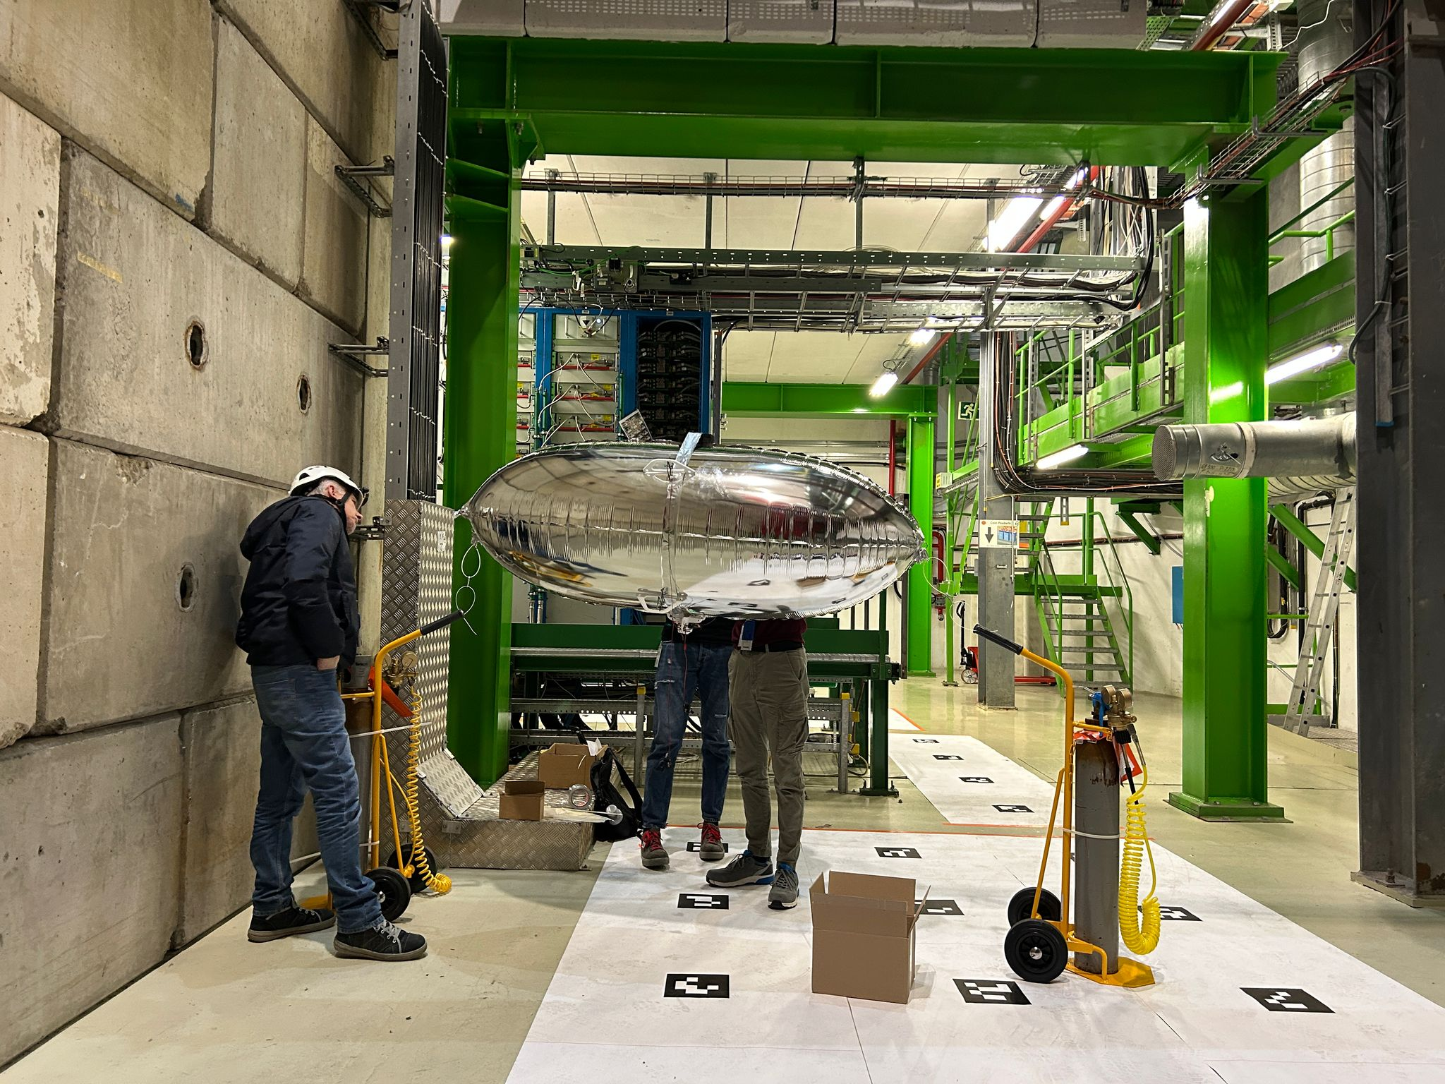
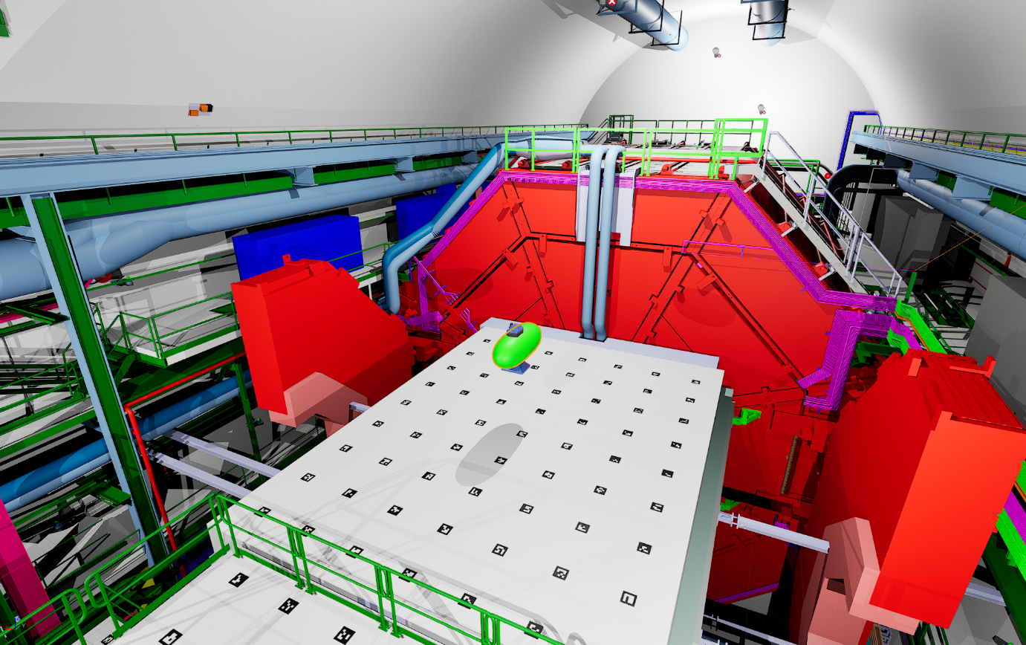
Blimp flight test
First test done on 6 and 7 March
Repeat test today, March 21st, with magnets on
Elisa

Slide 8
Gas activities (EP-DT)
TPC:
  Filling of the Envelope humidifier → done
  Leak search → done
  Replace filters, distribution → done
  Installation of a pressure dumper on the input of the pumps to reduce the gas vibration impacts on the chamber and test (built, tests second part of February) → ongoing
  Dismount and check safety valves in CO2 removal → ongoing
  Maybe dismantling of the pump 2 and send it to manufacturer for maintenance and cleaning → ?
TRD:
  Replace 1 pump by the spare and send it to maintenance → done
  Replace the Festo module purifier → done
  Replace Festo in distribution module (leak N2)
  Leak search → ongoing. One leak fixed on the purifier on the rotameter but a new leak appeared in the purifier on the valve VY2104 leak to the exhaust line, not outside, so difficult to find. Second leak in the mixer to find (Roberto, Mattia, Gianluca, L-Philippe). Now the leak seems to be really located in the purifier.
  Check safety valves → ongoing
HMPID:
  Regeneration of the manual purifier → done
  Check the analysis devices in CR5 → ongoing
  Restart CH4: 1 April
TOF:
  Replace one pump with spare and send it to the manufacturer → done
  Replace the Festo Module → done
  Change filter in purifier, pump, exhaust → done
  Installation of flow meters in the backup lines in the cavern → done, except software
  Leak in the purifier, pollution on the flammable gas detection sensor → leak identified on the pump (membrane leaking to the outside). Membrane change ongoing
  Change second pump in pump module and send to manufacturer
  Check of the oxygen mixture content
MCH:
  Test of the mixture to check the ratio (if not good, then calibration of the mass flow controllers) → done
  Filling humidifier → done
  Leak search Mixer and Humidifier → done
  Reading of the distribution rack 61, one channel totally wrong → will be fixed today
MID:
  Distribution bubbler reconnected, system restarted, purged with Ar and then restarted
  Remove the Zimmerli in the mixer to test it → done
  Test the functioning in “dummy chamber mode” → done
  Change the pressure sensor on the distribution → done
  Leak search on mixer and exhaust modules → done
  Pump 2 membrane to be changed → next week
  Filling of the humidifier → maybe we need a stop about 10 minutes
  Safety valves to be checked in the purifier
Louis-Philippe

Slide 9
Other activities
EN-AA: PX24 PAD consolidation: today, Friday March 21st 14:00 – 16:30 → no access UX25
TE-VSC: open miniframe manual valve on Monday, March 24th
EN-HE: remove batteries of both nacelles: Monday March 31st 14:00
TRAKA in ARC: remove card 31 March – 1 April (Klaus will take out all the keys beforehand)

Slide 10
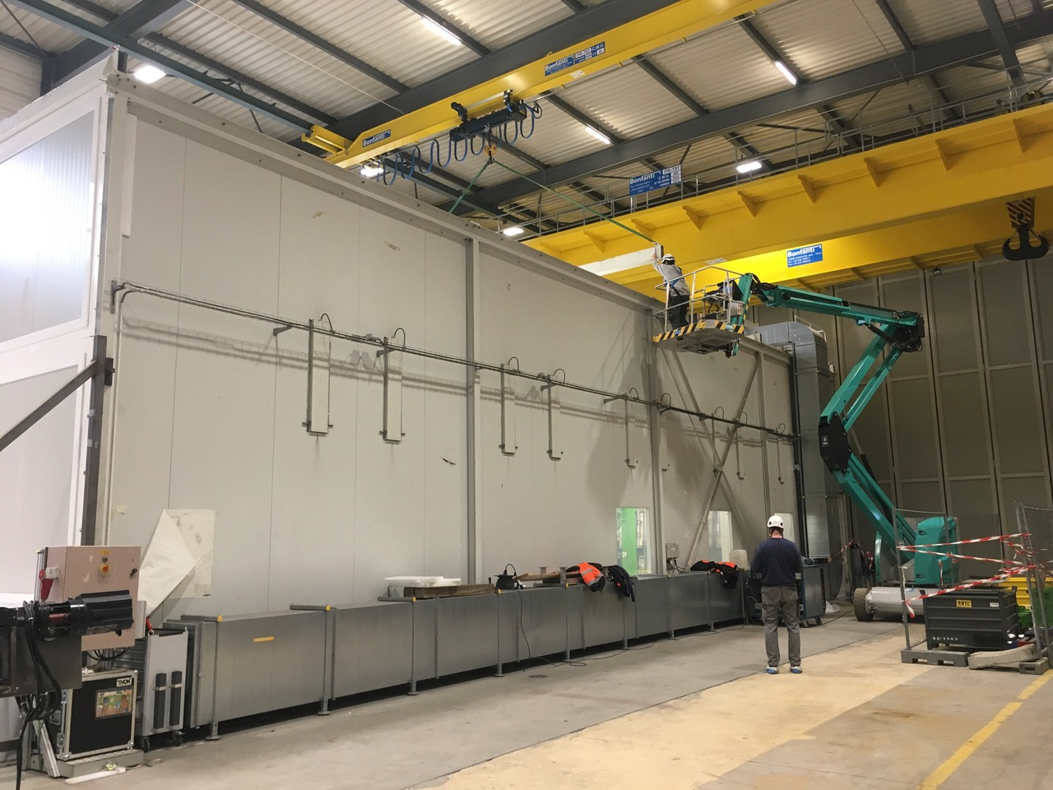
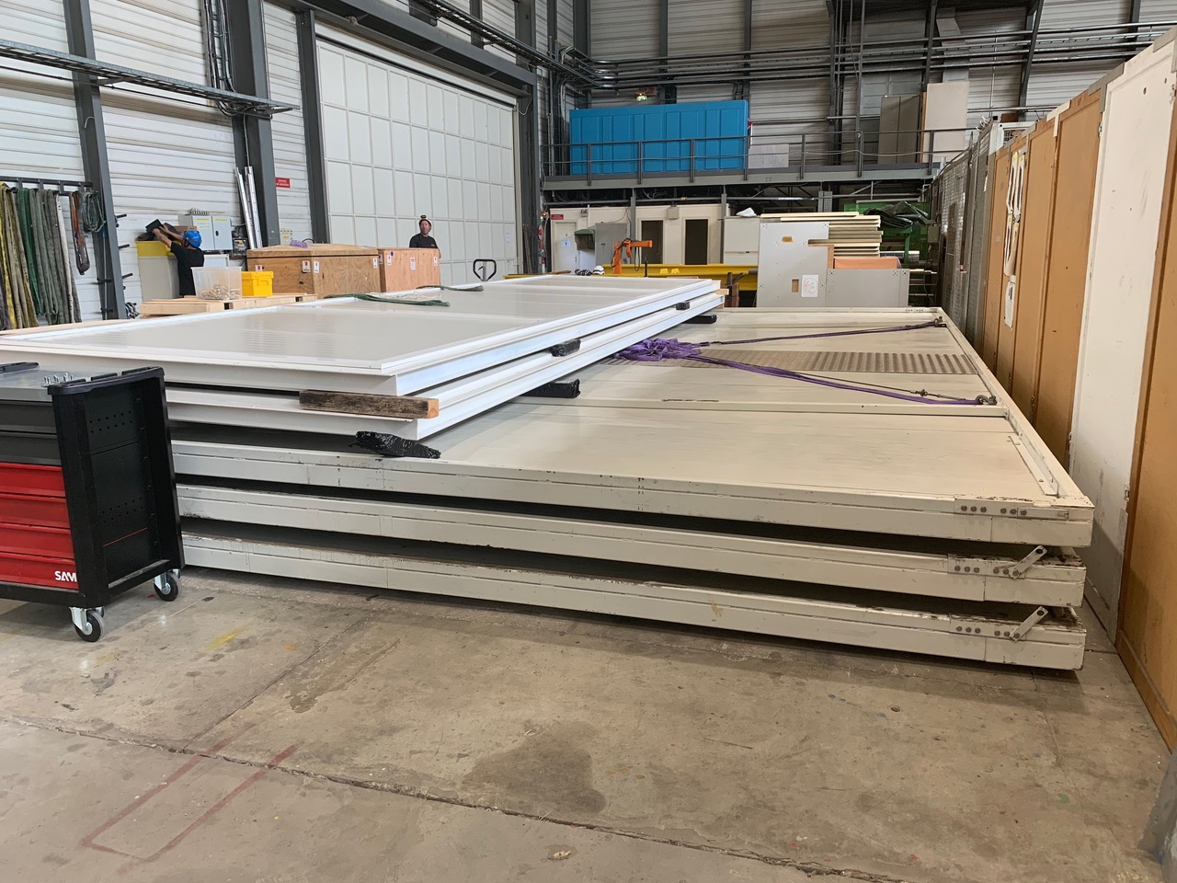
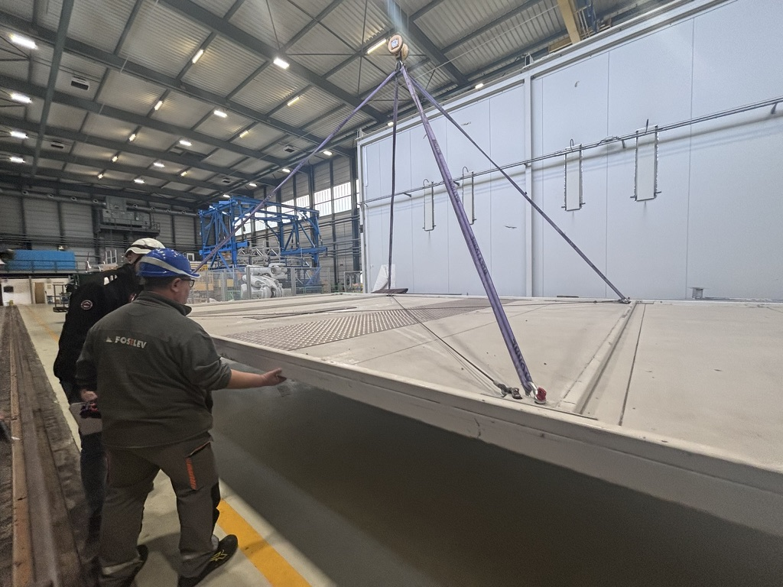
SXL2 cleanroom roof consolidation
Roof panels require consolidation: stiffening of corridors where stepping is foreseen for roof opening/closing
One panel inspected in March, work organised during the summer (EN)

