Slide 1
DSF cooling plant progress
A. Francescon and M. Janda

Slide 2
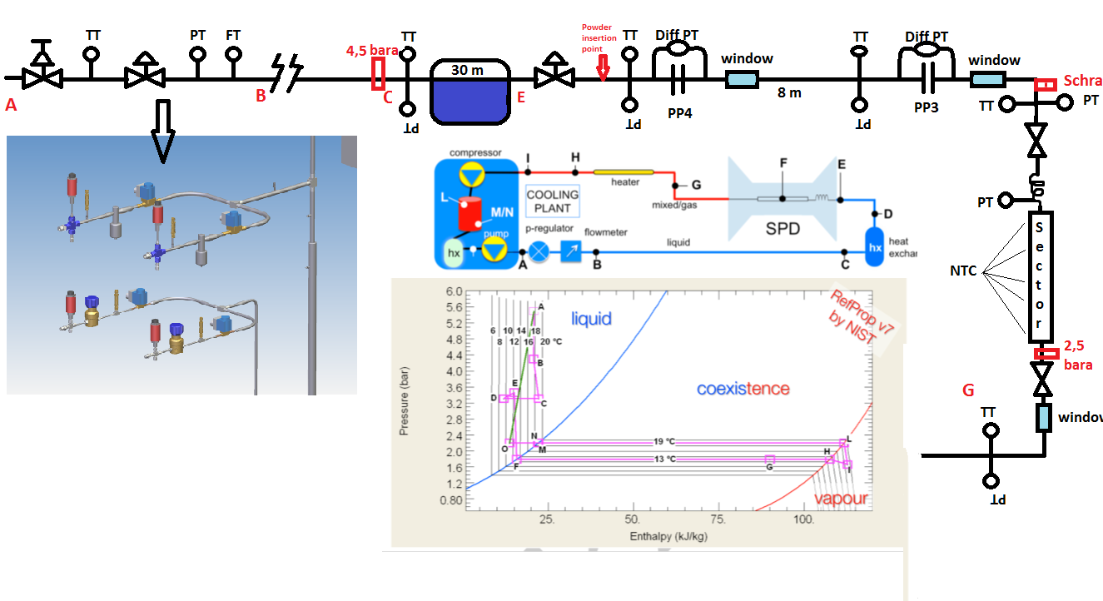

Slide 3
Test section status
The test section is already built on the Bosch.
We only miss:
one differential pressure transmitter
tranparent plastic pipe as windows
temperature transmitters
flowmeter

Slide 4
Test section next activities
Dummy sector degassing
Test section cleaning
Flowmeter installation and connection to ELMB.

Slide 5
The plant
The plant should be ready to move to DSF.
After the arrival we havo to:
connect the loops to the SS pipes outside DSF;
close the line inside DSF (maybe excluding the test section?);
(install capillaries in between?).
Then we can start to test the plant, initially without the test section, then adding also the test section.

Slide 6
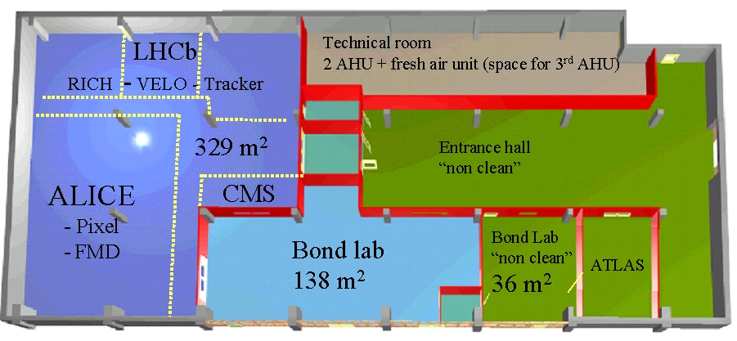

Slide 7
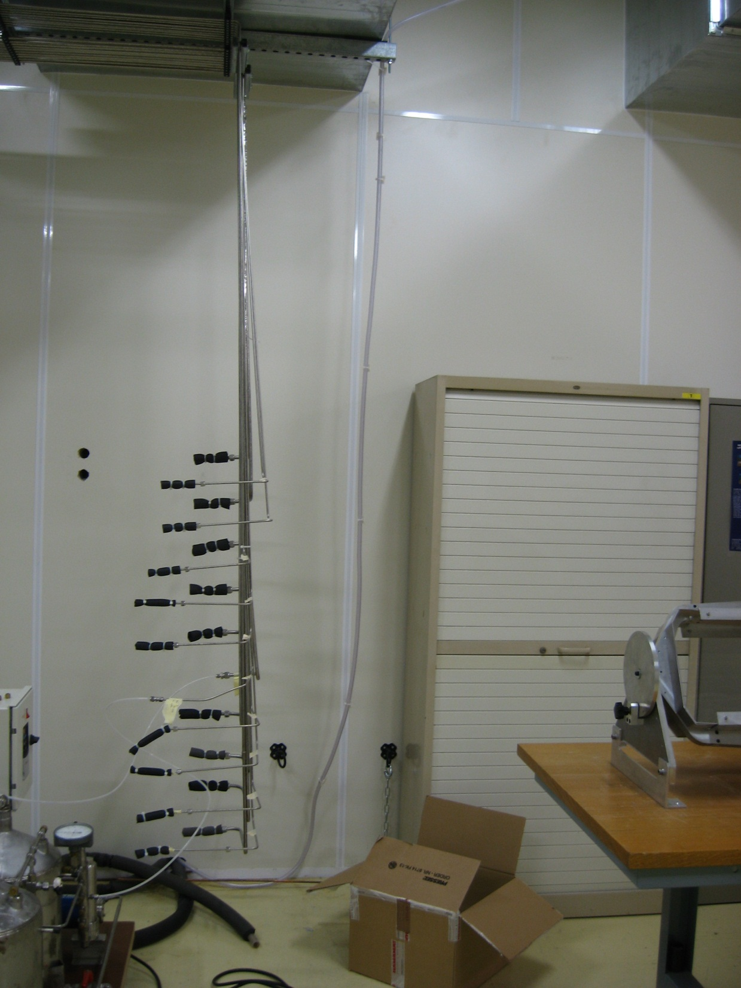

Slide 8
Other activities
ELMB and sensor calibration;
Finalize the readout of all sensors;
Integration between data from the plant and data from the test section in a single PVSS project.

