Slide 1


Comprehensive redesign of CLIC MB Injector
Y. Zhao, S. Doebert, A. Grudiev, A. Kurtulus, A. Latina, CERN
CLIC MB Injector Meeting
21/11/2024

Slide 2
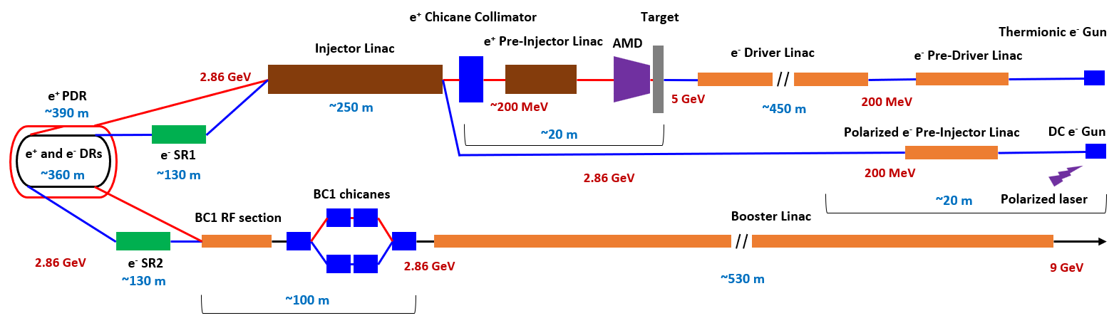
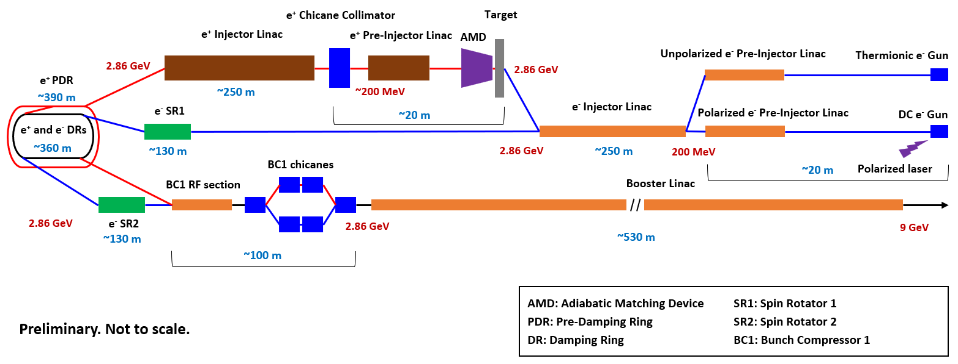
Layout
Old (baseline?)
New (alternative?)

Slide 3
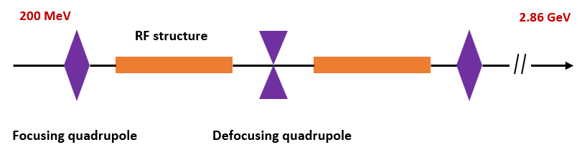
e- Injector Linac
Layout
RF structure
  f = 2 GHz, L = 1.5 m, Δφ = 2π/3 per cell, N_{cell} = 30, G = 15 MV/m, φ = 0°
  a₀ = (16+14)/2 = 15 mm, d₀ = (4.16+4.76)/2 = 4.46 mm
Beam parameters (DBA @ 380 GeV)
  δ_{E} = 1%, σ_{z} = 1 mm, Q_{b} = 1 nC
  Polarized e-: ε_{n,x,y} = 10 um, Unpolarized e-: ε_{n,x,y} = 50 um
FODO lattice
  FODO phase advance: 76.345°, k1 ~ 1.4715 m⁻¹
1.5 m

Slide 4
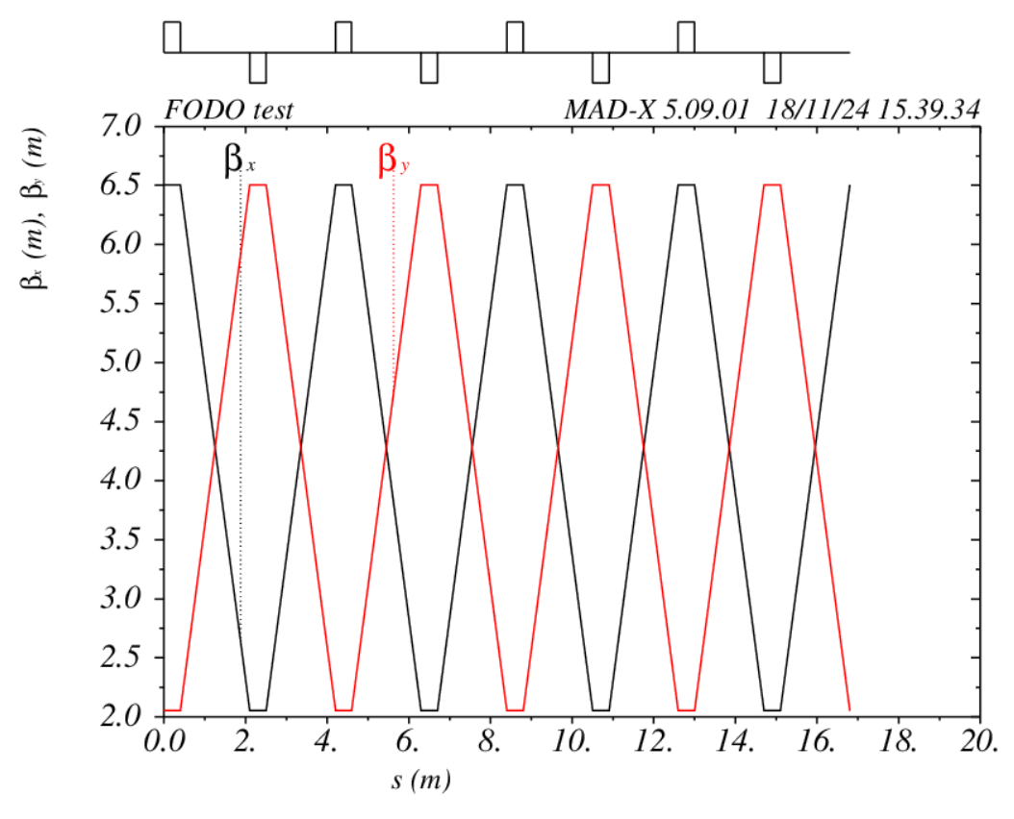
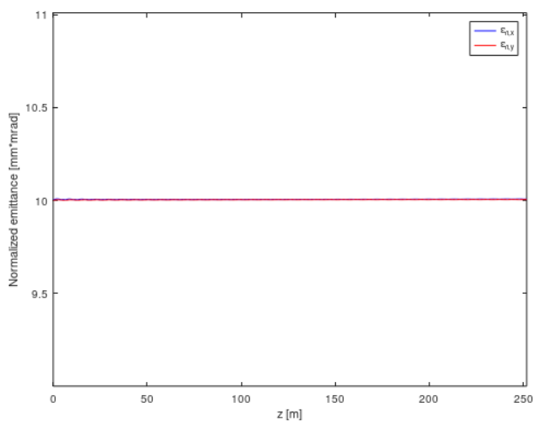
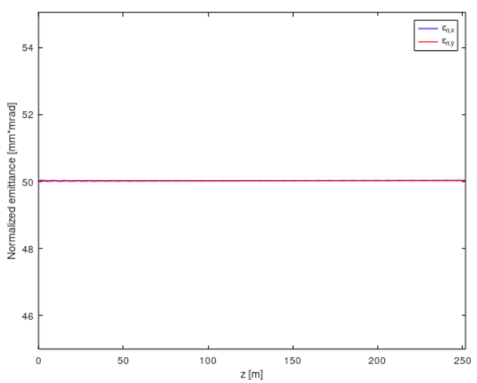
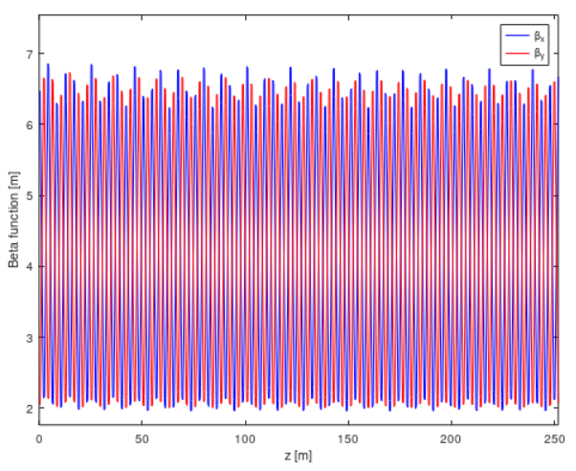
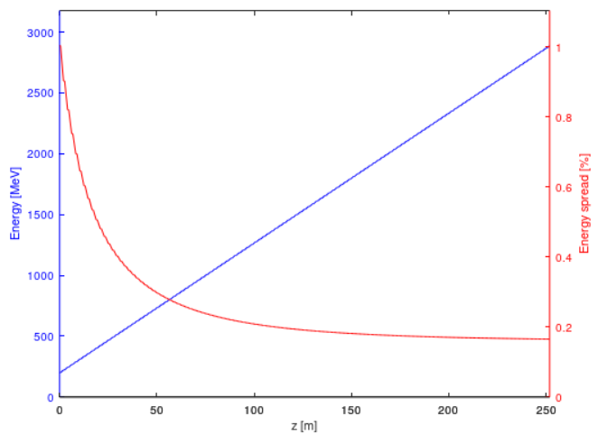
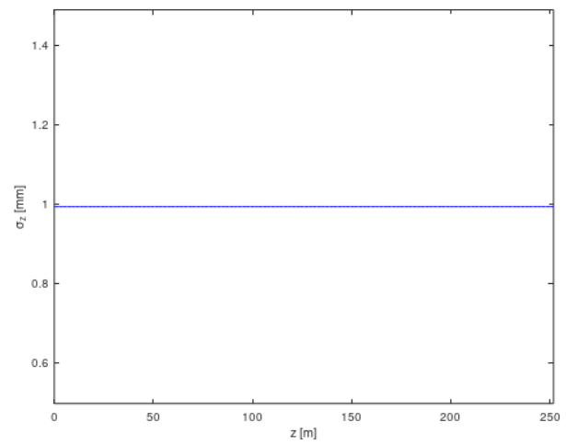
e- Injector Linac
60 FODO cells, 120 structures.
Twiss matching in MAD-X
Full bunch tracking in RF-Track

Slide 5
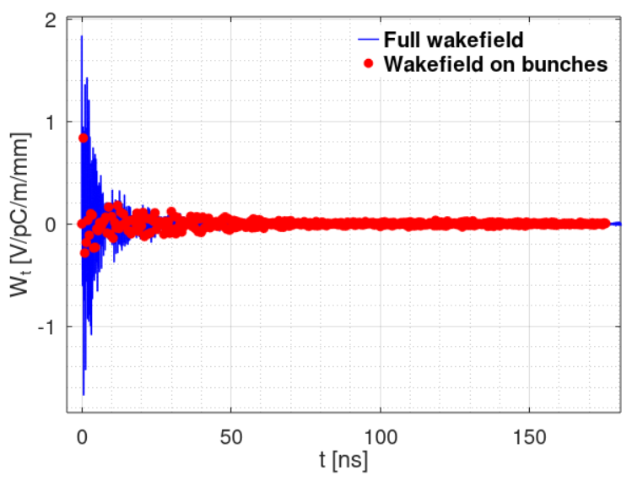
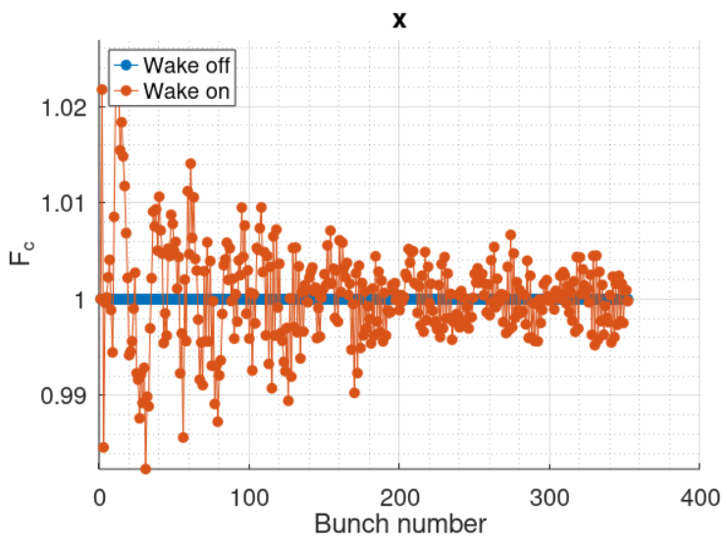
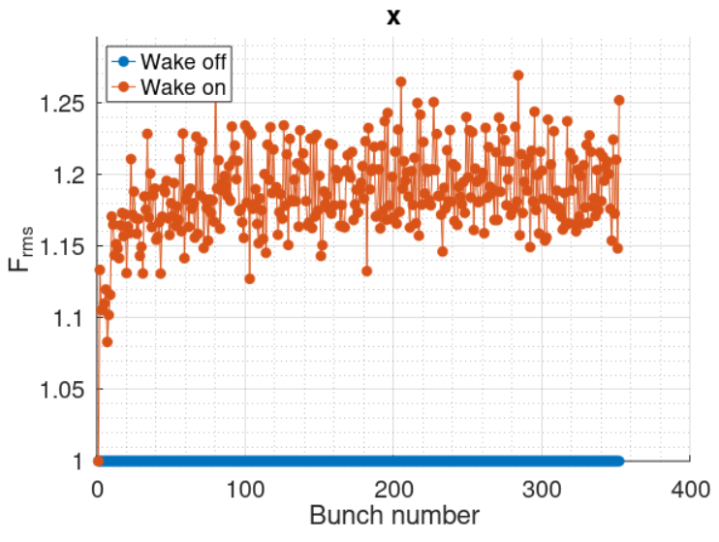
e- Injector Linac
Jitter amplifications (original wakefield from Adnan for 3 m structure)
Single particle tracking in RF-Track with 1.5 m structure.
Jitter amplification factor | x | y
Coherent (average) | 1.000 | 1.000
Coherent (maximum) | 1.023 | 1.023
Incoherent (average) | 1.186 | 1.062
Incoherent (maximum) | 1.269 | 1.109
Sum(|Wt|) = 9.86 V/pC/m/mm

Slide 6
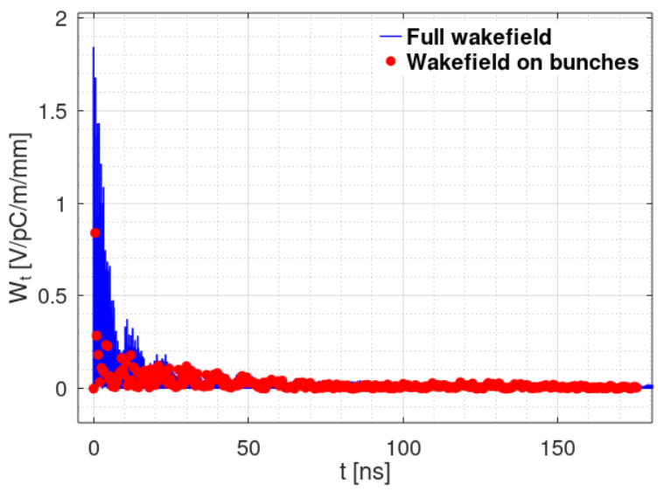
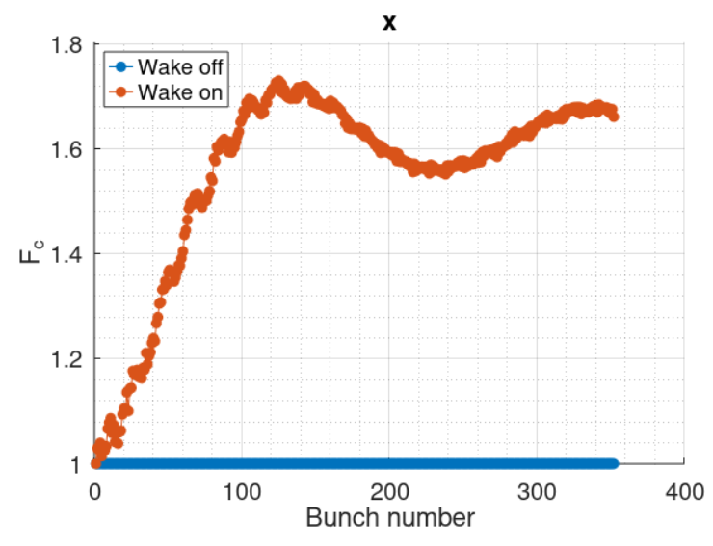
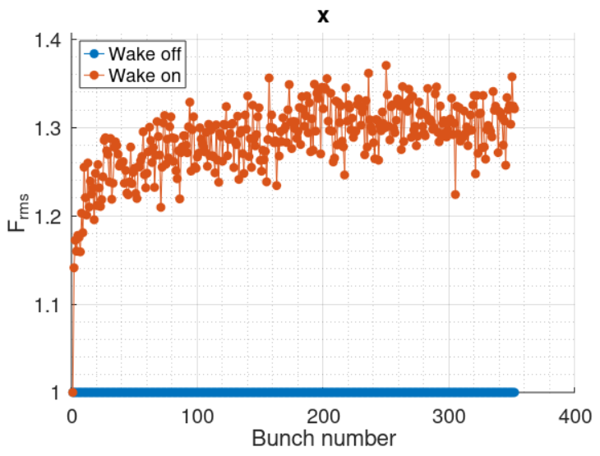
e- Injector Linac
Jitter amplifications (absolute wakefield)
Single particle tracking in RF-Track with 1.5 m structure.
Jitter amplification factor | x | y
Coherent (average) | 1.552 | 1.550
Coherent (maximum) | 1.731 | 1.729
Incoherent (average) | 1.287 | 1.113
Incoherent (maximum) | 1.370 | 1.166
Sum(|Wt|) = 9.86 V/pC/m/mm

Slide 7
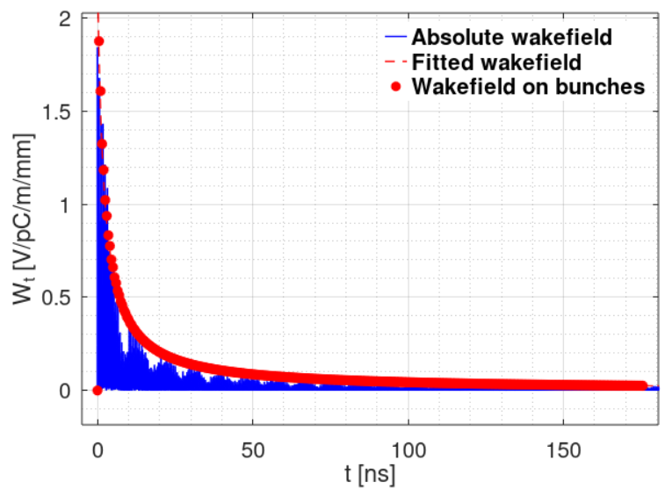
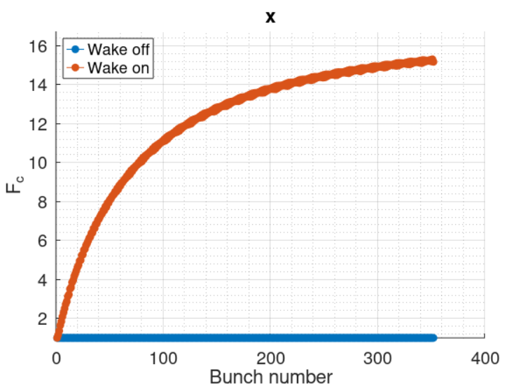
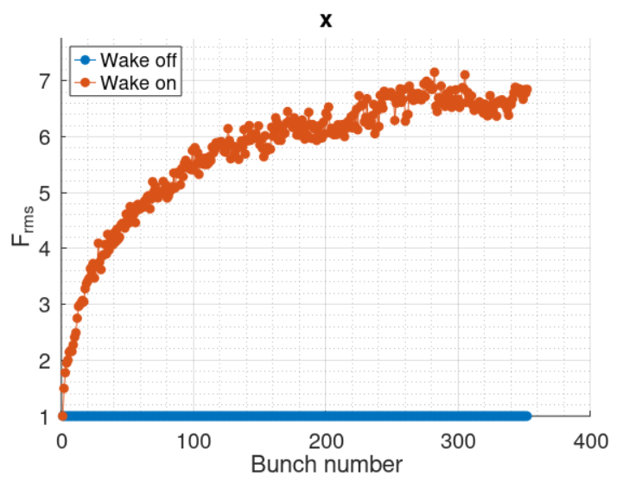

e- Injector Linac
Jitter amplifications (fitted absolute wakefield)
Fitting function:
$$W_{⊥(t)}=\frac{k}{1+\frac{t−T}{α}}=\frac{1.8 \text{V}\text{/}\text{pC}\text{/}\text{m}\text{/}\text{mm}}{1+\frac{t−T}{2.5 \text{ns}}}\text{, }t≥T=0.5 ns$$
Single particle tracking in RF-Track with 1.5 m structure.
Jitter amplification factor | x | y
Coherent (average) | 12.041 | 11.920
Coherent (maximum) | 15.304 | 15.112
Incoherent (average) | 5.730 | 4.827
Incoherent (maximum) | 7.154 | 6.096
Sum(|Wt|) = 39.87 V/pC/m/mm

Slide 8
e- Injector Linac
Imperfections and Beam-Based Alignment
Imperfections considered
  Position error (x, y): σ = 100 um
  Angular error (roll, pitch, yaw): σ = 100 urad
  BPM resolution: 1 um
  Following errors not considered for now:
    Magnatic strength error: σ = 0.1%
    RF gradient error: σ = 1%
    RF phase error: σ = 0.1°
    Beam position jitter (x, y): σ = 100 um
    Beam angular jitter (x’, y’): σ = 100 urad

Slide 9
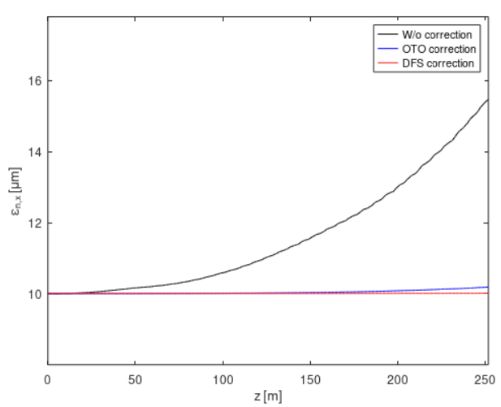
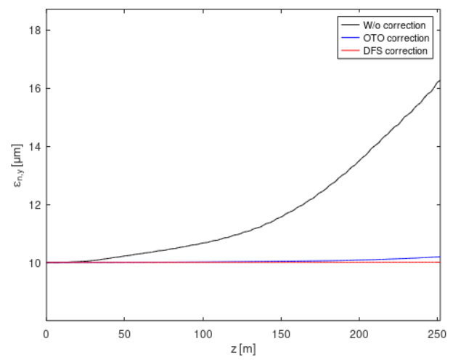
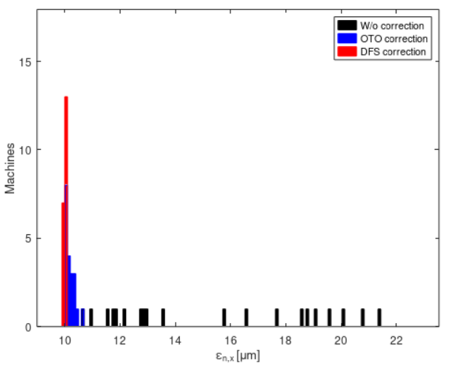
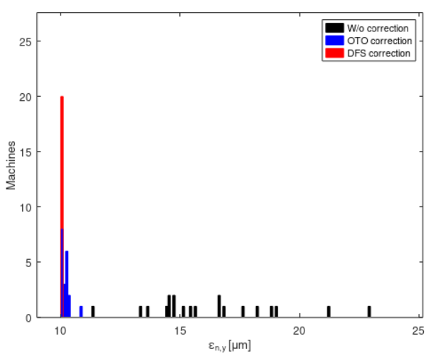
e- Injector Linac
Imperfections and Beam-Based Alignment
20 machines simulated for now.
Average emittance growths
Final emittances

Slide 10
Next steps
To do:
  Finalize e- Injector Linac study
  Restudy Positron Source for new layout
  Restudy RTML for new layout
  CLIC Project Meeting presentation
  IPAC’25 poster and paper

Slide 11
BACKUP

Slide 12
Design of new layout
Electron source
Electron source | Particle | Final energy | Simulation
DC e- Gun | Polarized e- | ~MeV | -
Thermionic e- Gun | Unpolarized e- | ~MeV | -
Polarized e- Pre-injector Linac | Polarized e- | 200 MeV | -
Unpolarized e- Pre-injector Linac | Unpolarized e- | 200 MeV | -
e- Injector Linac | Polarized e- Unpolarized e- | 2.86 GeV | RF-Track
Positron source:
PDR, DRs: not to simulate
SR, BC1, BL: included in RTML simulation

