Slide 1
LHC All Operation Availability Statistics 2024

Slide 2
Information I
These slides are a template to summarize availability of your machine in 2024. Please correct and complement the slides considering the following questions:
What are the main events & challenges impacting availability this year?
  Is this shown in the data, and does it match your expectations?
  Is any crucial aspect not visible in the data that should be pointed out?
What is the outlook for next year?
  Are you expecting interventions over YETS that might improve availability?
  It’s possible (though not sure) that bunch intensity will be increased in 2025. That could have an impact on availability. More…that choice may oblige a change of beam type (25 ns vs hyrid filling scheme), which may as well bring surprises for availability
  Could certain circumstances lead to an availability degradation?

Slide 3
Information II
There will be additional questions on each slide. Feel free to spread out comments over multiple slides as required
We only need reviews of 2024. Previous years are already well covered (e.g. see the Special RAWG on Accelerator Availability 2023, linked) https://indico.cern.ch/event/1340975/
All LHC faults this year can be found at:
https://aft.cern.ch/search?timePeriod=%257B%2522timePeriodType%2522%253A%2522fixed%2522%252C%2522startTime%2522%253A%252201012024000000%2522%252C%2522endTime%2522%253A%252201012025000000%2522%257D&accelerator=LHC&hadStates=BLOCKING_OP&excludedFaultStates=NON_BLOCKING_OP%252CUNDERSTOOD%252CSUSPENDED

Slide 4
Availability Schedule
Availability is counted over time periods as follows:
L4, PSB, PS, SPS: starts once beam is required by a downstream machine
L3, LEIR starts once beam is delivered to LHC
LHC starts with beam commissioning
ISOLDE, AD/ELENA, EAST, NORTH starts with respective physics period
LHC All Operations time periods are on the next page. Should these times be wrong, please correct them and let us know

Slide 5
LHC All Operations Periods
('05-04-2015 00:00:00','14-12-2015 00:00:00'),
('29-03-2016 00:00:00','05-12-2016 06:00:00'),
('01-05-2017 00:00:00','04-12-2017 06:00:00'),
('30-03-2018 00:00:00','03-12-2018 06:00:00'),
('26-04-2022 00:00:00','28-11-2022 09:30:00'),
('28-03-2023 00:00:00','30-10-2023 06:00:00'),
('08-03-2024 12:00:00','25-11-2024 06:00:00’) -> Not sure about the start date. If we consider beam commissioning in this (I would not, but it depends on how it is done historically) that would have to be 11.03, alternatively 05.04 (first SB) or 14th April (1200b -> start of physics production). END date is correct

Slide 6
2024 in Context
Does 2024 match your expectations? I’d say yes
What could be responsible for the observed trends? Best availability of Run3 (obvious), lower than second part of Run2, as running closer to the limit for Bunch intensity, heat load, magnets energy,…

Slide 7
System Downtime
Please elaborate on the main events and down time.
Can any trends be easily explained?
ONLY “visible” trend is increase in the QPS downtime, also clearly visible in both p and IONS separately. To be checked in details…

Slide 8
System Failure Rate
Are any mitigations foreseen?
How to you expect this to evolve in 2025?
Clear decrease of beam losses (thresholds adaptation + cleaner (BCMS beams vs hyrid)). Also small increase in OP, likely due to increase in sophistication of operation (combined levelling, more complicated MD?, to be checked, but may be fluctuation as it is very small)

Slide 9
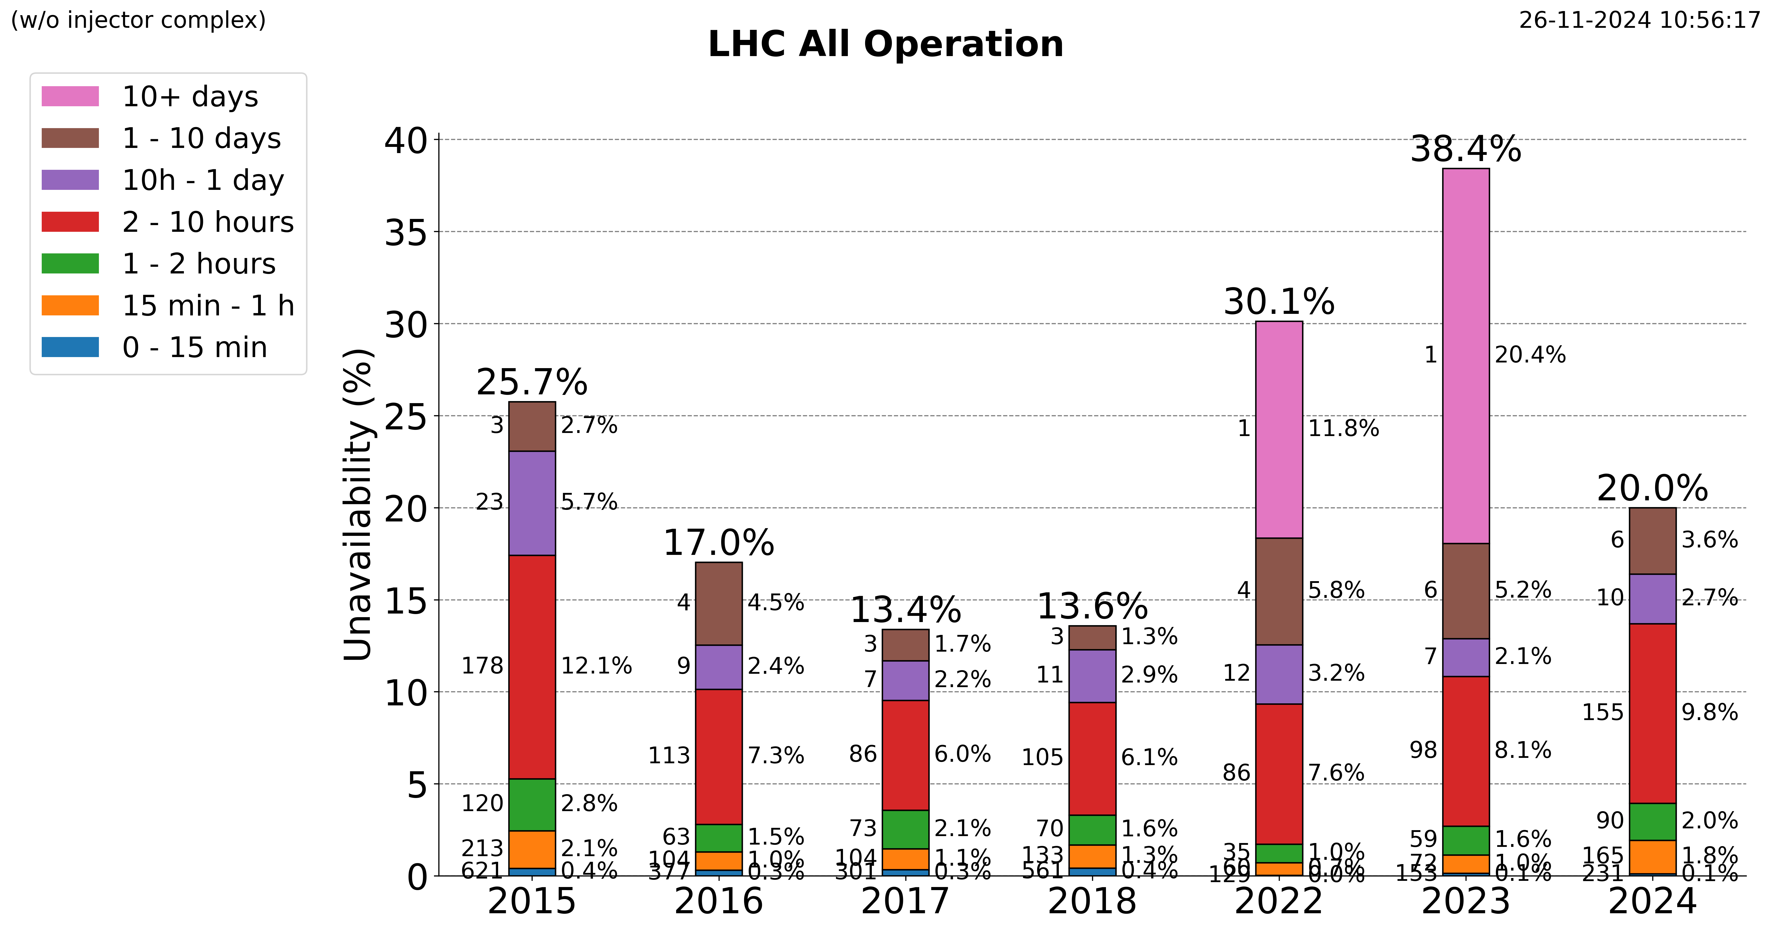
Unavailability by Duration
Do these trends match your expectations?
Any positive trends worth remarking?
Are any trends worrying?
In line with expectations! Worth mentioning that the 2 cryo events of IP8 (21 April and 10 October (which BTW are not mentioned below), accounting for a total downtime of ~60h) are likely SUE on the electronic installed in UL84
Mitigation is planned for the upcoming YETS!
Cryogenics, 23 Sep: Cold compressor could not restart after SVC trip, 2d 4h
Cryogenics, 21 Apr: Loss of 1.8K pumping unit in LHC-8, 1d 17h
Cryogenics, 27 Aug: QURCA-8 stop due to faulty pressure transmitter, 1d 13h
QPS, 23 Nov: FPA and following QPS induced quench of ~20 dipoles in S81, 1d 12h
Magnet Circuits, 10 May: Quench in sector 23 needed cryo recovery, 1d 4h
Other>Heat Load, 24 Apr: High heat load in S78 reached max capacity of cryo system at P8, 1d 3h

Slide 10
Summary & Conclusion
Main message and conclusion for 2024?
GREAT year, all working better than previous years, no large faults
Would you like us to provide AFT statistics for a specific problem in more detail?
Worth checking the constant increase over Run3 of downtime from QPS
What is the outlook for next year? Are there any availability problems expected unless they are addressed over the YETS?
See S2 plus comment on mitigation for P8 cryo electronics in S9
Desiderata for fault tracking and AFT tool?

Slide 11
Appendix – top 5 systems for unavailability
For additional information / interest.
We will follow up on specific equipment down time with the relevant experts separately, but feel free to comment if you see something.

Slide 12
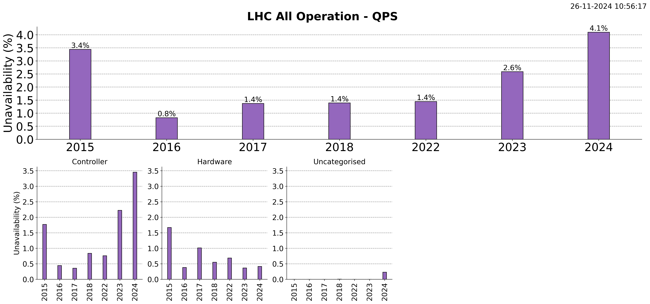

Slide 13
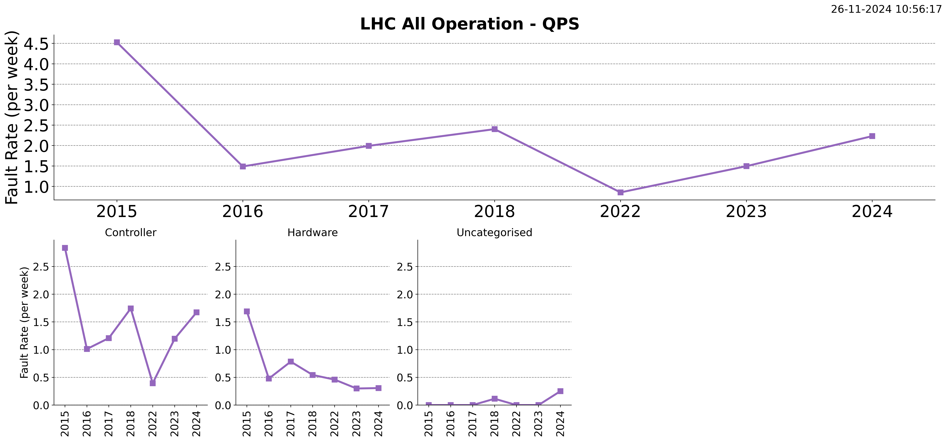

Slide 14
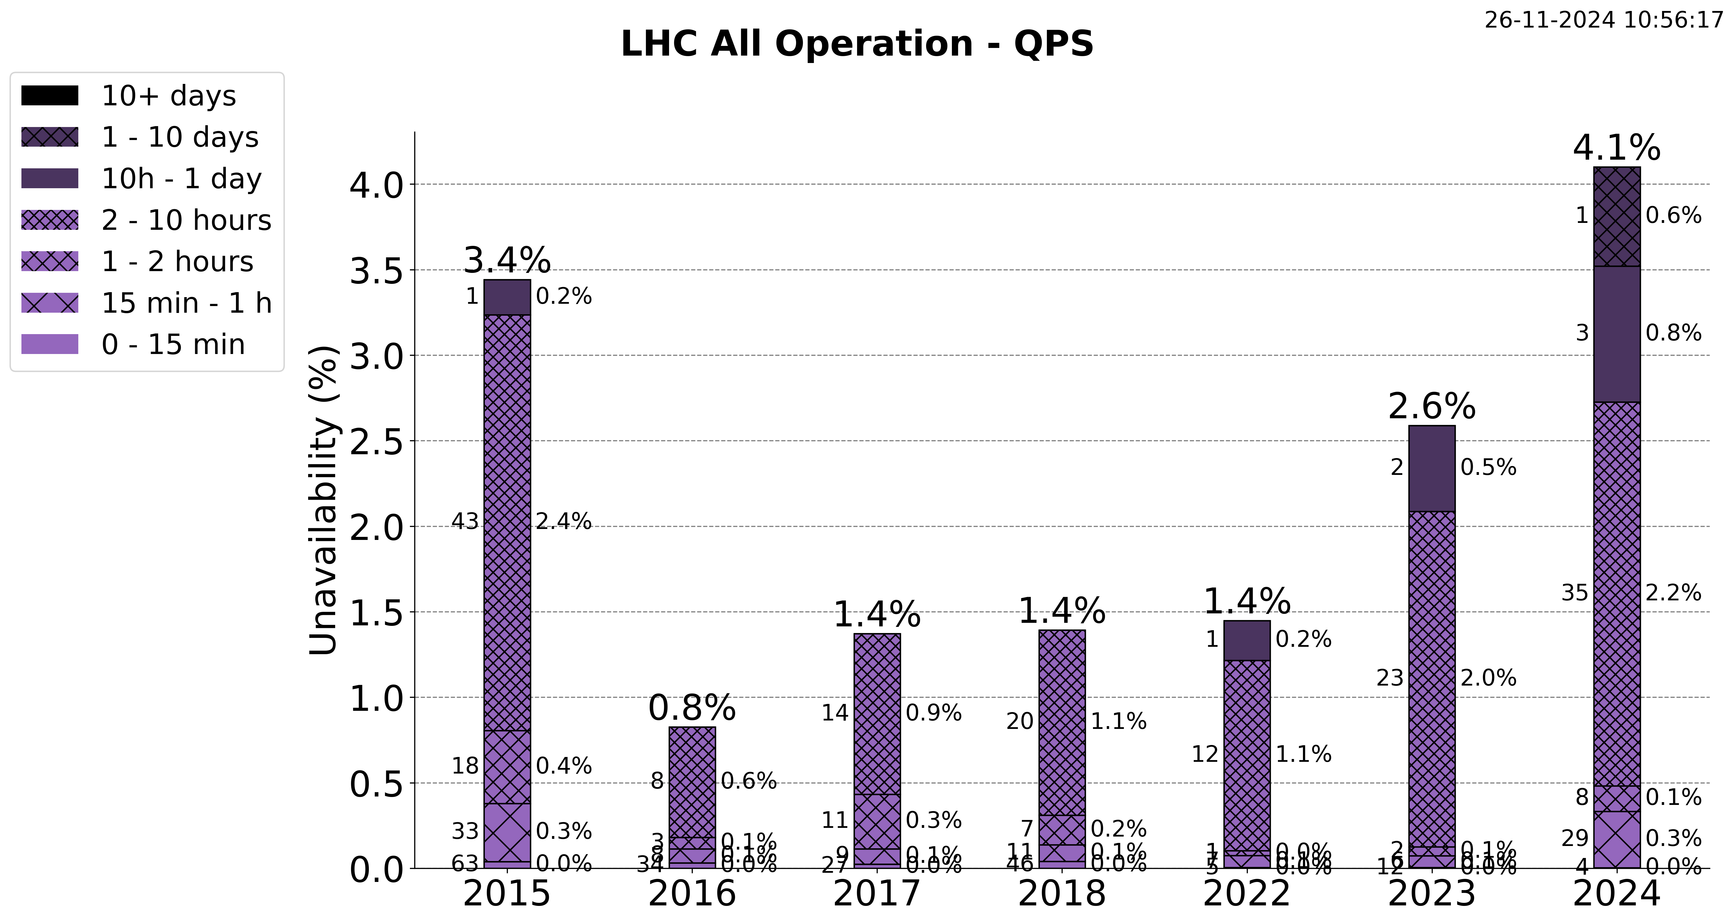

Slide 16
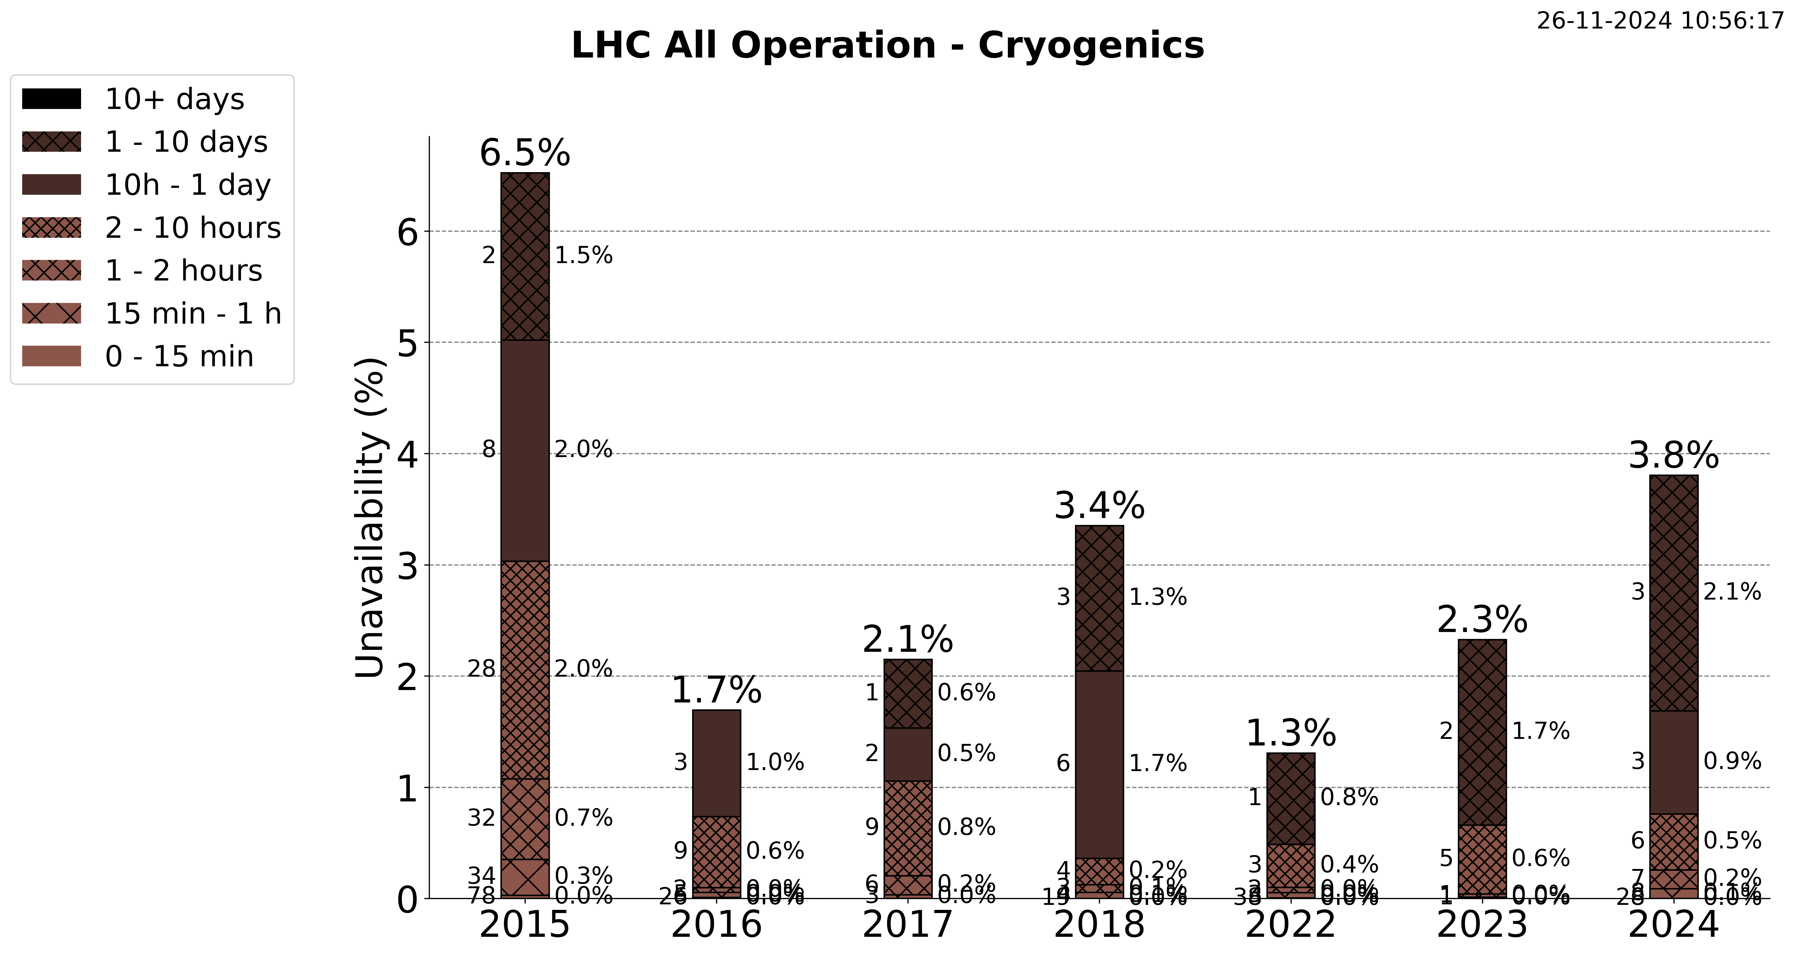

Slide 17
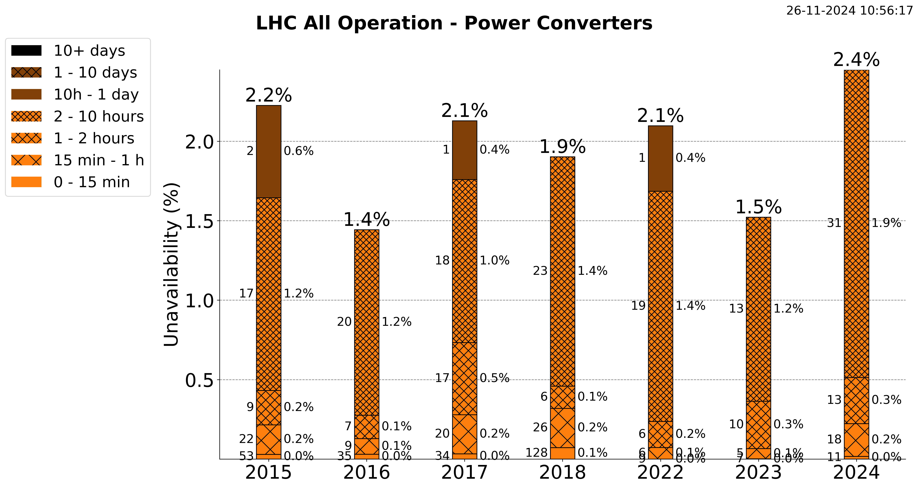

Slide 20
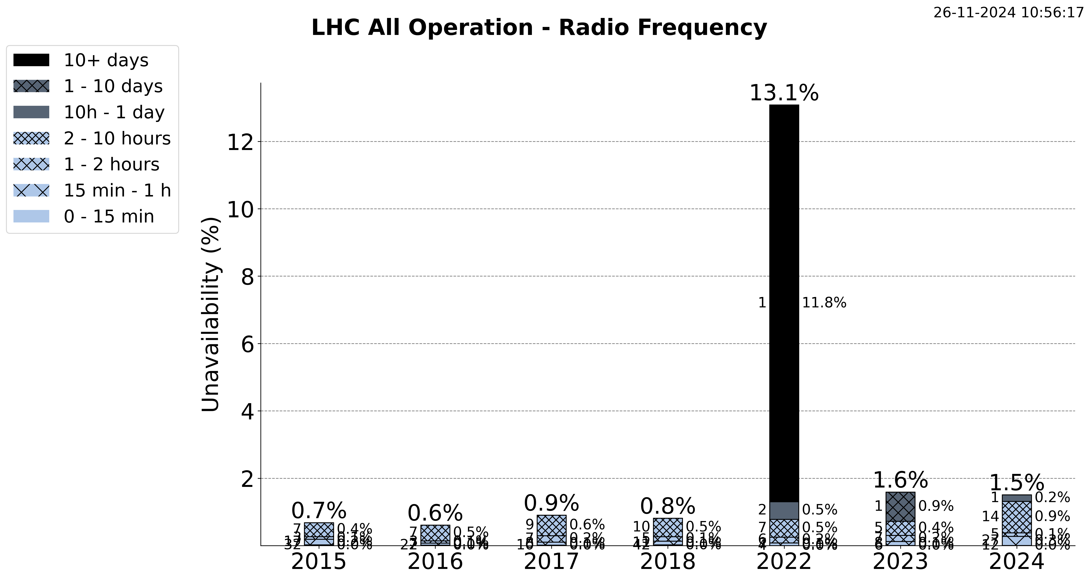

Slide 22
