Slide 1
Linac4 Availability Statistics 2024

Slide 2
Information I
These slides are a template to summarize availability of your machine in 2024. Please correct and complement the slides considering the following questions:
What are the main events & challenges impacting availability this year?
  Is this shown in the data, and does it match your expectations?
  Is any crucial aspect not visible in the data that should be pointed out?
What is the outlook for next year?
  Are you expecting interventions over YETS that might improve availability?
  Could certain circumstances lead to an availability degradation?

Slide 3
Information II
There will be additional questions on each slide. Feel free to spread out comments over multiple slides as required
We only need reviews of 2024. Previous years are already well covered (e.g. see the Special RAWG on Accelerator Availability 2023, linked) https://indico.cern.ch/event/1340975/
All LINAC4 faults this year can be found at:
https://aft.cern.ch/search?timePeriod=%257B%2522timePeriodType%2522%253A%2522fixed%2522%252C%2522startTime%2522%253A%252201012024000000%2522%252C%2522endTime%2522%253A%252201012025000000%2522%257D&accelerator=LINAC4&hadStates=BLOCKING_OP&excludedFaultStates=NON_BLOCKING_OP%252CUNDERSTOOD%252CSUSPENDED

Slide 4
Availability Schedule
Availability is counted over time periods as follows:
L4, PSB, PS, SPS: starts once beam is required by a downstream machine
L3, LEIR starts once beam is delivered to LHC
LHC starts with beam commissioning
ISOLDE, AD/ELENA, EAST, NORTH starts with respective physics period
Dedicated MDs and Technical Stops are excluded from availability monitoring.
LINAC4 time periods are on the next page. Should these times be wrong, please correct them and let us know

Slide 5
LINAC4 Physics Periods
('14-01-2021 09:00:00','21-04-2021 14:00:00'),
('22-04-2021 23:00:00','15-09-2021 05:00:00'),
('16-09-2021 11:00:00','15-11-2021 06:00:00'),
('21-02-2022 09:00:00','11-03-2022 08:30:00'),
('11-03-2022 12:00:00','17-05-2022 04:00:00'),
('17-05-2022 17:00:00','13-09-2022 08:00:00'),
('14-09-2022 12:00:00','28-11-2022 06:00:00'),
('03-03-2023 09:00:00','10-05-2023 08:00:00'),
('10-05-2023 12:00:00','20-06-2023 08:00:00'),
('21-06-2023 14:00:00','30-10-2023 07:30:00'),
('31-10-2023 18:00:00','13-11-2023 06:00:00'),
('15-02-2024 09:00:00','17-04-2024 08:00:00'),
('17-04-2024 17:30:00','12-06-2024 07:30:00'),
('14-06-2024 23:00:00','02-12-2024 06:00:00')

Slide 6
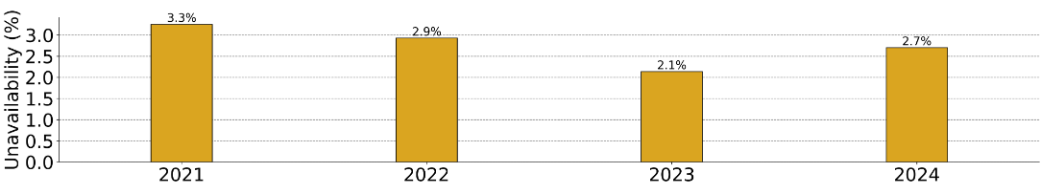
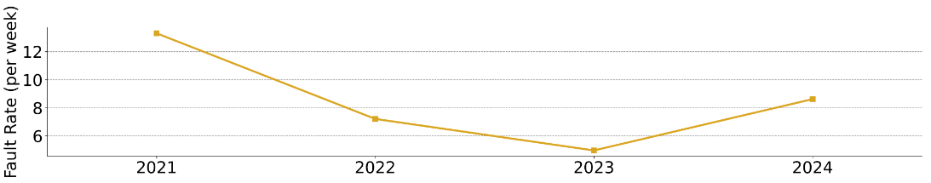
2024 in Context
Does 2024 match your expectations? Yes, as you will show later, the extra time in 2024 wrt 2023 is the CCDTL0304 klystron exchange. Btw a second klystron had to be exchanged for DTL1 but it happened during the TS, so it was transparent. All seems to indicate that we reached at steady state in performance with an expected availability for Linact4 from 97% to 98%.
What could be responsible for the observed trends? The klystron exchange is also associated with previous long stops (>10h like stops) for investigation on modulators, exchange of components, etc, etc. Moreover, this year we had suffered from important power cuts which required the source valve to be exchange twice causing degraded operation and several hours for the intervention.

Slide 7
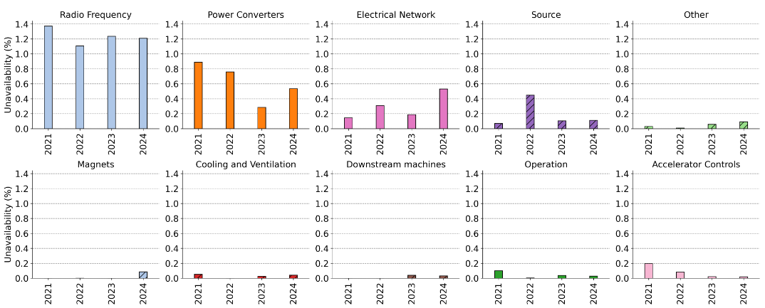
System Downtime
Please elaborate on the main events and down time.
Can any trends be easily explained?
New agreed way to share the faults
due to arc in klystron-modulator systems.
Any of this fault is now shared
between RF and EPC
2nd valve exchange. The one replaced in Sept, following
the power cut started misbehaving and the gas had to be pushed at the limit. Not operational conditions.
Intervention needed.
A couple of large power cuts, on top of the more conventional electrical glitches
Water leak on LT.BHZ30
MSC expert access.
Rare single events
A transformer in EAST area exploded and triggered general black-out. Long time to recover + Some double counting with the power cut fault

Slide 8
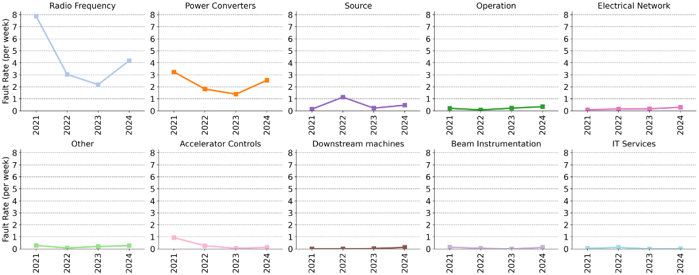
System Failure Rate
Are any mitigations foreseen?
How to you expect this to evolve in 2025?
Due to the fault sharing with RF.
The number of faults doubles for the same total downtime. Should remain as high as in 2024
2 valve exchanges and because of this, instabilities and fine tuning needed by the source expert in Sept-Oct and beginning Nov. Should go back down in 2023
Breakdown protection to all cavities, plus better identification of mis-pulses. In the past assigned to WD injection or others or BI. More short faults like 2-3 mins long. Probably will stau the same, between 3-5 per week.

Slide 9
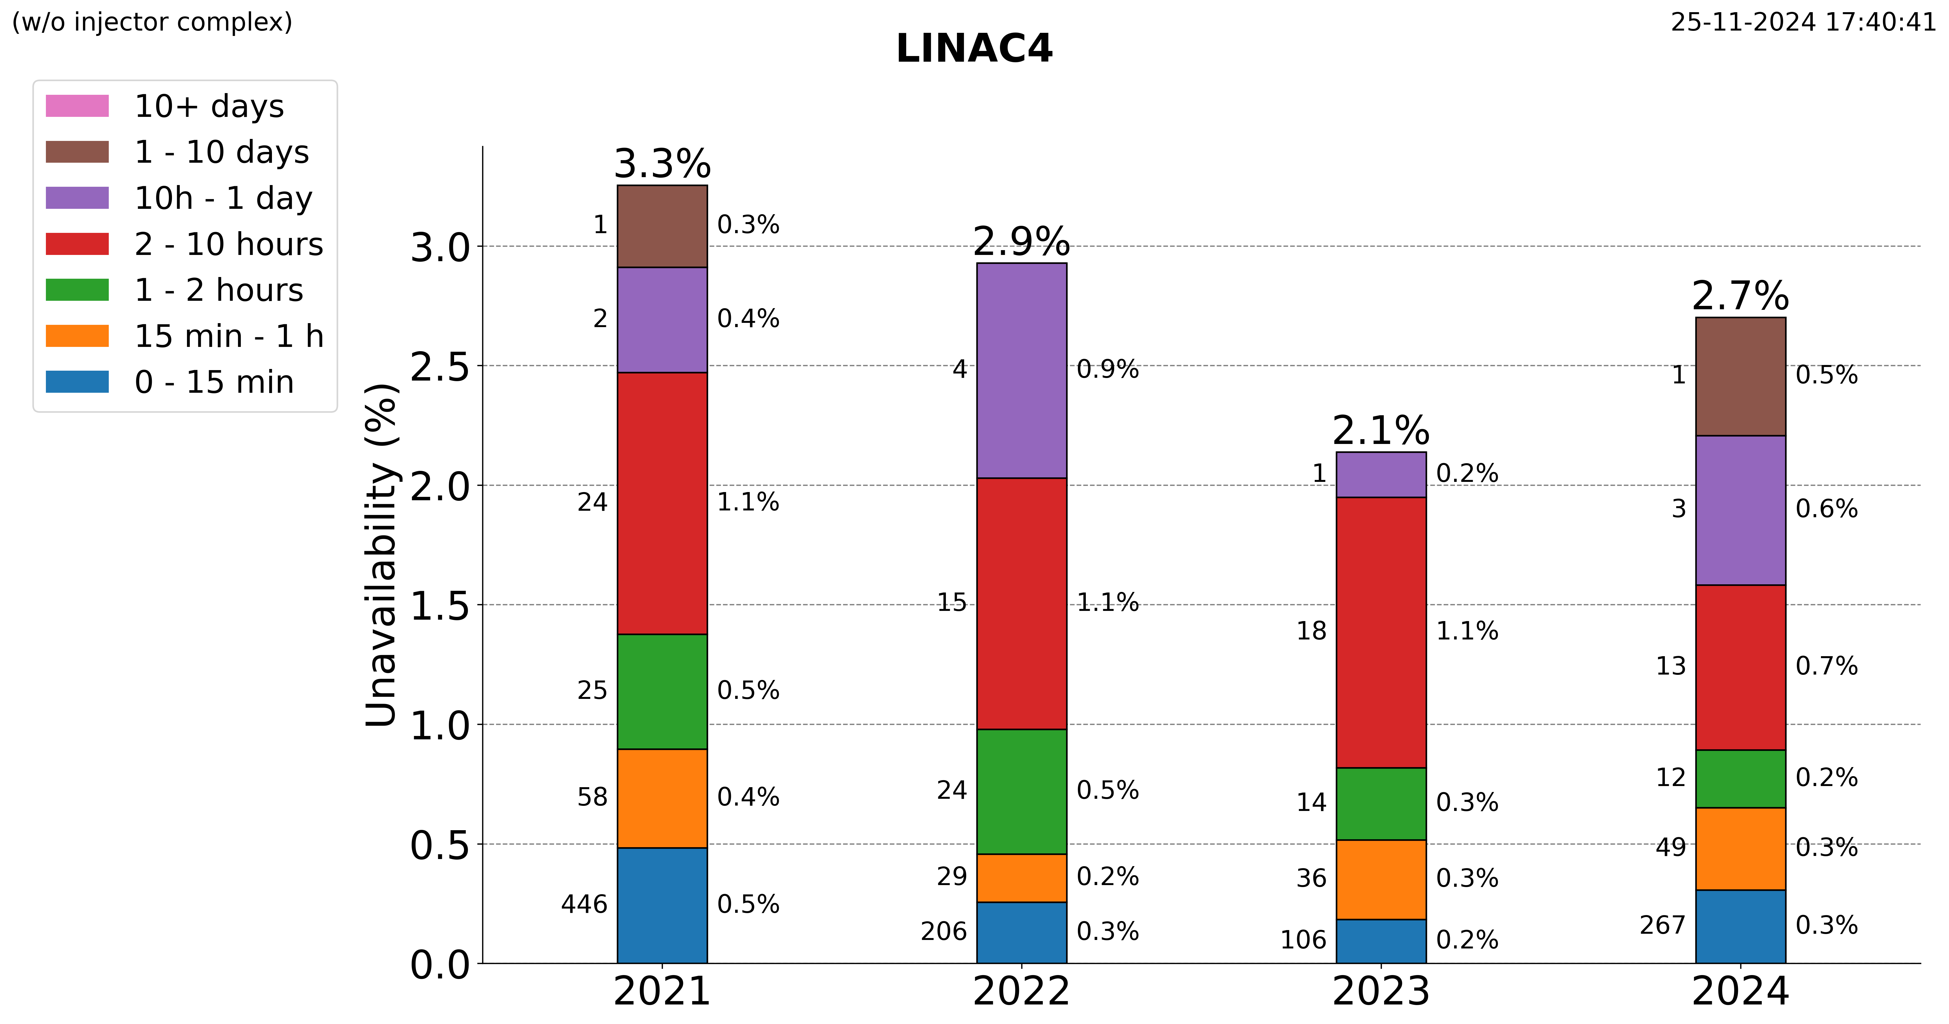
Unavailability by Duration
Do these trends match your expectations?
Any positive trends worth remarking?
Are any trends worrying?
Check the comments in the slides
CCDTL 3 Klystron exchange.
25th March
Notes:
If one removes the klystron exchange the availability remains compatible with 2023. Also a few more of 10-15h faults, due to power cut, exploding converters in EAST, valve exchange, so nothing really new under the sun.

Slide 10
Summary & Conclusion
Main message and conclusion for 2024?
  The Linac4 has reached a steady expected performance between 97-98%. The variation are mainly driven by single events, ie a klystron exchange, massive power cuts, valve issues, etc, etc which cannot be really anticipated.
Would you like us to provide AFT statistics for a specific problem in more detail?
  I would say nothing in particular
What is the outlook for next year? Are there any availability problems expected unless they are addressed over the YETS?
  The maintenance is always beneficial, e.g. for klystron. Otherwise we cannot anticipate the power cuts.
  For the valve, sometimes they are just not optimal, but that’s why we have commissioning and we are not supposed to change them during the run… it happens as a consequence of important electrical cuts.
Desiderata for fault tracking and AFT tool?
  Could the shown plots be generated from AFT in a report?

