Slide 1
AD Availability Statistics 2024
Accelerator Fault Statistics 2024, RAWG, 05.12.2024
1
Notes:
<number>

Slide 2
General comments
The plots have to be updated with the last week of operation: we had a couple of significant issue during the last week.
What are the main events & challenges impacting availability this year?
  Significant number of power cut affecting the hall complex with long recovery time (i.e. e-cooler filament)
  We had a couple of very long system un-availability of degraded mode wihich is not reflected in the statistic as we continue operation for most of the year in degraded mode
What is the outlook for next year?
  No significant change expected till LS3
  Systems are even more older and we can expect the same amount of failure even more
Accelerator Fault Statistics 2024, RAWG, 05.12.2024
2

Slide 3
Information I
These slides are a template to summarize availability of your machine in 2024. Please correct and complement the slides considering the following questions:
What are the main events & challenges impacting availability this year?
  Is this shown in the data, and does it match your expectations?
  Is any crucial aspect not visible in the data that should be pointed out?
What is the outlook for next year?
  Are you expecting interventions over YETS that might improve availability?
  Could certain circumstances lead to an availability degradation?
Accelerator Fault Statistics 2024, RAWG, 05.12.2024
3

Slide 4
Information II
There will be additional questions on each slide. Feel free to spread out comments over multiple slides as required
We only need reviews of 2024. Previous years are already well covered (e.g. see the Special RAWG on Accelerator Availability 2023, linked) https://indico.cern.ch/event/1340975/
All AD faults this year can be found at:
https://aft.cern.ch/search?timePeriod=%257B%2522timePeriodType%2522%253A%2522fixed%2522%252C%2522startTime%2522%253A%252201012024000000%2522%252C%2522endTime%2522%253A%252201012025000000%2522%257D&accelerator=AD&hadStates=BLOCKING_OP&excludedFaultStates=NON_BLOCKING_OP%252CUNDERSTOOD%252CSUSPENDED
Accelerator Fault Statistics 2024, RAWG, 05.12.2024
4

Slide 5
ADs Physics Periods
('30-04-2018 09:00:00','18-06-2018 09:00:00'),
('20-06-2018 09:00:00','17-09-2018 09:00:00'),
('19-09-2018 09:00:00','12-11-2018 06:00:00'),
('23-08-2021 09:00:00','15-09-2021 14:00:00'),
('16-09-2021 11:00:00','15-11-2021 06:00:00'),
('29-04-2022 09:00:00','17-05-2022 04:00:00'),
('17-05-2022 17:00:00','13-09-2022 08:00:00'),
('14-09-2022 12:00:00','28-11-2022 06:00:00'),
('30-06-2023 09:00:00','30-10-2023 07:30:00'),
('31-10-2023 18:00:00','13-11-2023 06:00:00'),
('22-04-2024 09:00:00','22-04-2024 23:00:00'),
('23-04-2024 07:00:00','23-04-2024 23:00:00'),
('24-04-2024 07:00:00','24-04-2024 23:00:00'),
('25-04-2024 07:00:00','12-06-2024 07:30:00'),
('14-06-2024 23:00:00','02-12-2024 06:00:00')
Delayed physics start due to magnet fault
Accelerator Fault Statistics 2024, RAWG, 05.12.2024
5

Slide 6
2024 in Context
Data do not reflect the degraded mode, non-availability of instruments, degraded mode of operation of the target and AD magnetic horn:
  downtime registered only for acces to try to fix the problems
Accelerator Fault Statistics 2024, RAWG, 05.12.2024
6

Slide 7
System Downtime
I think we should change the vertical scale to better see the data
Accelerator Fault Statistics 2024, RAWG, 05.12.2024
7

Slide 8
System Downtime
Significant increase of the AD e-cooler filament trips due to electrical perturbation or power cut:
  Long recovery time
Recurrent fault form last year:
  AD magnetic horn
  He level in BCCCA (non blocking, access needed to refill)
Problem with the magnetic horn:
  Same issue as end of last year
  Significant impact on availability but also on machine performance
Many trips of the e-cooler solenoid power supply (short duration) with big impact on availability: >8hours of beam setting-up needed after couple of event.
Many non-blocking faults with stochastic cooling (amplifiers and fualty relay) which does not really appears in statistics
Accelerator Fault Statistics 2024, RAWG, 05.12.2024
8

Slide 9
System Failure Rate
No significant change expected for 2025
Accelerator Fault Statistics 2024, RAWG, 05.12.2024
9

Slide 10
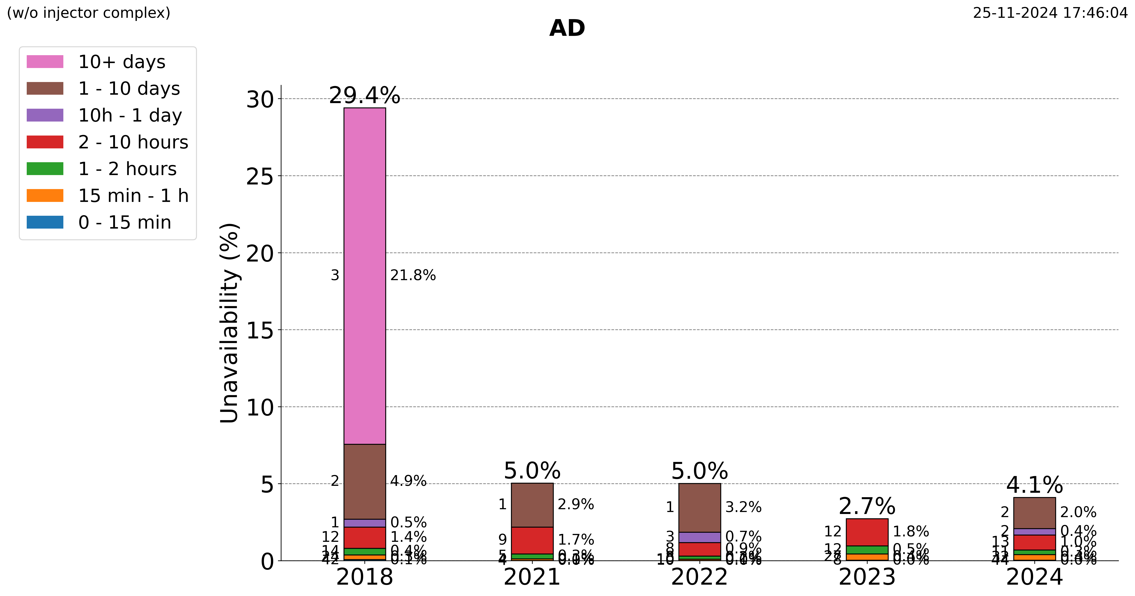
Unavailability by Duration
Do these trends match your expectations?
Any positive trends worth remarking?
Are any trends worrying?
10

Slide 11
Summary & Conclusion
Main issues coming from the same systems as last year: magnetic horn, problem with instrumentation
Increase number of events with electron cooler leading to long recovery time:
  E-cooler filament stops → 5 to 10 hours to ramp-up again
  Trip of the solenoid power supply: more than 8 hours to completely recover efficient cooling
Degraded performance due to non-blocking faults not appearing in the statistics (missing 1 C10 cavity, amplifiers of stochastic cooling, target non moving, bad relay in stochastic cooling)
Request for AFT next year: as AD is only used to fill ELENA, all fault affecting AD should be proagated by default to ELENA
Accelerator Fault Statistics 2024, RAWG, 05.12.2024
11

Slide 12
Summary & Conclusion
Main message and conclusion for 2024?
Would you like us to provide AFT statistics for a specific problem in more detail?
What is the outlook for next year? Are there any availability problems expected unless they are addressed over the YETS?
Desiderata for fault tracking and AFT tool?
Accelerator Fault Statistics 2024, RAWG, 05.12.2024
12

