Slide 1

Comprehensive introduction to WR
Maciej Lipinski
WR Collaboration / CERN
Training material

Slide 2
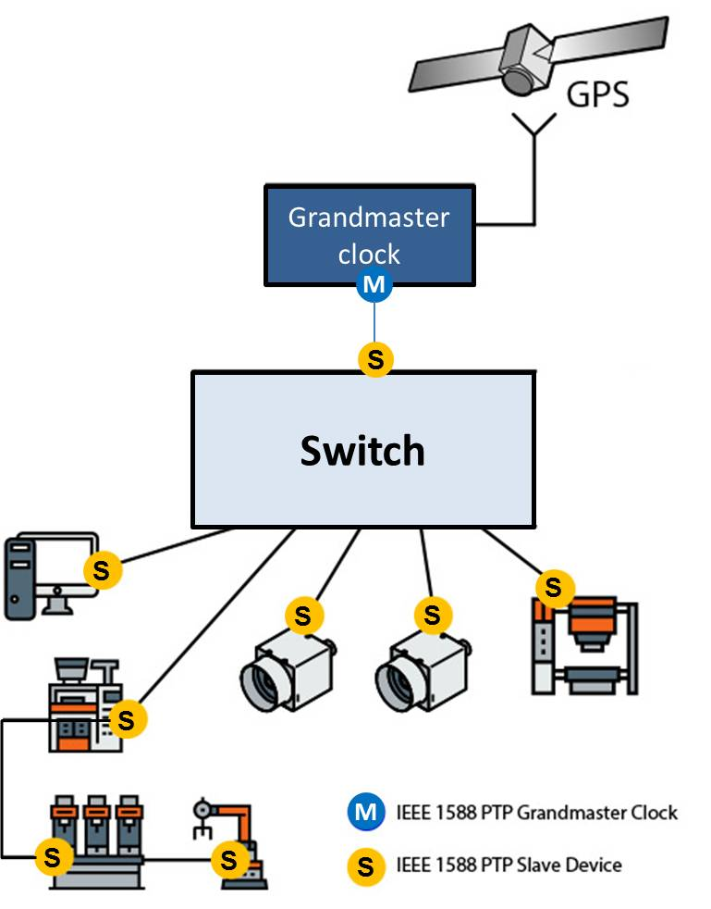
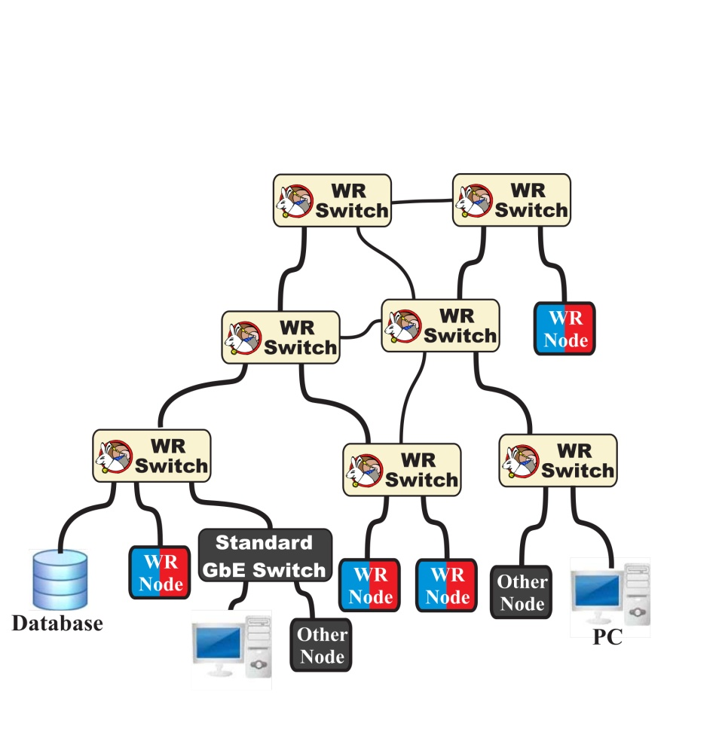
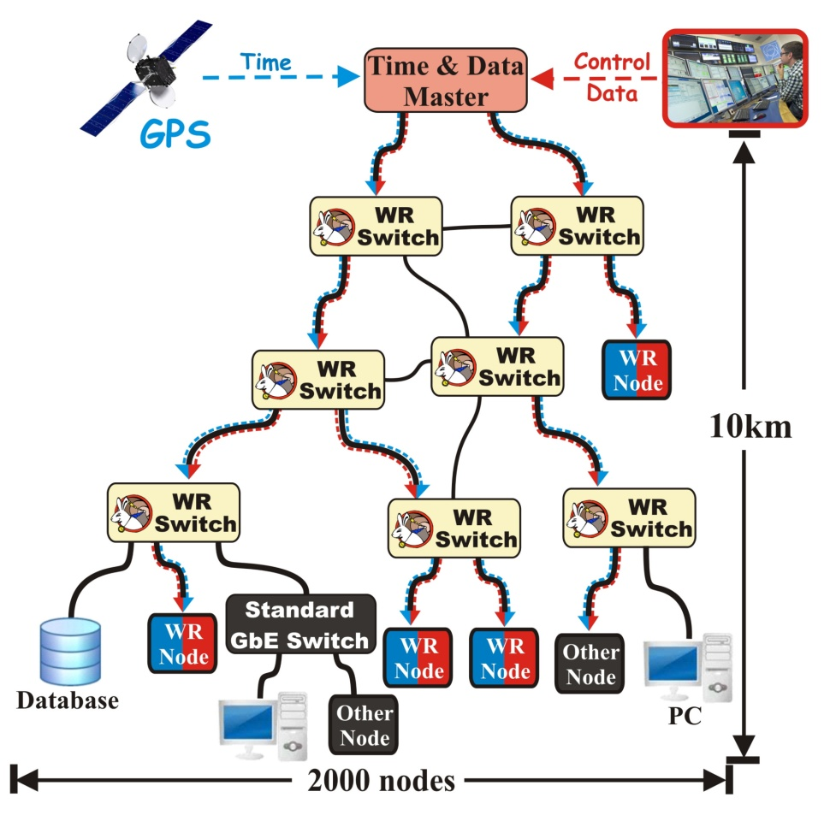
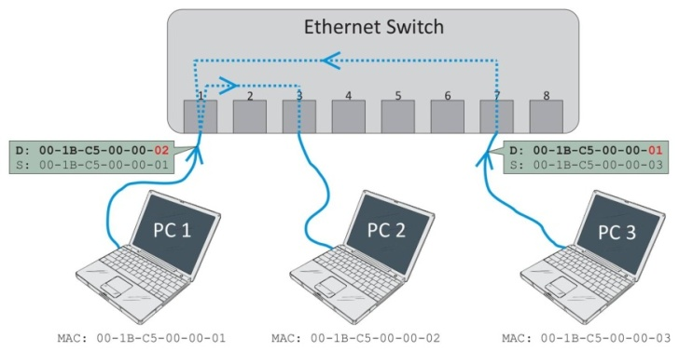
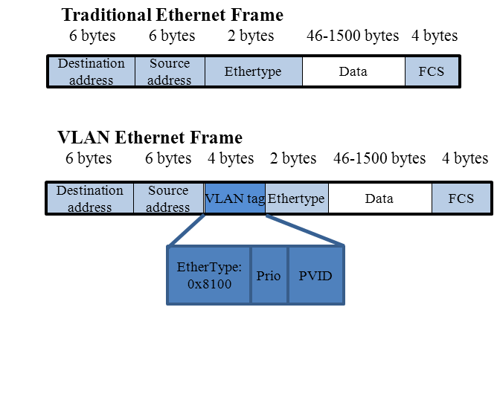
What is White Rabbit?
Based on well-established standards
  Ethernet (IEEE 802.3)
  Bridged Local Area Network (IEEE 802.1Q)
  Precision Time Protocol (IEEE 1588)
Extends standards to provide
  Sub-ns synchronisation
  Deterministic data transfer
Initial specs: 10km links and up to 2000 nodes
Plug and play
Open source & commercially available
Ethernet LAN with PTP Support

Slide 3
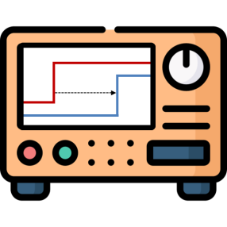
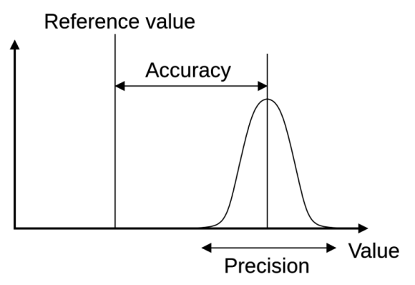
Synchronisation in a nutshell
11h50m00s
11h50m01s
Network
PPS
PPS

Slide 4






Synchronisation in a nutshell
11h50m00s
11h50m01s
Network
Accuracy
Light travels
To Moon
300 km
300 m
0.3m
0.3 mm
1s
1ms
1us
1ns
1ps

Slide 5
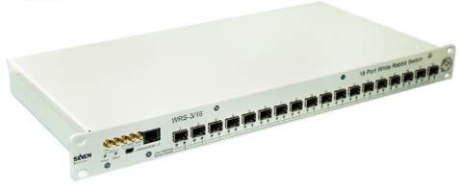
White Rabbit operation in a nutshell
White Rabbit = PTP + L1 syntonisation + phase detection + asymmetry correction
11h50m00s000000000.000ns
11h50m00s000000000.010ns
t₁
Precision Time Protocol
(PTP, IEEE 1588)
PTP limitations:
Free-running oscillators
Timestamp resolution
Symmetry assumption of
medium & hardware
t₂
(t₄ – t₁) – (t₃ – t₂)
2
t₃
Time_cor = + asym
t₄
t
Ethernet
t
Frequency
transfer
Enhance
delay measurement
thanks to common freq
Enhance
timestamp precision to ps level
by using phase detection techniques
Phase
detection
Phase offset with ps precision
Single bidirectional fiber
Link delay model
Calibration
Enhance
time corrections accuracy
by automatic medium asymmetry calculation and calibration of hardware delays
Asymmetry
corrections

Slide 6
White Rabbit operation in a nutshell
White Rabbit = PTP + L1 syntonisation + phase detection + asymmetry correction
11h50m00s000000000.000ns
11h50m00s000000000.010ns
t₁
Precision Time Protocol
(PTP, IEEE 1588)
PTP limitations:
Free-running oscillators
Timestamp resolution
Symmetry assumption of
medium & hardware
t₂
(t₄ – t₁) – (t₃ – t₂)
2
t₃
Time_cor = + asym
t₄
t
Ethernet
t
Frequency
transfer
Enhance
delay measurement
thanks to common freq
Enhance
timestamp precision to ps level
by using phase detection techniques
Phase
detection
Phase offset with ps precision
Single bidirectional fiber
Link delay model
Calibration
Enhance
time corrections accuracy
by automatic medium asymmetry calculation and calibration of hardware delays
Asymmetry
corrections

Slide 7
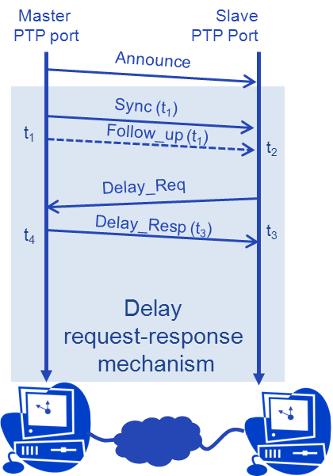
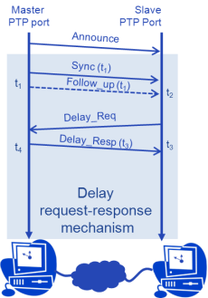
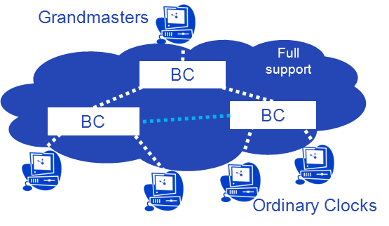
PTP overview
Packet-based hierarchical time-transfer protocol
PTP messages exchanged (relevant for WR)
  Announce
    Information needed to establish timing hierarchy (next slide)
  Delay Request-response mechanism
    Sync, Delay_Req, Delay_Resp, Follow_up (for two step)
    Used to calculate delay and offset on the slave side
  Optional: Signaling
    Used to pass information for optional features
Type-Length-Value (TLV) extension mechanism
  Used to pass information for optional features
  Can be attached to any time of PTP Message
Hierarchical distribution with master-slave hops
  Grandmaster – single source of time for entire network
  Boundary Clock – relies time downstream
  Ordinary Clock – consumer of time
(t₄ – t₁) – (t₃ – t₂)
2
Time_cor =

Slide 8

Timing Hierarchy
Two mechanisms in PTP to establish timing hierarhcy
Best Master Clock Algorithm (BMCA)
  Based on information from Announce and local config
  Distance-vector algorithm run individually on each devices
  Selects one Grandmaster for entire network
  Recommends state of each port:
    Master (transmitting time)
    Slave (receiving time)
    Passive (redundant)
  Dynamic reconfiguration when network changes,
  can take many seconds
External port configuration
  Manual configuration of each port state, via management
  Static, no dynamic reconfiguration
  No handling of mis-configuration
Grandmasters
M
P
S
M
BC
M
S
S
M
BC
M
P
BC
M
M
S
S
P
S
S
Ordinary Clocks (OCs)

Slide 9
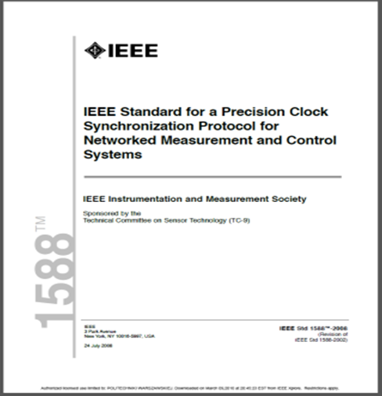
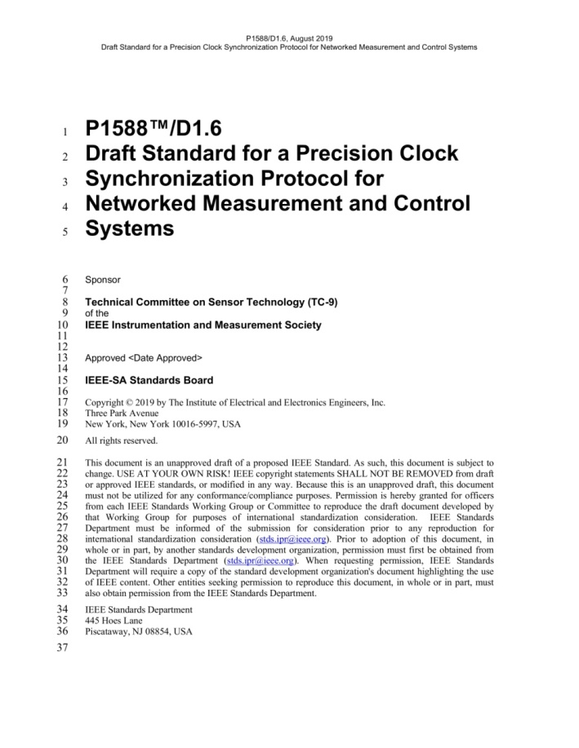
PTP Optional Features and Profiles

Slide 10
PTP Optional Features and Profiles
“Synchronisation framework”
“Extensible &
parameterised
core”
(attributes,
delay mechanism)
Optional parts
(optional features)

Slide 11
PTP Optional Features and Profiles
“Synchronisation framework”
“Extensible &
parameterised
core”
(attributes,
delay mechanism)
Transport mappings
Optional parts
(optional features)
Informative Annexes

Slide 12

PTP Optional Features and Profiles
“Synchronisation framework”
Telecom
“Extensible &
parameterised
core”
(attributes,
delay mechanism)
Profile: delay mechanism, attribute values & optional features
PTP
Applications
Transport mappings
Optional parts
(optional features)
Informative Annexes
Power

Slide 13
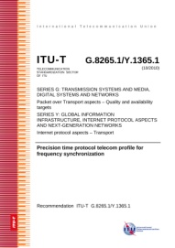

PTP Optional Features and Profiles
“Synchronisation framework”
Telecom
“Extensible &
parameterised
core”
(attributes,
delay mechanism)
ITU-T Profiles
Profile: delay mechanism, attribute values & optional features
PTP
Applications
Transport mappings
Optional parts
(optional features)
Informative Annexes
IEEE/IEC Profiles
Power

Slide 14
PTP Optional Features and Profiles
“Synchronisation framework”
Default PTP Profiles:
Delay Req-Resp
Peer-to-peer
High Accuracy
Telecom
“Extensible &
parameterised
core”
(attributes,
delay mechanism)
Profile: delay mechanism, attribute values & optional features
PTP
Applications
Transport mappings
Optional parts
(optional features)
Informative Annexes
Power

Slide 15

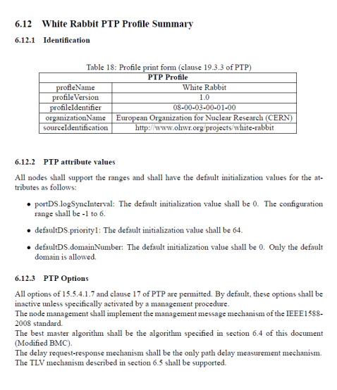
Original WR-PTP Extension and Profile (1)
Specified in: White Rabbit Specification: Draft for Comments, version 2.0, 2011
Defines WR extensions to PTP Protocols
  WR-specific Data Set Fields
  Modified BMCA – obsolete
  WR TLVs attached to Announce and Signaling messages
  User-defined events in PTP State Machine
  WR State Machine
Defines WR-PTP Profile
  Uses the WR extensions
  Uses CERN OUI (“unofficial PTP Profile)
Describes:
  Link Delay Model
  Delay Asymmetry Calculations
  Hardware Support
  https://white-rabbit.web.cern.ch/documents/WhiteRabbitSpec.v2.0.pdf

Slide 16
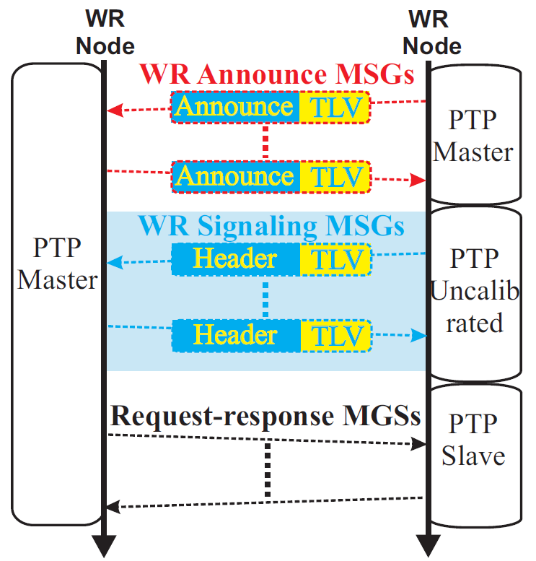
Original WR-PTP Extension and Profile (2)
WR Announce:
  Includes WR TLV
  Recognition of WR devices
WR Link setup
  Recognition of compatible WR config
  Frequency locking
  Calibration - obsolete
  Exchange of WR-parameters
Request-response mechanism
  Sub-ns part of timestamp exchanged in correctionField
  Nothing specific to WR
WR Link
Setup
Divergences from the published from the WR Spec v2.0:
The value of magic number in WR TLVs is 0xDEAD (not 0xABCD)
WR state timeouts specified for each WR state
The modified BMCA specified in 6.4 is NOT used, WR devices use
  Default BMCA (“auto” mode), or
  Fixed Port state (Master or Slave)

Slide 17
High Accuracy Default PTP Profile (HA PTP Profile)
“Synchronisation framework”
Default PTP Profiles:
Delay Req-Resp
Peer-to-peer
High Accuracy
Default PTP Profile included in 2019 edition
Based on WR-PTP Profile and WR extension
Compatible with other Default PTP Profiles
Standardisation project and details:
https://ohwr.org/projects/wr-std/wiki/wrin1588
IEEE 1588 PTP Std 2019 edition :
https://standards.ieee.org/ieee/1588/6825
“Extensible &
parameterised
core”
(attributes,
delay mechanism)
Profile: delay mechanism, attribute values & optional features
Transport mappings
Optional parts
(optional features)
Informative Annexes

Slide 18
Components of HA PTP Profile
HA-specific optional features
(active by default)
IEEE1588
“Core”
Generic optional features
(inactive by default)
Modify
BMCA
Calculation of the delayAsymmetry (16.8)
L1 Sync
(Annex L)
Enhance
Mechanism for external configuration
(17.6)
master Only
Mode
(9.2.2.2)
Configurable correction of timestamps (16.7)
Requires and specifies
default/allowed values
Defines attributes
and mechanisms
Requires and specifies
default/allowed values
High Accuracy Request-Response Default PTP Profile
(Annex I.5)
Informative annex describes Calibration Procedures to be used with the HA Default PTP Profile to allow sub-ns accuracy of synchronization
Informative annex describes HA Profile
implementation that provides
sub-ns accuracy of synchronisation
Calibration Procedures
(Annex N)
Sub-ns synchronisation using High Accuracy Default Profile (Annex M)

Slide 19
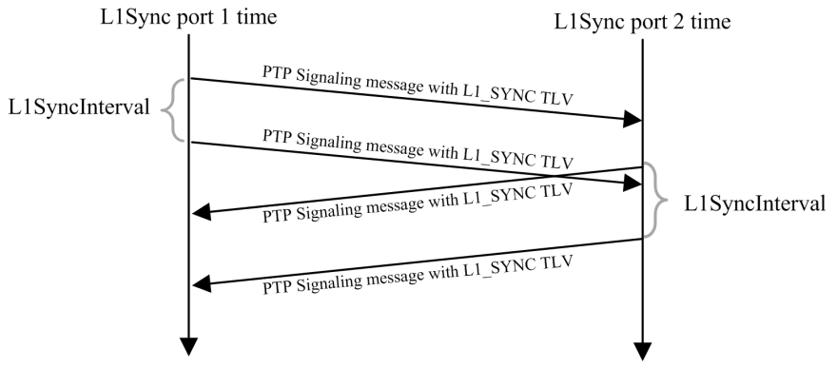
L1Sync optional feature (extension)
  Data sets: storing config & status
  L1_SYNC TLVs:
    Detection of L1Sync-supporting PTP Ports
    Exchange of config/status/parameters
  FSM: control of establishing of frequency transfer
  (syntonization)
  Improvements with respect to WR-PTP
    Exchange of information all the time
    (not only at the beginning)
    Formalized and more flexible relationship between
      PTP-based time transfer
      L1-based frequency transfer

Slide 20
WR-PTP vs. HA-PTP
  Protocol-viewpoint: incompatible
  Hardware-viewpoint: no difference
  Detailed comparison: htps://ohwr.org/project/wr-std/-/wikis/wrin1588
  WR Switches:
    Implement and support WR-PTP and HA-PTP
    Support auto-negotiation between WR-PTP and HA-PTP
  WR Nodes:
    Implement WR-PTP and HA-PTP but support only one at a time (limited space)

Slide 21
White Rabbit operation in a nutshell
White Rabbit = PTP + L1 syntonisation + phase detection + asymmetry correction
11h50m00s000000000.000ns
11h50m00s000000000.010ns
t₁
Precision Time Protocol
(PTP, IEEE 1588)
PTP limitations:
Free-running oscillators
Timestamp resolution
Symmetry assumption of
medium & hardware
t₂
(t₄ – t₁) – (t₃ – t₂)
2
t₃
Time_cor = + asym
t₄
t
Ethernet
t
Frequency
transfer
Enhance
delay measurement
thanks to common freq
Enhance
timestamp precision to ps level
by using phase detection techniques
Phase
detection
Phase offset with ps precision
Single bidirectional fiber
Link delay model
Calibration
Enhance
time corrections accuracy
by automatic medium asymmetry calculation and calibration of hardware delays
Asymmetry
corrections

Slide 22
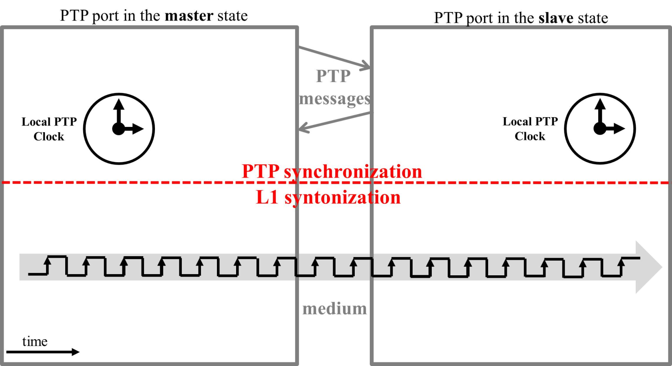
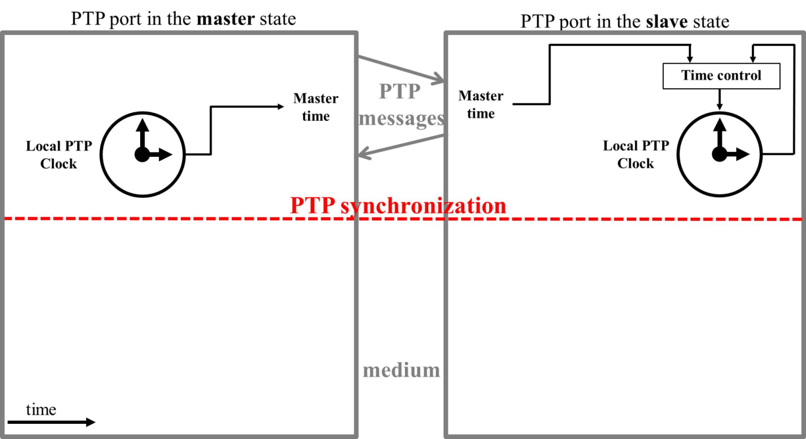
PTP synchronization vs. L1 Syntonization
Typical PTP implementation:

Slide 23
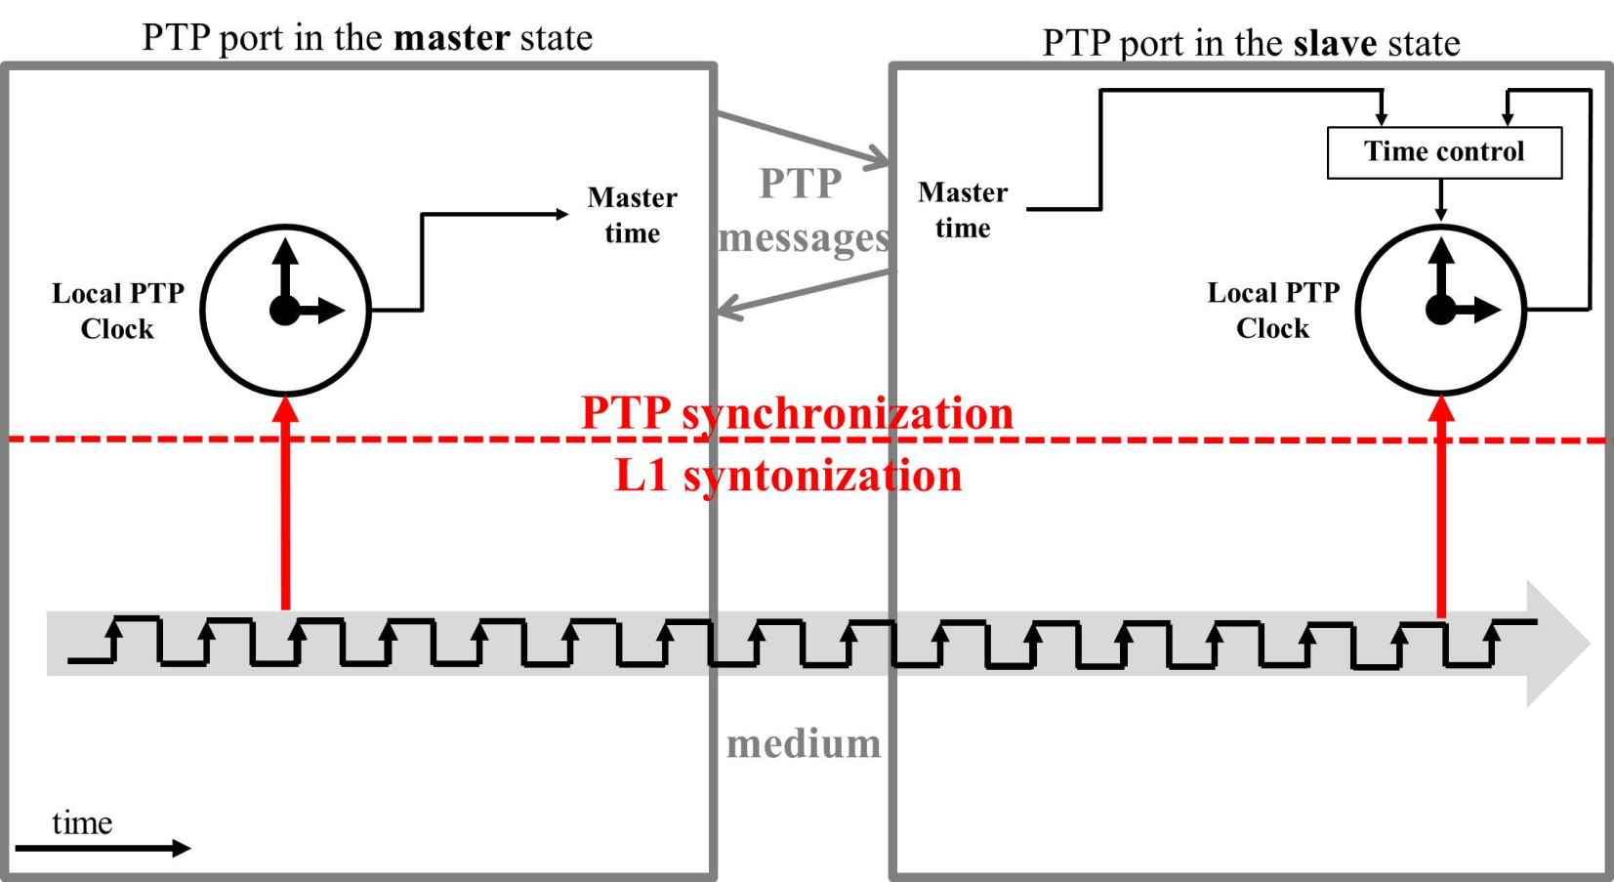
PTP synchronization vs. L1 Syntonization
G.8275.1: PTP telecom profile for time/phase with full support
(SyncE)

Slide 24
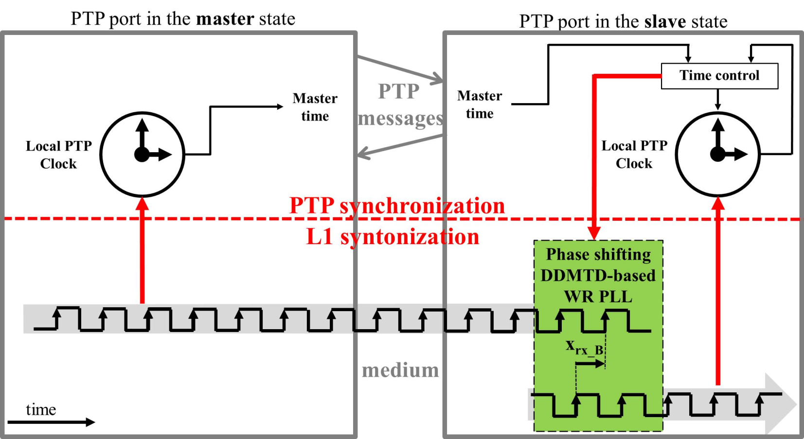
PTP synchronization vs. L1 Syntonization
White Rabbit / High Accuracy Default PTP Profile:

Slide 25
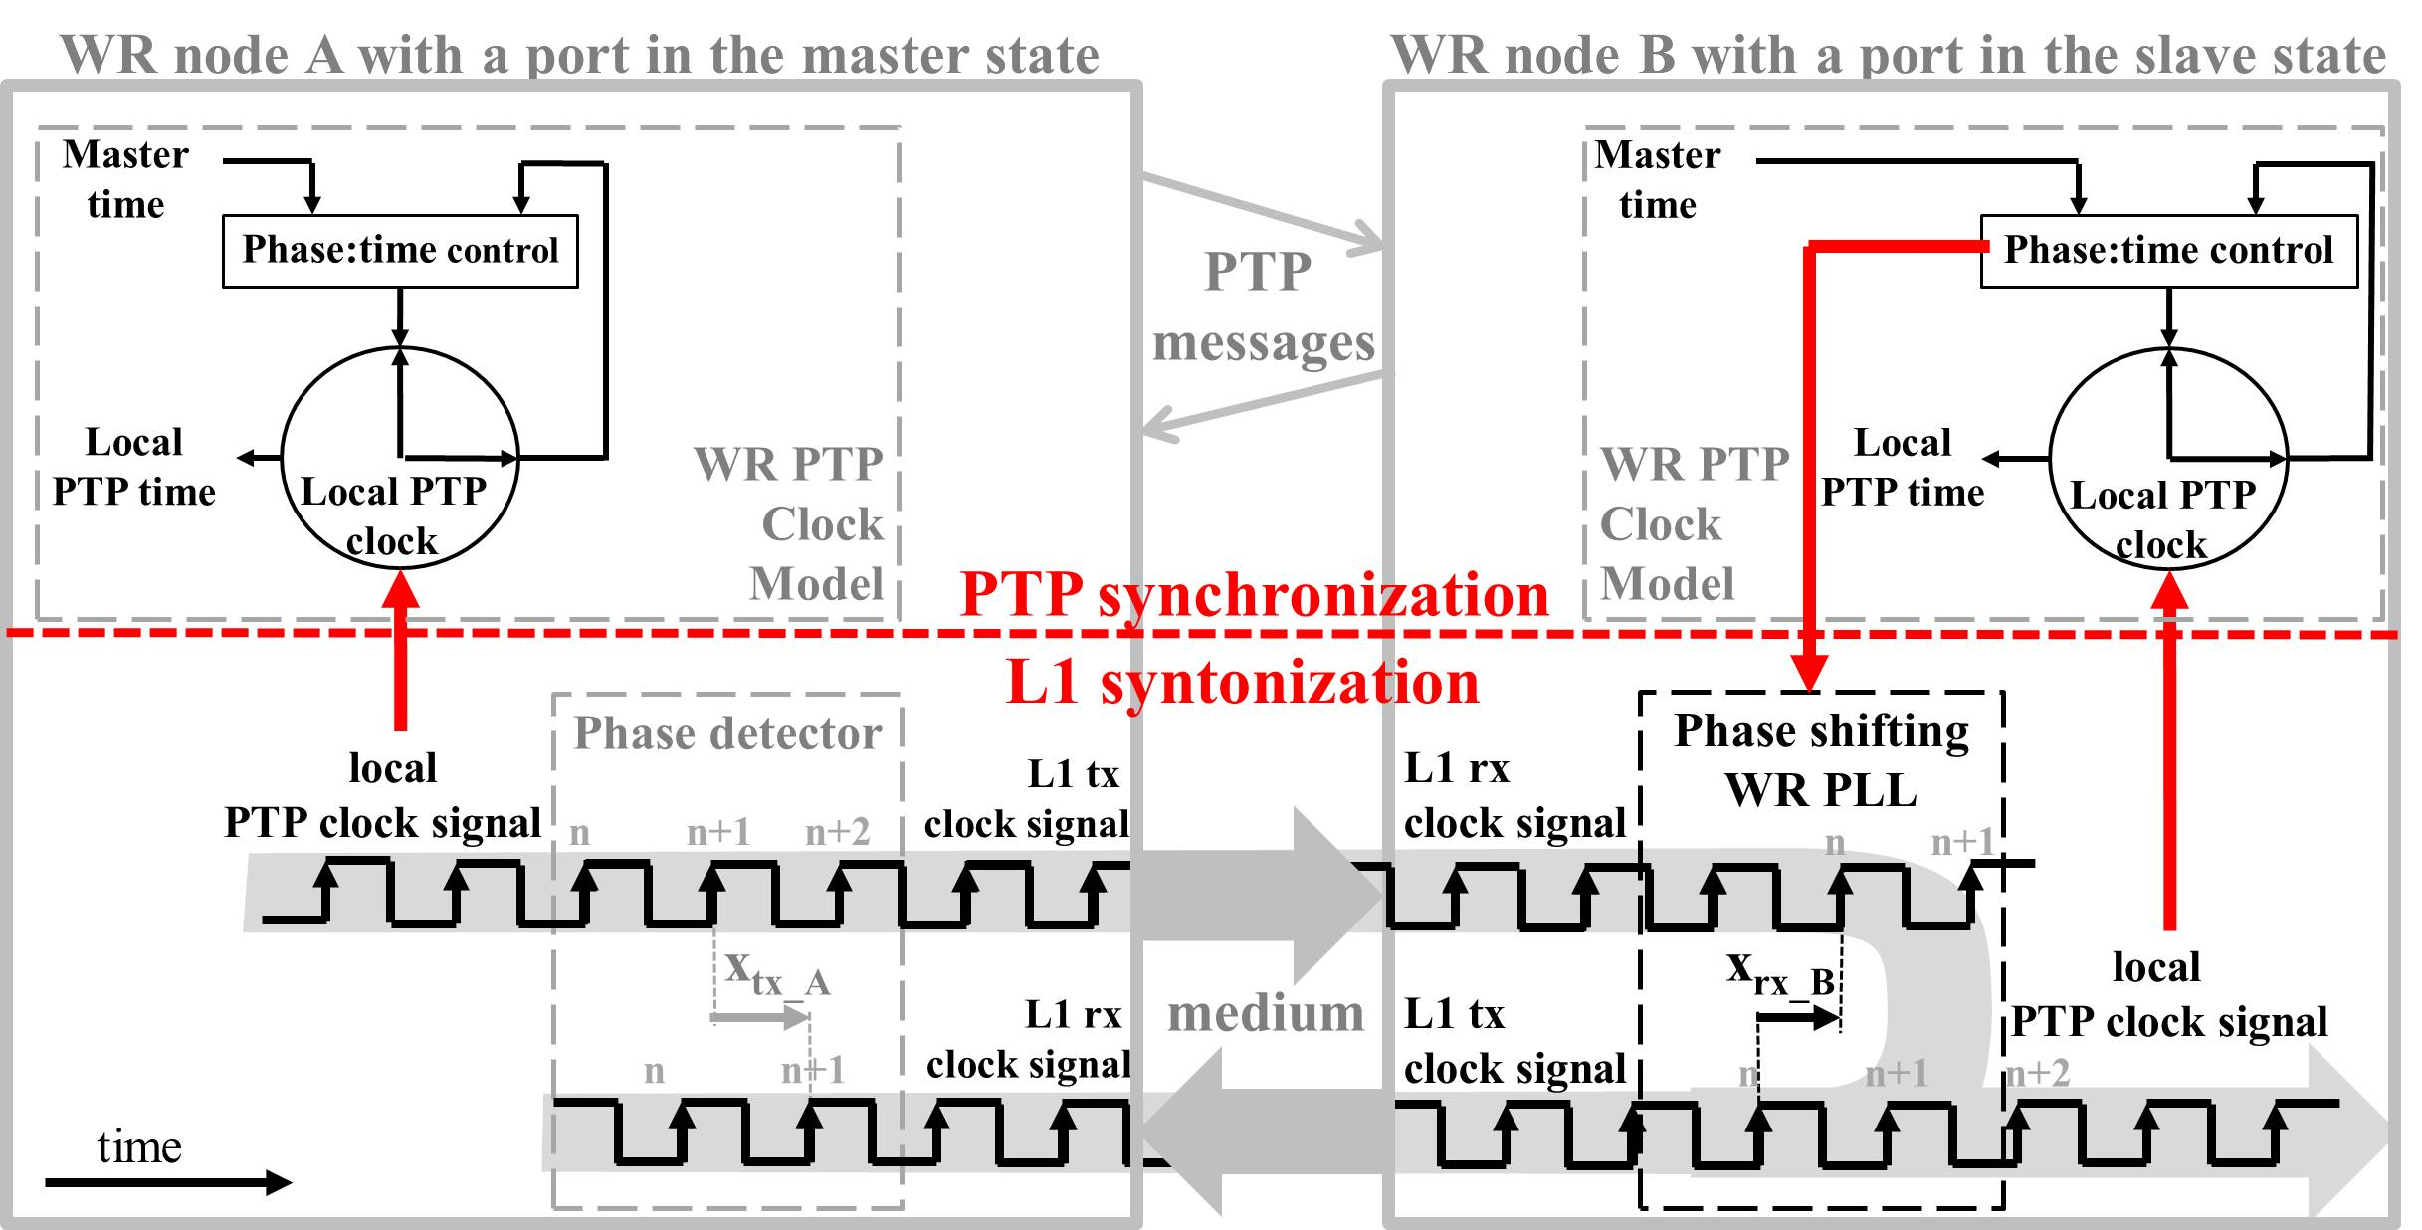
PTP synchronization vs. L1 Syntonization
White Rabbit / High Accuracy Default PTP Profile - detailed:

Slide 26
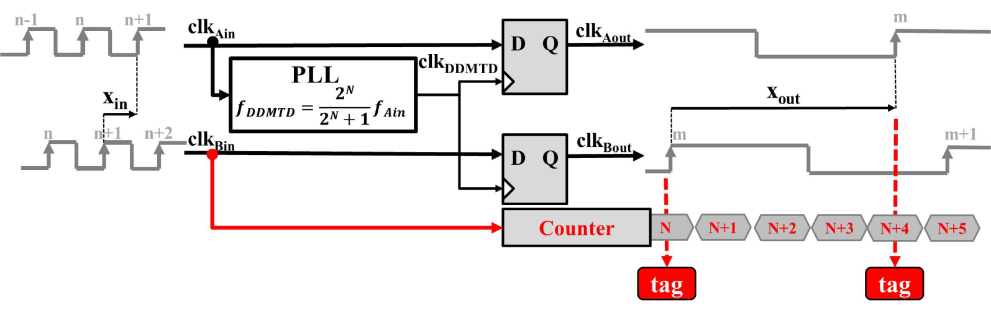
Phase detection
Digital Dual Mixer Time Difference (DDMTD)
Clever implementation of a phase detector in an FPGA
WR parameters:
  clkin = 62:5 MHz
  clkDDMTD = 62:496185 MHz (N=14)
  clkout = 3:814 kHz
Uses D-flip-flops to zoom-in phase offset
Allows for phase measurements at picosecond level

Slide 27
White Rabbit operation in a nutshell
White Rabbit = PTP + L1 syntonisation + phase detection + asymmetry correction
11h50m00s000000000.000ns
11h50m00s000000000.010ns
t₁
Precision Time Protocol
(PTP, IEEE 1588)
PTP limitations:
Free-running oscillators
Timestamp resolution
Symmetry assumption of
medium & hardware
t₂
(t₄ – t₁) – (t₃ – t₂)
2
t₃
Time_cor = + asym
t₄
t
Ethernet
t
Frequency
transfer
Enhance
delay measurement
thanks to common freq
Enhance
timestamp precision to ps level
by using phase detection techniques
Phase
detection
Phase offset with ps precision
Single bidirectional fiber
Link delay model
Calibration
Enhance
time corrections accuracy
by automatic medium asymmetry calculation and calibration of hardware delays
Asymmetry
corrections

Slide 28
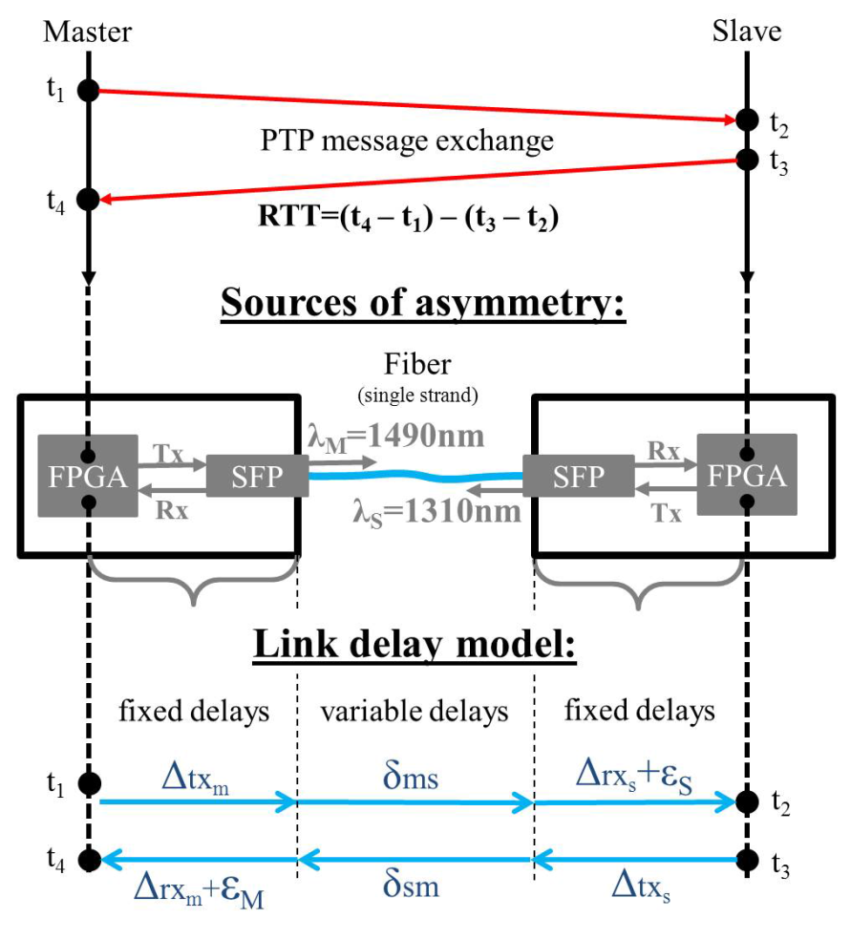
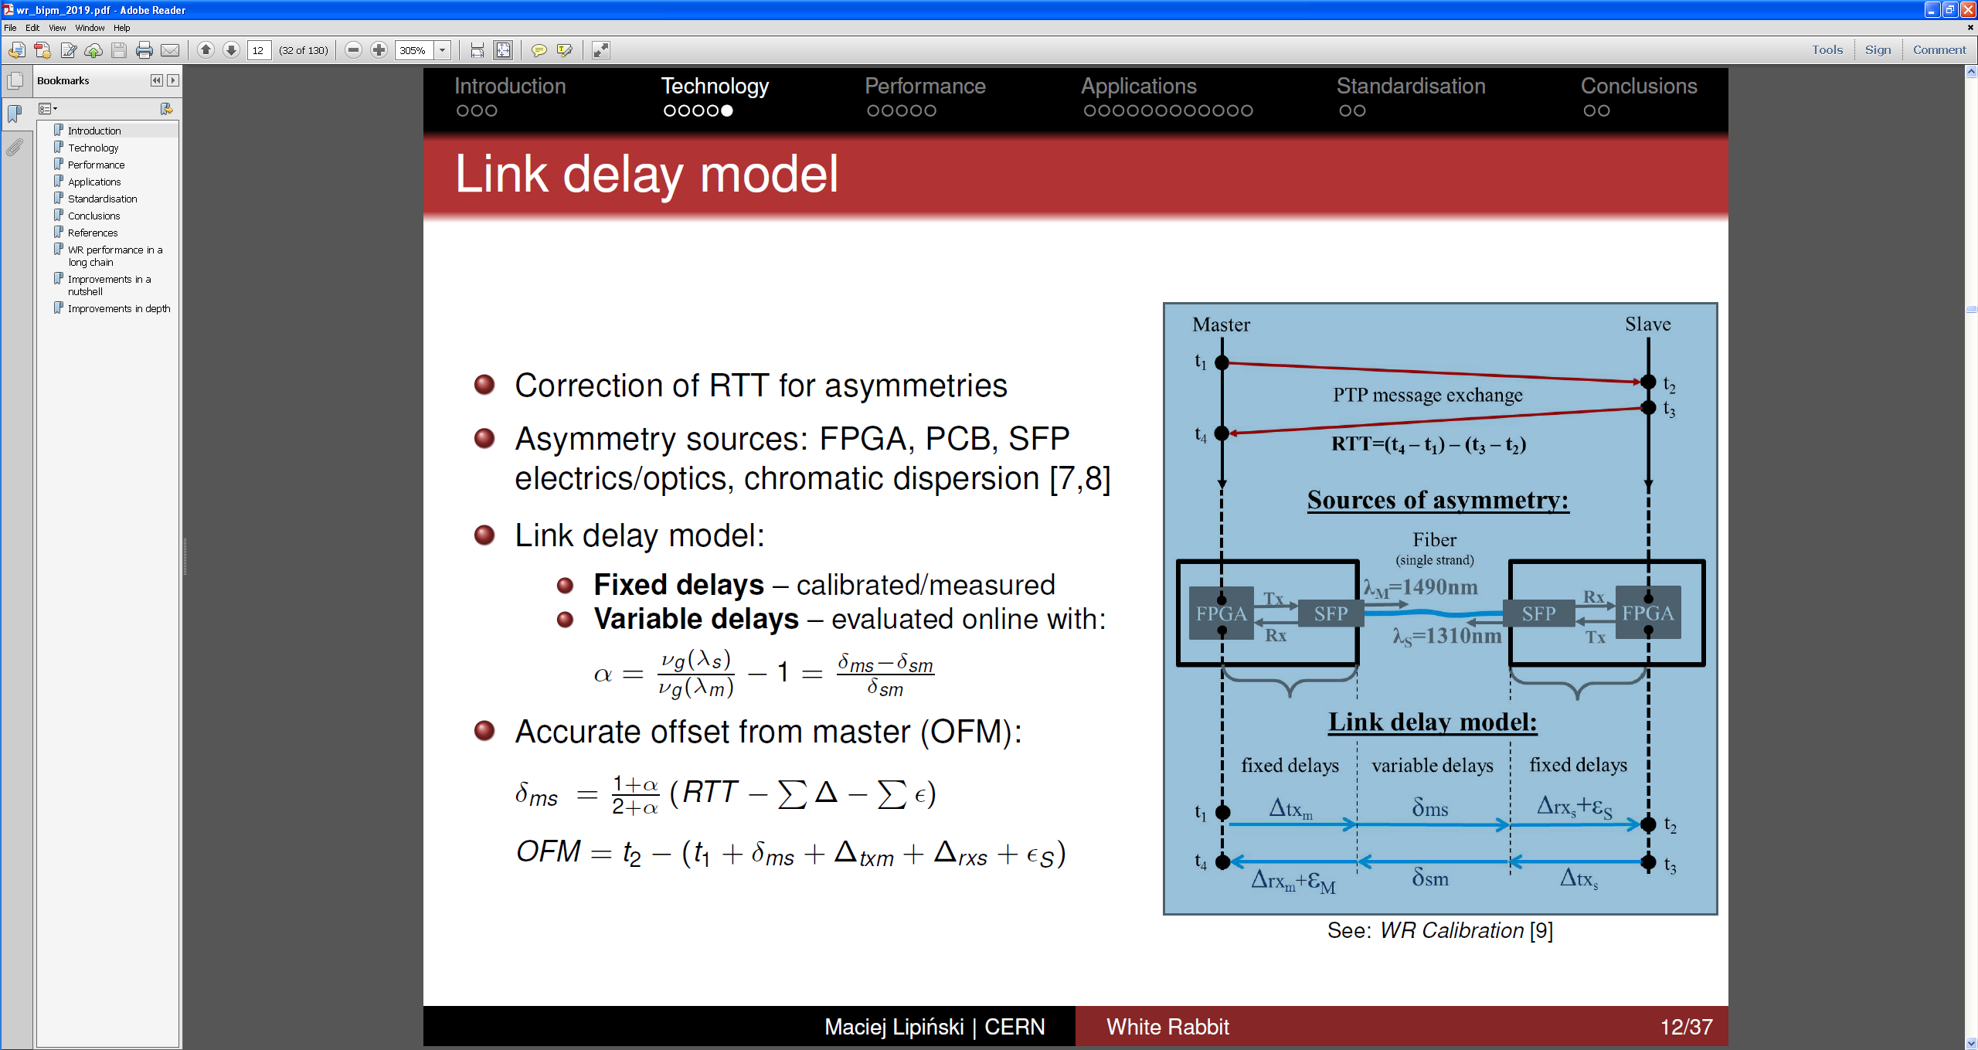
Asymmetries and link delay model
Correction of RTT for asymmetries
Asymmetry sources: FPGA, PCB, SFP electrics/optics, chromatic dispersion
Link delay model:
  Fixed delays – calibrated/measured
  Variable delays – evaluated online with
Accurate offset from master (OFM):

Slide 29
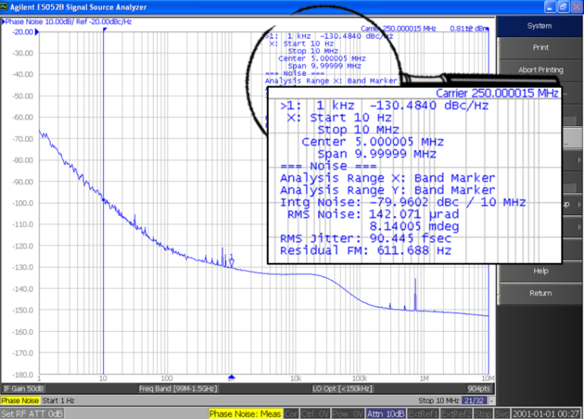
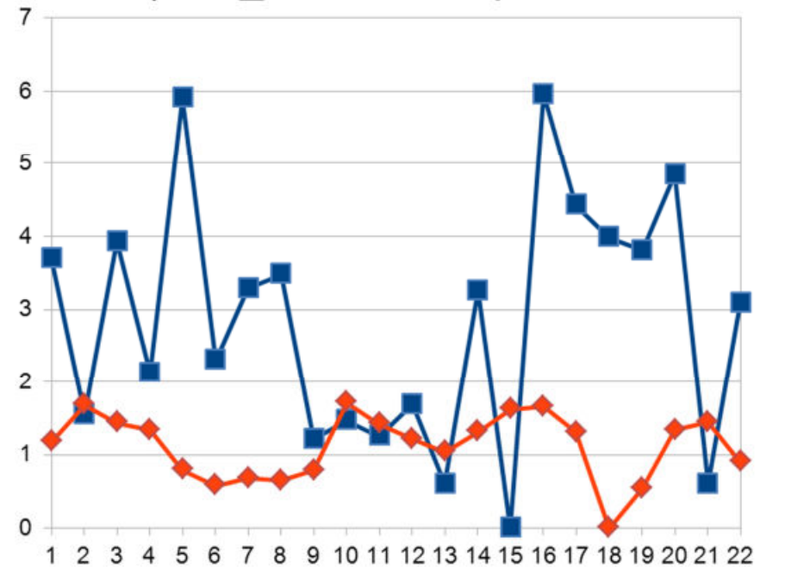
White Rabbit Performance
Time transfer performance
Network-level: < 1ns accuracy
A single link (<10km): < 20ps accuracy
Long-distance support: ~1000km
(up to 100km with < 500ps accuracy)
Frequency transfer performance
Standard: 11ps RMS
Low jitter: 2ps RMS
Best jitter: 100fs RMS
Synchronization over reboots
Offset [ps]
Time (1 PPS)
Clock (62.5MHz)
See “Intro to Oscillators” presentation at 16h45 for explanation
on frequency measurements

Slide 30


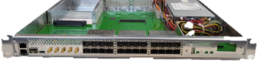
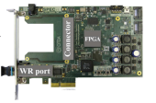
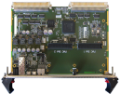


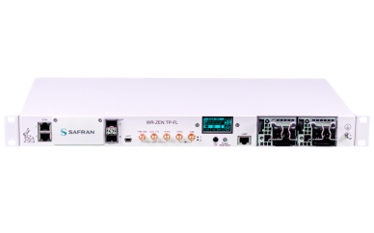
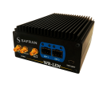
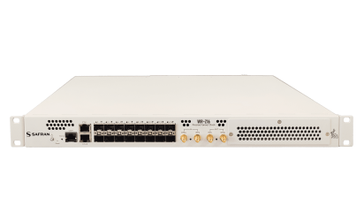
White Rabbit Devices
WR Switch (open-source)
  HW v3 – current
  HW v4 – future
WR Node
  Open source
  Proprietary
List of WR devices:
https://ohwr.org/project/white-rabbit/-/wikis/WRCompanies
* Timing fanout

Slide 31
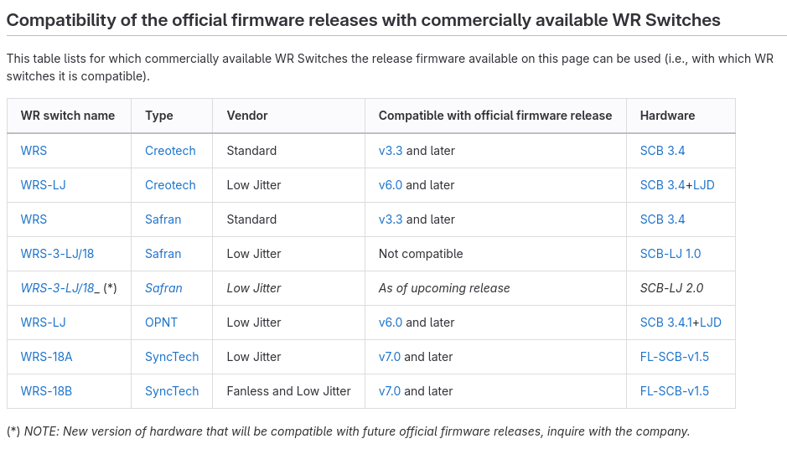
White Rabbit Switch v3
WR Switch type | Precision (sdev) |  | Accuracy (mean)
 | GM-in/out | GM-in/BC-out | Ports 1-12 (LPDC) | Ports 13-18
 | Jitter RMS (1 Hz – 100 kHz) | Jitter RMS (1 Hz – 100 kHz)
“Standard” | 9ps | 11 ps | <20ps | <200ps
“Low jitter” | 1ps | < 2 ps
Hardware:
  18 ports of 1 Gbps
  Xilinx Virtex 6 + ARM CPU
  Main types:
    Standard
    Low-jitter
Firmware (software + gateware):
  Official releases by WR Team at CERN
  Calibrated to CERN’s Golden Calibrator
  Low Phase Drift Calibration (LPDC)
    Phase repeatability over link-up/reboot
    Supported on ports 1-12
  Current release: v7.0
    Not all WRS hardware types compatible
https://ohwr.org/project/wr-switch-sw/-/wikis/home

Slide 32
LDPC vs. bitslide
Rx clock
Rx data (parallel)
Serial rx bit stream
SerDes
Bitslide
  Repeatability over reboots <200ps
  Bit-level misalignment between
    Serial word boarder
    and
    L1 rx clock signal recovered from the serial bit stream
  Determined by determining bit position
  Problem: b1 ≠ b2 ≠ b3 …
  Bitslide measurements (in ps) inaccurate
Low Phase Drift Calibration (LDPC)
  Repeatability over reboots <20ps
  Restart Clock and Data Recovery (CDR) until known bit position
  Reports bitslide zero (actual value included in relative calibration)
Bitslide
Serial rx bit stream
Rx high-speed clock
L1 rx clock signal
Parallel rx data (parallel)
Different
possible
positions
0011111000
1100000111
0011111000
Comma
Comma
Comma
b1 b2 b3 …

Slide 33
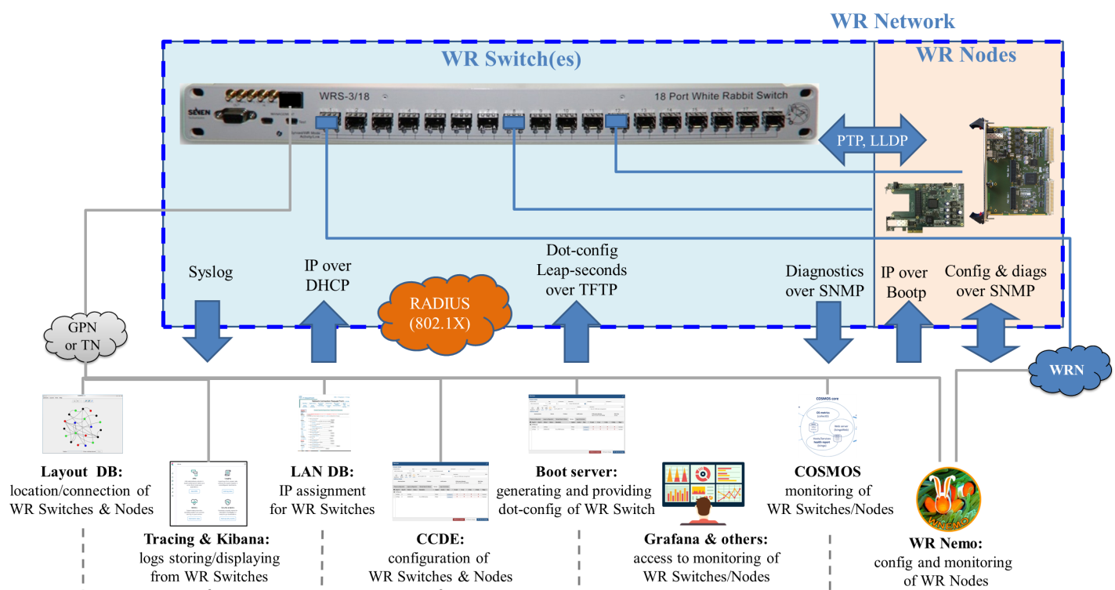
Networking Services
WR Switch services (config/monitoring) over
Standard Ethernet network
(GPN=General Purpose Network or TN=Technical Network)
Management Port
WR Node services (config/monitoring) over
WR Network
WR Port

Slide 34
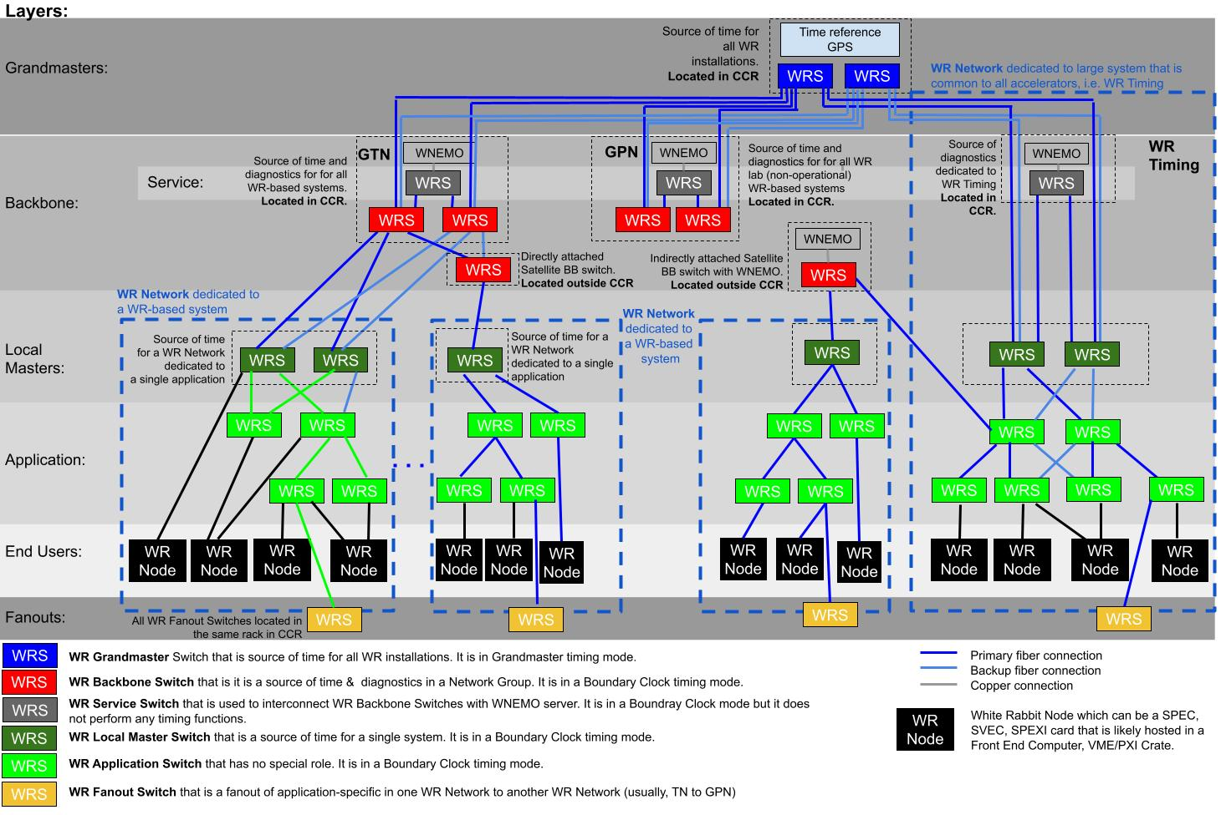
Network architectures
No application data in backbone.
Only diagnostics and time
WR Node
Time Diagnostics
Application Data:
Contained to one application network
Exchanged between networks only via dedicated switches

Slide 35
In this presentation you learned
Basics and components of WR Operation
PTP, WR-PTP, HA-PTP
L1 Syntonization and DDMTD
Types of Devices and WR Switches
Performance
Bitslide vs. LPDC
Networking Services
Network architecture at CERN

