Slide 1

WR Node
(WR PTP Core)
Maciej Lipinski
WR Collaboration / CERN
Training material

Slide 2
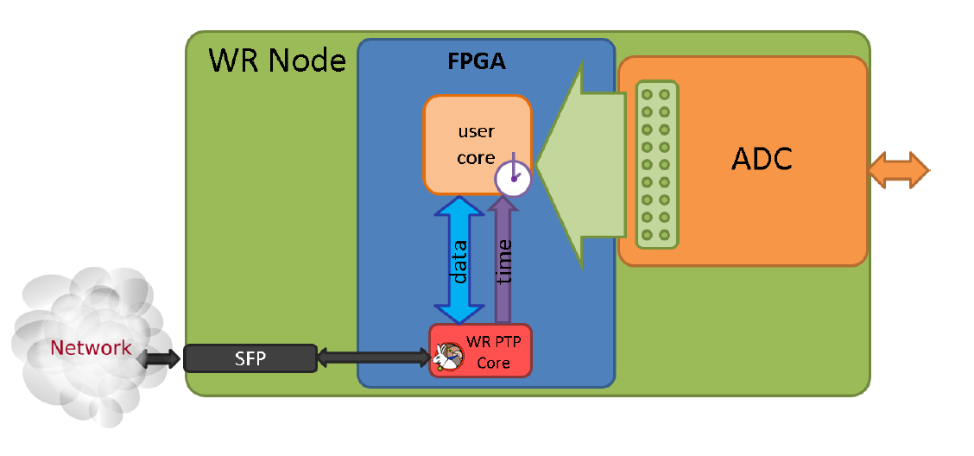







WR Node = WR PTP Core + hardware
WR PTP Core
WR PTP Core
(WRPC)
Hardware with WR support
source
sink
Simple PCIe FMC carrier (SPEC)
Simple VME FMC carrier (SVEC)
PCI eXtensions for Instr. (PXI) module
FPGA Mezzanine Card (FMC) module
CompactRIO White Rabbit
Mini-WR to WR-enable carrier
Tx
Ethernet
Rx
MAC I/F
PHY
Serdes
CLK_{REF}
CLK_{DMTD}
adjust
I2C
User Data
1-PPS
timecode
frequency
Peripheral
CPU/registers
External oscillators
timing I/F
Aux diags
Control/status
EEPROM
Pipelined WB
Slave I/F
GW: https://ohwr.org/project/wr-cores
SW: https://ohwr.org/project/wrpc-sw
Wiki: https://ohwr.org/project/wr-cores/-/wikis/wrpc-core
Release: https://ohwr.org/project/wr-cores/-/wikis/Current-release

Slide 3
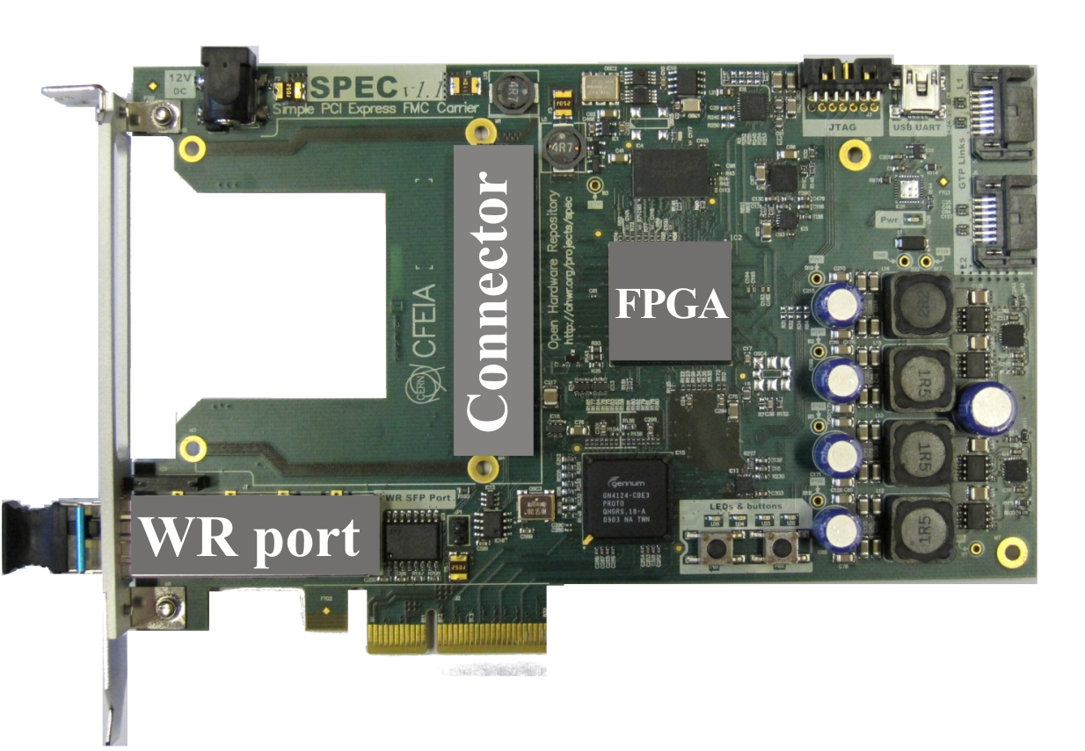
WR Node = WR PTP Core + hardware
FPGA
WR PTP Core
WR PTP Core
(WRPC)
Hardware with WR support
source
sink
Simple PCIe FMC carrier (SPEC)
Simple VME FMC carrier (SVEC)
PCI eXtensions for Instr. (PXI) module
FPGA Mezzanine Card (FMC) module
CompactRIO White Rabbit
Mini-WR to WR-enable carrier
Tx
Ethernet
Rx
MAC I/F
PHY
Serdes
CLK_{REF}
CLK_{DMTD}
adjust
I2C
User Data
1-PPS
timecode
frequency
Peripheral
CPU/registers
External oscillators
timing I/F
Aux diags
Control/status
EEPROM
Pipelined WB
Slave I/F
GW: https://ohwr.org/project/wr-cores
SW: https://ohwr.org/project/wrpc-sw
Wiki: https://ohwr.org/project/wr-cores/-/wikis/wrpc-core
Release: https://ohwr.org/project/wr-cores/-/wikis/Current-release

Slide 4
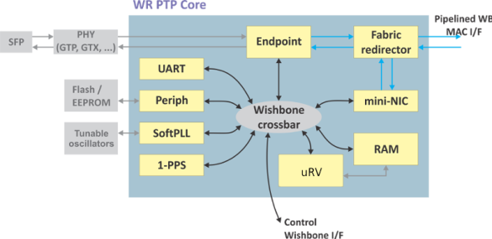
WR Node = WR PTP Core + hardware
FPGA
WR PTP Core
(WRPC)
Hardware with WR support
source
sink
Simple PCIe FMC carrier (SPEC)
Simple VME FMC carrier (SVEC)
PCI eXtensions for Instr. (PXI) module
FPGA Mezzanine Card (FMC) module
CompactRIO White Rabbit
Mini-WR to WR-enable carrier
Tx
Ethernet
Rx
MAC I/F
PHY
Serdes
CLK_{REF}
CLK_{DMTD}
adjust
I2C
User Data
1-PPS
timecode
frequency
Peripheral
CPU/registers
External oscillators
timing I/F
Aux diags
Control/status
EEPROM
Pipelined WB
Slave I/F
GW: https://ohwr.org/project/wr-cores
SW: https://ohwr.org/project/wrpc-sw
Wiki: https://ohwr.org/project/wr-cores/-/wikis/wrpc-core
Release: https://ohwr.org/project/wr-cores/-/wikis/Current-release

Slide 5

Accessing WR PTP Core
WR
Network
FPGA
UART
Parallel BUS
Register access
Chip-external: PCIe, VME, PXI
Chip-internal: AXI bus in SoC
Serial Communication over USB
Host
Ethernet Communication

Slide 6
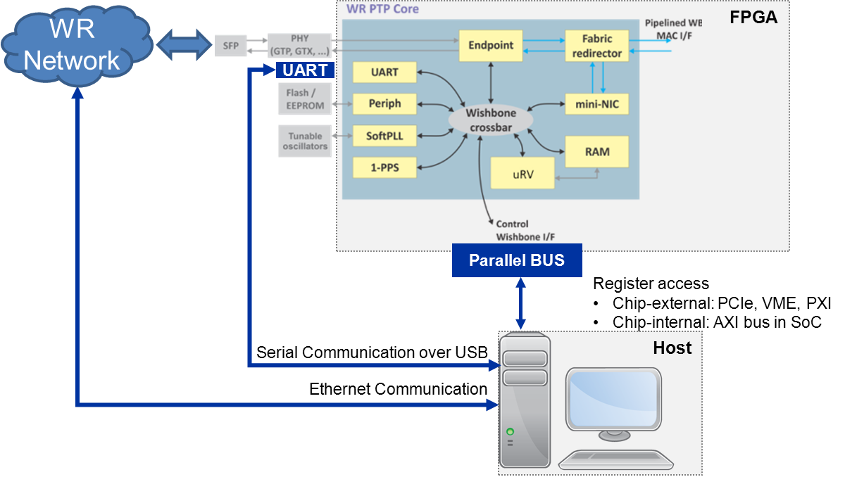
Accessing WR PTP Core
Register access over parallel bus
(access to all registers, using dedicated tools or direct memory mapping)
  Configuration and diagnostics
  Firmware loading
  Debugging (GDB, SoftPLL)
  Access to WRC shell via virtual UART
Serial communication over UART
  Access to WRC shell via physical UART
Ethernet communication over WR Network
  Access to WRC shell via netconsole
  SNMP get/set
  Syslog
Host
  Machine with OS (ideally Linux),
  e.g., PC, PL of SoC
  Hosts tools used to access WRPC
  Tools available in tools folder of https://ohwr.org/project/wrpc-sw

Slide 7
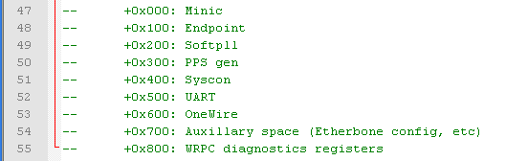
WRC shell: ways of accessing
Register access over parallel bus: vuart
  Tools available in tool folder of https://ohwr.org/project/wrpc-sw
    wrpc-vuart -f <resource> –o <UART module offset> - [depricated]
    wrpc vuart –b <board> -f <resource> -o <WRPC offset> - new “Swisstool”
    Example execution for SPEC reference design over PCIe)
    host# sudo ./wrpc-vuart -f /sys/bus/pci/devices/0000:01:00.0/resource0 -o 0x00500
    host# sudo ./wrpc vuart -b pci -f /sys/bus/pci/devices/0000:01:00.0/resource0 -o 0x00000
Serial communication over UART: use your favorite tool
  Bautrate: 115200
  Example tools: putty, picocom, minicom
  Example command:
  host# sudo picocom -b 115200 /dev/ttyUSB0
Ethernet communication over WR Network: nc
  netconsole must be enabled and configured on WRPC
  (see later slides)
  Example command:
  host# nc –u <IP of WRPC> 55
WRPC offset for SPEC ref design: 0x00000

Slide 8
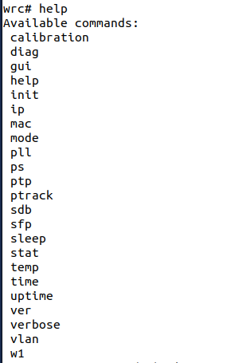
WRC shell: commands
WRC shell can be accessed using
  wrpc-vuart over parallel bus,
  serial communication over UART
  netconsole over WR Network
Commands available in WRC shell
  Basic commands: available by default in WRPC
  software binary available with release
  Advanced commands that need to be enabled before
  compiling new WRPC software binary - info later in this
  presentation

Slide 9
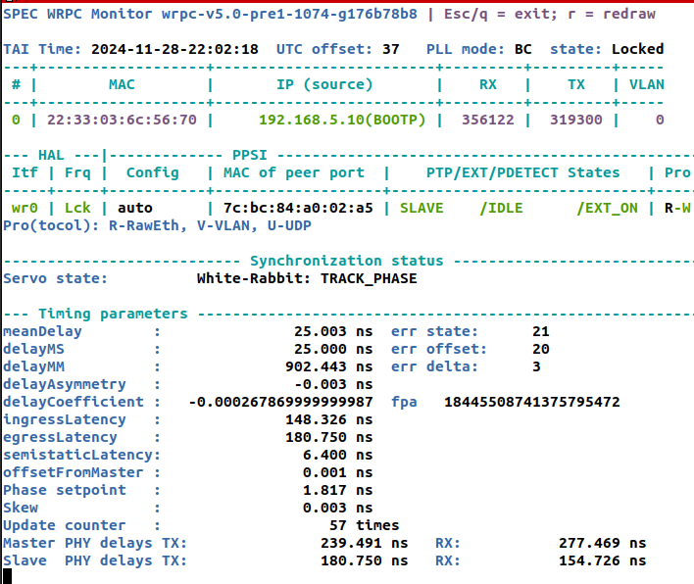
WRC shell: gui
wrc# gui
The best tool to start with
Equivalent of wr_mon available on WR Switch
(see detailed description in “WR Switch Basics” presentation)
Redesigned for WRPC v5
Gives many important information about WRPC status and configuration:
  Build version
  Link status
  PTP/WR configuration
  MAC of the peer
  PLL locking status
  Timing mode
  WR time
  Servo status (if in slave mode)

Slide 10
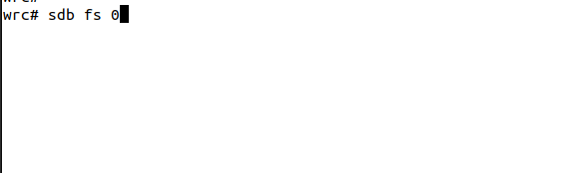
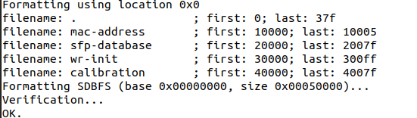
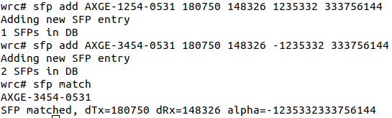

WRC shell: initial configuration
wrc# sdb fs 0
SDB = Self-Describing Bus (link)
Creates SDB FS image in Flash memory
Base address and sector size taken from HDL
SDBFS stores
  MAC address
  SFP database
  Init script
  t24p calibration
wrc# sfp add <PN> <egLat> <inLat> <relCoefH> <relCoefL>
Add SFP parameters to database:
  <PN> - SFP’s part number
  <egLat> - egress latency (deltaTx) [ps]
  <inLat> - ingress latency (deltaRx) [ps]
  <relCoefH> <relCoefL> - most & least significant
  9 digits of relative delay coefficient (alpha)
Database organized differently than on Switch
wrc# sfp match
Match inserted SFP with entry in database
wrc# sfp show
Show SFP database

Slide 11
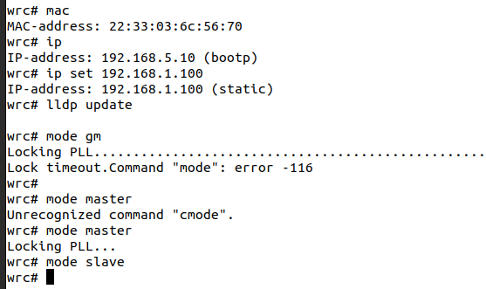


WRC shell: initial configuration
wrc# mode <PTP Mode>
Set PTP mode
  gm – for Grandmaster
  master for Free-running master
  slave for Slave
wrc# mac get
Report MAC address of WRPC
wrc# mac <cmd> xx:xx:xx:xx:xx:xx
Set MAC address to the value indicates with
xx:xx:xx:xx:xx:xx in HEX
cmd:
  set – set for runtime
  setp – set permanently
wrc# ip
Report IP address of WRPC which can be
either retrieved from DHCP server using bootp,
or set manually
wrc# ip set
Set manually IP v4 address of WRPC
d
d

Slide 12
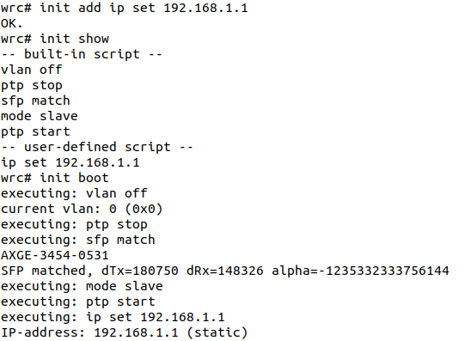
WRC shell: init script
WRPC allows to load user-defined initialization
script on every startup
This mechanism allows custom configuration
Commands
wrc# init add <cmd>
Adds command to the “user-defined” part
Any configuration command can be added
wrc# init show
Shows content of the script
wrc# init boot
Restart WRPC
d

Slide 13
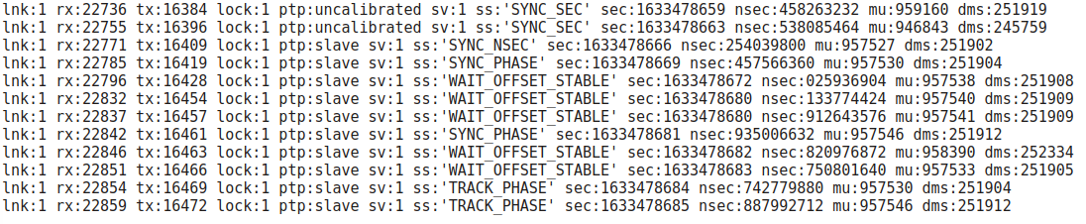
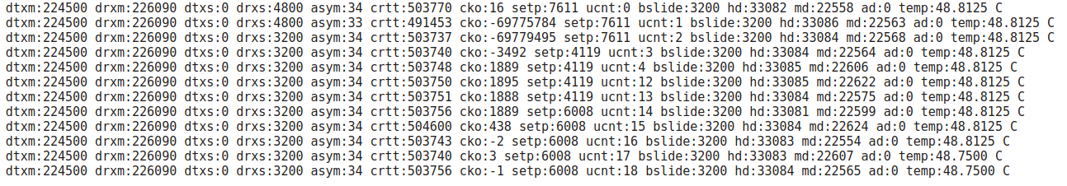
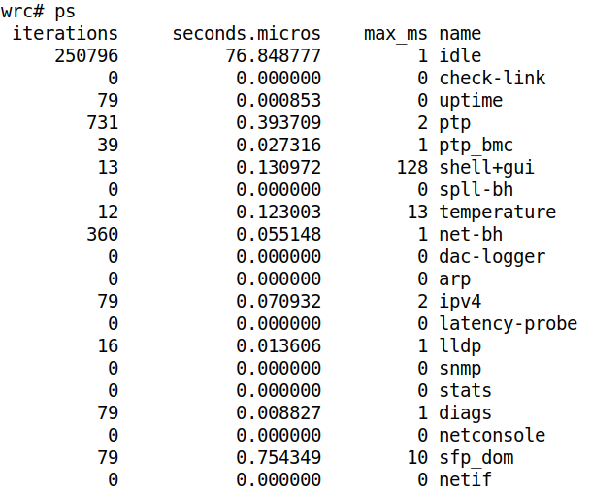
WRC shell: monitoring
wrc# stat <on | off>
Reports repeatedly (until off) loggable statistics
Without parameter, toggles reporting
wrc# stat bts
Prints bitslide value for established WR Link
wrc# ps
Manual – section 5.4.5
Prints:
  Task list
  Total time spent on task
  Maximum time spent on task
Possible to reset counters
If any task is executed longer
than 250-500ms might cause problems with synchronization.
This tool can help detect this
d

Slide 14
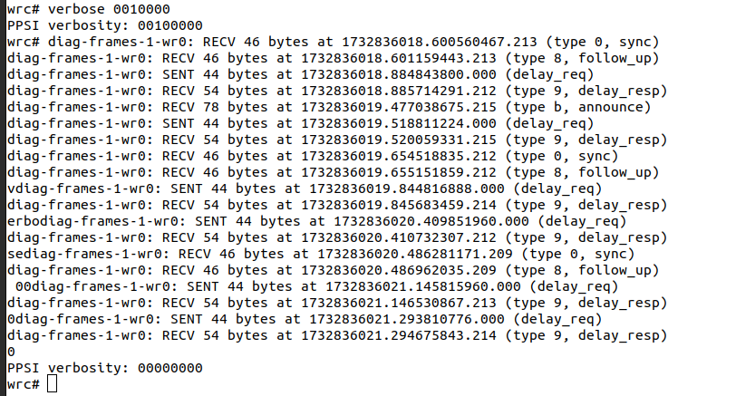
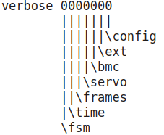
WRC shell: debugging
wrc# verbose bbbbbb
Sets level of verbosity of PTP daemon (PPSi)
Verbosity levels
d

Slide 15
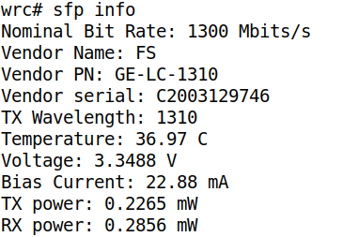
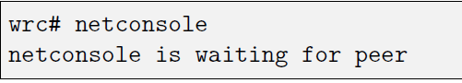
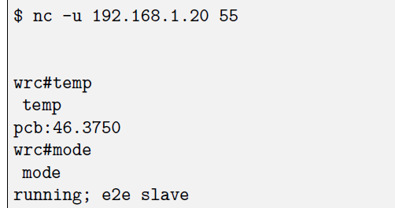
WRC shell: advanced commands
wrc# sfp info
Limited equivalent of wrs_sfp_dump
Prints basic information about SFP
Compilation options:
  CONFIG_CMD_SFP_INFO=y
wrc# netconsole
Manual – section 4.4
Enable netconsole, ready to accept connections
from remote host
Compilation options
  CONFIG_CMD_NETCONSOLE=y
  NETCONSOLE_DEF_WAIT=y
host#nc –u <IP> 55
d

Slide 16
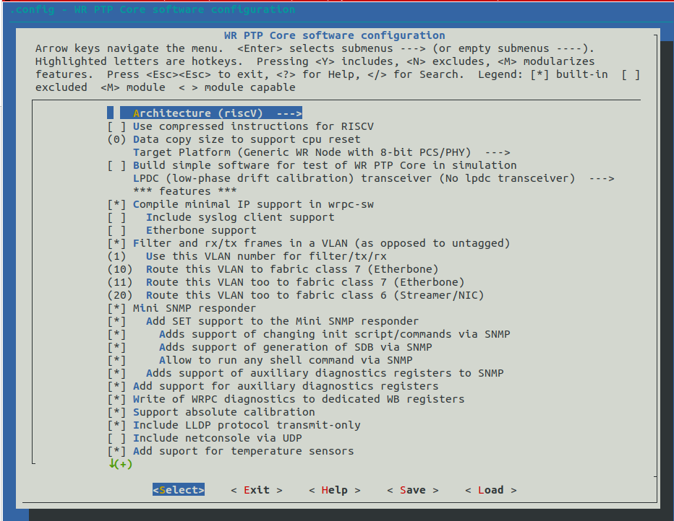
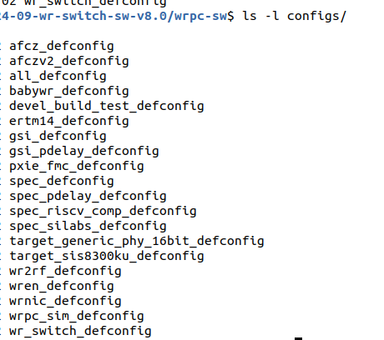
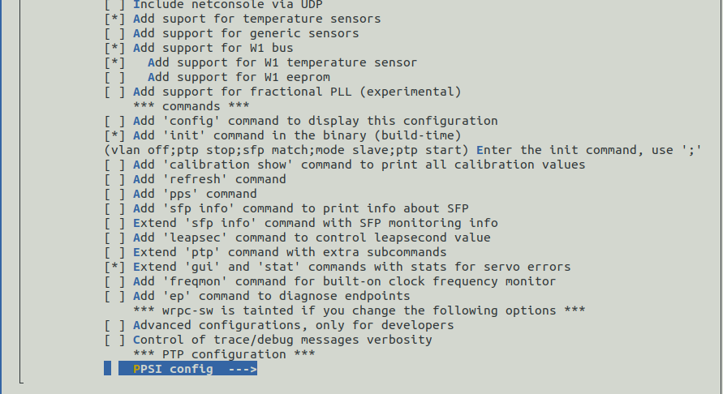
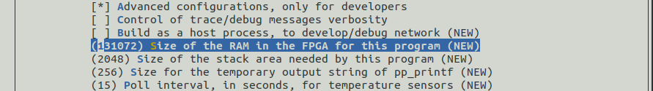
WRC compilation configuration
WRC software: https://ohwr.org/project/wrpc-sw
Needs to be compiled with suitable configuration
  Predefined for existing boards in configs
  Using predefined configuration:
  host# make <configuration file name>
  Access configuration menu:
  host# make menuconfig
  Configuration saved to file: .config
Important parameters which must match HW/GW
  Target Platform
    Generic WR Node 8-bit PCS/PHY
    Generic WR Node 16-bit PCS/PHY
    WR Switch
    AFCZ
    eRTM14/15
  Size of RAM in FPGA (in Advanced config)
    Should match RAM in FPGA
Many advanced commands can be added, e.g.,
  netconsole
  sfp info
  freqmon
Predefined SW configs:

Slide 17
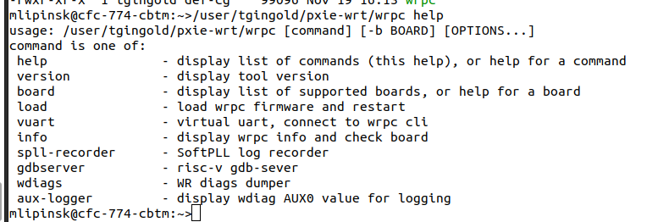
WRC host tools
Host tools are in tools folder of https://ohwr.org/project/wrpc-sw
Old tools (to be deprecated, still available):
host# wrpc-vuart -f <resource> –o <UART module offset> - access virtual UART
host# wrpc-diags -f <resource> –o <UART module offset> - access diagnostics registers
host# wrpc-load -f <resource> –o <UART module offset> - load software binary
New “swiss tool”:
host# wrpc <cmd> -b <board> <board-specific access to resource> <cmd-specific>
  Replaces existing tools above
  Provides new functionalities:
    Reading board and wrpc info
    Recording data from SoftPLL
    Providing gdb server for Risk-V
    Displaying diagnostics from
    auxiliary input (user-specific)
  More info on presentation by
  Tristan

Slide 18
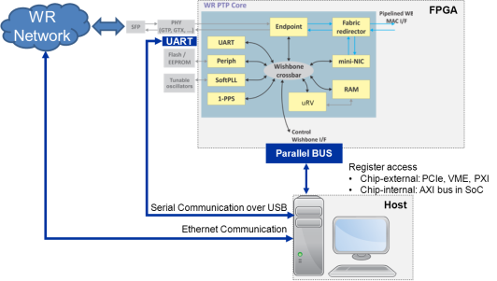
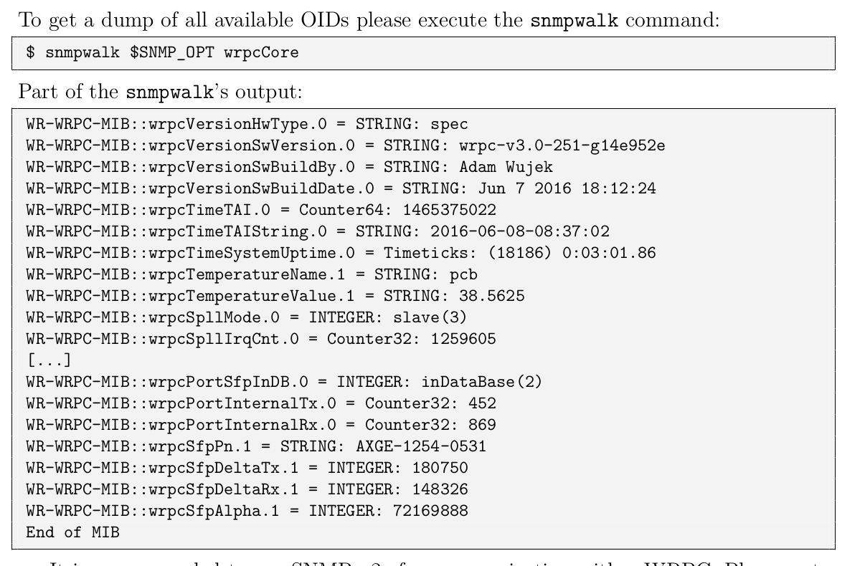
Standard services (1)
BOOTP (Manual – section 6)
  Allows to obtain IPv4 address from BOOTP server
SNMP (Manual – section 5.1)
  Single Network Management Protocol
  Diagnostics and configuration over WR Network
  MIB: WR-WRPC-MIB.txt
  Allows:
    Reading the monitoring values
    Managing SFP database
    Setting up init script
    Generating SDBFS
    Configuring netconsole
    Running shell commands
    Useful commands:
    host# snmpwalk
    host# snmpget
    host# snmpset
  Syslog (Manual – section 5.2)
    Send to server: boot time, links/sync status, temp
    Command to enable/configure
    wrp# syslog <IP> <MAC>
BOOTP
SNMP
syslog
BOOTP/syslog server
SNMP client

Slide 19
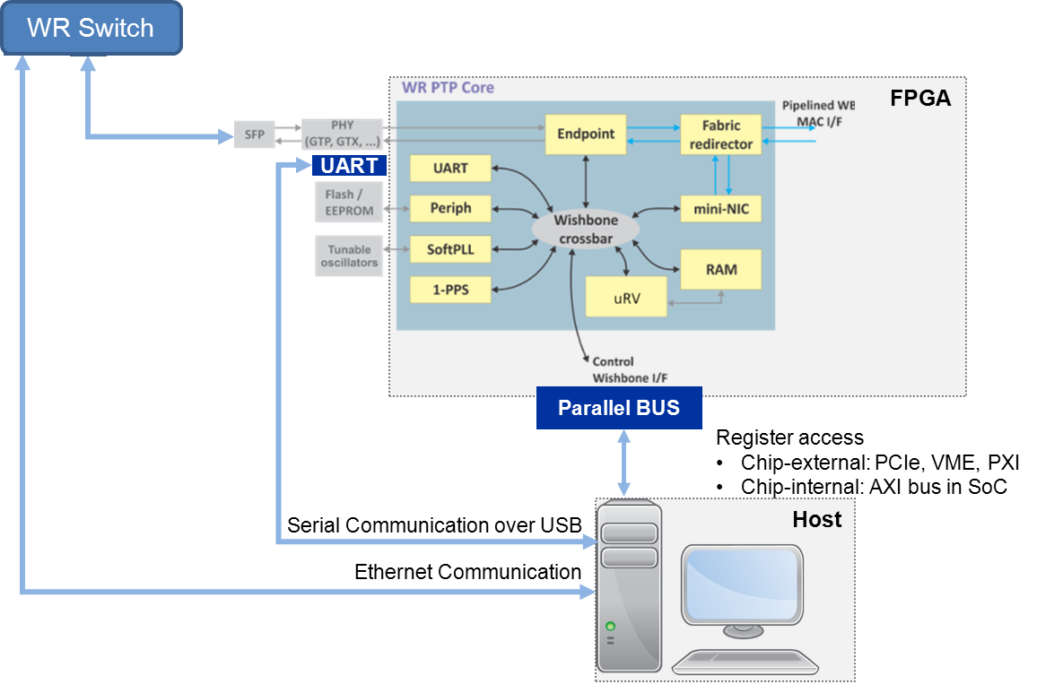
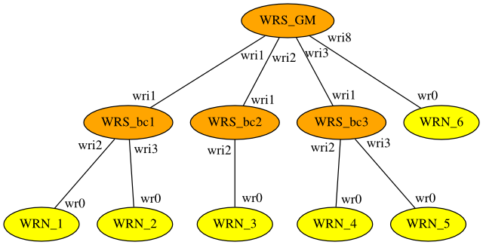
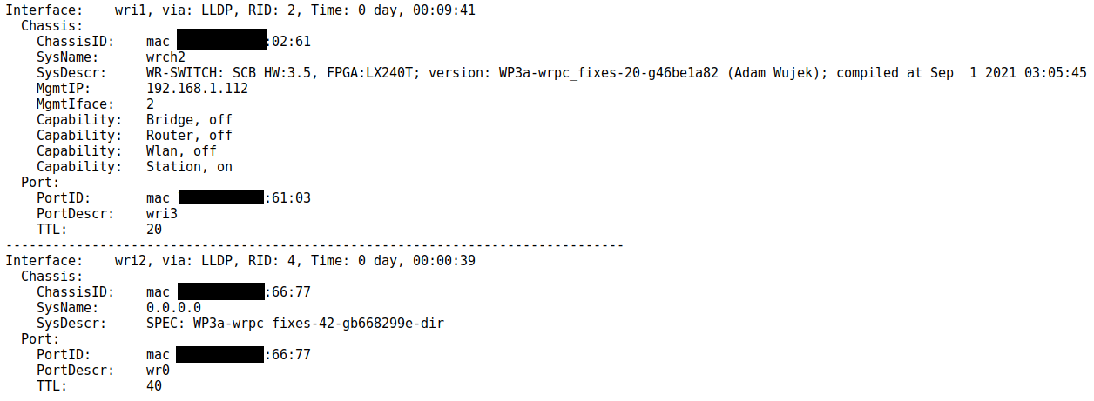
Standard services (2)
  LLDP
    Link Layer Discovery Protocol
    Allows to retreive information about
    device on the other side of a link
    WRPC: only reports its presence to a peer
    WR Switch uses LLDP to discover devices connected to it. WR Switch reports this information over SNMP to SNMP server
    Used to draw network tree:
LLDP
SNMP
SNMP client

Slide 20
Thank you
Summary
Method of accessing WR PTP Core
WRPC Shell
  Ways of accessing
  Ways of enabling command
  Commands
Compilation configuration
Host tools
Standard services

Slide 21
WR Node = WR PTP Core + hardware
UART
FPGA
WR PTP Core
WR
Network
SFP
WR Port
Parallel BUS
External: PCIe, VME, PXI
Internal: AXI bus in SoC
Ethernet Frames
Serial Communication over USB

Slide 22
Accessing WR PTP Core
WR Switch
FPGA
UART
Parallel BUS
Register access
Chip-external: PCIe, VME, PXI
Chip-internal: AXI bus in SoC
Serial Communication over USB
Host
Ethernet Communication

