Slide 1

WR Switch and Node
Architecture
Maciej Lipinski
WR Collaboration / CERN
Training material

Slide 2
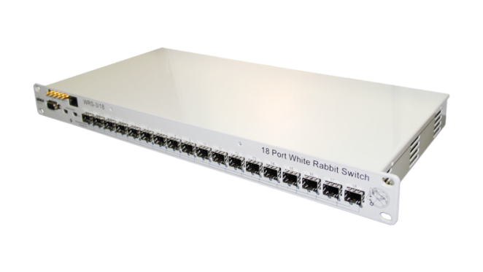
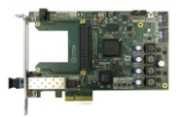

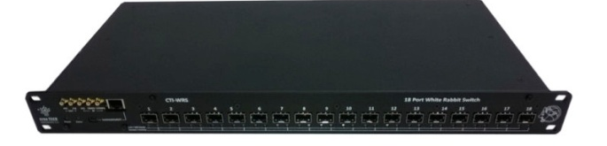
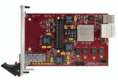




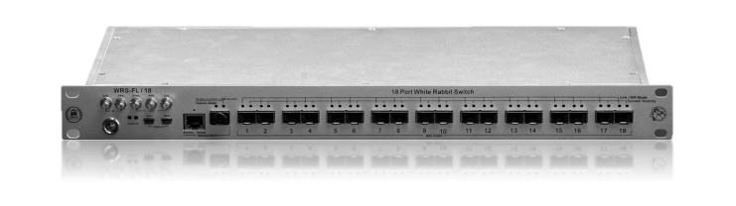

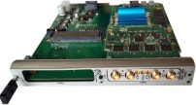
WR Devices
WR switch
WR node
Simple PCIe FMC
carrier (SPEC)
Simple VME FMC carrier (SVEC)
PCI eXtensions for Instr. (PXI) module
FPGA Mezzanine Card (FMC) module
CompactRIO White Rabbit
Mini-WR to WR-enable carrier
AMC FMC Carrier (AFC) compliant with MTCA.4
www.ohwr.org/project/white-rabbit/wikis/Switch
www.ohwr.org/project/white-rabbit/wikis/Node

Slide 3

WR Devices – architecture
WR switch
WR node
CPU
(ARM)
Other
SNMPd
RTUd
WR-PTP (PPSi)
WR PTP Core
(WRPC)
Software
CPU
(LM32/RiskV)
FPGA
Drivers
HW Abstr Layer (HAL)
LLDP
SNMPd
WR-PTP (PPSi)
CPU
(LM32/RiskV)
FPGA
HW lib
SoftPLL-SW
SoftPLL-SW
Serdes
CLK_{REF}
CLK_{DMTD}
adjust
I2C
User Data
1-PPS
timecode
frequency
Peripheral
CPU/registers
Networking
modules
SoftPLL
GW
SoftPLL
GW
Gateware
(HDL)
Endpoint
with timestamper
Endpoint
with timestamper
Deterministic GbE SerDes
providing bitslide or LPDC
Deterministic GbE SerDes
providing bitslide or LPDC
PPS output
Fiber
PPS output
DAC
DAC
2x
2x
Hardware
VCTCXO
SFP
SFP
VCTCXO
www.ohwr.org/project/white-rabbit/wikis/Switch
www.ohwr.org/project/white-rabbit/wikis/Node

Slide 4
Repositories: WR Switch
WR switch
wrpc-sw
SoftPLL-SW
WR Node-only SW
(LLDP, SNMPd, Shell)
Host tools
wr-switch-sw
Build environment
Linux/buildroot
Daemons except PPSI
Userspace
PPSi
PTP Daemon
WR & HA profile & ext
urv-core
- RiskV CPU
wr-cores
WR-specific modules
Endpoint
GbE SerDes
SoftPLL-GW
Reference Top designs
wr-switch-hdl
Top design
Networking modules
general-cores
- non-WR modules
To get to the repo, add prefix https://ohwr.org/project/, e.g., https://ohwr.org/project/wr-cores

Slide 5

Repositories: WR Node
WR switch
WR PTP Core
(WRPC)
WR node
wrpc-sw
SoftPLL-SW
WR Node-only SW
(LLDP, SNMPd, Shell)
Host tools
wr-switch-sw
Build environment
Linux/buildroot
Daemons except PPSI
Userspace
Repository specific to
a WR Node SW
Might not be needed
Integration of diagnostics into custom SW
PPSi
PTP Daemon
WR & HA profile & ext
urv-core
- RiskV CPU
wr-cores
WR-specific modules
Endpoint
GbE SerDes
SoftPLL-GW
Reference Top designs
wr-switch-hdl
Top design
Networking modules
Repository sepcific to a WR Node HDL repo
Top design
Node-specific stuff
general-cores
- non-WR modules
To get to the repo, add prefix https://ohwr.org/project/, e.g., https://ohwr.org/project/wr-cores

Slide 6
WR Timing Architecture of WR Switch and WR Node

Slide 7
WR Timing Architecture
HW
GW (FPGA)
SW(ARM, RiskV/LM32)
Non-PTP
Ethernet
traffic
rx tx
SFP
rx
tx
WR_GT*_PHY
Bitslide or LPDC
Deterministic config
DDMTD (optional)
rx
tx
Endpoint
PCS (8b10b)
Ethernet/VLANs
Timestamping
Rx/Tx clk-cross
rx+ts
tx
Ethernet Traffic Handling modules
rx+ts
tx
Network
Interface
Controller
(NIC)
NIC driver
PTP daemon
PTP/WR/HA
Fine timestamps
Servo
(time, phase)
rx+ts
tx
PTP msg
coarse
timetamps
tx timestamp (ts)
TX_TSU (only WR Switch)
FIFO with tx timestamps

Slide 8
WR Timing Architecture
HW
GW (FPGA)
SW(ARM, RiskV/LM32)
Non-PTP
Ethernet
traffic
rx tx
SFP
rx
tx
WR_GT*_PHY
Bitslide or LPDC
Deterministic config
DDMTD (optional)
rx
tx
Endpoint
PCS (8b10b)
Ethernet/VLANs
Timestamping
Rx/Tx clk-cross
rx+ts
tx
Ethernet Traffic Handling modules
rx+ts
tx
Network
Interface
Controller
(NIC)
NIC driver
PTP daemon
PTP/WR/HA
Fine timestamps
Servo
(time, phase)
rx+ts
tx
PTP msg
coarse
timetamps
clk_{wr}
clk_{DDMTD}
clk_{rx}[id]
tx timestamp (ts)
VCXOs
Track
Phase
Setpoint
TX_TSU (only WR Switch)
FIFO with tx timestamps
Tx timestamps
SoftPLL SW
Select clk_{ref} from clk_{rx}[id] and clk_{ext}
Calculate phase error from tags
  Between clk_{ref} and clk_{wr}
  Ideal and real clk_{wr}
PI controller to generated clk_{DDMTD}
PI controller to generated clk_{wr}
Softpll GW
DDMTD+deglicher
Interrupt generation
Tag mux
Phase tag[ch]
Interrupt
Rx clock channel
DAC
DAC

Slide 9
WR Timing Architecture
HW
GW (FPGA)
SW(ARM, RiskV/LM32)
Non-PTP
Ethernet
traffic
rx tx
SFP
rx
tx
WR_GT*_PHY
Bitslide or LPDC
Deterministic config
DDMTD sampler (optional)
rx
tx
Endpoint
PCS (8b10b)
Ethernet/VLANs
Timestamping
Rx/Tx clk-cross
rx+ts
tx
Ethernet Traffic Handling modules
rx+ts
tx
Network
Interface
Controller
(NIC)
NIC driver
PTP daemon
PTP/WR/HA
Fine timestamps
Servo
(time, phase)
rx+ts
tx
PTP msg
coarse
timetamps
clk_{wr}
clk_{DDMTD}
clk_{rx}[id]
tx timestamp (ts)
VCXOs
Track
Phase
Setpoint
TX_TSU (only WR Switch)
FIFO with tx timestamps
Tx timestamps
SoftPLL SW
Select clk_{ref} from clk_{rx}[id] and clk_{ext}
Calculate phase error from tags
  Between clk_{ref} and clk_{wr}
  Ideal and real clk_{wr}
PI controller to generated clk_{DDMTD}
PI controller to generated clk_{wr}
Softpll GW
DDMTD+deglicher
Interrupt generation
Tag mux
Phase tag[ch]
Interrupt
Rx clock channel
DAC
DAC
10MHz
clk_{ext} (62.5 or 125MHz)
PLL

Slide 10
WR Timing Architecture
HW
GW (FPGA)
SW(ARM, RiskV/LM32)
PPS gen
Keeps WR Time (sec+nsec)
Generates PPS out
Syncs to PPS in
PPS out
PPS in
Get WR Time
Set WR Time (sec and nsec)
Non-PTP
Ethernet
traffic
Non-PTP
Ethernet
traffic
rx tx
SFP
rx
tx
WR_GT*_PHY
Bitslide or LPDC
Deterministic config
DDMTD (optional)
rx
tx
Endpoint
PCS (8b10b)
Ethernet/VLANs
Timestamping
Rx/Tx clk-cross
rx+ts
tx
Ethernet Traffic Handling modules
rx+ts
tx
Network
Interface
Controller
(NIC)
NIC driver
PTP daemon
PTP/WR/HA
Fine timestamps
Servo
(time, phase)
rx+ts
tx
PTP msg
coarse
timetamps
clk_{wr}
clk_{DDMTD}
clk_{rx}[id]
tx timestamp (ts)
VCXOs
Track
Phase
Setpoint
TX_TSU (only WR Switch)
FIFO with tx timestamps
Tx timestamps
SoftPLL SW
Select clk_{ref} from clk_{rx}[id] and clk_{ext}
Calculate phase error from tags
  Between clk_{ref} and clk_{wr}
  Ideal and real clk_{wr}
PI controller to generated clk_{DDMTD}
PI controller to generated clk_{wr}
Softpll GW
DDMTD+deglicher
Interrupt generation
Tag mux
Phase tag[ch]
Interrupt
Rx clock channel
DAC
DAC
10MHz
clk_{ext} (62.5 or 125MHz)
PLL

Slide 11
DDMTD and SoftPLL

Slide 12
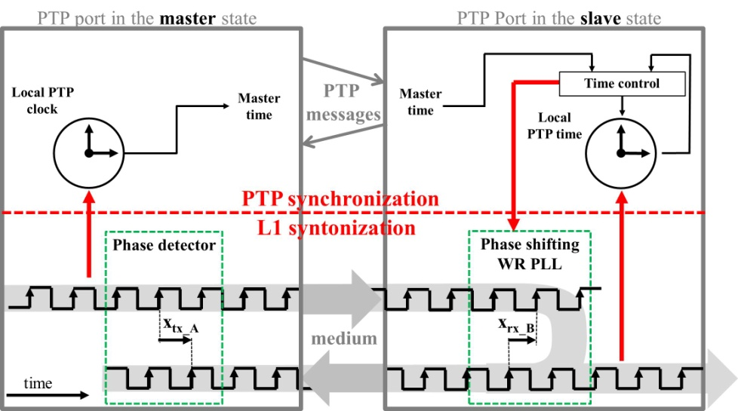
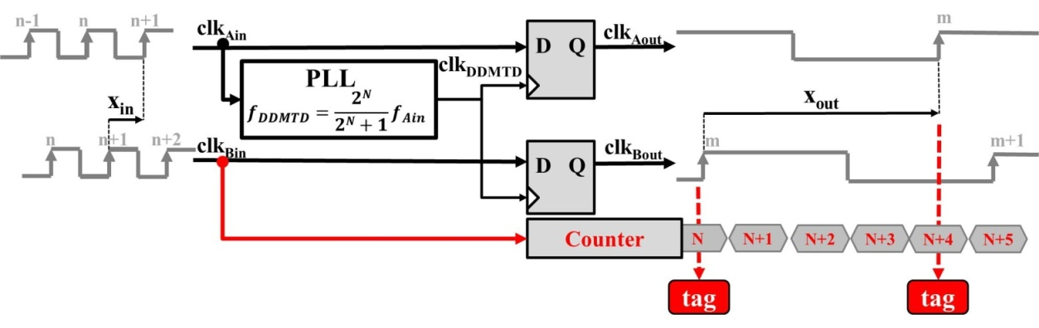
DDMTD
d
Digital Dual Mixer Time Difference (DDMTD)
Precise phase measurements in FPGA
Used on Grandmaster to lock to external clock
Used on GM and Master to enhance timestamps
Used on Slave for phase-shifting PLL
WR parameters:
  clk in = 62.5 MHz
  clk DDMTD = 62.496185 MHz (N=14)
  clk out = 3.814 kHz
Theoretical resolution of 0.977 ps
Local WR Clock signal
L1 rx clock signal

Slide 13
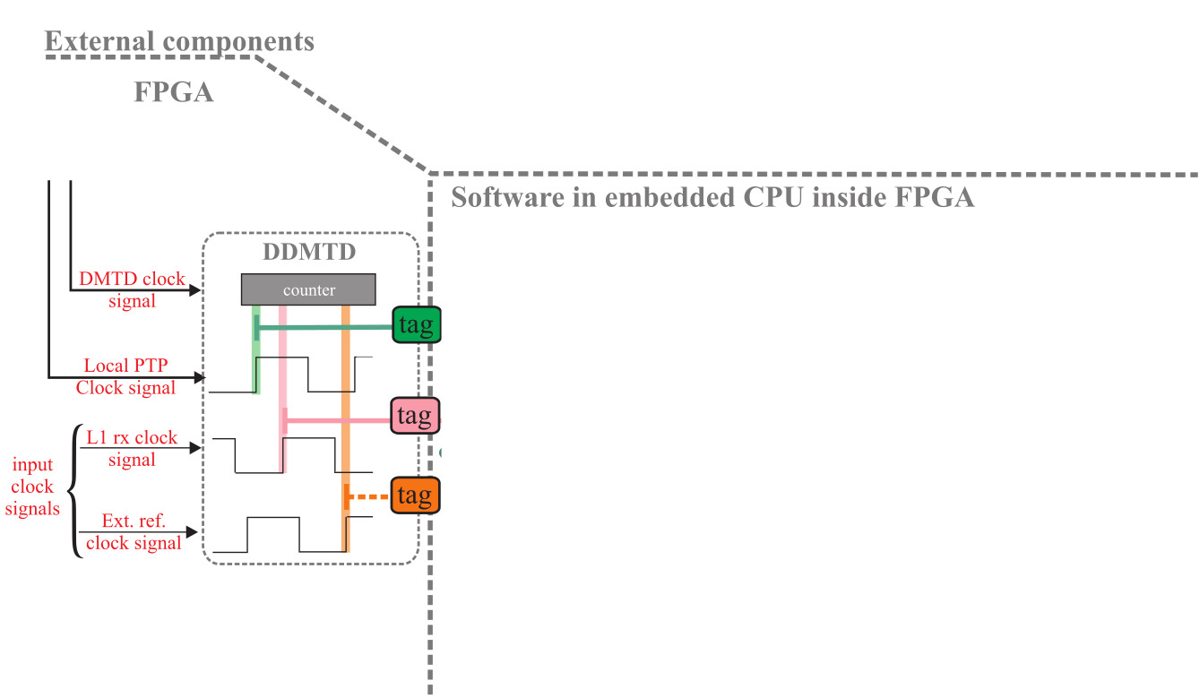

SoftPLL architecture

Slide 14
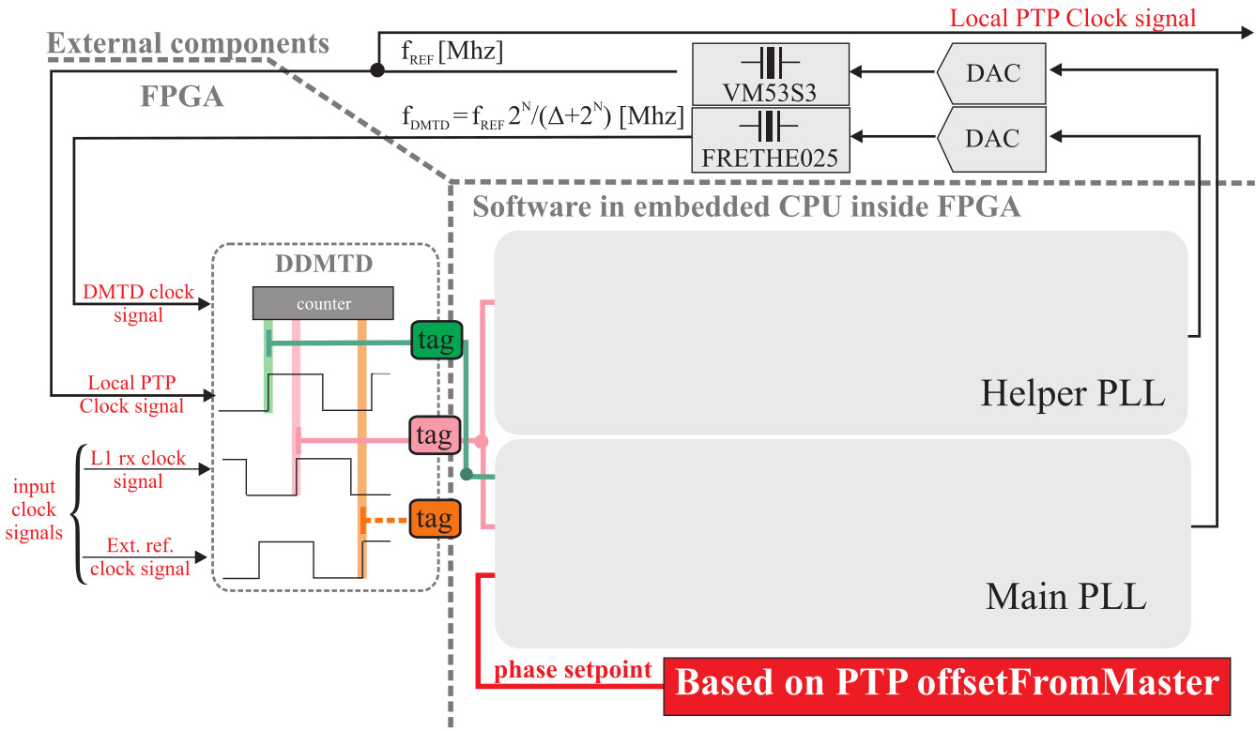
SoftPLL architecture
Local WR Clock signal
Local WR

Slide 15
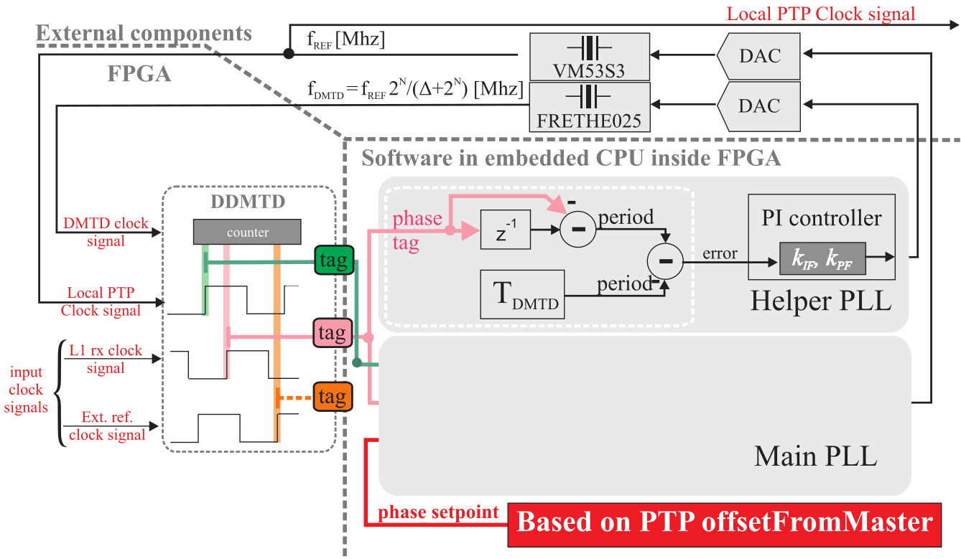
SoftPLL architecture
Local WR Clock signal
Local WR

Slide 16
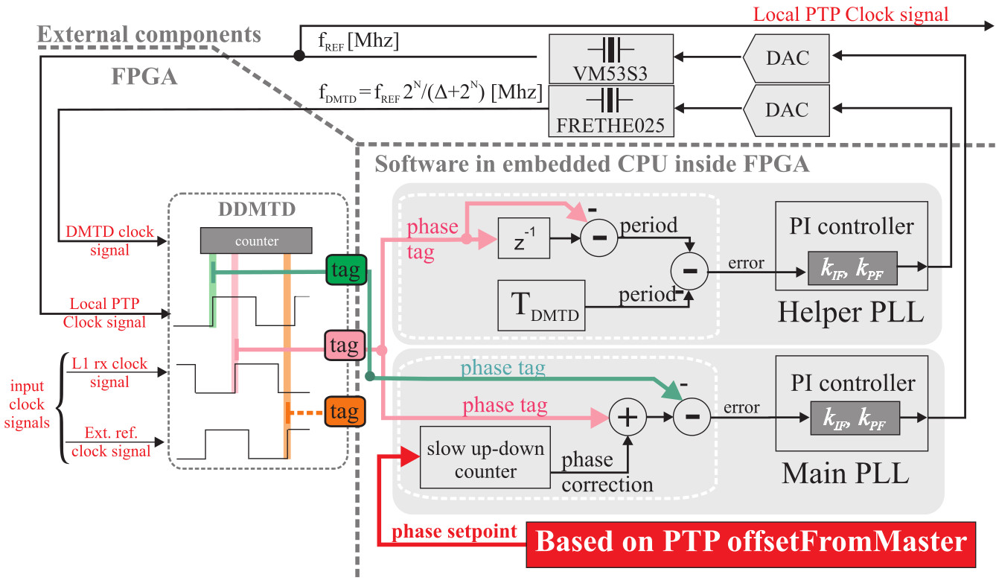
SoftPLL architecture
Local WR Clock signal
Local WR

Slide 17
Data Forwarding Architecture of WR Switch

Slide 18
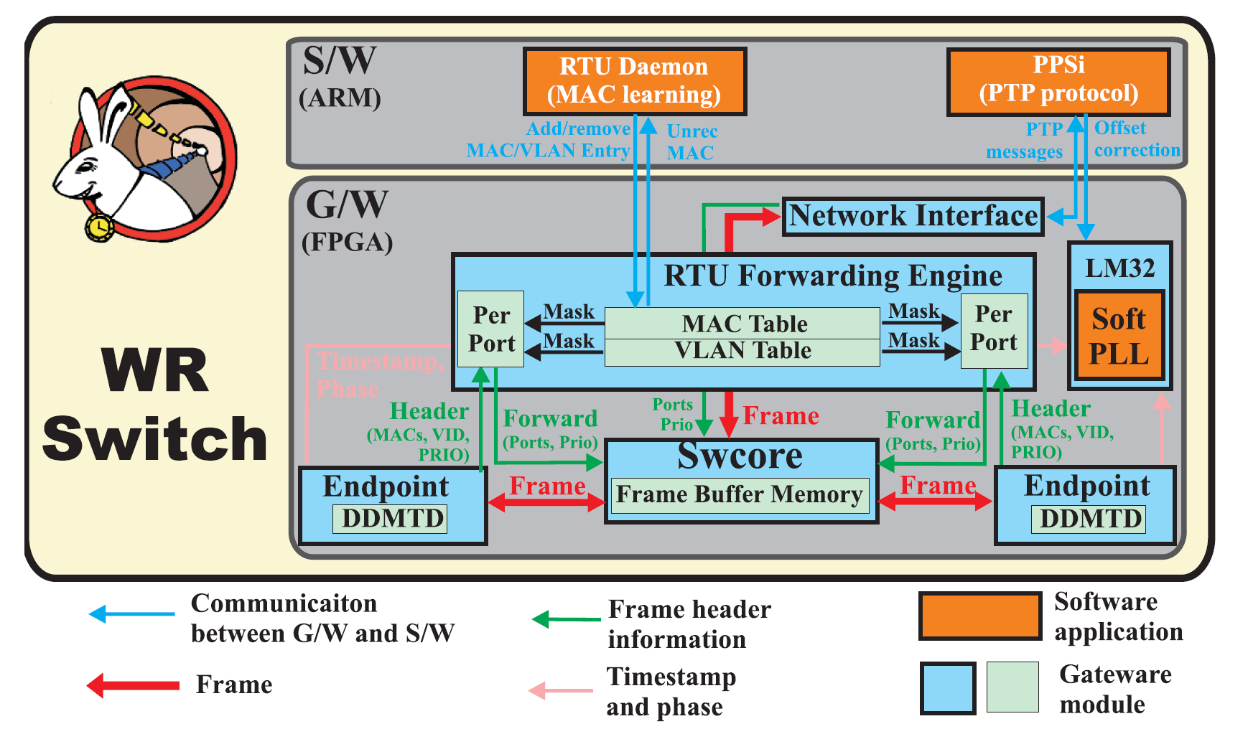
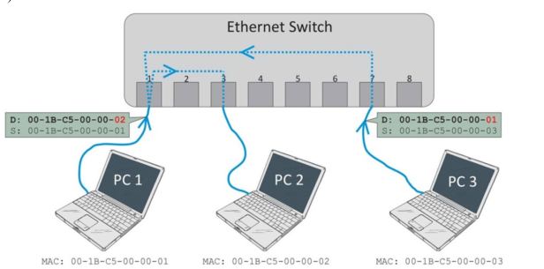
WR Switch - Data Forwarding Architecture
CPU
Source: M. Lipinski, Methods to Increase Reliability and Ensure Determinism in a White Rabbit Network, WUT PhD, Warsaw, Poland 2016

Slide 19
Interconnections of HDL modules in the WR Switch

Slide 20
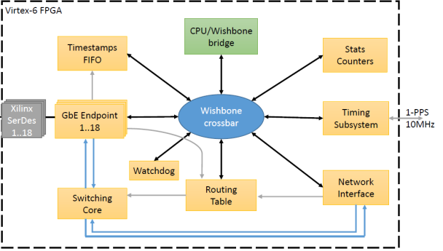
Interconnections of HDL modules

Slide 21
Interconnections of HDL modules in the WR Node

Slide 22
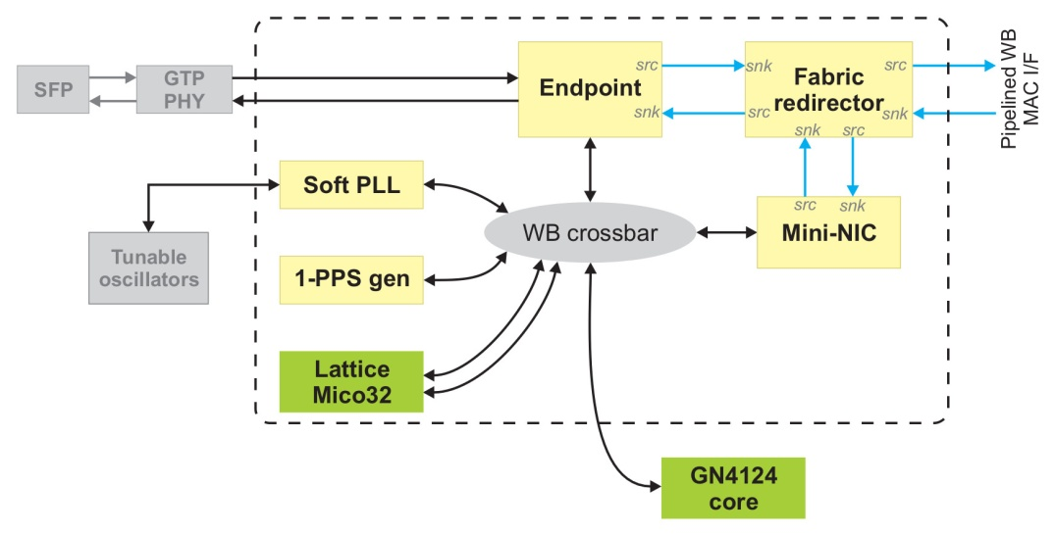

WR Node – HDL modules and their communication
WR PTP Core
(WRPC)
Serdes
CLK_{REF}
CLK_{DMTD}
adjust
I2C
User Data
1-PPS
timecode
frequency
Peripheral
CPU/registers

Slide 23
Software environment of the WR Switch

Slide 24
Compilation of software
Repository: https://ohwr.org/project/wr-switch-sw
Developers Manual: link
Compiling all software - execute wrs_build-all,ideally:
git clone git://ohwr.org/white-rabbit/wr-switch-sw.git
git submodule init
git submodule update
/path/to/wr-switch-sw/build/wrs_build-all 2>&1 | tee logfile \ | grep "^20..-..-.. ..:“
Compiling your own SW to work on WRS
BRX=/home/a/wr/wrs/clean/build/build/
LINUX=$BRX/linux-3.16.38/
CROSS_COMPILE=$BRX/buildroot-2016.02/output/host/usr/bin/arm-buildroot-linux-gnueabi-
make

Slide 25
Summary
WR Device Architecture and repositories
WR Timing Architecture in the WR Switch and WR Node
DDMTD and SoftPLL
Data Forwarding Architecture on the WR Switch
Compilation errors
NOTE: See backup slides for figures with detailed:
WR Switch HW-GW-SW interactions
WR Switch – detailed HDL modules design
Endpoint Block Diagram

Slide 26
Backup slides

Slide 27
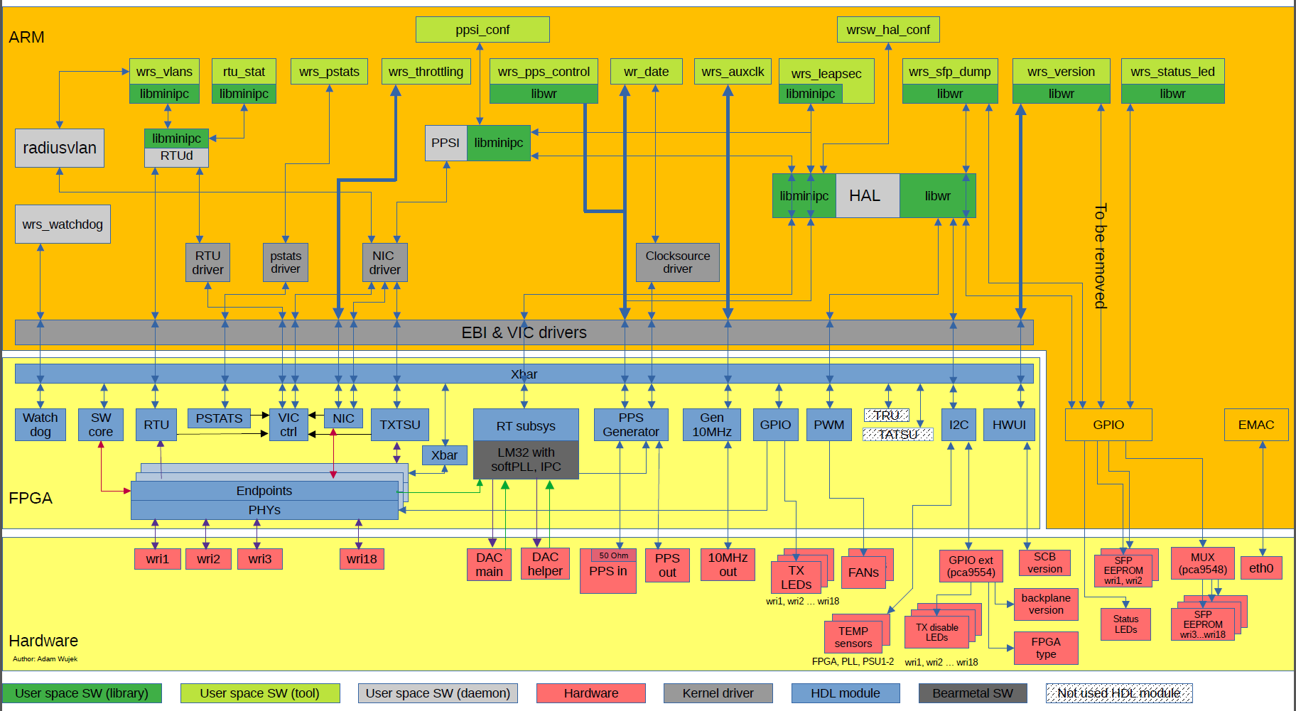
WR Switch HW-GW-SW interactions

Slide 28
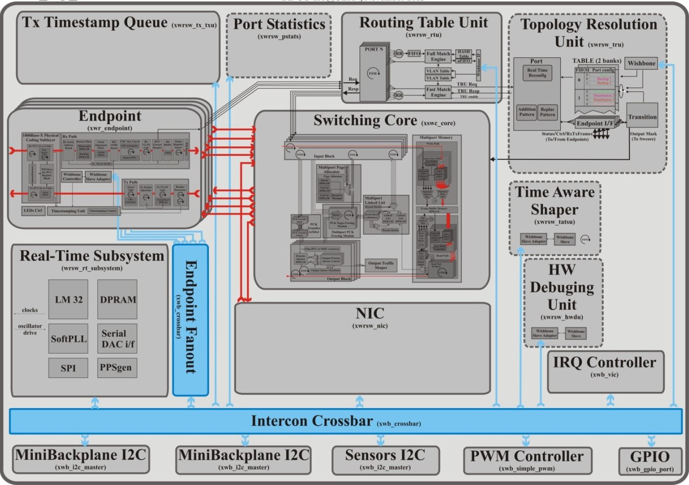
WR Switch – detailed HDL modules design

Slide 29
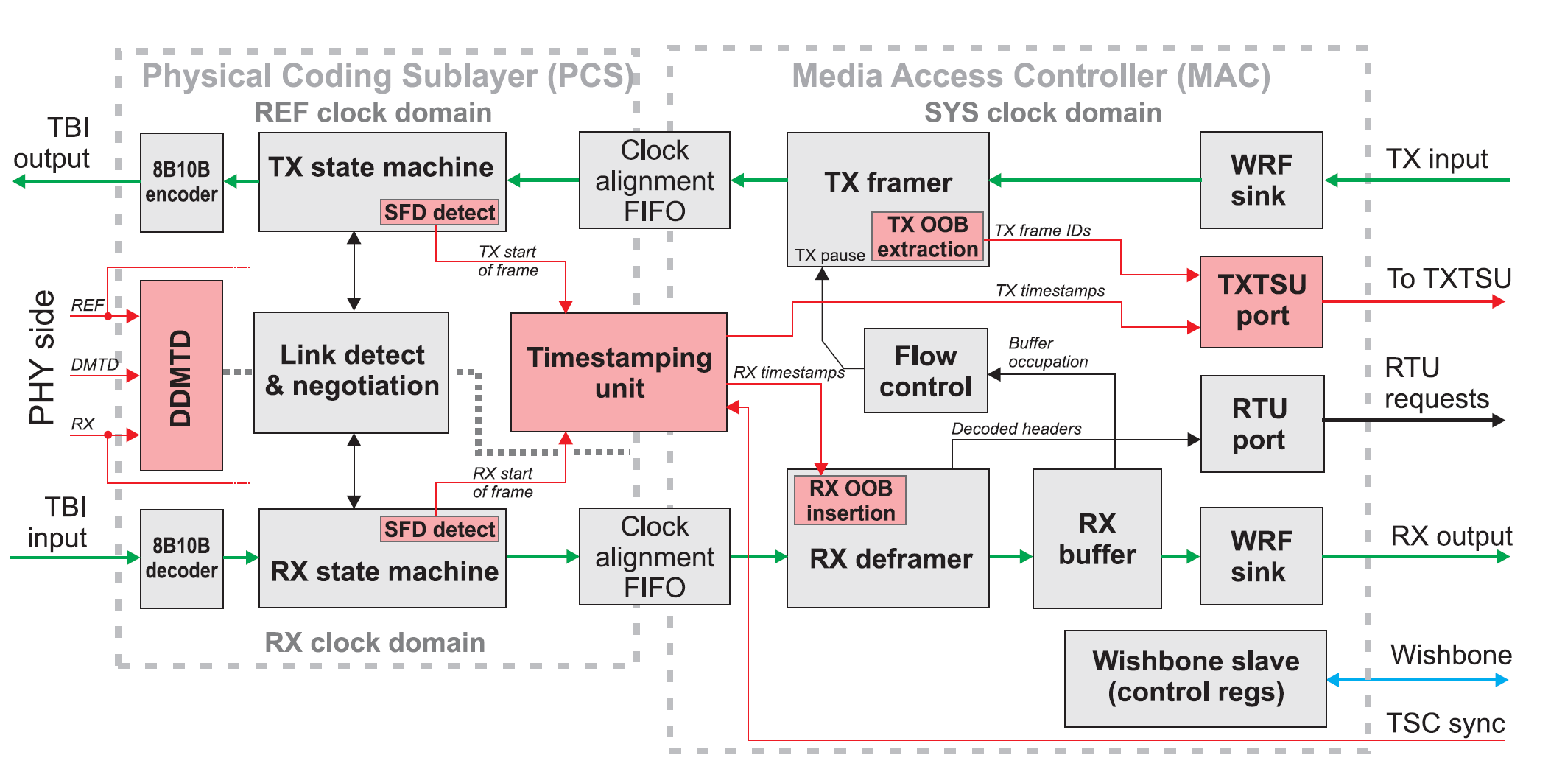
Endpoint Block Diagram
Source: T. Włostowski. Precise time and frequency transfer in a White Rabbit network. WUT Master’s thesis, Warsaw, Poland, May 2011.

