Slide 1


Oscillators a basic training
Training material

Slide 2
Agenda
    Intro to Oscillators
      What is an Oscillator?
      Resonator Types
      Quartz Oscillator Types
      Specifying an Oscillator
      Oscillator Noise

Slide 3
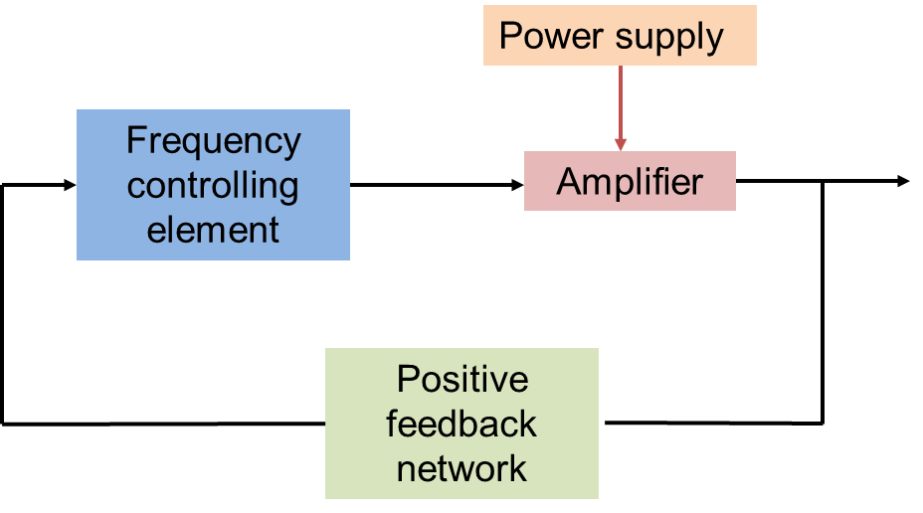
What is an Oscillator?
  An electronic oscillator can be considered as a device that provides an output waveform which fluctuates between two states in a repetitive, periodic and stable state.
  An oscillator needs two parameters to function:
  A positive feedback mechanism, and a gain greater than one.
    This gain is known as the Barkhausen criteria:
    The loop gain must be at unity (1) or greater
    The feedback loop must have a total phase shift of zero
  A quartz crystal based oscillator uses the crystal as the frequency controlling element, while additional electronics provide the feedback and positive gain required to sustain oscillation.
  Quartz is the most common resonator used because of its piezoelectric property, which has very high Q. It also has a long history of technical development with well-understood parameters, which allow predictable behavior.

Slide 4

Resonator Types
Resonator Types | Frequency Accuracy | Cost Indication | Frequency | Resonator Principle
LC/RC Oscillators | Stability ±10% | $0.05 | 1Hz to 500kHz | Controlled charge/discharge of capacitor via a damping mechanism
Ceramic Resonators | Stability ±1000ppm to ±5000ppm (0.1% to 0.5%) | $0.05 to $0.2 | 3MHz to 70MHz | Piezo coupling to mechanical resonance of shaped lead zirconate titanate (PZT)
Commodity Quartz Oscillators | Stability ±0.5ppm to ±100ppm | $0.1 to $1 | 32.768kHz, 1MHz to 800MHz | Piezo coupling to mechanical resonance of shaped quartz
MEMS Oscillators | Stability ±0.5ppb to ±50ppm | $1 to $10 | 32.768kHz, 1MHz to 800MHz | Piezo coupling to mechanical resonance of shaped silicon
High Stability Quartz Oscillators (OCXO’s) | Stability ±0.2ppb to ±50ppb (±0.0002ppm to 0.05ppm) | $100 to $1k | 10MHz to 100MHz | Piezo coupling to mechanical resonance of shaped quartz
Rubidium Oscillators | Stability ±0.02ppb to ±0.05ppb Ageing ±5E-12 in 24hours | $500 to $5k | 6.834,682,610,904 GHz (coupled to Quartz to give 10MHz) | Microwave control loop inducing hyperfine transition of electrons in Rubidium-87 atoms
Cesium Clocks | Ageing ±1E-12 to ±5E-13 | $50k to $100k | 9.192,631,770 GHz (coupled to Quartz to give 10MHz) | Microwave control loop inducing hyperfine ground states of Cesium-133 atoms. Note: Current definition of the SI unit of second
Hydrogen Maser | Ageing ±3E-16 in 24hours | $250k to $500k | 1.420,405,751,77 GHz (coupled to Quartz to give 10MHz) | Microwave control loop inducing hyperfine ground states of Hydrogen atoms
Optical Clocks | Ageing 1s in 15 billion years | Development only | THz | Optical Frequency control loop of various types
PCB mountable devices
Stand-alone units

Slide 5
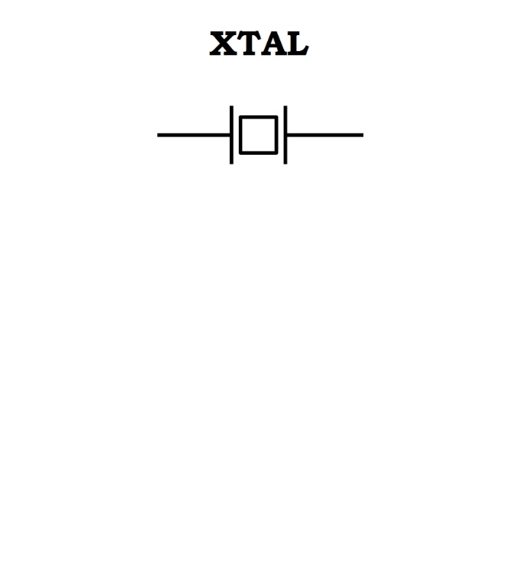
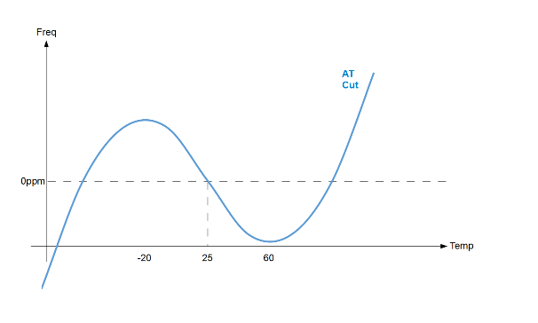
Quartz Oscillator types
Type | Device name | Description | Accuracy | Power
SPXO | Simple Packaged Crystal Oscillator | An oscillator based on the characteristics of AT-cut quartz but with no frequency adjustment or temperature compensation. | ±10ppm to ±100ppm | 50mW
VCXO | Voltage Controlled Crystal Oscillator | As SPXO but with ability to adjust the output frequency with an external control voltage. | ±10ppm to ±100ppm | 50mW
TCXO | Temperature Compensated Crystal Oscillator | As SPXO but with built-in temperature compensation circuitry to adjust for deviation over temperature due to AT-cut quartz characteristics. | ±50ppb to ±5ppm | 50mW
OCXO | Oven Controlled Crystal Oscillator | Oscillator that has a built-in heater to hold the SC-cut quartz crystal at a temperature near its inflection point where the frequency/temperature characteristic is flattest to achieve optimum frequency accuracy. | ±1ppb to ±50ppb | 1W to 5W
RBXO | Rubidium Controlled Crystal Oscillator | Oscillator consists of a rubidium ‘physics package’ that is locked to an OCXO. The OCXO provides the output signal while under control of the rubidium section. | ±0.5ppb | 5W
Type | Device name | Description | Accuracy | Power
SPXO | Simple Packaged Crystal Oscillator | An oscillator based on the characteristics of AT-cut quartz but with no frequency adjustment or temperature compensation. | ±10ppm to ±100ppm | 50mW
VCXO | Voltage Controlled Crystal Oscillator | As SPXO but with ability to adjust the output frequency with an external control voltage. | ±10ppm to ±100ppm | 50mW
TCXO | Temperature Compensated Crystal Oscillator | As SPXO but with built-in temperature compensation circuitry to adjust for deviation over temperature due to AT-cut quartz characteristics. | ±50ppb to ±5ppm | 50mW
OCXO | Oven Controlled Crystal Oscillator | Oscillator that has a built-in heater to hold the SC-cut quartz crystal at a temperature near its inflection point where the frequency/temperature characteristic is flattest to achieve optimum frequency accuracy. | ±1ppb to ±50ppb | 1W to 5W
RBXO | Rubidium Controlled Crystal Oscillator | Oscillator consists of a rubidium ‘physics package’ that is locked to an OCXO. The OCXO provides the output signal while under control of the rubidium section. | ±0.5ppb | 5W
Type | Device name | Description | Accuracy | Power
SPXO | Simple Packaged Crystal Oscillator | An oscillator based on the characteristics of AT-cut quartz but with no frequency adjustment or temperature compensation. | ±10ppm to ±100ppm | 50mW
VCXO | Voltage Controlled Crystal Oscillator | As SPXO but with ability to adjust the output frequency with an external control voltage. | ±10ppm to ±100ppm | 50mW
TCXO | Temperature Compensated Crystal Oscillator | As SPXO but with built-in temperature compensation circuitry to adjust for deviation over temperature due to AT-cut quartz characteristics. | ±50ppb to ±5ppm | 50mW
OCXO | Oven Controlled Crystal Oscillator | Oscillator that has a built-in heater to hold the SC-cut quartz crystal at a temperature near its inflection point where the frequency/temperature characteristic is flattest to achieve optimum frequency accuracy. | ±1ppb to ±50ppb | 1W to 5W
RBXO | Rubidium Controlled Crystal Oscillator | Oscillator consists of a rubidium ‘physics package’ that is locked to an OCXO. The OCXO provides the output signal while under control of the rubidium section. | ±0.5ppb | 5W
Type | Device name | Description | Accuracy | Power
SPXO | Simple Packaged Crystal Oscillator | An oscillator based on the characteristics of AT-cut quartz but with no frequency adjustment or temperature compensation. | ±10ppm to ±100ppm | 50mW
VCXO | Voltage Controlled Crystal Oscillator | As SPXO but with ability to adjust the output frequency with an external control voltage. | ±10ppm to ±100ppm | 50mW
TCXO | Temperature Compensated Crystal Oscillator | As SPXO but with built-in temperature compensation circuitry to adjust for deviation over temperature due to AT-cut quartz characteristics. | ±50ppb to ±5ppm | 50mW
OCXO | Oven Controlled Crystal Oscillator | Oscillator that has a built-in heater to hold the SC-cut quartz crystal at a temperature near its inflection point where the frequency/temperature characteristic is flattest to achieve optimum frequency accuracy. | ±1ppb to ±50ppb | 1W to 5W
RBXO | Rubidium Controlled Crystal Oscillator | Oscillator consists of a rubidium ‘physics package’ that is locked to an OCXO. The OCXO provides the output signal while under control of the rubidium section. | ±0.5ppb | 5W
Type | Device name | Description | Accuracy | Power
SPXO | Simple Packaged Crystal Oscillator | An oscillator based on the characteristics of AT-cut quartz but with no frequency adjustment or temperature compensation. | ±10ppm to ±100ppm | 50mW
VCXO | Voltage Controlled Crystal Oscillator | As SPXO but with ability to adjust the output frequency with an external control voltage. | ±10ppm to ±100ppm | 50mW
TCXO | Temperature Compensated Crystal Oscillator | As SPXO but with built-in temperature compensation circuitry to adjust for deviation over temperature due to AT-cut quartz characteristics. | ±50ppb to ±5ppm | 50mW
OCXO | Oven Controlled Crystal Oscillator | Oscillator that has a built-in heater to hold the SC-cut quartz crystal at a temperature near its inflection point where the frequency/temperature characteristic is flattest to achieve optimum frequency accuracy. | ±1ppb to ±50ppb | 1W to 5W
RBXO | Rubidium Controlled Crystal Oscillator | Oscillator consists of a rubidium ‘physics package’ that is locked to an OCXO. The OCXO provides the output signal while under control of the rubidium section. | ±0.5ppb | 5W
Type | Device name | Description | Accuracy | Power
SPXO | Simple Packaged Crystal Oscillator | An oscillator based on the characteristics of AT-cut quartz but with no frequency adjustment or temperature compensation. | ±10ppm to ±100ppm | 50mW
VCXO | Voltage Controlled Crystal Oscillator | As SPXO but with ability to adjust the output frequency with an external control voltage. | ±10ppm to ±100ppm | 50mW
TCXO | Temperature Compensated Crystal Oscillator | As SPXO but with built-in temperature compensation circuitry to adjust for deviation over temperature due to AT-cut quartz characteristics. | ±50ppb to ±5ppm | 50mW
OCXO | Oven Controlled Crystal Oscillator | Oscillator that has a built-in heater to hold the SC-cut quartz crystal at a temperature near its inflection point where the frequency/temperature characteristic is flattest to achieve optimum frequency accuracy. | ±1ppb to ±50ppb | 1W to 5W
RBXO | Rubidium Controlled Crystal Oscillator | Oscillator consists of a rubidium ‘physics package’ that is locked to an OCXO. The OCXO provides the output signal while under control of the rubidium section. | ±0.5ppb | 5W
Type | Device name | Description | Accuracy | Power
SPXO | Simple Packaged Crystal Oscillator | An oscillator based on the characteristics of AT-cut quartz but with no frequency adjustment or temperature compensation. | ±10ppm to ±100ppm | 50mW
VCXO | Voltage Controlled Crystal Oscillator | As SPXO but with ability to adjust the output frequency with an external control voltage. | ±10ppm to ±100ppm | 50mW
TCXO | Temperature Compensated Crystal Oscillator | As SPXO but with built-in temperature compensation circuitry to adjust for deviation over temperature due to AT-cut quartz characteristics. | ±50ppb to ±5ppm | 50mW
OCXO | Oven Controlled Crystal Oscillator | Oscillator that has a built-in heater to hold the SC-cut quartz crystal at a temperature near its inflection point where the frequency/temperature characteristic is flattest to achieve optimum frequency accuracy. | ±1ppb to ±50ppb | 1W to 5W
RBXO | Rubidium Controlled Crystal Oscillator | Oscillator consists of a rubidium ‘physics package’ that is locked to an OCXO. The OCXO provides the output signal while under control of the rubidium section. | ±0.5ppb | 5W
5 / 23
White Rabbit Collaboration – Training Material

Slide 6
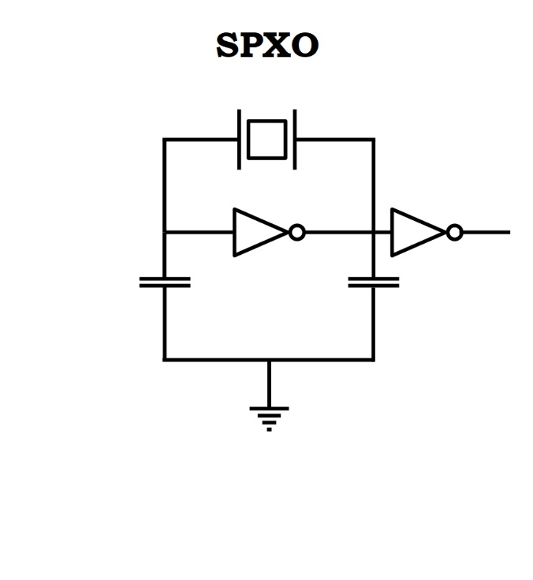
Quartz Oscillator types
Type | Device name | Description | Accuracy | Power
SPXO | Simple Packaged Crystal Oscillator | An oscillator based on the characteristics of AT-cut quartz but with no frequency adjustment or temperature compensation. | ±10ppm to ±100ppm | 50mW
VCXO | Voltage Controlled Crystal Oscillator | As SPXO but with ability to adjust the output frequency with an external control voltage. | ±10ppm to ±100ppm | 50mW
TCXO | Temperature Compensated Crystal Oscillator | As SPXO but with built-in temperature compensation circuitry to adjust for deviation over temperature due to AT-cut quartz characteristics. | ±50ppb to ±5ppm | 50mW
OCXO | Oven Controlled Crystal Oscillator | Oscillator that has a built-in heater to hold the SC-cut quartz crystal at a temperature near its inflection point where the frequency/temperature characteristic is flattest to achieve optimum frequency accuracy. | ±1ppb to ±50ppb | 1W to 5W
RBXO | Rubidium Controlled Crystal Oscillator | Oscillator consists of a rubidium ‘physics package’ that is locked to an OCXO. The OCXO provides the output signal while under control of the rubidium section. | ±0.5ppb | 5W
Type | Device name | Description | Accuracy | Power
SPXO | Simple Packaged Crystal Oscillator | An oscillator based on the characteristics of AT-cut quartz but with no frequency adjustment or temperature compensation. | ±10ppm to ±100ppm | 50mW
VCXO | Voltage Controlled Crystal Oscillator | As SPXO but with ability to adjust the output frequency with an external control voltage. | ±10ppm to ±100ppm | 50mW
TCXO | Temperature Compensated Crystal Oscillator | As SPXO but with built-in temperature compensation circuitry to adjust for deviation over temperature due to AT-cut quartz characteristics. | ±50ppb to ±5ppm | 50mW
OCXO | Oven Controlled Crystal Oscillator | Oscillator that has a built-in heater to hold the SC-cut quartz crystal at a temperature near its inflection point where the frequency/temperature characteristic is flattest to achieve optimum frequency accuracy. | ±1ppb to ±50ppb | 1W to 5W
RBXO | Rubidium Controlled Crystal Oscillator | Oscillator consists of a rubidium ‘physics package’ that is locked to an OCXO. The OCXO provides the output signal while under control of the rubidium section. | ±0.5ppb | 5W
Type | Device name | Description | Accuracy | Power
SPXO | Simple Packaged Crystal Oscillator | An oscillator based on the characteristics of AT-cut quartz but with no frequency adjustment or temperature compensation. | ±10ppm to ±100ppm | 50mW
VCXO | Voltage Controlled Crystal Oscillator | As SPXO but with ability to adjust the output frequency with an external control voltage. | ±10ppm to ±100ppm | 50mW
TCXO | Temperature Compensated Crystal Oscillator | As SPXO but with built-in temperature compensation circuitry to adjust for deviation over temperature due to AT-cut quartz characteristics. | ±50ppb to ±5ppm | 50mW
OCXO | Oven Controlled Crystal Oscillator | Oscillator that has a built-in heater to hold the SC-cut quartz crystal at a temperature near its inflection point where the frequency/temperature characteristic is flattest to achieve optimum frequency accuracy. | ±1ppb to ±50ppb | 1W to 5W
RBXO | Rubidium Controlled Crystal Oscillator | Oscillator consists of a rubidium ‘physics package’ that is locked to an OCXO. The OCXO provides the output signal while under control of the rubidium section. | ±0.5ppb | 5W
Type | Device name | Description | Accuracy | Power
SPXO | Simple Packaged Crystal Oscillator | An oscillator based on the characteristics of AT-cut quartz but with no frequency adjustment or temperature compensation. | ±10ppm to ±100ppm | 50mW
VCXO | Voltage Controlled Crystal Oscillator | As SPXO but with ability to adjust the output frequency with an external control voltage. | ±10ppm to ±100ppm | 50mW
TCXO | Temperature Compensated Crystal Oscillator | As SPXO but with built-in temperature compensation circuitry to adjust for deviation over temperature due to AT-cut quartz characteristics. | ±50ppb to ±5ppm | 50mW
OCXO | Oven Controlled Crystal Oscillator | Oscillator that has a built-in heater to hold the SC-cut quartz crystal at a temperature near its inflection point where the frequency/temperature characteristic is flattest to achieve optimum frequency accuracy. | ±1ppb to ±50ppb | 1W to 5W
RBXO | Rubidium Controlled Crystal Oscillator | Oscillator consists of a rubidium ‘physics package’ that is locked to an OCXO. The OCXO provides the output signal while under control of the rubidium section. | ±0.5ppb | 5W
Type | Device name | Description | Accuracy | Power
SPXO | Simple Packaged Crystal Oscillator | An oscillator based on the characteristics of AT-cut quartz but with no frequency adjustment or temperature compensation. | ±10ppm to ±100ppm | 50mW
VCXO | Voltage Controlled Crystal Oscillator | As SPXO but with ability to adjust the output frequency with an external control voltage. | ±10ppm to ±100ppm | 50mW
TCXO | Temperature Compensated Crystal Oscillator | As SPXO but with built-in temperature compensation circuitry to adjust for deviation over temperature due to AT-cut quartz characteristics. | ±50ppb to ±5ppm | 50mW
OCXO | Oven Controlled Crystal Oscillator | Oscillator that has a built-in heater to hold the SC-cut quartz crystal at a temperature near its inflection point where the frequency/temperature characteristic is flattest to achieve optimum frequency accuracy. | ±1ppb to ±50ppb | 1W to 5W
RBXO | Rubidium Controlled Crystal Oscillator | Oscillator consists of a rubidium ‘physics package’ that is locked to an OCXO. The OCXO provides the output signal while under control of the rubidium section. | ±0.5ppb | 5W
Type | Device name | Description | Accuracy | Power
SPXO | Simple Packaged Crystal Oscillator | An oscillator based on the characteristics of AT-cut quartz but with no frequency adjustment or temperature compensation. | ±10ppm to ±100ppm | 50mW
VCXO | Voltage Controlled Crystal Oscillator | As SPXO but with ability to adjust the output frequency with an external control voltage. | ±10ppm to ±100ppm | 50mW
TCXO | Temperature Compensated Crystal Oscillator | As SPXO but with built-in temperature compensation circuitry to adjust for deviation over temperature due to AT-cut quartz characteristics. | ±50ppb to ±5ppm | 50mW
OCXO | Oven Controlled Crystal Oscillator | Oscillator that has a built-in heater to hold the SC-cut quartz crystal at a temperature near its inflection point where the frequency/temperature characteristic is flattest to achieve optimum frequency accuracy. | ±1ppb to ±50ppb | 1W to 5W
RBXO | Rubidium Controlled Crystal Oscillator | Oscillator consists of a rubidium ‘physics package’ that is locked to an OCXO. The OCXO provides the output signal while under control of the rubidium section. | ±0.5ppb | 5W
Type | Device name | Description | Accuracy | Power
SPXO | Simple Packaged Crystal Oscillator | An oscillator based on the characteristics of AT-cut quartz but with no frequency adjustment or temperature compensation. | ±10ppm to ±100ppm | 50mW
VCXO | Voltage Controlled Crystal Oscillator | As SPXO but with ability to adjust the output frequency with an external control voltage. | ±10ppm to ±100ppm | 50mW
TCXO | Temperature Compensated Crystal Oscillator | As SPXO but with built-in temperature compensation circuitry to adjust for deviation over temperature due to AT-cut quartz characteristics. | ±50ppb to ±5ppm | 50mW
OCXO | Oven Controlled Crystal Oscillator | Oscillator that has a built-in heater to hold the SC-cut quartz crystal at a temperature near its inflection point where the frequency/temperature characteristic is flattest to achieve optimum frequency accuracy. | ±1ppb to ±50ppb | 1W to 5W
RBXO | Rubidium Controlled Crystal Oscillator | Oscillator consists of a rubidium ‘physics package’ that is locked to an OCXO. The OCXO provides the output signal while under control of the rubidium section. | ±0.5ppb | 5W
6 / 23
White Rabbit Collaboration – Training Material

Slide 7
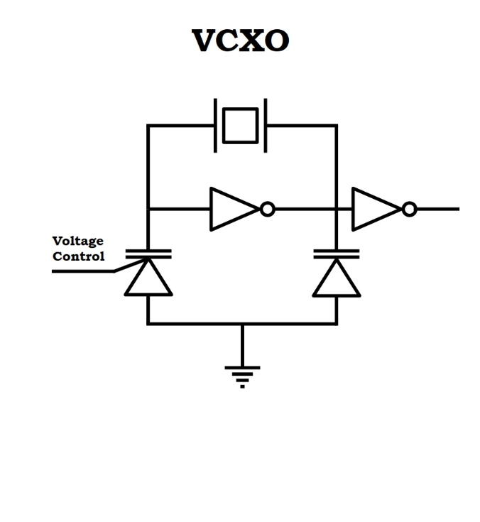
Quartz Oscillator types
Type | Device name | Description | Accuracy | Power
SPXO | Simple Packaged Crystal Oscillator | An oscillator based on the characteristics of AT-cut quartz but with no frequency adjustment or temperature compensation. | ±10ppm to ±100ppm | 50mW
VCXO | Voltage Controlled Crystal Oscillator | As SPXO but with ability to adjust the output frequency with an external control voltage. | ±10ppm to ±100ppm | 50mW
TCXO | Temperature Compensated Crystal Oscillator | As SPXO but with built-in temperature compensation circuitry to adjust for deviation over temperature due to AT-cut quartz characteristics. | ±50ppb to ±5ppm | 50mW
OCXO | Oven Controlled Crystal Oscillator | Oscillator that has a built-in heater to hold the SC-cut quartz crystal at a temperature near its inflection point where the frequency/temperature characteristic is flattest to achieve optimum frequency accuracy. | ±1ppb to ±50ppb | 1W to 5W
RBXO | Rubidium Controlled Crystal Oscillator | Oscillator consists of a rubidium ‘physics package’ that is locked to an OCXO. The OCXO provides the output signal while under control of the rubidium section. | ±0.5ppb | 5W
Type | Device name | Description | Accuracy | Power
SPXO | Simple Packaged Crystal Oscillator | An oscillator based on the characteristics of AT-cut quartz but with no frequency adjustment or temperature compensation. | ±10ppm to ±100ppm | 50mW
VCXO | Voltage Controlled Crystal Oscillator | As SPXO but with ability to adjust the output frequency with an external control voltage. | ±10ppm to ±100ppm | 50mW
TCXO | Temperature Compensated Crystal Oscillator | As SPXO but with built-in temperature compensation circuitry to adjust for deviation over temperature due to AT-cut quartz characteristics. | ±50ppb to ±5ppm | 50mW
OCXO | Oven Controlled Crystal Oscillator | Oscillator that has a built-in heater to hold the SC-cut quartz crystal at a temperature near its inflection point where the frequency/temperature characteristic is flattest to achieve optimum frequency accuracy. | ±1ppb to ±50ppb | 1W to 5W
RBXO | Rubidium Controlled Crystal Oscillator | Oscillator consists of a rubidium ‘physics package’ that is locked to an OCXO. The OCXO provides the output signal while under control of the rubidium section. | ±0.5ppb | 5W
Type | Device name | Description | Accuracy | Power
SPXO | Simple Packaged Crystal Oscillator | An oscillator based on the characteristics of AT-cut quartz but with no frequency adjustment or temperature compensation. | ±10ppm to ±100ppm | 50mW
VCXO | Voltage Controlled Crystal Oscillator | As SPXO but with ability to adjust the output frequency with an external control voltage. | ±10ppm to ±100ppm | 50mW
TCXO | Temperature Compensated Crystal Oscillator | As SPXO but with built-in temperature compensation circuitry to adjust for deviation over temperature due to AT-cut quartz characteristics. | ±50ppb to ±5ppm | 50mW
OCXO | Oven Controlled Crystal Oscillator | Oscillator that has a built-in heater to hold the SC-cut quartz crystal at a temperature near its inflection point where the frequency/temperature characteristic is flattest to achieve optimum frequency accuracy. | ±1ppb to ±50ppb | 1W to 5W
RBXO | Rubidium Controlled Crystal Oscillator | Oscillator consists of a rubidium ‘physics package’ that is locked to an OCXO. The OCXO provides the output signal while under control of the rubidium section. | ±0.5ppb | 5W
Type | Device name | Description | Accuracy | Power
SPXO | Simple Packaged Crystal Oscillator | An oscillator based on the characteristics of AT-cut quartz but with no frequency adjustment or temperature compensation. | ±10ppm to ±100ppm | 50mW
VCXO | Voltage Controlled Crystal Oscillator | As SPXO but with ability to adjust the output frequency with an external control voltage. | ±10ppm to ±100ppm | 50mW
TCXO | Temperature Compensated Crystal Oscillator | As SPXO but with built-in temperature compensation circuitry to adjust for deviation over temperature due to AT-cut quartz characteristics. | ±50ppb to ±5ppm | 50mW
OCXO | Oven Controlled Crystal Oscillator | Oscillator that has a built-in heater to hold the SC-cut quartz crystal at a temperature near its inflection point where the frequency/temperature characteristic is flattest to achieve optimum frequency accuracy. | ±1ppb to ±50ppb | 1W to 5W
RBXO | Rubidium Controlled Crystal Oscillator | Oscillator consists of a rubidium ‘physics package’ that is locked to an OCXO. The OCXO provides the output signal while under control of the rubidium section. | ±0.5ppb | 5W
Type | Device name | Description | Accuracy | Power
SPXO | Simple Packaged Crystal Oscillator | An oscillator based on the characteristics of AT-cut quartz but with no frequency adjustment or temperature compensation. | ±10ppm to ±100ppm | 50mW
VCXO | Voltage Controlled Crystal Oscillator | As SPXO but with ability to adjust the output frequency with an external control voltage. | ±10ppm to ±100ppm | 50mW
TCXO | Temperature Compensated Crystal Oscillator | As SPXO but with built-in temperature compensation circuitry to adjust for deviation over temperature due to AT-cut quartz characteristics. | ±50ppb to ±5ppm | 50mW
OCXO | Oven Controlled Crystal Oscillator | Oscillator that has a built-in heater to hold the SC-cut quartz crystal at a temperature near its inflection point where the frequency/temperature characteristic is flattest to achieve optimum frequency accuracy. | ±1ppb to ±50ppb | 1W to 5W
RBXO | Rubidium Controlled Crystal Oscillator | Oscillator consists of a rubidium ‘physics package’ that is locked to an OCXO. The OCXO provides the output signal while under control of the rubidium section. | ±0.5ppb | 5W
Type | Device name | Description | Accuracy | Power
SPXO | Simple Packaged Crystal Oscillator | An oscillator based on the characteristics of AT-cut quartz but with no frequency adjustment or temperature compensation. | ±10ppm to ±100ppm | 50mW
VCXO | Voltage Controlled Crystal Oscillator | As SPXO but with ability to adjust the output frequency with an external control voltage. | ±10ppm to ±100ppm | 50mW
TCXO | Temperature Compensated Crystal Oscillator | As SPXO but with built-in temperature compensation circuitry to adjust for deviation over temperature due to AT-cut quartz characteristics. | ±50ppb to ±5ppm | 50mW
OCXO | Oven Controlled Crystal Oscillator | Oscillator that has a built-in heater to hold the SC-cut quartz crystal at a temperature near its inflection point where the frequency/temperature characteristic is flattest to achieve optimum frequency accuracy. | ±1ppb to ±50ppb | 1W to 5W
RBXO | Rubidium Controlled Crystal Oscillator | Oscillator consists of a rubidium ‘physics package’ that is locked to an OCXO. The OCXO provides the output signal while under control of the rubidium section. | ±0.5ppb | 5W
Type | Device name | Description | Accuracy | Power
SPXO | Simple Packaged Crystal Oscillator | An oscillator based on the characteristics of AT-cut quartz but with no frequency adjustment or temperature compensation. | ±10ppm to ±100ppm | 50mW
VCXO | Voltage Controlled Crystal Oscillator | As SPXO but with ability to adjust the output frequency with an external control voltage. | ±10ppm to ±100ppm | 50mW
TCXO | Temperature Compensated Crystal Oscillator | As SPXO but with built-in temperature compensation circuitry to adjust for deviation over temperature due to AT-cut quartz characteristics. | ±50ppb to ±5ppm | 50mW
OCXO | Oven Controlled Crystal Oscillator | Oscillator that has a built-in heater to hold the SC-cut quartz crystal at a temperature near its inflection point where the frequency/temperature characteristic is flattest to achieve optimum frequency accuracy. | ±1ppb to ±50ppb | 1W to 5W
RBXO | Rubidium Controlled Crystal Oscillator | Oscillator consists of a rubidium ‘physics package’ that is locked to an OCXO. The OCXO provides the output signal while under control of the rubidium section. | ±0.5ppb | 5W
7 / 23
White Rabbit Collaboration – Training Material

Slide 8
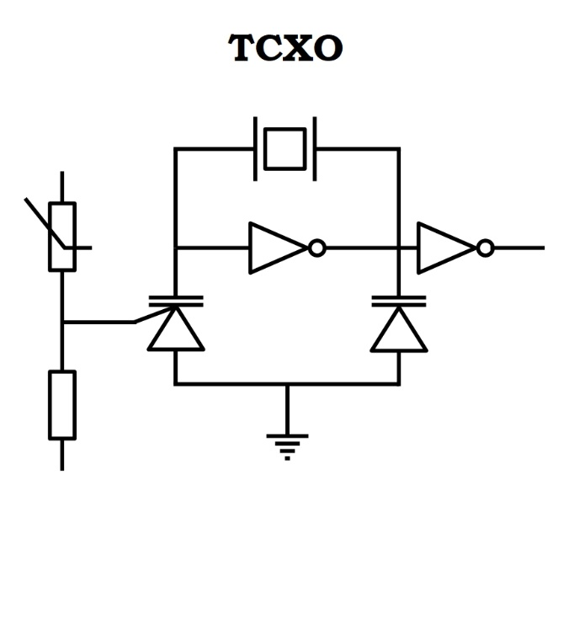
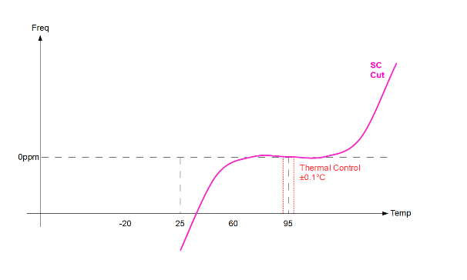
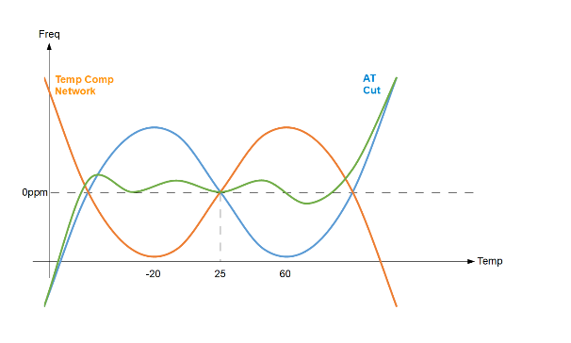
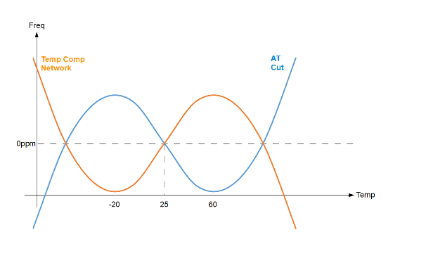
Quartz Oscillator types
Type | Device name | Description | Accuracy | Power
SPXO | Simple Packaged Crystal Oscillator | An oscillator based on the characteristics of AT-cut quartz but with no frequency adjustment or temperature compensation. | ±10ppm to ±100ppm | 50mW
VCXO | Voltage Controlled Crystal Oscillator | As SPXO but with ability to adjust the output frequency with an external control voltage. | ±10ppm to ±100ppm | 50mW
TCXO | Temperature Compensated Crystal Oscillator | As SPXO but with built-in temperature compensation circuitry to adjust for deviation over temperature due to AT-cut quartz characteristics. | ±50ppb to ±5ppm | 50mW
OCXO | Oven Controlled Crystal Oscillator | Oscillator that has a built-in heater to hold the SC-cut quartz crystal at a temperature near its inflection point where the frequency/temperature characteristic is flattest to achieve optimum frequency accuracy. | ±1ppb to ±50ppb | 1W to 5W
RBXO | Rubidium Controlled Crystal Oscillator | Oscillator consists of a rubidium ‘physics package’ that is locked to an OCXO. The OCXO provides the output signal while under control of the rubidium section. | ±0.5ppb | 5W
Type | Device name | Description | Accuracy | Power
SPXO | Simple Packaged Crystal Oscillator | An oscillator based on the characteristics of AT-cut quartz but with no frequency adjustment or temperature compensation. | ±10ppm to ±100ppm | 50mW
VCXO | Voltage Controlled Crystal Oscillator | As SPXO but with ability to adjust the output frequency with an external control voltage. | ±10ppm to ±100ppm | 50mW
TCXO | Temperature Compensated Crystal Oscillator | As SPXO but with built-in temperature compensation circuitry to adjust for deviation over temperature due to AT-cut quartz characteristics. | ±50ppb to ±5ppm | 50mW
OCXO | Oven Controlled Crystal Oscillator | Oscillator that has a built-in heater to hold the SC-cut quartz crystal at a temperature near its inflection point where the frequency/temperature characteristic is flattest to achieve optimum frequency accuracy. | ±1ppb to ±50ppb | 1W to 5W
RBXO | Rubidium Controlled Crystal Oscillator | Oscillator consists of a rubidium ‘physics package’ that is locked to an OCXO. The OCXO provides the output signal while under control of the rubidium section. | ±0.5ppb | 5W
Type | Device name | Description | Accuracy | Power
SPXO | Simple Packaged Crystal Oscillator | An oscillator based on the characteristics of AT-cut quartz but with no frequency adjustment or temperature compensation. | ±10ppm to ±100ppm | 50mW
VCXO | Voltage Controlled Crystal Oscillator | As SPXO but with ability to adjust the output frequency with an external control voltage. | ±10ppm to ±100ppm | 50mW
TCXO | Temperature Compensated Crystal Oscillator | As SPXO but with built-in temperature compensation circuitry to adjust for deviation over temperature due to AT-cut quartz characteristics. | ±50ppb to ±5ppm | 50mW
OCXO | Oven Controlled Crystal Oscillator | Oscillator that has a built-in heater to hold the SC-cut quartz crystal at a temperature near its inflection point where the frequency/temperature characteristic is flattest to achieve optimum frequency accuracy. | ±1ppb to ±50ppb | 1W to 5W
RBXO | Rubidium Controlled Crystal Oscillator | Oscillator consists of a rubidium ‘physics package’ that is locked to an OCXO. The OCXO provides the output signal while under control of the rubidium section. | ±0.5ppb | 5W
Type | Device name | Description | Accuracy | Power
SPXO | Simple Packaged Crystal Oscillator | An oscillator based on the characteristics of AT-cut quartz but with no frequency adjustment or temperature compensation. | ±10ppm to ±100ppm | 50mW
VCXO | Voltage Controlled Crystal Oscillator | As SPXO but with ability to adjust the output frequency with an external control voltage. | ±10ppm to ±100ppm | 50mW
TCXO | Temperature Compensated Crystal Oscillator | As SPXO but with built-in temperature compensation circuitry to adjust for deviation over temperature due to AT-cut quartz characteristics. | ±50ppb to ±5ppm | 50mW
OCXO | Oven Controlled Crystal Oscillator | Oscillator that has a built-in heater to hold the SC-cut quartz crystal at a temperature near its inflection point where the frequency/temperature characteristic is flattest to achieve optimum frequency accuracy. | ±1ppb to ±50ppb | 1W to 5W
RBXO | Rubidium Controlled Crystal Oscillator | Oscillator consists of a rubidium ‘physics package’ that is locked to an OCXO. The OCXO provides the output signal while under control of the rubidium section. | ±0.5ppb | 5W
Type | Device name | Description | Accuracy | Power
SPXO | Simple Packaged Crystal Oscillator | An oscillator based on the characteristics of AT-cut quartz but with no frequency adjustment or temperature compensation. | ±10ppm to ±100ppm | 50mW
VCXO | Voltage Controlled Crystal Oscillator | As SPXO but with ability to adjust the output frequency with an external control voltage. | ±10ppm to ±100ppm | 50mW
TCXO | Temperature Compensated Crystal Oscillator | As SPXO but with built-in temperature compensation circuitry to adjust for deviation over temperature due to AT-cut quartz characteristics. | ±50ppb to ±5ppm | 50mW
OCXO | Oven Controlled Crystal Oscillator | Oscillator that has a built-in heater to hold the SC-cut quartz crystal at a temperature near its inflection point where the frequency/temperature characteristic is flattest to achieve optimum frequency accuracy. | ±1ppb to ±50ppb | 1W to 5W
RBXO | Rubidium Controlled Crystal Oscillator | Oscillator consists of a rubidium ‘physics package’ that is locked to an OCXO. The OCXO provides the output signal while under control of the rubidium section. | ±0.5ppb | 5W
Type | Device name | Description | Accuracy | Power
SPXO | Simple Packaged Crystal Oscillator | An oscillator based on the characteristics of AT-cut quartz but with no frequency adjustment or temperature compensation. | ±10ppm to ±100ppm | 50mW
VCXO | Voltage Controlled Crystal Oscillator | As SPXO but with ability to adjust the output frequency with an external control voltage. | ±10ppm to ±100ppm | 50mW
TCXO | Temperature Compensated Crystal Oscillator | As SPXO but with built-in temperature compensation circuitry to adjust for deviation over temperature due to AT-cut quartz characteristics. | ±50ppb to ±5ppm | 50mW
OCXO | Oven Controlled Crystal Oscillator | Oscillator that has a built-in heater to hold the SC-cut quartz crystal at a temperature near its inflection point where the frequency/temperature characteristic is flattest to achieve optimum frequency accuracy. | ±1ppb to ±50ppb | 1W to 5W
RBXO | Rubidium Controlled Crystal Oscillator | Oscillator consists of a rubidium ‘physics package’ that is locked to an OCXO. The OCXO provides the output signal while under control of the rubidium section. | ±0.5ppb | 5W
Type | Device name | Description | Accuracy | Power
SPXO | Simple Packaged Crystal Oscillator | An oscillator based on the characteristics of AT-cut quartz but with no frequency adjustment or temperature compensation. | ±10ppm to ±100ppm | 50mW
VCXO | Voltage Controlled Crystal Oscillator | As SPXO but with ability to adjust the output frequency with an external control voltage. | ±10ppm to ±100ppm | 50mW
TCXO | Temperature Compensated Crystal Oscillator | As SPXO but with built-in temperature compensation circuitry to adjust for deviation over temperature due to AT-cut quartz characteristics. | ±50ppb to ±5ppm | 50mW
OCXO | Oven Controlled Crystal Oscillator | Oscillator that has a built-in heater to hold the SC-cut quartz crystal at a temperature near its inflection point where the frequency/temperature characteristic is flattest to achieve optimum frequency accuracy. | ±1ppb to ±50ppb | 1W to 5W
RBXO | Rubidium Controlled Crystal Oscillator | Oscillator consists of a rubidium ‘physics package’ that is locked to an OCXO. The OCXO provides the output signal while under control of the rubidium section. | ±0.5ppb | 5W
8 / 23
White Rabbit Collaboration – Training Material

Slide 9
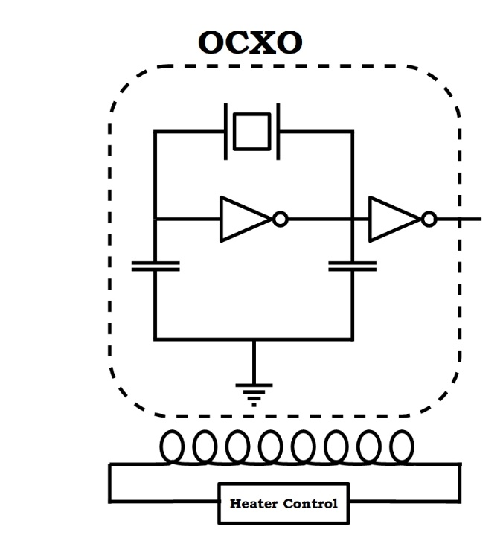
Quartz Oscillator types
Type | Device name | Description | Accuracy | Power
SPXO | Simple Packaged Crystal Oscillator | An oscillator based on the characteristics of AT-cut quartz but with no frequency adjustment or temperature compensation. | ±10ppm to ±100ppm | 50mW
VCXO | Voltage Controlled Crystal Oscillator | As SPXO but with ability to adjust the output frequency with an external control voltage. | ±10ppm to ±100ppm | 50mW
TCXO | Temperature Compensated Crystal Oscillator | As SPXO but with built-in temperature compensation circuitry to adjust for deviation over temperature due to AT-cut quartz characteristics. | ±50ppb to ±5ppm | 50mW
OCXO | Oven Controlled Crystal Oscillator | Oscillator that has a built-in heater to hold the SC-cut quartz crystal at a temperature near its inflection point where the frequency/temperature characteristic is flattest to achieve optimum frequency accuracy. | ±1ppb to ±50ppb | 1W to 5W
RBXO | Rubidium Controlled Crystal Oscillator | Oscillator consists of a rubidium ‘physics package’ that is locked to an OCXO. The OCXO provides the output signal while under control of the rubidium section. | ±0.5ppb | 5W
Type | Device name | Description | Accuracy | Power
SPXO | Simple Packaged Crystal Oscillator | An oscillator based on the characteristics of AT-cut quartz but with no frequency adjustment or temperature compensation. | ±10ppm to ±100ppm | 50mW
VCXO | Voltage Controlled Crystal Oscillator | As SPXO but with ability to adjust the output frequency with an external control voltage. | ±10ppm to ±100ppm | 50mW
TCXO | Temperature Compensated Crystal Oscillator | As SPXO but with built-in temperature compensation circuitry to adjust for deviation over temperature due to AT-cut quartz characteristics. | ±50ppb to ±5ppm | 50mW
OCXO | Oven Controlled Crystal Oscillator | Oscillator that has a built-in heater to hold the SC-cut quartz crystal at a temperature near its inflection point where the frequency/temperature characteristic is flattest to achieve optimum frequency accuracy. | ±1ppb to ±50ppb | 1W to 5W
RBXO | Rubidium Controlled Crystal Oscillator | Oscillator consists of a rubidium ‘physics package’ that is locked to an OCXO. The OCXO provides the output signal while under control of the rubidium section. | ±0.5ppb | 5W
Type | Device name | Description | Accuracy | Power
SPXO | Simple Packaged Crystal Oscillator | An oscillator based on the characteristics of AT-cut quartz but with no frequency adjustment or temperature compensation. | ±10ppm to ±100ppm | 50mW
VCXO | Voltage Controlled Crystal Oscillator | As SPXO but with ability to adjust the output frequency with an external control voltage. | ±10ppm to ±100ppm | 50mW
TCXO | Temperature Compensated Crystal Oscillator | As SPXO but with built-in temperature compensation circuitry to adjust for deviation over temperature due to AT-cut quartz characteristics. | ±50ppb to ±5ppm | 50mW
OCXO | Oven Controlled Crystal Oscillator | Oscillator that has a built-in heater to hold the SC-cut quartz crystal at a temperature near its inflection point where the frequency/temperature characteristic is flattest to achieve optimum frequency accuracy. | ±1ppb to ±50ppb | 1W to 5W
RBXO | Rubidium Controlled Crystal Oscillator | Oscillator consists of a rubidium ‘physics package’ that is locked to an OCXO. The OCXO provides the output signal while under control of the rubidium section. | ±0.5ppb | 5W
Type | Device name | Description | Accuracy | Power
SPXO | Simple Packaged Crystal Oscillator | An oscillator based on the characteristics of AT-cut quartz but with no frequency adjustment or temperature compensation. | ±10ppm to ±100ppm | 50mW
VCXO | Voltage Controlled Crystal Oscillator | As SPXO but with ability to adjust the output frequency with an external control voltage. | ±10ppm to ±100ppm | 50mW
TCXO | Temperature Compensated Crystal Oscillator | As SPXO but with built-in temperature compensation circuitry to adjust for deviation over temperature due to AT-cut quartz characteristics. | ±50ppb to ±5ppm | 50mW
OCXO | Oven Controlled Crystal Oscillator | Oscillator that has a built-in heater to hold the SC-cut quartz crystal at a temperature near its inflection point where the frequency/temperature characteristic is flattest to achieve optimum frequency accuracy. | ±1ppb to ±50ppb | 1W to 5W
RBXO | Rubidium Controlled Crystal Oscillator | Oscillator consists of a rubidium ‘physics package’ that is locked to an OCXO. The OCXO provides the output signal while under control of the rubidium section. | ±0.5ppb | 5W
Type | Device name | Description | Accuracy | Power
SPXO | Simple Packaged Crystal Oscillator | An oscillator based on the characteristics of AT-cut quartz but with no frequency adjustment or temperature compensation. | ±10ppm to ±100ppm | 50mW
VCXO | Voltage Controlled Crystal Oscillator | As SPXO but with ability to adjust the output frequency with an external control voltage. | ±10ppm to ±100ppm | 50mW
TCXO | Temperature Compensated Crystal Oscillator | As SPXO but with built-in temperature compensation circuitry to adjust for deviation over temperature due to AT-cut quartz characteristics. | ±50ppb to ±5ppm | 50mW
OCXO | Oven Controlled Crystal Oscillator | Oscillator that has a built-in heater to hold the SC-cut quartz crystal at a temperature near its inflection point where the frequency/temperature characteristic is flattest to achieve optimum frequency accuracy. | ±1ppb to ±50ppb | 1W to 5W
RBXO | Rubidium Controlled Crystal Oscillator | Oscillator consists of a rubidium ‘physics package’ that is locked to an OCXO. The OCXO provides the output signal while under control of the rubidium section. | ±0.5ppb | 5W
Type | Device name | Description | Accuracy | Power
SPXO | Simple Packaged Crystal Oscillator | An oscillator based on the characteristics of AT-cut quartz but with no frequency adjustment or temperature compensation. | ±10ppm to ±100ppm | 50mW
VCXO | Voltage Controlled Crystal Oscillator | As SPXO but with ability to adjust the output frequency with an external control voltage. | ±10ppm to ±100ppm | 50mW
TCXO | Temperature Compensated Crystal Oscillator | As SPXO but with built-in temperature compensation circuitry to adjust for deviation over temperature due to AT-cut quartz characteristics. | ±50ppb to ±5ppm | 50mW
OCXO | Oven Controlled Crystal Oscillator | Oscillator that has a built-in heater to hold the SC-cut quartz crystal at a temperature near its inflection point where the frequency/temperature characteristic is flattest to achieve optimum frequency accuracy. | ±1ppb to ±50ppb | 1W to 5W
RBXO | Rubidium Controlled Crystal Oscillator | Oscillator consists of a rubidium ‘physics package’ that is locked to an OCXO. The OCXO provides the output signal while under control of the rubidium section. | ±0.5ppb | 5W
Type | Device name | Description | Accuracy | Power
SPXO | Simple Packaged Crystal Oscillator | An oscillator based on the characteristics of AT-cut quartz but with no frequency adjustment or temperature compensation. | ±10ppm to ±100ppm | 50mW
VCXO | Voltage Controlled Crystal Oscillator | As SPXO but with ability to adjust the output frequency with an external control voltage. | ±10ppm to ±100ppm | 50mW
TCXO | Temperature Compensated Crystal Oscillator | As SPXO but with built-in temperature compensation circuitry to adjust for deviation over temperature due to AT-cut quartz characteristics. | ±50ppb to ±5ppm | 50mW
OCXO | Oven Controlled Crystal Oscillator | Oscillator that has a built-in heater to hold the SC-cut quartz crystal at a temperature near its inflection point where the frequency/temperature characteristic is flattest to achieve optimum frequency accuracy. | ±1ppb to ±50ppb | 1W to 5W
RBXO | Rubidium Controlled Crystal Oscillator | Oscillator consists of a rubidium ‘physics package’ that is locked to an OCXO. The OCXO provides the output signal while under control of the rubidium section. | ±0.5ppb | 5W
9 / 23
White Rabbit Collaboration – Training Material

Slide 10
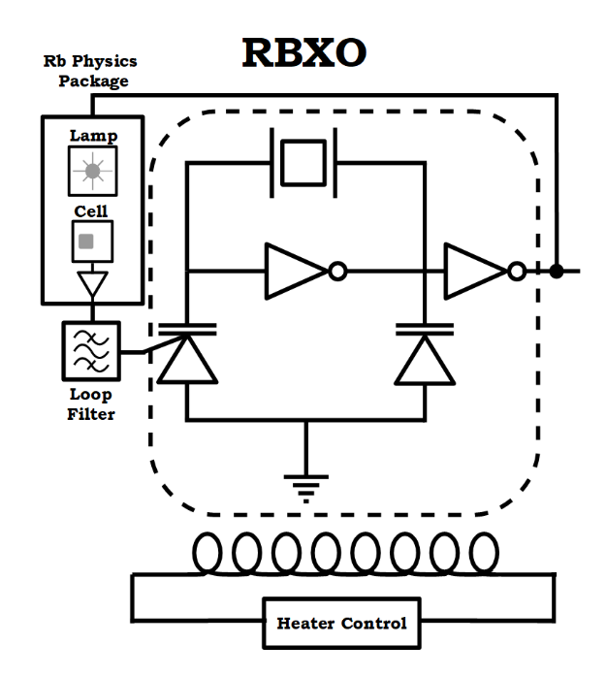
Quartz Oscillator types
Type | Device name | Description | Accuracy | Power
SPXO | Simple Packaged Crystal Oscillator | An oscillator based on the characteristics of AT-cut quartz but with no frequency adjustment or temperature compensation. | ±10ppm to ±100ppm | 50mW
VCXO | Voltage Controlled Crystal Oscillator | As SPXO but with ability to adjust the output frequency with an external control voltage. | ±10ppm to ±100ppm | 50mW
TCXO | Temperature Compensated Crystal Oscillator | As SPXO but with built-in temperature compensation circuitry to adjust for deviation over temperature due to AT-cut quartz characteristics. | ±50ppb to ±5ppm | 50mW
OCXO | Oven Controlled Crystal Oscillator | Oscillator that has a built-in heater to hold the SC-cut quartz crystal at a temperature near its inflection point where the frequency/temperature characteristic is flattest to achieve optimum frequency accuracy. | ±1ppb to ±50ppb | 1W to 5W
RBXO | Rubidium Controlled Crystal Oscillator | Oscillator consists of a rubidium ‘physics package’ that is locked to an OCXO. The OCXO provides the output signal while under control of the rubidium section. | ±0.5ppb | 5W
Type | Device name | Description | Accuracy | Power
SPXO | Simple Packaged Crystal Oscillator | An oscillator based on the characteristics of AT-cut quartz but with no frequency adjustment or temperature compensation. | ±10ppm to ±100ppm | 50mW
VCXO | Voltage Controlled Crystal Oscillator | As SPXO but with ability to adjust the output frequency with an external control voltage. | ±10ppm to ±100ppm | 50mW
TCXO | Temperature Compensated Crystal Oscillator | As SPXO but with built-in temperature compensation circuitry to adjust for deviation over temperature due to AT-cut quartz characteristics. | ±50ppb to ±5ppm | 50mW
OCXO | Oven Controlled Crystal Oscillator | Oscillator that has a built-in heater to hold the SC-cut quartz crystal at a temperature near its inflection point where the frequency/temperature characteristic is flattest to achieve optimum frequency accuracy. | ±1ppb to ±50ppb | 1W to 5W
RBXO | Rubidium Controlled Crystal Oscillator | Oscillator consists of a rubidium ‘physics package’ that is locked to an OCXO. The OCXO provides the output signal while under control of the rubidium section. | ±0.5ppb | 5W
Type | Device name | Description | Accuracy | Power
SPXO | Simple Packaged Crystal Oscillator | An oscillator based on the characteristics of AT-cut quartz but with no frequency adjustment or temperature compensation. | ±10ppm to ±100ppm | 50mW
VCXO | Voltage Controlled Crystal Oscillator | As SPXO but with ability to adjust the output frequency with an external control voltage. | ±10ppm to ±100ppm | 50mW
TCXO | Temperature Compensated Crystal Oscillator | As SPXO but with built-in temperature compensation circuitry to adjust for deviation over temperature due to AT-cut quartz characteristics. | ±50ppb to ±5ppm | 50mW
OCXO | Oven Controlled Crystal Oscillator | Oscillator that has a built-in heater to hold the SC-cut quartz crystal at a temperature near its inflection point where the frequency/temperature characteristic is flattest to achieve optimum frequency accuracy. | ±1ppb to ±50ppb | 1W to 5W
RBXO | Rubidium Controlled Crystal Oscillator | Oscillator consists of a rubidium ‘physics package’ that is locked to an OCXO. The OCXO provides the output signal while under control of the rubidium section. | ±0.5ppb | 5W
Type | Device name | Description | Accuracy | Power
SPXO | Simple Packaged Crystal Oscillator | An oscillator based on the characteristics of AT-cut quartz but with no frequency adjustment or temperature compensation. | ±10ppm to ±100ppm | 50mW
VCXO | Voltage Controlled Crystal Oscillator | As SPXO but with ability to adjust the output frequency with an external control voltage. | ±10ppm to ±100ppm | 50mW
TCXO | Temperature Compensated Crystal Oscillator | As SPXO but with built-in temperature compensation circuitry to adjust for deviation over temperature due to AT-cut quartz characteristics. | ±50ppb to ±5ppm | 50mW
OCXO | Oven Controlled Crystal Oscillator | Oscillator that has a built-in heater to hold the SC-cut quartz crystal at a temperature near its inflection point where the frequency/temperature characteristic is flattest to achieve optimum frequency accuracy. | ±1ppb to ±50ppb | 1W to 5W
RBXO | Rubidium Controlled Crystal Oscillator | Oscillator consists of a rubidium ‘physics package’ that is locked to an OCXO. The OCXO provides the output signal while under control of the rubidium section. | ±0.5ppb | 5W
Type | Device name | Description | Accuracy | Power
SPXO | Simple Packaged Crystal Oscillator | An oscillator based on the characteristics of AT-cut quartz but with no frequency adjustment or temperature compensation. | ±10ppm to ±100ppm | 50mW
VCXO | Voltage Controlled Crystal Oscillator | As SPXO but with ability to adjust the output frequency with an external control voltage. | ±10ppm to ±100ppm | 50mW
TCXO | Temperature Compensated Crystal Oscillator | As SPXO but with built-in temperature compensation circuitry to adjust for deviation over temperature due to AT-cut quartz characteristics. | ±50ppb to ±5ppm | 50mW
OCXO | Oven Controlled Crystal Oscillator | Oscillator that has a built-in heater to hold the SC-cut quartz crystal at a temperature near its inflection point where the frequency/temperature characteristic is flattest to achieve optimum frequency accuracy. | ±1ppb to ±50ppb | 1W to 5W
RBXO | Rubidium Controlled Crystal Oscillator | Oscillator consists of a rubidium ‘physics package’ that is locked to an OCXO. The OCXO provides the output signal while under control of the rubidium section. | ±0.5ppb | 5W
Type | Device name | Description | Accuracy | Power
SPXO | Simple Packaged Crystal Oscillator | An oscillator based on the characteristics of AT-cut quartz but with no frequency adjustment or temperature compensation. | ±10ppm to ±100ppm | 50mW
VCXO | Voltage Controlled Crystal Oscillator | As SPXO but with ability to adjust the output frequency with an external control voltage. | ±10ppm to ±100ppm | 50mW
TCXO | Temperature Compensated Crystal Oscillator | As SPXO but with built-in temperature compensation circuitry to adjust for deviation over temperature due to AT-cut quartz characteristics. | ±50ppb to ±5ppm | 50mW
OCXO | Oven Controlled Crystal Oscillator | Oscillator that has a built-in heater to hold the SC-cut quartz crystal at a temperature near its inflection point where the frequency/temperature characteristic is flattest to achieve optimum frequency accuracy. | ±1ppb to ±50ppb | 1W to 5W
RBXO | Rubidium Controlled Crystal Oscillator | Oscillator consists of a rubidium ‘physics package’ that is locked to an OCXO. The OCXO provides the output signal while under control of the rubidium section. | ±0.5ppb | 5W
Type | Device name | Description | Accuracy | Power
SPXO | Simple Packaged Crystal Oscillator | An oscillator based on the characteristics of AT-cut quartz but with no frequency adjustment or temperature compensation. | ±10ppm to ±100ppm | 50mW
VCXO | Voltage Controlled Crystal Oscillator | As SPXO but with ability to adjust the output frequency with an external control voltage. | ±10ppm to ±100ppm | 50mW
TCXO | Temperature Compensated Crystal Oscillator | As SPXO but with built-in temperature compensation circuitry to adjust for deviation over temperature due to AT-cut quartz characteristics. | ±50ppb to ±5ppm | 50mW
OCXO | Oven Controlled Crystal Oscillator | Oscillator that has a built-in heater to hold the SC-cut quartz crystal at a temperature near its inflection point where the frequency/temperature characteristic is flattest to achieve optimum frequency accuracy. | ±1ppb to ±50ppb | 1W to 5W
RBXO | Rubidium Controlled Crystal Oscillator | Oscillator consists of a rubidium ‘physics package’ that is locked to an OCXO. The OCXO provides the output signal while under control of the rubidium section. | ±0.5ppb | 5W
10 / 23
White Rabbit Collaboration – Training Material

Slide 11
Specifying an Oscillator : Basics
The basic setup of an oscillator requirement will need to be defined
Value | Description | Example
Frequency | Low cost commodity oscillators are available in a wide range of frequencies. High performance oscillators may only be available in a few frequencies. | 10.0MHz
Supply Voltage | Oscillators need stable power rails, as noise on the power rail can translate to frequency modulation on the output. Ovenised oscillators will need high power requirements and often higher voltage levels. | 12V
Power | Warm up: For Ovenised oscillators, this may be very high for a brief period. It may be necessary to manage power delivery during warm up. Steady state: Power requirements during normal operation. | Warm up: @3.3V 800mA max 5min max Steady State: @3.3V 25°C 350mA max
Output | The output logic of the oscillator required for compatibility with other circuitry. | CMOS, Sine, LVPECL, LVDS
Frequency Tolerance | A measure of the maximum frequency accuracy at room temperature, normally 25°C (this can be removed using the pulling function). | ±0.05ppb @ 25°C
Frequency Stability | A measure of the maximum frequency deviation when varied over the operating temperature range and relative to the tolerance value. | ±0.3 ppb typical
Temperature Range | The temperature range over which the frequency stability figure is guaranteed. | -40 to 85°C
Pulling | An ability to change the frequency of the output by controlling an input, either via an analogue DC voltage level, or a digital input. | Pulling ±2ppb min Control Voltage 2.5V ±2.5V
Digital Control | Some digital control line functions may be available with the oscillator. | Enable/Disable of RF Input pin Oscillator Lock Output pin
11 / 23
White Rabbit Collaboration – Training Material

Slide 12
Specifying an Oscillator : Basics
Parameters of oscillators used in various WR devices
Value | WR Node (BabyWR) | WR Switch v3 / WR Node (SPEC) | WR Switch v4 | Low Jitter Daughterboard
Frequency | 125MHz | 25 MHz | 10 MHz | 20 MHz
Supply Voltage | 2.5V | 3.0V | 3.3V
Power | Max 62mA @ 2.5V | Max 2mA @ 3.0V | Max 10mA @ 3.3V
Output | LVCMOS | Sine, DC block, AC coupled | LVCMOS
Frequency Tolerance
Frequency Stability | ±50ppb | ±2.5ppm | ±50ppb
Temperature Range | -20 to +70°C | -30 to +70°C | 0 to +70°C
Pulling | ±25ppm | ±12ppm | ±10ppm
Digital Control | I2C, Output Enable | N/A | N/A
12 / 23
White Rabbit Collaboration – Training Material
Notes:
WR Switch V4 – main : 10MHz DOT050V-010.0M
WR Switch v4 – helper: 0.2-800MHz Si549 (549BACB001937ABG)
WR Switch v3 – main: VM53S3-25.000-2.5/-30+75
WR Switch v3 – helper:FRETHE025
Low Jitter Daughterboard (LJD)– main: 20MHz DOT050V-020.0M
WR Node (BabyWR) – main: SIT5359AC-FSG25IM-125.000000
AC=-20 to 70
FS=+/-50ppb
125MHz
IM= Output enable, +/-25ppm

Slide 13
Specifying an Oscillator : Advanced
As the frequency stability specification increases, the effect of various environmental changes become more significant
Value | Description | Example
Ageing | Change of frequency over longer time periods. | Ageing (after 30days): ±0.005ppb max/day ±0.05ppb max/month ±0.5ppb max/year
Load Co-Efficient | Change of frequency caused by variations on the output load. | Load Variation (±5% change): ±5ppb max
Pushing | A measure of the slight change in frequency caused by variations in the supply voltage. | Supply Voltage Variation (±5% change): ±5ppb max
Shock/ Vibration/ Acceleration | Definition of the effect of physical motion on the oscillator. These figures are often statements of survivability of the oscillator, not a measure of the effect on the frequency during the effect. | Mechanical Shock: IEC 60068-2-27, Test Ea: Acceleration of 50G peak amplitude for 11ms duration
Retrace | A definition of the effect of power cycling the oscillator. How close will the frequency be compared to that before the power cycle? | Retrace (24hrs on, 1 hour off, 1 hour on): ±0.02ppb typ
Gravitational Force | Gravitational pull causes a change to the frequency of the oscillator, therefore oscillator orientation must be controlled. | ±2E-12/g (Ref 2g tip over test)
Magnetic Field Sensitivity | Magnetic field changes induce a change in frequency of the oscillator, therefore movements of items causing changes to the magnetic field must be controlled. | ±2E-11/Gauss
These points are relevant even in a stable system. The effect of the other points should be removed after power up, stabalisation and lock to external source.
13 / 23
White Rabbit Collaboration – Training Material

Slide 14
Specifying an oscillator : Noise
The primary function of an oscillator is to create a stable frequency. When all else is held constant, noise is a measure of the remaining instability of the signal.
Value | Description | Example
Phase Noise | Frequency domain measurement quantifying the power of frequencies at offsets from the main mode (carrier frequency). | Phase Noise (typ): -108dBc/Hz @ 1Hz -134dBc/Hz @ 10Hz -152dBc/Hz @ 100Hz -155dBc/Hz @ 1kHz -158dBc/Hz @ 10kHz -157dBc/Hz @ 100kHz
Spurious | Particularly found on oscillators containing digital components, this quantifies the power ratio of the main mode to any frequencies seen on the output which are not harmonics of the main mode | Spurious: -80dBc max
Jitter | Time domain measurement of the deviation from a perfect waveform. | Period Jitter (typ @ 10000 cycles @ 3.3V): 1.15ps RMS, 9.6ps pk-pk @ 25MHz 1.02ps RMS, 8.1ps pk-pk @ 50MHz
Short term Stability (ADEV) | Time domain measurement of the average deviation from a perfect wave at specific averaging time windows. | Short Term Stability (ADEV) typical: 1s 5.5E-11 10s 7.1E-12 100s 7.5E-12
14 / 23
White Rabbit Collaboration – Training Material

Slide 15
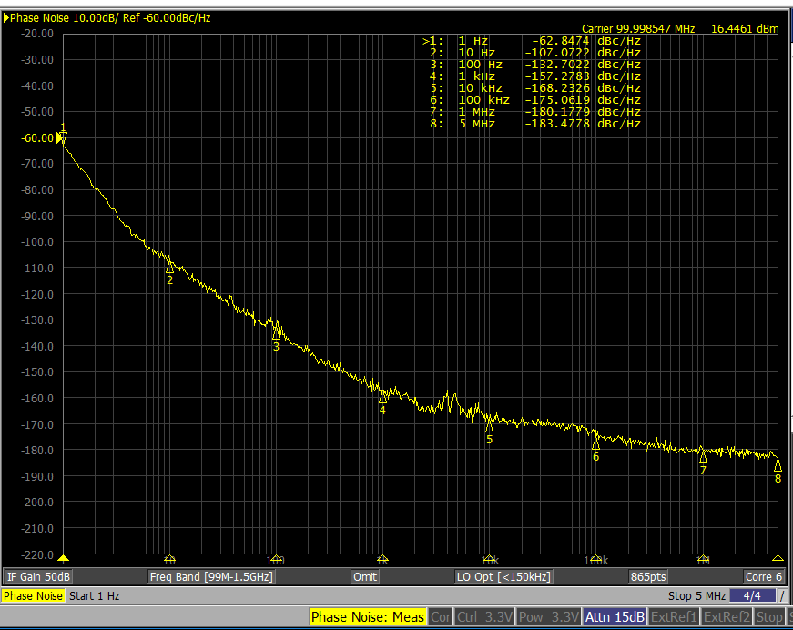
Oscillator Noise: Phase Noise
Measurement of power at offsets from the carrier frequency
The output is similar to that of a spectrum analyser.
Specialised equipment is used to measure phase noise, >$100kUSD
Its getting quicker but accurate phase noise measurements can still take a long time to make (5 mins to 1 hour)
Power supply, cabling, test fixture, screening will all make a very big difference to the measurement.
The power of the noise is concentrated at the carrier and reduces to a noise floor.
Close-in noise is attributed to the resonator.
Noise far from the carrier is attributed to the oscillator circuit.
15 / 23
White Rabbit Collaboration – Training Material

Slide 16
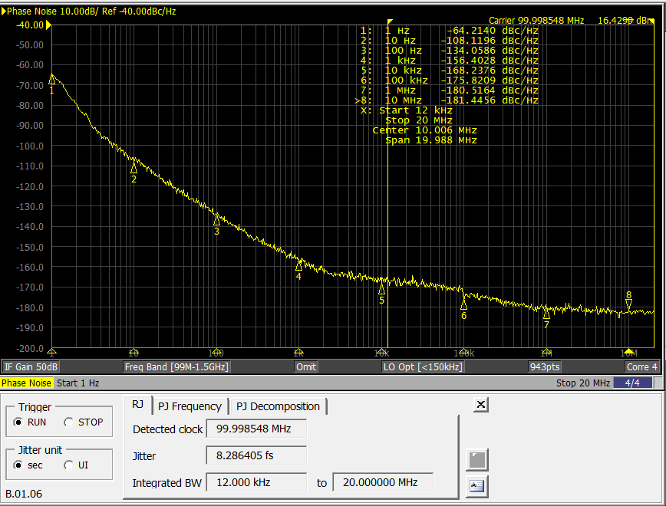
Oscillator Noise: Phase Jitter
Phase jitter is calculated from the area under the PN Plot within some band width
12kHz to 20MHz: 8.3fs
16 / 23
White Rabbit Collaboration – Training Material

Slide 17
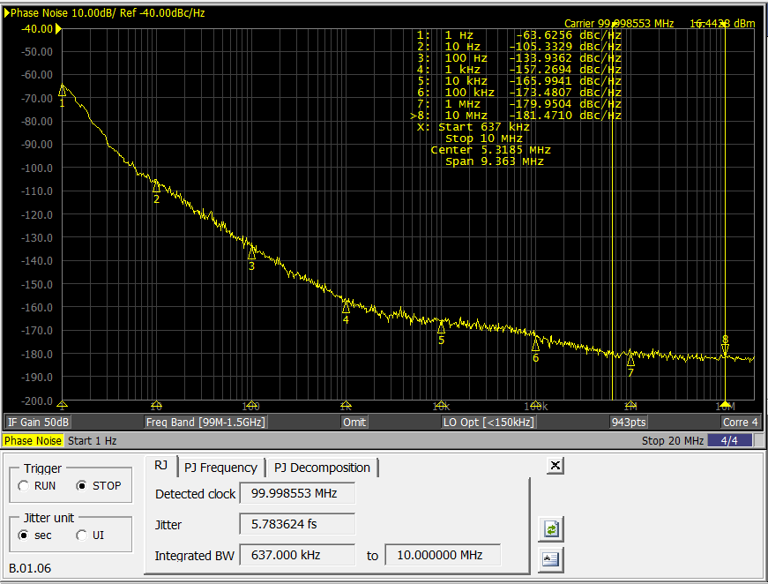
Oscillator Noise: Phase Jitter
Phase jitter is calculated from the area under the PN Plot within some band width
637kHz to 10MHz: 5.8fs
17 / 23
White Rabbit Collaboration – Training Material

Slide 18
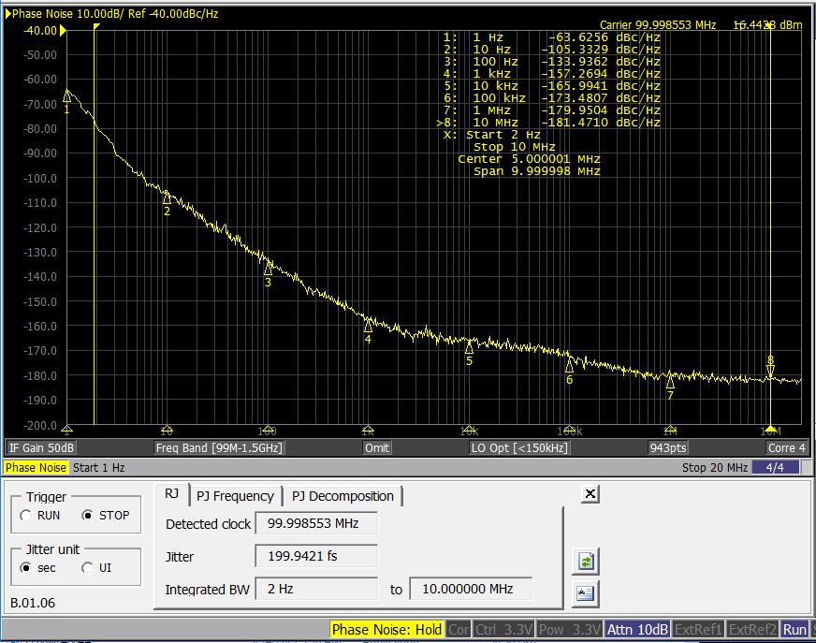
Oscillator Noise: Phase Jitter
Phase jitter is calculated from the area under the PN Plot within some band width
2Hz to 10MHz: 200fs
18 / 23
White Rabbit Collaboration – Training Material

Slide 19
Oscillator Noise: Phase Jitter
Phase jitter is calculated from the area under the PN Plot within some band width
12kHz to 20MHz: 8.3fs
637kHz to 10MHz: 5.8fs
2Hz to 10MHz: 200fs
So BW is important to check
12kHz to 20MHz used as a standard for comparison. But perhaps not relevant for your application
Application | Data rate | Bandwidth
10/100MB Ethernet | 125MBPS | 20kHz to 20MHz
Gb eithernet | 1.25Gbps | 637kHz to 10MHz
10G Ethernet | 10.3225Gbps | 637kHz to 20MHz
100G Ethernet | 4x25Gbps | 1.875 to 20MHz
XAUI | 3.125Gbps | 1.875 to 10MHz
Fiber Channel | 1.0625Gbps | 637kHz to 10MHz
Fiber Channel | 2.125Gbps | 1.275 to 10MHz
Fiber Channel | 4.25Gbps | 2.55 to 10MHz
SAS/SATA | 6Gbps | 600kHz to 20MHz
SONET OC-3 | 155Mbps | 12kHz to 20MHz
SONET OC-12 | 622Mbps | 12kHz to 20MHz
SONET OC-48 | 2.48Gbps | 12kHz to 20MHz
19 / 23
White Rabbit Collaboration – Training Material

Slide 20
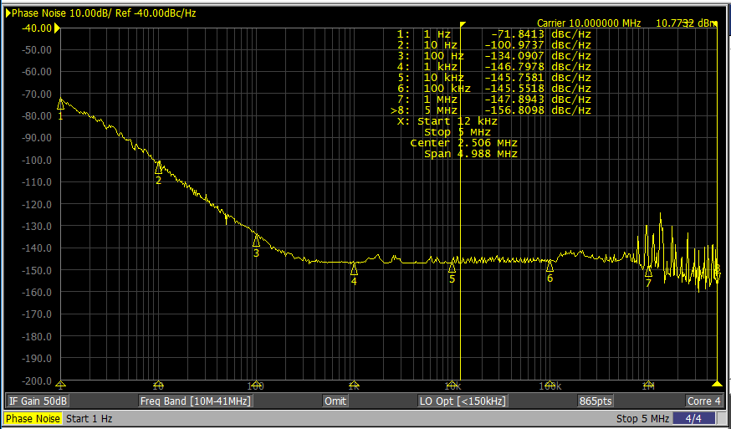
Oscillator Noise: Phase Noise Spurious
Complex systems, especially those including digital systems can show spurious peaks on the phase noise plot.
Designers attempted to move this noise outside the bandwidth of interest.
Normally quantified as being the dB difference between the peak of the spurious vs the carrier frequency e.g.
Spurious frequency: 80dBc max
20 / 23
White Rabbit Collaboration – Training Material

Slide 21
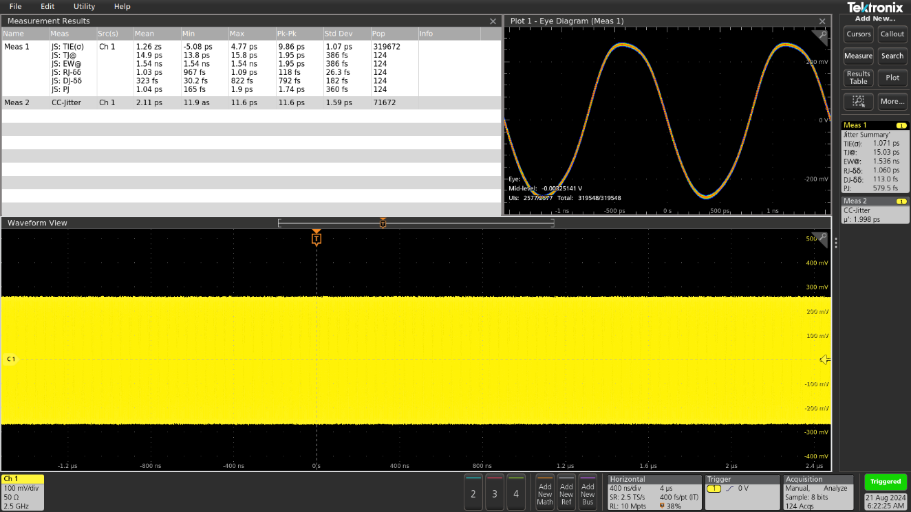
Oscillator Noise: Jitter
Time domain measurement normally made on an oscilloscope.
Must have high bandwidth high sample rate scope.
(Watch out for default settings as this may be a reduced sample rate.)
Random jitter: unpredictable electronic noise. Typically follows a normal distribution due to being caused by thermal noise in an electrical circuit.
Deterministic jitter: jitter that is predictable and reproducible. Has a known non-normal distribution.
Total Jitter: the sum of deterministic jitter plus random jitter
All values are calculated and discussed in statistical terms mean, pk-pk, Standard Dev etc
Jitter contributes to a total bit error rate calculation.
A good oscillator will be a small contribution to the calculation
21 / 23
White Rabbit Collaboration – Training Material

Slide 22
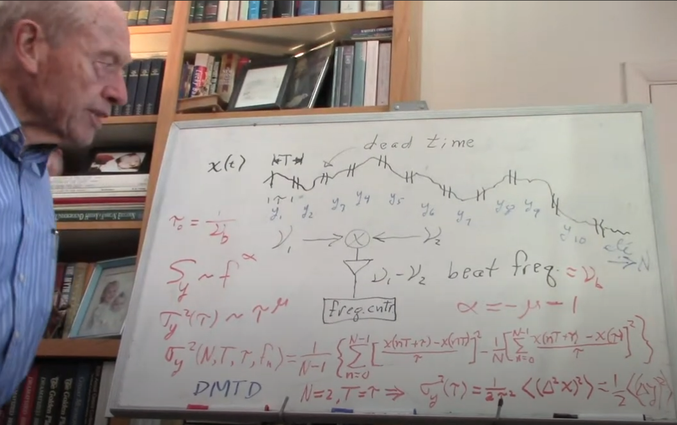
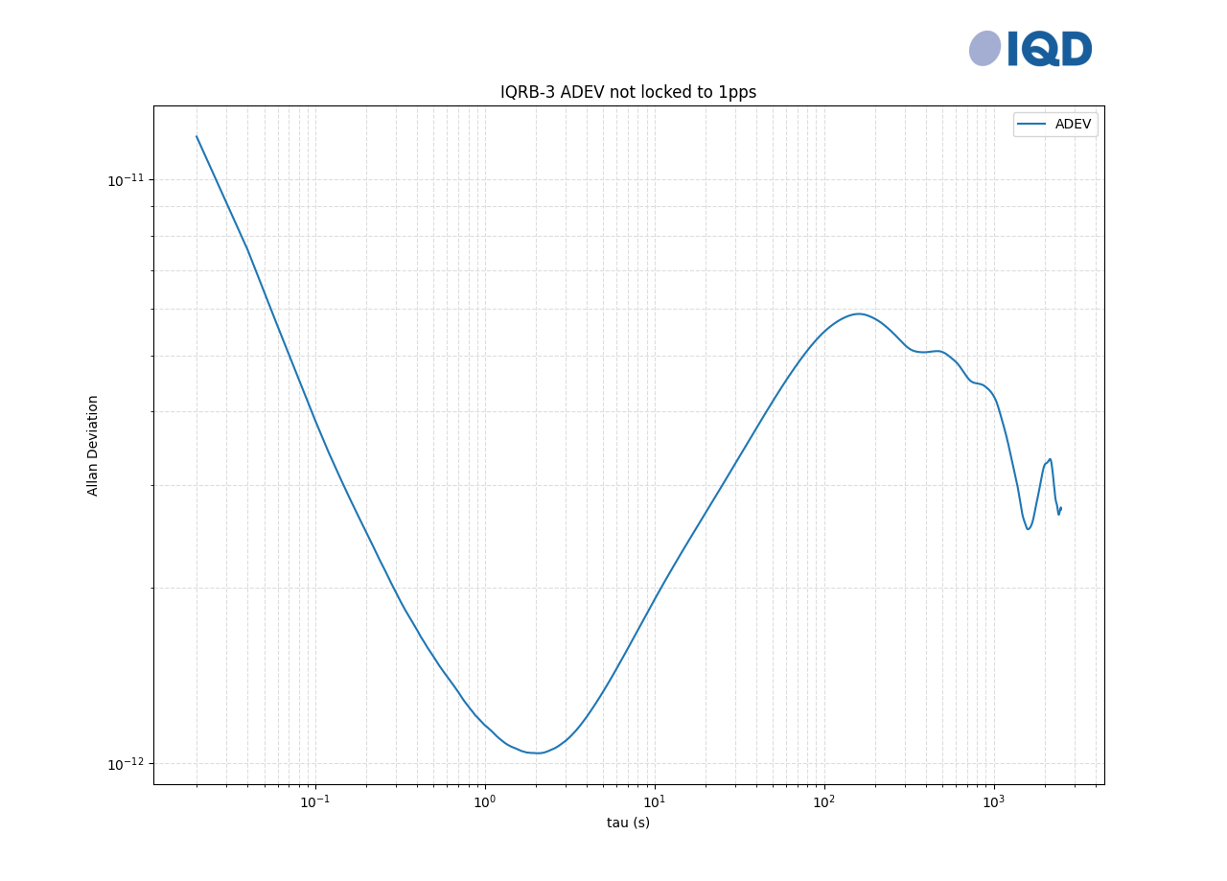
Oscillator Noise: Allan Deviation, ADEV
Created by David Allan
A derivative of Time Interval Error
ADEV is the log-log plot of the square root of Allan Variance, AVAR
Mathematically complex to describe
Allan variance is intended to estimate stability due to noise processes and not that of systematic errors or imperfections such as frequency drift or temperature effects.
Measured on a counter or specialise instrument
Must be gap free, i.e. no gap between samples
(note measurements of 0.5E-11@1sec Tau is the 20ps limit of most equipment)
The plot shows us, from second to second how much will the frequency change, then for 10s, then 100s…
This plot shows:
4E-11 @0.1sec tau
1E-12 @1sec tau
2E-11@10sec tau
22 / 23
White Rabbit Collaboration – Training Material

Slide 23
Further reading
Open source information with more details on oscillators can be found here:
John R. Vig Quartz Crystal Resonators and Oscillators for Frequency Control and Timing Applications - A Tutorial
https://ieee-uffc.org/technical-committees/frequency-control/educational-resources
Renesas: Understanding Jitter Units
https://www.renesas.com/en/document/apn/815-understanding-jitter-units
https://www.iqdfrequencyproducts.com/en/support/document-library IQD Phase Noise to Jitter Conversion
David Allan - Whiteboard Lesson
https://www.youtube.com/watch?v=CGh8n8fyVhk
Quartz Crystal for Electrical Circuits : Raymond A.Heising
Handbook of Quartz Crystal Devices : David Salt
23 / 23
White Rabbit Collaboration – Training Material

