Slide 1
LHC status
Matteo Solfaroli
Moriond QCD and high energy interactions
March 31st, 2025

Slide 2
Outline
2024 run highlights
2025 configuration and main challenges
Considerations on beam intensity increase
2025 schedule and projections
Oxygen run preparation

Slide 3

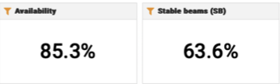
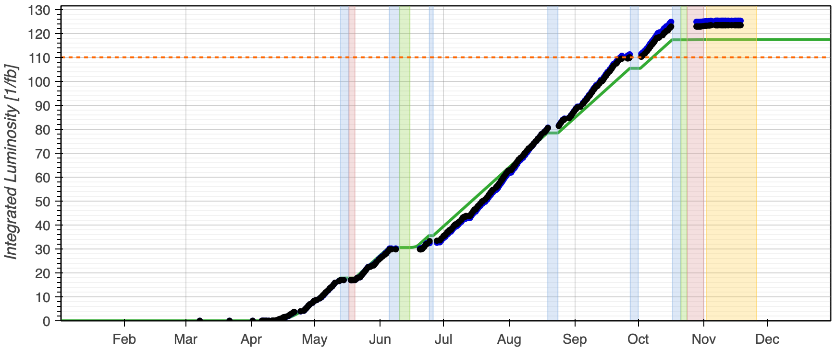
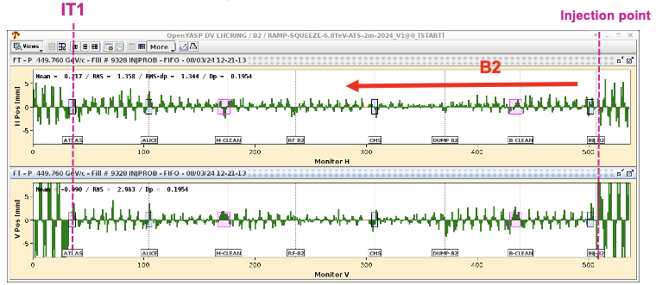
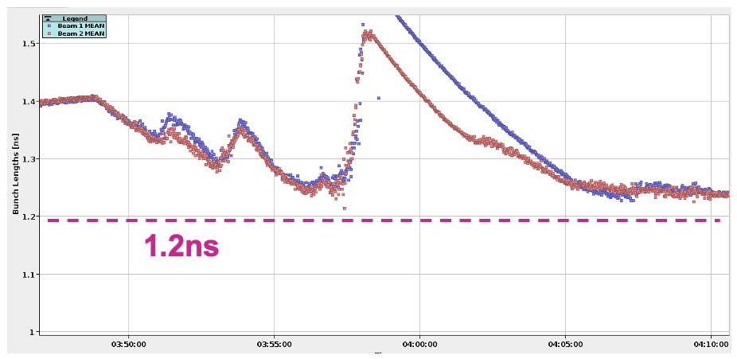
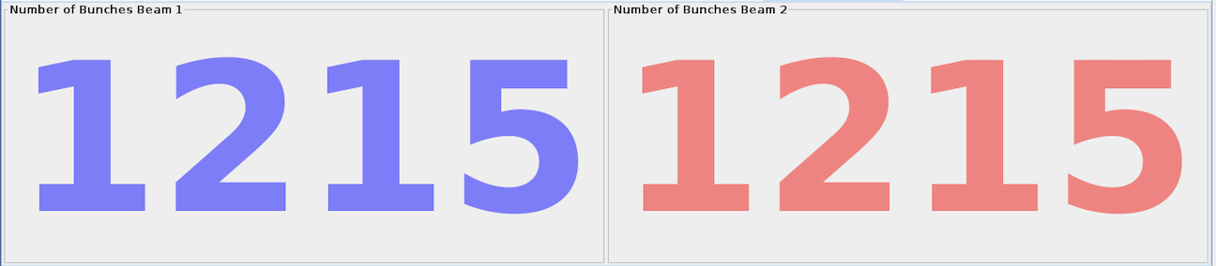
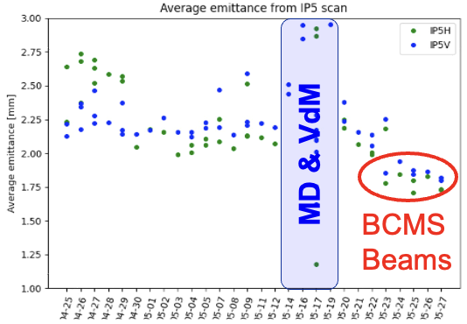
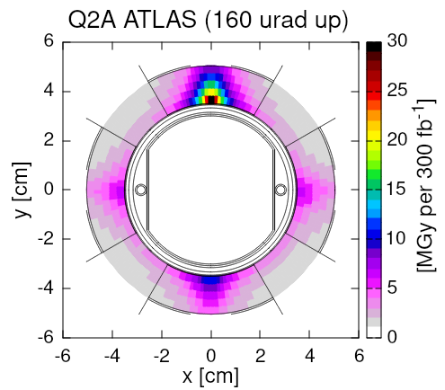
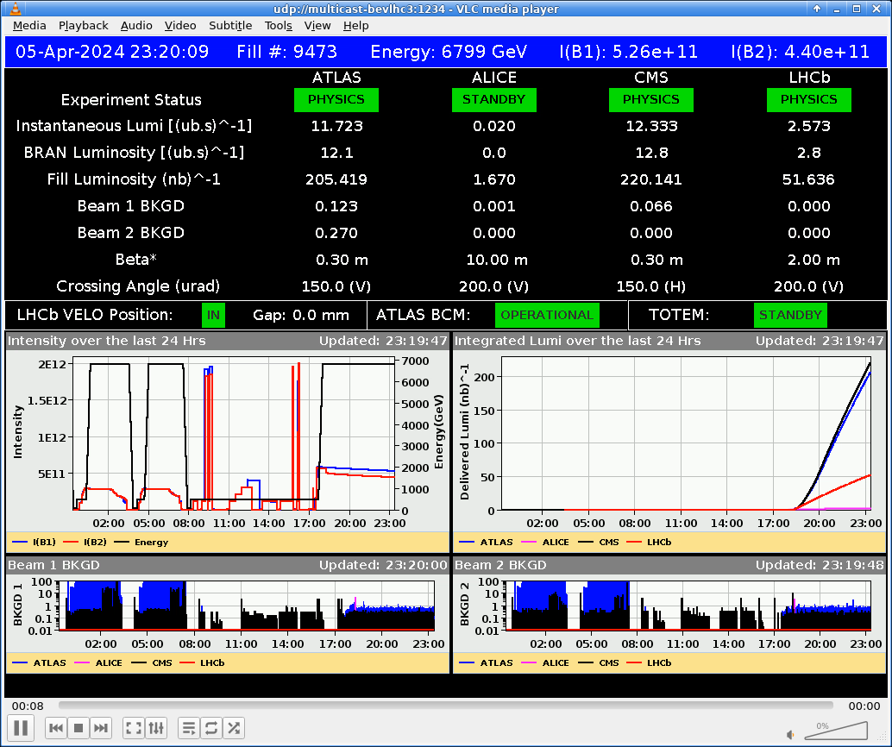
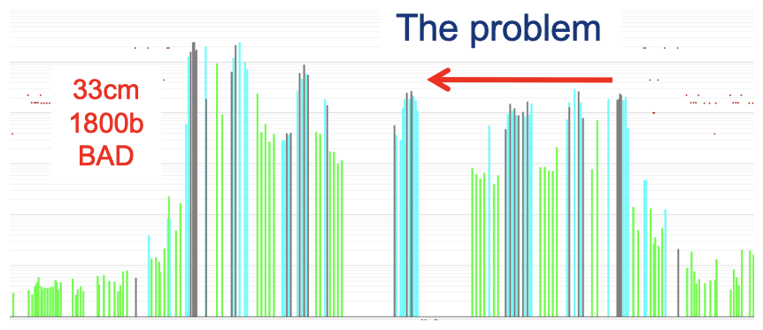
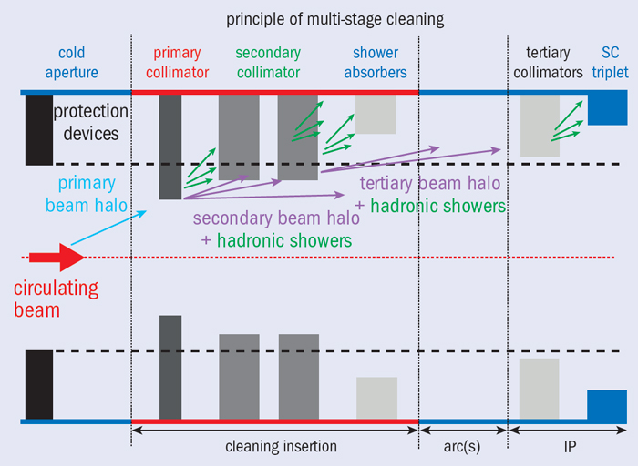
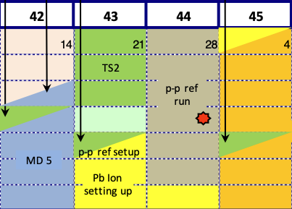
LHC in 2024
VdM & Calibration
Runs, 16th – 20th May
Stable Lumi
Production
Summer period
First injection: 8th March (3 days early)
Bunch length control/target
Limit RF module heating risk
IONS run
(YETS started on 25th November)
1200 bunches on 14th April (10 days early)
BCMS beams
May
Beyond 110 fb⁻¹
1.9 nb⁻¹ in IP1/2/5
(same as 2023 in 50% of the time)
pp run
ref run
IONS run
March
Q1
April
May
June
July
August
September
October
Q4
November
Reverse Polarity optics
commissioned (~ +1 week)
First Stable Beams @6.8 TeV 5th April (3 days early)
β* limited to 36 cm 17th April
β* back to 30 cm 17th June
pp reference run 28th Oct – 2nd Nov
90% availability
LHCb VELO closed for the 1st time

Slide 4
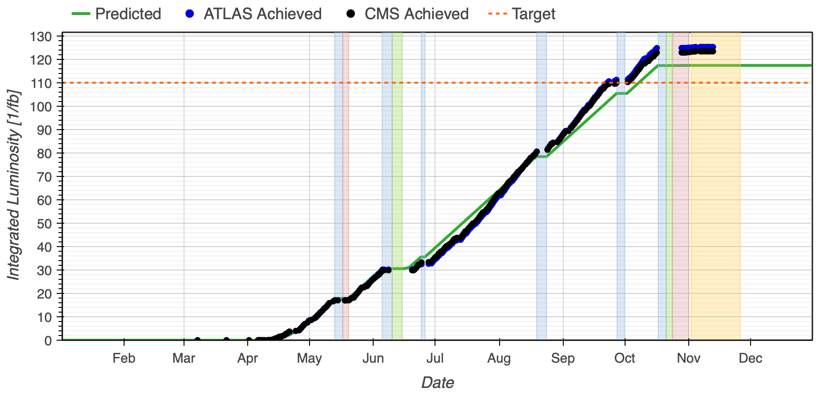
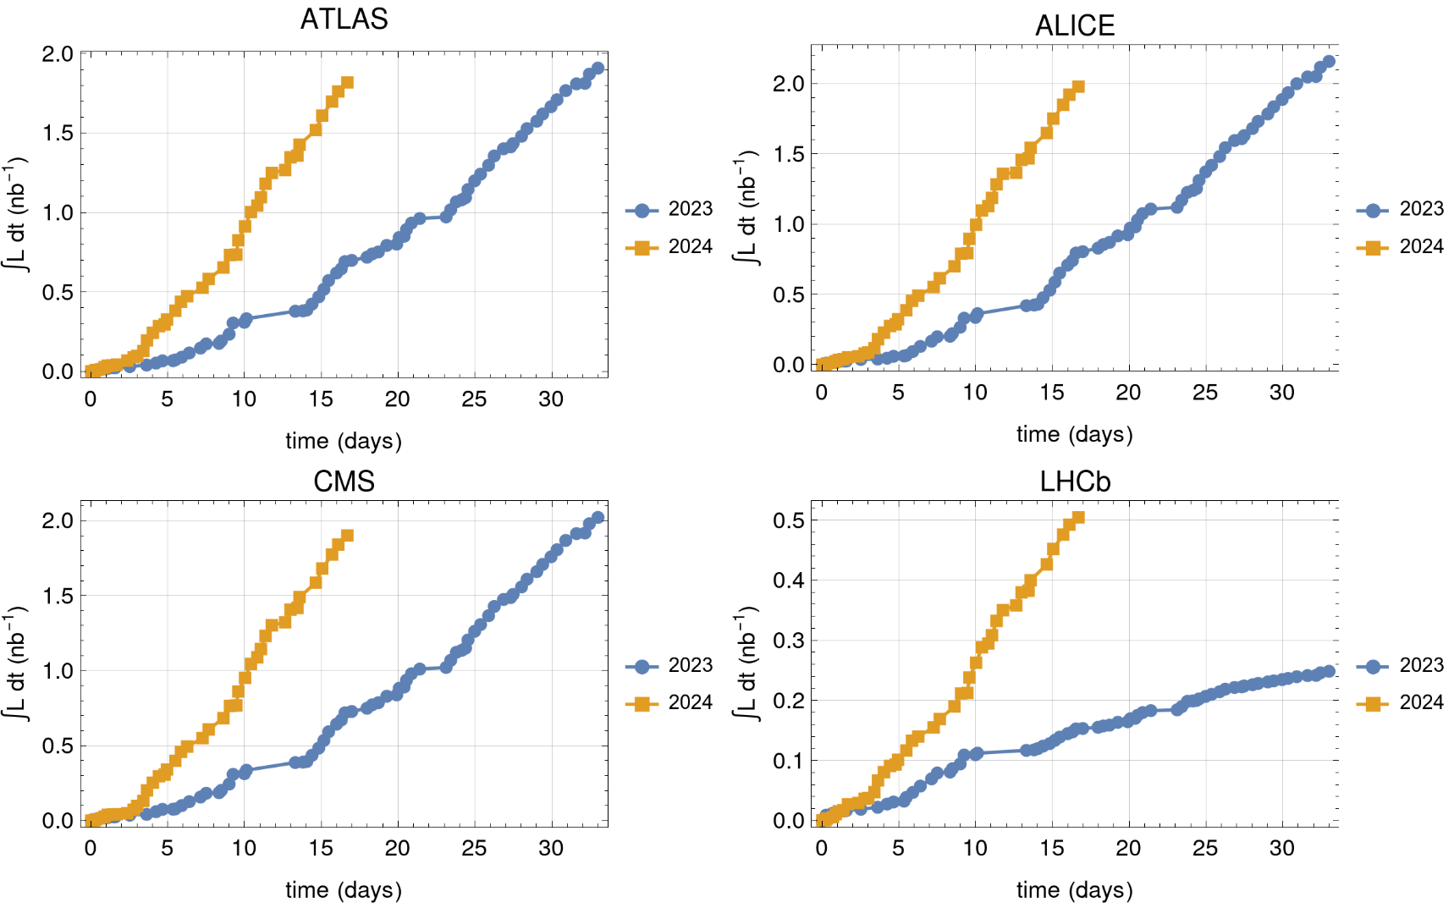
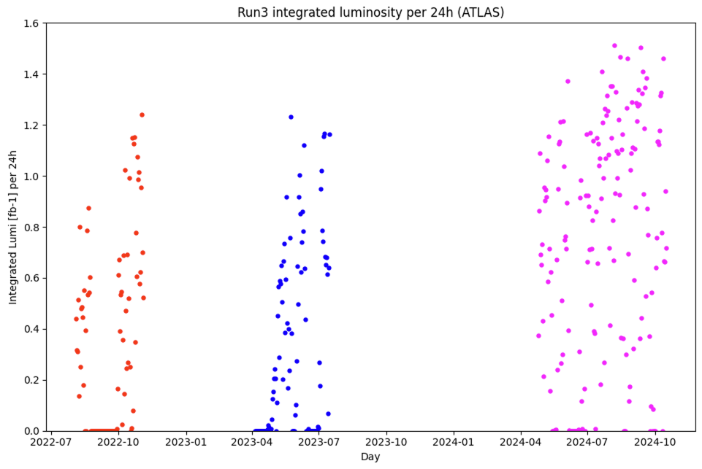
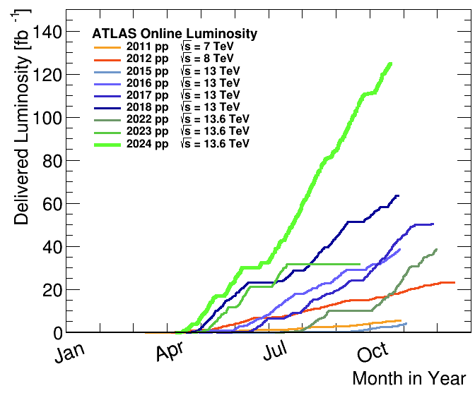
2024 production
IONS
124 fb⁻¹ in ATLAS/CMS
11 fb⁻¹ in LHCb
67.5 pb⁻¹ in ALICE
Highest production rate ever
Single most productive year in LHC history so far!
2024 AVG rate = 0.83 fb⁻¹/24h
2024 highest rate = 1.5 fb⁻¹/24h
(midnight to midnight)
IP1/2/5: Almost same luminosity as 2023, in about half the time, achieving the (ambitious) target of 1.9 nb⁻¹
IP8: About double the 2023 luminosity in about half the time
~2h of levelling at 6.4x10²⁷ cm⁻² s⁻¹
~30% higher intensity with
performance beyond HL-LHC projection
LS1
LS2
M.Lamont @Moriond-QCD 2024

Slide 5
Outline
2024 run highlights
2025 configuration and main challenges
Considerations on beam intensity increase
2025 schedule and projections
Oxygen run preparation

Slide 6
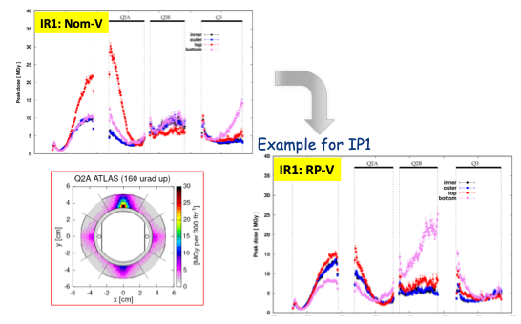
Triplet radiation and optics
Radiation doses to the inner triplet magnets approach estimated damage levels (large uncertainties!)
  Dose can be spread over different azimuths by:
    Changing crossing angles (sign, plane)
    Inverting the triplet quadrupole polarities (RP optics)
RP in both IR1 and IR5 with flipped planes is the best configuration!
2024: RP optics in IP1
  ➔ increased background FASER / SND
2025 compromise:
  Nominal polarity in IR1
  RP in IR5
  Plane inversion
  Simulations indicate good background for FASER and SND

Slide 7
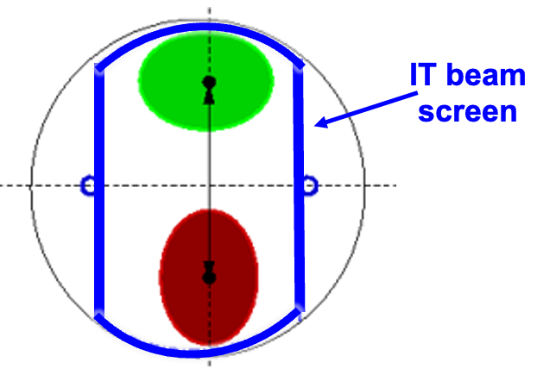


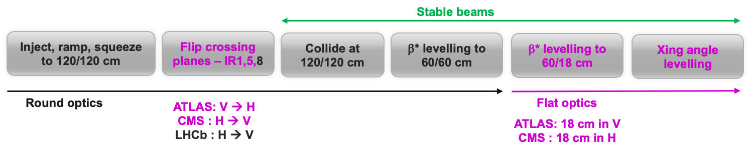
Flat optics in 2025 machine cycle
The IT beam screen shape is asymmetric and optimized to allow larger aperture in the “standard” crossing plane
  Beam size in IT quadrupoles is ∝ 1/√β
For rotated crossing planes:
  Less aperture in the rotated crossing plane: minimum β* increases 30->60 cm
  More aperture in the rotated separation plane: minimum β* decreases 30->18 cm
  To ensure equivalent performance reach use flat optics (β*_{x} ≠ β *_{y})
Flat optics configurations were already tested in MDs, no issues expected
New optics corrections will have to be established for all configurations
Apertures must be checked to confirm configuration choices
  Xing/sep planes maintained as previous years at injection to maximize aperture
  Never had bad surprises in Runs 2 & 3

Slide 8
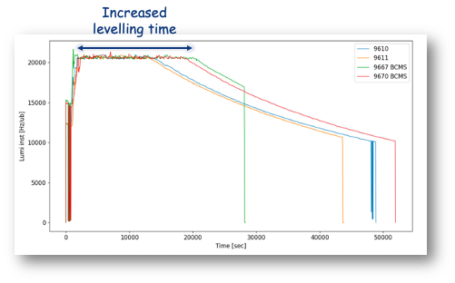
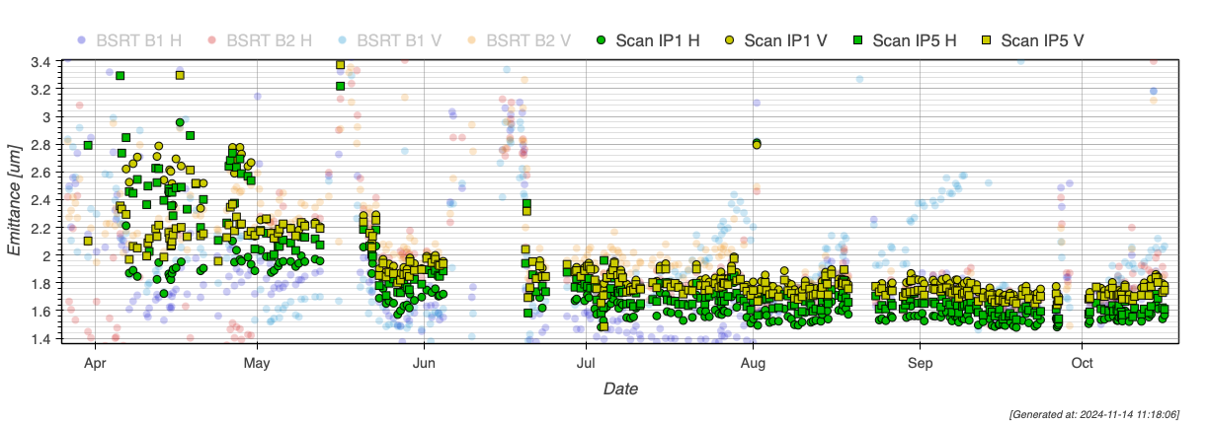
BCMS beam
With a nx36b patterns filling scheme, standard 25 ns and Batch Compression and (bunch) Merging and (bunch) Splitting (BCMS) beams are interchangeable
+ ~2h levelling with BCMS beams
Optimized BCMS beam deployed in May
  10% higher brightness
  Better equivalent cross-section
  Smaller emittance also beneficial for losses reduction, especially at injection
Standard: ~ 2 µm
2025
BCMS will be used as baseline
BCMS
~ 1.7 µm

Slide 9
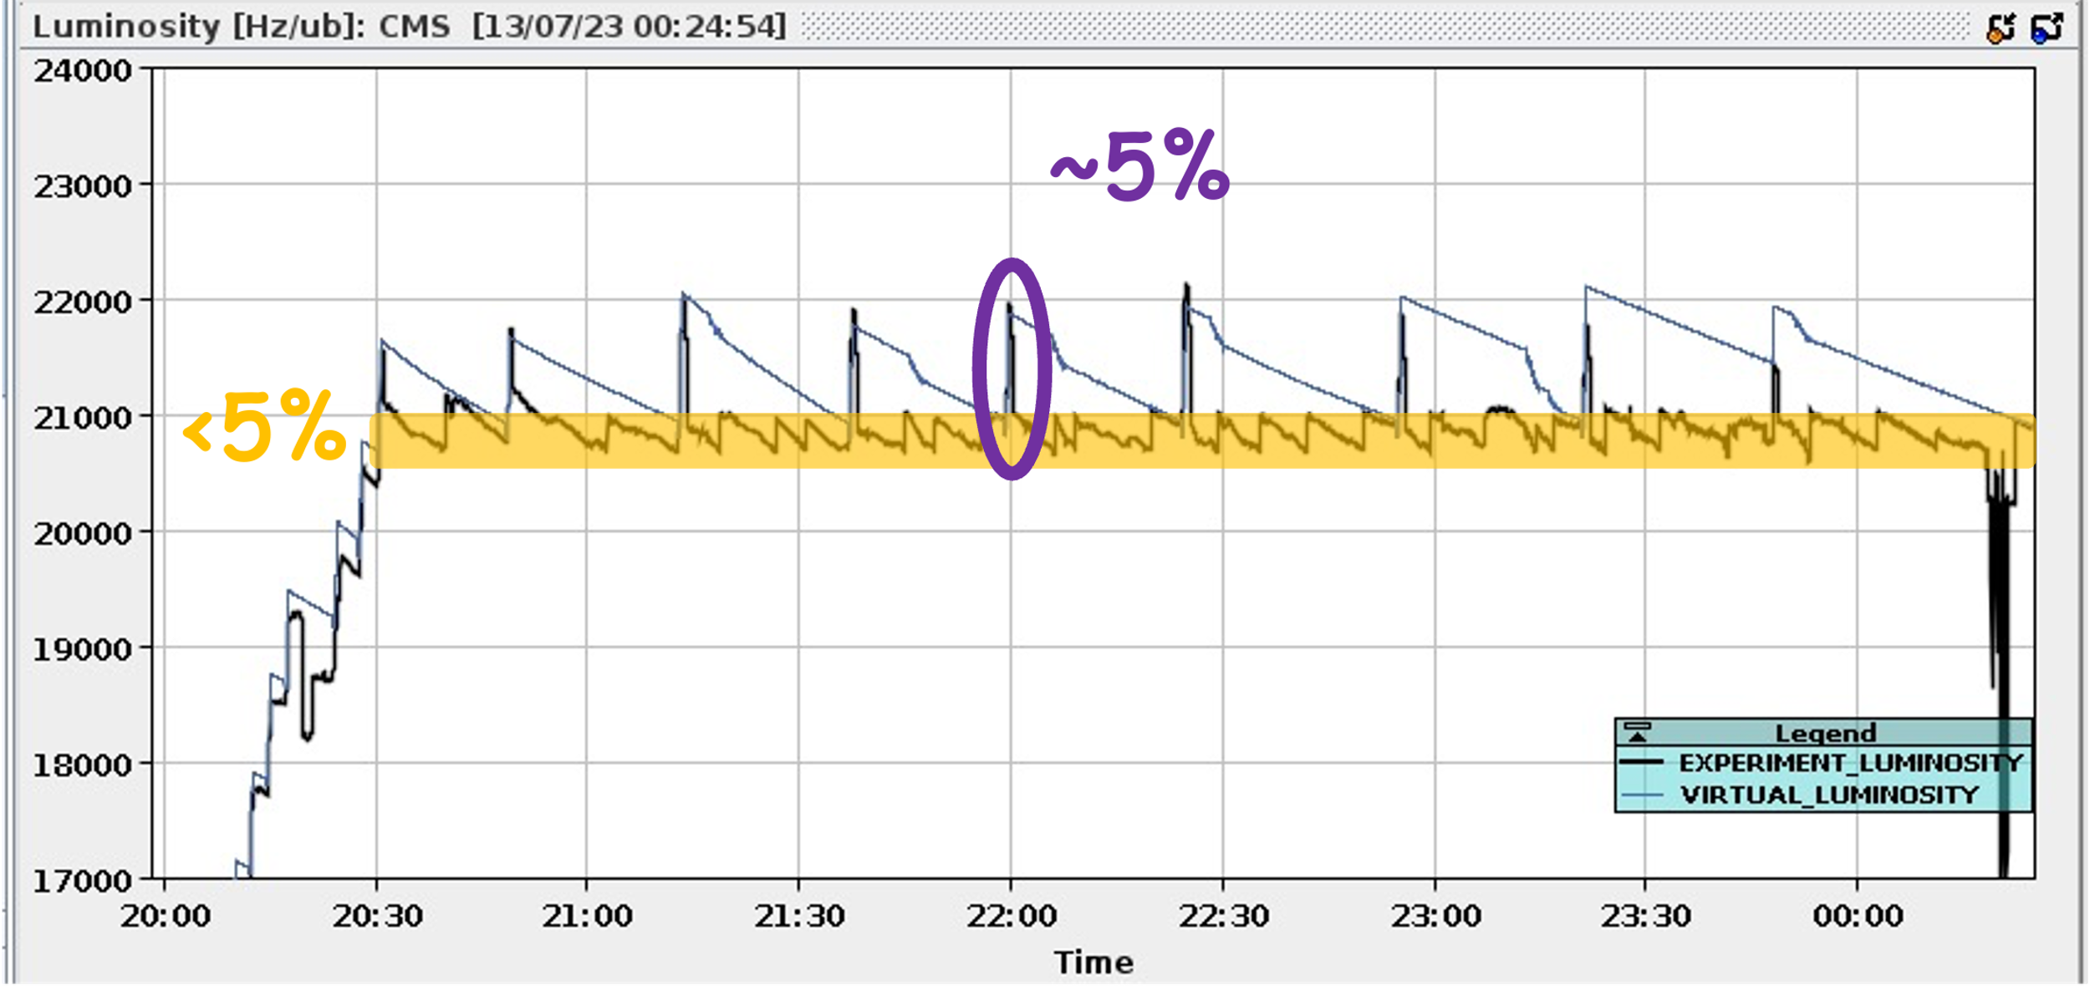
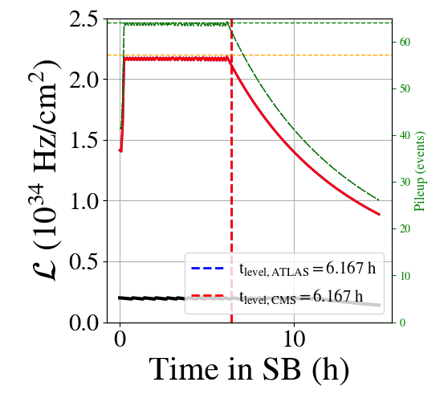
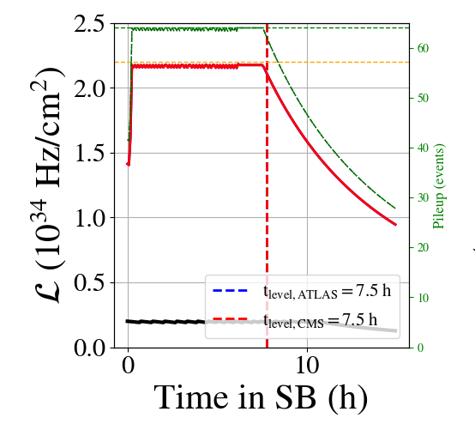
Levelling in physics
Luminosity levelling is required by cooling limitations in the Inner Triplet magnets
Combined β* (~beam size) & offset levelling allowed for
  6-7 hours levelling with BCMS beams
  Well balanced luminosity bet CMS and ATLAS
  LHCb levelled through the entire fill
Luminosity control below 2.5% (5% is Run3 request)
Bunch intensity increase will extend levelling time
2025: adding “continuous” Xing angle levelling:
  Additional 1.5h of levelling
  +3.5% integrated luminosity (when no premature dump)
  Main motivation: explore flat optics in aggressive beam-beam configuration to prepare for HL-LHC alternative to baseline scenario

Slide 10
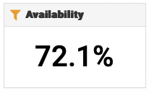
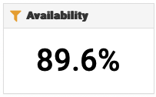
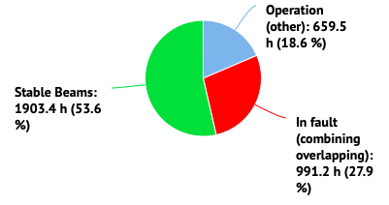
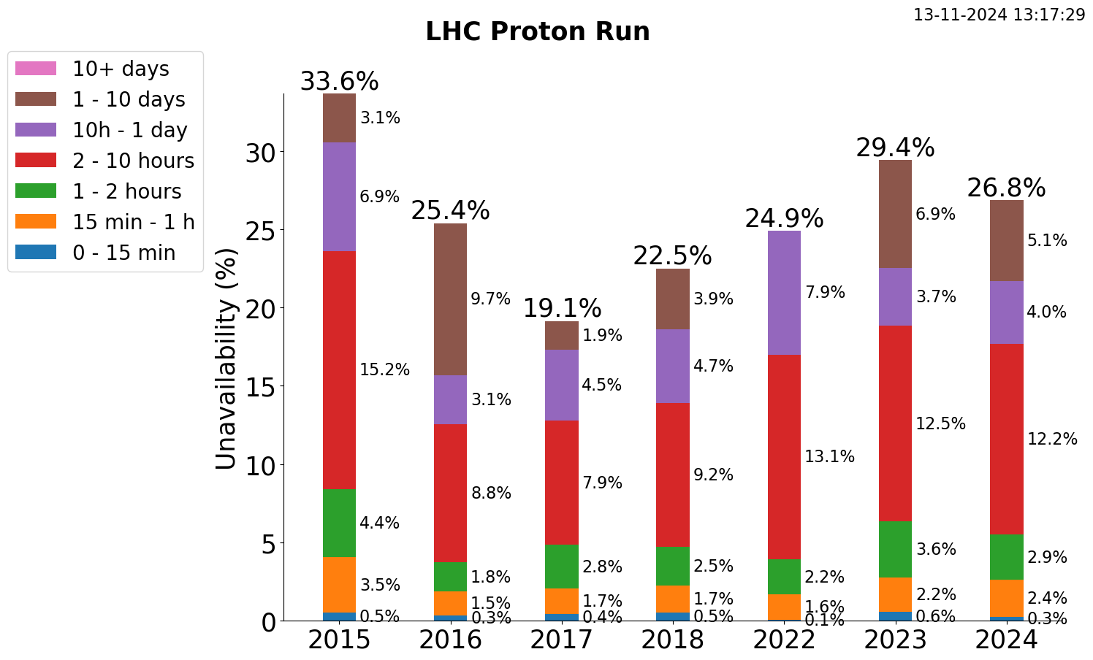
Availability
pp run
pp reference run
Availability is THE key factor for accelerator performance
Availability factor was ~constant through Run2 and Run3 for small (<24h) faults
Minor differences in numbers are due to slightly different choices in term of dates (including or not scrubbing run, TS recovery etc)
NOTE: the availability of the proton run is calculated on the effective time from the retrospetctively calculated schedule (long faults are not included)

Slide 11
Outline
2024 run highlights
2025 configuration and main challenges
Considerations on beam intensity increase
2025 schedule and projections
Oxygen run preparation

Slide 12
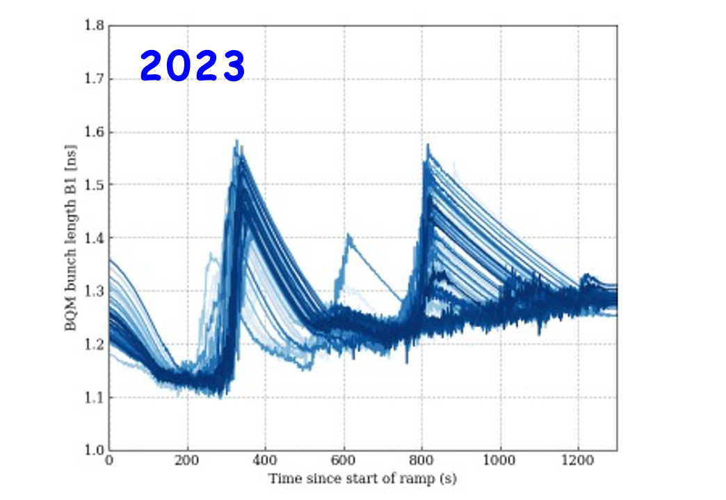
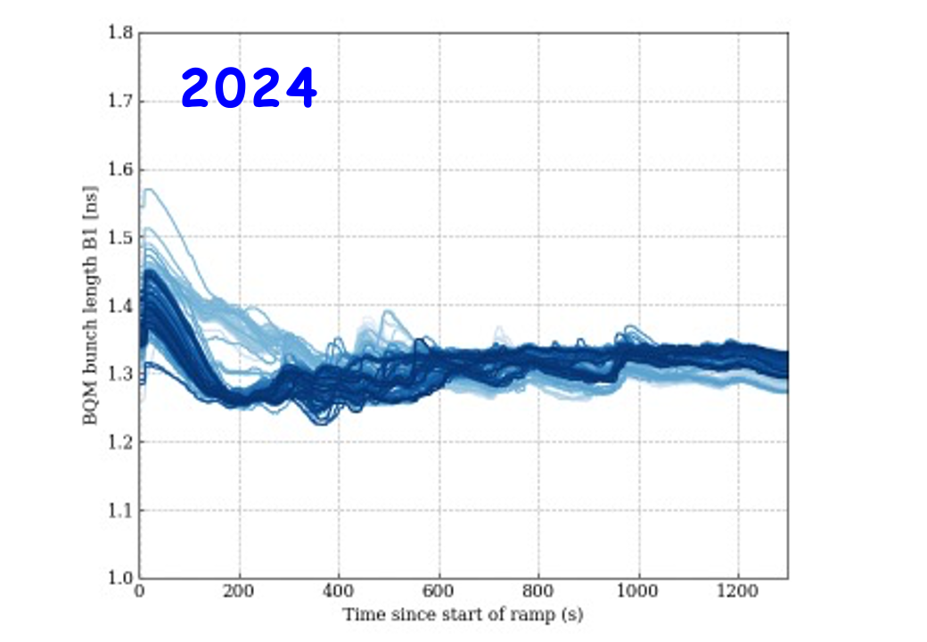
Intensity limitations - vacuum modules
Improved control of bunch length provides safety factor in power deposition
IMPACT in 2023
~5 days lost
Bunch intensity limited to 1.6x10¹¹ ppb
IMPACT in 2024
Bunch intensity limited to 1.6x10¹¹ ppb, while maximizing the bunch length throughout the cycle
  Difficult to identify intensity limitation (strong dependence on contact quality)
Problem traced to localized heating of the tension spring of diameter 212 (ID212) modules, consolidation completed:
71 most critical module replaced
2025
This operational improvement, together with the consolidation open a potential window for higher intensity tests/operation, with very low risk of impact on availability

Slide 13
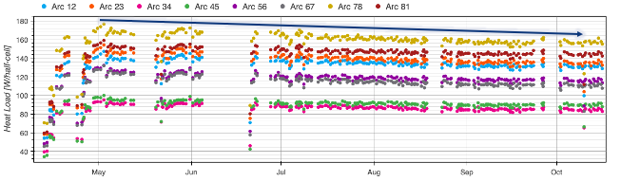
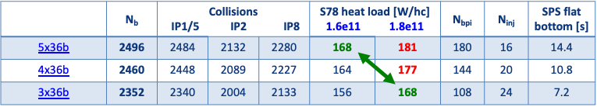
Intensity limitations - heat load
Operation challenges coming from heat load:
IT heat load:
  Limits instantaneous lumi at ~2.1x10³⁴ cm⁻² s⁻¹
Arc heat load:
  Limitation on train length, total number of bunches, bunch intensity
  Limited by ~170 W/half-cell in sector 7-8 (+10 W for operational margin)
2024 operation with trains of 3x36b
2025
Small margin (~10%) gained by conditioning over 2024 (not enough for an additional full train)
3x36b: 2024 scheme, compatible with 1.8e¹¹ ppb
4x36b: compromise with more collisions than in 2024, expected limit ~1.7e¹¹ ppb
5x36b: maximizes n. of collisions, limited to ~1.6e¹¹ ppb

Slide 14
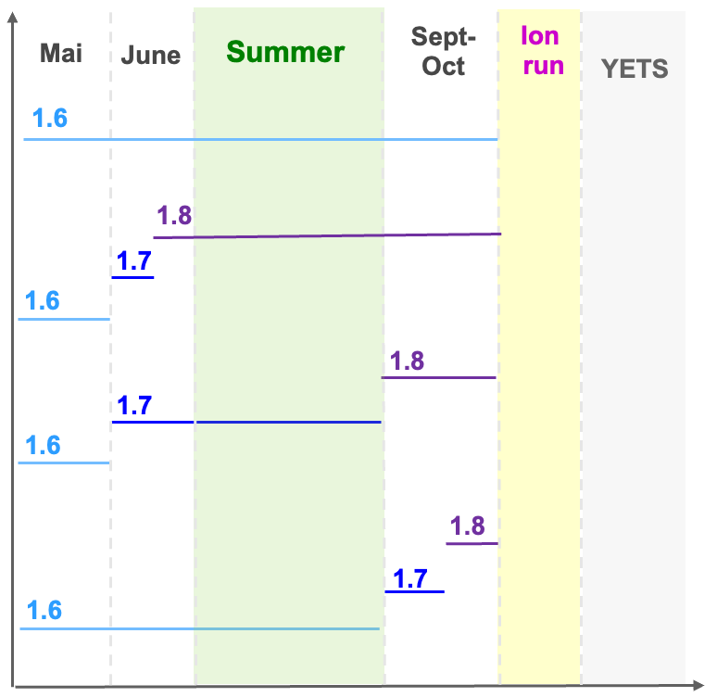
Bunch intensity in 2025
In Run3 LHC has been so far operated with train of 1.6×10¹¹ ppb:
  Run3 target of 1.8×10¹¹ was not (yet) achieved
The injector chain achieved LIU target parameters at SPS flat top in 2024
  4x72b @2.3×10¹¹ ppb
Different scenarios discussed for 2025 run
  No risk pp production - NOT more knowledge at end of 2025 than today!
  Early, distributed, late intensity steps towards 1.8x10¹¹ ppb (Run 3 goal)
Chosen scenario
Stable run at 1.6x10¹¹ ppb until september THEN increase bunch intensity until 1.8x10¹¹ ppb, before ION run

Slide 15

Towards HL-LHC bunch intensities
End of Run 3: last window to probe HL-LHC beam intensities
Critical investment into the success of HL-LHC!
Increasing intensity can reveal “unexpected limitations”
  BSRT mirror, (old) TDIs, vacuum modules, roman pots
Once operation at 1.8x10¹¹ ppb (Run3 goal) demonstrated, explore intensity range up to 2.3x10¹¹ ppb
  Beam dynamics tests: compatible with intensity limits (lower number of bunches)
    Started: RF capture, electron cloud, beam in(stability), beam-beam…
  Heating test (≥ 2000 bunches)
    Heating power will exceed the peak values achievable in operation with 1.8×10¹¹ ppb
    Potential risk to components and to machine availability from “unexpected limitations”
Heating test proposed for the end of Run 3:
Advance the ion run by 2 weeks
No risk to physics program in case of failures
Collisions not needed but would be possible

Slide 16
Outline
2024 run highlights
2025 configuration and main challenges
Considerations on beam intensity increase
2025 schedule and projections
Oxygen run preparation

Slide 17
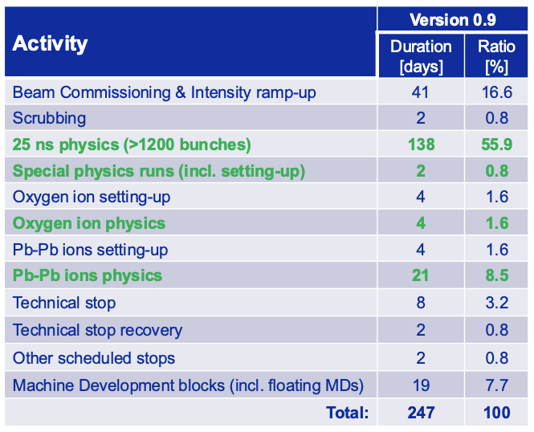

Schedule
Injector complex already restarted
  Beam is in the SPS
Experimental caverns closed on April 2nd
Transfer lines check on April 4th
Beam in LHC ~April 8th
First stable beams at 6.8 TeV in week of May 1st
Intensity ramp up (number of bunches) at 1.6×10¹¹ p/b → full machine around mid-May
Oxygen run during 1st week of July
About 2-day delay wrt original schedule due to ATLAS cooling problem (water leak) in the Argon calorimeter

Slide 18
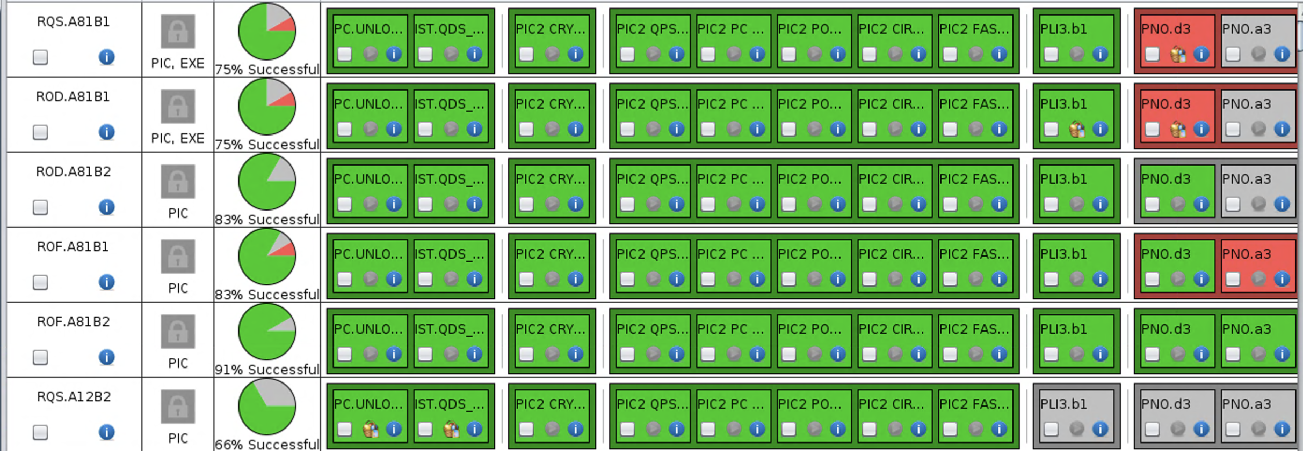

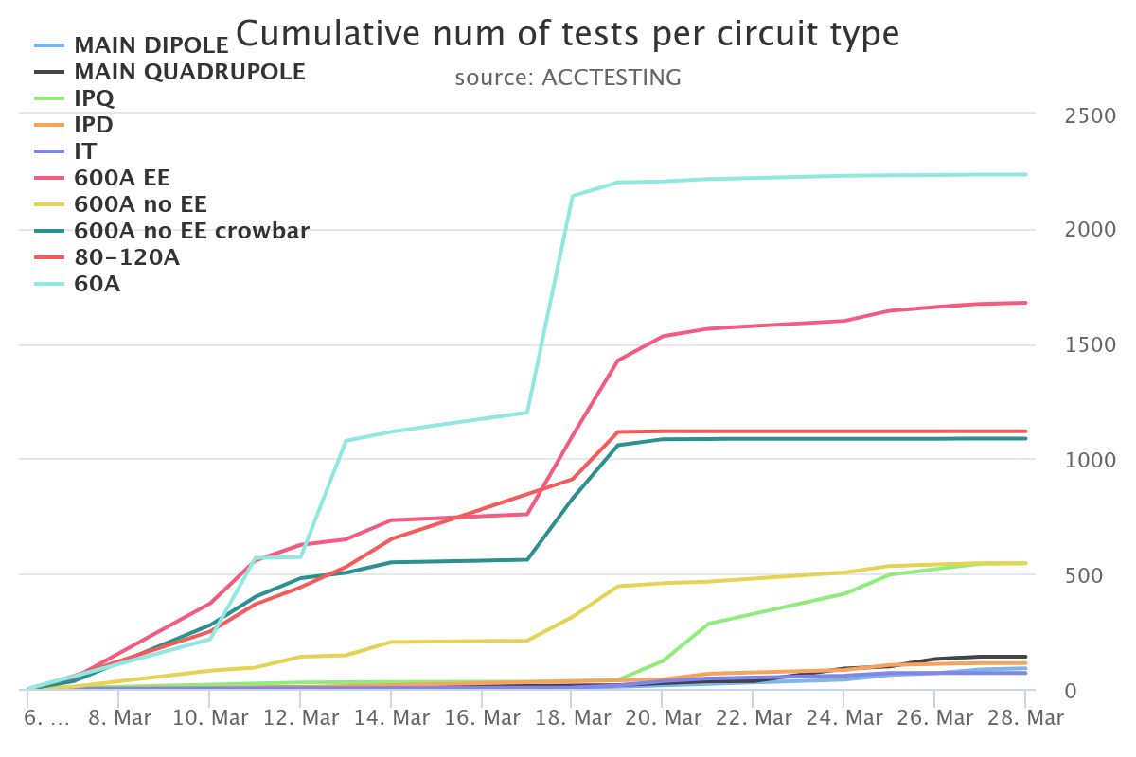
~800 quick interlock tests
Almost 1600 superconducting circuits
Over 10,000 tests to be executed and analysed
Sophysticated tools to ensure robustness reproducibility and traceability throughout the execution process
Enhanced automation for increased efficiency
Cross-departmental effort: two weeks campaign involving approximately 10 groups across ATS sector
Entering now Machine check-out phase

Slide 19
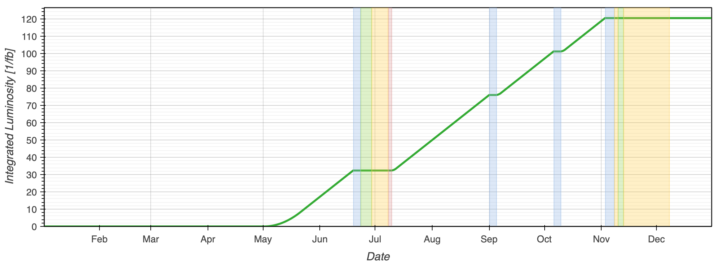
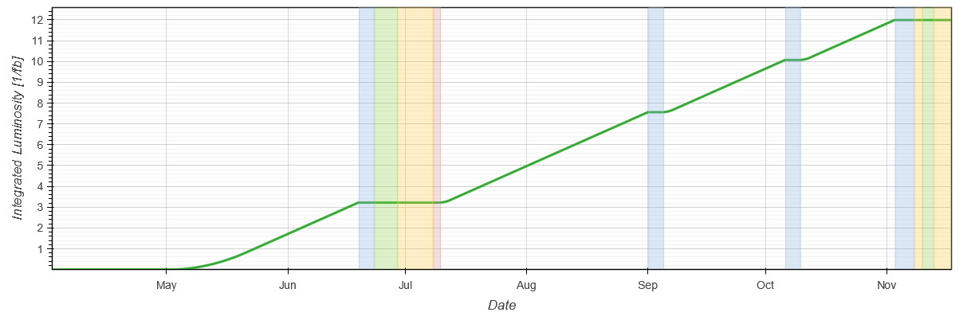
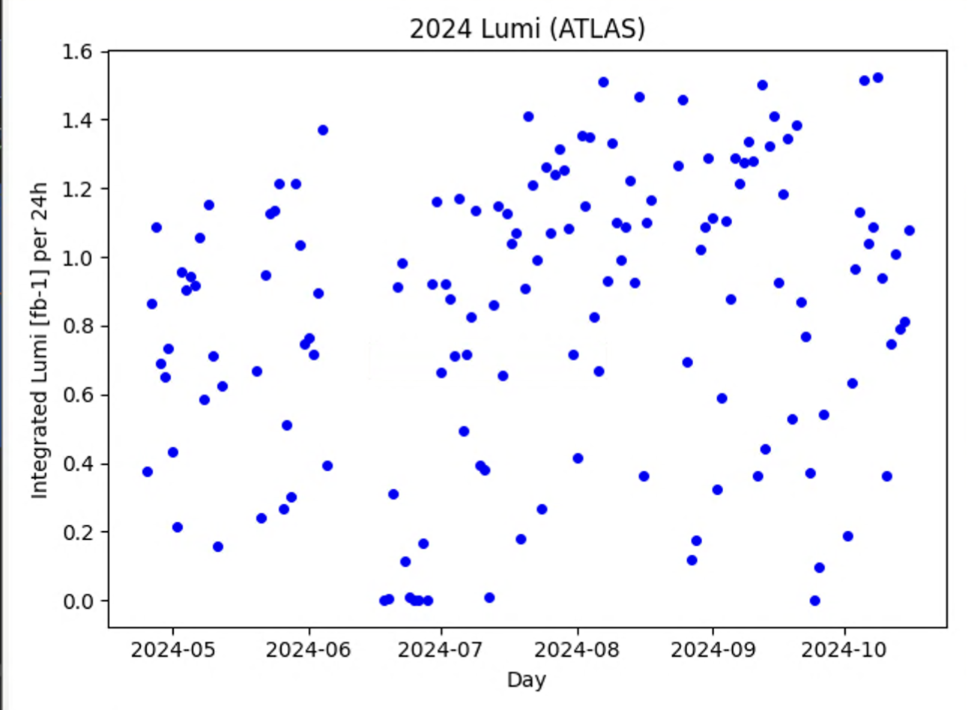
Performance estimate
ATLAS/CMS prediction
~120 fb⁻¹
Performance estimate depends on filling schemes and availability…
Assuming availability 2024-like and filling scheme based on 4x36b, expected perfomance (based on 2024 AVG rate):
  ATLAS/CMS: ~120 fb⁻¹
  LHCb: ~12 fb⁻¹
  ALICE: ~50 pb⁻¹
LHCb prediction (driven by hours in stable beams and levelling target)
12 fb⁻¹
2024 AVG production rate
0.83 fb⁻¹
Impact from delay generated by ATLAS leak negligible

Slide 20
Outline
2024 run highlights
2025 configuration and main challenges
Considerations on beam intensity increase
2025 schedule and projections
Oxygen run preparation

Slide 21
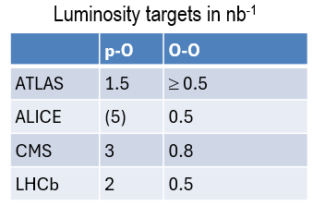
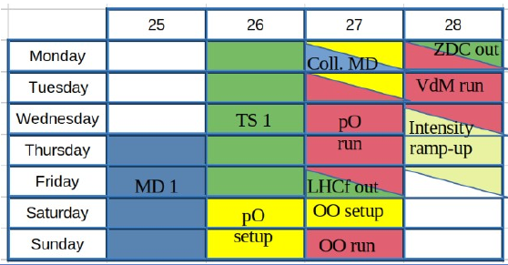
Oxygen run
Pb-Pb
p-O
O-O
Injection
Injection
Injection
8 days allocated for Oxygen - setup and physics run
Initial plan relied on a single machine configuration for PbPb, OO and pO to minimize setup overhead:
The requests from the experiments are however incompatible with this simple plan (LHCf b* ≥ 1m, OO at 5.36 TeV)
We will need 3 distinct configurations for PbPb, OO and pO
Ramp to 6.8 Z TeV, β*=1m/
1.5m
Ramp to 6.8 Z TeV, β*=1m/
1.5m
Ramp to 5.36 Z TeV, β*=1m/
1.5m
Squeeze β*=0.5m
1m
Physics
Squeeze β*=0.5m
1m
Luminosity targets in nb⁻¹
Physics
Physics
Plan by LPC
Preferred by experiments

Slide 22
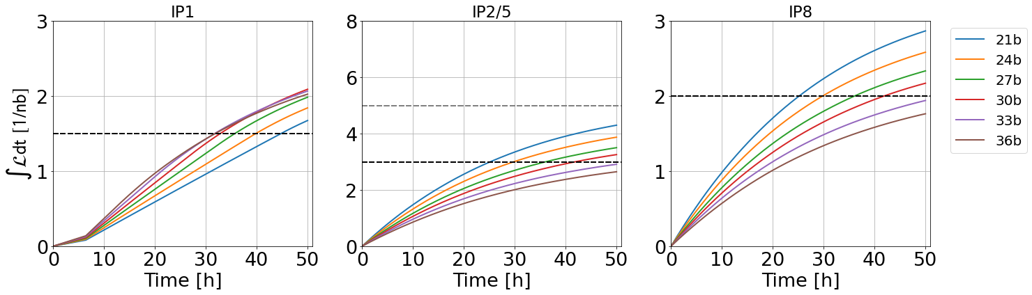
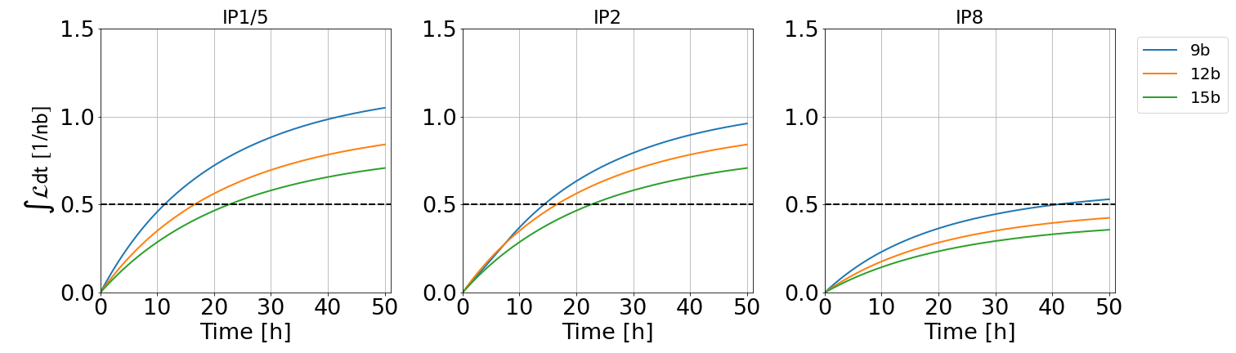
Oxygen run
R. Bruce, N. Triantafyllou, LBOC #176
pO 6.8 Z TeV, β*IP1/2/5 = 1m, β*IP8 = 1 .5m
First estimates indicate that some targets are difficult to reach. Time estimates range between 7days (perfect availability) and 9days
Short run is very sensitive to availability
O-O performance depends strongly on bunch intensity (and emittance) delivered by injectors
NeNe run does not fit into the time frame
  No overhead wrt OO on machine side
OO 5.36 Z TeV, β*IP1/2/5 = 0.5 m, β*IP8 = 1 m

Slide 23

Conclusions
LHC is ready for 2025 operation
  Stable operation with 1.6x10¹¹ ppb until the end of summer
  Increase bunch intensity to reach 1.8x10¹¹ ppb before the ION run
  ~120 fb⁻¹, 12 fb⁻¹, ~50pb⁻¹ can be in reach in 2025, assuming 2024-like availability
The 2025 pp configuration will be adapted to limit radiation to the triplet magnets and to improve conditions for forward physics in IR1
  Polarity back to “normal” in IR1, “reversed” in IR5
Pushing bunch intensity during Run3 is key to unveil potential limitations before LS3 and prepare the road to HL-LHC
The oxygen run boundary conditions are complex: iterations needed to converge to a performance and configuration that fits into the time frame
It looks easy, but…
This is challenging stuff - that we can operate the LHC at this level is a phenomenal achievement and a testament to the remarkable commitment of everyone involved.
M.Lamont @Moriond-QCD 2024

Slide 24
SPARE

Slide 25
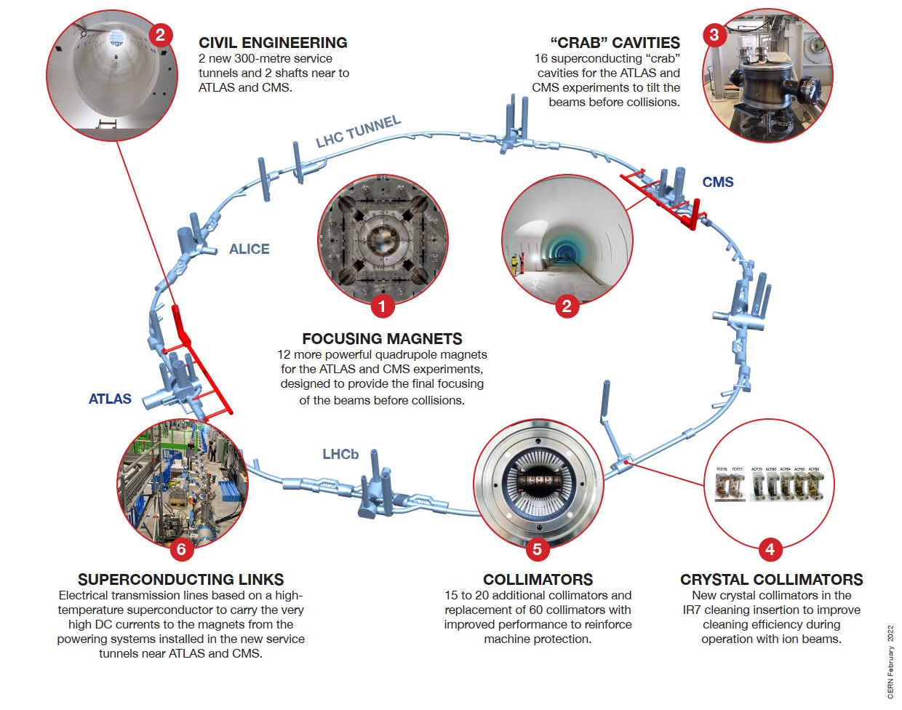
HL-LHC at a glance
HL-LHC is the main project for LS3
No accelerator upgrade project has so many challenging novelties, covering such a broad technology spectrum
Technology intensive project!
Major upgrades in P1 and P5, large fraction of LHC will remain unchanged
The above picture shows only a subset of the major technology landmarks of the project

Slide 26
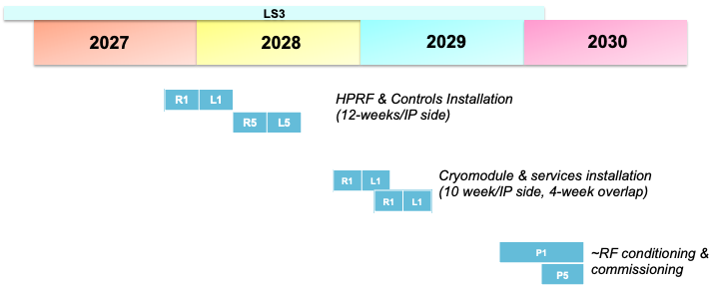
Crab cavities
Staged installation in YETS 30/31 was initially considered to cope with delay in equipment delivery
Studies show that staged RFD installation is not feasible, without having impact on Run 4 physics program
Mitigation action being implemented to ensure that the full system can be installed during LS3
NO delay expected

Slide 27
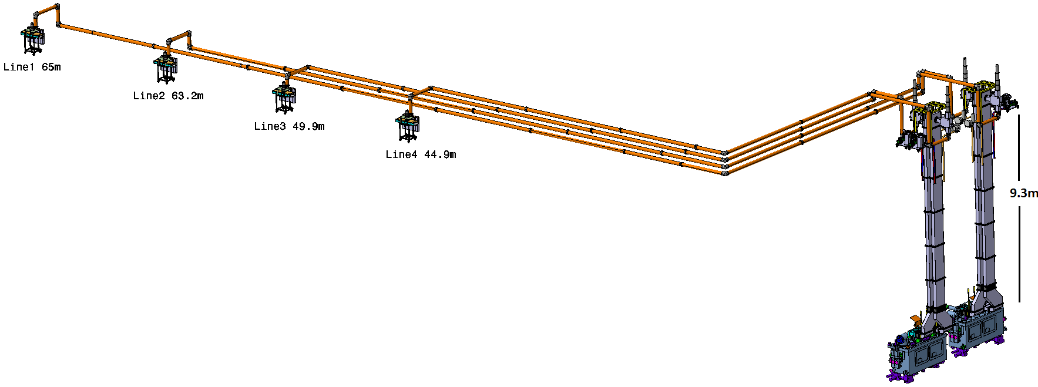
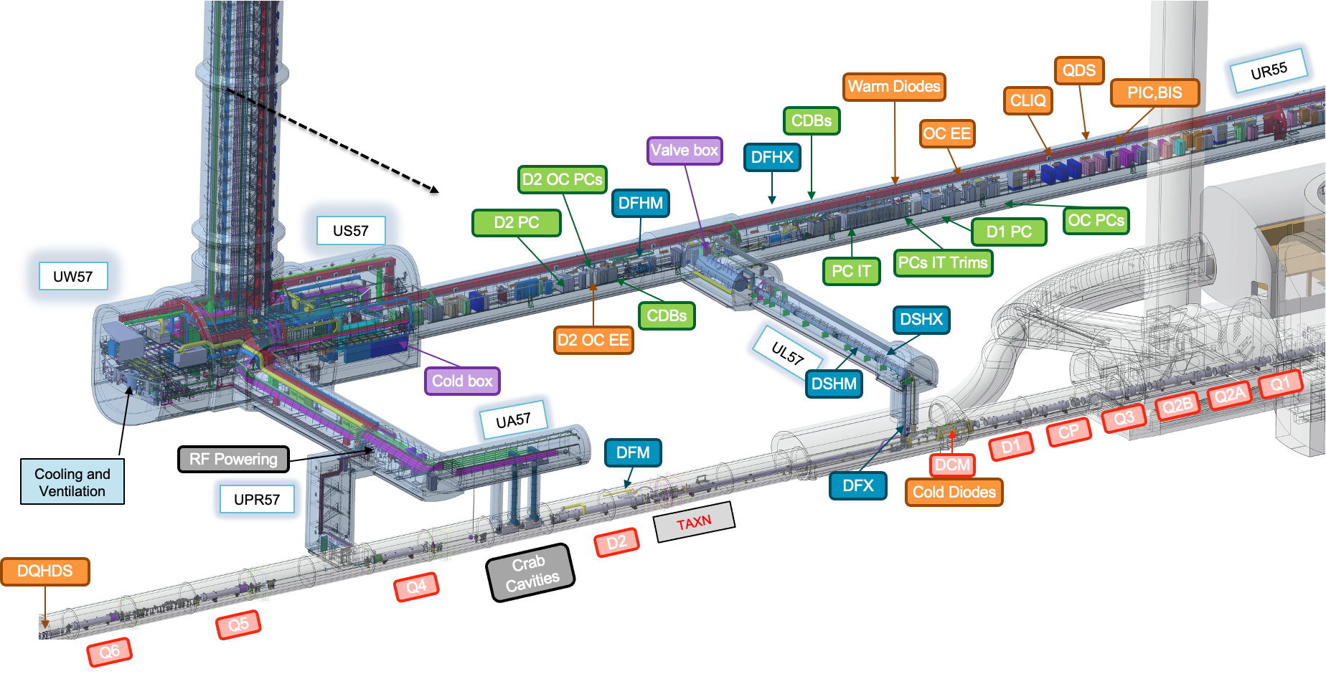
Vertical cores
Technical constraints to execution of the Vertical Cores, combined with the limited access to LHC (2-month), created significant challenges
  ➔ first invitation to tender unsuccessful
Revision of the schedule and constraints to ensure that the works could proceed
New invitation to tender, allowing more flexibility
  issued in January, outcome assessment by May 2025
NO delay expected

Slide 28
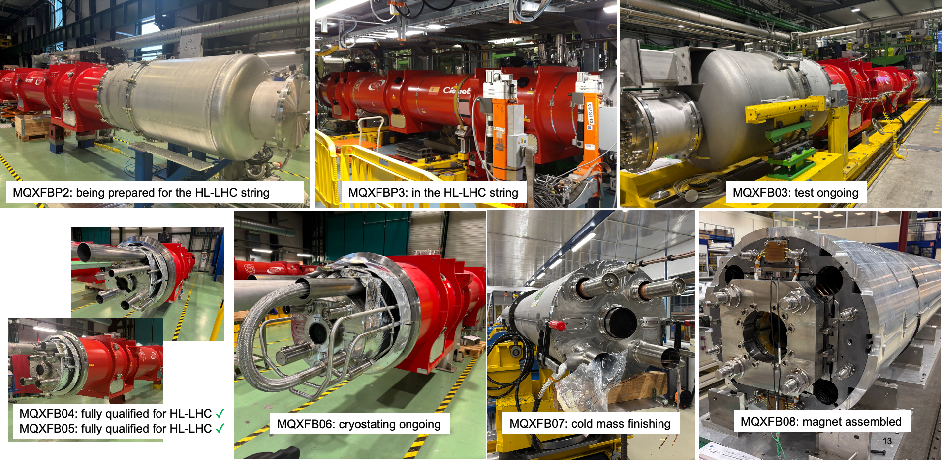

Magnets
NO delay expected
NbTi Magnets: well known technology, smooth production
Nb₃Sn Magnets: new technology that entails some challenges
  Technology well under control
  Full production speed
  ≈ 1 year float for installation for each magnet
4 more magnets to build (B09-B12)
Coil
Magnet
Cold mass
Test | MQXFB03 |  |  |  | MQXFB04 |  |  |  | MQXFB05 |  |  |  | MQXFB06 |  |  |  | MQXFB07 |  |  |  | MQXFB08 |  |  |  | MQXFB09 |  |  |  | MQXFB10 |  |  |  | MQXFB11 |  |  |  | MQXFB12

Slide 29
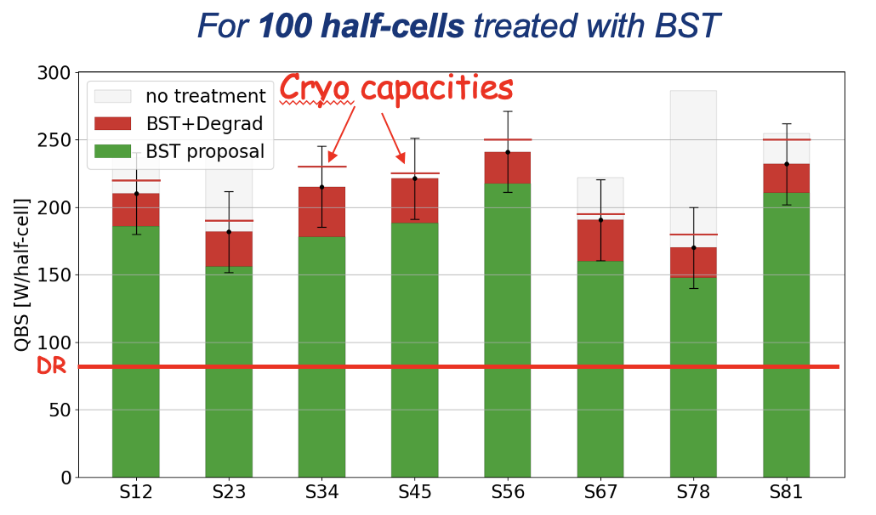
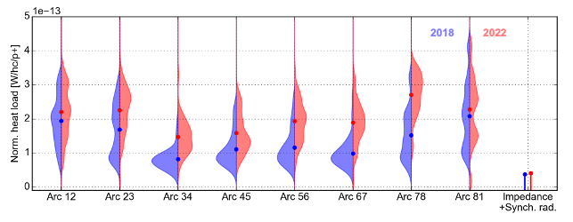
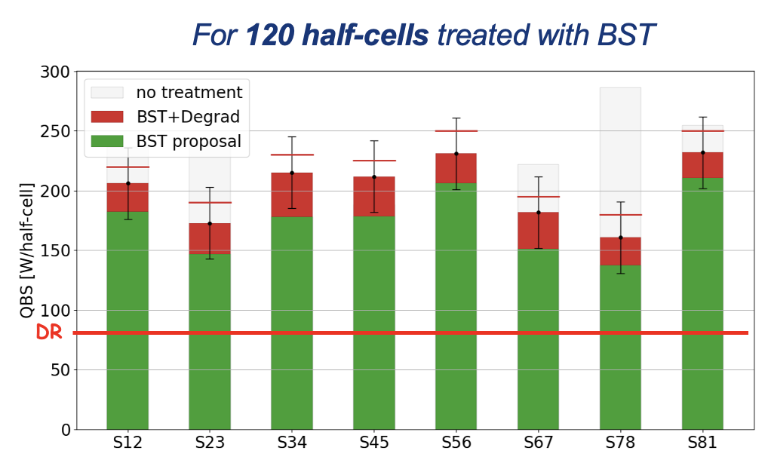
Beam Screen Treatment (BST)
BST to cope with higher heat load due to increased intensity and (possibly) further surface degradation
Initial scope of 100 cells, new baseline 120 cells, (140 under discussion), to gain extra margin in case of degradation
Run2-Run3 Heat load comparison

Slide 30


HL-LHC operation
Recent update: IONS operation in 2031-2041

Slide 31

HL-LHC operation
Several options are being studied to prepare mitigations for potential performance limitations and/or to further push integrated luminosity
NO pile-up increase
losses mitigation (dynamic aperture and tails control)
flat optics
Pile-up increase
Most efficient way to increase integrated luminosity
200 pile-up (7.5x10³⁴ cm⁻²s⁻¹) relies on engineering margins

Slide 32

HL-LHC operation
Identify parameters for HL-LHC operation (still to be further developed) to reach the 3000 fb⁻¹ goal, even with ion runs until the end of HL-LHC
An intermediate PU value in Run 5 would allow to reach the 3000 fb⁻¹ goal

Slide 33

Beam screen treatment
OBJECTIVES
Remove CuO and/or increase surface carbon concentration on selected BS
Beam Screen (BS) surface passivation (robustness against re-oxidation)
Risks:
Degradation of un-treated half-cells during future LS
  Extremely difficult to quantity and impossible to localize
Higher than expecter heat loads of treated half-cells
Low(er) number of treated half-cells in LS3
Possible mitigations?
Treat larger number of half-cells (more margins)
Produce less e-cloud
  Filling scheme (36b/48b (2022), hybrid (2023))
  Continue the beam screen treatment in future LS
A scenario treating 100 half-cells looks realistic

Slide 34
Heat-load – the problem
*Beam screen values are given as example, as e-cloud varies along the machine
Beam screen*
285 W/hc
☹
Cryogenic operation margin
for daily operation
(handle transients during
injection and magnet ramping)
+ facing disturbances
Operational margin
Operational margin
Operational margin
Beam screen
84 W/h
Beam screen*
170 W/hc
Beam screen*
160 W/hc
Inner Triplet
BASE
(2 K loops, thermal shields, DFB, SAM, RF, etc.)
1 cryoplant capacity
~18 kW @4.5 K
Inner Triplet
BASE
(2 K loops, thermal shields, DFB, SAM, RF, etc.)
BASE
(2 K loops, thermal shields, DFB, SAM, RF, etc.)
BASE
(2 K loops, thermal shields, DFB, SAM, RF, etc.)
LHC
Design Report
LHC
Today
HL-LHC
(without BST)
HL-LHC
(with BST)
NB: The graphics are not scaled, they are only illustrative

Slide 35


Why flat optics ?
ATLAS for standard
V crossing
IT beam screen
The IT beam screen shape is asymmetric and optimized to allow larger aperture in the “standard” crossing plane
accommodates the beam separation due to the crossing angle bump to reach the same β* in both planes
Beam size in IT quadrupoles is ∝ 1/√β
For rotated crossing planes:
Less aperture in the rotated crossing plane: minimum β* increases from 30 cm to 60 cm
More aperture in the rotated separation plane: minimum β* decreases from 30 cm to 18 cm
to ensure equivalent performance reach use flat optics (β*_{x} ≠ β *_{y})
Beam separation in due to crossing angle bump

Slide 36

Beta* limitation (36 cm)
Significant losses on secondary collimator in fill 9530 (17th April)
300-400 um orbit shift is needed to induce observed hierarchy breakage
Highest losses in the
middle of insertion (instead of extremities, where primary collimators are located)
Broken hierarchy can compromise protection
➔ limitation on beta* (about 1-2% loss)
Studies, tests and simulations indicated that losses are generated by particles in the off-momentum halo (not core of the beam)
Various mitigations put in place to improve the behaviour
Machine re-validated after TS#1 with mitigations in place
Beta* limitation lifted

Slide 37



Intensity limitations – vacuum modules
ID212
Vacuum module failure in cell 4L1 (June 2023):
Repair results in ~5 days loss
Bunch intensity limited to 1.6×10¹¹ p/b in 2023/2024
Tension spring
RF fingers
Pipe tube
Problem traced to localized heating of the tension spring of diameter 212 (ID212) modules for:
non ideal contact fingers/tube
two beams
beam offsets
Consolidation campaign, completed during the present YETS 24-25
4 modules left in single beam configuration (no offset)
2023 JAP talk, C.Antuono & P.Krkotic
aggravating factors
Deformable RF fingers (DRF)
Optimized unshielded bellows

