Slide 1

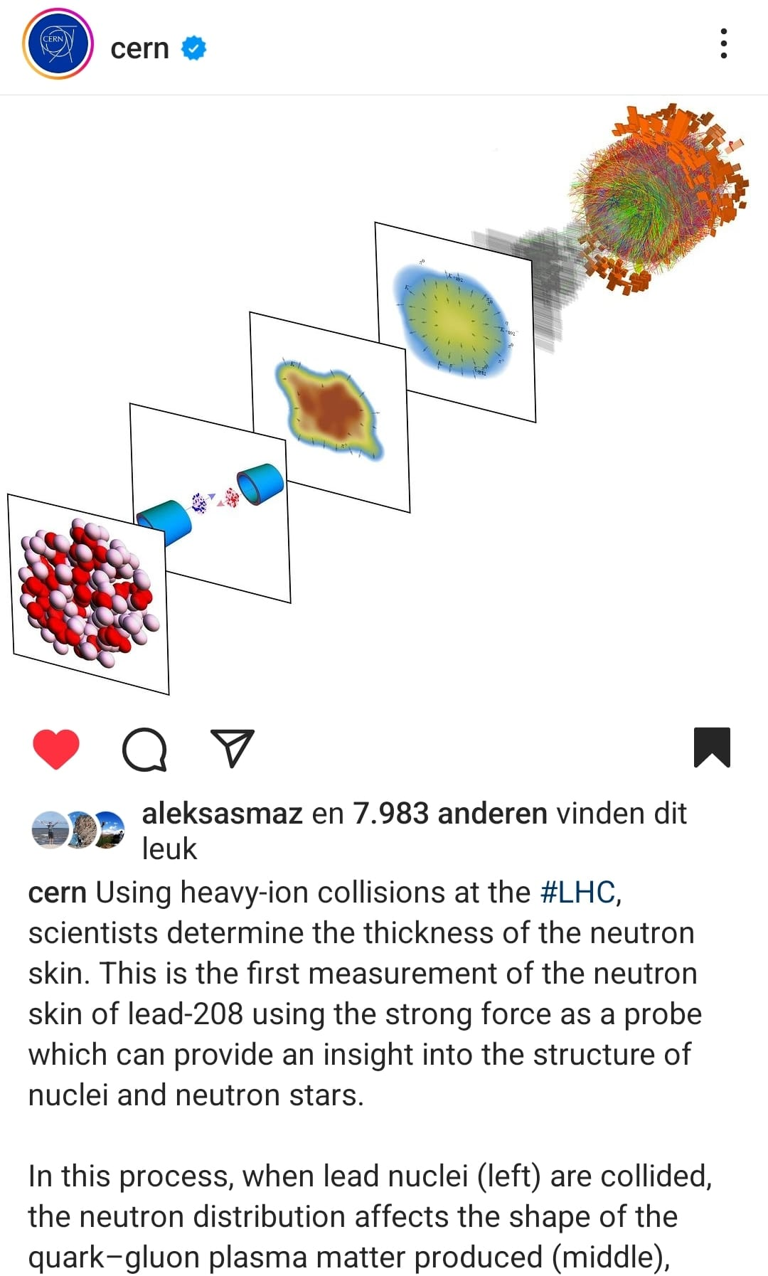


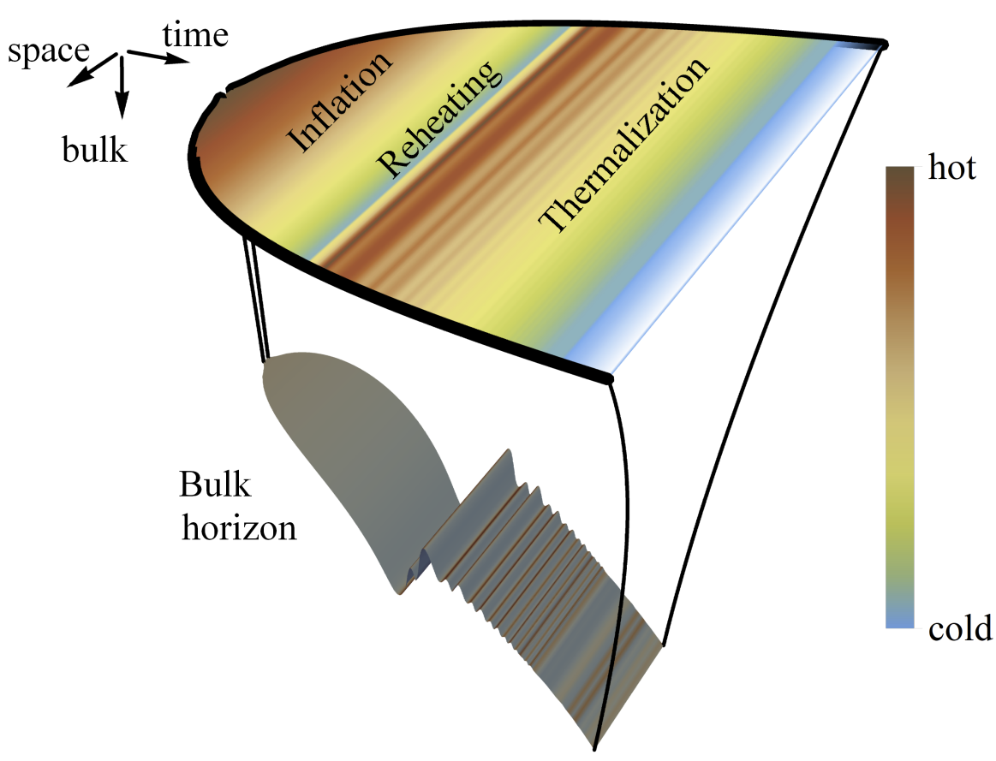
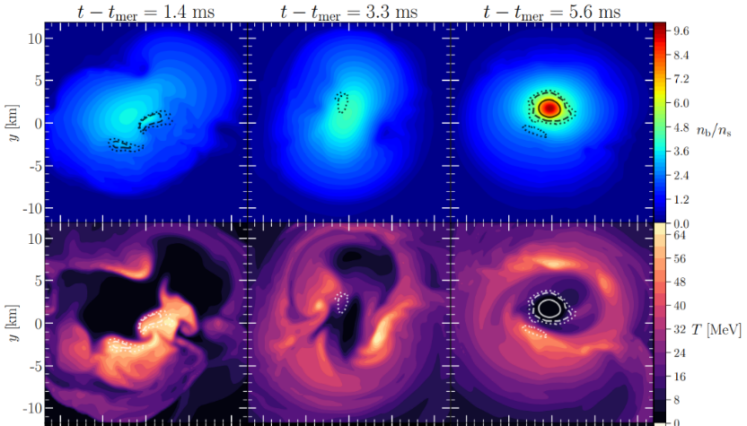
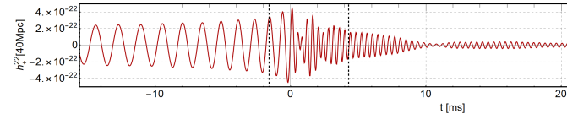
Holography as a bridge between QCD and Gravitation
Surprising connections from quark matter to gravitational waves
belvedere
Wilke van der Schee
59th Rencontres de Moriond
La Thuile, 2 April 2025

Slide 2
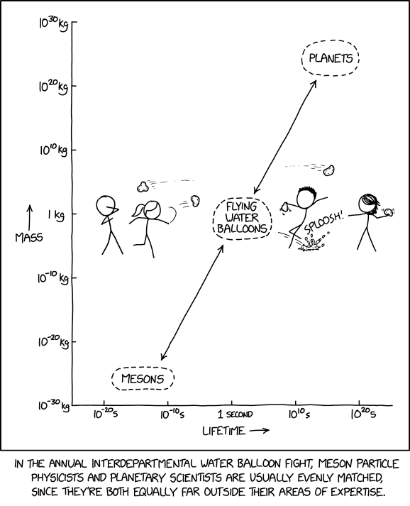
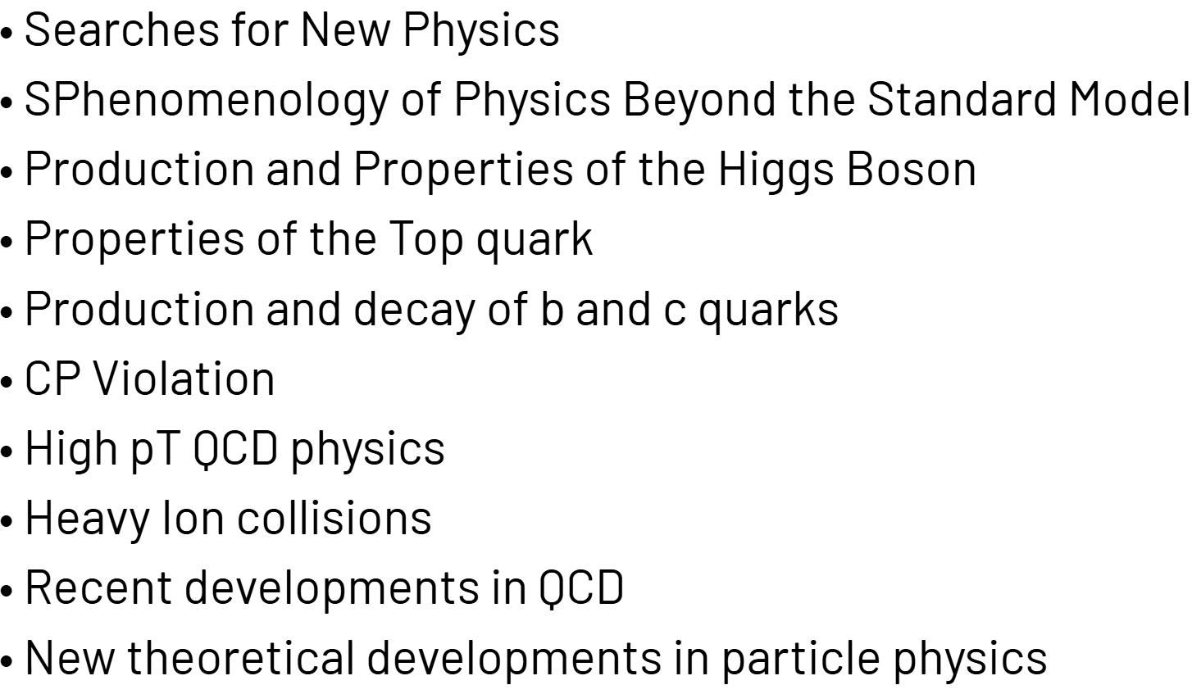
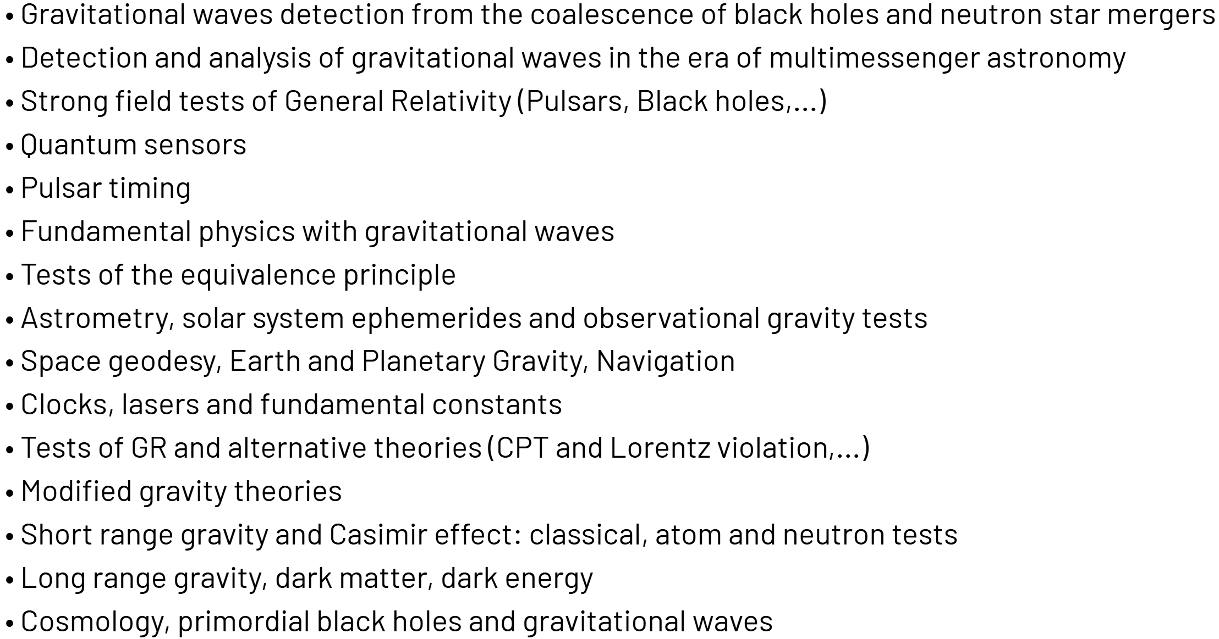
QCD and gravitation
Wilke van der Schee, CERN/Utrecht
Randall Munroe, https://www.xkcd.com/2561/ (10 March 2025)
Notes:
Many states + linearized

Slide 3
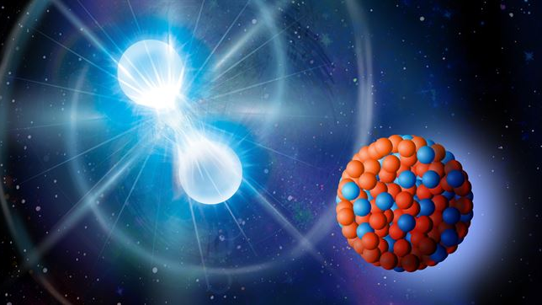
Surprising connections
Wilke van der Schee, CERN/Utrecht
Neutron skin of heavy elements
Neutron star EOS

Slide 4
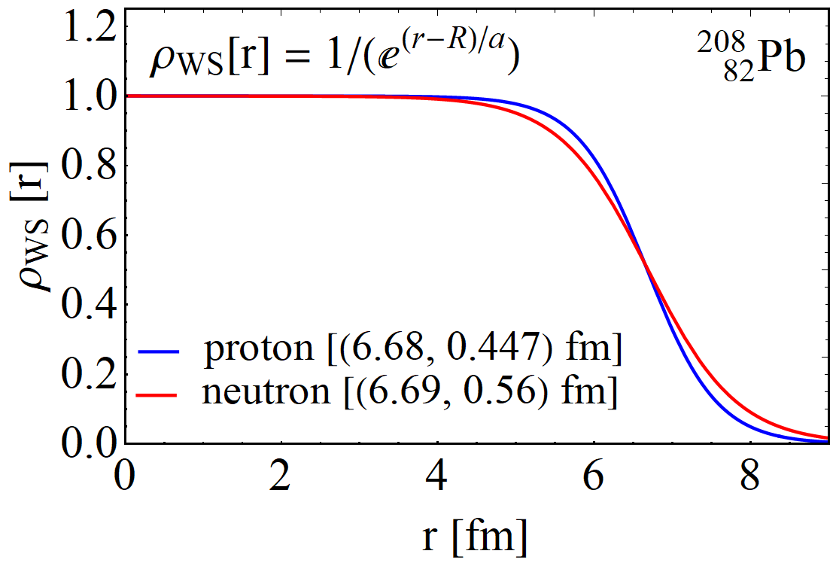
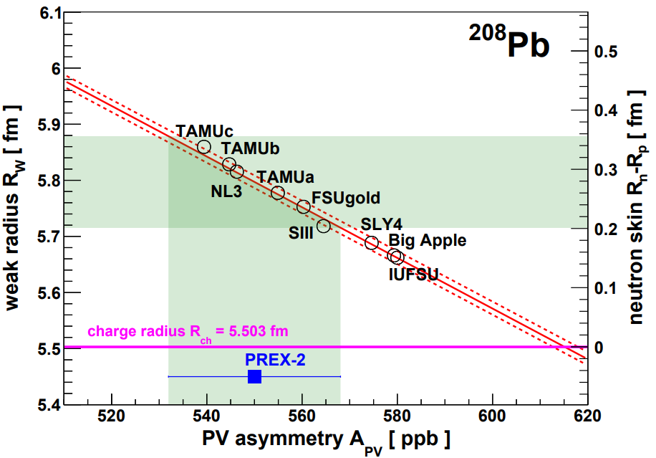
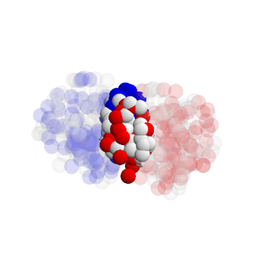
The neutron skin and the QCD EOS
Wilke van der Schee, CERN/Utrecht
Neutron pressure versus density
  Neutron star: pressure by gravity
  Lead-208: pressure by surface tension
  Similar densities (saturation density)
  Direct implications for neutron star M-R relation
How to measure the neutron density?
  PREX2: measure weak radius (114 Coulombs of 954 MeV electrons)
  Heavy ions: measure baryon radius?
Heavy ions: profile influences many observables
  Interplay with bulk viscosity, initial stage model etc
  Likely need a full global analysis
PREX, Accurate Determination of the Neutron Skin Thickness of 208Pb through Parity-Violation in Electron Scattering (2021)

Slide 5
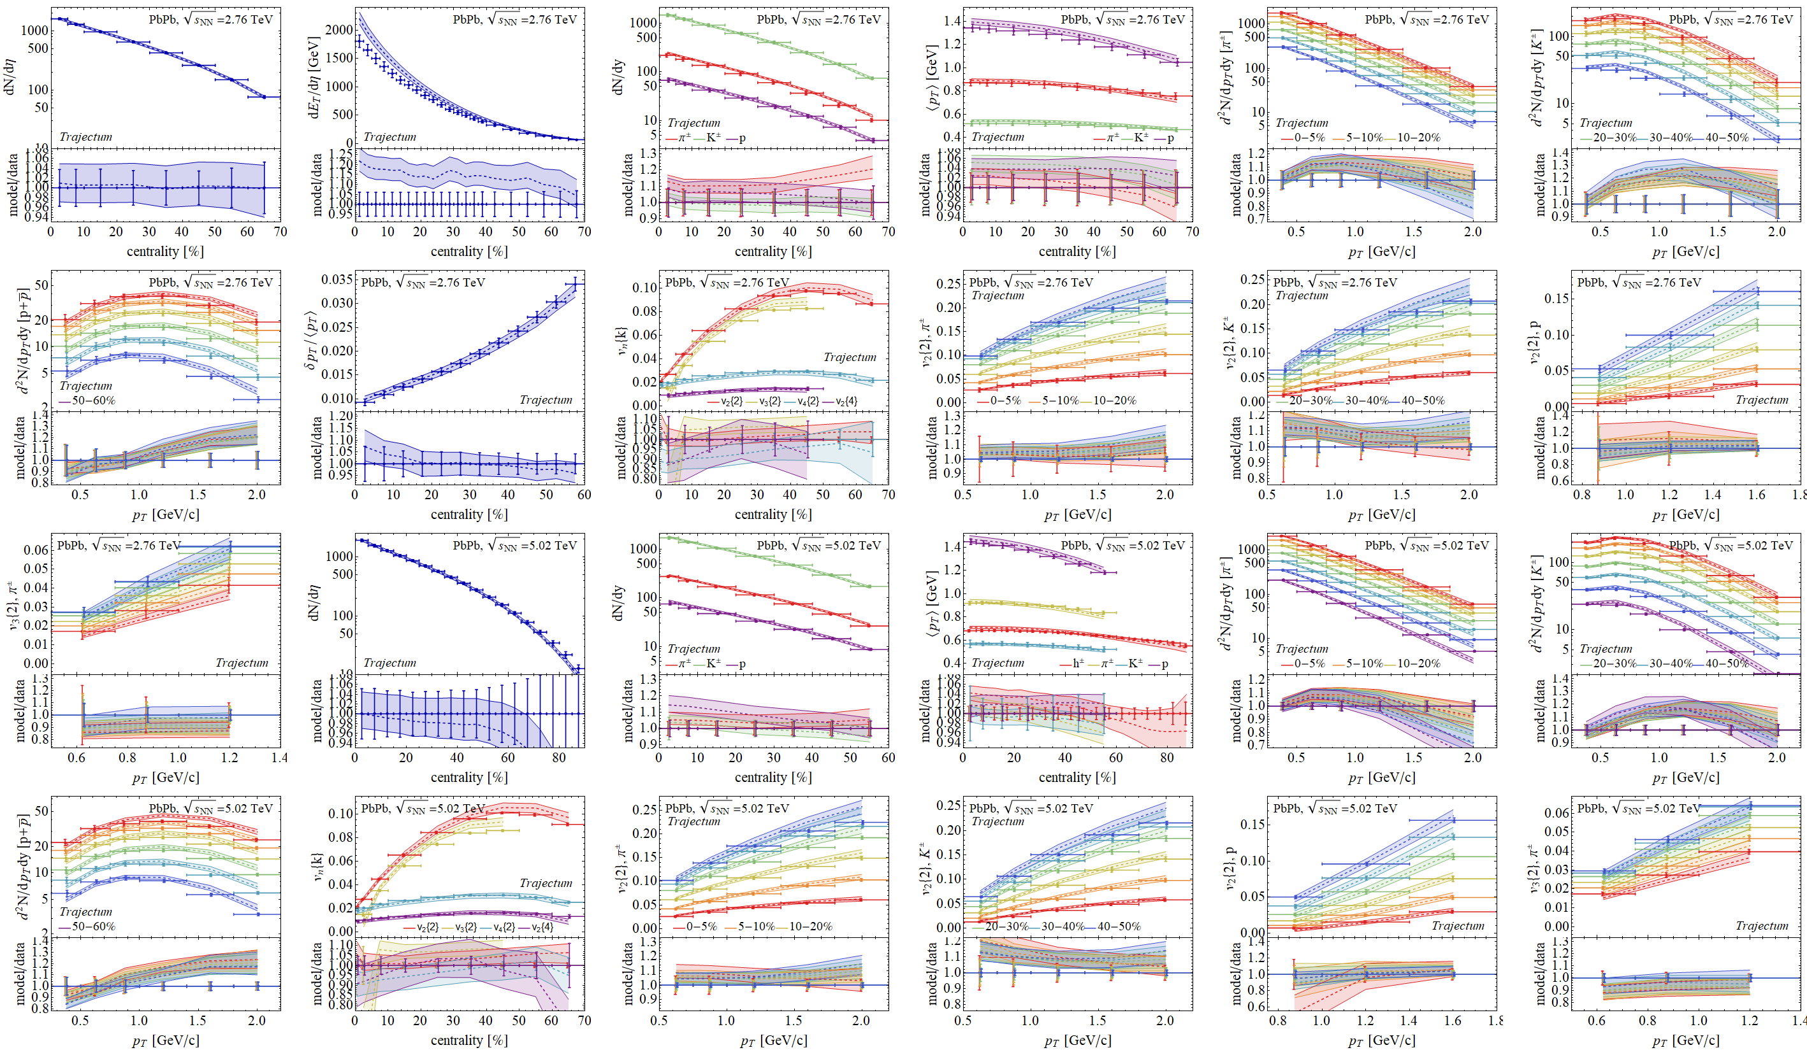
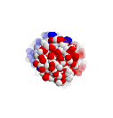

Experimental observables: a wealth of data
Posterior

Slide 6
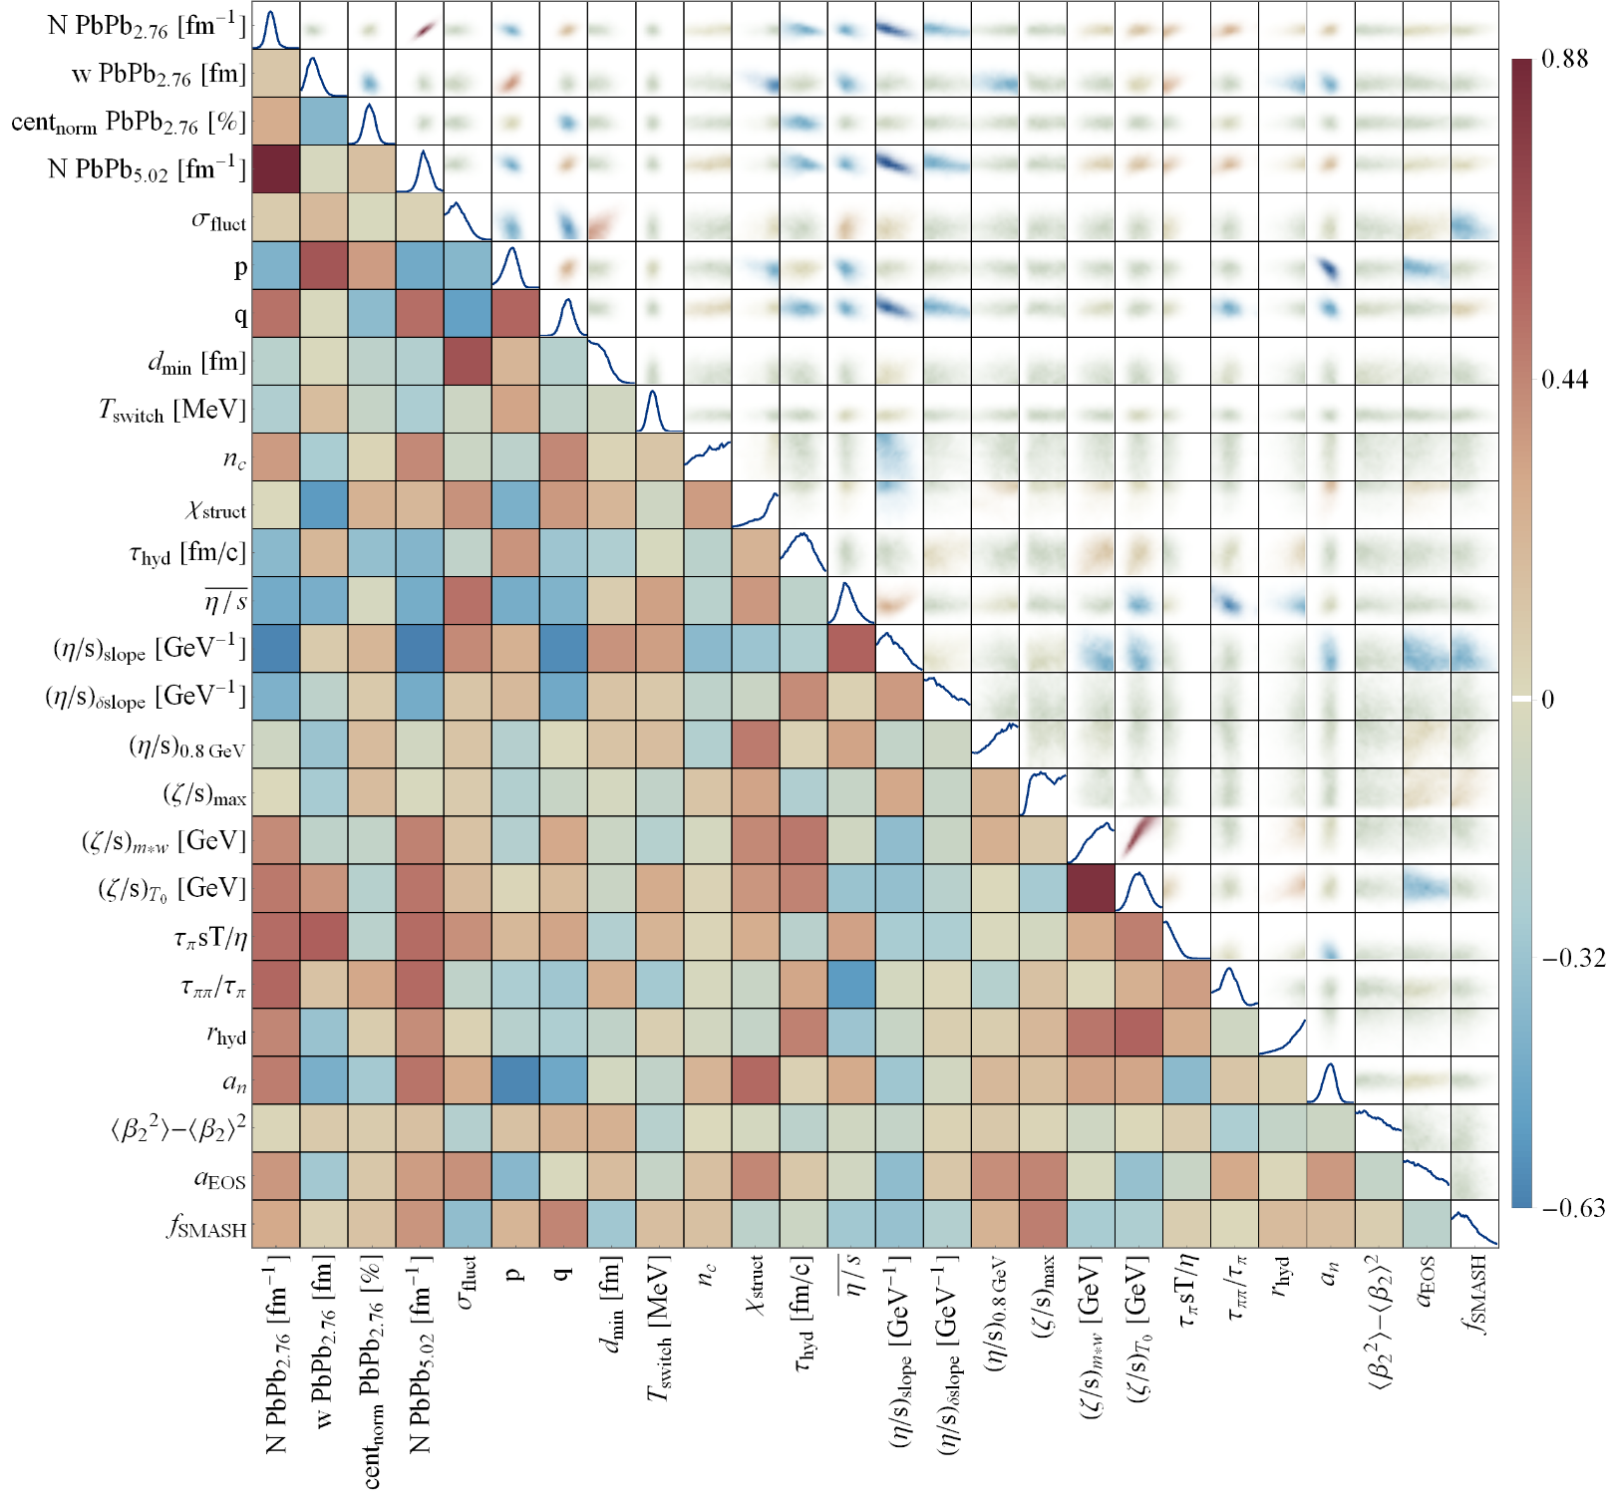
Full posterior distributions
Wilke van der Schee, CERN/Utrecht
Some parameters better constrained than others
  Correlations are important, e.g. with initial stage model (in this case Trento)

Slide 7
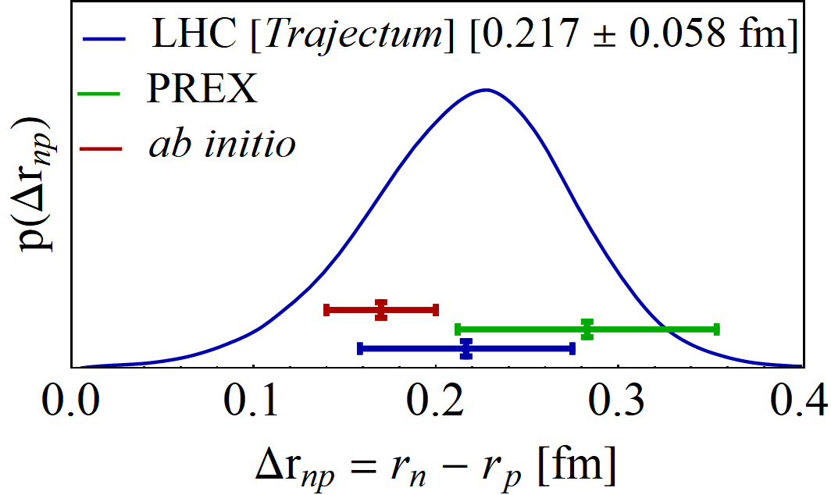
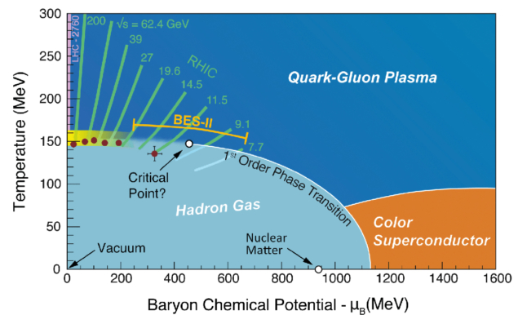
The neutron skin – final result
Wilke van der Schee, CERN/Utrecht
Transform to neutron radius minus proton radius
Final result consistent but smaller than PREX II
Uncertainty is about 20% smaller than PREX II
Cross section is crucially important,
but also centrality dependence
  Important to vary Trento parameters in particular
Interplay between regions in QCD phase diagram is interesting
Initial shape: zero temperature, nuclear matter
Evolution: zero density, EOS from lattice
PREX II, Accurate Determination of the Neutron Skin Thickness of ²⁰⁸Pb through Parity-Violation in Electron Scattering (2022)
Baishan Hu et al, Ab initio predictions link the neutron skin of 208Pb to nuclear forces (2021)

Slide 8

Surprising connections
Wilke van der Schee, CERN/Utrecht
Heavy ion collisions
Neutron star mergers
https://musesframework.io/ Modular Unified Solver of the Equation of State

Slide 9
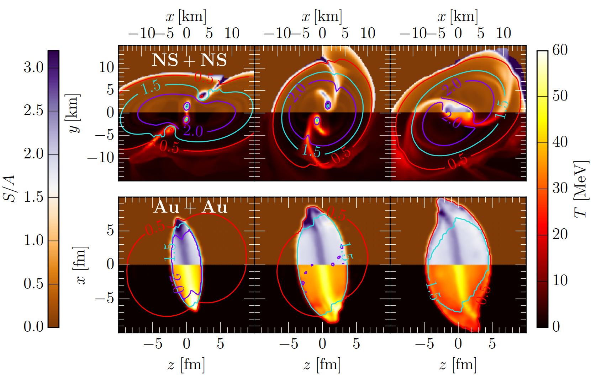
Neutron stars and heavy ions
Wilke van der Schee, CERN/Utrecht
Neutron star merger
Scales are vastly different (10¹⁸)
Temperature and density can be similar
(at low energy)
Relativistic hydrodynamics, viscosities (small size versus neutrinos)
Non-equilibrium physics, bulk viscosity (small size vs neutrinos, phase transitions)
Low energy heavy ion collision (AuAu @ 0.4 GeV)
Elias R. Most, Anton Motornenko, Jan Steinheimer, Veronica Dexheimer, Matthias Hanauske, Luciano Rezzolla and Horst Stoecker, Probing neutron-star matter in the lab: similarities and differences between binary mergers and heavy-ion collisions (2022)

Slide 10
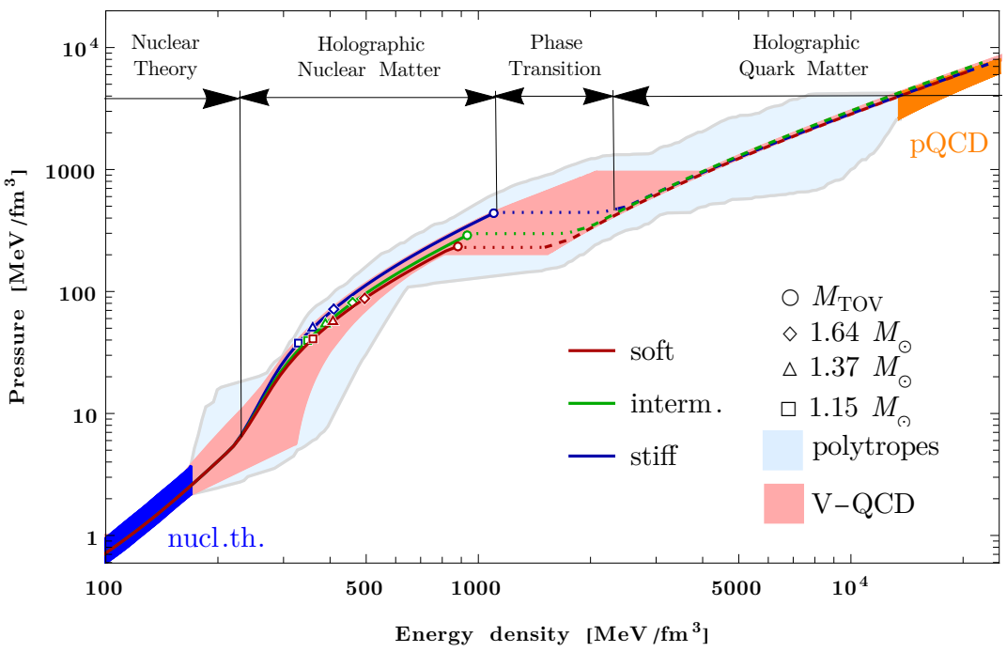
Neutron stars and heavy ions
Wilke van der Schee, CERN/Utrecht
High energy heavy ion collisions probe different axis QCD phase diagram
No known theory can access entire phase diagram:
Lattice QCD at zero density
pQCD at high temperature / density
Nuclear theory in low density hadronic phase
Holography to connect them (?)
  Includes temperature and hadron-quark phase transition
  Matched to both lattice (zero density and pQCD)
  In
pQCD
Samuel Tootle, Christian Ecker, Konrad Topolski, Tuna Demircik, Matti Järvinen, Luciano Rezzolla, Quark formation and phenomenology in binary neutron-star mergers using V-QCD (2022)

Slide 11
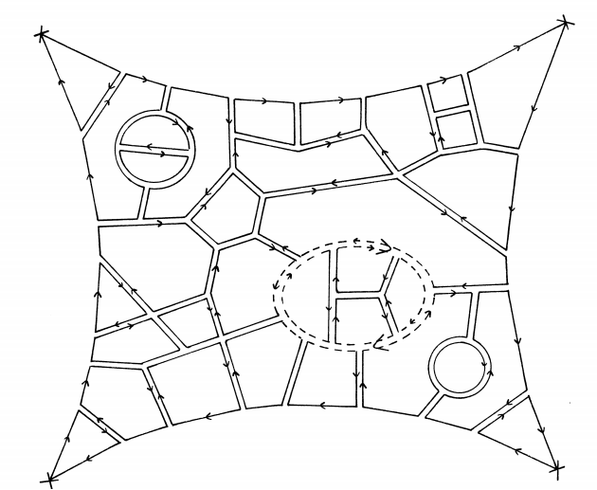
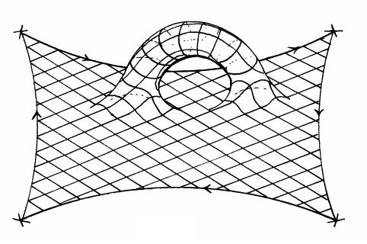
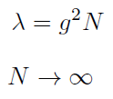
`Qcd’ as a string theory
Wilke van der Schee, CERN/Utrecht
Non-perturbative gluons → string theory → (quantum) gravity
q
q
Planar limit:
fixed
q
q
Gerard ’t Hooft, A planar diagram theory for strong interactions (1974)
Juan Martin Maldacena, The Large N limit of superconformal field theories and supergravity (1997)

Slide 12
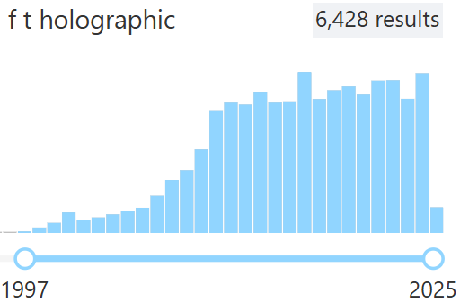
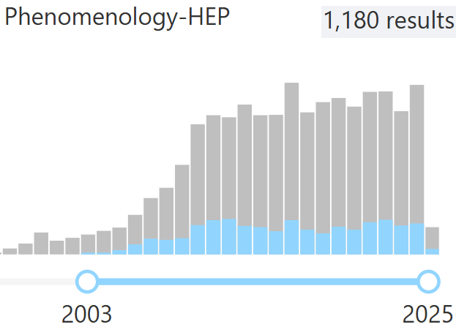
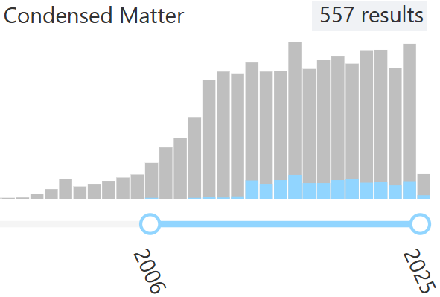
holography
Wilke van der Schee, CERN/Utrecht
By now a mature field to study non-perturbative physics,
continued interest from hep-ph to cond-mat.str-el
What it cannot:
Precision physics for `standard model’ physics
Quantum gravity for `our’ universe
What it can:
Qualitative insights in non-perturbative QFT or quantum gravity
Real time dynamics, lessons about hydro, phase transitions etc
Relatively sophisticated (first principle) model building
Juan Martin Maldacena, The Large N limit of superconformal field theories and supergravity (1997)

Slide 13
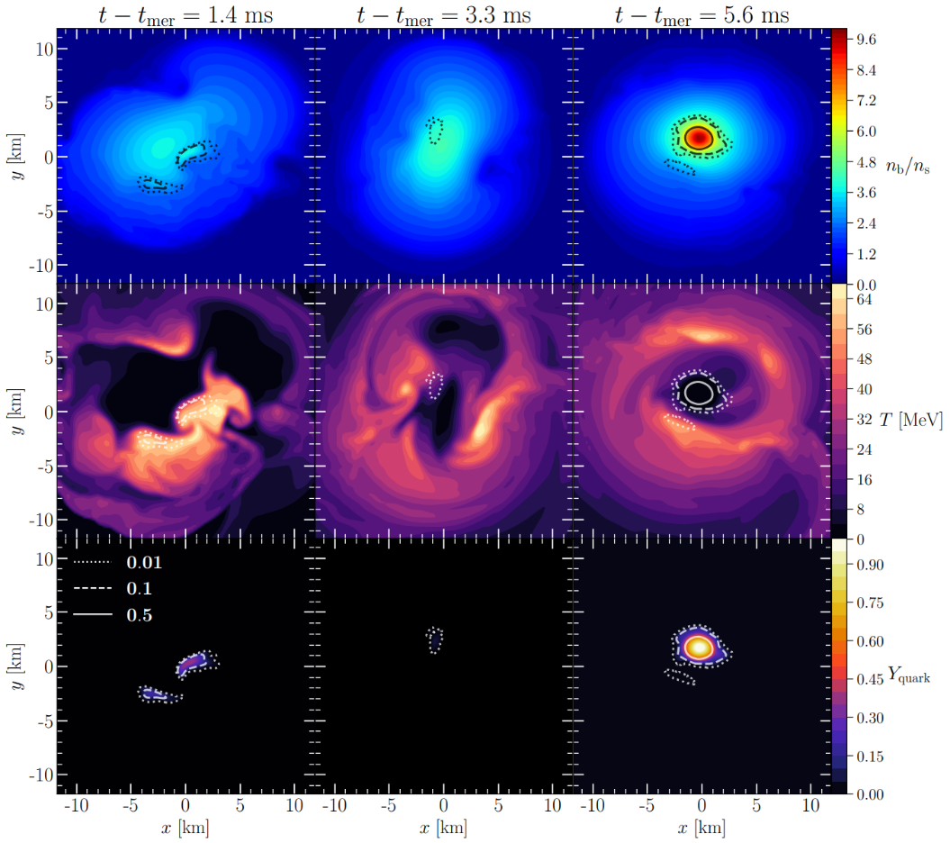
Neutron stars and holography
Density
Temperature
`Quark phase’
Quark phases driven by temperature (early time)
and density (late time)
First order phase soft transition leads to prompt collapse
Multimessenger gamma ray seconds after GW170817 rules out prompt collapse
  In
Samuel Tootle, Christian Ecker, Konrad Topolski, Tuna Demircik, Matti Järvinen, Luciano Rezzolla, Quark formation and phenomenology in binary neutron-star mergers using V-QCD (2022)
Ramandeep Gill, Antonios Nathanail, Luciano Rezzolla, When Did the Remnant of GW170817 Collapse to a Black Hole? (2019)

Slide 14
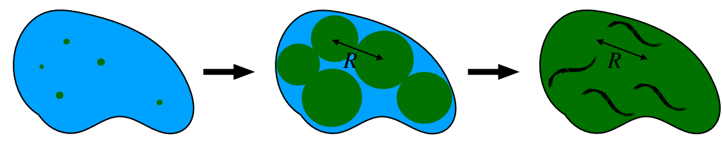
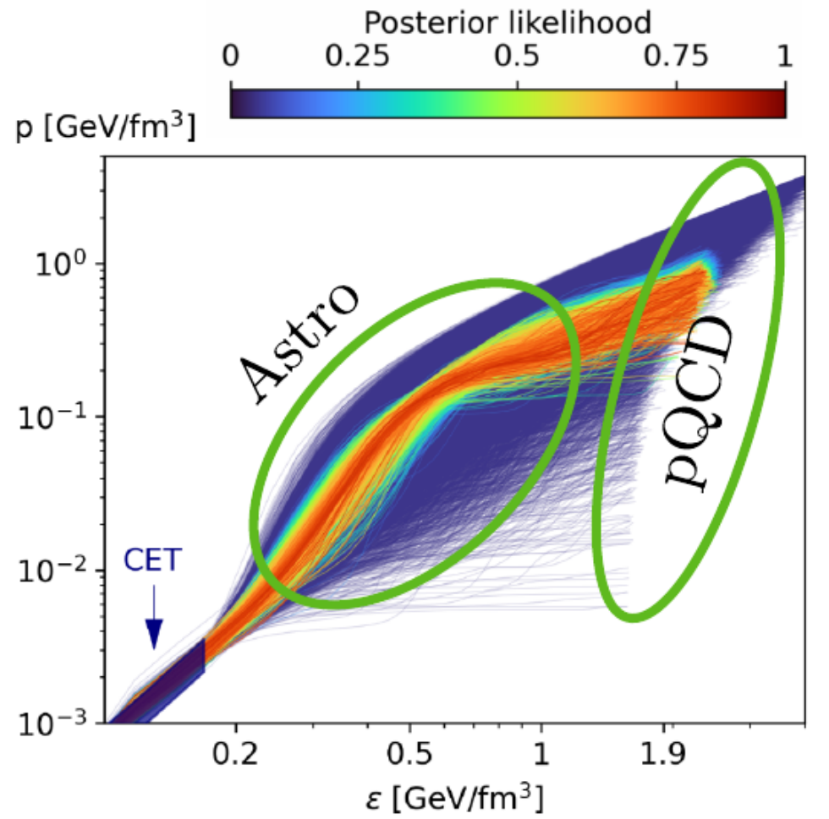
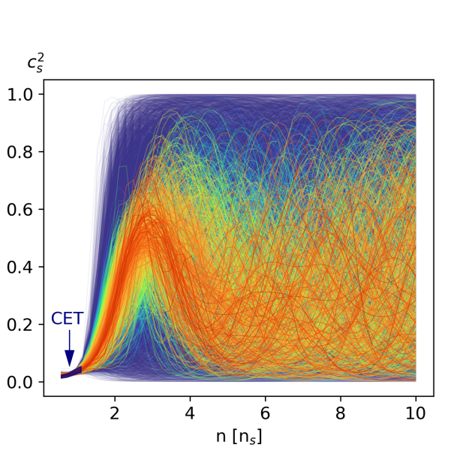
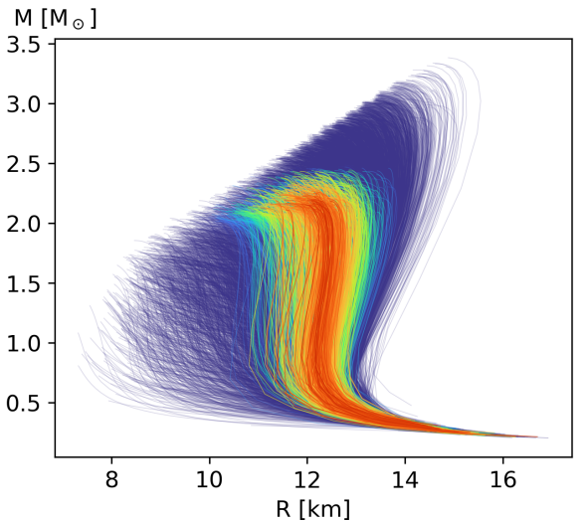
Surprising connections
Wilke van der Schee, CERN/Utrecht
1st order hadronic – quark transition conjectured
Potential bubble walls in neutron star mergers
Tyler Gorda, Oleg Komoltsev and Aleksi Kurkela, Ab-initio QCD Calculations Impact the Inference of the Neutron-star-matter Equation of State (2022)
Jorge Casalderrey-Solana, David Mateos and Mikel Sanchez-Garitaonandia, Mega-Hertz Gravitational Waves from Neutron Star Mergers (2022)

Slide 15
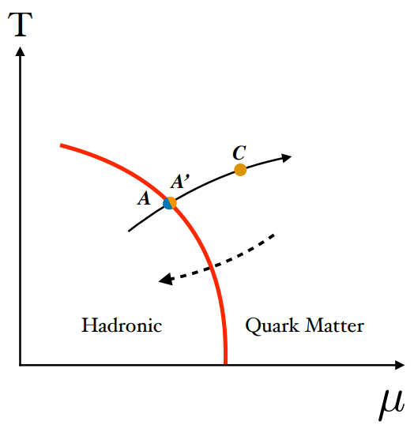
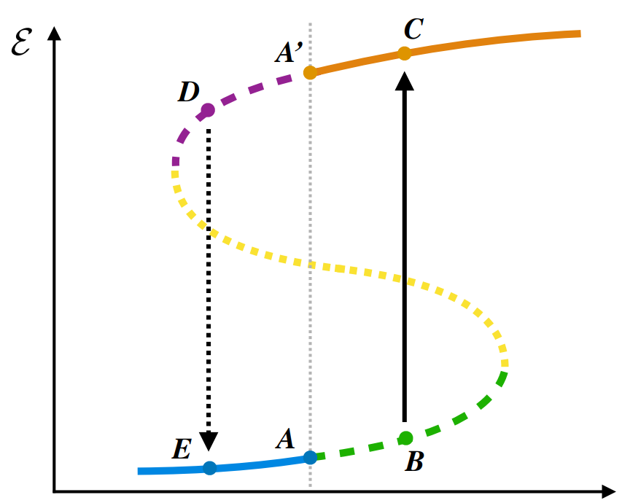
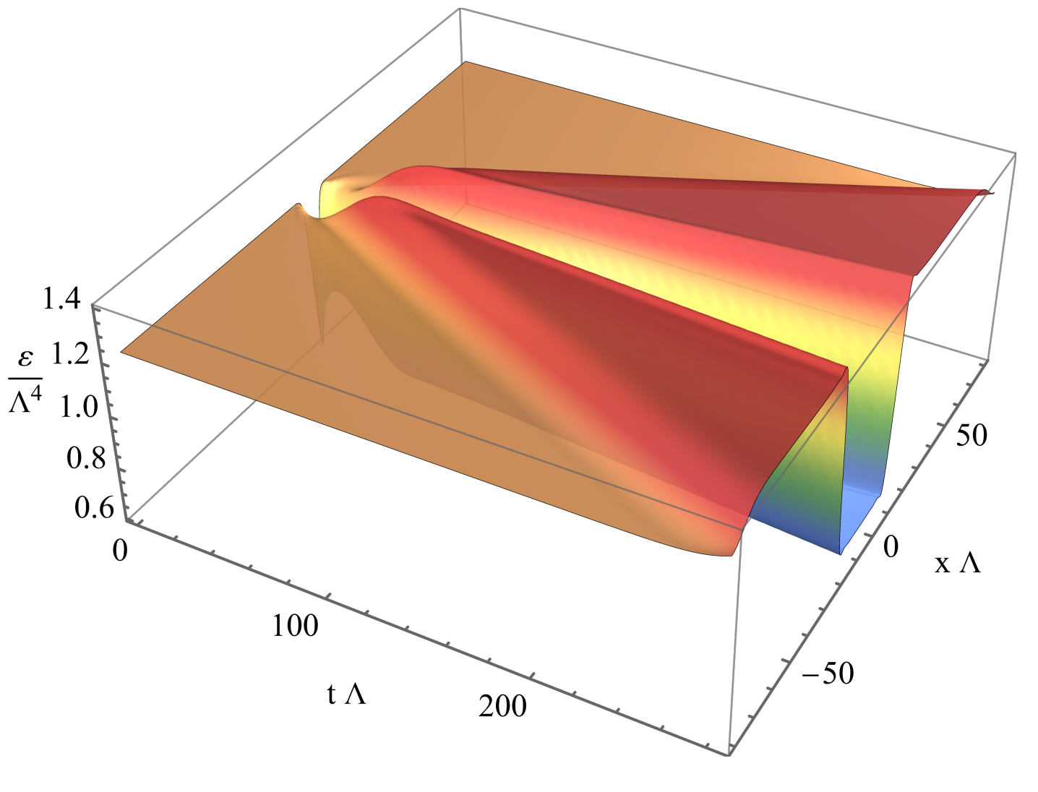
Bubble wall velocities
Wilke van der Schee, CERN/Utrecht
Holographic `bubbles’ (planes) in a QCD-like phase diagram
Relevant for neutron stars and potentially early universe
Superheated and supercooled transitions
The bubble wall velocity is microscopic information
  After determining velocity hydro can be used (WallGo)
Signature gravitational waves (MHz for mergers)
Yago Bea, Mauro Giliberti, David Mateos, Mikel Sanchez-Garitaonandia, Alexandre Serantese and Miguel Zilhao, Bubble dynamics in a QCD-like phase diagram (2024)

Slide 16
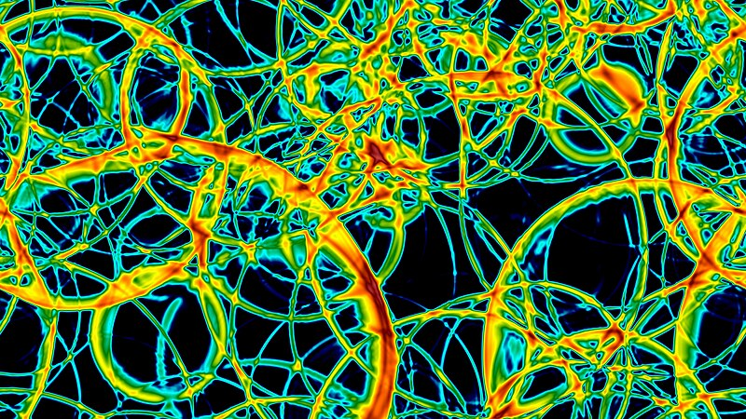
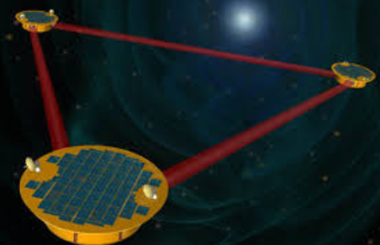
Surprising connections
Wilke van der Schee, CERN/Utrecht
Potential (BSM) first order phase transitions at zero density
Bubble walls in the early universe

Slide 17
Surprising connections
Wilke van der Schee, CERN/Utrecht
Formation of quark-gluon plasma
Colliding gravitational waves

Slide 18
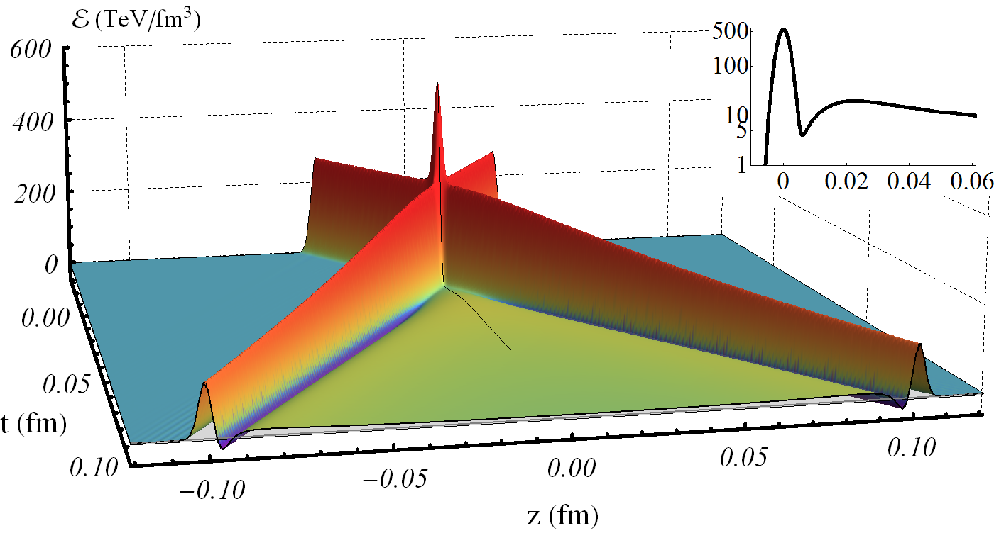
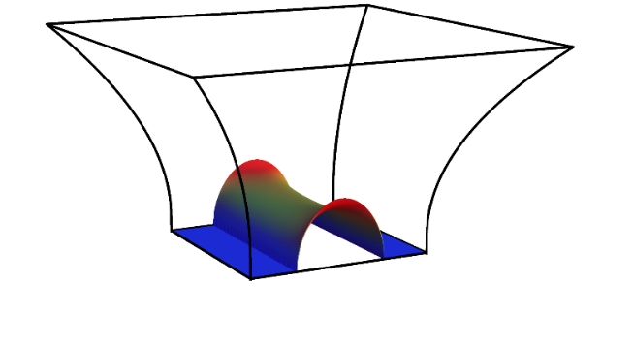
Thermalisation in holography
Wilke van der Schee, CERN/Utrecht
Simulating a heavy ion collisions with colliding
gravitational waves in AdS₅?
Near boundary collision is `transparent’
A bulk event horizon forms (in AdS)
Energy density is non-monotonic
Negative energy density trailing on the lightcone (purple)
Viscous relativistic hydrodynamics applies
‘as fast as possible’ (1/T(t)): hydrodynamisation
Not a perfect model for heavy ions (no boost invariance)
Extra AdS direction
WS, Gravitational Collisions and the Quark-Gluon Plasma (2014)

Slide 19
Surprising connections
Wilke van der Schee, CERN/Utrecht
The building of spacetime
Entanglement
Shinsei Ryu, Tadashi Takayanagi, Holographic Derivation of Entanglement Entropy from AdS/CFT (2006)
Mark Van Raamsdonk, Building up spacetime with quantum entanglement (2010)

Slide 20
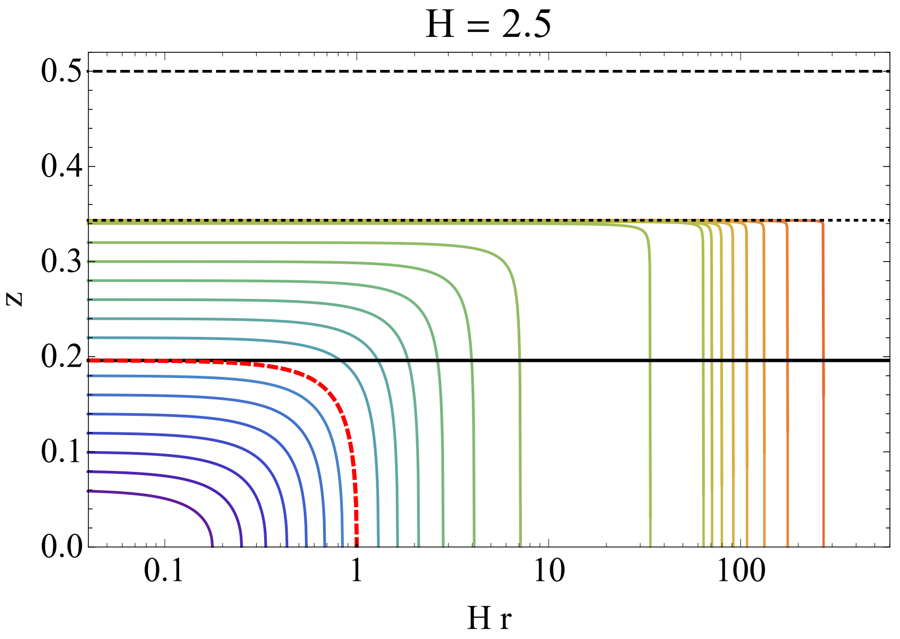
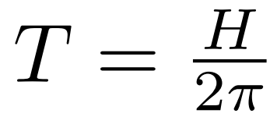
EMPTY ds on the boundary
Wilke van der Schee, CERN/Utrecht
Extra AdS direction
Event, apparent and ‘entanglement’ horizons for bulk dual to empty de Sitter
  The event horizon gives the de Sitter temperature
Entanglement entropy = extremal surface: interesting picture of de Sitter entropy
  Subtle: entropy needs regularisation both
  in QFT and in AdS
  Only `superobservers’ can see behind event horizon (if and only if (!))
Event horizon:
Cosmological horizon
Jorge Casalderrey, Christian Ecker, David Mateos and WS, Strong-coupling dynamics and entanglement in de Sitter space (2020)

Slide 21
Surprising connections
Wilke van der Schee, CERN/Utrecht
Amplitudes
Gravitational radiation /
galaxy clustering

Slide 22
Surprising connections
Wilke van der Schee, CERN/Utrecht
Reheating after inflation
Thermalisation of
quark-gluon plasma

Slide 23
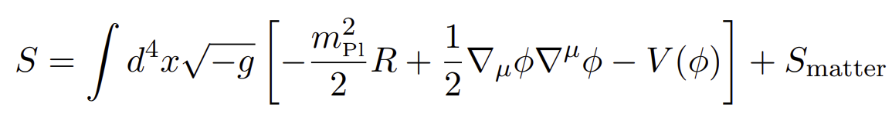

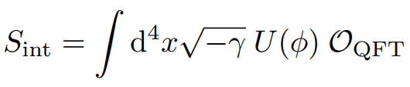
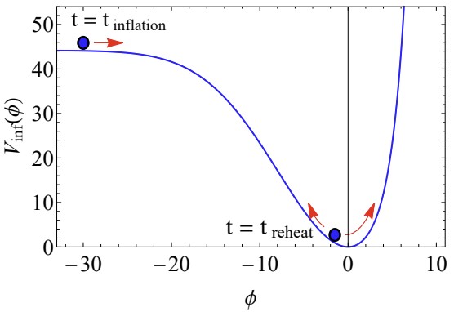
Inflation, reheating and holography
Wilke van der Schee, CERN/Utrecht
Holographic set-up
  ‘standard’ EH + inflaton + coupling to scalar:
  Inflaton acts as a source for the scalar operator
Three technical complications
  Gravity on the boundary (semi-classical (!))
  Better to have a non-conformal model
  (otherwise de Sitter is trivial)
  Currently challenging to get many e-foldings
Inflaton potential
Christian Ecker, WS, Jorge Casalderrey and David Mateos, Holographic evolution with dynamical boundary gravity (2021)
Christian Ecker, Elias Kiritsis and WS, Dynamical Inflaton Coupled to Strongly Interacting Matter (2023)
Notes:
Many states + linearized

Slide 24
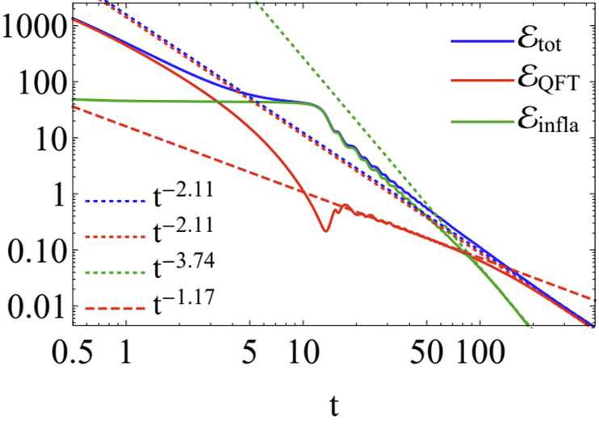
reheating and thermalisation
Wilke van der Schee, CERN/Utrecht
Inflation
Expanding Universe
Strongly coupled QFT as a mechanism for thermalization
  Proof-of-principle: sQFT plus inflaton with dynamical gravity
  Inflaton sources QFT: natural reheating when rolling down
  Boundary metric sources bulk metric
    Bulk thermalises `as fast as possible’ (time ~ 1/temperature)
Some crucial differences
  We start at high temperature; never `empty’ de Sitter
    Similar to warm inflation?
    Technical problem to get enough e-foldings?
  QFT similar to N=4 SYM, link with SM not obvious?
Reheating
Thermalisation
Notes:
Many states + linearized

Slide 25
Holography as a bridge between qcd and gravity
Wilke van der Schee, CERN/Utrecht
Several surprising connections between fields
Neutron stars, nuclear structure
Heavy ion collisions, nuclear structure
Condensed matter, holography (not covered)
Cosmology, bubbles, holography
Quantum gravity, black holes, holography (not covered)
Several recent results ☺

