Slide 2
Report on
High Field Magnet Programme
E. Todesco, HFM programme leader
B. Auchmann, HFM programme co-leader
24 September 2024, SPC

Slide 3
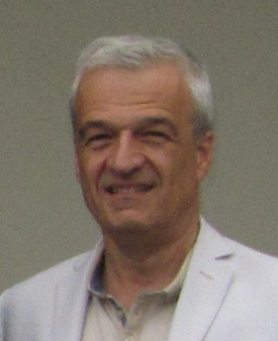

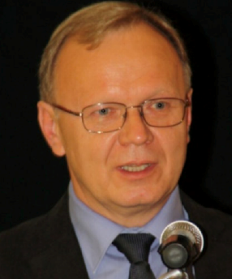
A big thanks to our predecessors
D. Tommasini, leading
EuroCirCol studies 2014-2020
Luca Bottura, leading
HFM program 2020-2021
Andrzej Siemko, leading
HFM program 2022-2023

Slide 4
Contents
Guidelines for the program
Status of Nb₃Sn and recent results
HTS hopes and challenges
Appendix: News from US and China

Slide 5
Guidelines since 2024
Orient HFM more towards direct R&D for FCC-hh
Injecting the experience we are getting from the HL-LHC project
More synergies between the numerous WPs, and with other programs – in particular with US MDP

Slide 6


HFM as direct R&D
Direct R&D: focused on a magnet for a specific use (in our case of accelerators, making TeV, i.e. T m)
  Example: LARP mandate for the LHC IR upgrade was something like “build a 90 mm aperture quadrupole, with 200 T/m, …”
  Note that target can evolve in time
Generic R&D: focused on developing the technology, not directly related to a specific application (making T, not TeV)
  Example: MDP mandate “explore the limits of Nb₃Sn technology, reduce training, …”

Slide 7
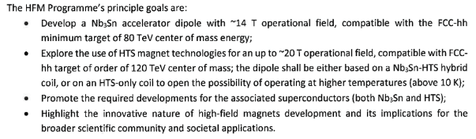
HFM as direct R&D
Our main mandate is to make a dipole for FCC-hh
For Nb₃Sn the target is 14 T operational field, giving a c.o.m. energy of 85-90 TeV
For HTS the target is a range 16-20 T operational field, giving 100-120 TeV c.o.m. energy
We keep one non-FCC WP: HTS solenoids for muon collider
Programme

Slide 8
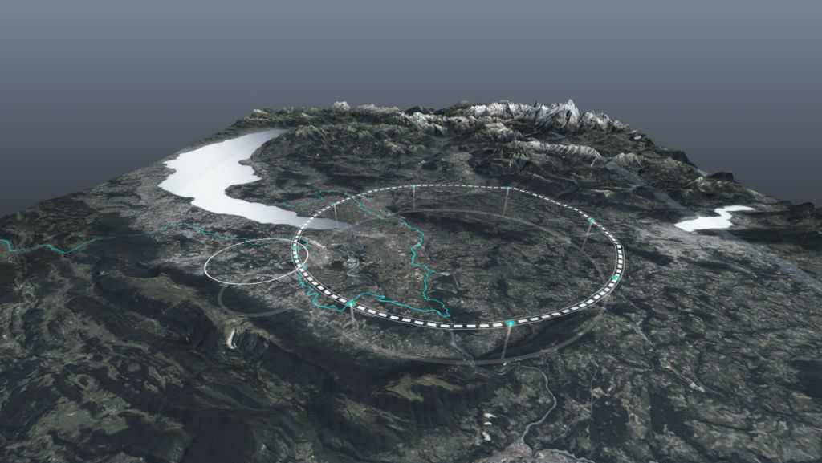
FCC-hh targets
The new targets for FCC-hh in Nb₃Sn allow reaching 90 TeV with 87% filling factor
  The magnet is at 80% of short sample, and this gives more margin, allowing to consider operation at 4.5 K according to HL-LHC experience
  14 T operational field means that short sample shall systematically reach 15-15.5 T
FCC-hh parameters | CDR 2019 | 2024-Nb₃Sn | 2024-HTS
Dipole field (T) | 16.0 | 14.0 | 16-20
Tunnel length (km) | 100 | 90.7 | 90.7
Arc length (km) | 82.0 | 76.9 | 76.9
Arc filling factor (adim) | 0.80 | 0.87 | 0.85
Energy c.o.m (TeV) | 100 | 90 | 100-125
Loadline margin | 86% | 80% | TBD
FCC layout and evolution of parameters

Slide 9
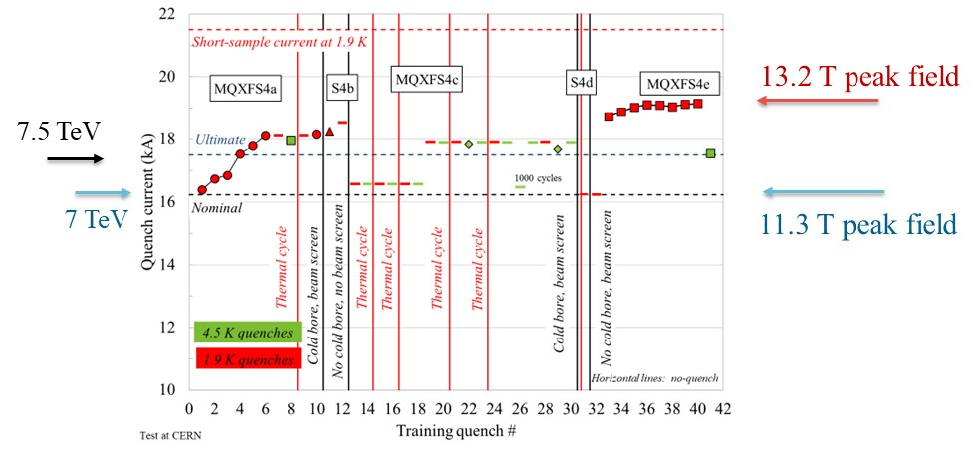
FCC targets and feedback from HL-LHC
14 T operational field means that short models shall systematically reach 15-15.5 T
  Do not make confusion between operational and achieved field: LHC dipoles reached 9.5 T, but they operate in the LHC slightly above 8.0 T
  HL-LHC short models systematically reached >13 T, but they will operate at 11.3 T
MQXFS4 test results [S. Izquierdo Bermudez, J. C. Perez, P. Ferracin, F. Mangiarotti, et al.]

Slide 10
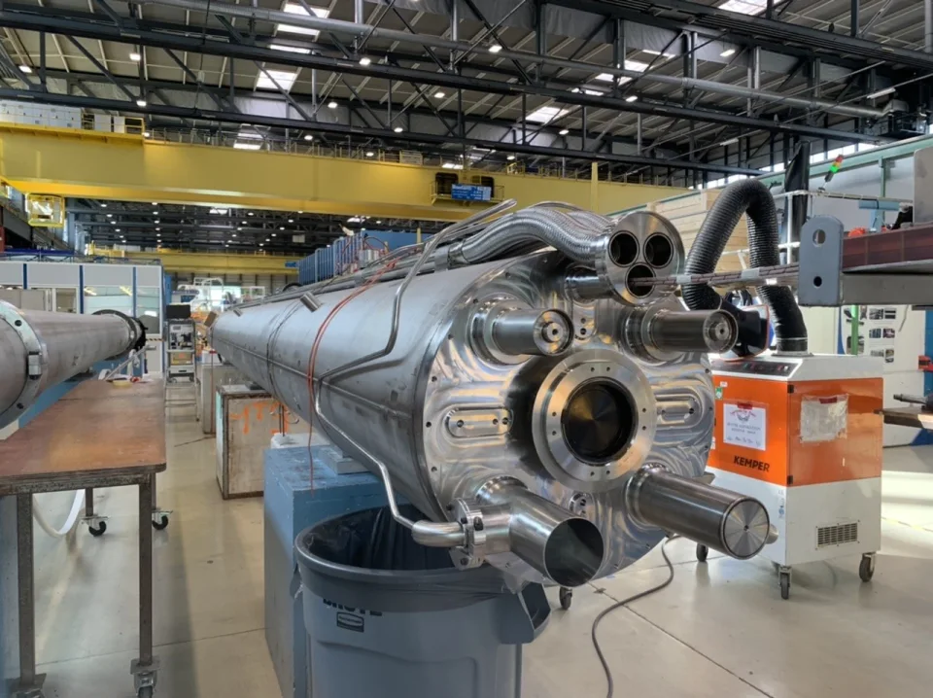
FCC targets and feedback from HL-LHC
Having the magnet at 80% of short sample at 1.9 K (instead of 86%), allows to consider operation at 4.5 K
  HL-LHC MQXF experience shows that all magnets reaching operational field at 1.9 K are also able to operate at 4.5 K
  With what margin ? We are exploring this aspect
Powering test of first six conform MQXFA magnets
[J. Muratore, B. Ahia, S. Feher, G. Ambrosio et al. ]
One of the first 7-m.long Nb₃Sn magnets

Slide 11
Integration in the FCC
Two paths are given to reach a higher filling factor
  Optimization of the lattice, together with the optics team
    Longer cell--> less and less powerful quadrupoles → more space for dipoles
  Work on high gradient correctors
    Ideal test bench for HTS, and allows to get more TeV for the same field
    For the moment scarce feedback on this proposal, please help
Cooling
  We are working on the 4.5 K option that has been opened by the HL-LHC results (WP4.6, P. Borges de Sousa and R. van Weelderen)
  First preliminary results give a factor >3 of energy saving in going from 1.9 K to 4.5 K

Slide 12
Roadmap for Nb₃Sn
At the beginning of 2024 we were asked to present an accelerated roadmap FCC based on Nb₃Sn
15 m long prototypes (>5 of each type)
5 m long prototypes of one selected design
(>5 of each type)
Short model program on two selected designs
(>5 of each type)
Ongoing 12 T and 14 T short models (seven designs, 1 or 2 of each type)
Selection of final design
to start long magnets
2024
2025
2026
2027
2028
2029
2030
2031
2032
2033
2034
2035
2036
2037
2038
2039
2040
2041
LHC RunIII
HL-LHC RunIV
HL-LHC RunV
HL-LHC RunVI

Slide 13
Roadmap for Nb₃Sn
This is rather a conservative roadmap, and could be shortened by 5-10 years (with more risk and cost) having less staggered phases and with earlier involvement of the industry
Installation and commissioning
Production and test
Industrialization (pre-series magnets)
Tender for the series
2040
2041
2042
2043
2044
2045
2046
2047
2048
2049
2050
2051
2052
2053
2054
2055
2056
2057
LHC RunVI

Slide 14
Table of contents
Guidelines for the program
Status and results of Nb₃Sn
HTS hopes and challenges
Appendix: news from US and China

Slide 15
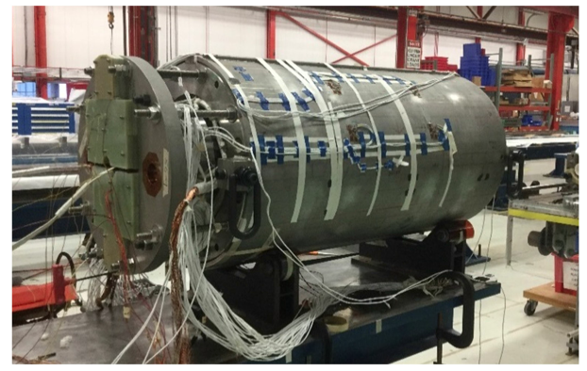
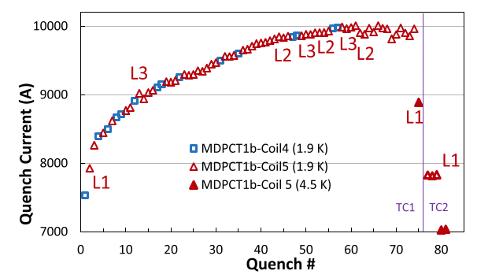

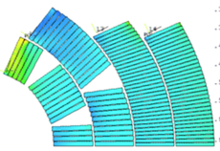
Nb₃Sn program for 14 T
The cosθ option: the more classical path
  MDPCT1: four layer cos theta made in FNAL reached 14.5 T at 4.2 K but degraded
    This path was abandoned by MDP
  INFN is proposing to have a 4 layer cosθ (endorsed by steering board, not yet approved)
    Test in 2029-30 at earliest
Power tests of MDPCT1 [S. Stoynev, et al. IEEE TAS 32 (2022) 4000705]

Slide 16
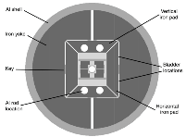

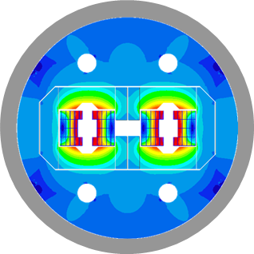
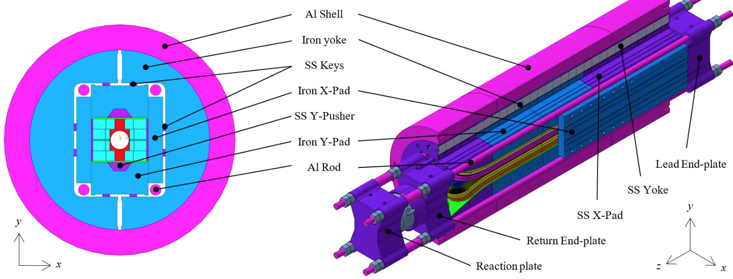

Nb₃Sn program for 14 T
The block option: this design has the world record
  Advantage: no stress accumulation in the midplane
  HD2 reached 13.8 T at 4.2 K
  Two options:
    CERN (no grading) – test in 2026
    CEA (with grading) –test in 2027/8
[G. L. Sabbi, et al. IEEE TAS 15 (2005) 1128]
14 T block dipole (J. C. Perez, et al.)
14 T block dipole F2D2 (E. Rochepault, et al.)

Slide 17

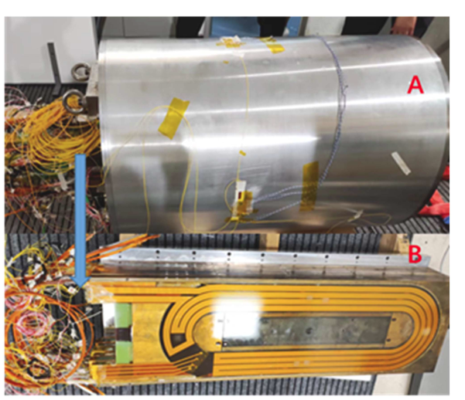
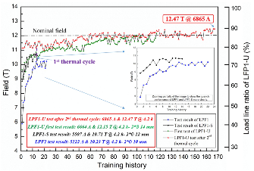
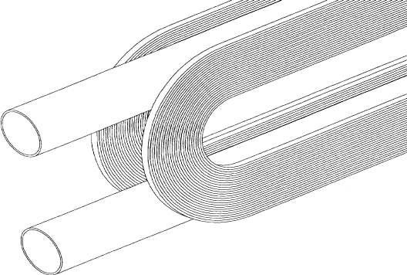
Nb₃Sn program for 14 T
The common coil design: a simpler path ?
  Racetrack coils (but non planar coils needed for correcting field quality) – less efficiency
  The IHEP program reached 12.5 T in Nb₃Sn, but with small aperture (14 mm and no field quality, see appendix)
  CIEMAT is planning to build a common coil, test in 2027/8
Common coil design
[R. Gupta, IPAC 1997 3344]
LFP3 magnet [J. Shi, Q. Xu, et al., IEEE TAS 34 (2024) 4701405]
    LPF1 training [C. Wang, et al., SUST 36 (2023) 065006]

Slide 18
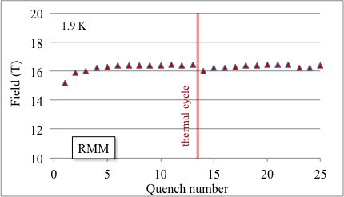
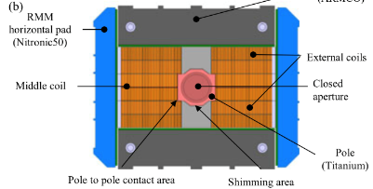
Recent results: Nb₃Sn magnets
All these design do not rely on stress management
  RMM, based on a block coil, proved that 14 T can be achieved with a large margin without interception of stress
  RMM reached 16.4 T in a 50 mm bore in 2022
Test of reproducibility of the assembly coming in fall 2024
Test of reproducibility of manufacturing (new set of coils) in 2025
Cross-section and training of RMM [E. Gautheron, et al. IEEE TAS 33 (2023) 4004108]

Slide 19

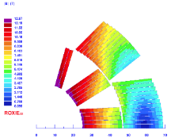
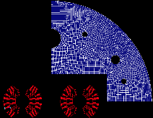
Nb₃Sn program: the 12 T option
A 12 T dipole based on cosθ geometry is in the HFM baseline since 2020
  Why a 12 T ? Mainly because it can provide a cheaper magnet
    It has about 30% less conductor
FalconD cross-section [S. Farinon, et al.]

Slide 20

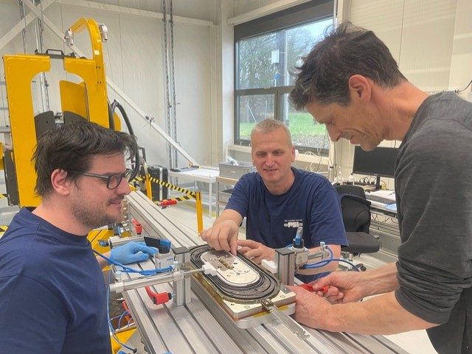
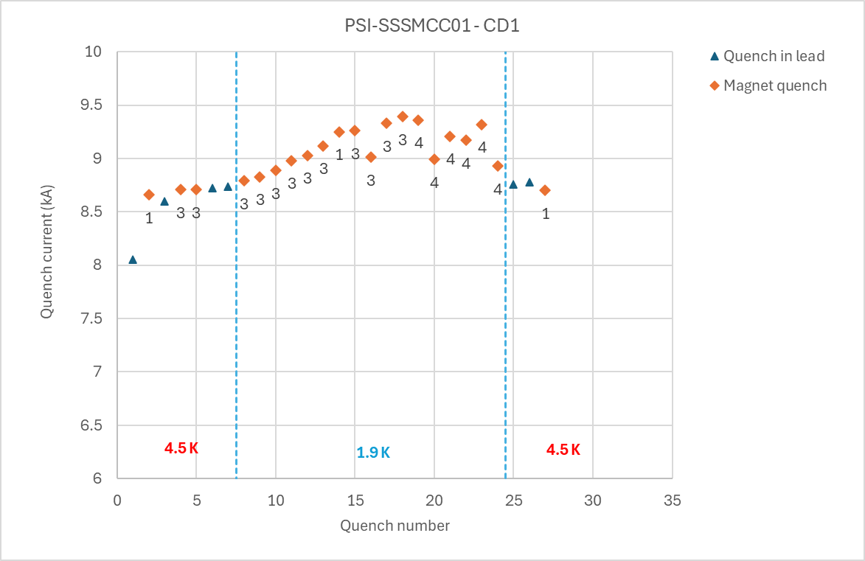
Nb₃Sn program: stress management
Even though stress management is mandatory only towards 20 T, it can provide precious margin at 14 T – PSI explores this option
  Test of PSI subscale stress managed common coil (SSSMCC) at CERN – wax impregnated, reaction and test made at CERN
  Peak field in the coil of 6.5 T reached, >5 T in in the centre (June 2024)
Short sample 1.9 K
Short sample 4.5 K
Test of SSSMCC in SM18 (G. Willering, et al.)
Manufacturing of SSSMCC in PSI (D. Araujo, B Auchmann, et al.)

Slide 21
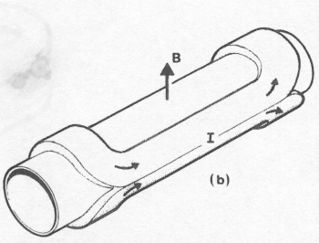
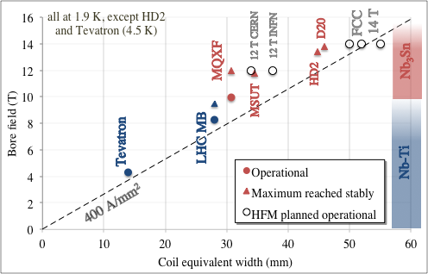
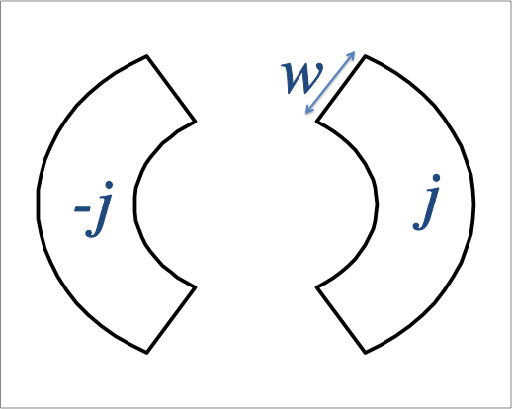
What are we building
μ₀/2

Slide 22
Table of contents
Guidelines for the program
Status and results of Nb₃Sn
HTS hopes and challenges
News from US and China

Slide 23
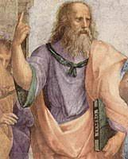
HTS: the ideal superconductor?
… a critical current that does not decrease with field
… a critical current that does not increase at lower fields (to reduce hysteresis, persistent currents)
… 1500 A/mm² (just what is needed, nothing more) at high temperatures
Ideal superconductor,
at temperatures >> 70 K
[Raffaello et al., The School of Athens,
detail, Musei Vaticani (1510)]
… and
Cheap: 5 $/(kA m)
Stress resistent at least up to 200 MPa
Available in long (km) lengths

Slide 24
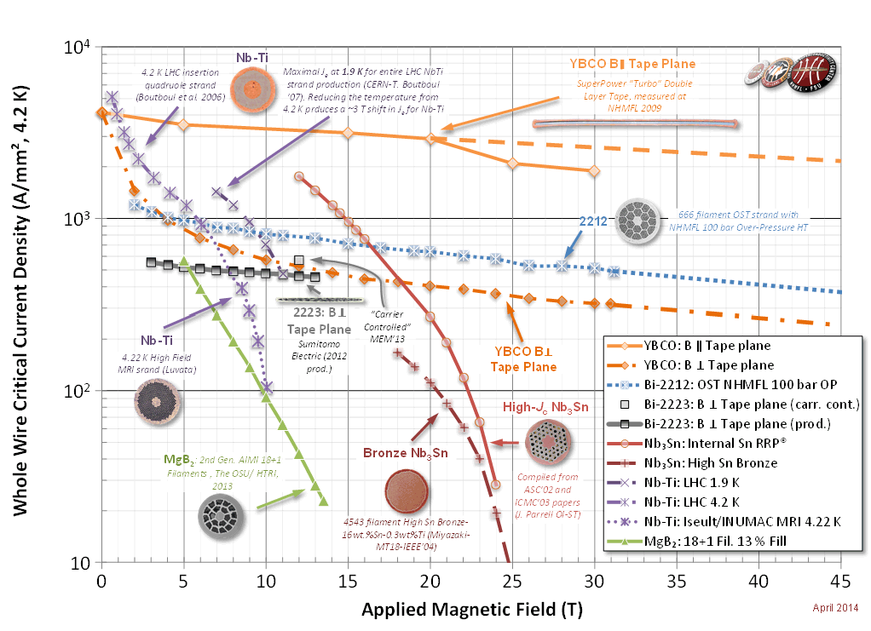
HTS: the ideal superconductor?
… a critical current that does not decrease with field
… a critical current that does not increase at lower fields (to reduce hysteresis, persistent currents)
… 1500 A/mm² (just what is needed, nothing more) at high temperatures
[Raffaello et al., The School of Athens,
detail, Musei Vaticani (1510)]
… and
Cheap: 5 $/(kA m)
Stress resistent at least up to 200 MPa
Available in long (km) lengths

Slide 25
Three paths for HTS
BSSCO 2212 (mainly developed in the USA)
    Available in round strand, dipoles reaching 1.5 T have been done (LBNL)
    Expensive, complicated manufacturing process (more than Nb₃Sn): reaction at 800 C in 100 bar of O₂
    No activities foreseen in HFM
REBCO (strong impluse from fusion investments of order of BCHF)
    Recently, large reduction of cost, but still one 5-10 larger than what needed in the unfavorable direction, and with limited lengths
    Available in tape, cable geometries being considered (Roebel, Corc®, Star ®)
    Hysteresis losses can be a showstopper: the filament is the tape width
    Workhorse for HFM
    IBS (strong impulse from China)
    Critical current is improving (see appendix)
    Potentially cheaper than REBCO
    One WP in HFM

Slide 26
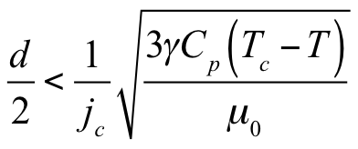
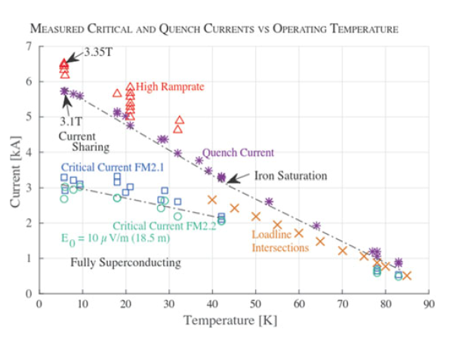
The challenge of hysteresis losses
The larger temperature margin and lower j at low field, allows stability with very large filaments in one direction (up to 12 mm)
Hysteretic losses, that are today critical for the FCC-hh (target of 5 kJ/m is given), can be a showstopper in this case
In case of HTS insert, both common coil and cosθ have the cables perpendicular to the field: the ideal is the block, where they are parallel
Feather magnet tested in 2017, REBCO,
block aligned: it reached 4.5 T, but did not prove
all accelerator features
[L. Rossi, et al, Instruments 5 (2021) ]
Is REBCO tape a viable conductor for HEP
main dipole magnets ? Question still open today
First powering of Feather
[L. Rossi, et al, IEEE TAS 28 (2018) 4001810]

Slide 27
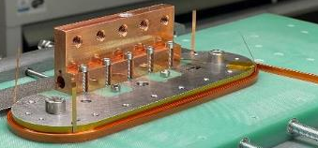
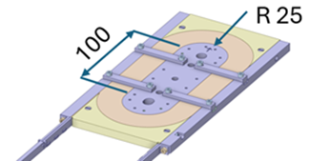
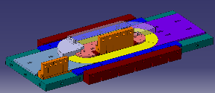
HTS news
Production line in KIT commissioned (B. Holzapfel et al.) in March 2024
At CERN, racetrack wound with dielectric insulated (DI) REBCO and went through preliminary tested at 77 K
  A research line of MI (metal insulated) is also active in HFM (CEA)
  Remember that all magnets for fusion are NI (non insulated) – not good for us
Then a test at 4.5 K – 20 K will be done
Optimized for number of racetracks
[A. Ballarino, et al., HFM TE day https://indico.cern.ch/event/1425262/ ]

Slide 28
Never forget the specificity of accelerator magnets
First: An accelerator dipole is not a solenoid !!
  Field is not parallel to the wire, forces are not perpendicular to the wire, stresses are 50% larger than magnet pressure
Second: Overall current densities of ∼500 A/mm² are a peculiar feature/challenge for accelerator magnets
  One order of magnitude above HEP detector magnets or fusion magnets
Third: magnet operational range is not a single point, but a whole set of currents (from injection to high field)
 | Overall current density (A/mm²) | Superconductor current density (A/mm²) | Ramp | Field in conductor (T)
Tevatron dipole | 360 | 1550 | slow | 4.7
LHC dipole | 360/440 | 1260/1820 | slow | 8.6
ATLAS BCT | 30 | 950 | very slow | 3.9
ITER (TF & CS) | 20 to 40 | 150 | very fast | 5 to 13
HL-LHC SC link | 17 | 1450 | slow | Self field (<1 T)

Slide 30
Table of contents
Guidelines for the program
Status and results of Nb₃Sn
HTS hopes and challenges
News from US and China

Slide 31

SPPC
Comparison between FCC-hh and SPPC
  As FCC-hh, SPPC went through a modification of parameters
  Today it relies on 20 T magnet, with 100 km tunnel, and 125 TeV c.o.m.
  The 20 T are given by 13 T in Nb₃Sn and 7 T in HTS
FCC-hh parameters | CDR 2019 | 2024-Nb₃Sn | 2024-HTS
Dipole field (T) | 16.0 | 14.0 | 16-20
Tunnel length (km) | 100 | 90.7 | 90.7
Arc length (km) | 82.0 | 76.9 | 76.9
Arc filling factor (adim) | 0.80 | 0.87 | 0.85
Energy c.o.m (TeV) | 100 | 90 | 100-125
Loadline margin | 86% | 80% | TBD
SPPC parameters | Nb₃Sn (2019) | HTS (2019) | Nb₃Sn/HTS (2023)
Dipole field (T) | 12.0 | 20-24 | 20 (13+7)
Tunnel length (km) | 100 | 100 | 100
Arc length (km) | 81.8 | 81.8 | 81.8
Arc filling factor (adim) | 0.79 | 0.79 | 0.79
Energy c.o.m (TeV) | 75 | 125-150 | 125

Slide 32
SPPC magnets
IHEP has selected the common coil design
  Steps aiming at 20 T increasing field and aperture
  2018-2023: LFP1 Nb₃Sn magnet reached 12.5 T in 14 mm aperture
    Configuration based on flat racetrack, without field quality
  LFP3 construction ongoing since two years, aiming at 13 T with Nb₃Sn plus 3 T with HTS
    Nb₃Sn coils limited at 11 T, HTS reached 3 T, then two coils lost during tests
    New set of coils being manufactured, test at the end of 2024
Common coil design
[R. Gupta, IPAC 1997 3344]
LFP3 magnet [J. Shi, Q. Xu, et al., IEEE TAS 34 (2024) 4701405]
    LPF1 training [C. Wang, et al., SUST 36 (2023) 065006]

Slide 33
SPPC magnets
The common coil shall contain a part (7 T) in HTS
  China is investing on IBS since many years – solenoids successfully built
  Considerable progress in the past years, but still far from target
  HFM also has a WP on IBS development WP2.16, A. Malagoli from CNR SPIN)
IBS target 2025
IBS achieved 2022
IBS achieved 2019
IBS achieved 2016
Improvement in IBS [see talk by Q. Xu, in Marseille, 2024 https://indico.in2p3.fr/event/20053/ ]

Slide 34
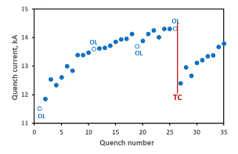
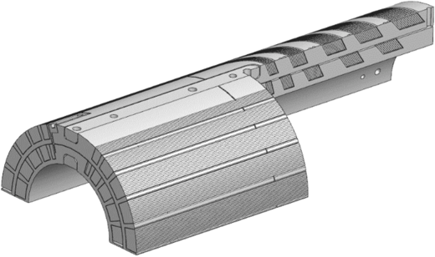
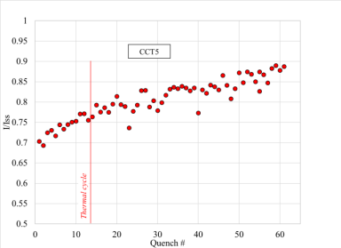
US magnet development program (MDP)
MDP aims at reaching 20 T with an hybrid magnet
  To reach 20 T the stress management is mandatory
  Two paths: CCT and Cosθ
Cosθ from FNAL: 12.7 T but in mirror
CCT from LBNL: 8.5 T in 90 mm aperture
PSI within the HFM: 10.1 T in 66 mm aperture
  This path abandoned in favour of a stress managed common coil
12.7 T peak field
10.0 T peak field

Slide 35
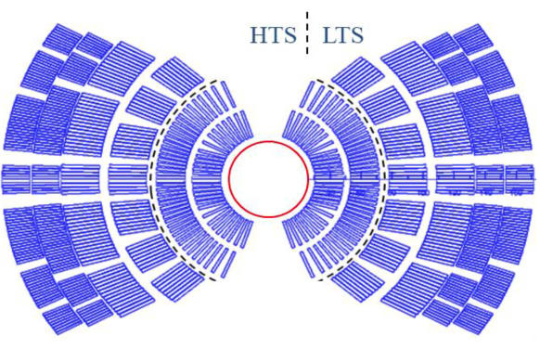
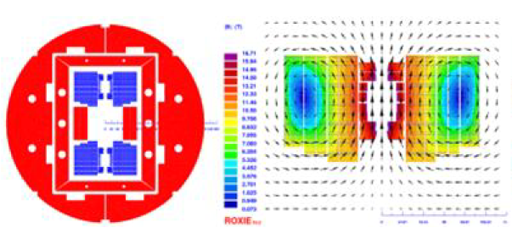
Hybrid or all HTS ?
All-HTS coil open the possibility of 20 K operation, which could consume less energy
  Beware of drawing « easy » conclusions on sustainability … it is a very complex computation that is not intuitive
«Hybrid» makes use of HTS in higher field regions, and of cheaper Nb₃Sn up to 13-15 T
  This option is being developed in the US by MDP, and in China by IHEP
HFM has not yet taken any decision on this
Hybrid design for 20 T magnet
[P. Ferracin, et al, IEEE TAS 33 (2023) 4002007
and 4LOr1B-01]
Hybrid design for 20 T magnet
[Q. Xu, et al, CEPC design report, pg 749]

