Slide 2
Update on High Field Magnets Programme
E. Todesco
LDG, 20th September 2024

Slide 3
Contents
Summary of actions in first half of 2024 and plan for the next 12 months
News since last LDG (June 2024) https://indico.cern.ch/event/1413617/

Slide 4
Summary of actions
Steering board March 2024 https://indico.cern.ch/event/1383912/
  Mandate: setting HFM as a direct R&D
  Target for Nb₃Sn of 14 T operational field and 90 TeV energy
  Roadmap for Nb₃Sn FCC-hh option for operation in 2050/55 (and not in 2070)
  Activation of a unique HFM forum https://hfm.web.cern.ch/hfm-forum
Steering board June 2024 https://indico.cern.ch/event/1425470/
  Activation of working groups https://hfm.web.cern.ch/hfm-working-groups
  Activation of common forum with the US-MDP
  Order of Nb₃Sn conductor
  Streamlining of 12 T INFN and CERN activities on Nb₃Sn dipoles: focusing on the same coil geometry and joining the efforts
    Two different conductors and cables used in the previous baseline

Slide 5
Summary of actions
  HFM-TE day to review the CERN program, share information and have a internal discussion https://indico.cern.ch/event/1425262/
Steering board 4th October 2024 (to come)
  Cost estimate for Nb₃Sn dipoles, and difference between 12 and 14 T
  Update of deliverable and costs for CERN activities
  Preparation of ESPP
  Analysis of the 4.5 K option, focus on sustainability
First targets for 2025
  Simplification of structure to allow the activation of PSM (program steering meeting)
  More detailed roadmap for proving that HTS can be used for accelerator magnets

Slide 6
Contents
Summary of actions in first half of 2024 and plan for the next 12 months
News since last LDG (June 2024)
  Focus on sustainability/cost and activities on integration: cooling
  Nb₃Sn magnets activities:
    PSI small scale common coil test at CERN: 7 T
    First windings in CEA for R2D2
    Winding the second set of coils for RMM
  Nb₃Sn order of conductor
  HTS racetracks wound and tested at 77 K at CERN

Slide 7
Focus on sustainability and cost
As it was shown in previous meeting, the change of targets allows to imagine a 14 T magnet, at 80% of loadline at 1.9 K, but operating at 4.5 K
  This is what HL-LHC triplet magnet are proving today
  This option would allow a considerable savings in the cryogenics (order of a factor 3)
The option of a cooling at 4.5 K is being studied from several points of view
  Cryogenics: what one can expect as variation of temperature along the string of magnets
  Magnet: how to measure the temperature margin of a magnet operating at 4.5 K ? Is it possible to test at 5.5-6 K to prove a 1-1.5 K margin ?
Ways to reduce the He inventory are also being considered
  From “fully floating” magnets to semidry magnets (from 20 l/m of He as in the LHC, to 5 l/m) [P. Borges de Sousa will report in October]

Slide 8
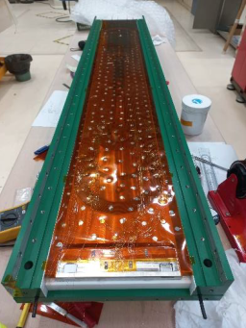
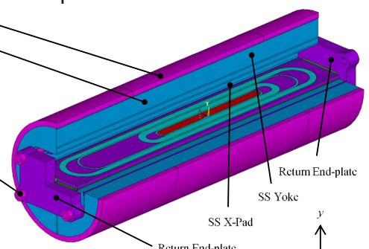
Winding coils
In CEA the first Nb₃Sn coils for the R2D2 model have been wound
  Electrical issues found in the layer jump – analysis ongoing
RMM program at CERN
  Second assembly of the 16 T magnet is ready for test (reproducibility of assembly) – test in October
  Second set of coil is being manufactured at CERN (reproducibility of manufacturing)
Setting agreements with MDP to have 44 strands cable manufactured in LBNL for the 14 T block dipole magnet

Slide 9
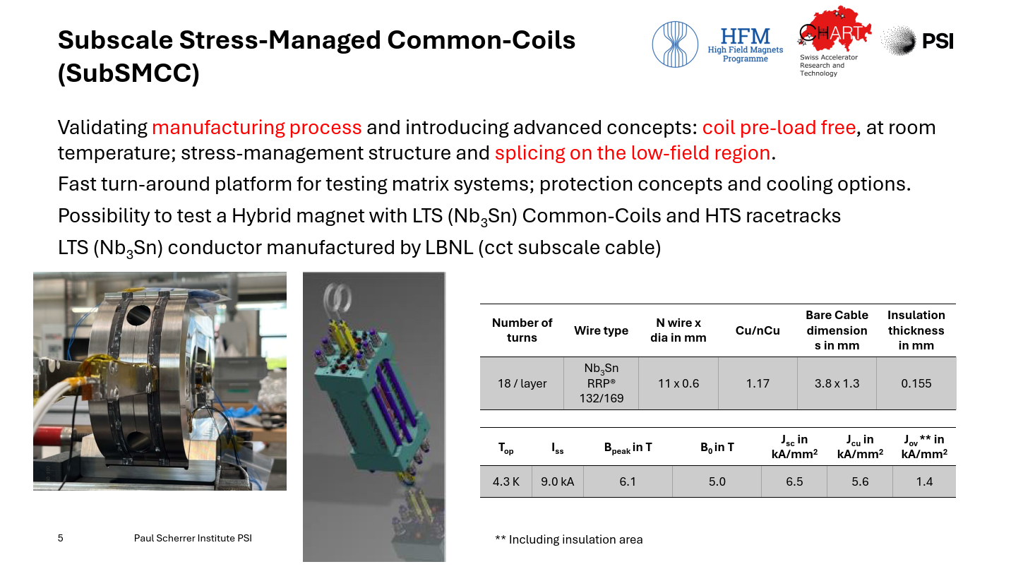
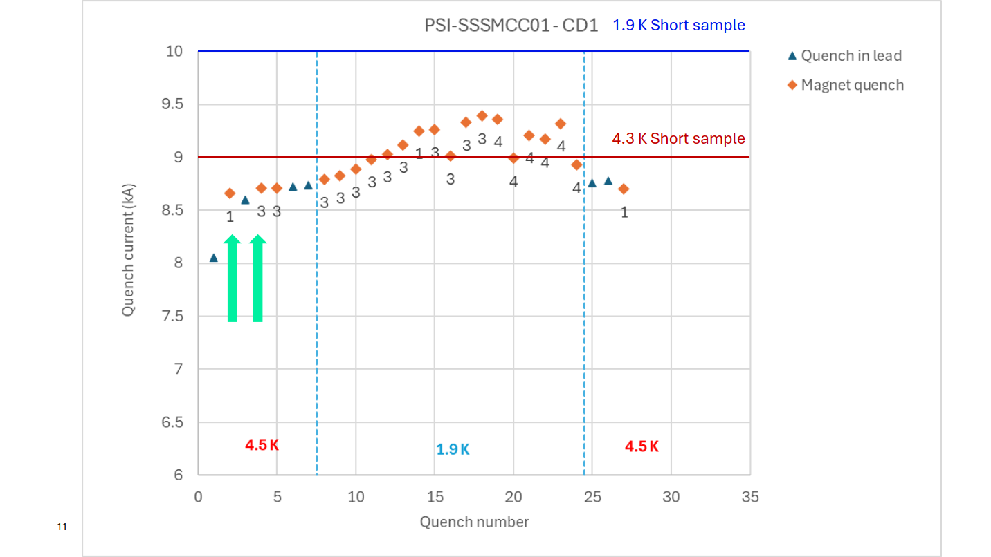
Test of small subscale stress managed common coil (SSSMC)
This magnet belongs to the “stress managed family”, such as CCT developed in LBNL or SMcosθ developed in FNAL
  First subscale to test the technology with Nb₃Sn in HFM
  Reaction and test done at CERN: 6 T reached, close to short sample at 1.9 /4.5 K
  Next steps: a higher field magnet (with more coil) , based on available strand, aiming at 12 T
See ASC conference in SLC, and HFM forum in July https://indico.cern.ch/event/1432805/
SSMC magnet [D. Araujo, et al.]
Test results [G. Willering, et al.]

Slide 10
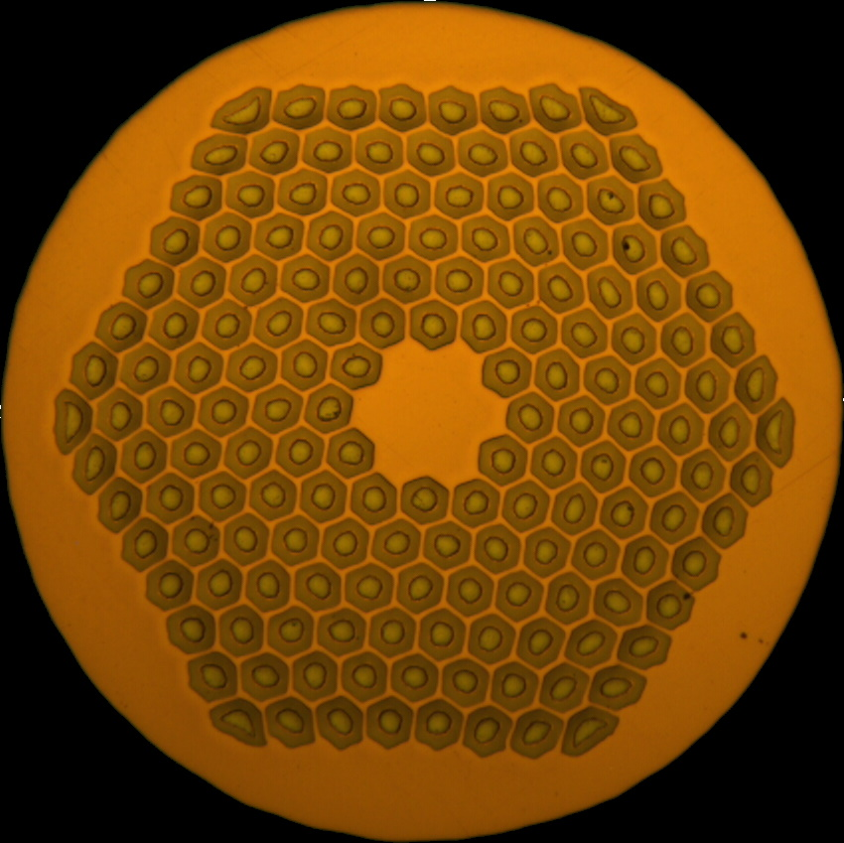
Order of Nb₃Sn strand
Decision to order 1.1 mm and 0.7 mm strand (T. Boutboul et al.)
  162 / 169 layout for the 1.1 mm, giving the higher performance, is selected
    Backup of 150/169 also ordered
  Order not directly related to the needs of collaboration (strategic reserve)
  Will arrive not before 2 years – we will probably go through a period of scarce availability of strand for the program
  Collaborations are building magnet around the available cable (as for instance PSI)
  Guidelines to make all efforts not to waste the available strand, and to limit the contingencies usually added
  Program of characterization of 162/169 strand ongoing
162/169 layout from OST

Slide 11
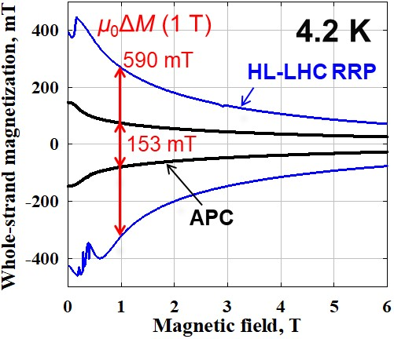
Nb₃Sn strand improvement
Significant APC advancement in the US, reported at the ASC in SLC, and presented in HFM forum on Sept. 16 by X. Xu https://indico.cern.ch/event/1454133/
  Getting rid of high current desitites at low field (hysteresis) and increasing current at low field – large reduction of hysteresis losses
  Efforts also ongoing in HFM
Pinning force comparision between RRP and APC (left) and magnetization (right)
[Xingchen Xu, et al., ASC conference]

Slide 12
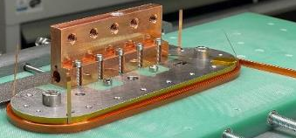
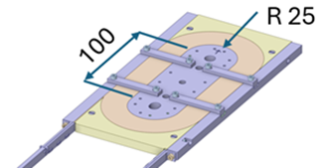
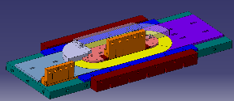
HTS news
Production line in KIT commissioned (B. Holzapfel et al.) in March 2024 as reported previously
At CERN, racetrack wound with dielectric insulated (DI) REBCO and went through preliminary tested at 77 K
Then a test at 4.5 K – 20 K will be done
Optimized for number of racetracks
[A. Ballarino, et al., HFM TE day https://indico.cern.ch/event/1425262/ ]

Slide 13
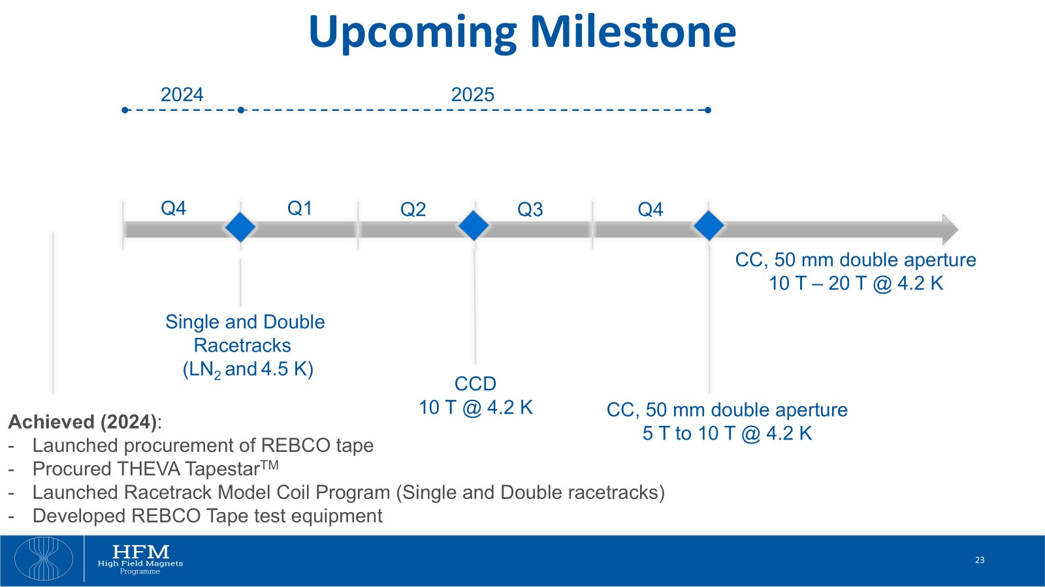
HTS news
Path towards a common coil with 50 mm free aperture with flat coils (no field quality) is being defined
[A. Ballarino, et al., HFM TE day https://indico.cern.ch/event/1425262/ ]

