Slide 2
HFM status,
with focus on Nb₃Sn
E. Todesco, B. Auchmann
7 June 2024, LDG in BNL
(previous talk at LDG on HFM was in 26 April 2024
see https://indico.cern.ch/event/1408924/ )

Slide 3
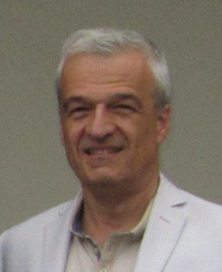

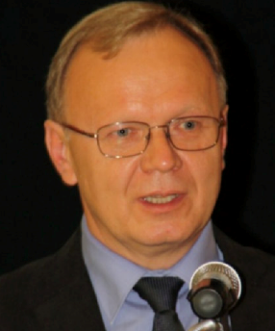
A big thanks to our predecessors
Davide Tommasini, leading
EuroCirCol studies 2014-2020
Luca Bottura, leading
HFM program 2020-2021
Andrzej Siemko, leading
HFM program 2022-2023

Slide 4
Contents
Guidelines and updated targets
Recent results and their implication
Planned magnets
Updated roadmap
Nb₃Sn conductor status and challenges
HTS challenges (followed by talk from A. Ballarino)

Slide 5
Guidelines
Previous management put in place a rich R&D program
  Wide range of activities covering all aspects of technology development
  Wide network of laboratories working on HFM via collaboration agreements
2024 guidelines, presented in March steering board
  Set quantitative targets for HFM magnets, and an accelerated roadmap for Nb₃Sn
  Stronger link to FCC-hh studies
  Stronger links to US-Magnet Development Program
  More continuity with previous research made by the community in the past decades (including HL-LHC)
  Enhancing synergies between collaborations

Slide 6
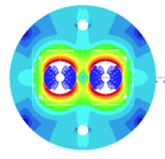
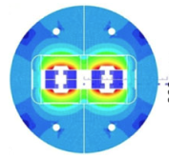
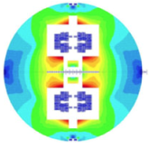
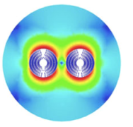
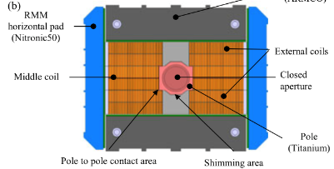
Historical on targets for Nb₃Sn magnets
2014: the target of EuroCirCol was a 16 T operational field magnet at 86% of loadline at 1.9 K, with a conductor 50% more performant than the available
This led to proposing four different designs in 2018
In parallel, CERN launched a
magnet technological program whose aim
was to build a 16 T demonstrator RMM
Cross-sections of 16 T dipoles [D. Tommasini, et al., IEEE Trans. Appl. Supercond. 28 (2018)]
Coil cross-sections of RMM [D. Tommasini, et al., IEEE Trans. Appl. Supercond. 28 (2018)]

Slide 7
HFM targets for Nb₃Sn magnets
The proposal is to have 14 T operational field at 80% of the short sample of the existing conductor at 1.9 K today (the so-called improved hilumi Nb₃Sn conductor)
  LHC magnets, in classical Nb-Ti, designed for 86% of short sample limit, all reaching this target during test, are operating today at 83% (6.8 TeV)
  The larger margin opens the possibility to operate at 4.5 K according to HL LHC experience
This proposal allows reaching 90 TeV c.o.m energy in FCC-hh
  90 TeV with present baseline of a 90 km tunnel, achieved also via an optimization of the filling factor (longer cells)
  It is a compromise between reasonable ambition and a target that can be reached
  If more performant conductor is developed and affordable (see the section about conductor), we will decide either to increase the operational field to get more TeV or to reduce the conductor mass to save $
  The designs proposed for EuroCirCol are compatible with these targets, so previous work on design shall not be lost

Slide 8
Contents
Guidelines and updated targets
Recent results and their implication
Planned magnets
Updated roadmap
Nb₃Sn conductor status and challenges
HTS challenges (followed by talk from A. Ballarino)

Slide 9
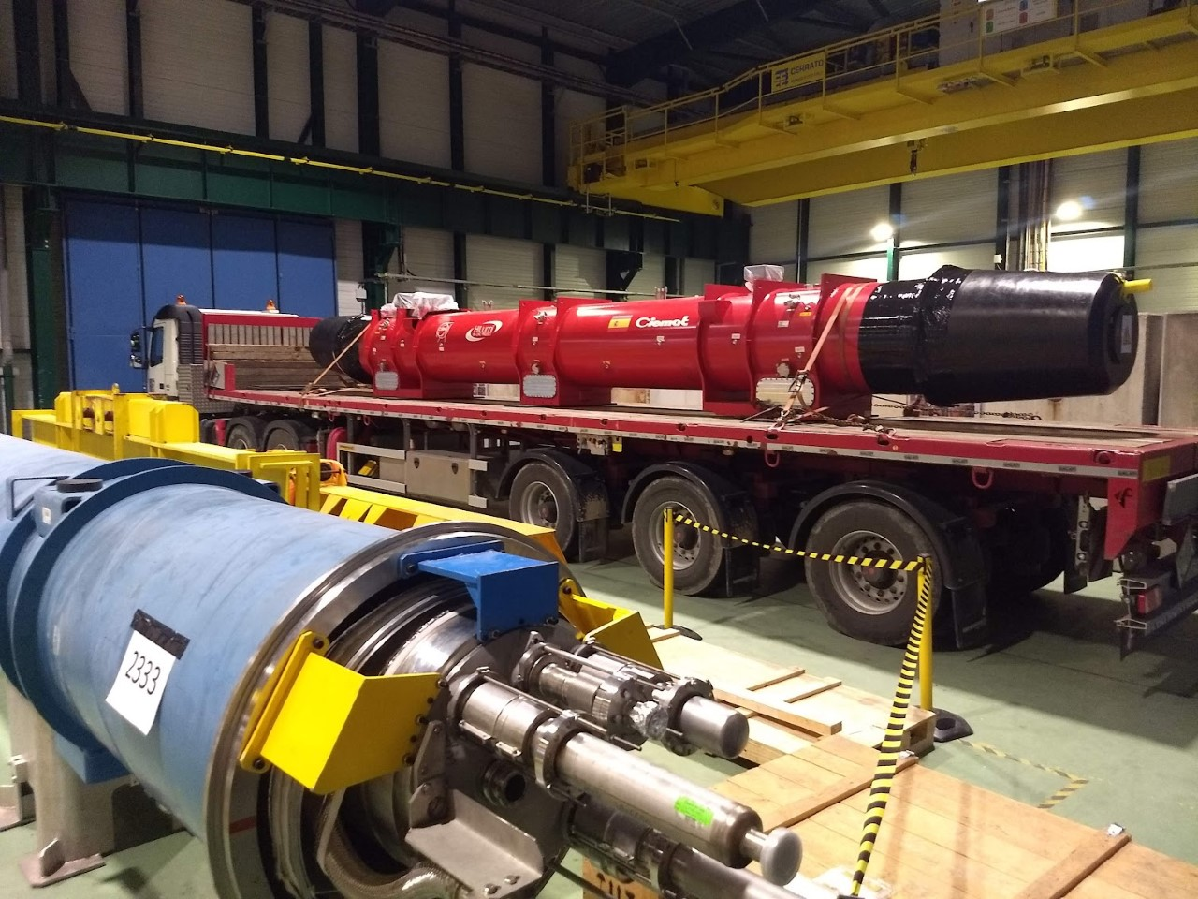
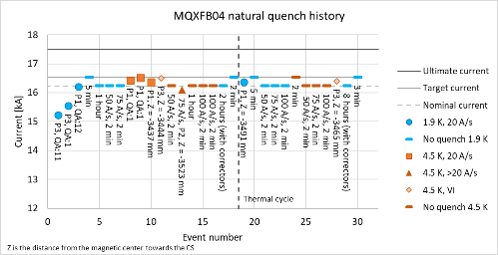
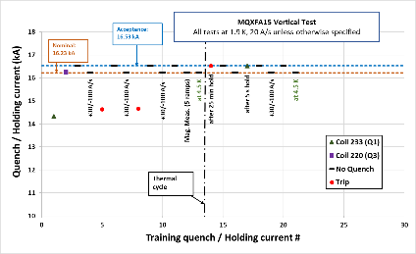
Recent results for Nb₃Sn magnets: margin and 4.5 K
Experience on HL-LHC interaction region magnets, working at 77% of loadline fraction (23% margin) is showing that
  This margin is being obtained with a good reproducibility
  Scaling up to 7 m long has been completed successfully
  Magnets are also working at 4.5 K
Therefore with this target one can have also the possibility of working at 4.5 K

Slide 10
Recent results for Nb₃Sn magnets: production
HL-LHC is the first experience with a Nb₃Sn magnet production:
  Production of 3500 km of strand, 0.85 mm diameter, completed – both CERN and the US partners using same supplier
  More than 100 coils built in the US, in two sites
  More than 50 coils built at CERN
  Magnet assembly in two sites (LBNL and CERN), more than 20 mangets assembled
  Integration of the magnet, using Al shells and bladder and keys loading, in a cold mass compatible with integration in an accelerator has been proved both in the US and at CERN in 2022-2023
A total of 30 magnets will be built and tested

Slide 11
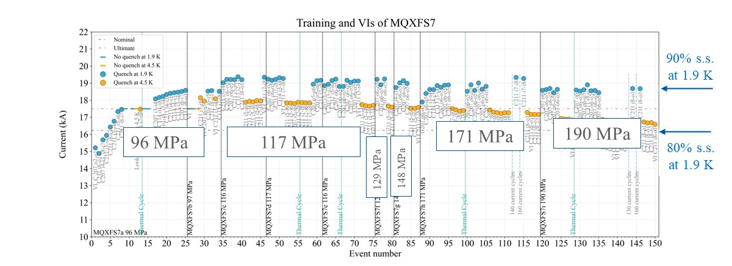
Recent results for Nb₃Sn magnets: stress limits
Similar to what done in TQ magnet, high preload are being explored (up to 200 MPa)
  Test is ongoing, at 200 MPa nominal performance is still reachable, but signs of irreversible performance degradation in the range above 90% of short sample limit (but with a PIT conductor)
In EuroCirCol studies, a limit of 150 MPa at room temperature and 200 MPa at 1.9 K have been given – all designs satisfied these requirements [D. Tommasini, et al. IEEE TAS 28 (2018) 4001305]
  With the reduction of the operational field from 16 T to 14 T, all EuroCirCol design at 14 T will satisfy the limits 120 MPa at room temperature and 150 MPa at cryogenic conditions
Preload experiment on MQXFS7, ongoing since 2023 (S. Izquierdo Bermudez, F. Mangiarotti, et al.)

Slide 12
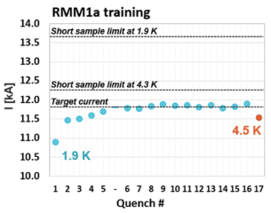
Recent results for Nb₃Sn magnets: towards 16 T
EuroCirCol launched a MTP (magnet technological program) with the construction and test of RMM (50 mm aperture)
  Block coil, but no flared ends, targeting 16 T
  This magnet operates with low current density and very large coil width (not affordable for FCC-hh)
  It reached 16.4 T, proving that the singularity in the straght part of the block coil design is not a showstopper, and that there is a large margin for operation at 14 T on the mechanical side
  We will reassemble with higher preload and we will manufacture a second set of coils to verify reproducibility (in 2024-2025)
16 T
Cross-section and training of RMM [E. Gautheron, et al. IEEE TAS 33 (2023) 4004108]

Slide 13
Contents
Guidelines and updated targets
Recent results and their implication
Planned magnets
Updated roadmap
Nb₃Sn conductor status and challenges
HTS challenges (followed by talk from A. Ballarino)

Slide 14
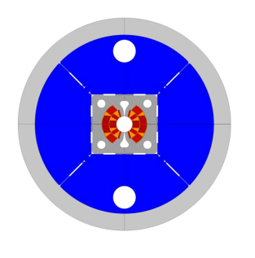
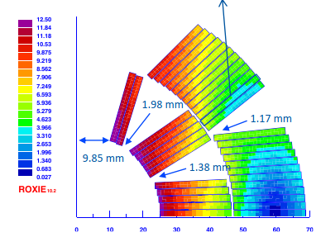
FalconD (cos θ, two layers)
This is the most conservative magnet, based on two layer cosθ, with a 12 T operational field and possibility of reaching fields above 13 T with a very low quantity of conductor (INFN Italy, manufacturing in industry)
  See talk on HFM forum, March https://indico.cern.ch/event/1389304
Winding starting this year, test in 2026
INFN is also proposing a 4 layer design aiming at 14 T
FalconD cross-section and coil [R. Valente, et al., IEEE TAS 30 (2020) 4001905

Slide 15
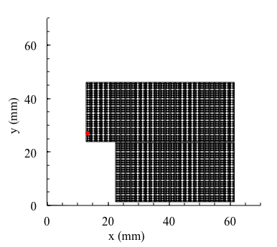
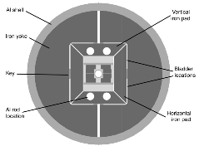
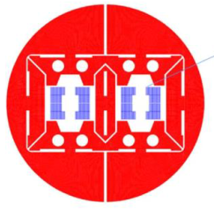
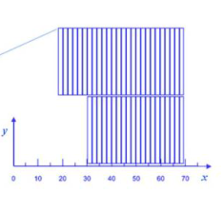
14 T, block design, CERN
Block coil
  FrescaII, achieving 14.6 T, is based on block coil
  Same coil design as HD2 reached 13.74 T at 4.5 K in 2005-2010
  A simple design based on a two-layer coil, no grading is proposed
  Design is ongoing, winding in 2025 and test in 2026
  Support from the LBNL for the cable manufacturing (more than 40 strands, same of TF1)
  See talk on 14 T meeting, February 2023 https://indico.cern.ch/event/1248907/
HD2 cross-section and coil [G. L. Sabbi, et al., IEEE TAS 15 (2005) 1128-1131,
P. Ferracin, et al., IEEE TAS19 (2009) 1240-1243]
CERN 14 T cross-section and coil
(J. C. Perez, S. Izquierdo Bermudez, A. Haziot et al)

Slide 16

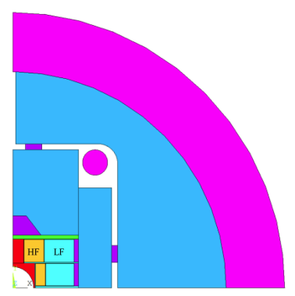
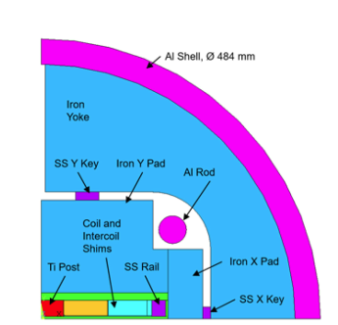
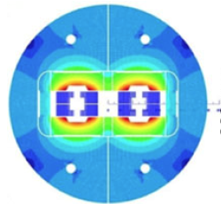
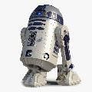
14 T, block design, CEA
CEA is developing a more complex block design (F2D2), with grading and four layers coils
  Winding and test will take place after 2025
  Intermediate step: R2D2, to have two racetrack with two different cables - winding is ongoing and test in 2026, with target field of 11.5 T
F2D2 cross-section and coil [H. Felice, et al., IEEE TAS 29 (2019) 4001807]
R2D2 cross-section and 3D model
[V. Calvelli, et al., IEEE TAS 31 (2021) 4002706]

Slide 17
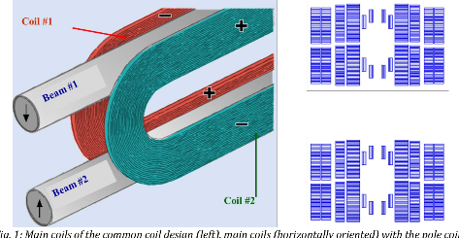

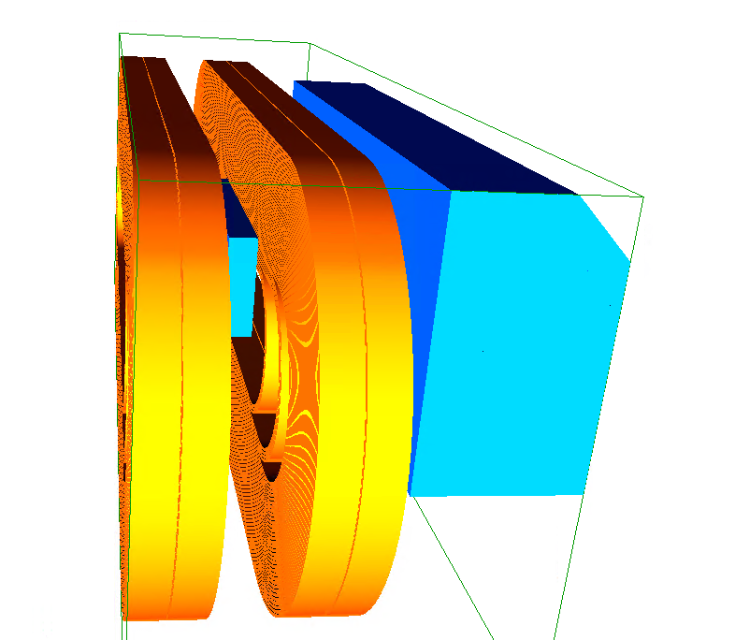
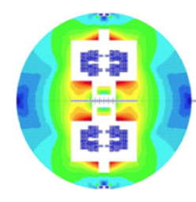
14 T, common coil, CIEMAT
Common coil design has been proposed since the last century
  Advantage is to have flat coils (most of them)
  Design is less effective (more conductor)
CIEMAT is proposing to manufacture such magnet
  Design is ongoing, test not before 2027
Intermediate step: ISAAC magnet, with two racetrack coils from CERN
  Target field above 12 T, it has a short sample of 14 T, test in 2025 (see also meeting on 21 March 2024, https://indico.cern.ch/event/1389304/ )
Common coil concept (R. Gupta, et al.)

Slide 18
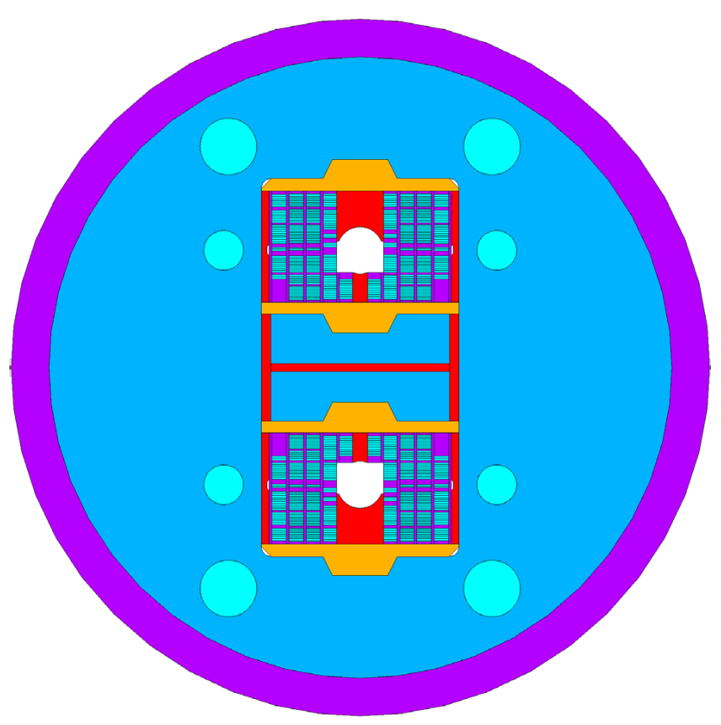
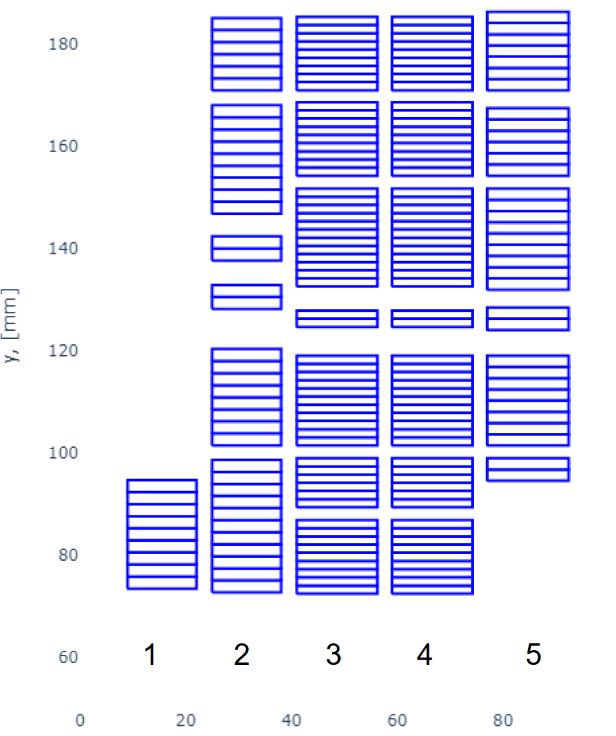
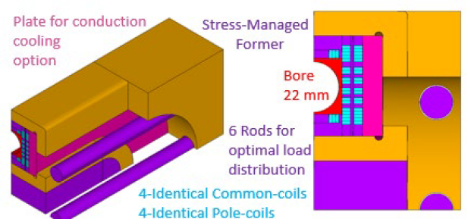

14 T, stress managed common coil, PSI
PSI is proposing a fully stress-managed magnet, with grading
  Stress management at 14 T is not required, but adds margin to a large production
  Stress is managed both vertically and horizontally
  The asymmetric coil design allows to have only flat coils
  Test not before 2026
Intermediate step: a small model proving the technology, to be tested in 2024
Stress managed common coil [D. Araujo,. B. Auchmann, et al.]

Slide 19
Contents
Guidelines and updated targets
Recent results and their implication
Planned magnets
Updated roadmap
Nb₃Sn conductor status and challenges
HTS challenges (followed by talk from A. Ballarino)

Slide 20
Roadmap to full scale prototypes
At the horizon of HL-LHC RunIV, we shall select one or two designs, and have a short model program (at least five models) to explore performance reproducibility, dependence on assembly parameters
  This should take about 4 years
During RunV, we shall launch the scaling to 15 m
  To be completed at the end of the decade, where we shall be ready for industrialization
  One could also involve industry already in this phase
15 m long prototypes (>5 of each type)
5 m long prototypes of one selected design
(>5 of each type)
Short model program on two selected designs
(>5 of each type)
Ongoing 12 T and 14 T short models (seven designs, 1 or 2 of each type)
Selection of final design
to start long magnets
2024
2025
2026
2027
2028
2029
2030
2031
2032
2033
2034
2035
2036
2037
2038
2039
2040
2041
LHC RunIII
HL-LHC RunIV
HL-LHC RunV
HL-LHC RunVI

Slide 21
Industrialization, production, and commissioning
At the end of HL-LHC, tender for the series
  Production and test over nine years
  Installation and commissioning in parallel
Installation and commissioning
Production and test
Industrialization (pre-series magnets)
Tender for the series
2040
2041
2042
2043
2044
2045
2046
2047
2048
2049
2050
2051
2052
2053
2054
2055
2056
2057
LHC RunVI

Slide 22
Contents
Guidelines and updated targets
Recent results and their implication
Planned magnets
Updated roadmap
Nb₃Sn conductor status and challenges
HTS challenges (followed by talk from A. Ballarino)

Slide 23
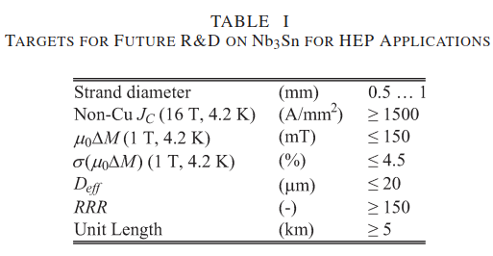
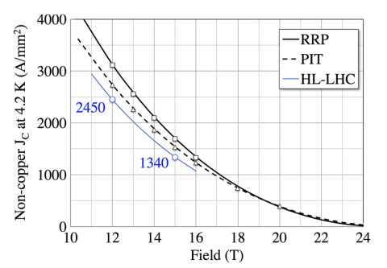
Conductor historical
Targets for the conductor set in 2014:
  Critical current of 1500 A/mm² at 16 T and 4.2 K (it is 1000 A/mm² in the HL LHC conductor requirements)
  Filament size of 20 μm (it is 50 μm in HL-LHC)
Today (ten years later) we are at
  Critical current of 1200 A/mm² at 16 T and 4.2 K → we have to lower the field from 16 T to 14 T if we want to keep affordable volume of conductor with proved margin
  Filament size of 50 μm → impact on hysteresis losses, that with this filament are twice the target of FCC design, but this can be avoided working at 4.5 K – field quality can be mitigated by correctors ?
Nb₃Sn conductor targets of 2014
L. Bottura, A. Ballarino, IEEE TAS 25 (2015) 6000906

Slide 24
Conductor development
Today we have only one provider of this type of strand: we should have more manufacturers able to produce this strand
Ongoing work on increase of critical current:
  Activities in the HFM program at University of Geneva and at TU Bergakademie Freiberg (S. Hopkins, et al., talk on June 3 https://indico.cern.ch/event/1419912/ )
  Very promising, but not yet an industrialised wire technology validated for accelerator magnet applications
  Still to be demonstrated:
    Long lengths
    Degradation on cabling
    Magnetothermal stability
X. Xu et al., Supercond. Sci. Technol. 36 035012 (2023)

Slide 25
HTS outlook
In the Eucard2, two dipoles were built in 2018-2020, both using Roebel cable
  Feather2 at CERN, reaching 3.1-3.5 T at 4.5 K but followed by degradation
  Cost dipole at CEA, limited in one coil (1.5 T reached)
HTS has been successfully used to build solenoids achieving more than 20 T bore field
Large improvement in the achieved current density and cost reduction, but quench detection and protection is still a critical issue
Accelerator dipoles present specific requirements
  Compact to fit the tunnel: use of very high overall current densities
  High level field quality, also at injection and during ramp
  Low hysteresis losses to limit the energy consumption – savings induced by operation at 20 K could be wiped out by much larger hysteresis losses
Note that for accelerator dipole specific technologies were developed
  Rutherford cables to reduce ramp rate effects
  Very high current densities (for instance, twice of what is required by ITER)
  Very thin filaments to reduce hysteresis
These technical challenges (including modeling) have to be addressed in HFM

