Slide 1
1
General Information
& Study News
Frank Zimmermann
FCC-ee Accelerator & Optics Design Meeting #198 & 69th FCCIS WP2.2 meeting, 27 November 2024

Slide 2
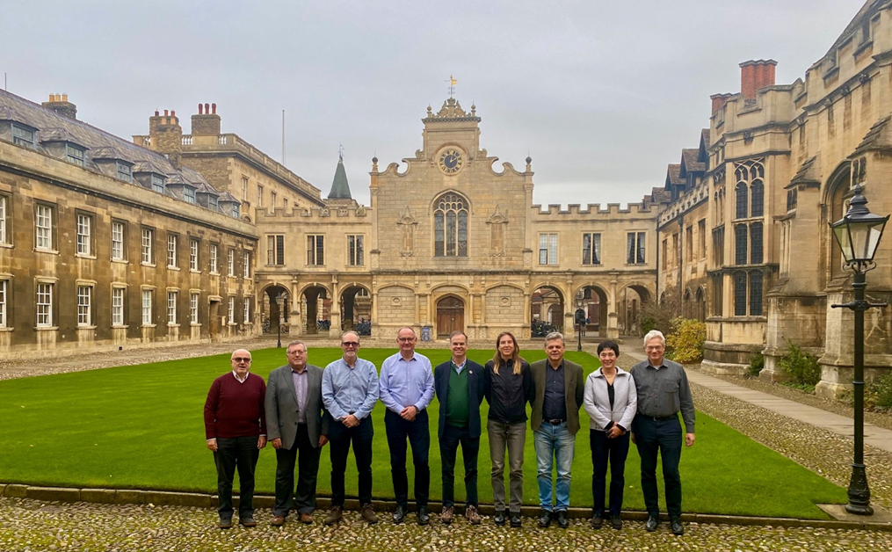
SAC meeting #8, Peterhouse Cambridge, 18-20 November 2024

Slide 3
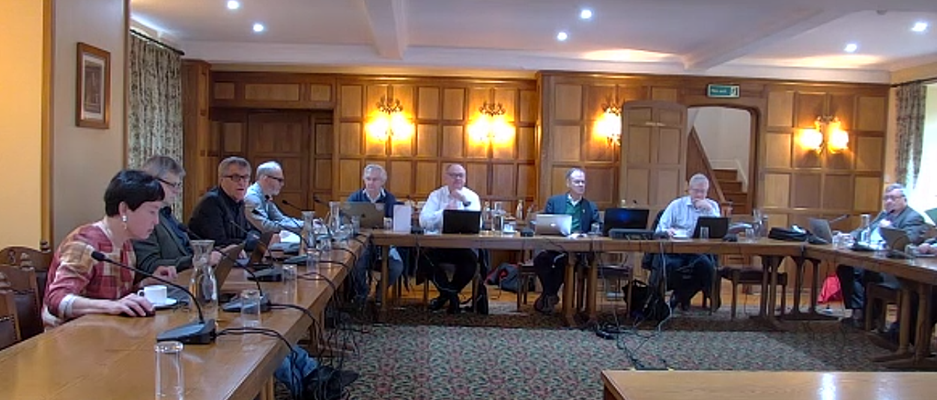
SAC meeting #8, Peterhouse Cambridge, 18-20 November 2024

Slide 4
SAC meeting #8, Peterhouse Cambridge, 18-20 November 2024
On site: Riccardo Bartolini (DESY), Michael Benedikt (CERN, FCC Study Leader), Christian Carli (CERN), Gerardo Ganis (CERN), Cédric Garion (CERN), Andre Henriques (CERN), Gudrun Hiller (U. Dortmund), Patrick Janot (CERN), Ivan Karpov (CERN), Philippe Lebrun (ESI), Peter McIntosh (STFC UKRI), Michiko Minty (BNL), Katsunobu Oide (UNIGE), Andy Parker (Cambridge University, Chair), Franck Peauger (CERN), Roberto Tenchini (University Pisa and INFN Pisa), Rogelio Toms (CERN), Tim Watson (CERN), Frank Zimmermann (CERN, Secretary)
Most SAC members present in person (Kyo Shibata, Belen Gavela, Alain Chabert, Srinivas Krishnagopal, Heinz Ehrbar remote)
Most presenters attending in person (Anton Lechner, Bernhard Auchmann, David d’Enterria remote)
Goal: to tick off as many points from the mid-term report as possible

Slide 5
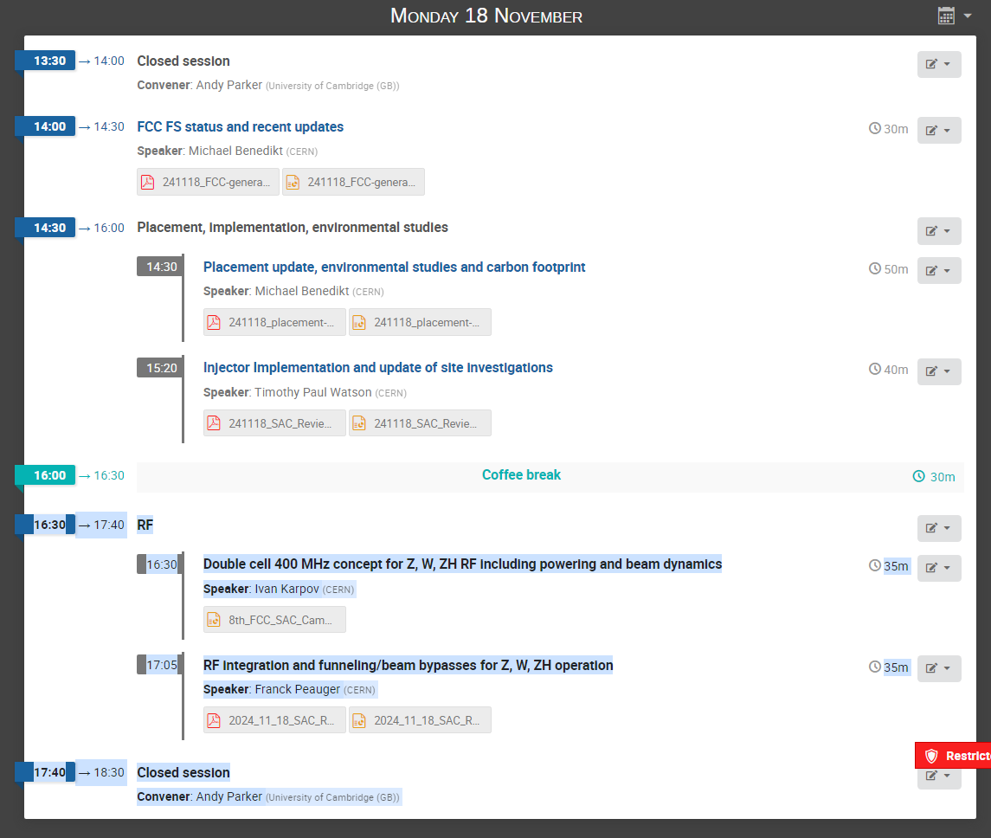
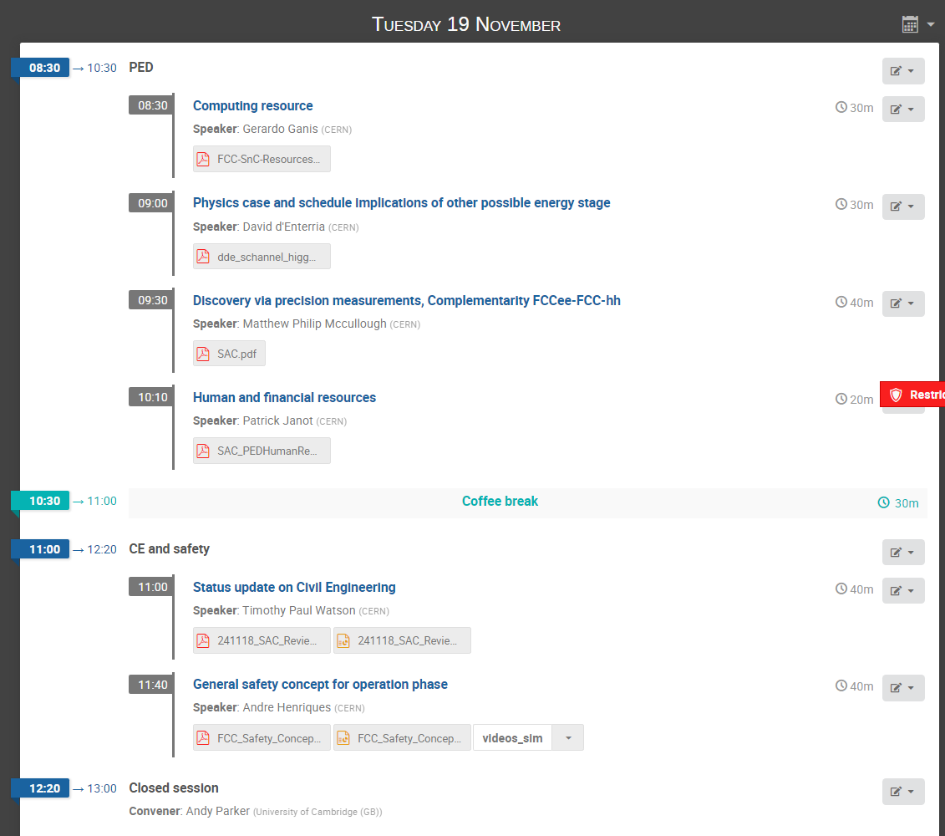
SAC Program 1st half

Slide 6
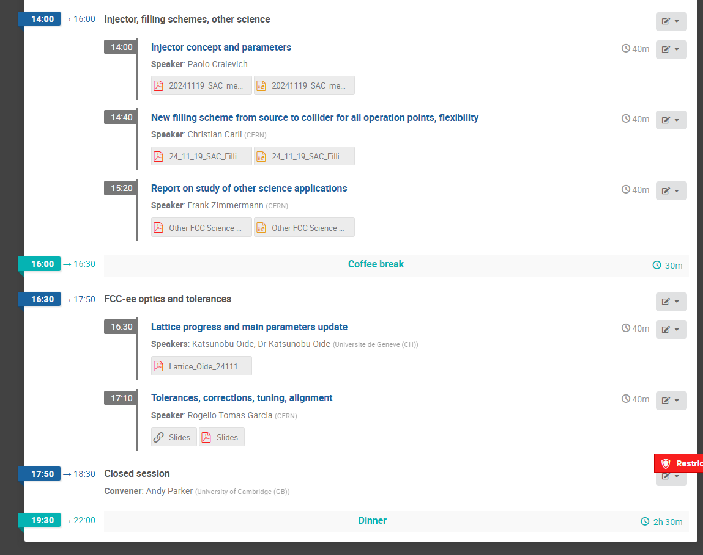
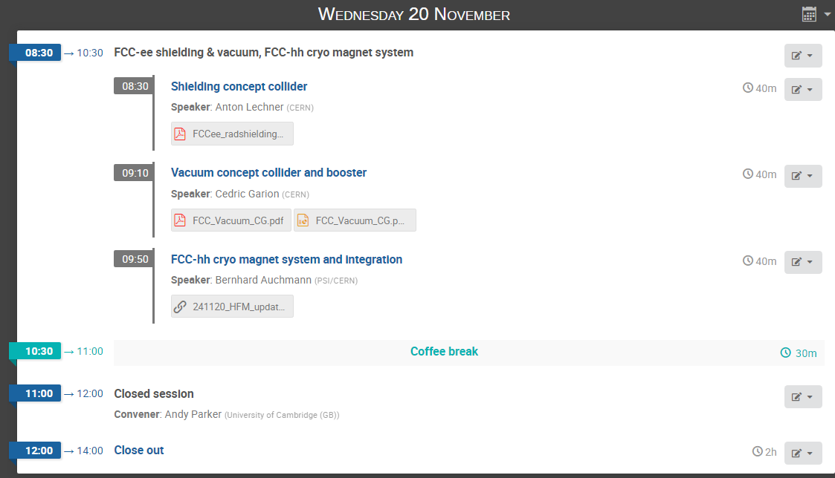
SAC Program 2nd half

Slide 7
SAC #8: regarding FCC-ee optics & tolerances (K. Oide, R. Tomas)
discussion points:
choice of baseline optics
filling time from scratch
→ monochromatization optics
→ 100 micron initial quad-BPM alignment questioned
→ a4 tolerance for sextupoles (30 units) flagged red
→ study error effects on injection efficiency
→ effect of beam-beam on tolerances

Slide 8
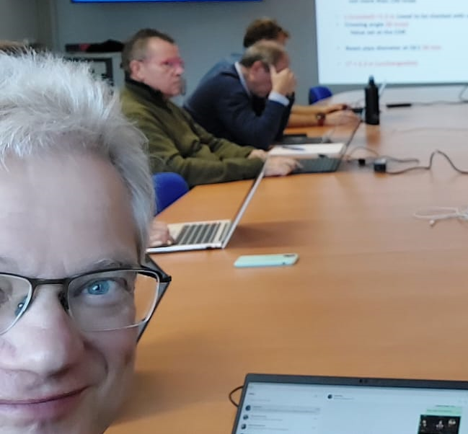
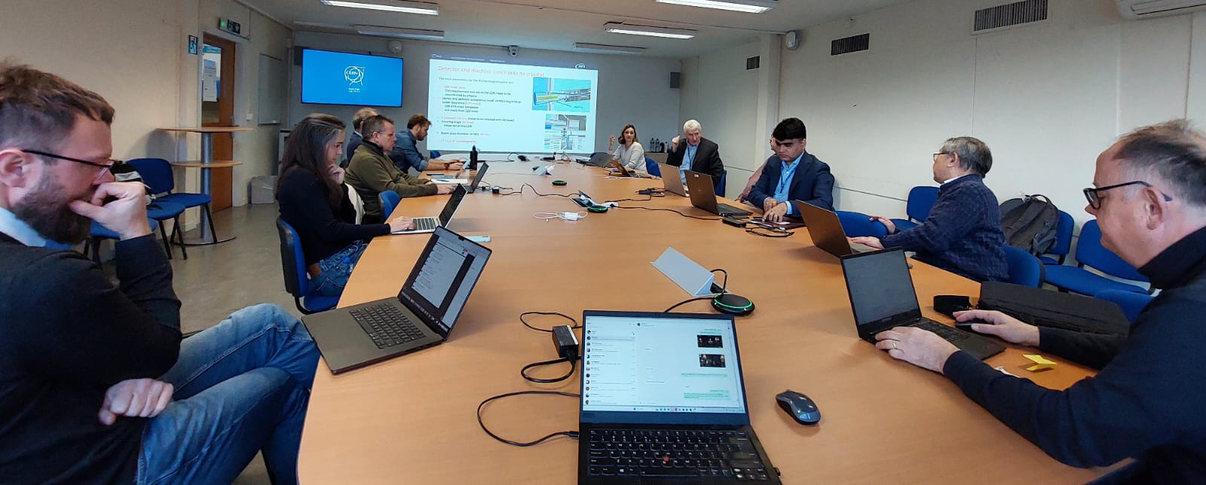
FCC-ee MDI Mini-workshop, 22 November 2024
Participants:
Ilya Agapov (DESY), Patricia Borges de Sousa (CERN), Manuela Boscolo (INFN-LNF), Jean-Paul Burnet (CERN), Francesco Fransesini (INFN-LNF), Mike Koratzinos (PSI), Katsunobu Oide (U. Geneva), Brett Parker (BNL), Vittorio Parma (CERN), John Seeman (SLAC), Laurent Tavian (CERN), Vikas Teotia (BNL), Frank Zimmermann (CERN)

Slide 9
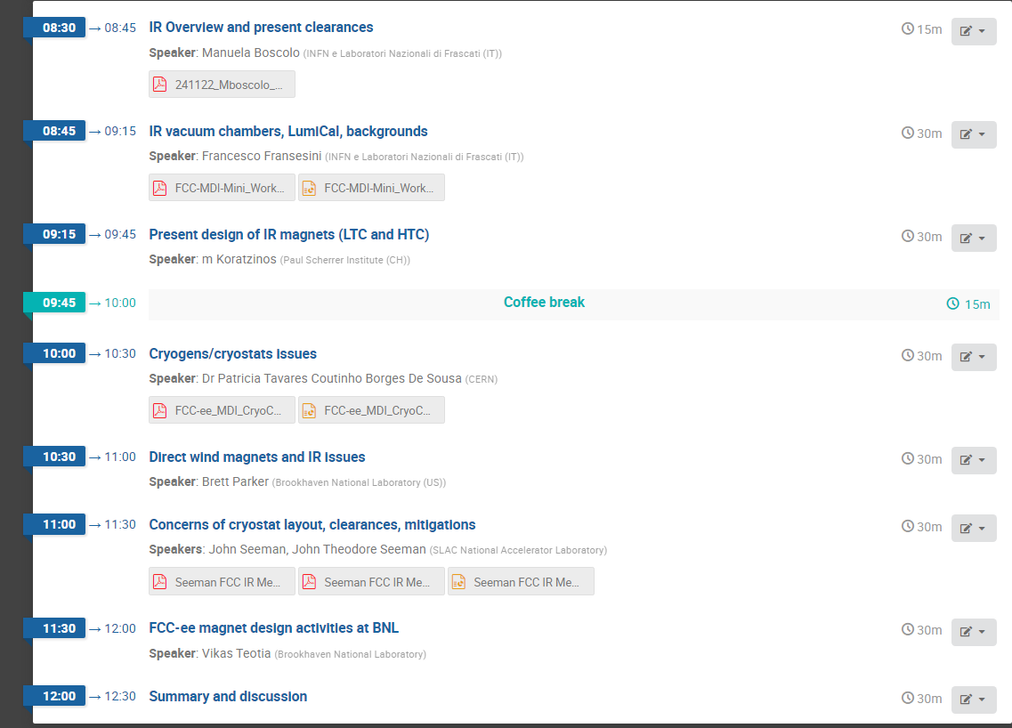
Program

Slide 10
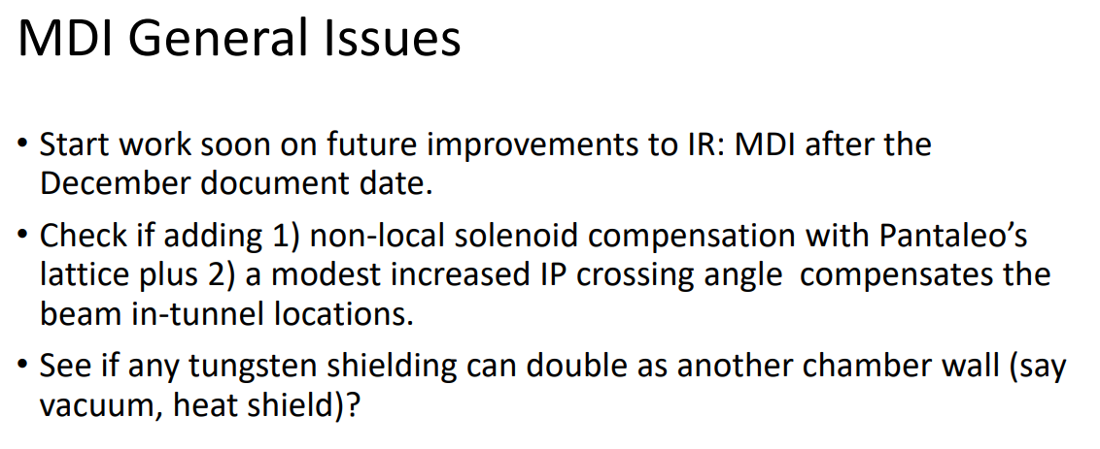
MDI mini-WS discussions (J. Seeman et al.)

Slide 11
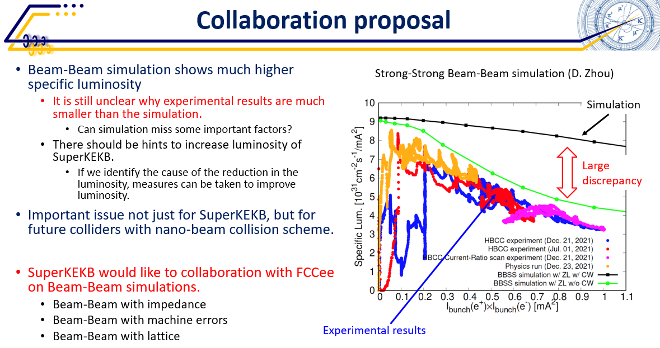
CERN-KEK Committee mtg #19, 26 Nov 2024
Kyo Shibata

Slide 12
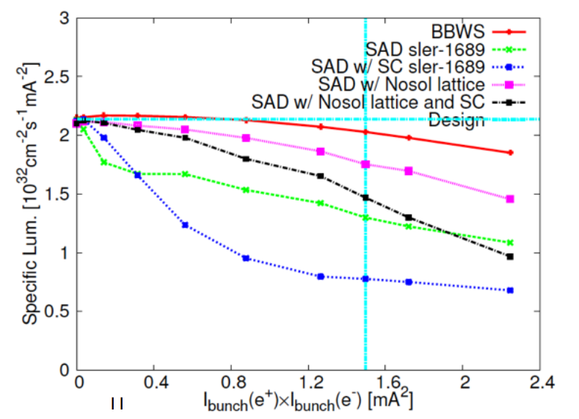
is luminosity drop unexpected ? - SKEKB ARC, February 2015
Demin Zhou

Slide 13
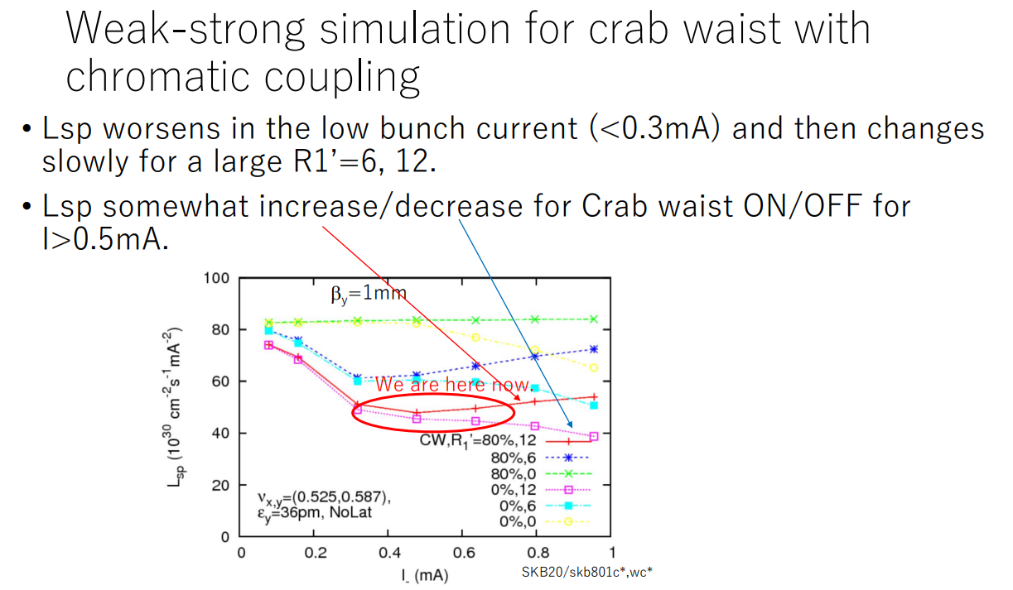
is luminosity drop unexpected ? - SKEKB ARC, July 2020
Kazuhito Ohmi

Slide 14
F.Z.
recent big achievement ☺
we waited ~18 years for this ☹ since Akio Morita’s stay at CERN in 2006/2007
Now, thanks to
J. Salvesen, G. Iadarola, G. Broggi, H. Sugimoto, and K. Oide :
complete model of SuperKEKB LER and HER, including IR with tilted solenoid and overlapping elements available in CERN simulation framework xsuite since last week !
With this CERN FCC team could carry out many studies for SuperKEKB:
Optics, beam-beam, collimation, SR background, injection,..

Slide 15





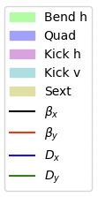
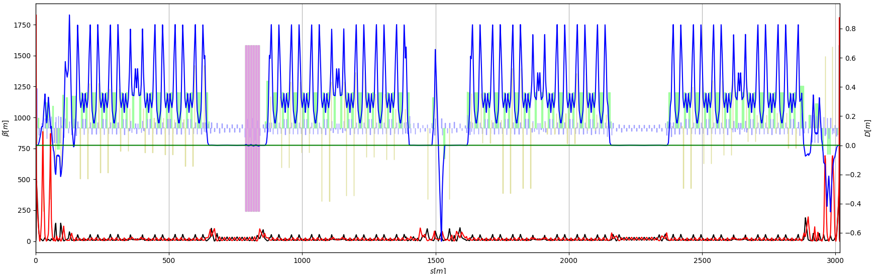
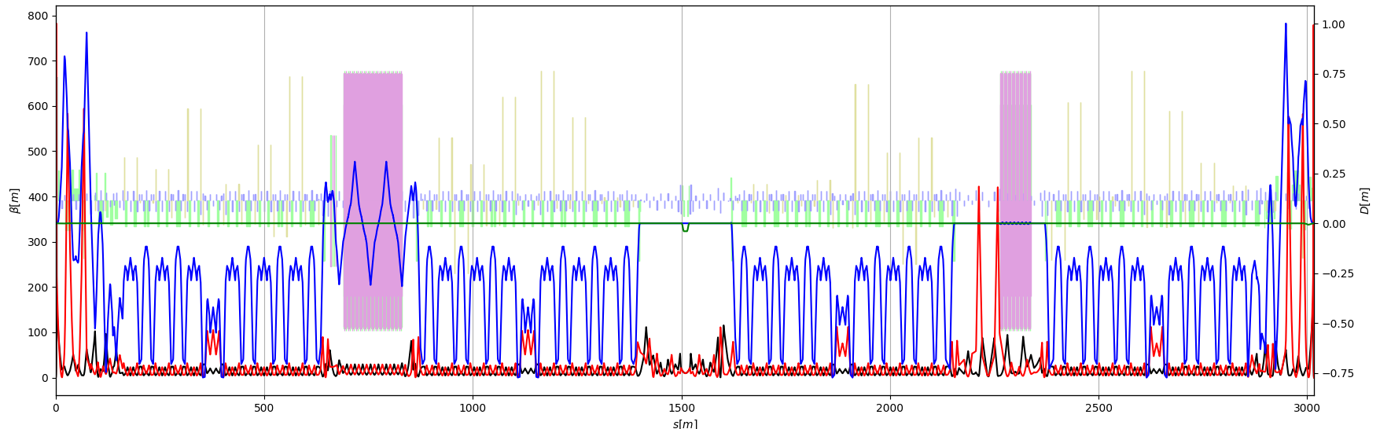
SuperKEKB Lattice Conversion
strong collaboration between CERN and KEK
alternative modelling strategy for IR
many additional features & improvements to Xsuite have come about as a result of this effort
J. Salvesen, G. Iadarola, G. Broggi, H. Sugimoto, K. Oide
F.Z.

Slide 16
Other FCC-ee science applications under study
→ Workshop on “Other Science Opportunities at the FCC-ee”
28-29 November at CERN, https://indico.cern.ch/event/1454873/
for example:
FCC-ee booster as diffraction limited storage ring with coherent synchrotron radiation down to 0.1 Å
FCC-ee injector as the world’s ultimate positron source for material studies and paving a path towards the first Bose-Einstein condensation of Ps (511-keV gamma-ray laser)
using beamstrahlung for radionuclide production
e⁻ beam driven neutron source
etc.

Slide 17
FSR status
contributions are coming in ! ☺
4 more weeks till Xmas
some teams write separate documents to integrate them later
be careful with references (avoid duplications) !

Slide 18
timeline for pre-TDR phase
“new” collider baseline optics by early 2026
possibly LCC optics
must have integrated collimation, RF, inj./extr. straights
non-local solenoid compensation
should define milestones in 2025 to get there
work needed for booster optics
strengthen CEA team ?
explore polarized injector for pilot bunches
- TL optics with spin rotators, polarizer ring

Slide 19
welcome Takashi Mori from KEK !
topic: dynamics after injection with beam-beam

Slide 20
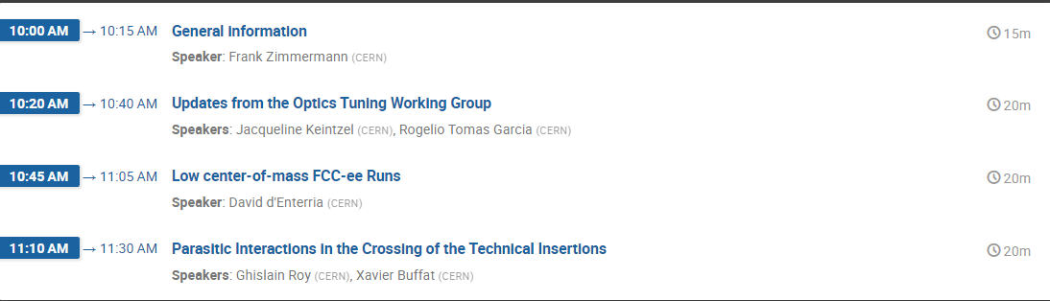
Today’s agenda

