Slide 1
Beam crossing in technical insertions
2024-11-27 -- FCC-ee Accelerator Design Meeting
Xavier Buffat, Ghislain Roy

Slide 2
Crossings in Technical Insertions
FCC-ee has four IP’s with both beams arriving from the inside and exiting on outside: Points A, D, G, and J.
Hence the need to cross the beams, “outside to inside” between IP’s, in all technical insertions, at Point B (injection and dumps), Point F (Collimation), Point H (Collider RF) and Point L (Booster RF, no identified function for collider)
Small horizontal crossing angles (1.6 mrad full angle) to limit radiated power in insertions
Limited tunnel real estate and cannot increase angle over a long distance as in IP’s
Common crossing scheme is required at all energies in PB, PF and PL
Different crossing at ZH and t-tbar (electro-magnetic combined elements) in Point H (Collider RF)
High number of bunches at Z and W implies the possibility of long-range beam-beam encounters in the crossing region in technical insertions

Slide 3
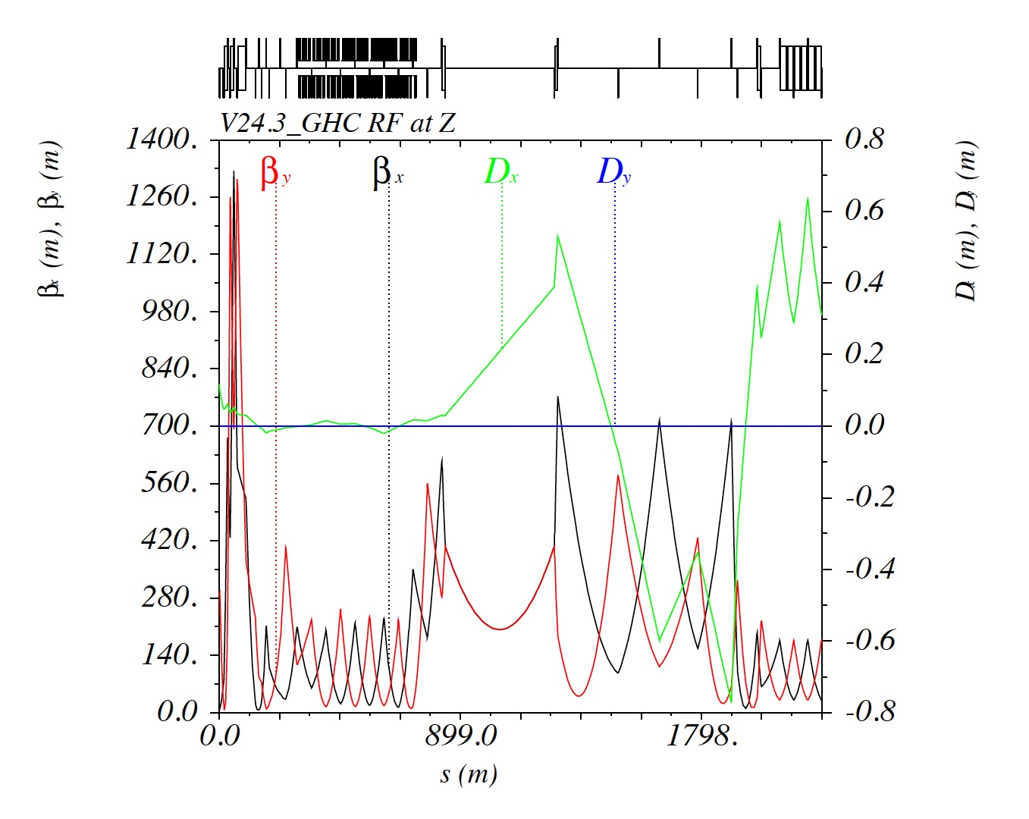
BRX1: l=10m, angle=850urad

Slide 4
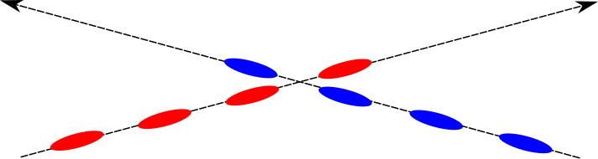
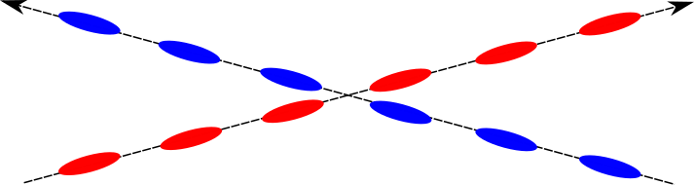
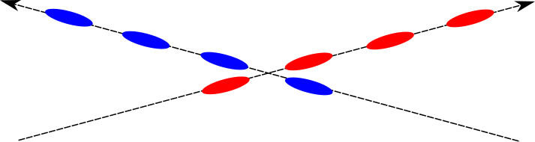
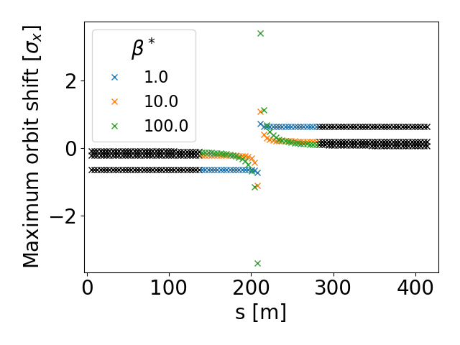
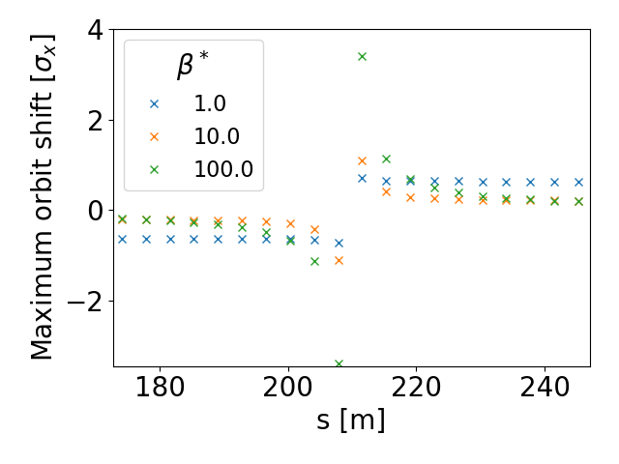
Orbit effect due to long-range beam-beam interaction
A common chamber longer than the bunch spacing leads to multiple bunch crossings
    → Parasitic long-range beam-beam interactions.
    To first order, these interactions lead to a change of the beam orbits
Due to the bunch train structure featuring gaps, some bunches are missing parasitic encounters
    → bunch-by-bunch orbit spread (PACMAN effect)
X.Buffat
Head
Middle
Tail
Assumption:
  Full crossing angle: 1.6mrad
  Drift space with minimum β at the center of the common chamber (smallest beta function at closest encounters minimizes the effect)
End of common chamber when the orbits are separated by more than twice the beam pipe radius
The horizontal orbit spread is in the order of the beam size, which is significant, mitigation is required.
  → Vertical separation bump allowing for separate beam pipes and no long-range encounters
  → Larger crossing angle, active compensation, others?

Slide 5
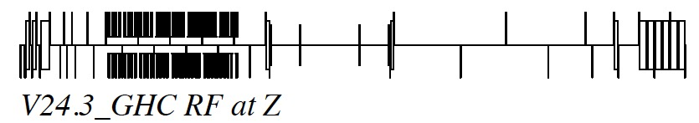
Vertical crossing in separate beam pipes
Vertical dipoles
closed vertical bump; no interleaved elements; single power supply;
field equivalent to that of horizontal switch dipoles
BRX1: L=10m, angle=835 urad MBD: L=5m, angle=350 urad
195m
95m
Provides 70 mm vertical beam separation,
over two times the beam pipe radius

Slide 6
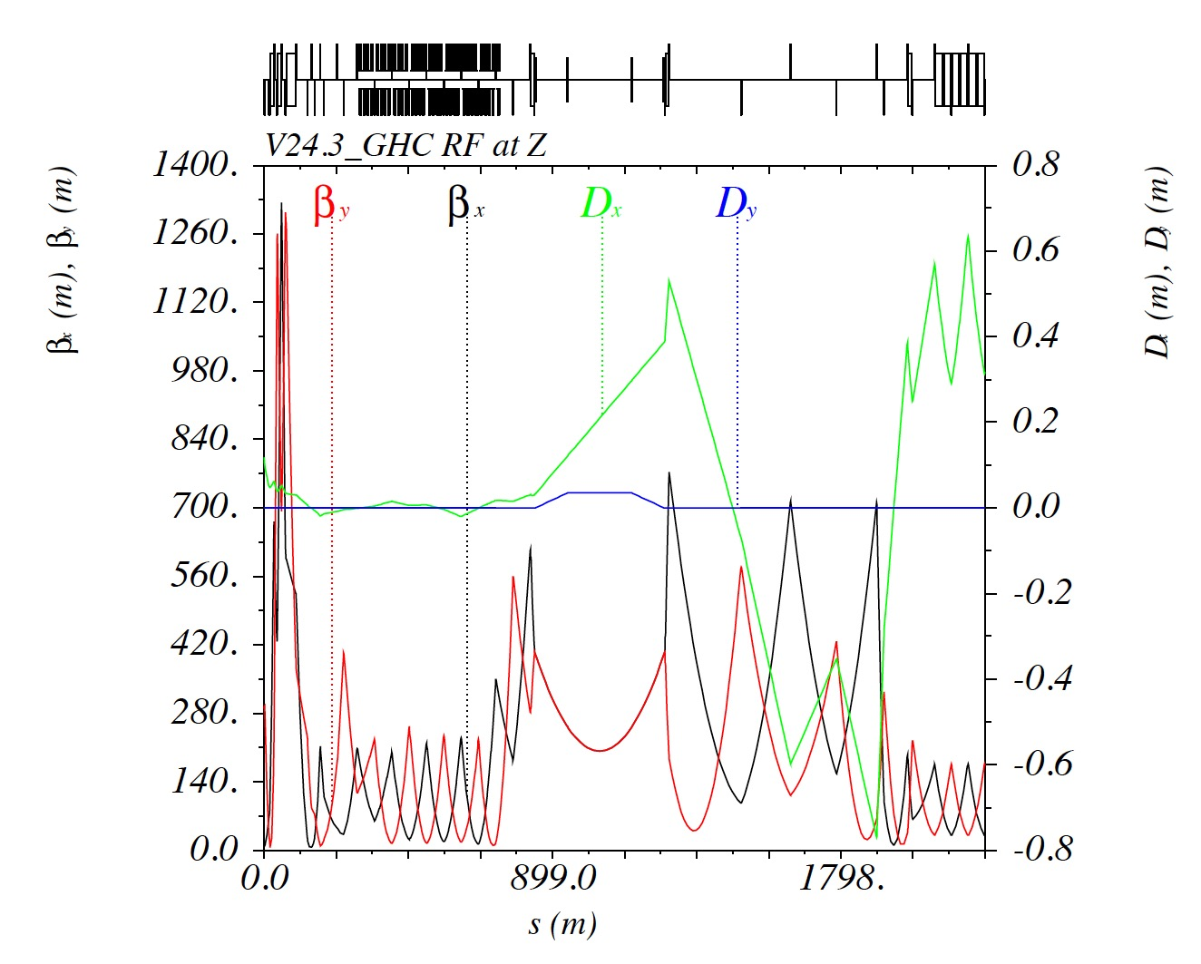

Slide 7
Conclusions
A closed vertical bump is possible in the different technical insertions at all energies.
This allows beam crossings in different vacuum chambers,
and suppresses entirely the long-range beam-beam interactions.
Layout to be optimised for mechanical integration, powering scheme and limitation of Synchrotron Radiation generation in technical insertions, close to sensitive equipment.
Effect of vertical bumps on polarisation?

Slide 9
Thank you for your attention.
2024-11-27 -- FCC-ee Accelerator Design Meeting
Xavier Buffat, Ghislain Roy
9

