Slide 1
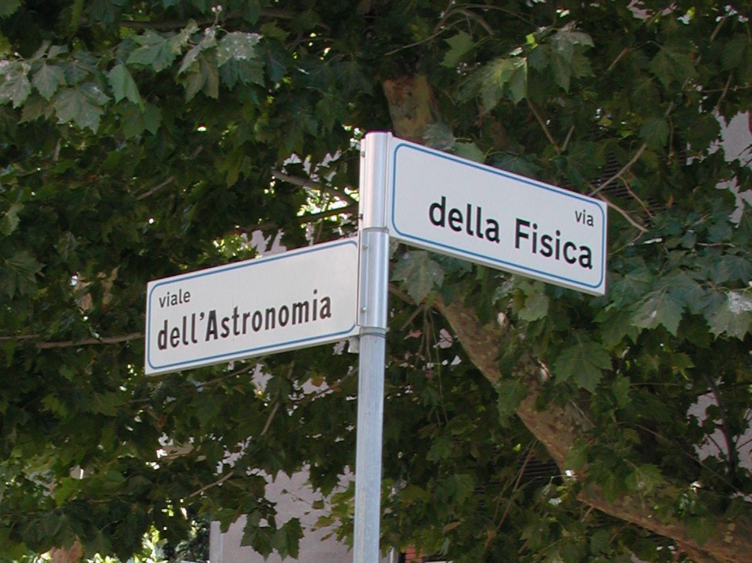
Cosmological Standard Model and Its Implications for Beyond the Standard Model of Particle Physics
CERN Rocky Kolb
28 July 2011 University of Chicago

Slide 2
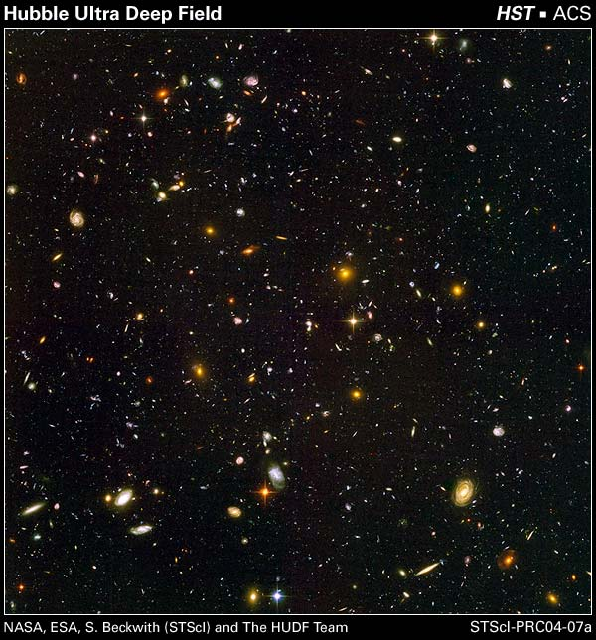


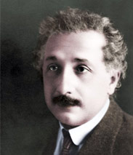
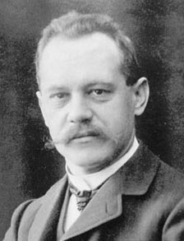

Standard Cosmological Model ΛCDM
"How helpful is astronomy's pedantic accuracy, which I used to secretly ridicule!"
DARK MATTER
INFLATION
DARK ENERGY
Einstein’s to Arnold Sommerfeld on December 9, 1915 (measurements of the perihelion advance of Mercury)
Beyond Standard Model Physics

Slide 3
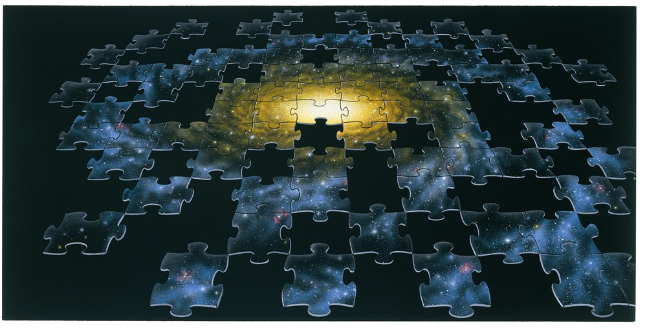
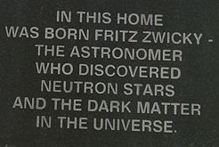
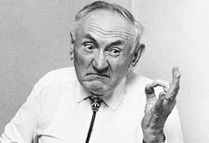
Dark Matter
Fritz Zwicky
Clusters 1930s
Swiss (Mollis, Glarus)
ETHZ: Weyl,
Scherrer, & Debye
Varna, Bulgaria
Fritz Zwicky

Slide 4
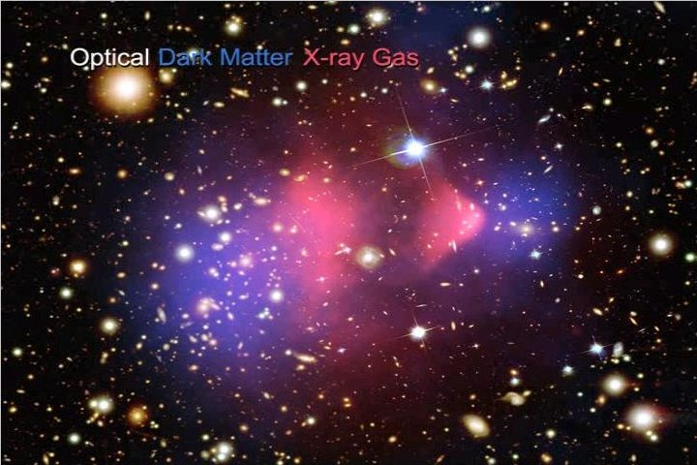
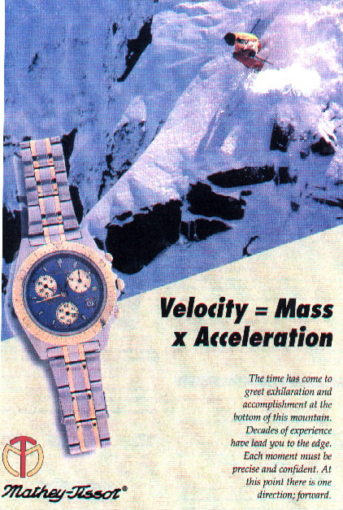
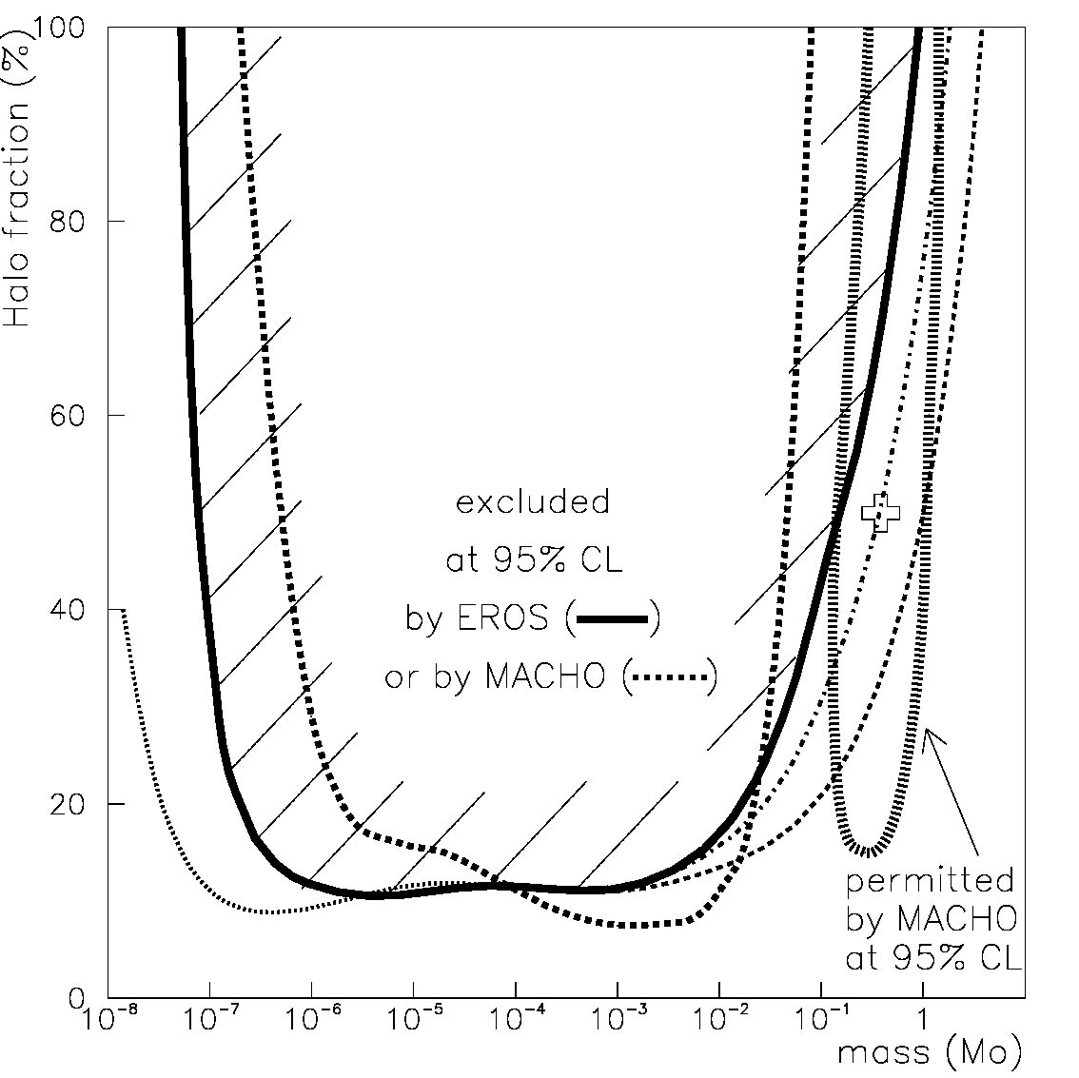
Dark Matter
Modified Newtonian Dynamics
Planets
The Bullet Cluster
Microlensing
Dwarf stars
MACHOS
Size disadvantaged stars
Black holes
Particle relic from the bang
WIMP
The WIMPs dominate the MACHOs

Slide 5
Particle Relic from the Bang
neutrinos
sterile neutrinos, gravitinos
LSP (neutralino)
LKP (lightest Kaluza-Klein particle)
B.E.C.s, axions, axion clusters
solitons (Q-balls, B-balls, odd-balls, …)
supermassive wimpzillas
thermal relics
nonthermal relics
Mass range
Interaction strength range
B.E.C.
axion clusters
Only gravitational: wimpzillas
Strongly interacting: B balls

Slide 6
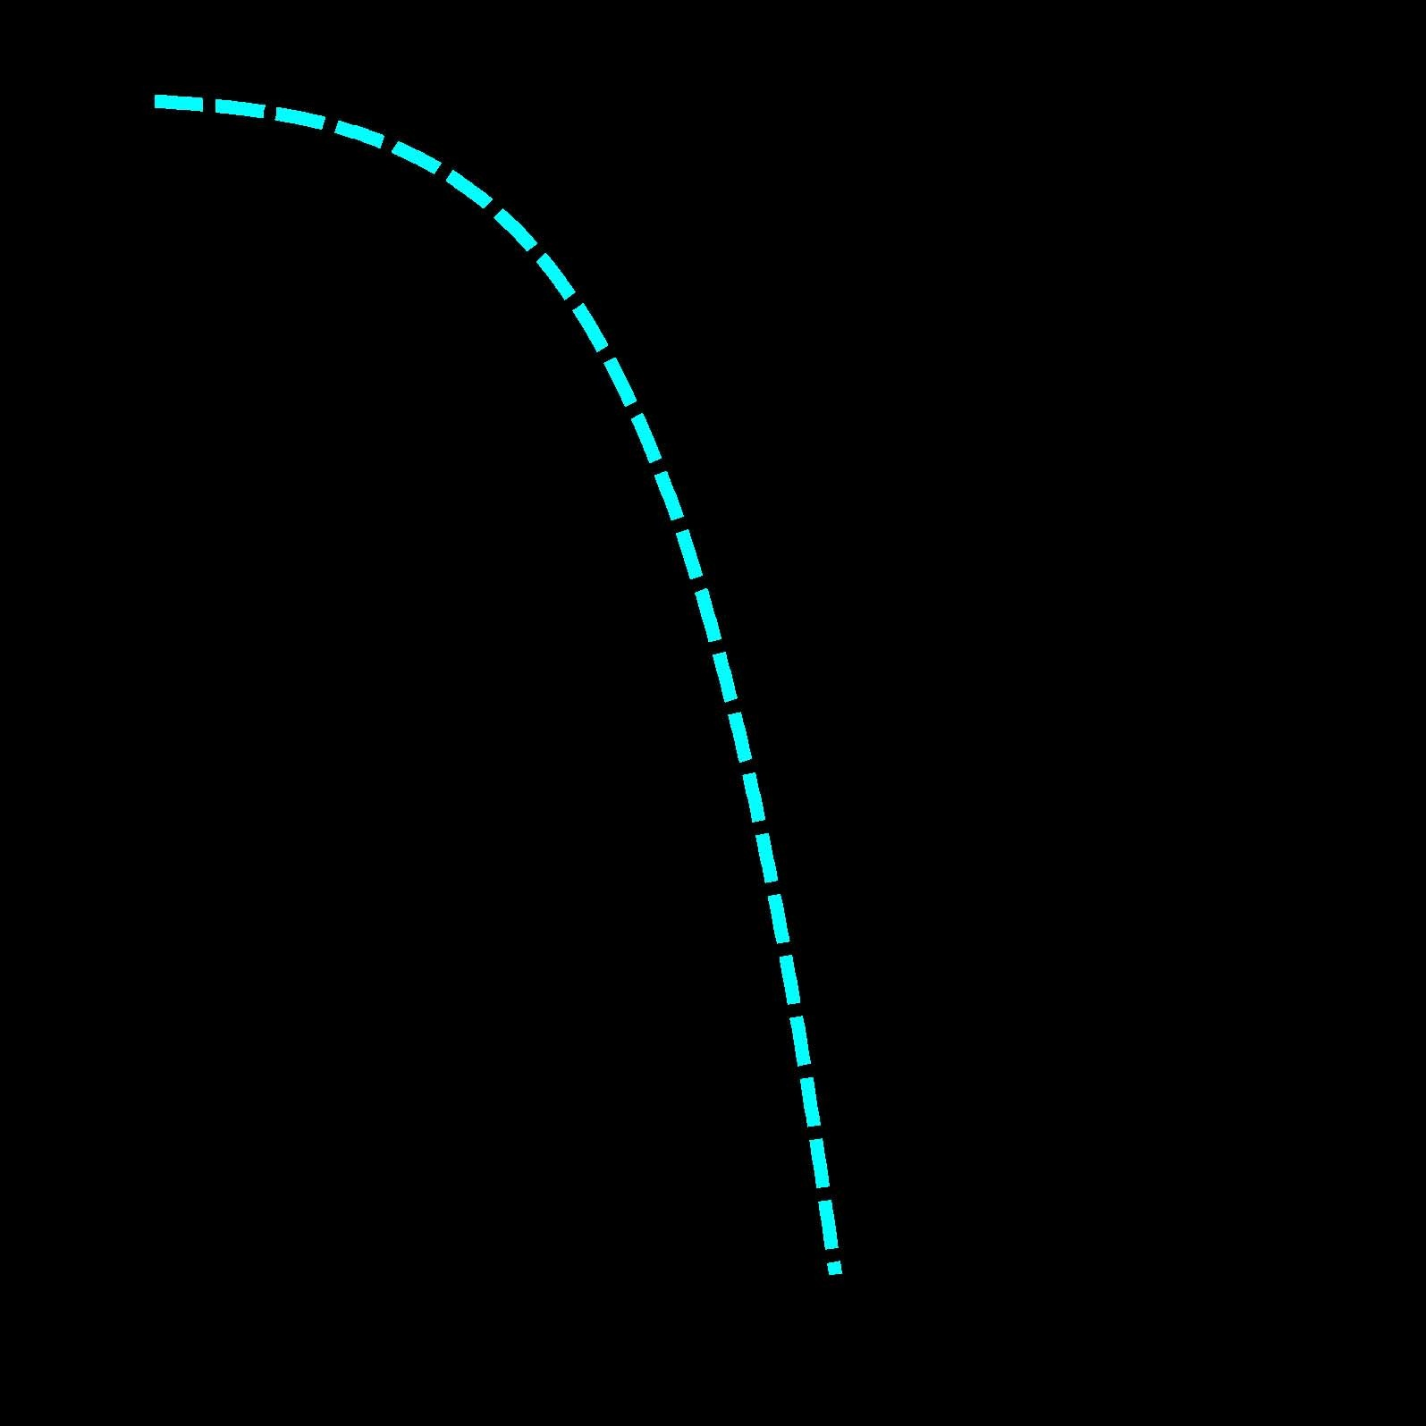
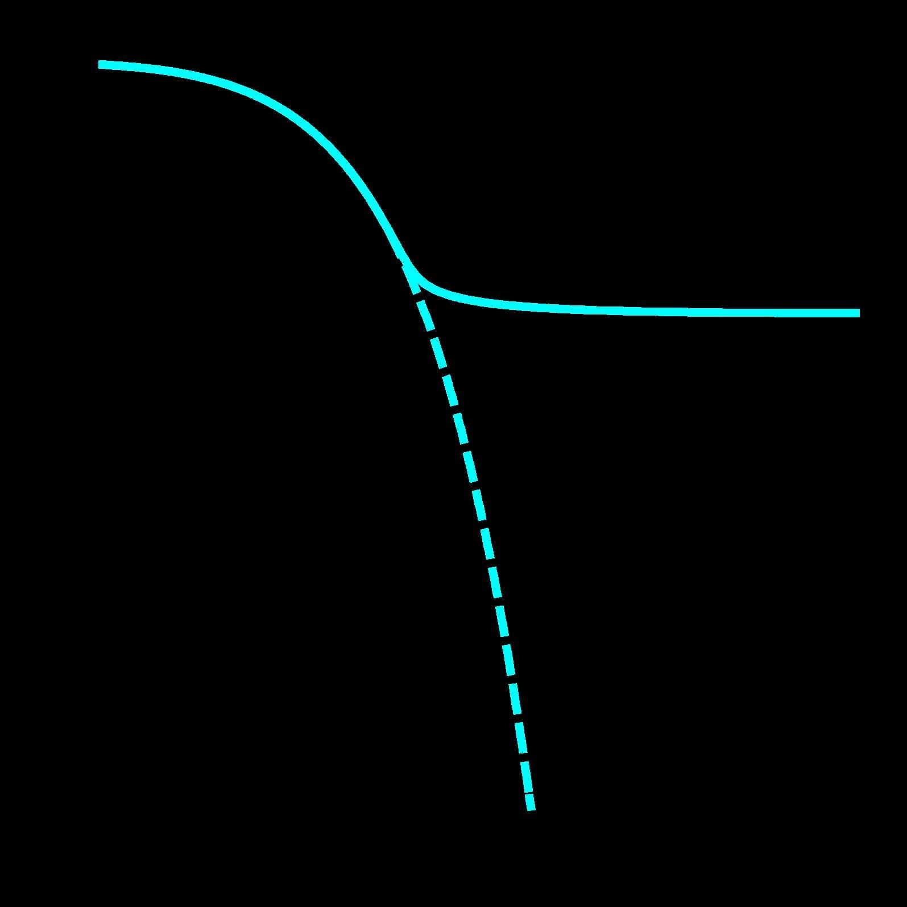
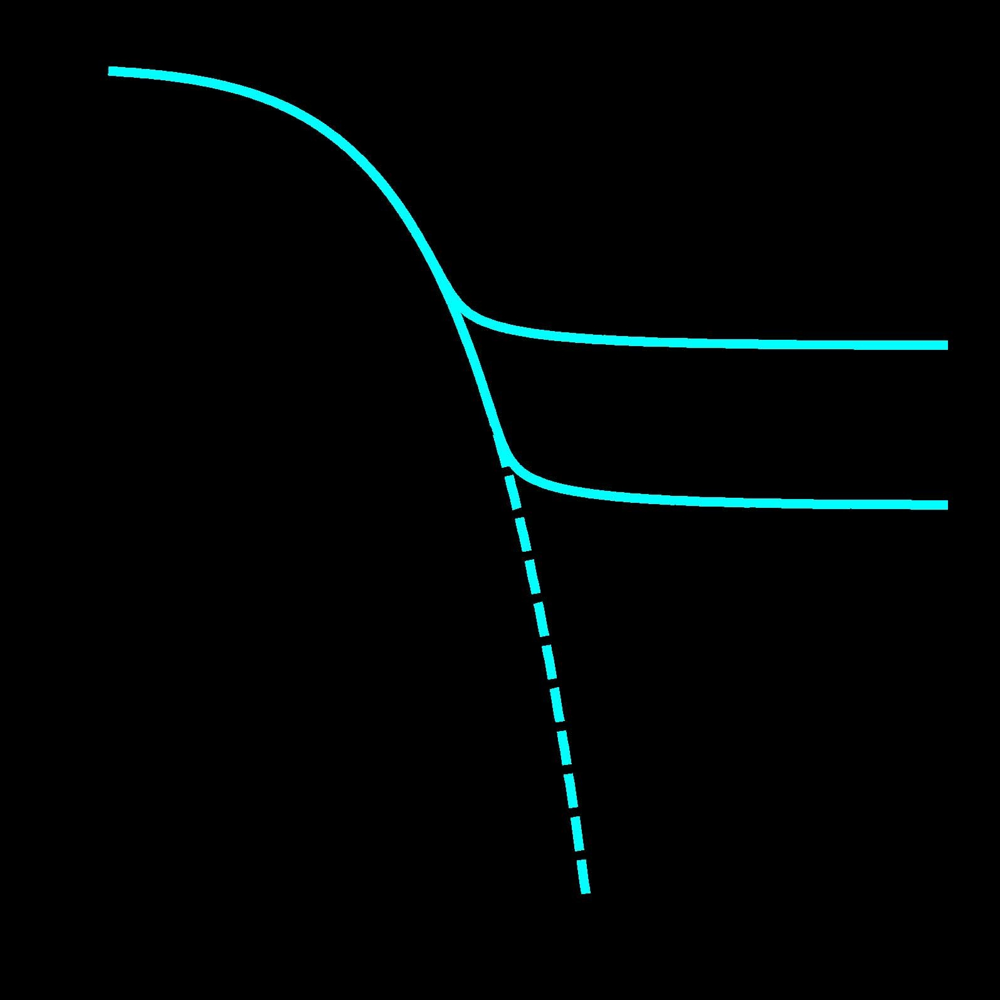
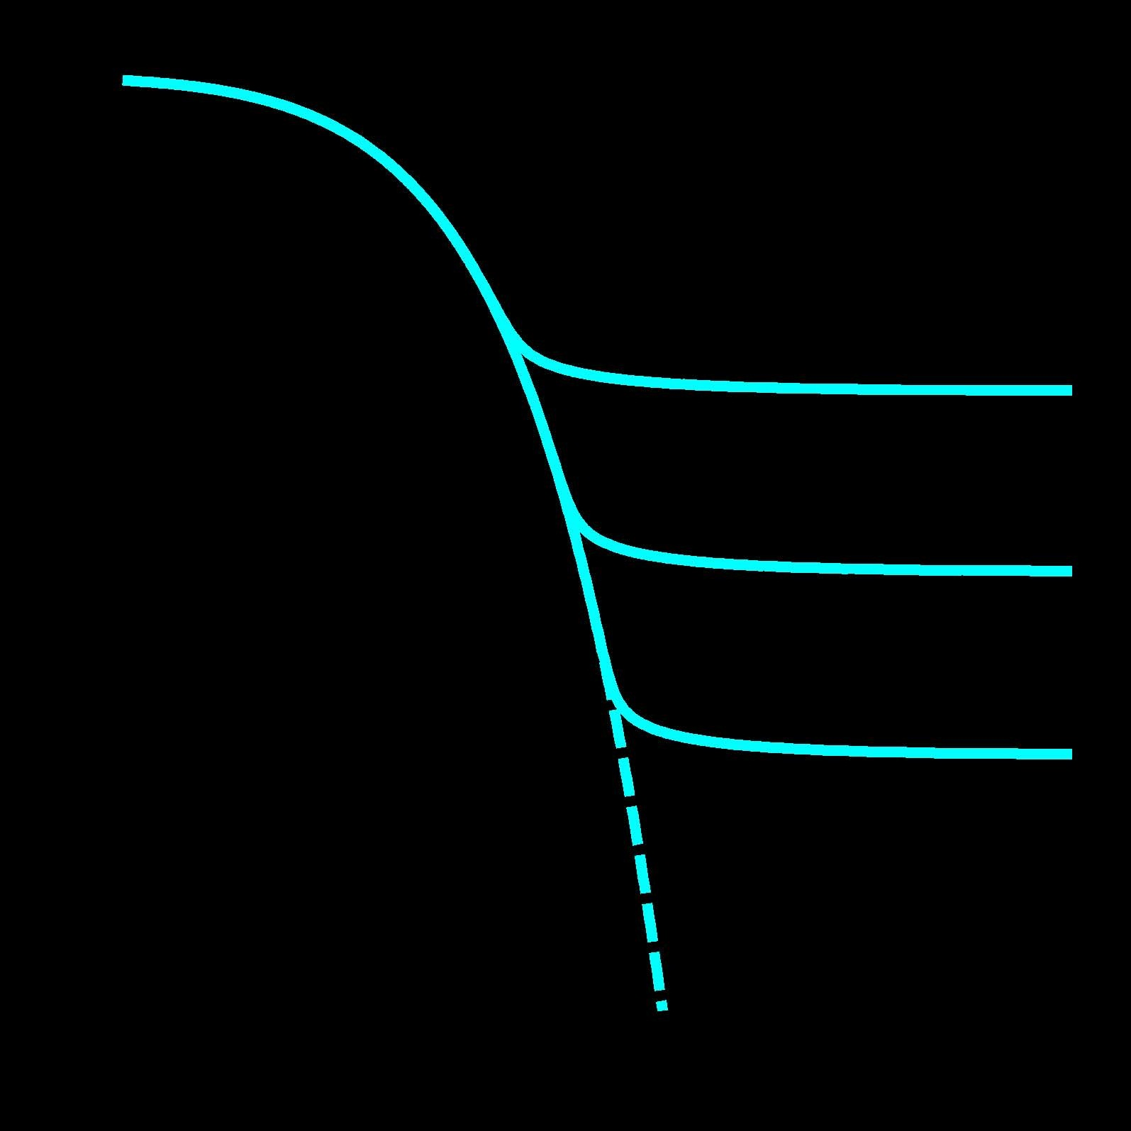
Cold Thermal Relics*
1
10⁻⁵
increasing σ_{A}
Ω
Relative abundance
10⁻¹⁰
Ω
Ω
10⁻¹⁵
decreasing Ω
e^{−M / T}
e^{−M / T}
equilibrium
e^{−M / T}
equilibrium
equilibrium
e^{−M / T}
equilibrium
10⁻²⁰
1
10¹
10²
10³
M / T
* An object of particular veneration.

Slide 7


The WIMP “Miracle”
Ω ⇒ Cross section (& mass ?) of order weak scale
WIMP (Weakly Interacting Massive Particle)
mir·a·cle
\ˈmir-i-kəl \
noun
1 : an extraordinary event manifesting
divine intervention in human affairs
Coincidence or Causation?

Slide 8
WIMPs
Goal: Discover dark matter and its role in shaping the universe
Particle Physics:
Discover dark matter and learn how it is …
… grounded in physical law
… embedded in an overarching physics model/theory
Astro Physics:
Understand the role of dark matter in …
… formation of structure
… evolution of structure
            WIMPs:
            massive, stable, “weakly” interacting, SU(3)_{C} × U(1)_{EM} singlet
            WIMP must be a BSM (but perhaps not far BSM) particle.

Slide 9
WIMPs
Too good to be true?

Slide 10
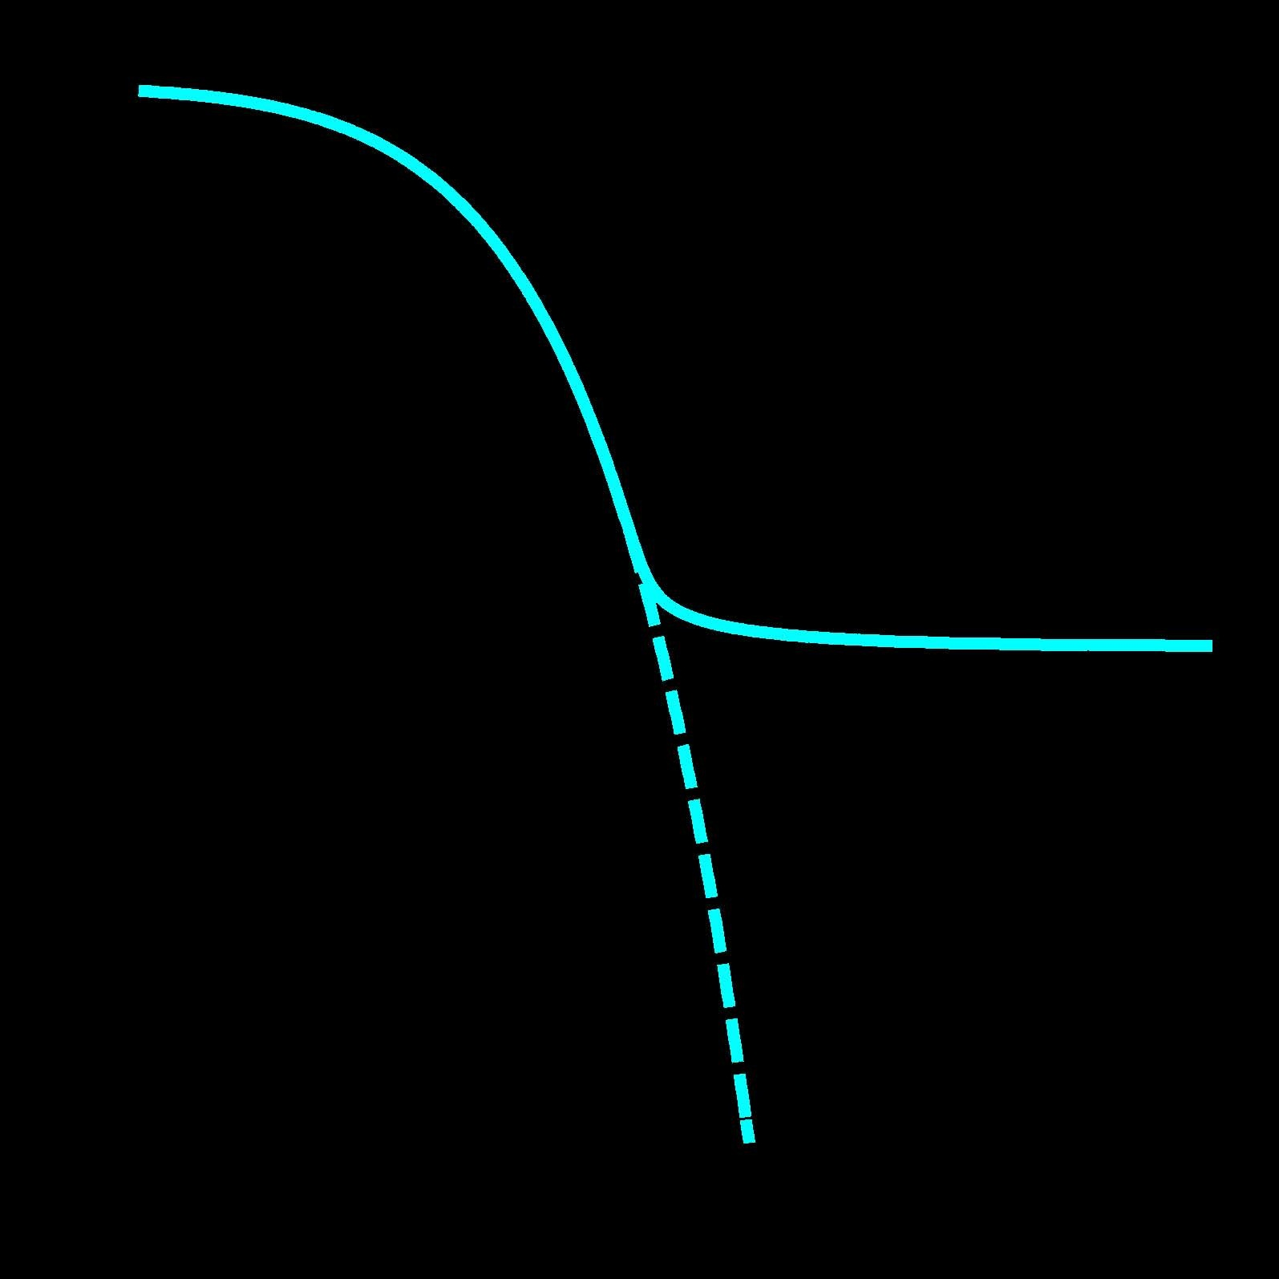
WIMPs
1
10⁻⁵
Relative abundance
10⁻¹⁰
10⁻¹⁵
10⁻²⁰
1
10¹
M/T
10²
10³
Not quite so simple:
Not quite so simple:
velocity dependence
co-annihilation
resonances
superwimps
dependence on M, g*,
...
velocity dependence
local phase-space density
flavor dependence
co-production
Sommerfield enhancement
…

Slide 11
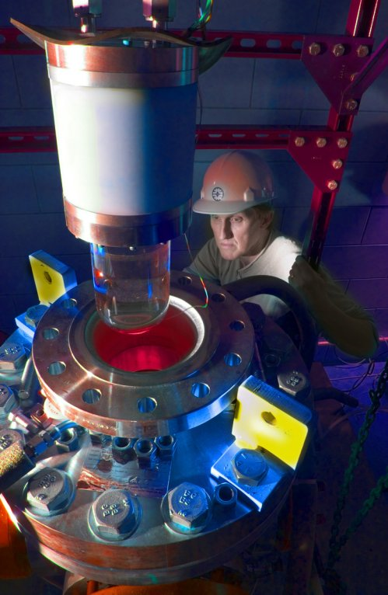
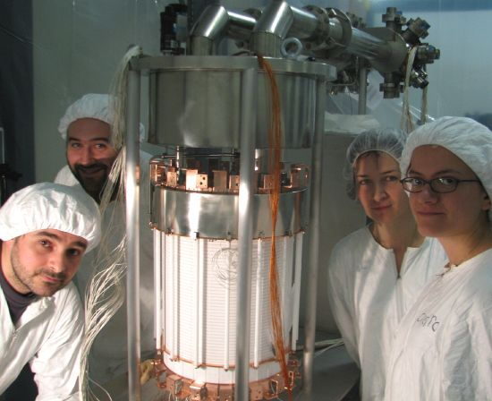
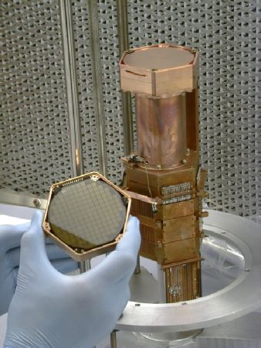
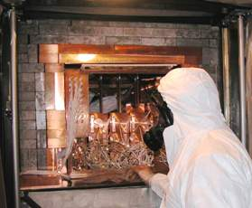
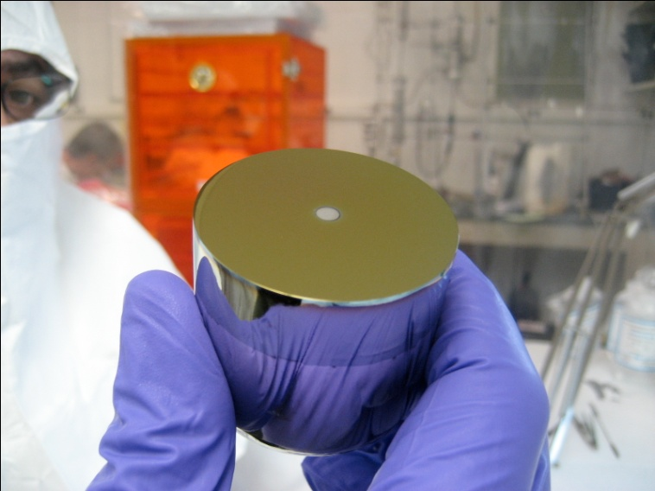
Direct Detection
COUPP
XENON
CDMS
DAMA
CoGeNT
( + EDELWEISS,
CRESST, EURECA,
ZEPLIN, DEAP, ArDM,
WARP, LUX, SIMPLE,
PICASSO, DMTPC,
DRIFT, KIMS, …)

Slide 12
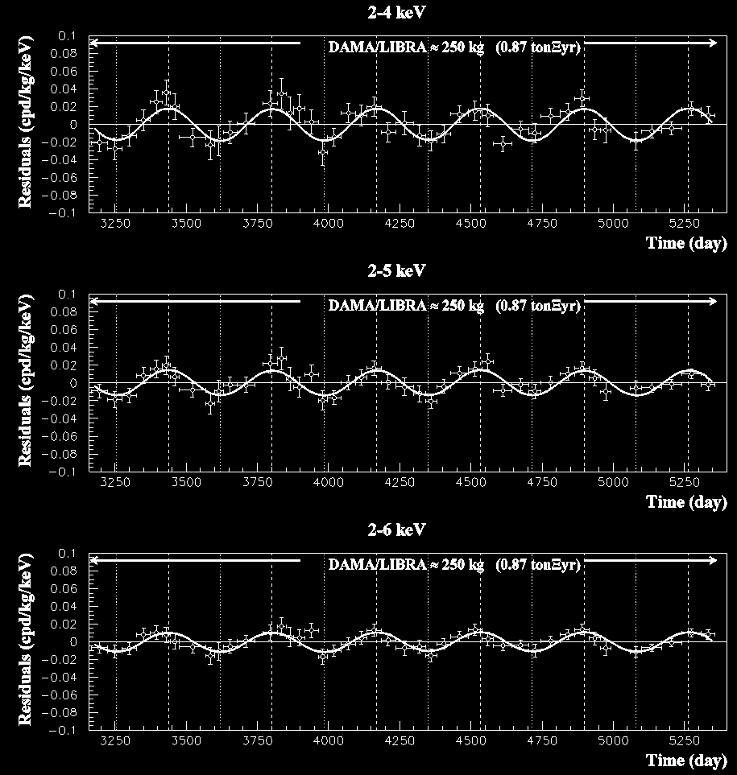
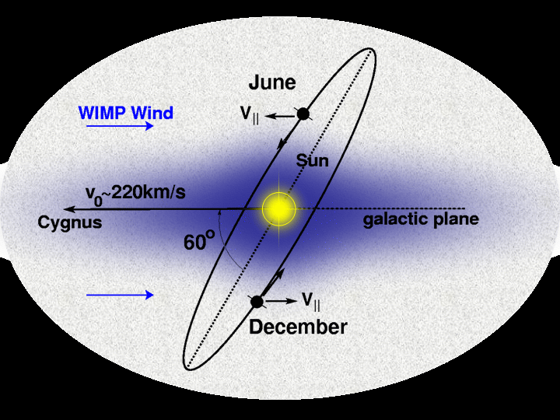
DAMA
cos ω (t − t₀)
T = 2π /ω = 1 year
t₀ = 152.5^{d} (2 June)

Slide 13
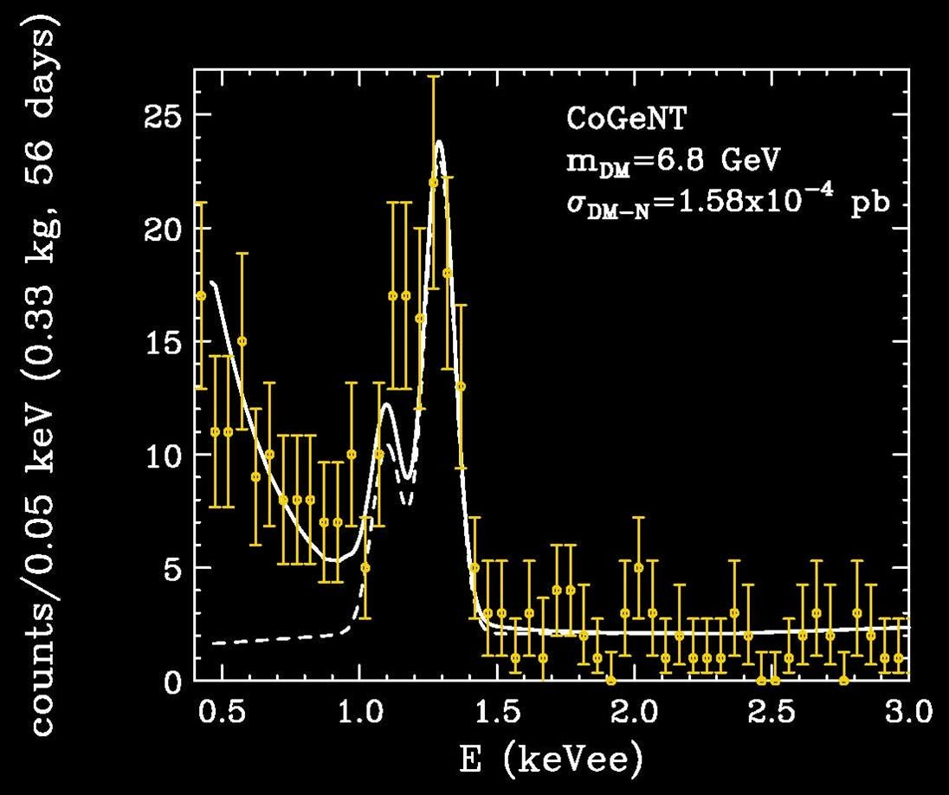
CoGeNT

Slide 14
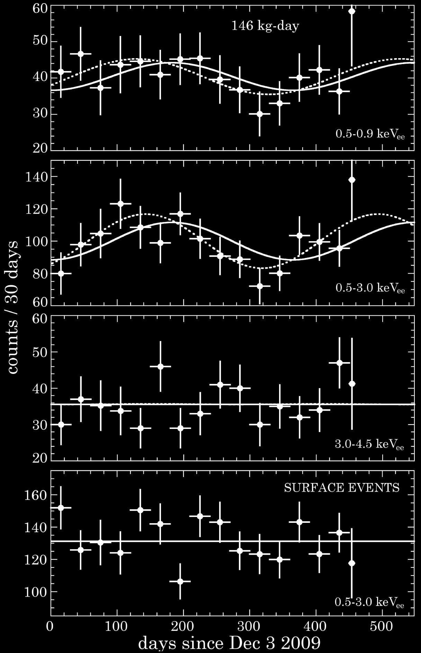
CoGeNT
annual modulation
at 2.8σ
Aalseth et al. 2011

Slide 15
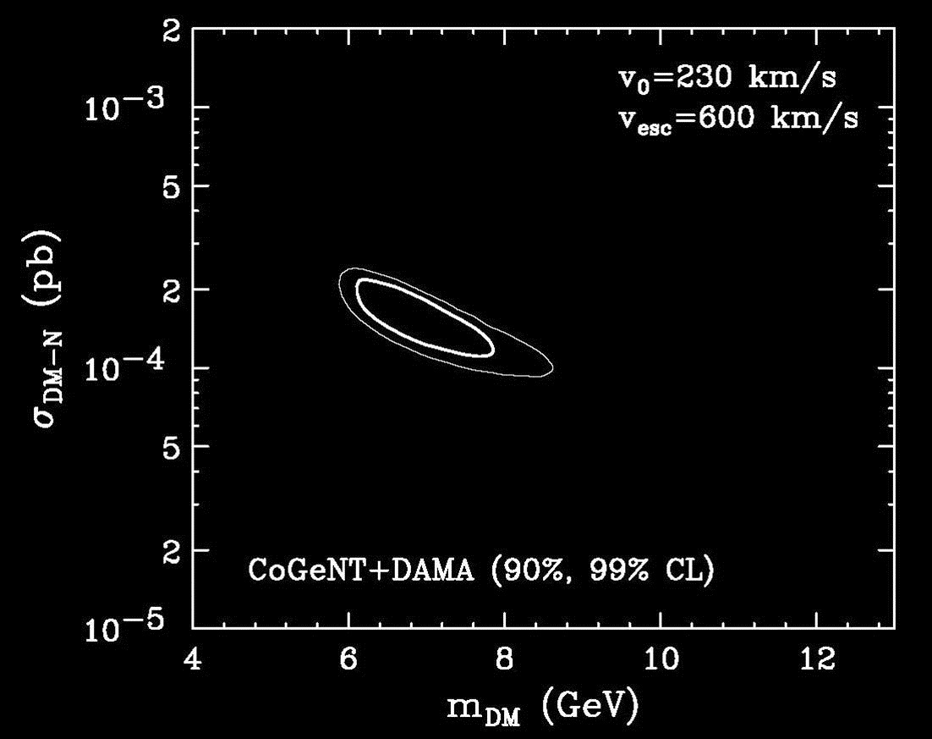
CoGeNT + DAMA
Hooper et al. 2010

Slide 16
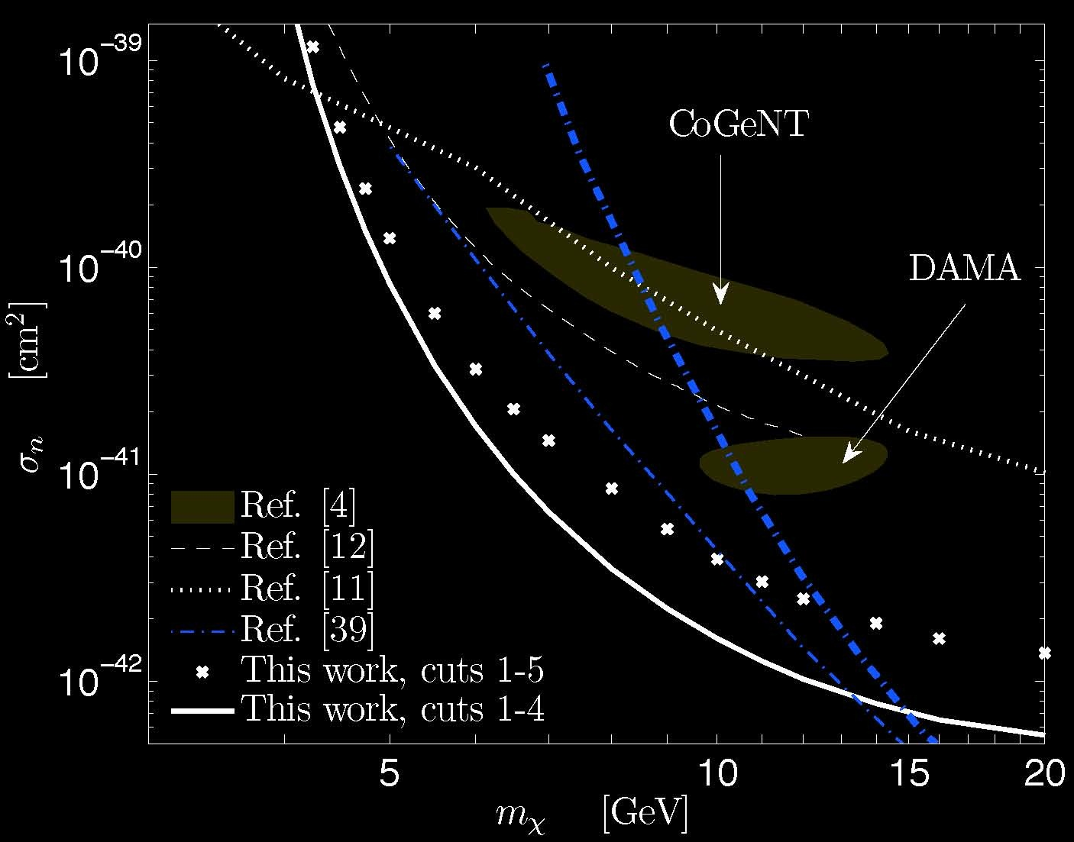
XENON/CDMS
CDMS
CDMS
XENON
Angle et al. 2011

Slide 17
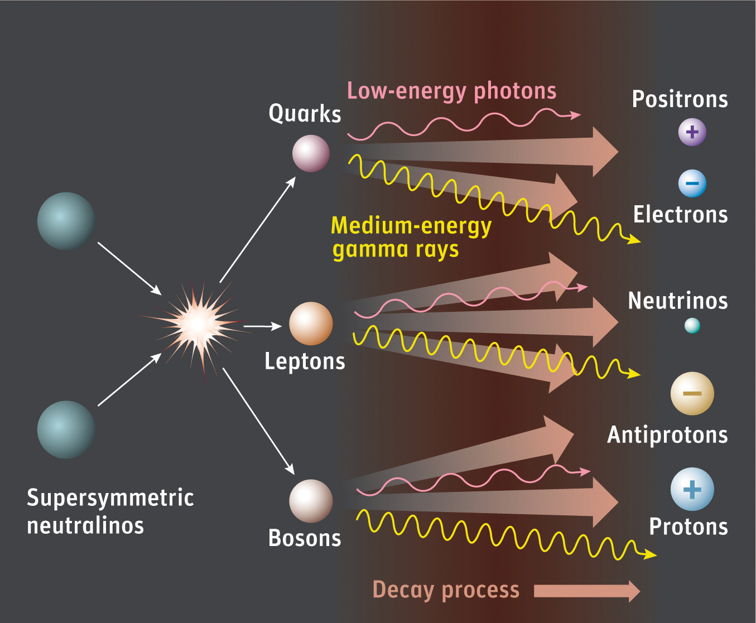
Indirect Detection
Galactic Center
Dwarf spheroidals
DM clumps, Sun
Wimps

Slide 18
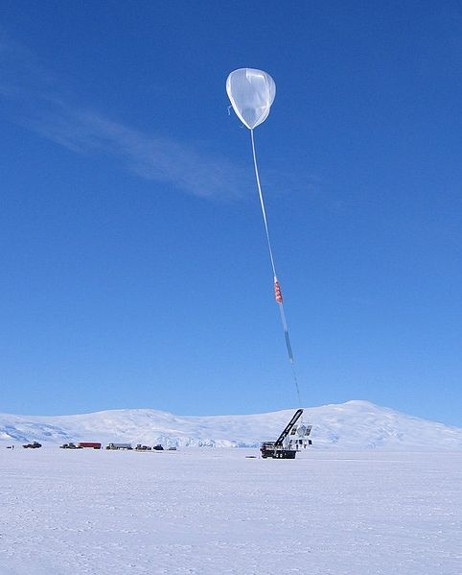
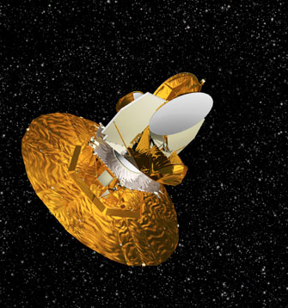
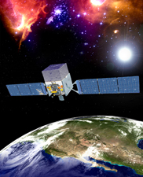
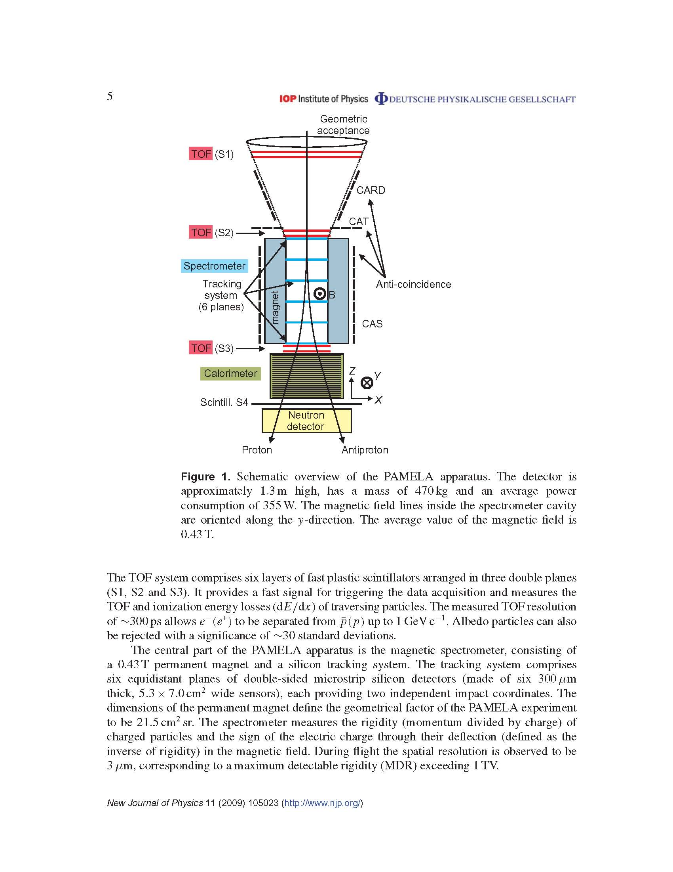
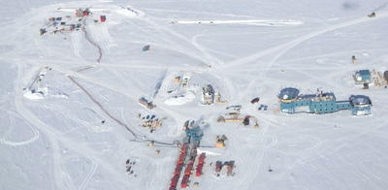
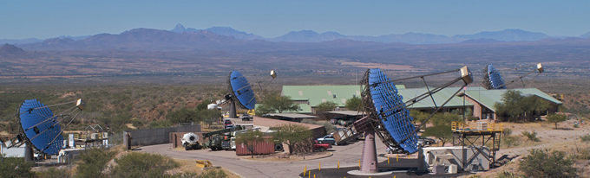

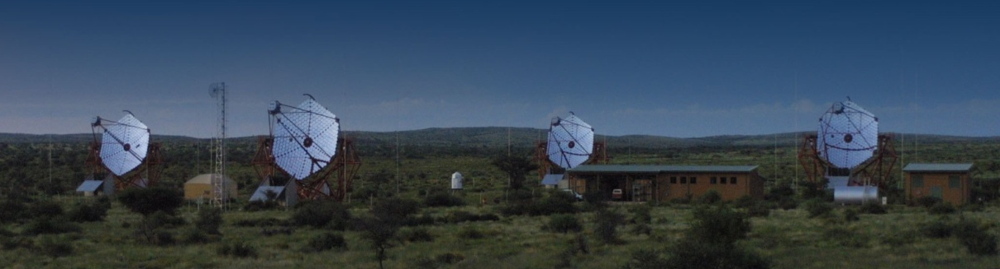
Indirect Detection
PAMELA
WMAP
ATIC
Fermi/GLAST
Veritas
IceCube
H.E.S.S.
AMS

Slide 19
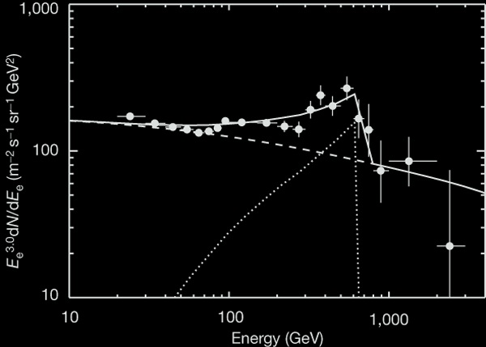
ATIC
ATIC data
GALPROP prediction
620 GeV
WIMP annihilation
Chang et al. 2008

Slide 20
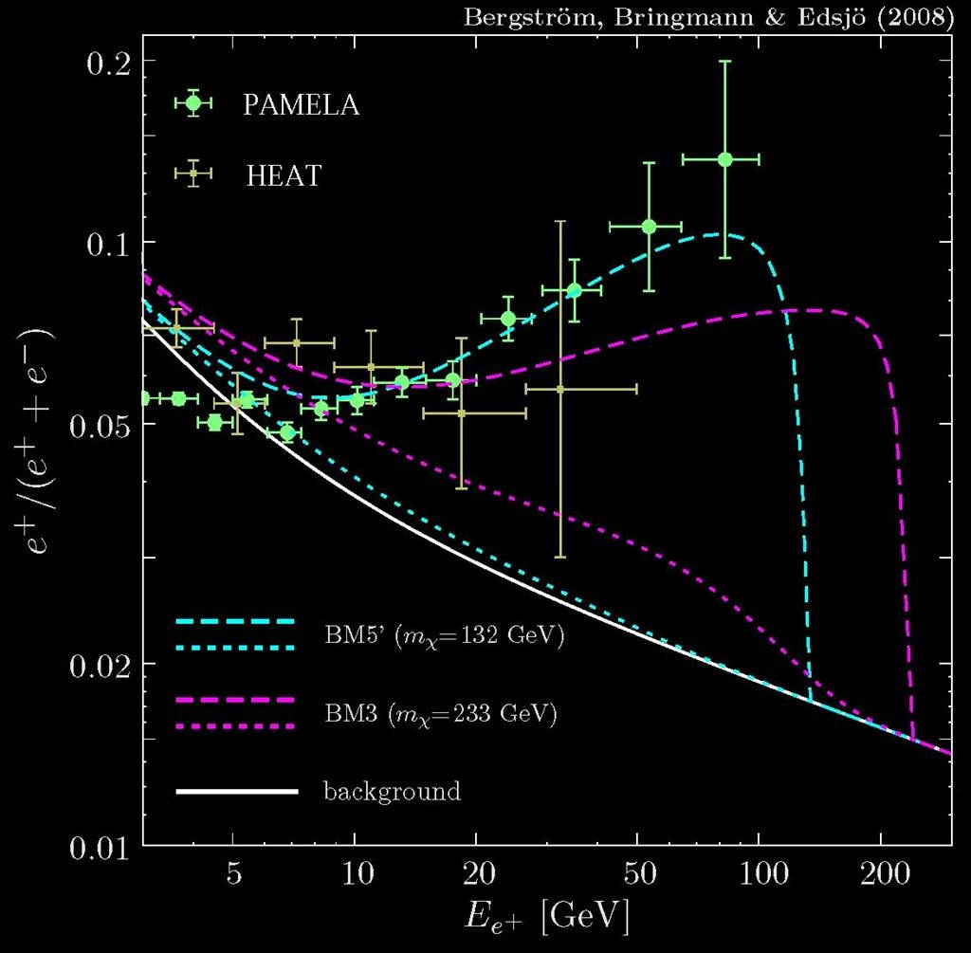
PAMELA

Slide 21
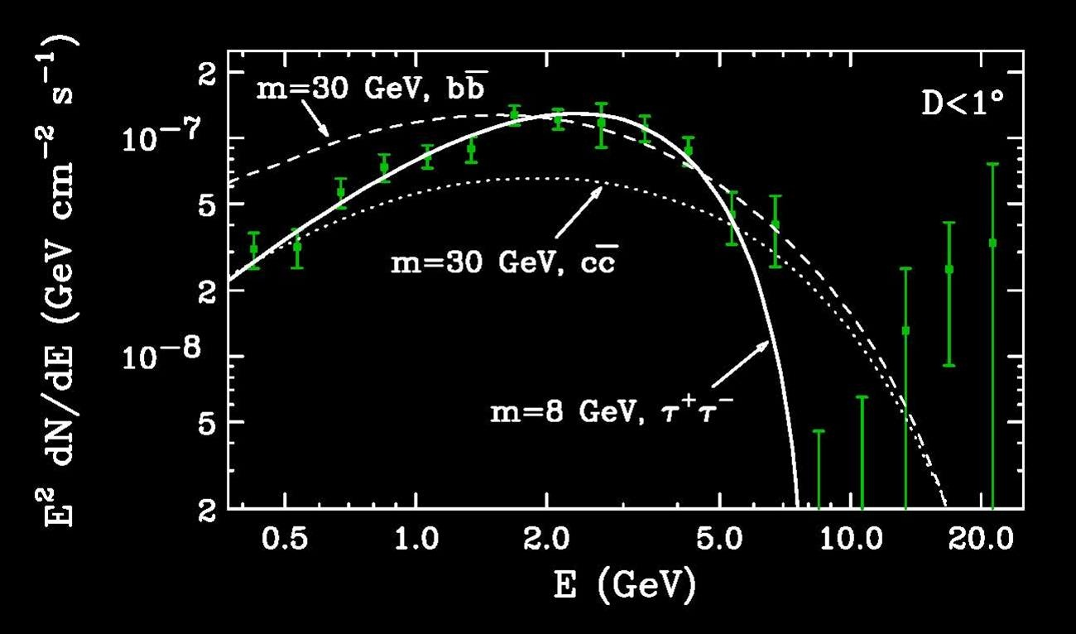
Fermi/GLAST
Hooper & Goodenough 2010

Slide 22
WIMPs
WIMPs: causation or coincidence?
Situation now is muddled
  direct hints: DAMA/LIBRA, CoGeNT, CRESST II, …
  indirect hints: PAMELA, ATIC, Fermi/GLAST, …
  LHC will soon weigh in: …

Slide 23
WIMPs
Collider Searches
Maverick WIMP
WIMP is a loner.
Use effective field theory,
  e.g.: 4-Fermi interaction.
WIMP only new species.
Clear relationships between
annihilation-scattering-
production cross sections.
Social WIMP
WIMP part of a social network.
Motivated model framework,
  e.g.: low-energy SUSY.
Many new particles/parameters.
Muddy relationships between
annihilation-scattering-
production cross sections.

Slide 24
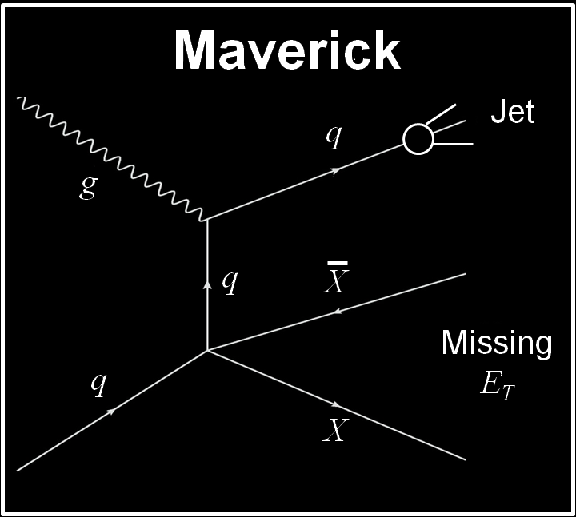
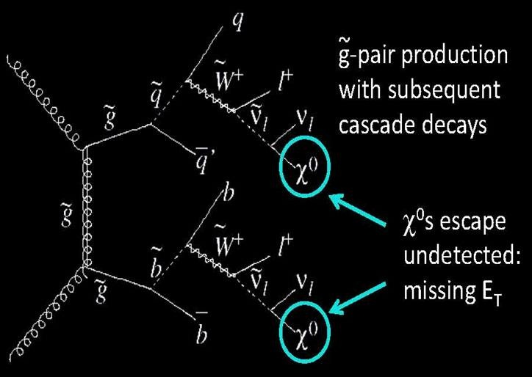
WIMPs
Collider Searches
Maverick WIMPs
Social WIMPs
coupling from Ω
Backgrounds (neutrino, QCD, …)
Complicated decay chain

Slide 25
WIMPs
WIMPs: causation or coincidence?
Situation now is muddled
  direct hints: DAMA/LIBRA, CoGeNT, CRESST II, …
  indirect hints: PAMELA, ATIC, Fermi/GLAST, …
  LHC will soon weigh in: …
In the next decade the WIMP hypothesis will have either
convincing evidence, or a near-death experience.
Direct, indirect, collider information: confusing decade.
How will we all know they all see the same phenomenon?
Let’s hope for this problem!!!!

Slide 26
Dark Questions
Why only one WIMP?
If social network of several WIMPs, stronger interacting ones:
  ― Easier to detect
  ― Smaller Ω
Super-WIMPs
Self-interacting WIMPs
Inelastic WIMPs
Leptophilic WIMPs
Flavor-dependent WIMP couplings
Haze, fog, mist
And this is just for WIMPs!

Slide 27
WIMPs
Dark matter is a complex physical phenomenon.
WIMPs are a simple, elegant, compelling explanation for a complex physical phenomenon.
“For every complex natural phenomenon there is a simple, elegant, compelling, wrong explanation.”
— Tommy Gold

Slide 28
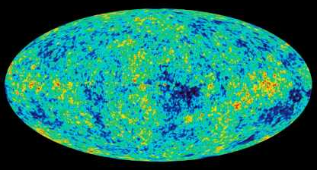
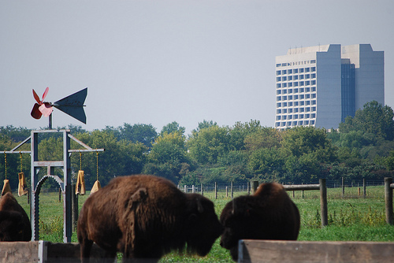

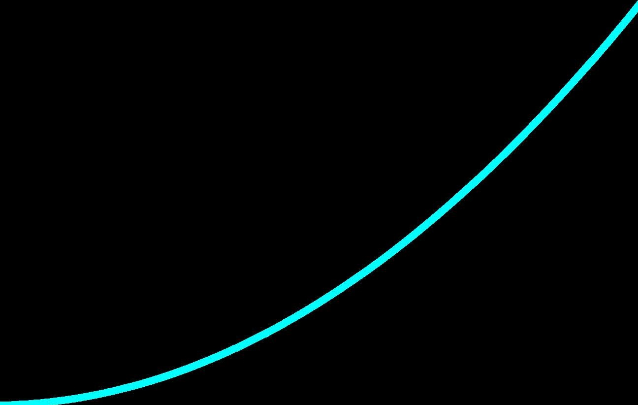

Inflation
V (φ)
inflaton
φ
WMAP
Classical Equations of Motion
V (φ ) ≠ 0 V (φ ) = 0
Quantum Fluctuations
δφ δρ δT

Slide 29
Disturbing the Quantum Vacuum
Changing Electric field
Particle creation
Particle creation if energy gained in acceleration from electric field over a Compton wavelength exceeds the particle’s rest mass.
Schwinger (1951); Heisenberg & Euler (1935); Weisskopf (1936)

Slide 30
Disturbing the Quantum Vacuum
Tidal gravitational field
Particle creation
Black
Hole
Particle creation if energy gained in acceleration from gravitational field over a Compton wavelength exceeds the particle’s rest mass.
Hawking (1974); Bekenstein (1972)

Slide 31
Disturbing the Quantum Vacuum
Expanding Universe
Particle creation
expansion
of space
Particle creation if energy gained in expansion over a Compton wavelength exceeds the particle’s rest-mass.
Schrödinger’s alarming phenomenon (1939)

Slide 32
Disturbing the Quantum Vacuum
The Proper Vibrations of the Expanding Universe
Erwin Schrödinger, Physica 6, 899 (1939)
Introduction:
“ … production of matter, merely by expansion,… Alarmed by these prospects, I have examined the matter in more detail.”
Conclusion:
“ … There will be a mutual adulteration of [particles] in the course of time, giving rise to … the ‘alarming phenomenon’.”

Slide 33
Disturbing the Quantum Vacuum
The Proper Vibrations of the Expanding Universe
Erwin Schrödinger, Physica 6, 899 (1939)
Creation of a single pair of particles somewhere
in a Hubble volume V_{H} = (c H₀)⁻³ = 10¹² Mpc³
in a Hubble time t_{H} = H₀⁻¹ = 10¹⁰ years
with a Hubble energy E_{H} =  H₀ = 10⁻³³ eV
Alarming?

Slide 34
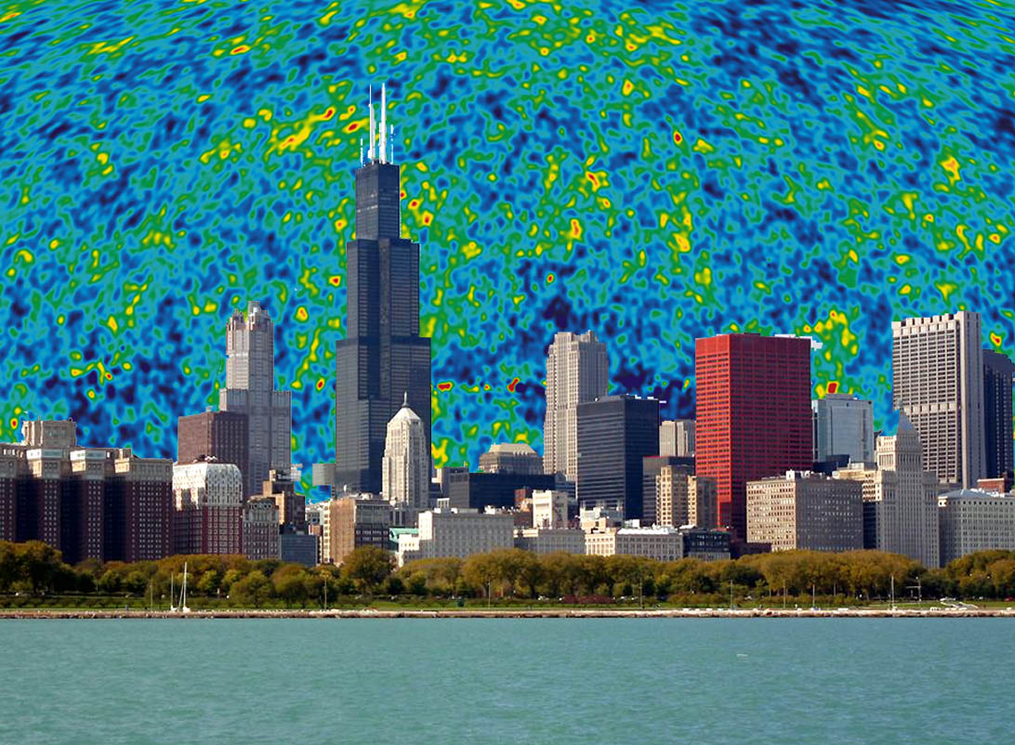
Disturbing the Quantum Vacuum

Slide 35
Most Fundamental Question
Is inflation eternal? Is there a multiverse?
Does inflation do what it was invented to do?

Slide 36


Next Most Fundamental Question
What if exact Harrison-Zel’dovich perturbation spectrum?
spectral index exactly unity
no gravitational waves
exactly gaussian perturbations
only curvature perturbations
Harrison
Zel’dovich
What do observations tell us about spectral index (n)?
Search for gravitational waves from B-mode polarization (r).
Search for non-gaussianity ( f_{NL} ).
Theory developments: effective field theory approach.
Who is the inflaton … superstrings ⇒ inflaton ?

Slide 37

Inflation & Superstrings Are a Match
Strings attached?
Mature 37-year-old idea (superstrings) seeks a partner to develop some physical implications.
Make some perturbations?
Lonely 32-year-old scalar field (inflaton) seeks a fundamental theory in which to be embedded.

Slide 38
Additional Fundamental Questions
How did inflation begin? (is it eternal)
How did inflation end? (preheating, reheating, defrosting, ….)
Other particle production (gravitons, WIMPZILLAS, ….)
Why only one inflaton? (isocurvature perturbations)
Why so gaussian? (nonlinearities)
Was inflation “normal?” (3-D FRW)
Dynamics in terms of a normal scalar field? (k-essence, …)
Perturbations from fluctuations in the inflaton? (curvaton)

Slide 39
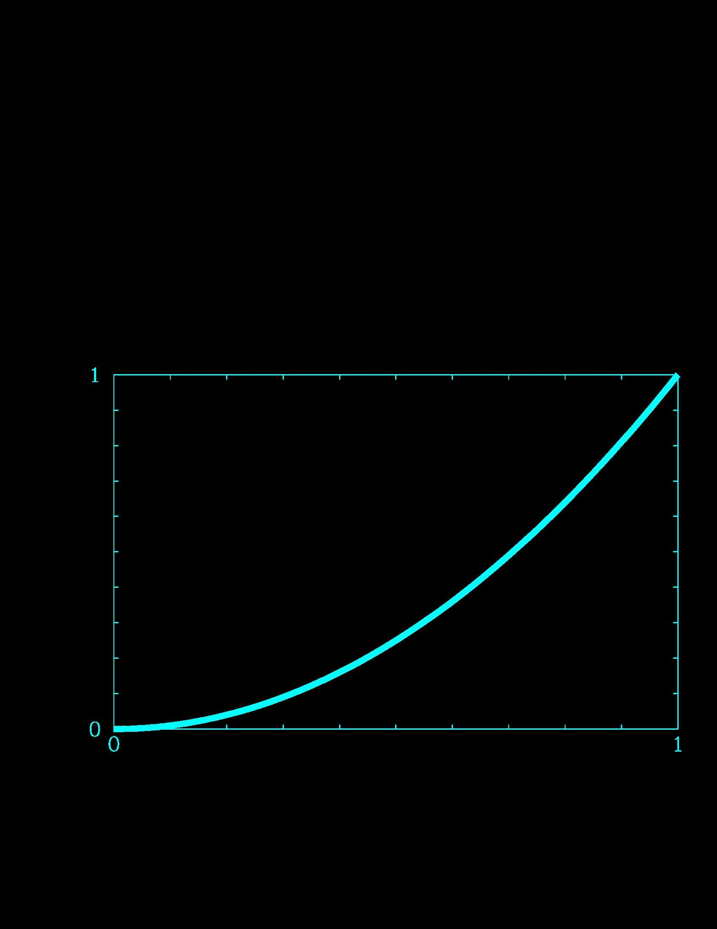
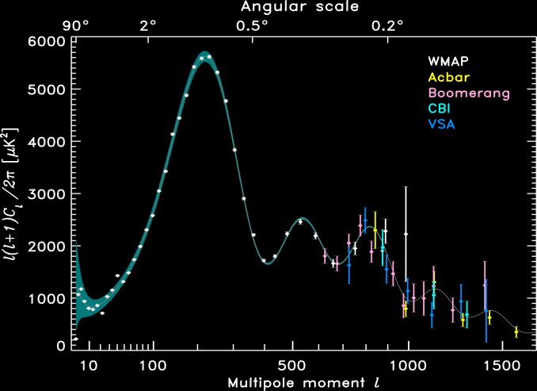
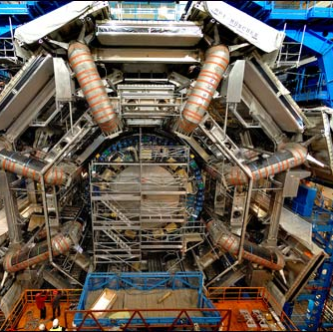
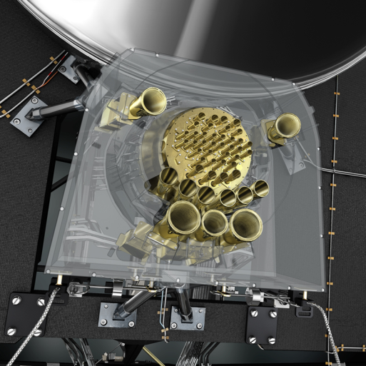
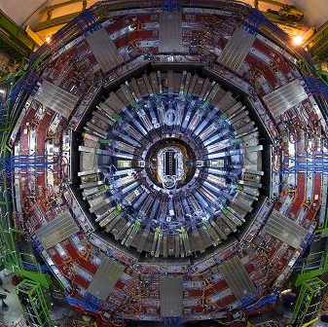
Additional Fundamental Questions
What was the expansion rate during inflation?
What was the general shape of the potential (reconstruction)?
Can we learn about unification, strings, Planck physics?
V (φ)
inflaton
φ
Weak-scale
detectors
Planck-scale
detectors
ATLAS
CMS

Slide 40

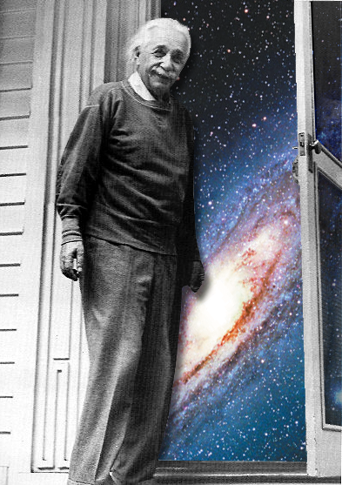
Cosmological Constant (Dark Energy)
1917 Einstein proposed
cosmological constant, Λ.
1929 Hubble discovered
expansion of the Universe.
1934 Einstein called it
“my biggest blunder.”
1998 Astronomers found
evidence for it, and renamed
it “Dark Energy.”

Slide 41
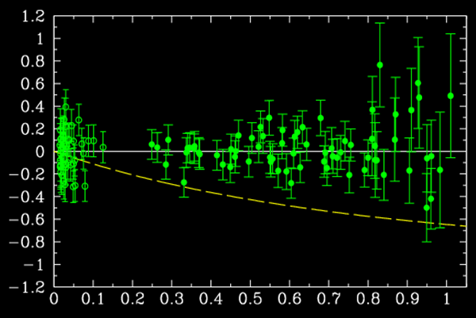
The Cosmological Constant
ΛCDM
data
Einstein-de Sitter:
spatially flat matter model
(maximum theoretical bliss)
confusing astronomical notation
related to supernova brightness
Astier et al. (2006) SNLS
supernova redshift z
1) Hubble diagram (SNe)
The case for Λ:
5) Galaxy clusters
6) Age of the universe
7) Structure formation
2) Cosmic Subtraction (1 − 0.3 = 0.7)
3) Baryon acoustic oscillations
4) Weak lensing

Slide 42
The Cosmoillogical Constant
The Cosmological Constant
The Unbearable Lightness of Nothing
ρ _{Λ} = 10⁻³⁰ g cm⁻³ ….. so small, and yet not zero!

Slide 43
Taking Sides!
Can’t hide from the data – ΛCDM too good to ignore
  SNe
  Subtraction: 1.0 − 0.3 = 0.7
  Baryon acoustic oscillations
  Galaxy clusters
  Weak lensing
  …
H(z) not given by
Einstein–de Sitter
G₀₀ (FLRW)  8π G T₀₀(matter)
Modify right-hand side of Einstein equations (ΔT₀₀)
  Constant (“just” a cosmoillogical constant)
  Not constant (dynamics described by a scalar field)
Modify left-hand side of Einstein equations (ΔG₀₀)
  Beyond Einstein (non-GR)
  (Just) Einstein (back reaction of inhomogeneities)

Slide 44


Tools to Modify the Right-Hand Side
anthropic principle the landscape
Duct Tape
scalar fields (quintessence)

Slide 45
Anthropic/Landscape/DUCTtape
Many sources of vacuum energy.
String theory has many (>10⁵⁰⁰ ?) vacua … the landscape.
The multiverse could populate many (all?) vacua.
Very, very rarely vacua have cancellations that yield a small Λ.
While exponentially uncommon, they are preferred because …
… more common values of Λ results in an inhospitable universe.
Anthropic principle requires Λ  Λ_{OBS}.
Explains a (10¹²⁰ −1)σ result.

Slide 46
Anthropic/Landscape/DUCTtape
The anthropic “principle” can explain the cosmoillogical constant.
Perhaps there is no better idea than the anthropic principle …
… (people without ideas can still have principles).
But principles must not be applied selectively.
What does this mean for particle physics?
  Does it explain the weak scale/Planck scale hierarchy?
  Who needs low-energy SUSY?
  Give up searching for many answers (masses, etc.).
  No dreams of a final theory.
Is particle physics an environmental science?

Slide 47

Quintessence/WD–40
Many possible contributions.
Why then is total so small?
Perhaps some dynamics sets global vacuum energy to zero …
… but we’re not there yet!
V(φ)
Requires m_{φ} ; 10⁻³³ eV
Λ
0
φ
Can nature admit ultralight scalar fields?
Long-range forces?

Slide 48
Tools to Modify the Left-Hand Side
Braneworld modifies Friedmann equation
  Friedmann equation not from G₀₀ = 8π G T₀₀ Binetruy, Deffayet, Langois
Gravitational force law modified at large distance
Five-dimensional at cosmic distances Deffayet, Dvali, Gabadadze
Tired gravitons
Gravitons unstable-leak into bulk Gregory, Rubakov & Sibiryakov
Gravity changes at distance R ≈ Gpc
Becomes repulsive Csaki, Erlich, Hollowood & Terning
n = 1 KK graviton mode very light
m ≈ (Gpc)⁻¹ Kogan, Mouslopoulos, Papazoglou, Ross & Santiago
Einstein & Hilbert got it wrong
  f (R) Carroll, Duvvuri, Turner & Trodden
“Backreaction” of inhomogeneities
No dark energy Räsänen, Kolb, Matarrese, Notari, Riotto, Buchert; Ellis; Celerier

Slide 49


Dark Energy
H(z)
d_{L}(z)
V(z)
Growth
BAO
strong
lensing
d_{A}(z)
clusters
strong lensing
SNe
clusters
weak lensing
clusters
weak lensing
"Nothing more can be done by the theorists. In this matter it is only you, the astronomers, who can perform a simply invaluable service to theoretical physics."
Einstein in August 1913 to astronomer Erwin Freundlich encouraging him to measure the deflection of light by the sun.

Slide 50

Asymptotic de Sitter Space?
Our cosmic horizon is limited — finite visible Universe
Finite-dimensional Hilbert space
Have to do astronomy now!

Slide 51
Dark Energy
Dark energy is a complex physical phenomenon.
Λ is a simple, elegant, compelling explanation for a complex physical phenomenon.

Slide 52


Cosmological Standard Model and Its Implications for Beyond the Standard Model of Particle Physics
“Until cosmology and particle physics can be brought together in the same context, there is not much hope for real progress in cosmology.” — N. Bohr, 1939
CERN Rocky Kolb
28 July 2011 University of Chicago

