Slide 1

H→bb Analysis for the CDR
Tomáš Laštovička
WG6 Meeting 31/8/2011
Notes:
1

Slide 2
Quick update of changes/additions
Primary vertex reconstruction studied in more detail
  allows one to draw conclusions regarding secondary vertices
598 sample (qqeν) did not contain b quarks
  negligible effect, checked with
  sample 649, added to the analysis
Polar angle cut relaxed
  it was selecting the central barrel only
  max(|η₁|,|η₂|) added to neural net inputs
  leads to a modest improvement and to utilization of the forward caps

Slide 3
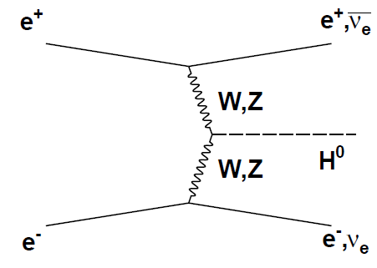
Drafts of plots/tables for the CDR

Slide 4
Primary vertex reconstruction
Done with 636 sample (qqνν), only light quark jets selected (u,d,s)
  60BX overlay, full Sim/Rec, ISR, …
  Resolution in x-y (green) and z (blue) and vtx position in x-y for n_{tracks} > 20

Slide 5
Flavour tagging
The usual b-tag plot
  mis-tag rate for c (blue) and light (green) jets as a function of b-tag efficiency
  complemented by a similar plot for c-tag (worse performance, as expected) with b-jets (red) and light jets (green)

Slide 6
Stacked control plots
Demonstrate ability to separate signal and background of the two most separating variables
  the invariant mass of jet-pair and a sum of their flavour tags.

Slide 7
Neural net output
Demonstrates the separation of signal with the signal selection neural net
  arrow = working point; omits low values due to huge background statistics in bins.

Slide 8
NN performance and working point selection plots
Statistical uncertainty and signal purity as a function of signal selection efficiency
  show rather uncertainty flat behavior, combined with purity allows for a proper working point selection

Slide 9
Higgs peak over the background
Illustrates invariant mass reconstruction at low p_{T}/E
  Analysis background (yellow) and signal (blue); i.e. Z-peak vs. Higgs-peak
  Signal purity strongly depends on the invariant mass reconstruction.

Slide 10
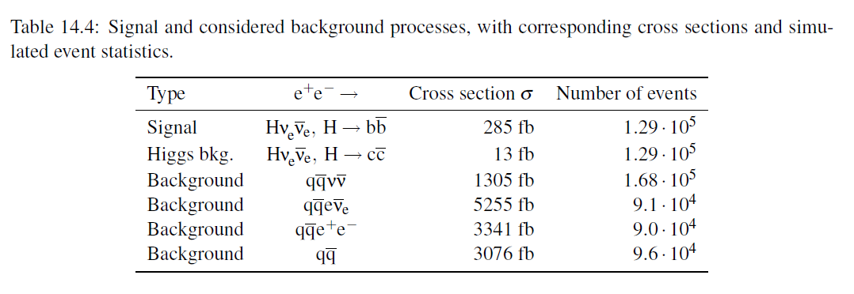
Table 1 – Summary of samples

Slide 11
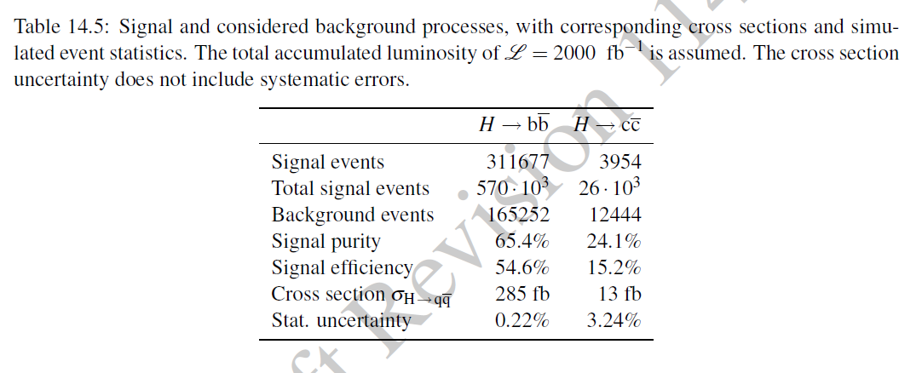
Table 2 – Summary of results
The H→cc channel was added to complement H→bb results. The analysis itself is identical to that of the H→bb and only signal/background in the NN training is flagged accordingly.

