Slide 1
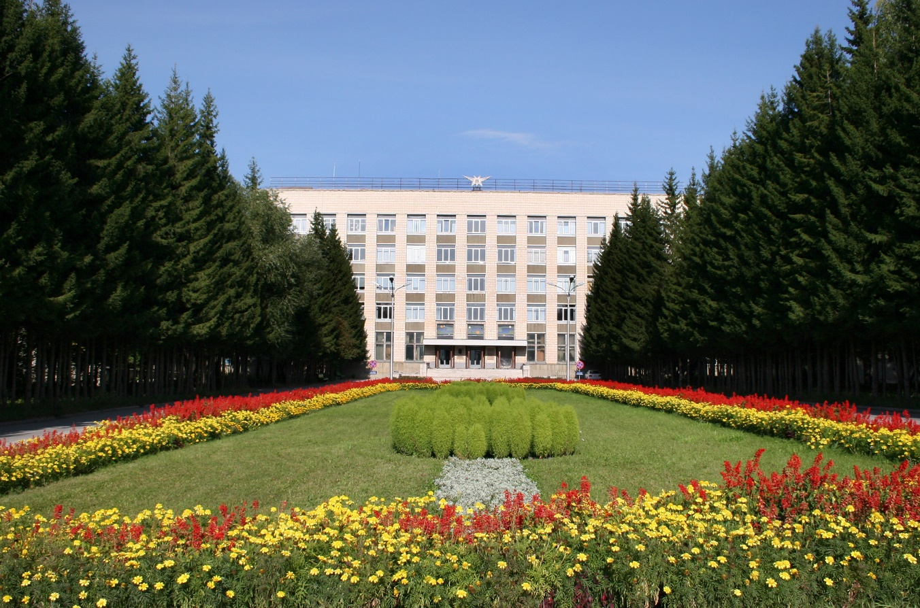
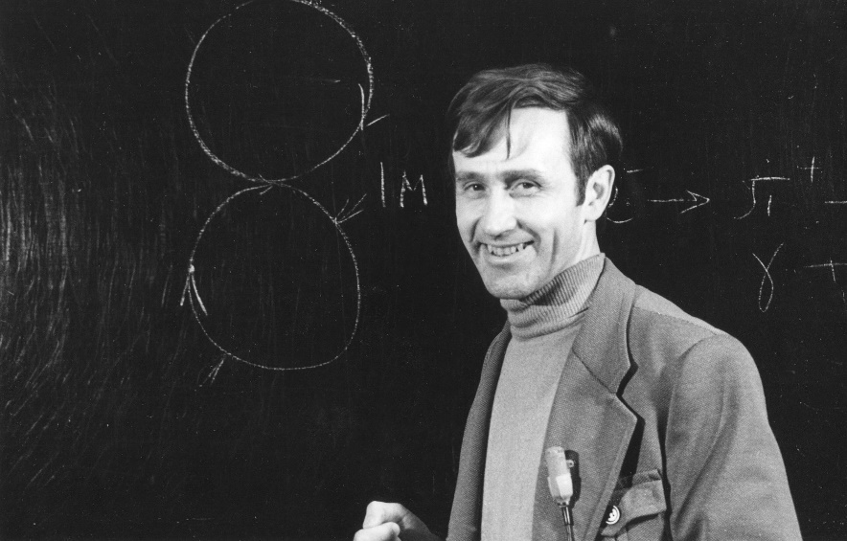
The history of colliding beams in Novosibirsk
Alexandr Skrinsky

Slide 2
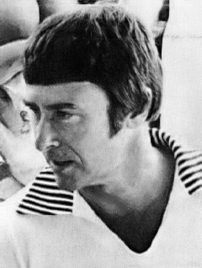
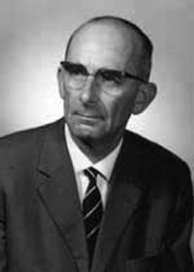
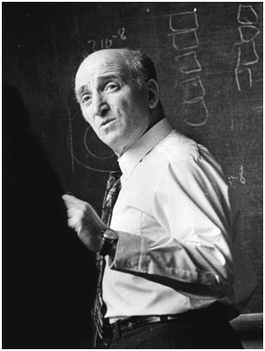
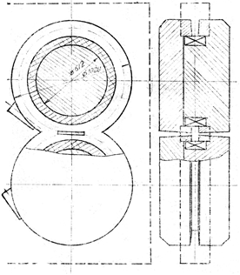
In 1956, the Geneva Conference on the Peaceful Uses of Atomic Energy
Gerard O'Neill (USA) presented at this conference a proposal for an experiment at Stanford to test the "point-likeness" of an electron in electron-electron colliding beams.
Rolf Widerøe who was the originator of many particle concepts, including the betatron accelerator, in 1943 introduced the theoretical concept of colliding particles head-on to increase interaction energy.
Gerard K. O'Neill
Rolf Wideröe
Gersh Budker
Gersh Budker, at the time the head of the Laboratory of New Acceleration Methods at the Institute of Atomic Energy (now the Kurchatov Center), participated in this conference and gave several presentations. He was fascinated with the idea of ​​colliding beams, which became the main project of his laboratory and, later, of the New Institute he founded in Novosibirsk.
One of the first sketches of the VEP-1 magnet

Slide 3
This year, 1956, I was still a student of the Moscow State University.
And joint the Budker Laboratory of New Methods of Acceleration of the Institute of Atomic Energy led by academician I.V.Kurchatov.
Upon arriving after Geneva Conference, Budker proposed me to start the Colliding beams activity. I immediately started to work in the field.

Slide 4
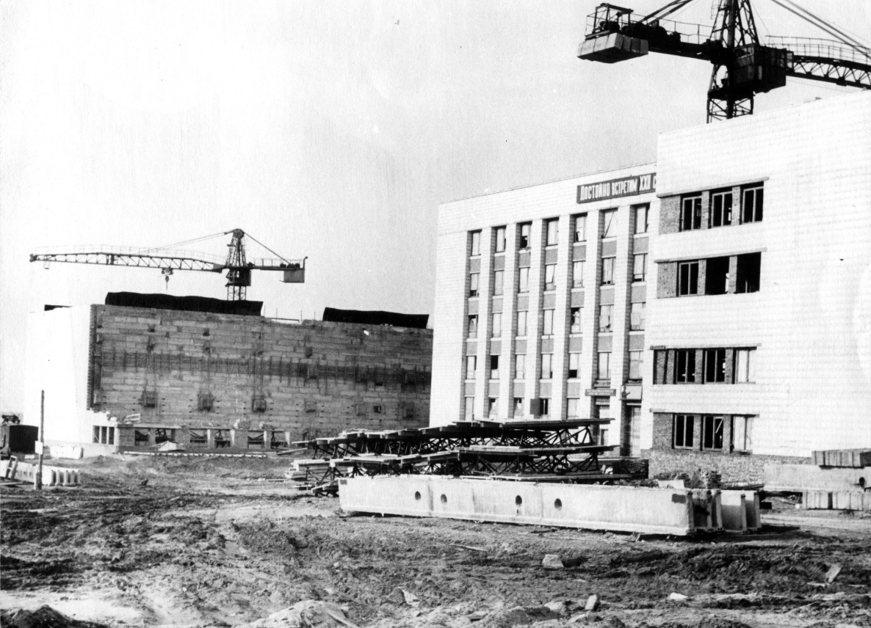
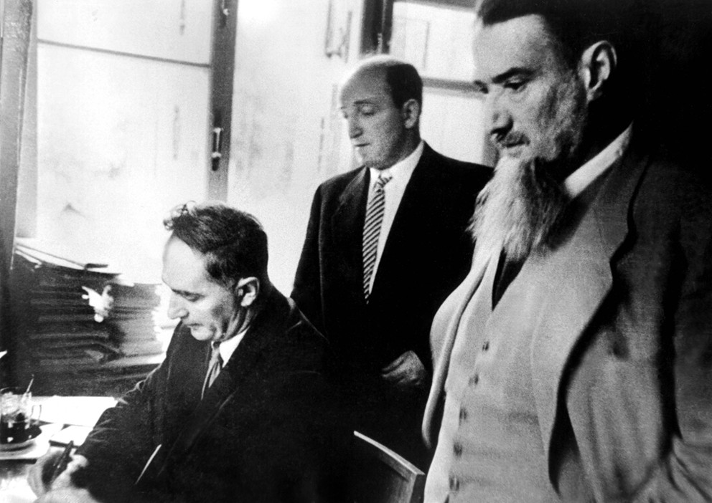
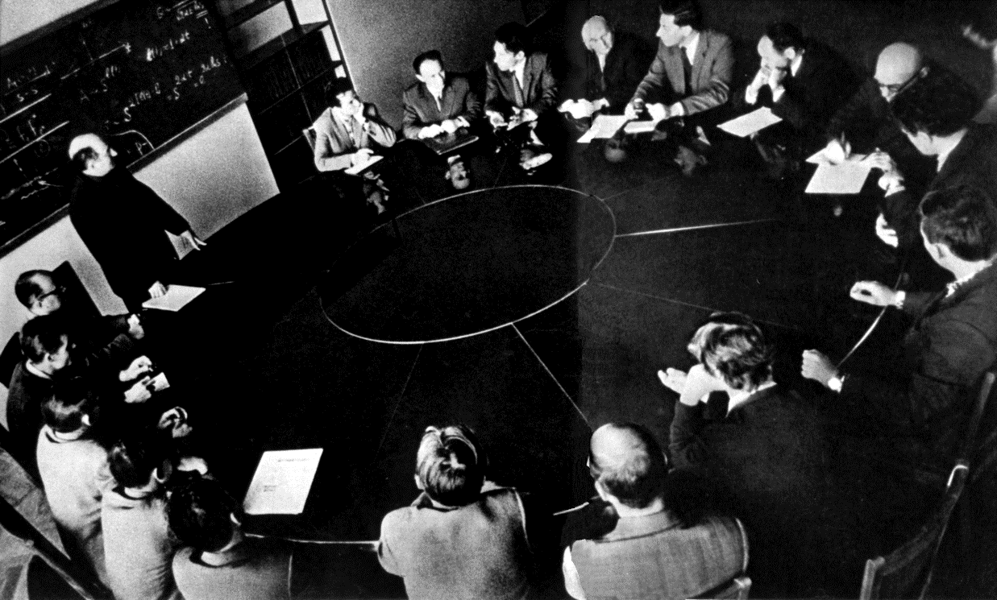
1962, construction of the main building of the Institute of Nuclear Physics, Novosibirsk
1958, signing of government documents on the establishment of the Institute of Nuclear Physics in Novosibirsk.
A team of young physicists, led by G. Budker, enthusiastically took on the implementation of colliding beams ideas. (Round table)

Slide 5
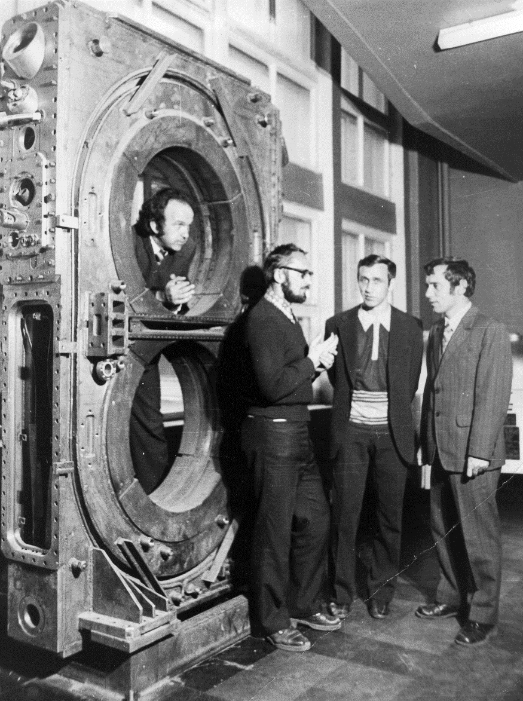
VEP-1
The decision to work on colliding e-e- beams was made in 1957.
The general scheme was finalized by 1959.
E = 90 MeV - 320 MeV (total); L= 5*10 ²⁷ cm⁻²s⁻¹
For us it was crucial step in our lives/
Experiments 1965-1967 – in parallel to the Princeton-Stanford group. electron-electron scattering,
double bremsstrahlung (first observation and study)
3
1
G.Kulipanov
S.Popov
A.Skrinsky
G.Tumaikin
2
Storage rings
Transfer lines
Synchrotron

Slide 6

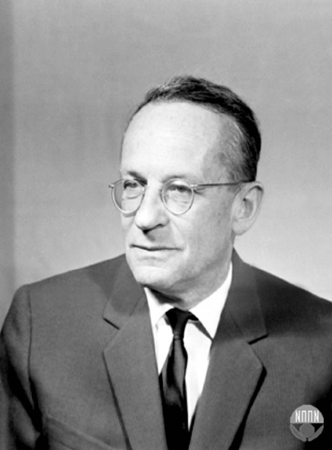
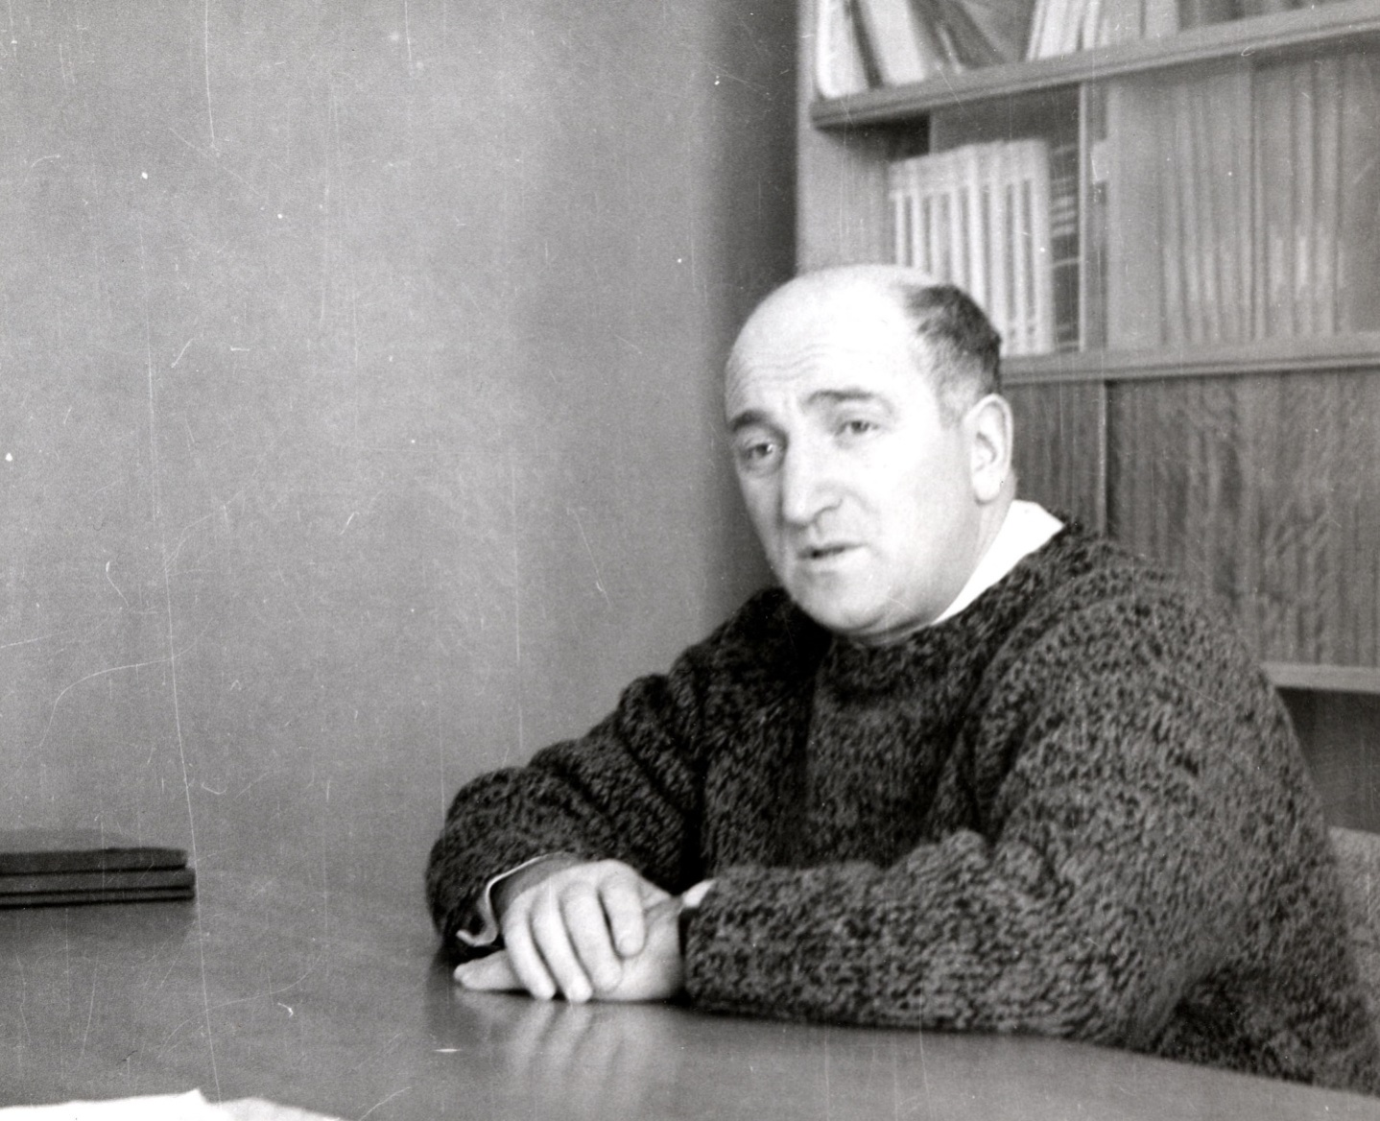


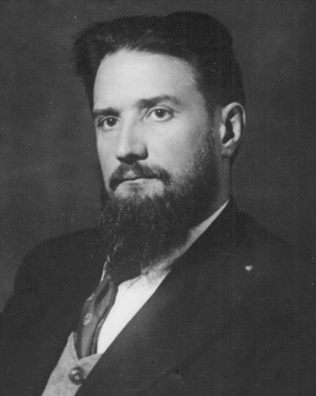
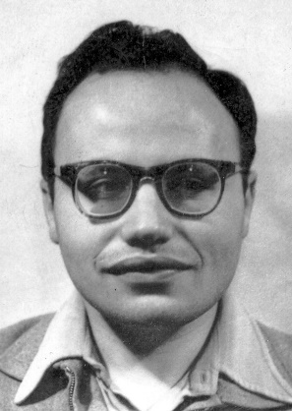
Vladimir Veksler
Three referees concluded:
«The idea of ​​an e⁺e⁻ collider is very interesting from a scientific point of view, but is completely unrealizable in practice» ⇒
I.Kurchatov «We will do it!»
Vladimir Baier
Gersh Budker
First discussions in INP of electron-positron
collisions. 1959
Isaak Pomeranchuk
Igor Kurchatov

Slide 7
VEPP-2 – the world first annihilation experiments 1967-1970
First observation of ρ-meson production in annihilation - 1967.
Systematic study of ρ, ω , φ − mesons1967-1970.
First observation of two-photon events (e⁺e⁻ pair production)- 1969.
Discovery of multi-hadronic production in e⁺e⁻ annihilation - 1969.
First observation of radiative beam polarization -1970.
E=2^{x}700 MeV
L=4^{x}10²⁸ cm⁻²s⁻¹
1. Pre-accelerator
2. Synchrotron B-3M
3. Parabolic lenses
4. Converter
5. Storage ring
3
1
4
5
2
1 meter
3
A

Slide 8
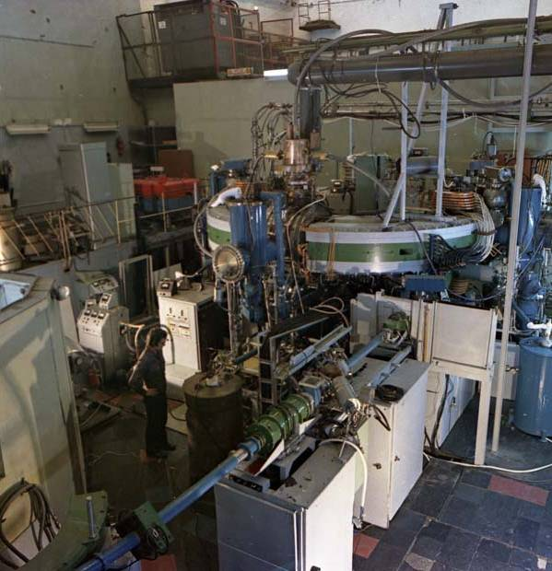
VEPP-2 – the world first annihilation experiments 1967-1970

Slide 9
VEPP-2M
VEPP-2M — operated 1974-2000;
2E=0.4-1.4 GeV;
L_{max}=4*10³⁰cm^{–2}sec^{–1} at E₀=510 MeV;
Total integrated luminosity ≈80 pb^{–1}.
The major achievement: development of the resonant depolariztion technique for precise
measurements of elementary particles masses and achievement of the record accuracy in the mass measurements of elementary particles (from 1975) – now at VEPP-4M - 3*10⁻⁶ !

Slide 10
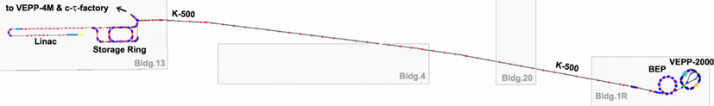
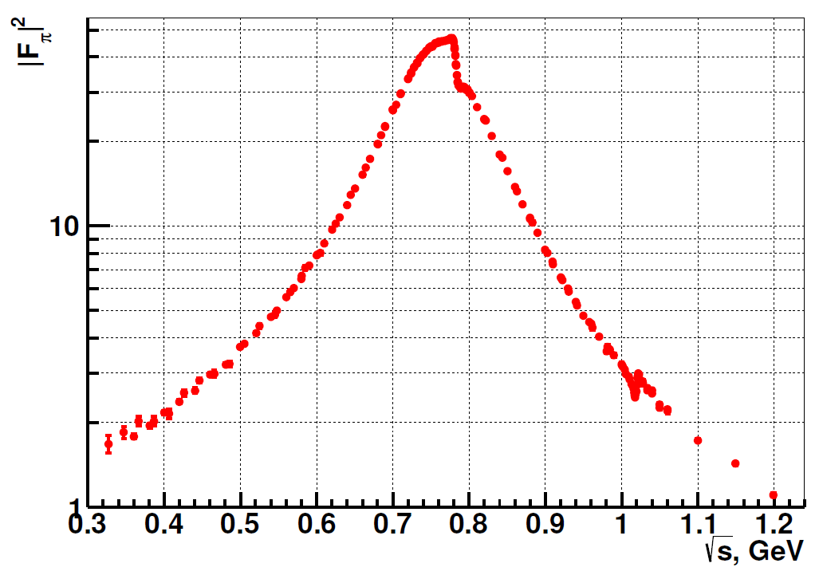
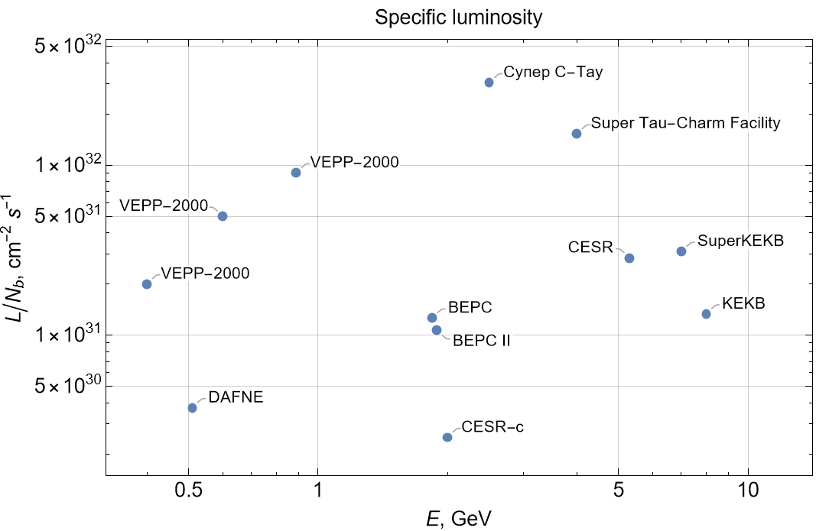
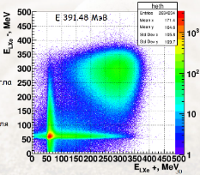
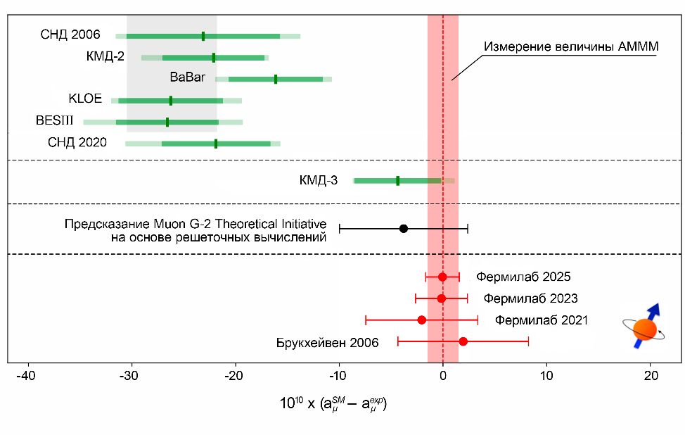
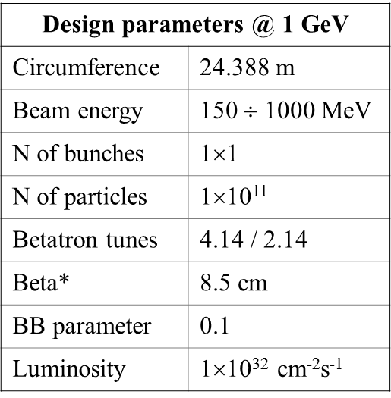
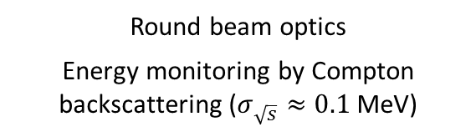
VEPP-2000
250 m beamline
VEPP-2000
Injection complex
209 energy points
Data collected at
2013, 2018, 2020
10 years of data taking and data analysis
Record per-bunch luminosity of colliders
SND-2006
Experimental value
KMD-2
SND-2020
KMD-3
Round beam optics
Energy monitoring by Compton backscattering ($σ_{\sqrt{s}}≈0.1$ MeV)
Lattice
FNL 2025
FNL 2023
BNL
FNL 2021

Slide 11
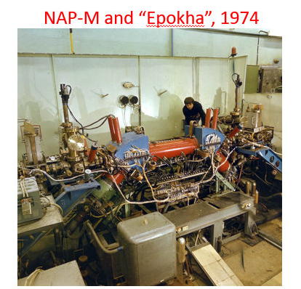
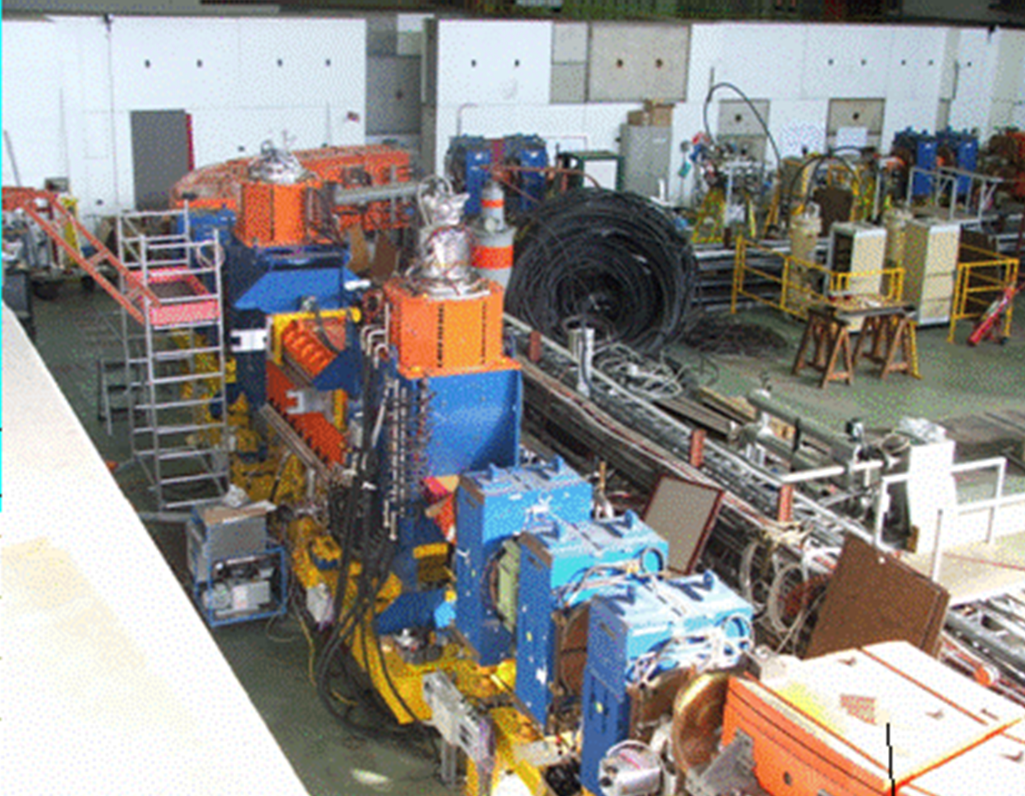
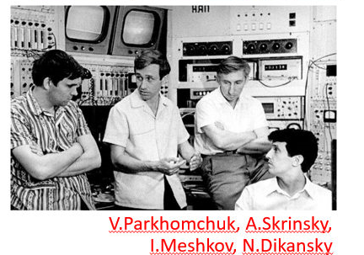
Electron cooling
Pioneer work starting in the 1960s on proton-antiproton colliders and cooling.
As a result — CERN proton-antiproton program.
The same technique was used to store ions in LEAR.

Slide 12
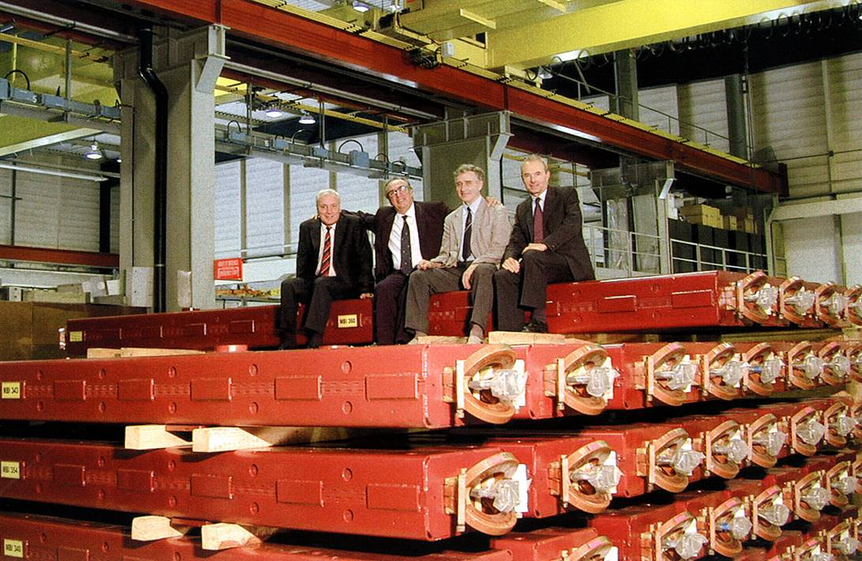
CERN is investing 1/3 of the global (project) price in Russian LHC systems, Russia is investing the same amount of money, and our centers are taking on the implementation of their parts of the project and supplying the corresponding equipment for 2/3 of the global price.

Slide 13
Summing up

Slide 14
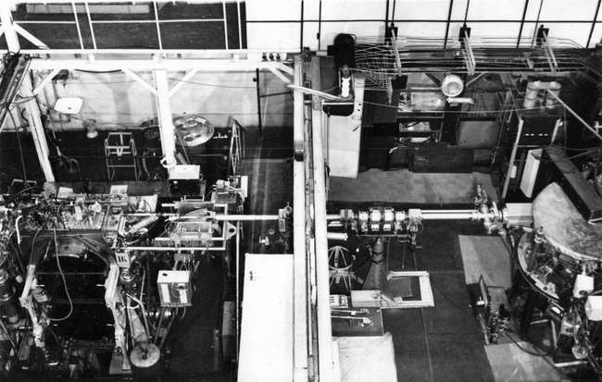
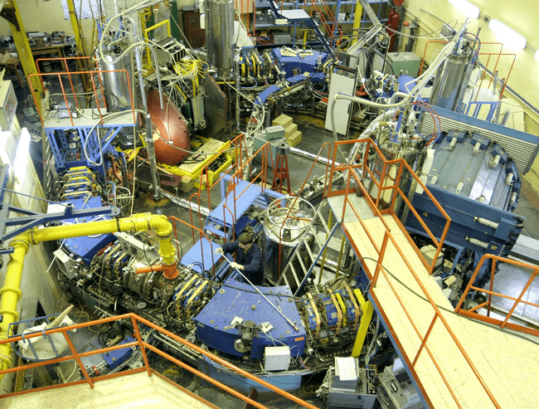
VEP-1
Major scientific achievements of the Budker Institute of Nuclear Physics (BINP), Novosibirsk, that have made a significant contribution to the development of Particle Physics
The colliding beams method. Construction of the first electron-electron collider and tests of the QED (Quantum Electrodynamics) at this facility.
Construction of the first collider and experiments with colliding electron-positron beams.
The method of linear colliding beams was proposed.
The method of resonant depolarization for the precise measurement of the average beam energy in colliders. Record-precision measurement of the masses of a number of particles. Development of the theory describing beam polarization in storage rings with a strong-focusing structure.
Measurement of the total cross-section of hadron production in e+e- annihilation from the threshold up to 9.5 GeV. Determination of the hadronic vacuum polarization contribution to the muon g-2 (anomalous magnetic moment).
VEPP-2000

Slide 15
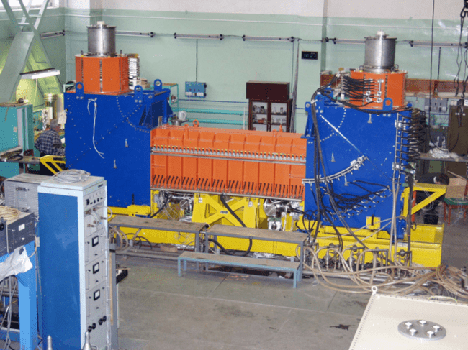

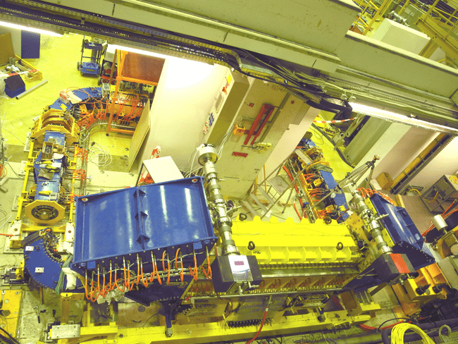
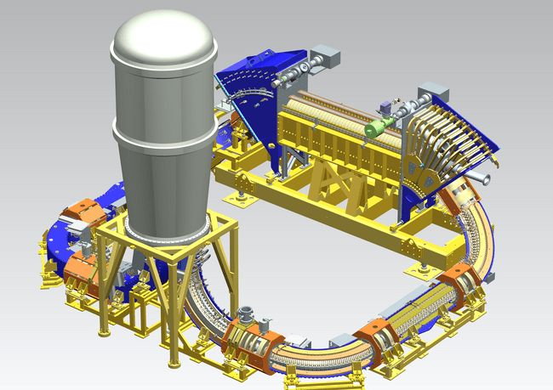
Development and advancement of the electron cooling method.
- Friction forces due to finite magnetic field and cooling section transit time effects.
Proposal of the ionization cooling method for muons and the concept of muon colliders.
The charge-exchange injection method.
One of the first cooling device produced by BINP
Electron cooling machine for COSY, Germany – project (right) and result (left)

Slide 16


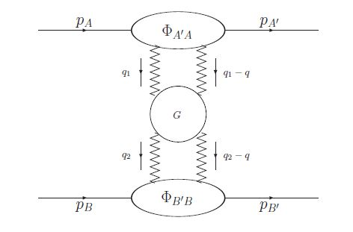


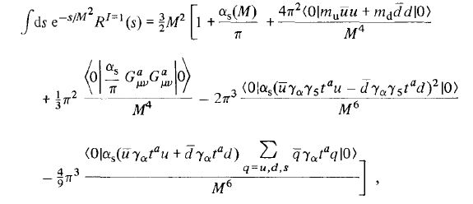
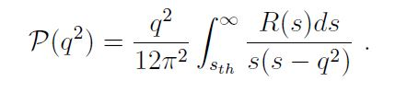
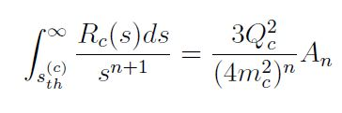
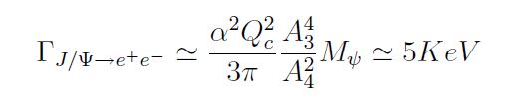
Contributions to the development of Quantum Electrodynamics (QED):
First observation of double bremsstrahlung.
Discovery of the effect of impact parameter restriction in single bremsstrahlung (MD-effect).
- Remarkable results obtained in the theory of radiation effects in the field of an intense electromagnetic wave, and a powerful formalism of quasi-classical Green's functions has been developed (V.N. Bayer, A.I. Milstein et al.).
First experimental measurement of weak interaction effects in atomic transitions (L.M. Barkov et al.). Confirmation of the parity violation effect in the weak neutral currents.
Development of the BFKL method for describing total cross-sections of semi-hard processes in QCD (V.S. Fadin et al.):
Sum rules in QCD (A.I. Vainshtein et al.):
Reggeization hypothesis (proved by V. Fadin, L. Lipatov et al.)
Balitsky-Fadin-Kuraev-Lipatov (BFKL) equation
Condensates contributions
Sum rules and J/Ψ decay parametrization width via moments An

