Slide 1

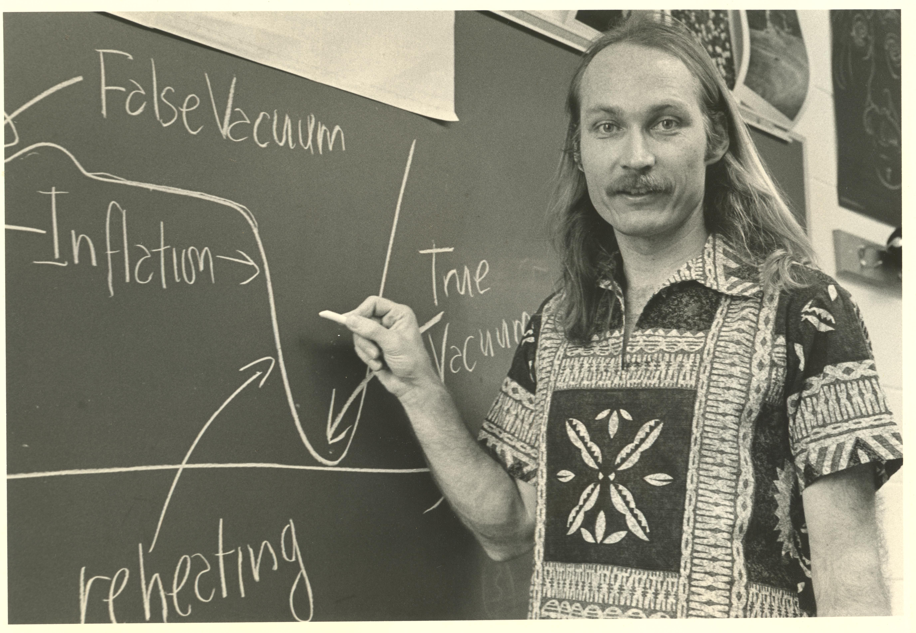
1980s & 1990s:
Particle Dark Matter
Central to particle physics today
Central to astrophysics and cosmology today
A big part of the glue that joins both fields
Michael S. Turner
“from where I sat”
UChicago, 1978 – 2019+
Fermilab, 1983 – 1997+
UCLA, 2022 – present
Kurosawa’s Roshōmon

Slide 2
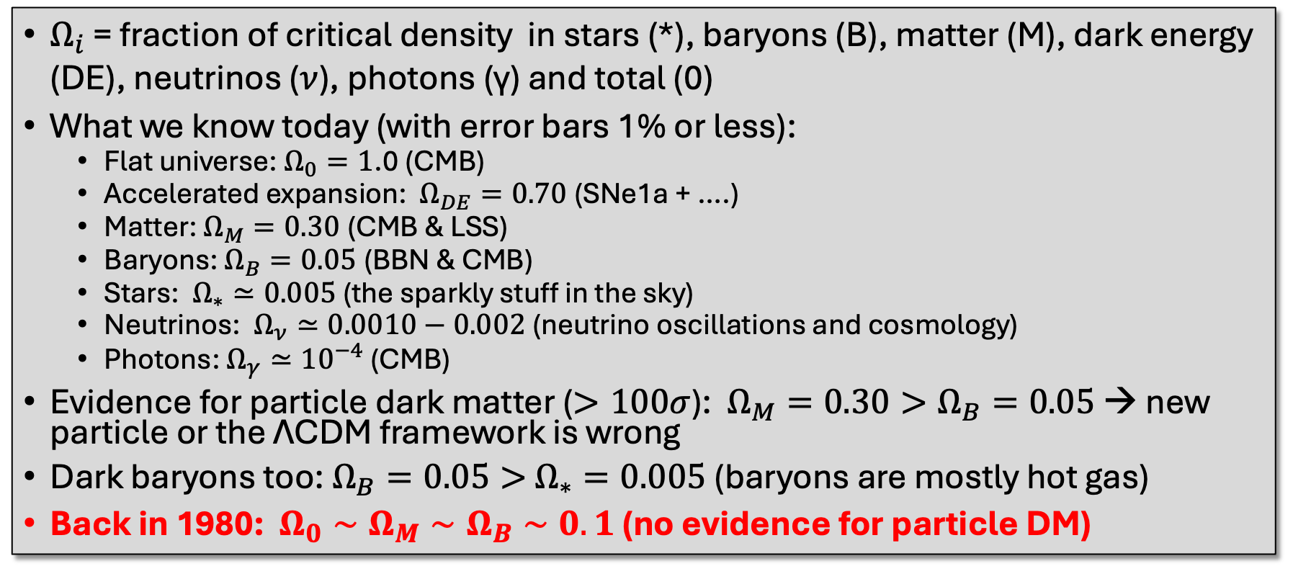
Complicated Universe
$Ω_{i}$ = fraction of critical density in stars (*), baryons (B), matter (M), dark energy (DE), neutrinos ($ν$), photons (γ) and total (0)
What we know today (with error bars 1% or less):
  Flat universe: $Ω_{0}=1$.0 (CMB)
  Accelerated expansion: $Ω_{DE}=0.70$ (SNe1a + ….)
  Matter: $Ω_{M}=0.30$ (CMB & LSS)
  Baryons: $Ω_{B}=0.05$ (BBN & CMB)
  Stars: $Ω_{∗}≃0.005$ (the sparkly stuff in the sky)
  Neutrinos: $Ω_{ν}≃0.0010−0.002$ (neutrino oscillations and cosmology)
  Photons: $Ω_{γ}≃{10}^{−4}$ (CMB)
Evidence for particle dark matter ($>100σ$): $Ω_{M}=0.30>Ω_{B}=0.05$ → new particle or the ΛCDM framework is wrong
Dark baryons too: $Ω_{B}=0.05>$ $Ω_{∗}=0.005$ (baryons are mostly hot gas)
Back in 1980: $Ω_{0}∼Ω_{M}∼Ω_{B}∼0.1$ (no evidence for particle DM)
Where needed: h = H₀/100km/s/Mpc = $0.70±0.02$“Hubble constant”

Slide 3
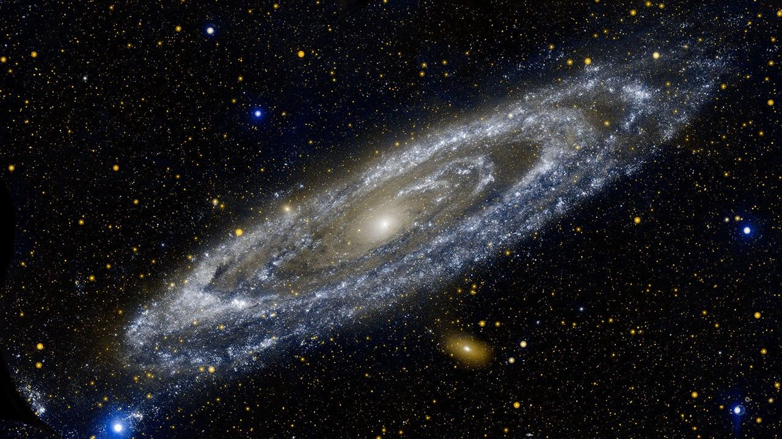
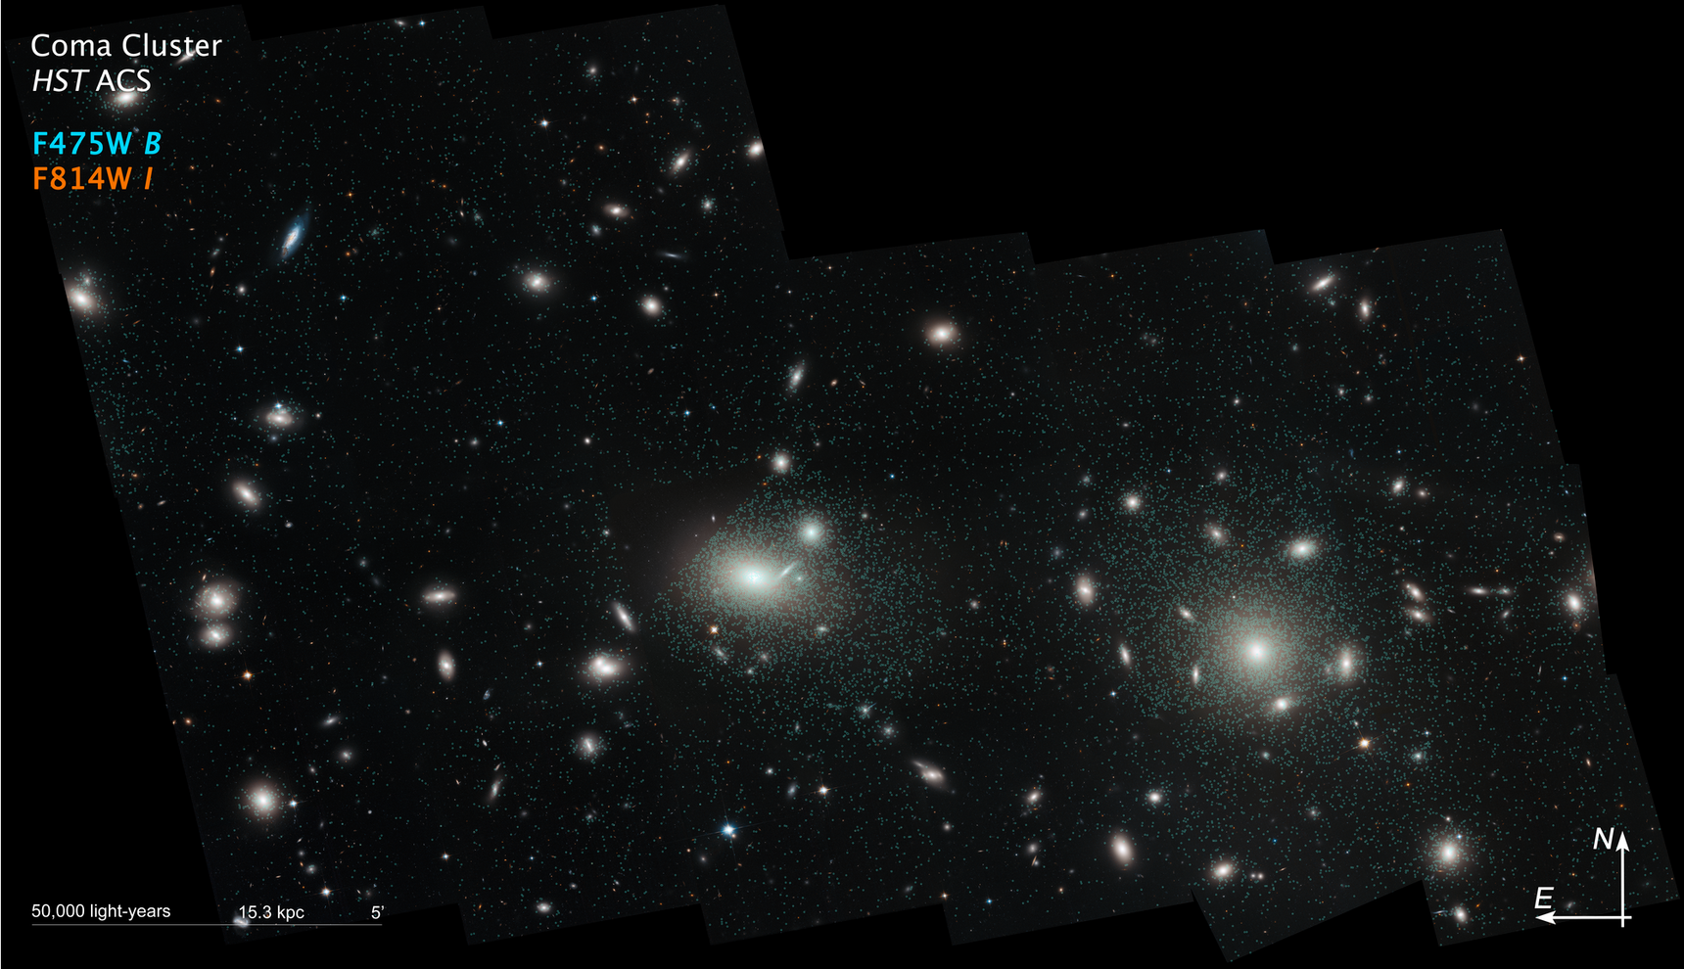
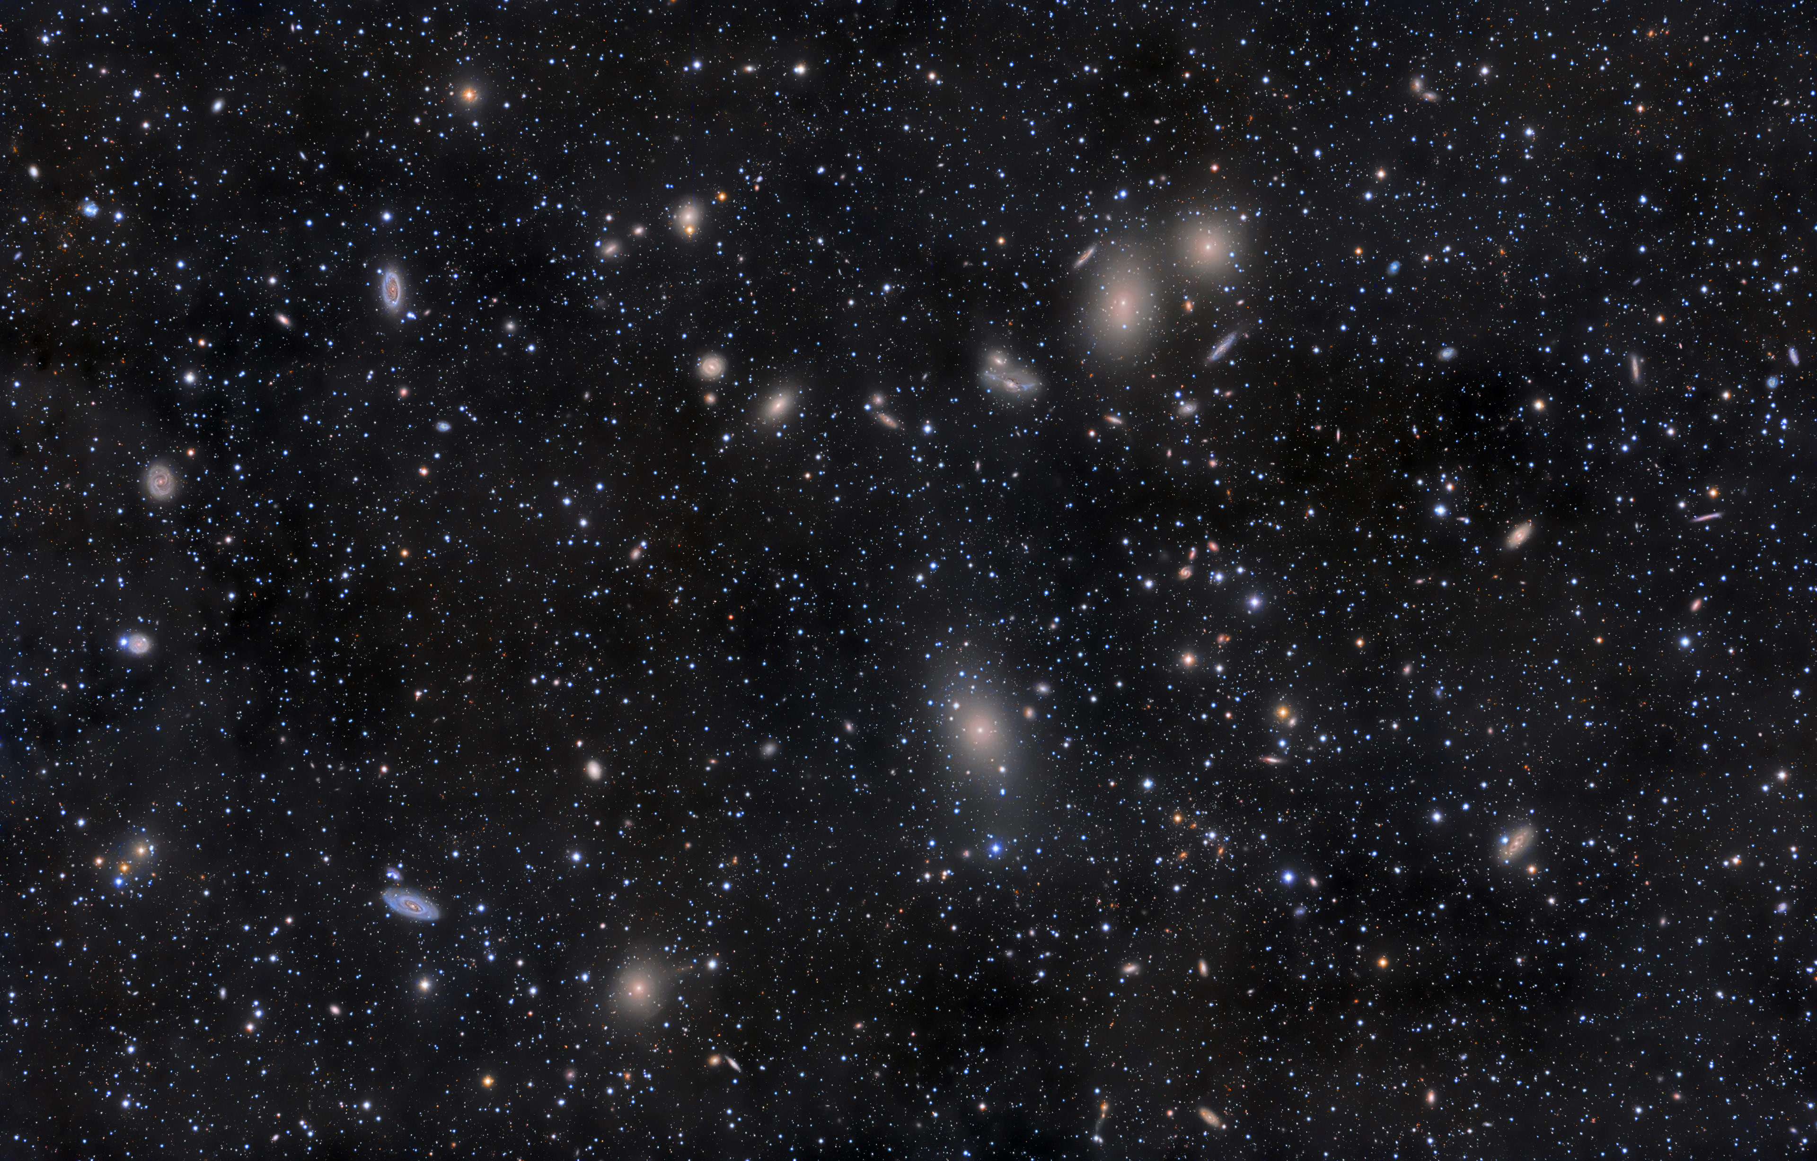
Early voices in the wilderness: the gravity of stars alone cannot hold together galaxies and clusters of galaxies
Zwicky 1933: Coma cluster
Smith 1936: Virgo cluster
Lundmark 1930 and Babcock 1939: Andromeda

Slide 4
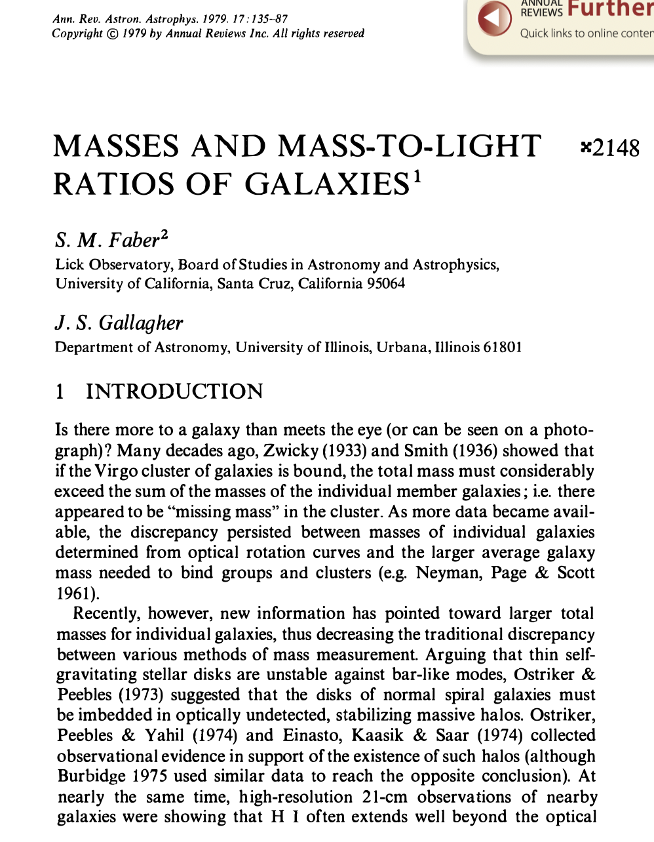
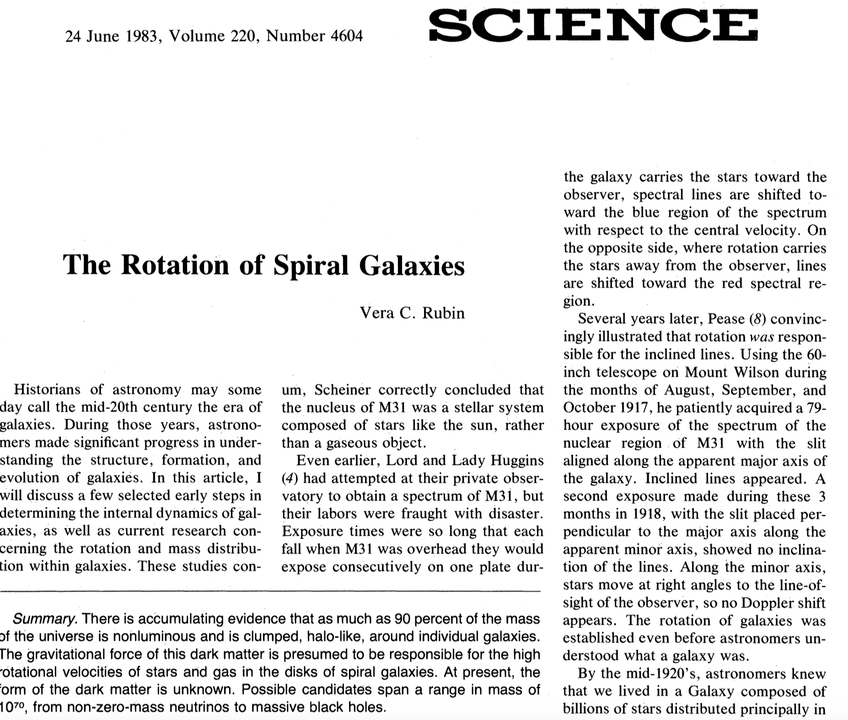
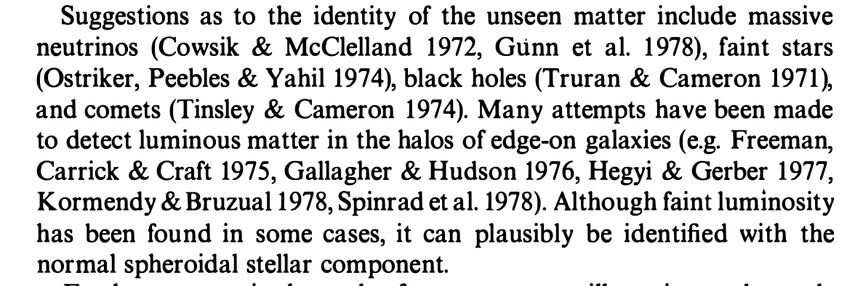
Circa 1980: Dark matter becomes real in astronomy

Slide 5
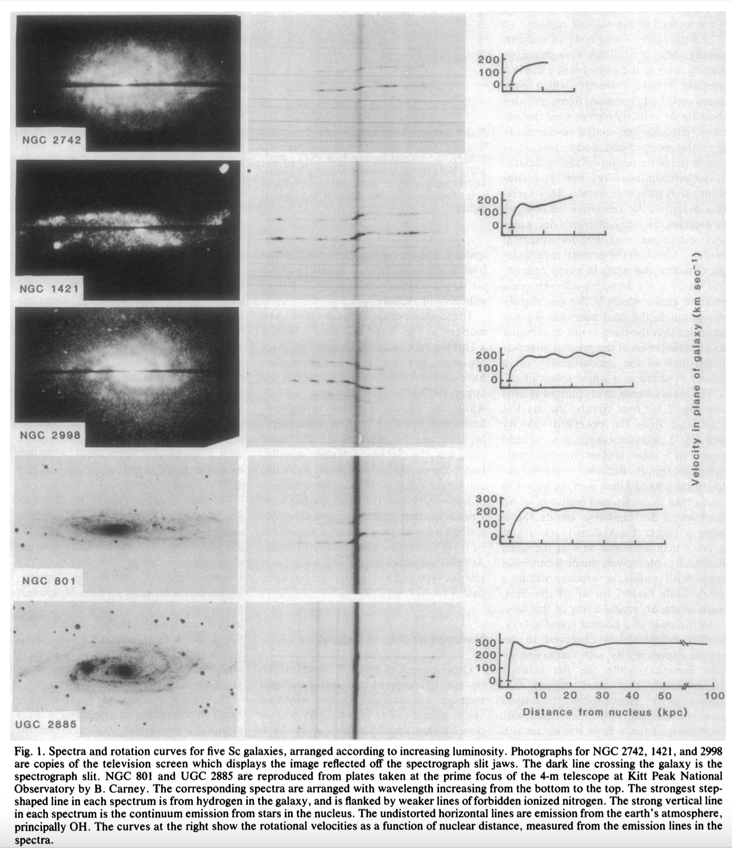
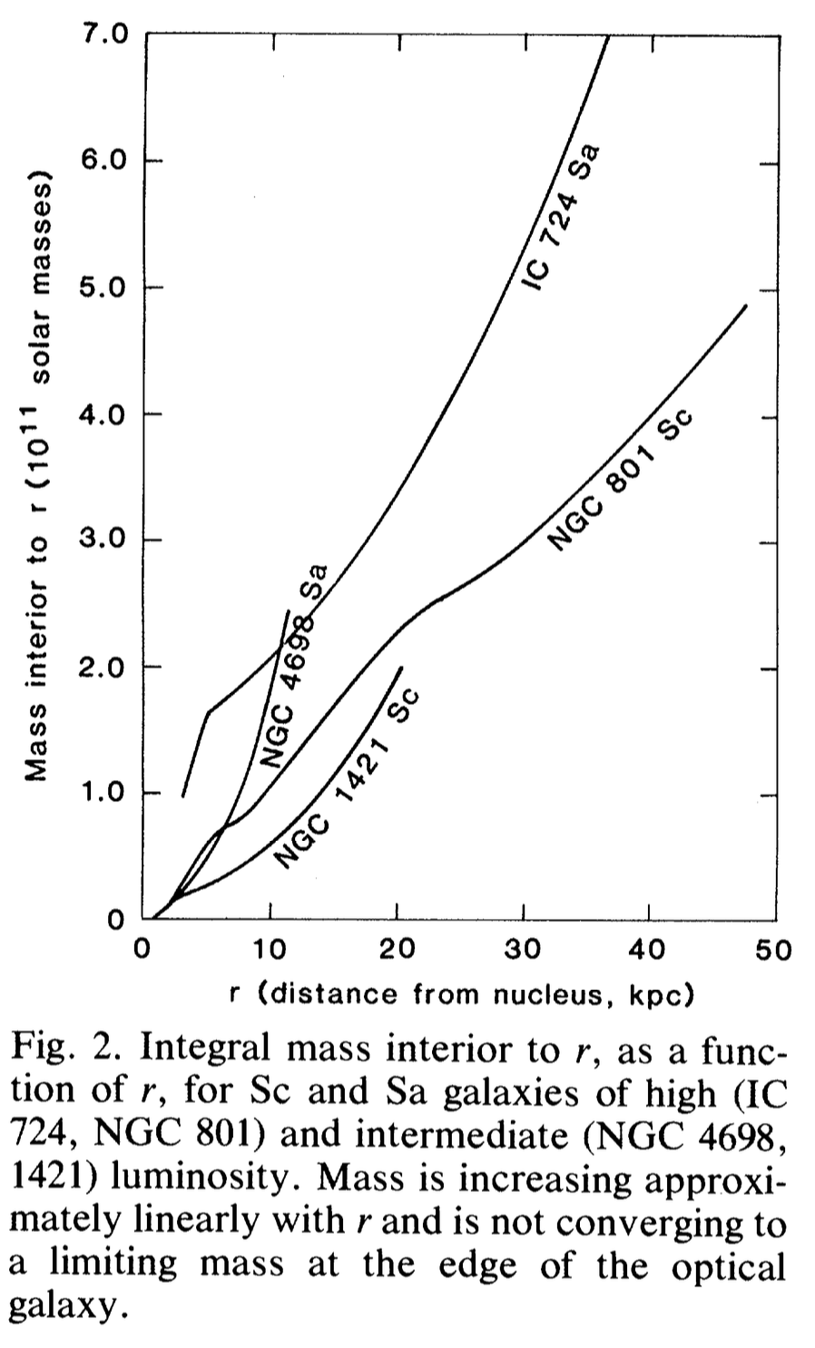
Rubin, Science 1983

Slide 6
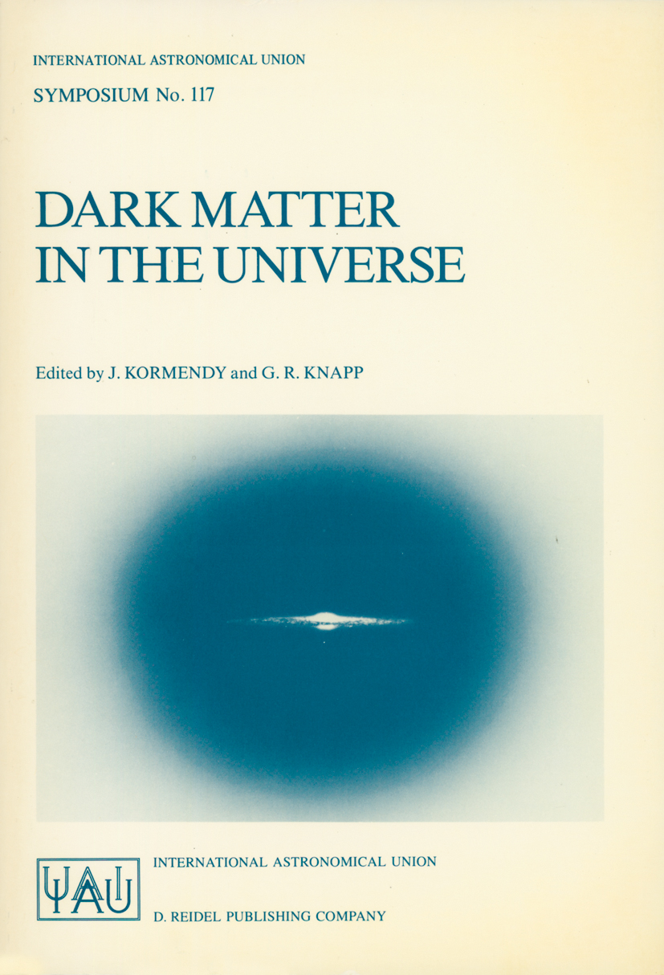
Astronomers interested in particle dark matter
IAU Symposium #117 Dark Matter in the Universe (June 1985)
Turner: “Dark Matter candidates – a tour of the zoo”

Slide 7
How did particle physicists get interested in dark matter?

Slide 8
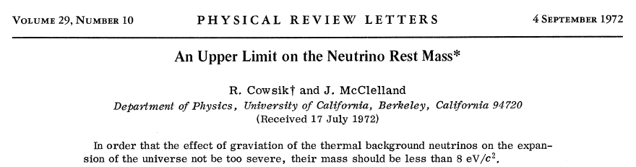
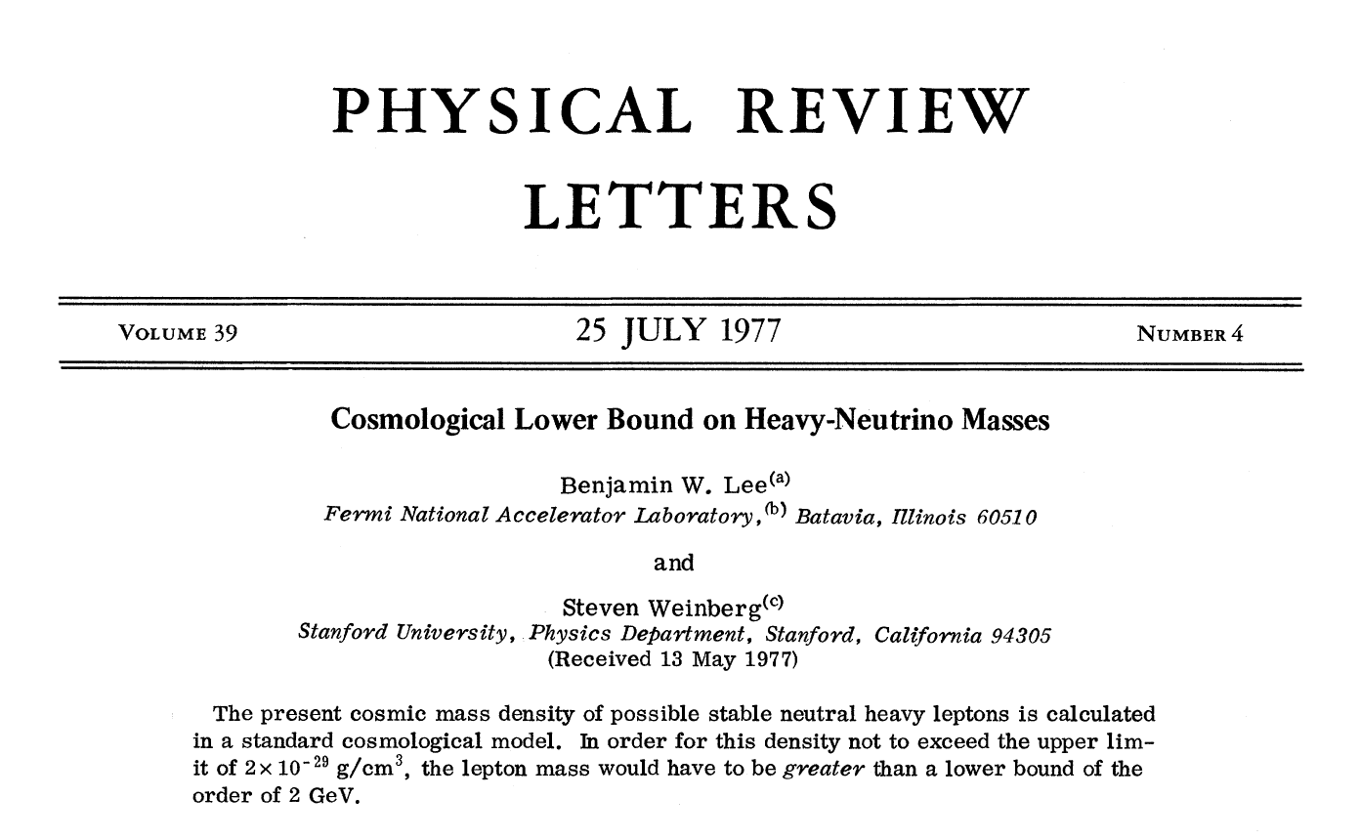
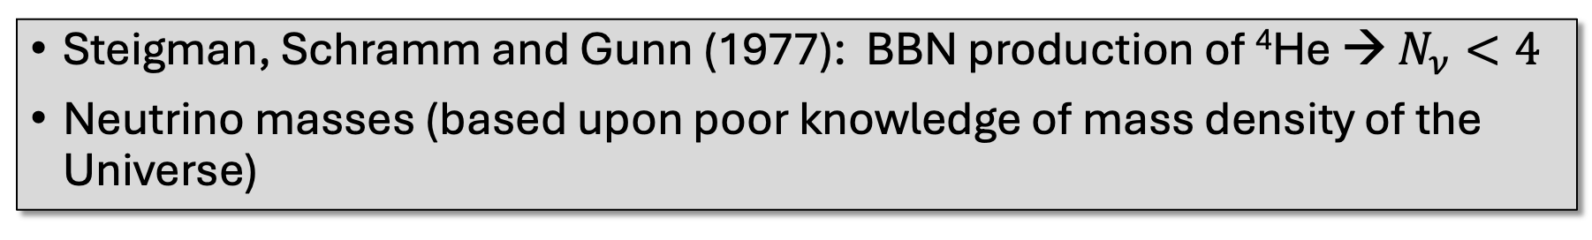
Particle physics used “the heavenly lab” to constrain particle physics
Steigman, Schramm and Gunn (1977): BBN production of ⁴He → $N_{ν}<4$
Neutrino masses (based upon poor knowledge of mass density of the Universe)
Thermal relic calculation

Slide 9


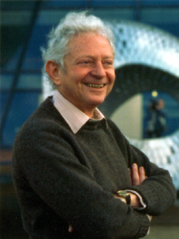
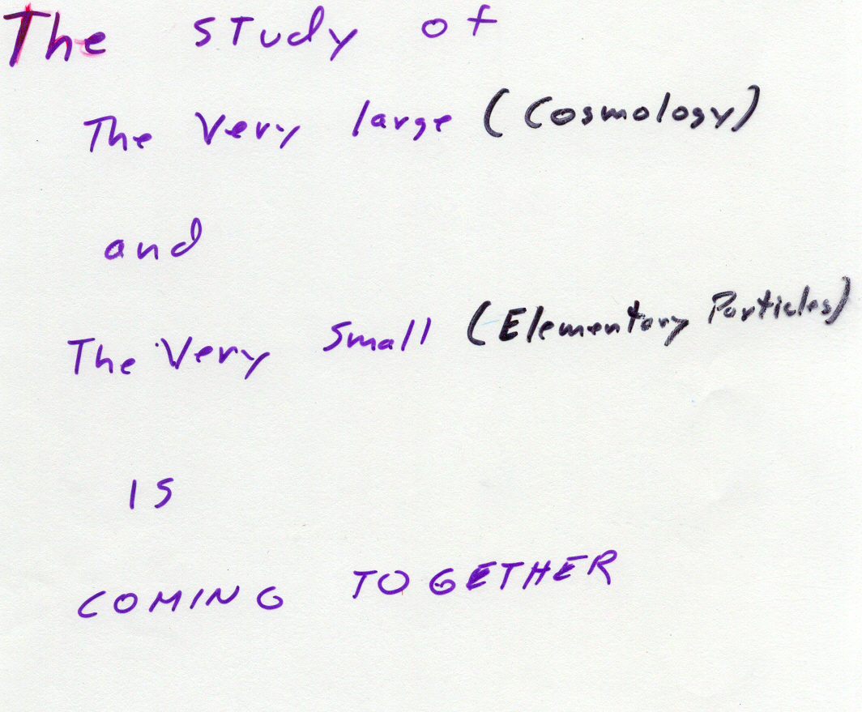
1981: Schramm & Lederman hike in the Dolomites and challenge NASA to fund cosmology group at Fermilab

Slide 10

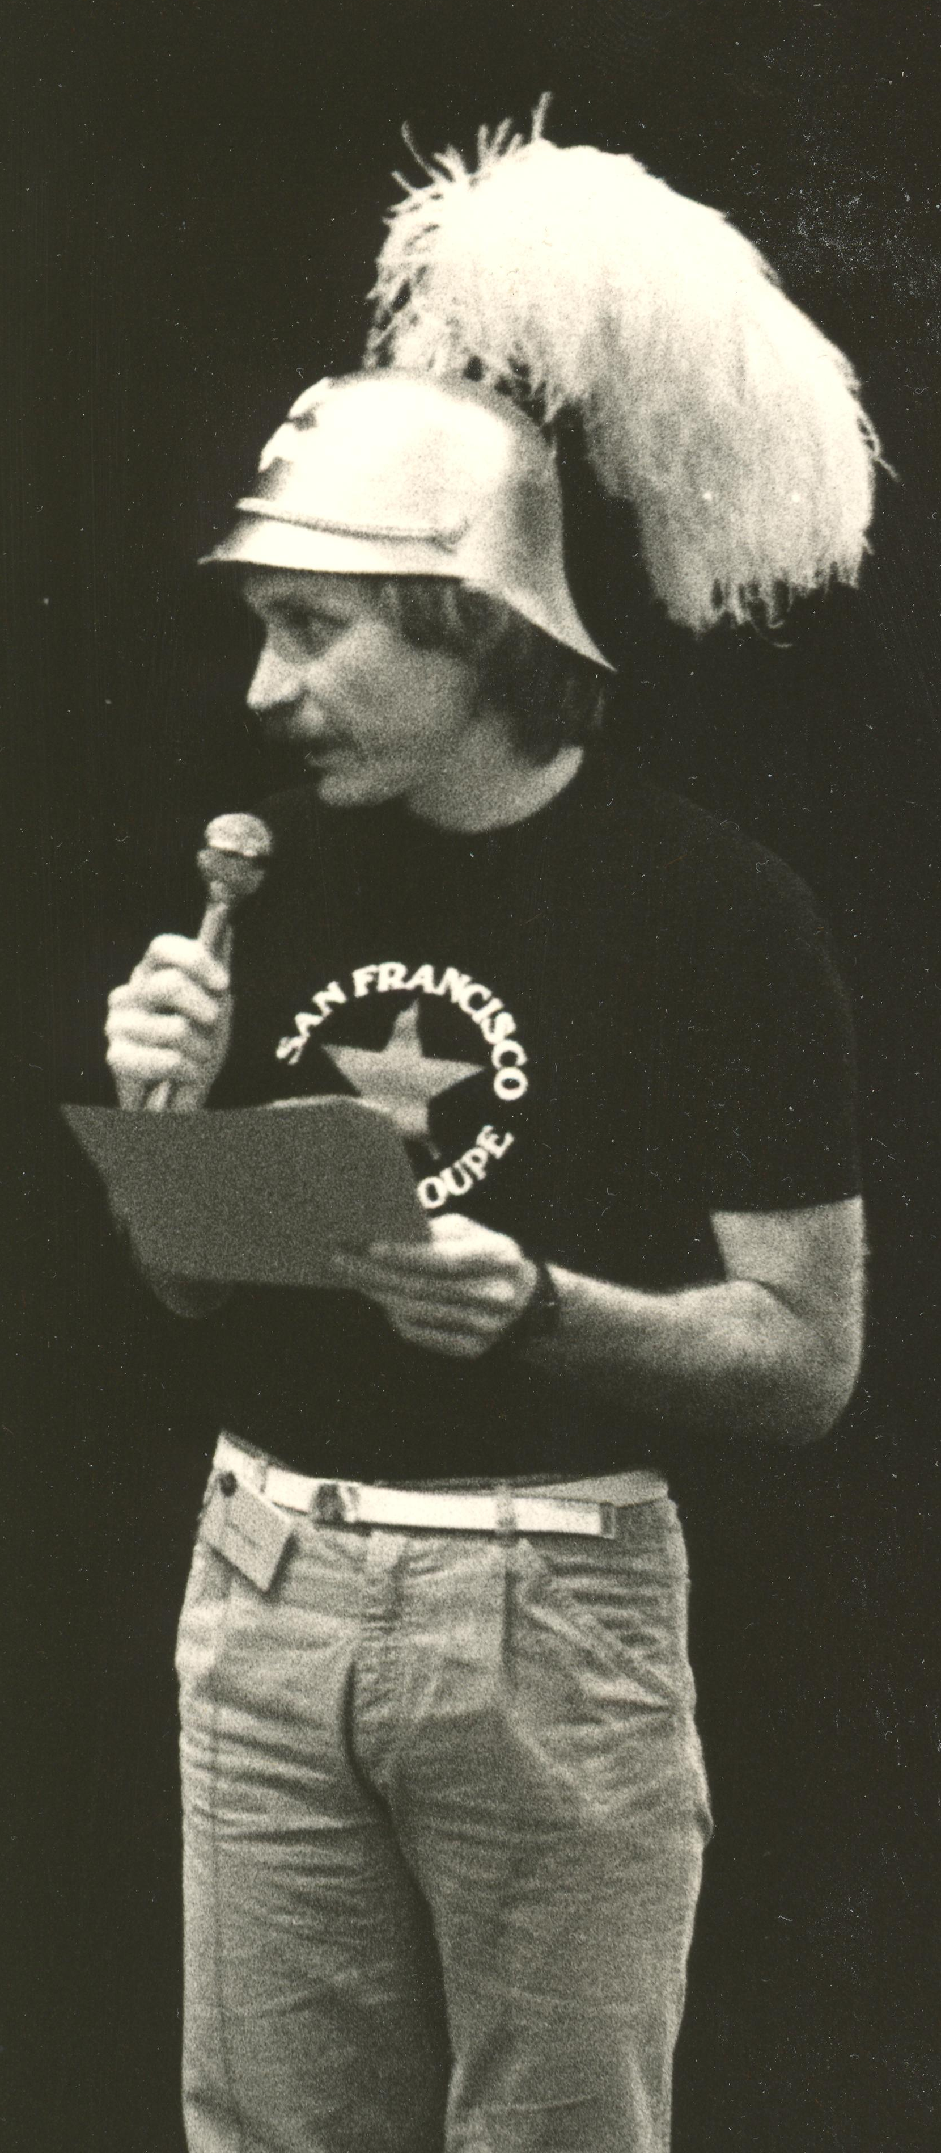
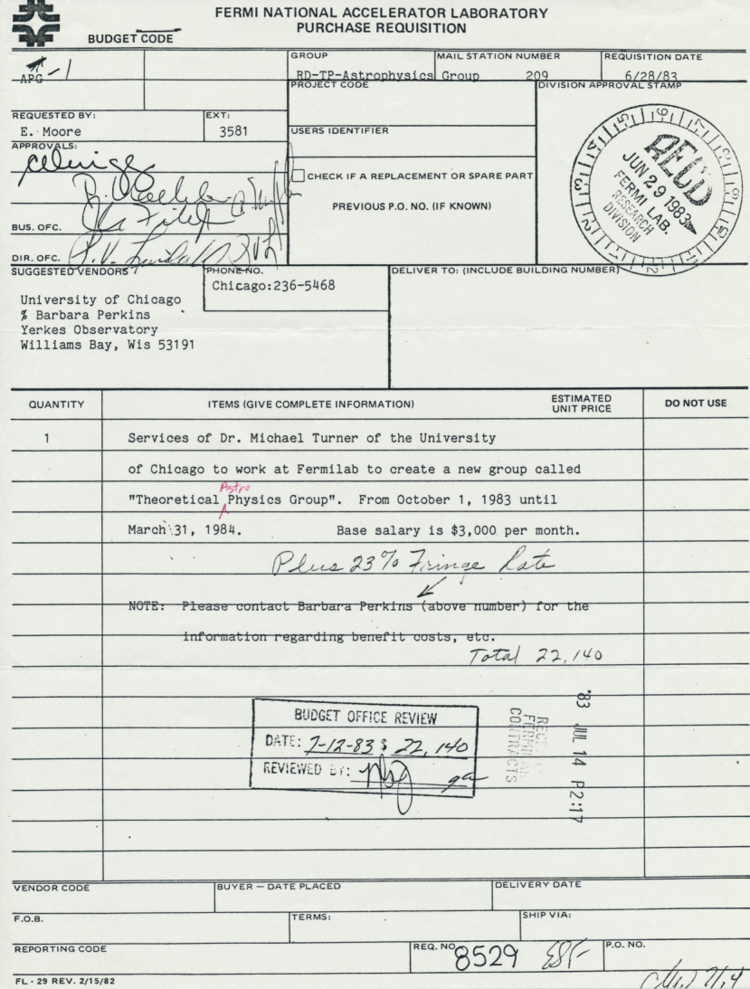
Turner and Kolb arrive at Fermilab as part of the infamous “class of 1983”
(more from Kolb in next talk)

Slide 11
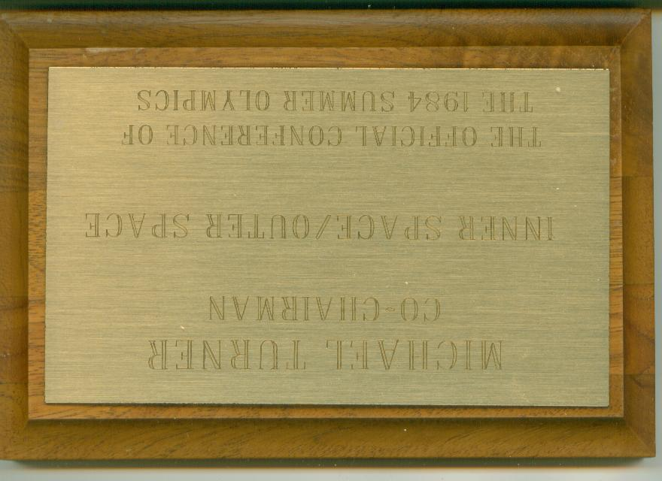
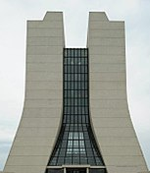
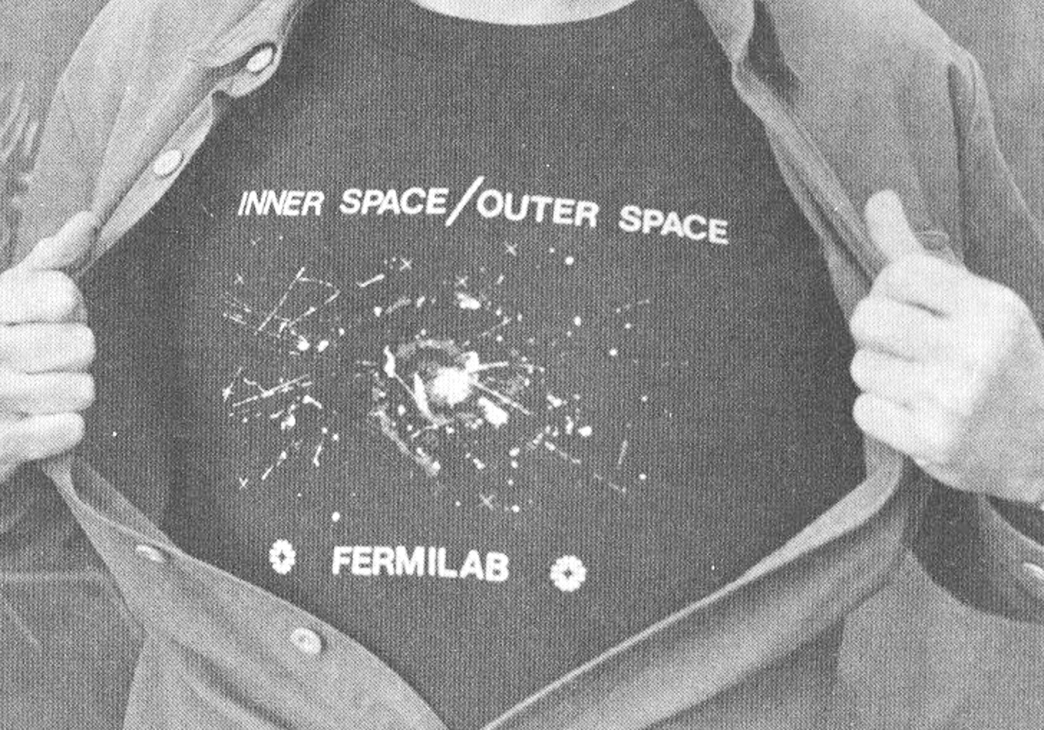
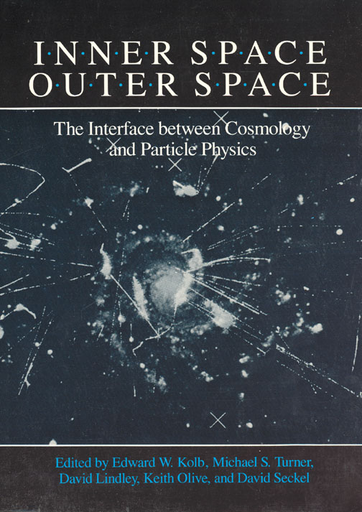
Fermilab becomes the mother church of particle physics & cosmology
InnerSpace/OuterSpace (1984)
Inflation,
Monopoles,
CDM rising,
HDM falling,
CMB limits only,
LSS: CfA1,
Cosmic Strings,
Axions,
SUSY dark matter still to come

Slide 12
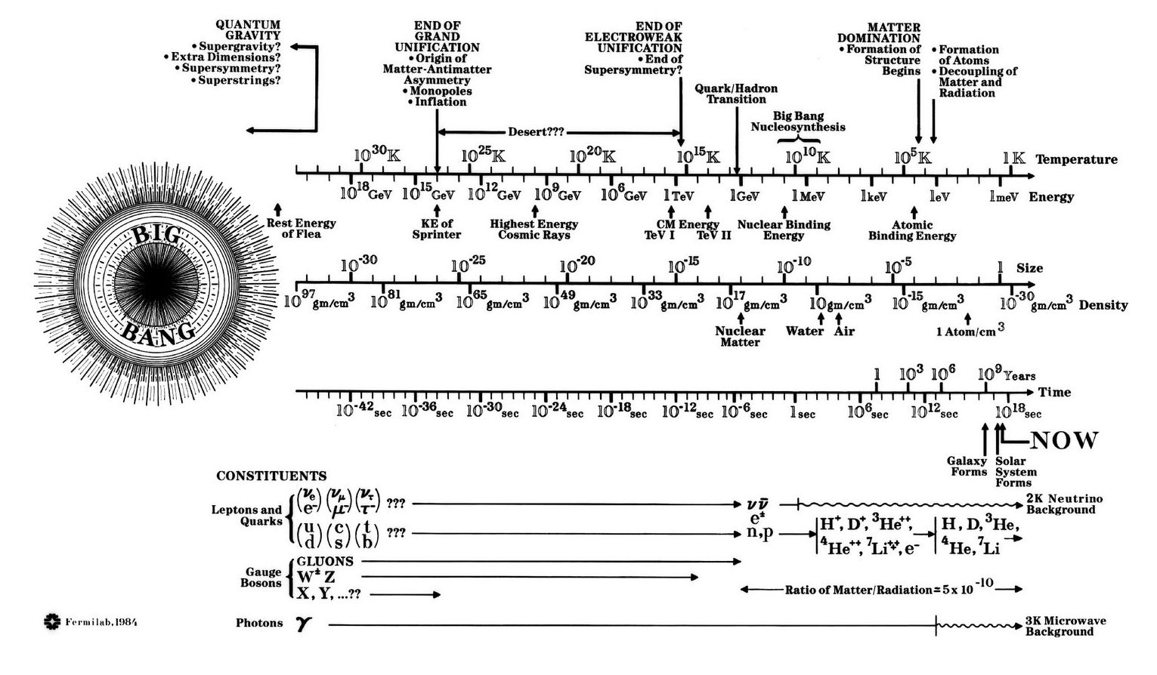
Iconic Fermilab poster created by Angela Gonzales

Slide 13
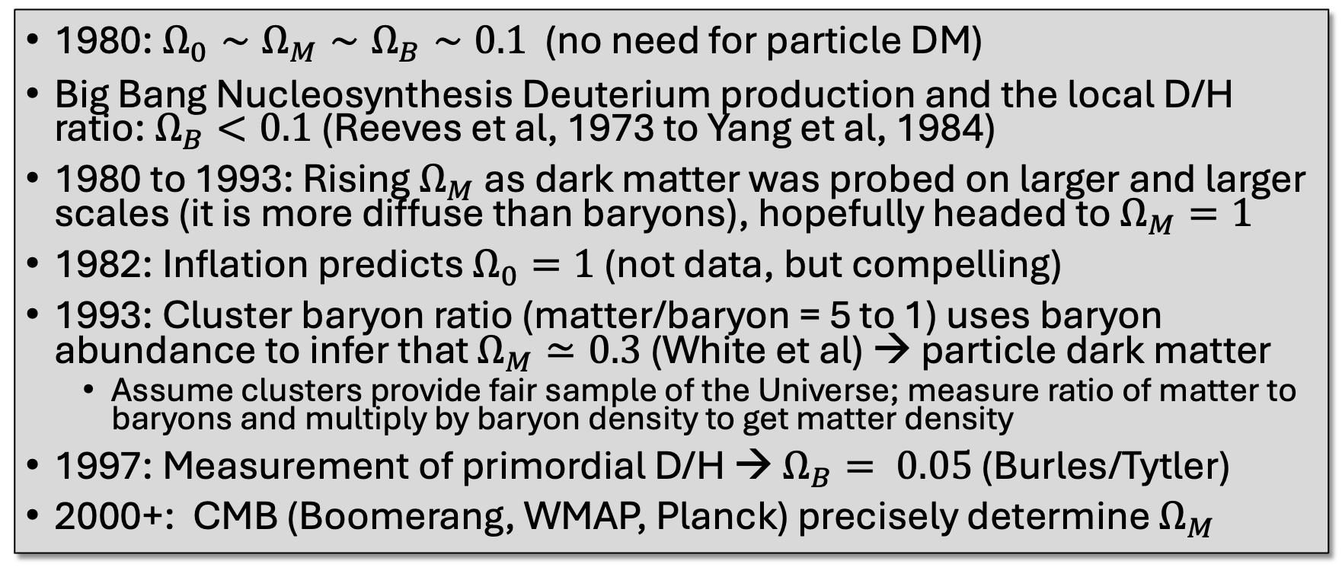
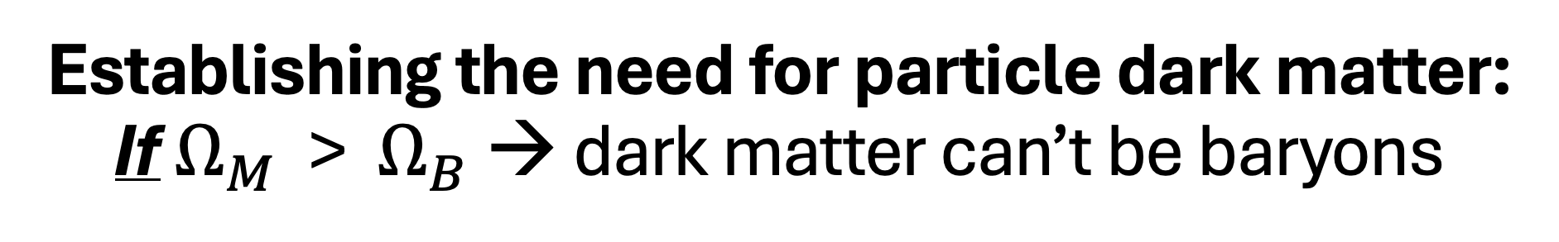
Establishing the need for particle dark matter:
If $Ω_{M}$ > $Ω_{B}$ → dark matter can’t be baryons
1980: $Ω_{0}∼Ω_{M}∼Ω_{B}∼0.1$ (no need for particle DM)
Big Bang Nucleosynthesis Deuterium production and the local D/H ratio: $Ω_{B}<0.1$ (Reeves et al, 1973 to Yang et al, 1984)
1980 to 1993: Rising $Ω_{M}$ as dark matter was probed on larger and larger scales (it is more diffuse than baryons), hopefully headed to $Ω_{M}=1$
1982: Inflation predicts $Ω_{0}=1$ (not data, but compelling)
1993: Cluster baryon ratio (matter/baryon = 5 to 1) uses baryon abundance to infer that $Ω_{M}≃0.3$ (White et al) → particle dark matter
  Assume clusters provide fair sample of the Universe; measure ratio of matter to baryons and multiply by baryon density to get matter density
1997: Measurement of primordial D/H → $Ω_{B}= 0.05$ (Burles/Tytler)
2000+: CMB (Boomerang, WMAP, Planck) precisely determine $Ω_{M}$

Slide 14
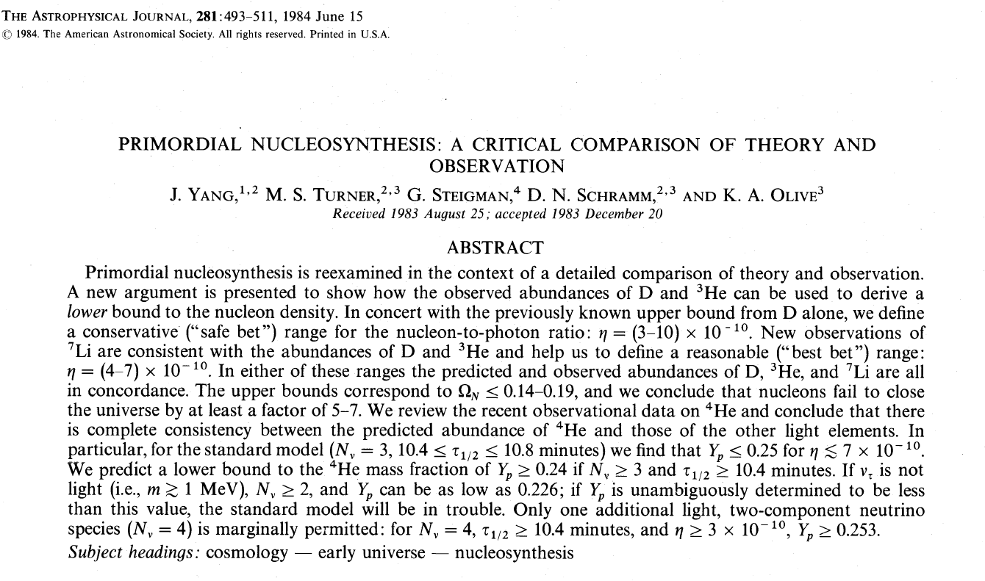
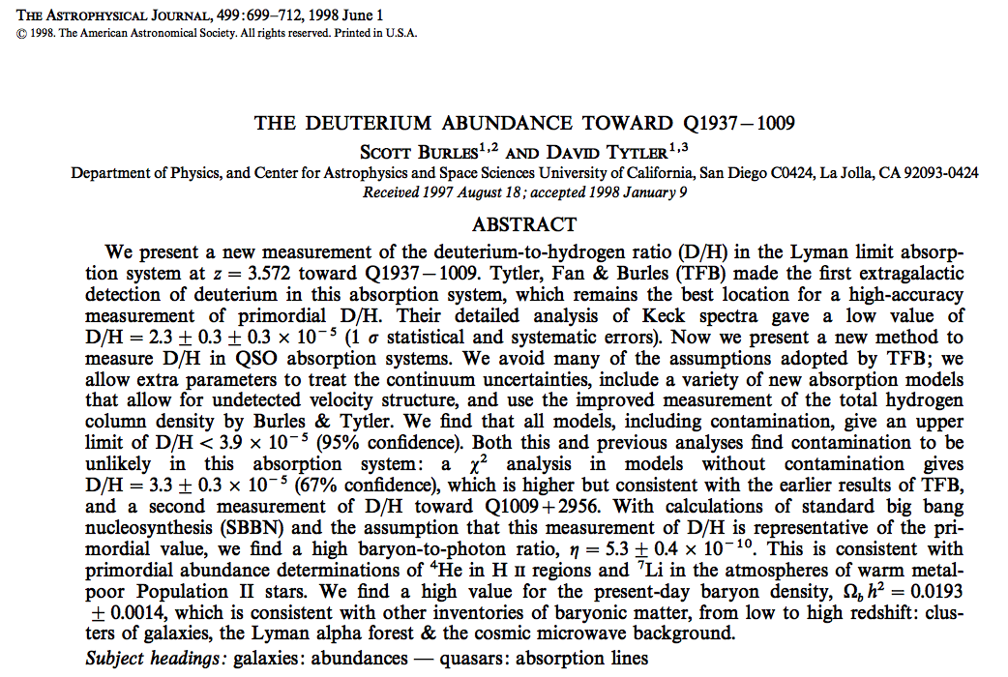
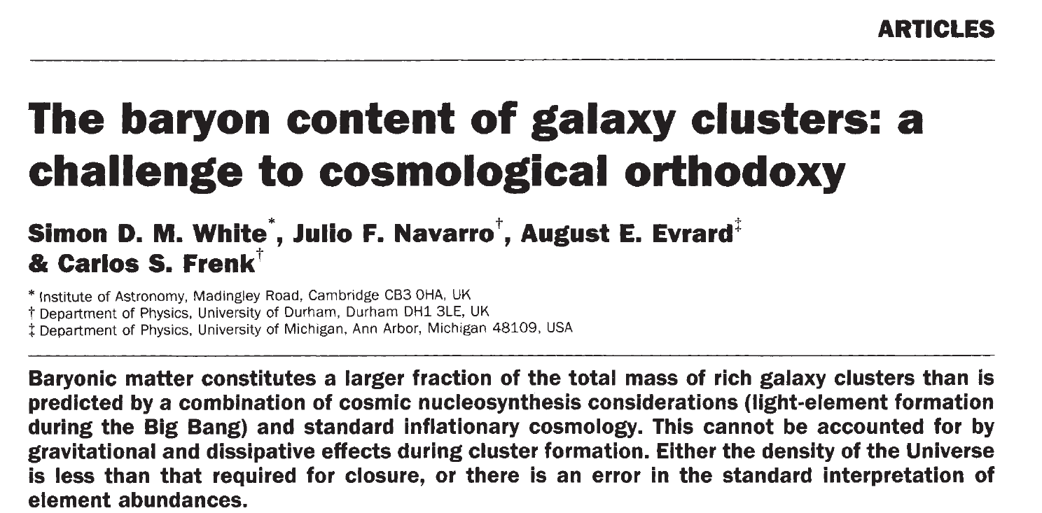
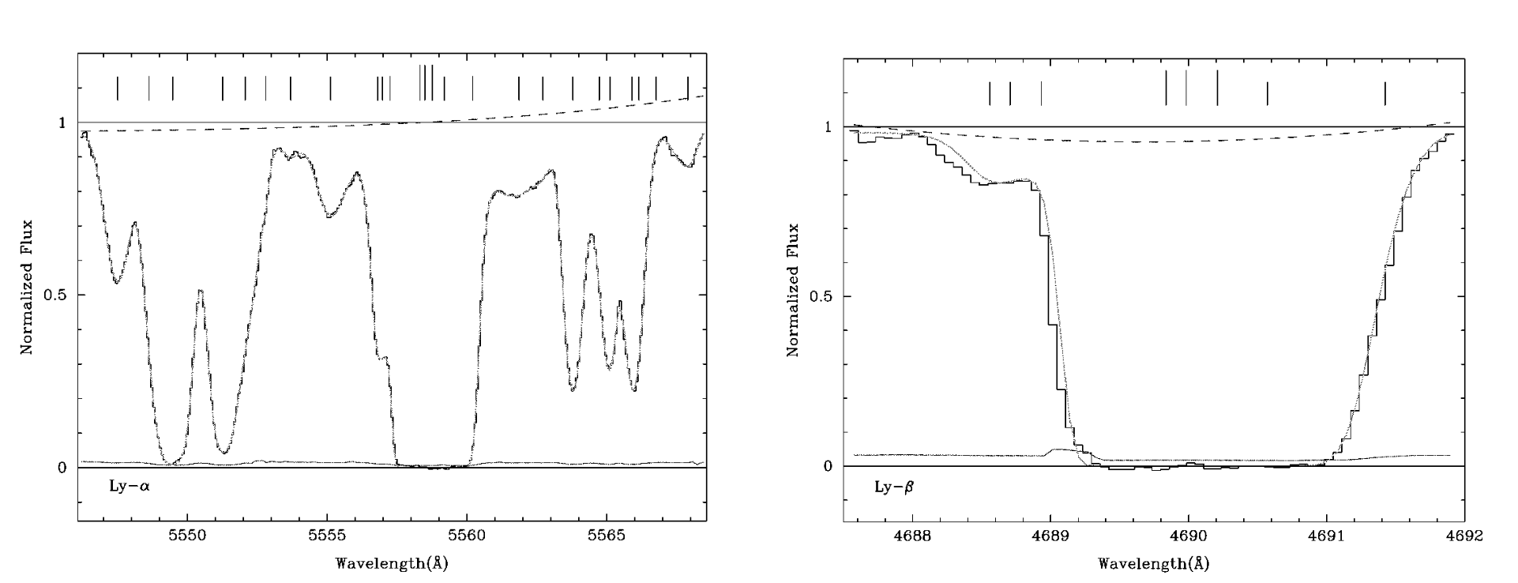
Nature 1993

Slide 15
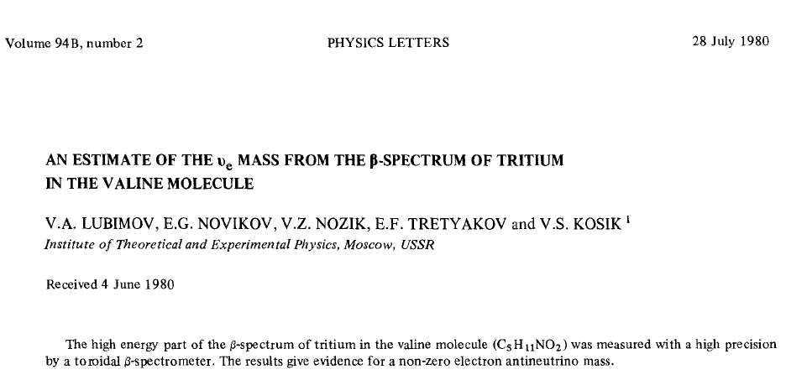
1980: Neutrinos and HDM a wrong result transforms cosmology!
Ω_{ν} = m_{ν}/91h²eV ≈ m_{ν}/45 eV ≈ 1

Slide 16
1980: 1st place Gravity Research Foundation essay

Slide 17
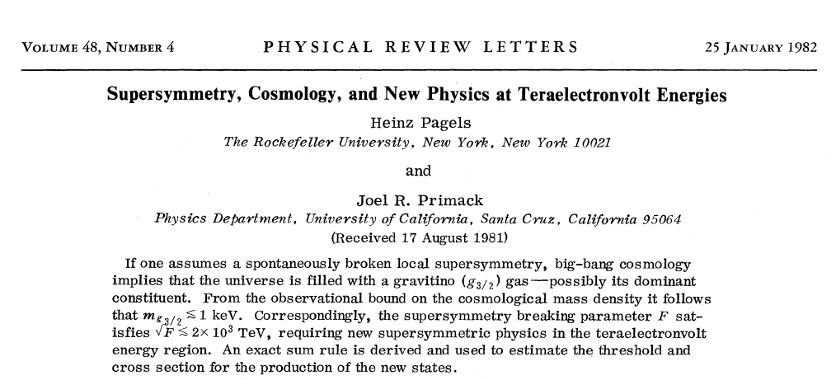
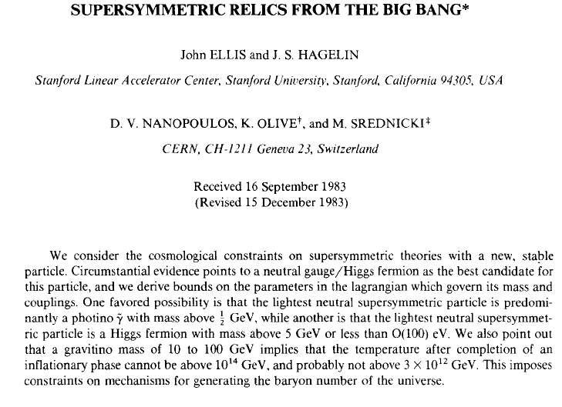
Supersymmetric dark matter
Lee-Weinberg revisited: constraining SUSY
(not dark matter yet)
keV gravitino as dark matter
Behaves as warm (not cold) dark matter
Bond, *Szalay and Turner, 1982
*Booker Prize winner is the other Szalay

Slide 18
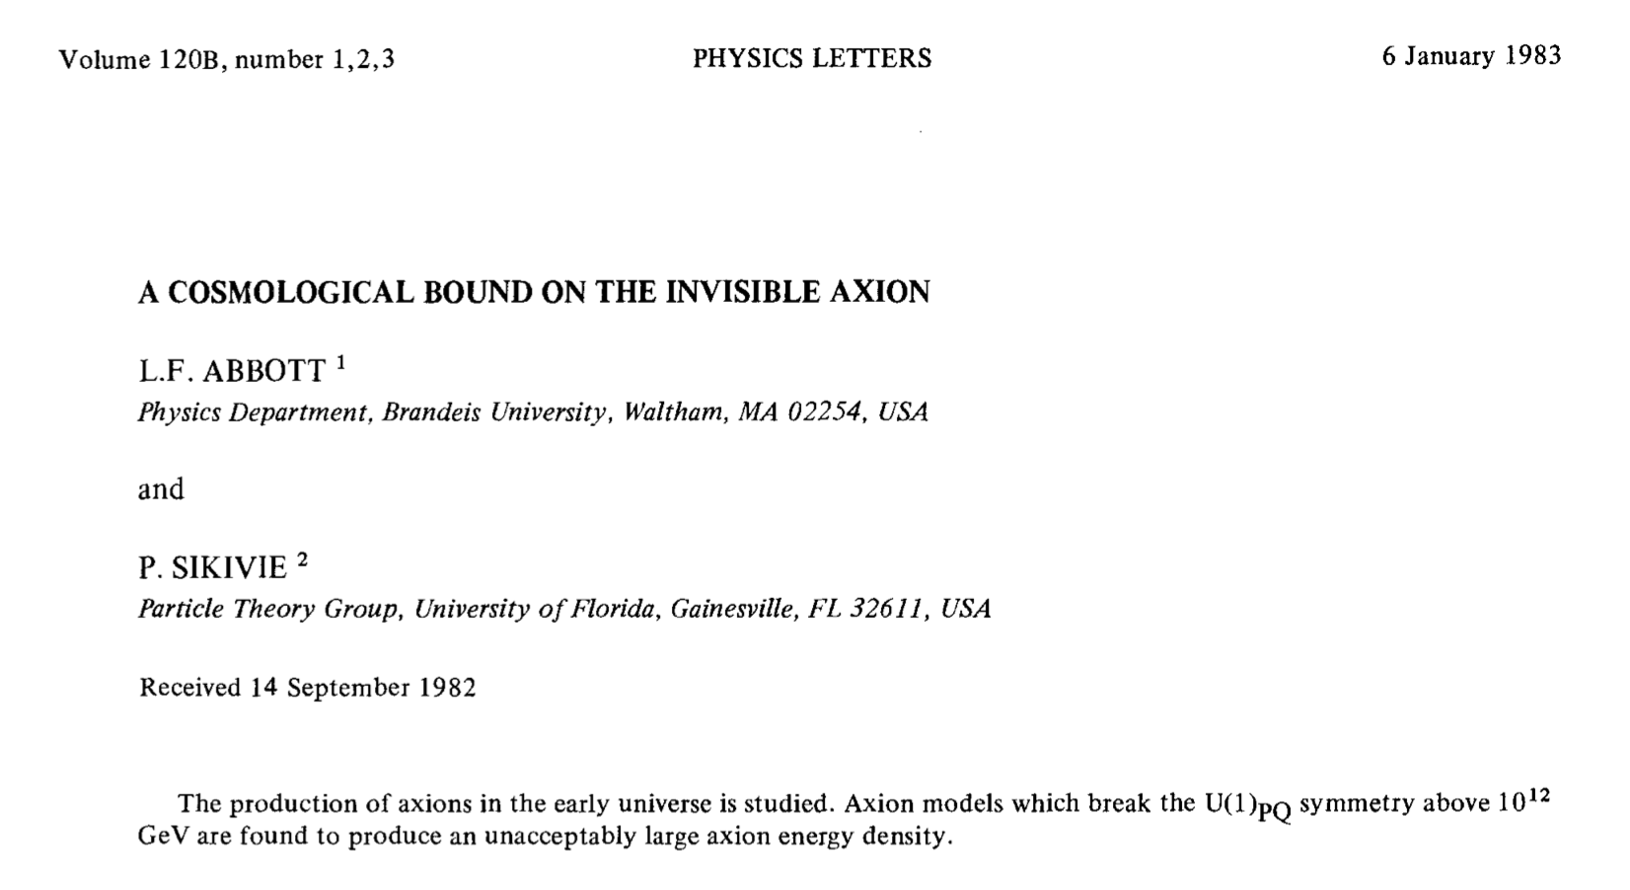
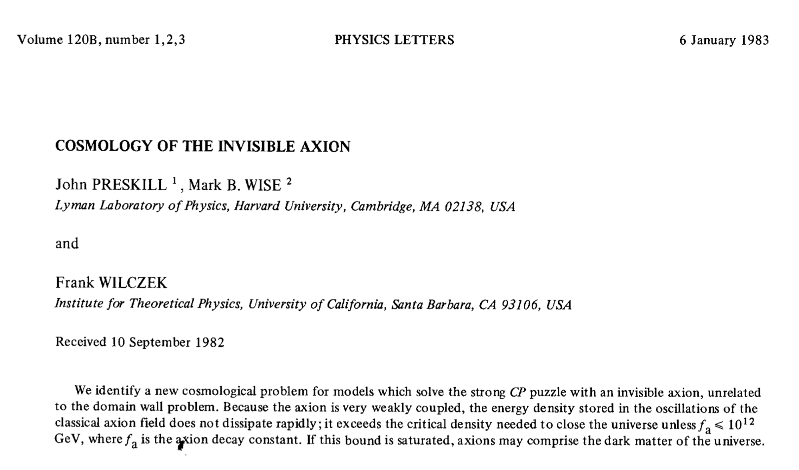
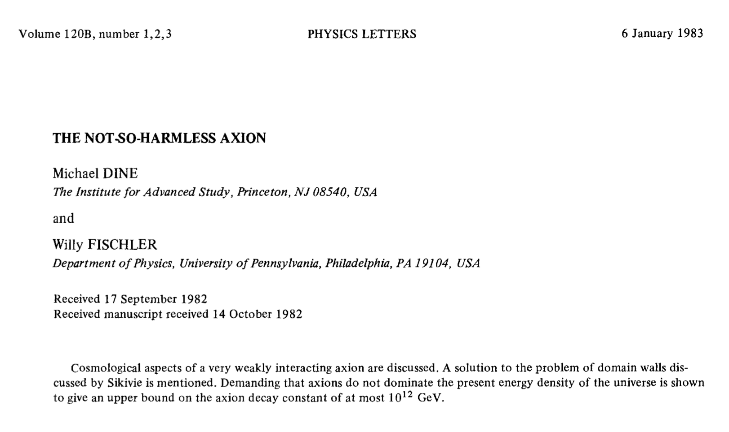
Not so invisible axions
… may comprise the dark matter!
… cosmological limits

Slide 19
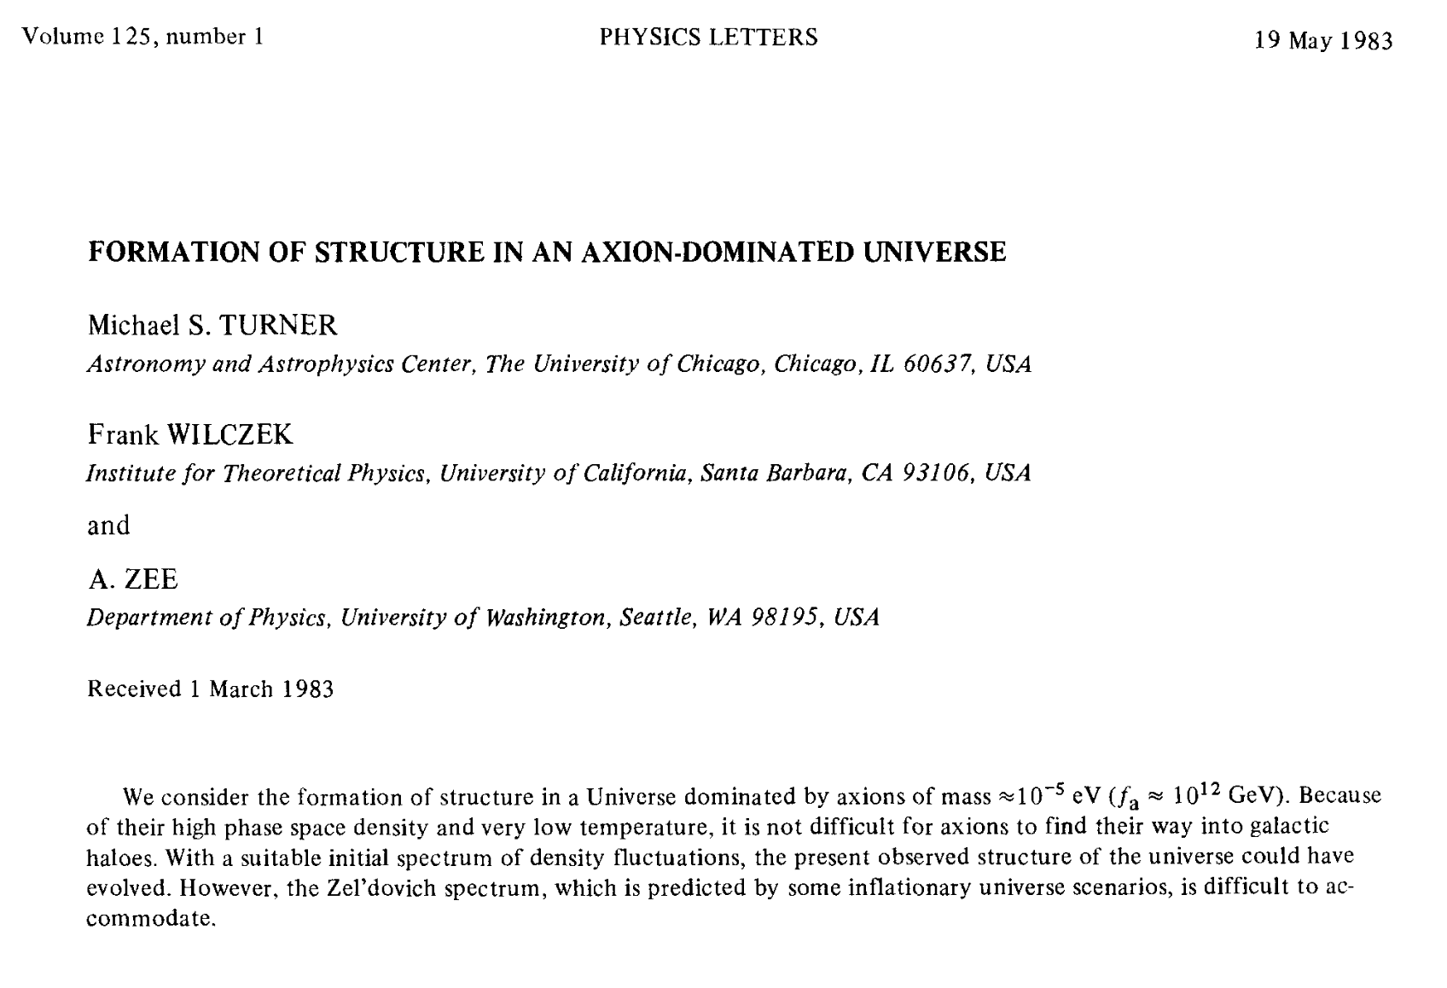
Hot, warm* and cold running dark matter!
HDM: neutrinos (Schramm & Steigman, 1981)
WDM: gravitinos (Pagels and Primack, 1982)
CDM: axions (Turner, Wilczek and Zee, 1983; Peebles, 1984)
“Hot:” dark matter particles move fast (relativistic) when structure formation begins
“Cold:” dark matter particles move slowly (non-relativistic) when structure formation begins
*warm not available in the UK

Slide 20

1984: Inner Space/Outer Space the winner is: Cold Dark Matter

Slide 21
Cold Dark Matter officially becomes the theory of structure formation

Slide 22
Dark matter candidates
Neutrinos still a possible “cosmic spice”

Slide 23
Some diversions and some misdirections
Cosmic Strings: Kibble, Vilenkin, Turok, Shellard, Albrecht, … 1981 to 2000 (RIP CMB)
Magnetic monopoles: Cabrera 1982
MOND: Milgrom 1983
17-keV neutrino: Simpson 1989
MACHOs: Alcock et al 1989 to 1998 (RIP)
WDM (again): Dodelson/Widrow 1994
Annual modulation: DAMA/Libra 1995 – present(!)
WIMPZILLA: Kolb/Chung/Riotto 1998

Slide 24
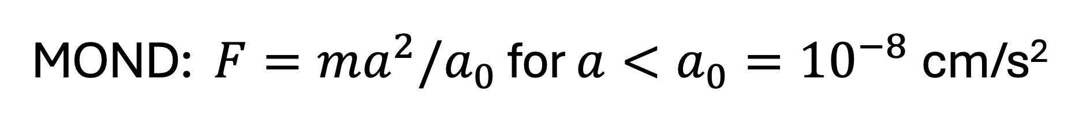
MOND: $F=ma^{2}/a_{0}$ for $a<a_{0}={10}^{−8}$cm/s²

Slide 25
MOND: $F=ma^{2}/a_{0}$ for $a<a_{0}={10}^{−8}$cm/s²
If MOND is Right I’ll Eat My Powerpoint (laptop included)!

Slide 26
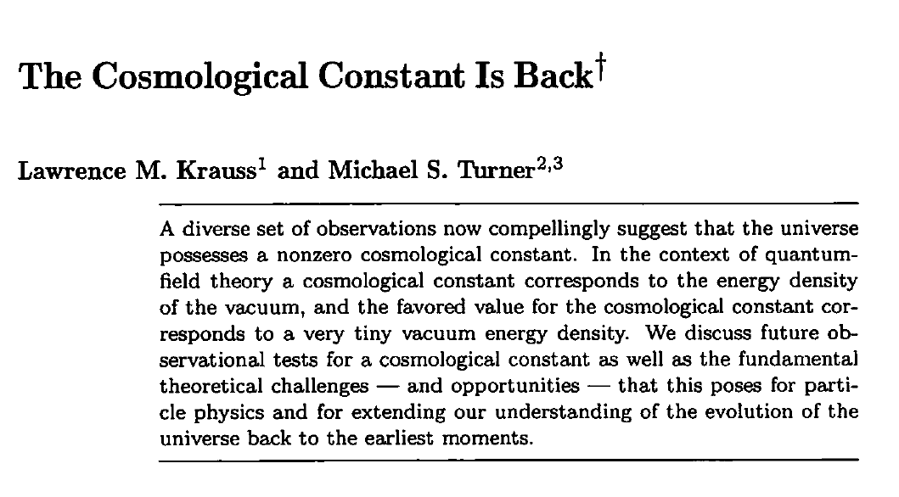
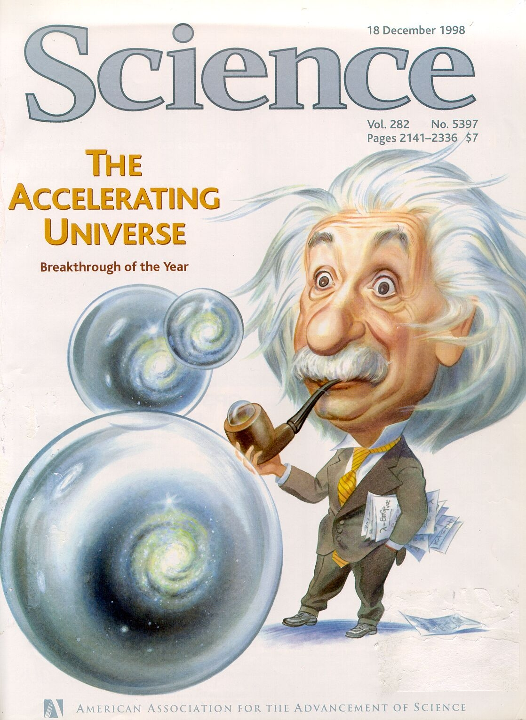
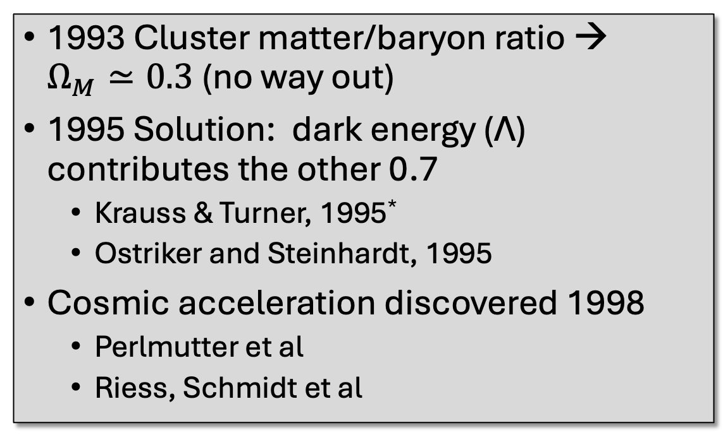
1993 – 2000: The rise of ΛCDM
1993 Cluster matter/baryon ratio → $Ω_{M}≃0.3$ (no way out)
1995 Solution: dark energy (Λ) contributes the other 0.7
  Krauss & Turner, 1995*
  Ostriker and Steinhardt, 1995
Cosmic acceleration discovered 1998
  Perlmutter et al
  Riess, Schmidt et al
*5th place Gravity Research Foundation Essay

Slide 27
Testing particle dark matter
Direct detection of halo DM particles (see Stodolsky’s talk)
Indirect detection of halo DM annihilations
Accelerator production of DM particles
Large-scale structure
  Sloan Digital Sky Survey (Chicago, Fermilab, JHU, Princeton, and Washington)
  SDSS II, III, …
  DES, DESI (Dark Energy)

Slide 28
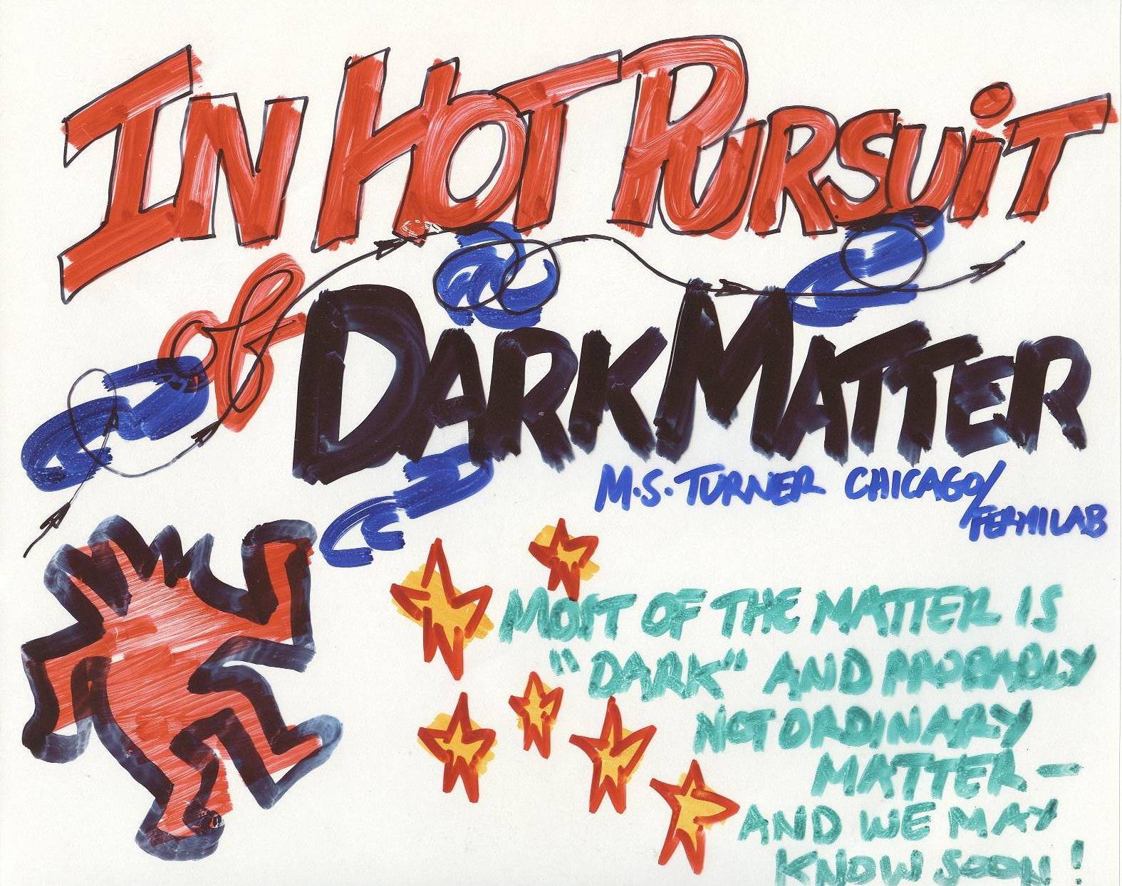
Full Court Press!!
Produce at LHC
Detect particles in our halo
Detect annihilation products

Slide 29
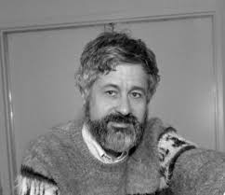
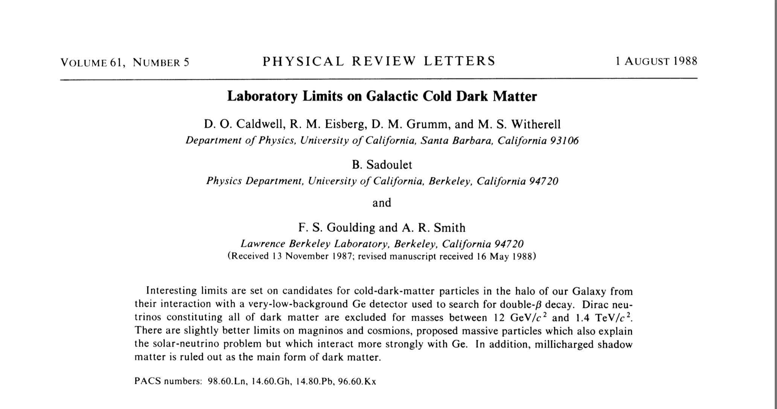
Seeking dark matter directly (halo particles)
Second documented case of “Adult-onset astrophysics”
Director of the NSF Center for Particle Astrophysics (UC, Berkeley): 1989 – 2001

Slide 30
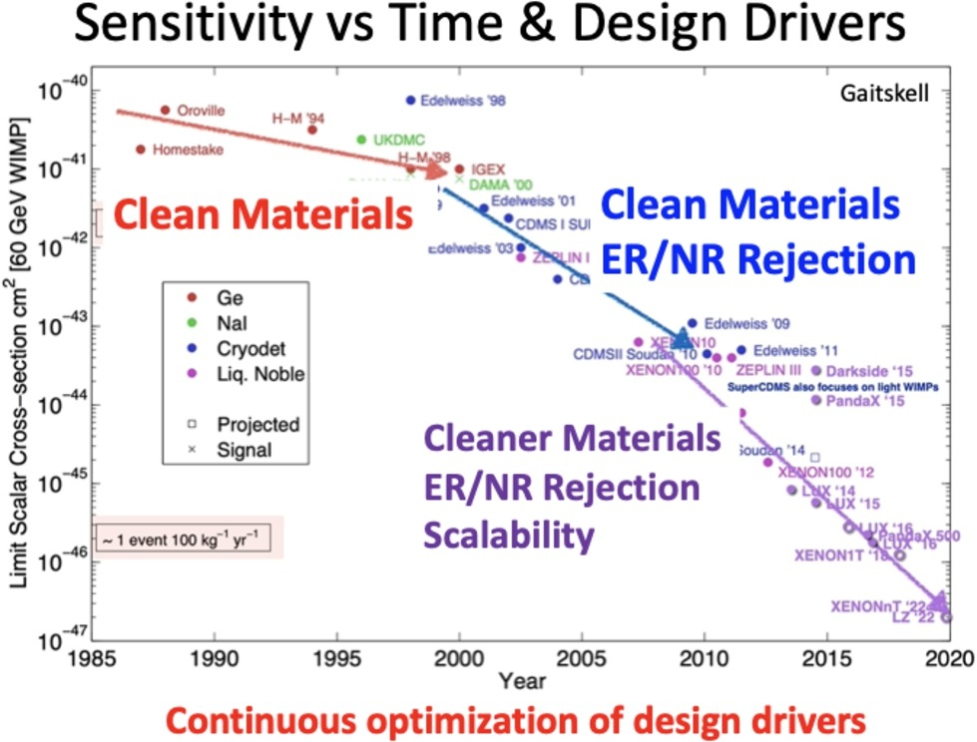
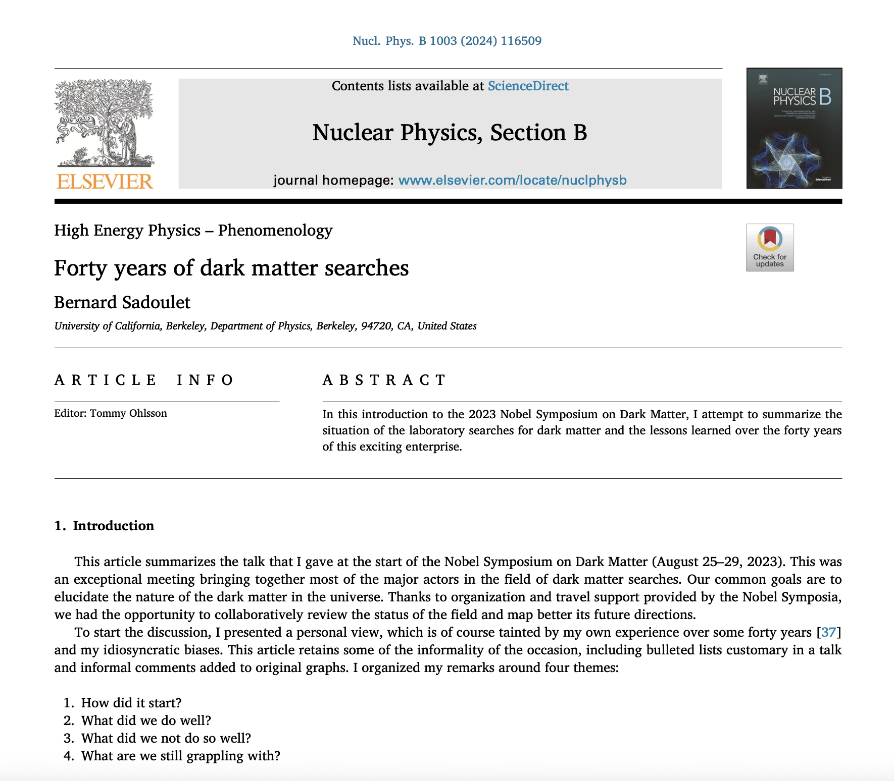
Major and multiple efforts to discover the dark matter particle

Slide 31
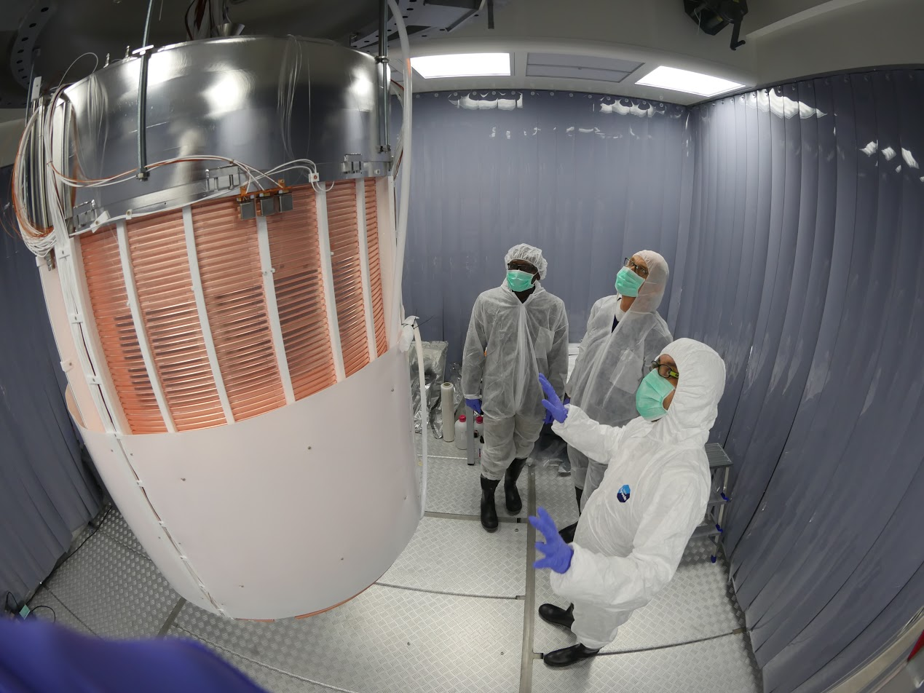

Big, beautiful detectors but no WIMPs
Notes:
31

Slide 32
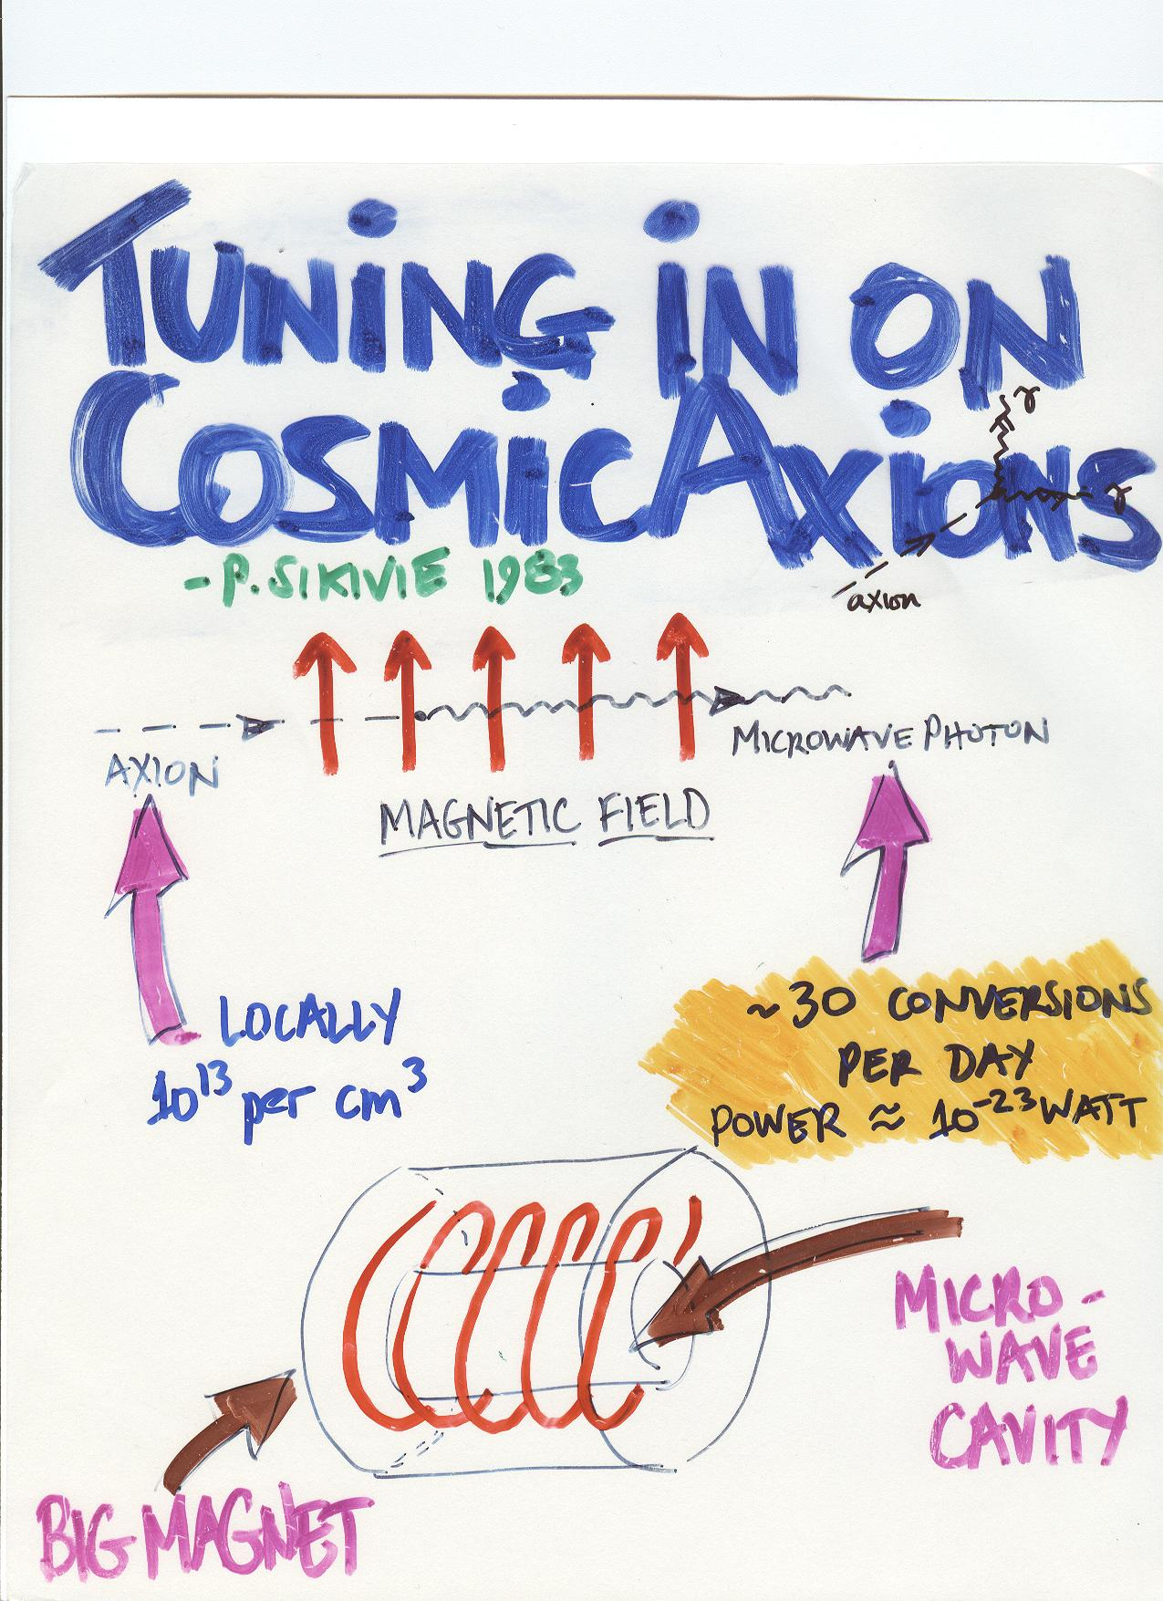
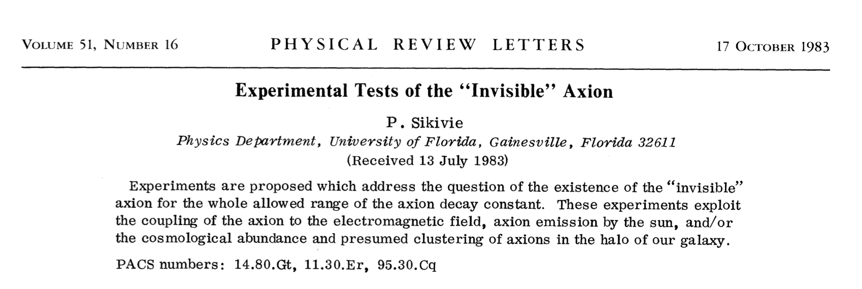
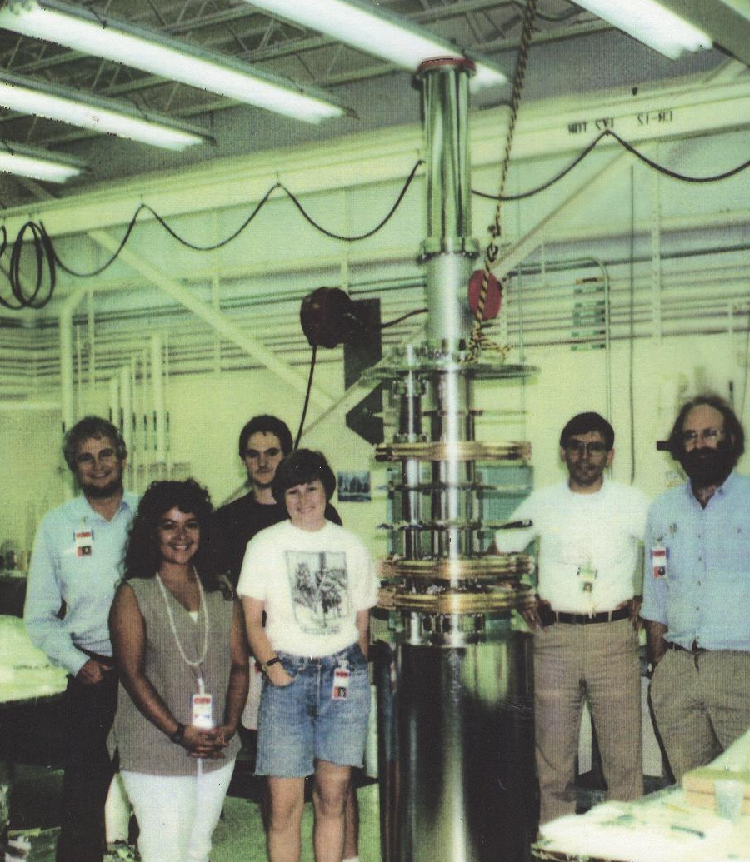
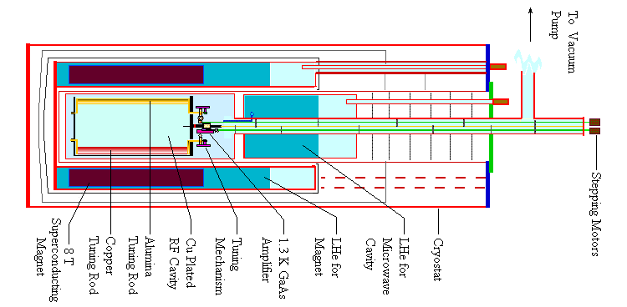
Don’t forget axions! (see Quinn’s talk)

Slide 33



Slide 34




Triumphs and challenges
Triumphs
  ΛCDM in place by 2000 (flat Universe from Boomerang 2000; BBN baryon density from deuterium 1998 and matter density from cluster baryon fraction)
  Marriage of particle physics and cosmology (dark matter centerpiece) transformed the vocabulary of cosmology (dark matter, dark energy, baryogenesis, inflation), merged the agendas, and created a big tent
  Precision cosmology no longer an oxymoron!
  Sloan Digital Sky Survey transforms astronomy
Challenges (opportunities!)
  Dark matter particle not identified
  Dark matter particle and dark energy
  are not in SM
  Why is $\frac{Ω_{DM}}{Ω_{B}}≃5$?
  How many kinds of particle DM?

Slide 35


Cosmic consistency:
Ω_{B}h² at <1% precision
D/H + Nuclear physics at t ~ 1 sec → Ω_{B}h² = 0.02166 ± 0.00015
CMB + Gravity driven acoustic oscillations at t = 380,000 yrs → Ω_{B}h² = 0.02237 ± 0.00015

Slide 36


Old vocabulary
Quark Soup
Dark Matter
WIMPs
Physics Today February 1970
Inflation
Baryogenesis
Dark Energy
CDM
Notes:
Our understanding of the Universe when the University of Chicago began

Slide 37

Big tent of particle physics today

Slide 38

Dark matter candidates: boomer and Gen Z

Slide 39


Airtight evidence for nonbaryonic DM
CMB & BBN
Ω_{B}h² = 0.0222 ± 0.0002
vs.
CMB/SDSS
Ω_{M}h² = 0.143 ± 0.001
> 50σ discrepancy

Slide 40

Explaining the coincidence between the matter and baryon densities

Slide 41

Enter: The WIMP

