Slide 1
Cosmological Particle Physics
1980-2000, particle cosmology emerged as a frontier field
The Standard Model and Beyond
Rocky Kolb
Fermilab (1983-2006)
University of Chicago (1984-present)

Slide 2
Frontier of Particle Cosmology
explorers ⇒ pioneers ⇒ settlers
Prior to the1980s particle cosmology was unsettled territory, although there were a few intrepid explorers.
neutrino mass, lifetime, number
GUTS and baryogenesis
axions
BBN
Starting in the early 1980s, pioneers began to appear.
inflation
dark matter taken seriously by particle physicists
By the end of the 1990s, settlers arrived and early universe/cosmology became established as part of (BSM) particle physics.
Story here is told from a personal perspective with three snapshots in time:
1984, 1988, 1995.

Slide 3

Three snapshots in time
Conference @ Fermilab May 1984
Proceedings: > 600 pages
University of Chicago Press
Eds. EWK, Turner, Lindley, Olive, Seckel
Resource Letter: Cosmology and Particle Physics, Eds.
D. Lindley, EWK, & D. Schramm, Am. J. Physics 56, 1988
1994 Snowmass Summer Study
Proceedings: > 600 pages
World Scientific Press, 1995
Eds. EWK & R. Peccei

Slide 4
Snapshot #1: Inner Space/Outer Space 1984
Fermilab Theoretical Astrophysics Group
Lederman & Schramm hike in the Dolomites, 1981.
Lederman (Fermilab Director) decides on astrophysics at Fermilab with NASA support.
Fall 1983, Kolb & Turner arrive & start Fermilab group.
First wave of postdocs: David Lindley, Keith Olive, David Seckel. By 2000, about 35 postdocs and many visitors.
Organized international conference in May 1984
“Inner Space/Outer Space” (IS/OS)
IS/OS was first conference that included cosmologists, particle theorists, particle experimentalists, astrophysicists, relativists, cosmic-ray physicists, low-temperature physicists.
Over 200 participants.

Slide 5
Snapshot #1: Inner Space/Outer Space 1984
Over 200 participants, including
Particle Theorists:
L. Abbott, S. Barr, W. Bardeen, Bj Bjorken, M. Einhorn, S. Ellis, P. Freund, H. Goldberg, J. Harvey,
B. Kayser, P. Langacker, J. Polchinski, J. Preskill, C. Quigg, M. Srednicki, E. Weinberg, S. Weinberg, M. Yoshimura
Cosmo Theorists:
J. Bahcall, D. Bond, A. Guth, J. Gott, R. Holman, N. Kaiser, K. Sato, P. Sikivie, J. Silk, G. Steigman, P. Steinhardt, A. Szalay, A. Vilenkin, S. White
Particle Experimentalists:
B. Barish, H. Frisch, L. Lederman, A. Melissinos, F. Sciulli, P. Trower
Cosmo Observers:
M. Davis, D. De Young, J. Gunn, J. Huchra, B. Pagel, P. Richards, D. Wilkinson
Relativists:
B. Carr, J. Hartle, R. Kantowski, L. Parker, M. Perry, R. Ruffini, L. Smolin, R. Wald, C. Will
Magicians:
The Amazing Randi
Plus many others from Fermilab & UChicago
Notes:
Motohiro Yoshimura

Slide 6
Snapshot #1: Inner Space/Outer Space 1984
Nine Subject Areas, Ninety Presentations
Standard models of particle physics and cosmology.
Microwave background radiation.
Origin and evolution of large-scale structure.
Inflationary universe.
Massive magnetic monopoles.
Supersymmetry, supergravity, and quantum gravity.
Cosmological constraints on particle physics.
Cosmology in extra dimensions.
Directions and connections in particle physics and cosmology.

Slide 7
Snapshot #1: Inner Space/Outer Space 1984
Inflation
The new inflationary universe, A. Guth
Supersymmetric inflation, B. Ovrut & P. Steinhardt
Inflation in N = 1 supergravity, M. Srednicki
Fluctuations in cosmological models, R. Brandenberger
Behavior of the Higgs field in new inflationary universe, A. Guth and S.-Y. Pi
Evolution of classical Higgs field and fate of inflationary universe, K. Sato and H. Kodama
Conditions for formation of bubble universes, J. R. Gott
Inflation in wall-dominated universe, D. Seckel
Notes:
Hideo

Slide 8
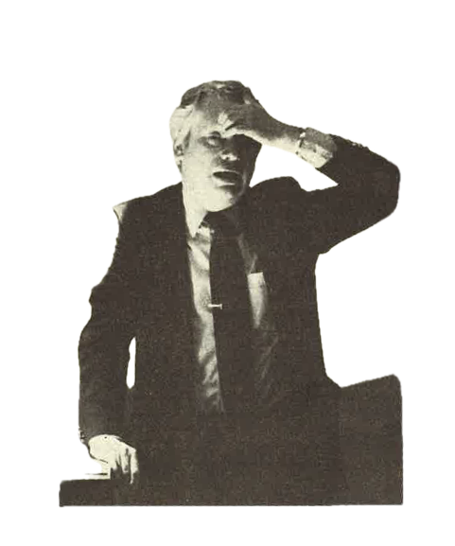
Snapshot #1: Inner Space/Outer Space 1984
Cosmology in Extra Dimensions*
Physics in higher dimensions, S. Weinberg
Kaluza-Klein cosmology: Techniques for Quantum Compactification, M. Rubin
High-temperature quantum effects in Kaluza-Klein cosmology, M. Yoshimura
More dimensions-less inflation, D. Lindley
Inflation from extra dimensions, S. Barr
Massless fermions in Kaluza-Klein theories, G. Venturi
Reduced gauge group of symmetric Kaluza-Klein space, R. Kantowski
Cosmology in higher dimensions, C. Vayonakis
* Extra dimensions ⇒ Kaluza-Klein
No superstrings—just before Green/Schwarz

Slide 9
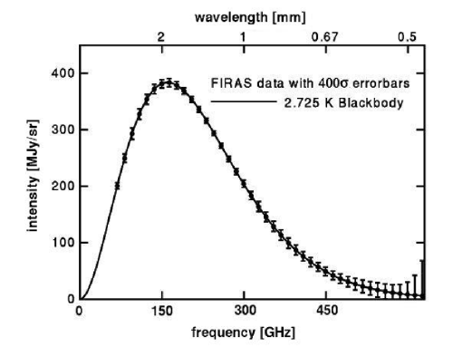
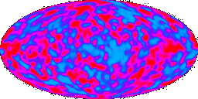
Snapshot #1: Inner Space/Outer Space 1984
Cosmic Microwave Background
Eight talks
Spectrum (1 talk)
Upper limits on anisotropies (3 talks)
Theoretical implications (4 talks)
Peterson, Richards,
Bonomo, Timusk
Spectrum and anisotropies reported by COBE in 1992
Wilkinson

Slide 10
Snapshot #1: Inner Space/Outer Space 1984
From Joe Polchinski’s talk
(for many astros, first intro to SUSY)
Supersymmetry, Supergravity, Quantum Gravity
Supersymmetry and supergravity, J. Polchinski
Supersymmetric relics from the big bang, J. Hagelin
Is spontaneously broken supersymmetry restored at high temperature, M. Kulab
The photino, the axino, and the gravitino in cosmology, J. Kim
Higgs masses and supersymmetry, R. Flores and M. Sher
Initial conditions, J. Hartle
Path integral quantum cosmology, B. Berger
S

Slide 11

Snapshot #1: Inner Space/Outer Space 1984
Other Particle-Cosmology Topics
Axions in astrophysics and cosmology, P. Sikivie
Role of axions in neutron star cooling, N. Iwamoto
Mirror fermions and cosmology, G. Senjanović
Review of neutrinos and neutrino mass from particle physics experiments, F. Sciulli
New and old accelerators, Bj Bjorken
Axions, neutrinos, and strings, F. Stecker
Present status of grand unification and proton decay, P. Langacker

Slide 12
Snapshot #1: Inner Space/Outer Space 1984
By 1984 much of current areas of research in Particle Cosmology were in place: cold dark matter, number neutrinos, inflation & temperature/density perturbations.
Some of the areas covered at the meeting did not pan out: monopoles, Kaluza-Klein, proton decay & GUTs, cosmic strings as seeds of structure formation...
Was such a meeting conceivable in May 1974? Maybe not.
For cosmology, particle physicists probably would have used Gravitation and Cosmology (Weinberg 1972).
Was there a maximum temperature?
Composite particle model:
Elementary particle model: “quarks” in degrees of freedom
Asymptotic freedom (1973) & J /Ψ (November 1974)
J. Collins & M. Perry, Phys. Rev. Lett. 34,1353 (1975)
“The quark model implies that superdense matter … consists of quarks rather than hadrons. Bjorken scaling implies quarks interact weakly. An asymptotically free gauge theory allows realistic calculations taking full account of strong interactions.”

Slide 13
Snapshot #2: Resource Letter 1988
Resource Letter:
Cosmology and Particle Physics
David Lindley, EWK, David N. Schramm
Am. J. Physics 56, June 1988

Slide 14
Snapshot #2: Resource Letter 1988
Resource Letter:
Cosmology and Particle Physics
David Lindley, EWK, David N. Schramm
Am. J. Physics 56, June 1988

Slide 15
Snapshot #2: Resource Letter 1988
New Particles:
Neutrinos (mass, lifetime, number of families)
SUSY relics
Magnetic Monopoles
Cowsik, McClelland, Lee, Weinberg, Dicus, Kolb, Teplitz, Lindley, Steigman, Schramm, Gunn, Ellis, Hagelin, Nanopoulas, Olive, Srednicki, Zel’dovich, Khlopov, Turner, Parker, Bogdan
Dark Matter and Galaxies:
Cold dark matter
Hot and warm dark matter (neutrinos)
Dark matter & structure
Davis, Efstathiou, Frenk, White, Bond, Efstathiou, Silk, Peebles
Baryogenesis:
CP, C, B violation
Sakharov
Resource Letter:
Cosmology and Particle Physics
David Lindley, EWK, David N. Schramm
Am. J. Physics 56, June 1988

Slide 16
Snapshot #2: Resource Letter 1988
Phase Transitions:
Domain walls and strings
Cosmic Strings
Gravitational interactions of strings
Kibble, Turok, Bhattacharjee, Hogan, Rees
Inflation:
Old inflation
New inflation
GUTs and inflation
Guth, Linde, Albrecht, Steinhardt
Quantum Gravity:
Wave function of the universe
Creation of the universe from nothing
Hartle, Hawking, Vilenkin
Resource Letter:
Cosmology and Particle Physics
David Lindley, EWK, David N. Schramm
Am. J. Physics 56, June 1988
No mention of: leptogenesis, EWK phase transition, CMB limits, density perturbations & gravitational waves from inflation, extra dimensions, axions, superstrings, BBN …

Slide 17
Snapshot #3: Snowmass Summer Study 1994
Organized by EWK and Roberto Peccei.
Two-week workshop.
Convenors: Jim Cronin, Wick Haxton, Bernard Sadoulet, Paul Steinhardt, Kip Thorne.
450 participants: astronomers, astrophysicists, cosmologists, high-energy physicists, nuclear physicists, gravitation physicists.
Quotes from the introduction
Cronin, Haxton, EWK, Peccei, Sadoulet, Steinhardt, Thorne
Organizational and computational talents of particle physicists emboldened astronomers [to undertake large projects].
[It is a] sad testament to the times that the potential for new discoveries does not seem to be limited by a lack of ideas, technology, or proposals, but by fiscal realities and the artificially constructed barriers of the existing science policy framework. [Would the same statement be made in 2025?]

Slide 18
Snapshot #3: Snowmass Summer Study 1994
More than 20 working groups and 5 supergroups
Neutrinos (Wick Haxton)
mass, oscillations, solar neutrinos, neutrino astro.
Cosmic Rays (Jim Cronin & Jonathan Ormes)
space-based γ-ray, ground-based γ-ray, over the knee cosmic rays, highest-energy cosmic rays.
Gravitational Phenomena (Kip Thorne)
black holes and cosmology, black hole astrophysics, gravity waves.
Low-Background experiments (Bernard Sadoulet)
proton decay, dark matter, other underground experiments.

Slide 19
Snapshot #3: Snowmass Summer Study 1994
More than 20 working groups and 5 supergroups
Cosmology (Paul Steinhardt)
cosmological models, baryogenesis, nucleosynthesis, cosmic background radiation, structure formation (simulation and phenomenology), observational cosmology.
Sixty papers in proceedings.

Slide 20
Snapshot #3: Snowmass Summer Study 1994
Changes from IS/OS (1984) ⇒ Snowmass (1994)
CMB anisotropies & spectrum (COBE) strengthened evidence for inflation.
Dark-matter direct detection experiments were getting off the ground (and underground).
Axion searches starting.
High-energy cosmic rays became part of the conversation.
Advances in large-scale structure observations and theory. Cold dark matter emerges as best model. Hot dark matter (neutrinos) disfavored.
Case for kilometer-scale ν detectors (IceCube).
Gravitational waves & black-hole astrophysics.
String theory and quantum gravity included.
Neutrino oscillations (solar, atmospheric, accelerator) more prominent.

Slide 21
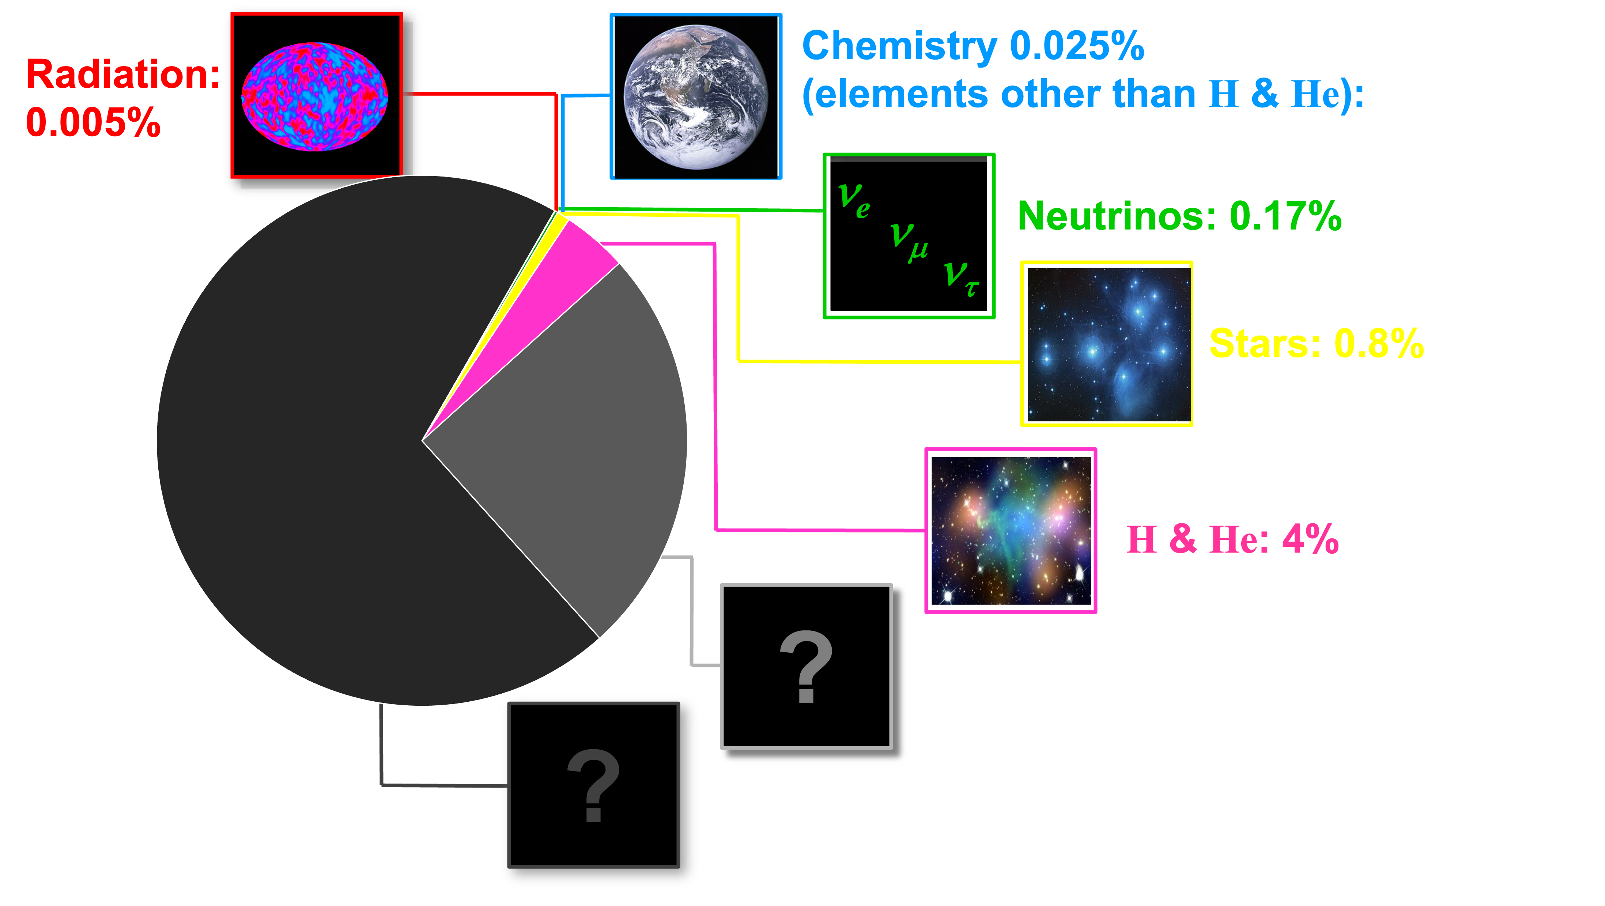
Particle Cosmology, fin de siècle
Standard Model of Cosmology in place
1998: Discovery of dark energy (Λ) reconciled inflationary predictions of a flat universe (Ω = 1) with astronomers’ insistence that Ω_{M} ≈ 0.25.
ΛCDM is standard model for evolution of structure.
Despite heroic experimental efforts and many theoretical ideas, nature of dark matter still a mystery.
Awaiting compelling particle physics model for inflation.
Why is Λ so small, and is it constant?

Slide 22
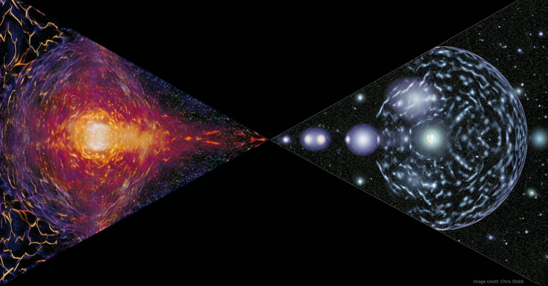
Cosmological Particle Physics
A frontier field, Particle Cosmology, emerged in the 1980s and 1990s.
Originally on the fringes, cosmology is now firmly embedded in BSM particle physics.
Ideas from particle physics drove much of modern cosmology; big-bang theory, observation (e.g., SDSS), experiment.
Chicagoland (Fermilab and U. Chicago) played a central role, esp. in 1980s.
It was (and still is) terribly exciting to have a ringside seat (sometimes in the ring) in the merging of Inner Space and Outer Space.
Rocky Kolb
Fermilab (1983-2006)
University of Chicago (1984-present)

