Slide 1
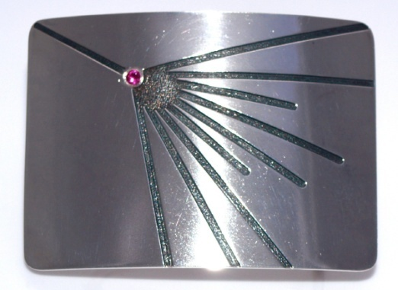
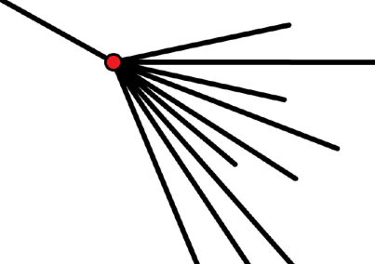
Neutrino Telescopes and High Energy Cosmic Ray Detectors
CERN History Symposium
Alan Watson
University of Leeds, UK
a.a.watson@leeds.ac.uk

Slide 2
Currently, information about neutrinos above ~100 TeV is dominated
by results from IceCube, while the major data on the highest energy
cosmic rays above ~ 1 EeV are from the Pierre Auger Observatory
Both projects had their genesis in the period 1980 – 2000
Predictions for fluxes of neutrinos and ultra-high energy
cosmic rays are not many and not very reliable
Still poor - but essentially guesses in 1980s
‘Why make it so big?’ is thus a difficult question to answer
Claims for PeV photons from Cygnus X-3 played an important role

Slide 3
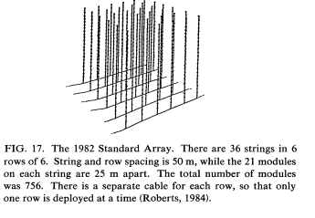
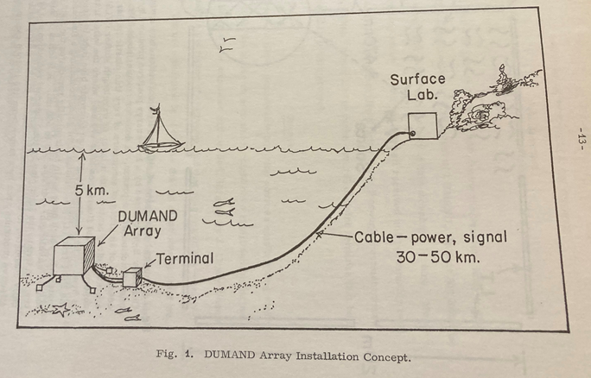
First concept of a Neutrino Telescope
Markov 1960: “ ... to install detectors deep in a lake or a sea and to determine the direction of charged particles with the help of Cherenkov radiation”
US, European and Soviet scientists
Strings with photomultipliers
to detect Cherenkov light produced
by upward-travelling muons created
by neutrinos
1980: First Funding
1980: Regan ends Soviet involvement
after invasion of Afghanistan
1996: DUMAND funding ended
- but left a rich legacy of ideas
and technology
DUMAND Array Installation Concept: Arthur Roberts 1978

Slide 4
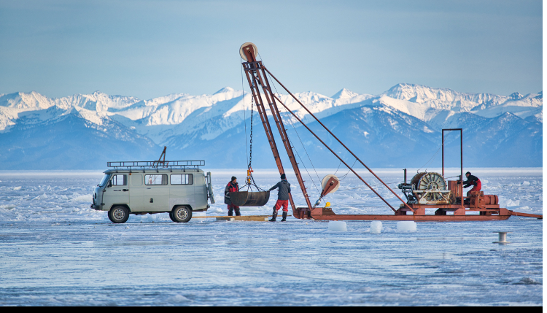
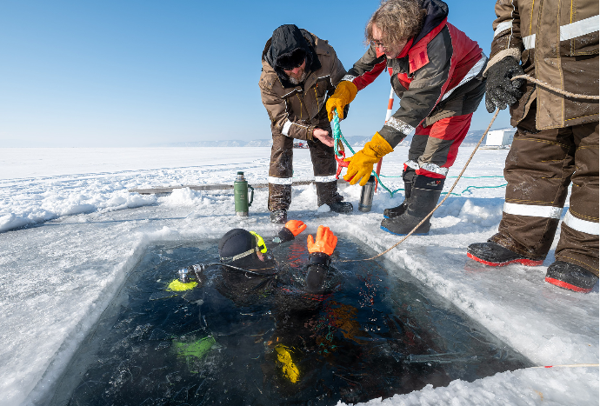
Deployment at Lake Baikal:
concept developed in 1981
Detectors at depth of ~1 km
-Russian and East German involvement
1981: First deployment at Lake Baikal
1993: Third string deployed:
First neutrino team to achieve this
1996: First three neutrinos detected
2025: 0.6 km³
~2028: 1 km³

Slide 5
Birth of IceCube
1987: Francis Halzen learned of Russian attempts at Vostok (in Antarctica)
to detect neutrinos using radio signals produced in the ice
Idea of ‘DUMAND in Ice’ was born
1990: Test string of photomultipliers deployed on Greenland Ice Sheet
1993-4: AMANDA Collaboration deploy first four strings at South Pole

Slide 6
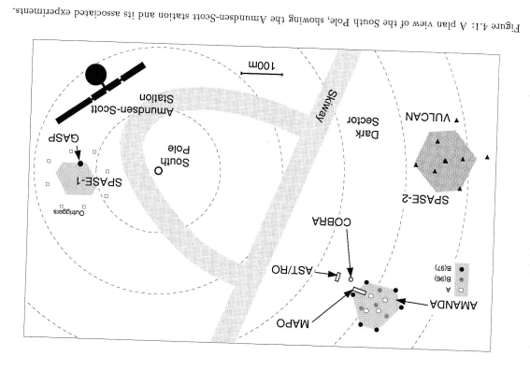
South Pole Instruments: 1998
Four Strings 1993/4
What is SPASE?
SPASE-I 1987
SPASE-2
30 detectors 1994

Slide 7
SPASE-1 was a small air-shower array built by the Bartol-Leeds Collaboration
to look for 100 TeV gamma-rays from X-ray binaries and SN1987A
1983: Report by Kiel group that photons of ~ 1PeV had been detected from Cygnus X-3,
an X-ray binary (neutron star + normal star)
Confirmation by UK group at Haverah Park
Claims perhaps erroneous
– though currently rumours that LHAASO have found it to be a variable source
Other groups claimed to see PeV gamma-rays from Vela X-1, LMC X-4 and Her X-1 - all X-ray binary system
1986: Hillas pointed out that South Pole (2835 m) was best place from which to observed X-ray binaries
1987: SN1987A – 27⁰ from zenith - predictions of high energy photons
Gaisser, Harding and Stanev (Nature 1987)
Particle acceleration and production of energetic photons in SN1987A
Berezinsky and Ginzburg (Nature 1987)
Cosmic rays and gamma radiation from the shell of SN1987A

Slide 8
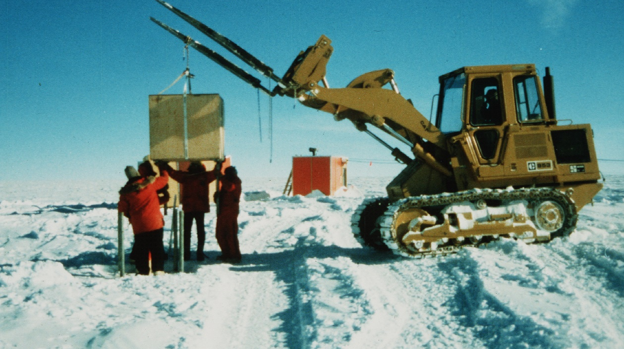
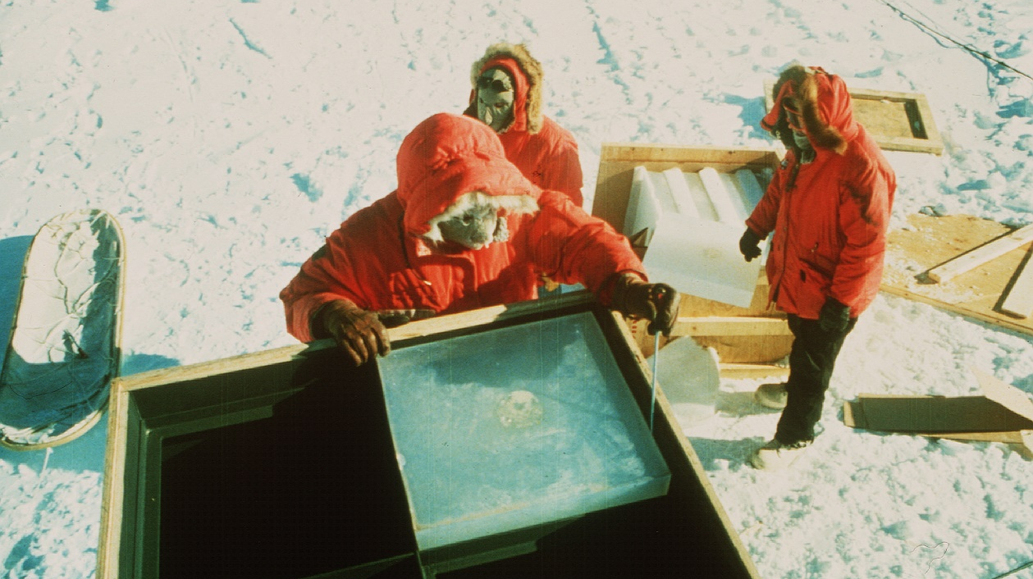
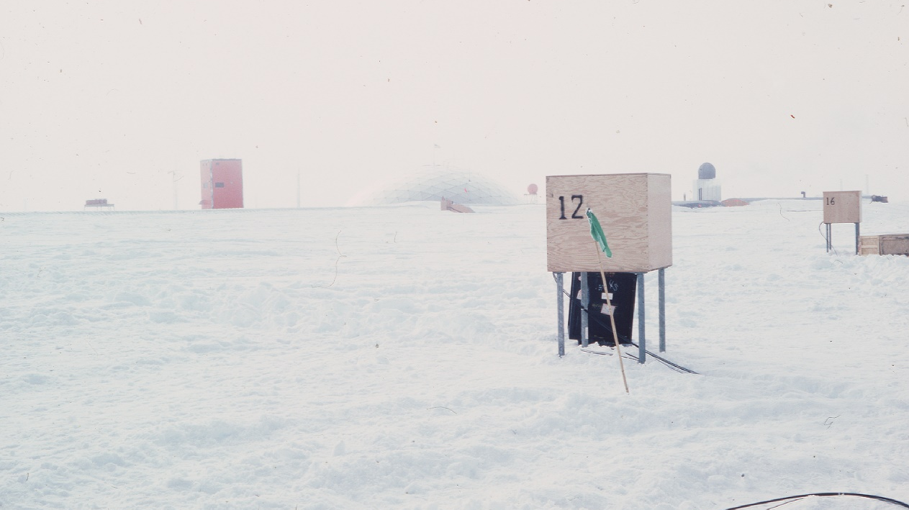
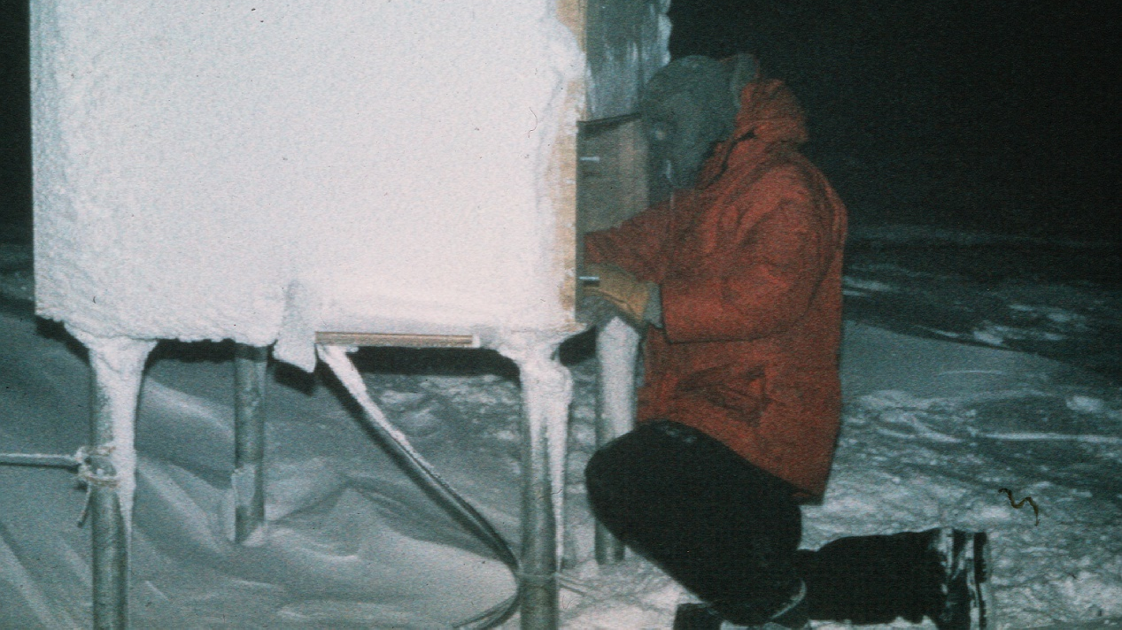
Nigel Smith working in winter at – 60⁰ C
now TRIUMF Director
Observations started in December 1978

Slide 9
The first four AMANDA strings were at depths between 800 - 1000 m
An unexpectedly high coincidence rate between AMANDA and SPASE-1
led to the conclusion that there were bubbles at this depth
Russians had warned about the bubble problem at this depth - ignored
Coincidences were also used to survey the positions of the AMANDA modules to an accuracy of ~ 5 m
AMANDA-B with 86 modules on 4 strings were positioned at 1500 – 2000 m in 1996
The IceCube modules are at depths between 1450 and 2450 m, with a shower array directly above the detector. First IceCube string was deployed in 2004-5 season
Completion of IceCube in 2011-12

Slide 10
The Cygnus X-3 claims drew several eminent particle physicists into cosmic ray physics.
Most prominent was undoubtedly James Cronin (Nobel Prize 1980)
Cronin: Ann. Rev. Nucl. Part. Sci. 2014
His view of his future in 1985
“For 30 years, I performed experiments at high-energy accelerators. But the opportunity to work in a small group with a few students and senior colleagues was coming to an end
By the mid 1980s, many of the most important experiments proposed at accelerators were becoming larger and more expensive and often required hundreds of physicists..………the evolving nature of the experiments did not appeal to me.
Important as these future experiments were, I realized that they would take place with or without me.
For any future experiment in which I would participate, I wanted to make a difference even if the experiment was not of the greatest importance (measurement of π⁰ lifetime). Thus, I began to look for other areas of research.
Built a shower array (CASA) of 1 km² to look for photons from Cygnus X-3, having had his plans critiqued by several in the cosmic ray field

Slide 11
Birth of Auger Observatory
1990: Watson Review Article: “Need to build 1000 km² ”
1991: Cronin to me ‘You are not ambitious enough: we should build 5000 km² ’
Late 1991: Cronin and I made first design study in Leeds
Built a collaboration of about 400 scientists from 17 countries
Fortunate time to attract people from particle physics:
SSC had just been terminated – opportunity of Fermi Lab involvement
Scientist from LEP were looking for other activities, e.g. Giorgio Matthiae
Pierre Darriulat looking for opportunities to develop physics in Vietnam

Slide 12
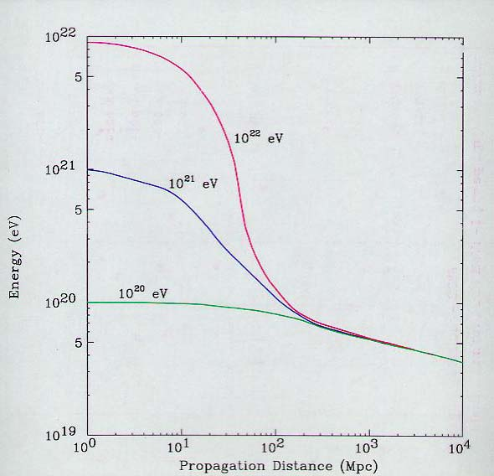
p + γ_{2.7 K} → Δ+ → p + π⁰
or n + π⁺
Fe⁵⁶ + γ_{2.7 K, IR} → Fe⁵⁵ + n
Greisen and Zatsepin and Kuzmin (1966): GZK effect
A prediction:
Does the cosmic ray
spectrum terminate?
Cosmic rays of energy above 10²⁰ eV expected to be very rare – but no local sources evident
1993: HiRes (Utah) group reported event of 3 x 10²⁰ eV and AGASA (Japan) claimed several trans-GZK events
Exotic explanations:
1998: Coleman and Glashow: Lorenz invariance breakdown
1999: Berezinsky: Ultrahigh Energy Cosmic Rays from cosmological relics
1999: Kuzmin and Tkachev: Ultrahigh energy cosmic rays and inflation relics

Slide 13
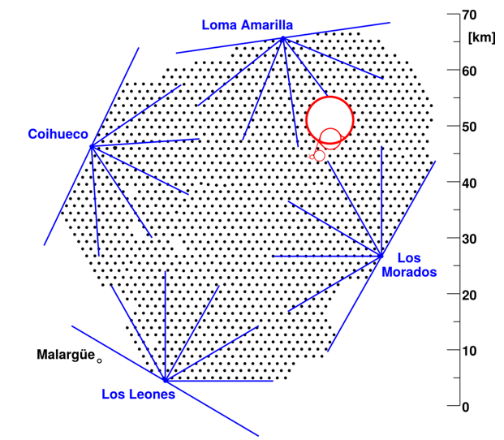
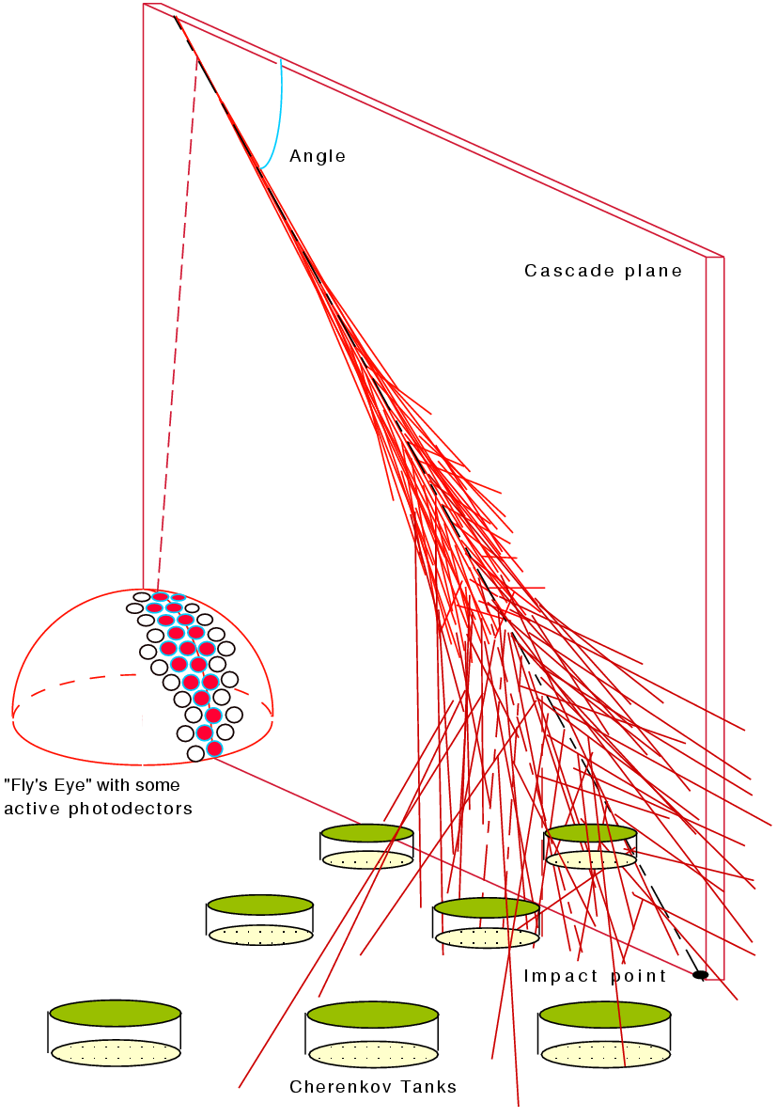
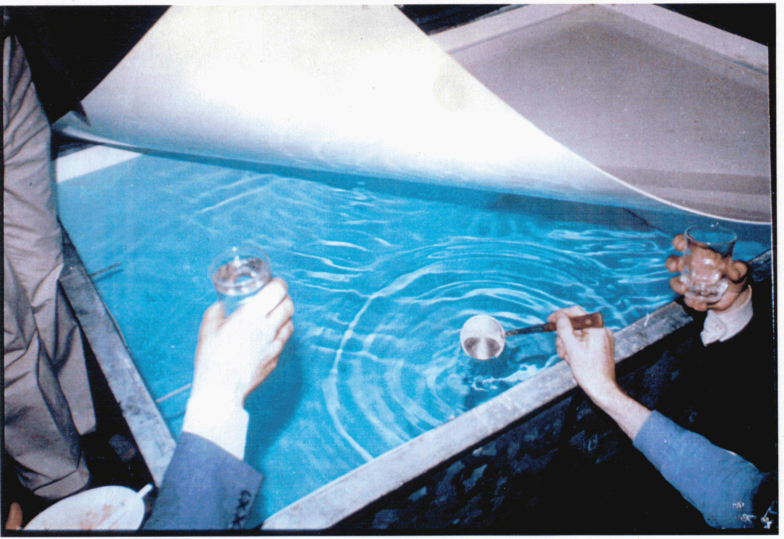
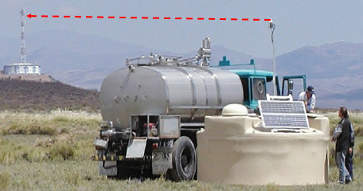
1995: Six-month Design Workshop held at Fermi Lab, hosted by John Peoples
Cronin extracted $100k from Director of UNESCO
Many avenues explored: 3000 km², N and S
Hybrid design: water-Cherenkov and fluorescence detectors
Cherenkov detectors give large zenith angle range
Cost per site ~$50M
Water still clear after 25 years – Existence proof!

Slide 14
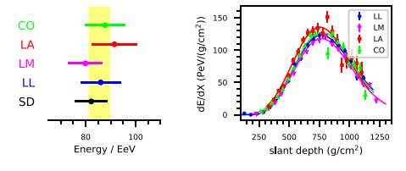
The fluorescence technique is very challenging
Limited duty cycle: less that 10%
Intensive atmospheric monitoring needed – aerosol problems, mirror cleaning – very hard work
Difficult to study small scale anisotropies
Only Utah group had used it seriously
Much tougher to get science out than expected – but hybrid approach very advantageous

Slide 15
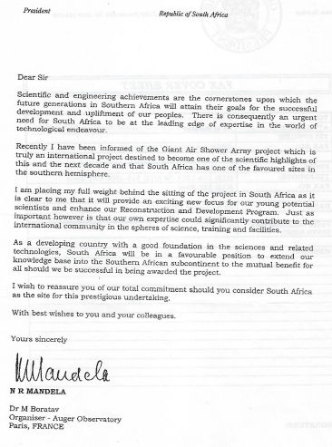
Where to build it?
Site searches undertaken in 1994/5
Requirements:
Latitude between 30⁰ and 40⁰ , North and South
400 – 1500 m above sea-level
Clear skies
Suitable infra-structure
Flat
In Southern Hemisphere, the possibilities were:
Australia
South Africa
Argentina
Argentina chosen: President Menem promised
11 M pesos at time when $1 = 1 Ar Peso
Devaluation of 4:1 in 2002
November 1995

Slide 16
How to have plans reviewed?
The Axford Panel: 23 – 24 November 1994
W I Axford, Max Planck Director, Lindau
R Cowsik, Bangalore
N Demassieux, Telcom Paris Tech
R Ekers, Australia
M T Koshiba, Tokyo
J Steinberger, CERN
Very strongly supportive report
Useful when attempting to get funding
Though NSF view was negative:
‘Of course it was a strong report:
You chose the Panel’

Slide 17
Tensions between ‘Fluorescence vs Hybrid approaches’ caused great problems in getting funding
Team in Utah (NSF funded) and Japanese argued for ‘All Fluorescence’ approach
Led to issues with US review by SAGENAP (Scientific Advisor Group for non-accelerator Physics)
At first meeting decision was deferred with reasonable questions
At second meeting, answers were presented but a member of the Utah group presented an alternative proposal (El Cheapo) that he argued should be done before Auger Observatory was developed
This undoubtedly helped to lead to a rejection of the proposal
Appeared that the Panel mis-trusted surface detector arrays also wanted to see a ‘descope’
Eventually, after a third meeting with NSF now involved, $7.5 M was awarded
to start work in Argentina: $30M had been sought
With hindsight, a very sensible decision
Cronin made valiant efforts to involve the Utah group: two years sabbatical at Utah – disaster!

Slide 18
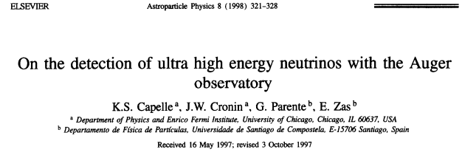
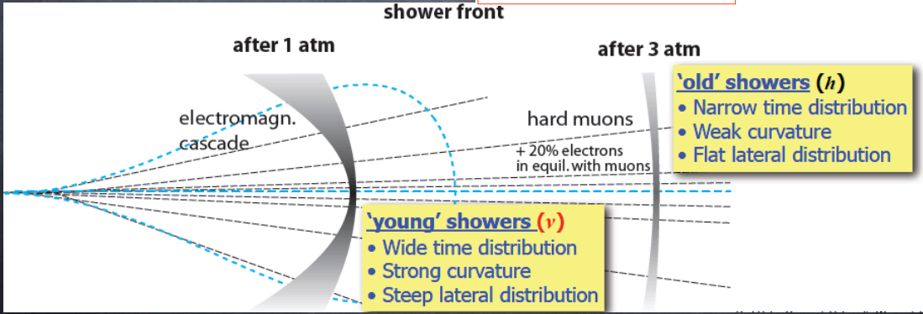
Auger Observatory as a Neutrino Detector:
but too late for the SAGENAP evaluation

Slide 19
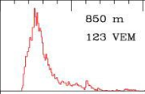
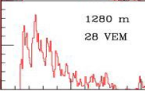
96 stations triggered
10¹⁹ eV, 13°, 4 μs

Slide 20
Summary:
Purpose-built Neutrino Telescopes are operational at
Lake Baikal (Siberia: 0.6 km³), IceCube (South Pole: 1 km³)
and km3Net (Mediterranean: 1 km³)
Others are under development: NEON (South China Sea: 10 km³),
P-One (off coast of western Canada: 1 km³)
Auger Observatory has potential to see neutrinos above 10¹⁸ eV
=========================================================
UHECR studies continue at Auger Observatory (3000 km² ) and at the Telescope
Array: scintillators and fluorescence (700 km²) – another hybrid detector!
– discussions began 1999/2000, primarily a US (Utah/Japanese effort)
The Cygnus X-3 ‘discovery’ played an important role – recent news suggests that it is ‘ON’ again – and a potential neutrino source

