Slide 1
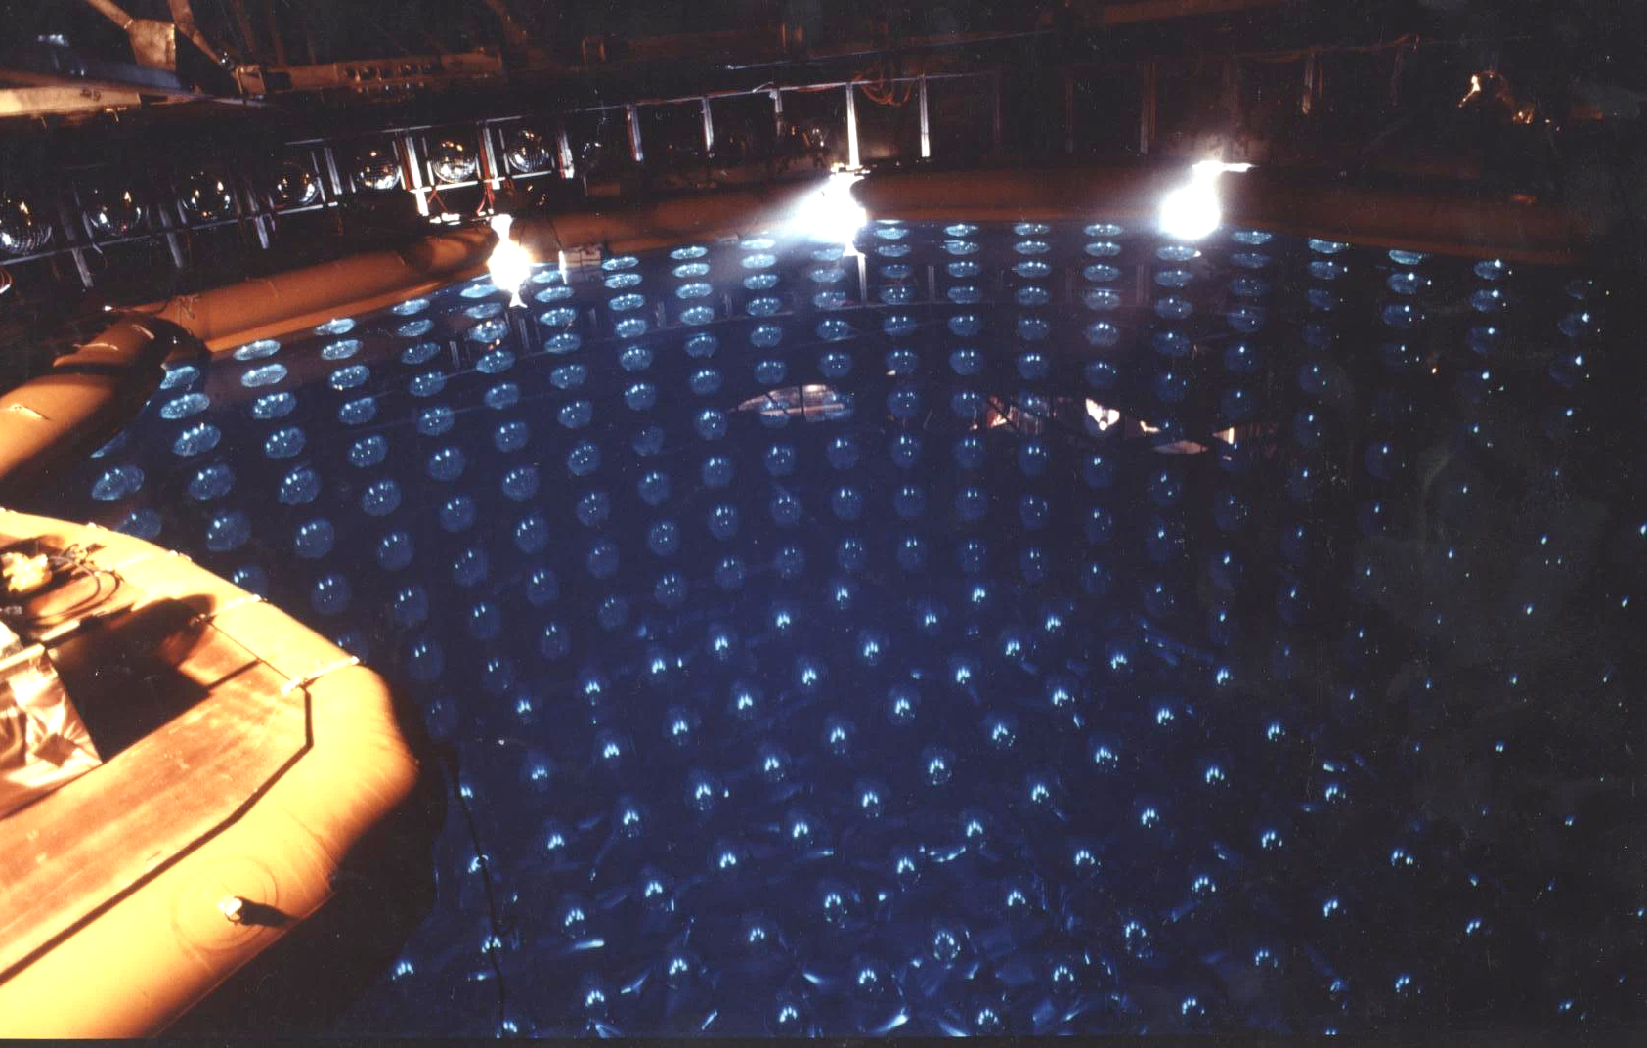
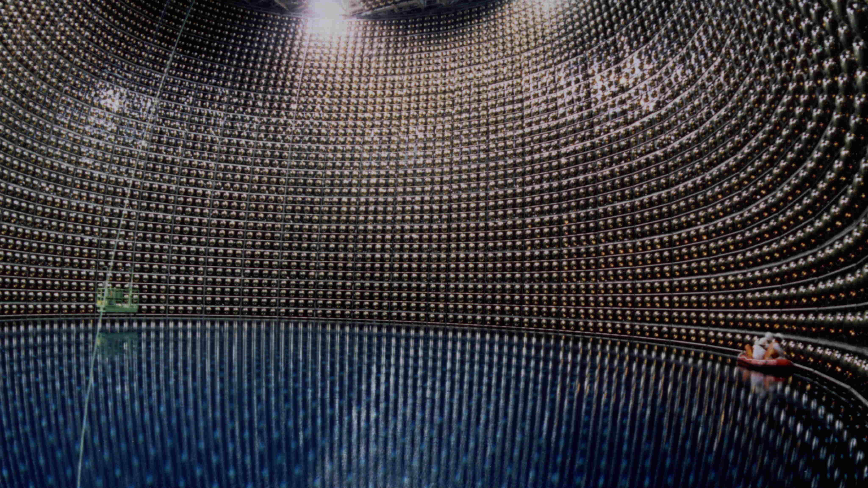
Kamiokande and Super-Kamiokande
4th Symposium on the History of Particle Physics
CERN, Nov. 10-13, 2025
Takaaki Kajita
Institute for Cosmic Ray Research, The Univ. of Tokyo
Notes:
251113 30min incl. Q&A

Slide 2
Outline
Kamiokande
Super-Kamiokande
Atmospheric neutrino oscillations
Solar neutrino oscillations
Summary
2

Slide 3
Kamiokande
3

Slide 4
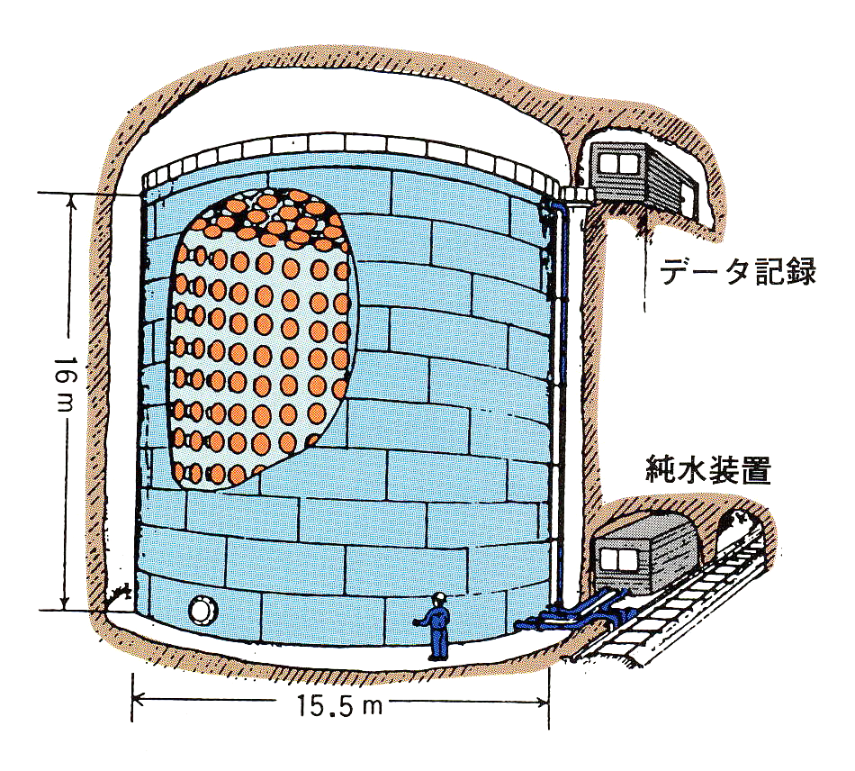
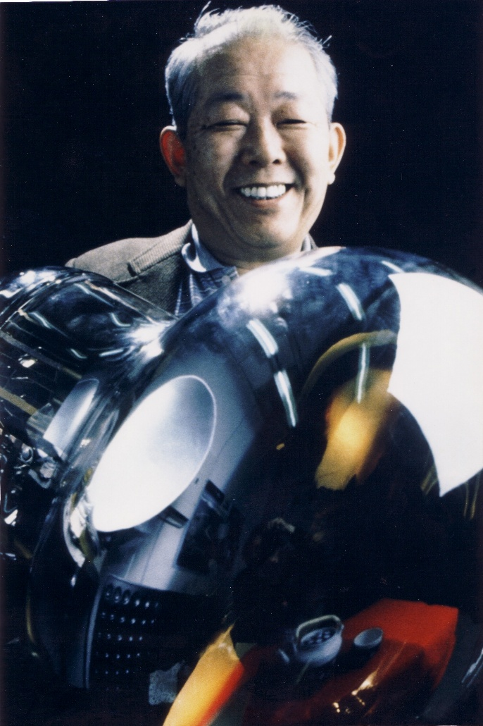
Kamiokande
In late 1978, Prof. Sugawara made a phone call to Prof. Koshiba asking a talk on a possible proton decay experiment at the workshop on “The Unified Theory and the Baryon Number in the Universe”, which was held in KEK in 1979. ➔Prof. Koshiba proposed the initial concept of Kamiokande.
The news then came from USA that an 8000 ton water Cerenkov detector surrounded by 2000 5-inch diameter PMTs (IMB experiment) was proposed.
In 1979, M. Koshiba discussed with T. Hiruma (president of Hamamatsu TV Co.) T. Hiruma agreed to develop large PMTs jointly with the University of Tokyo group.
TK, M.Koshiba, A.Suzuki, Eur. Phys. J. H. 37 (2012) 33-73
Kamiokande (3000 ton water tank)
Elec.
Water system
Masatoshi Koshiba
Credit PETER MENZEL / SCIENCE PHOTO LIBRARY
4

Slide 5
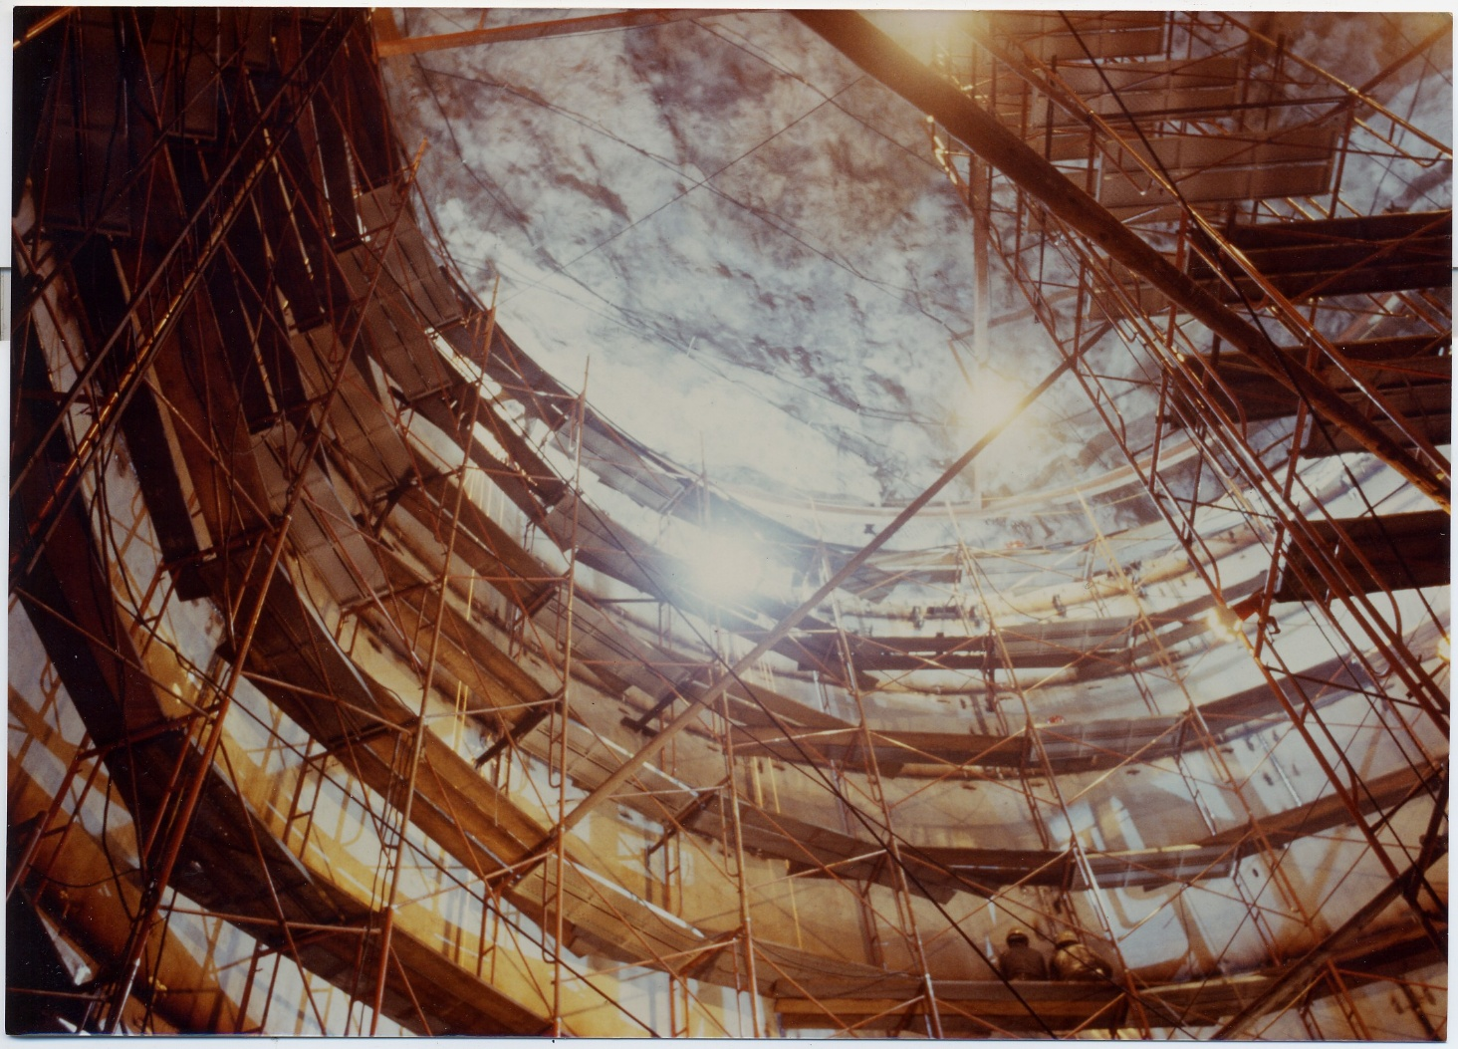
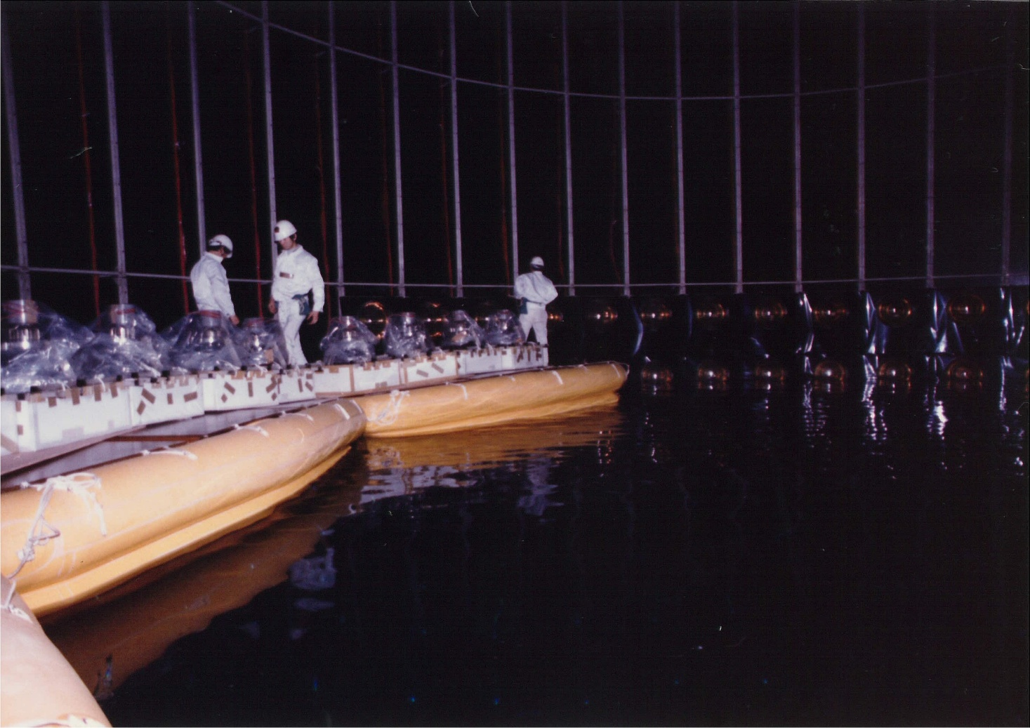
Construction of the Kamiokande detector
Installation of PMTs probably in May 1983
Kamiokande tank construction probably in late 1982
The Kamiokande experiment started on July 6, 1983.
5

Slide 6
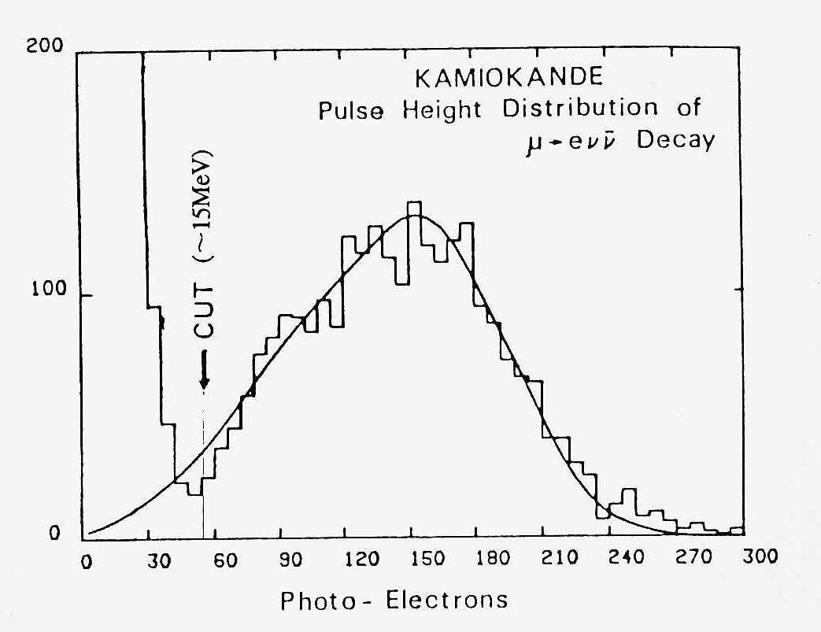
Didn’t observe proton decays, but…
Neutrinos with the energies of about 10 MeV could be observed.
Prof. Koshiba proposed to improve the Kamiokande detector to observe ⁸B solar neutrinos (Autumn 1983).
12 authors
Pulse height distribution of electrons from the decay of cosmic ray stopping muons (early autumn 1983)
The observed flux by the Homestake experiment was about 30% of the expectation by the standard solar model. (R. Davis Jr., D. S. Harmer and K. C. Hoffman PRL 20 (1968) 1205)
6

Slide 7
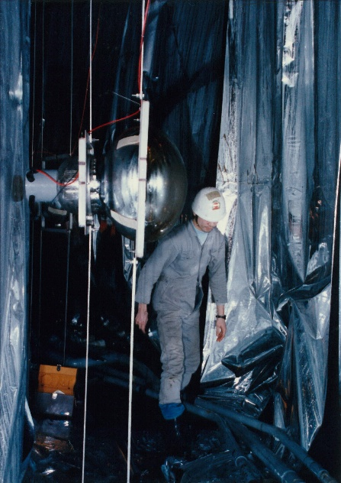
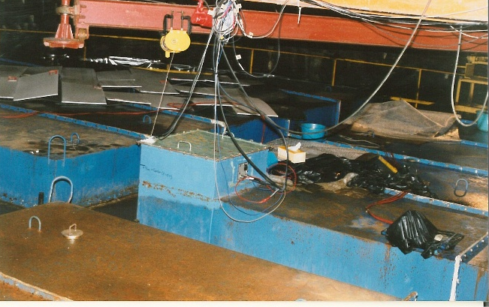
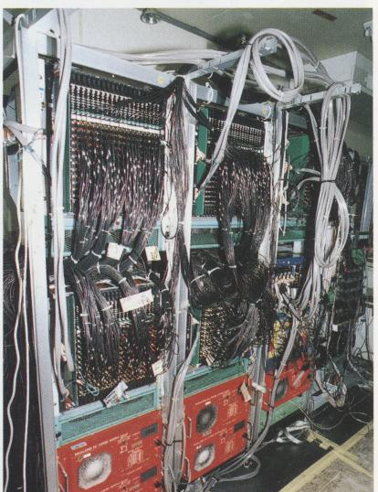
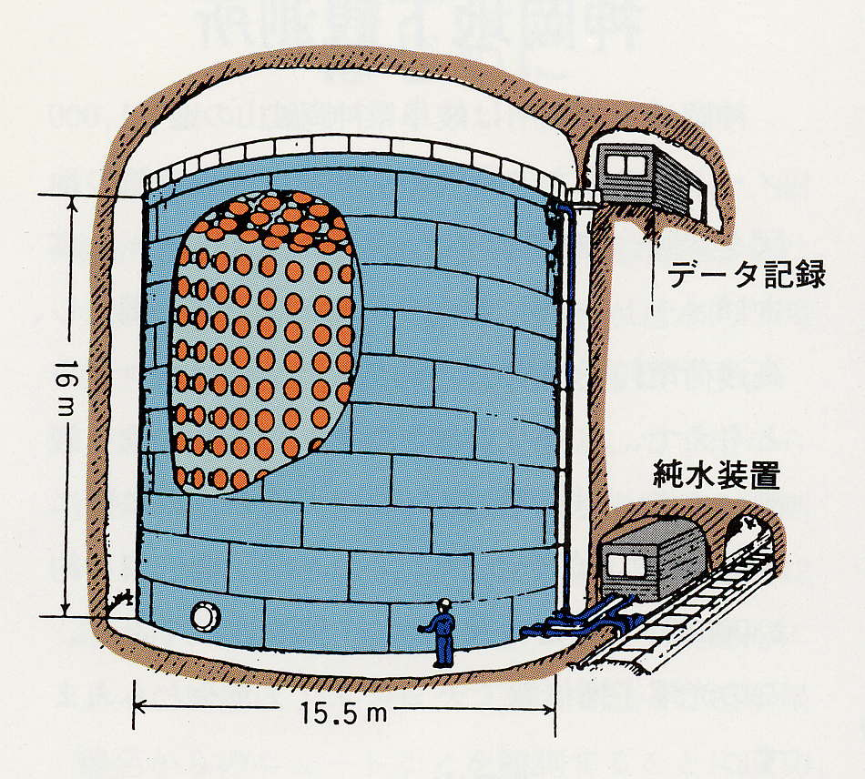
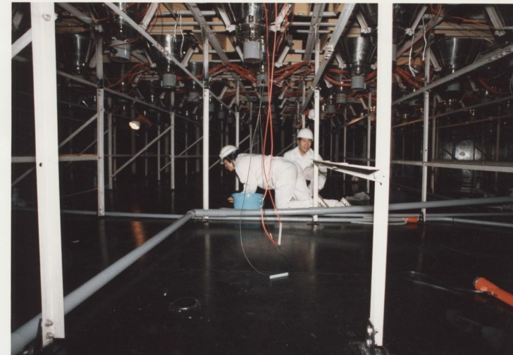
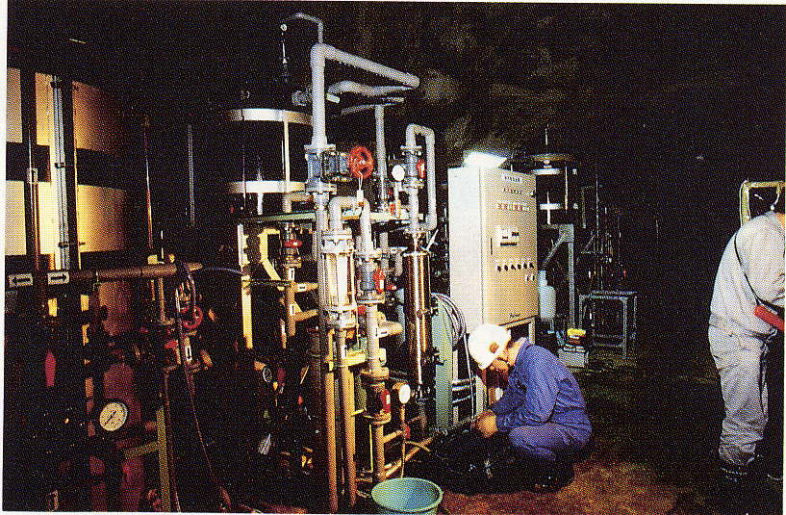
Toward Kamiokande-II (1984-6)
Airtight roof with Rn free air
(1987)
Electronics that measure multi-hit T and Q (U. of Penn)
Installation of anti-counters (outer detectors)
electronics
Water system
Improvement of the water purification system
7

Slide 8
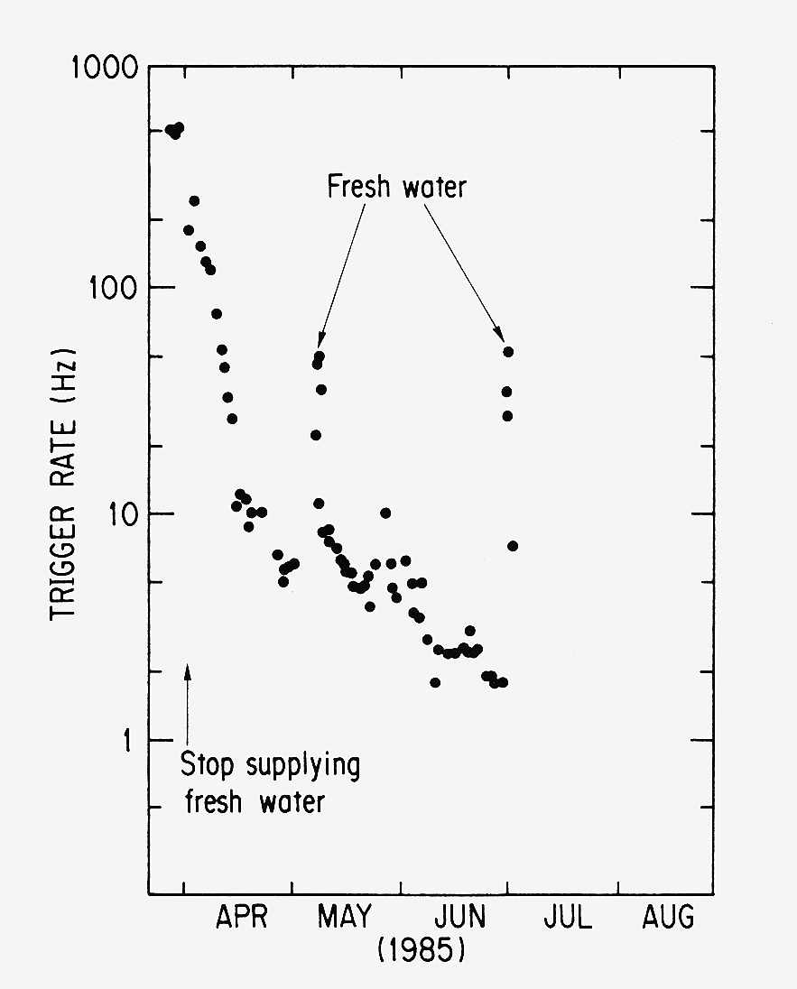
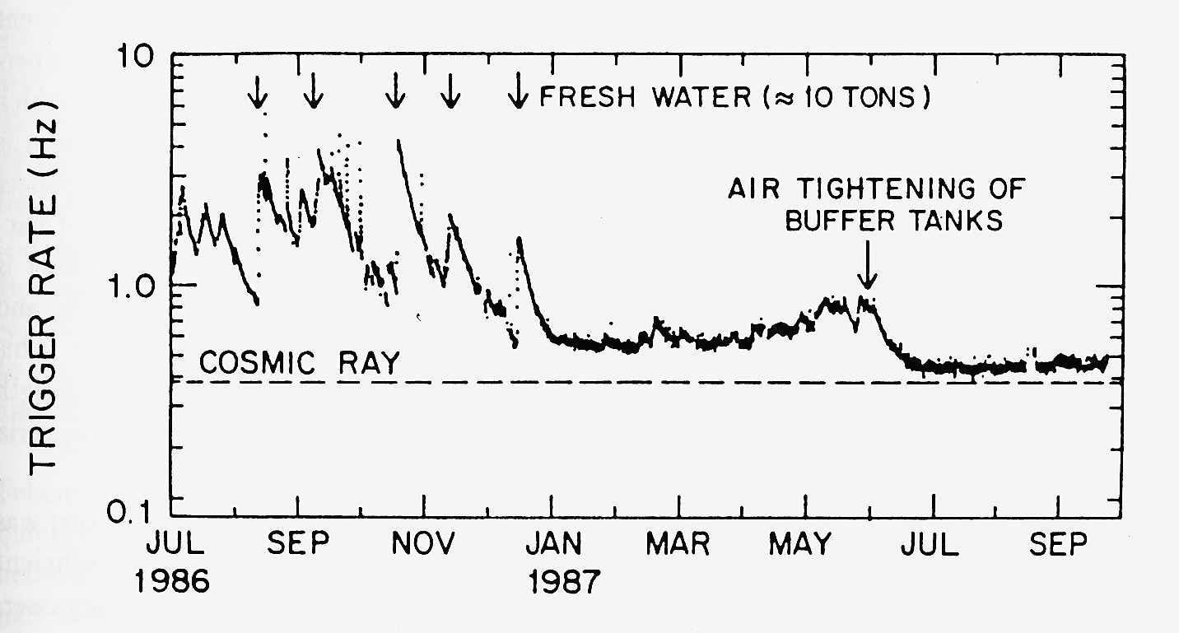
Water and the trigger rate
Radioactivities, in particular Rn at that stage, was the most serious issue.
Stable trigger rate was achieved in Jan. 1987.
8

Slide 9
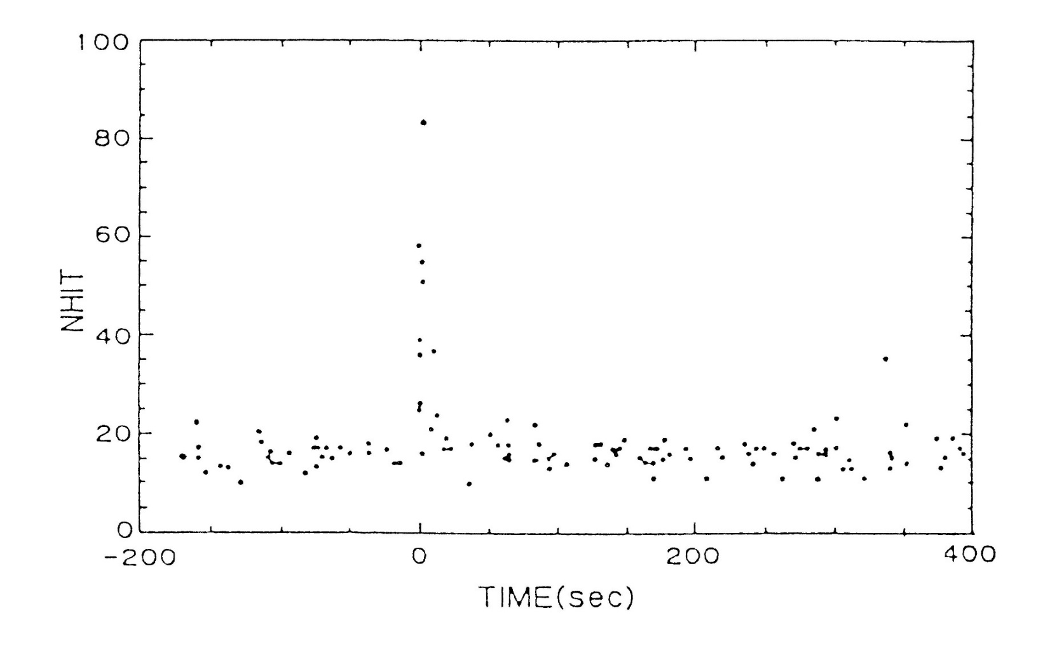
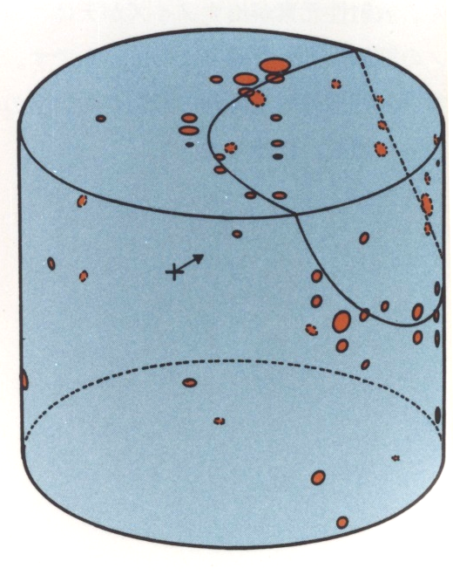
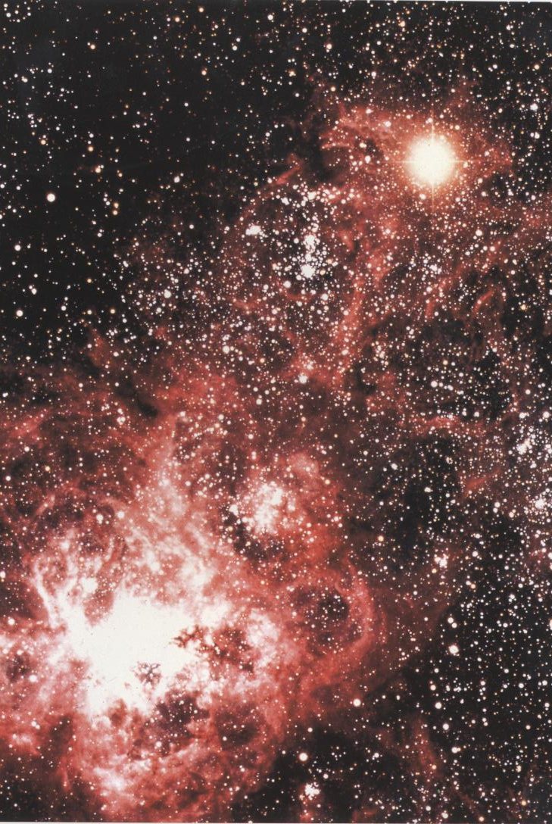
SN1987A (Feb. 23, 1987)
K. Hirata et al., Phys. Rev. Lett. 58 (1987) 1490.
SN1987A (at LMC)
Number of PMT hits
Prof. Kosiba said; “Many people say I am fortunate. However, at that time, neutrinos came to everywhere on the earth. Only people who prepared for them were able to observe them.”
@Anglo Australian Observatory
The IMB and Baksan experiments also observed the neutrino signal.
9

Slide 10
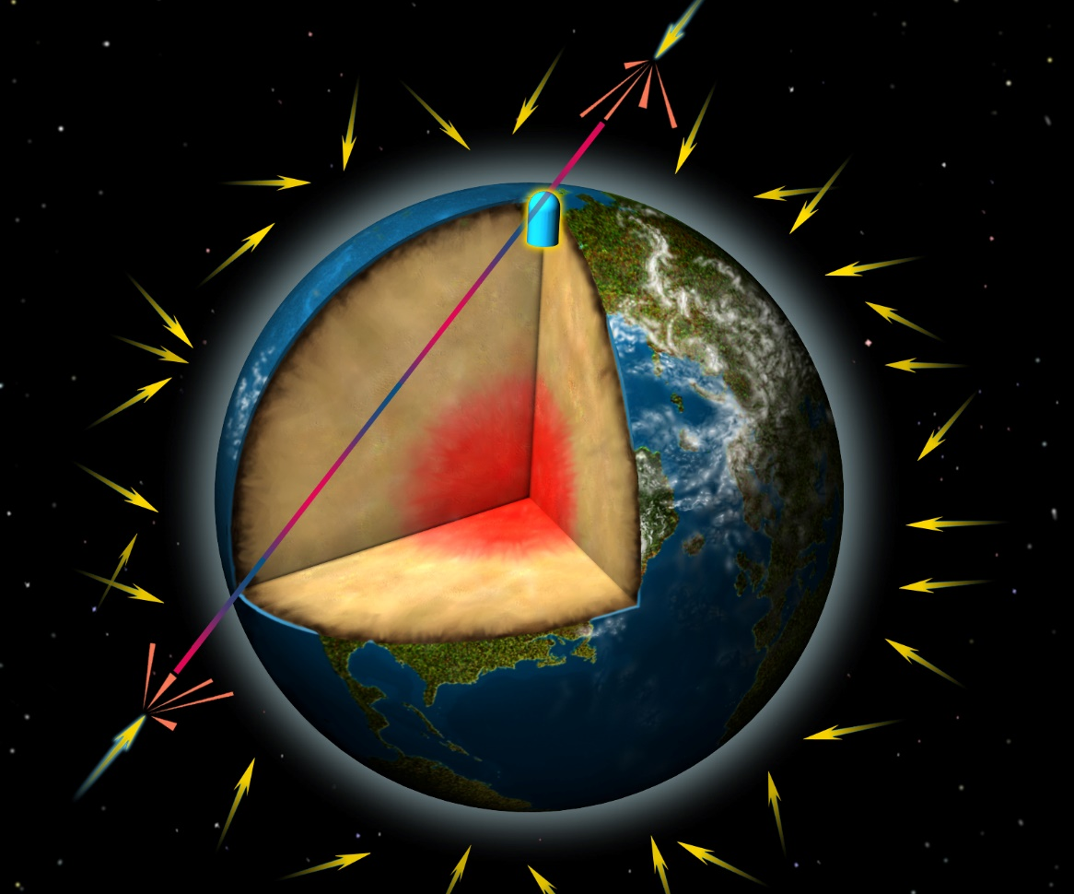
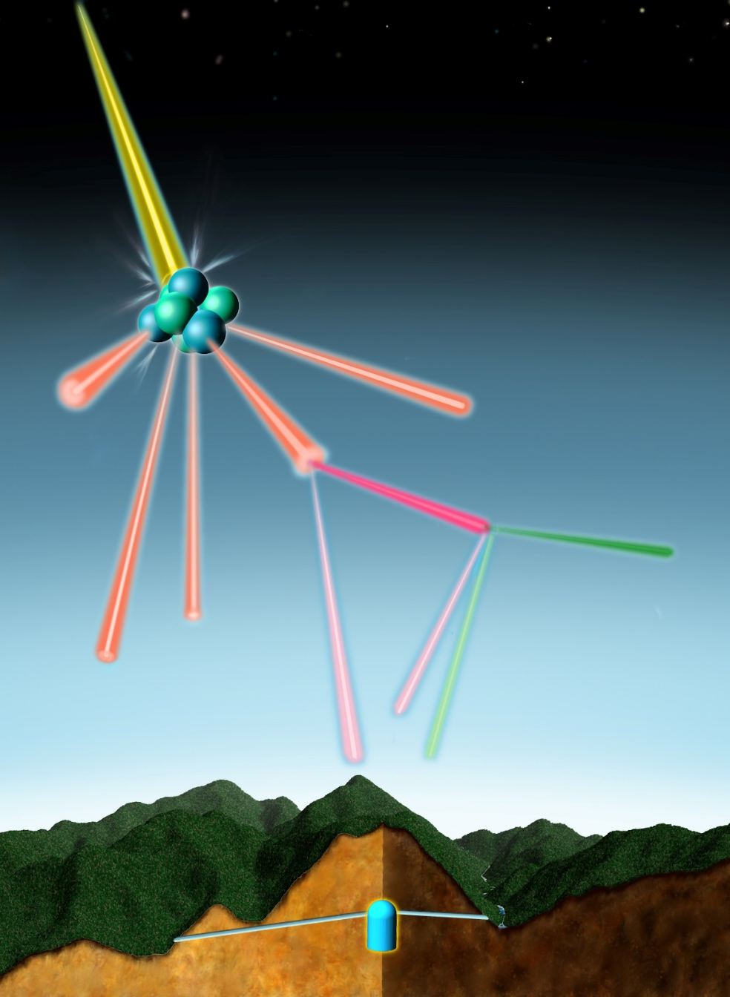
Atmospheric neutrinos: background for proton decay
Cosmic ray
Incoming cosmic rays
Air nucleus
Pion
Muon
Electron
2 muon-neutrinos
1 electron-neutrino
© David Fierstein, originally published in Scientific American, August 1999
10

Slide 11
Missing atmospheric muon-neutrinos
Proton decay experiments in the 1980’s observed many atmospheric neutrino events.
Kamiokande wanted to improve the proton decay searches with improved analysis, including much improved particle identification (electron-like or muon-like).
During these studies, missing muon-neutrinos (or smaller muon-like/electron-like ratio) were observed.
K. Hirata et al, Phys.Lett.B 205 (1988) 416.
IMB experiment also observed the missing muon-neutrinos.
D. Casper et al., PRL 66 (1991) 2561.
R. Becker-Szendy, PRD 46 (1992) 3720.
11

Slide 12
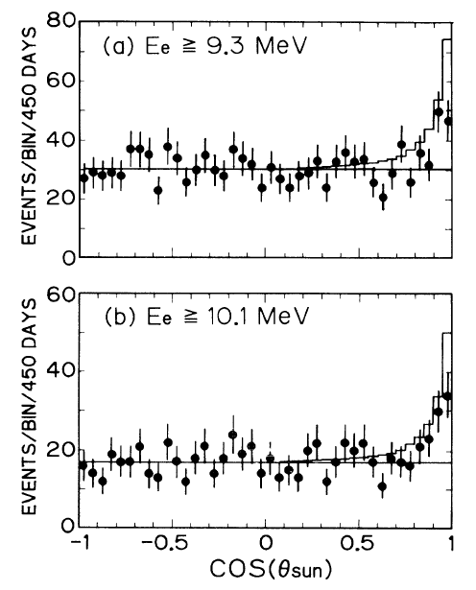
Confirmation of missing solar neutrino problem (1989)
K. S. Hirata et al., Phys. Rev. Lett. 63 (1989) 16.
The Kamiokande results on;
Supernova neutrinos (1987)
Missing atmospheric muon-neutrinos (1988)
Missing solar neutrino (1989)
were recognized to be very important.
The construction of the Super-Kamiokande experiment was approved in 1991 by the Japanese government. The construction was scheduled for 5 years.
SSM prediction
About 50 solar ν
background
(Other solar neutrinos experiments (SAGE, Gallex/GNO) in the 1990’s also confirmed the missing solar neutrino problem.)
12

Slide 13
Super-Kamiokande
13

Slide 14
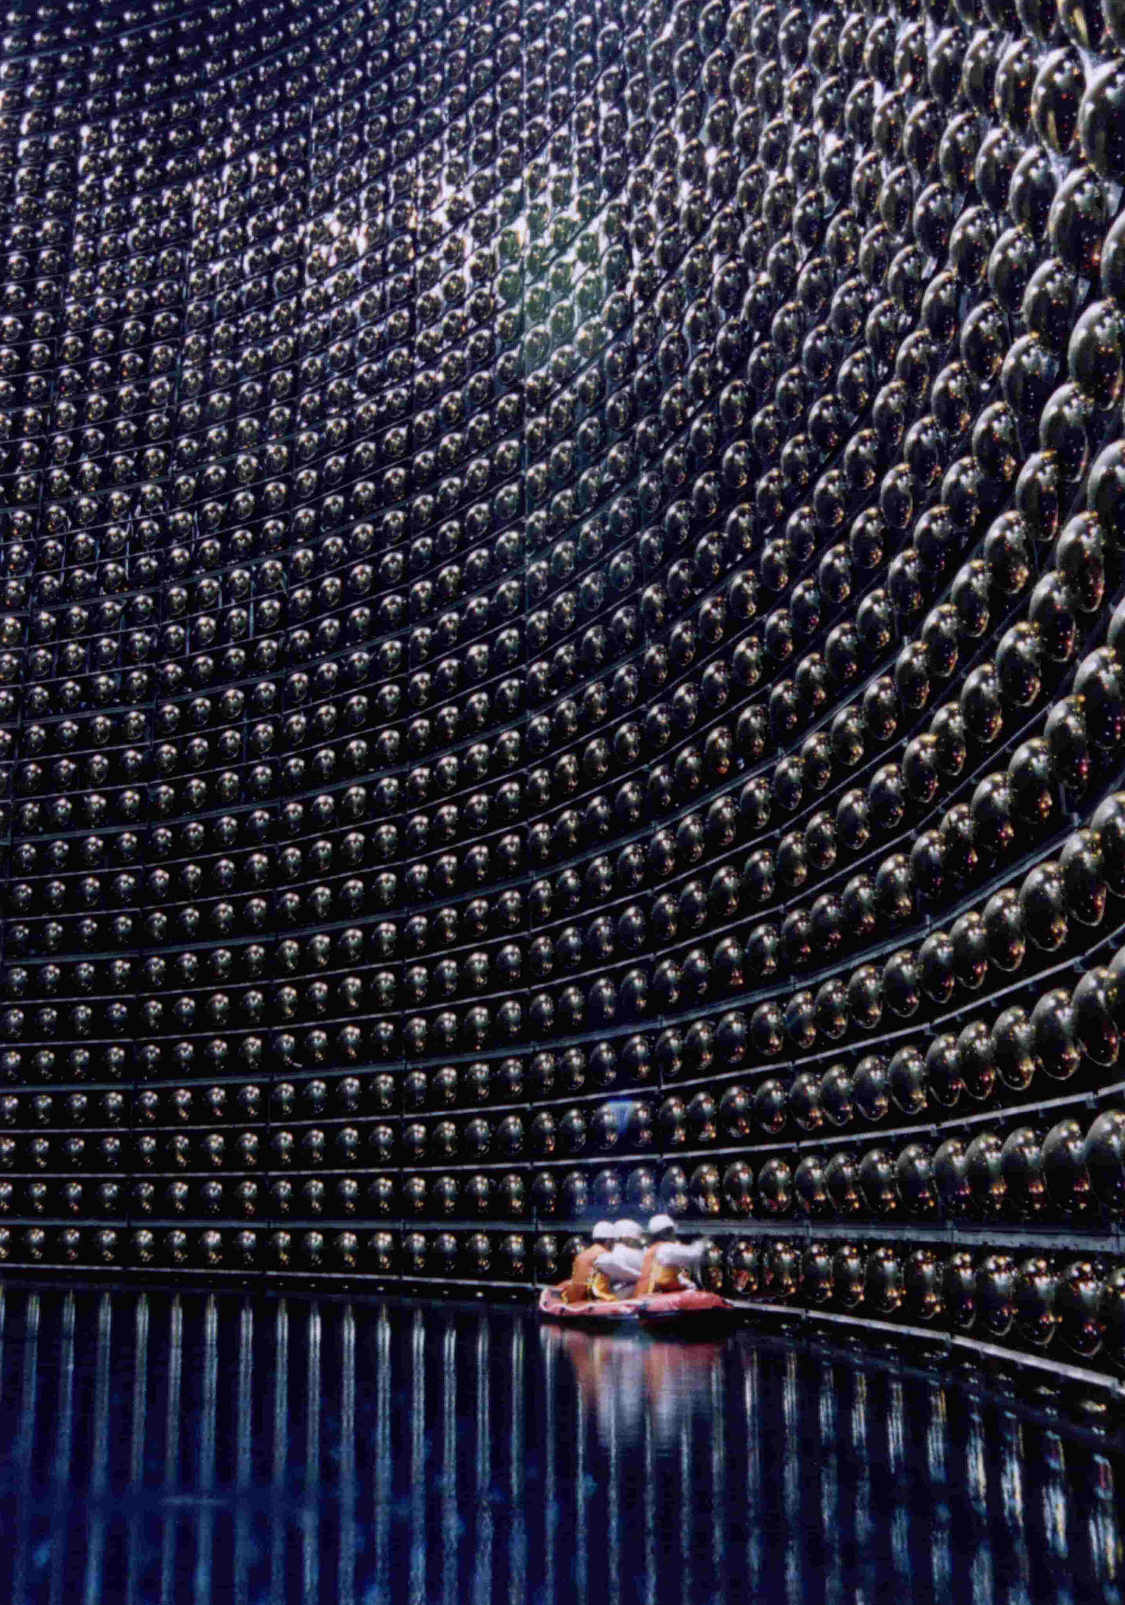
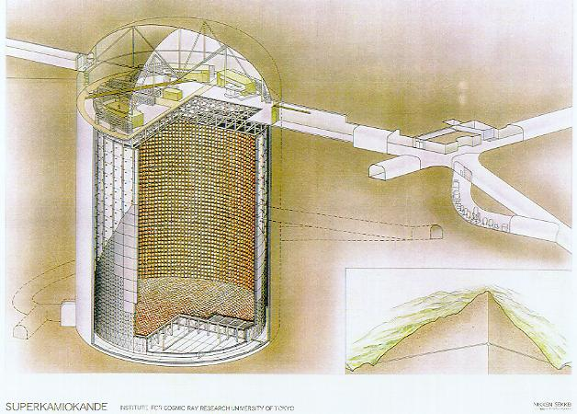











Super-Kamiokande
50,000 ton water Cherenkov detector (22,500 ton fiducial volume)
４２ｍ
３９ｍ
１０００ｍ underground
~230 collaborators
14

Slide 15
Initial idea of Super-Kamiokande (1983)
In the fall of 1983, Prof. Koshiba recognized that solar neutrinos can be detected in Kamiokande. At the same time, he proposed Super-Kamiokande to study solar neutrinos in detail (and to search for proton decays).
Initial drawing of the Super-Kamiokande detector
(In “32 kton Water Cherenkov Detector (JACK) A proposal for detailed studies of nucleon decays and for low energy neutrino detection” by M. Koshiba, in Proceedings of workshop on Grand Unified Theories and Cosmology (Dec. 7-10, 1983, KEK, Tsukuba, Japan)
15

Slide 16
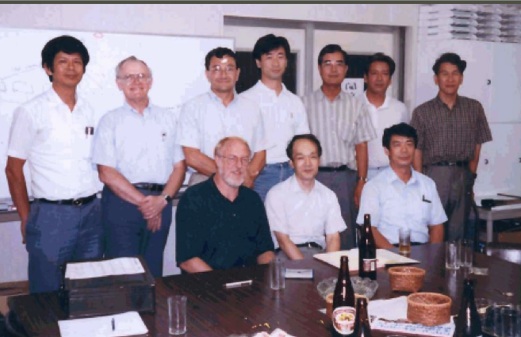
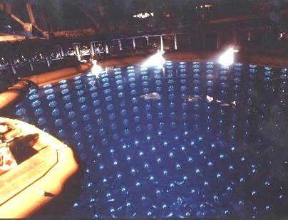
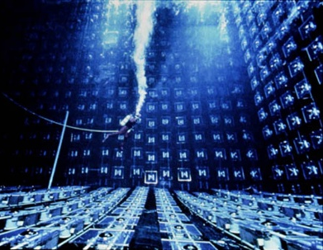
Beginning of the Super-Kamiokande collaboration
Y. Totsuka
At that meeting, people agreed that
Kamiokande
IMB
Y. Suzuki
TK
W. Kropp
H. Sobel
K. Nishikawa
A. Suzuki
&
K. Nakamura
J. Arafune
(ICRR director)
J. Stone
work together.
at Institute for Cosmic Ray Research, Aug. 28, 1992
16

Slide 17
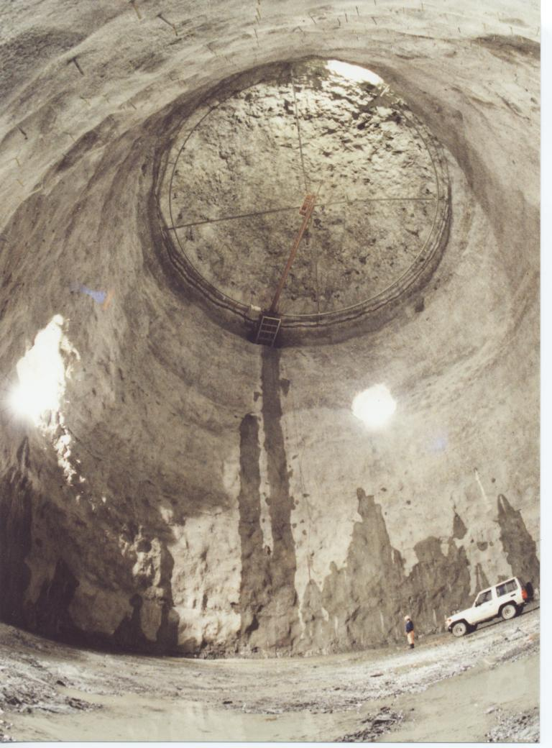
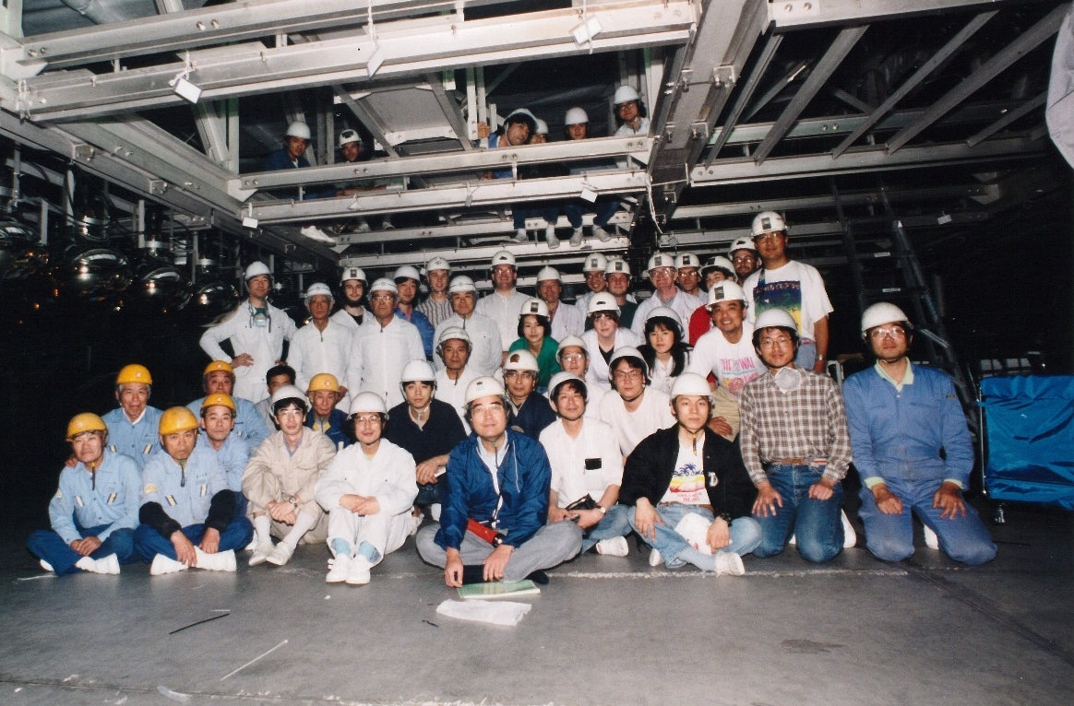
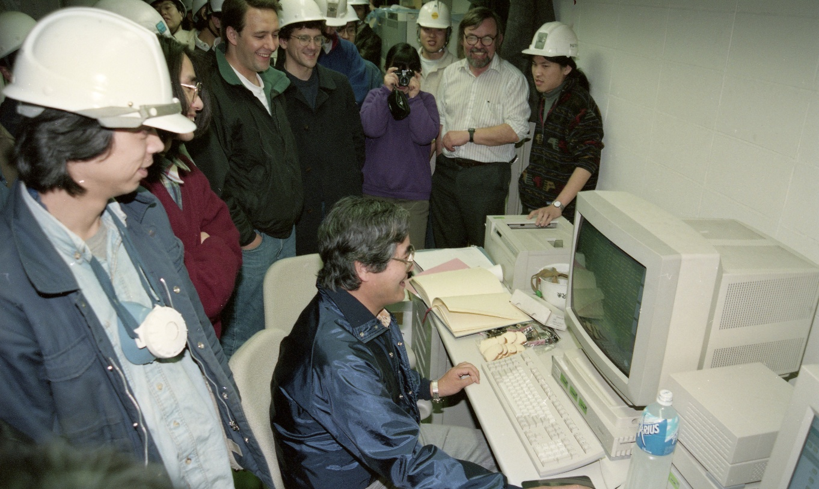
Construction of the Super-Kamiokande detector
Spring
1995
Yoji Totsuka
Before Summar in 1994
Super-Kamiokande started taking data at 0:00 on April 1, 1996
17

Slide 18
Atmospheric neutrino oscillations
18

Slide 19
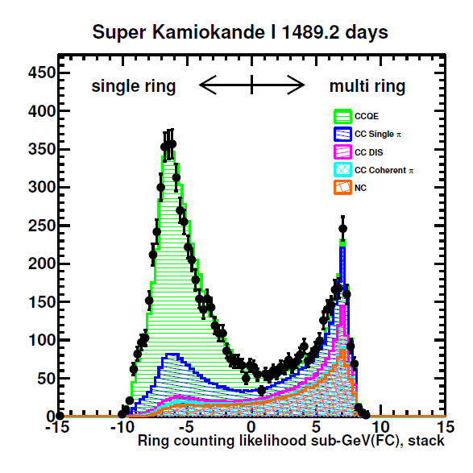
Fully automated analysis
One of the limitation of the Kamiokande’s atmospheric neutrino analysis was the necessity of the event scanning for all data and Monte Carlo events, due to no satisfactory ring identification software.
Hough transformation + maximum likelihood
Multi Cherenkov ring event
ν
19

Slide 20
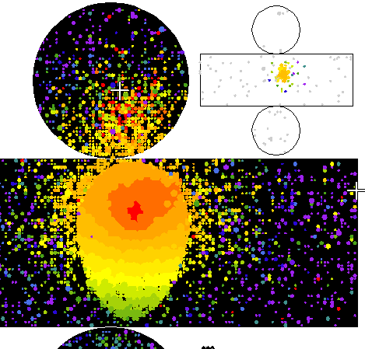
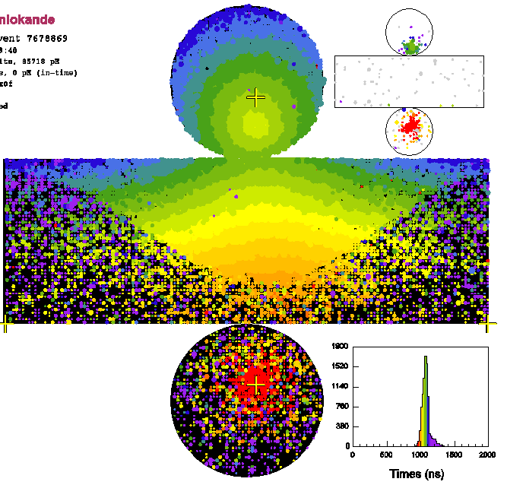
Event type and neutrino energy
Partially contained
1 ring μ-like
1 ring e-like
Upward going μ
All these events are used in the analysis.
20

Slide 21
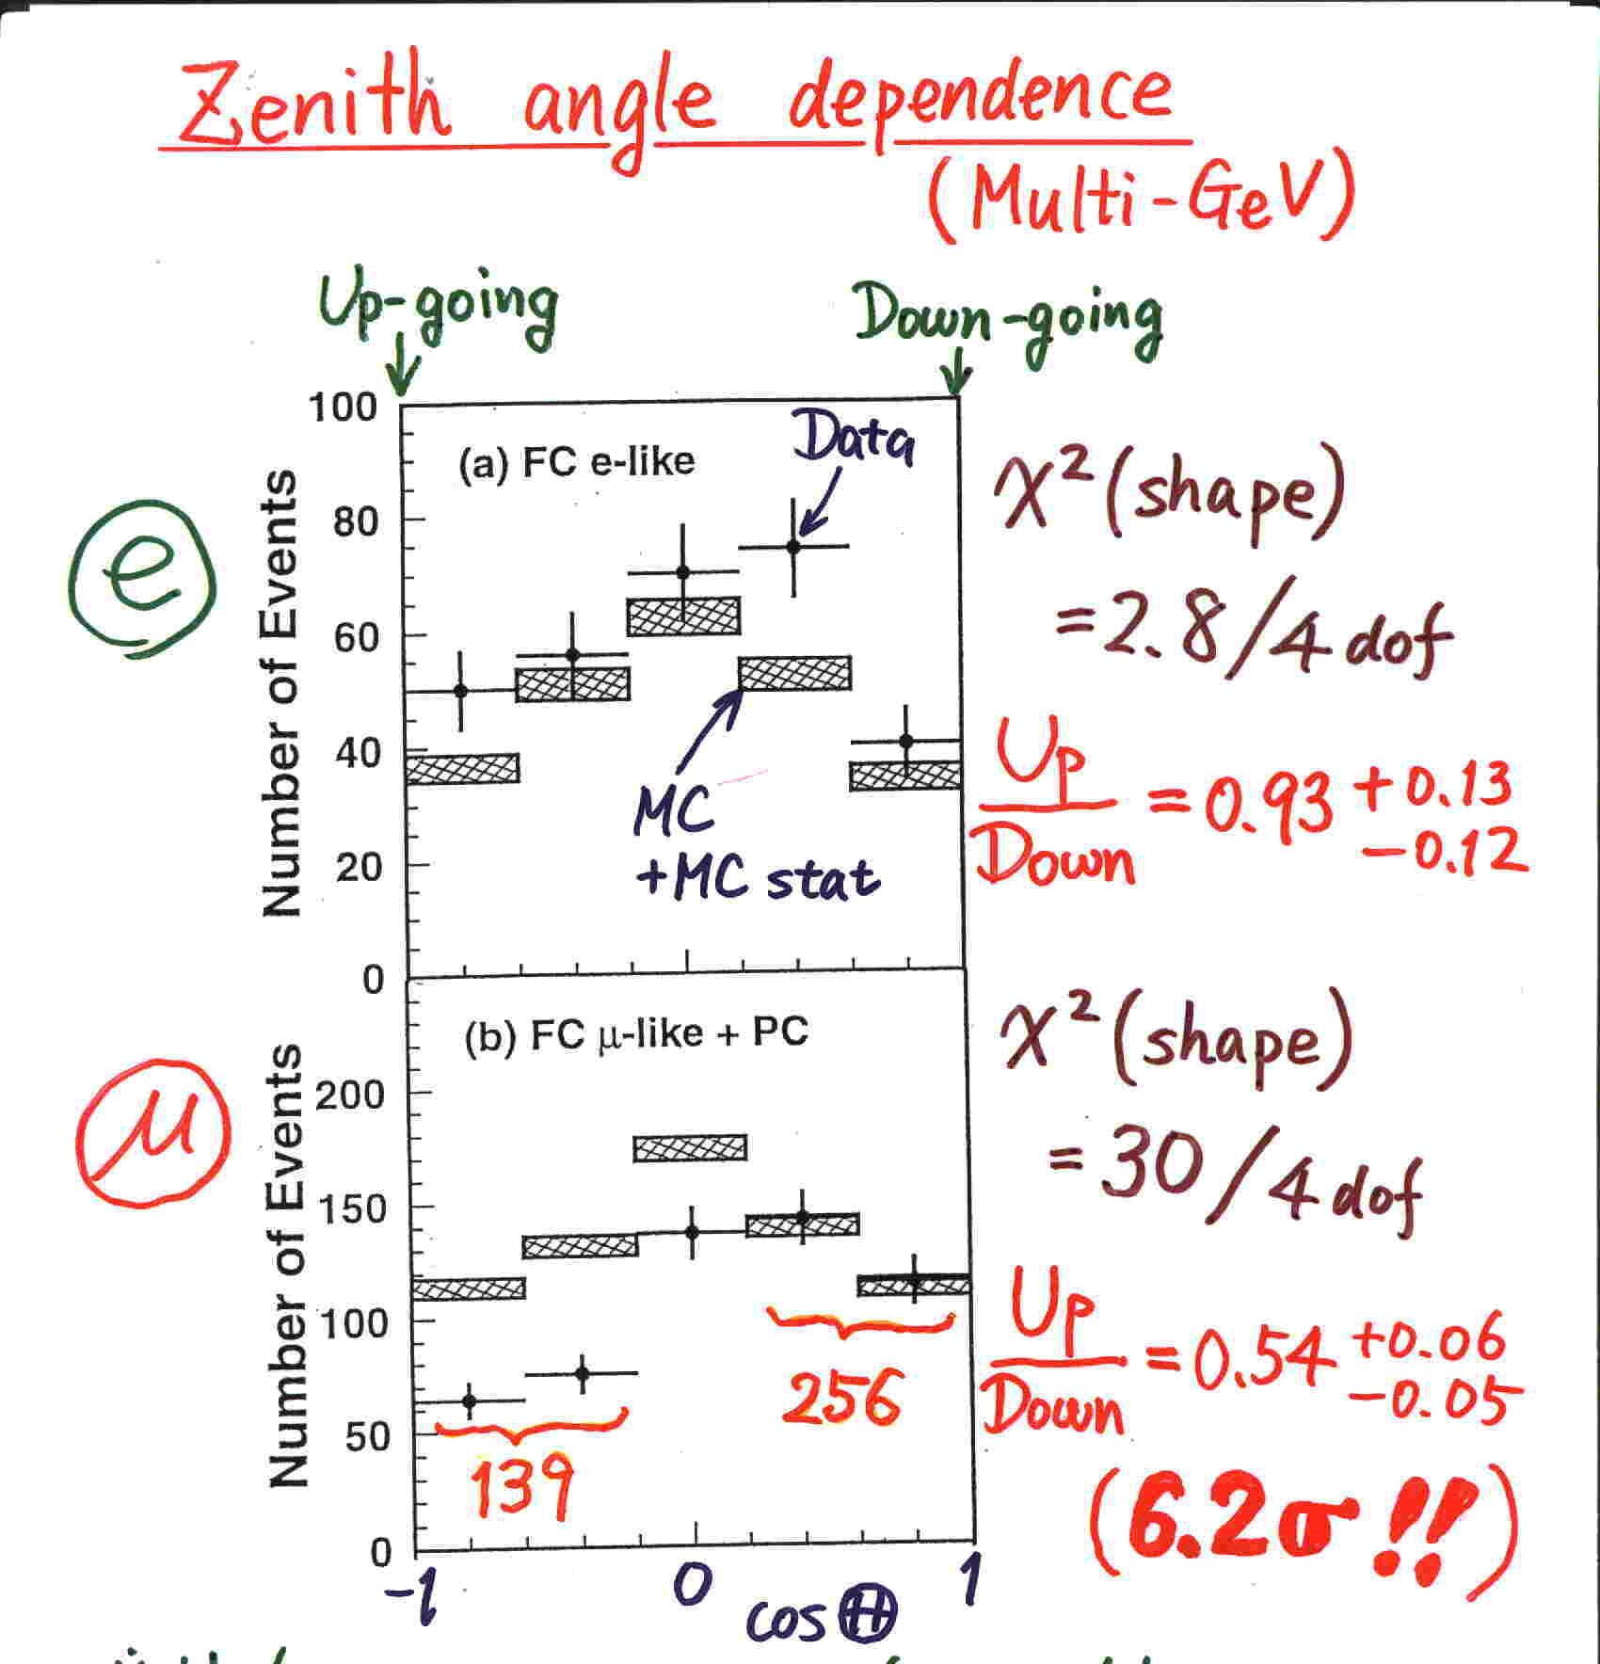
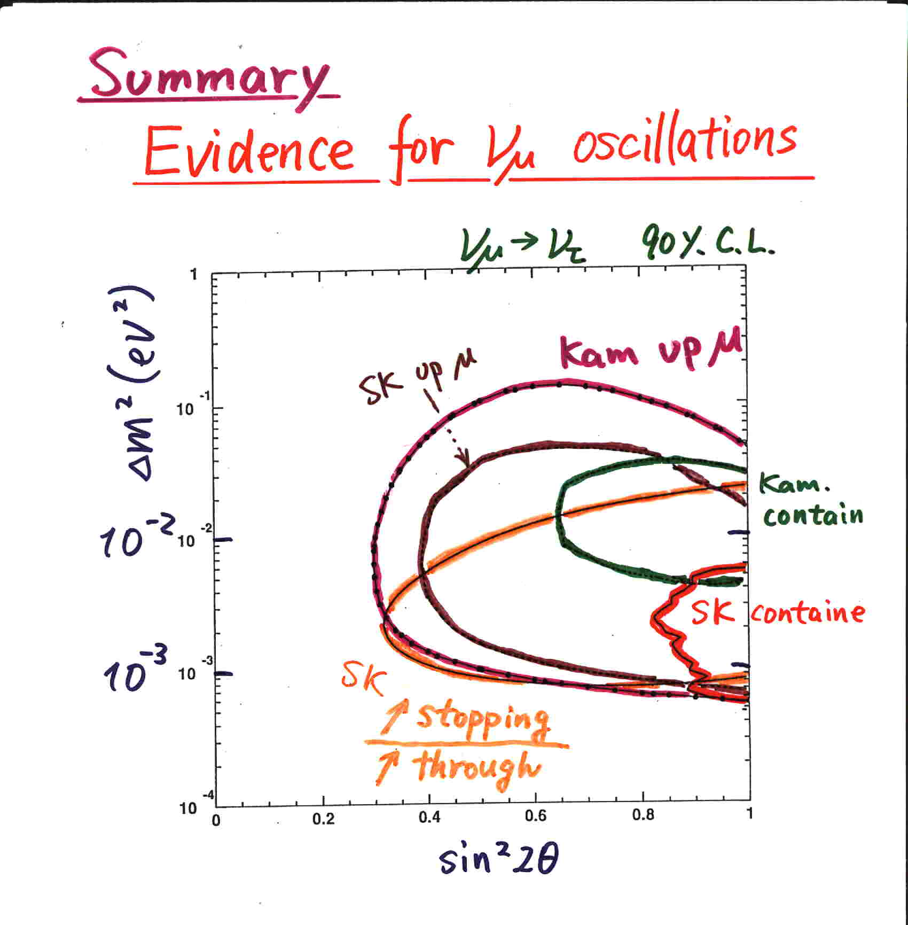
Evidence for neutrino oscillations (Super-Kamiokande @Neutrino 1998)
Y. Fukuda et al., PRL 81 (1998) 1562
Super-Kamiokande concluded that the observed zenith angle dependece (and the other supporting data) gave evidence for neutrino oscillations.
21

Slide 22

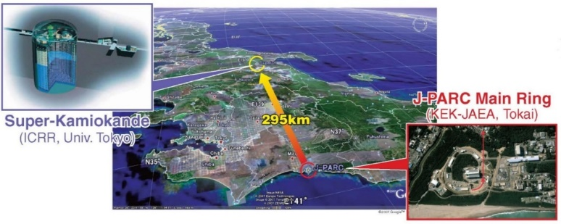
Super-K as the far detector in LBL experiments (after 2000)
T2K
K2K
K2K, PRD 74 (2006) 072003
T2K, Phys.Rev.D 96 (2017) 1, 011102
C. Giganti (T2K), Neutrino 2024
22

Slide 23
Solar neutrino oscillations
23

Slide 24
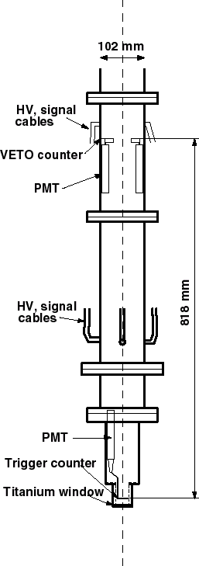
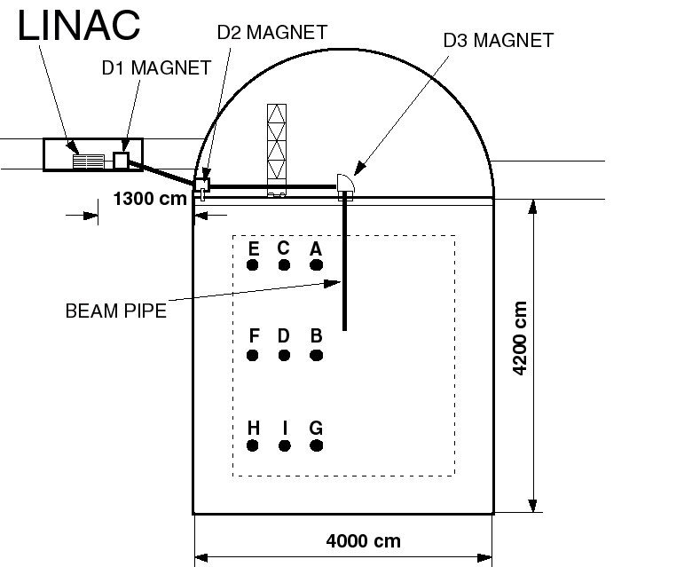
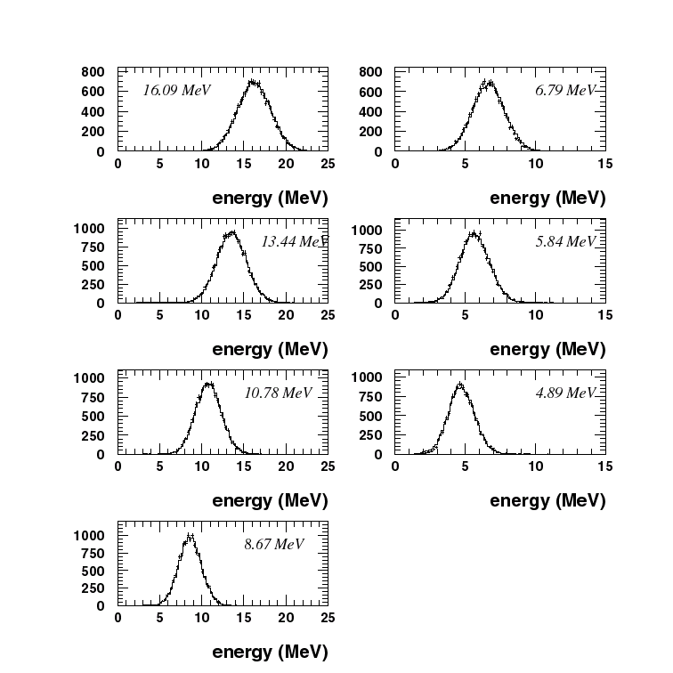
Calibration of Super-K with an electron LINAC
Super-K tried to observe evidence for solar neutrino oscillation by day-night effect or spectrum distortion.
➔ Precise calibration of absolute energy scale, energy resolution, and angular resolution using electron LINAC.
ENDCAP
0.1mm thick Ti window
Systematic error in the absolute energy scale : 0.64 % (SK-I).
Super-K, NIM A 421 (1999) 113-129
Beam energy: 5 ~ 16 MeV/c
24

Slide 25
Solar neutrino studies in Super-Kamiokande
Super-K PLB 539 (2002) 179-187
Super-K accurately observed ⁸B solar neutrinos by νe→νe, and tried to observe day-night flux difference or spectrum distortion, which were predicted by neutrino oscillations in matter.
May 31, 1996 – July 13, 2001 (1496 days )
ν + e⁻ → ν + e⁻
22400±230 solar ν events
(14.5 ev/day)
5-14MeV 0.5MeV/c²
Assuming ν_{e} only:
background
Data
+0.016
= 0.465±0.005
SSM_{BP2000}
-0.015
However, no clear evidence for spectrum distortion nor day-night effect.
➔ We had to wait for the SNO data. (talk by A. Smirnov)
25

Slide 26
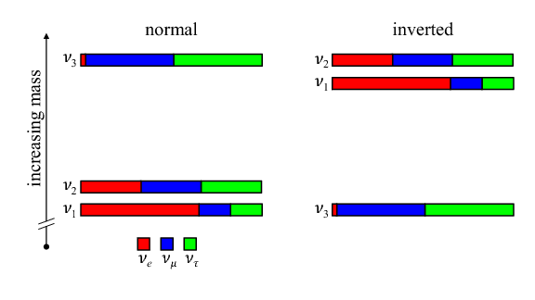
Oscillation parameters (2025)
Normal mass Ordering (NO), Inverted mass Ordering (IO)
Ivan Esteban et al., JHEP 12 (2025) 216,
e-Print: 2410.05380 [hep-ph]
See also many other references
Δm₂₁²: (2.5%)
NO
IO
θ₁₂ : (2.1%)
θ₁₃: (1.3%)
θ₂₃: (2.1%^{(*)})
Δm₃₁²: (0.8%^{(*)})
(Numbers in parenesis are 1σ uncertainties assuming NO.
^{(*)} some ambiguity)
26

Slide 27
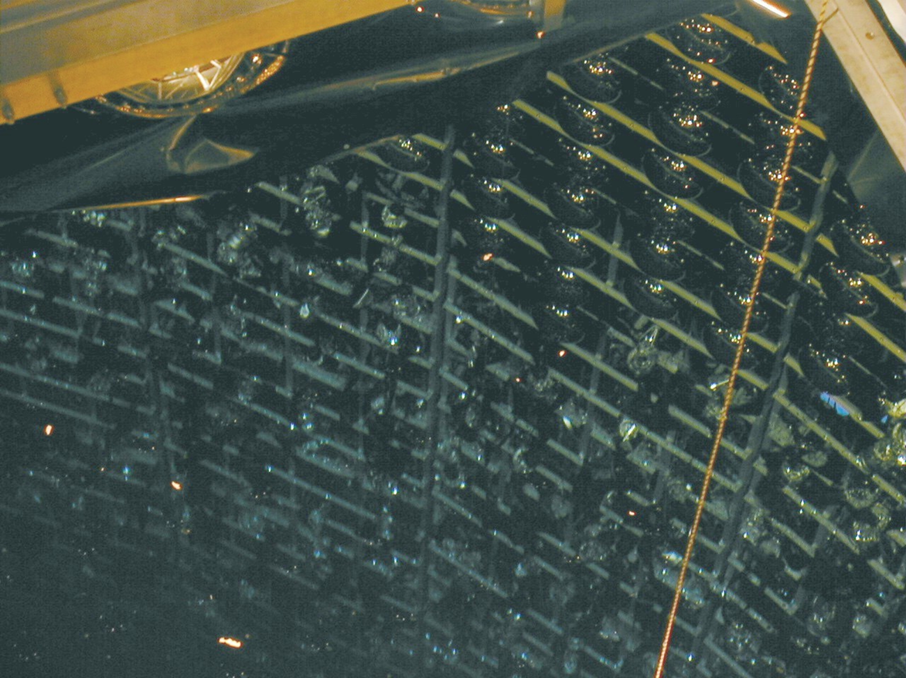
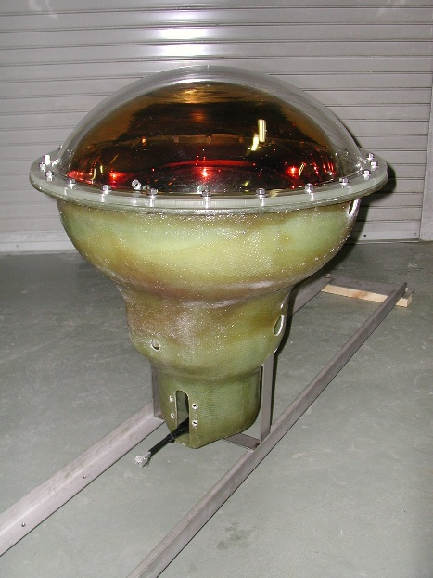
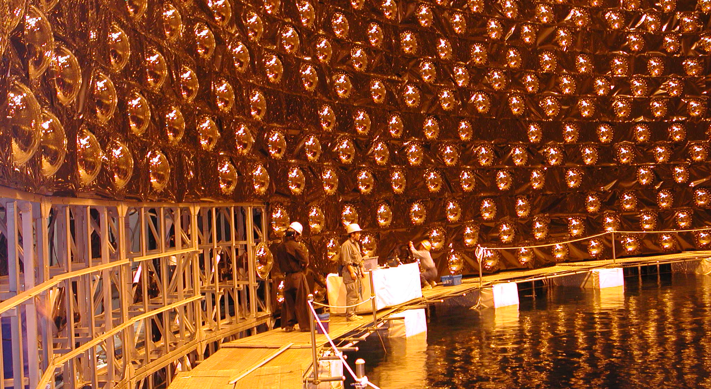
Accident (Nov. 12, 2001)
In 2001, after about 5 years of operation, Super-Kamiokande was drained water and dead PMTs were replaced.
It was possible to rebuild Super-K by;
the strong leadership of Prof. Totsuka, and
The strong support by many people.
Super-K was partially recovered with the survived PMTs in 2002 (photo), and fully recovered in 2006.
More than a half of the PMTs were broken.
27

Slide 28
Summary
Kamiokande
  observed supernova neutrinos (1987),
  found missing atmospheric muon-neutrinos (1988),
  and confirmed the missing solar neutrino problem (1989).
Super-Kamiokande
  discovered atmospheric neutrino oscillations (1998),
  and contributed to the solar neutrino oscillation (after 2000).
Super-Kamiokande continues contributing to (neutrino) physics; atmospheric and solar neutrinos, far detector of K2K and T2K, relic supernova neutrinos, proton decay searches, ….
28

Slide 30
Evidence for solar neutrino oscillations (after 2000)
SNO PRL 89 (2002) 011301
SNO PRC 72 (2005) 055502
SNO PRL 87 (2001) 071301
(A plot based on the salt-phase data)
SSM 68%CL
SK ES 68%CL
SNO NC 68%CL
SNO CC
68%CL
SNO CC
68%CL
SNO ES 68%CL
SK ES 68%CL
3.3σ evidence for non-zero (ν_{μ}+ν_{τ}) flux
Four different measurements intersect at a point.
Evidence for (ν_{μ}+ν_{τ}) flux

