Slide 1
4th International Symposium on the History of Particle Physics CERN 10-13 November 2025
Rare searches
The low background frontier
A. Bettini
G. Galilei Physics and Astronomy Dept. Padua University; INFN Padova. Italy

Slide 2
Looking at the very-high energies from the keyhole
Very high energy scale phenomena, above accelerators, can happen spontaneously.
The larger the energy scale, the rarer are the events
Hidden by the noise of mundane events
We cannot see the stars during the day due to the background of Sun light
High energy frontier = ultra-low background frontier.
Physics Beyond the Standard Model discovered
Neutrino oscillations
Neutrinos have a mass
Neutrinos change flavour
Dark matter
(Dark energy)

Slide 3
The backgrounds
Main Background categories
cosmic rays and induced radioactivity
environmental radioactivity (from concrete and anything in the hall)
radio-impurities in the detector and shielding
radon emanation from the detector’s surfaces
neutrons from fission, (α,n) reactions, and from cosmic-ray muons interactions.
Depending on energy scale
keV MeV GeV
DM 0ν2β p-decay
Solar ν
1995. The review article: G. Heusser, Low-radioactivity background techniques Ann. Rev. Nucl. Part. Sci. 45, 543

Slide 4
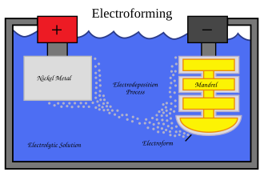
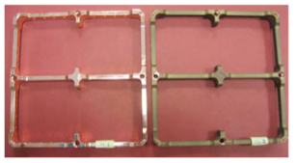
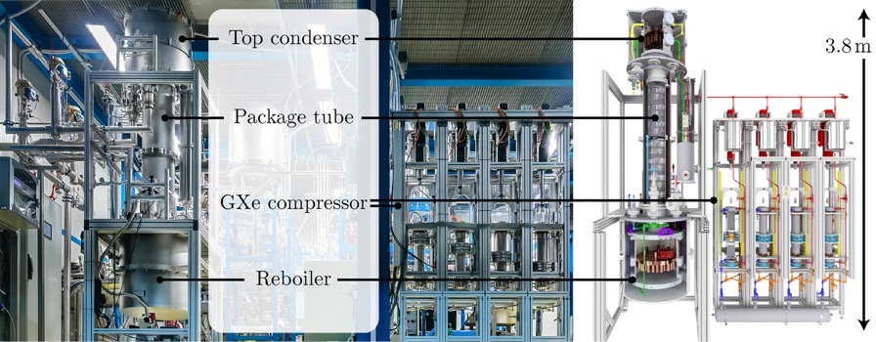
Examples of background reduction techniques
Extremely radio-pure materials for all the detector and shields elements
Simulations to establish the maximum tolerable activity of each component
Techniques for very low level assay
Electroforming (building atom by atom via electrolysis)
.....
Advanced surface and sub-surface cleaning treatment
Washing with ultrasounds
Tumbler
Electropolishing/ etching (down to 100 µm)
Surface passivation
Plasma cleaning
Clean for low impurity outgassing
.....
During data taking
XENONnT Rn removal system

Slide 5
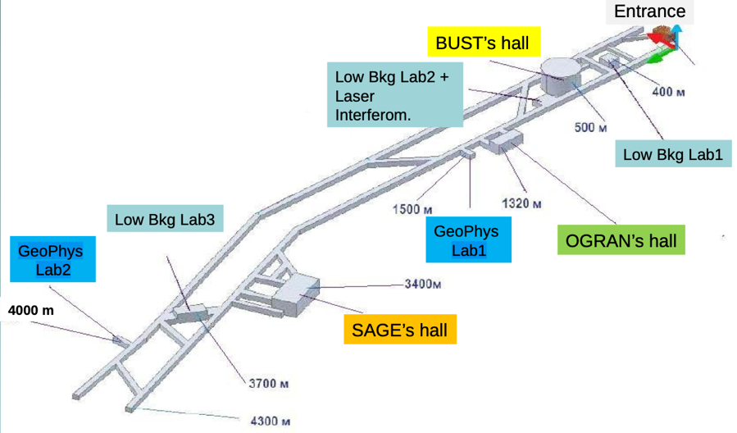
Go underground
Prehistory
1965. Discovery of atmospheric neutrinos, Two gold mines, India and South Africa
1968. Ray Davis & John Bahcall. Solar Neutrino Puzzle, Homestake gold mine
The first dedicated laboratory
Baksan Neutrino Observatory
Low Background Labs screened by radioactive radiation of the rocks with layers of ultra-pure shielding materials absorbing radiation
1960s. URSS. M. Markov, with A. Chudakov, G. Zatzepin and A. Pomasky develop the idea of a dedicated underground facility proposal, especially built with a horizontal access tunnel under a mountain (Elbrus), rather than in a mine, including an external campus (Neutrino Village)
1967 BNO approved
1973. Experiments start

Slide 6
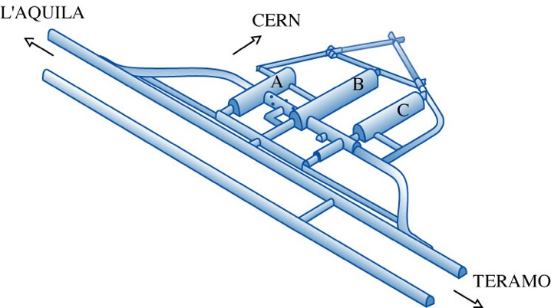
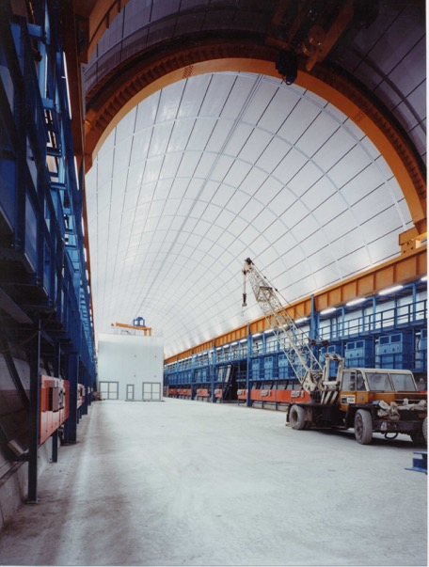
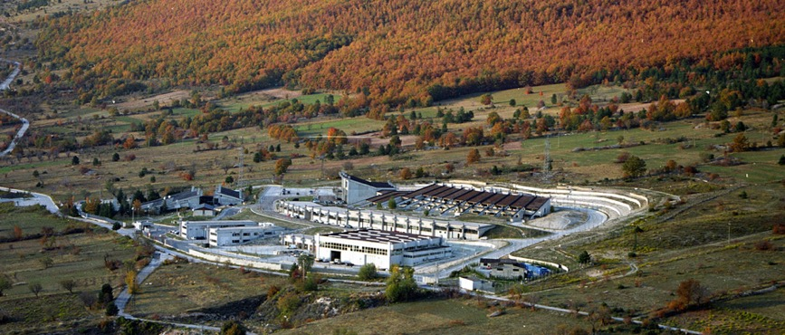
Laboratori Nazionali del Gran Sasso
The first large, high technology, underground laboratory to host and provide services (mechanics, electronics, chemistry, low activity screening, etc. ) to several different experiments from the international community
1979. Project developed by A. Zichichi
1987. Civil works completed
See Iarocci’s talk

Slide 7
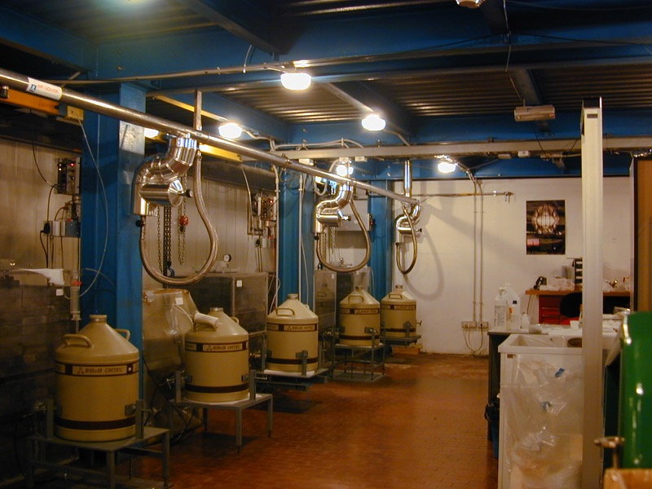
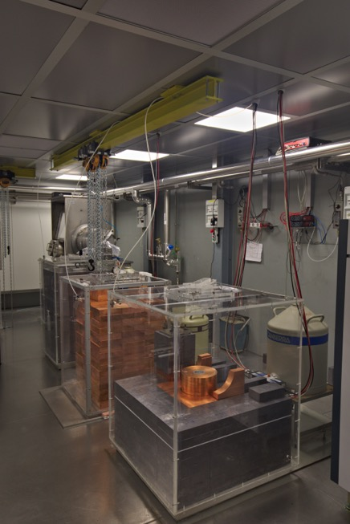
Extreme low level assay
Gamma spectroscopy, with HPGe detectors. 15 underground at LNGS; Sensitivity 10-100 µBq/kg
Complementary techniques (2001 on):
Inductively Coupled Plasma Mass Spectroscopy, sensitivity on parent activity 1 µBq/kg
Glow Discharge Mass Spectroscopy; 10 ppt sensitivity on bulk composition
Neutron Activation Aanalysis. Sensitivity 0.01 µBq/kg
Radon emanation test facilities

Slide 8
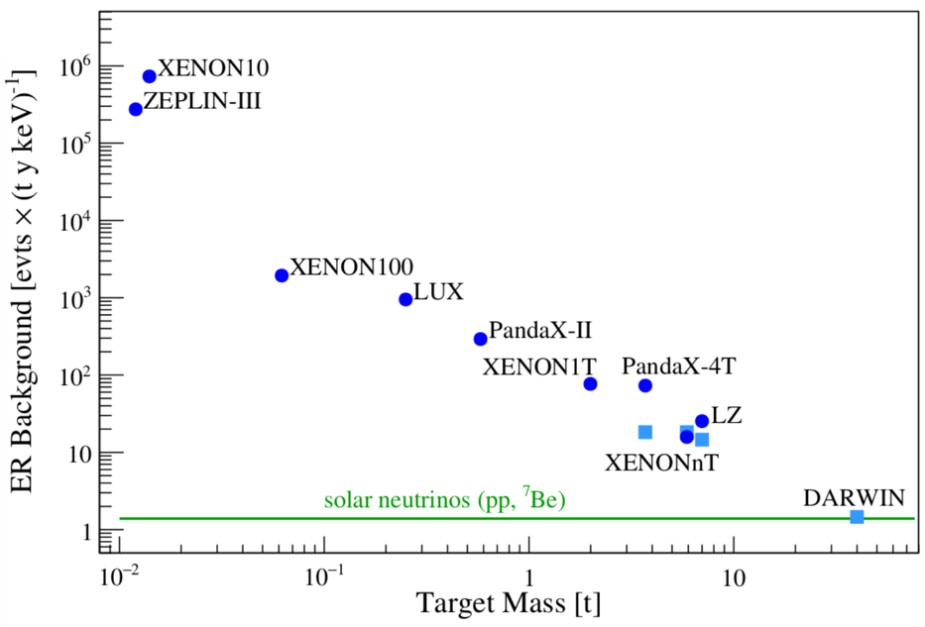
Investments in the 1990s paid-off
Ge detectors for 0ν2β (best energy resolution).
Background free conditions [counts/(kg keV yr)] @ 2 MeV
1990... 2011.. 2015... 2022 2030?
HM GERDA I GERDA II LEGEND100 LEGEND 1000
5 10^{–2} 1 10^{–2} 5 10^{–4} 2 10^{–4} target 1 10^{–5} target
T_{1/2} > 2.1 10²⁵ 1.8 10²⁶ 10²⁷ yr 10²⁸ yr
Fruits 2006-today
LXe TPC for DM
Increase detector mass
Reduce background in proportion
Thanks to Elena Aprile and Michael Murra
Phil. Trans. R. Soc. A382 (2023) 0083

Slide 9
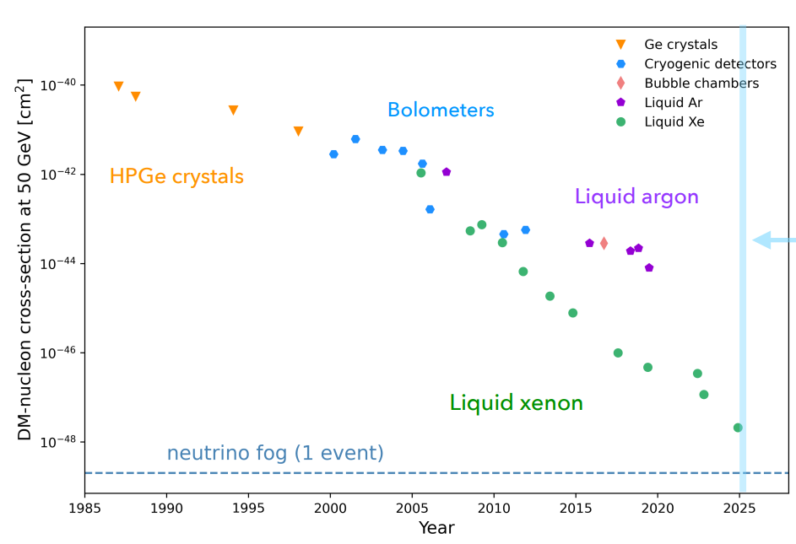
Direct Dark Matter history in a nutshell
Plot by Laura Baudis, Zurich

Slide 10
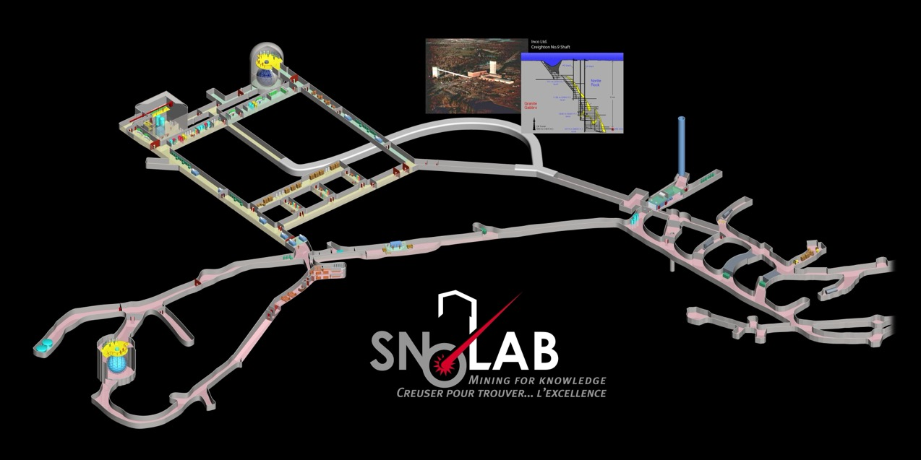
Lab in a working mine
In a mine access is usually vertical via shafts a few metres diameter (Kamioka horizontal)
Need relatively long drifts to reach regions with rock quality (to reach norite at SNOLab) suitable for digging experimental halls (smaller useful/total vol.)
Unitary excavation costs substantially higher due to hoist rock and interference with mine operation

Slide 11
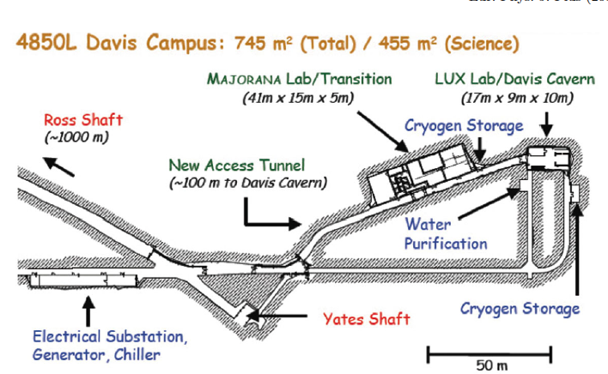
Lab in abandoned mine - Homestake
€
Much more expensive in an abandoned mine (Homestake)
2011 estimated cost for refurbishment of two shafts 150 M$
2011 corrected for inflation cost of the entire LNGS 96 M€ (17 300 m² ,180 000 m³)

