Slide 1
Demographic Shifts in Particle Physics
Emmanuel Tsesmelis
4th Symposium on the History of Particle Physics
13 November 2025

Slide 2

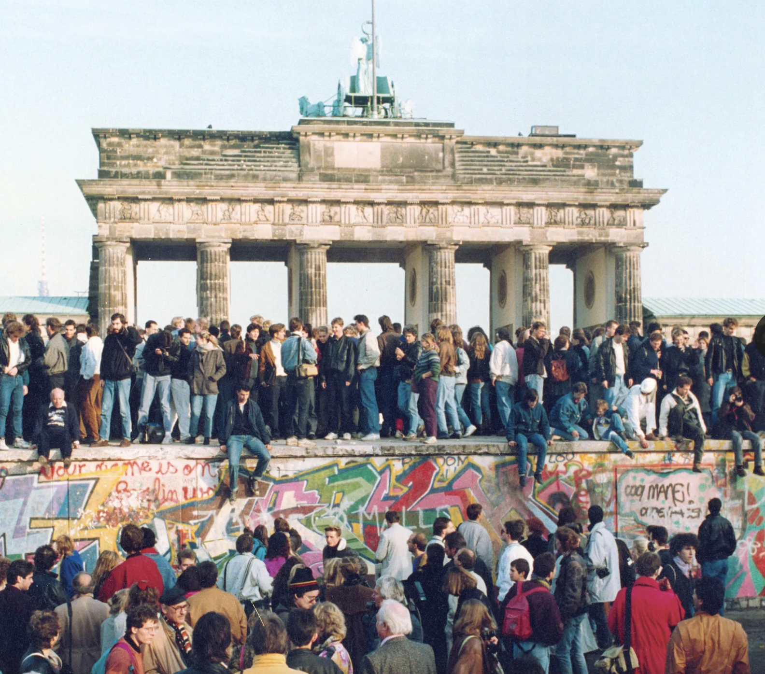
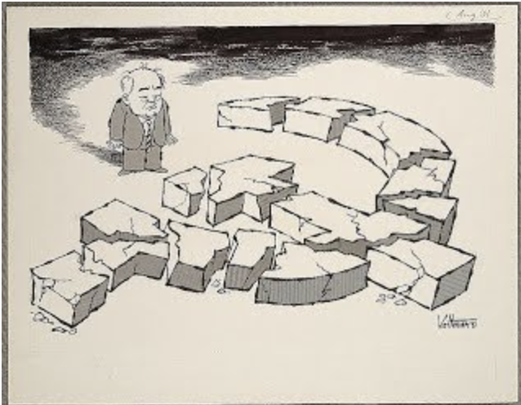

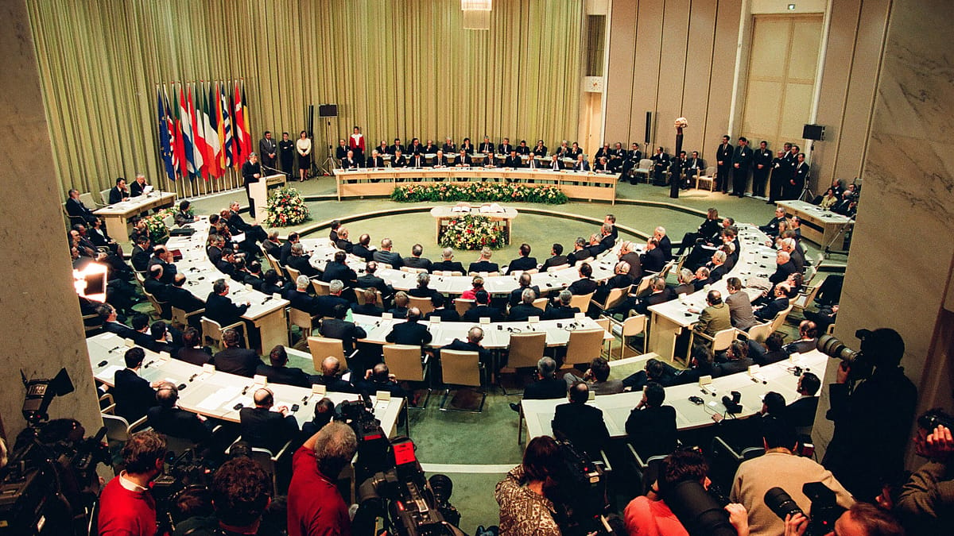
World Events
Timeline Tagline
1980s-1990s
1985
1989
1991
1992
Geneva Summit
Berlin Wall Falls
Cold War Ends
Rise of Asia
Maastricht Treaty
Britannica
Britannica
Origins
Getty
Politico
November 19, 1985 - The first meeting in six years between the leaders of the Soviet Union and the United States occurs when Mikhail Gorbachev and Ronald Reagan engage in a five-hour summit conference in Geneva, Switzerland. CERN plays an indirect and symbolic role.
November 9, 1989 - The Berlin Wall falls when German citizens are allowed to travel freely between East and West Germany for the first time. On October 3, 1990, East Germany officially joined the Federal Republic of Germany (West Germany), formally reunifying the country.
December 1991 - the Soviet Union splits into fifteen separate countries. It marked the end of the Cold War.
The period saw the rise of newly industrialized countries in East Asia (e.g. Republic of Korea), which experienced rapid industrialization and economic growth, while China, India and Japan continued their economic development.
The Maastricht Treaty, officially the Treaty on European Union, was signed in Maastricht, Netherlands, on February 7, 1992, and came into effect on November 1, 1993, establishing the European Union.

Slide 3

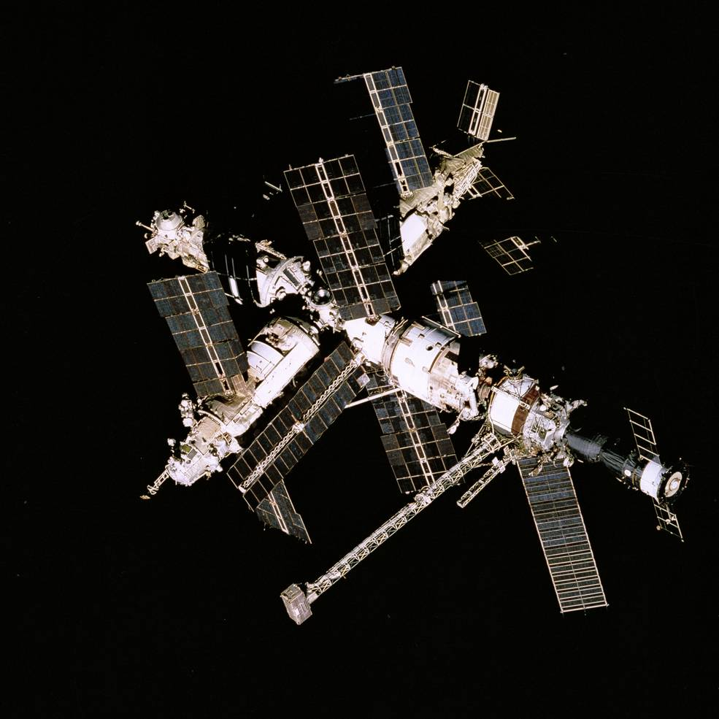
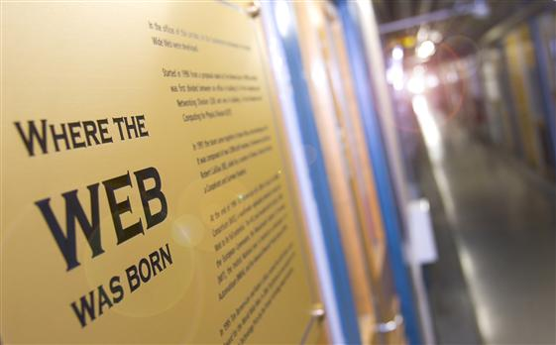
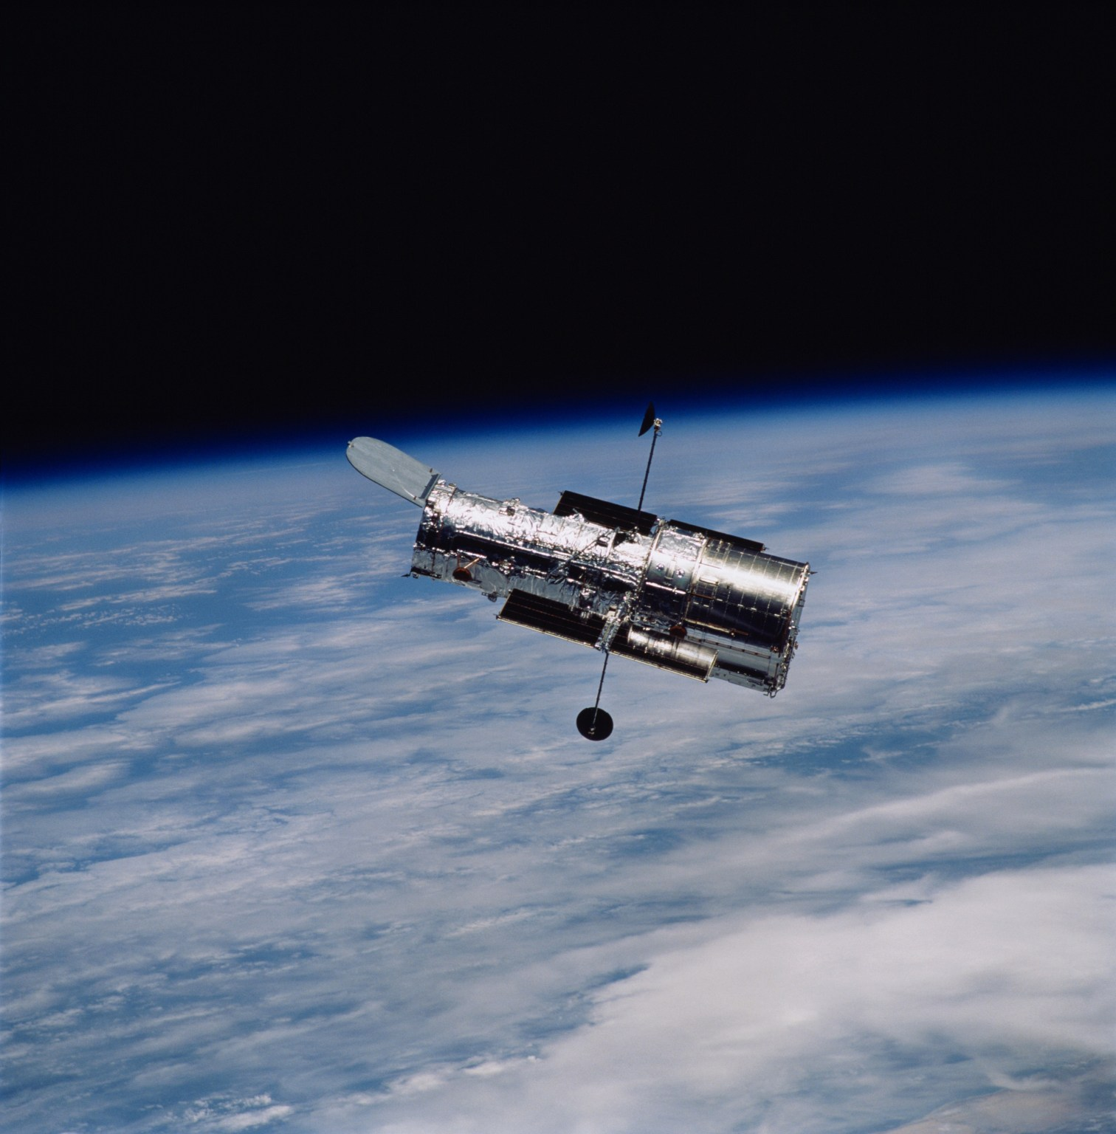
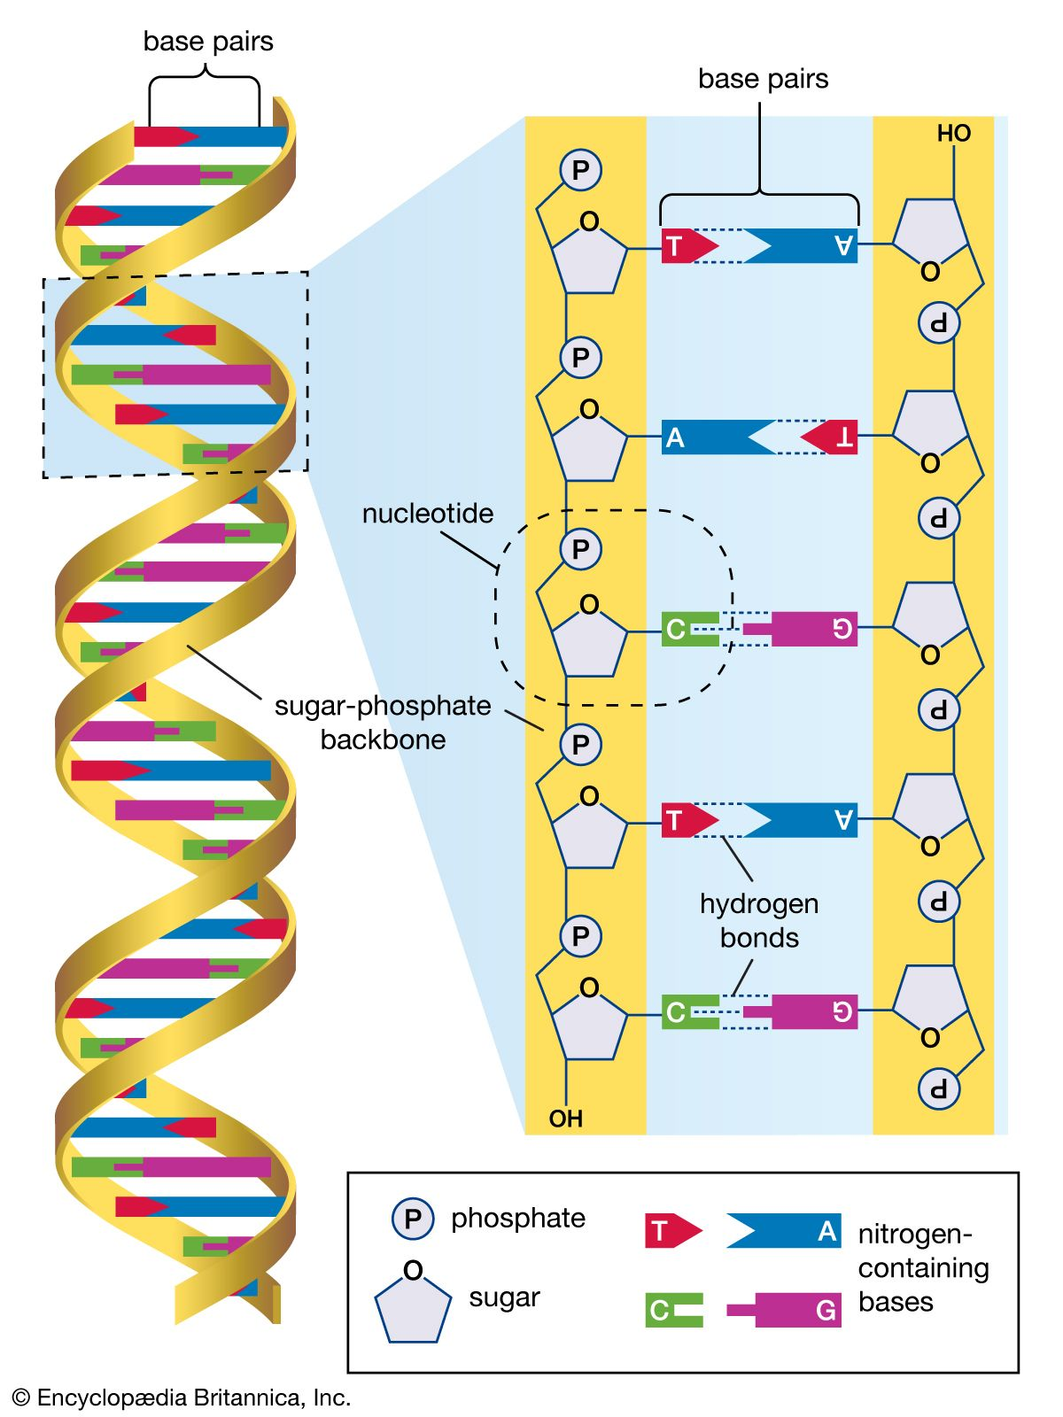
Science & Technology Events
1980s-1990s
1989
1990
1990
1995
The Internet
The WWW
Hubble Space Telescope
Human Genome Project
Space Exploration
Council of Europe
CERN
NASA
Britannica
NASA
The Internet, expanded and facilitated the worldwide proliferation of interconnected networks.
WWW invented at CERN.
The Hubble Space Telescope is launched. It is the first sophisticated optical observatory placed into orbit around Earth.
The Human Genome Project, a project to map the location of all the genes on every chromosome in human beings, begins.
The U.S. space shuttle Atlantis docks with the Russian space station Mir, opening a new period of international collaboration in space research and exploration.

Slide 4
Trends of Globalisation of Particle Physics
1980s
Particle physics was predominantly led by major research institutions in Western Europe—such as CERN and various national laboratories (including DESY)—as well as by key facilities in the United States (including BNL, FNAL, and SLAC) and the Soviet Union.
1990s
A significant shift toward international collaboration emerged, with countries such as Australia, Brazil, Canada, China, India, Republic of Korea, and Russia playing increasingly prominent roles in major scientific experiments.
Globalisation facilitated the integration of scientists from around the world into major international collaborations (Latin America, Eastern Europe, and Asia). The emergence of large, multinational research projects significantly increased cross-border mobility and scientific exchange. Training initiatives—such as the CERN Summer Student Programme—have played a vital role in bringing students from underrepresented regions into the particle physics pipeline, fostering diversity and inclusion in the field.

Slide 5
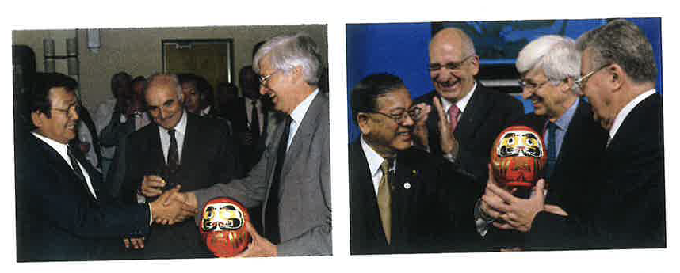
Globalisation of Particle Physics
Despite significant technological advancements, the scale of particle colliders continued to grow, and their construction costs reached several billion Swiss francs.
To support such large-scale projects, a new level of international collaboration became essential.
Countries contributed not only to the construction of detectors but also to the collider infrastructure.
DESY: The “HERA Model” exemplified this approach, with France and Italy manufacturing superconducting dipole magnets for proton storage ring of HERA.
CERN: Successfully secured over half a billion Swiss francs in contributions to the LHC project from non-member states including Canada, India, Japan, Russia, and the United States.
By the end of the 20th century, CERN was no longer serving only its European Member States. It had evolved into a truly global institution, engaging a wide range of nations from around the world. CERN had become a leading symbol of the internationalisation and globalisation that defined the post-Cold War era.
Left: Japan Minister Yosano and former CERN DG, Chris Llewellyn Smith, holding the Daruma doll with one painted eye (June 1995).
Right: To mark the LHC Project completion, the second eye of the Daruma doll was filled in by Toshio Yamauchi, Senior Vice-Minister of Education of Japan, in the presence of CERN DG Robert Aymar, Chris Llewellyn Smith and Swiss President Pascal Couchepin (October 2008).

Slide 6
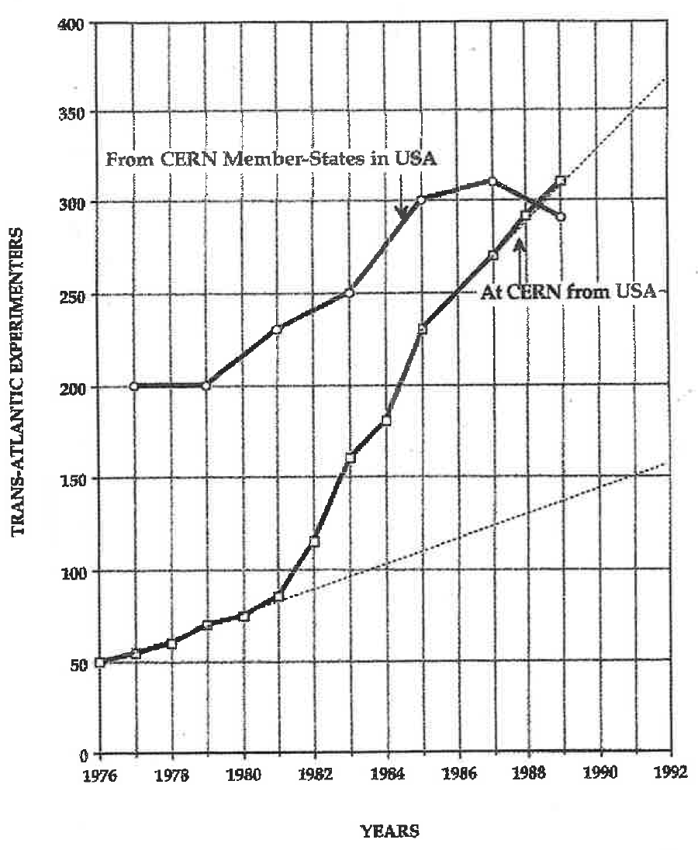
Experimental Collaborations
In the 1980s, particle physics collaborations typically involved dozens to a few hundred scientists — as seen at LEP (Large Electron–Positron Collider). At that time, more than two-thirds of the components for LEP detectors were provided by external institutes, mostly as in-kind contributions. This marked a significant shift from earlier projects, where outside contributions were minimal.
With LEP, CERN evolved into a truly international laboratory, serving a global community of particle physicists. The project also helped reverse the brain drain from Europe to the United States. During LEP’s construction, the number of American scientists at CERN grew rapidly, and by the time LEP became operational, a dynamic exchange had emerged between European researchers in the U.S. and their counterparts at CERN.
The 1990s saw another dramatic expansion in collaboration size, with experiments like ATLAS and CMS at the LHC involving thousands of physicists and engineers from around the world.
This transformation reshaped the structure of scientific work — increasing the need for coordination and shifting recognition from individuals to large, collaborative teams.
(KEK Monthly Reports & KEK News)
Total = 519
Number of Scientists and Engineers from outside US
(Higgins, 2025)
(H. Schopper, 2009)

Slide 7
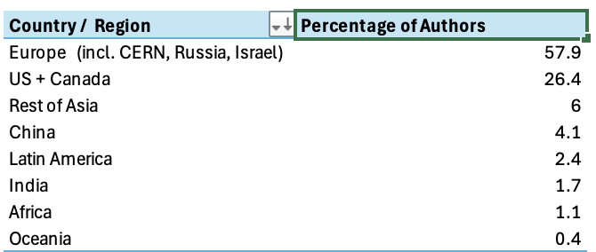
The W Boson and International Collaboration An Example
1980s- UA1 and UA2 4.2 % of the authors were from outside Europe (US)
G. Arnison et al. (UA1 Collaboration): “Experimental observation of isolated large transverse energy electrons with associated missing energy at √s = 540 GeV.”, Physics Letters B, 122 (1983) 103–116.
P. Bagnaia et al. (UA2 Collaboration): “Observation of single isolated electrons of high transverse momentum in events with missing transverse energy at the CERN proton–antiproton collider.”, Physics Letters B, 122 (1983) 476–485. 1990s – The LEP Collaborations
The ALEPH Collaboration; The DELPHI Collaboration; The L3 Collaboration; The OPAL Collaboration; The LEP Electroweak Working Group. “Electroweak measurements in electron–positron collisions at W-boson-pair energies at LEP”, Physics Reports 532 (2013), no. 4: 119–244.
2000s – ATLAS and CMS
CMS Collaboration: “High-precision measurement of the W boson mass with the CMS experiment at the LHC”, arXiv:2412.13872 (2024); Submitted to Nature ATLAS Collaboration:. “Measurement of the W-boson mass and width with the ATLAS detector using proton–proton collisions at 7 TeV.”, Eur. Phys. J. C 84, 1309 (2024).
LEP
ATLAS & CMS
S. Mele, 2025

Slide 8







CERN Membership
1992-
1993
1999
1983
1985
1991
1991
1992
Spain (rejoins)
Portugal
Finland
Poland
Czechoslovak Republic
Hungary
Bulgaria
The Czech Republic and Slovak Republic re-joined CERN after their mutual independence in 1993.

Slide 9





CERN Observer Status
To promote participation of non-Member States in the LHC programme,
the CERN Council granted Observer status to several countries between 1991 and 2002.
1991
1995
1997
1997
2002
Israel
Japan
Russian Federation
United States of America
India
Observer status introduced on the basis of CERN’s general mandate to cooperate with external partners.
1961 – Türkiye (ended with accession to Associate Membership in 2015)
1962 – Yugoslavia (following withdrawal from Membership; ended in 1992 with the dissolution of the federal state)
1963 – Poland (ended with accession to Membership in 1991)

Slide 10
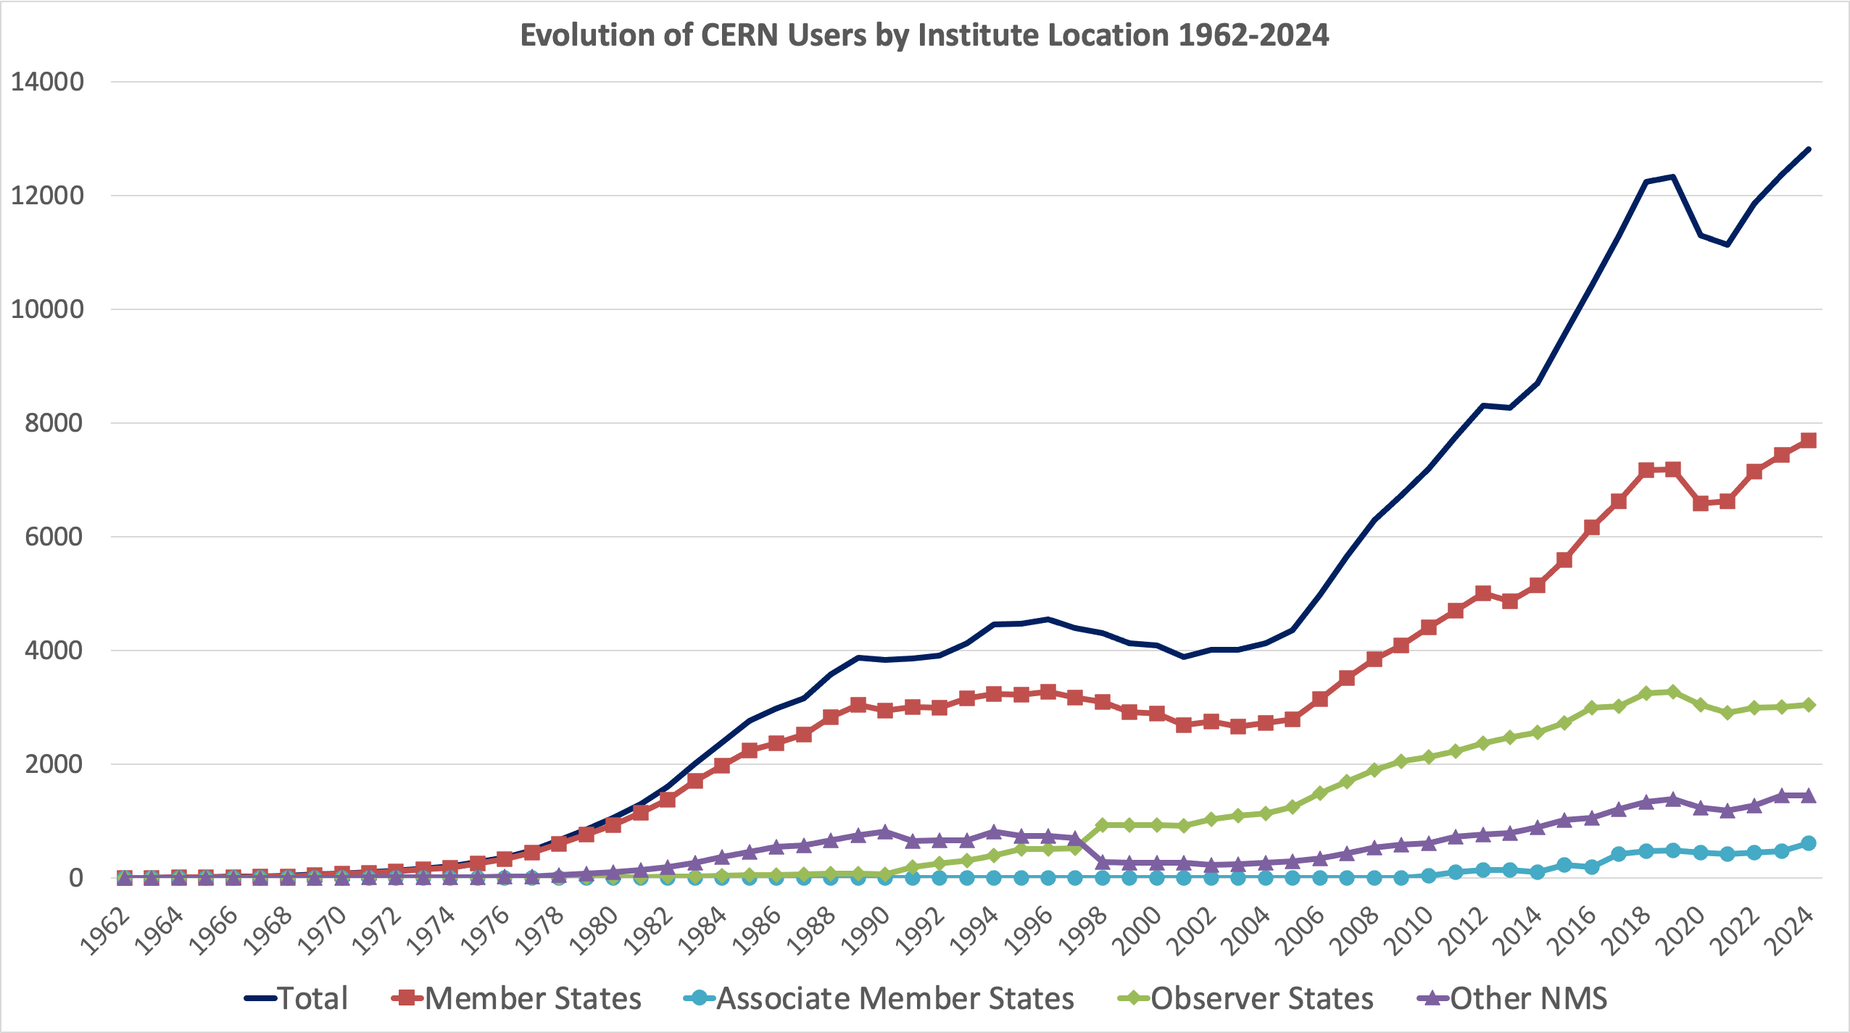
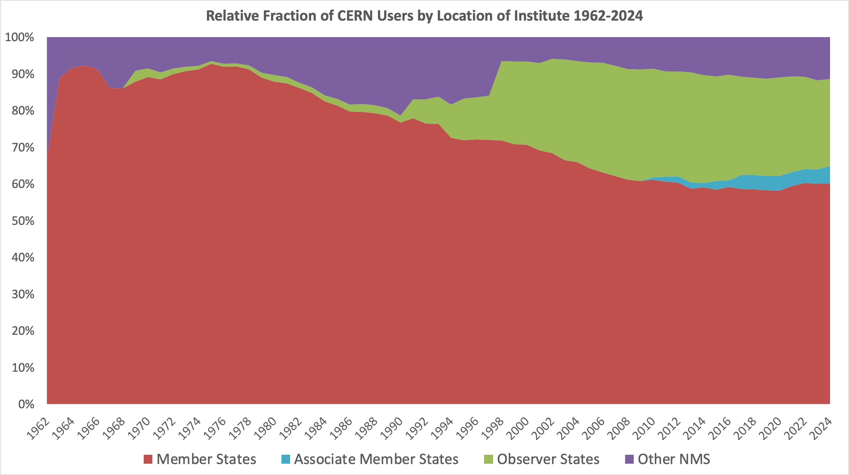
The Growing User Community
CERN: Number of Users 1962-2024
CERN: Relative Fractions of Users 1962-2024
2000
1980
1980
2000
DESY: Significant increase in the number of Users for particle physics and synchrotron radiation facilities in the 1980s and 1990s, By 2000, DESY hosted more than 3000 Users annually from around 40 countries and the clear upward trajectory continues today.
IHEP Beijing: International collaboration through BEPC/BES (e.g. US), the establishment of satellite-based computer link with CERN (1988) and involvement in HERA, LEP, LHC, MARK-J.
JINR: International collaborations in particle physics experiments formed with CERN, DESY, INFN, Japan, US.

Slide 11
CERN Members of Personnel
Data Source: CERN HR

Slide 12
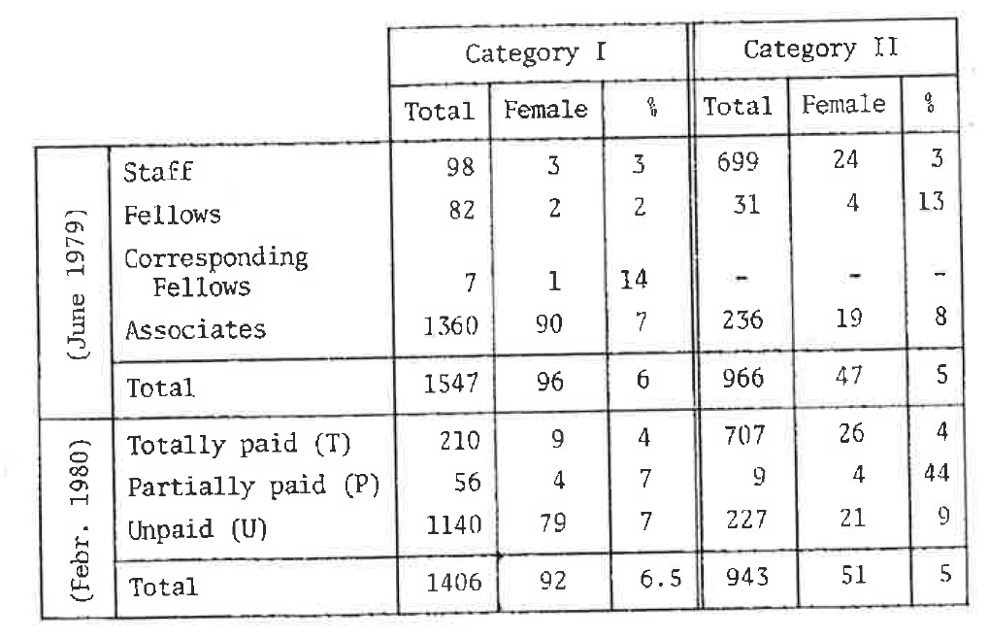
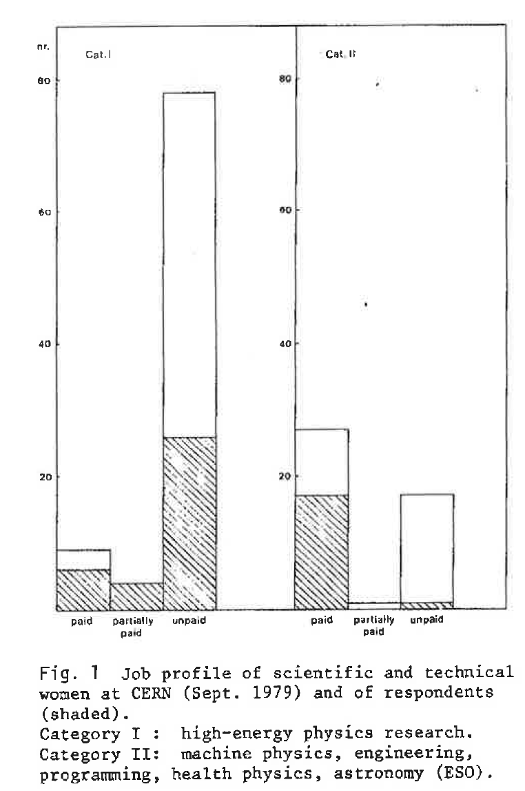
Gender Representation
1980s: Women were significantly underrepresented, particularly in senior and leadership roles.
Typically making up less than 5% of faculty / staff.
1990s-2000s: Gradual increase in participation of women.
By early 2000s, women made up around 10-15% of PhDs in particle physics in Europe and the US.
Women remained underrepresented, especially in leadership positions.
Specific initiatives, like those at CERN and national labs, began focusing on gender equity in recruitment, mentoring and career development.
Scientific &
technical
personnel
at CERN
Job profiles of female
scientific & technical at CERN
M. K. Gaillard, 1980

Slide 13




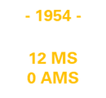
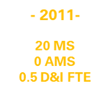
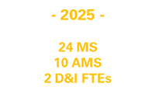


Evolution: CERN Diversity & Inclusion Programme
Gender Equality Plan
Staff Assoc EDI
>26% women in STEM Arrivals
21 Department D&I Focal Points
5 informal networks
EIRO Forum D&I WG
15.5% women in STEM arrivals
13 parties D&I Roundtable
1980
1996
1998
2010
2011
2014
2017
2019
2020
2021
2025
Report from Mary Gilliard on Women at CERN (Click HERE)
Equal Opportunities Panel (EOAP) established
Equal Opportunites becomes Diversity & Inclusion
Official Launch of D&I Programme
Establishment of Employee Networks at CERN
«Diversity» = No.1 most appreciated workplace attribute
– CERN Staff Survey 2019
Publication of CERN’s “Statement on Diversity and Inclusiveness”
Launch of 25 by ‘25 Strategy
>800 applicants for D&I Officer (Grad)
- Mar 2025
First Equal Opportunities Officer appointed & Publication of 1st Equal Opportunities Policy
1st CERN Diversity Policy
International collaboration
-Diversity in our DNA-
Organic, sustainable growth
Expansion and engagement of D&I Programme activities
CERN D&I Office

Slide 14
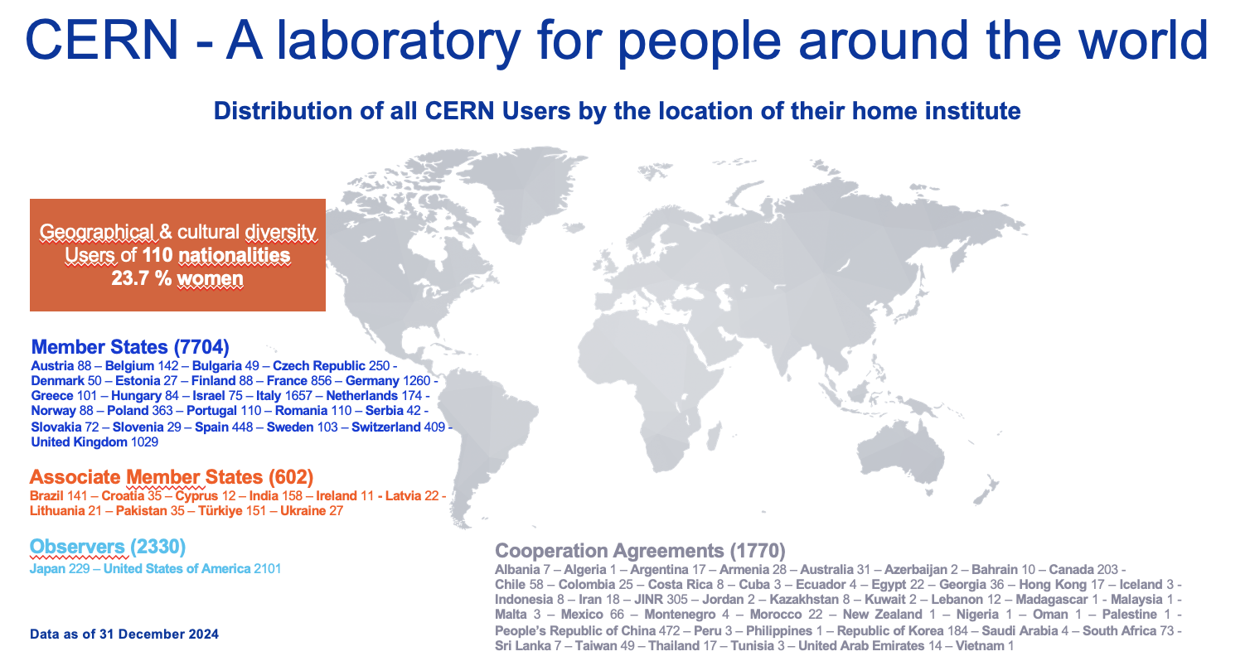
Concluding Remarks
The globalisation of particle physics continues today
Employees:
2704 staff,
1181 graduates and fellows
Associates:
12 406 users, 1401 others

Slide 15
Thank you

