Slide 1

Post 1980s Diaspora of
Russian Particle Physicists
Vladimir SHILTSEV (NIU)
4th Intl. Symposium on the History of Particle Physics ● CERN, Nov.13, 2025

Slide 2
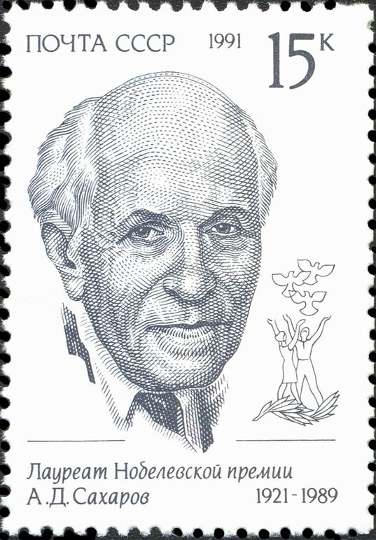

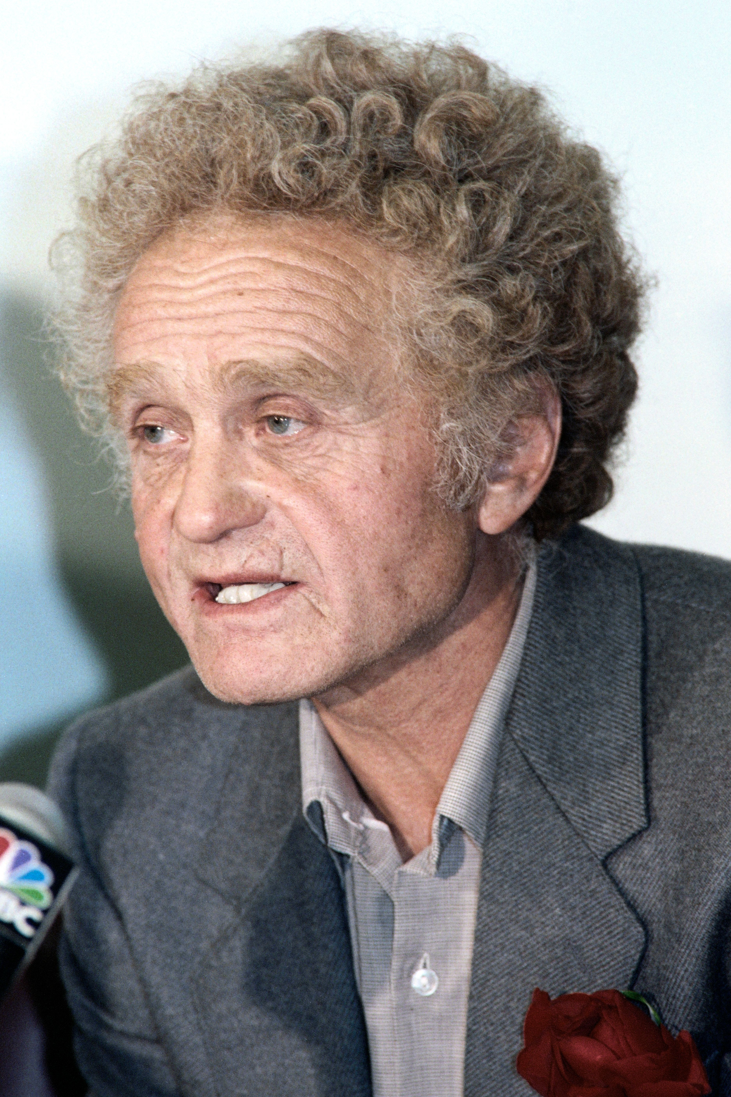

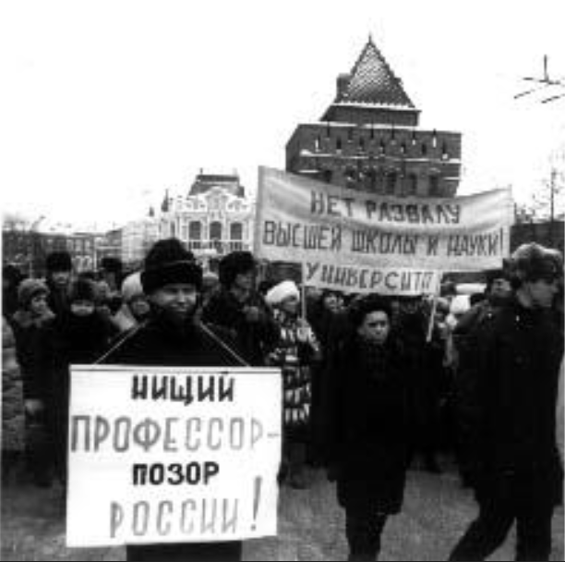
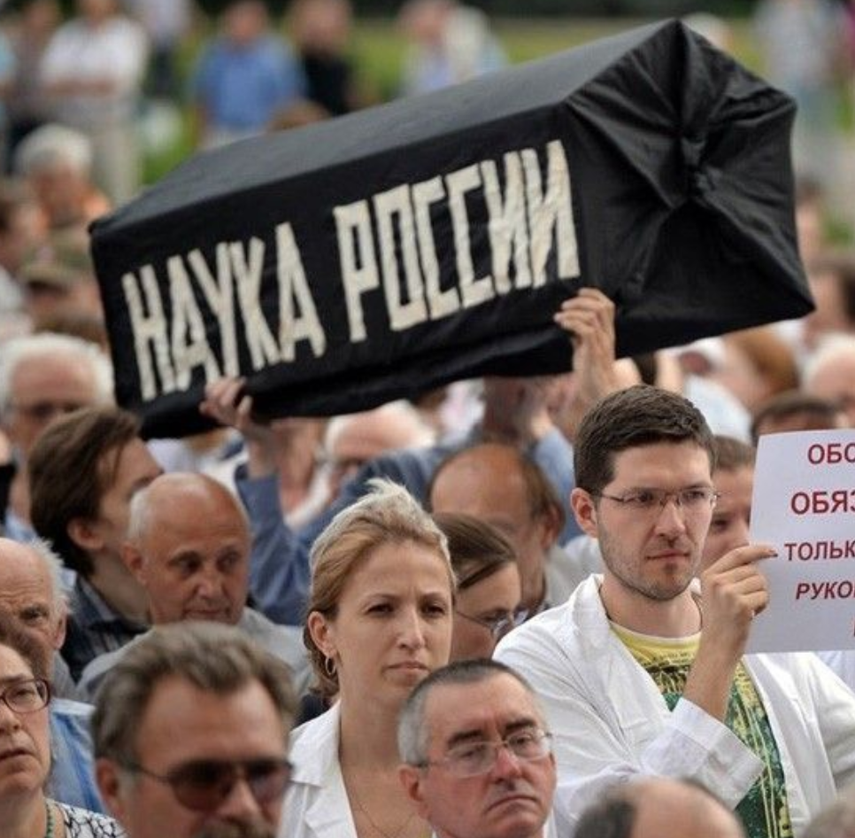
Andrei Sakharov
1987-1991
Yuri Orlov
1991
1994
“Russia’s Science”
“Pauper Professors
– Russia’s Shame!”
2013

Slide 3
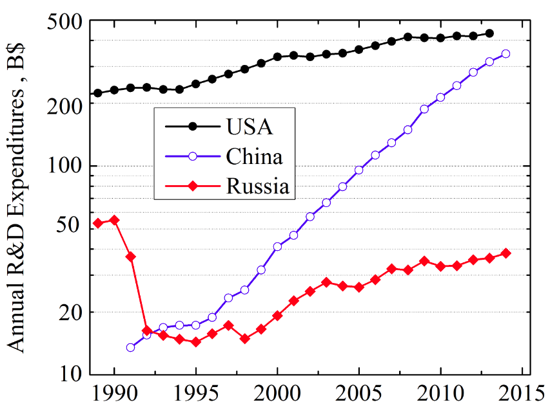
OECD Research & Development Data
USSR,
PPP

Slide 4
Results of Science’s Plight in 1991-2001
~50% Researchers left science
~45% Remained in their profession
~5% Emigrated
Total of ~15,000-20,000 reseachers
Europe (>40%), US (~30%), Asia, Israel, FSU…
many more engaged in short-term visits
~40% of them physicists
incl. ~2,000-3,000 in Particle Physics (HEP, NP, Astro)
~(5-7)% of the world’s total

Slide 5
Reasons of the “Brain Drain”
Economic Crisis – Collapse of USSR led to severe funding cuts; many research institutes faced closure.
Lack of Demand & Prospects – Scientists lost support and research opportunities, leading to disillusionment.
Low Pay & Insecurity – Salaries fell below living standards; social protections eroded.
Professional Growth Abroad – Foreign institutions offered better pay, equipment, and research opportunities.
Loss of State Support – Science lost priority in reforms, accelerating the outflow of talent

Slide 6
Features of the Russian “Brain Drain”
High qualification:
because of strong scientific schools at home
among emigre sci: ~20% Dr.Sci. (Habil.), >50% Candidates (PhDs)
Liberalized emigration policy, Int’l collaborations and personal connections facilitated mobility
Main destinations: Western Europe (>40%), North America (~30%); less to Asia, some to CIS/FSU
Typical: temporary work visits → later emigration… about 3:1
“Bridge” role: beyond individual contributions, diaspora helped to link Russian institutes and resources to international science, benefiting both sides and sustaining Russian physics until renewed investments in the 2010s–2020s

Slide 7
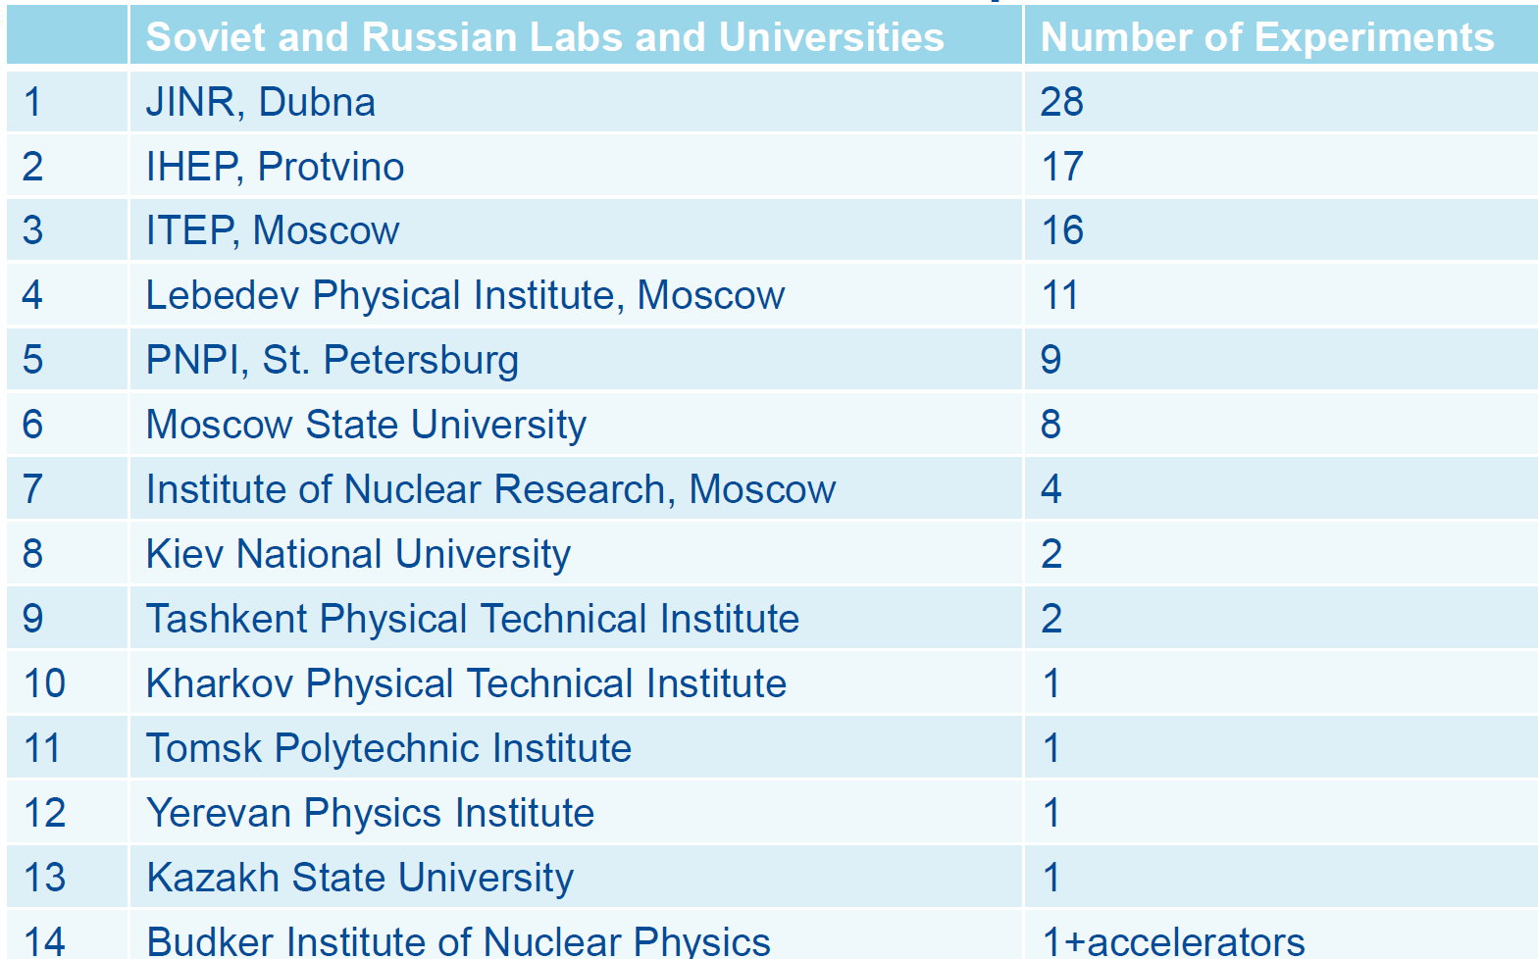
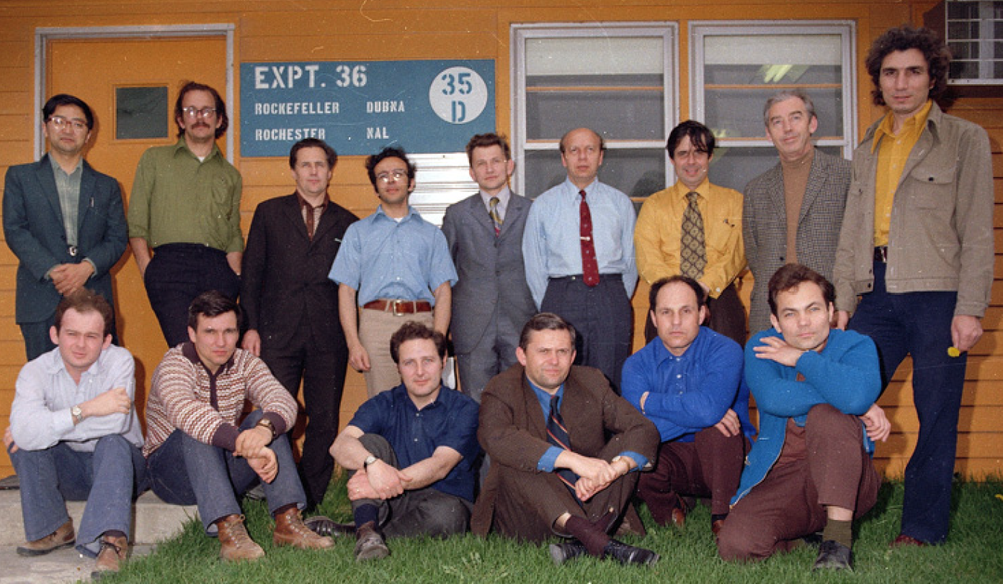
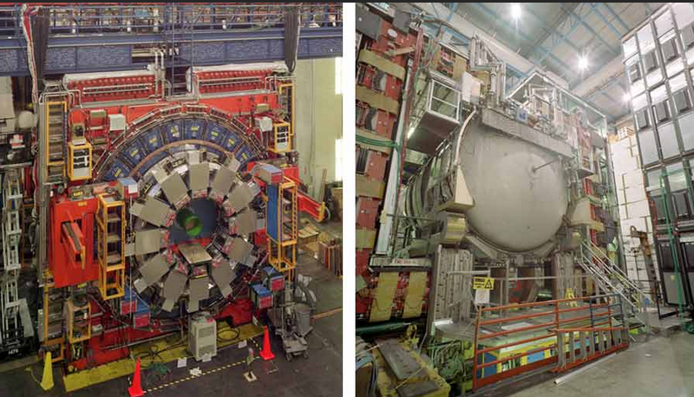
Soviet/Russian Labs/Universities in Fermilab Experiments (1972-2017)
E-36 (1973)
CDF
D0
Also collab with:
BNL, SLAC
LAMPF, etc
from V.Yarba presentation (RASA, 2017)
1995 top quark discovery: 49 out of ~840 authors
(already ~1/2 in diaspora)

Slide 8
FSU/RUS Collaborators 1990’s-2000s’
Collaboration | # Authors | FSU | Diaspora | Comments
D0 | 436 | 27 | 15 | Top-quark discovery (1995) Refs. [3, 4]
CDF | 403 | 0 | 7
ALEPH | 540 | 0 | 1 | Electroweak measurements at Z- and W- energies (2000) Ref. [5]
DELPHI | 450 | 17 | 9
L3 | 368 | 8 | 20
OPAL | 391 | 0 | 1
Belle | 207 | 15 | 1 | CP violation in B decays (2001) Refs. [6, 7]
BaBar | 563 | 15 | 8
All expt’s | 3343 | 82 | 62 | 4.3%

Slide 9

Victor Yarba: IHEP→SSCL→FNAL
UNK Project Leader, SSC HEB Leader, Assoc. Technical Division Head, APS Fellow (2004)

Slide 10
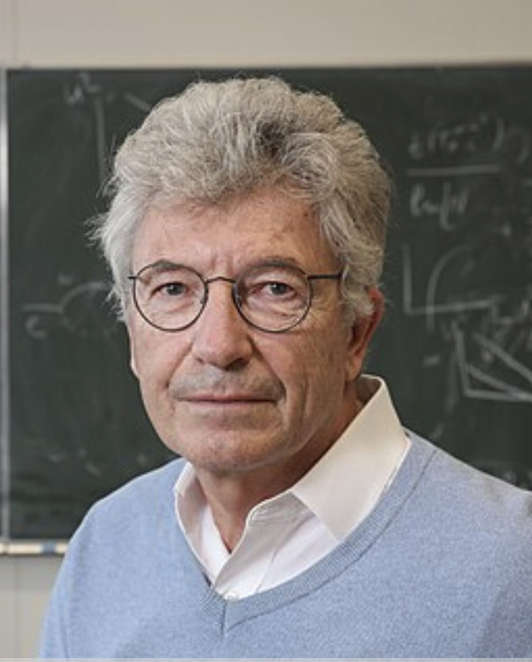
Mikhail Shaposhnikov: INR → CERN/EPFL
Markov Prize for fundamental physics (2005) Humboldt Research Prize (2008) Andrei Sakharov gold medal (2011)
“…for his works on electroweak processes at high temperatures and the baryon asymmetry of the Universe”.
CERN Theory Division (1991)
Director of the Inst. Of Theoretical Physics, U.Lausanne (1999) and Laboratory for Particle Physics and Cosmology, EPFL (2003)

Slide 11
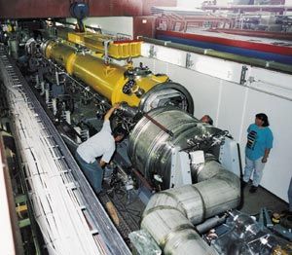
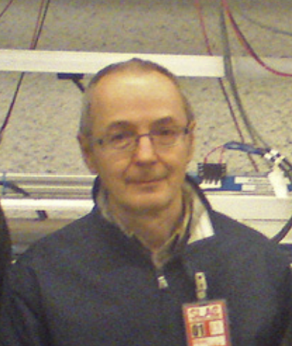

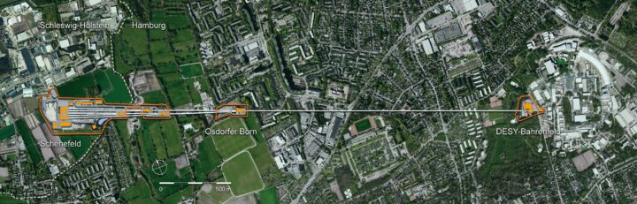

Evgeny Saldin: BINP → DESY
Inventor of SASE FEL (1979, with Kondratenko)
Biorn Wiik Prize (2000)
Innovation Prize (2012)
FEL Prize (2015)

Slide 12
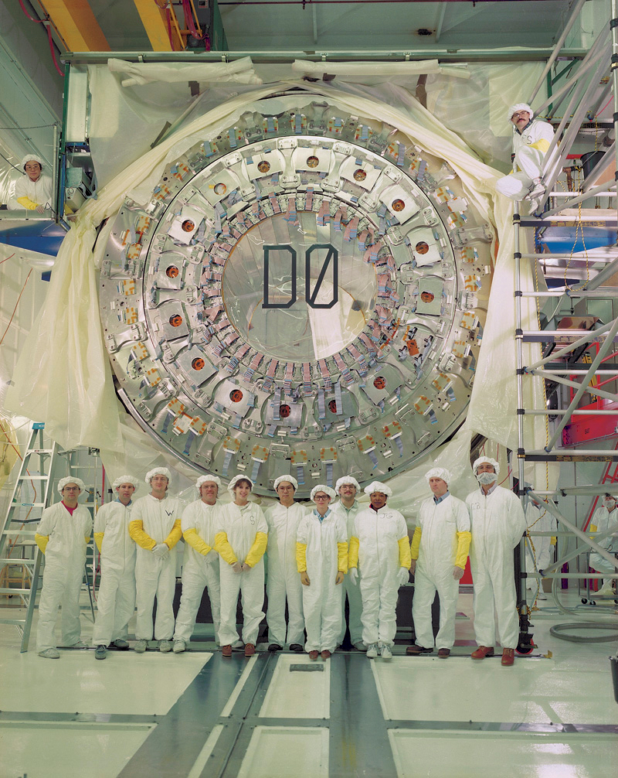
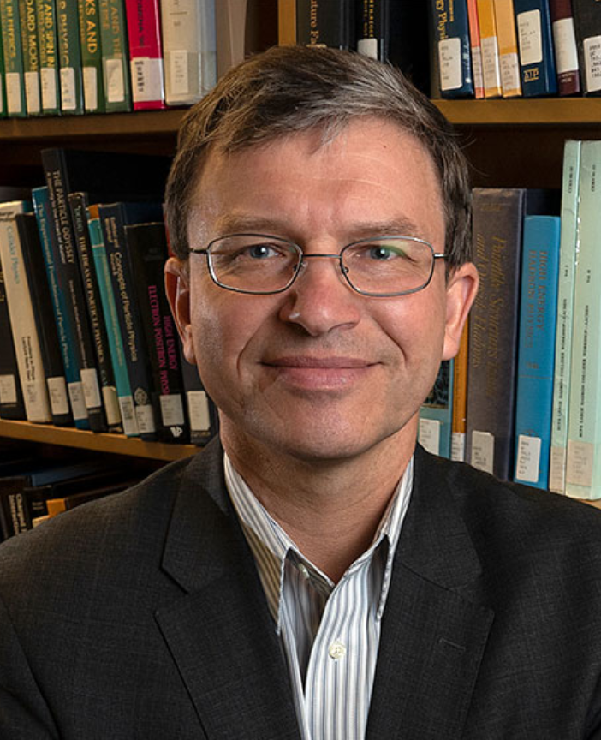
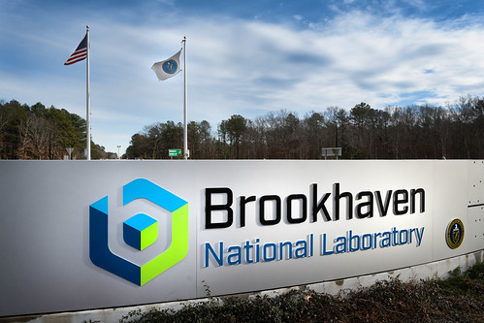
Dmitri Denisov: IHEP→ FNAL→ BNL
DZero Collaboration (1987)
1995 top quark discovery
DZero Spokesperson (2006)
APS Fellow (2008)
EPS HEP Prize (2019): ”…to the DØ and CDF collaborations for the discovery of the and the detailed measurement of its properties.“
AAAS Fellow (2024)
Lead BNL Particle Physics Program

Slide 13
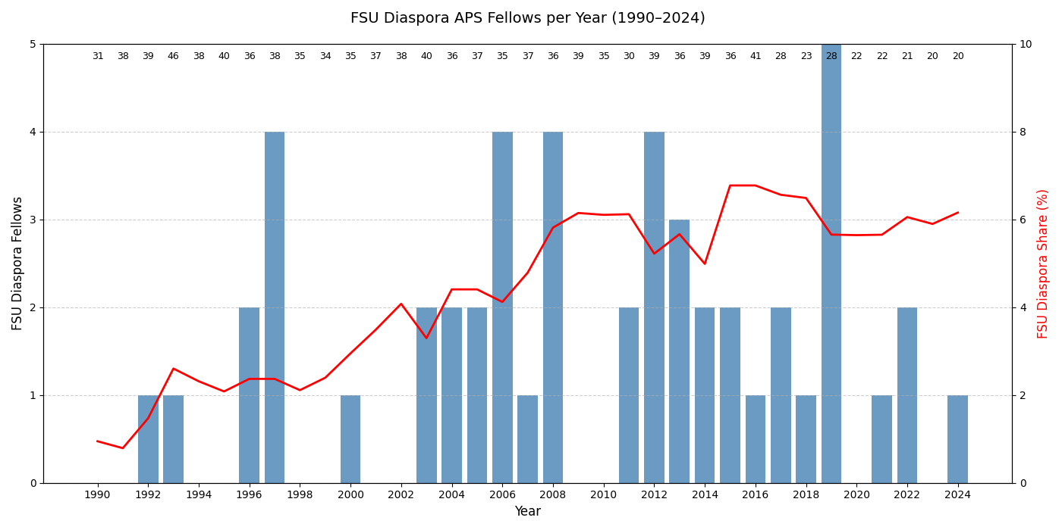

FSU Diaspora: ~5% of APS Fellows DPF+DNP+DPB

Slide 14
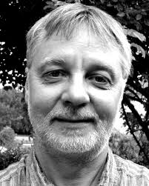
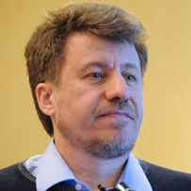
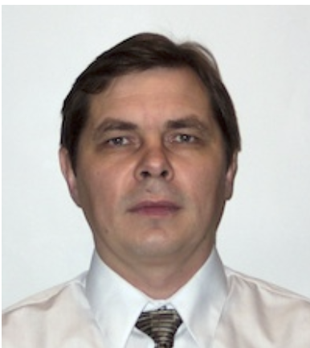
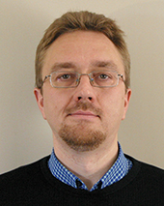
EPS-AG Accelerator Prizes: 4 out of 32 over 1994-2023
Diaspora: Younger Generation
1994 Igor Syratchev, BINP, Protvino → CERN
For his work in demonstrating efficient RF pulse compression, satisfying the very high peak RF power requirements of high gradient accelerator structures.
2004 Vladimir Shiltsev, FNAL, Batavia, IL
For many important contributions to accelerator physics theory, simulations, hardware development,…. In particular for his pioneering work on electron-lens beam-beam compensation.
2008 Viatcheslav Danilov, ORNL/SNS
For numerous contributions to accelerator physics, in particular for the proposal, calculation, design, construction, and demonstration of efficient laser H- stripping
2023: Mikhail Krasilnikov, DESY/Zeuthen, Germany
for his achievements in the development of high brightness electron beams and a high power, tunable THz SASE free electron laser based on those beams, demonstrating lasing at the PITZ facility in 2022

Slide 15
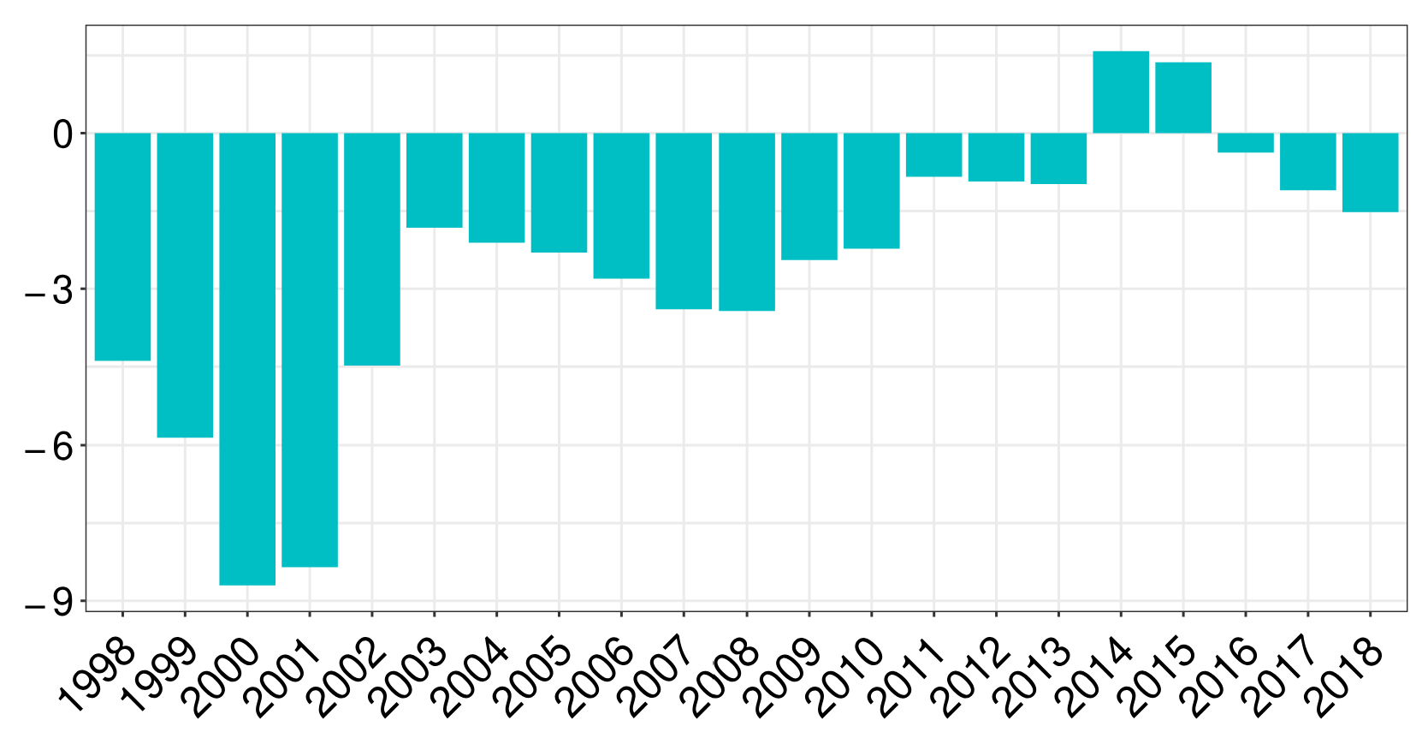
How Long Did It Last?
Net migration rates per 1,000 researchers in Russia
A.Subbotin, S.Aref, Scientometrics (2021) 126:7875–7900
Of note (1): Not only outflow, but also inflow – approx. 3:2

Slide 16
Not the Largest of the “Brain Drains”…
….that makes an average ~12.5% increase per step
[Refs]
YEARS | NUMBER OF RESEARCHERS | FROM | TO | COMMENTS
1720-1760 | ~200 | SWISS, GER, FRA | RUS | St.Petersburg Academy
1860-preWWI | 1,000-3,000 | RUS, IRE, E. and S.Europe | GER, UK, FRA | New science centers
1930s/40s | ~2,000 | GER, AUT and satellites | UK, USA, S.America… | Nazi policies
1960s-1980s | >25,000 | UK, CAN | USA | “Brain Drain” term coined by the Royal Soc.
1970-1980s | >3,000 | USSR | Israel | Migration of Jews
1990s-2010s | >15,000 | RUSSIA | USA, W.EUR, ASIA, ISR | USSR Break-up
2010s-2020s | >30,000 | US, Europe | CHINA, Europe | “Reverse Brain Drain”
[1]
[2]
So, due to regular improvements the evolution was
[3]
[4-6]
[2]
[2,7]
[8]

Slide 17
Summary: Russian Particle Physics Diaspora
Boosted by the end of the Cold War and breakup of the USSR
O(2,000–3,000), ~5% of world’s HEP + Nuclear Physics workforce
major wave in the 1990s, much reduced by the 2010s
Main destinations: Western Europe, North America
Many accomplished senior scientists, many talented early-career researchers - in most major labs and Universities
Strengthened international collaborations, labs, universities, experiments, projects, facilities
Strong support from Western colleagues during the hardships of the 1990s–2000s — exemplified of solidarity and reaffirmed that science is truly international.

Slide 18
Thank You for Your Attention!
Acknowledgments:
Discussions and input from
Victor Yarba
Michael Riordan
Dmitri Denisov
Andrei Gritsan
Jerry Blazey
Questions?

