Slide 1
IV International History Symposium Reaching out and making a difference – the growth of formal and informal engagement
Paola Catapano, Head of Editorial Content production, Deputy Group Leader
Education Communications and Outreach - International relations
Notes:
TX for invitation

Slide 2

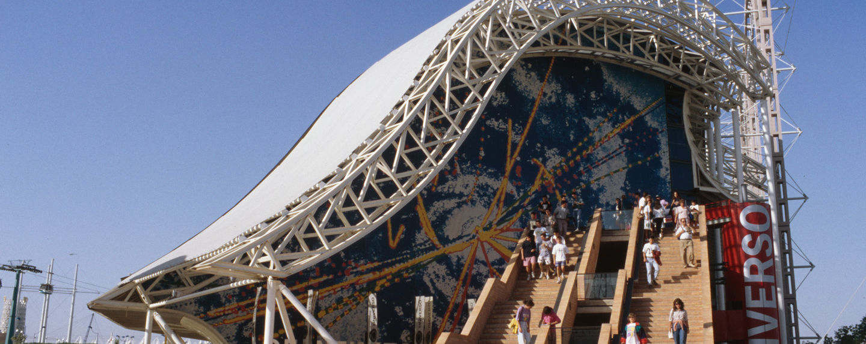
@CERN since 1990
1987 Master’s degree Trieste, Simultaneous Interpreter
1990 CERN P.A. DG Carlo Rubbia
1994 Head of Visits & Exhibitions, Section + Group leader
1997 Master’s Science Journalism SISSA, science journalism in Italy (press and TV) and project leader + event and multimedia producer /host/author at CERN - documentaries for RAI (Italian national TV); writer for CERN Courier
Since 2016 Head of Audio-visual Productions CERN: producer, host, writer, public speaker
11/12/25
Paola Catapano
Notes:
You all know me, presumabl read my cv
30 years at CERN, 20 as science journalist: , covered different roles in communications, =>”360° communicator
CERN is more than just my workplace, it’s my home, and part of my professional identity; I have a thorough knowledge of the lab and its scientific community!, I am a passionate of the science and a committed advocate of its values and its values;

Slide 3
From the beginning of CERN, a Public Relations Section was part of the Scientific and Technical Services. It was responsible for activities such as publication of press releases, organization of interviews, contacts with journalists, preparation and distribution of descriptive leaflets. … and in 1958 became known as the Public Information Office (PIO). The Office was responsible for relations with the press, the preparation of documents for journalists, the organization of visits, conferences and CERN's participation in exhibitions.
Flyer Open Day 1955
“Archives of Public Information Office (PIO) /
Press and Visits Service” (CERN Scientific Information Service).
Notes:
Flyer distributed at Open Day 1955 – CERN Foundation Stone Ceremony, Open to the public

Slide 4
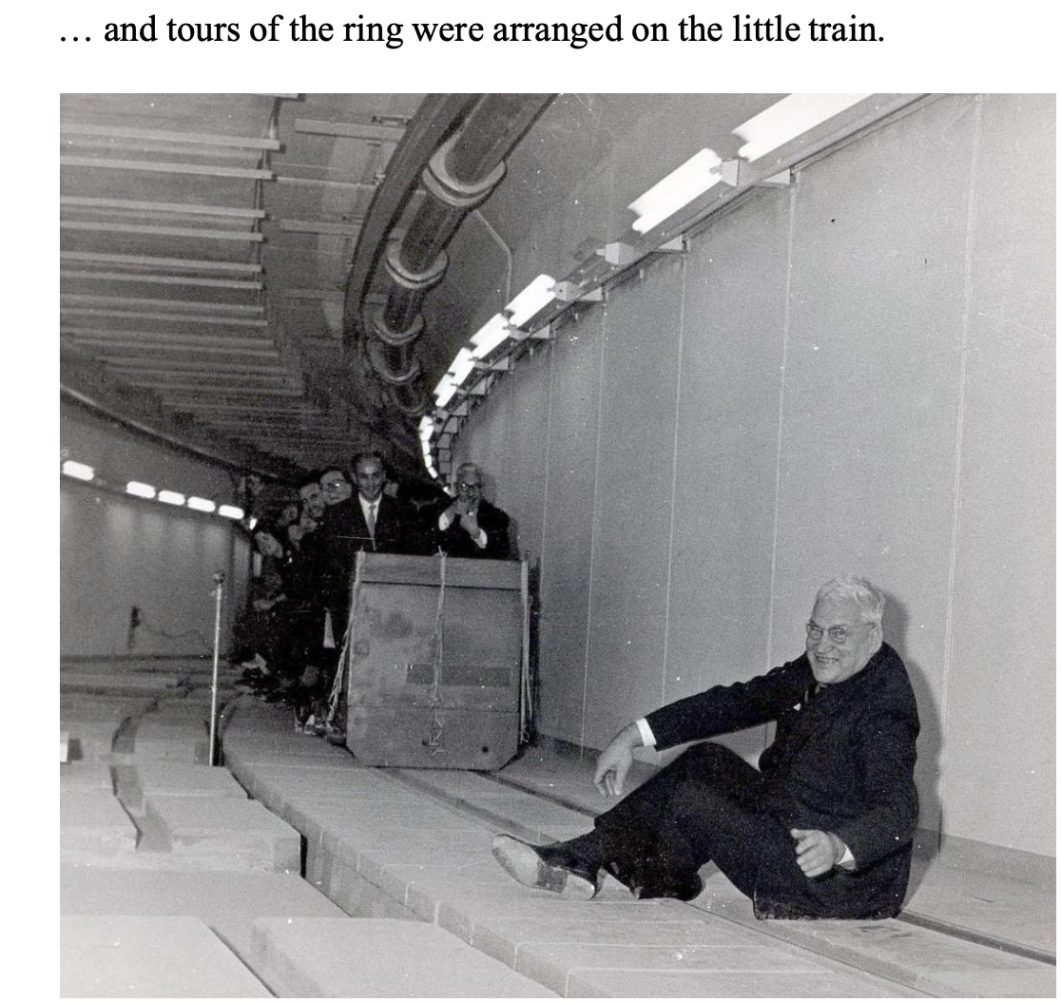
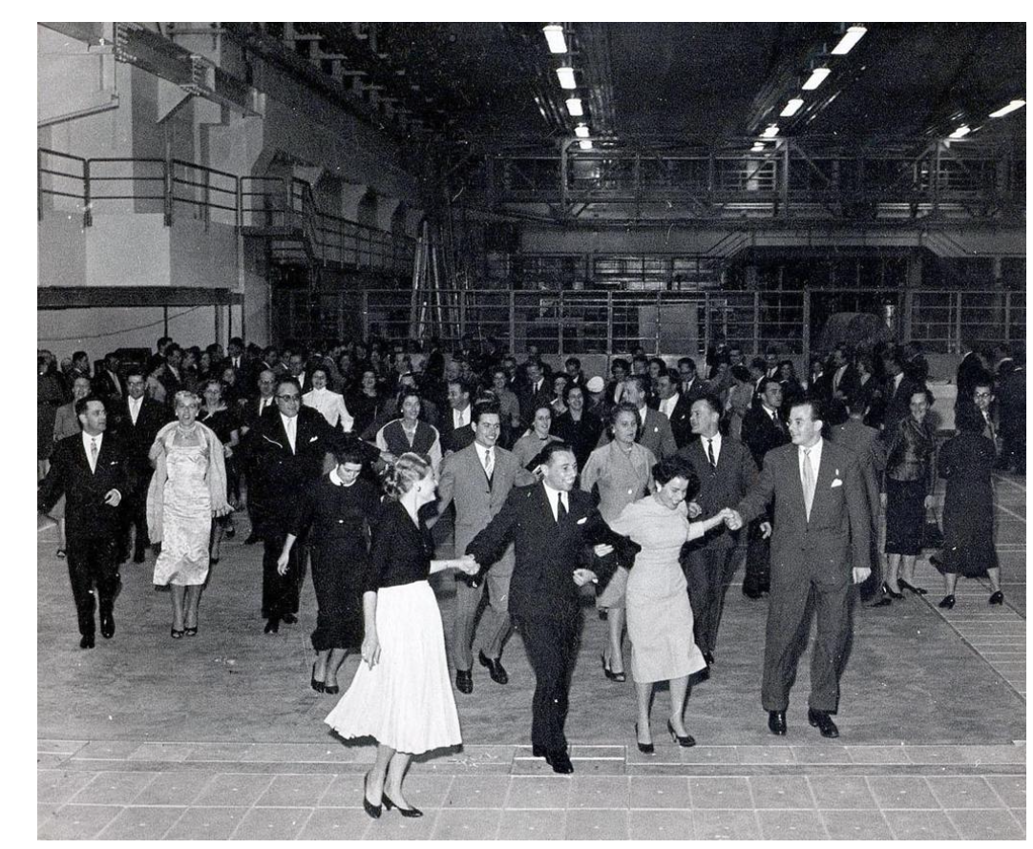
Open Days PS 1957

Slide 5
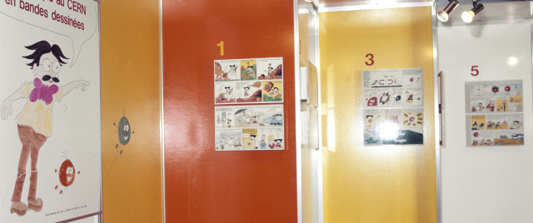
CERN Exhibition Annecy, 1977

Slide 6
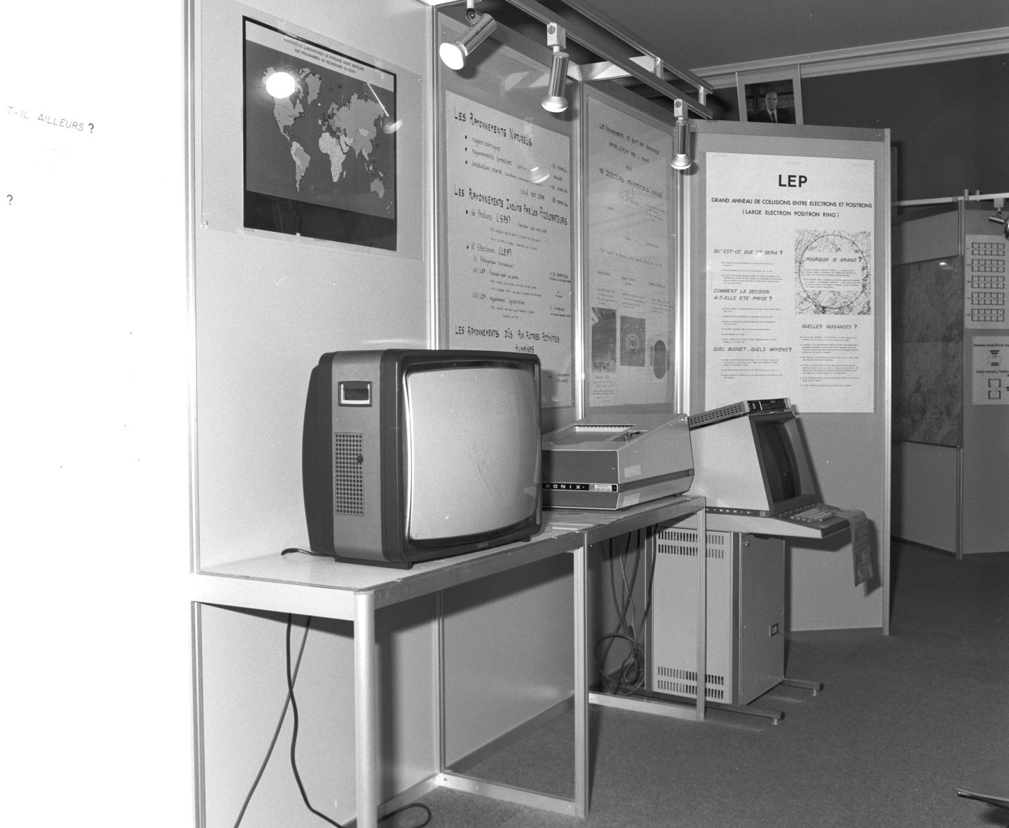
1980: LEP is approved … and showcased !
LEP Exhibition in Ferney-Voltaire, 1982
Les activités de "Relations publiques" menées dans le cadre de la politique traditionnelle d'ouverture vers l'extérieur ont été plus particulièrement orientées vers l'aboutissement du projet LEP. Parmi les activités de Presse, Visites, Films, Information générale et Contacts Extérieurs, les deux premières ont été particulièrement poussées et ce principalement au niveau local (Etats hôtes). ….
…. et plus particulièrement orientés vers les représentants des populations du Pays de Gex et les pouvoirs publics départementaux et centraux dans la perspective du projet LEP qui aura un impact direct sur une douzaine de communes. .

Slide 7
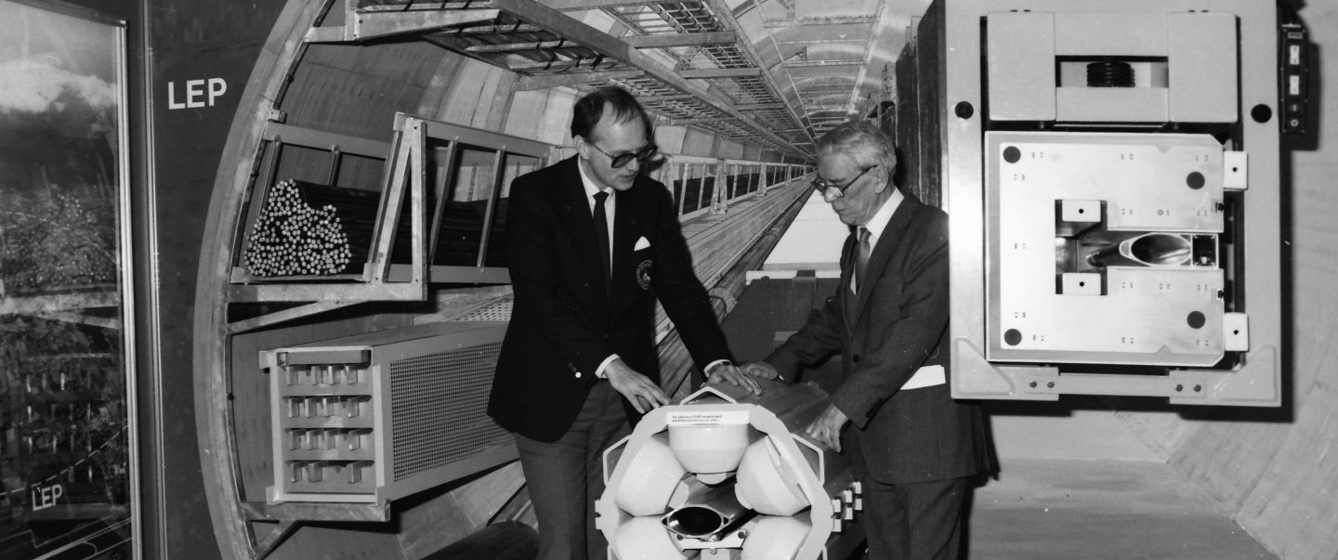
LEP Travelling Exhibition Lund, 1985

Slide 8
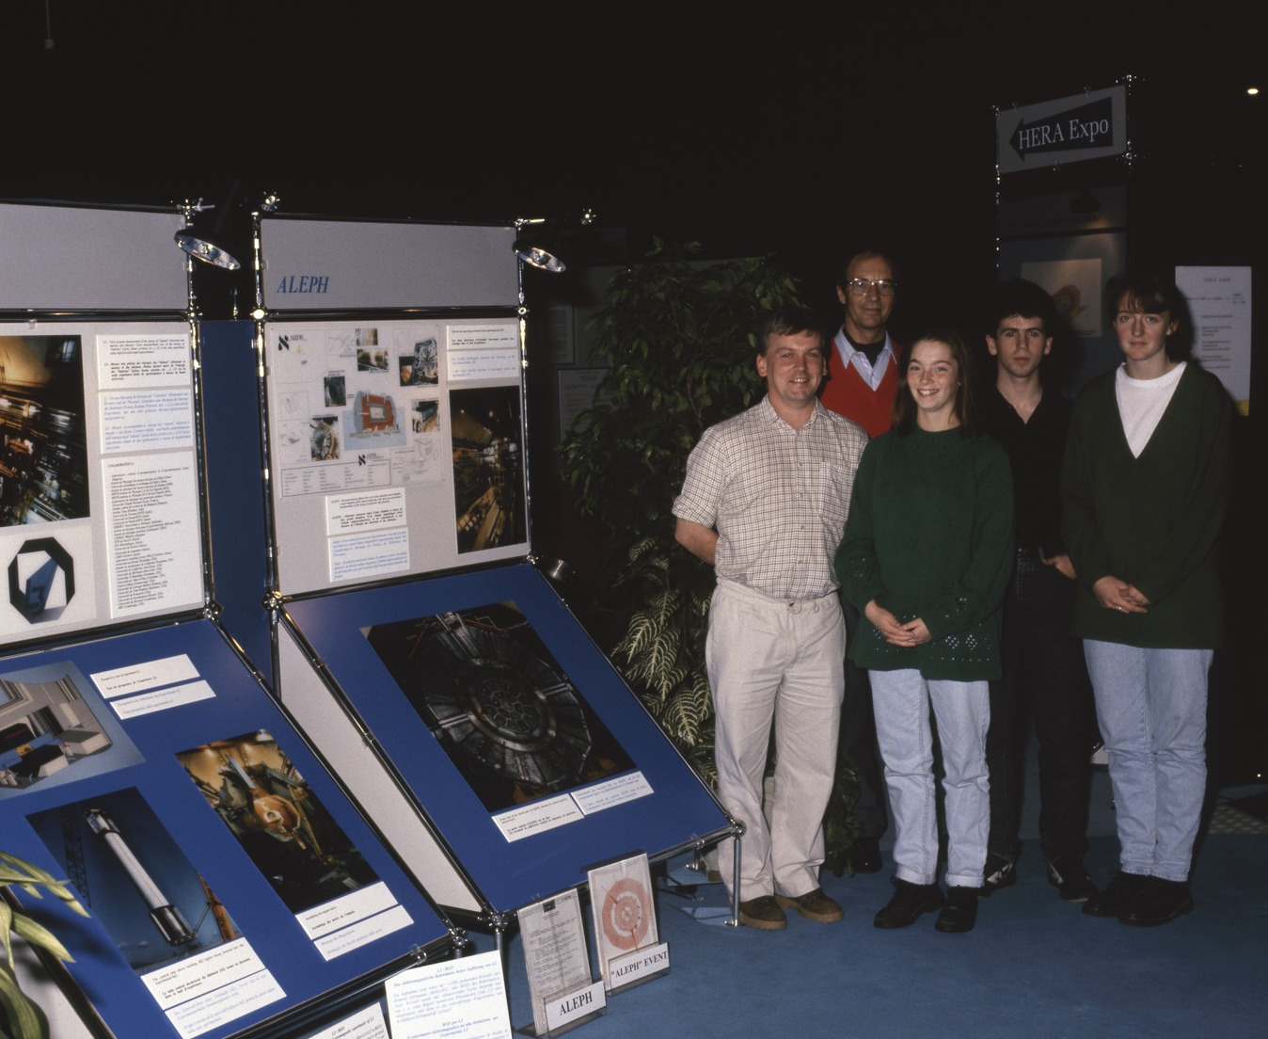
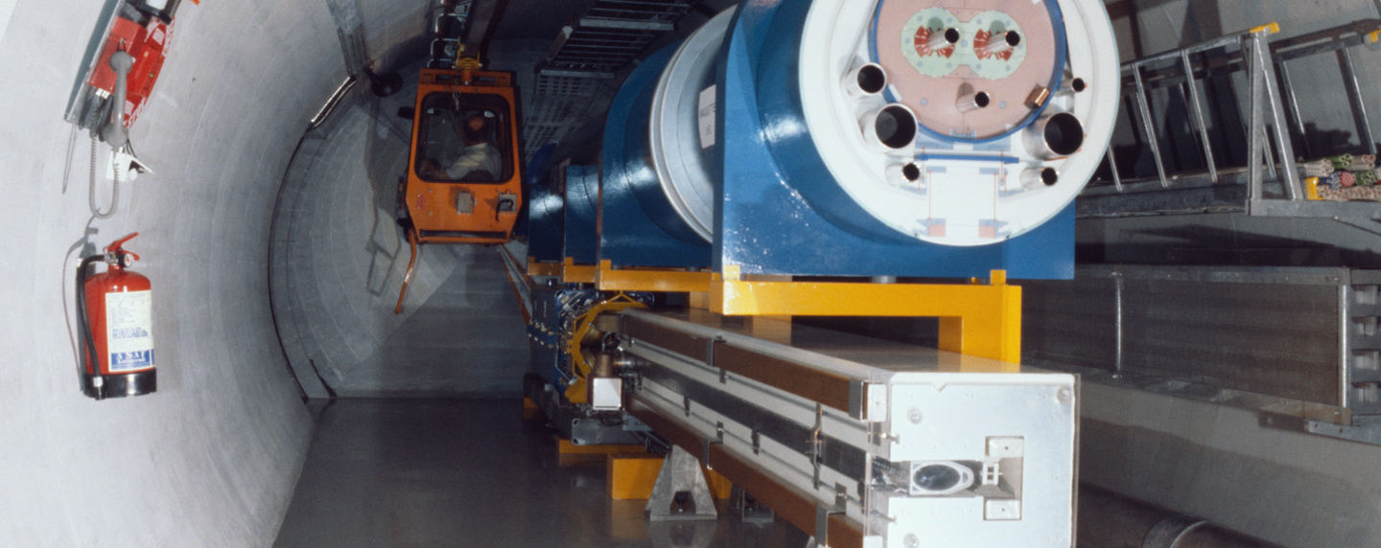
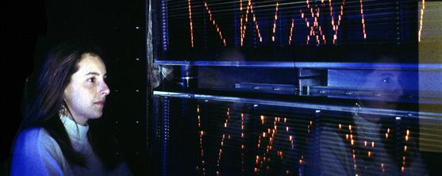
1990: Microcosm

Slide 9
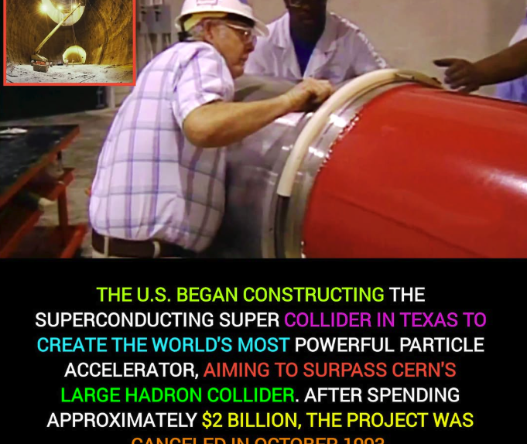
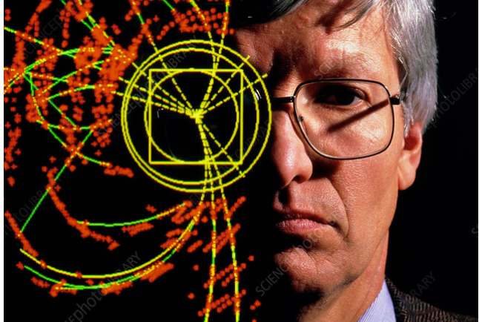
1993
“We cannot continue to ask for public funding if we are not able to explain what we do."
Notes:
COMMUNICATIONS BECOME STRATEGIC FOR THE SURVIVAL OF THE LAB

Slide 10
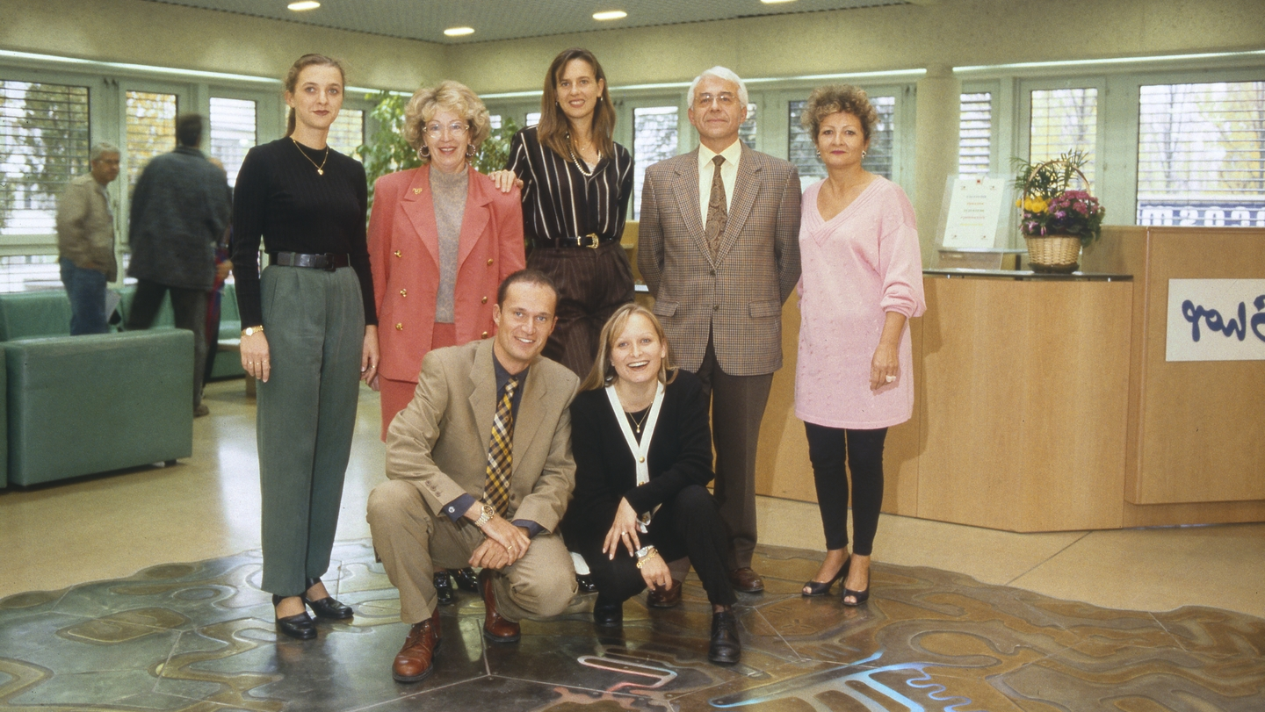
1994
Notes:
Peggie RIMMER was recruited as a new head of Comms - bringing together all exhibitions, press, publications, film, graphics, for the first time -
Cern40th MY FIRST JOB IN COMMS
Professionalized visits programme, guides training, guides’ tools, messaging and safety; recruit youth ! Create new interns positions, stzudents, phds…
1995_ MASTER’S IN COMMS TRIESTE SISSA
Open days

Slide 11
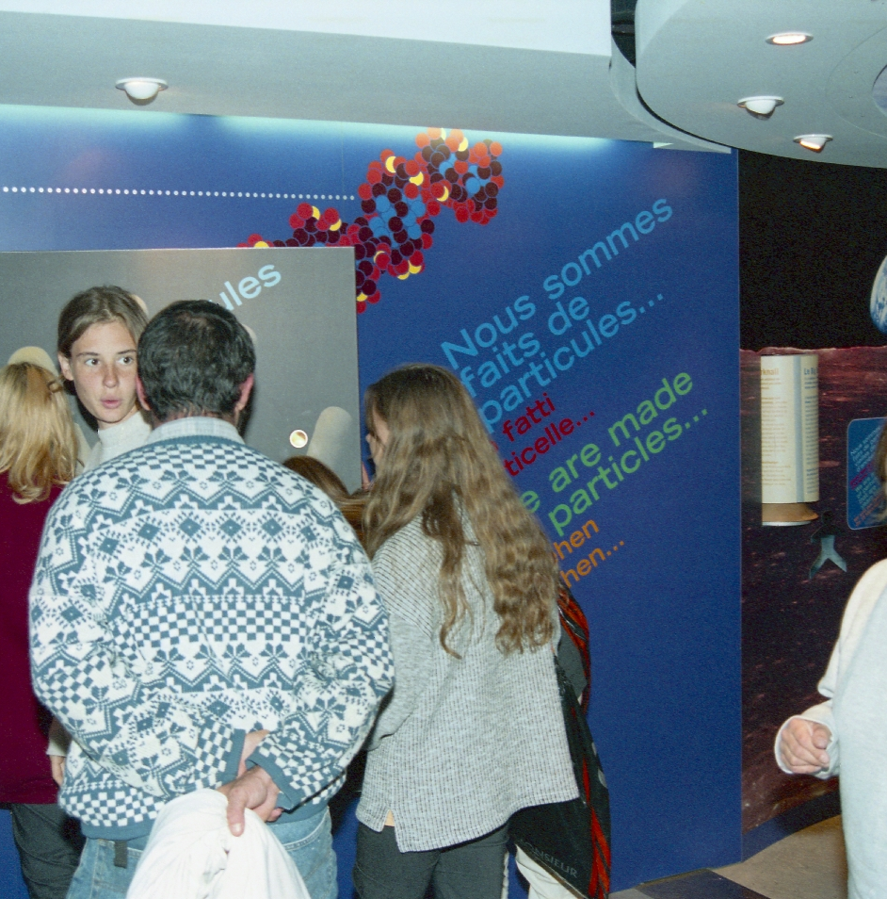
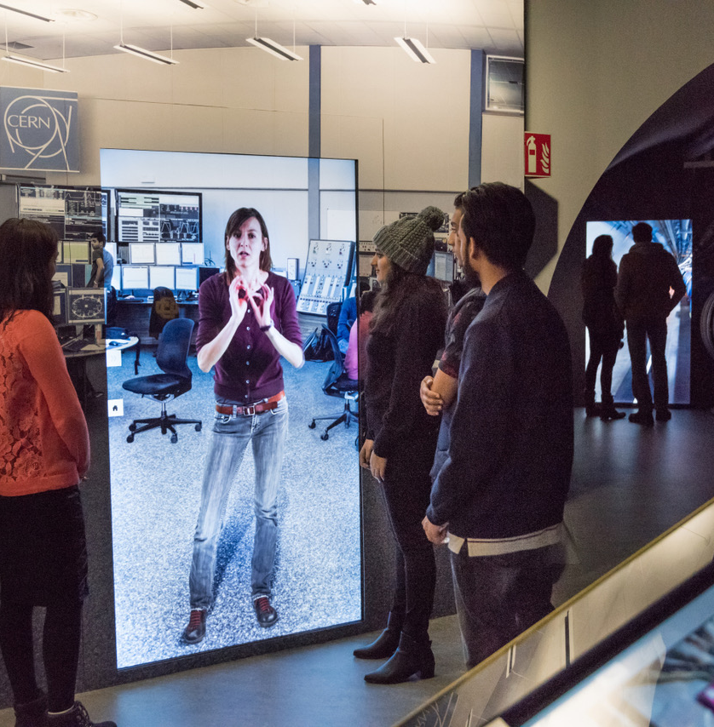
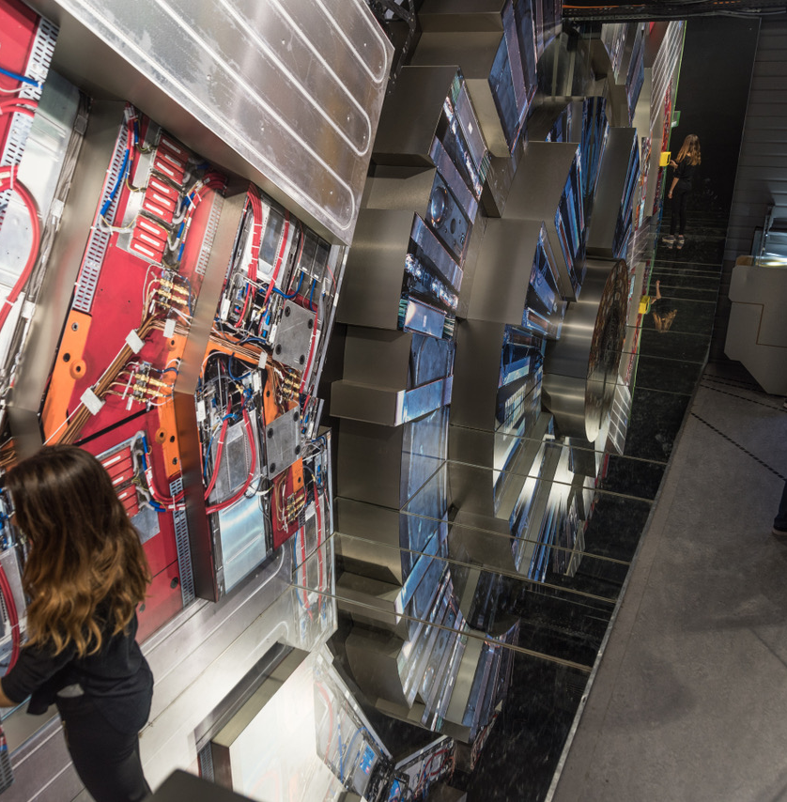
MICROCOSM revamped
1997
2007
Notes:
CERN increased links to external cultural institutions and professionalized (Heather Mayfield’s time at CERN - from the London Science Museum: She led to Emma Sander’s position being created and the start of a more visitor-centred approach to exhibitions and audience research.

Slide 12
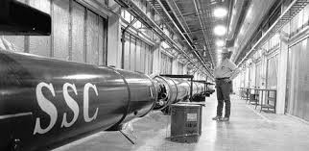
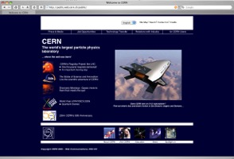
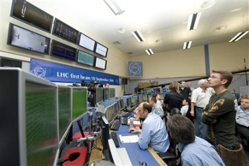
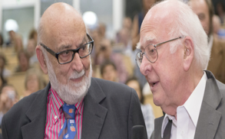
Historical perspective of CERN Comms
1993
2000
2007
2008
2010-13
SSC canceled in USA
Angels&Demons
Hollywood
Black Holes
A discovery and a Nobel Prize
Particle physics no longer strategic; questioned by governments. Communications suddenly strategic!
Dan Brown’s novel staged at CERN reaches fame after Da Vinci Code publication
Angels & Demons director and cast come to CERN; ATLAS and LHC featured in the film
… “bless” the start-up” of the LHC and make CERN world-famous
Particle physics fully into (popular) culture, CERN is a worldwide brandname .. .
Strategic Vision
Notes:
WHERE DOES MY STRATEGIC VISION COME FROM? I witnessed it all
The story of comms starts in 1993, when I witnessed the first turning point in CERN Communications, the demise of the SSC, when the activity suddenly became “strategic” for the survival of the field and the LAB for the first time
EXTRA S
A&D became a best seller, translated in many languages. This marked the first “quantum” jump in CERN’s popularity with the general public, as witnessed by the correlation between the IP addresses of viewers of the website I proposed and contributed to create and the countries where book translations were published. CERN becomes a “household name”
- 2008 – 2013: Exceptional times with record breaking figures for both the lives and the clips (pioneering YT channel), part of the comms package, still unsurpassed world wide
VERYYITHING BIGGER LARGER PROFESISONALISED

Slide 13
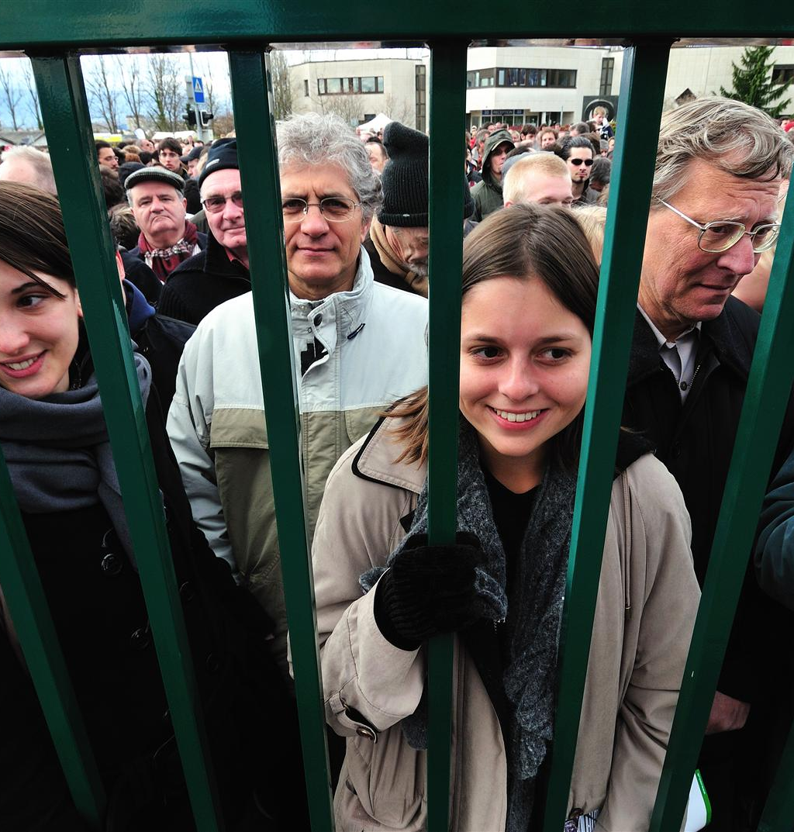
Open Days 1957 vs 2008
75 000 visitors

Slide 14
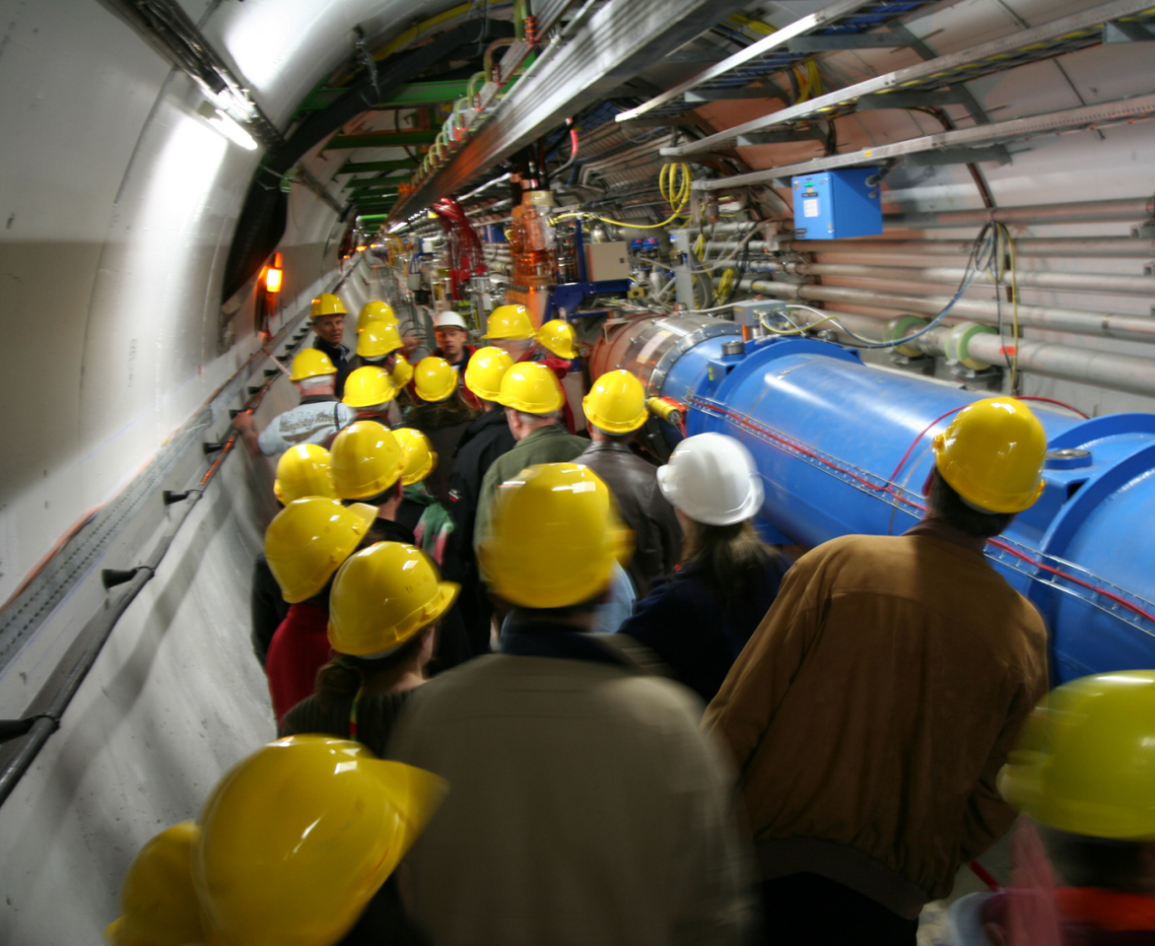
Open Days 1957 vs 2008

Slide 15
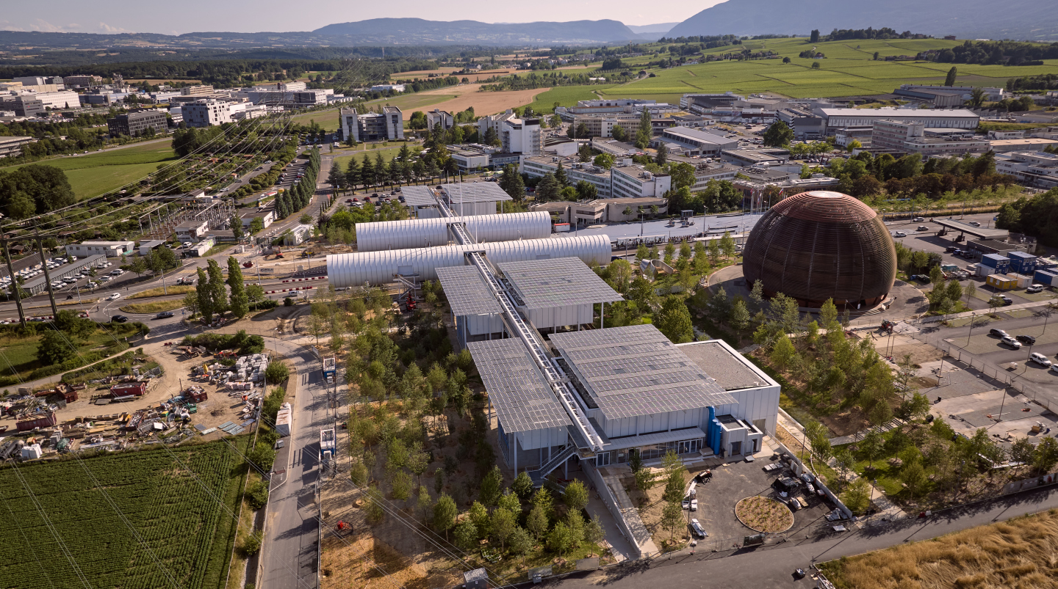
750 000 visitors

