Slide 1
Anomaly detection in monojet searches using the New Physics Learning Machine
Group meeting 20.11.24
Giada Badaracco

Slide 2
Motivation: The region of phase space to which monojets searches are more sensible is likely to contain NP. Hence focusing on monojet searches could be successful in terms of anomaly detection.
Goal: To make the monojet search completely model agnostic and compatible with a broaden set of alternative hypotheses through the NPLM method.
Method: NPLM uses the dataset to find the best suited alternative hypotheses set and then calculates the p-value representing the probability of your dataset to represent an anomaly wrt to the SM. This leads to the advantage of being sensible to several frameworks and not just a constrained one referring to a specific BSM model within a specific parameter phase space.

Slide 3
Challenges: In order to use NPLM, one needs the SM Reference sample to have the same number of events as the the data sample. But in monojet searches this is not the case. More precisely, in our dataset the QCD multijet background is under represented (N~100k). This is problematic, since the QCD multijet background events lie in the tail and would also be the ones that are more likely to constitute a signal
Solution: Use Normalizing Flows to model the QCD contribution to the background in the latent space

Slide 4
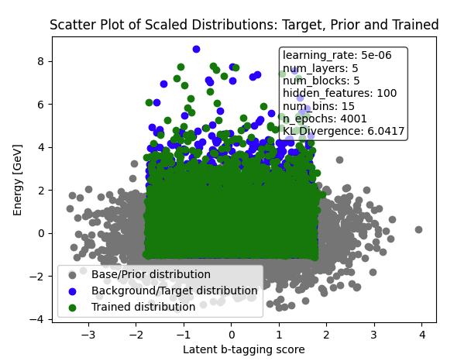
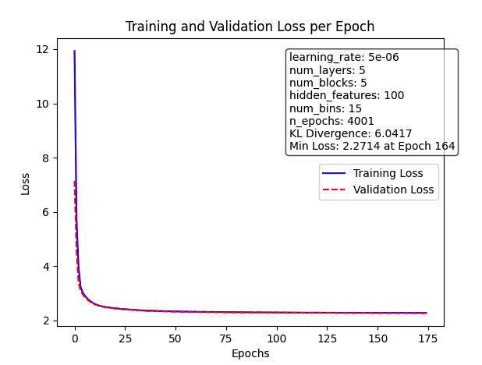
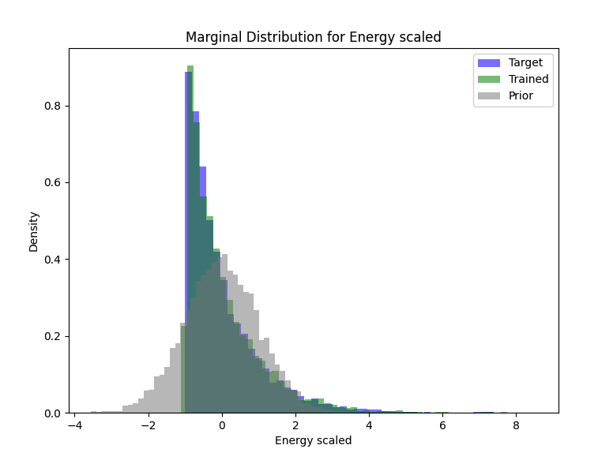
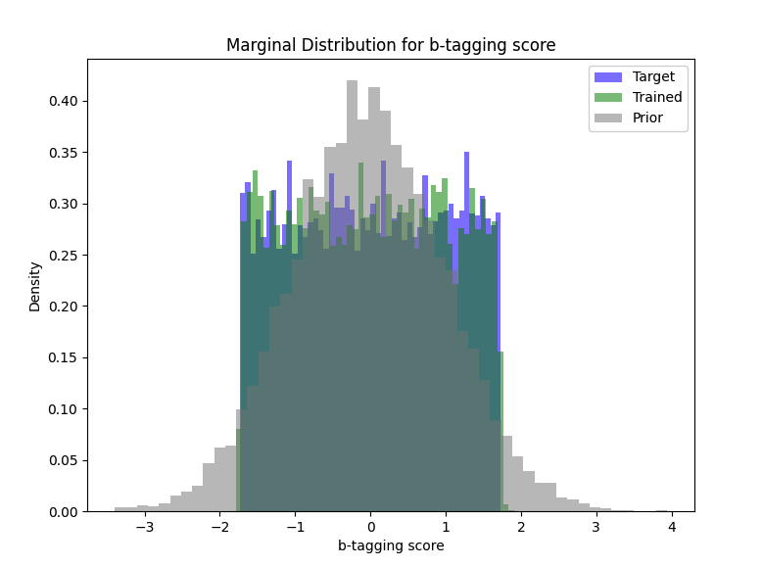
What I am working on now

